Slide 1

BEL-EVEN®
Future-proof your skin from the effects of daily stress
Teaser Presentation
11-2020

Slide 2


Today’s stressful 24/7 lifestyle affects all of us…
…sustained stress can make your skin appear visibly aged
66% of UK women feel lifestyle, including stress level, is most important in determining the appearance of skin*
Consumers increasingly link stress, diet, hydration, and UV exposure to skin health.
66% of US men aged
18-24 are most concerned about stress as a health concern**
While we may mentally escape, our skin needs time and space to regenerate and rebalance its resources as well
Consumers increasingly link stress, diet, hydration, and UV exposure to skin health.
Source: Mintel research

Slide 3


Stress and the skin
Stress is a natural stimulant of our body and appears in case of change in the environment. We react and cope with stress in a very individual way
Stress, at an optimum dosage level has positive effects on our organism
Unfortunately, today´s hectic lifestyle results in sustained stress levels that “stress out” our natural stress response
The effects of increased mental and physical stress are multiple, affecting as well our skin biology while also generating unbalanced, high skin cortisol levels
Persistent high cortisol levels could result in unwanted signs of ageing, as lines and wrinkles,
skin thinning, reduced skin elasticity and
lower skin barrier functionality

Slide 4
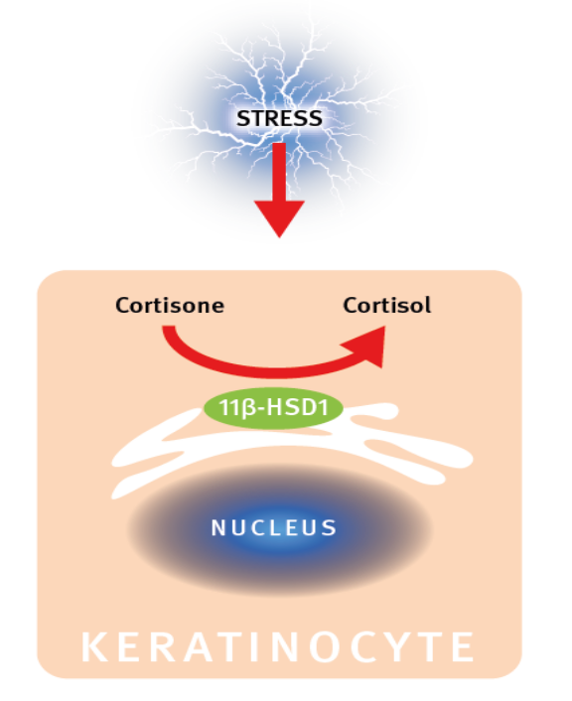
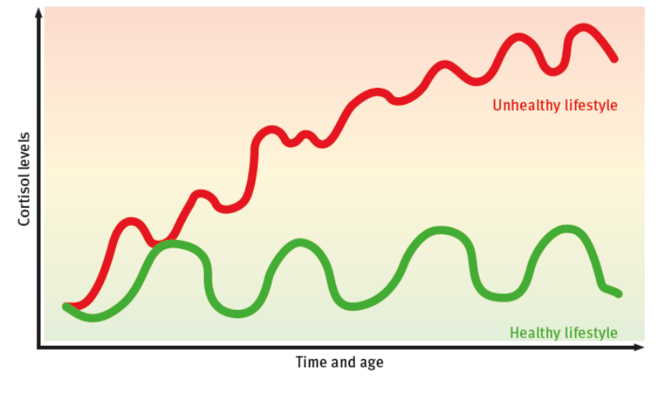
Balancing Cortisol levels through11β-HSD1 inhibition
Small amounts of Cortisol are good for you to handle your stress. Only locally do high amounts cause unwanted signs of ageing like fine lines and wrinkles, less elasticity, skin thinning, and reduced skin barrier functionality.
1
2
BEL-EVEN® inhibits the enzyme 11β-HSD1 which ultimately rebalances cortisol levels
Permanent stress results in high levels of Cortisol
Modified from: Tiganescu et. al, J. Clin. Inv. 2013, 3051-3060

Slide 5
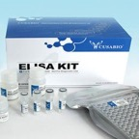
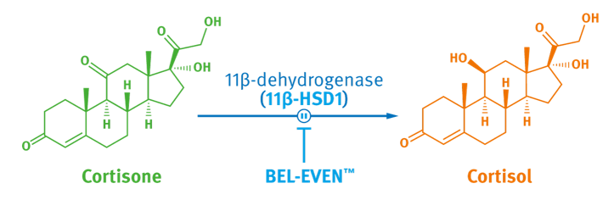
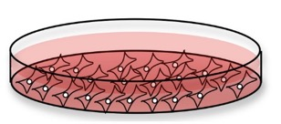
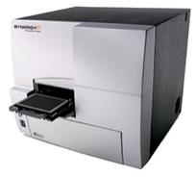
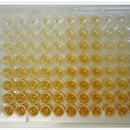
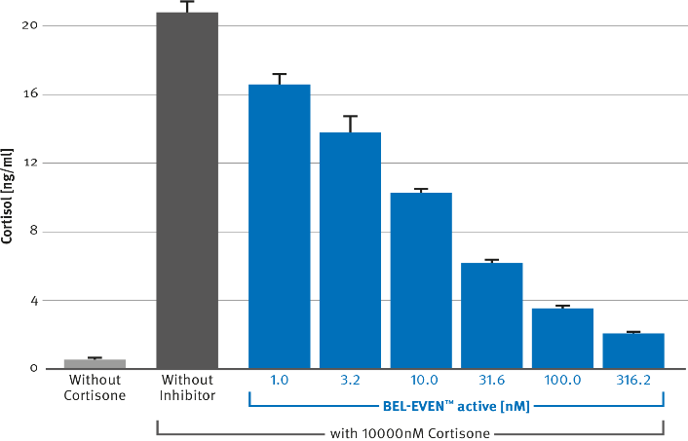
BEL-EVEN® inhibits conversion of cortisone into cortisol
Assay principle
Addition of Cortisone
+/-
Inhibitor
2D cell culture with keratinocytes
Detection of the yellow signal by absorption
The in vitro dose-dependent inhibition of cortisol generation via the enzyme 11β-HSD1 is key to rebalance cortisol levels
Cortisol Assay Kit
The more cortisol the less yellow the colour

Slide 6


Three good reasons to choose BEL-EVEN®
KEEP IT SIMPLE: Consumers understand the harmful effects of elevated cortisol levels in skin. BEL-EVEN® offers a simple and straightforward mode of action to rebalance cortisol levels.
TELL THE TRUTH: Consumers expect realistic product claims. BEL-EVEN® offers a clear and easy to communicate real benefit for the user.
The BEL-EVEN® benefit is clearly visible.
CONSIDER THE OCCASION: Highly stressed people are often under time pressure. BEL-EVEN® is fast and easy to use. It supports concepts to use on the go or at any time that are in-line with today's lifestyle.
Insides inspired by Mintel consumer research

Slide 7


Let DSM ease your stress!

Slide 8
DISCLAIMER
Copyright © 2020 DSM Nutritional Products, 4002 Basel, Switzerland.
www.dsm.com/personal-care. All rights reserved.
Although DSM has used diligent care to ensure that the information provided herein is accurate and up to date, DSM makes no representation or warranty of the accuracy, reliability, or completeness of the information. This presentation only contains scientific and technical information for business to business use. Country- or region-specific information should also be considered when labeling or advertising to final consumers. This publication does not constitute or provide scientific or medical advice, diagnosis, or treatment and is distributed without warranty of any kind, either expressly or implied. In no event shall DSM be liable for any damages arising from the reader’s reliance upon, or use of, these materials. The reader shall be solely responsible for any interpretation or use of the material contained herein. The content of this document is subject to change without further notice. Please contact your local DSM representative for more details. All trademarks listed in this brochure are either registered trademarks or trademarks of DSM in The Netherlands and/or other countries unless explicitly otherwise stated.
DISCLAIMER FORMULATION GUIDELINES
This information is for illustration purposes only and based upon our current knowledge and experience at the time of printing. We do not make any representation or warranty of any kind, express or implied, including merchantability or fitness for a particular use, with respect to such information or its application. Use of this information is at your discretion and risk. Nothing herein relieves you from carrying out your own suitability determinations and tests. You are responsible for observing all laws and regulations relevant to your products, uses or processes. We do not assume any liability in connection with your product and its use. The foregoing information and suggestions are also provided without warranty of non-infringement as to the intellectual property rights of third parties, and shall not be construed as any inducement to infringe the rights of third parties.

