Slide 1
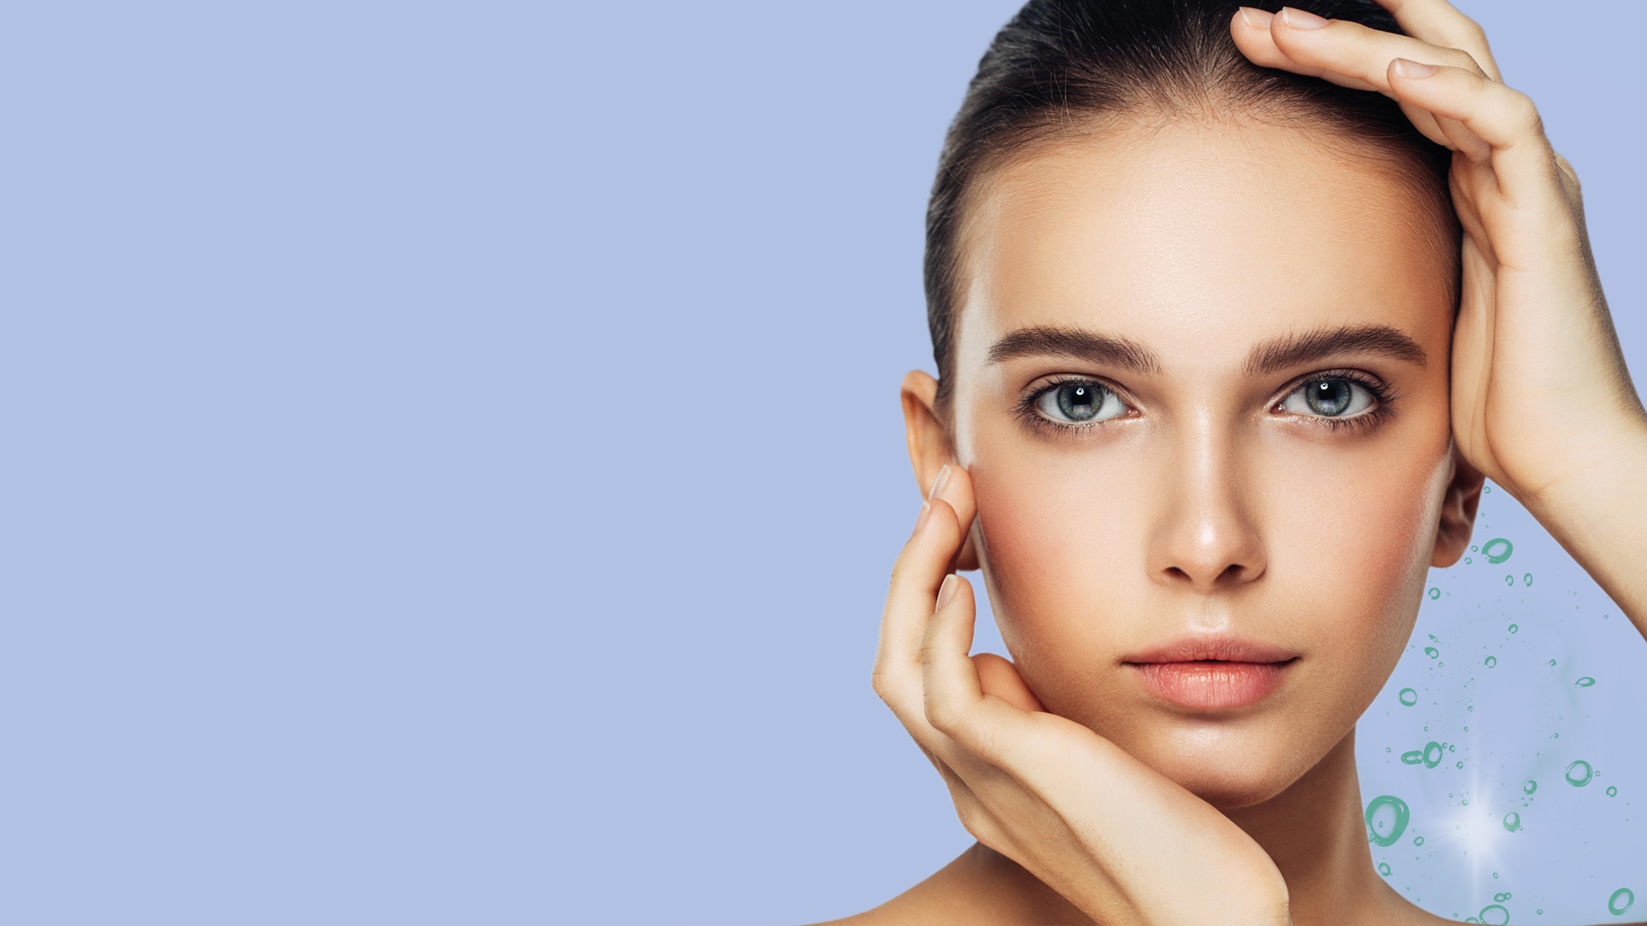
COLHIBIN CB
Helps to delay the signs of time
06.2023

Slide 2
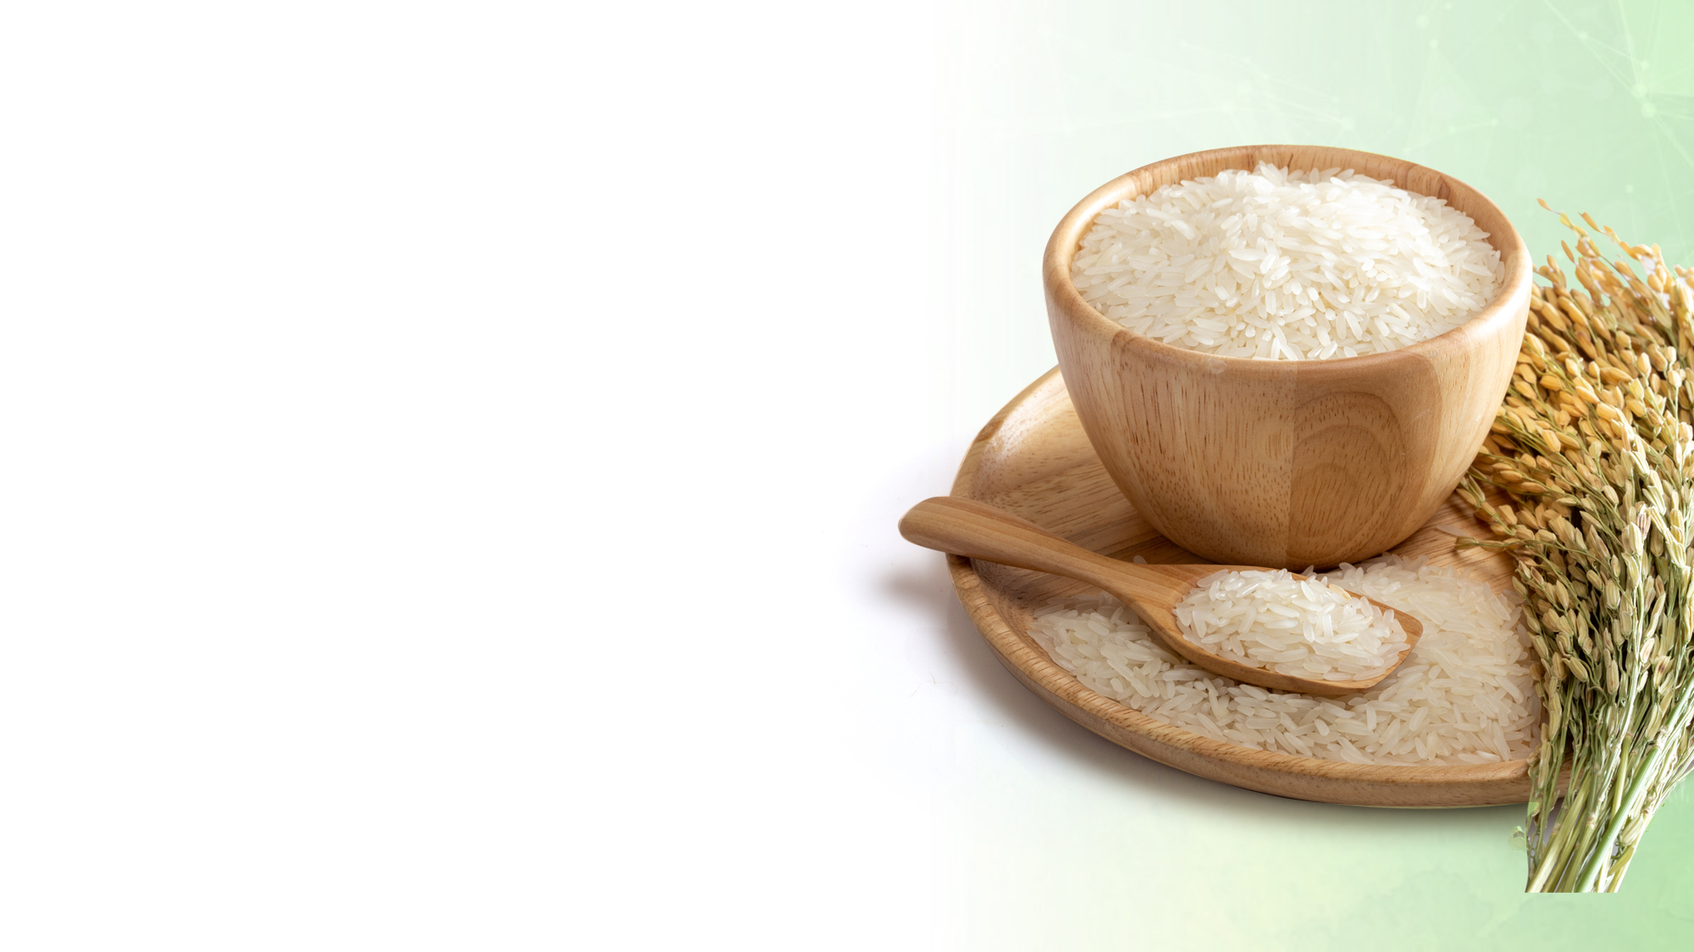
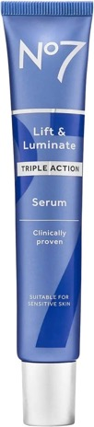
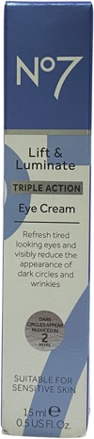

Rice gets a beauty boost
Like many traditional tips and folk remedies, rice (Oryza
sativa L.) is one of the major cereal food crops in the world.
Rice is not just food; it’s loaded with health-promoting bioactive components.
Rice protein has a higher nutritional value than other plant proteins such as wheat, corn and oat .¹
Rice is also beneficial for skin and hair
Rice is currently causing a stir on social
networks, where rice water and rice powder
are proving to be must-haves to help fight
the signs of aging, reduce wrinkles & fine
lines, and help smooth the skin.
Women in Asia have recycled the water
in which rice is cooked for centuries to
help strengthen their hair.
These reasons could encourage many
brands to look to rice when concocting
their future cosmetics.
with
Hydrolyzed Rice Protein
1 Koo et al. 2007

Slide 3
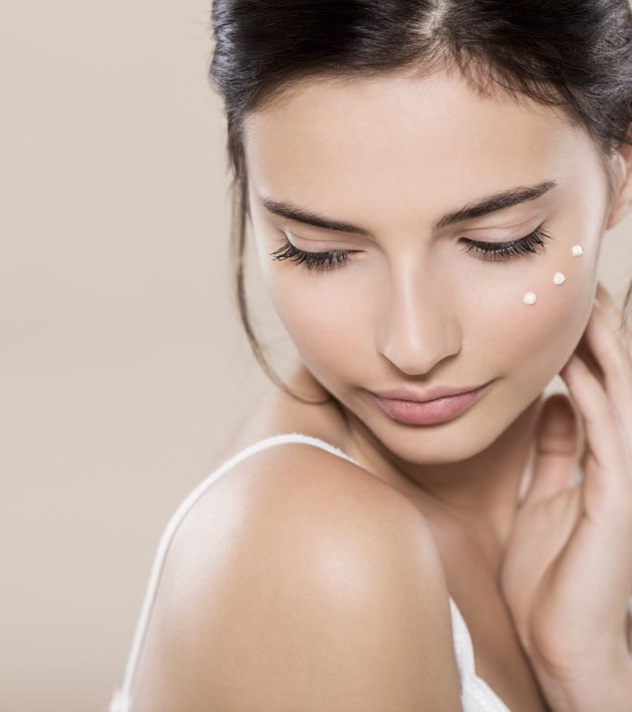


Peptides help take beauty to the next level
Peptides have been a buzz word in skincare for the last decade, due to their anti-aging effects on skin.
Peptides are seen as one of the most potent skin actives in cosmetics that take skincare to the next level, by targeting very specific skin biological mechanisms.
In recent years, natural rice peptides with skin benefits beyond their pure nutritional value are on the rise.
COLHIBIN CB is a highly concentrated mixture of natural peptides, extracted from edible rice protein.

Slide 4







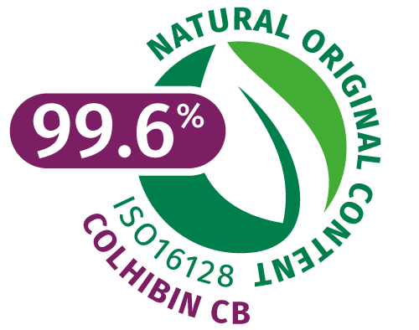





COLHIBIN CB helps to delay the signs of time
ID Card
INCI NAME
(active)
Hydrolyzed Rice Protein
Technology
COLHIBIN CB is a highly concentrated mixture of natural peptides with low molecular weights, extracted from edible rice protein
Helps to delay the signs of time
Highly effective Collagenase (MMP) inhibitor, which helps protect skin from unscheduled collagen degradation*
Helps to reduce skin roughness**
Effective solution for healthy-looking hair**
KEY
BENEFITS
* In vitro ** In vivo
TECHNICAL
Form: Liquid
Use level: 1–5%
pH of use: 3-9
Preservative:
Phenoxyethanol-free
Solubility: water soluble
Biodegradability: Expected to be biodegradable
Raw material verified by ECOCERT GREENLIFE, conform to the COSMOS Standard
NATRUE
Approved
REGISTRATION
CERTIFICATION
Patent
4

Slide 5

Produced from rice protein
Extracted by water
COLHIBIN CB, the result of a carefully isolated fraction of natural rice-derived peptide, has a 99.6% natural origin (ISO 16128).
The production process is operated under mild conditions without hazardous chemical substances.
Dried rice is ground, dissolved in water, centrifuged, rinsed, resolubilized and filtered to obtain the peptide fraction of the rice protein.
The hydrolyzed rice protein is then dissolved in water and Pentylene glycol (produced from natural resources).

Slide 6
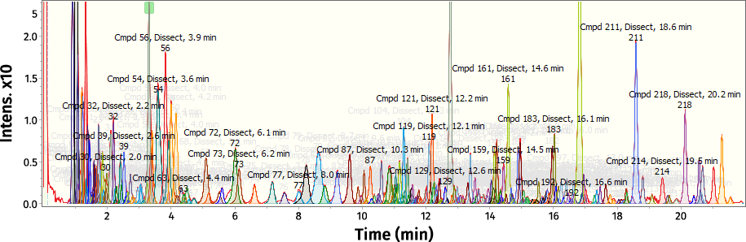
COLHIBIN CB is rich in Di-, Tri-, and Tetra- rice peptides
…with low molecular weights
COLHIBIN CB | Molecular weight 202–310 Da | Molecular weight 310–510 Da | Molecular weight 510–740 Da
Di- and Tri- peptides | ~100
Tetra-peptides |  | ~110
Penta-, Hexa-, peptides |  |  | ~10
COLHIBIN CB contains more than 220 peptides of which the majority have a relative Molecular Weights (MW) of less than 800 Daltons, analyzed by LC-HR-MS.
Di- Tri- peptides
MW: 200 – 310 Da
Tetra- peptides
MW: 310 – 510 Da
Penta- Hexa- peptides
MW: 510 – 740 Da
COLHIBIN CB is particularly rich in
Di-, Tri- and Tetra- rice peptides.

Slide 7
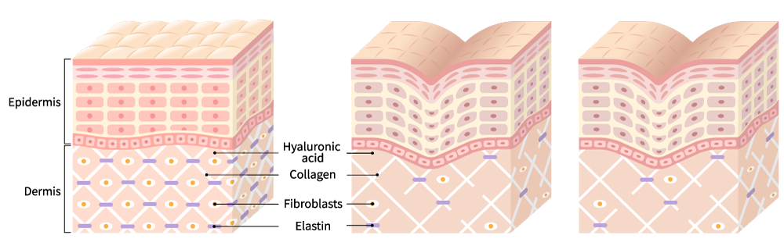
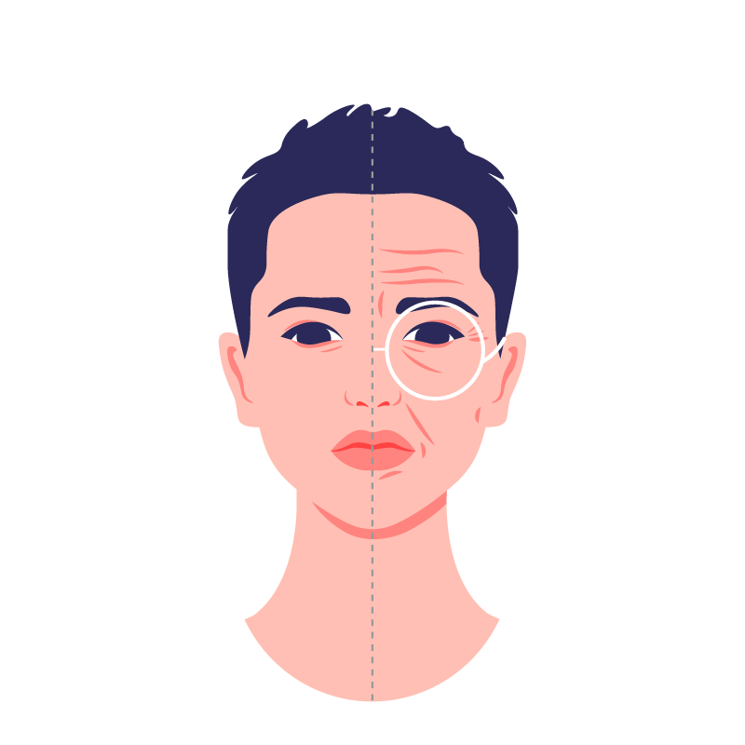
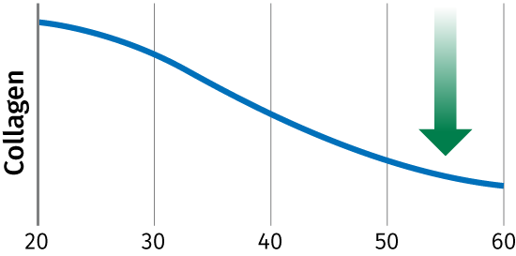
Mode of action
Skin aging
COLHIBIN CB
With age, the Collagen density in the Dermis decreases and its network becomes increasingly fragmented, presenting shorter and less organized fibers. The skin becomes rough and wrinkles are formed.
Aged skin is characterized by a strong loss
of Collagen and upregulated Collagenases
also known as Matrix Metalloproteinases
(MMP) activity.
An increase in MMP expression accelerates
the Collagen degradation.
COLHIBIN CB inhibits MMP 1 enzyme and helps prevent degradation of type 1 Collagen.
MMP’s ↑
High density of collagen
Degradation of
collagen
Lack of
collagen
COLHIBIN CB ( ) inhibits MMP 1 ( )
Skin aging
Reference: Asserin et al. (2015) J Cosmet Dermatol, 14, 291-301
Papakonstantinou et al. (2012) Dermato-Endocrinol 4:3, 253–258

Slide 8
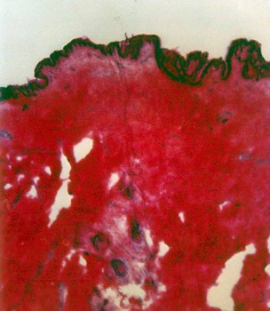
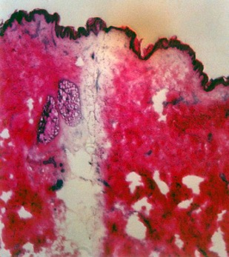
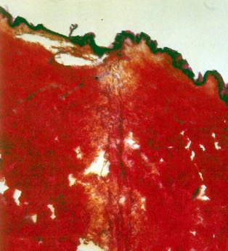
Protection of skin against collagenases – ex vivo
COLHIBIN CB
This ex-vivo study was performed with human skin explants taken from plastic surgery.
Cotton threads were saturated with collagenase (400Units/ml) with/without COLHIBIN CB (5%) and set down on the skin sections. The skin sections were then incubated for three hours. At the end of the reaction the skin was fixed and stained with eosine/saffron.
No staining is observed at sites where collagenase destroyed the collagen fibers (blue arrow).
The colored cross section (right) is due to a strong protection of collagen by COLHIBIN CB and demonstrates a reduction of collagenase derived cutaneous damage compared to the placebo (left).
Placebo
Collagenase only
Collagenase + 5% COLHIBIN®
COLHIBIN CB is a highly effective Collagenase (MMP) inhibitor, which helps protect skin from unscheduled collagen degradation

Slide 9
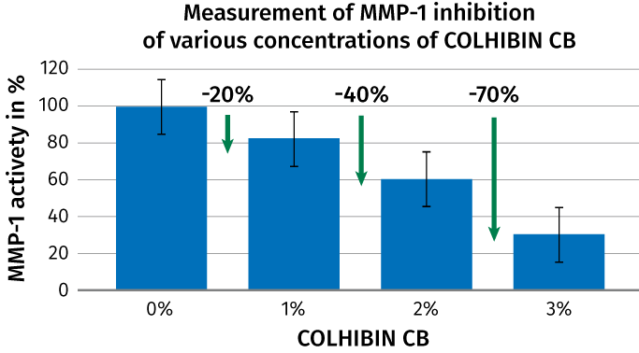

Inhibition of MMP-1 – in vitro
COLHIBIN CB
Various concentrations of COLHIBIN CB and MMP-1 were added to a native collagen containing solution. The concentration dependent inhibition effect of COLHIBIN CB was measured in a photometric assay.
Up to 70% reduction of MMP-1 have been obtained with COLHIBIN CB

Slide 10
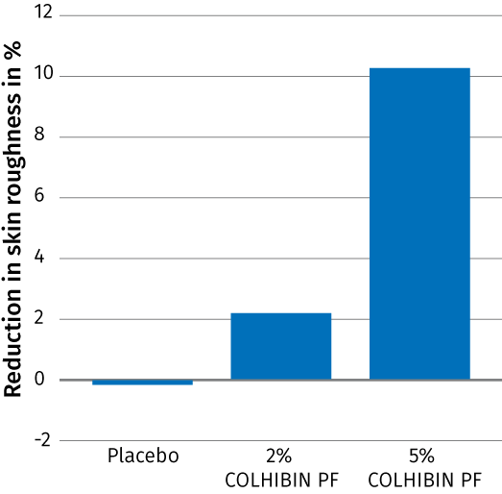
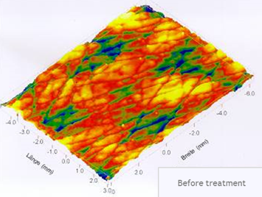
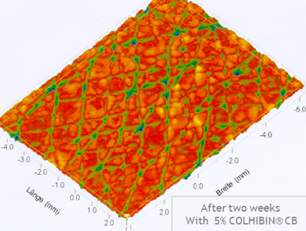

Visible reduction of skin roughness – in vivo
COLHIBIN CB
To demonstrate the beneficial effect of COLHIBIN CB (5%) on the skin surface we performed a 14 days in-vivo study with 20 volunteers.
The skin surface relief was optically measured on silicon replica taken from the skin of the volunteers before and 14 days after twice daily application of a formulation containing COLHIBIN CB (5%).
The figures shows the mean difference in skin roughness before and after 14 days treatment of a formulation with COLHIBIN CB (5%).
After 2 weeks up to 10% reduction of skin roughness after frequent use of COLHIBIN CB
After 2 weeks twice daily application of a formulation with COLHIBIN CB skin roughness is visibly reduced.

Slide 11



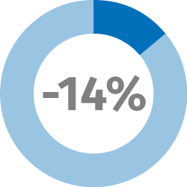

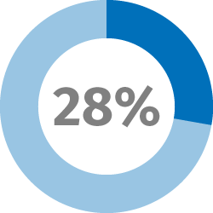
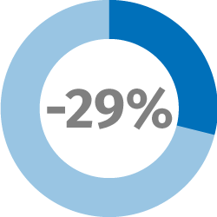
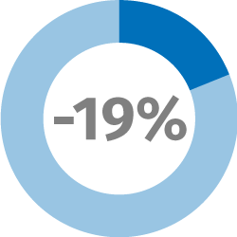
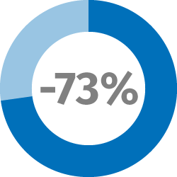
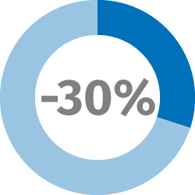
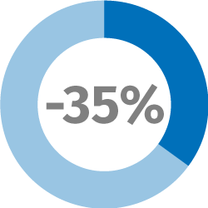
Helps to promote healthy-looking hair
COLHIBIN CB
Shampoo
Leave-on
single application
Reduction in COMBING FORCE
Hair BREAKAGE
Reduction
SPLIT ENDS Reduction
(dry combing force at tips)
HAIR FIBERS
vs
PLACEBO
WET
1 CYCLE
3 CYCLES
Reduction in COMBING FORCE
DRY
1 CYCLE
3 CYCLES
Bleached Caucasian hair
Breakage: repeated combing test
COLHIBIN CB at 3% as supplied
WET
DRY
11
11

Slide 12





Easy-to-use
COLHIBIN CB
Can be processed either warm (<80°C) or cold and is incorporated in the aqueous phase of a cosmetic formulation
COLHIBIN CB is a clear, yellowish aqueous solution
Soluble in water at all ratios
Recommended dosage: up to 5%
Stable in a pH-range from 3-9

Slide 13



Rice Peptide Nourishing Cream
With COLHIBIN CB and TILAMAR® PDO with NØØVISTA™
This rice peptide nourishing cream perfectly revitalizes the skin and slows down the aging process of the skin, thanks to which the skin maintains its smoothness, elasticity and youthful appearance. It absorbs quickly into the skin without leaving it sticky.
The cream is recommended for mature skin.
COLHIBIN CB helps to delay the signs of time and helps smooth the skin.
TILAMAR® PDO with NØØVISTA™ provides hydration, sensory enhancement as well as preservative boosting performance.

Slide 14
Rice Peptide Nourishing Cream
96.61% Natural Origin (ISO 16128)
 | Ingredient | % w/w | Function
A | Aqua | 64.66 | Solvent
 | Sodium Gluconate | 0.20 | Chelating Agent
 | TILAMAR® PDO with NØØVISTA™ | 5.00 | Sensory, Hydration, Active carrier and Preservative booster
 | Xanthan Gum | 0.20 | Thickener
B | Cetearyl Olivate, Sorbitan Olivate | 4.00 | Emulsifier
 | Cetearyl Alcohol | 1.50 | Co-emulsifier
 | Phenoxyethanol, Ethylhexylglycerin | 1.00 | Preservative
 | Caprylic/Capric Triglyceride | 8.00 | Emollient
 | Octyldodecanol | 10.00 | Emollient
 | Dimethicone | 2.00 | Emollient
C | Hydroxyethyl Acrylate/Sodium Acryloyldimethyl Taurate Copolymer | 0.40 | Thickener
D | COLHIBIN CB (Hydrolyzed Rice Protein, Glycerin, Aqua, Pentylene glycol, Sodium benzoate) | 3.00 | Active
E | Citric Acid, Aqua | 0.04 | pH adjuster
Procedure
Mix Phase A and heat under stirring to 75-80°C.
Mix Phase B and heat under stirring to 75-80°C.
At the end of the heating phase, add Phase C into Phase B.
Add Phase B+C into Phase A and homogenize 1 min at 15000 rpm.
Let cool to ±35°C under stirring.
Add Phase D and stir moderate until it's homogeneous.
Adjust to pH 5.5 with Phase E.
Let stir for another 15 min.
pH: 5.8
Viscosity: 17 800 mPa.S
(spindle RV05 / 10rpm)
SK-E-101976-7 See disclaimer Guide Formulations

Slide 15
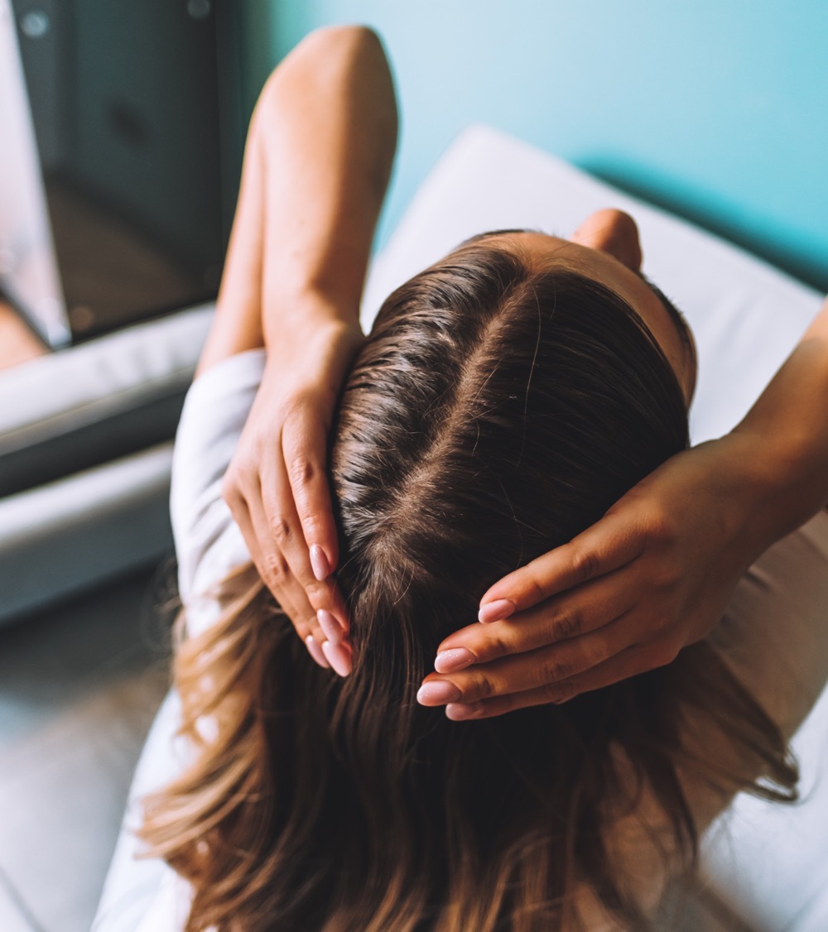
Reset the Time Therapy
With COLHIBIN CB, ALPAFLOR® EDELWEISS CB, LIPOGARD, D-PANTHENOL 75L, PHYTANTRIOL, TILAMAR® Quat 640
This hair conditioning formulation protects and stimulates the scalp, strengthens and revitalizes the hair, limiting hair fall due to breakage.
From root to end, the hair looks stronger and revitalized.
COLHIBIN CB helps to promote healthy-looking hair.
ALPAFLOR® EDELWEISS CB helps to improve hair density.
LIPOGARD provides strong anti-oxidant properties and help to stimulate the hair’s natural keratin synthesis.
D-Panthenol 75L helps strengthen hair, retain moisture, and improves the texture of damaged hair.
PHYTANTRIOL the time-tested hair secret to repair, enhance and protect, from root to tip.
TILAMAR® Quat 640 delivers ultimate conditioning performance.

Slide 16
Reset the Time Therapy
90.62% Natural Origin (ISO 16128)
 | Ingredient | % w/w | Function
A | Aqua | 80.85 | Solvent
 | Behentrimonium Chloride, Isopropyl Alcohol | 3.13 | Conditioner
 | TILAMAR® Quat 640 (Polyquaternium-6, Aqua) | 1.50 | Conditioner
B | Cetyl Alcohol | 3.77 | Emollient
 | Isopropyl Myristate | 2.00 | Emollient
 | Isopropyl Palmitate | 2.00 | Emollient
 | PPG-3 Myristyl Ether | 2.00 | Emollient
 | Behenyl Alcohol | 0.80 | Emollient
C | COLHIBIN CB (Hydrolyzed Rice Protein, Glycerin, Aqua, Pentylene glycol, Sodium benzoate) | 0.20 | Active
 | D-Panthenol 75L (Panthenol, Aqua) | 0.75 | Active
 | ALPAFLOR® EDELWEISS CB (Leontopodium Alpinum Flower/Leaf Extract, Glycerin, Aqua) | 0.10 | Active
D | Phytantriol (Phytantriol) | 0.50 | Active
 | Phenoxyethanol, Ethylhexylglycerin | 0.80 | Preservative
 | LIPOGARD (Ubiquinone, Tocopheryl Acetate, Squalane) | 0.10 | Active
 | Cyclopentasiloxane & Dimethiconol | 1.00 | Conditioner
 | Perfume | 0.50
Procedure
Heat Phase A to 85°C.
Heat Phase B to 85°C.
Add Phase B to Phase A under moderate stirring.
Cool the formulation to 40°C and add Phase C under stirring until the formulation is homogenous.
Add Phase D under stirring until formulation is homogenous.
pH: 5.3
Viscosity: 30 933 mPa.S
(spindle RV04 / 3rpm)
HC-E-101023-30 See disclaimer Guide Formulations

Slide 17

COLHIBIN CB
In a nutshell
COLHIBIN CB is rich in rice peptides with low molecular weights, extracted from edible rice protein
COLHIBIN CB helps
to delay the signs
of time
Highly effective Collagenase (MMP) inhibitor, which helps protect skin from unscheduled collagen degradation*
Helps to reduce
skin roughness**
Helps to promote
healthy-looking hair**
* In vitro ** In vivo

Slide 18
Disclaimer
Copyright © 2023 DSM Nutritional Products, 4002 Basel, Switzerland.
www.dsm.com/personal-care. All rights reserved.
DSM has used diligent care to ensure that the information provided herein is accurate and up-to-date, however, DSM makes no representation or warranty, either expressly or implied, of the accuracy, reliability, or completeness thereof. The information provided herein contains scientific and product information for business to business use and does not constitute or provide scientific or medical advice, diagnosis or recommendation for treatment. Country or region-specific information should be considered when labeling or advertising to final consumer. In no event shall DSM be liable for any damages arising from or reliance upon, or use of, any information provided herein. The content of this document is subject to change without further notice. Please contact your local DSM representative for further details. All trademarks listed in this document are either (registered) trademarks of, or trademarks licensed by, the DSM group of companies in the Netherlands and/or other countries, unless explicitly stated otherwise.

