Slide 1
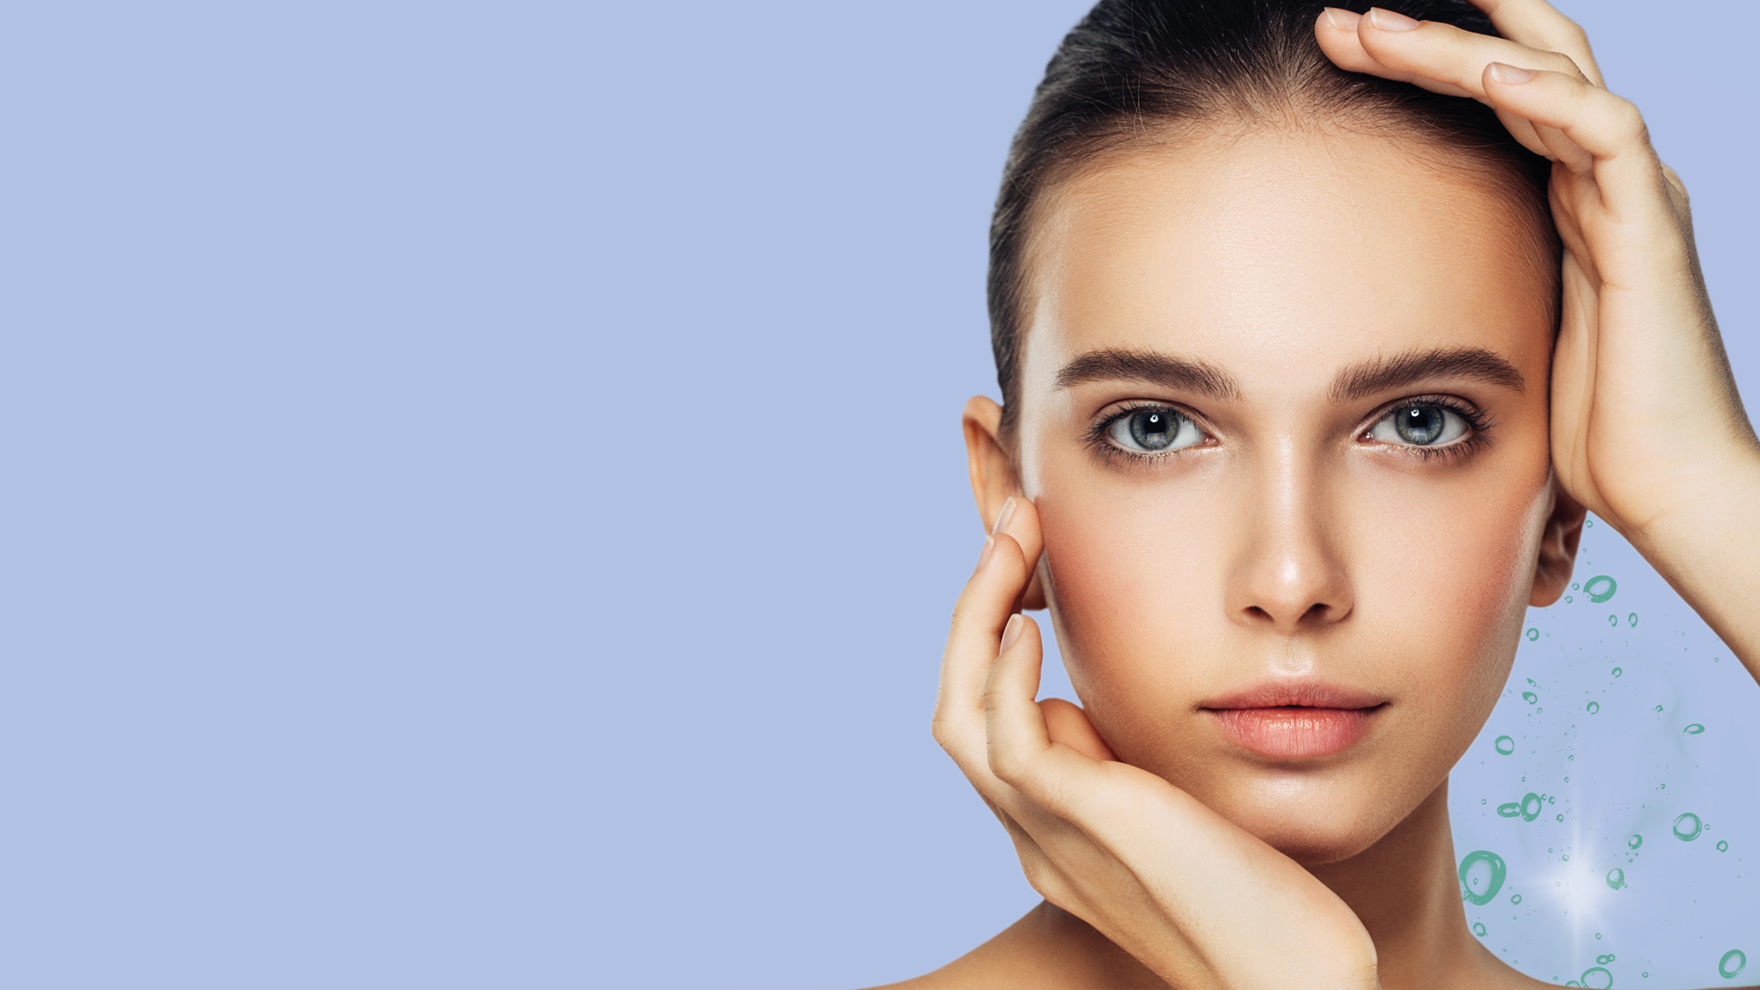
COLHIBIN CB
Helps to delay the signs of time
2023-06

Slide 2







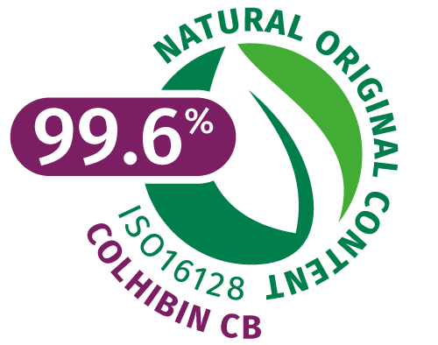





COLHIBIN CB helps to delay the signs of time
ID Card
INCI NAME
(active)
Hydrolyzed Rice Protein
Technology
COLHIBIN CB is a highly concentrated mixture of natural peptides with low molecular weights, extracted from edible rice protein
Helps to delay the signs of time
Highly effective Collagenase (MMP) inhibitor, which helps protect skin from unscheduled collagen degradation*
Helps to reduce skin roughness**
Effective solution for healthy-looking hair**
KEY
BENEFITS
* In vitro ** In vivo
TECHNICAL
Form: Liquid
Use level: 1–5%
pH of use: 3-9
Preservative:
Phenoxyethanol-free
Solubility: water soluble
Biodegradability: Expected to be biodegradable
Raw material verified by ECOCERT GREENLIFE, conform to the COSMOS Standard
NATRUE
Approved
REGISTRATION
CERTIFICATION
Patent
2

Slide 3
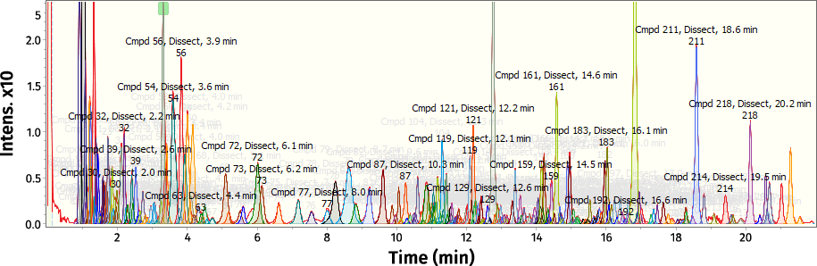
COLHIBIN CB is rich in Di-, Tri-, and Tetra- rice peptides
…with low molecular weights
COLHIBIN CB | Molecular weight 202–310 Da | Molecular weight 310–510 Da | Molecular weight 510–740 Da
Di- and Tri- peptides | ~100
Tetra-peptides |  | ~110
Penta-, Hexa-, peptides |  |  | ~10
COLHIBIN CB contains more than 220 peptides of which the majority have a relative Molecular Weights (MW) of less than 800 Daltons, analyzed by LC-HR-MS.
Di- Tri- peptides
MW: 200 – 310 Da
Tetra- peptides
MW: 310 – 510 Da
Penta- Hexa- peptides
MW: 510 – 740 Da
COLHIBIN CB is particularly rich in
Di-, Tri- and Tetra- rice peptides.

Slide 4
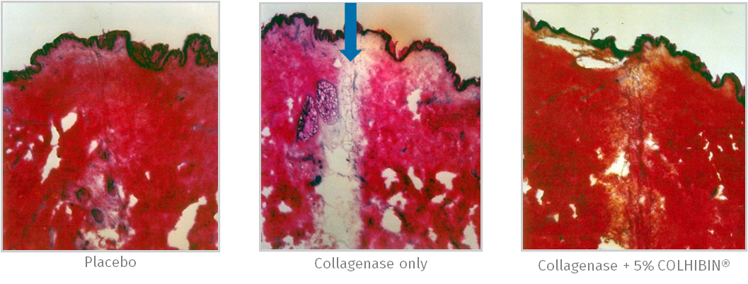
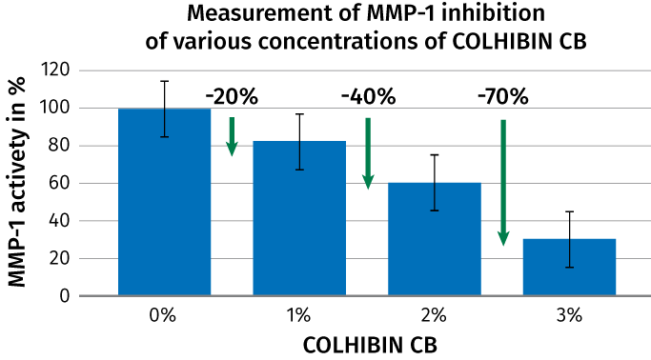

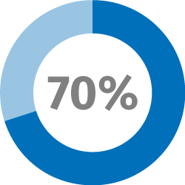
COLHIBIN CB
Highly effective Collagenase (MMP-1) inhibitor
EX VIVO WITH SKIN EXPLANTS
IN VITRO
COLHIBIN CB is a highly effective Collagenase (MMP) inhibitor, which helps protect skin from unscheduled collagen degradation.
Up to 70% reduction of MMP-1 have been obtained with COLHIBIN CB

Slide 5
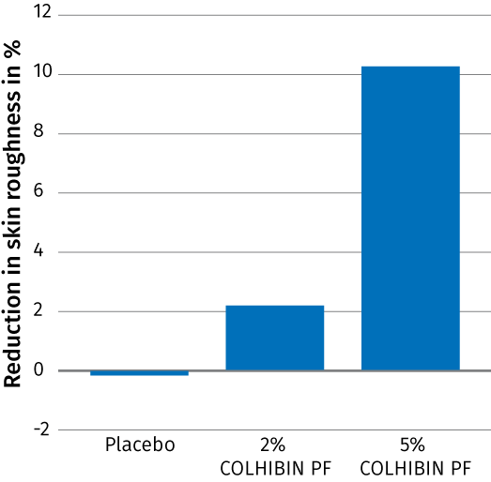
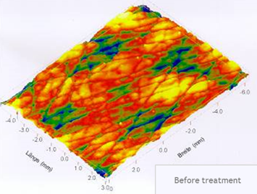
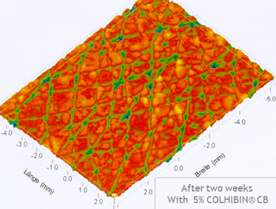

COLHIBIN CB
Visible reduction of skin roughness – in vivo
To demonstrate the beneficial effect of COLHIBIN CB (5%) on the skin surface we performed a 14 days in-vivo study with 20 volunteers.
The skin surface relief was optically measured on silicon replica taken from the skin of the volunteers before and 14 days after twice daily application of a formulation containing COLHIBIN CB (5%).
The figures shows the mean difference in skin roughness before and after 14 days treatment of a formulation with COLHIBIN CB (5%).
After 2 weeks up to 10% reduction of skin roughness after frequent use of COLHIBIN CB
After 2 weeks twice daily application of a formulation with COLHIBIN CB skin roughness is visibly reduced.

Slide 6
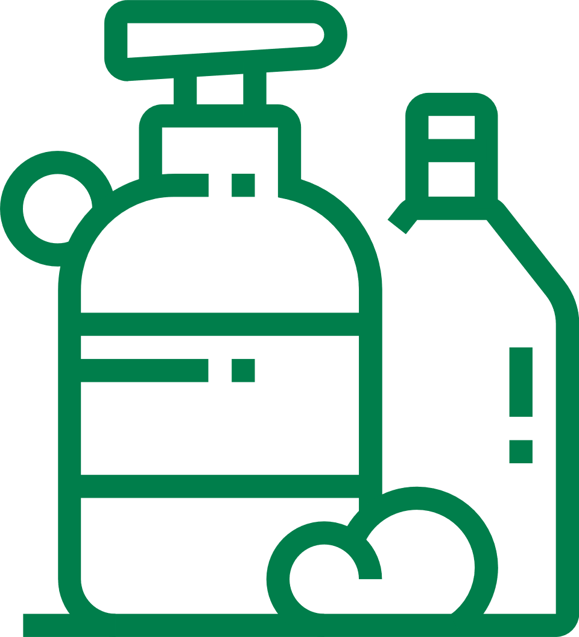


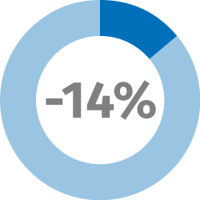
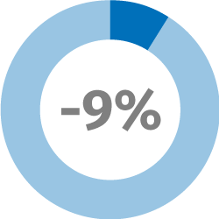
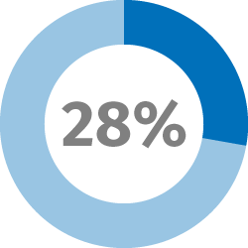
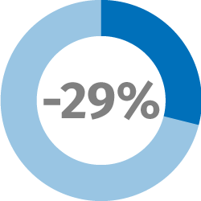
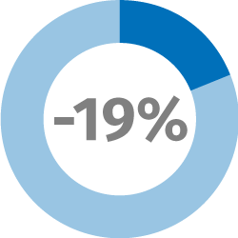
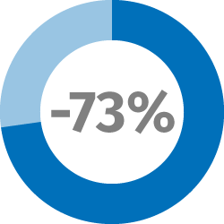
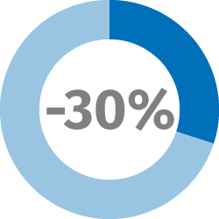
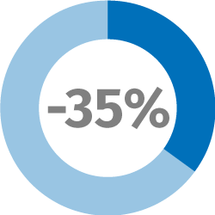

COLHIBIN CB
Helps to promote healthy-looking hair
Shampoo
Leave-on
single application
Reduction in COMBING FORCE
Hair BREAKAGE
Reduction
SPLIT ENDS Reduction
(dry combing force at tips)
HAIR FIBERS
vs
PLACEBO
WET
1 CYCLE
3 CYCLES
Reduction in COMBING FORCE
DRY
1 CYCLE
3 CYCLES
Bleached Caucasian hair
Breakage: repeated combing test
COLHIBIN CB at 3% as supplied
WET
DRY
6
6

Slide 7
Disclaimer
Copyright © 2023 DSM Nutritional Products, 4002 Basel, Switzerland.
www.dsm.com/personal-care. All rights reserved.
DSM has used diligent care to ensure that the information provided herein is accurate and up-to-date, however, DSM makes no representation or warranty, either expressly or implied, of the accuracy, reliability, or completeness thereof. The information provided herein contains scientific and product information for business to business use and does not constitute or provide scientific or medical advice, diagnosis or recommendation for treatment. Country or region-specific information should be considered when labeling or advertising to final consumer. In no event shall DSM be liable for any damages arising from or reliance upon, or use of, any information provided herein. The content of this document is subject to change without further notice. Please contact your local DSM representative for further details. All trademarks listed in this document are either (registered) trademarks of, or trademarks licensed by, the DSM group of companies in the Netherlands and/or other countries, unless explicitly stated otherwise.

