Slide 1

DISMUTIN® PF
Powerful Skin Detoxifier

Slide 2


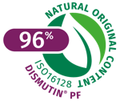

DISMUTIN® PF
Powerful Skin Detoxifier
Unique product features
DISMUTIN® PF is a cosmetic ingredient developed as a powerful skin detoxifier
Aqueous solution of highly purified skin-identical copper-zinc Superoxide Dismutase (Cu/Zn SOD)
Made by aerobic fermentation isolated from a natural yeast strain of Saccharomyces cerevisiae
96% natural origin (ISO 16128)
Excellent stability and high SOD activity (45000 – 55000 PIU*/ml) guarantee outstanding efficacy
Composition
INCI (active): superoxide dismutase
Recommended dosage
0.2–1%
2

Slide 3



DISMUTIN® PF
Powerful Skin Detoxifier
Benefits
Skin-identical Superoxide Dismutase to support the cell's own detoxification system
Protects the skin against the harmful effects of reactive oxygen radicals formed by UV radiation or environmental factors, such as pollution
Helps to prevent premature skin aging characterized by dehydration, wrinkle formation, age spots and loss of elasticity

Slide 4



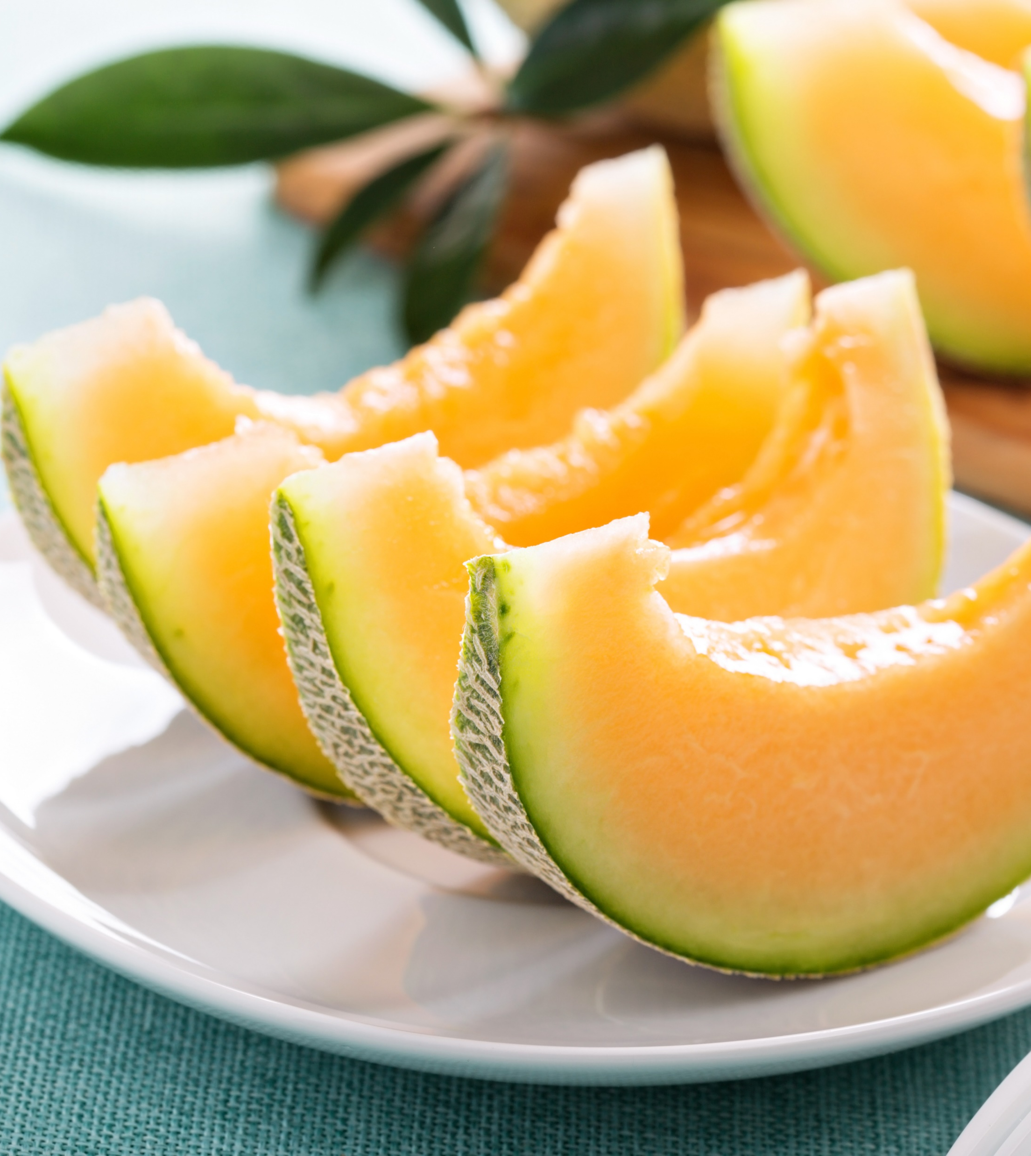
Understanding the need
What is Superoxide dismutase?
Superoxide dismutase – or SOD – has been known as the enzyme of live since 1968
SOD is a metal-containing antioxidant enzyme found in a variety of different foods, including:
  - Honeydew, cantaloupe, wheat, corn and green vegetables like broccoli and cabbage
SOD is widespread in the human body, including skin
Here, we focus on human skin copper/zinc superoxide dismutase (Cu/Zn SOD), the enzyme that plays a fundamental role in protecting cells from oxidative stress
*Biofactors. 2015 Nov 12; 41(6): 383–390

Slide 5
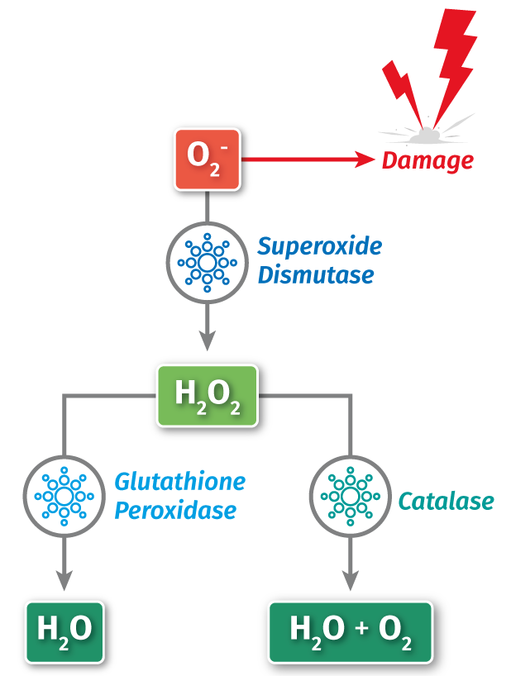
Copper/Zinc Superoxide Dismutase
Mode of action
Oxygen is essential for life; however it is also a very reactive molecule
Reactive oxygen species (ROS) are free radicals created from oxygen that are very unstable and may cause a lot of cellular damage
Superoxide radical (O₂¯) is the most dangerous of the ROS because it can also produce other oxygen free radicals
The most effective defense against superoxide (O₂¯), is the antioxidant enzyme Copper/Zinc Superoxide Dismutase (Cu/Zn SOD)
Cu/Zn SOD neutralizes superoxide (O₂¯), turning it into hydrogen peroxide; this one has to be further converted by other antioxidant enzymes (glutathione peroxidase, catalase) into oxygen and water
Cu/Zn SOD remains intact during inactivation of superoxide and can continue its magic, while non-enzymatic antioxidants (like vitamin E) are used up during neutralization
Graphic adapted from: American Journal of Sports Science and Medicine, 2013, Vol. 1, No. 1, 7-12

Slide 6
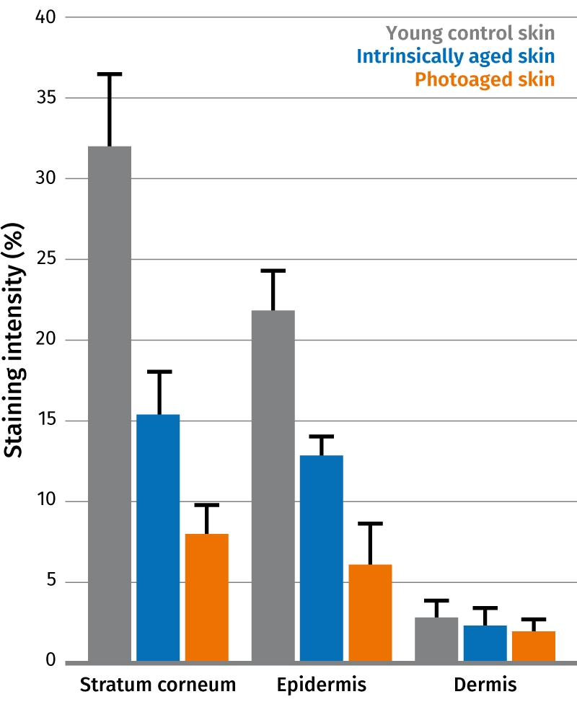
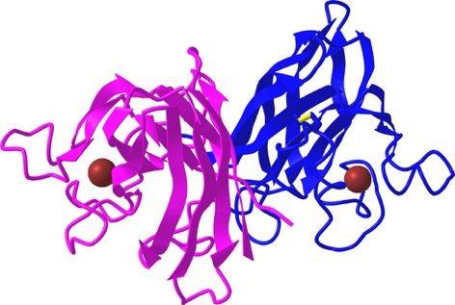
Copper/Zinc Superoxide Dismutase
In Human Skin
Copper/Zinc Superoxide Dismutase
(Cu/Zn SOD) is a stable enzyme
containing 153 amino acid (MW 15.9 kDa)¹
Cu/Zn SOD exists as a dimer of identical subunits, binding one Zinc atom and one Copper atom, which together have either a structural or catalytic function¹
Cu/Zn SOD is found at high levels in the Stratum corneum and Epidermis, but only low levels are found in the Dermis²
As we age, the levels of Cu/Zn SOD in the skin are depleted, so applying Cu/Zn SOD topically can counteract this loss²
Crystal Structure of Human Cu/Zn SOD³
1. Copper/Zinc Superoxide Dismutase in Human Skin: Current Knowledge Frontiers in Medicine Volume 7, Article 183, 2020.
2. Sanders et al. The journal of investigative dermatology vol. 118, no 4, April 2002. 3. https://www.ncbi.nlm.nih.gov/Structure/pdb/2ZKY

Slide 7
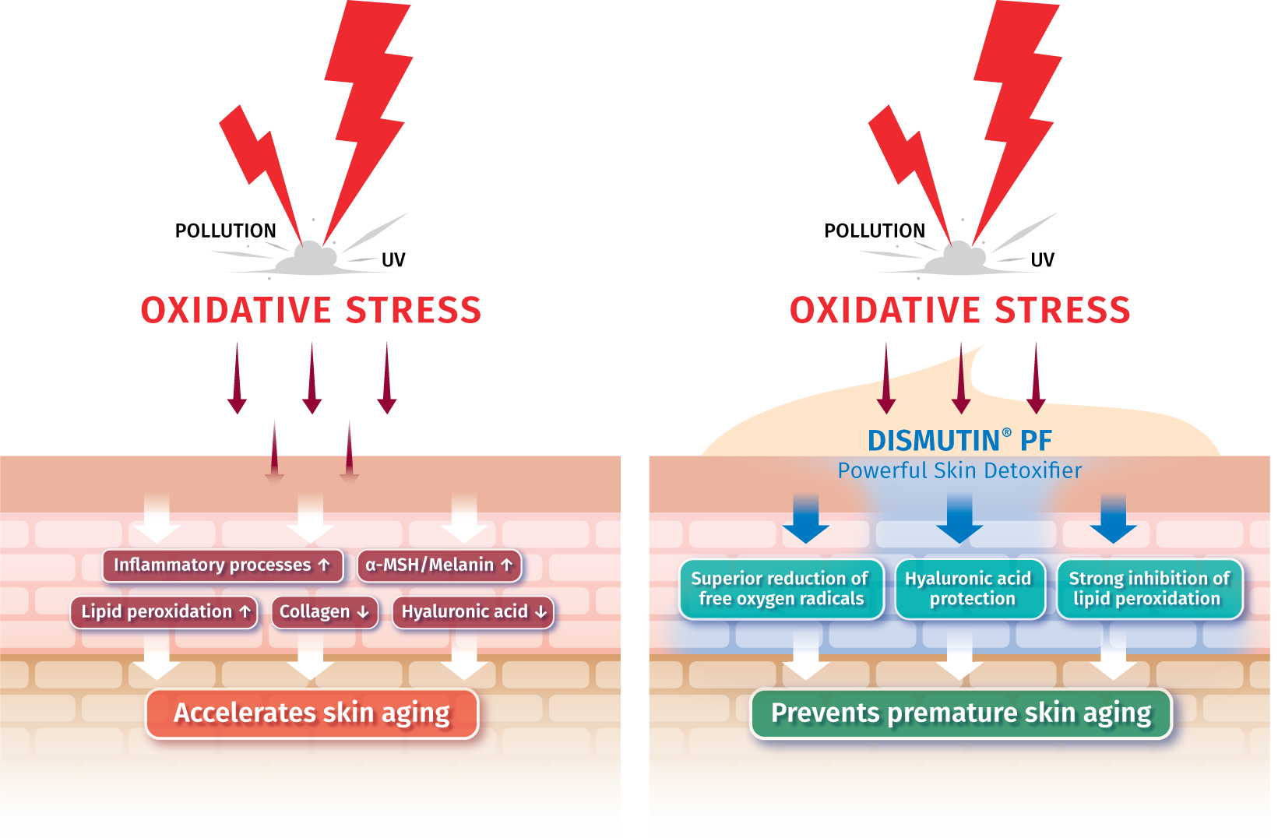
Understanding the Solution
DISMUTIN® PF Mode of action
Oxidative stress causes cellular damage and can directly damage lipids, proteins and sugars
Specifically, it can degrade collagen and hyaluronic acid and contribute to premature skin aging, i.e to the appearance of fine lines and wrinkles
It can accelerate skin pigmentation and triggers inflammation processes as well
DISMUTIN® PF protects the skin against the harmful effects of free oxygen radicals formed by UV radiation or environmental factors, such as pollution
DISMUTIN® PF strongly reduces free oxygen radicals and inhibits lipid peroxidation
DISMUTIN® PF thus helps to prevent premature skin aging characterized by dehydration, wrinkle formation, loss of elasticity and age spots
Notes:
Topical application of CoQ10 and Vitamin E acetate helps to balance the endogenous antioxidant level and to protect of peroxidation. This is important mainly for young and older skin, which have are known to have a significantly decreased Vitamin E and CoQ10 content compared to people in their thirties. Lit: Passi et al.: Lipophilic antioxidants in human sebum and aging. Free Radical Research, 36, 471-477 (2002)

Slide 8
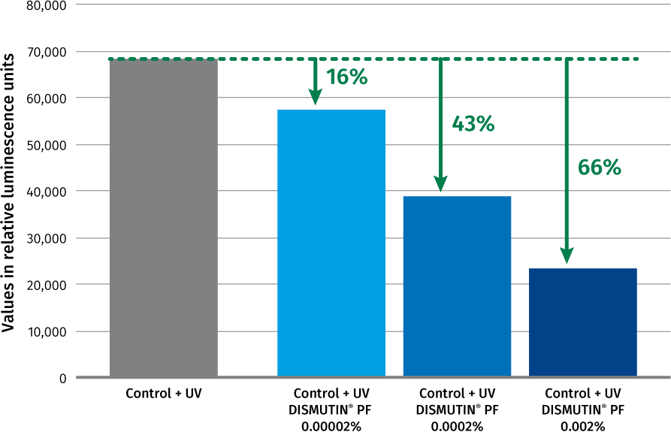
DISMUTIN® PF
Strong inhibition of lipid peroxidation
Effect of DISMUTIN® PF on free radicals synthesis by human keratinocytes in suspension after UV irradiation
Test method
In this in-vitro model, keratinocyte cultures, incubated with different concentrations of DISMUTIN® PF, were irradiated for 30 min with UV-A and B. The lipidperoxides formed due to reactive oxygen species were measured by means of luminiscence as relative luminiscence units.
Up to 66% reduction of lipid peroxidation mainly by scavenging reactive oxygen radicals
Notes:
Aim
To quantify, ex vivo on human, the scavenging effect of the product LIPOGARD versus PLACEBO.
Selection of subjects
6 healthy volunteers aged between 23 and 41.
Principle an devices
An UVA irradiation allows to increase the free radical rate. On coetaneous lipids free radicals generate lipoperoxides. The measuring out was implemented with a probe which became fluorescent in presence of peroxides.
Experimental schedule
On the inner part of the forearm, four zones are delimited:
- on irradiated zone which will not be treated
- a non irradiated non treated zone (base rate of the subject)
- an irradiated zone which will be treated with placebo
- an irradiated zone which will be treated with the product LIPOGARD
- Just after irradiation: application of the product LIPOGARD an placebo
Conclusion
The product LIPOGARD has a scavenger activity ad decreases under these experimental conditions, the peroxide rate of stratum corneum induced by UVA-rays.
The treatment with LIPOGARD can neutralize the negative irradiation effect by decreasing the peroxide rate of the treated irradiated zone.
LIPOGARD can be considered as a good free radicals scavenging product.

Slide 9
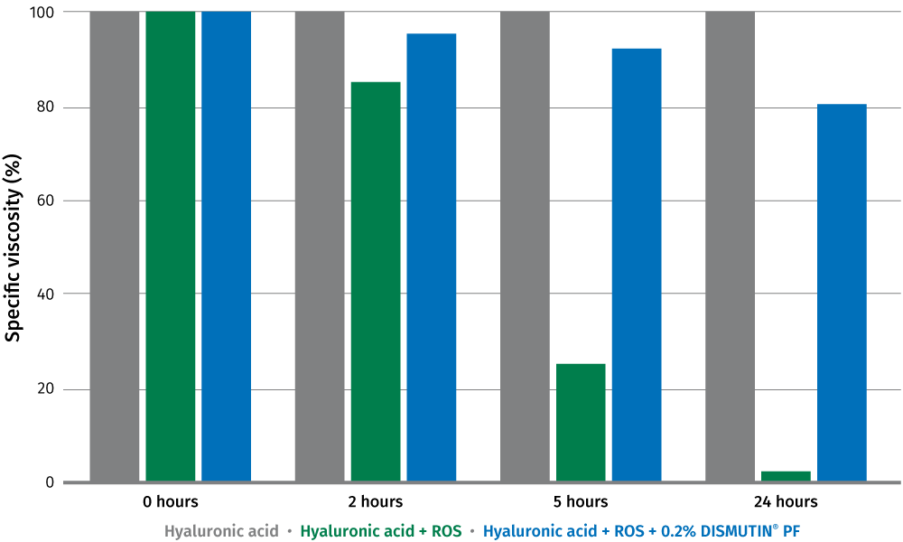
DISMUTIN® PF
Protection of hyaluronic acid against oxygen radicals
Specific viscosity of a hyaluronic acid solution in presence of the ROS-generating system and DISMUTIN® PF
Test method
The protective effect of DISMUTIN® PF was studied by exposing high molecular weight hyaluronic acid to a system which generates free oxygen radicals (hypoxanthine/xanthine oxidase*).
The consequences of the attack of free radicals were determined by measuring the decrease in the viscosity of a solution of hyaluronic acid (0.25%).
DISMUTIN® PF (0.2%) protects hyaluronic acid against oxygen radicals
Xanthine oxidase (XOD), widely found in tissues, is an enzyme that catalyzes the oxidation of hypoxanthine into xanthine and of xanthine into uric acid, whereby Superoxide anion radical (O₂°¯) is formed.
*Voegeli et al International Journal of Cosmetic Science 15,153-161 (1993)
Notes:
Xanthine oxidase (XOD), widely found in tissues, is an enzyme that catalyzes the
oxidation of hypoxanthine into xanthine and of xanthine into uric acid, whereby
Superoxide anion radical (O₂°¯) a hydrogen peroxide (H202) are formed.

Slide 10
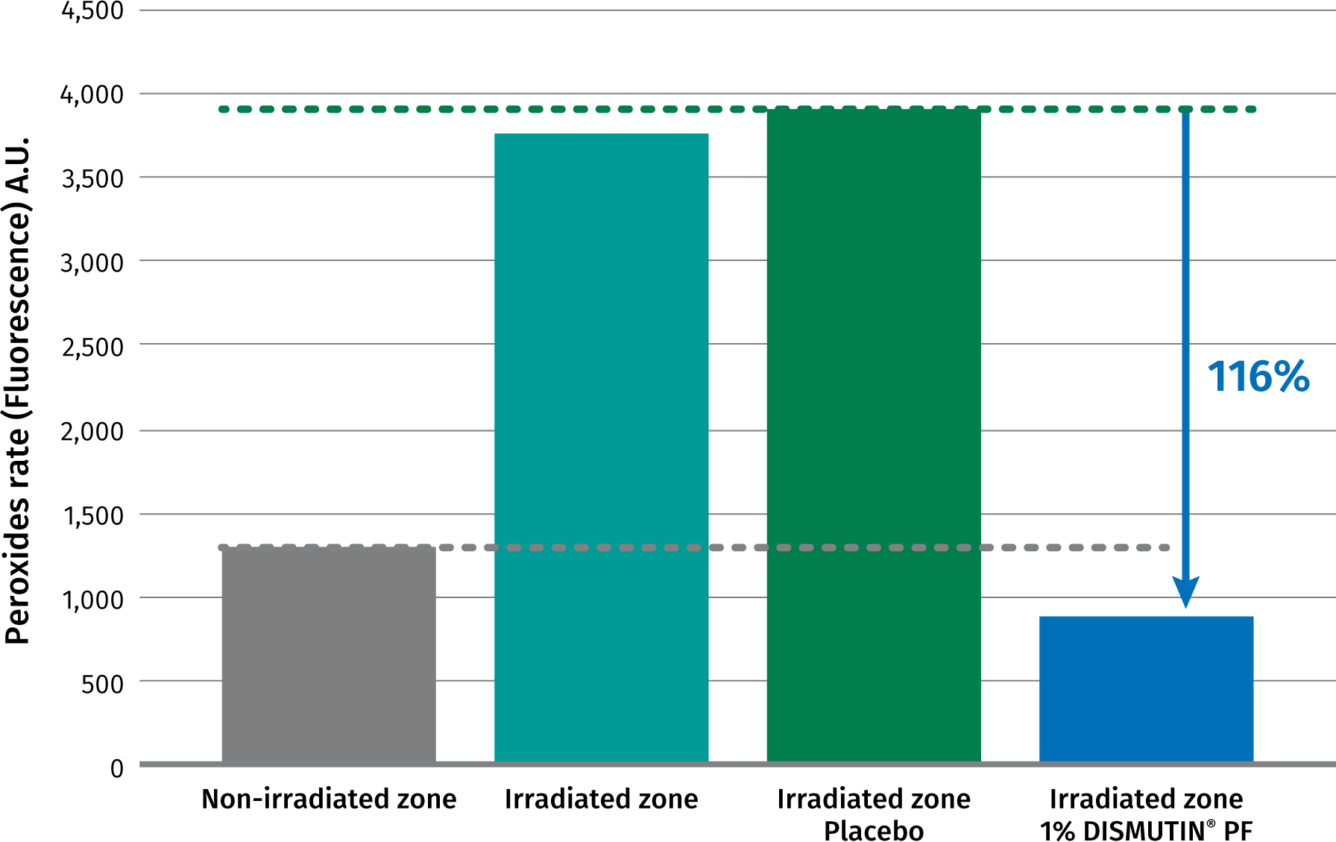
DISMUTIN® PF
Superior reduction of reactive oxygen radicals – proved in an in vivo study
Cutaneous peroxide rate by fluorescence measurement on analyzed skin zones
Test method
In this in-vivo study, marked zones on 5 volunteers’ (average age of 29 years) forearms were irradiated by UVA (SUN 3000S®/Mutzhas). Afterwards, one field was treated with a placebo cream and one with cream containing 1% DISMUTIN® PF. A non-irradiated zone was used as the control.
24 hours after UV-irradiation, each test zone was stripped twice. The second strip was used for the peroxide determination (fluorescence determination).
Superior reduction of UV-induced reactive oxygen radicals
DISMUTIN® PF thus supports the cell's own detoxification system and protects the skin against UV-induced damage
Notes:
Aim
To quantify, ex vivo on human, the scavenging effect of the product LIPOGARD versus PLACEBO.
Selection of subjects
6 healthy volunteers aged between 23 and 41.
Principle an devices
An UVA irradiation allows to increase the free radical rate. On coetaneous lipids free radicals generate lipoperoxides. The measuring out was implemented with a probe which became fluorescent in presence of peroxides.
Experimental schedule
On the inner part of the forearm, four zones are delimited:
- on irradiated zone which will not be treated
- a non irradiated non treated zone (base rate of the subject)
- an irradiated zone which will be treated with placebo
- an irradiated zone which will be treated with the product LIPOGARD
- Just after irradiation: application of the product LIPOGARD an placebo
Conclusion
The product LIPOGARD has a scavenger activity ad decreases under these experimental conditions, the peroxide rate of stratum corneum induced by UVA-rays.
The treatment with LIPOGARD can neutralize the negative irradiation effect by decreasing the peroxide rate of the treated irradiated zone.
LIPOGARD can be considered as a good free radicals scavenging product.

Slide 11
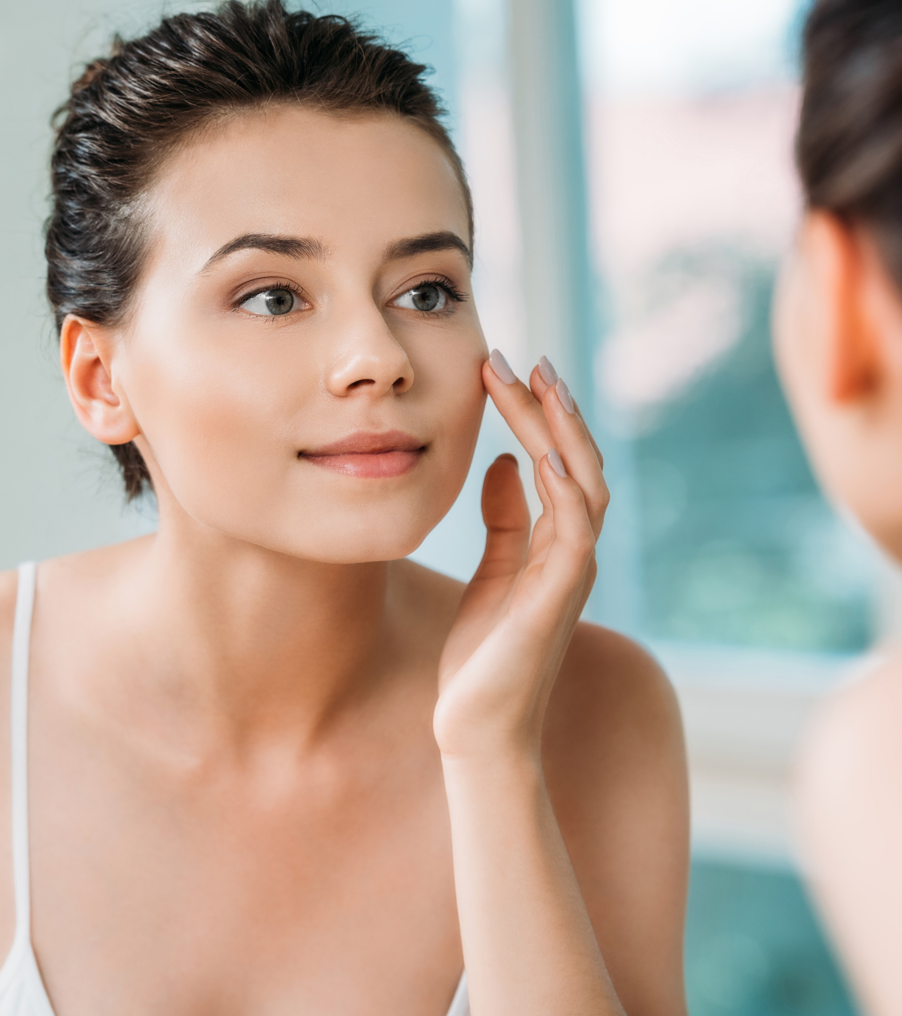




That makes DISMUTIN® PF
The ideal active ingredient for…
  Beauty detox treatments to restore skin (mask, mist, etc. ...)
  Powerful antioxidant applications
  De-aging daily creams for regeneration
  Any kind of protection formulations
  (sun care, environmental stress, pollution, etc. …)

Slide 12

And DISMUTIN® PF
Is easy to formulate
Water soluble
The optimal pH for formulations ranges from 5.0–8.0
Can be processed either warm (<60°C) or cold and is incorporated into the aqueous phase of a cosmetic formulation
Concentration of 0.2–1% for best efficacy results

Slide 13
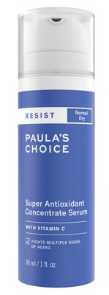
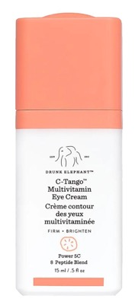
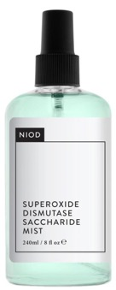
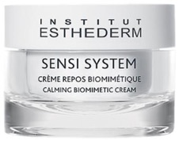
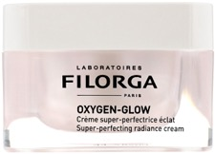
DETOX Cosmetics
With Superoxide Dismutase
Superoxide Dismutase Saccharide Mist
A mist infused with a more potent form of superoxide dismutase derived from yeast with an extremely high activity of up to 55000 pyrogallol autoxidation inhibitor units per ml to fight oxidation and reduce inflammation.
Super Antioxidant Concentrate Serum
It uses Vitamin C and peptides plus potent antioxidants to help preserve and rejuvenate skin’s surface and visibly enhance firmness.
This state-of-the-art serum helps minimize damage from environmental attack that causes skin to look older, while also helping to visibly improve a dull skin tone It.
C-Tango Multivitamin
Eye Cream
This eye cream contains responsibly sourced global ingredients, including five forms
of vitamin C that work together
to brighten uneven tone and firm.
It offers unparalleled defense against damaging UV rays, pollution and other free radicals when paired with peptides and antioxidants like vitamin E and superoxide dismutase
Calming Biomimetic
Cream
Instantly calm sensitized skin from various environmental pollutants and external stressors as it adds glow, improves skin sensitivity, and helps it to regain comfort.
Optimizes skin environment, offering strong anti-oxidant efficacy for healthy skin
Oxygen-Glow
Super-perfecting radiance cream
Smooths – Evens –
Plumps – Detoxifies
Source: from brand websites

Slide 14
Disclaimer
www.dsm.com/personal-care. All rights reserved.
DSM has used diligent care to ensure that the information provided herein is accurate and up to date, however, DSM makes no representation or warranty, either expressly or implied, of the accuracy, reliability, or completeness thereof. The information provided herein contains scientific and product information for business-to-business use and does not constitute or provide scientific or medical advice, diagnosis or recommendation for treatment. Country or region- specific information should be considered when labelling or advertising to final consumer. In no event shall DSM be liable for any damages arising from or reliance upon, or use of, any information provided herein. The content of this document is subject to change without further notice. Please contact your local DSM representative for more details. All trademarks listed in this document are either (registered) trademarks of, or trademarks licensed by, the DSM group of companies in the Netherlands and/or other countries, unless explicitly stated otherwise.
Disclaimer Formulation Guideline
This information is for illustration purposes only and based upon our current knowledge and experience at the time of printing. We do not make any representation or warranty of any kind, express or implied, including merchantability or fitness for a particular use, with respect to such information or its application. Use of this information is at your discretion and risk. Nothing herein relieves you from carrying out your own suitability determinations and tests. You are responsible for observing all laws and regulations relevant to your products, uses or processes. We do not assume any liability in connection with your product and its use. The foregoing information and suggestions are also provided without warranty of non-infringement as to the intellectual property rights of third parties, and shall not be construed as any inducement to infringe the rights of third parties.

