Slide 1

ELHIBIN® PF
Retains Youthful Skin Elasticity
Master Presentation
09-2020

Slide 2





Loss of Skin Elasticity is One of the Main Ageing Concerns
20’s
30’s
40’s
50’s

Slide 3
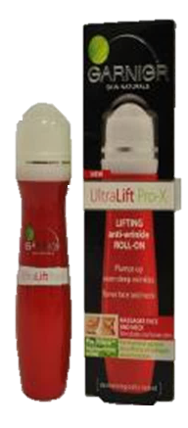
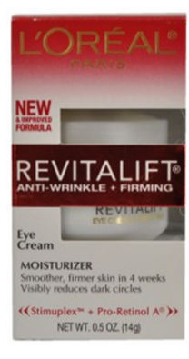
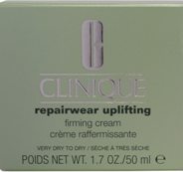
Many Recent Product Launches do Claim Benefits for Elastic Skin
~10% of skin care launches in 2012 claim benefits for elastic skin
..against age dependent
elasticity loss..
..encourages
elastin production..
..improves
skin’s elasticity..

Slide 4
Proper Skin Elasticity Depends on Healthy Elastic Fibers in the papillary dermis
Elastic fibers are mainly built in young age
They are required to function for many years, during which time they are at risk of accumulating damage
Especially exposure to UV light lead to elastic fiber breakdown
Elastic fiber breakdown is hardly reversible and thus key reason for accelerated ageing
Visible evidence is less elastic skin with reduced resilience, sagging and wrinkling
Elastase, a serine protease, responsible for the elastic fiber breakdown in the papillary dermis
Elastase control in the papillary keeps your skin elastic
Notes:
The remarkable longevity of ECM proteins in general and of the elastic fiber system in particular, is thought to pre-dispose these assemblies to the risk of molecular ageing. For example, types I and II collagen in human skin and cartilage have estimated half-lives of 15 and 95 years whilst the age of elastic fiber components is equivalent to many times the age of the individual.
In addition, elastin synthesis and deposition is predominantly confined to foetal and early postnatal development by post-transcriptional mechanisms, which mediate the decay of elastin mRNA in adults. As a consequence, in humans, individual elastic fiber proteins are required to function for many years, during which time they are at risk of accumulating damage.

Slide 5


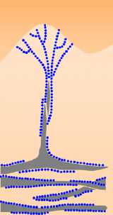
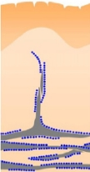

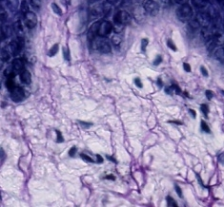
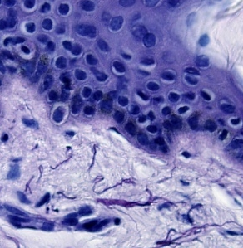
Mainly Elastic Fibers in the Papillary Dermis are Affected
Young skin
Mature skin
Papillary dermis
Reticular dermis
Addressing the papillary dermis is key to maintain skin elasticity
Notes:
The elastic fiber system also adopts a characteristic, highly ordered, architecture in which perpendicularly oriented at the DEJ merge with large diameter elastin-rich elastic fibers in the reticular dermis.

Slide 6
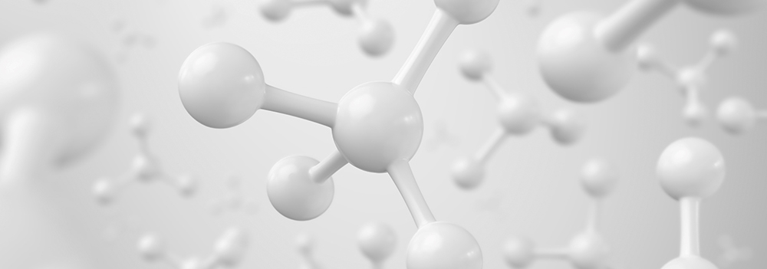
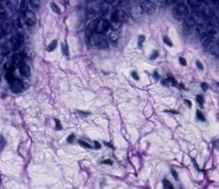
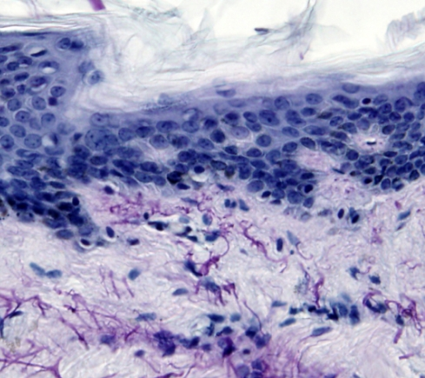



Elastic Fibers Degradation in the Papillary Dermis is a Natural Process as we Age
30’s
40’s
50’s
Starting in the 40’s these changes in the papillary dermis become visible
Notes:
Elastin staining in human skin sections
Tissue sections prepared by fixing in formalin and embedded in paraffin are required. For staining we used 3-5 um thick paraffin sections. Deparaffinising and rehydration of sections were done the usual way. Elastin was detected by Elastica-van-Gieson (Merck) according to manufacturer’s instructions. In brief: Sections were stained in resorcin-fuchsin for 10 min and rinsed under running tap water for 1min.
Then Weigerts A&B was applied 1:1 for 5min, and again rinsed under running tap water for 1min. Dehydration was done by increasing alcohol concentration and 2x xylene incubation. Xylene-wet slides are then mounted with cover slips in the presence of Entallan. Stained Tissue sections were analysed with an Olympus BX51 Microscope with a 40x objective.

Slide 7
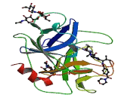
Physiological Role of Human Elastase
Elastases are proteinases that hydrolyse proteins, in particular elastin
They play an important role in tissue regeneration
Different forms exist in skin:
leukocyte elastase
fibroblast elastase
At elevated levels leukocyte elastase is one of the most harmful enzymes for the skin
Leukocyte elastase up-regulation directly leads to elastin break down
Human Leukocyte Elastase
Copyright © 2009-2013 | Uscn Life Science Inc. |
Notes:
Neutrophile elastase is a serine protease in the same family as chymotrypsin and has broad substrate specificity. Secreted by neutrophils during inflammation, it destroys bacteria and host tissue. As with other serine proteases it contains a charge relay system composed of the catalytic triad of histidine, aspartate, and serine residues that are dispersed throughout the primary sequence of the polypeptide but that are brought together in the three dimension conformation of the folded protein. The gene encoding neutrophil elastase, ELA2, consists of five exons. The neutrophil form of elastase is 218 amino acids long, with two asparagine-linked carbohydrate chains. It is present in azurophil granules in the neutrophil cytoplasm. There appear to be two forms of neutrophil elastase, termed IIa and Iib.

Slide 8
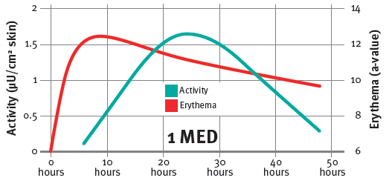
After UV Exposure Elastase Activity is Significantly
Up-regulated within Hours with a Maximum after 24 Hours
R Voegeli et al. C&T 111: 51-55, 1996
Notes:
Six female subjects (phototypes II and III), who hadn't previously been exposed to the sun for two months, were radiated with a dose of 1 MED on the lower back. Erythema development (red curve) was determined with a Minolta chromameter. Elastase activity (blue curve) was evaluated with a specific chromogenic peptide substrate 6, 24 and 48 hours after UV-radiation.
All radiated areas showed an increase in free elastase content over time. Elastase, however, seemed to have no influence on erythema development during the period of the study. The maximum average elastase activity found was 1.6 μU/cm² of skin 24 hours after radiation (blue curve).
Interestingly adjacent unradiated control areas showed an small increase in elastase activity, suggesting that elastase release is partially a systemic event.

Slide 9
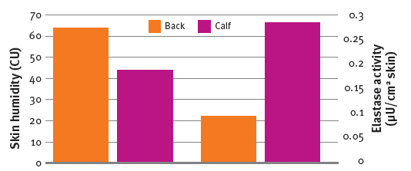

Elastase Activity in Dry Skin is Significantly Higher than in Well Moistured Skin
R Voegeli et al. C&T 111: 51-55, 1996
Notes:
The skin hydration was determined on twelve female subjects with clinically dry skin using a Corneometer. Measurements were taken on their lower backs (a normally well-hydrated skin area) and on their calves (a usually desiccated region). Elastase activity was evaluated as in the UV study.
The average skin hydration was 64 Corneometer units (CU) on the back (blue bar) and 44 CU on the calf (red bar).
The average elastase activity on the back was 0.09 μU/cm2 of skin and on the calf 0.28 μU/cm2 of skin, respectively. The average overall increase was 311% and the individual increase 430%.
It could be concluded, that dry skin is connected with an elevated level of free elastase associated with increased corneocyte shedding.

Slide 10
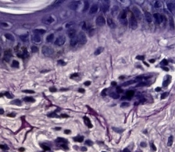


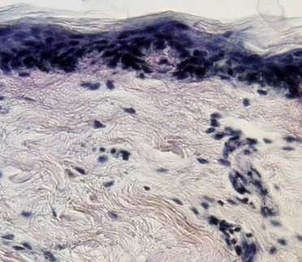
Elastase Induced Accelerated Elastic Fibers Degradation in the Papillary Dermis
In the 30’s elastic fibers
still have limited resistance
to survive elastase stress.
Degradation already visible.
In the 40’s this self defense capability is gone, no elastic network is visible after elastase stress.
Naturally aged skin
Elastase stressed skin
Remaining elastic fibers
Notes:
Elastin digest by HLE in human skin sections
We used 3-5 um thick paraffin sections. Deparaffinising and rehydration of sections were done the usual way. We incubated the tissue sections with different concentrations of human leukocyte elastase (HLE) in a humidity chamber for 18 h at 37°C.Tissue sections were washed in PBS and stained with Elastica van Gieson Kit according to manufacturer’s instructions followed by increasing alcohol concentration and 2x xylene. Xylene-wet slides are then mounted with cover slips in the presence of Entallan. Stained Tissue sections were analysed with an Olympus BX51 Microscope with a 40x objective.

Slide 11

ELHIBIN® PF
Retains Youthful Skin Elasticity

Slide 12

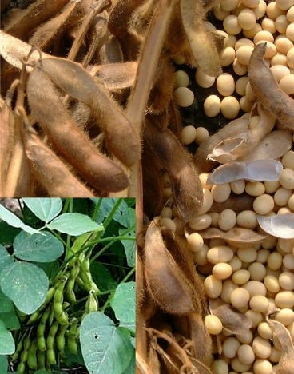
ELHIBIN® PF
Unique Product Features
Unique Product Features
Has a unique double activity to protect the elastic network in the papillary dermis
  Direct effect on elastase as an effective elastase inhibitor
  Indirect, reduces two main causes of increased elastase activity, skin irritation and dry skin
Carefully manufactured GMO and Isoflavone
free soy derived protein complex
for best performance
Contains Bowman Birk elastase Inhibitor responsible for the activity and high levels of essential amino acids
Notes:
To support the skin in its fight against free elastase DSM has developed the soy bean derived elastase inhibitor system ELHIBIN® PF.
ELHIBIN® PF PF is isolated and purified as a highly active aqueous solution in a worldwide patented, multistep down-stream procedure according to GMP.
Standardized activity: >15 EIU/ml
Stable between pH 5.5 - 8
Processing temperature < 60°C
Compatible with EtOH at concentrations up to 20%
Elastin is a protein primarily composed of the amino acids glycine, valine, alanine , and proline.
The essential amino acids Valine and Glycine produces collagen and elastin which are necessary for skin maintenance and rejuvenation

Slide 13
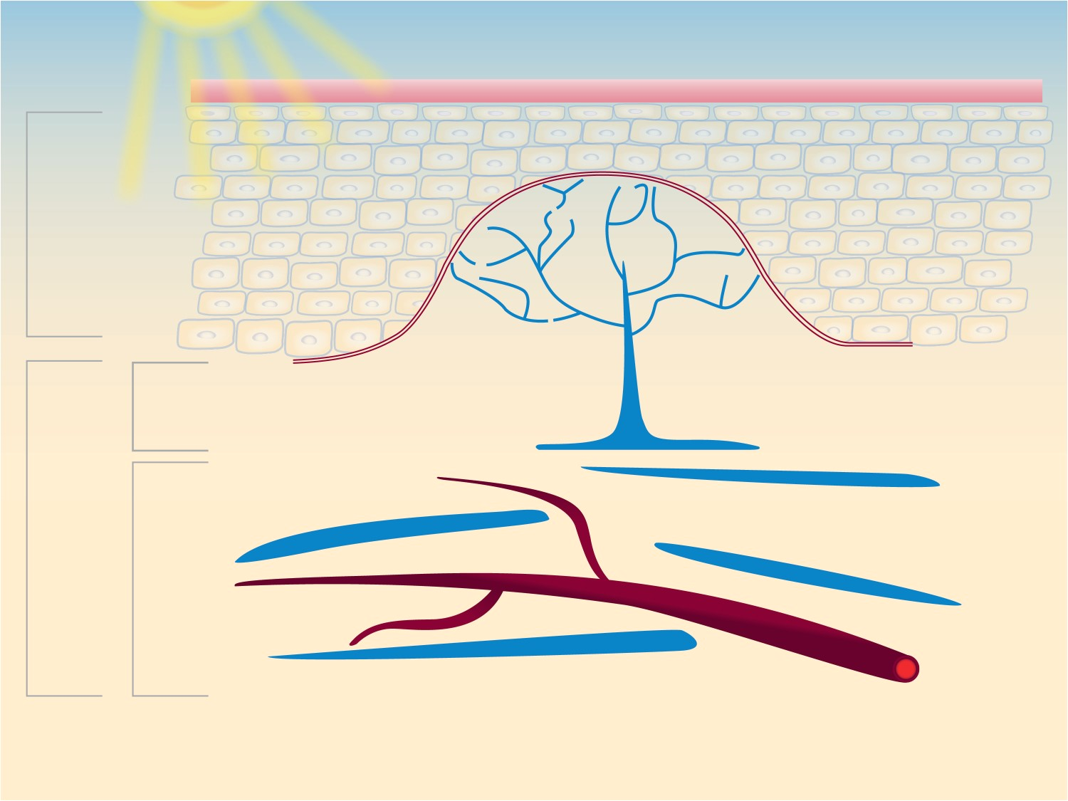


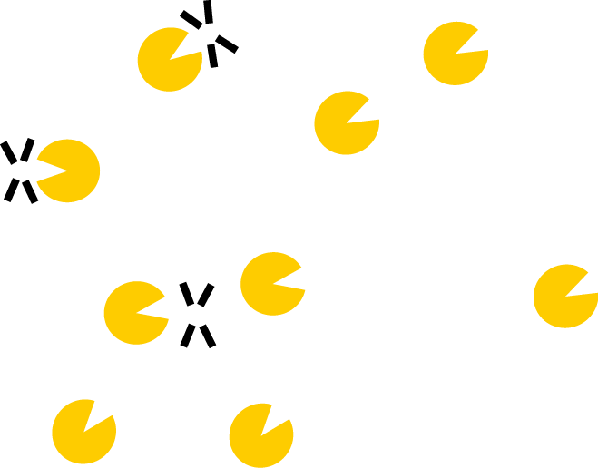
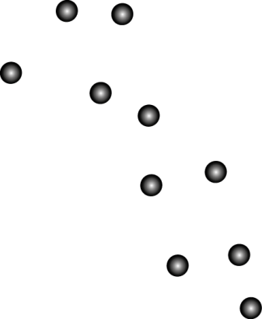
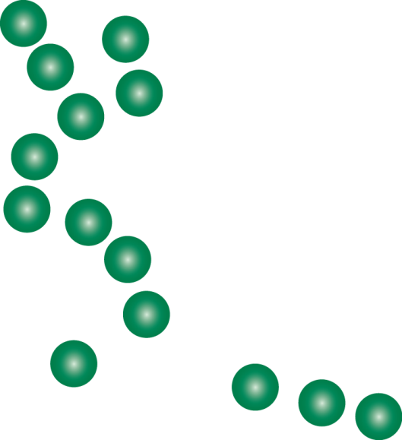




ELHIBIN® PF
UV
ELHIBIN® PF
Stratum corneum
Mode of action
mode of action
ELHIBIN®PF
Epidermis
4
Inflammation
Dermal
epidermal
junction
3
papillary
1
Elastic fiber
Dermis
2
reticular
Capillary
1) Inflammation (red) and cytokine release
2) Leukocyte recruitment by cytokines followed by dermal infiltration
3) Elastase release by leukocytes and elastic fiber degradation
4) Elastic fiber protection through elastase inhibition by ELHIBIN®PF
Notes:
ELHIBIN® PF’s mode of action is schematically depicted in the figure above. In brief, elastin is the main component of the elastic fibers, which allow the skin to resume its shape after stretching or contracting. It is the elastic fibers that give the skin its resiliency and smooth feel.
Elastic fibers are gradually degraded with age, especially the thin fibrils in the papillary dermis. This degradation is mediated through the intrinsic effects of the ageing process as well as by UV radiation.
UV radiation leads to inflammation which in turn releases cytokines into the dermis. The cytokines attract leukocytes through dermal microcapillaries and the leukocytes infiltrate the tissue at the site of inflammation. The leukocytes subsequently release the enzyme elastase, which then degrades the thin fibrils in the papillary dermis.
ELHIBIN® PF efficiently inhibits elastase activity, protecting the fibrils from UV-induced degradation. Elastase inhibition is therefore the perfect choice to fight against naturally occurring and externally induced elastin degradation.

Slide 14
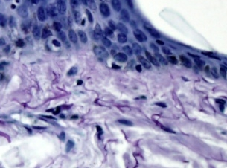
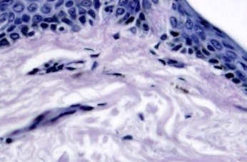
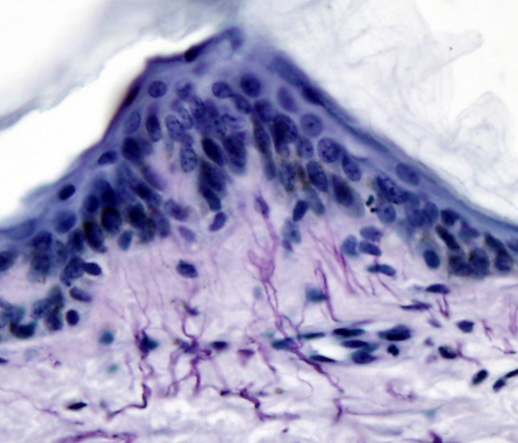
ELHIBIN® PF
Protects Skin from Accelerated Elastase Induced Ageing
human leukocyte elastase
human leukocyte elastase
+ ELHIBIN®PF
untreated
Papillary dermis taken from a 43-year-old subject
Protected elastic network
in the papillary dermis
Notes:
Elastin staining in human skin sections
Tissue sections prepared by fixing in formalin and embedded in paraffin are required. For staining we used 3-5 um thick paraffin sections. Deparaffinising and rehydration of sections were done the usual way. Elastin was detected by Elastica-van-Gieson (Merck) according to manufacturer’s instructions. In brief: Sections were stained in resorcin-fuchsin for 10 min and rinsed under running tap water for 1min.
Then Weigerts A&B was applied 1:1 for 5min, and again rinsed under running tap water for 1min. Dehydration was done by increasing alcohol concentration and 2x xylene incubation. Xylene-wet slides are then mounted with cover slips in the presence of Entallan. Stained Tissue sections were analysed with an Olympus BX51 Microscope with a 40x objective.
Elastin digest by HLE in human skin sections
We used 3-5 um thick paraffin sections. Deparaffinising and rehydration of sections were done the usual way. We incubated the tissue sections with different concentrations of human leukocyte elastase (HLE) in a humidity chamber for 18 h at 37°C.Tissue sections were washed in PBS and stained with Elastica van Gieson Kit according to manufacturer’s instructions followed by increasing alcohol concentration and 2x xylene. Xylene-wet slides are then mounted with cover slips in the presence of Entallan. Stained Tissue sections were analysed with an Olympus BX51 Microscope with a 40x objective.

Slide 15
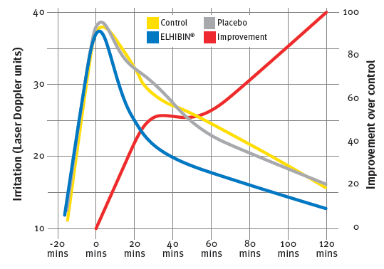
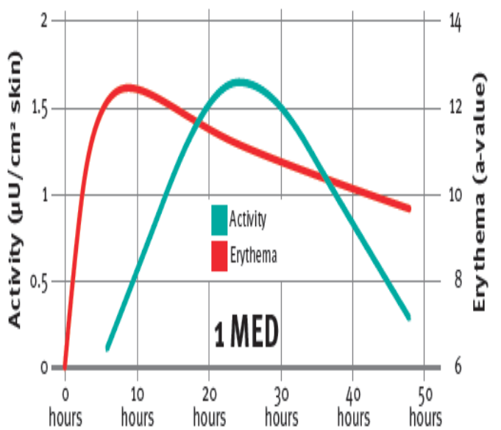
Anti-irritant Properties of ELHIBIN® PF
Irritated skin shows higher elastase levels
ELHIBIN® PF (5%) (blue curve) reduced the irritation compared to the placebo formulation (grey curve) by more than 50% and thus helps to keep Elastase activity low.
Notes:
The anti-irritant properties of ELHIBIN® PF incorporated at 5% into a gel formulation were evaluated on the inner forearm of ten female subjects previously treated with Balsam of Peru under semi-occlusive conditions.
The skin irritation was assessed with laser Doppler methodology.
The formulation with ELHIBIN® PF (green curve) reduced the irritation compared to the placebo formulation (blue curve) and the untreated control area (red curve) by more than 30% shortly after application and more than 50% throughout the study.
The results demonstrate that ELHIBIN® PF is a very effective anti-irritant.

Slide 16
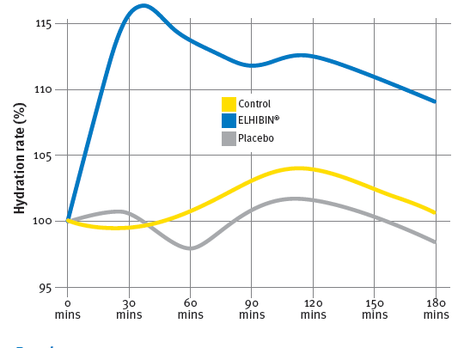
Moisturizing properties of ELHIBIN® PF
Dry skin shows higher elastase levels
Single application of 5% ELHIBIN® PF has a clear benefit to moisture the skin and thus keep Elastase activity on a low level.
Notes:
The moisturizing efficacy of a single application of ELHIBIN® PF was determined by use of the Corneometer methodology.
A gel containing 5% ELHIBIN® PF and the corresponding placebo were applied on the inner forearm of female subjects.
It could impressively be demonstrated that the ELHIBIN® PF containing formulation (green curve) led to a 10% increase of skin hydration, which persisted for at least three hours after the application.

Slide 17

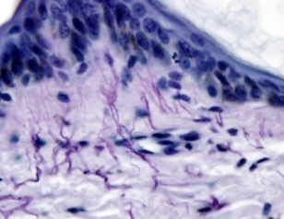
ELHIBIN® PF Activity at a Glance
Without
ELHIBIN PF
With
ELHIBIN PF
Damaged Elastin network
Protected Elastin network

Slide 18

ELHIBIN® PF
Key Benefits
Retains Youthful Skin Elasticity
Helps to delay naturally occurring skin ageing
Fights against accelerated
UV induced skin ageing
Particularly effective for skin through the 30s into the 50s
Diminishes skin sagging and improves skin resilience
Offers excellent anti-irritant and moisturizing properties

Slide 19

ELHIBIN® PF
Cosmetic Applications
Retains Youthful Skin Elasticity
Beauty care products that help to retain a youthful looking skin
Beauty care products to delay the loss of skin elasticity
Anti-ageing products claiming
anti-sagging and improved resilience
Anti-ageing protecting treatment
Sun care products to claim
an anti-ageing benefit

Slide 20
ELHIBIN® PF
Intense Elasticity Retaining Serum
Carefully purified plant based anti-ageing complex with ELHIBIN® PF for young looking elastic and firm skin
Phase | Ingredients | INCI Name | % w / w | Supplier
A | Pemulen TR-1 | ACRYLATES/C10-30 ALKYL ACRYLATE CROSSPOLYMER | 0.30 | 100435
 | Imwitor 372 P | GLYCERYL STEARATE CITRATE | 2.50 | 100399
 | Cetiol C5 | COCO-CAPRYLATE | 3.00 | 100037
 | Lipocire Na 10 Pastilles | HYDROGENATED COCO-GLYCERIDES | 2.50 | 100413
 | LexFeel 7 | NEOPENTYL GLYCOL DIHEPTANOATE | 2.00 | 100647
 | Cetiol OE | DICAPRYLYL ETHER | 2.00 | 100037
B | Preservative |  | q.s.
 | Glycerin 99.5% | GLYCERIN | 2.00 | 100654
 | WATER DEM. | AQUA | 81.40
C | Natriumhydroxid 30% Lösung | SODIUM HYDROXIDE | 0.50
D | ELHIBIN® PF | GLYCINE SOJA PROTEIN | 3.00 | 100288

Slide 21
DISCLAIMER
Copyright © 2020 DSM Nutritional Products, 4002 Basel, Switzerland.
www.dsm.com/personal-care. All rights reserved.
Although DSM has used diligent care to ensure that the information provided herein is accurate and up to date, DSM makes no representation or warranty of the accuracy, reliability, or completeness of the information. This presentation only contains scientific and technical information for business to business use. Country- or region-specific information should also be considered when labeling or advertising to final consumers. This publication does not constitute or provide scientific or medical advice, diagnosis, or treatment and is distributed without warranty of any kind, either expressly or implied. In no event shall DSM be liable for any damages arising from the reader’s reliance upon, or use of, these materials. The reader shall be solely responsible for any interpretation or use of the material contained herein. The content of this document is subject to change without further notice. Please contact your local DSM representative for more details. All trademarks listed in this brochure are either registered trademarks or trademarks of DSM in The Netherlands and/or other countries unless explicitly otherwise stated.
DISCLAIMER FORMULATION GUIDELINES
This information is for illustration purposes only and based upon our current knowledge and experience at the time of printing. We do not make any representation or warranty of any kind, express or implied, including merchantability or fitness for a particular use, with respect to such information or its application. Use of this information is at your discretion and risk. Nothing herein relieves you from carrying out your own suitability determinations and tests. You are responsible for observing all laws and regulations relevant to your products, uses or processes. We do not assume any liability in connection with your product and its use. The foregoing information and suggestions are also provided without warranty of non-infringement as to the intellectual property rights of third parties, and shall not be construed as any inducement to infringe the rights of third parties.

Slide 22
Back up ELHIBIN® PF

Slide 23
Soy remains trendy
“There can be no doubt that the soybean is one
of the most promising of all agricultural plants for an almost unlimited variety of industrial uses, and that it is going to play an outstanding role in the future economic life of this country.”
Henry Ford

Slide 24
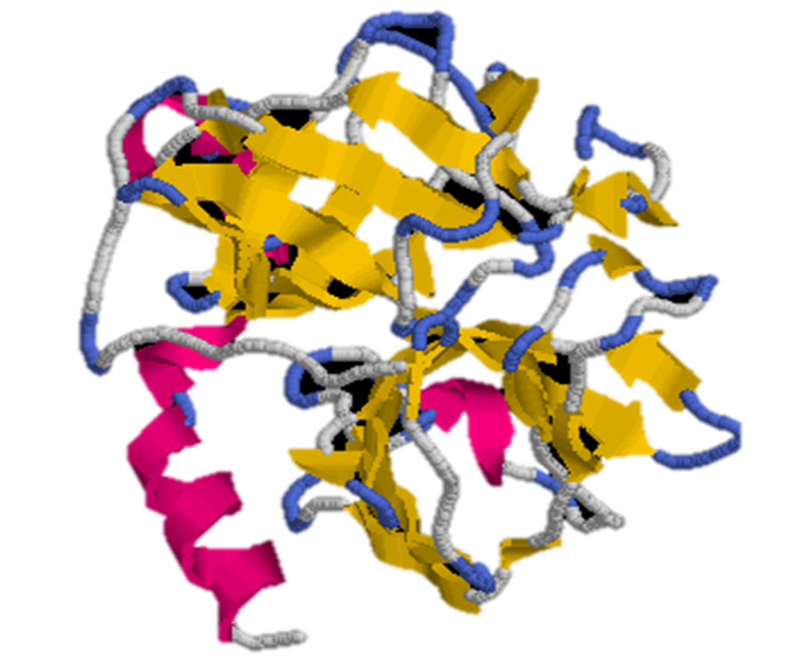
Physiological functions of proteinases
Protein digestion
Inflammation
Immune response
Wound healing
Maturation of hormones
Hemostasis
These processes are controlled and regulated by proteinase inhibitors.
Notes:
Proteinases are involved in nearly every aspect of life. They aid in protein digestion and regulatory mechanisms, such as:
inflammation,
complement activation,
wound healing,
maturation of hormones and
blood coagulation and fibrinolysis.
All these processes are controlled and regulated by proteinase inhibitors. As proteinases are also recognized as possible pathogenic factors in many diseases, proteinase inhibitors are intensively studied.
Chymotrypsin, trypsin, and elastase are three enzymes that cleave protein chains. Each has its own selectivity: they cleave proteins at different structure points.
They have very strong structural similarity. They use the same mechanism for the cleavage, a mechanism that very much resembles the mechanism we would write for the acid-catalyzed hydrolysis of an amide.
Their structural similarity (cf figure): Superposition of Trypsin (yellow), Elastase (green), and Chymotrypsin (blue) Backbones.

Slide 25
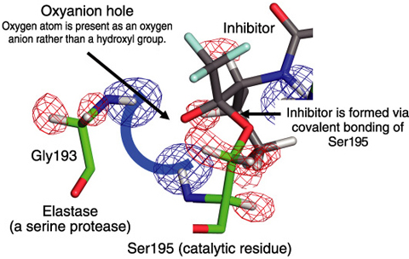
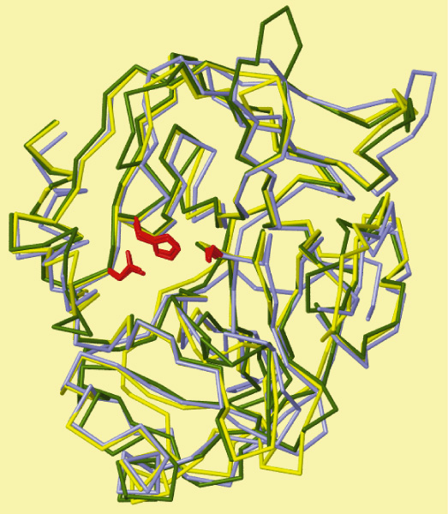
Proteinase
Proteinase Inhibitor Interaction
Uncontrolled proteolytic reactions represent a danger for the skin
Proteinase activity is carefully regulated by specific inhibitors
Proteinase inhibitors fit to the active center of proteinases
The complete masking of the active center blocks the proteinase activity
Proteinase-proteinase inhibition balance is an important factor in skin homeostasis
Tamada, T. et al., Combined High-Resolution Neutron and X-ray Analysis of Inhibited Elastase Confirms the Active-Site Oxyanion Hole but Rules against a Low-Barrier Hydrogen Bond, Journal of the American Chemical Society, vol.131, no.31, 2009, p.11033-11040.
Active center of Elastase
Red: Elastase Binding site
Notes:
Any uncontrolled proteolytic reaction represents a danger for the integrity of the cell or even the entire organism.
Disturbance of the sensitive proteinase/proteinase inhibitor balance may lead to uncontrolled reactions. Therefore, proteinase activity must be carefully regulated by specific inhibitors.
Chymotrypsin, trypsin, and elastase are three enzymes that cleave protein chains. Each has its own selectivity: they cleave proteins at different structure points. However they are all so called serine Proteinases because of the Amino Acide Serine in position 195.
They have very strong structural similarity. They use the same mechanism for the cleavage, a mechanism that very much resembles the mechanism we would write for the acid-catalyzed hydrolysis of an amide.
Their structural similarity (cf figure): Superposition of Trypsin (yellow), Elastase (green), and Chymotrypsin (blue) Backbones.

Slide 26
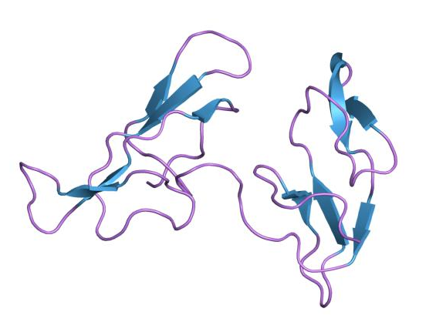
Bowman–Birk Inhibitor
A Plant Derived Elastase Inhibitor
These inhibitors are primarily found in plants and in particular in the seeds of legumes
Proteins of the Bowman–Birk inhibitor family work as serine proteinase inhibitors
High resolution structure of Bowman-Birk protease inhibitor
(Source: Wikipedia)

Slide 27
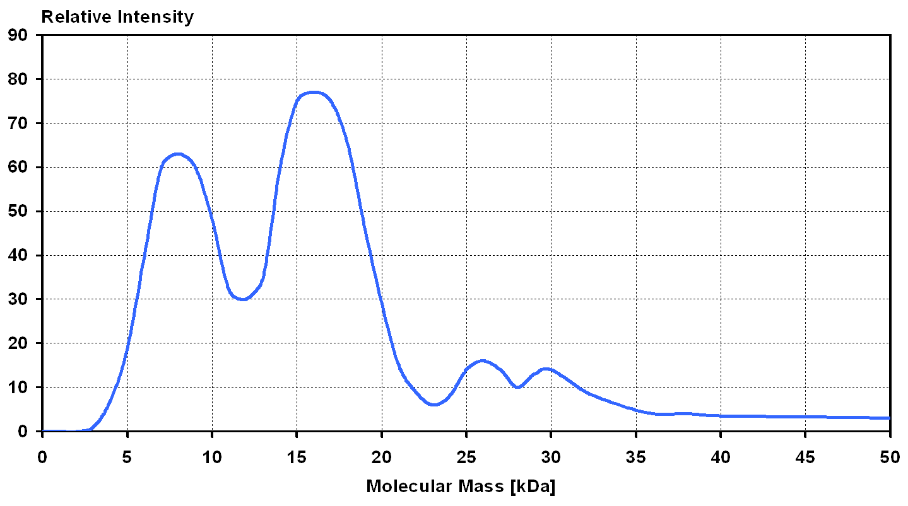
Molecular Mass Distribution of ELHIBIN® PF
Two peaks at 8000 and 16000 D
Notes:
SDS-Page
MW-marker: 14.4 / 20.1 / 30 / 43 / 67 / 94 kDa
C Elhibin = 1:50
Application volume 1 μl
Detection: silver staining

Slide 28
DISCLAIMER
Copyright © 2020 DSM Nutritional Products, 4002 Basel, Switzerland.
www.dsm.com/personal-care. All rights reserved.
Although DSM has used diligent care to ensure that the information provided herein is accurate and up to date, DSM makes no representation or warranty of the accuracy, reliability, or completeness of the information. This presentation only contains scientific and technical information for business to business use. Country- or region-specific information should also be considered when labeling or advertising to final consumers. This publication does not constitute or provide scientific or medical advice, diagnosis, or treatment and is distributed without warranty of any kind, either expressly or implied. In no event shall DSM be liable for any damages arising from the reader’s reliance upon, or use of, these materials. The reader shall be solely responsible for any interpretation or use of the material contained herein. The content of this document is subject to change without further notice. Please contact your local DSM representative for more details. All trademarks listed in this brochure are either registered trademarks or trademarks of DSM in The Netherlands and/or other countries unless explicitly otherwise stated.
DISCLAIMER FORMULATION GUIDELINES
This information is for illustration purposes only and based upon our current knowledge and experience at the time of printing. We do not make any representation or warranty of any kind, express or implied, including merchantability or fitness for a particular use, with respect to such information or its application. Use of this information is at your discretion and risk. Nothing herein relieves you from carrying out your own suitability determinations and tests. You are responsible for observing all laws and regulations relevant to your products, uses or processes. We do not assume any liability in connection with your product and its use. The foregoing information and suggestions are also provided without warranty of non-infringement as to the intellectual property rights of third parties, and shall not be construed as any inducement to infringe the rights of third parties.

