Slide 1
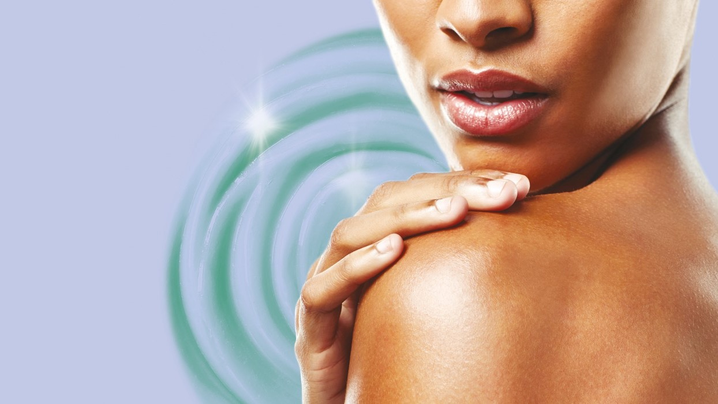




ERYTHRULOSE
The natural tanning adjunct for a new dimension of sun- kissed tan
04-2022

Slide 2




Outline
1
The power of tanned skin
What is the fascination of tanned skin
and what is the role of the consumer ?
2
Some figures and numbers
Opportunities to grow and to come
close to consumer expectations.
3
ERYTHRULOSE & DHA
Facts & figures you should not miss!
4
10 good reasons to infuse self-tanning
formulations with ERYTHRULOSE!
Conclusion

Slide 3

ERYTHRULOSE-
The natural tanning adjunct for a new
dimension of sun-kissed tan

Slide 4
Outline
1
The power of tanned skin
What is the fascination of tanned skin
and what is the role of the consumer ?
2
Some figures and numbers
Opportunities to grow and to come
close to consumer expectations.
3
ERYTHRULOSE & DHA
Facts & figures you should not miss!
4
10 good reasons to infuse self-tanning
formulations with ERYTHRULOSE!
Conclusion

Slide 5
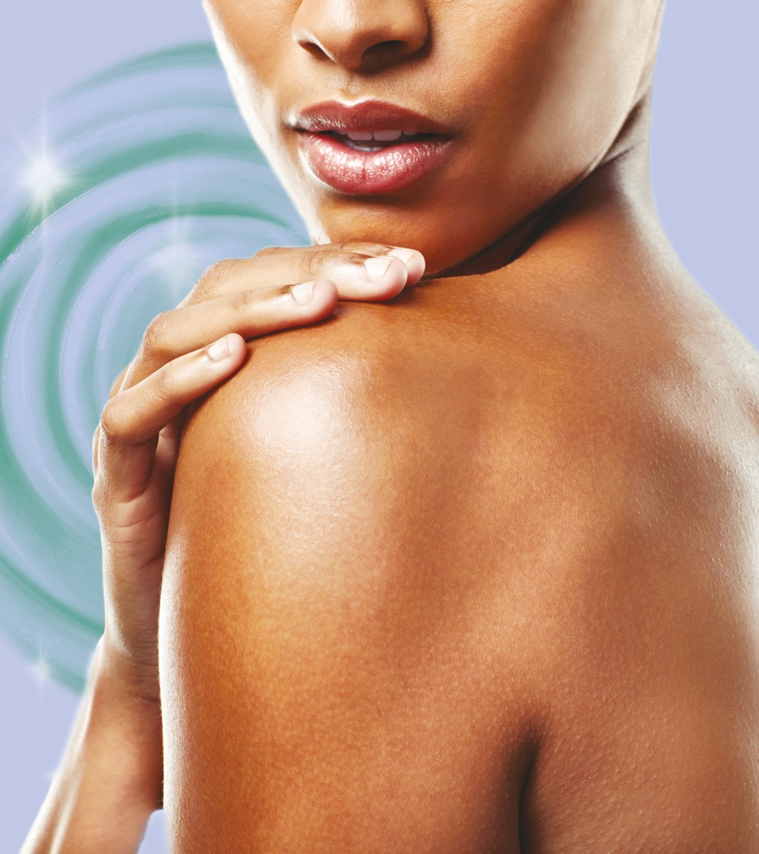

“Fashion designer Coco Chanel has long been acknowledged as one source of inspiration behind the tanning trend as she helped steer the masses away from the porcelain skin era of the early 1900s after holidaying in St Tropez in 1923.
But by that point people had already realized they wanted to add a bit of color to their lives. Along with the growing fashion trend for looser clothes and smaller bathing costumes for women, tanned skin had become fashionable.”

Slide 6
The success story of skin tanning
Self tanning ^{is a safe alternative-}
We do not have to go out in the sun to get a skin tan. A self-tanning active helps us get that sun-kissed glow in a healthy, convenient way. We feel better for boosting our beauty with a touch of bronze color. The positive reactions that stem from our perception of ourselves as a more healthy-looking person make us feel more confident.
Self tanning ^{is hot-}
The beauty industry is promoting the use of self-tanners, creating opinions and recommendations. Products are discussed and compared in publications and blogs. Word-of-mouth is becoming more and more relevant for the consumer, especially when advisors are experienced in the use of the specific tanner.

Slide 7
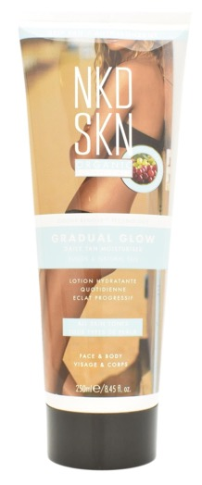
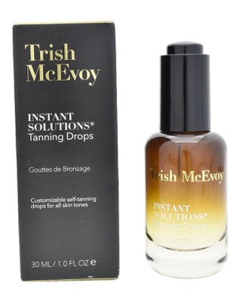
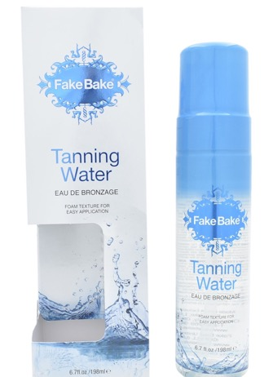
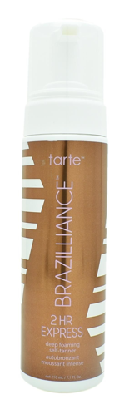
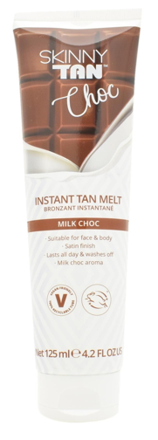
New innovations and claims in the self-tanner market
«Transforms any cream into a custom self-tanner»
«Made with natural extracts and organic botanicals»
«Deep, long-lasting hydration»
«Develops in just two hours»
«Washes off with soap & water»
Challenging current textures, product forms, and ingredients…
Source: Mintel

Slide 8
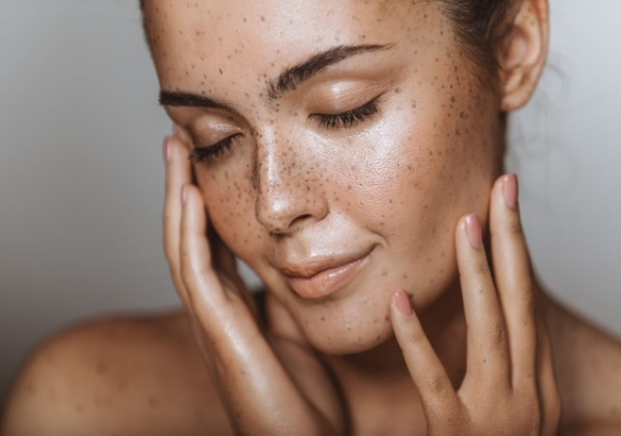
Factors that are currently limiting full success
Self tanning ^{is sensitive}
Which product should we choose to achieve the best tanning results?
How can we differentiate between the great choices the market offers? How can we ensure that they deliver what they promise?

Slide 9
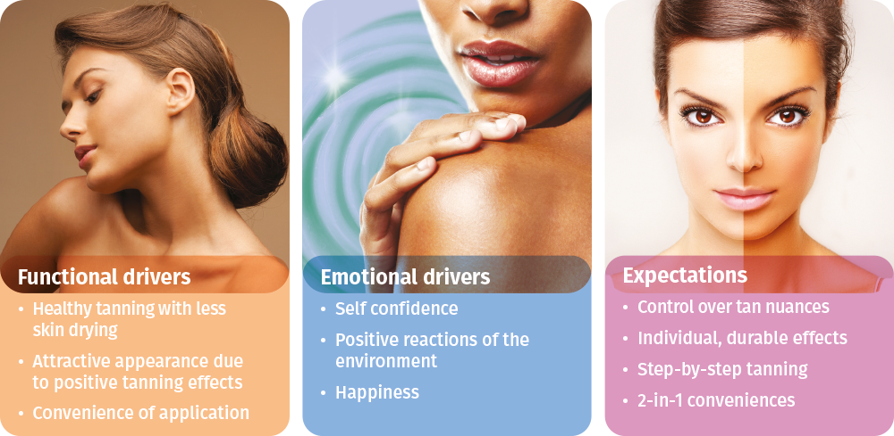
Self tanning– a mixture of sensitive expectations & drivers

Slide 10

It’s the consumers who decide what is HOT or NOT…
Does the product I choose match my skin tone?
HOW EASY IS IT TO APPLY?
Does it look natural?
DOES IT SMELL?
DO I SEE FAST RESULTS?
LOOK & FEEL
HOW LONG WILL IT LAST?
WHAT ABOUT THE DRYING TIME?
Will it leave streaks on my clothes or hands?
Will people recognize that I used self-tanner?
Is it a cream, gel, spray or a mousse?

Slide 11
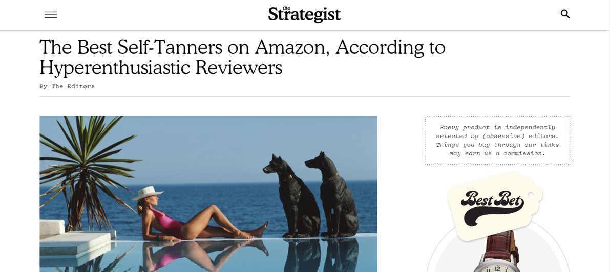

…and they are pushing for optimization
“Most self-tanners contain dihydroxyacetone (DHA), a colorless sugar that interacts with the top layer of skin to darken. According to Locke, who works with Olivia Wilde, Katharine McPhee, and the cast of Dancing with the Stars, an orange tint is often due to an oversaturation of DHA—which can occur when you layer on too much product or use a self-tanner with a percentage of DHA too high for your skin type.”
“Locke says choosing the right formula also determines how your tan will appear. "Go with a reputable brand, one that uses a lower percentage of DHA so that you can build your color accordingly," she says.
Bronze-seekers should also go for products
infused with ERYTHRULOSE…”
Using the right self-tanner is a topic.
Using the right ingredient is a must.
“The Best Self-Tanners on Amazon, According to Hyperenthusiastic Reviewers.” The Strategist, The Strategist, 8 May 2020, nymag.com/strategist/article/best-self-tanners-face-and-body.html.
Baraf, Meredith, and Fiona Locke. “Celebrity Bronzing Experts' Self-Tanner Secrets.” ELLE, ELLE, 5 Oct. 2017, www.elle.com/beauty/makeup-skin-care/tips/a2453/summer-glow-best-self-tanner-tips-443802/.

Slide 12
Outline
1
The power of tanned skin
What is the fascination of tanned skin
and what is the role of the consumer ?
2
Some figures and numbers
Opportunities to grow and to come
close to consumer expectations.
3
ERYTHRULOSE & DHA
Facts & figures you should not miss!
4
10 good reasons to infuse self-tanning
formulations with ERYTHRULOSE!
Conclusion

Slide 13

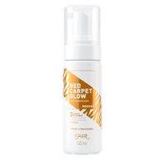
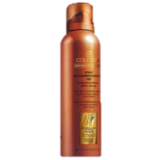
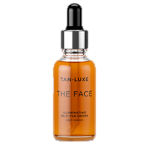
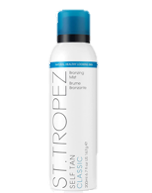
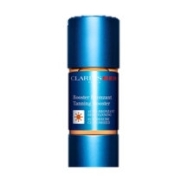
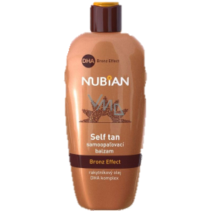
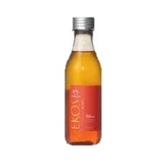
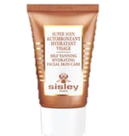
Already 36% of new innovative products use ERYTHRULOSE in their formula
ERYTHRULOSE & DHA
64 % beauty care products
with DHA only
36 % beauty
care products combining
ERYTHRULOSE
& DHA
GNPD, 2017 – 2020,Number of variants, Beauty & Personal Care , DHA vs. ERYTHRULOSE & DHA in combination

Slide 14
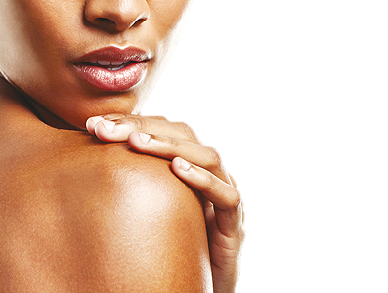
The tanning market is ready for a change
DHA has dominated the market for many years as the traditional fast acting self tanning molecule.
However DHA has clear limitations in terms of homogenous skin tone, long lasting effects and residue of color on the palms and skin drying.
Overcoming these disadvantages would reduce consumers’ reluctance and thus generate market opportunities.

Slide 15
ERYTHRULOSE
The perfect tanning adjunct
Key advantages:
Perfectly compatible with DHA in formulations
Long lasting color
Homogenous skin tone
Less streaking
Less skin drying

Slide 16

ERYTHRULOSE – Tanning with Sugar
ERYTHRULOSE
Product features
ERYTHRULOSE is a clear, yellowish solution of a natural keto-sugar for cosmetic applications.
ERYTHRULOSE is 100% natural origin.
ERYTHRULOSE is produced by fermentation of natural derived erythritol.
ERYTHRULOSE does not contain preservatives
Mode of action
ERYTHRULOSE reacts via the Maillard reaction with free primary or secondary amino groups in the upper layers of the stratum corneum, yielding to brown polymeric products (melanoids) that are directly bound to the skin
CH₂-OH
C=O
HO-C-H
CH₂-OH
(S)-1,3,4-Trihydroxy-2-butanone
Appearance:
Yellow, highly viscous
solution
Water content:
approx. 20%
INCI name:
Erythrulose

Slide 17
Outline
1
The power of tanned skin
What is the fascination of tanned skin
and what is the role of the consumer ?
2
Some figures and numbers
Opportunities to grow and to come
close to consumer expectations.
3
ERYTHRULOSE & DHA
Facts & figures you should not miss!
4
10 good reasons to infuse self-tanning
formulations with ERYTHRULOSE!
Conclusion

Slide 18

ERYTHRULOSE
in combination with
DHA offers a new dimension to your tanning formula.

Slide 19
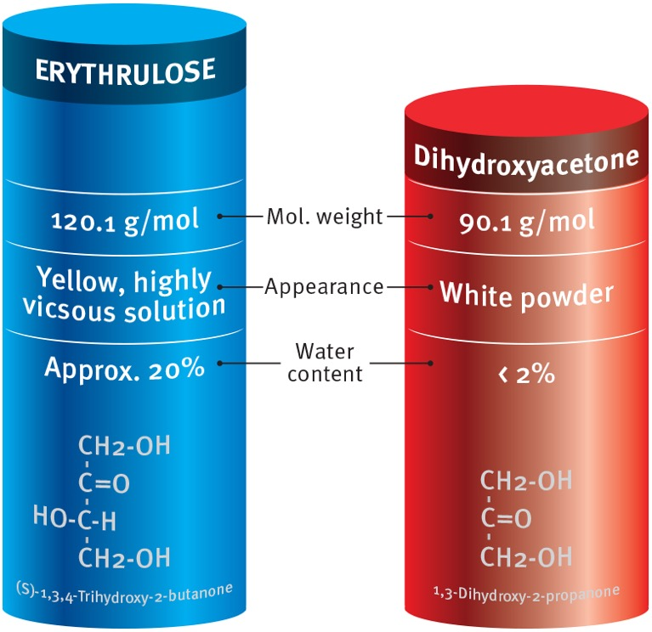
ERYTHRULOSE and DHA- a comparison

Slide 20
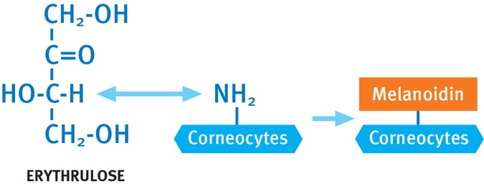
Well known mechanism provides outstanding results
ERYTHRULOSE reacts with free primary or secondary amino groups in the upper layers of the stratum corneum.
Melanoidins are high molecular weight polymers that are formed by this conversion of ERYTHRULOSE with amino acids, peptides or proteins.
Melanoidins are bound to proteins of the stratum corneum mainly via lysine side-chains, their color is comparable to the appearance of natural sun tan.
The reaction of ERYTHRULOSE with skin is slow and gentle, which
makes it possible to produce a natural, long-lasting, even tan
without streaks.

Slide 21
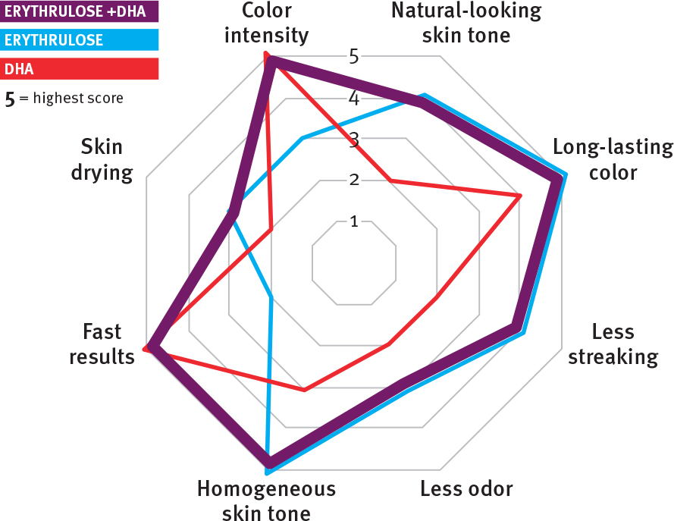
The powerful combination makes the difference

Slide 22
ERYTHRULOSE – the natural, long lasting colour enhancer
In vivo study of a self-tanning formulation containing ERYTHRULOSE and DHA
Study Design 8 healthy female volunteers
10 days application on the back
4 days post application measurement
Formulations O/W emulsions containing:
3.5% DHA and
1.5% ERYTHRULOSE
5% DHA

Slide 23
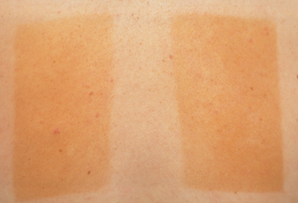
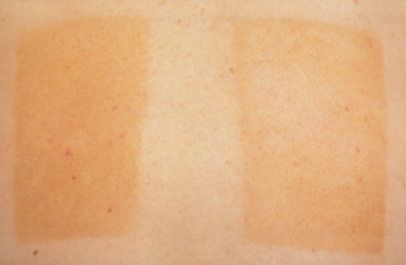
ERYTHRULOSE – the natural, long lasting colour enhancer
Mixture with
ERYTHRULOSE
DHA
Mixture with
ERYTHRULOSE
DHA
End of application period
Day 10
4 days after last application
Day 14
Combination leads to visibly better results after 14 days.

Slide 24
ERYTHRULOSE – diminishes skin drying
during tanning treatments
In vivo study of a self-tanning formulation containing ERYTHRULOSE and DHA
Study Design 5 healthy female volunteers
7 days application on the inner forearms
15 days continuous measurement period
Formulations gel formulations containing 0.5-molar concentration of total tanning agent:
DHA & ERYTHRULOSE (0.5 + 0.5 mole)
DHA (0.5 mole)
ERYTHRULOSE (0.5 mole)
Placebo

Slide 25
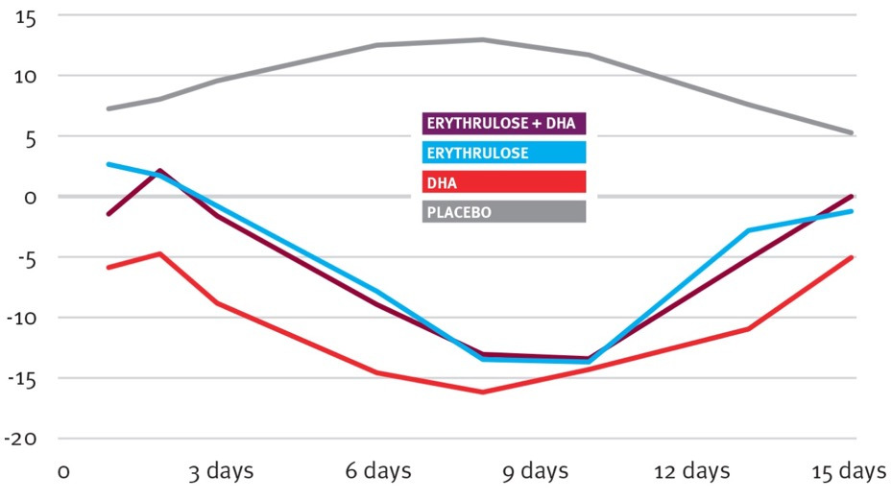
ERYTHRULOSE – diminishes skin drying
during tanning treatments
Long-term application
ERYTHRULOSE improves skin hydration compared
to DHA alone. Skin feels better moisturized and
less dry.
Difference in Skin Humidity [%]
Application period
Time [days]

Slide 26
ERYTHRULOSE – leads to a homogenous skin tone
In vivo study of a self-tanning formulation containing ERYTHRULOSE and DHA
Study Design 5 healthy female volunteers
7 days application on the back
8 days post application measurement
Formulations O/W emulsions containing:
4.5% DHA and
6% ERYTHRULOSE

Slide 27
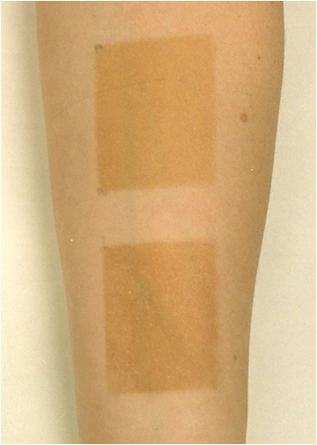
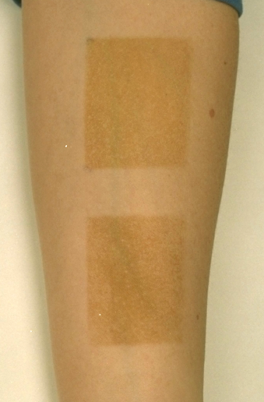
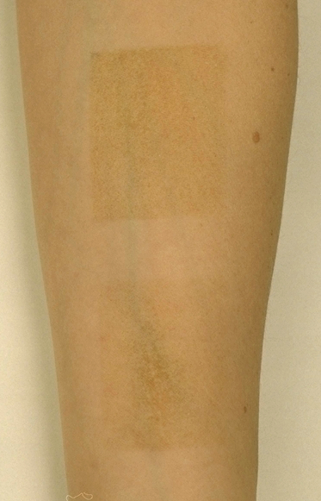
ERYTHRULOSE – leads to a homogenous skin tone
0.5 molar concentration of ERYTHRULOSE (6%) and DHA (4.5%) in a gel formulation
7 days of application, monitoring of tanning results between day 8 and 15
ERYTHRULOSE
DHA
Day 8
Day 10
Day 15
Adding ERYTHRULOSE visibly improves the long-term benefit of a tanning formulation.

Slide 28
ERYTHRULOSE – comparison of the staining of palms during and after application
In vivo study of a self-tanning formulation containing ERYTHRULOSE and DHA
Study Design 6 healthy volunteers (women & men)
Palms, half side single application
Formulations O/W emulsions containing:
5 % ERYTHRULOSE
5 % DHA

Slide 29
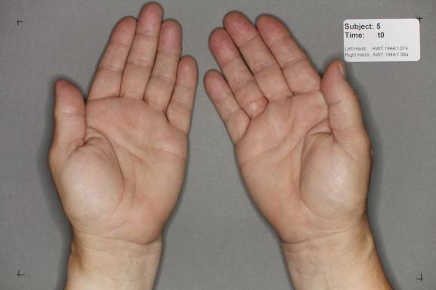
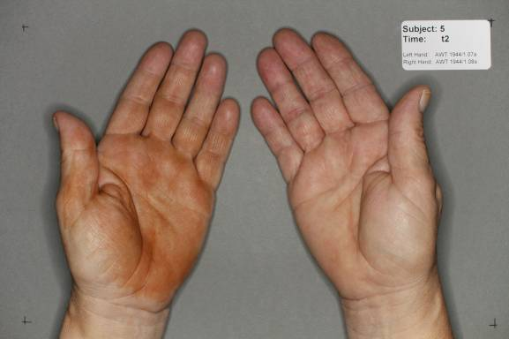
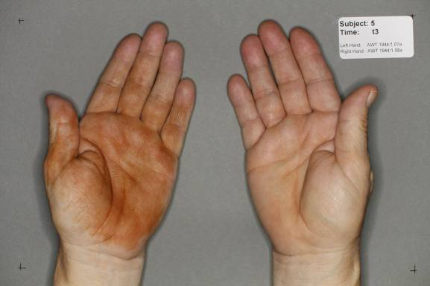
ERYTHRULOSE – less coloration of palms
in vivo results
Palm coloration test: Application of a self-tanning lotion containing
5% DHA
5% ERYTHRULOSE
5% DHA
5% ERYTHRULOSE
T= 0h
T= 6h
5% DHA
5% ERYTHRULOSE
ERYTHRULOSE clearly improves
the application process and
reduces negative emotions caused by coloured palms.
T= 9h

Slide 30
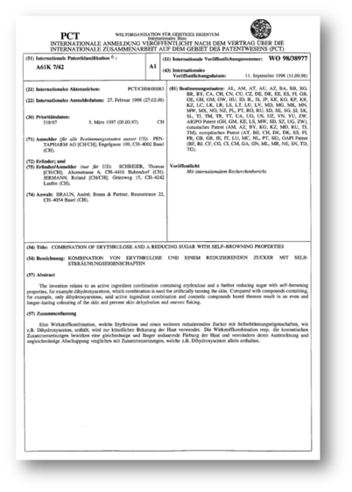

ERYTHRULOSE – freedom to operate
Patent situation
ERYTHRULOSE – state of the art
DSM holds a combination patent
(WO 98/38977) claiming ERYTHRULOSE with DHA. Free licenses are available for our customers.
Combinations with additional
ingredients
A few patent documents
claiming combinations
with other ingredients
for specific applications
need to be checked but
are not considered as a
hurdle
High degree
of freedom
for applications
with ERYTHRULOSE
Regulatory situation
ERYTHRULOSE can be used in all
countries for any kind of cosmetic
product
There are no local particular
restrictions known for the US the combined use together
with DHA is mandatory
DSM has a Reach registration for ERYTHRULOSE
→ Allows development of global products

Slide 31
Outline
1
The power of tanned skin
What is the fascination of tanned skin
and what is the role of the consumer ?
2
Some figures and numbers
Opportunities to grow and to come
close to consumer expectations.
3
ERYTHRULOSE & DHA
Facts & figures you should not miss!
4
10 good reasons to infuse self-tanning
formulations with ERYTHRULOSE!
Conclusion

Slide 32

10 reasons to use
ERYTHRULOSE
In combination with DHA
Homogenous skin tone
Gradual and natural- looking glow
Longer lasting tan
Less streaking
Moisturization
Easy application
Instant bronze glow
High stability
No bad smell
Patent protection

Slide 33
ERYTHRULOSE in a nutshell
Why should ERYTHRULOSE be your choice?
ERYTHRULOSE optimizes the efficacy of
DHA by enhancing the color to give
a natural, homogeneous and glowing skin tone.
Due to its low level of aggressive properties it
leaves less staining on the palms and clothes,
making it more convenience and easy application.
What is the benefit for the end consumer?
Major customer concerns can be eliminated by
combining DHA & ERYTHRULOSE leading to
more reliable and promising self tanning
solutions serving unmet consumer needs.
What would be the benefit for the brand?
Products enriched with ERYTHRULOSE will
increase their credibility in the market and
perform more convincingly on the skin.

Slide 34
DISCLAIMER
Copyright © 2022 DSM Nutritional Products, 4002 Basel, Switzerland.
www.dsm.com/personal-care. All rights reserved.
Although DSM has used diligent care to ensure that the information provided herein is accurate and up to date, DSM makes no representation or warranty of the accuracy, reliability, or completeness of the information. This presentation only contains scientific and technical information for business to business use. Country- or region-specific information should also be considered when labeling or advertising to final consumers. This publication does not constitute or provide scientific or medical advice, diagnosis, or treatment and is distributed without warranty of any kind, either expressly or implied. In no event shall DSM be liable for any damages arising from the reader’s reliance upon, or use of, these materials. The reader shall be solely responsible for any interpretation or use of the material contained herein. The content of this document is subject to change without further notice. Please contact your local DSM representative for more details. All trademarks listed in this brochure are either registered trademarks or trademarks of DSM in The Netherlands and/or other countries unless explicitly otherwise stated.
DISCLAIMER FORMULATION GUIDELINES
This information is for illustration purposes only and based upon our current knowledge and experience at the time of printing. We do not make any representation or warranty of any kind, express or implied, including merchantability or fitness for a particular use, with respect to such information or its application. Use of this information is at your discretion and risk. Nothing herein relieves you from carrying out your own suitability determinations and tests. You are responsible for observing all laws and regulations relevant to your products, uses or processes. We do not assume any liability in connection with your product and its use. The foregoing information and suggestions are also provided without warranty of non-infringement as to the intellectual property rights of third parties, and shall not be construed as any inducement to infringe the rights of third parties.

