Slide 1
ETERWELL™ HAIR
Hair longevity powered
by senolytic science

Slide 2


“Hair care is the new
TRENDS
skincare”
Nicolas Hieronimus, L'Oréal Group CEO
Increasingly, consumers are realizing that hair care goes far beyond
the strands. It starts
at the root.

Slide 3

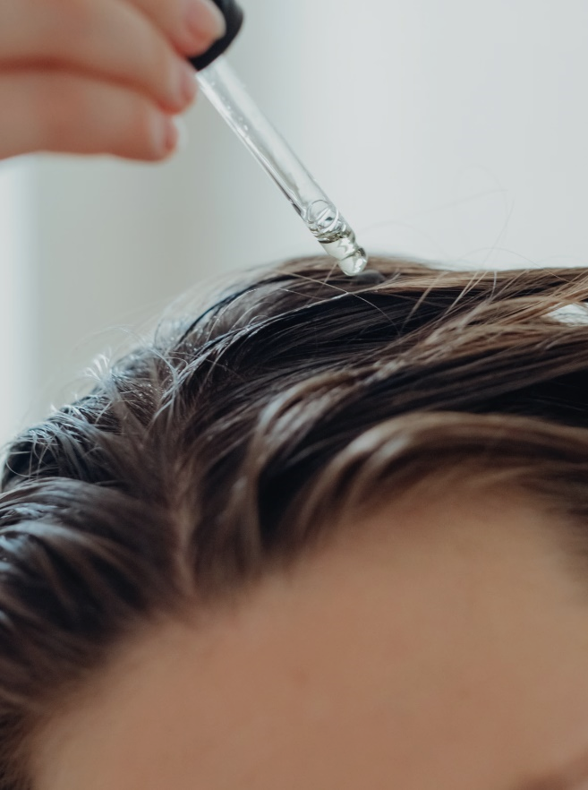
The search for hair care is starting to mirror key trends in skincare
TRENDS
Sustainability
Skinification

Slide 4

The search for hair care is starting to mirror key trends in skincare
TRENDS
*Source: In-Cosmetics Connect
36% of hair care professionals worldwide have looked for relevant applications and active ingredients*.
Consumers are paying more attention
to the overall health of their hair.
Skinification
First-aid approach: solutions based on the environment and different stages of life.
Therapeutic Hair Practices: Consumers are maintaining their hair care rituals at home while now integrating therapeutic head care for a more holistic approach.

Slide 5
TRENDS
The search for hair care is starting to mirror key trends in skincare
*Source: Mintel
67% of global consumers
are looking for eco-friendly beauty products.*
Sustainability

Slide 6

And yes, aging is a primary motivation when it comes to hair care
TRENDS
*Source: Euromonitor
Consumers want their hair to age healthily
and stay naturally beautiful. They’re looking for proactive solutions
for this purpose.
Top global hair concerns (2022)*
58%
54%
42%
Aging hair
Damaged hair
Scalp problems

Slide 7

In this context, is the buzzword
longevity

Slide 8
In this context, is the buzzword
TRENDS
Focus on targeting the root causes of hair aging: what do hair follicles need to grow healthy hair?
longevity
Hair care tailored to different stages of life
An anti-aging hair care line must embrace the concept of longevity.
Preventive approach: care that extends the health expectancy of hair

Slide 9
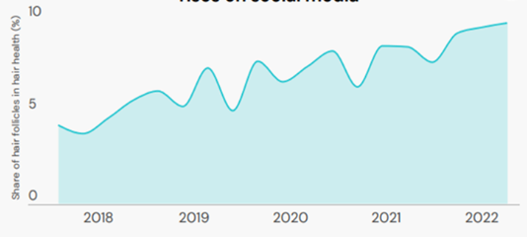
Consumers are realizing that longevity is closely linked to hair follicles
TRENDS
Conversation on healthy hair follicles rises on social media
Source: WGSN, Future of Hair care 2025
13% of users in the category
mentioned hair follicles in 2022
(+2 p.p. compared to the previous year).
Gentle exfoliating products
are becoming more appealing
Some ingredients stand out as solutions to deal with the buildup of residue caused by daily hair care, balancing the scalp, encouraging healthy hair growth.
What’s Next?
Actives and technologies designed to stimulate hair follicles.
Hair stimulation
Many brands have recommended scalp massages with tools or devices that help to increase blood circulation in the area.

Slide 10

We are stepping into the era of hair cellular beauty, where hair root care reaches a new level
TRENDS
We know it's not possible to stop the passage
of time, but science has already proven
that we can slow down biological aging
by addressing root cause.
Essentially, science-backed products
designed to boost the hair’s cellular
processes are a solution to help
follicles resist aging.

Slide 11


TRENDS
“Formula inspired by the science
of cellular reprogramming, which integrates the revolutionary field
of senescence for the first time
in a night cream”
When it comes to cellular processes, it’s impossible not to mention senolytic science
And, following the latest trends in skin care, there is still space to explore senolytic science
in hair care.

Slide 12

The senolytics concept applied to hair care
WHAT'S NEXT
As time goes by and various stressors take their toll, hair follicles lose efficiency, disrupting the natural renewal process of the hair.
This is due to many cells becoming
inactive and remaining in the hair system
as “zombie cells,” essentially damaging healthy cells by triggering an inflammation cycle that affects the volume and appearance of the hair.
The build up of these cells, called senescent cells, must be removed
for optimal hair renewal.

Slide 13
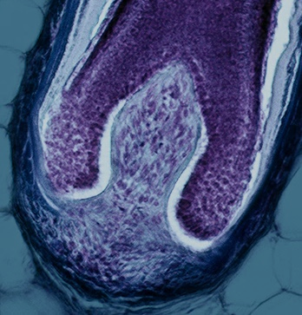


Let's take a closer look at the process of senescence and how it impacts hair health
WHAT'S NEXT
  ↑ Senescence markers Apoptosis inhibitors
  ↓ Apoptosis markers
  ↑ Senescent Cells
  ↑ SASPs
  ↑ Hair greying & hair loss
Senescent cells lose their ability to divide and properly produce key proteins like melanin, keratin, and KAP. As a result, they release SASPs (senescence-associated secretory phenotype), which also push surrounding cells into an undesirable senescent state.
The accumulation of senescent cells leads to aging with the aging phenotype.
Normal Follicle Dermal Papilla Cells
Senescent Follicle Dermal Papilla Cells
SASP

Slide 14

How can senolytic science support the development of a solution capable of reprogramming hair cells and eliminating those that hinder the process, while supporting the healthy function of the remaining cells?
Using advanced technology
and scientific expertise
in the development of holistic and sustainable solutions,
we set out to find the answer.

Slide 15

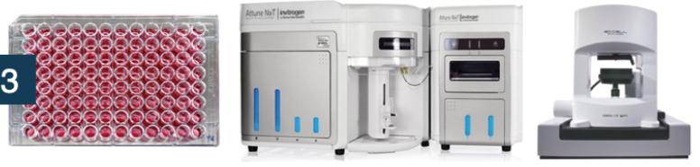

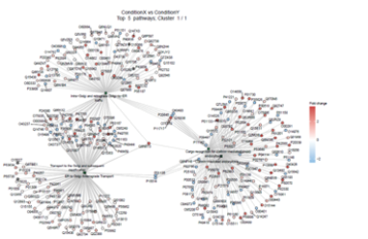

Relying on exclusive hair senolytic capabilities
1
internal scientific expertise
Experts with extensive experience
in senescence knowledge field
Key in vitro models: skin and hair senolytics, along with senescence marker assays - Over 3,000 conditions tested
Design and identification
of senolytic compounds using AI
Ex vivo and in vivo experience
with multi-omics and 3D analyses
Automation and robotics
2
3
4
5

Slide 16
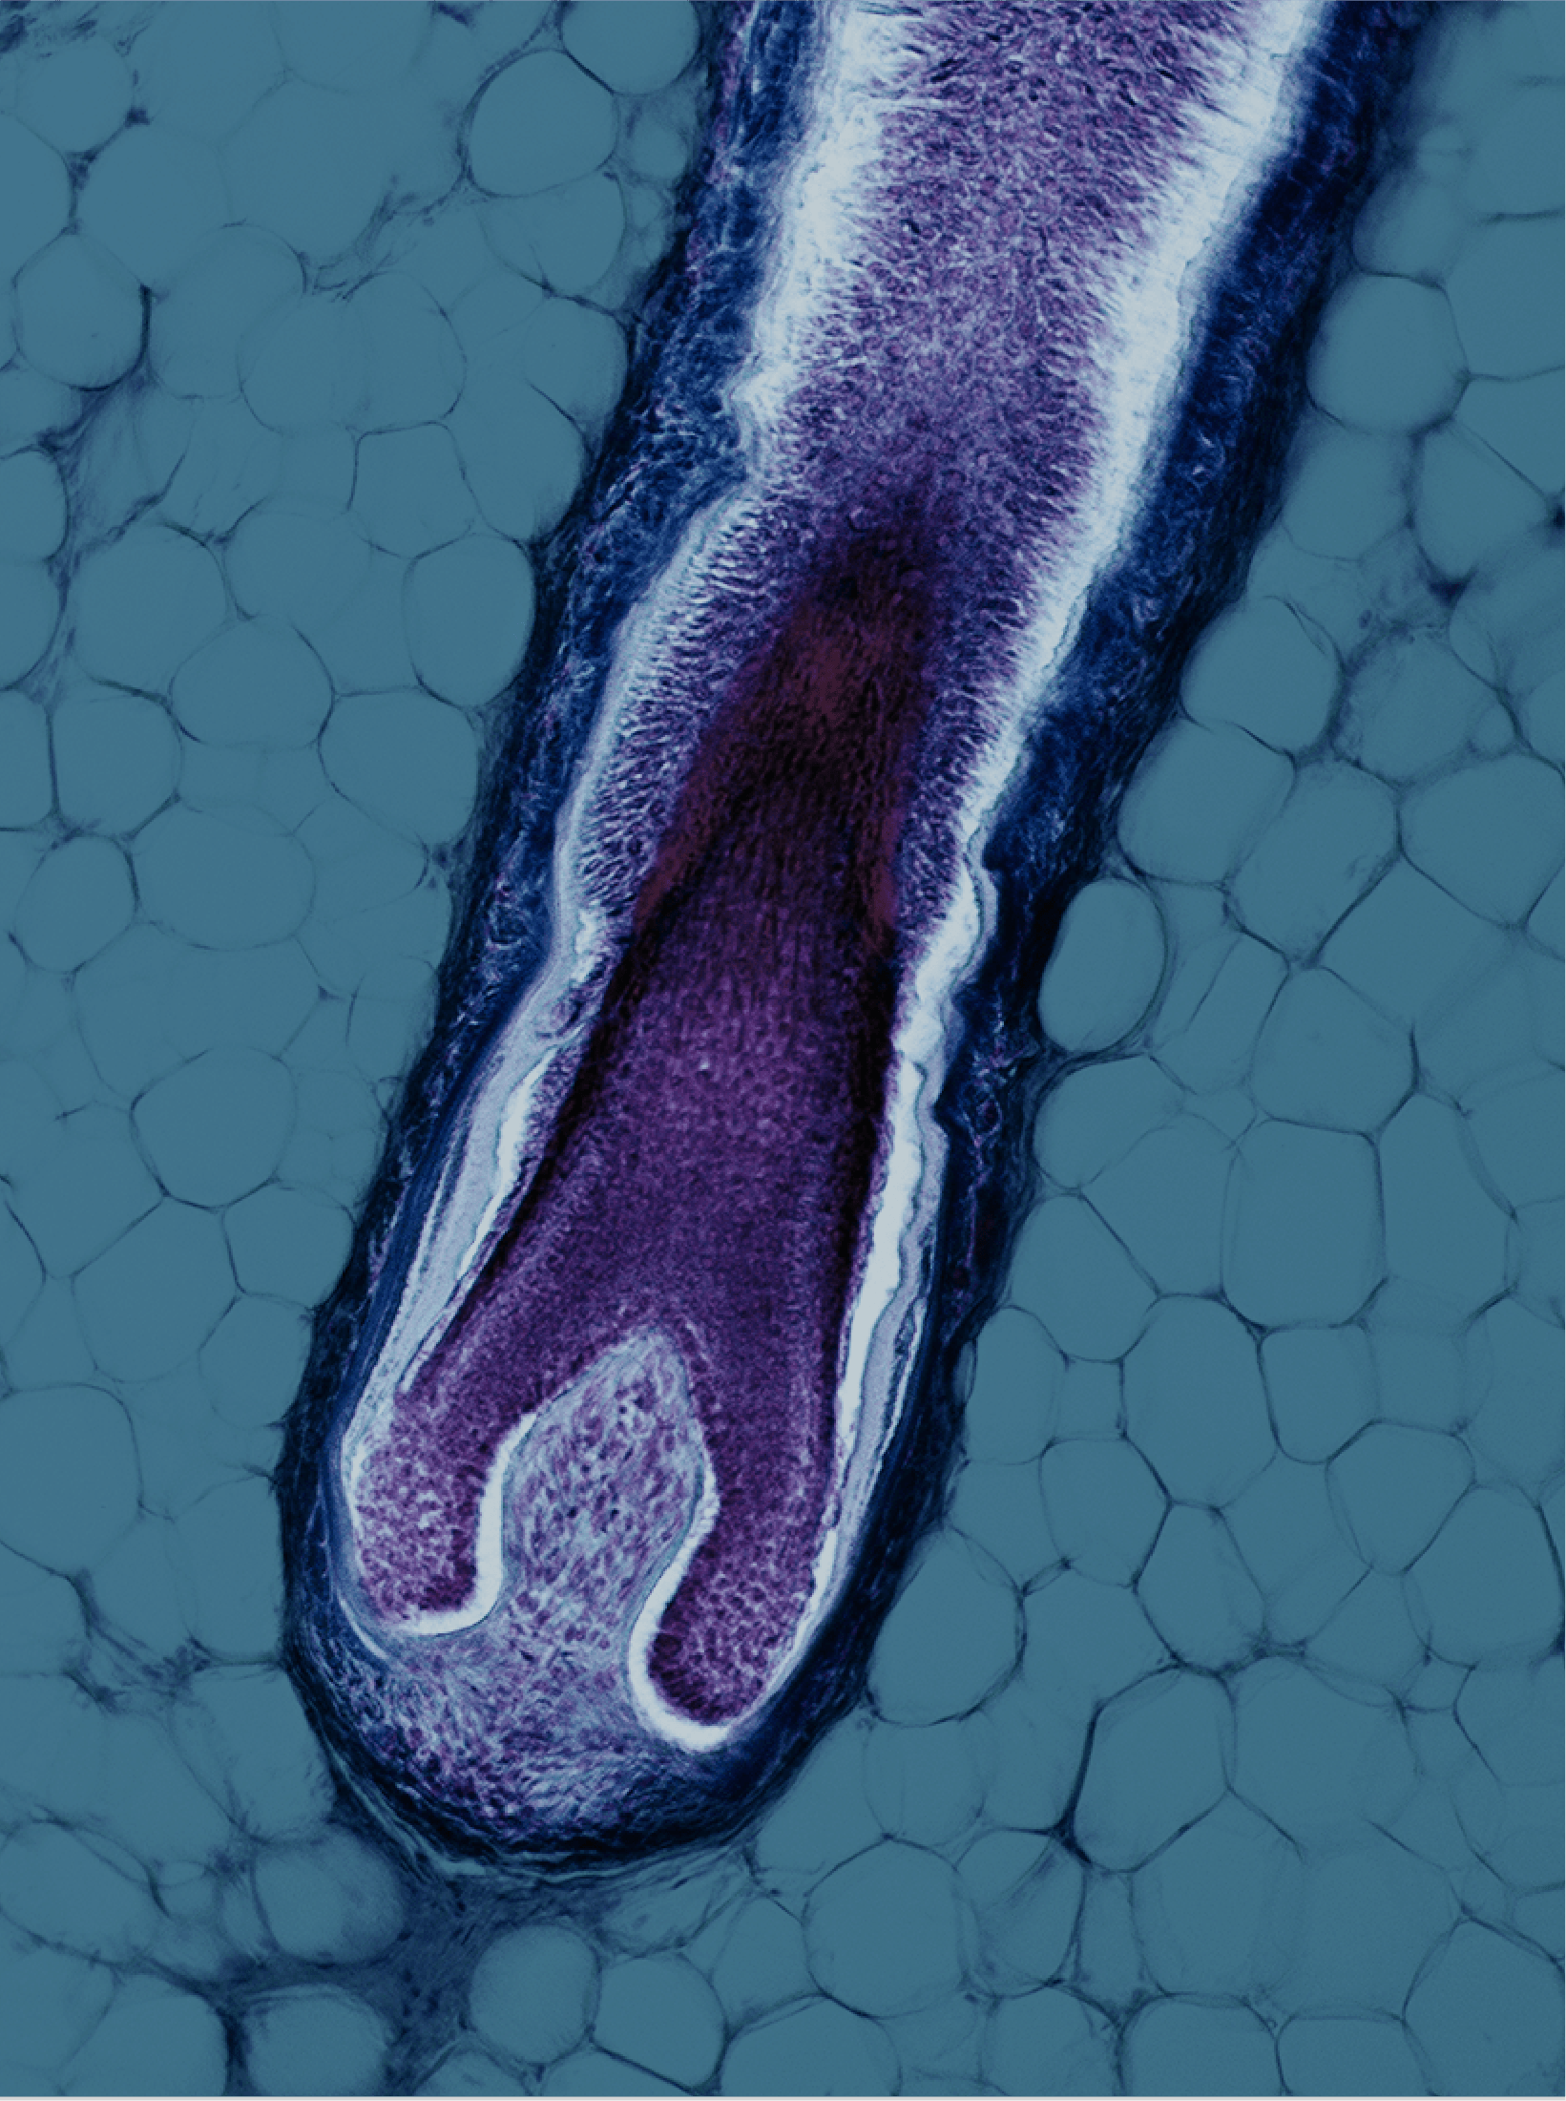
We developed the first and only test model for hair senescent cells
By testing our bioactives on hair follicles*,
we discovered an ingredient that goes beyond consumer expectations!
We present a groundbreaking
solution that will redefine the
concept of anti-aging hair care.
*Senescent Follicle Dermal Papila Cells

Slide 17


Slide 18



INTRODUCING
ETERWELL™ HAIR works
at the cellular level to remove harmful senescent cells from the follicles, reduce inflammation, balance the scalp, help prevent hair loss, and promote hair density.
Giving new life and increased longevity to the hair, which start to naturally renew.

Slide 19

MODE OF ACTION
Key benefits
Hair care healthy aging acting at the cellular level
Helps reboot the natural hair revival processes
Increases hair longevity impaired by
folliculo-destructive senescent cells*
Helps prevent hair loss**
Significantly improves hair density** by average 5% in 5 months and up to 28% for the best volunteer
Helps slow down the premature ageing of hair
Calms sensitive, irritated, and dry scalp
Reduces inflammaging (reducing the expression
of inflammatory cytokines induced ICAM-1)*
Efficient at low concentration***
*: in vitro and ex vivo, ** in vivo *** 0.5% in leave on condition
Notes:
Data on the reduction of inflammatory cytokines are shown in the presentation of ALPAFLOR® LINUM AO. ETERWELL™ HAIR is the CB (Clean Beauty) version of ALPAFLOR® LINUM AO for which we are preparing an equivalence report. The Inflammaging claim will be further developed with the second wave of promotion including the full line up supporting the promotion of ETERWELL™ HAIR.

Slide 20
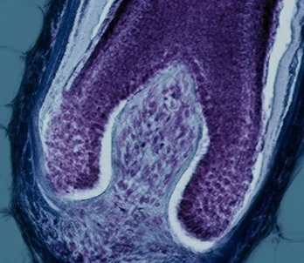
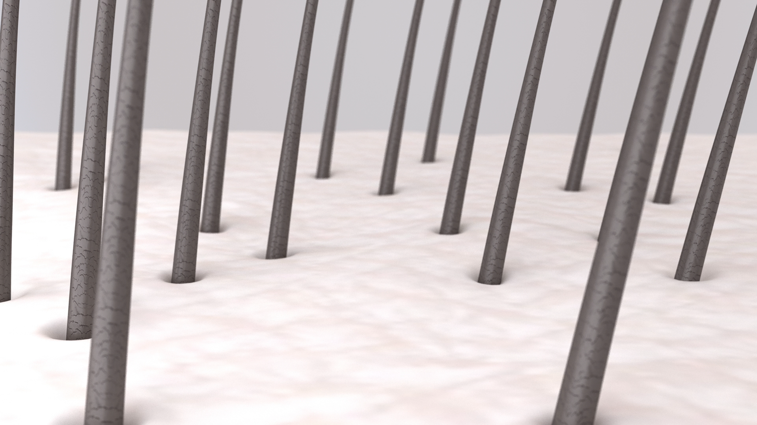
MODE OF ACTION
Acts on the hair root at the cellular level, clearing only senescent cells by targeted apoptosis
Reduces SASPs
Increases functional Keratin
Improves hair density and hair longevity
For young, healthy-looking hair*
*No data available
Normal Follicle Dermal Papilla Cells
Senescent Follicle Dermal Papilla Cells
SASP

Slide 21

A truly senolytic active ingredient, with complete proof of action in vitro and in vivo

Slide 22
Less senescent cells, more longevitality for hair
IN VITRO RESULTS
53% less senescent cells
with 0.001%* ETERWELL™ HAIR
Highly potent in our in vitro model
mimicking aged hair follicles
Model uses H₂O₂-induced senescent
Follicle Dermal Papilla Cells
Significant and dose-dependent
senolytic activity
30
*dry extract ** Navitoclax (senolytic drug used as positive reference
27
22
-53%
13
14
Treatment of Follicle Dermal Papilla Cells
70% normal
30% senescent
Flow cytometer
+ Senescence-associated beta-galactosidase marker
**
*
ETERWELL™ HAIR *

Slide 23
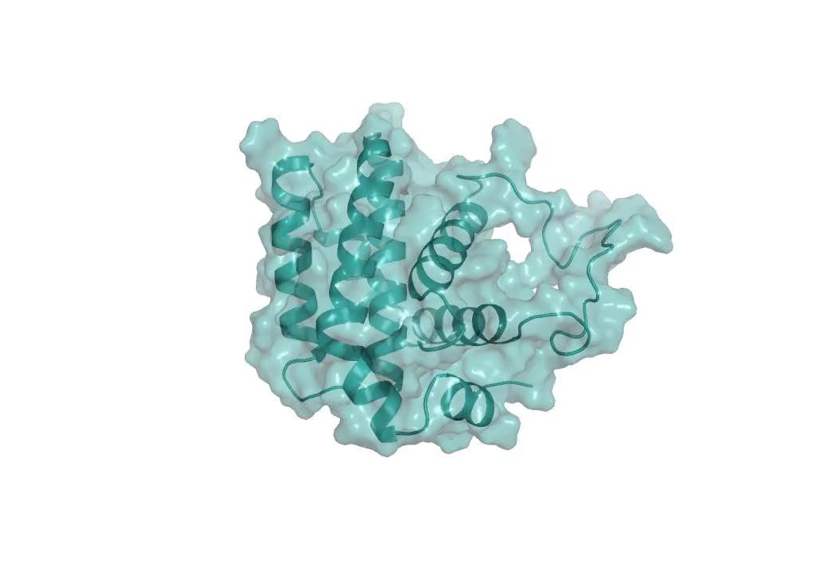
With a clear Senolytic mode of action
IN VITRO RESULTS
BCL-2 is a protein that inhibits apoptosis, the natural process that occurs when a cell intentionally “decides” to die after being damaged or becoming senescent.
30
*dry extract
27
22
13
14
This anti-apoptotic protein will keep senescent, “zombie cells” alive.
BCL-2 needs to be inhibited or neutralized to unlock the apoptotic process and clear the senescent cells from the cellular environment.
BCL-2 inhibition demonstrates
a clear Senolytic process.
0.001%* of ETERWELL™ HAIR inhibits 66% of
BCL-2 In Vitro
Time Resolved Fluorescence Resonance Energy Transfer
(TR-FRET assays)

Slide 24

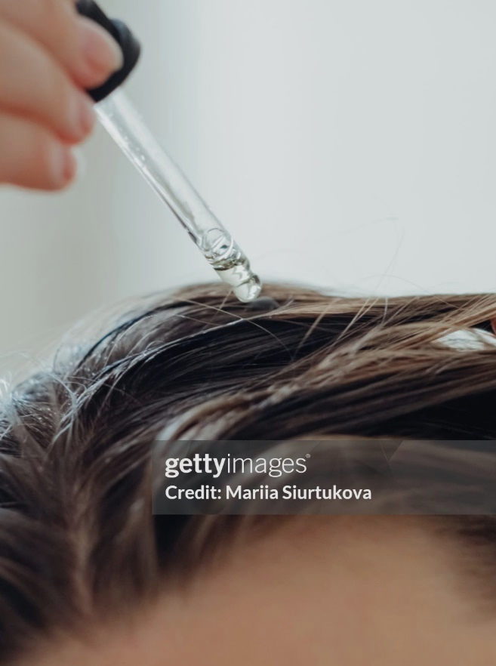
Clinical study design: testing on those who need our solution the most
IN VIVO RESULTS
In vivo study with 2 groups, one placebo
and one with 0.5% ETERWELL™ HAIR
Two groups of 30 volunteers each
Groups composed of female and male with general hair loss (>90 hairs lost in a combined wash and comb test)
Age: 30–65 yo
One Group of 30 volunteers using PLACEBO
One Group of 30 volunteers using a leave on formula containing ETERWELL™ HAIR 0.5%
One daily application of scalp serum (no rinse)
Five months study
Evaluation of the Anagen (growing phase of the follicle) vs Telogen (resting phase of the follicle) phases of hair
Measurement of the hair density
Proteomics analysis on hair sampling
GROUP 2:
ETERWELL™ HAIR
0.5%
GROUP 1:
Placebo

Slide 25
Clear improvement of the hair vitality
Anagen/Telogen ratio measurement
IN VIVO RESULTS
"AT ratio" is a way of measuring the health of the hair, comparing
the number of hairs in the growth phase (anagen) with those
in the resting or shedding phase (telogen).
The higher the ratio, the more vitality and health the hair will show.
*
*
*
0.5% ETERWELL™ HAIR
0.5% ETERWELL™ HAIR
The number of hair follicles in the growth phase (anagen) increased, while those in the resting phase (telogen) decreased. This improvement of +5.2 was significant compared to the placebo (*p<0.05)
70% of the volunteers who used the active formulation showed improvement in the ratio between the growth and resting phases, compared to fewer than 45% in the placebo group (*p<0.05).
Notes:
70% of the volunteers showing a positive response means showing a positive efficacy, a stimulation of Anagen phase vs Telogen phase when using the product. This is not volunteers comments but data-based statement. This is a strong positive response for hair density testing if compared with other benchmarks like Minoxidil (known to generate more hair loss for the 3 first month of the treatment and with a positive response <50%).

Slide 26
Showing highly significant hair density increase
IN VIVO RESULTS
**
Hair density is significantly increased (average + 5%, up to 28% for the best volunteer) and outperforming the placebo.
+5%
0.5% ETERWELL™ HAIR
Error bars = standard error of the mean.
**p<0.01 T150 vs baseline

Slide 27
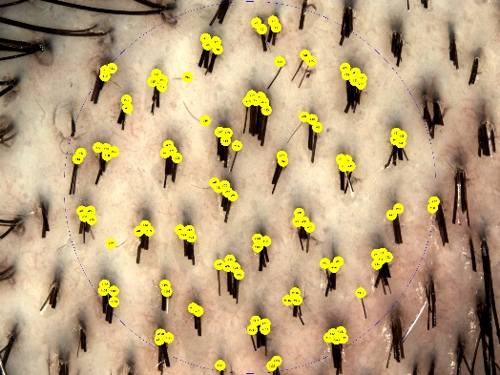
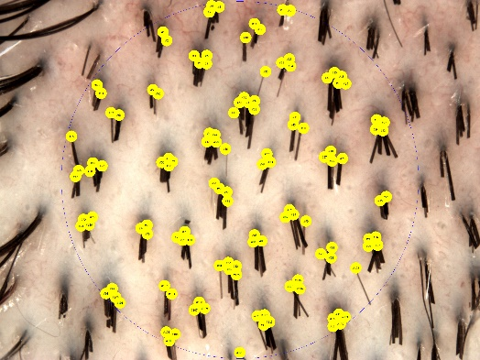
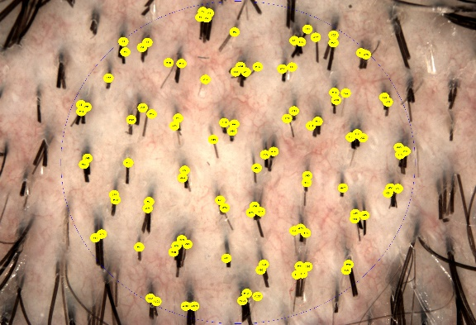
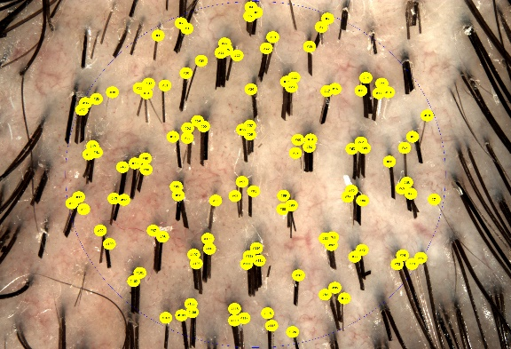
Showing highly significant hair density increase with proven photographic evidence
IN VIVO RESULTS
T0
T150
T0
T150
24%
27%
Placebo - Volunteer #10P
0.5% ETERWELL™ HAIR –Volunteer #19A
Placebo
Average 5% hair density increase after 150 days
Up to 28% increase for the best volunteer

Slide 28
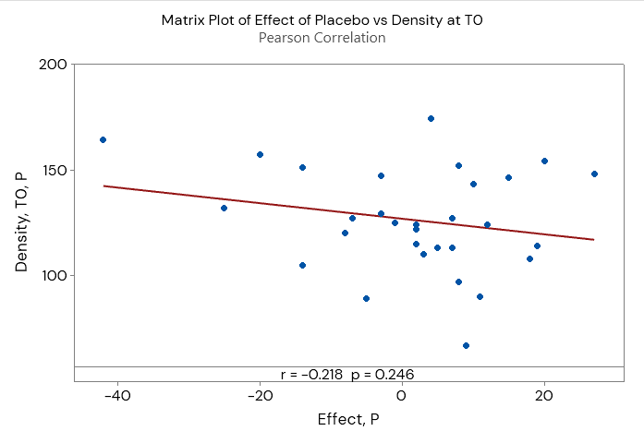
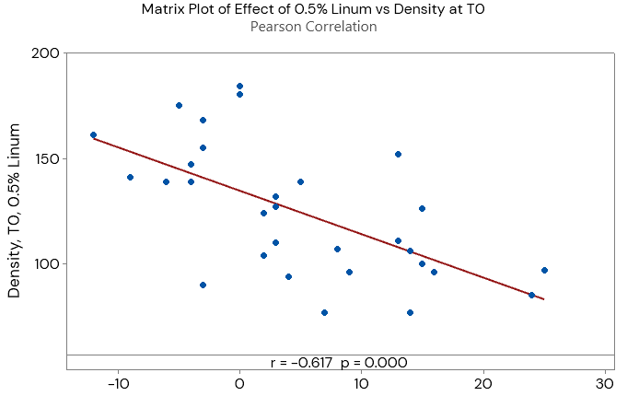
Showing highly significant hair density increase, especially for low hair density volunteers:
Hair density, placebo group vs test group
IN VIVO RESULTS
0.5% ETERWELL™ HAIR
No significant correlation between hair density at T0 and placebo effect.
Significant negative correlation between hair density at T0 and ETERWELL™ HAIR effect.
The less hair the volunteers had,
the more ETERWELL™ HAIR increased hair density

Slide 29
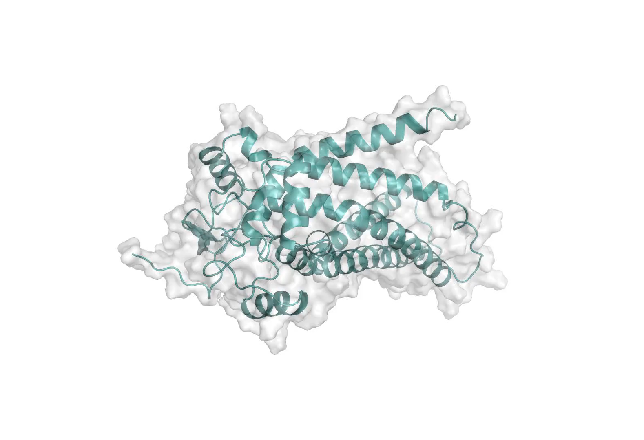
Proteome analysis
Proteome analysis is the study of proteins that are present in hair strands and the scalp. This analysis explores how these proteins interact and how their functions can affect hair growth, health, and structure.

Slide 30
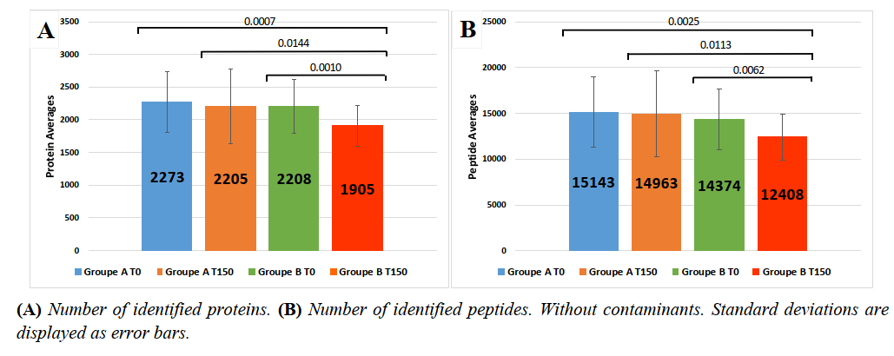
Overall proteins
PROTEOME ANALYSIS
In our analysis, we identified that after 5 months, using the placebo did not significantly affect the number of identified proteins, whereas using ETERWELL™ HAIR led to a reduction in the diversity of expressed proteins.
This reduction in diversity could indicate that ETERWELL™ HAIR is regulating and stabilizing
the hair’s protein environment!
A significant reduction in the number of different proteins when using ETERWELLTM HAIR, from 2,208 different types to 1,905.
blue & orange PLACEBO, green & red ETERWELL™ HAIR

Slide 31
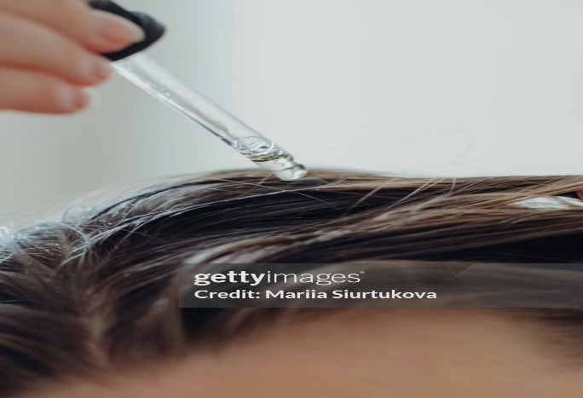
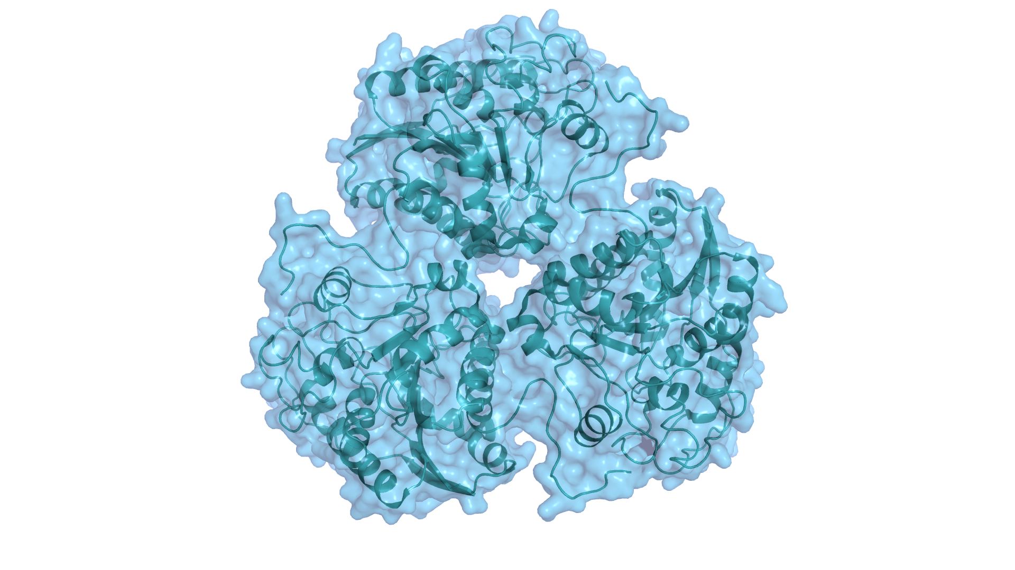
Inhibition of
Arginase-1 (ARG1)
PROTEOME ANALYSIS
p=0.023
ETERWELL™ HAIR lowered the levels of Arginase-1: an enzyme that breaks down Arginine, which is a key building block of keratin and the primary material that makes up hair.
This points to a positive impact on the hair renewal cycle and density.
+28.4%
-37.3%
0.5% ETERWELL™ HAIR

Slide 32
Increase in hair keratin
PROTEOME ANALYSIS
p=0.002
+1%
p=0.099
-26.2%
While reducing destructive enzymes, ETERWELL™ HAIR also boosted hair keratin levels over time when compared to the placebo group.
+78.7%
+29.6%
0.5% ETERWELL™ HAIR
0.5% ETERWELL™ HAIR
We can expect active formation of the hair shaft with thicker,
fuller and better-quality hair.
p=0.0004
+5.9%
-25.6%
+22.9%
-3.3%
0.5% ETERWELL™ HAIR
0.5% ETERWELL™ HAIR

Slide 33
Increase in keratin-associated proteins
PROTEOME ANALYSIS
p=0.082
p<0.001
+28.2%
+26.7%
-31.5%
ETERWELL™ HAIR not only boosted keratin levels but also increased proteins essential for the proper formation of keratin in the hair fiber.
-2.4%
0.5% ETERWELL™ HAIR
0.5% ETERWELL™ HAIR
We can expect stronger, more resilient, and better-protected strands, resulting in higher-quality hair.
p<0.001
+25.6%
-28.5%
0.5% ETERWELL™ HAIR

Slide 34

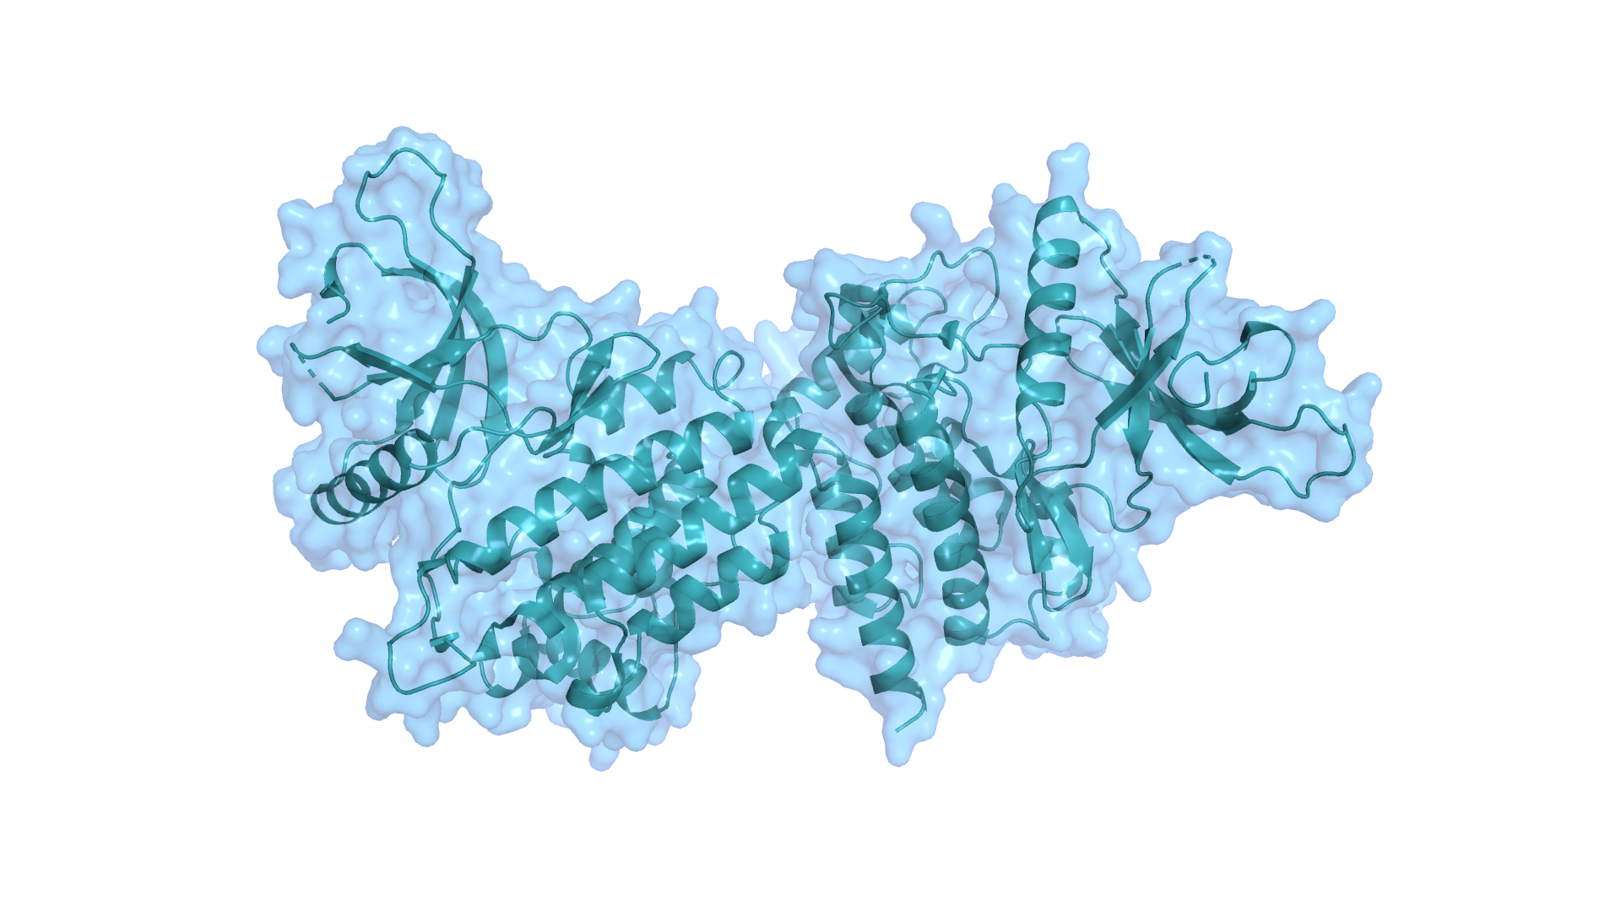
Alopecia promotor inhibition
PROTEOME ANALYSIS
p = 0.028
+38.2%
The results also point to a reduction in Janus Kinase 2 (JAK2), a protein that has been studied for its impact on alopecia (hair loss).
This not only confirms but also explains the significant improvement in hair density observed in the in vivo studies.
-24.9%
0.5% ETERWELL™ HAIR
JAK2 inhibition reverses alopecia areata in mice (Xing et al. nature medicine VOLUME 20 | NUMBER 9 | SEPTEMBER 2014) | JAK2 inhibitor Baricitinib induced hair regrowth in alopecia patients (Freitas et al. Drugs (2023) 83:761–770)

Slide 35
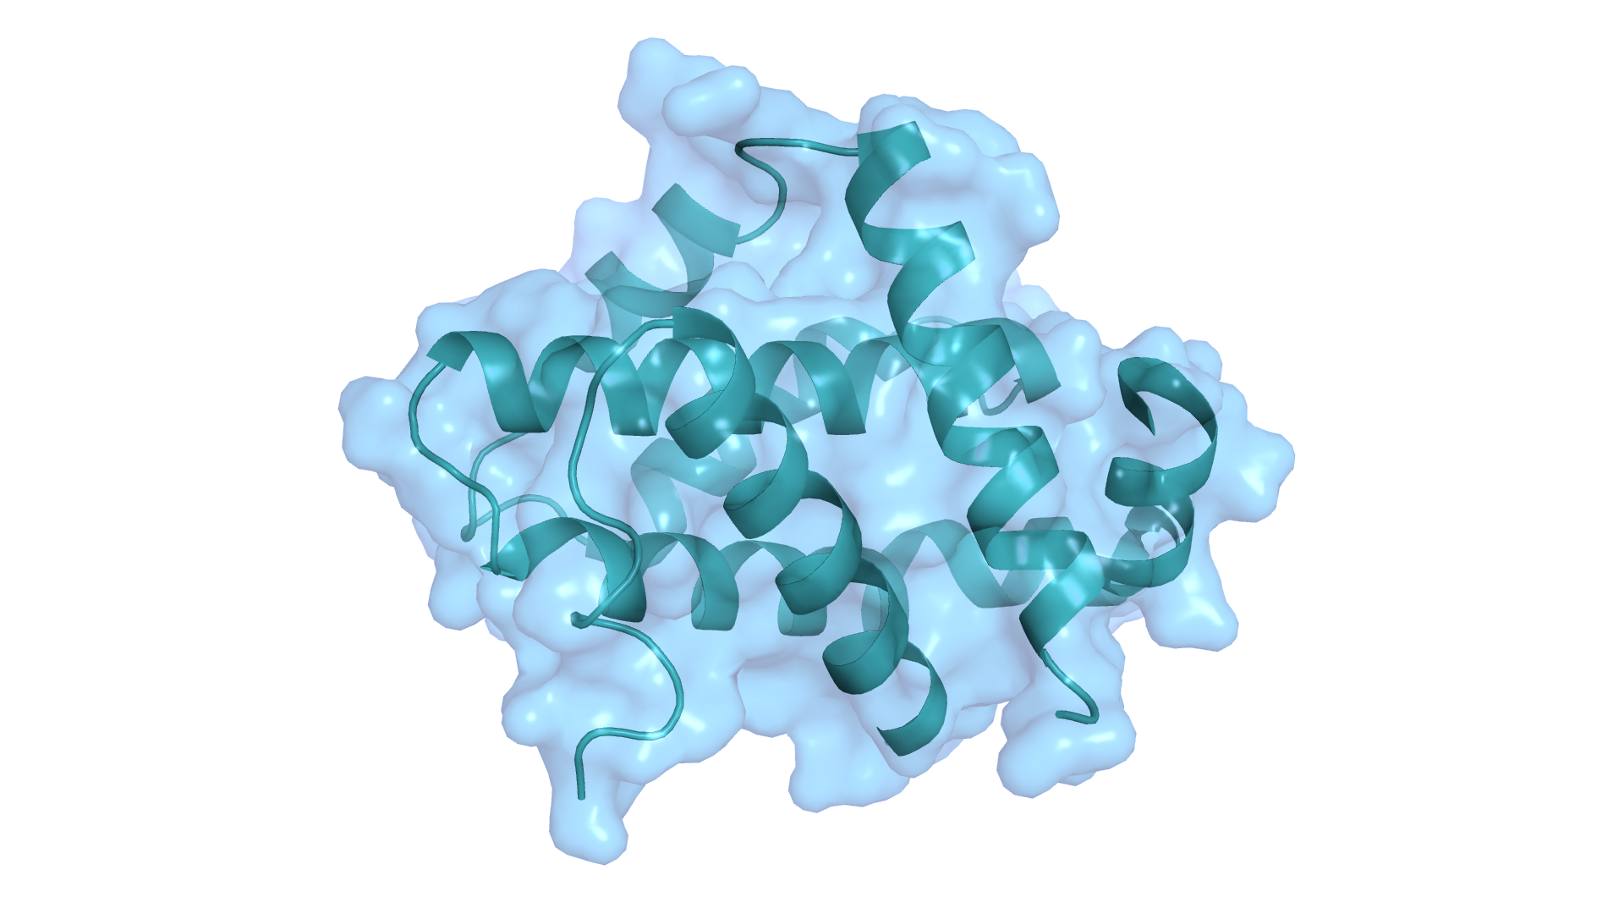
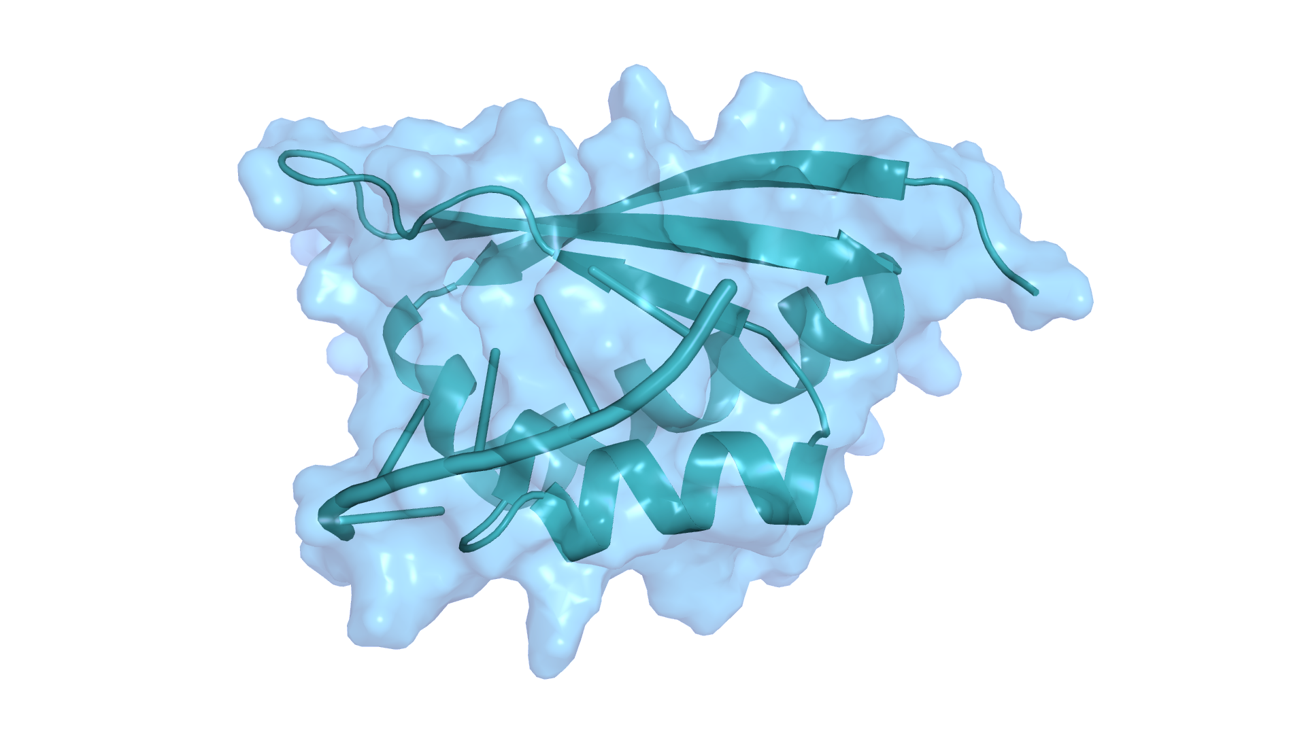
Apoptosis markers
PROTEOME ANALYSIS
p=0.041
-2.2%
-20.2%
Here we can see a decrease in Bcl2L1 and HNRNPK, elements that plays a key role in the senescence process, forcing cells into their senescent, or "zombie" state.
This finding confirms the BCL-2 pathway found previously in vitro.
Bcl2L1
0.5% ETERWELL™ HAIR
p=0.064
- 22%
-58.7%
HNRNPK
0.5% ETERWELL™ HAIR

Slide 36
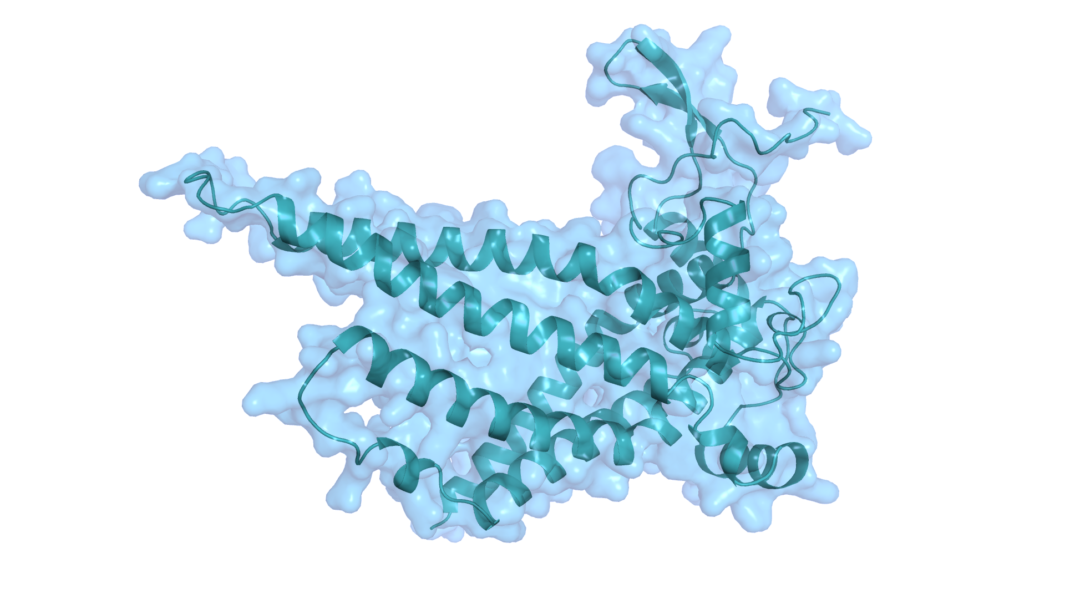
Apoptosis marker MTCH1
PROTEOME ANALYSIS
0.017
+23.8%
The results also indicate that ETERWELL™ HAIR works by triggering an increase in MTCH1, a mitochondrial protein that has the power to induce apoptosis by itself.
In other words, it affects
a key mechanism for
eliminating the senescent zombie cells.
-13.1%
0.5% ETERWELL™ HAIR
MTCH1 (aka presenilin-1 associated protein) is a mitochondrial protein that induces apoptosis in a Bcl-2 independent way (Li et al. Biochimica et Biophysica Acta 1832 (2013) 453–474) | MTCH1 is sufficient to induce apoptosis in a Bax/Bak independent manner (Lamarca et al. European Journal of Cell Biology 87 (2008) 325–334)

Slide 37
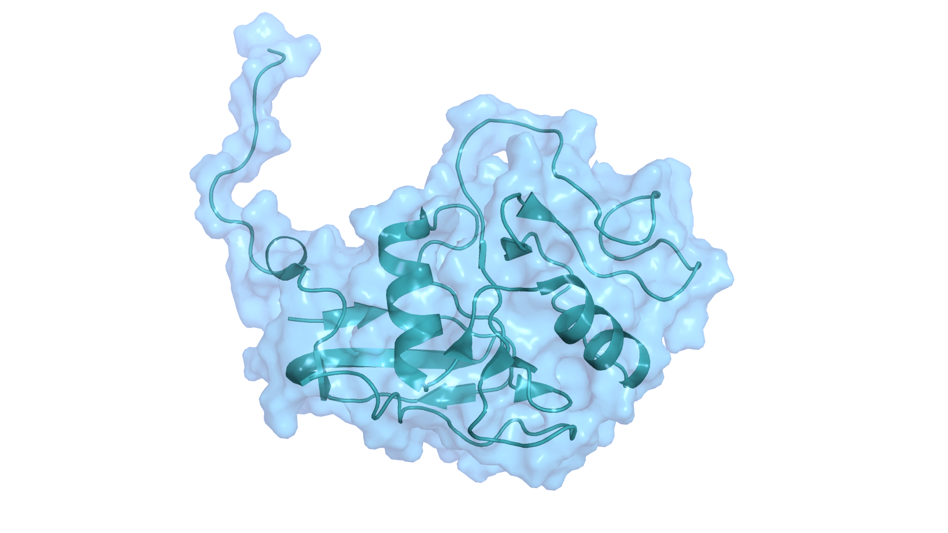
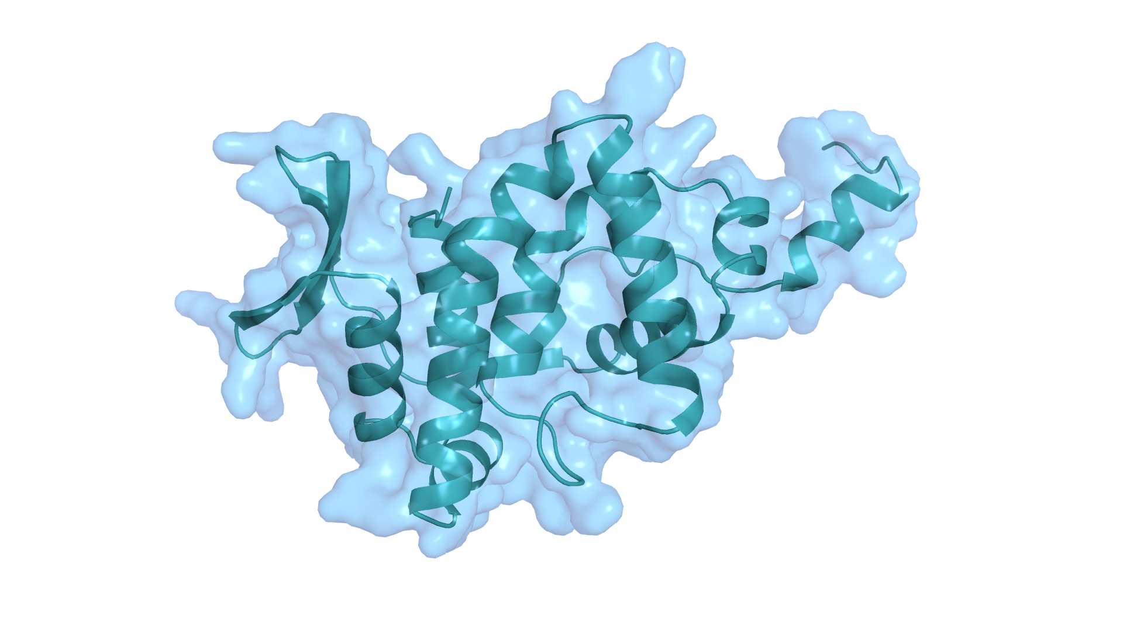
Senescence inducing markers
PROTEOME ANALYSIS
p=0.001
+17.5%
-25.6%
As a result of modulating apoptosis markers, there is a drop in senescent markers.
HRAS
0.5% ETERWELL™ HAIR
In other words:
ETERWELLTM HAIR is able
to reprogram cells so that they enter apoptosis, eliminating zombie cells
that harm the hair system!
p=0.002
+24.7%
-27.7%
AIMP3
0.5% ETERWELL™ HAIR

Slide 38

Outstanding Results
DIRECT SENOLYTIC EFFECT BOOSTING HAIR LONGEVITALITY
53% less senescent Follicle Dermal Papilla Cells with 0.001%* ETERWELL™ HAIR in vitro
Inhibition of Arginase 1 expression
in vivo
Increase of Keratin and Keratin associated proteins markers in vivo
Inhibition of Alopecia promotor JAK2 in vivo
Inhibition of Apoptosis inhibitors in vitro and in vivo
Increase of Apoptosis promotor MTCH1 in vivo
Reduction of senescence inducing markers in vivo
SCREENED WITH dsm-firmenich’s FIRST IN CLASS SENOLYTIC MODEL
Using Senescent Follicle Dermal Papilla Cells
Relevant for hair care
SIGNIFICANT RESULTS AT LOW CONCENTRATION IN VIVO (0.5%, 150 DAYS)
Average 5% hair density increase after 150 days. Up to 28% for the best volunteer.
70% positive response
to ETERWELLTM HAIR with
an increase of Anagen phase (growth phase)
A/T ratio increased by 5.2
vs placebo
Correlation between hair density and efficacy of ETERWELLTM HAIR
Results strongly validated by Proteome analysis
*dry extract
A CLEARLY SELECTIVE MODE OF ACTION
Specific re-programming of Zombie cells via specific modulation of Apoptosis markers
Demonstrated direct Senolytic effect

Slide 39

And all of this is possible without harming people or the planet

Slide 40

And all of this is possible without harming people or the planet
ETERWELL™ HAIR combines advanced hair care with Sustainability: made with 100% natural ingredients and ethically sourced Alpine blue flax, it cares for the planet while transforming hair.
It’s the right choice for those seeking effectiveness and beauty with awareness.

Slide 41

A Holistic Sustainable Solution
BIODIVERSITY
PROTECTION
Preserving Swiss alpine biodiversity through organic cultivation and sustainable land use.
Cosmos/Natrue certified ingrediente.
REGENERATIVE
FARMING
Aligned with the Union Ethical BioTrade (UEBT) Regenerative Farming (beyond responsible sourcing and ethical practices).
Focuses on improved soil restoration, water purification, maintenance of biodiversity,
and enhanced climate resilience.
RESPONSIBLE
SOURCING
Fair for Life fair trade certified. Transparent and traceable supply chain from seeds to bioactive.
Ethical relationship with small stakeholders. Guaranteed minimum price for farmer, fixed before the harvesting season.
LIMITED
ENVIRONMENTAL IMPACT
Low carbon footprint with less than 3 kg CO₂eq/kg.
Application of green chemistry principles and gentle extraction process using organic etanol.
WATER-SAVING FORMULATION
The formulas are designed for easy rinse-off, significantly reducing water consumption during use.

Slide 42








Organic, ethical and fully traceable bioactive
*Safe use level from 0.2 to 2% according to the Final list published to support China Safety Assessment issued in February 2025 without further regulatory requirements
Plant: LINUM ALPINUM – Alpine blue flax
Parts of the plant: aerial parts
Harvest: May, July, September, full blooming
Standardization in Flavonoids: 40mg/100g
(UHPLC calculated as saponarin)
INCI Name: Glycerin, Water, Linum Alpinum Flower/Leaf/Stem Extract, Citric Acid
INCI name China listing: Linum Alpinum Extract
China listing: IECSC listed, IECIC listing*
Natural origin content: 100% according to ISO16128
Suggested concentration: 0.5–3% ETERWELL™ HAIR

Slide 43
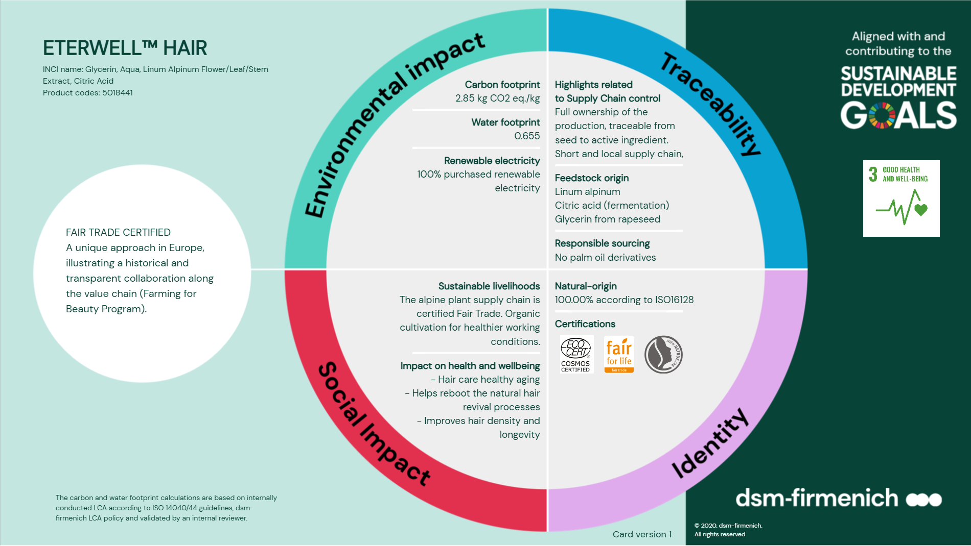

Slide 44

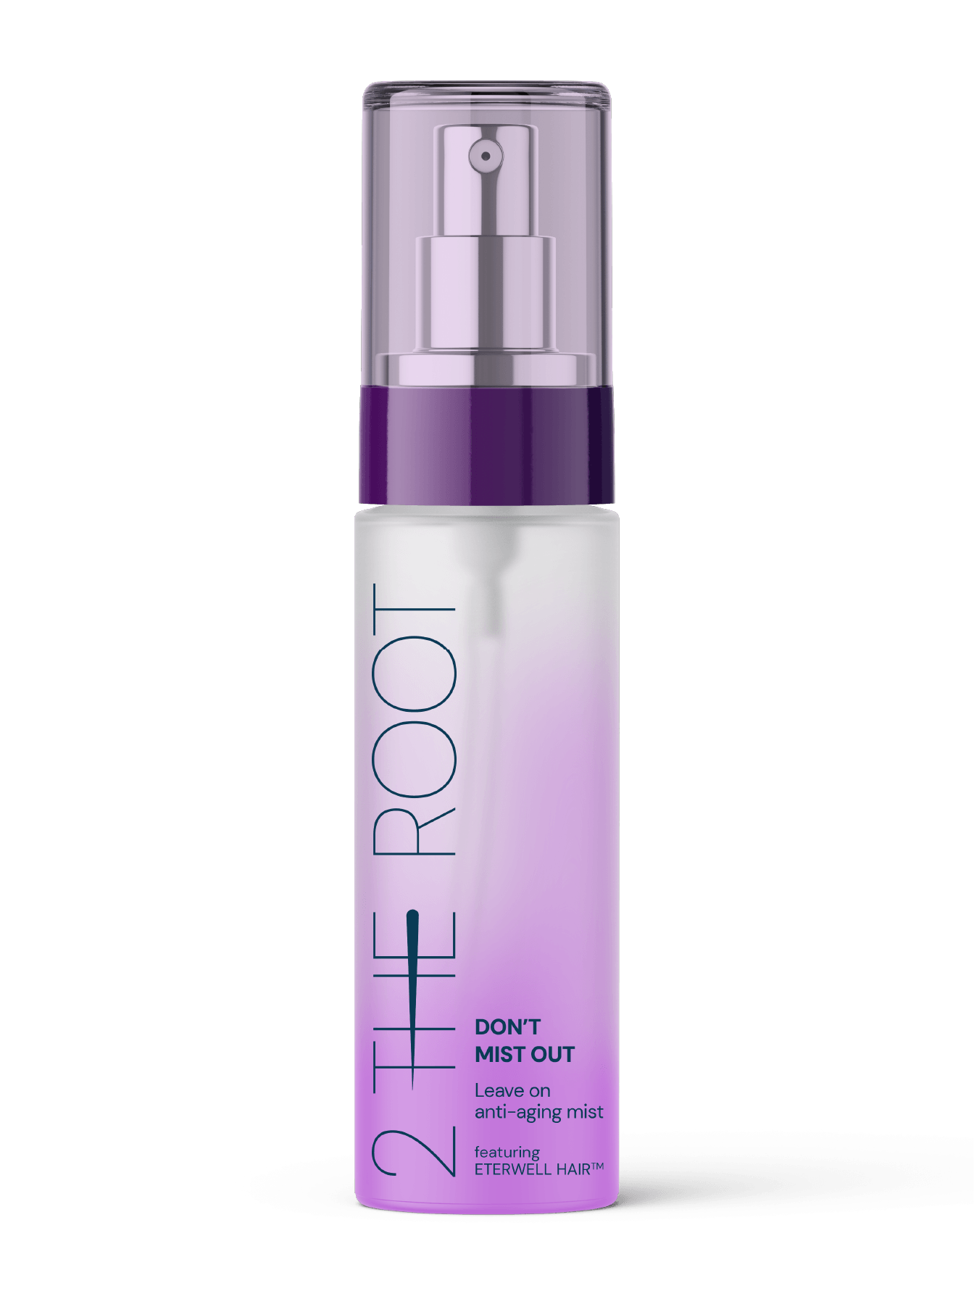

Products are for illustration only, not for sale
dsm-firmenich is not responsible for final product claims.
Don’t
Mist Out
Featuring
ETERWELL™ HAIR
Leave on
anti-aging mist
Hair longevitality,
starting from the cells
With 97% natural-origin ingredients, this Leave On Hair Mist reinvigorates your hair and scalp by combining the power of ETERWELL™ HAIR, an eco-conscious solution powered by cutting-edge senolytic science, with a dream team of Hair Vitamins - Panthenol for deep hydration, Vitamin B3 for fuller, thicker hair, and Vitamin B6 for strength and nourishment. The formulation also contains PENTAVITIN®, our star moisturizer that acts like a Keratin magnet, locking in moisture while strengthening the scalp barrier.
Featuring Rejuven Hair, a science infused fragrance with emotiwaves® energy and clearsense® beauty technologies, designed to evoke emotions and provide a lasting feeling of freshness.

Slide 45







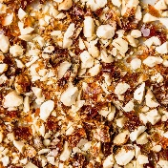

Rejuven
Hair
A science
infused fragrance
TOP NOTES
clean efficacy
Grapefruit - orange - ozonic accord
emotiwaves® energy
dsm-firmenich neuroscience-based fragrance technology designed to drive emotions through scents
+
HEART NOTES
blooming & radiant
Peach - freesia - lily of the valley
clearsense® beauty
dsm-firmenich cutting-edge technology designed to defend against the perception of unpleasant odors on hair & body
BASE NOTES
caring & comforting
Musk - praline - soft woods

Slide 46


Slide 47
Disclaimer
Copyright © DSM Nutritional Products Ltd 2025, 4002 Basel, Switzerland.
www.dsm-firmenich.com. All rights reserved.
dsm-firmenich has used diligent care to ensure that the information provided herein is accurate and up-to-date, however, dsm-firmenich makes no representation or warranty, either expressly or implied, of the accuracy, reliability, or completeness thereof. The information provided herein contains scientific and product information for business to business use and does not constitute or provide scientific or medical advice, diagnosis or recommendation for treatment. Country or region-specific information should be considered when labelling or advertising to final consumer. In no event shall dsm-firmenich be liable for any damages arising from or reliance upon, or use of, any information provided herein. The content of this document is subject to change without further notice. Please contact your local dsm-firmenich representative for further details. All trademarks listed in this document are either (registered) trademarks of, or trademarks licensed by, the dsm-firmenich group of companies, unless explicitly stated otherwise.
Disclaimer Formulation Guideline
This information is for illustration purposes only and based upon our current knowledge and experience at the time of printing. We do not make any representation or warranty of any kind, express or implied, including merchantability or fitness for a particular use, with respect to such information or its application. Use of this information is at your discretion and risk. Nothing herein relieves you from carrying out your own suitability determinations and tests. You are responsible for observing all laws and regulations relevant to your products, uses or processes. We do not assume any liability in connection with your product and its use. The foregoing information and suggestions are also provided without warranty of non-infringement as to the intellectual property rights of third parties and shall not be construed as any inducement to infringe the rights of third parties.

