Slide 1


“Hair care is the new
TRENDS
skincare”
Nicolas Hieronimus, L'Oréal Group CEO
Increasingly, consumers are realizing that hair care goes far beyond
the strands. It starts
at the root.

Slide 2

And yes, aging is a primary motivation when it comes to hair care
TRENDS
*Source: Euromonitor
Consumers want their hair to age healthily
and stay naturally beautiful. They’re looking for proactive solutions
for this purpose.
Top global hair concerns (2022)*
58%
54%
42%
Aging hair
Damaged hair
Scalp problems

Slide 3


TRENDS
“Formula inspired by the science
of cellular reprogramming, which integrates the revolutionary field
of senescence for the first time
in a night cream”
When it comes to cellular processes, it’s impossible not to mention senolytic science
And, following the latest trends in skin care, there is still space to explore senolytic science
in hair care.

Slide 4
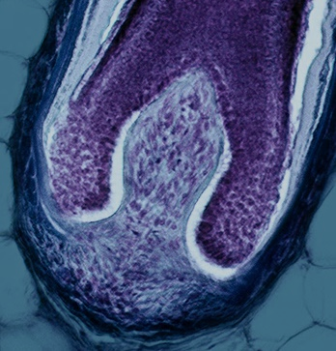


Let's take a closer look at the process of senescence and how it impacts hair health
WHAT'S NEXT
  ↑ Senescence markers Apoptosis inhibitors
  ↓ Apoptosis markers
  ↑ Senescent Cells
  ↑ SASPs
  ↑ Hair greying & hair loss
Senescent cells lose their ability to divide and properly produce key proteins like melanin, keratin, and KAP. As a result, they release SASPs (senescence-associated secretory phenotype), which also push surrounding cells into an undesirable senescent state.
The accumulation of senescent cells leads to aging with the aging phenotype.
Normal Follicle Dermal Papilla Cells
Senescent Follicle Dermal Papilla Cells
SASP

Slide 5
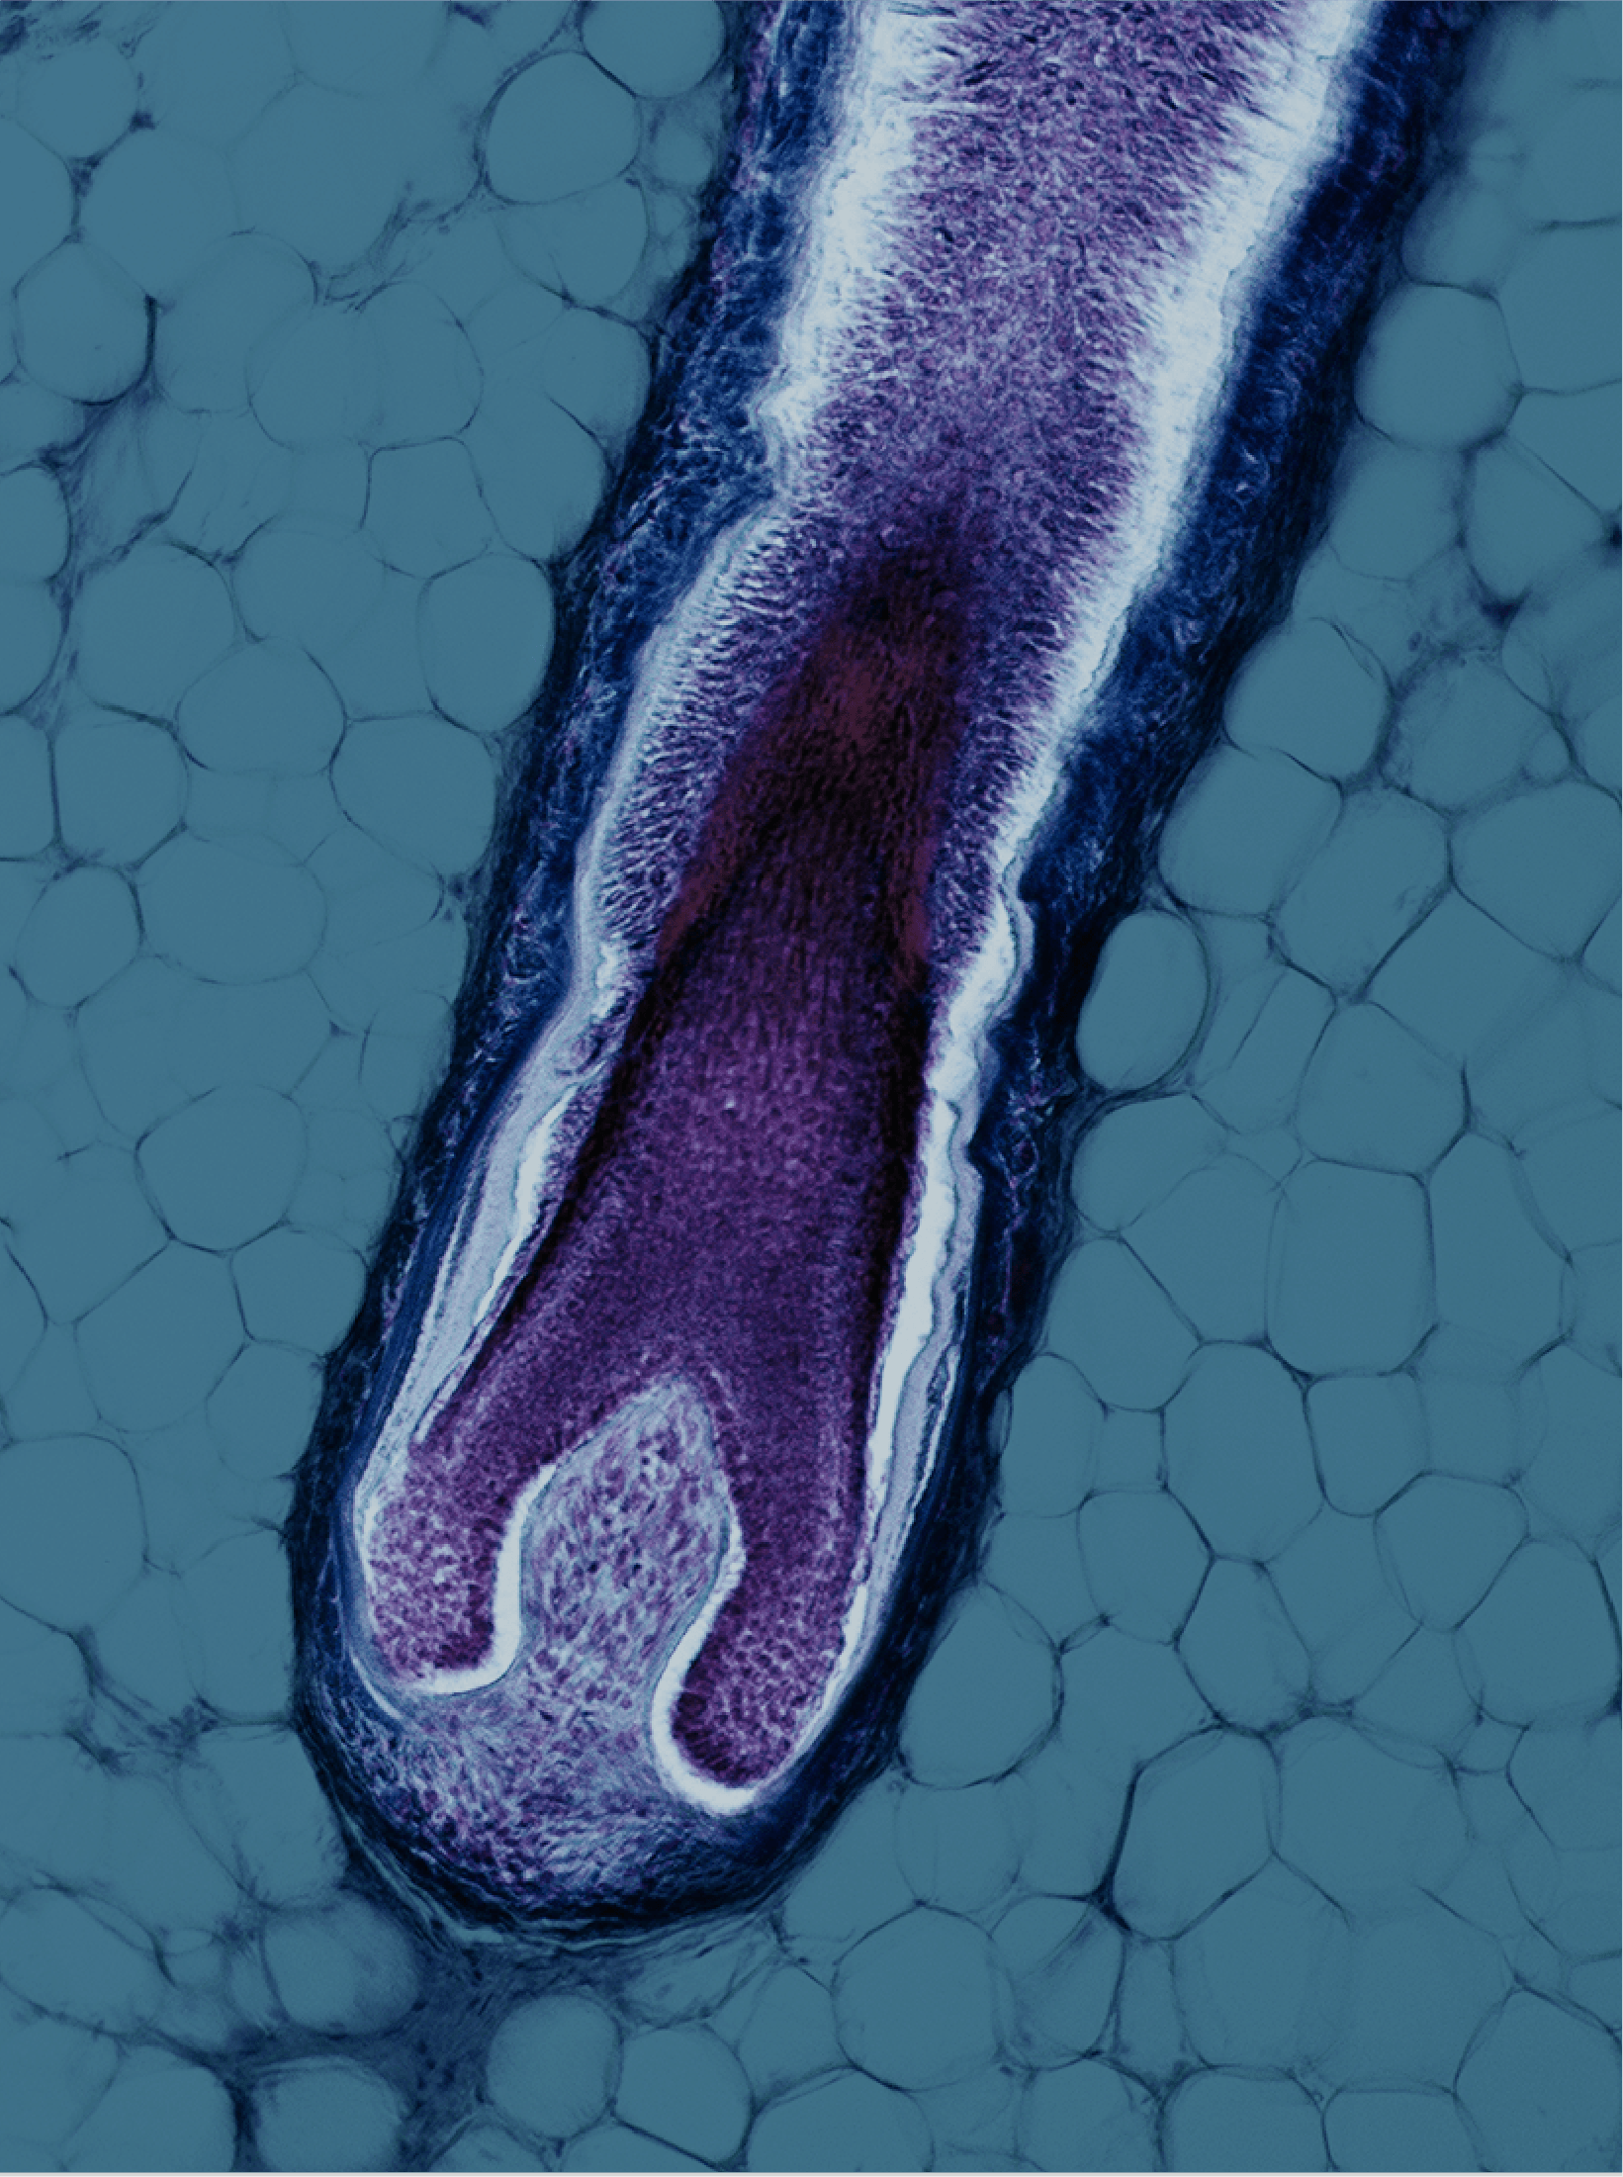

We developed the first and only test model for hair senescent cells
By testing our bioactives on hair follicles*,
we discovered an ingredient that goes beyond consumer expectations!
We present a groundbreaking
solution that will redefine the
concept of anti-aging hair care.
*Senescent Follicle Dermal Papila Cells

Slide 6
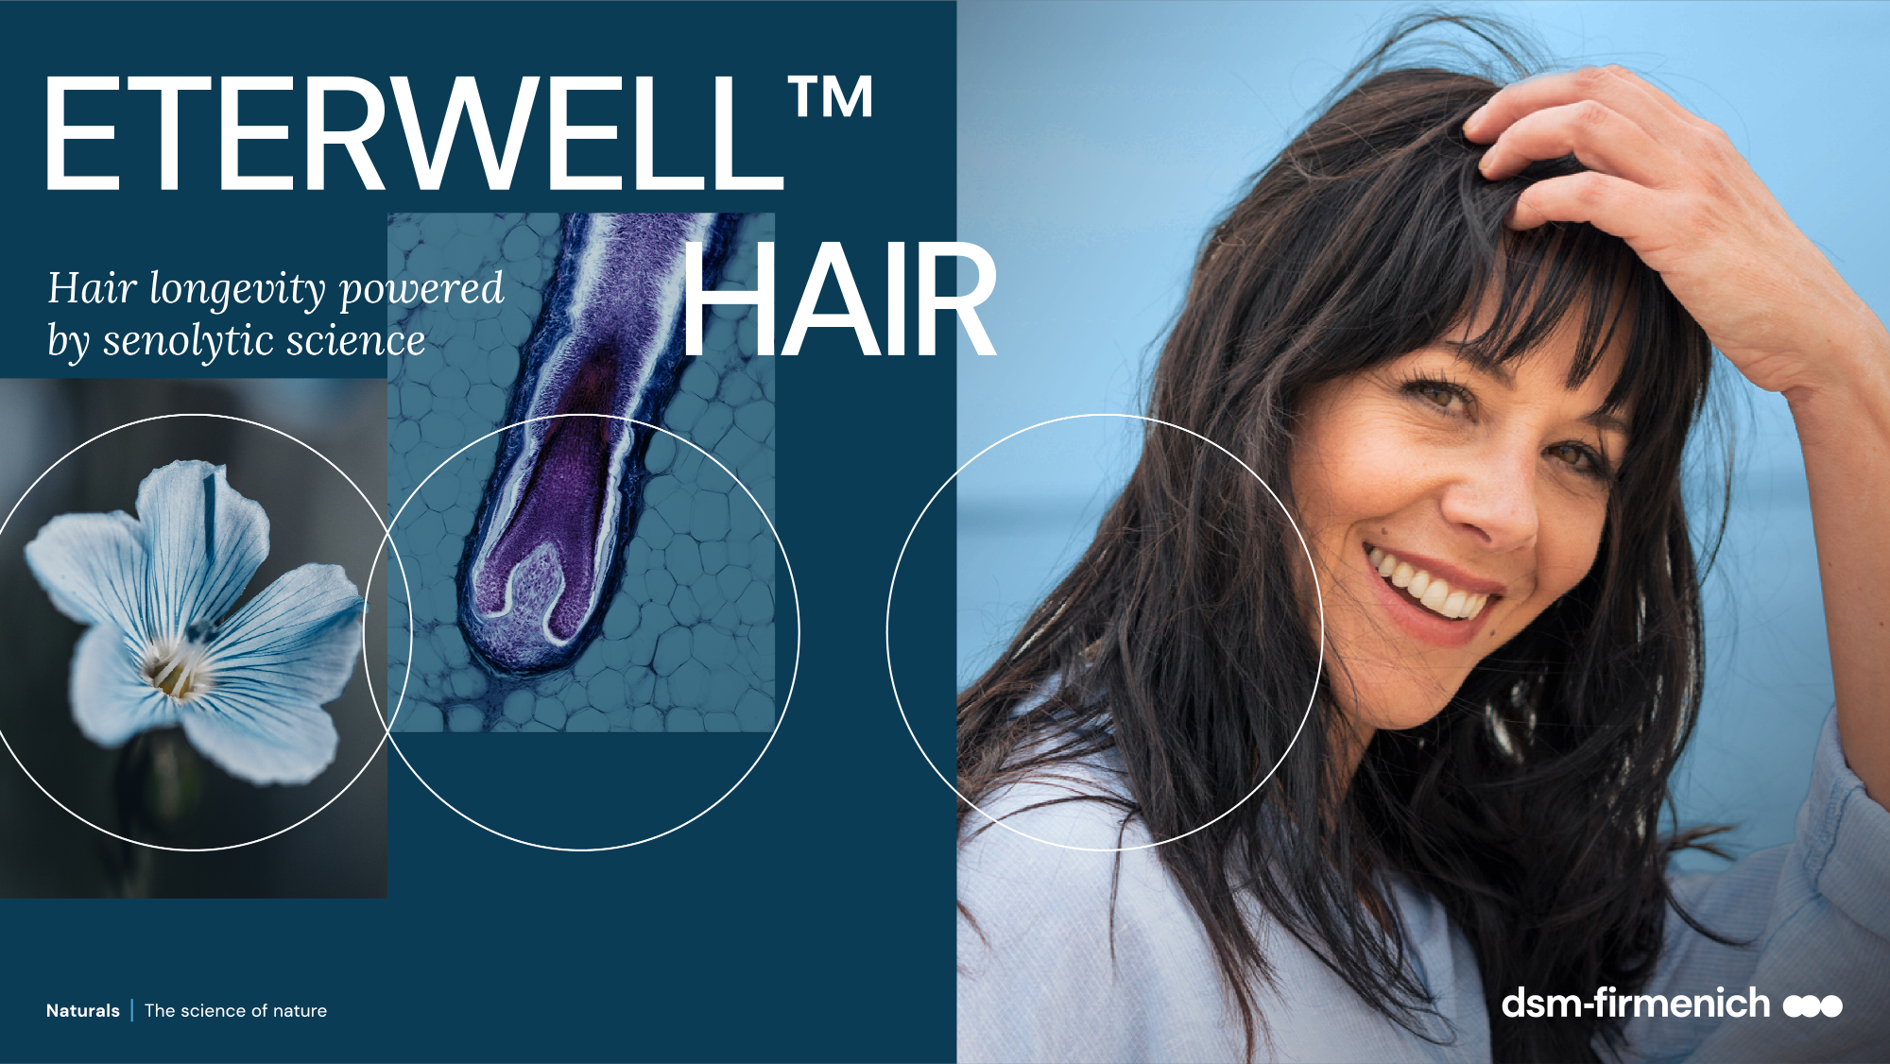

Slide 7


MODE OF ACTION
Key benefits
Hair care healthy aging acting at the cellular level
Helps reboot the natural hair revival processes
Increases hair longevity impaired by
folliculo-destructive senescent cells*
Helps prevent hair loss**
Significantly improves hair density** by average 5% in 5 months and up to 28% for the best volunteer
Helps slow down the premature ageing of hair
Calms sensitive, irritated, and dry scalp
Reduces inflammaging (reducing the expression
of inflammatory cytokines induced ICAM-1)*
Efficient at low concentration***
*: in vitro and ex vivo, ** in vivo *** 0.5% in leave on condition
Notes:
Data on the reduction of inflammatory cytokines are shown in the presentation of ALPAFLOR® LINUM AO. ETERWELL™ HAIR is the CB (Clean Beauty) version of ALPAFLOR® LINUM AO for which we are preparing an equivalence report. The Inflammaging claim will be further developed with the second wave of promotion including the full line up supporting the promotion of ETERWELL™ HAIR.

Slide 8

A truly senolytic active ingredient, with complete proof of action in vitro and in vivo

Slide 9
Less senescent cells, more longevitality for hair
IN VITRO RESULTS
53% less senescent cells
with 0.001%* ETERWELL™ HAIR
Highly potent in our in vitro model
mimicking aged hair follicles
Model uses H₂O₂-induced senescent
Follicle Dermal Papilla Cells
Significant and dose-dependent
senolytic activity
30
*dry extract ** Navitoclax (senolytic drug used as positive reference
27
22
-53%
13
14
Treatment of Follicle Dermal Papilla Cells
70% normal
30% senescent
Flow cytometer
+ Senescence-associated beta-galactosidase marker
**
*
ETERWELL™ HAIR *

Slide 10
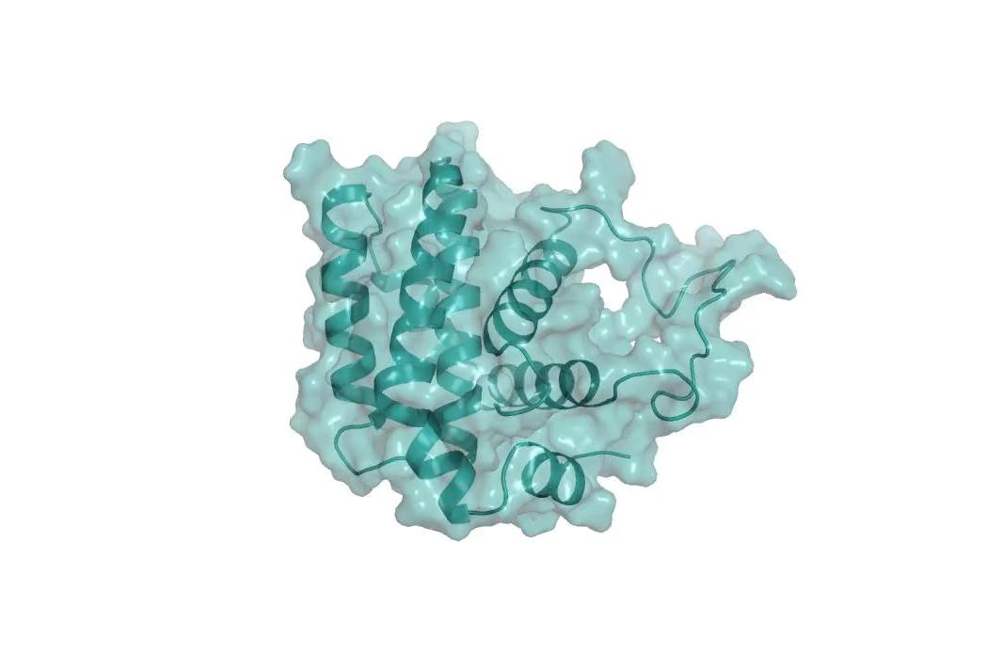
With a clear Senolytic mode of action
IN VITRO RESULTS
BCL-2 is a protein that inhibits apoptosis, the natural process that occurs when a cell intentionally “decides” to die after being damaged or becoming senescent.
30
*dry extract
27
22
13
14
This anti-apoptotic protein will keep senescent, “zombie cells” alive.
BCL-2 needs to be inhibited or neutralized to unlock the apoptotic process and clear the senescent cells from the cellular environment.
BCL-2 inhibition demonstrates
a clear Senolytic process.
0.001%* of ETERWELL™ HAIR inhibits 66% of
BCL-2 In Vitro
Time Resolved Fluorescence Resonance Energy Transfer
(TR-FRET assays)

Slide 11
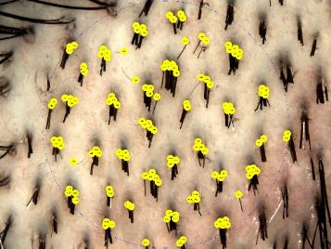
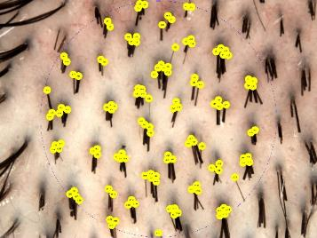
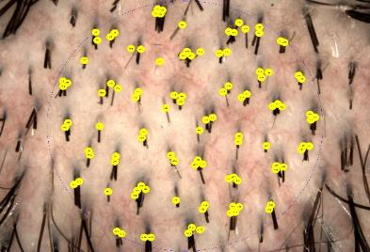
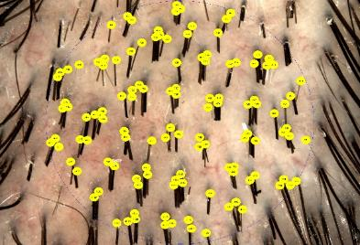
Showing highly significant hair density increase with proven photographic evidence
IN VIVO RESULTS
T0
T150
T0
T150
24%
27%
Placebo - Volunteer #10P
0.5% ETERWELL™ HAIR –Volunteer #19A
Placebo
Average 5% hair density increase after 150 days
Up to 28% increase for the best volunteer

Slide 12

Outstanding Results
DIRECT SENOLYTIC EFFECT BOOSTING HAIR LONGEVITALITY
53% less senescent Follicle Dermal Papilla Cells with 0.001%* ETERWELL™ HAIR in vitro
Inhibition of Arginase 1 expression
in vivo
Increase of Keratin and Keratin associated proteins markers in vivo
Inhibition of Alopecia promotor JAK2 in vivo
Inhibition of Apoptosis inhibitors in vitro and in vivo
Increase of Apoptosis promotor MTCH1 in vivo
Reduction of senescence inducing markers in vivo
SCREENED WITH dsm-firmenich’s FIRST IN CLASS SENOLYTIC MODEL
Using Senescent Follicle Dermal Papilla Cells
Relevant for hair care
SIGNIFICANT RESULTS AT LOW CONCENTRATION IN VIVO (0.5%, 150 DAYS)
Average 5% hair density increase after 150 days. Up to 28% for the best volunteer.
70% positive response
to ETERWELLTM HAIR with
an increase of Anagen phase (growth phase)
A/T ratio increased by 5.2
vs placebo
Correlation between hair density and efficacy of ETERWELLTM HAIR
Results strongly validated by Proteome analysis
*dry extract
A CLEARLY SELECTIVE MODE OF ACTION
Specific re-programming of Zombie cells via specific modulation of Apoptosis markers
Demonstrated direct Senolytic effect

Slide 13









Organic, ethical and fully traceable bioactive
*Safe use level from 0.2 to 2% according to the Final list published to support China Safety Assessment issued in February 2025 without further regulatory requirements
Plant: LINUM ALPINUM – Alpine blue flax
Parts of the plant: aerial parts
Harvest: May, July, September, full blooming
Standardization in Flavonoids: 40mg/100g
(UHPLC calculated as saponarin)
INCI Name: Glycerin, Water, Linum Alpinum Flower/Leaf/Stem Extract, Citric Acid
INCI name China listing: Linum Alpinum Extract
China listing: IECSC listed, IECIC listing*
Natural origin content: 100% according to ISO16128
Suggested concentration: 0.5–3% ETERWELL™ HAIR

Slide 14

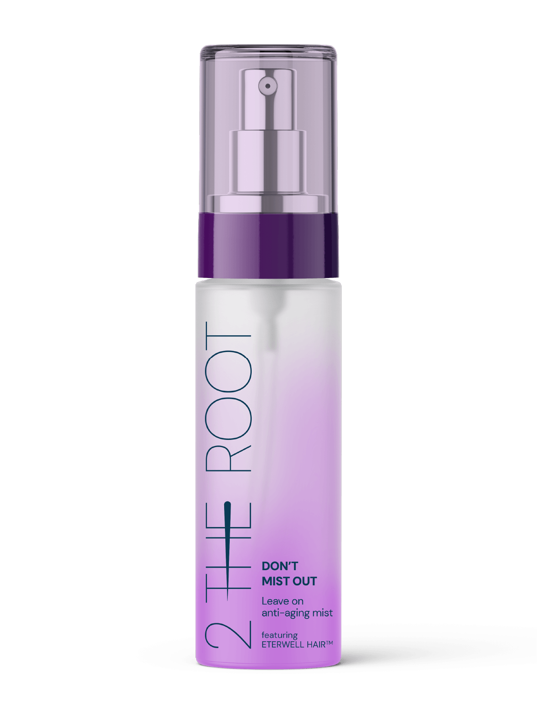

Products are for illustration only, not for sale
dsm-firmenich is not responsible for final product claims.
Don’t
Mist Out
Featuring
ETERWELL™ HAIR
Leave on
anti-aging mist
Hair longevitality,
starting from the cells
With 97% natural-origin ingredients, this Leave On Hair Mist reinvigorates your hair and scalp by combining the power of ETERWELL™ HAIR, an eco-conscious solution powered by cutting-edge senolytic science, with a dream team of Hair Vitamins - Panthenol for deep hydration, Vitamin B3 for fuller, thicker hair, and Vitamin B6 for strength and nourishment. The formulation also contains PENTAVITIN®, our star moisturizer that acts like a Keratin magnet, locking in moisture while strengthening the scalp barrier.
Featuring Rejuven Hair, a science infused fragrance with emotiwaves® energy and clearsense® beauty technologies, designed to evoke emotions and provide a lasting feeling of freshness.

Slide 15
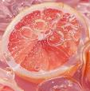
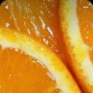

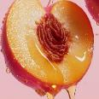


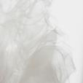
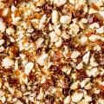
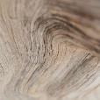
Rejuven
Hair
A science
infused fragrance
TOP NOTES
clean efficacy
Grapefruit - orange - ozonic accord
emotiwaves® energy
dsm-firmenich neuroscience-based fragrance technology designed to drive emotions through scents
+
HEART NOTES
blooming & radiant
Peach - freesia - lily of the valley
clearsense® beauty
dsm-firmenich cutting-edge technology designed to defend against the perception of unpleasant odors on hair & body
BASE NOTES
caring & comforting
Musk - praline - soft woods

Slide 16


Slide 17
Disclaimer
Copyright © DSM Nutritional Products Ltd 2025, 4002 Basel, Switzerland.
www.dsm-firmenich.com. All rights reserved.
dsm-firmenich has used diligent care to ensure that the information provided herein is accurate and up-to-date, however, dsm-firmenich makes no representation or warranty, either expressly or implied, of the accuracy, reliability, or completeness thereof. The information provided herein contains scientific and product information for business to business use and does not constitute or provide scientific or medical advice, diagnosis or recommendation for treatment. Country or region-specific information should be considered when labelling or advertising to final consumer. In no event shall dsm-firmenich be liable for any damages arising from or reliance upon, or use of, any information provided herein. The content of this document is subject to change without further notice. Please contact your local dsm-firmenich representative for further details. All trademarks listed in this document are either (registered) trademarks of, or trademarks licensed by, the dsm-firmenich group of companies, unless explicitly stated otherwise.
Disclaimer Formulation Guideline
This information is for illustration purposes only and based upon our current knowledge and experience at the time of printing. We do not make any representation or warranty of any kind, express or implied, including merchantability or fitness for a particular use, with respect to such information or its application. Use of this information is at your discretion and risk. Nothing herein relieves you from carrying out your own suitability determinations and tests. You are responsible for observing all laws and regulations relevant to your products, uses or processes. We do not assume any liability in connection with your product and its use. The foregoing information and suggestions are also provided without warranty of non-infringement as to the intellectual property rights of third parties and shall not be construed as any inducement to infringe the rights of third parties.

