Slide 1
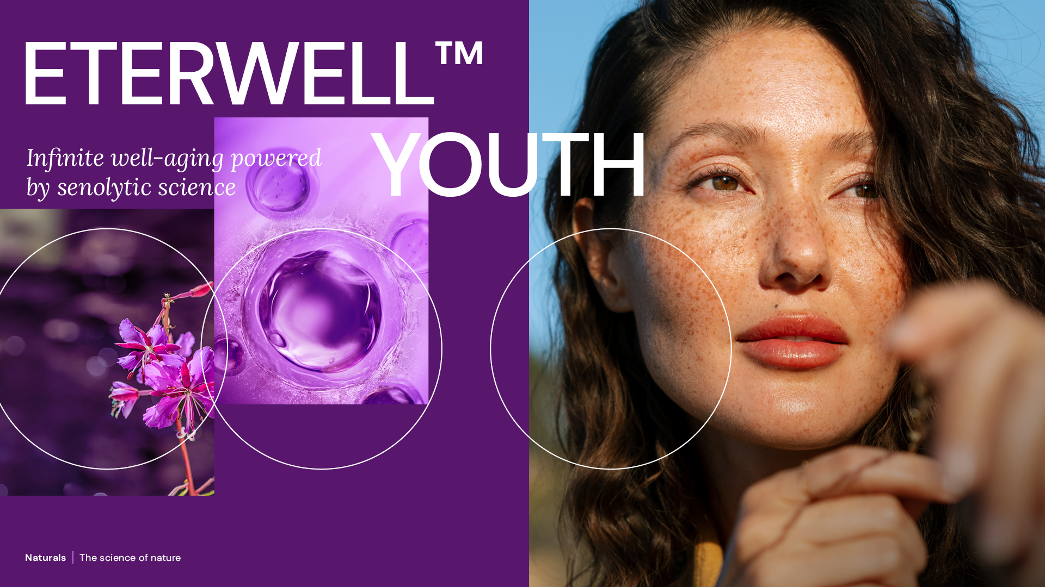
10x winner
Prestigious awards of Scientific excellence & innovation
June 2026

Slide 2
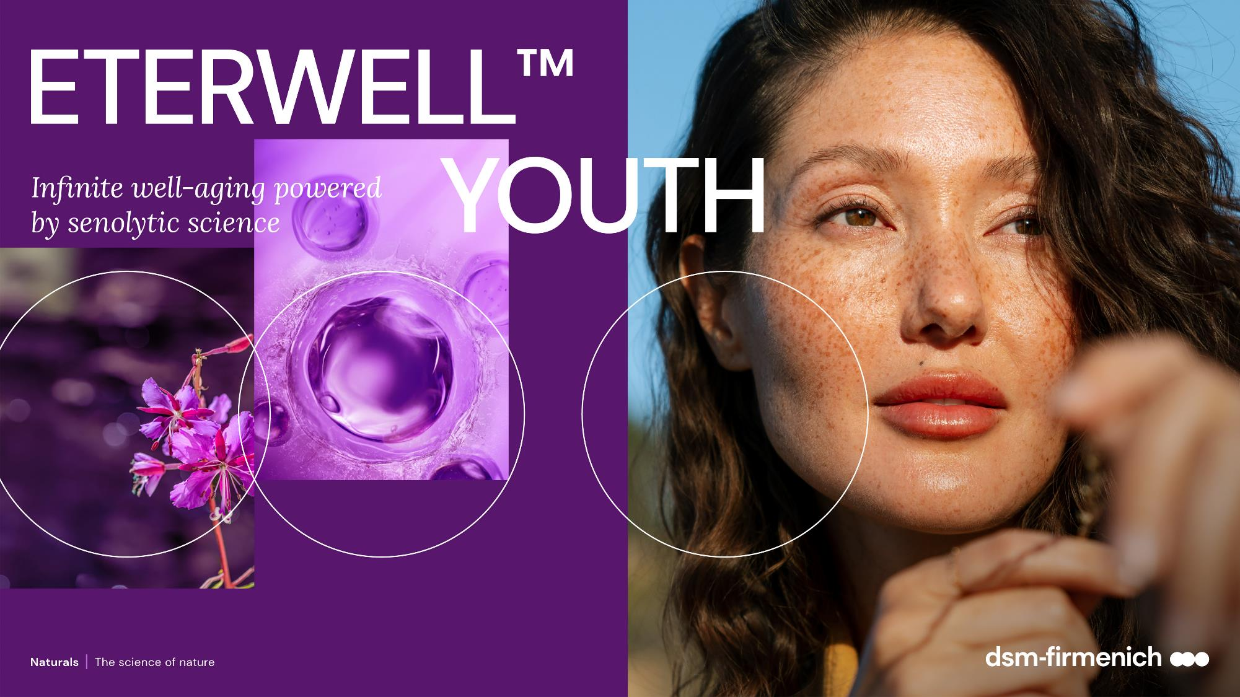
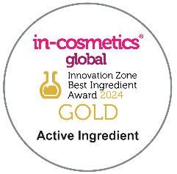





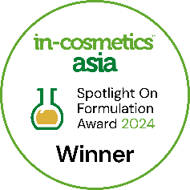

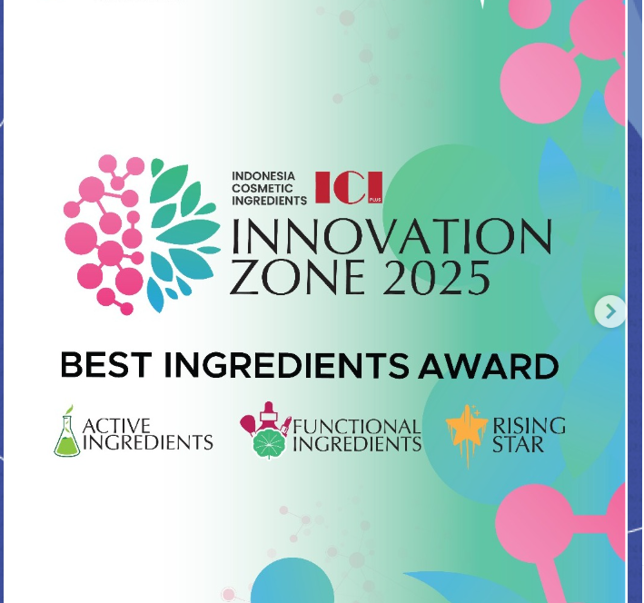

10x winner
Prestigious awards of Scientific excellence & innovation

Slide 3

ETERWELL™ YOUTH
Infinite well-ageing – fully effective at every skin layer
Key benefits
Holistic healthy ageing - acts at the cellular level†
Helps to revert skin damage induced by zombie cells†
Helps restoring and boosting collagen †
Synergetic potential with other actives on Collagen*
Helps slow down the premature ageing of skin*
Reverses the skin appearance by 6 years in just 2 weeks and 9 years after 3 months*
Reduces the appearance of fine lines and wrinkles*
Helps increase skin elasticity and skin smoothness*
Provides a rejuvenated skin appearance with vibrant healthy looking-skin
* In vivo. † In vitro and ex vivo.

Slide 4

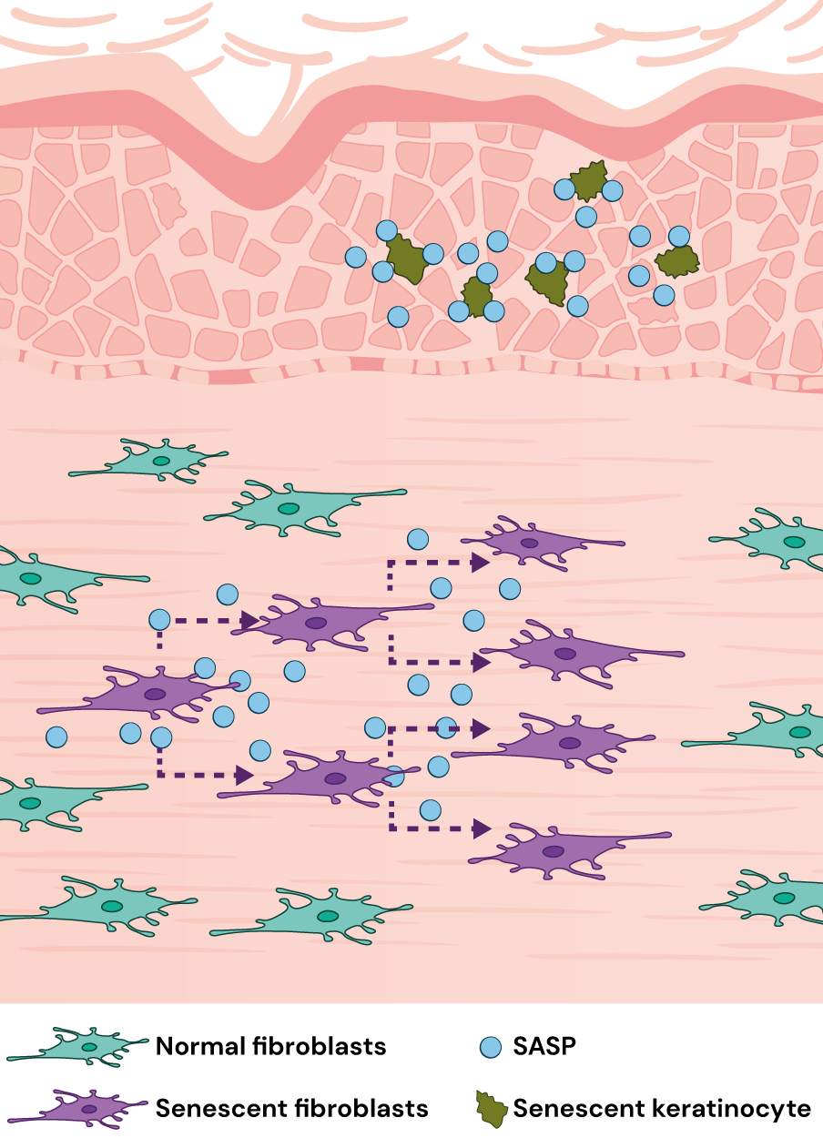
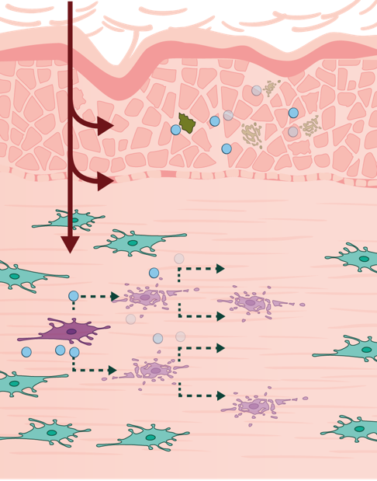
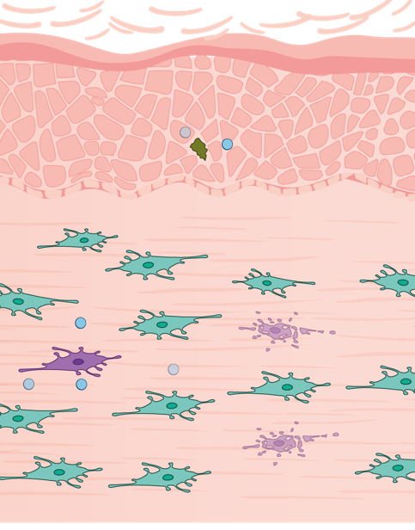
Mode of action
Senolytics is tackling the fundamental source of skin ageing, helping senescent (zombie) cells into apoptosis
Main senescence inducers:
Ageing
Exposome:
UV, pollution
Oxidants
Toxins
    ↑ Skin texture
    ↑ Improvement of physiological age by 6 years
    ↓ Skin roughness
  ↑ p 16 and p21
  ↓ p 16 and p21
Biological action*
Skin benefits
  ↑ Senescent cells
  ↑ DEJ: Skin structure (healthy undulations)
  ↓ SASPs (eg. IL1)
  ↑ SASPs
  ↓ Senescent cells
The senescent cells do not work anymore, release SAPs (Senescent-associated secretory phenotype) which are damaging the surrounding cells (snowball effect)
  ↑ Collagen
  ↑ Wrinkles
  ↑ Sagging skin
  ↑ Boosting effect of other actives
    ↑ Skin elasticity
    ↓ Appearance
    of wrinkles
* in vitro and ex vivo

Slide 5
ETERWELL™ YOUTH: true senolytic active
A new life for your skin
Direct senolytic effect:
-52% senescent fibroblasts with 0.0005%† ETERWELL™ YOUTH*
+200% increase of cell death after only 48 hours (Realtime visualisation)*
-46% p21 expression (senescence marker) at 0.024%†**
Outstanding active boosting effect
+40% Collagen I expression at 0.024%†**
+54% boosting activity of Retinol on Collagen 1 by ETERWELL™ YOUTH vs Retinol alone*
ETERWELL™ YOUTH
does not increase death of normal cells
† Dry exact. * In vitro. ** Ex vivo.
Notes:
.
Dry extract: ratio to be applied X40 to get the equivalence of commercial extract, for instance 0.0005%= 0.002% and 0.024% = 1%

Slide 6
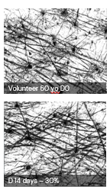
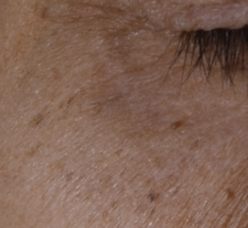
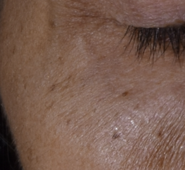
Holistic healthy ageing on 3 skin layers
Significant results vs placebo in vivo
Skin microrelief
wrinkle
Baseline
Holistic significant healthy ageing activities with 3% ETERWELL™ YOUTH vs placebo in vivo
+24% improvement of skin texture and smoothness after 2 weeks,. Skin appearance looks 6 years younger after 2 weeks
+22% improvement of skin undulation at the Dermal-Epidermal junction for a better skin structure after 3 months
+18% skin firmness, elasticity and bouncing improvement after 2 months
-17% wrinkle volume reduction on crow's feet after 3 months
3 months
Study design:
Two groups of 25 volunteers each (female with mixed skin ethnicities),
aged 45–60 yo, with an average at 55 yo.
Twice daily application with 3% ETERWELL™ YOUTH

Slide 7






ETERWELL® YOUTH
ID Card
INCI NAME:
Epilobium Fleischeri Leaf/Stem Extract (and glycerin, water, citric acid)
SUSTAINABILITY:
Organic cultivation, ethical and traceable sourcing, supporting alpine biodiversity with low impact on the environment
TECHNOLOGY:
Gentle ethanolic extraction of dried rare alpine Willowherb plant following green chemistry principles
Standardization in Flavonoids (as myricitrin)
100% of natural origin – no preservative
TECHNICAL:
Form: Liquid
pH of use: 3.5- 5.5
Use level: 1-3%
Preservative: Free
Solubility: Water
Biodegradable: readily biodegradable
BENEFITS:
Helps revert skin damage induced by zombie cells in excess*
Boost collagen*
Appearance of wrinkles are significantly reduced**
Restores the skin structure with improved skin elasticity and smoothness**
Increases skin resilience with skin texture rebirth**
Helps slow down the premature ageing of skin**
Provides a rejuvenated skin appearance with vibrant healthy looking-skin**
REGISTRATION
CERTIFICATION:
* in vitro ** in vivo

Slide 8
Disclaimer
Copyright © dsm-firmenich Switzerland AG, 2026, 4002 Basel, Switzerland.
www.dsm-firmenich.com. All rights reserved.
dsm-firmenich has used diligent care to ensure that the information provided herein is accurate and up-to-date to the best of its knowledge. However, dsm-firmenich makes no representation or warranty, either expressly or implied, of the accuracy, reliability, completeness, or suitability thereof. The information provided herein contains scientific and product information for business-to-business use and does not constitute or provide scientific or medical advice, diagnosis or recommendation for treatment options. Country or region-specific information should be considered when labelling or advertising to final consumer. In no event shall dsm-firmenich be liable for any direct or indirect damages arising from or reliance upon, or use of, any information provided herein. The content of this document is subject to change without further notice. Please contact your local dsm-firmenich representative for the latest information. All trademarks listed in this document are either (registered) trademarks of, or trademarks licensed by, the dsm-firmenich group of companies, unless explicitly stated otherwise.
Disclaimer Formulation Guideline
The information provided herein is provided for information purposes only and has been prepared by dsm-firmenich in accordance with its own methodology.
dsm-firmenich has used diligent care to ensure that it is accurate and up-to-date, however, dsm-firmenich makes no representation or warranty, either expressly or implied, of the accuracy, reliability, or completeness thereof. In no event shall dsm-firmenich be liable for any damages arising from or reliance upon, or use of, any information provided herein. Further, dsm-firmenich shall not bear any liability for the application and/or use of any processed material containing its product(s). The formulation of the finished product is the customer’s sole responsibility. It is the customer’s responsibility to determine the suitability of dsm-firmenich’s products regarding user specific purposes, assess compatibility and stability of their finished product(s) and to ensure compliance of their finished product(s) with relevant laws and regulations. Any product, marketing or other claims made by customer are its sole responsibility. The content of this document is subject to change without further notice. Please contact your local dsm-firmenich representative for further details. © dsm-firmenich Switzerland AG, 2026.
© 2026

