Slide 1
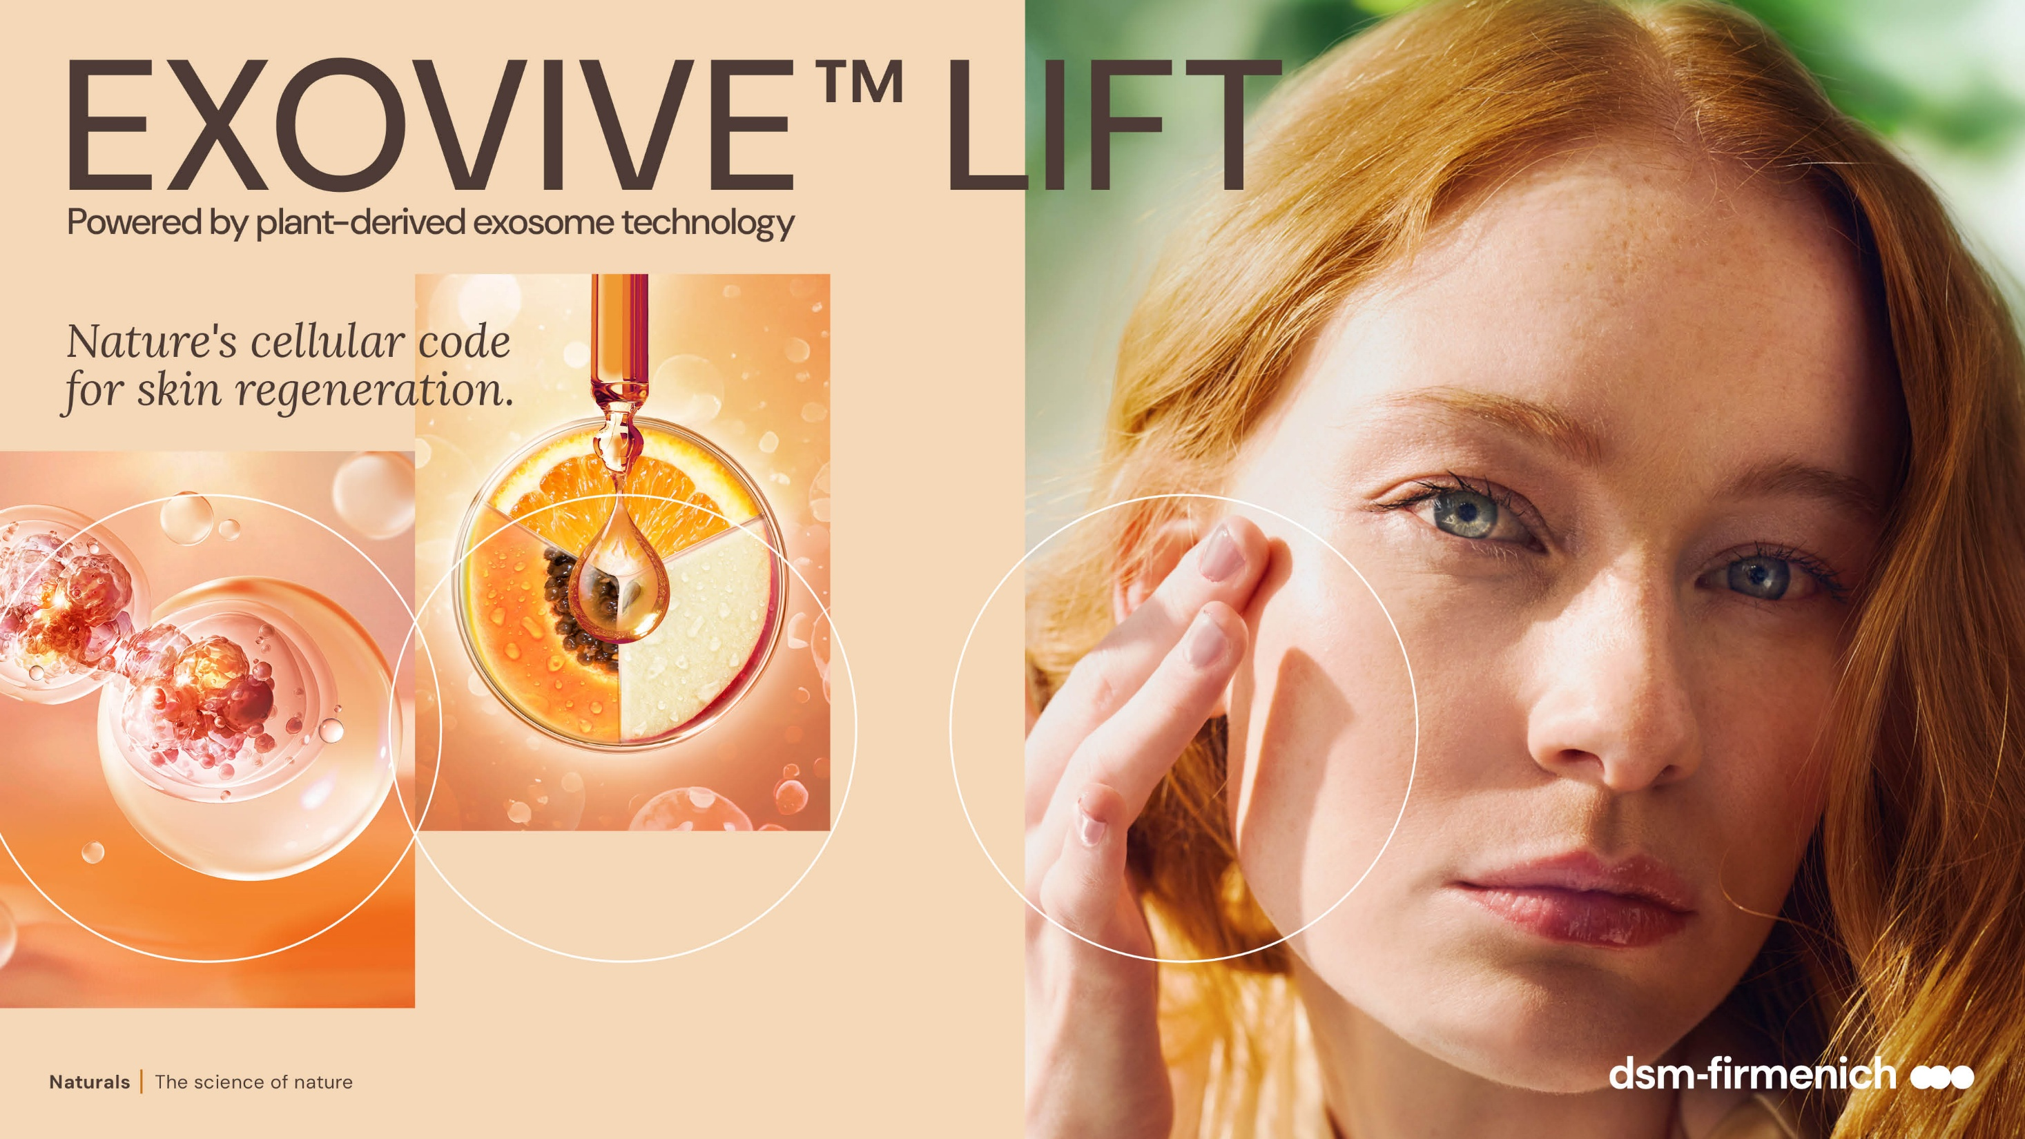

April 2026

Slide 2

Concepts &
Line-up

Slide 3


EXOVIVE™ LIFT brings possibilities to connect with brands from different market spaces.
Here we land two different propositions for the same ingredient.
3

Slide 4
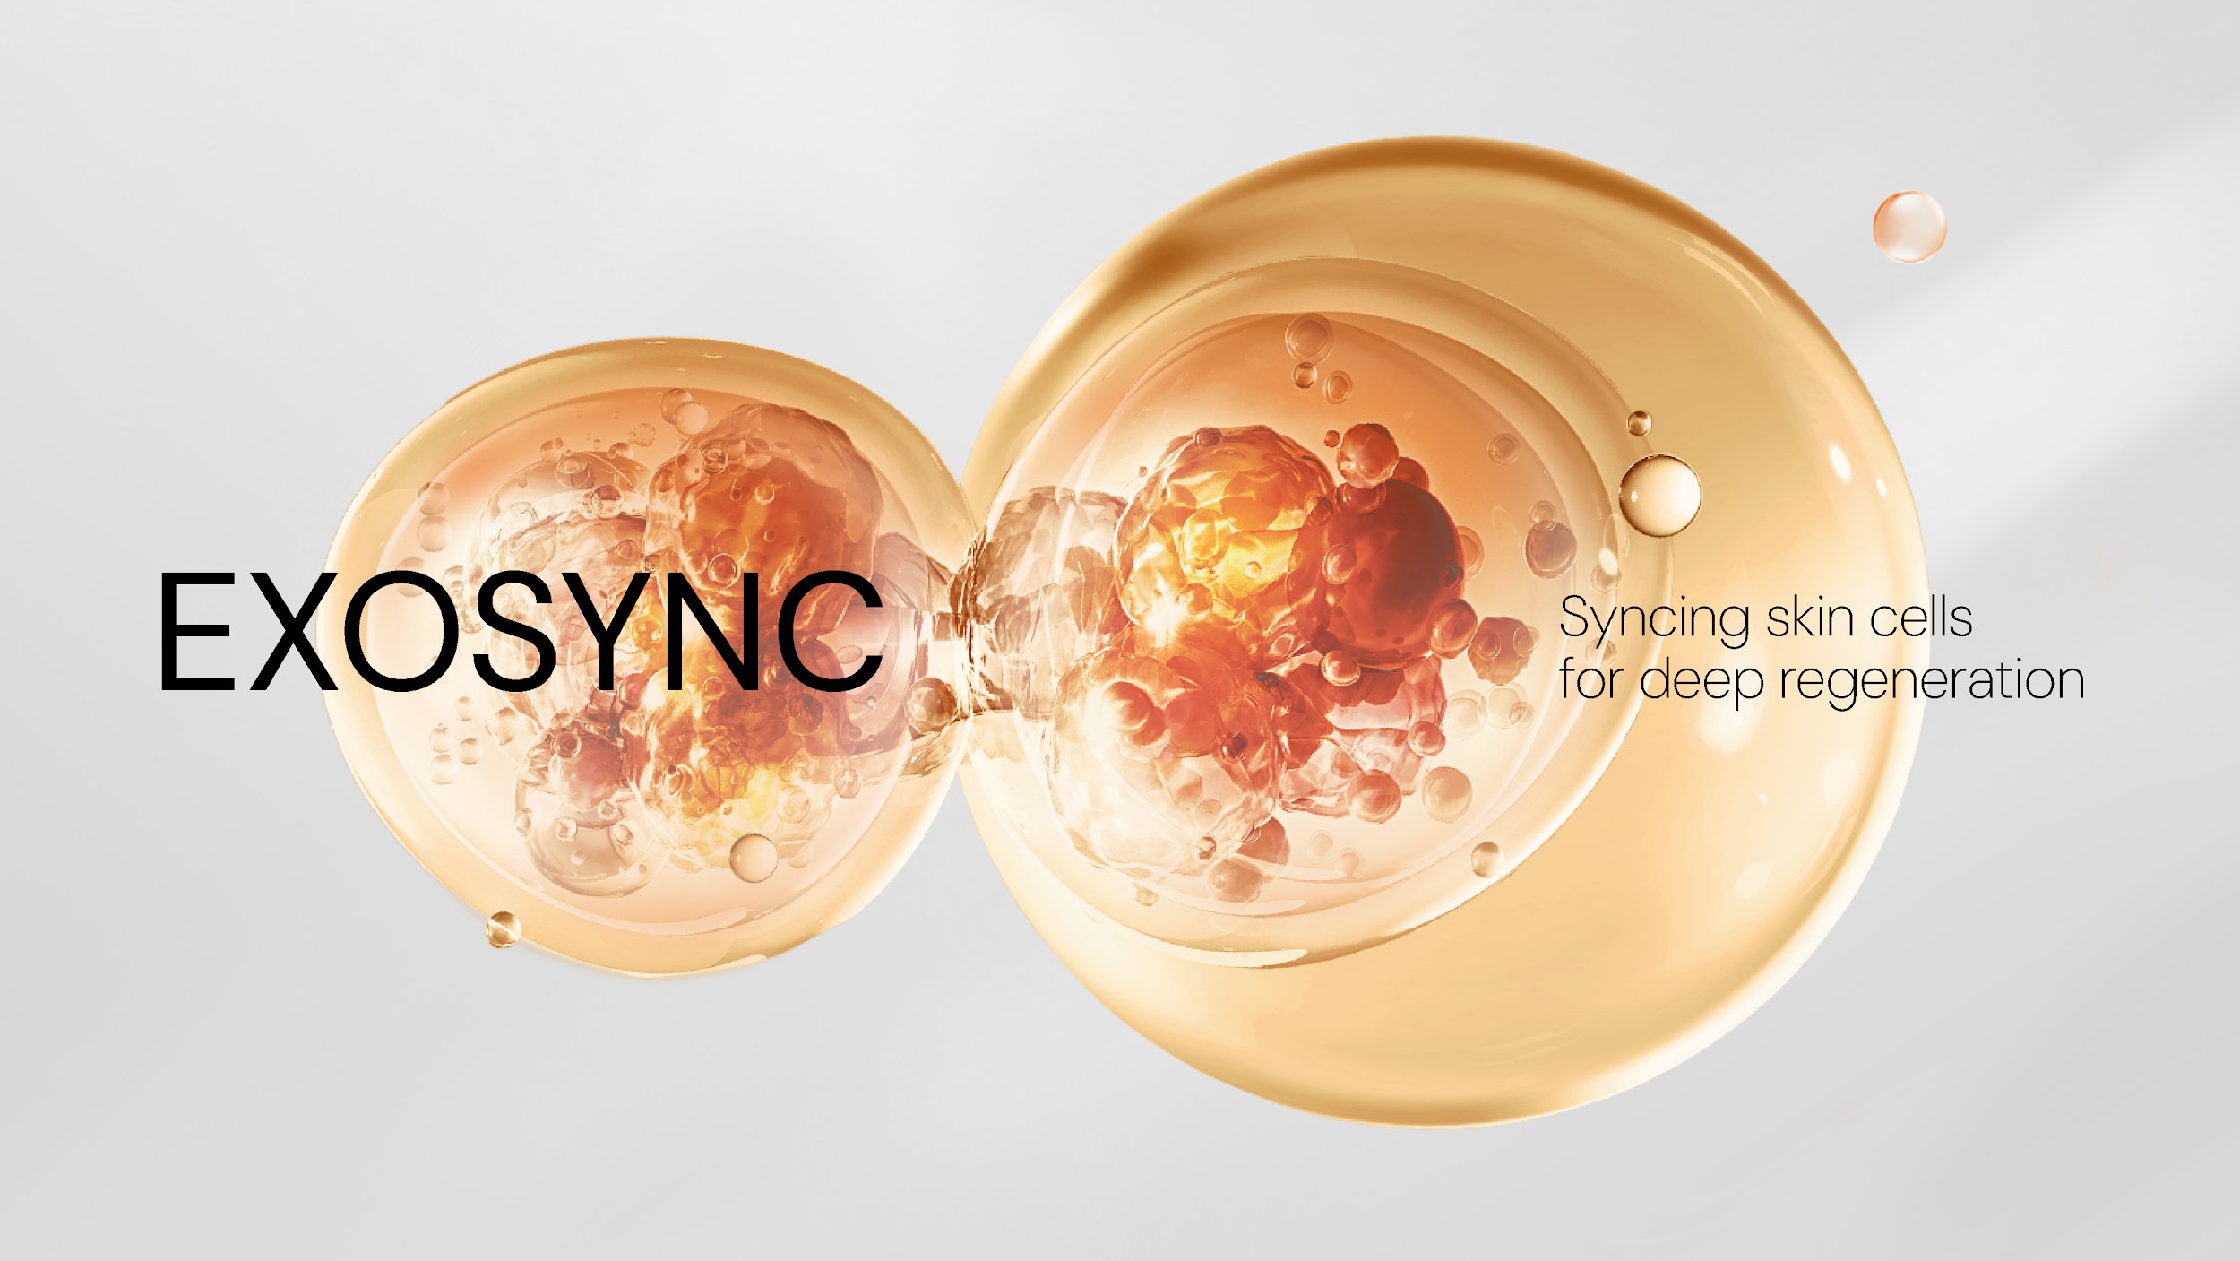

Slide 5
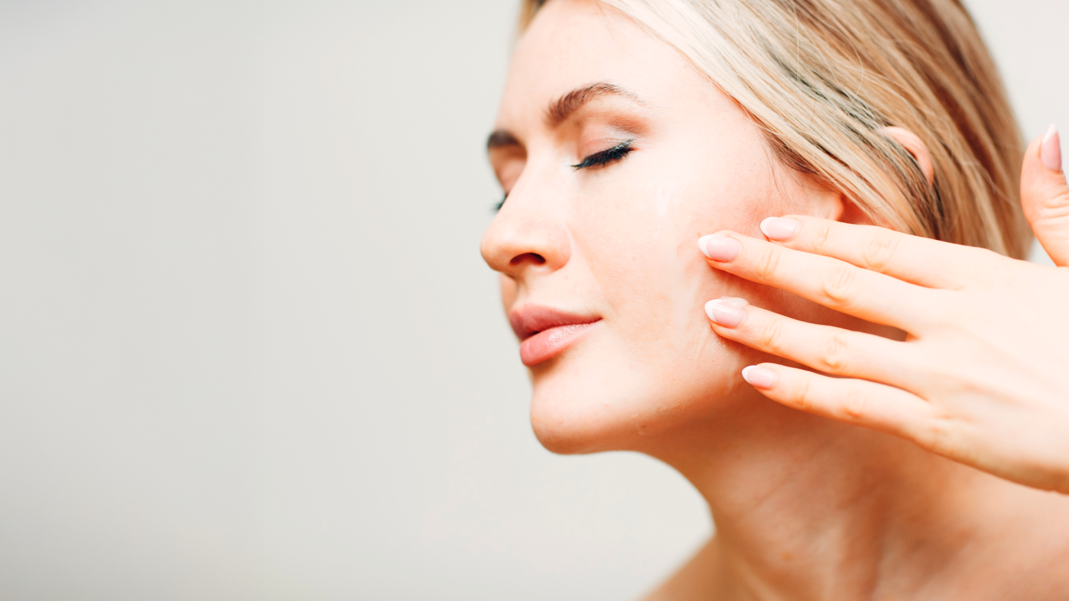



Is it possible to speak the native language
of youthful skin? Exosome science says yes.
The skin is a living network of cells, constantly communicating through microscopic messengers called exosomes. When cells stop talking, skin begins to age. Aging, at its core, is a communication breakdown. When cells stop talking, skin begins to age. But this dialogue can be restored.
Intercellular communication within plants happens in the same way. Powered by the innovative EXOVIVE™ LIFT, the EXOSYNC line combines cutting-edge
dermo-medical science with dsm-firmenich’s
expertise in decoding the intelligence of nature.
Plant-derived exosomes - pure actives condensed in
a cell-like membrane that penetrates easily - mirror the skin's own communication system to reactivate cellular dialogue, delivering the performance of professional treatments in your daily routine.
The result? Visible skin renewal and a more youthful, sculpted look. Or, in other words: the future of natural skincare science.

Slide 6
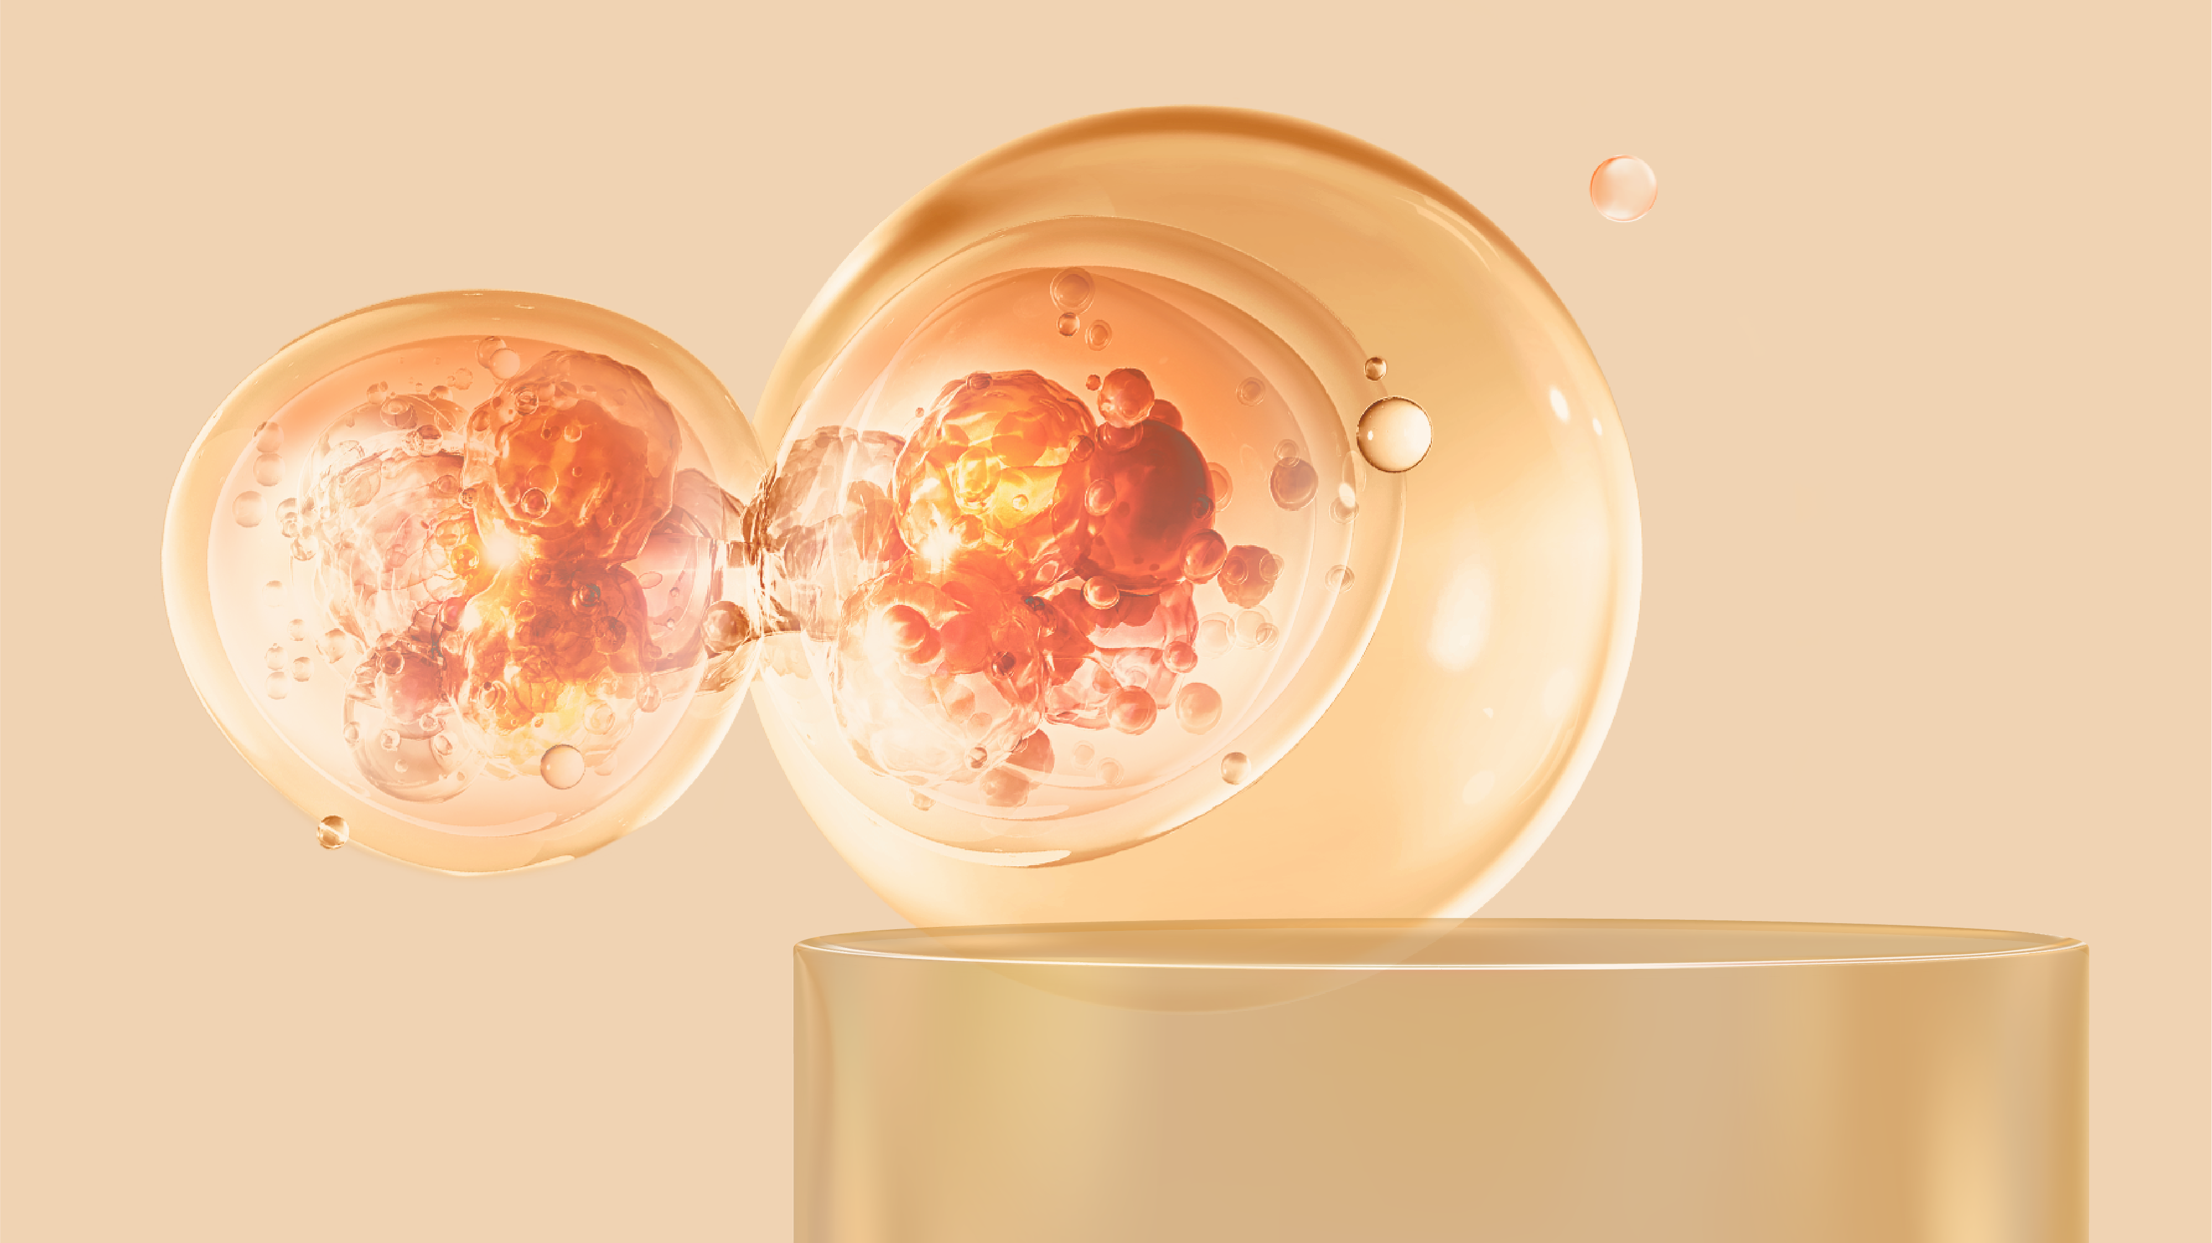
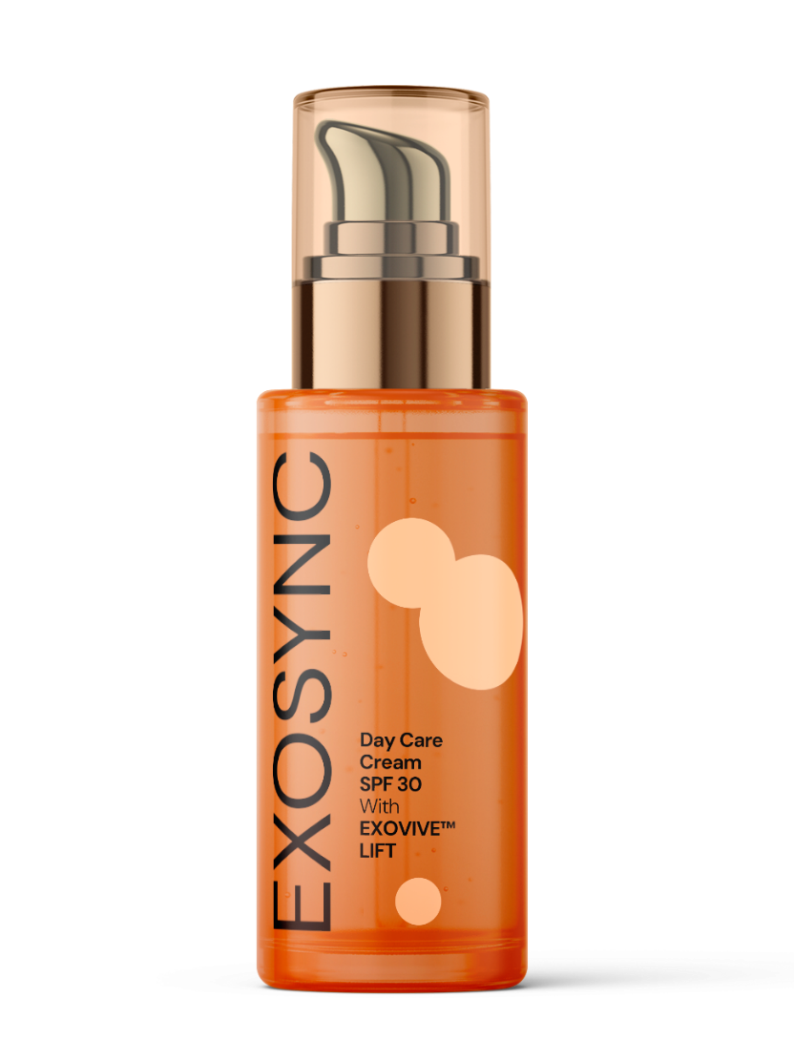
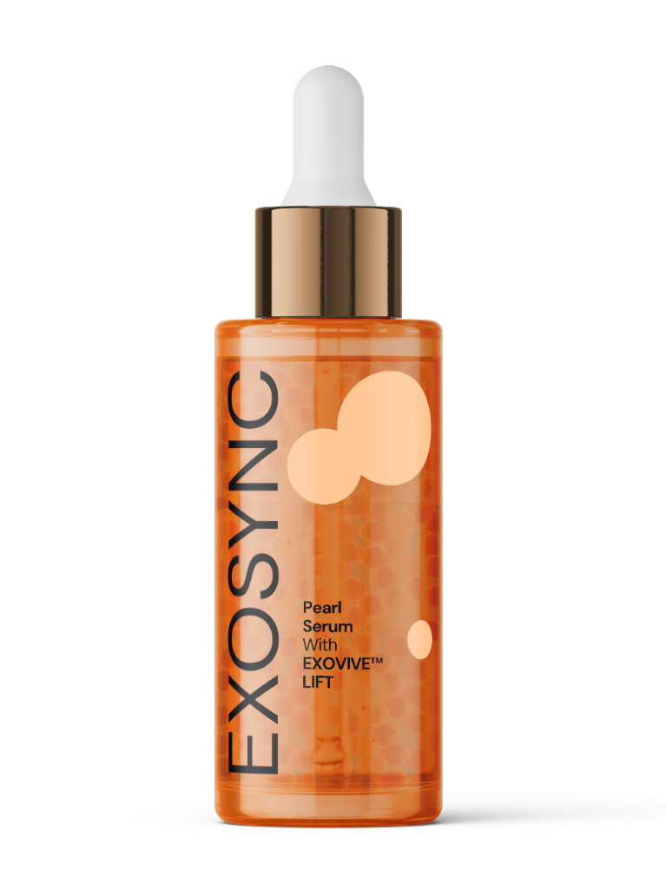
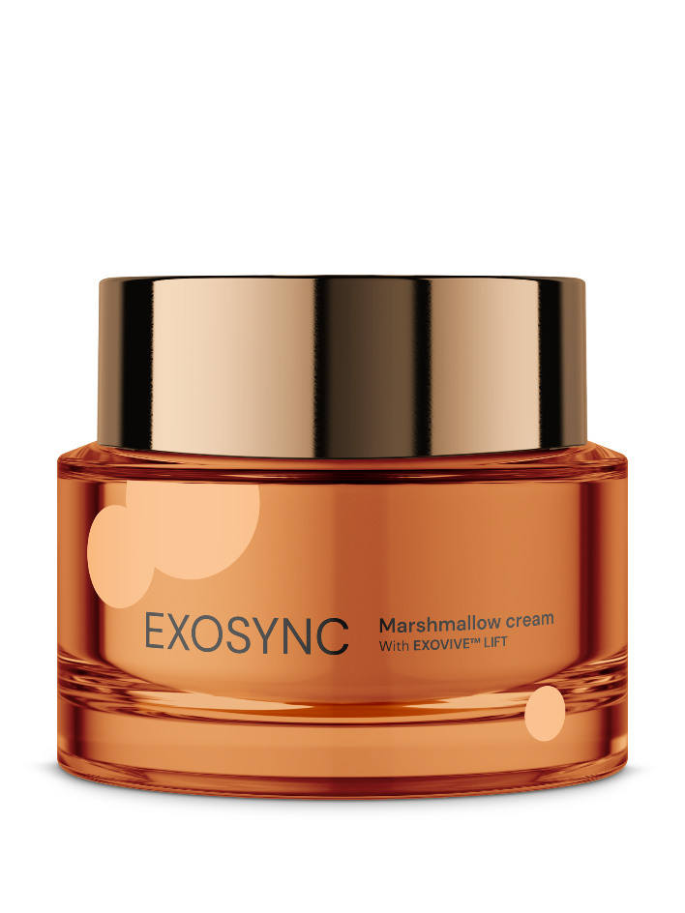


Slide 7
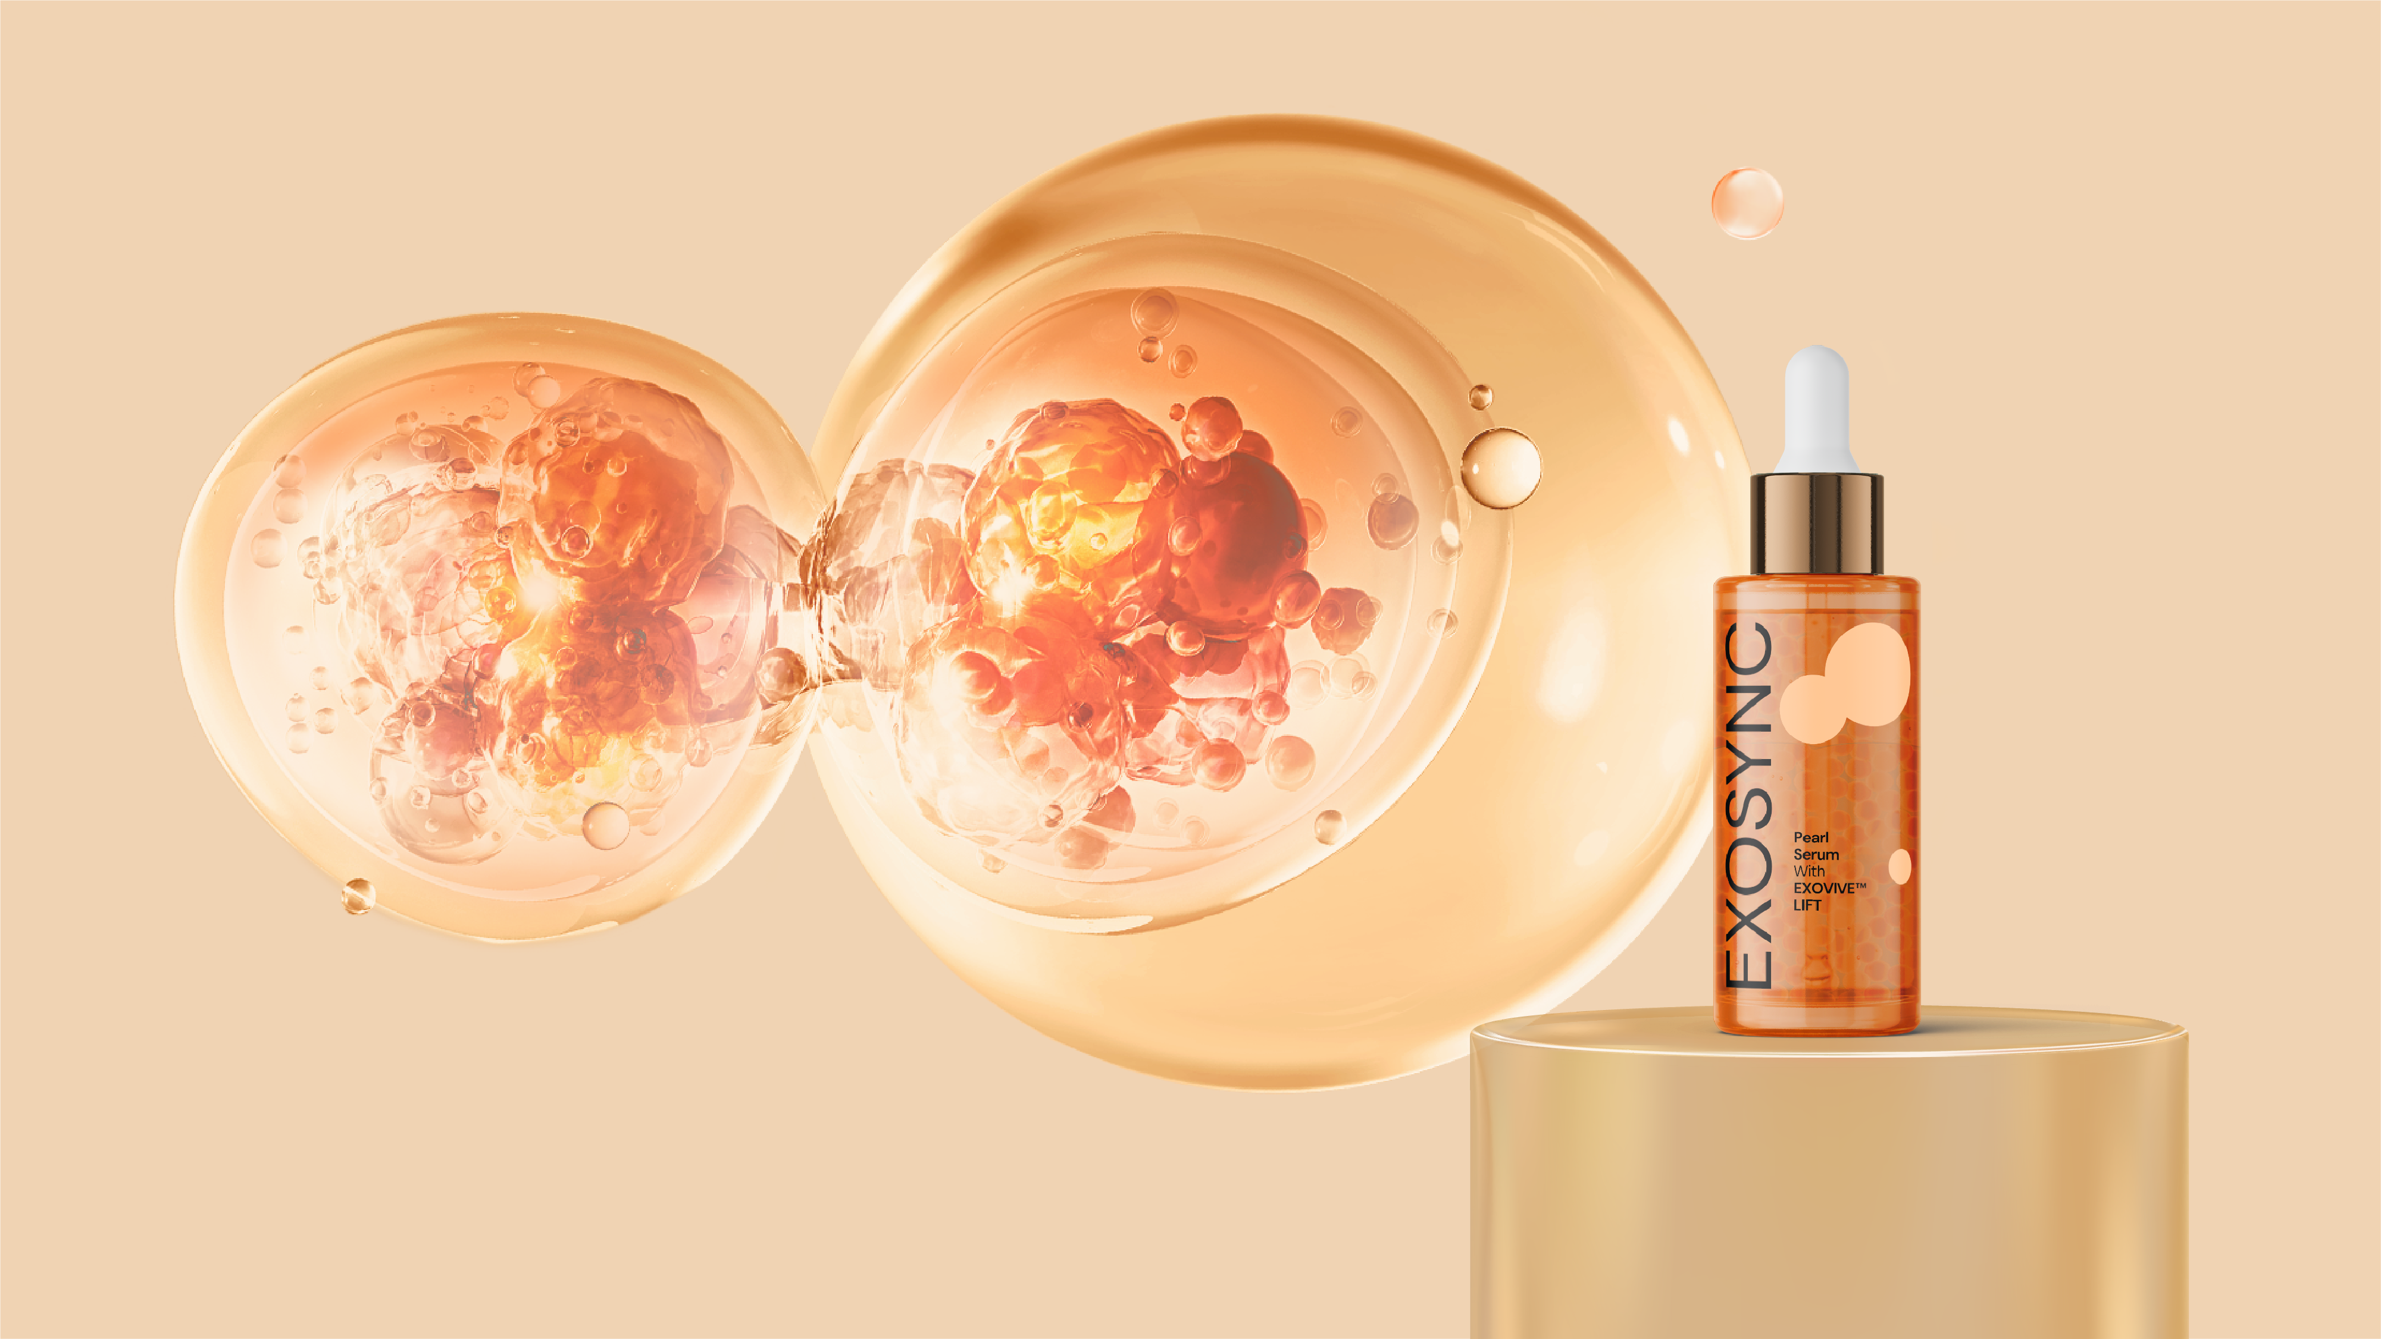
Reverses 8 years of wrinkles
Up to +30% skin’s elasticity
+90% Collagen I boost
with EXOVIVE™ LIFT
Syncing skin cells
for deep regeneration
Pearl Serum
Pearl Serum is a luxurious concentrate that enhances skin elasticity and firmness. Infused with EXOVIVE™ LIFT and the collagen-boosting duo SYN®-COLL CB and ETERWELL™ YOUTH, it delivers powerful anti-aging benefits. Luminous pearls release potent actives upon application, restoring skin’s youthful bounce and vitality.

Slide 8
Reverses 8 years of wrinkles
Up to +30% skin’s elasticity
+90% Collagen I boost
with EXOVIVE™ LIFT
Syncing skin cells
for deep regeneration
Pearl Serum
SK-E-102856-31
Ingredients: AQUA, ALGIN, GLYCERIN, PENTYLENE GLYCOL, SYN®-COLL CB (1%), ETERWELL™ YOUTH (1%), C13-14 ALKANE, POLYGLYCERYL-6 CAPRYLATE, POLYGLYCERYL-4 CAPRATE, POLYACRYLATE CROSSPOLYMER-6, CAPRYLYL GLYCOL, BIS-POLYCITRONELLYL SUCCINATE, SODIUM PHYTATE, UNDECANE, MICA, PINK BLOSSOM P02R418 (0.05%), EXOVIVE™ LIFT (0.026%), IRON TITANIUM OXIDE, SILICA, CI 77891, TIN OXIDE

Slide 9
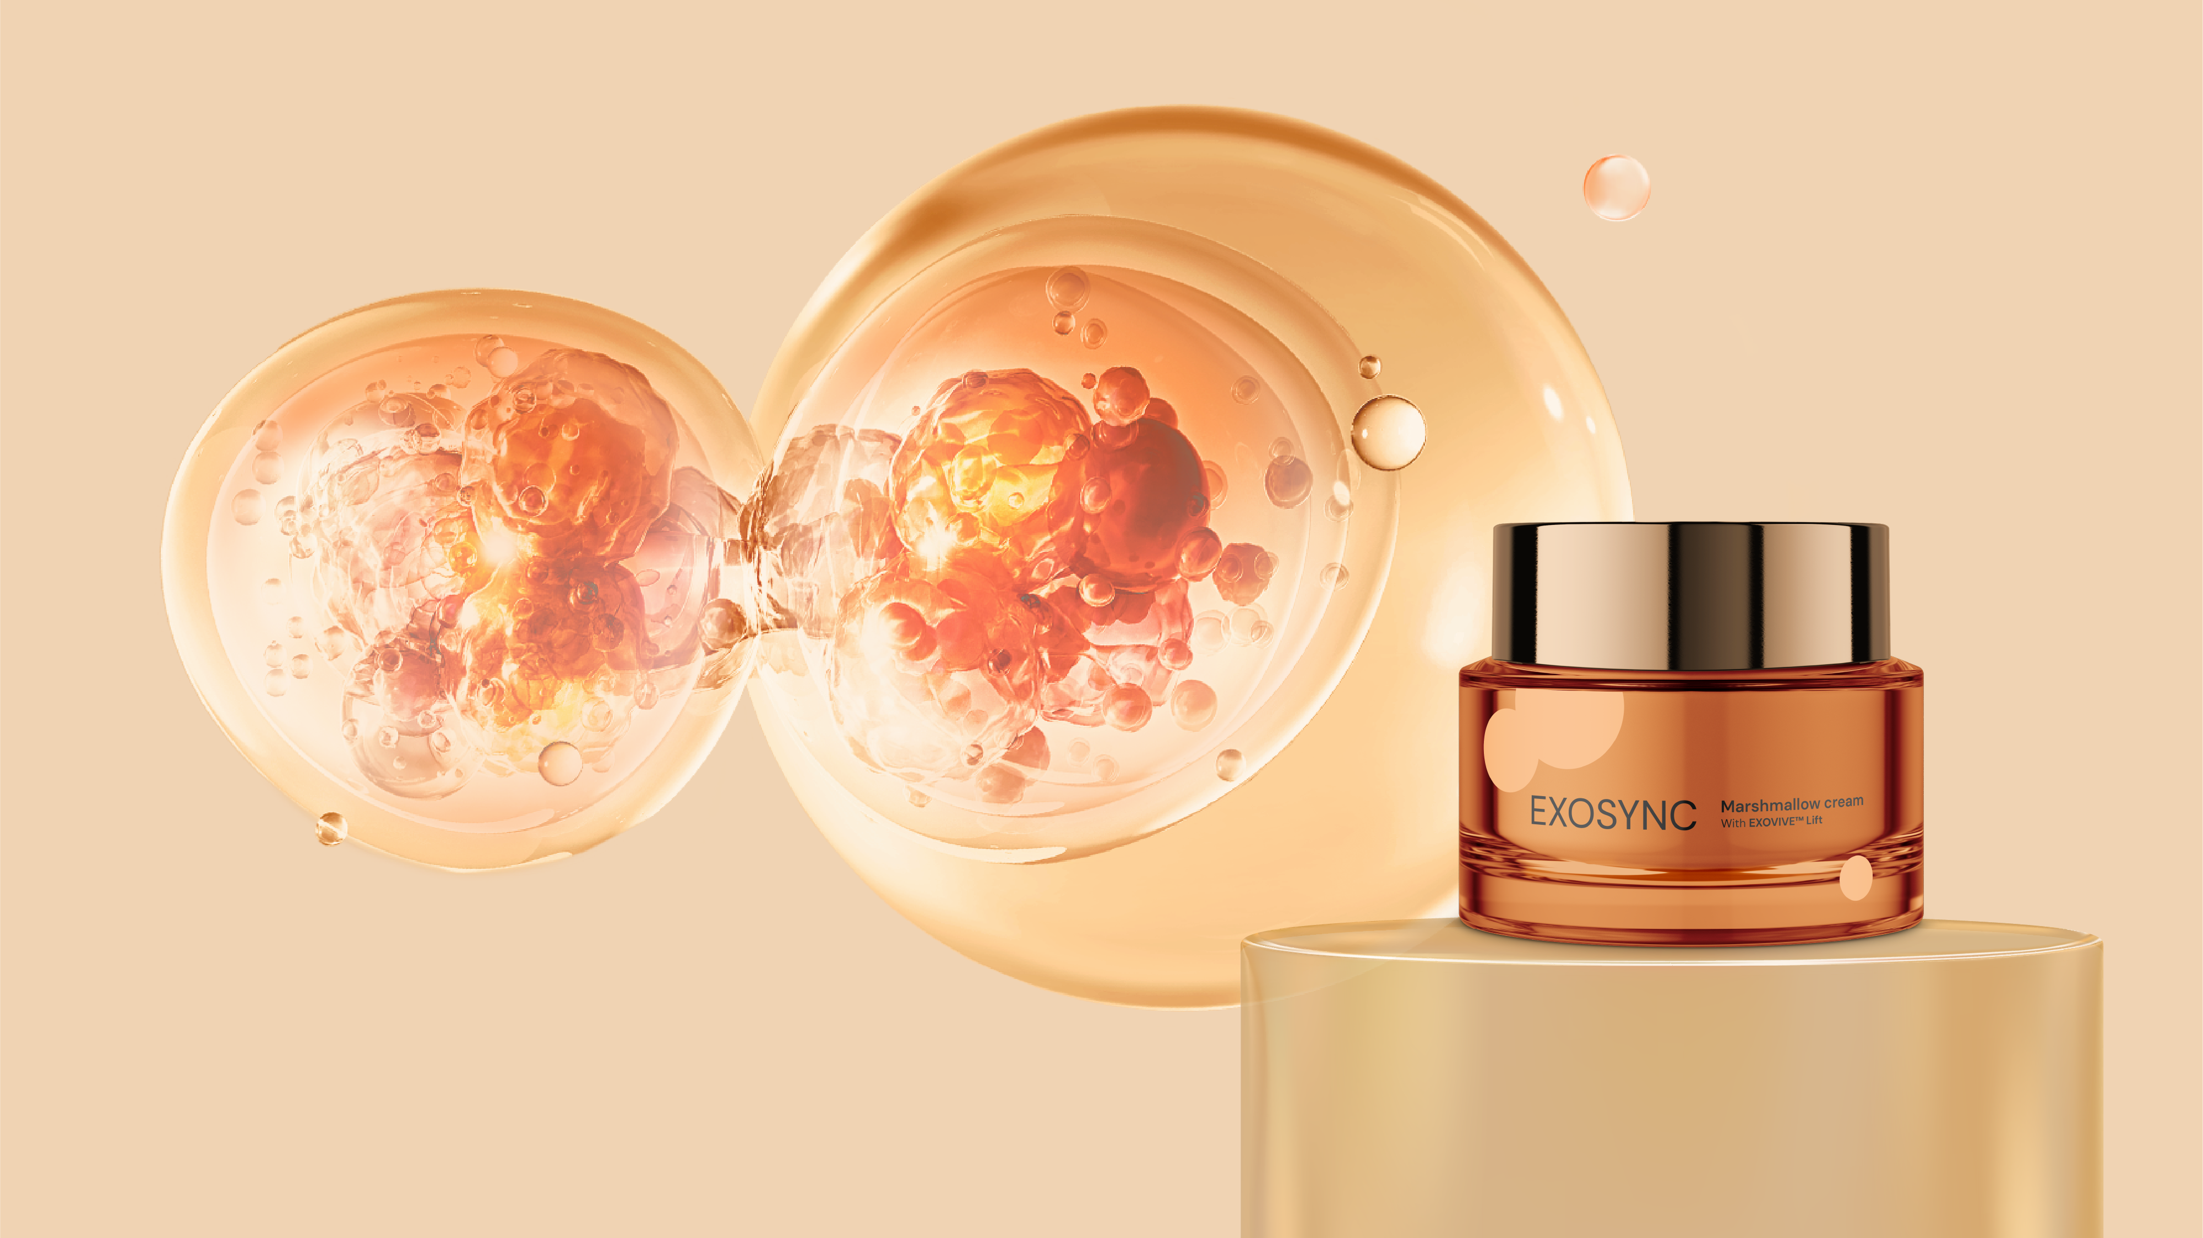

with EXOVIVE™ LIFT
Reverses 8 years of wrinkles
Up to +30% skin’s elasticity
+90% Collagen I boost
Syncing skin cells
for deep regeneration
Marshmallow Cream
SK-E-102649-23
Ingredients: AQUA, PROPANEDIOL, MACADAMIA INTEGRIFOLIA/TETRAPHYLLA SEED OIL, ORYZA SATIVA BRAN OIL, BUTYLENE GLYCOL, GLYCERYL BEHENATE, Niacinamide PC (3%), POLYGLYCERYL-6 DISTEARATE, CANDELILLA/JOJOBA/RICE BRAN POLYGLYCERYL-3 ESTERS, JOJOBA ESTERS, ARGAN OIL (1%), STIMU-TEX® AS (1%), POTATO STARCH MODIFIED, ACACIA DECURRENS FLOWER CERA, Mixed Tocopherols 95 (0.5%), HYA-ACT™ XS (0.5%), CAPRYLYL GLYCOL, GLYCERYL CAPRYLATE/CAPRATE, CETYL HYDROXYETHYLCELLULOSE, PINK BLOSSOM P02R418 (0.3%), EXOVIVE™ LIFT (0.026%), GLYCERIN, POLYGLYCERIN-3, CITRIC ACID, HELIANTHUS ANNUUS SEED CERA

Slide 10
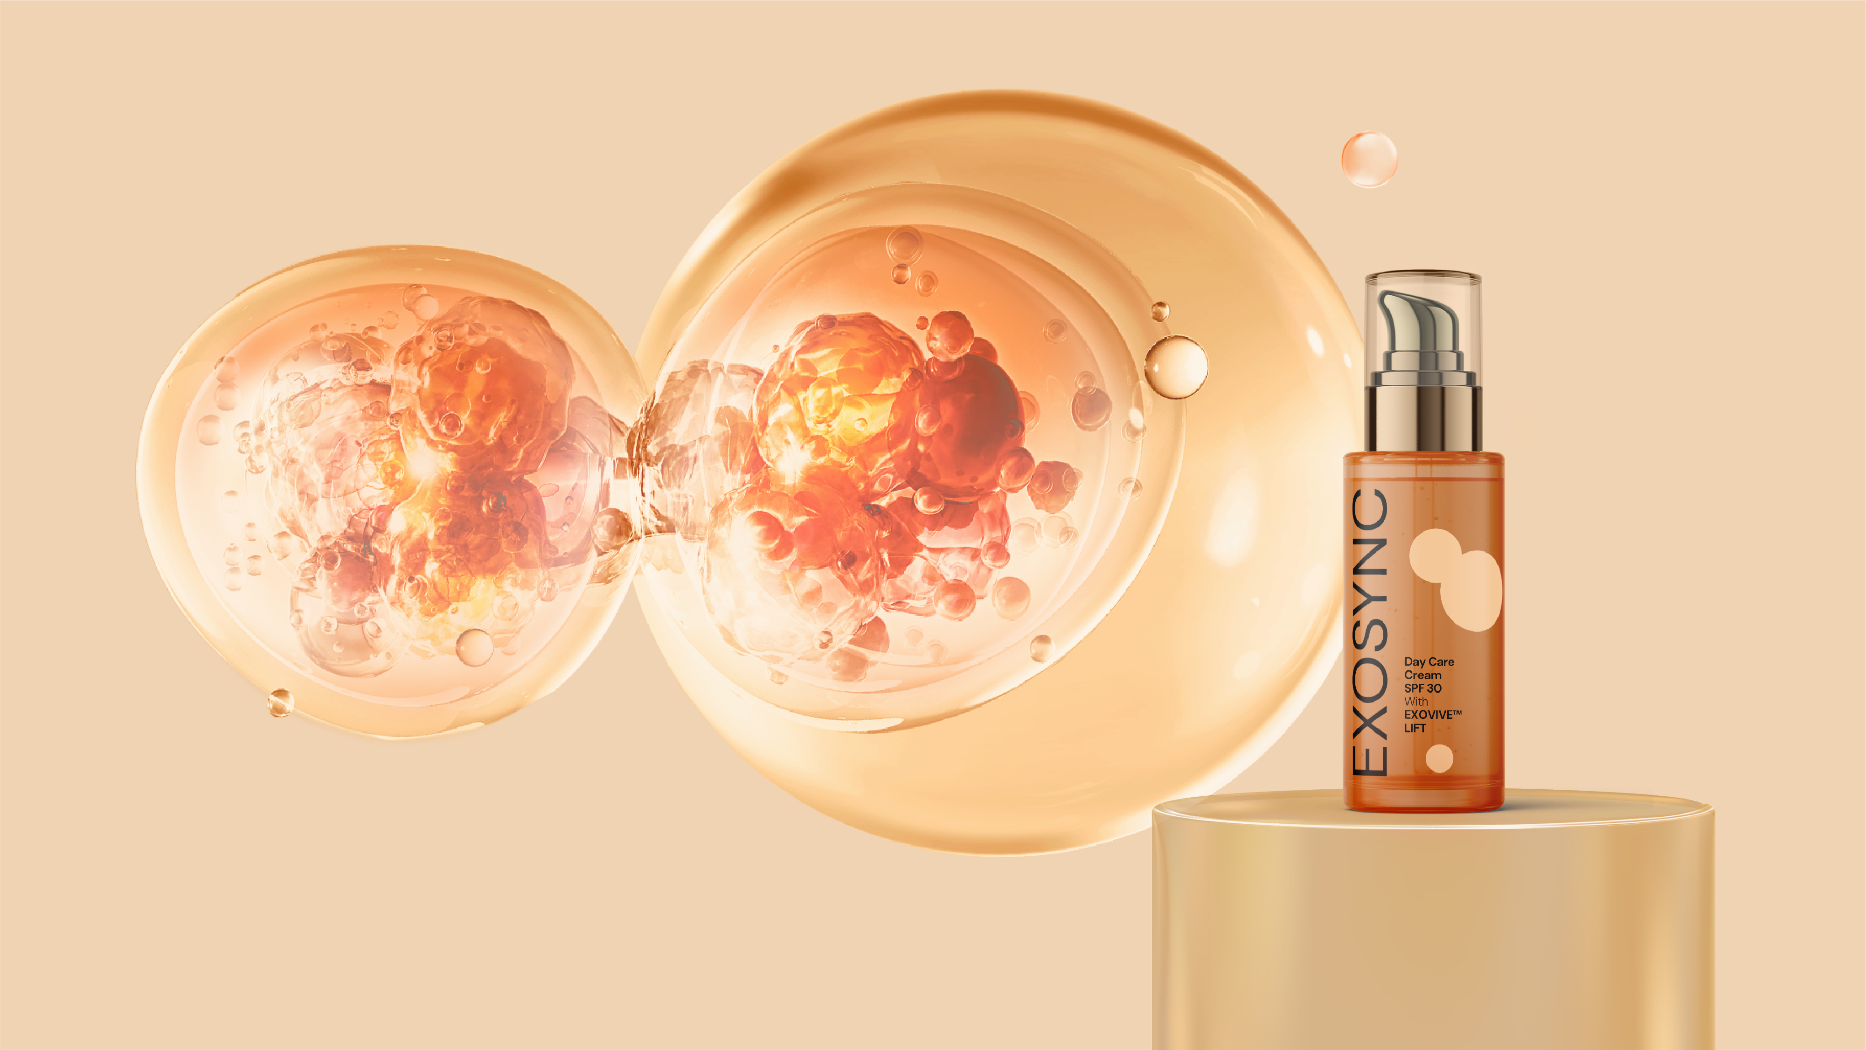
Reverses 8 years of wrinkles
Up to +30% skin’s elasticity
+90% Collagen I boost
with EXOVIVE™ LIFT
Syncing skin cells
for deep regeneration
Day Care Cream SPF 30
Day Care Cream SPF 30 is a high-performance daily moisturizer designed to protect the skin with a high eco-profile scire. It features EXOVIVE™ LIFT, and its exosome technology that enhances skin firmness and elasticity and a modern PARSOL® UV-filter system that efficient sun protection. Also enriched with the natural biotech duo REGU®-AGE CB and PEPHA®-CTIVE CB, delivering visible smoothness and radiance, making it an ideal choice for new generation natural science.

Slide 11
Reverses 8 years of wrinkles
Up to +30% skin’s elasticity
+90% Collagen I boost
with EXOVIVE™ LIFT
Syncing skin cells
for deep regeneration
Day Care Cream SPF 30
SK-E-102807-14
Ingredients: AQUA, DICAPRYLYL CARBONATE, PARSOL® DHHB (6%), C12-15 ALKYL BENZOATE, ISOPROPYL LAUROYL SARCOSINATE, PROPANEDIOL, PARSOL® EHT (5%), PARSOL® Shield (2%), PEPHA®-CTIVE CB (2%), REGU®-AGE CB (2%), POLYGLYCERYL-10 STEARATE, VALVANCE® Touch 210 (1%), BEHENYL ALCOHOL, CAPRYLYL GLYCOL, PINK BLOSSOM P02R418 (0.5%), XANTHAN GUM, GLYCERYL CAPRYLATE, MICA, CITRIC ACID, CI 77891, EXOVIVE™ LIFT (0.026%), CI 77491, TOCOPHEROL

Slide 12

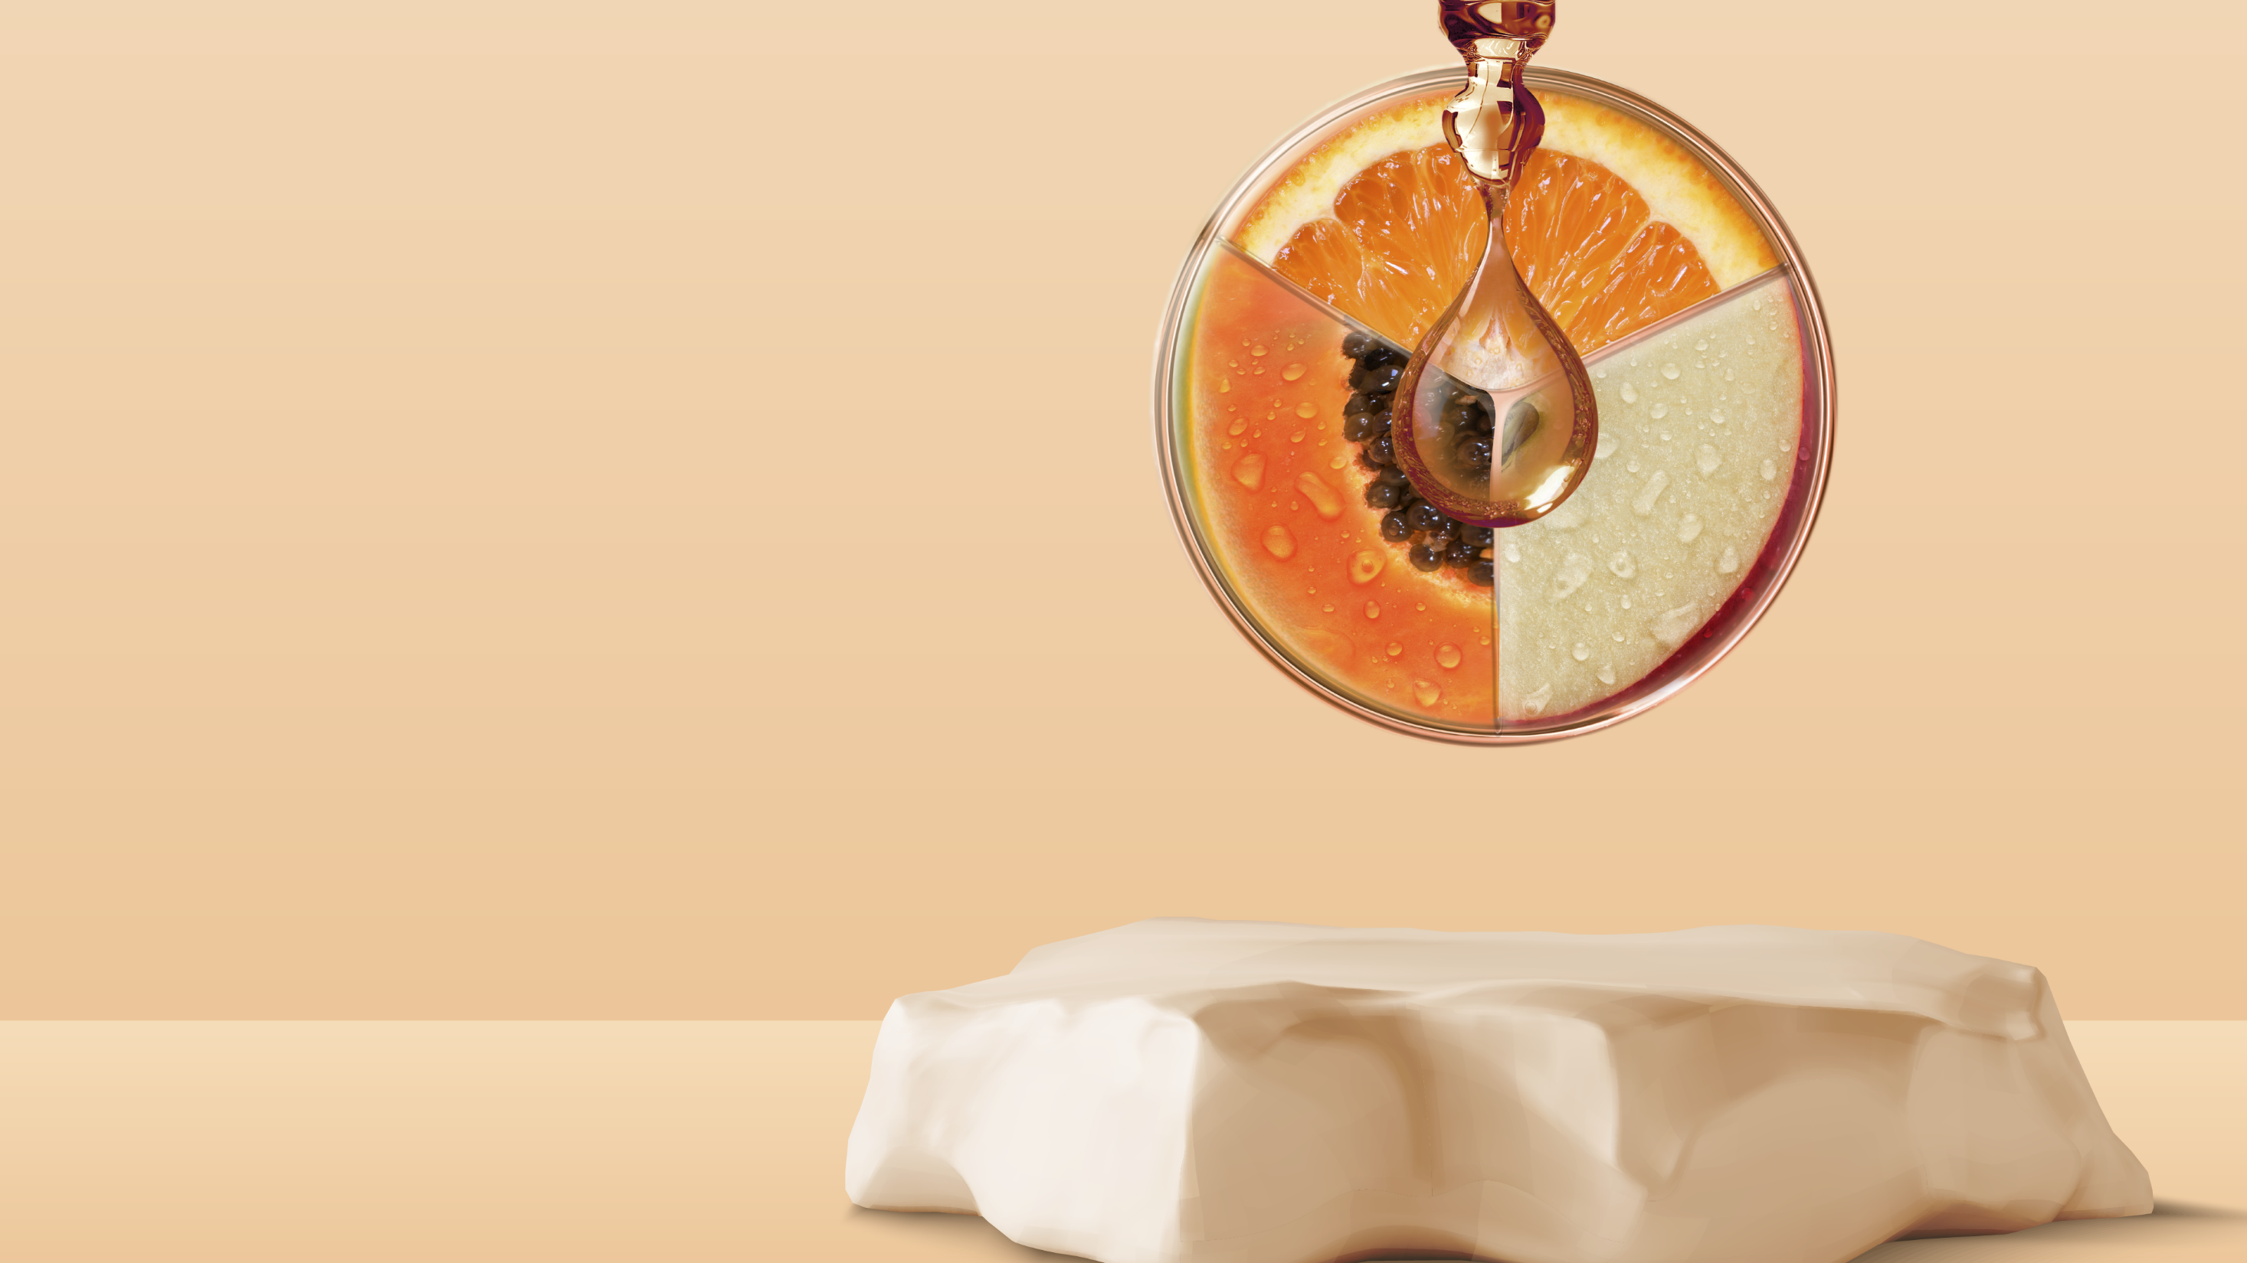


with EXOVIVE™ LIFT
Syncing skin cells
for deep regeneration
PINK BLOSSOM P02R418
Premium olfactive experience.
Youth quintessence captured in a fragrance
Floral notes are giving vibrancy & elegance to the fragrance, while AMBROX® captive with unparalleled depth, exudes a timeless natural sensuality.
powered with emotiboost® accord, neuroscientifically proven to make you feel confident.
top: red fruits pear peach
mid: rose muguet violet
fond: musky vanilla powdery
Notes:
TECHNO: powered with emotiboost™ accord, designed* to make you feel confident, that supports the idea of premium application, emotional benefit good for mature skins

Slide 13

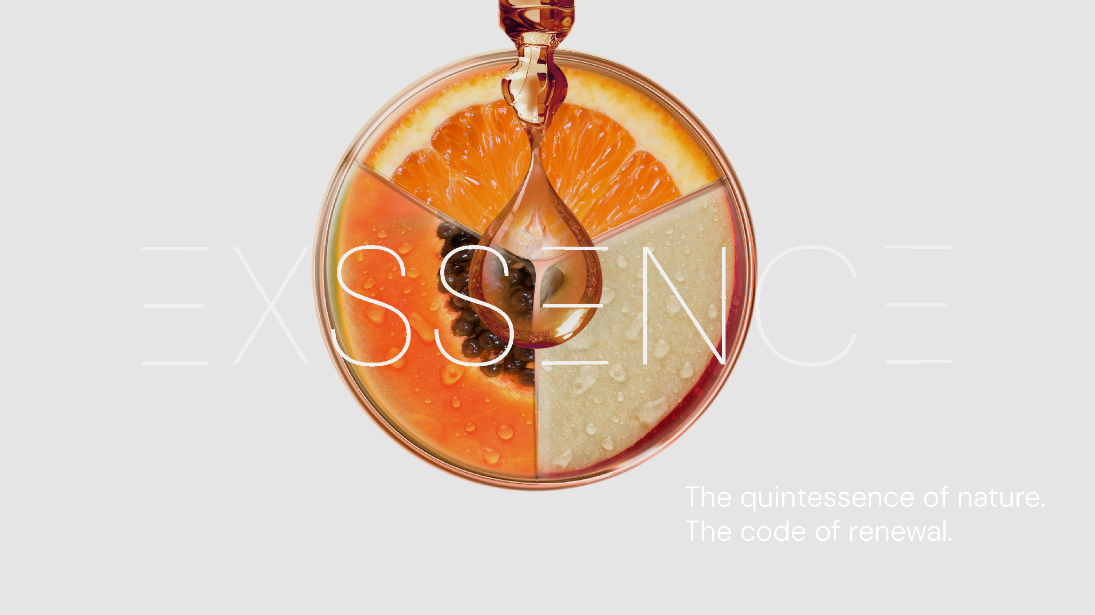

Slide 14
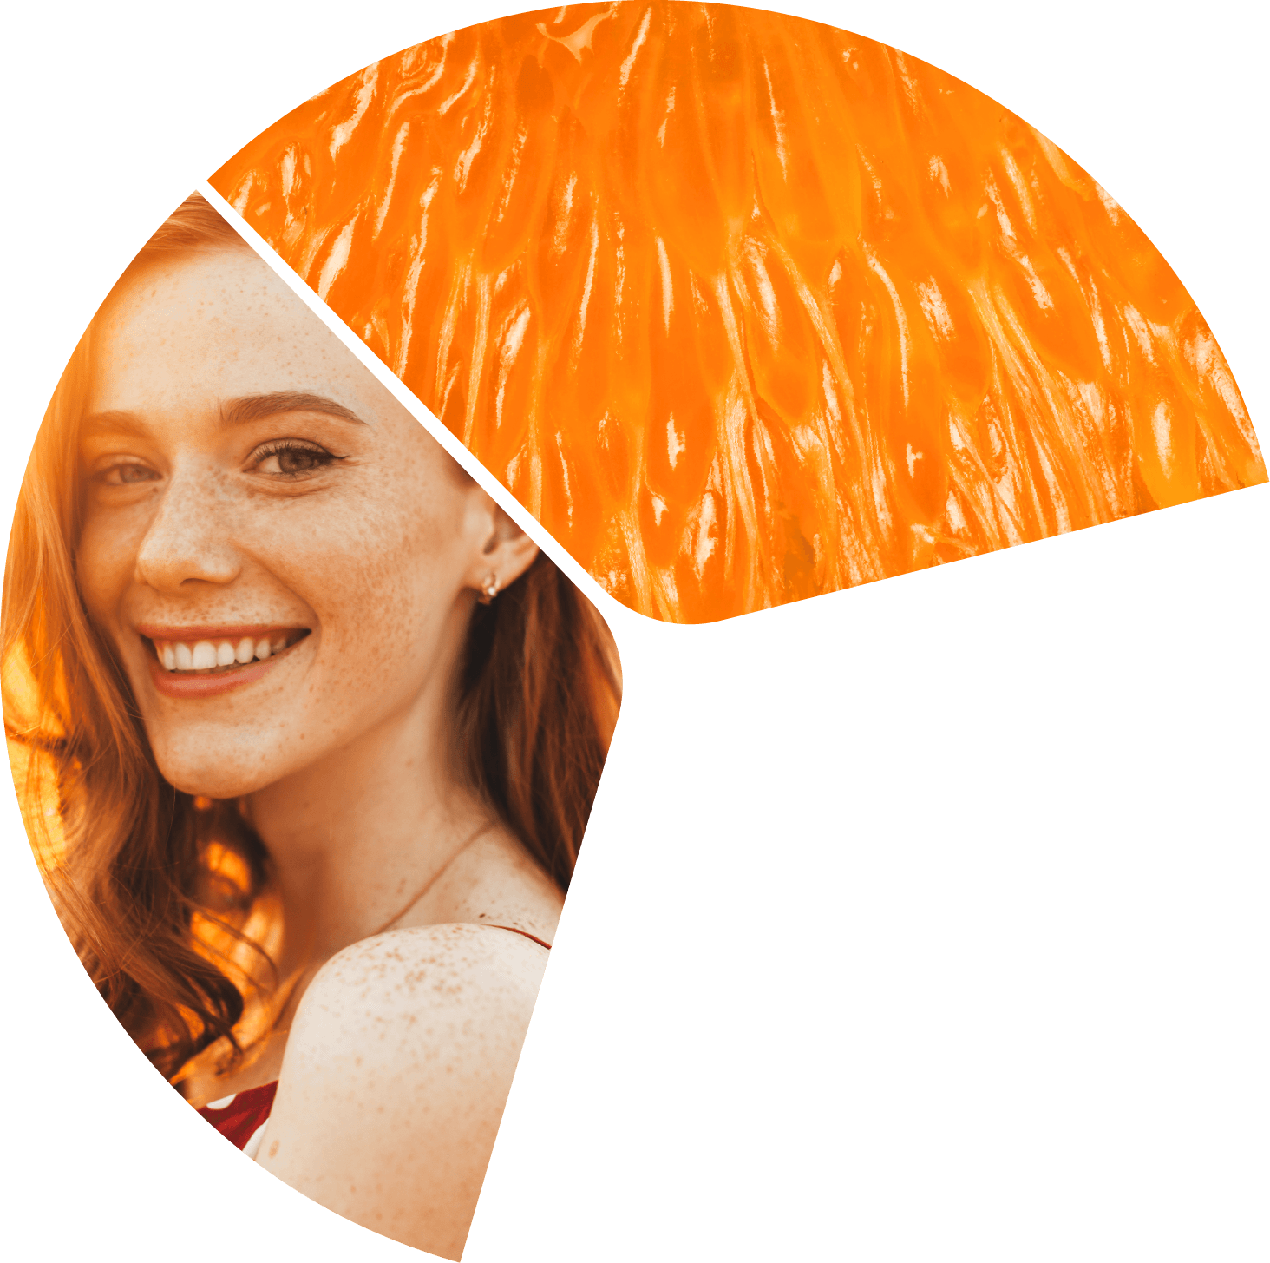

The quintessence of nature.
The code of renewal.

Slide 15
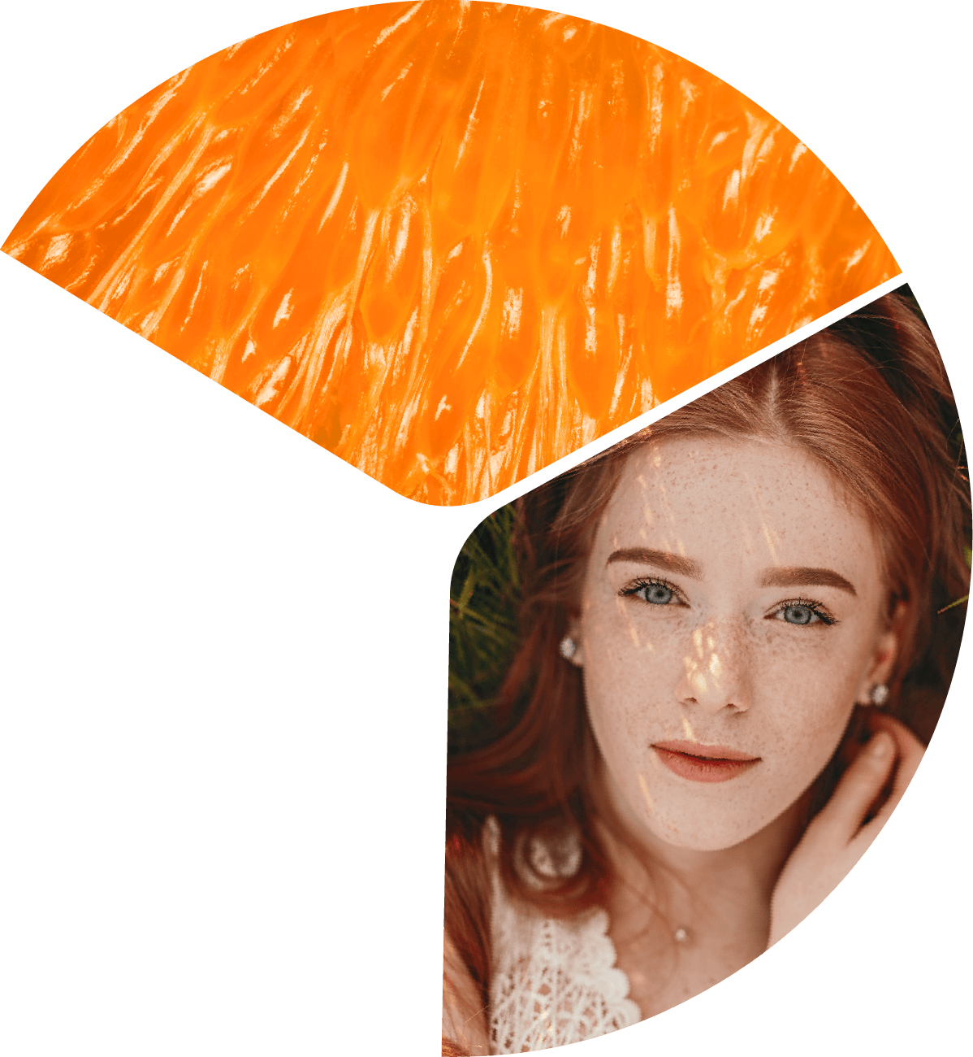
The quintessence of nature.
The code of renewal.
What if nature could speak directly to your skin?
Exosome science says yes. The skin is a living network of cells, constantly communicating through microscopic messengers called exosomes Aging, at its core, is a communication breakdown. When cells stop talking, skin begins to age. But this dialogue can be restored.
Intercellular communication within plants happens in the same way. Powered by the innovative EXOVIVE™ LIFT, the Exssence line captures the quintessence of nature to resume skin cells communication. Carefully sourced from organic natural origins, plant-derived exosomes are preserved at full
potency through dsm-firmenich's sustainable patented extraction process. Like perfectly crafted puzzle pieces, they integrate harmoniously with your skin's own communication system, reactivating the cellular communication and supporting natural regeneration.
The result? Skin that glows with vitality, sculpted and youthful. The pinnacle of natural skincare science.

Slide 16
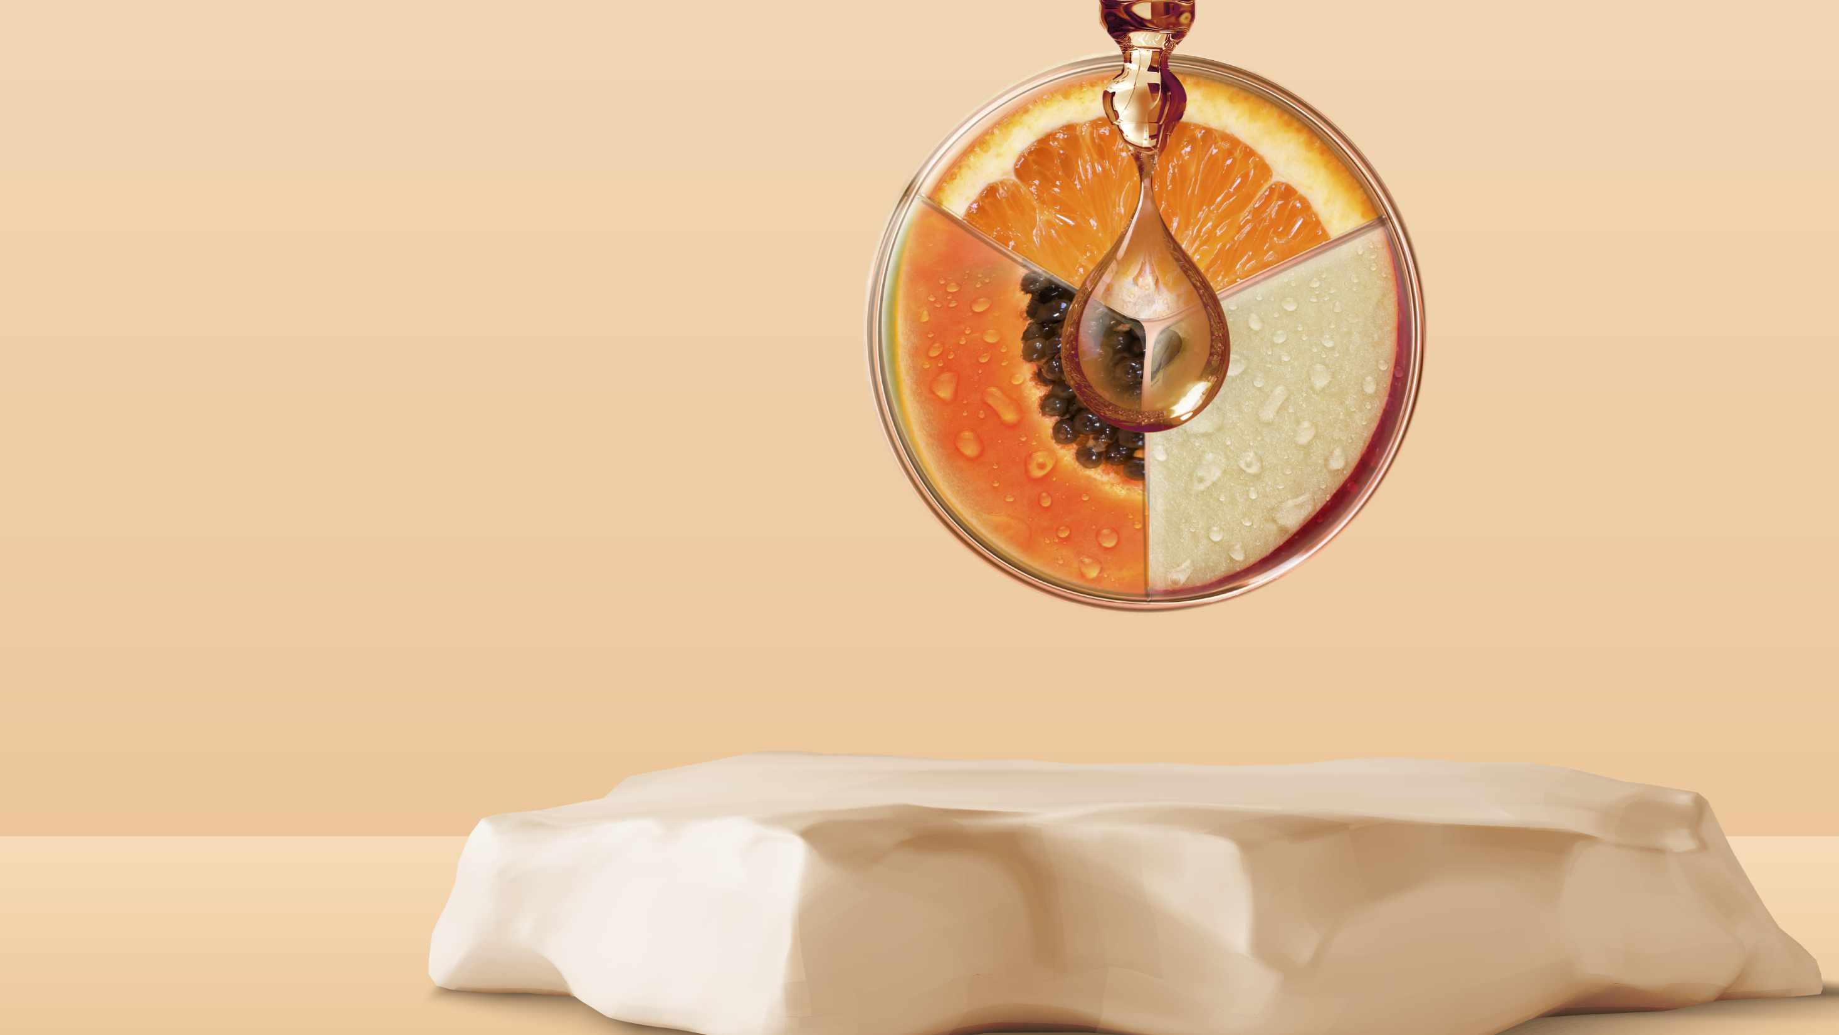
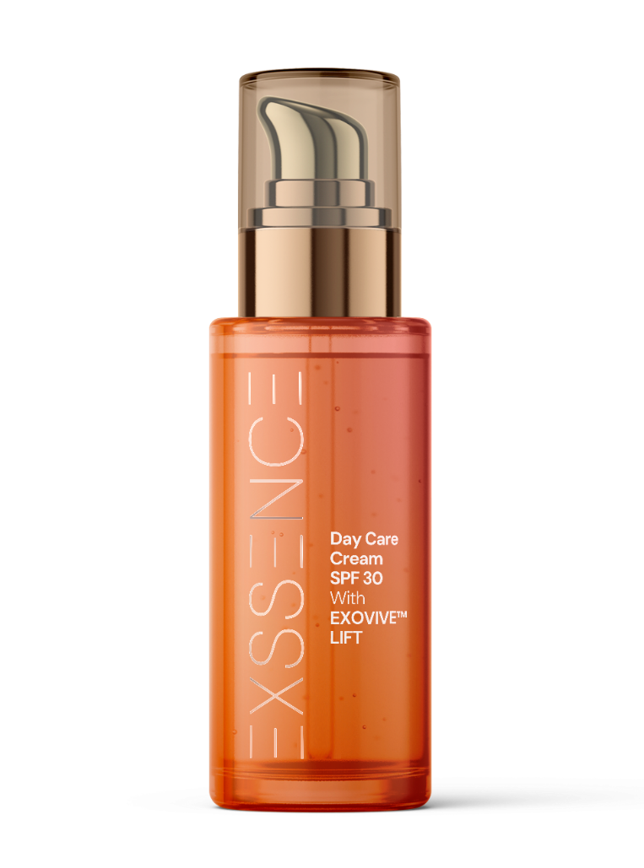
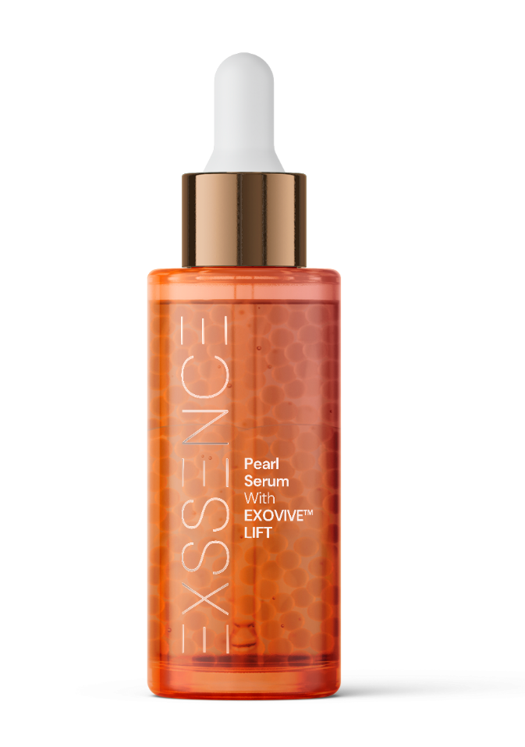
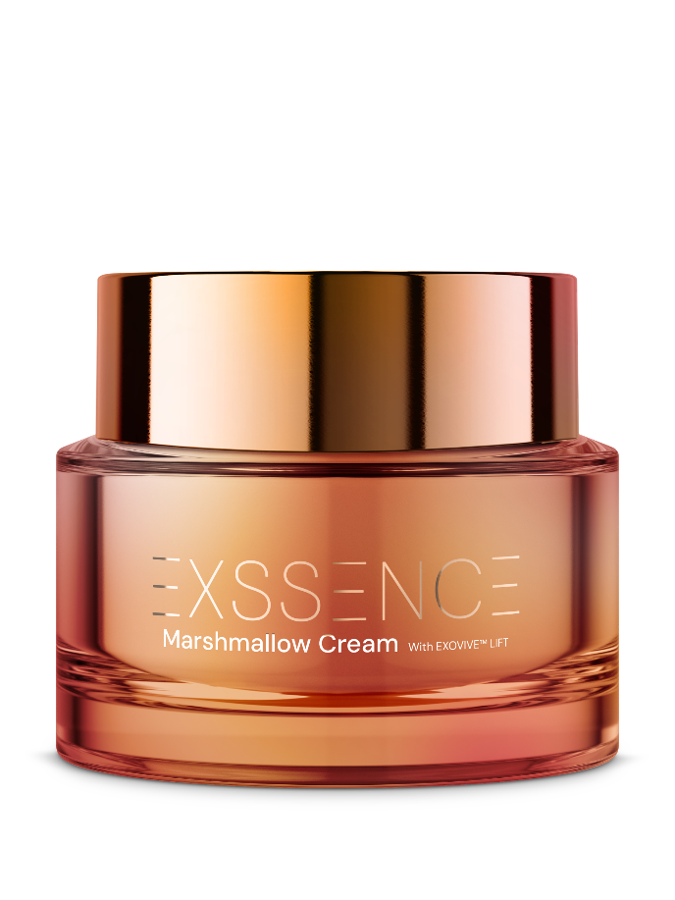
The quintessence of nature.
The code of renewal.

Slide 17
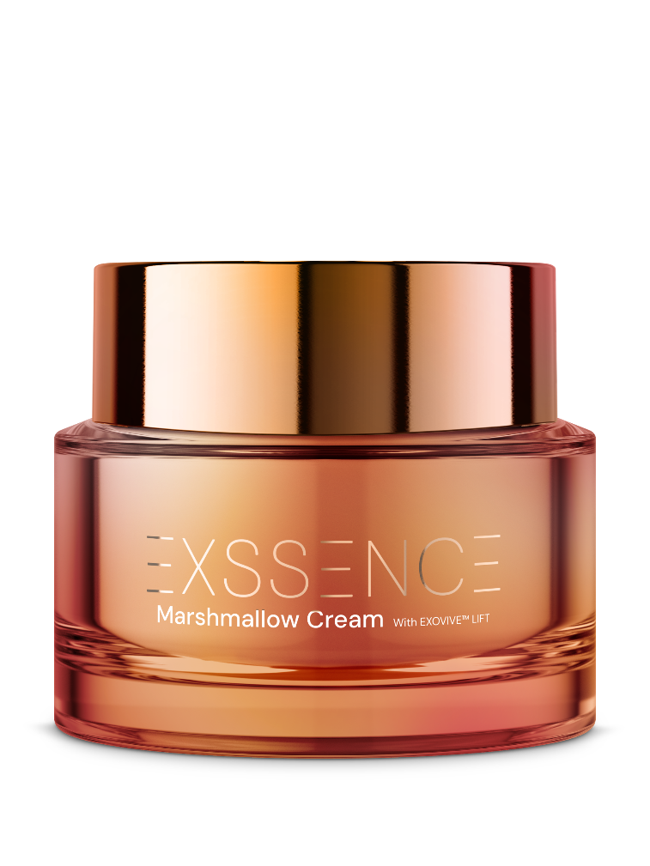
with EXOVIVE™ LIFT
The quintessence of nature.
The code of renewal.
Marshmallow Cream
A sensorially rich, nutritive skincare cream that melts effortlessly into the skin for a soft, velvety finish. Infused with EXOVIVE™ LIFT, a powerful exosome complex and with a blend of HYA-ACTTM XS, STIMU-TEX® AS and Niacinamide PC to protect the skin. It visibly enhances skin elasticity and firmness. This luxurious formula delivers both indulgent texture and transformative results for a radiant and smoothed complexion.
98.47% natural origin content

Slide 18
with EXOVIVE™ LIFT
The quintessence of nature.
The code of renewal.
Marshmallow Cream
SK-E-102649-23
Ingredients: AQUA, PROPANEDIOL, MACADAMIA INTEGRIFOLIA/TETRAPHYLLA SEED OIL, ORYZA SATIVA BRAN OIL, BUTYLENE GLYCOL, GLYCERYL BEHENATE, Niacinamide PC (3%), POLYGLYCERYL-6 DISTEARATE, CANDELILLA/JOJOBA/RICE BRAN POLYGLYCERYL-3 ESTERS, JOJOBA ESTERS, ARGAN OIL (1%), STIMU-TEX® AS (1%), POTATO STARCH MODIFIED, ACACIA DECURRENS FLOWER CERA, Mixed Tocopherols 95 (0.5%), HYA-ACT™ XS (0.5%), CAPRYLYL GLYCOL, GLYCERYL CAPRYLATE/CAPRATE, CETYL HYDROXYETHYLCELLULOSE, PINK BLOSSOM P02R418 (0.3%), EXOVIVE™ LIFT (0.026%), GLYCERIN, POLYGLYCERIN-3, CITRIC ACID, HELIANTHUS ANNUUS SEED CERA

Slide 19
with EXOVIVE™ LIFT
The quintessence of nature.
The code of renewal.
Pearl Serum
Pearl Serum is a luxurious concentrate that enhances skin elasticity and firmness. Infused with EXOVIVE™ LIFT and the collagen-boosting duo SYN®-COLL CB and ETERWELL™ YOUTH, it delivers powerful anti-aging benefits. Luminous pearls release potent actives upon application, restoring skin’s youthful bounce and vitality.
99,56% natural origin content

Slide 20
with EXOVIVE™ LIFT
The quintessence of nature.
The code of renewal.
Pearl Serum
SK-E-102856-31
Ingredients: AQUA, ALGIN, GLYCERIN, PENTYLENE GLYCOL, SYN®-COLL CB (1%), ETERWELL™ YOUTH (1%), C13-14 ALKANE, POLYGLYCERYL-6 CAPRYLATE, POLYGLYCERYL-4 CAPRATE, POLYACRYLATE CROSSPOLYMER-6, CAPRYLYL GLYCOL, BIS-POLYCITRONELLYL SUCCINATE, SODIUM PHYTATE, UNDECANE, MICA, PINK BLOSSOM P02R418 (0.05%), EXOVIVE™ LIFT (0.026%), IRON TITANIUM OXIDE, SILICA, CI 77891, TIN OXIDE

Slide 21
with EXOVIVE™ LIFT
The quintessence of nature.
The code of renewal.
Day Care Cream SPF 30
Day Care Cream SPF 30 is a high-performance daily moisturizer designed to protect the skin with a high eco-profile scire. It features EXOVIVE™ LIFT, and its exosome technology that enhances skin firmness and elasticity and a modern PARSOL® UV-filter system that efficient sun protection. Also enriched with the natural biotech duo REGU®-AGE CB and PEPHA®-CTIVE CB, delivering visible smoothness and radiance, making it an ideal choice for new generation natural science.

Slide 22
with EXOVIVE™ LIFT
The quintessence of nature.
The code of renewal.
Day Care Cream SPF 30
SK-E-102807-14
Ingredients: AQUA, DICAPRYLYL CARBONATE, PARSOL® DHHB (6%), C12-15 ALKYL BENZOATE, ISOPROPYL LAUROYL SARCOSINATE, PROPANEDIOL, PARSOL® EHT (5%), PARSOL® Shield (2%), PEPHA®-CTIVE CB (2%), REGU®-AGE CB (2%), POLYGLYCERYL-10 STEARATE, VALVANCE® Touch 210 (1%), BEHENYL ALCOHOL, CAPRYLYL GLYCOL, PINK BLOSSOM P02R418 (0.5%), XANTHAN GUM, GLYCERYL CAPRYLATE, MICA, CITRIC ACID, CI 77891, EXOVIVE™ LIFT (0.026%), CI 77491, TOCOPHEROL

Slide 23

with EXOVIVE™ LIFT
The quintessence of nature.
The code of renewal.
PINK BLOSSOM P02R418
Premium olfactive experience.
Youth quintessence captured in a fragrance
Floral notes are giving vibrancy & elegance to the fragrance, while AMBROX® captive with unparalleled depth, exudes a timeless natural sensuality.
powered with emotiboost® accord, neuroscientifically proven to make you feel confident.
top: red fruits pear peach
mid: rose muguet violet
fond: musky vanilla powdery
Notes:
TECHNO: powered with emotiboost™ accord, designed* to make you feel confident, that supports the idea of premium application, emotional benefit good for mature skins

Slide 24
Disclaimer
Copyright © dsm-firmenich Switzerland AG, 2026, 4002 Basel, Switzerland.
www.dsm-firmenich.com. All rights reserved.
dsm-firmenich has used diligent care to ensure that the information provided herein is accurate and up-to-date to the best of its knowledge. However, dsm-firmenich makes no representation or warranty, either expressly or implied, of the accuracy, reliability, completeness, or suitability thereof. The information provided herein contains scientific and product information for business-to-business use and does not constitute or provide scientific or medical advice, diagnosis or recommendation for treatment options. Country or region-specific information should be considered when labelling or advertising to final consumer. In no event shall dsm-firmenich be liable for any direct or indirect damages arising from or reliance upon, or use of, any information provided herein. The content of this document is subject to change without further notice. Please contact your local dsm-firmenich representative for the latest information. All trademarks listed in this document are either (registered) trademarks of, or trademarks licensed by, the dsm-firmenich group of companies, unless explicitly stated otherwise.
Disclaimer Formulation Guideline
The information provided herein is provided for information purposes only and has been prepared by dsm-firmenich in accordance with its own methodology.
dsm-firmenich has used diligent care to ensure that it is accurate and up-to-date, however, dsm-firmenich makes no representation or warranty, either expressly or implied, of the accuracy, reliability, or completeness thereof. In no event shall dsm-firmenich be liable for any damages arising from or reliance upon, or use of, any information provided herein. Further, dsm-firmenich shall not bear any liability for the application and/or use of any processed material containing its product(s). The formulation of the finished product is the customer’s sole responsibility. It is the customer’s responsibility to determine the suitability of dsm-firmenich’s products regarding user specific purposes, assess compatibility and stability of their finished product(s) and to ensure compliance of their finished product(s) with relevant laws and regulations. Any product, marketing or other claims made by customer are its sole responsibility. The content of this document is subject to change without further notice. Please contact your local dsm-firmenich representative for further details. © dsm-firmenich Switzerland AG, 2026.
© 2026

