Slide 1
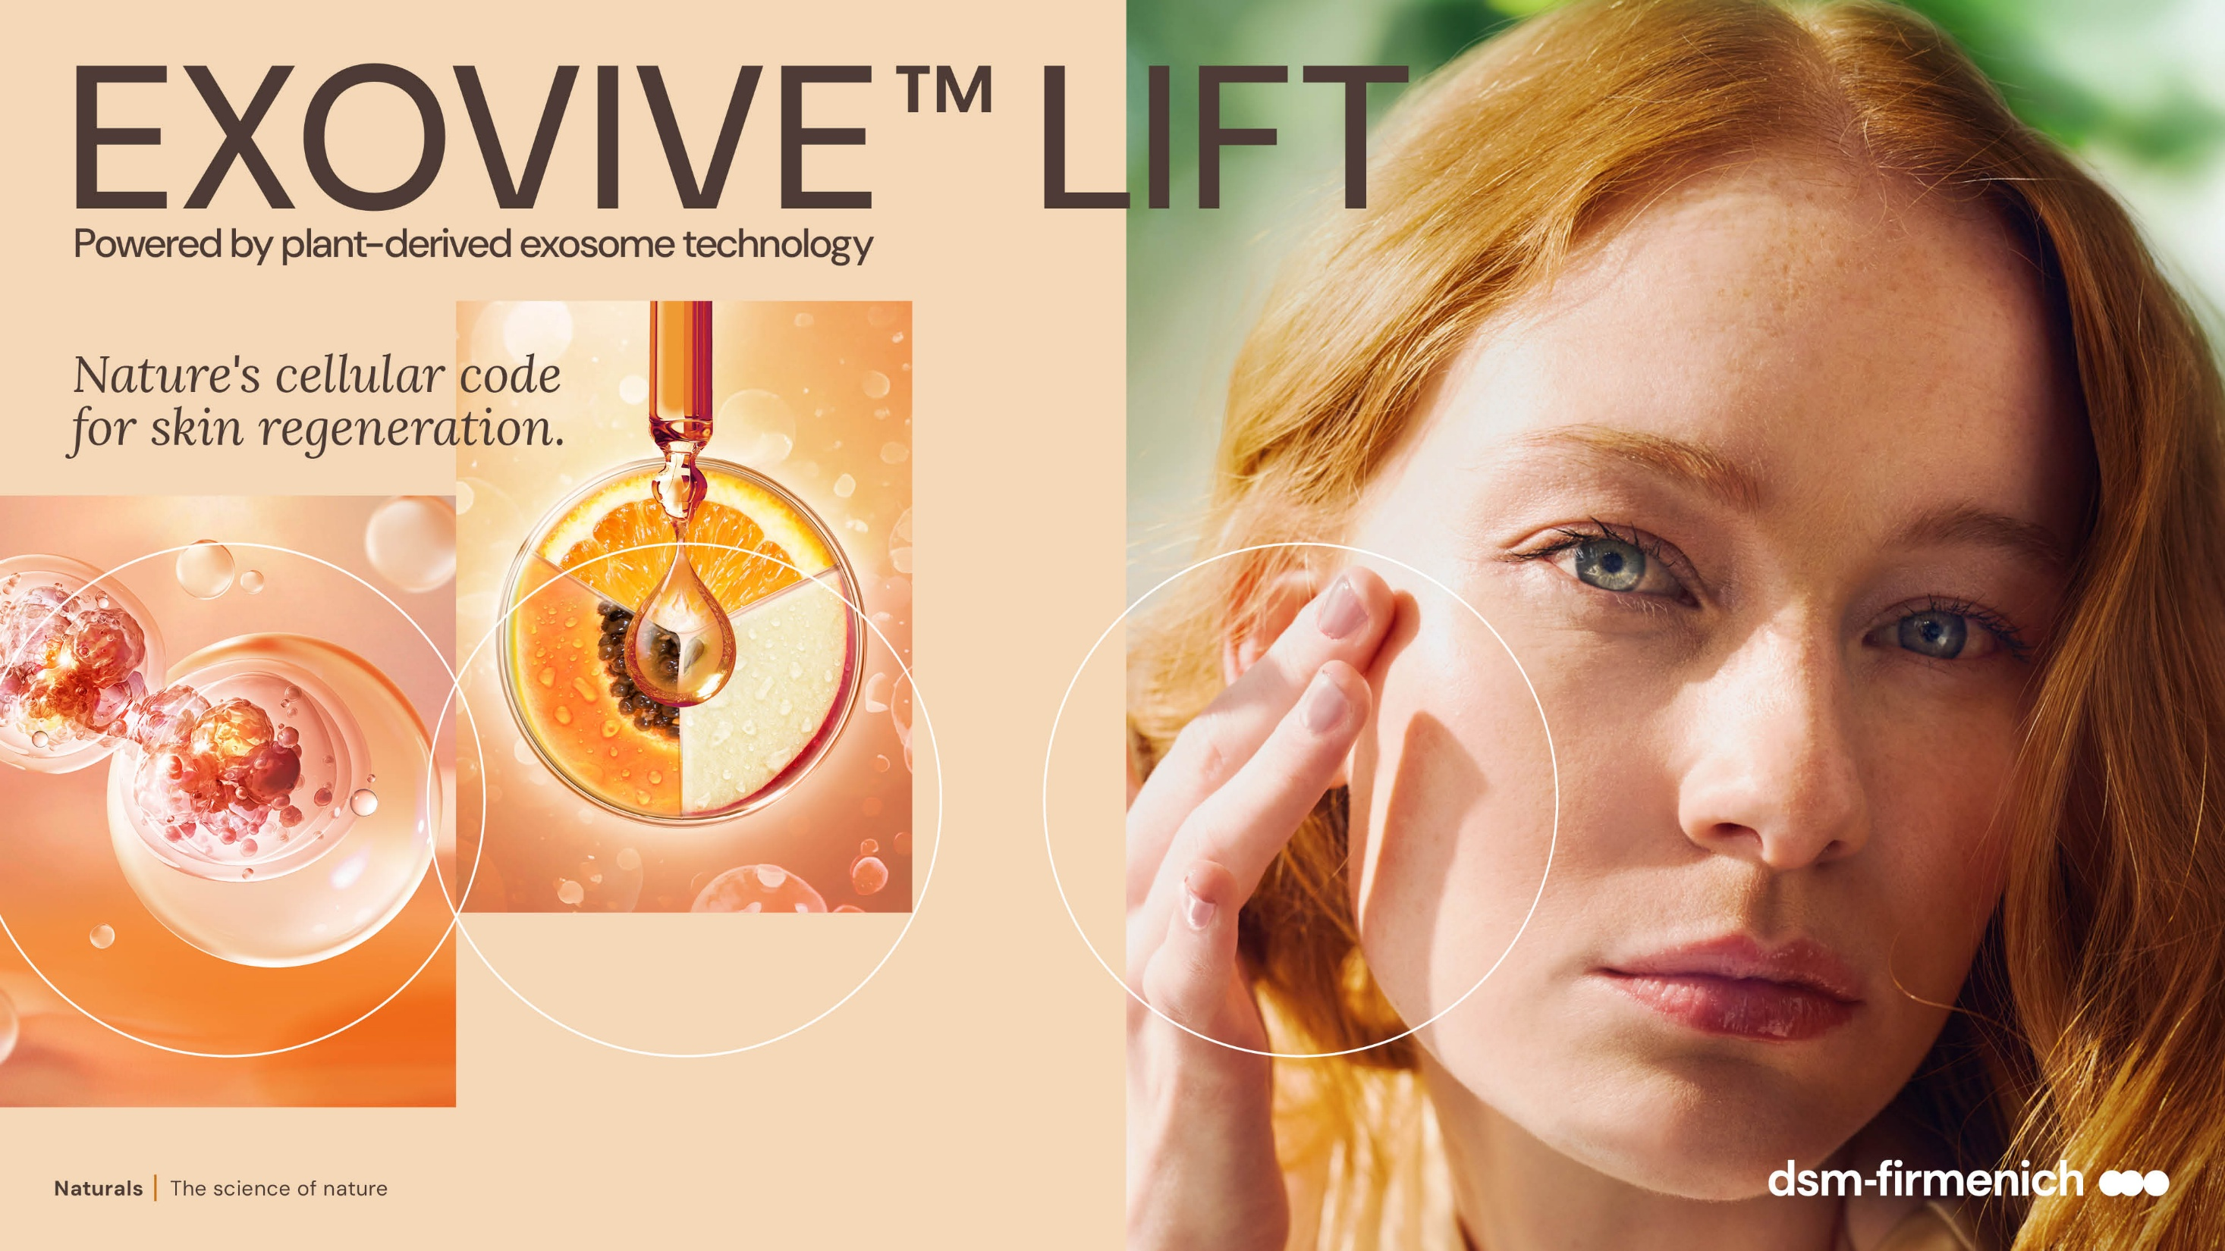

April 2026

Slide 2
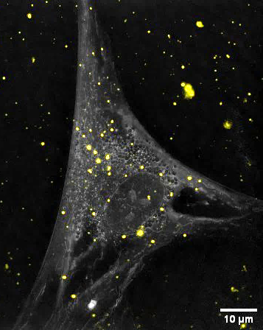
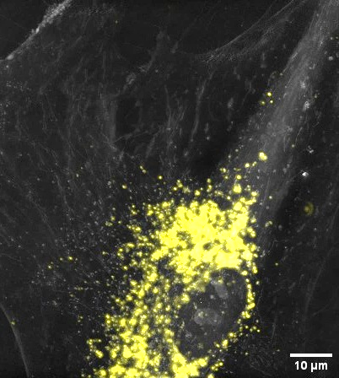
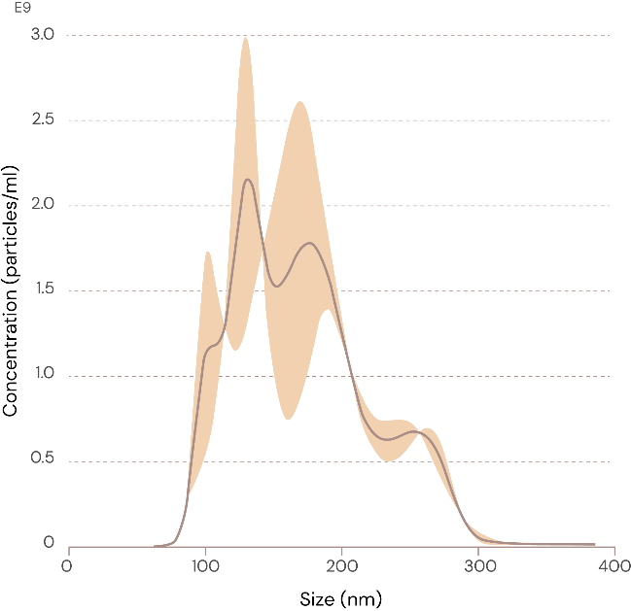

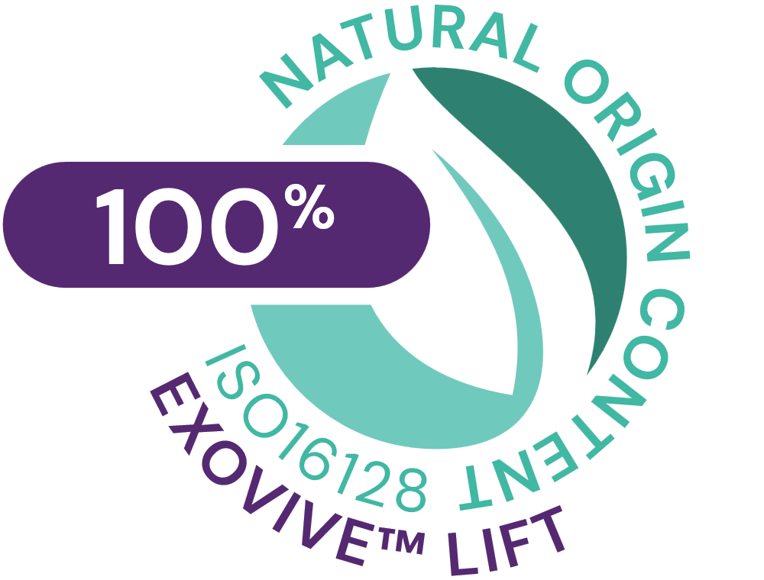

EXOVIVE™ LIFT: nature’s cellular code
Plant derived exosomes from EXOVIVE™ LIFT entering the fibroblasts and surrounding the perinucleus
Plant-derived exosomes nurture, re-programm and restore the cell communication.
When cells stop talking, skin starts aging. Aging, at its core, is a communication breakdown
Setting new standards in the field of plant-derived exosomes:
Unique blend of 3 organic fruits: Alpine Apple, Mediterranean Tangerine and Sicilian Papaya
Impressive visualization of plant-derived exosomes entering fibroblasts and migrating to the nucleus
Powder form containing 3.8 trillion exosomes/g, vesicles size between 100 and 300nm with a low use level 0.026%, delivering one billion vesicles in a single application (1 ml)
Highly Sustainable and proprietary manufacturing extraction process preserving the vesicles: from organic Italian biodiversity, with low carbon footprint
Exosomes are extracellular vesicles used as couriers to exchange essential nutrients such as peptides, lipids, secondary metabolites, antioxidants and growth factors, amongst others.
They also deliver genetic instructions that enable key regeneration processes (e.g. miRNA).
Characterization:
secondary metabolites: flavonoids (nairutin, hesperidin, phloridzin,…), antioxidants (ascorbic acid, catalase,…), triterpenoids, phenolic acids,…
>40k miRNAs identified, some (miR164, miR390,…) have skin benefits such as skin regeneration, barrier function, extracellular matrix homeostasis
Distribution curve of EXOVIVE™ LIFT vesicles
More than 90% of vesicles have a size above 100nm

Slide 3
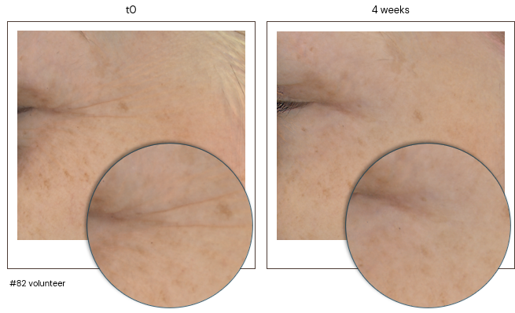
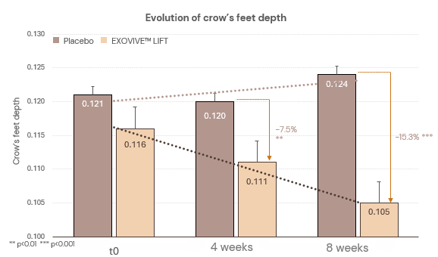
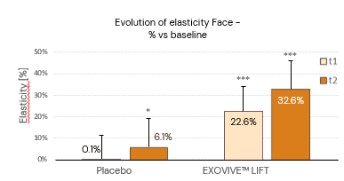
EXOVIVE™ LIFT: nature’s cellular code for skin regeneration
Setting new standards in the field of plant-derived exosomes:
+90% Collagen 1 boost in vitro
Outstanding clinically proven* efficacy after 2 months:
Re-densifies & plumps the skin for a more youthful and sculpted look
Reverses 8 years of wrinkles appearance (4 years in just 1 month)
+33% significant impressive boost in skin elasticity and + 22% skin firmness
+15% skin plumping vs placebo
Overperforms the equivalent standard fruit extract: 9x better crow’s feet depth improvement and 3.9x better elasticity boost than fruit extract
Proteomics study*:
Almost 3000 proteins identified on tape strips, +200 proteins significantly modulated by EXOVIVE™ LIFT
Plant miRNA plays a key role: Clear mode of action how EXOVIVE™ LIFT can trigger wrinkle improvement via fruit miRNAs regulation on specific skin proteins involved on key biological pathways such as chronic inflammation, loss of proteostasis and intercellular communication
Skin longevity: tackles 8 hallmarks beyond intercellular communication of aging by up-regulating key proteins vs placebo involved in skin regeneration, skin barrier, extracellular matrix,…
4 weeks ​
8 weeks ​
*: in vivo

Slide 4
EXOVIVE™ LIFT
ID Card: 5018504
INCI NAME:
Malus Domestica Fruit Extract, Citrus Reticula (Tangerine) Fruit Extract, Carica Papaya (Papaya) Fruit Extract, Maltodextrin
SUSTAINABILITY:
Organic cultivation, responsible sourcing, with low impact on the environment
TECHNOLOGY:
Gentle isolation of plant-derived exosomes from fruit juice with physical processes only
3.8 trillions plant-derived vesicles per g
100% of natural origin – no preservative
TECHNICAL:
Form: Powder
pH of use: 3.0- 10.0
Use level: 0.026% (in vivo)
Preservative: Free
Solubility: Water
Biodegradable: Readily biodegradable
BENEFITS:
Re-densifies and plumps the skin for a more youthful and sculpted look**
Reverses the wrinkle appearance by 8 years after 2 months, and by 4 years in just 1 month**
+33% significant impressive boost of skin elasticity**
+90% collagen I *
Tackles 8 hallmarks beyond altered intercellular communication by modulating key proteins involved in skin regeneration (via miRNAs*)**
REGISTRATION
CERTIFICATION:
* In vitro ** In vivo

Slide 5
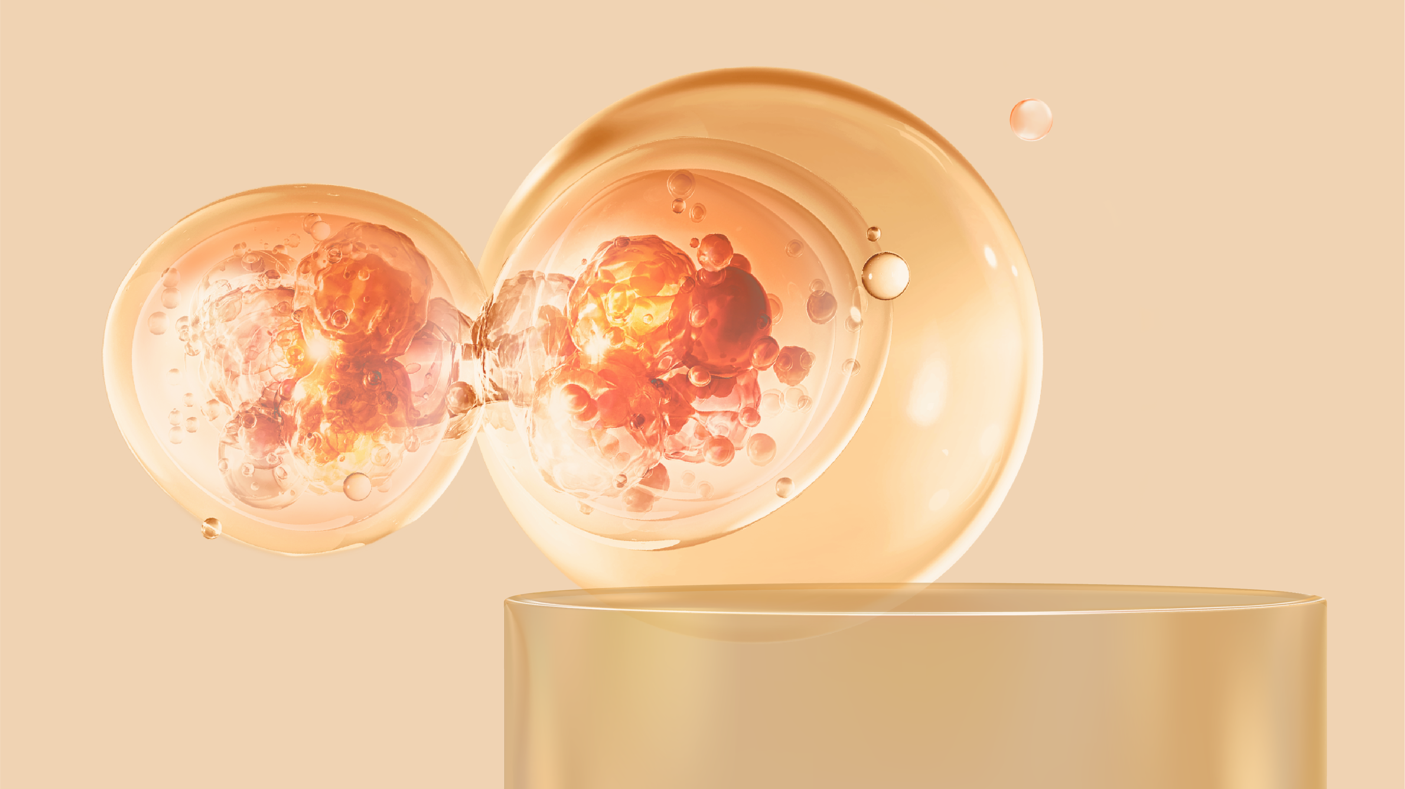

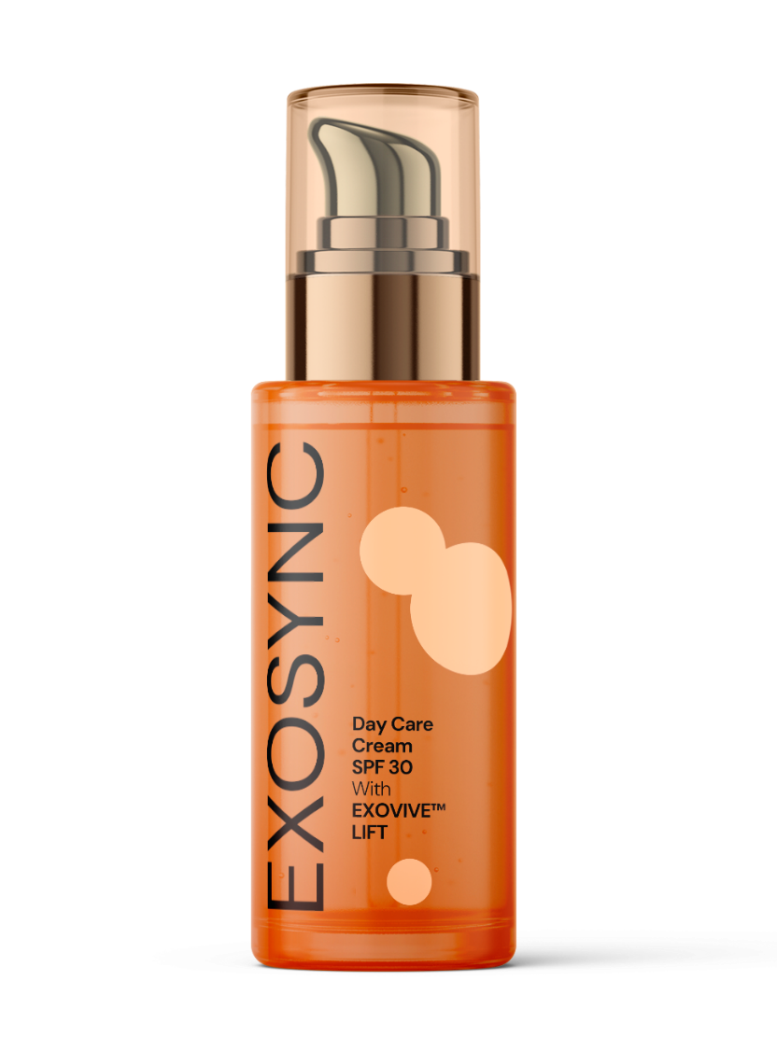
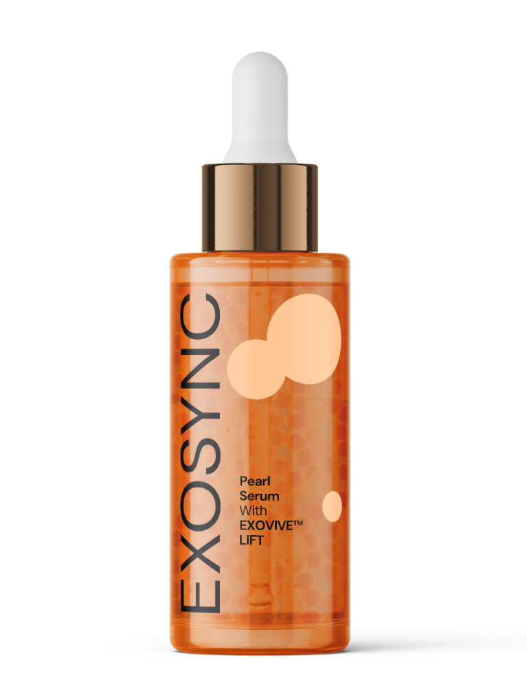
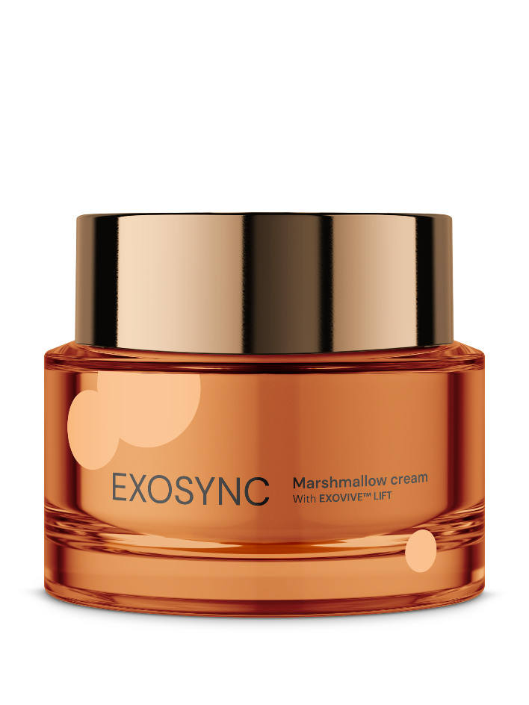

Reverses 8 years of wrinkles
Up to +30% skin’s elasticity
with EXOVIVE™ LIFT
Syncing skin cells
for deep regeneration
What if nature could speak directly to your skin?
Exosome science says yes. The skin is a living network of cells, constantly communicating through microscopic messengers called exosomes Aging, at its core, is a communication breakdown. When cells stop talking, skin begins to age. But this dialogue can be restored.
Intercellular communication within plants happens in the same way. Powered by the innovative EXOVIVE™ LIFT, the EXOSYNC line captures the quintessence of nature to resume skin cells communication. Carefully sourced from organic natural origins, plant-derived exosomes are preserved at full

Slide 6
Disclaimer
Copyright © dsm-firmenich Switzerland AG, 2026, 4002 Basel, Switzerland.
www.dsm-firmenich.com. All rights reserved.
dsm-firmenich has used diligent care to ensure that the information provided herein is accurate and up-to-date to the best of its knowledge. However, dsm-firmenich makes no representation or warranty, either expressly or implied, of the accuracy, reliability, completeness, or suitability thereof. The information provided herein contains scientific and product information for business-to-business use and does not constitute or provide scientific or medical advice, diagnosis or recommendation for treatment options. Country or region-specific information should be considered when labelling or advertising to final consumer. In no event shall dsm-firmenich be liable for any direct or indirect damages arising from or reliance upon, or use of, any information provided herein. The content of this document is subject to change without further notice. Please contact your local dsm-firmenich representative for the latest information. All trademarks listed in this document are either (registered) trademarks of, or trademarks licensed by, the dsm-firmenich group of companies, unless explicitly stated otherwise.
Disclaimer Formulation Guideline
The information provided herein is provided for information purposes only and has been prepared by dsm-firmenich in accordance with its own methodology.
dsm-firmenich has used diligent care to ensure that it is accurate and up-to-date, however, dsm-firmenich makes no representation or warranty, either expressly or implied, of the accuracy, reliability, or completeness thereof. In no event shall dsm-firmenich be liable for any damages arising from or reliance upon, or use of, any information provided herein. Further, dsm-firmenich shall not bear any liability for the application and/or use of any processed material containing its product(s). The formulation of the finished product is the customer’s sole responsibility. It is the customer’s responsibility to determine the suitability of dsm-firmenich’s products regarding user specific purposes, assess compatibility and stability of their finished product(s) and to ensure compliance of their finished product(s) with relevant laws and regulations. Any product, marketing or other claims made by customer are its sole responsibility. The content of this document is subject to change without further notice. Please contact your local dsm-firmenich representative for further details. © dsm-firmenich Switzerland AG, 2026.
© 2026

Slide 7

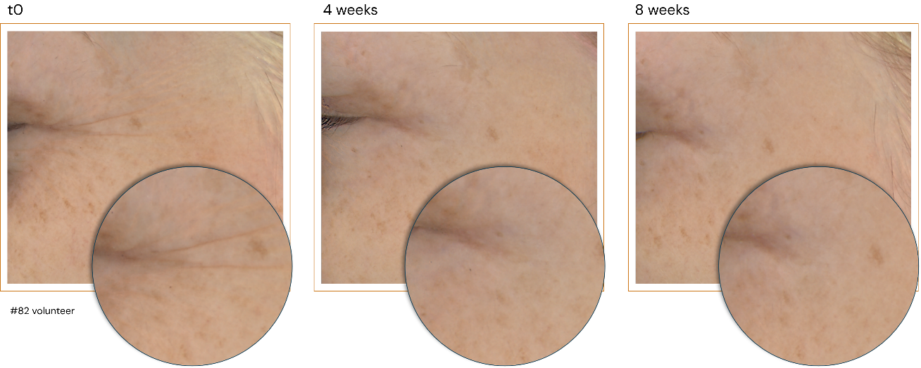
The Longevity Challenge
Our Solution
Proven Efficacy
When cells
stop talking,
skin starts aging
EXOVIVE™
Next generation science-backed
Plant-derived exosomes
Decoding nature’s intelligence. Delivering superior results.
dsm-firmenich sets new scientific standards
Characterization & standardization
1Bln vesicles in 1 ml
Visualization of mode of action
>40k miRNAs identification
+90% Collagen boost*
Outstanding in vivo results:
Re-densifies & plumps the skin +33% skin elasticity (after
2 months, highly significant)
Reverses 8 years of wrinkles
Superiority vs equivalent plant extract
Skin is a living network
of cells constantly communicating, through microscopic messengers called exosomes, which are used by cells to share nutrients and genetic instructions (miRNA).
As we age, the dialogue
fades and skin loses vitality.
Aging at its core is a communication breakdown.
What if nature could restart
the conversation?
Intercellular communication within plants happens in the same way.
By comparing plant & human miRNA sequences, we found an explanation for how these cross‑kingdom miRNAs support smoother, younger‑looking skin.​
Inspired by regenerative medicine, EXOVIVE™ speaks skin's native language, helping it remember how to be young.
It nurtures, reprograms & restores.
EXOVIVE™ LIFT
2 months, double-blinded, randomized, half-face, placebo-controlled study. Twice daily application. 45 Female volunteers, per application mainly phototype II to III, 37 to 69 y.o. 0.026% EXOVIVE™ LIFT (1 billion plant-derived exosomes per ml)

Slide 8

EXOVIVE™ LIFT: nature’s cellular code
Plant-derived exosomes nurture, re-program and restore the cell communication
Setting new standards in the field of plant-derived exosomes:
Outstanding clinically proven** efficacy in two months:
Re-densifies & plumps the skin for a more youthful and sculpted look
+33% significant impressive boost in skin elasticity and + 22% skin firmness
Reverses 8 years of wrinkles appearance after 2 months and 4 years in just 1 month
+15% skin plumping vs placebo
Tackles 8 hallmarks beyond intercellular communication of aging by up-regulating key proteins involved in skin regeneration, skin barrier, extracellular matrix,… (via miRNAs*)**
Overperforms the equivalent standard fruit extract
+90% Collagen 1 boost*
Unique blend of 3 organic fruits: Alpine Apple, Mediterranean Tangerine and Sicilian Papaya
Impressive visualization of plant-derived exosomes entering fibroblasts and migrating to the perinucleus region
Characterization (secondary metabolites and >40k miRNAs) & standardization
One billion vesicles in a single application (1 ml)
Highly Sustainable and proprietary manufacturing extraction process preserving the vesicles: from organic Italian biodiversity, with low carbon footprint
Powder form containing 3.8 trillion exosomes/g, low use level 0.026% , vesicles size between 100 and 300nm
4 weeks ​
8 weeks ​
*: in vitro
** in vivo

