Slide 1

Oct 2026

Slide 2
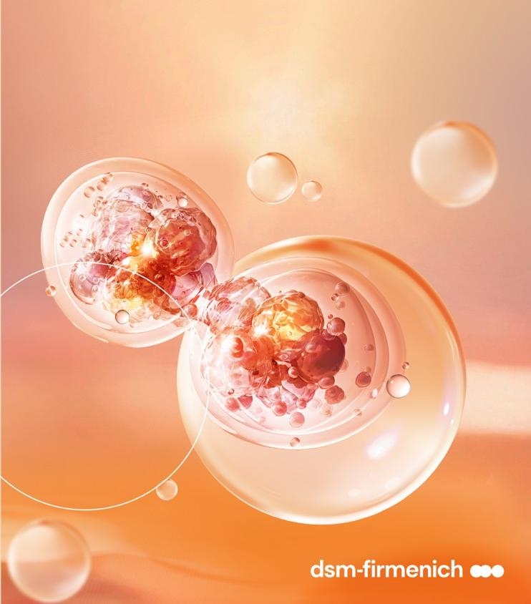
Agenda
From in-clinic to daily routine: the exosomes revolution
Introducing EXOVIVE™ LIFT
EXOVIVE™ LIFT substantiation
EXOVIVE™ LIFT line-up

Slide 3
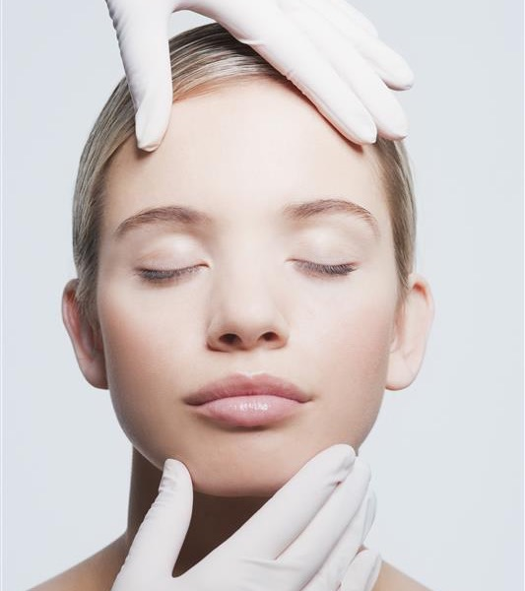

Exosomes
are sparking
a revolution
From in-clinic to daily routine, this breakthrough technology is rewriting the future of skincare.
Inspired by regenerative medicine, exosomes are now making waves in high-efficacy premium skincare, focusing on skin health and recovery.
Google searches for "Exosome" have surged 206% worldwide in the past year and skincare launches with exosome claims are rapidly growing in early adopter regions such as Korea and North America.
Source: WGSN & Mintel
Notes:
WGSN “The Exosome Opportunity” Key Ingredient 2025: The Exosome Opportunity - WGSN Beauty

Slide 4
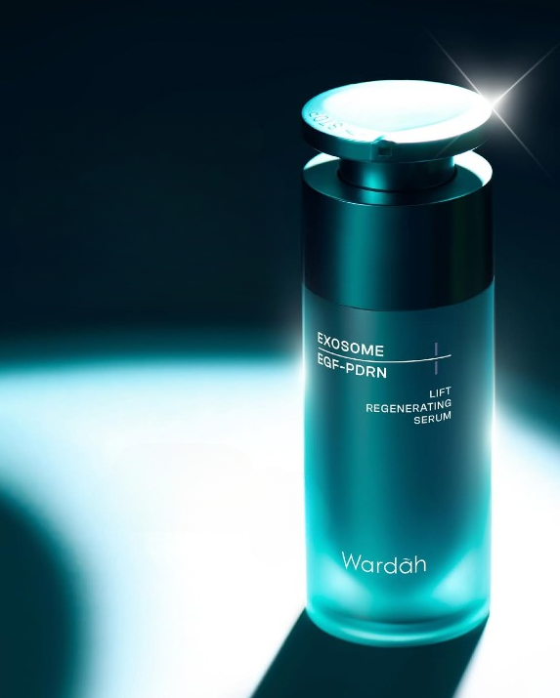
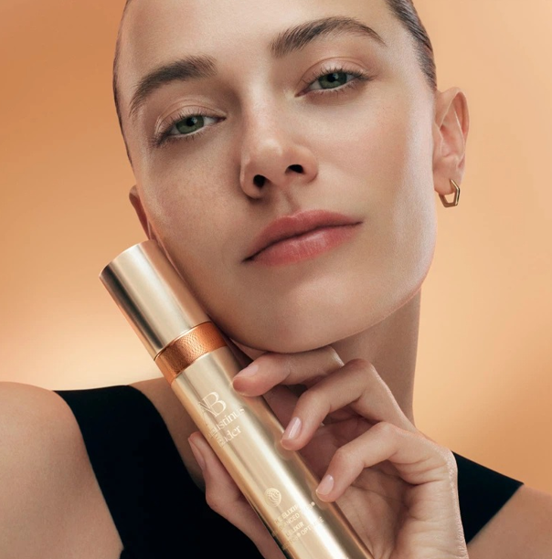
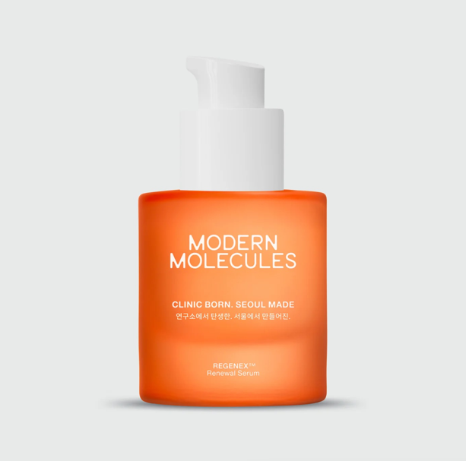
The Exosomes opportunity
Key ingredient 2025
Wardah Beauty dropped its first exosome-powered serum. It claims delivering skin regenerative benefits deeper into the skin.
Tapping into exosomes, Augustinus Bader has launched The Elixir, an ultra-concentrated skin renewal serum powered by a biomimetic delivery system and peptides to “enhance intercellular communication”, helping to visibly improve fine lines and wrinkles.
K-beauty inspired brand Modern Molecules has launched a new exosome-based serum that strengthens the skin’s repair abilities. Said to delay the skin’s ageing process by 5.5 years within two months.

Slide 5
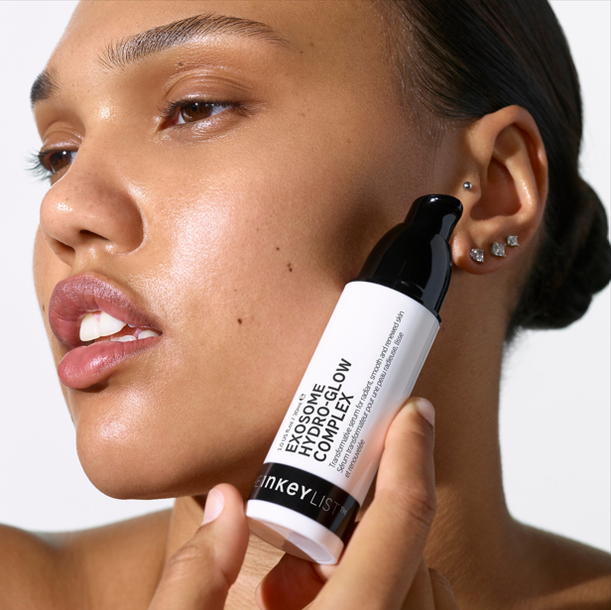
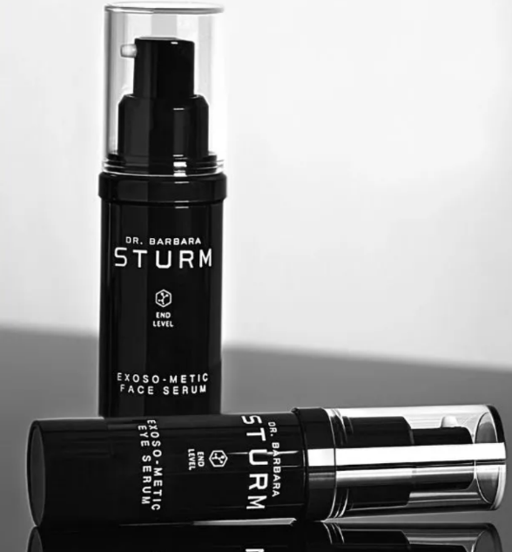
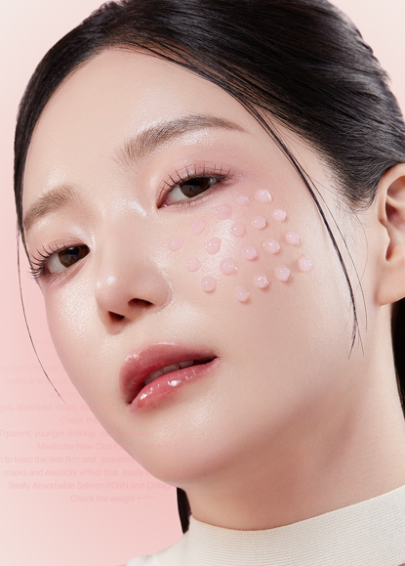
The Exosomes opportunity
Key ingredient 2025
INKEY List’s Exosome Hydro-Glow Complex resurfaces, rejuvenates and hydrates the skin with technology previously exclusive to professional cosmetic clinics. Its formula is packed with 3 mln plant-derived exosomes to boost collagen.
Dr. Barbara Sturm's Exoso-Metic Face Serum, with unique blend of exosome and growth factor technologies, harnesses the power of natural cell communication, for effective anti-aging and skin regeneration.
Korean brand Medicube’s new PDRN Pink Collagen Exosome Shot Ampoule is an aesthetic-grade ampoule with exosomes-coated spicules.

Slide 6


When cells stop talking,
skin starts aging
Skin is a living network of cells constantly communicating, through microscopic
messengers called exosomes.
Exosomes are extracellular vesicles used as couriers to exchange essential nutrients such as peptides,
lipids, antioxidants and growth factors, amongst others.
They also deliver genetic instructions that enable key regeneration processes (e.g. miRNA).
They nurture, re-programme, restore.
As we age, fewer messages get through.
Cellular conversations quiet, and skin loses its vitality, leading to premature aging. It is one of the known hallmarks of aging (“intercellular communication”).
Aging, at its core, is a communication breakdown.

Slide 7
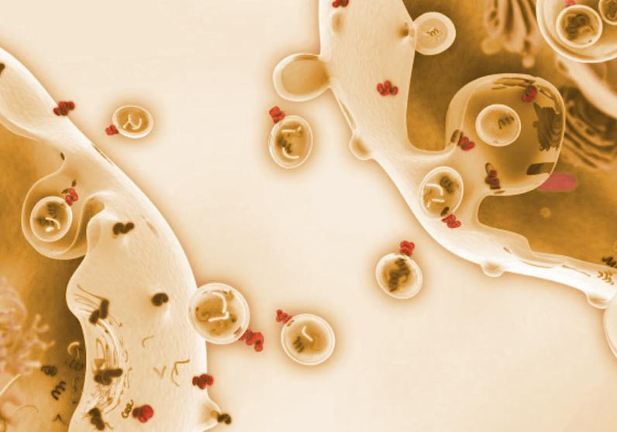
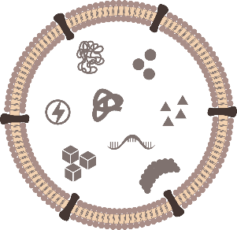
The extracellular vesicles
vesicles with cargo migrating from one cell to another cell
A recent pharmaceutical discovery
Extracellular vesicles have been discovered for the first time in 1980s in red blood cell and have been named Exosomes in 1990s, but their role wasn’t clear at that time and first suspected to be used as a cellular trash can.
They are present in almost all animal and vegetal cells.
The vesicle is surrounded by a lipidic bilayer membrane. This membrane includes also adhesion molecules and receptor proteins to recognize the target cells.
Exosomes are the tiniest vesicles, reserved to human being. Extracellular vesicles have a size within a range from 30nm to 1000nm.
Typical micro-vesicle
Proteins and amino acids
Adhesion molecules
Enzymes
Antioxidants
ATP
Micronutrients
Phospholipid
bilayer
microRNA
mRNA
DNA
Metabolites
Lipids

Slide 8
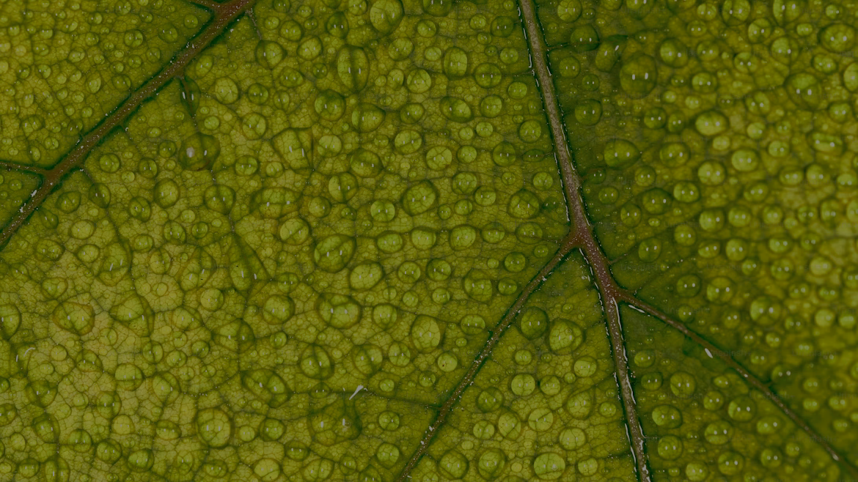

What if nature could
resume the conversation?
Intercellular communication within plants happens in the same way.
Plant extracellular vesicles serve as carriers and provide unique natural protection for secondary metabolites (bioactives) against oxidation and enzymatic damage. They are nature’s quintessence, the most potent part of the plant, which promotes resilience, growth and renewal at a cellular level.
With a similar structural lipidic bilayer membrane as a cell membrane,
plant-derived exosomes can easily penetrate and enter target skin cells
for enhanced biological activity and superior efficacy.
Plant-derived exosomes don’t just penetrate skin,
they integrate, like a piece of the same puzzle.

Slide 9
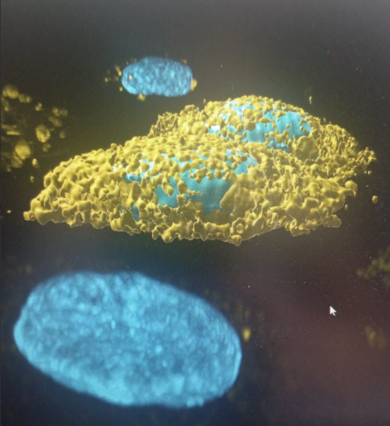
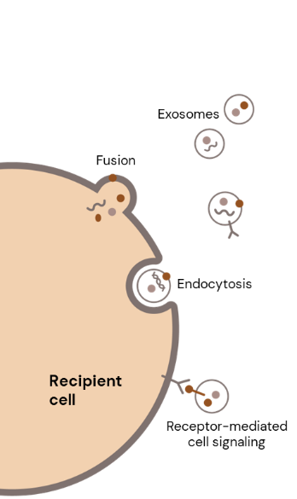
Plant-derived Exosomes
Visualization of Plant-derived Exosomes
Image is captured with confocal microscope
in yellow: Plant-derived Exosomes
in blue: nucleus of fibroblast
High bio-compatibility for strong efficacy
Plant-derived Exosomes enter the recipient cell by 3 mechanisms: Fusion – Endocytosis - Receptor cell signaling
Once inside the skin cell, they migrate to the nucleus. They are highly effective at delivering bioactive molecules, offering advantages in targeting, stability, and biocompatibility.
Their size: between 100 and 300nm.
Extracellular space

Slide 10

At dsm-firmenich we're decoding nature's intelligence
Introducing EXOVIVE™
Welcome to the future of natural skincare science!

Slide 11






Our partner: EXOLAB
20 years of experience and patented technology
A pioneer in the world of plant-derived extracellular vesicles.
Founded through the shared vision of pioneers Valerio Carconi & Lorenzo Cilli, both seasoned veterans of multinational corporations and successful entrepreneurs, along with esteemed researchers Mariantonia Logozzi & Stefano Fais.
Dr. Mariantonia Logozzi, CTO, is the pivotal researcher (former Researcher at the Italian NIH, ISS, 76 publications on PubMed), co-founder and owner with prof. Stefano Fais (CSO) (former Head of Research at the Italian NIH, ISS, up to 240 publications on PubMed), Valerio Carconi (marketing coordinator) and Lorenzo Cilli (CFO).
Superiority of plant-derived exosomes from organic farming vs conventional farming:
  More (up to +49%) microvesicles derived from organic agriculture compared to conventional fruits.
  Smaller vesicles derived from organic agriculture compared to vesicles from conventional fruits
  Higher antioxidant capacities in the organic agriculture-derived microvesicles than in conventional nanovesicles
  High stability regarding chemical lysis/pH and physical lysis/ultrasonic bath
Prof. Stefano Fais
CSO
Dr. Mariantonia Logozzi
CTO and Head of innovation
Scientific publications:
Logozzi M. et al. , Nanovesicles from organic agriculture-derived fruits and vegetables: characterization and functional antioxidant content, Int. j. Mol. Sci,, 2021, 22, 8170
Logozzi M. et al., The potentiality of plant-derived nanovesicles in human health – a comparison with human exosomes and artificial nanoparticles, , Int. j. Mol. Sci,, 2022, 23, 4919
Logozzi M. et al., Antioxidant effect of a plant-derived extracellular vesicles’ mix on human skin fibroblasts: induction of a reparative process, Antioxidants, 2024, 13, 1373, Seminars in cancer biology, 2022, 86, 13-125
IP on technology and plant blends:
WO2022157726A1 Nanovesicules deriving from biological plants as natural carriers of phyto-complexes for nutraceutical, cosmetic and regenerative use
WO2022201066A1 Method of applying electrical impulses for the purpose of loading various molecules into plant-derived nanovesicles
Valerio Ferri
CEO
Lorenzo Cilli
CFO
Valerio Carconi
Head of Sales
& Marketing

Slide 12
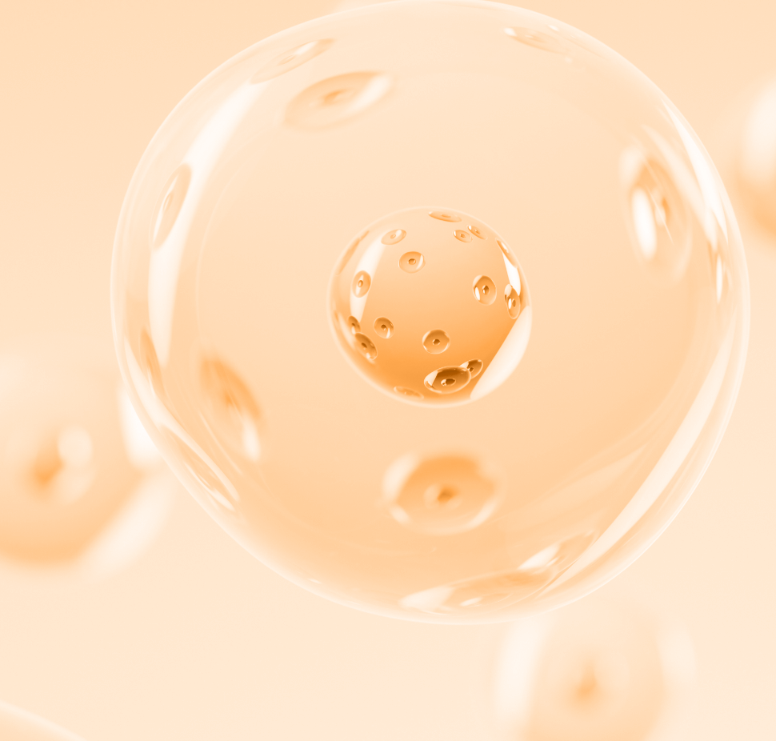

Gentle, solvent-free extraction
process preserving exosome integrity
1
Fruits/Plants
extraction
2
Extract*
Exosomes are isolated through a multi-step physical process using centrifugation and filtration, removing cellular debris (e.g. fibers, cells, mitochondria) and larger vesicles (e.g. apoptotic bodies).
Physical extraction only (pressing, centrifugation, filtration)
No solvents used
Mild conditions to preserve exosome integrity
Low energy process
Higher exosome yield from organic fruits vs conventional sourcing
isolation
3
Filtration
Centrifugation
purification
4
Filtration
drying
5
Spray Drying
EXOVIVE™
12
*: squeezing for fruit and cold-water infusion for plants

Slide 13

From fruit to root…
Fruits
…we harness the
whole plant to deliver nature’s intelligence.
Flowers
Leaves.
Roots

Slide 14
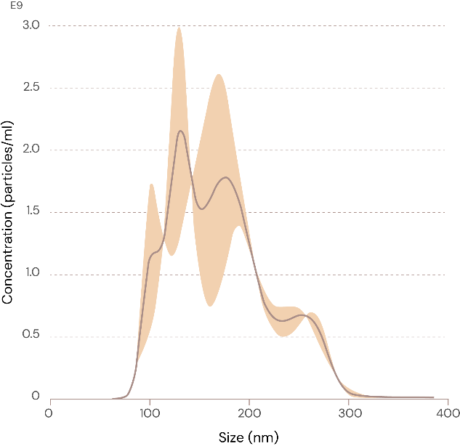
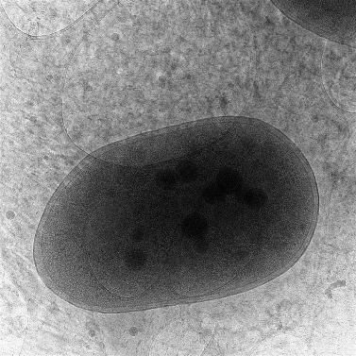
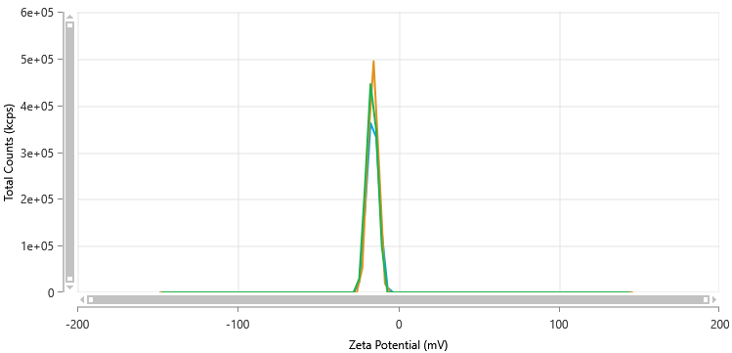
Extracellular vesicles with a size above 100nm
Visualization of plant-derived exosomes by microscope and analysis of the size of the vesicles
Unique technology to isolate the plant vesicles, preserving intact the membrane of vesicle.
Every lot is quantified in number of plant-derived exosomes to guarantee the efficacy
Severe quality control: the size and shape of vesicles are controlled, and only valid vesicles are counted.
The zeta potential of plant-derived exosomes is measured by Dynamic Light Scattering (DLS) to guarantee a high stability in liquid solution and high ability to penetrate biological membrane.
NTA: Nanoparticle Tracking Analysis
Distribution curve of EXOVIVE™ LIFT vesicles
More than 90% of vesicles have a size above 100nm
Microscope: evaluation of nanovesicle integrity through TEM (Transmission Electron Microscopy) analysis) Plant-derived exosomes (black) in keratinocyte.
b
Notes:
The orangeline in the NTA graph represents the standard variation of particle size distribution (of extracellular vesicles). Nanoparticle Tracking Analysis (NTA) utilizes the properties of both light scattering and Brownian motion in order to obtain the nanoparticle size distribution of samples in liquid suspension.
Briefly, for this analysis vesicles in a liquid suspension are placed in a sample chamber and illuminated by a shaped laser beam. The particles scatter the laser light, which is collected by a 20x microscope objective and captured on video by a digital camera. The video shows the particles moving due to Brownian motion. The Nanoparticle Tracking Analysis (NTA) software analyzes the particles individually and calculates their hydrodynamic diameters using the Stokes-Einstein equation. Real-time monitoring allows for the detection of subtle changes in particle populations, and all results are visually validated.

Slide 15
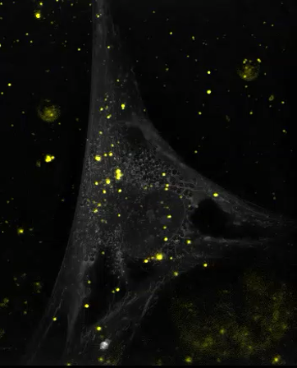
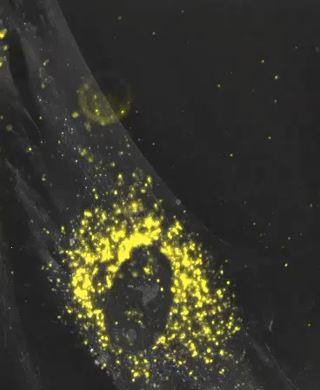
Plant-derived exosomes effectively deliver bioactives into cells
At 3 hours, plant-derived exosomes transported from the extracellular space into cells.
At 13 hours, plant-derived exosomes transported from the
cell periphery and concentrated in the perinuclear region.
Holotomography microscope (Nanolive) visualization: plant derived exosome EXOVIVE™ LIFT (labeled in yellow) entering the fibroblast and migrating to the nucleus
Notes:
Human dermal fibroblasts were treated with 6×10⁹/ml exosomes. These exosomes exhibited substantial accumulation and considerable dynamism within the cells. Regardless of whether they moved rapidly or slowly, or displayed continuous or paused movement patterns, their final destination remained consistent: the perinuclear region. After 3 hours still many vesicles floating in the intercellular space. After 13 hours almost all vesicles have entered the cells

Slide 16
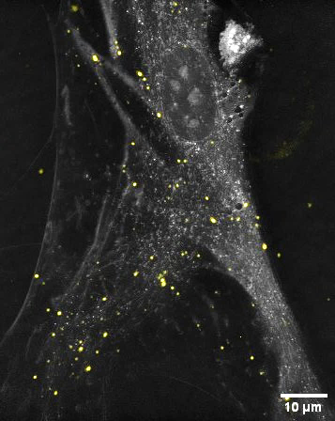
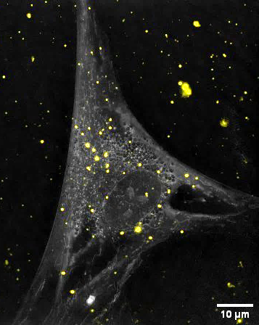
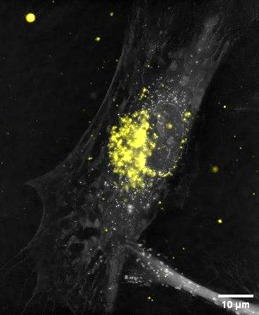
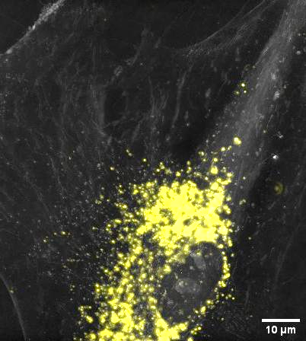
The uptake of plant-derived exosomes
cell nucleus
cell nucleus
cell nucleus
cell nucleus
0.5 h 3 h 5 h 24 h
Exosomes began to localize in the peripheral region of the cells
Exosomes already transported to the perinuclear region
Majority of exosomes had accumulated near the nucleus
Accumulation within the cells had further increased
Holotomography microscope (Nanolive) visualization: EXOVIVE™ LIFT (labeled in yellow) entering the fibroblast and migrating to the nucleus.
16
Notes:
Prelabeled exosome, washout dye in excess, seed cells in petridash, add prelabeled and purified exosome, image acquisition with nanolive (holotomography ) microscope

Slide 17
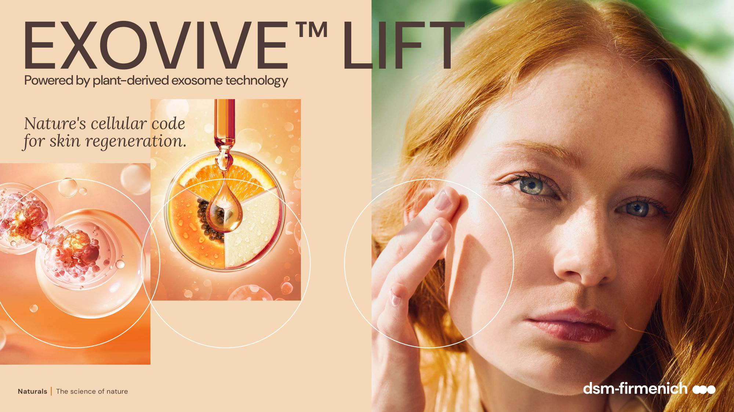


Slide 18

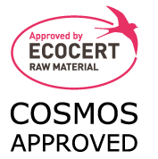

EXOVIVE™ LIFT
ID Card: 5018504
INCI NAME:
Malus Domestica Fruit Extract, Citrus Reticula (Tangerine) Fruit Extract, Carica Papaya (Papaya) Fruit Extract, Maltodextrin
SUSTAINABILITY:
Organic cultivation, responsible sourcing, with low impact on the environment
TECHNOLOGY:
Gentle isolation of plant-derived exosomes from fruit juice with physical processes only
3.8 trillions plant-derived vesicles per g
100% of natural origin – no preservative
TECHNICAL:
Form: Powder
pH of use: 3.0- 10.0
Use level: 0.026% (in vivo)
Preservative: Free
Solubility: Water
Biodegradable: Readily biodegradable
BENEFITS:
Re-densifies and plumps the skin for a more youthful and sculpted look**
Reverses the wrinkle appearance by 8 years after 2 months, and by 4 years in just 1 month**
+33% significant impressive boost of skin elasticity**
+90% collagen 1 *
Tackles 9 hallmarks by modulating key proteins involved in skin regeneration (via miRNAs*)**
REGISTRATION
CERTIFICATION:
* In vitro ** In vivo after 2 months

Slide 19
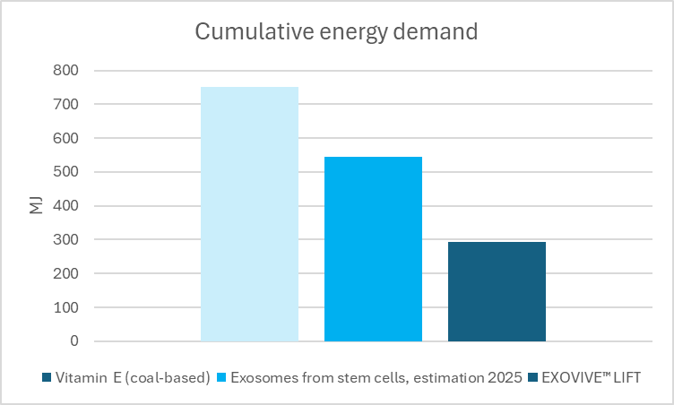
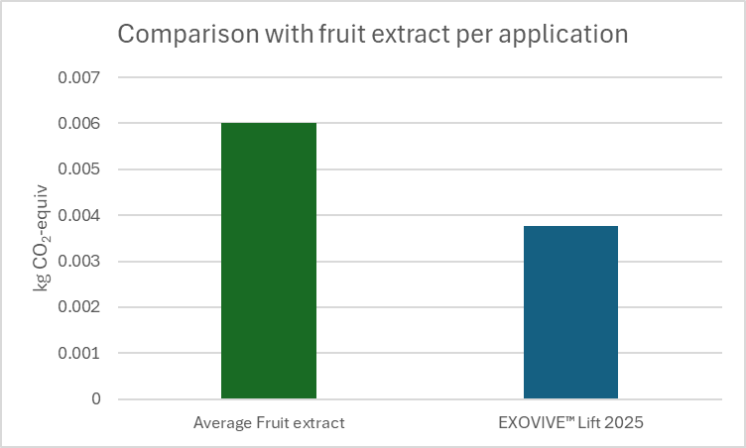

High performance. Minimal environmental impact
Fruit extraction uses mild physical processes, resulting in lower energy demand vs Vitamin E (coal based) and Exosomes from stemcell culture.
  It does not compete with food production and requires limited land. (1) Supports responsible sourcing and biodiversity.
  It generates biodegradable waste, repurposed as compost or animal feed.
EXOVIVE™ LIFT delivers ~40% lower carbon footprint vs typical botanical extracts in final product (2)
  Fruit extracts used at 3% in creams generate around 6 mg CO₂-eq per application, compared to 3.77 mg CO₂-eq for EXOVIVE™ LIFT (3)
  A single hand wash with warm water generates up to 0.016 kg CO₂-eq, which is much higher than one EXOVIVE™ LIFT daily application (3.77 mg CO₂-eq).
EXOVIVE™ LIFT adds performance without increasing formula footprint
  A cream with 2.9% glycerin + 0.026% EXOVIVE™ LIFT has the same carbon footprint as a cream with 3% glycerin alone.
1) 7.5 m²*year/kg, calculated using "Selected LCI methods", EcoInvent 2.0, version 1.07
2) Based on apple juice extract carbon footprint data.
3) Calculated for a typical cream containing 0.026% EXOVIVE™ LIFT
Notes:
- EXOVIVE™ LIFT delivers visible skin benefits with an ultra-low carbon footprint 3.77 mg CO₂-eq per daily application.
This is the single number people should remember.
Calculated for a typical cream containing 0.026% EXOVIVE™ LIFT.
- You can add a high-performance active ingredient with virtually no additional carbon impact.

Slide 20
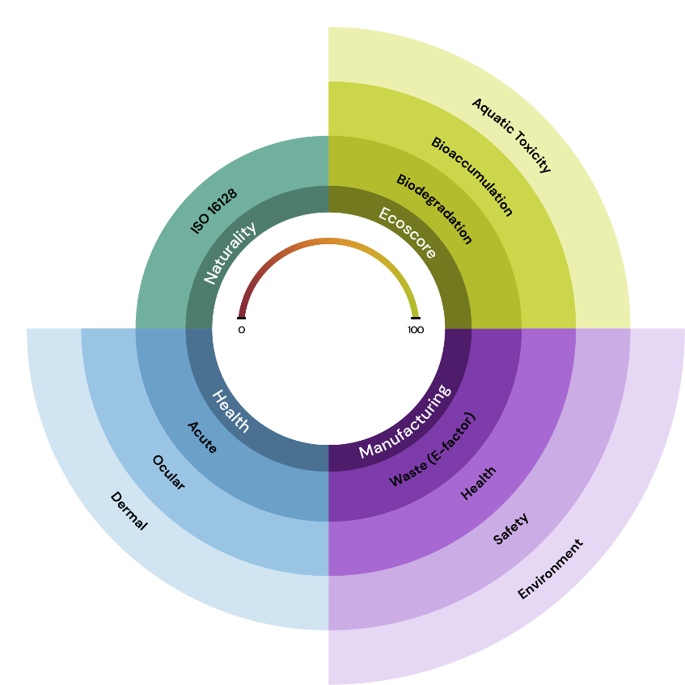

EXOVIVE™ LIFT: strong green chemistry profile*
confidential
Ecoscore
Readily biodegradable
No bioaccumulation
Not ecotoxic
Naturality
100% natural origin according to ISO 16126
: 100
Green Chemistry Score
: 100
100
Manufacturing
Extremely low waste (fruit residues fully re-used as organic fertilizers)
Physical / mechanical processing only
Mild conditions preserving bioactivity
: 100
Health
Water-based process
(no solvents)
Pesticides-free, organic cultivation
: 100
* dsm-firmenich Green Chemistry scoring method

Slide 21
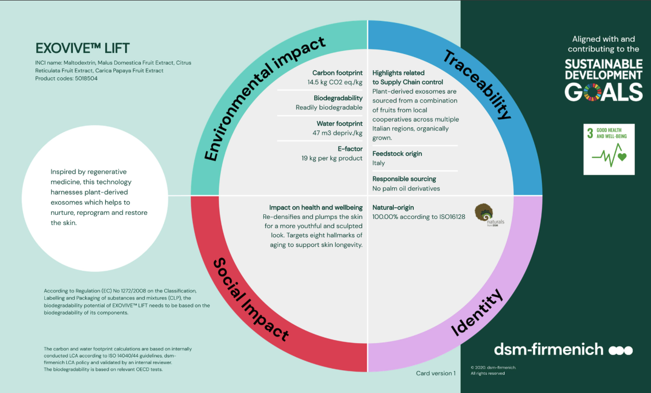

Slide 22
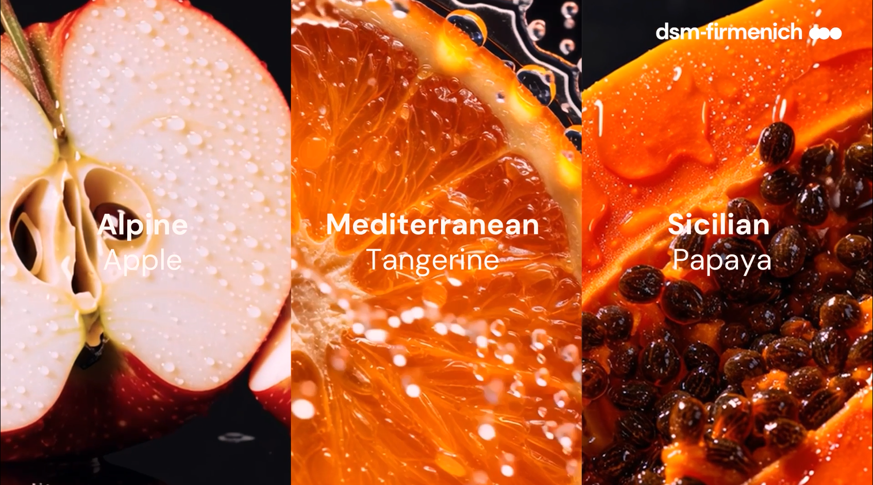

Slide 23
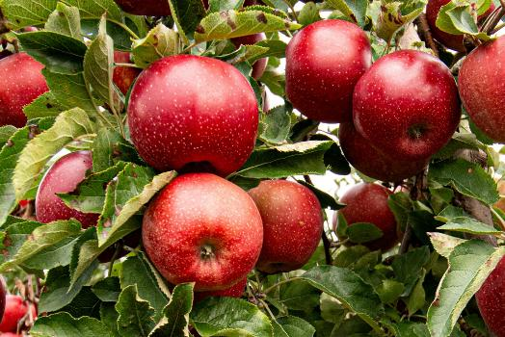
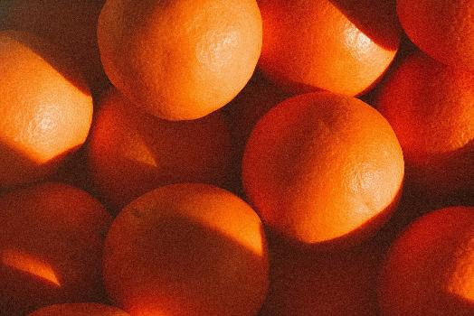
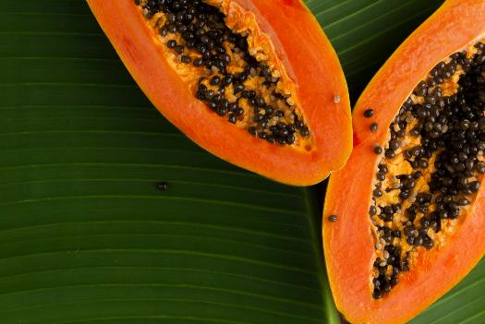
EXOVIVE™ LIFT: Nature’s finest, responsibly sourced ingredients
High-performing blend of fruits, cultivated with care and tradition
100% organically grown and sourced from local Italian cooperatives
Higher bioactive content than in products from conventional agriculture
Alpine Apple
Mediterranean Tangerin
Sicilian Papaya
Sourced in South Tyrol, Gala variety, benefiting a special Alpine-mediterranean climate with sunny days, cool nights and mineral-rich soils that enhance the metabolites production (such as catechin, quercetin, phloretin,…).
  Sourced in Calabria, grown under an ideal mediterranean climate, Calabria's soil is rich in organic matter and contains essential minerals like magnesium, calcium, and potassium, which contribute to the high quality and intense flavor of the fruit. The fruit is rich in vitamin C, antioxidants, and fiber. Harvesting happens between September and May.
Sourced in Sicily, Formosa and Solo varieties, the paradise for the fruits, with an island’s warm and sunny climate which favors optimal ripening. The soil used is primarily rocky, which is beneficial as it helps maintain a cool temperature in the summer and warmth during the winter. The cut grass is left on the soil, eliminating the need for added fertilizer. Rich in lycopene, papain, vitamin A,…
23

Slide 24
EXOVIVE™ LIFT
Mode of action
Two main activities:
1. Secondary metabolites
Unique blend of actives, efficiently delivered into target skin cells for enhanced biological activity: enzymatic & non-enzymatic antioxidants, phenolic compounds, flavonoids and ATP (important to provide energy for radical scavenging mechanisms), leading to antioxidant activity/reduction of inflammatory mediators/ protein expression.
2. miRNAs, genetic instructions
Short non-coded RNA molecules, fine-tuning how genes are expressed, natural switches for cell behavior. In skin biology, they orchestrate regeneration, barrier integrity, inflammation control, and extracellular matrix remodeling key processes defining healthy, youthful skin.

Slide 25
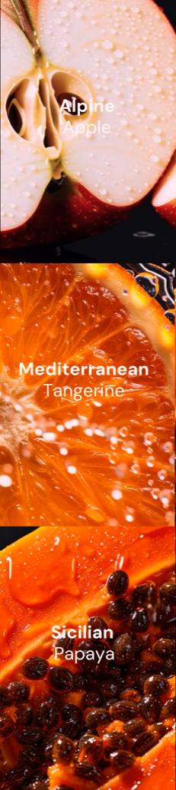
EXOVIVE™ LIFT
Characterization
Composition of main compounds:
Maltodextrin 70.7% / Plant-derived Exosome extract 29.3%
Sugars: Fructose, Glucose, Sucrose
Proteins and peptides (after hydrolysis 19 amino acids out of 20 have been identified, proline and asparagine the most abundant, cysteine absent)
Lipids
miRNAs
Secondary metabolites (as per table, with several skin benefits** such as antioxidant (NRF2 pathway), anti-inflammatory (TNF-α, IL6 inhibitors), protection against UV damage, wound healing, reducing signs of aging)
Secondary metabolites
Flavonoids | Nairutin, Hesperidin, Phloridzin*, Naringetin,* Hesperetin*, Trilobatin*, Sinensetin*
Triterpenoids | Limonin*, Nomilin*
Phenolic acids | Chlorogenic acid, Cryptochlorogenic acid
Antioxidants | Ascorbic acid, Catalase, SOD-1, Glutathione, Melatonin
Nucleotide | ATP
*: Proposed identification based on LC-MS-MS analysis
** Based on literature

Slide 26
49,000+ miRNAs identified in EXOVIVE™ LIFT
Playing an essential role in skin regeneration, skin barrier and the extracellular matrix
miRNAs | Skin regeneration | Skin barrier /immune/ inflammation | Extracellular Matrix | Epigenetic renewal
miRNA159 ^{1,2} |  | x
miRNA164 ^{1,2} | x | x | x
miRNA 171 ³ | x |  | x
miRNA 319 ¹ | x | x
miRNA 391 ¹ | x | x | x
miRNA 398 ² | x |  |  | x
miRNA 399 ¹ | x
Found in
1: Apple
2: Tangerine
3: Papaya
Skin regeneration:
miRNAs like miRNA159, miRNA164, and miRNA171 regulate growth factors and transcriptional co-regulators involved in fibroblast activation, collagen synthesis, and keratinocyte renewal. This supports smoother, denser, and more resilient skin.
Barrier and immune modulation:
Certain miRNAs (e.g., miRNA164, miRNA391, miRNA398) fine-tune immune and stress-related genes, balancing inflammatory cascades and autophagy. This promotes skin resilience.
Extracellular matrix homeostasis:
miRNAs targeting FN1 and glycosyltransferases sustain structural proteins like fibronectin and regulate matrix glycosylation, which contributes to elasticity, volume, and structural cohesion of the dermis.
Epigenetic renewal and longevity:
miRNAs like miRNA398 influence epigenetic regulators supporting long-term cellular function and slowing senescence-related decline in fibroblast vitality. Youthful looking skin for longer
Source: Sanchez-Romo D. et al., Identification of potential target genes in Homo sapiens, by miRNA of Triticum aestivum: A cross kingdom computational approach, Non-Coding RNA Research 2022, 7, 89-97
Notes:
miRNAs:
Apple: 47’250
Tangerine: 642
Papaya: 368

Slide 27
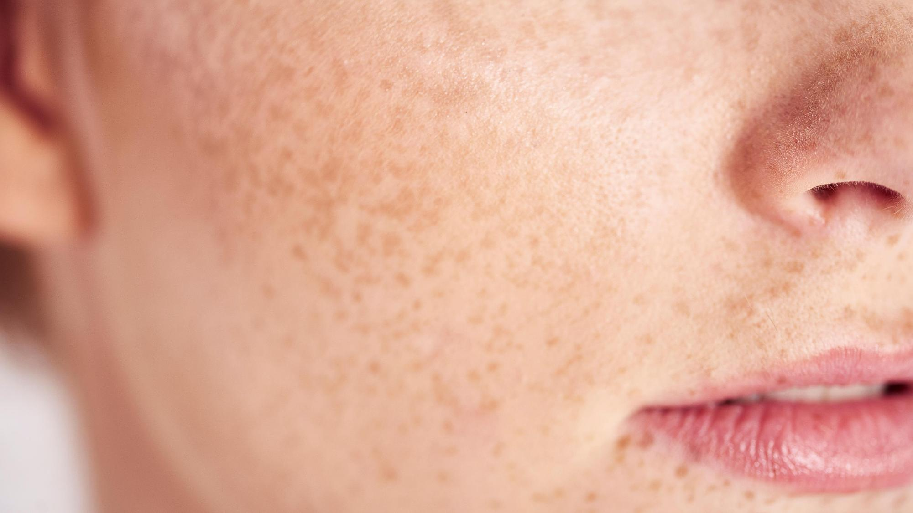
Proven efficacy

Slide 28
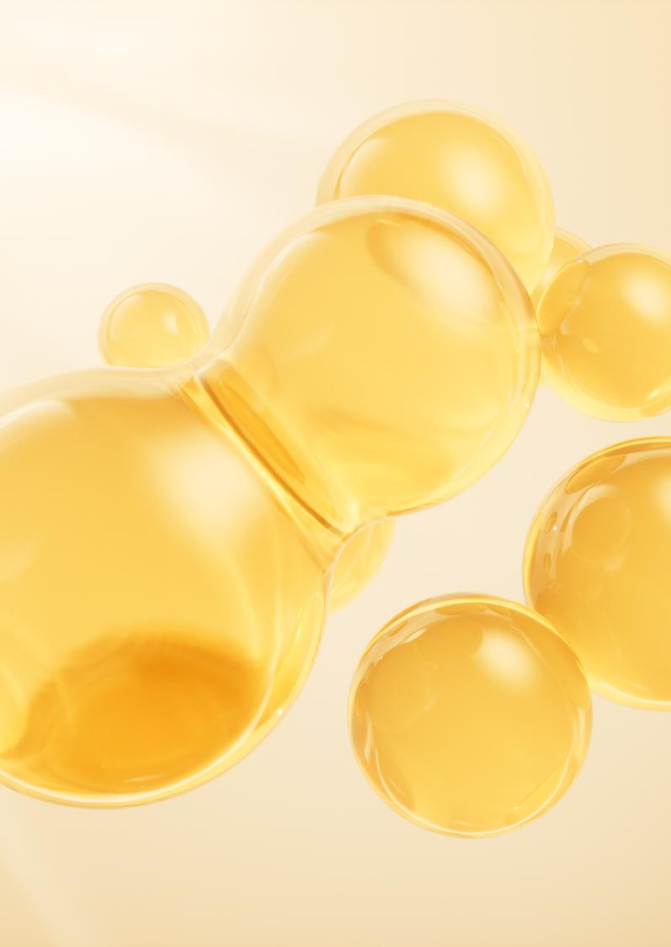

EXOVIVE™ LIFT
+90% Collagen-boost, at low concentration
****
**
*
**
CTRL
TGF-β
10^6/ml
10^7/ml
10^9/ml
EXOVIVE™ LIFT
* p<0.05, ** p<0.005 ***p<0.0005 ****p<0.0001
** p<0.01 *** p<0.001
Collagen 1 expression measured by flow cytometry in primary human dermal fibroblasts, concentration of EXOVIVE™ LIFT at 10^6, 10^7 and 10^9 plant-derived exosomes per ml

Slide 29

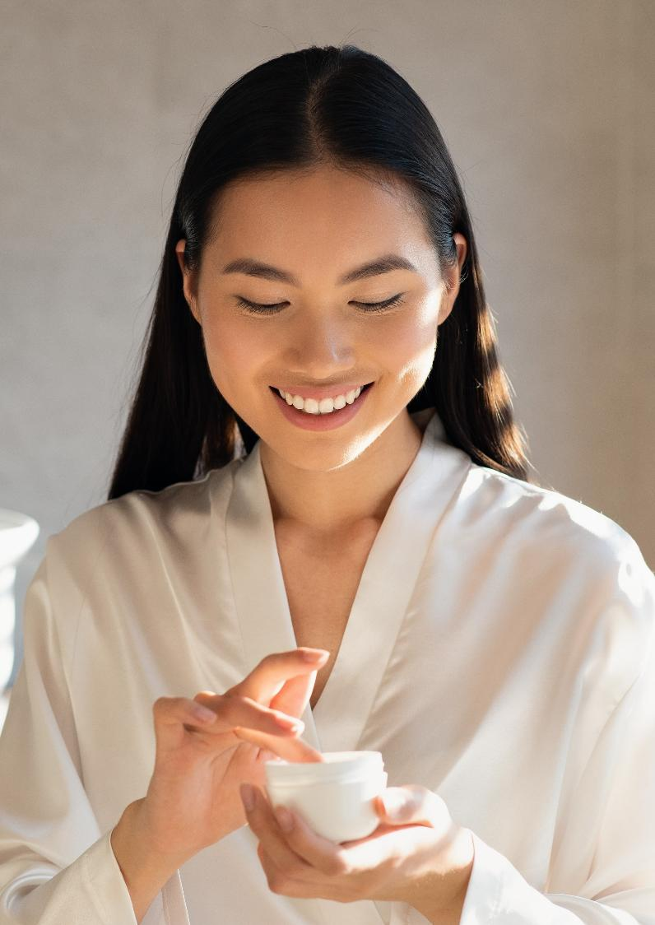
In vivo study design
Blind study with randomization
Hemiface application, twice daily
Female volunteers, mainly phototype II to III, aged from 37 to 69 years
45 volunteers per application
0.026% EXOVIVE™ LIFT (1 billion plant-derived exosomes per ml)
Placebo controlled, cream-gel formulation
2 months study, time points: T0, 4 weeks, 8 weeks
Self-assessment questionnaire
Cutometer
Firmness
Elasticity
Antera 3D
Crow’s feet wrinkle depth
D-Squame
Tape stripping
Antera 3D
Plumping volume

Slide 30

Wrinkles depth increases by ≈ 2%* every year
Cross‑sectional data on total volunteers at baseline prior to treatment
Wrinkle depth vs. age
0.25
Patent
application pending on skin clock
0.20
Wrinkle depth [mm]
0.15
0.10
Based on crows' feet wrinkles depth measurement from both facial sides of all volunteers at baseline
prior to treatment
*: 1.86%
0.05
40
50
Age [year]
60
70

Slide 31
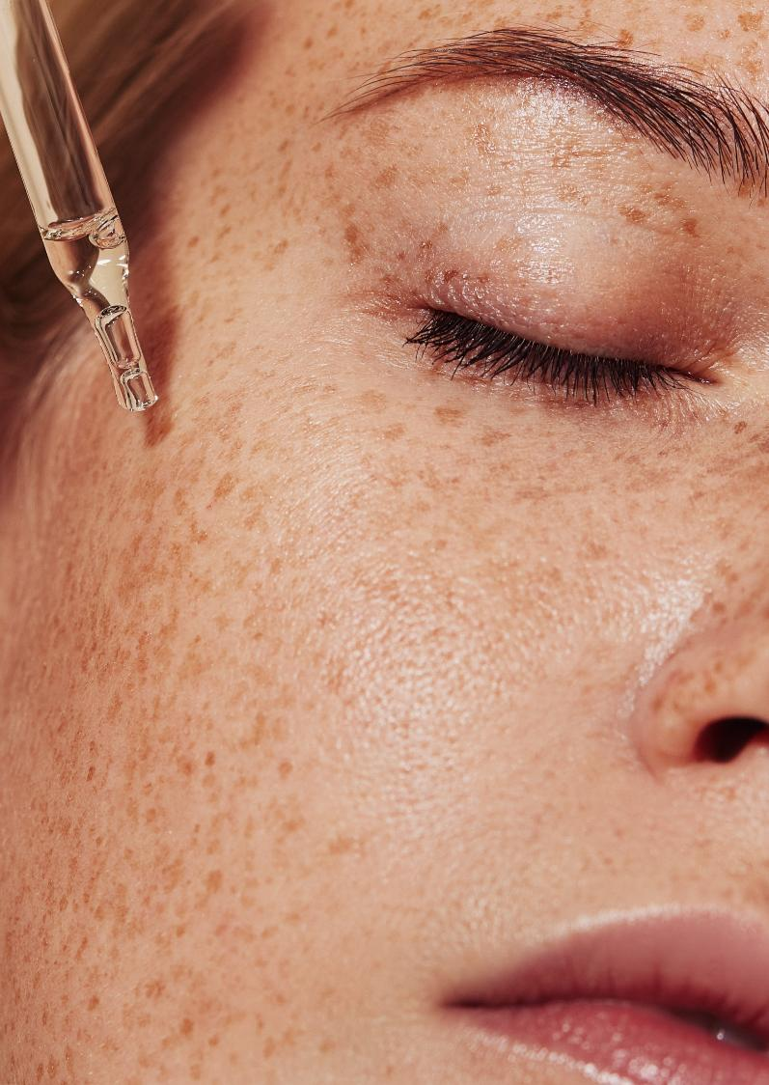
Wrinkles look 8 years* younger after 2 months
-15% significant reduction of wrinkles’ depth
Placebo
EXOVIVE™ LIFT
The skin is visibly smoother
-7.5%
**
-15.3% ***
4 weeks
8 weeks
** p<0.01 *** p<0.001
EXOVIVE™ LIFT significantly reduces the depth of crow’s feet wrinkles by -15% vs placebo after 2 months (wrinkle appearance looks 4 years younger in just 1 month)
* The effect of the formulation with EXOVIVE™ LIFT is compared to the yearly rate of crows’ feet wrinkle depth increase. Within 8 weeks, EXOVIVE™ LIFT reduces wrinkle depth compared to placebo by an amount comparable to approximatively 8 years of wrinkle depth increase

Slide 32
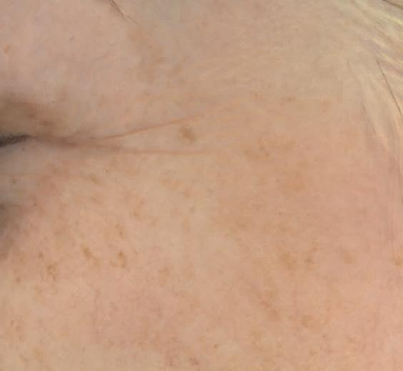
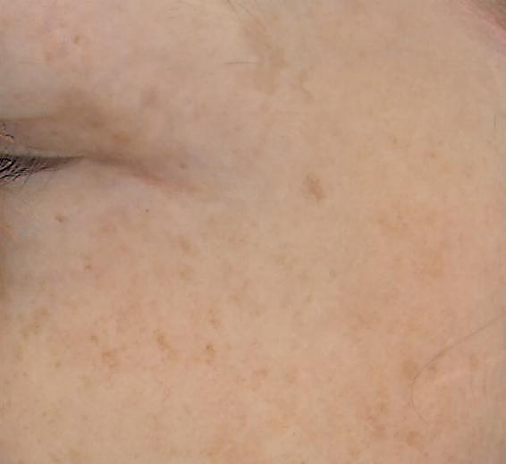
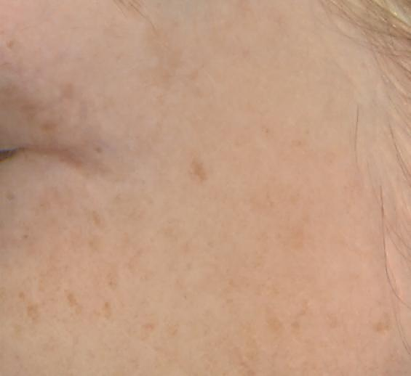
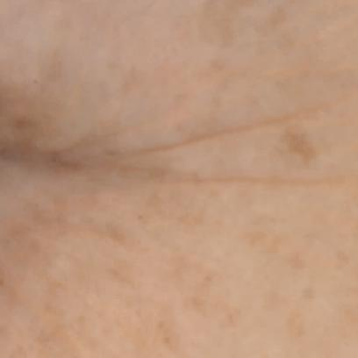
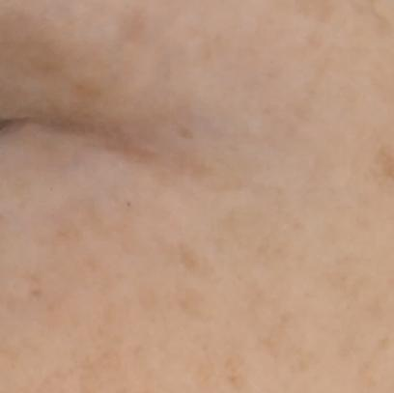
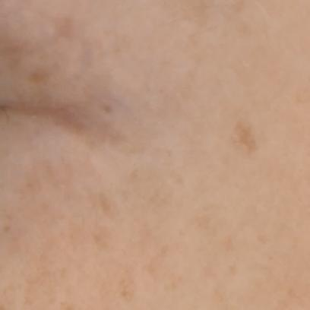
EXOVIVE™ LIFT
Impressive visible reduction of wrinkles’ depth
(up to -64% on this volunteer, 60+ y.o.)
t0
4 weeks
8 weeks
t1
t2
#82 volunteer

Slide 33
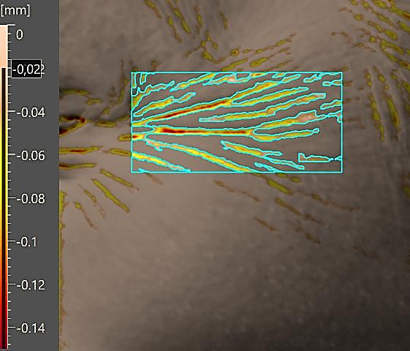
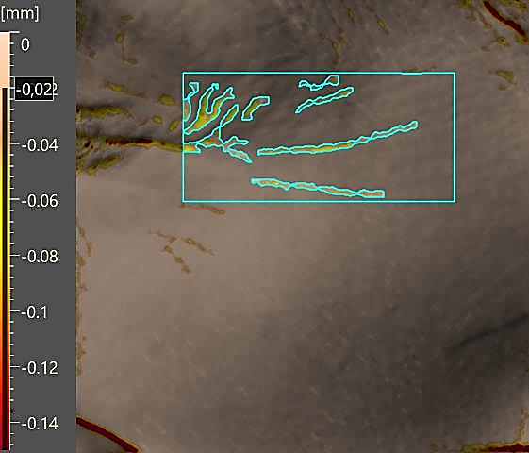
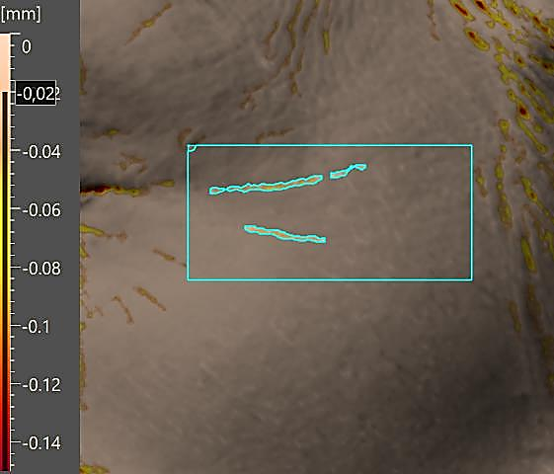
With EXOVIVE™ LIFT, up to -64% wrinkles’ depth reduction
t0
4 weeks
8 weeks
#82 volunteer (66 y.o.), skin type II
Wrinkles indentation is the combination of several criteria: length, area, volume, depth and count.
EXOVIVE™ LIFT
Wrinkles’ Length -90%
Wrinkles’ Area -93%
Wrinkles’ Volume -95%
in just 4 weeks
for volunteer #82

Slide 34
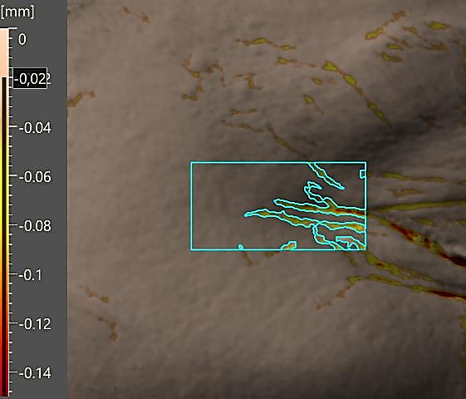
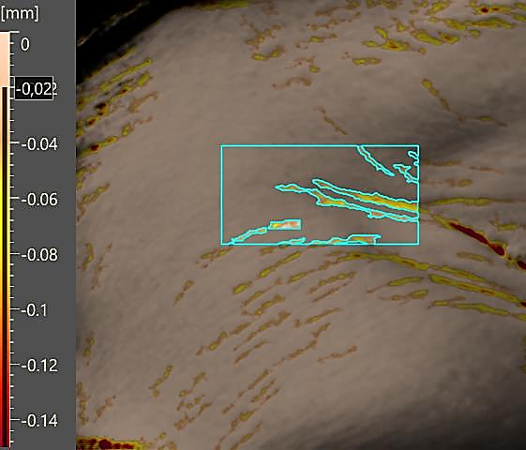
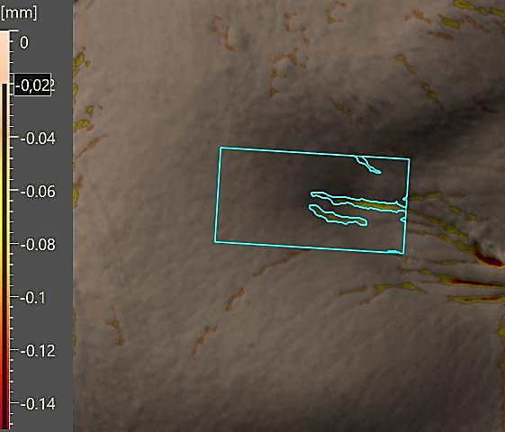
EXOVIVE™ LIFT reduces up to -32% the depth of fine lines
t0
4 weeks
8 weeks
#31 volunteer (55 y.o. ),
skin type II
Wrinkles indentation is the combination of several criteria: length, area, volume, depth and count.
EXOVIVE™ LIFT
Wrinkles’ Length -55%
Wrinkles’ Area -55%
Wrinkles’ Volume -62%
in 8 weeks
for volunteer #31

Slide 35

With EXOVIVE™ LIFT, skin is significantly revamped in just 4 weeks
Provides a rejuvenated and lifted skin appearance
In just 4 weeks:
skin elasticity is boosted by +23% vs T0 & placebo
& skin firmness by +18% vs T0
After 8 weeks:
skin elasticity by +33% and skin firmness by +22% vs T0
***
***
***
***
*
***
***
Placebo
EXOVIVE™ LIFT
Placebo
EXOVIVE™ LIFT
***
*
***
*
EXOVIVE™ LIFT vs Placebo
EXOVIVE™ LIFT vs Placebo
* p<0.05 ** p<0.01 *** p<0.001
4 weeks
8 weeks

Slide 36





EXOVIVE™ LIFT
Promotes plumped youthful-looking skin
The skin is visibly plumped with a rejuvenated appearance
For #55 volunteer (43 y.o.), images of plumping volume by Antera 3D, color code from light blue (the least plumped) to purple (the most plumped).
The expansion of the purple area signifies that more skin is plumped after treatment.
In just 4 weeks: EXOVIVE™ LIFT significantly increases the skin plumping by +12% vs placebo (+8% vs T0)
In 2 months:
+15% vs placebo (+10% vs To)
**
*
Placebo
EXOVIVE™ LIFT

Slide 37
EXOVIVE™ LIFT convinces the volunteers!
…my skin
feels softer
…my skin
feels firmer
…overall skin appearance improved
…I would use it as part of my cosmetic routine
94%
90%
90%
80%
86%
82%
…my skin feels revitalized
…wrinkles & fine lines improved
By using EXOVIVE™ LIFT at 0.026% for 2 months, 90% of volunteers agree:
skin feels softer, firmer and overall skin appearance has improved!
Naturals | The science of nature

Slide 38
EXOVIVE™ LIFT significantly outperforms standard fruit extract
EXOVIVE™ LIFT significantly outperforms the corresponding standard fruit mix extract, in all aging end-points.
9x better wrinkle reduction
3.9x better skin elasticity
29x better skin plumping
2.4x better skin firmness
after 2 months
3.9x better
than juice
9x better than juice
EXOVIVE™ LIFT vs Placebo
Fruit juice vs Placebo
EXOVIVE™ LIFT vs Placebo
Fruit juice vs Placebo
29x better
than juice
2.4x better
than juice
EXOVIVE™ LIFT vs Placebo
Fruit juice vs Placebo
EXOVIVE™ LIFT vs Placebo
Fruit juice vs Placebo
Fruit juice at the same concentration as EXOVIVE™ LIFT: 0.026%

Slide 39


More than 200 proteins significantly modulated by EXOVIVE™ LIFT
Method of Analysis: Proteomics on tape strips
240 skin tape-strips samples on 12 patients, 5 tape-strips were collected from each cheek (exosome-based treatment, and placebo) at two time points (Baseline and 8 weeks). The first tape-strip from each condition was not analyzed.
2943 human proteins were identified in all samples combined.
We compared first significant changes happening during the 2-month study for each placebo and EXOVIVE™ LIFT, and then we compare these 2 results and took the proteins significantly over- or under-abundant (fold changes ≥ 2 or ≤ 0.5):
EXOVIVE™ LIFT changes after 2 months vs Placebo
An LC-MS/MS instrument continuously analyses the fractions of a nano-HPLC separation of peptides resulting from the enzymatic digestion of a protein extract.
Protein Identification Data were processed with Proteome Discoverer 3.0. Proteins were identified by SEQUEST-HT search algorithm, comparing acquired MS/MS spectra to theoretical MS/MS peptide spectra derived in silico from a database of protein sequences.

Slide 40
1- New way to assess proteomics – Mode of action
Connection of clinical phenotype with molecular mode of action
Screening of Biological Pathways
Proteomics
Proteins associated with wrinkle change by EXOVIVE™ LIFT*
Selection of key biological pathways
Selection of key proteins and related genes
On tape strips from clinical study
Pathway = many related proteins
We found out how the improvement of wrinkles by EXOVIVE™ LIFT is correlated to some key biological pathways
Based on 12 volunteers having placebo and EXOVIVE™ LIFT on the same face
40
Notes:
Instead of looking at single proteins, we combine correlations of proteins into results for pathways, providing more reliable and potent insights
Pathway = many related proteins

Slide 41


Correlation between proteins and wrinkles change, both with EXOVIVE™ LIFT
Change of crow’s feet wrinkles and proteins abundance after 2 months with EXOVIVE™ LIFT vs their change after 2 months with placebo
proteins correlated with deeper wrinkles
EXOVIVE™ LIFT effect on wrinkle depth
1 dot = 1 volunteer

Slide 42

Identification of biological pathways modulated by EXOVIVE™ LIFT
Example of a pathway involved in chronic inflammation: MHC1 with key proteins correlated with wrinkles change by EXOVIVE™ LIFT
Instead of looking at single proteins, we combine correlations of proteins into results for pathways, providing more reliable and potent insights
Pathway = many related proteins
Example: Antigen processing and presentation (MHC1, KEGG database)
MHC1: upstream pathway of many immune and inflammaging processes in skin: barrier integrity, chronic inflammation, pigment,…
Proteins significantly correlated to wrinkle change and involved on this pathway are highlighted in red and pinkish color
Scale of proteins correlation after 2-month treatment
The genes shown here are those that contributed most to the pathway signal in our data, helping us understand why this pathway stood out in the analysis.
MHC1: major histocompatibility Class1 antigen, KEGG: Kyoto Encyclopedia of genes and genomes

Slide 43
EXOVIVE™ LIFT the perfect fit for skin longevity
Clinical improvements in wrinkle depth are associated with several hallmarks of aging
Chronic inflammation
Decreased activity in pathways typically engaged during immune stress and protein misfolding, consistent with lower cellular stress (“inflammaging”)
Pathways:
less antigen processing and presentation/ MHC1 (***, KEGG database)
less protein folding chaperone (*, GO database), needed when the cell is under stress. When damaged or misfolded proteins are efficiently cleared by the proteasome, the cell experiences less stress and therefore requires fewer protein‑folding chaperones.
Loss of proteostasis
Increased capacity of the proteasome–peptidase network, the cell’s main machinery for degrading damaged or misfolded proteins
Pathways:
Proteasome (*, KEGG database)
Peptidase complex (*, GO database)
Endopeptidase complex (*, GO database)
Proteasome core complex (**, GO database)
Antigen Processing, UB ATP independent proteasomal degradation (*, Reactome database)
intercellular communication alteration
Upregulation of the cell’s own built‑in logistics system for receiving and routing tiny biological packages, such as exosomes
Pathways:
SNARE binding (*, GO database)
Signaling adaptor activity (*, GO database)
Vacuole (*, GO database)
KEGG: Kyoto Encyclopedia of genes and genomes
GO: Gene ontology

Slide 44

Transcriptomics:
cross-kingdom miRNA analysis
We found out how the improvement of wrinkles is correlated to some key biological pathways thus by key proteins which might be modulated by the plant miRNAs contained in the cargo of EXOVIVE™ LIFT vesicles
regulated by
Selection of key proteins and related genes
miRNA (human)
Matching miRNA seed (active part)
Identification of seed region
miRNA seed region binding to mRNA
Identification of seed region
miRNA is a small RNA (RiboNucleic Acid) molecule found in cells:
Non-coding RNA (doesn’t make protein itself)
Acts like a control dimmer switch that helps decide how much protein a gene should make
The seed region is the critical part that determines which mRNA it binds to
Multiple seed region matches were identified, supporting a sequence‑based mechanistic link between the miRNA cargo of EXOVIVE™ LIFT and the molecular changes associated with reduced wrinkle depth
EXOVIVE™ LIFT content
miRNA (fruit)
Based on 12 volunteers having placebo and EXOVIVE™ LIFT on the same face

Slide 45
Exploratory cross-kingdom correlation between human miRNAs and fruit miRNAs based on tape strips
How EXOVIVE™ LIFT can trigger key skin proteins regulation via its miRNAs
Calnexin
HSP70
Based on 2 specific proteins and their associated genes HSP70 and Calnexin part of MHC1 pathway
We look a at the miRNAs that regulates these genes and more specifically to their specific seed region (the active part of miRNA)
We look at the miRNAs in EXOVIVE™ LIFT and at their seed region
We identified the matches between human miRNA and fruit miRNA seed regions
Clear mode of action how EXOVIVE™ LIFT can trigger skin benefit via fruit miRNA regulation on key skin proteins
Regulated by Human miRNA:
hsa-miR-4434
hsa-miR-4516
Hsa-miR-3616
Regulated by Human miRNA:
hsa-miR-1269
hsa-miR-6854
Seed region of
hsa-miR-4434: AGGAGAAGUAAAGUAGAA
Seed region of
hsa-miR-6854-5p:
AAGCUCAGGUUUGAGAACUGC
Match with same seed region
miRNAs in plant exosome extract:
Apple:
mdm-miR 319, mdm-miR395, mdm-miR 390, mdm-miR 164,…
Papaya:
cpa-miR-390, cpa-miR164,…
Seed region from Papaya:
cpa-miR164b
UGGAGAAGCAGGGCACAUGCC
Seed region from Apple
mdm-miR-390a:
AAGCUCAGGAGGGAUAGCGCC
example
Source: Li D, Wang F, Xu Y, Zhou H, Ma X, Shen Y. “A Timely Review of Cross‑Kingdom Regulation of Plant‑Derived microRNAs.” Frontiers in Genetics 2021;12:613197.

Slide 46
2- Proteomics: EXOVIVE™ LIFT the perfect fit for skin longevity
Beyond altered intercellular communication, EXOVIVE™ LIFT tackles 8 other hallmarks of ageing - based on proteins significantly upregulated by EXOVIVE™ LIFT
Hallmarks of Ageing | Proteins |  | Function
Loss of proteostasis | ERGIC1 | Endoplasmic reticulum-Golgi intermediate compartment protein 1 | Maintains youthful protein processing and secretion for improved ECM and skin smoothness.
 | DPP3 | Dipeptidyl peptidase 3 | Fine-tunes peptide signaling for repair and turnover in the dermis, for healthy ECM turnover, lifts firmness and bounce.
 | SERPINA3 | Alpha-1-antichymotrypsin | Serine protease inhibitor that protects ECM components like collagen from enzymatic degradation.
 | SERPINB6 | Serpin B6 | Intracellular serine protease inhibitor, key for protecting cells from proteolytic stress and damage.
Mitochondrial dysfunction | MDH1 | Malate dehydrogenase | Enzyme in the mitochondrial citric acid cycle. Boosts cellular energy for optimal fibroblast renewal and wrinkle resistance.
Epigenetic alteration | SDR16C5 | Retinal short chain dehydrogenase reductase isoform 1, isoform CRA_c | Powers retinoid pathways, improving cell turnover and “resetting” skin’s youth code.
Stem Cell exhaustion | DYNLL2 | Dynein light chain 2, cytoplasmic | Drives intracellular trafficking for efficient cell division and renewal.
 | KRT74 | Keratin 74 | Structural keratin in hair follicle and epidermis. Strengthens skin structure and resilience (skin barrier), fights thinning and fragility in ageing skin.
 | KRT6B | Keratin, type II cytoskeletal 6B | Keratins contribute to skin barrier and structural integrity, supporting skin resilience. Fights thinning and fragility in ageing skin.
Genomic instability | HNRNPA2B1 | Heterogeneous nuclear ribonucleoproteins A2/B1 | Enhances RNA processing.
Telomere attrition | HNRNPA2B1 | Heterogeneous nuclear ribonucleoproteins A2/B1 | Preserves telomere function and slows cellular senescence.
Chronic inflammation | SERPINA3 | Alpha-1-antichymotrypsin | Reduces chronic inflammation, speeds up wound healing.
 | SERPINB6 | Serpin B6 | Preserves cell viability and tissue integrity—critical to both elasticity and regeneration dynamics.
Cellular senescence | SERPINB6 | Serpin B6 | Supports healthy longevity of skin cell.

Slide 47
EXOVIVE™ LIFT strongly overexpressed key proteins in vivo
Proteomics on tape strips
From around 3’000 proteins identified on tape strips, we have found more than 10 Proteins significantly upregulated by EXOVIVE™ LIFT after 2 months vs placebo.
178%
*
10 key selected proteins significantly overexpressed by EXOVIVE™ LIFT boosting skin longevity
+150%
+100%
Change from t2 to t0 [%]
53%
47%
EXOVIVE™ LIFT
+50%
*
35%
Placebo
24%
21%
*
19%
13%
*
*
**
*
6%
Genes: Proteins coded
DPP3: Dipeptidyl peptidase 3
DYNLL2: Dynein light chain 2, cytoplasmic
ERGIC1: Endoplasmic reticulum-Golgi intermediate compartment protein 1
HNRNPA2B1: Heterogeneous nuclear ribonucleoproteins A2/B1
KRT6B: Keratin, type II cytoskeletal 6B
KRT74: Keratin 74
MDH1: Malate dehydrogenase
SDR16C5: Retinal short chain dehydrogenase reductase family 16C Member 5,
SERPINA3: Alpha-1-antichymotrypsin
SERPINB6: Serpin B6
*
**
0%
*
-7%
-1%
-2%
-9%
-16%
-12%
-13%
-20%
-28%
-33%
-26%
DPP3
DYNLL2
ERGIC1
HNRNPA2B1
KRT6B
KRT74
MDH1
SDR16C5
SERPINA3
SERPINB6
Significance of changes EXOVIVE™ LIFT vs Placebo after 2 months
*: p <0.05, ** p<0.01
Protein

Slide 48
EXOVIVE™ LIFT by dsm-firmenich
Elevating science
Setting new standards in the field of plant-derived exosomes:
Characterization & standardization
One billion vesicles in a single application (1 ml)
>40k miRNAs identification with clear mode of action
+90% Collagen boost*
Outstanding clinically proven** after 2 months efficacy:
  Re-densifies & plumps the skin
  Boosts skin elasticity up to +33% and firmness by 22%
  Reverses 8 years of wrinkles
  Tackles 9 hallmarks by up-regulating key proteins involved in skin regeneration, skin barrier, extracellular matrix protection,…)
  Overperforms the equivalent standard fruit extract
* In vitro ** in vivo

Slide 49

dsm-firmenich plant-derived exosomes
THE TECHNOLOGY
PROVEN EFFICACY
Breakthrough
Protects and delivers the most bioavailable form of natural bioactive compounds, ensuring efficient cellular uptake and enhancing activity
Allows customized approach
In vivo proof of concept: significant superiority vs standard fruit extract
Outstanding in vivo results with significance vs T0 and placebo on key aging markers (wrinkle, elasticity, firmness, plumping,…)
UNIQUE PROCESS & SOLUTIONS
Exolab Italia trustful expert partner, >20 years' experience in the field of Exosomes, from pharma business
Plant-derived exosomes, with unique “synergy system” of fruits
State of the art visualization of exosomes with special microscopes
One billion plant-derived exosomes in a single application
Proven mode of action: secondary metabolites & miRNAS
Skin longevity: 9 hallmarks of ageing tackled based on proteins modulated with EXOVIVE™ LIFT in vivo
Stable powder form, low use level
Easy to formulate, clear solution
SUSTAINABILITY
100% Natural & sustainable: responsible sourcing, only physical processes, no solvent, low CFP

Slide 50

Concepts &
Line-up

Slide 51
EXOVIVE™ LIFT brings possibilities to connect with brands from different market spaces.
Here we land two different propositions for the same ingredient.

Slide 52


Slide 53


Is it possible to speak the native language
of youthful skin? Exosome science says yes.
The skin is a living network of cells, constantly communicating through microscopic messengers called exosomes. When cells stop talking, skin begins to age. Aging, at its core, is a communication breakdown. When cells stop talking, skin begins to age. But this dialogue can be restored.
Intercellular communication within plants happens in the same way. Powered by the innovative EXOVIVE™ LIFT, the EXOSYNC line combines cutting-edge
dermo-medical science with dsm-firmenich’s
expertise in decoding the intelligence of nature.
Plant-derived exosomes - pure actives condensed in
a cell-like membrane that penetrates easily - mirror the skin's own communication system to reactivate cellular dialogue, delivering the performance of professional treatments in your daily routine.
The result? Visible skin renewal and a more youthful, sculpted look. Or, in other words: the future of natural skincare science.

Slide 54





Slide 55

Reverses 8 years of wrinkles
Up to +30% skin’s elasticity
+90% Collagen I boost
with EXOVIVE™ LIFT
Syncing skin cells
for deep regeneration
Pearl Serum
Pearl Serum is a luxurious concentrate that enhances skin elasticity and firmness. Infused with EXOVIVE™ LIFT and the collagen-boosting duo SYN®-COLL CB and ETERWELL™ YOUTH, it delivers powerful anti-aging benefits. Luminous pearls release potent actives upon application, restoring skin’s youthful bounce and vitality.

Slide 56
Reverses 8 years of wrinkles
Up to +30% skin’s elasticity
+90% Collagen I boost
with EXOVIVE™ LIFT
Syncing skin cells
for deep regeneration
Pearl Serum
SK-E-102856-31
Ingredients: AQUA, ALGIN, GLYCERIN, PENTYLENE GLYCOL, SYN®-COLL CB (1%), ETERWELL™ YOUTH (1%), C13-14 ALKANE, POLYGLYCERYL-6 CAPRYLATE, POLYGLYCERYL-4 CAPRATE, POLYACRYLATE CROSSPOLYMER-6, CAPRYLYL GLYCOL, BIS-POLYCITRONELLYL SUCCINATE, SODIUM PHYTATE, UNDECANE, MICA, PINK BLOSSOM P02R418 (0.05%), EXOVIVE™ LIFT (0.026%), IRON TITANIUM OXIDE, SILICA, CI 77891, TIN OXIDE

Slide 57



with EXOVIVE™ LIFT
Reverses 8 years of wrinkles
Up to +30% skin’s elasticity
+90% Collagen I boost
Syncing skin cells
for deep regeneration
Marshmallow Cream
A sensorially rich, nutritive skincare cream that melts effortlessly into the skin for a soft, velvety finish. Infused with EXOVIVE™ LIFT, a powerful exosome complex and with a blend of HYA-ACTTM XS, STIMU-TEX® AS and Niacinamide PC to protect the skin. It visibly enhances skin elasticity and firmness. This luxurious formula delivers both indulgent texture and transformative results for a radiant and smoothed complexion.
98.47% natural origin content

Slide 58
with EXOVIVE™ LIFT
Reverses 8 years of wrinkles
Up to +30% skin’s elasticity
+90% Collagen I boost
Syncing skin cells
for deep regeneration
Marshmallow Cream
SK-E-102649-23
Ingredients: AQUA, PROPANEDIOL, MACADAMIA INTEGRIFOLIA/TETRAPHYLLA SEED OIL, ORYZA SATIVA BRAN OIL, BUTYLENE GLYCOL, GLYCERYL BEHENATE, Niacinamide PC (3%), POLYGLYCERYL-6 DISTEARATE, CANDELILLA/JOJOBA/RICE BRAN POLYGLYCERYL-3 ESTERS, JOJOBA ESTERS, ARGAN OIL (1%), STIMU-TEX® AS (1%), POTATO STARCH MODIFIED, ACACIA DECURRENS FLOWER CERA, Mixed Tocopherols 95 (0.5%), HYA-ACT™ XS (0.5%), CAPRYLYL GLYCOL, GLYCERYL CAPRYLATE/CAPRATE, CETYL HYDROXYETHYLCELLULOSE, PINK BLOSSOM P02R418 (0.3%), EXOVIVE™ LIFT (0.026%), GLYCERIN, POLYGLYCERIN-3, CITRIC ACID, HELIANTHUS ANNUUS SEED CERA

Slide 59

Reverses 8 years of wrinkles
Up to +30% skin’s elasticity
+90% Collagen I boost
with EXOVIVE™ LIFT
Syncing skin cells
for deep regeneration
Day Care Cream SPF 30
Day Care Cream SPF 30 is a high-performance daily moisturizer designed to protect the skin with a high eco-profile scire. It features EXOVIVE™ LIFT, and its exosome technology that enhances skin firmness and elasticity and a modern PARSOL® UV-filter system that efficient sun protection. Also enriched with the natural biotech duo REGU®-AGE CB and PEPHA®-CTIVE CB, delivering visible smoothness and radiance, making it an ideal choice for new generation natural science.

Slide 60
Reverses 8 years of wrinkles
Up to +30% skin’s elasticity
+90% Collagen I boost
with EXOVIVE™ LIFT
Syncing skin cells
for deep regeneration
Day Care Cream SPF 30
SK-E-102807-14
Ingredients: AQUA, DICAPRYLYL CARBONATE, PARSOL® DHHB (6%), C12-15 ALKYL BENZOATE, ISOPROPYL LAUROYL SARCOSINATE, PROPANEDIOL, PARSOL® EHT (5%), PARSOL® Shield (2%), PEPHA®-CTIVE CB (2%), REGU®-AGE CB (2%), POLYGLYCERYL-10 STEARATE, VALVANCE® Touch 210 (1%), BEHENYL ALCOHOL, CAPRYLYL GLYCOL, PINK BLOSSOM P02R418 (0.5%), XANTHAN GUM, GLYCERYL CAPRYLATE, MICA, CITRIC ACID, CI 77891, EXOVIVE™ LIFT (0.026%), CI 77491, TOCOPHEROL

Slide 61



with EXOVIVE™ LIFT
Syncing skin cells
for deep regeneration
PINK BLOSSOM P02R418
Premium olfactive experience.
Youth quintessence captured in a fragrance
Floral notes are giving vibrancy & elegance to the fragrance, while AMBROX® captive with unparalleled depth, exudes a timeless natural sensuality.
powered with emotiboost® accord, neuroscientifically proven to make you feel confident.
top: red fruits pear peach
mid: rose muguet violet
fond: musky vanilla powdery
Notes:
TECHNO: powered with emotiboost™ accord, designed* to make you feel confident, that supports the idea of premium application, emotional benefit good for mature skins

Slide 62



Slide 63

The quintessence of nature.
The code of renewal.

Slide 64

The quintessence of nature.
The code of renewal.
What if nature could speak directly to your skin?
Exosome science says yes. The skin is a living network of cells, constantly communicating through microscopic messengers called exosomes Aging, at its core, is a communication breakdown. When cells stop talking, skin begins to age. But this dialogue can be restored.
Intercellular communication within plants happens in the same way. Powered by the innovative EXOVIVE™ LIFT, the Exssence line captures the quintessence of nature to resume skin cells communication. Carefully sourced from organic natural origins, plant-derived exosomes are preserved at full
potency through dsm-firmenich's sustainable patented extraction process. Like perfectly crafted puzzle pieces, they integrate harmoniously with your skin's own communication system, reactivating the cellular communication and supporting natural regeneration.
The result? Skin that glows with vitality, sculpted and youthful. The pinnacle of natural skincare science.

Slide 65




The quintessence of nature.
The code of renewal.

Slide 66

with EXOVIVE™ LIFT
The quintessence of nature.
The code of renewal.
Marshmallow Cream
A sensorially rich, nutritive skincare cream that melts effortlessly into the skin for a soft, velvety finish. Infused with EXOVIVE™ LIFT, a powerful exosome complex and with a blend of HYA-ACTTM XS, STIMU-TEX® AS and Niacinamide PC to protect the skin. It visibly enhances skin elasticity and firmness. This luxurious formula delivers both indulgent texture and transformative results for a radiant and smoothed complexion.
98.47% natural origin content

Slide 67
with EXOVIVE™ LIFT
The quintessence of nature.
The code of renewal.
Marshmallow Cream
SK-E-102649-23
Ingredients: AQUA, PROPANEDIOL, MACADAMIA INTEGRIFOLIA/TETRAPHYLLA SEED OIL, ORYZA SATIVA BRAN OIL, BUTYLENE GLYCOL, GLYCERYL BEHENATE, Niacinamide PC (3%), POLYGLYCERYL-6 DISTEARATE, CANDELILLA/JOJOBA/RICE BRAN POLYGLYCERYL-3 ESTERS, JOJOBA ESTERS, ARGAN OIL (1%), STIMU-TEX® AS (1%), POTATO STARCH MODIFIED, ACACIA DECURRENS FLOWER CERA, Mixed Tocopherols 95 (0.5%), HYA-ACT™ XS (0.5%), CAPRYLYL GLYCOL, GLYCERYL CAPRYLATE/CAPRATE, CETYL HYDROXYETHYLCELLULOSE, PINK BLOSSOM P02R418 (0.3%), EXOVIVE™ LIFT (0.026%), GLYCERIN, POLYGLYCERIN-3, CITRIC ACID, HELIANTHUS ANNUUS SEED CERA

Slide 68
with EXOVIVE™ LIFT
The quintessence of nature.
The code of renewal.
Pearl Serum
Pearl Serum is a luxurious concentrate that enhances skin elasticity and firmness. Infused with EXOVIVE™ LIFT and the collagen-boosting duo SYN®-COLL CB and ETERWELL™ YOUTH, it delivers powerful anti-aging benefits. Luminous pearls release potent actives upon application, restoring skin’s youthful bounce and vitality.
99,56% natural origin content

Slide 69
with EXOVIVE™ LIFT
The quintessence of nature.
The code of renewal.
Pearl Serum
SK-E-102856-31
Ingredients: AQUA, ALGIN, GLYCERIN, PENTYLENE GLYCOL, SYN®-COLL CB (1%), ETERWELL™ YOUTH (1%), C13-14 ALKANE, POLYGLYCERYL-6 CAPRYLATE, POLYGLYCERYL-4 CAPRATE, POLYACRYLATE CROSSPOLYMER-6, CAPRYLYL GLYCOL, BIS-POLYCITRONELLYL SUCCINATE, SODIUM PHYTATE, UNDECANE, MICA, PINK BLOSSOM P02R418 (0.05%), EXOVIVE™ LIFT (0.026%), IRON TITANIUM OXIDE, SILICA, CI 77891, TIN OXIDE

Slide 70
with EXOVIVE™ LIFT
The quintessence of nature.
The code of renewal.
Day Care Cream SPF 30
Day Care Cream SPF 30 is a high-performance daily moisturizer designed to protect the skin with a high eco-profile scire. It features EXOVIVE™ LIFT, and its exosome technology that enhances skin firmness and elasticity and a modern PARSOL® UV-filter system that efficient sun protection. Also enriched with the natural biotech duo REGU®-AGE CB and PEPHA®-CTIVE CB, delivering visible smoothness and radiance, making it an ideal choice for new generation natural science.

Slide 71
with EXOVIVE™ LIFT
The quintessence of nature.
The code of renewal.
Day Care Cream SPF 30
SK-E-102807-14
Ingredients: AQUA, DICAPRYLYL CARBONATE, PARSOL® DHHB (6%), C12-15 ALKYL BENZOATE, ISOPROPYL LAUROYL SARCOSINATE, PROPANEDIOL, PARSOL® EHT (5%), PARSOL® Shield (2%), PEPHA®-CTIVE CB (2%), REGU®-AGE CB (2%), POLYGLYCERYL-10 STEARATE, VALVANCE® Touch 210 (1%), BEHENYL ALCOHOL, CAPRYLYL GLYCOL, PINK BLOSSOM P02R418 (0.5%), XANTHAN GUM, GLYCERYL CAPRYLATE, MICA, CITRIC ACID, CI 77891, EXOVIVE™ LIFT (0.026%), CI 77491, TOCOPHEROL

Slide 72

with EXOVIVE™ LIFT
The quintessence of nature.
The code of renewal.
PINK BLOSSOM P02R418
Premium olfactive experience.
Youth quintessence captured in a fragrance
Floral notes are giving vibrancy & elegance to the fragrance, while AMBROX® captive with unparalleled depth, exudes a timeless natural sensuality.
powered with emotiboost® accord, neuroscientifically proven to make you feel confident.
top: red fruits pear peach
mid: rose muguet violet
fond: musky vanilla powdery
Notes:
TECHNO: powered with emotiboost™ accord, designed* to make you feel confident, that supports the idea of premium application, emotional benefit good for mature skins

Slide 73
Disclaimer
Copyright © dsm-firmenich Switzerland AG, 2026, 4002 Basel, Switzerland.
www.dsm-firmenich.com. All rights reserved.
dsm-firmenich has used diligent care to ensure that the information provided herein is accurate and up-to-date to the best of its knowledge. However, dsm-firmenich makes no representation or warranty, either expressly or implied, of the accuracy, reliability, completeness, or suitability thereof. The information provided herein contains scientific and product information for business-to-business use and does not constitute or provide scientific or medical advice, diagnosis or recommendation for treatment options. Country or region-specific information should be considered when labelling or advertising to final consumer. In no event shall dsm-firmenich be liable for any direct or indirect damages arising from or reliance upon, or use of, any information provided herein. The content of this document is subject to change without further notice. Please contact your local dsm-firmenich representative for the latest information. All trademarks listed in this document are either (registered) trademarks of, or trademarks licensed by, the dsm-firmenich group of companies, unless explicitly stated otherwise.
Disclaimer Formulation Guideline
The information provided herein is provided for information purposes only and has been prepared by dsm-firmenich in accordance with its own methodology.
dsm-firmenich has used diligent care to ensure that it is accurate and up-to-date, however, dsm-firmenich makes no representation or warranty, either expressly or implied, of the accuracy, reliability, or completeness thereof. In no event shall dsm-firmenich be liable for any damages arising from or reliance upon, or use of, any information provided herein. Further, dsm-firmenich shall not bear any liability for the application and/or use of any processed material containing its product(s). The formulation of the finished product is the customer’s sole responsibility. It is the customer’s responsibility to determine the suitability of dsm-firmenich’s products regarding user specific purposes, assess compatibility and stability of their finished product(s) and to ensure compliance of their finished product(s) with relevant laws and regulations. Any product, marketing or other claims made by customer are its sole responsibility. The content of this document is subject to change without further notice. Please contact your local dsm-firmenich representative for further details. © dsm-firmenich Switzerland AG, 2026.
© 2026

Slide 75
EXOVIVE™ LIFT: synergetic blend of fruits
Unique synergy system
Evidence on collagen assay and scratch test blend of Apple, Mandarin and Papaya, unique combination of actives and miRNAs working together and increasing their potential benefits for enhanced biological activity
Scratch test: Wound healing in vitro assay on Normal human fibroblasts
Collagen Assay: In vitro assay on normal human fibroblasts
Pro-collagen I production (R92_Collagen I Assay [n=3])
*
Untreated control
Untreated control
EXOVIVE™ LIFT
Measurement after 24 and 48 hours with 10^6 vesicles/ml
Sample 10^6 exosomes/ml | Closure 24h
Control | 63.8%
Apple | 70.8%
Tangerine | 75.1%
Papaya | 67.6%
EXOVIVE™ LIFT | 83.1%
Almost 2 times faster with EXOVIVE™ LIFT compared to single fruit exosome fraction
EXOVIVE™ LIFT significantly stimulates Pro-collagen I at the tested concentrations, whereas the individual Exosome formulations exhibit only minor or negligible effects on Pro-collagen I induction
Un-paired t-test *p<0.05, **p<0.001

Slide 76





Plant-Derived Extracellular Vesicles from organic farming
Higher number of vesicles and slightly smaller size of vesicles vs conventional farming
Testing on 4 different fruits: kiwi, lemon, grapefruit and blood orange
+22%
+36%
+39%
+49%
In addition, the Total Antioxidant Capacity has been measured and was also significantly higher in the organic farming-derived vesicles:
+11% Kiwi, + 7% Lemon, +21% Grapefruit and +6% Blood orange
Quantification of conventional and organic farming-derived extracellular vesicles by NTA
* p<0.05, ** p<0.001, *** p<0.0001
Source: Logozzi M. et al. , Nanovesicles from organic agriculture-derived fruits and vegetables: characterization and functional antioxidant content, Int. j. Mol. Sci,, 2021, 22, 8170

Slide 77
Connection of clinical efficacy with coherent molecular mode of action
This integrative analysis links the clinical wrinkle‑reducing effects of EXOVIVE™ LIFT with :
molecular alterations identified through within‑subject proteomics and
the miRNA cargo of plant‑derived exosomes.
By correlating protein fold changes with each participant’s degree of improvement, we identified molecular programs that shift preferentially in individuals exhibiting stronger clinical responses.
To investigate whether plant miRNAs could plausibly contribute to these improvement‑aligned molecular patterns, we compared the seed regions of human miRNAs regulating key proteins with those of miRNAs present in apple, papaya, and tangerine exosomes.
Multiple seed matches were identified, supporting a sequence‑based mechanistic link between the miRNA cargo of EXOVIVE™ LIFT and the molecular changes associated with reduced wrinkle depth.
77

Slide 78
Role of miRNA
Importance of the seed region
miRNA is a small RNA (RiboNucleic Acid) molecule found in cells:
Non-coding RNA (doesn’t make protein itself)
Acts like a control dimmer switch that helps decide how much protein a gene should make
miRNA binds to messenger RNA (mRNA - genes make protein by first making mRNA), this binding reduces protein production
miRNA is made of a sequence of about 22 nucleotides (from 4 nucleobases: Adenine, Guanine, Cytosine and Uracil)
miRNA seed region binding to mRNA
Example of human miRNA 4434:
The seed region is the critical part that determines which mRNA it binds to.
Corresponds to nucleotides 2-7 (or 2-8)
It determines the target specificity
Small changes in the seed region can completely change which genes are regulated.
hsa-miR-4434: AGGAGAAGUAAAGUAGAA
Seed region
Naturals | The science of nature
78

Slide 79
Exosomes: overview on competition
Differentiators
  Genuine exosome (no liposome, no biomimetic exosome)
  Purification of exosome (no particulate matter, number of exosomes clearly mentioned)
  From organic fruit or plant (no stem cell)
  Unique fruit composition
  Cosmos approved (on going)
  Sustainable extraction, only physical processes, no solvent, low CFP
  Powder form, more stable, longer shelf life
  In vitro data at low concentration
  Clinical study showing significant superiority vs corresponding standard juice extract
  Significant and dose dependent skin benefits on main longevity markers: elasticity, firmness, wrinkles vs To and vs Placebo

Slide 80







New capability: Actives and fragrances encapsulation
Beautifying cosmetic formulations (featured on Pearl Serum)
Proprietary encapsulation technology
  Natural, biodegradable, macroscopic beads (0.3-4mm)
  Easily breakable under deposition without residues, creamy texture
  Encapsulation of cosmetic actives AND fragrance: high loading (>20%)
  Blooming fragrance performance
  Compatible with surfactant-containing bases
  Cosmetic ingredients encapsulation for improved protection and delivery
  Moisturizing cosmetic benefits
Support pigments, mica
Scent pearls in shower gel or liquid hand soap, for a skin moisturization and blooming fragrance performance.
Mono Pearl Fragrance: Each pearl contains the right amount of fragrance
Dual moisturizing hand sanitizer: Hydroalcoholic gel + moisturizing perfumed skin pearls for a dual-function product
Monodose skin pearl with or without fragrance, for daily use as face cream
80

Slide 81

EXOVIVE™ LIFT delivers key miRNAs
Method of analysis
Plant Material and Sampling: Apple (Malus domestica), Tangerine (Citrus reticulata), Papaya (Carica papaya)
Quality control and pre-processing: For each sample (which was analyzed in triplicate), the raw sequencing data was first checked for overall quality. This included checking the read quality values, detecting adapter contamination and checking the alignment rates.
Alignment and mapping: The cleaned reads were aligned to reference miRNA databases using tools such as Bowtie and miRDeep2. This step enabled the accurate identification and quantification of the known miRNAs in each replicate.
Differential expression analysis: The expression levels of miRNAs were compared in the three replicates and between different fruit samples. Statistical tools such as DESeq2 was used to identify significantly differentially expressed miRNAs.
Discovery of novel miRNAs: In addition to profiling known miRNAs, new miRNAs were predicted using miRDeep2.

Slide 82












Imaging the Uptake of Plant-Derived Exosomes into Cells Using Nanolive Microscope
Pre-label exosomes by Dill dye
Wash out excessive dye
Seed fibroblasts cells
Add pre-labeled and purified exosomes
Image acquisition

Slide 83
EXOVIVE™ LIFT outperforms placebo & convinces the volunteers!
…my skin
feels softer
…my skin
feels firmer
…overall skin appearance improved
…I would use it as part of my cosmetic routine
80%
94%
80%
90%
80%
90%
Placebo
EXOVIVE™ LIFT
Placebo
EXOVIVE™ LIFT
63%
80%
Placebo
EXOVIVE™ LIFT
73%
86%
73%
82%
Placebo
EXOVIVE™ LIFT
…my skin feels revitalized
…wrinkles & fine lines improved
By using EXOVIVE™ LIFT at 0.026% for 2 months, 90% of volunteers agree:
skin feels softer, firmer and overall skin appearance has improved!

