Slide 1
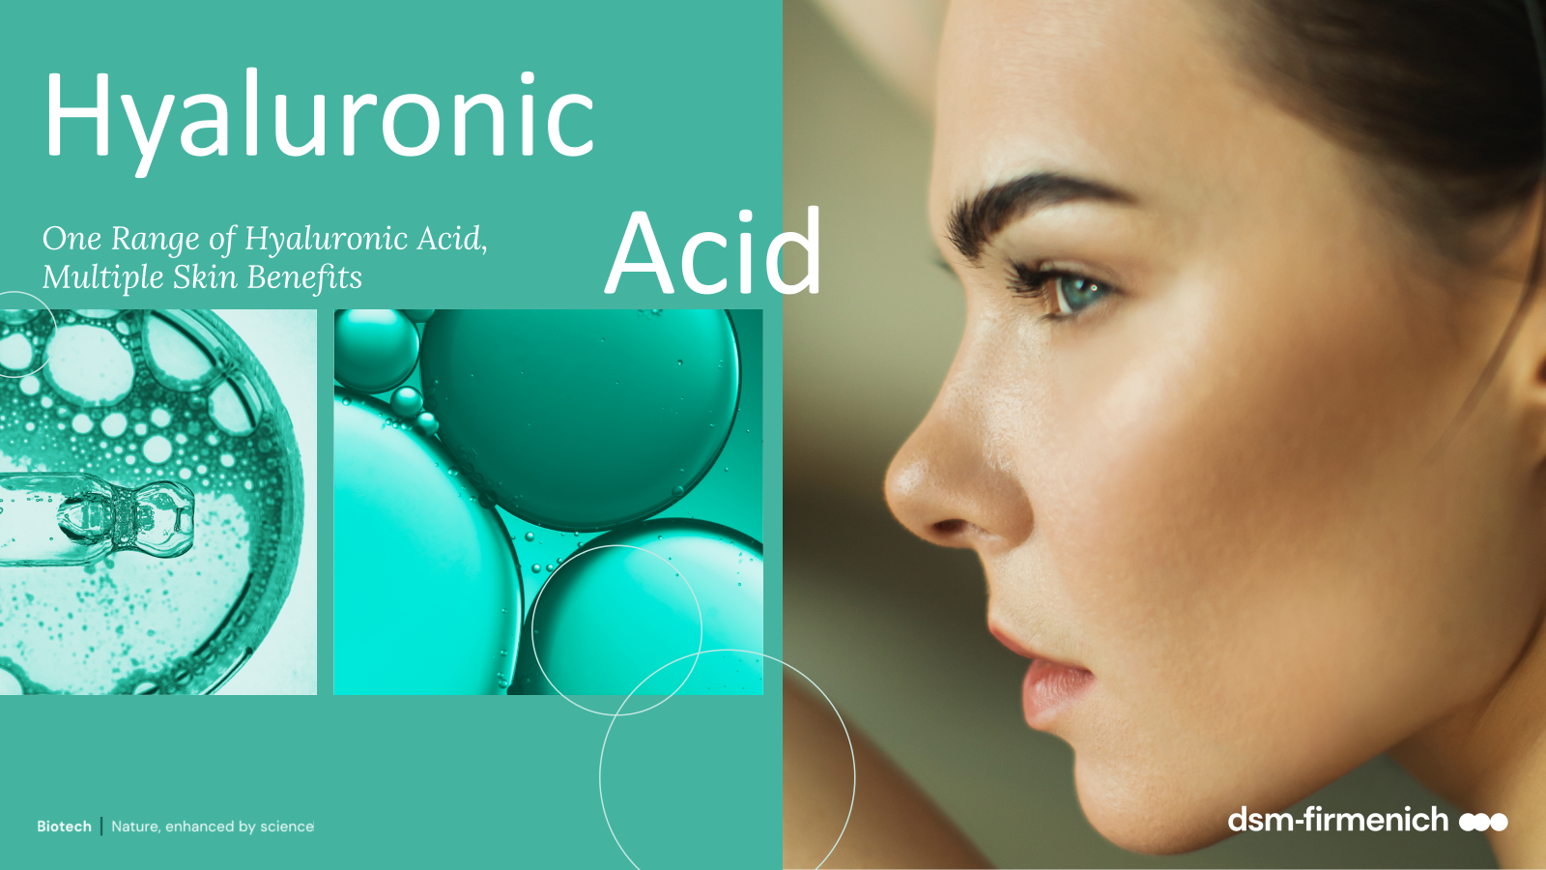
September 2026

Slide 2






No ingredient has taken the world of skincare by storm quite like hyaluronic acid has in recent years.
  Skincare's Most Popular Ingredient Vogue
  The ingredient you're seeing everywhere
  Harpers Bazaar
  The secret to bouncy, fresh, healthy-looking skin
  Glamour magazine
  Hyaluronic acid holds the key to smooth, flawless and hydrated skin
  Elle magazine
  Hyaluronic Acid, was the most searched skincare ingredient google.com in 2024

Slide 3
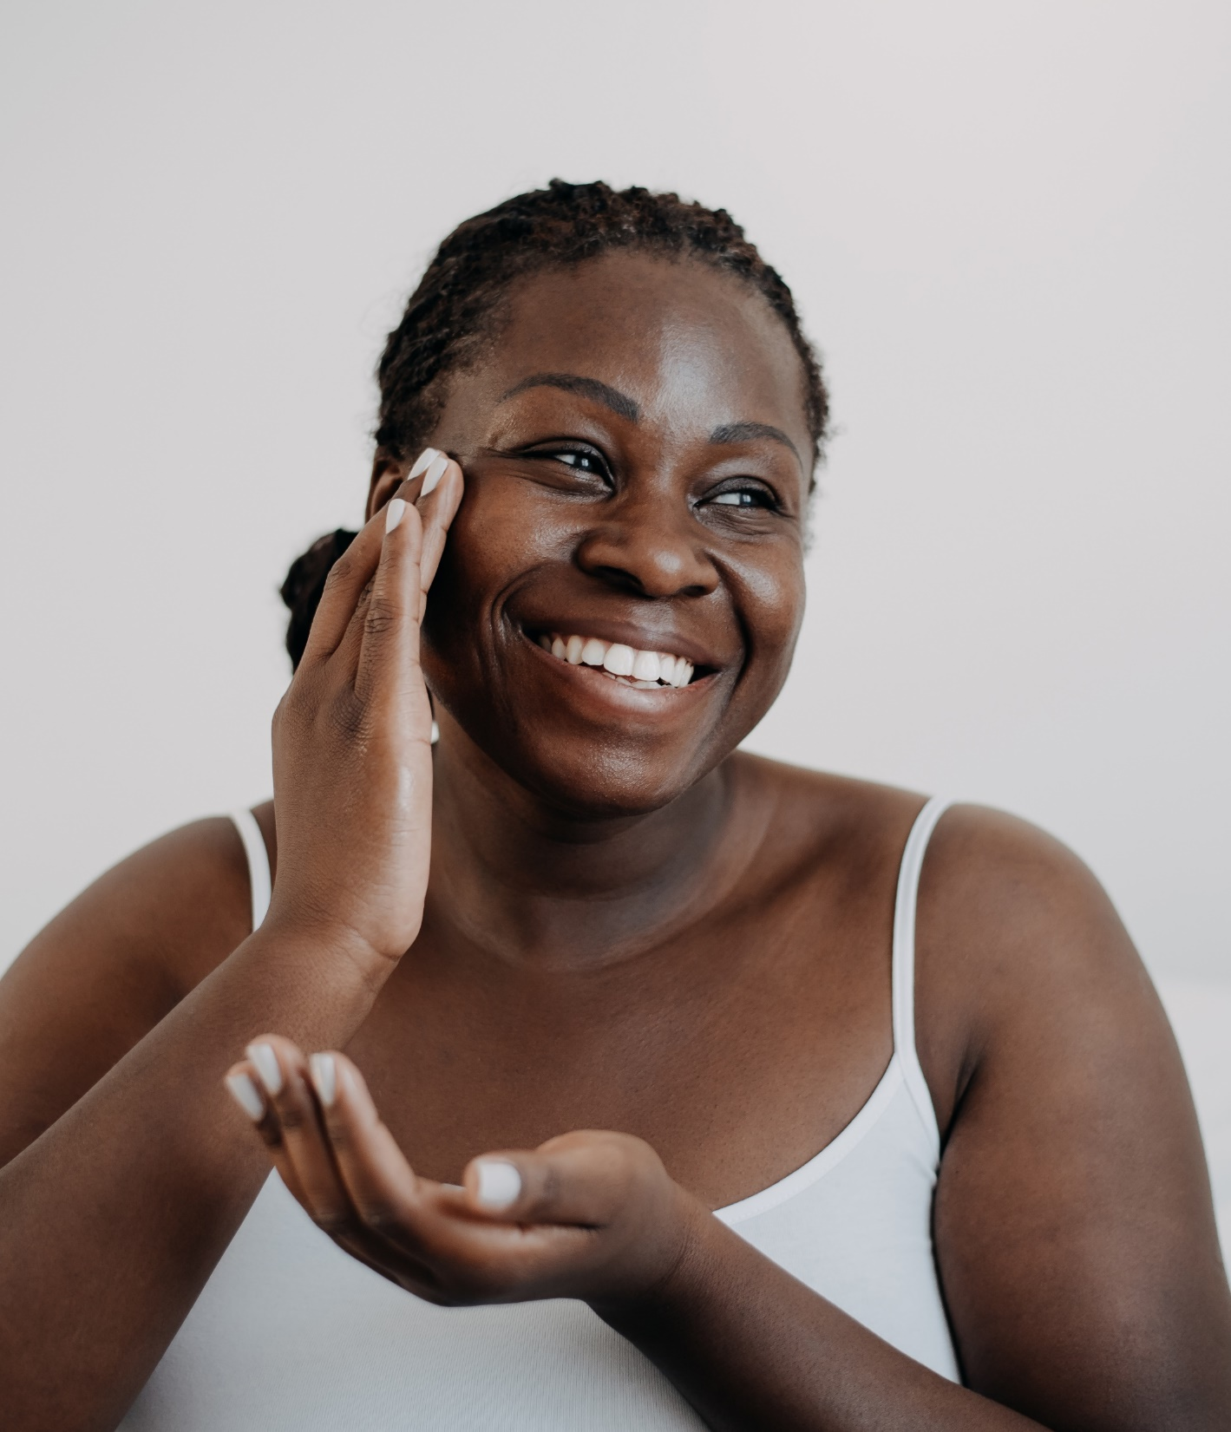
The hype on hyaluronic acid
More than 22000 skin care products containing hyaluronic acid claim to increase hydration within the skin.
The number of product launches with hyaluronic acid has grown with a CAGR of 55% over the past 4 years.
+55%
CAGR
+55%
Source: Mintel 2025

Slide 4
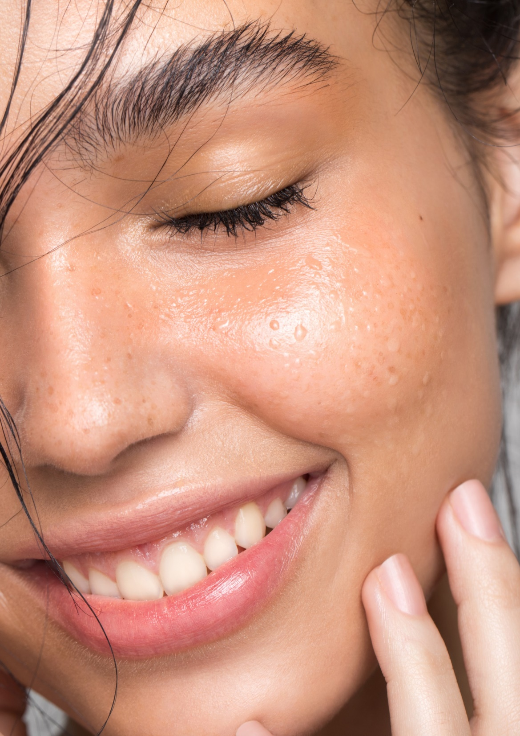



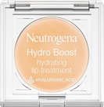
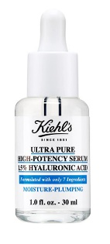

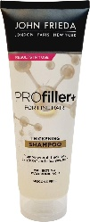

Hyaluronic acid becomes a coveted ingredient in new products…
If you have extremely dry skin…
If you want instant hydration…
If your skin is looking tired…
If you want to fix dry lips…
If you want stronger hair …
If you want to plump the skin…
If you want to treat fine lines…
If you want to treat wrinkles (with 1.5% HA)…

Slide 5

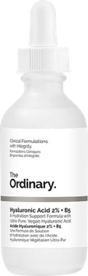
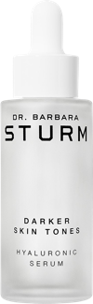
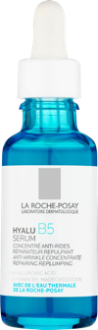


Best sellers contain various forms of hyaluronic acid for more efficacy
Best seller
Best seller
Best seller
This formula uses three forms of hyaluronic acid with varying molecular weights, to offer multi-depth hydration and visible plumping without drawing water out of the skin.
With long and short chain hyaluronic acid molecules to penetrate at different layers of your skin for an instant refresh, as well as for long-term glow.
With two different size of hyaluronic acid both to plump skin with moisture and 'fill out' the appearance of fine lines and wrinkles.

Slide 6


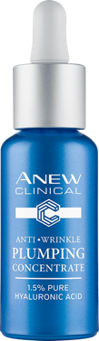
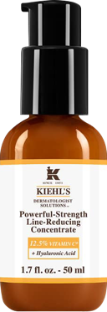
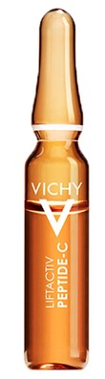
Anti-ageing products containing hydrolyzed hyaluronic acid form are on the rise
The number of product launches with Hydrolyzed Hyaluronic Acid has consistently grown with a CAGR of 16% over the past 5 years.
Hydrolyzed Hyaluronic Acid is a fragmented form of hyaluronic acid with a smaller molecular size.
+16%
Hydrolyzed Hyaluronic Acid is often used in anti-ageing creams and moisturizers for its ability to effectively hold water and fills wrinkles from inside.
Beauty & Care Product Launches with Hydrolyzed Hyaluronic Acid
CAGR
+16%

Slide 7
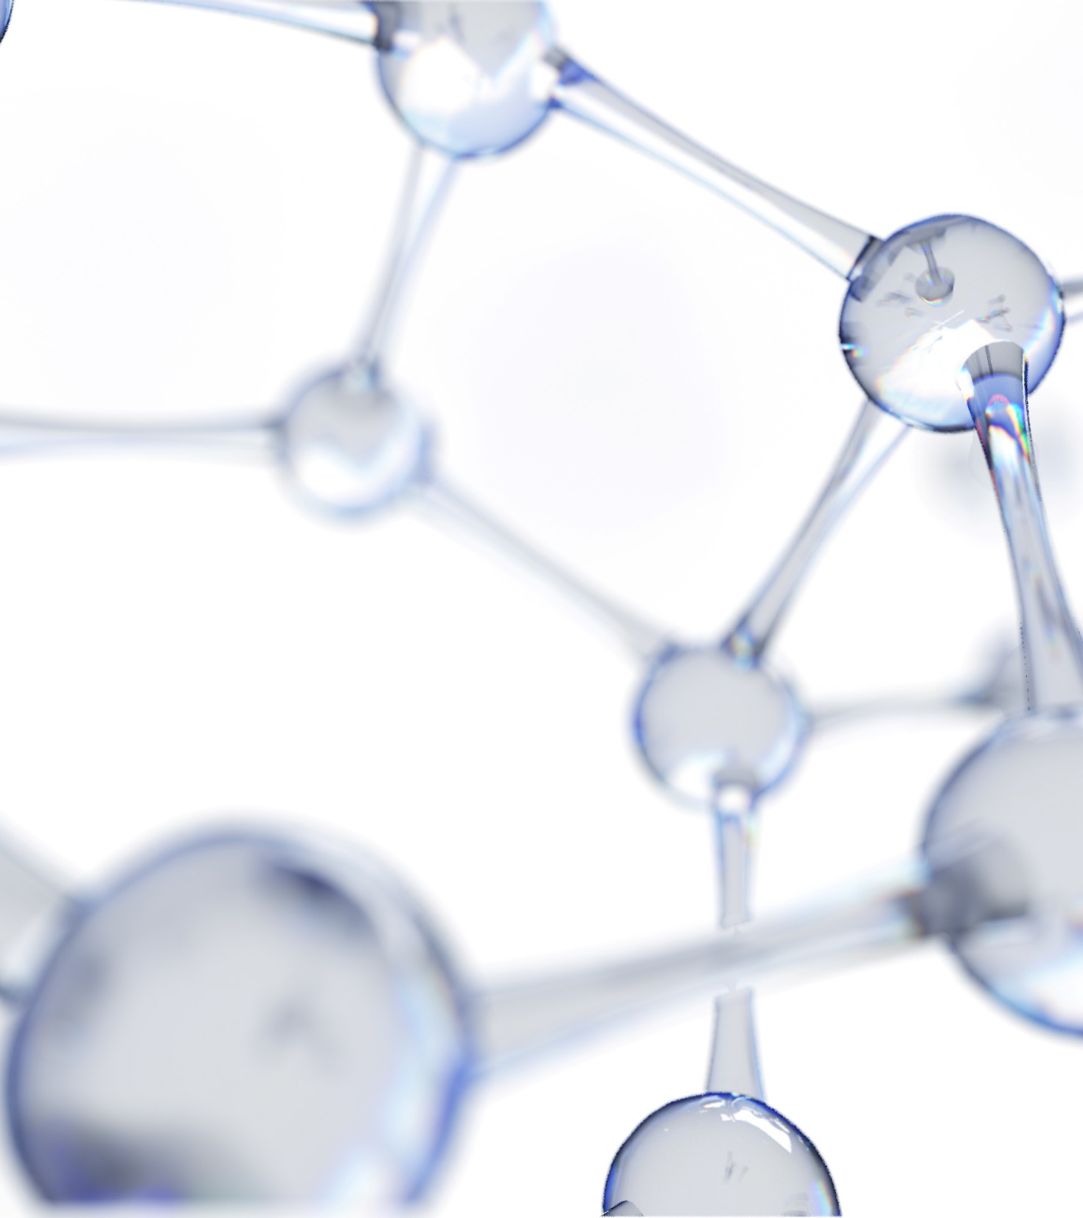
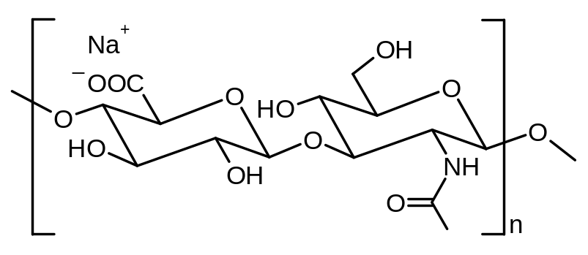
What is hyaluronic acid?
  hyaluronic acid is an unbranched disaccharide polymer comprising repeating disaccharide units of sodium glucuronate and D-N-acetylglucosamine.
  hyaluronic acid occurs as the salt form in our skin.
  the activity in skin is coming from the hyaluronic acid part and not from the salt.

Slide 8
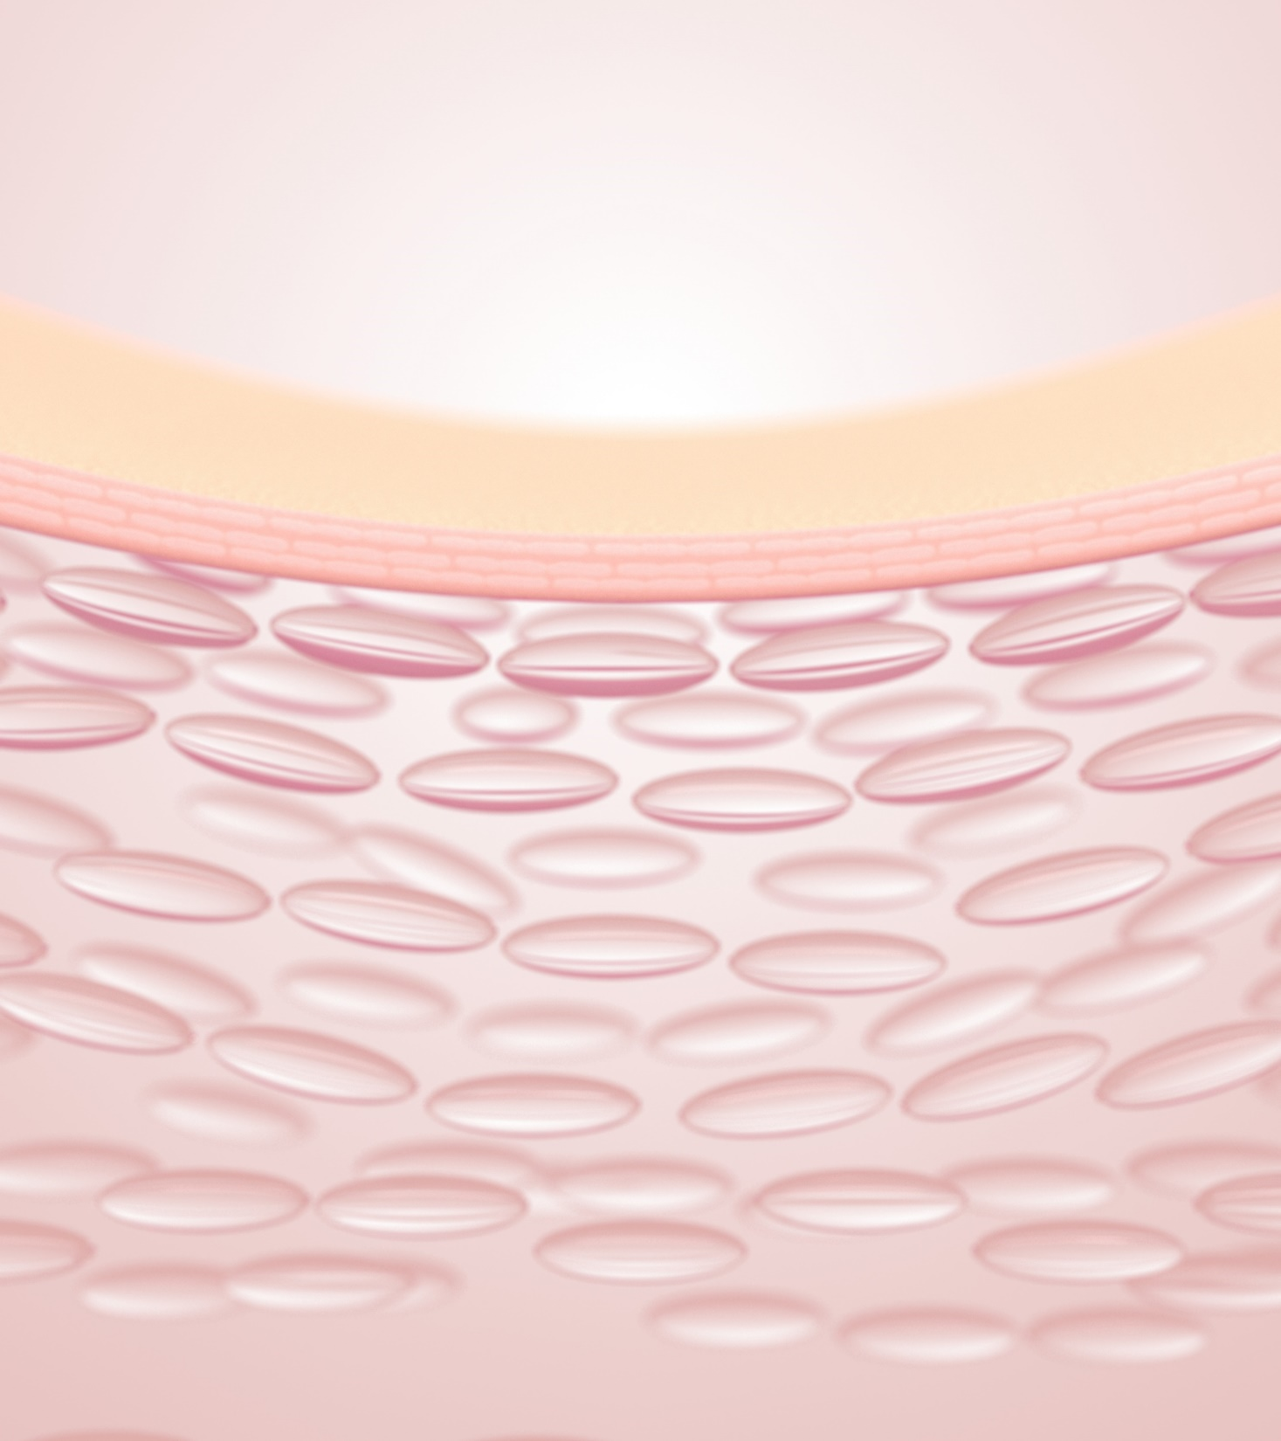
Hyaluronic acid is located in the first layers of the epidermis and dermis
Epidermis:
Hyaluronic acid serves as a filler between keratinocytes for nutrient exchange and as signaling ligand.
It maintains our skin’s moisture balance and keeps it hydrated.
Dermis:
Hyaluronic acid is a major component of the extracellular matrix of the skin and is vital for skin health.
It is a jelly-like substance that fills the space between collagen and elastin fibers to make skin flexible.
It plays a crucial role in aging.
Dermato-Endocrinology 4:3, 253–258; July–December 2012; ©

Slide 9

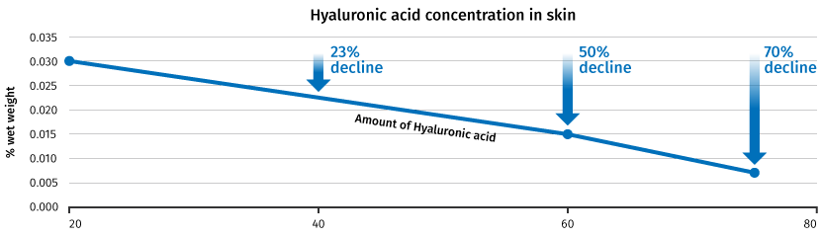
With age, hyaluronic acid in the skin decreases quite sharply …
  With age, hyaluronic acid in the skin decreases quite sharply*, resulting in a loss of hydration, volume and plumpness. Lines and wrinkles also appear, and skin is left looking dull.
Age (year)
*Longas et al, Carbohydr Res. 1987: 159: 127-36 *Eleni Papakonstantinou; Hyaluronic acid A key molecule in skin aging; Dermato-Endocrinology 43, 253–25, 2012

Slide 10
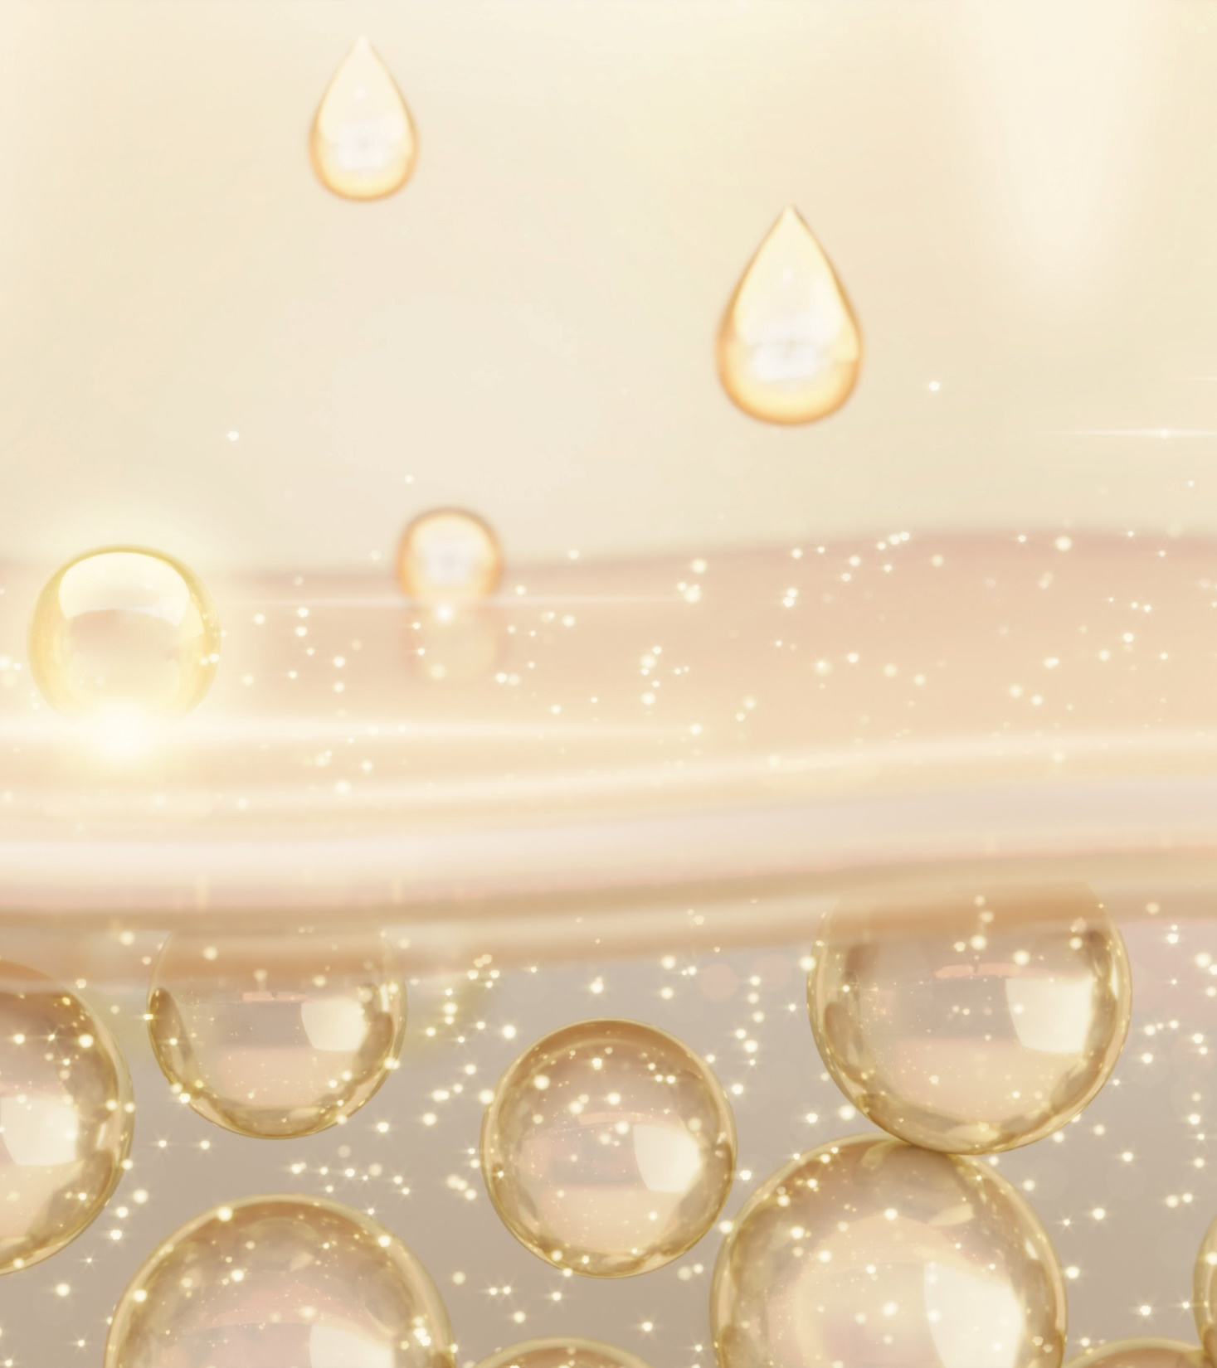
Hyaluronic acid in Beauty Products
  These days, you’d be hard-pressed to find a product that doesn’t have it in its formulation.
  Sodium hyaluronate is used mainly in skincare products.
  The salt allows for improved stability and solubility in water.
  Hyaluronic acid (HA) exists in different Molecular Weight (MW) forms:
    Medium - High Molecular Weight HA:
    500k - 2MDa
    INCI name: Sodium Hyaluronate
    Low Molecular Weight HA:
    100k - 500kDa
    INCI name: Sodium Hyaluronate
    Very Low Molecular Weight HA:
    below 100kDa
    INCI name: Hydrolyzed Hyaluronic Acid

Slide 11
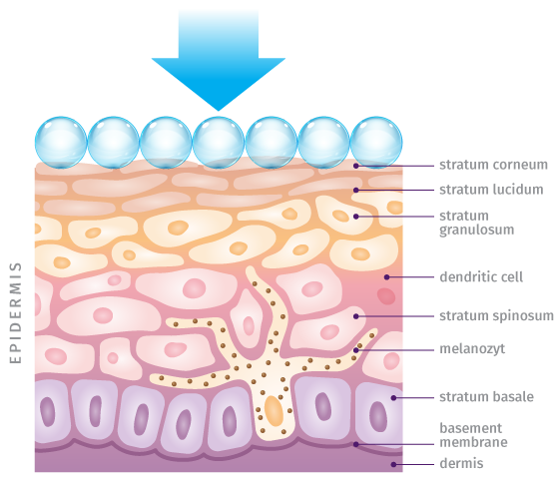
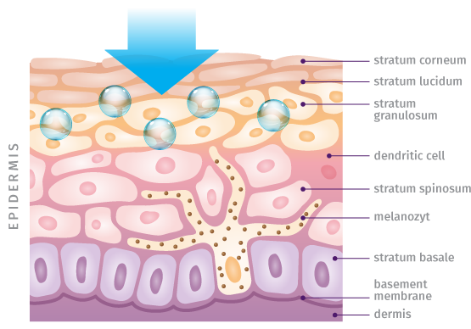
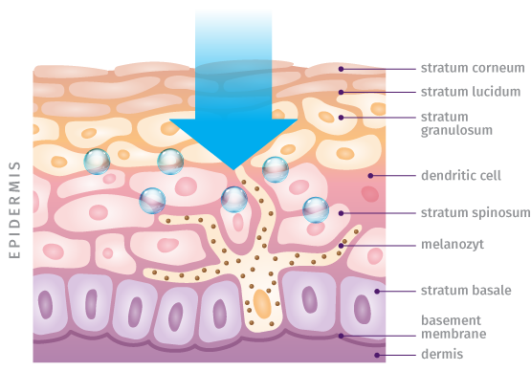
Benefits of different hyaluronic acid molecular weights*
Medium to High Molecular Weight HA >1.0M Da
Low (Small) Molecular Weight HA 100 - 500K Da
Very Low (Small) Molecular Weight HA 20 – 50K Da
It sits on the uppermost layers of the skin and acts as a sponge to deliver immediate hydration to the surface of skin.
It passes through the stratum corneum and is present in the superficial layer of the epidermis under stratum corneum to hydrate skin.
It can penetrate the space between the skin cells in the deepest layers of the epidermis and moisturize from within whilst filling up the gaps, leading to a plumped effect.
* Essendoubi et al, Human skin penetration of hyaluronic acid of different molecular weights as probed by Raman spectroscopy; skin research and technology 2015, 1-8

Slide 12
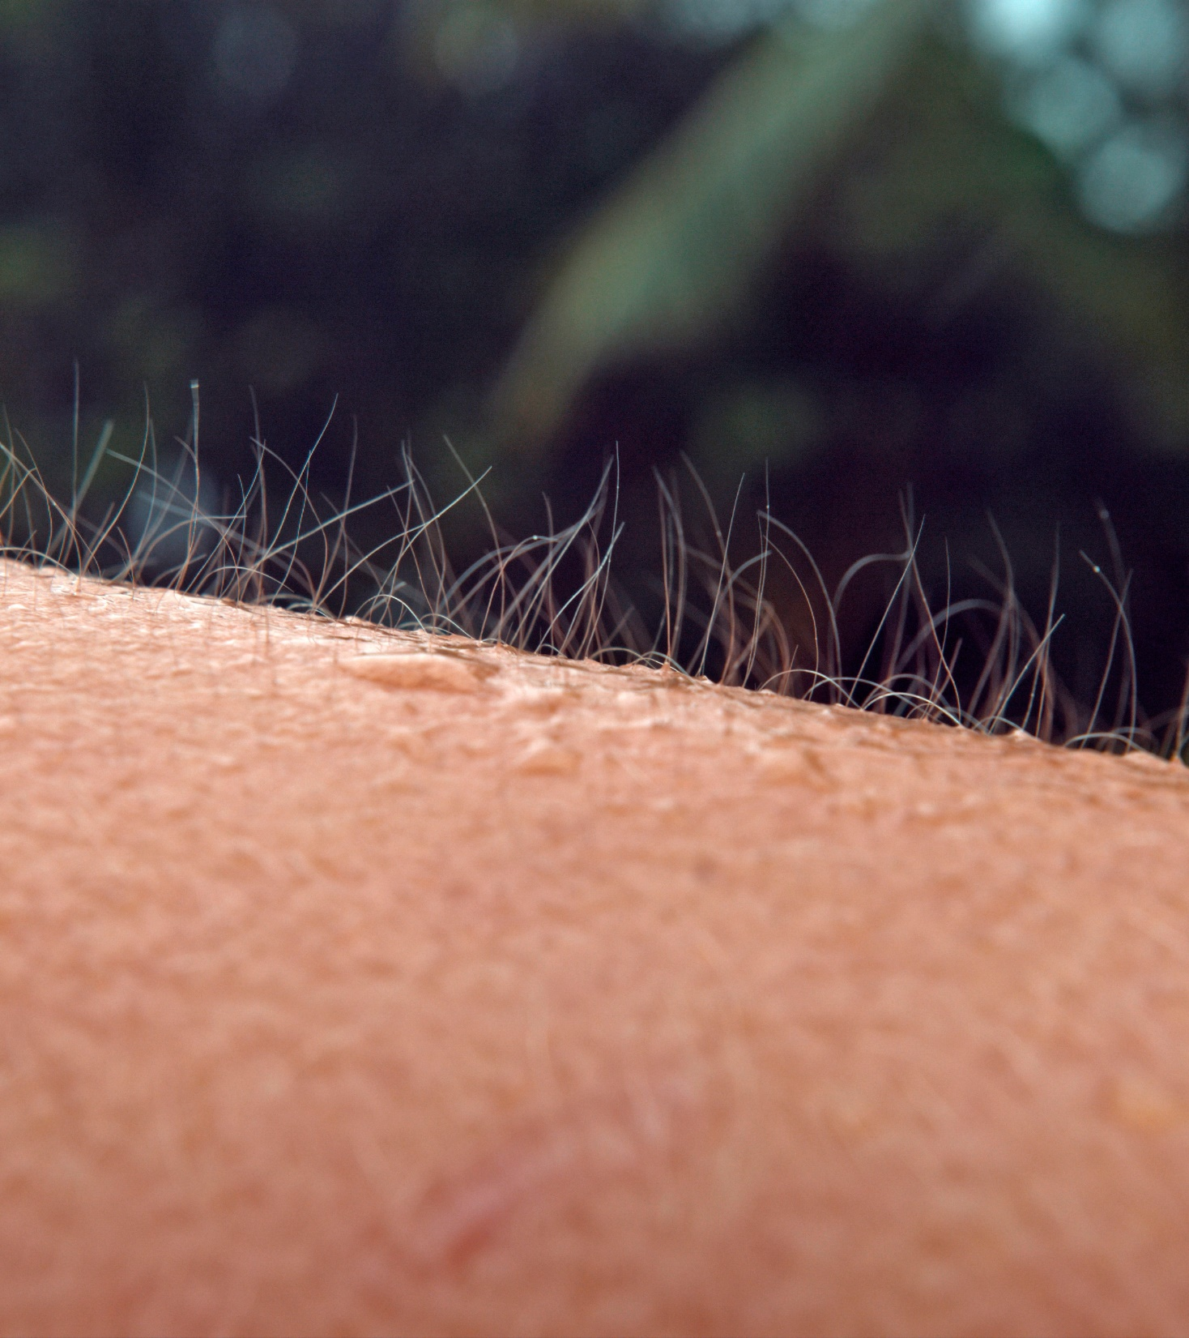
And why is it so commonly used?
  Usually, when hyaluronic acid is added to skincare products, its humectant properties draw moisture into the skin to keep our skin looking and feeling healthy.
  More than 20 claims & benefits why you need hyaluronic acid in your skin care regimen…
*https://www.jasondavies.com/wordcloud/

Slide 13


Hyaluronic
Acids
One Range of Hyaluronic Acids,
Multiple Skin Benefits
HYALURONIC ACID-BT/ HYASOL PF · High Molecular Weight
HYALURONIC ACID MMW · Medium-High Molecular Weight
HYA-ACT™ M · Medium Molecular Weight
HYA-ACT™ S · Small Molecular Weight
HYA-ACT™ XS · Very Small Molecular Weight
NEW!

Slide 14
dsm-firmenich has been exploring the beauty potential of hyaluronic acid and beyond
Launch of clean beauty versions:
SYN®-EYE CB
SYN®-HYCAN CB
Our heritage of the hyaluronic acid started 1978
Hyaluronic acid rooster-comb gained leadership in the international cosmetic market.
Launch HYALURONIC ACID-BT
Powerful high molecular weight (1.45 – 1.77MDa) hyaluronic acid
Launch HYASOL™ PF
1% aqueous solution of high molecular weight (1.45-1.77 MDa) HYALURONIC ACID-BT. Highly convenient and ready-to-use.
Low molecular weight hyaluronic acid combines with unique SYN®-peptide technology
Launch SYN®-EYE
Lineless eyes
within 7 days
1978
1980-s
2003
2015
2024
Launch hyaluronic acid rooster-comb
In 1983 Pentapharm developed an efficient method to extract and purify hyaluronic acid from rooster combs.
2026
Use our scientific expertise to stimulate hyaluronic acid synthesis in the human skin with unique peptide technology
Launch SYN®-HYCAN
Boosts skin’s own production of hyaluronic acid, leading to fuller, firmer skin in weeks.
Invest in the next generation of pure, biotechnology-based sodium hyaluronic acid.
Expand HA range
Launch HYA-ACT™ M, S, XS
1983
1990-s
2009
2021
Global launch
HYALURONIC ACID MMW
Added to the hyaluronic acid portfolio

Slide 15
dsm-firmenich hyaluronic acid portfolio
Different sizes for different benefits
Product | Molecular Weight (MW) | INCI name | PhysicalForm | Biotech process | Sugar Origin | Benefits
HYALURONIC ACID-BT | High MW 1.45-1.77 Mda | Sodium Hyaluronate | Powder | Fermentation | Beet root | Acts as a sponge to deliver immediate hydration and forms uniform viscoelastic surface film. Outstanding tactile experience and skin revival immediately after application.
HYASOL™ PF | High MW 1.45-1.77 Mda | Sodium Hyaluronate | Liquid | Fermentation | Beet root | Ready to use 1% aqueous solution of HYALURONIC ACID BT. Same benefits as HYALURONIC ACID BT.
HYALURONIC ACID MMW | Medium-High MW 1.0–1.8 Mda | Sodium Hyaluronate | Powder | Fermentation | Corn seeds | • Reliable standard HA hydration performance. • Scalable solution for large-scale manufacturing. • Commercial 10 kg pack size.
HYA-ACT™ M | Medium MW 1.0–1.3 Mda | Sodium Hyaluronate | Powder | Fermentation | Corn seeds | Provides immediate hydration Strengthens the protective skin barrier by building a superior protecting film.
HYA-ACT™ S | Small MW 200 – 400 Kda | Sodium Hyaluronate | Powder | Fermentation | Corn seeds | Acts as a hydration booster. Lock in moisture for an even greater hydration boost and calms reddened skin.
HYA-ACT™ XS | Very small MW 37 – 56 Kda | Hydrolyzed Hyaluronic Acid | Powder | Fermentation | Corn seeds | Supplies hyaluronic acid into the skin and plumps out fine wrinkles. Improves skin elasticity.
NEW!

Slide 16
dsm-firmenich hyaluronic acid portfolio
A powerhouse of different hyaluronic acid forms that delivers various consumer benefits
NEW!
HYALURONIC ACID MMW - MW 1.0–1.8 MDa
HYA-ACT™ XS
MW 37-56 kDa
HYA-ACT™ S
MW 200-400 kDa
HYA-ACT™ M
MW 1.0–1.3 MDa
HYALURONIC ACID-BT
MW 1.45 – 1.77 MDa
MW (MDa)
Hydration from within Plumps out fine wrinkles
Hydration booster Calms reddened skin
Immediate hydration Strengthens the protective barrier
Binds tremendous amounts of moisture to skin Outstanding tactile experience
  Very Small Molecular Weight
  (MW 37-56 kDa)
  INCI: Hydrolyzed Hyaluronic Acid
  Main benefits: Supplies hyaluronic acid into the skin and plumps out fine wrinkles
  Small Molecular Weight (MW 200-400 kDa)
  INCI: Sodium Hyaluronate
  Main benefits: Locks in moisture for an even greater hydration boost and calms reddened skin.
  Medium Molecular Weight (MW 1.0-1.3 MDa)
  INCI: Sodium Hyaluronate
  Main benefits: Enhances skin hydration and strengthens the protective barrier
  High Molecular Weight (MW 1.45-1.77 MDa)
  INCI: Sodium Hyaluronate
  Main benefits: Acts as a sponge to deliver immediate hydration and forms uniform viscoelastic surface film
HYALURONIC ACID MMW - Volume and manufacturing-friendly MMW HA
  Medium-High Molecular Weight (MW 1.0-1.3 MDa)
  INCI: Sodium Hyaluronate
  Main benefits: Reliable hydration support, Scalable production, Pack size convenient for high-volume manufacturing
NEW!

Slide 17
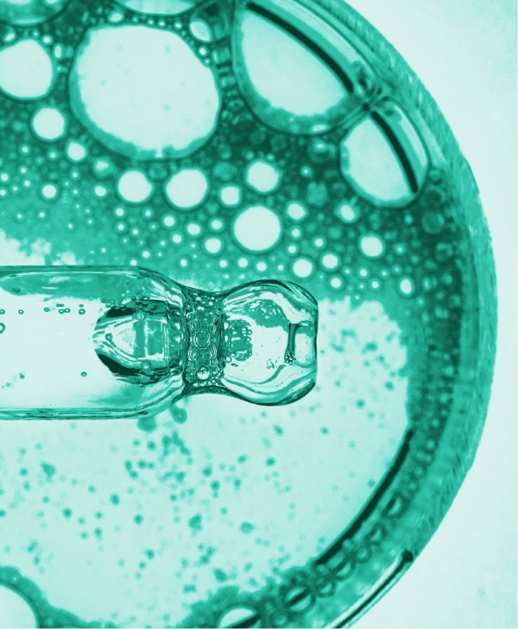

HYALURONIC ACID-BT
HYASOL PF
Experience immediate skin revival

Slide 18




HYALURONIC ACID-BT
ID Card
INCI NAME:
Sodium Hyaluronate
Powerful high molecular (1.45-1.77 MDa) Hyaluronic acid, manufactured by biotechnological fermentation in Europe
Derived from beet root - GMO free
Fine granuled powder for easier handling
100% natural origin (ISO 16128)
TECHNOLOGY:
TECHNICAL:
Form: White powder or granules
pH of use: 6.0-7.5
Use level: 0.01 - 1.00%
Preservative: free
Solubility: Slowly but completely water soluble
Acts as a sponge to deliver immediate hydration to the surface of skin
Forms uniform viscoelastic surface film
Binds tremendous amounts of moisture to skin
Outstanding tactile experience and skin revival immediately after application
BENEFITS:
REGISTRATION
CERTIFICATION
Raw material verified by ECOCERT GREENLIFE, conform to the COSMOS Standard
* in vitro ** in vivo

Slide 19
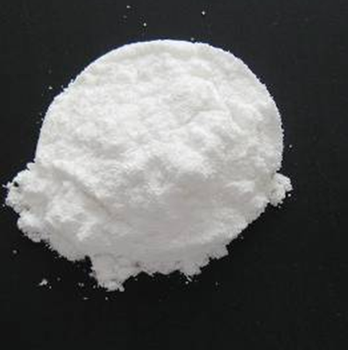
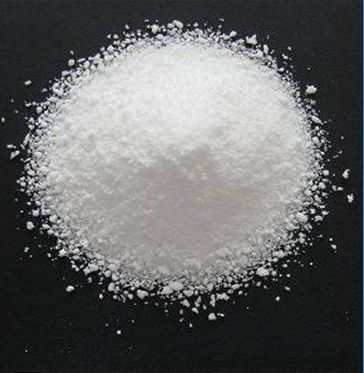
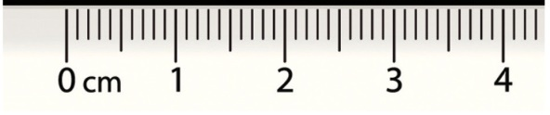
HYALURONIC ACID-BT
Specific quality for easier handling
Average Market Product
HYALURONIC ACID-BT
Fine granule
for easier handling
and dissolution
- Dust formation
- Slow solubility
+ Dust free
+ Faster solubility

Slide 20
HYASOL PF
ID Card
INCI NAME:
Sodium Hyaluronate, Aqua, Phenoxyethanol
TECHNOLOGY:
1% aqueous solution of high molecular (1.45-1.77 MDa) HYALURONIC ACID-BT
Highly convenient and ready-to-use
99.1% natural origin (ISO 16128)
TECHNICAL:
Form: Clear to slightly opalescent, colorless, viscous solution
pH of use: 4.0-10.0
Use level: 3–5%
Preservative: Phenoxyethanol
Solubility: Water soluble
Same benefits as HYALURONIC ACID-BT
BENEFITS:
REGISTRATION
CERTIFICATION

Slide 21
HYALURONIC ACID
NEW!
Reliable hydration performance
for scalable production
MMW
A volume and manufacturing-friendly MMW HA

Slide 22

HYALURONIC ACID MMW
NEW!
ID Card
INCI NAME:
Sodium Hyaluronate
Pure, biotechnologically manufactured, medium - high molecular weight hyaluronic acid of 1.0–1.8 MDa
Derived from corn seeds
GMO free
100% natural origin (ISO 16128)
TECHNOLOGY:
TECHNICAL:
Form: White, pale-yellow powder
pH of use: 4.0-11.0
Use level: 0.01-1%
Preservative: free
Solubility: Slowly but completely water soluble
Reliable standard hyaluronic acid hydration performance
Suitable for broad skin-care applications
Production-friendly solution attractive for customers looking for larger commercial pack sizes
Generates less dust, supporting easier use during production
BENEFITS:
REGISTRATION
CERTIFICATION
100
%
W
Raw material verified by ECOCERT GREENLIFE, conform to the COSMOS Standard
H
M
Y
M
A
-
L
D
U
I
R
C
O
A
C
N
I

Slide 23
NEW!
What makes HYALURONIC ACID MMW unique in our portfolio?
01
02
03
04
Portfolio role
Customer need
Manufacturing fit
Clear differentiation
Commercial and operational complement to the existing HA portfolio
Designed for customers seeking standard HA performance in larger commercial volumes
10 kg commercial pack size, production-friendly format and low dust generation for easier use during production
HYA-ACT™ M remains our premium, efficacy-focused medium molecular weight HA.
HYALURONIC ACID MMW is our volume and manufacturing-friendly medium molecular weight HA.
KEY TAKEAWAY
HYALURONIC ACID MMW expands customer choice with a reliable, scalable and production-friendly medium molecular weight HA solution for standard hydration applications.

Slide 24
HYA-ACT™
The hyaluronic acid line
for the ultimate beauty boost

Slide 25




HYA-ACT™ M (Medium Molecular Weight)
ID Card
INCI NAME:
Sodium Hyaluronate
Pure, biotechnologically manufactured, medium molecular weight hyaluronic acid of 1.0 – 1.3 MDa
Derived from sweet corn seeds
GMO free
100% natural origin (ISO 16128)
TECHNOLOGY:
TECHNICAL:
Form: White powder to granules
pH of use: 4.0-11.0
Use level: 0.01-1%
Preservative: free
Solubility: Slowly but completely water soluble
Provides immediate hydration : A single application enhances skin hydration up to 60% after just 1h.*
Strengthens the protective skin barrier, with an up to 26% reduction in TEWL after just 1h.*
Suitable for all kinds of facial and body care leave-on and rinse-off hydration products
BENEFITS:
REGISTRATION
CERTIFICATION
Raw material verified by ECOCERT GREENLIFE, conform to the COSMOS Standard
* in vivo

Slide 26

HYA-ACT™ M
Certified as Microbiome-friendly
Tested according to MyMicrobiome Standard 18.10*
Different aspects were tested at 1% in vitro
Diversity
Vitality
Balance
HYA-ACT™ M
respects the natural diversity of the skin microbiome
HYA-ACT™ M
doesn’t interfere with the growth behaviour of the natural skin microbiome
HYA-ACT™ M
respects the balance between skin-friendly bacteria such as Staphylococcus epidermidis and skin-harmful bacteria such as Staphylococcus aureus
* https://www.mymicrobiome.info/mymicrobiome-standard-18-10-tests-skin-microbiome-friendly.html
Notes:
Various aspects are examined: The microbial quality of the product.
The influence of the product on the natural, healthy skin balance.
• The skin-commensal bacterium Staphylococcus epidermidis keeps the skin with antimicrobial peptides (so-called bacteriocins) and pH adjustments healthy and keeps skin-harmful germs such as Staphylococcus aureus in check. The product should not disturb this balance between skin-friendly and skin harmful bacteria. This sensitive balance is investigated in conjunction with the product.
.
A co-culture of S. epidermidis and S. aureus is incubated with the product for 4 h. The ratio of the two microbes to each other is determined.
• The influence of the product on the bacterial diversity of the specific body region. Each body region is colonized by a certain microbial composition. For a healthy skin it is particularly important to maintain this biodiversity. The influence of the product on the respective microbial mixture is examined in the test. The aim is to find as many key organisms as possible after contact with the product.
A co-culture of key organisms of the specific body region is incubated with the product for 4 h.The ratio of the bacteria compared to the control (PBS) is determined.
• The influence of the product on the growth behavior of the microbes of the specific body region.
In addition to the diversity of the specific microbiome, the growth or number of different key organisms should not be influenced by the product. This is investigated in a skin-product contact model. The key organisms are brought into direct and indirect contact with the product and their growth is observed.
The influence of the product on the growth of each individual microbe of the key organisms of the specific body region is investigated and put in relation to the control (PBS). Product contact with the microorganisms is directly.

Slide 27
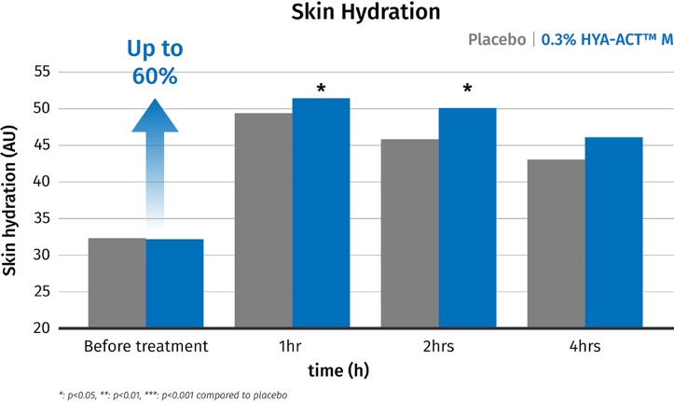
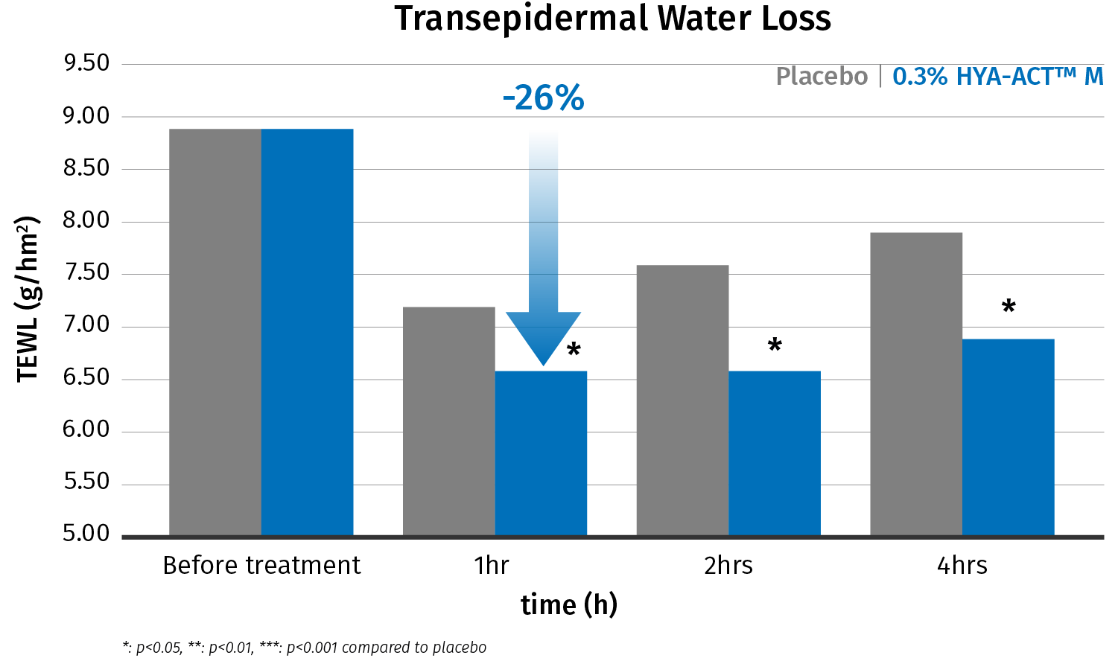
HYA-ACT™ M
Enhances skin hydration and strengthens the protective barrier
Test protocol: 20 female volunteers; application: single application, inner forearm; test products: lotion (placebo), lotion with 0.3% HYA-ACT™ M; measurement time points 1h, 2h and 4h; skin parameters: skin hydration (corneometer) and transepidermal water loss (TEWL).
A single application enhances
skin hydration up to 60% after just 1h.
Strengthens the protective skin barrier, with an up to 26% reduction in TEWL after just 1h.

Slide 28
HYA-ACT™ S (Small Molecular Weight)
ID Card
INCI NAME:
Sodium Hyaluronate
Biotechnologically manufactured, small molecular weight hyaluronic acid of 200 – 400 KDa
Derived from sweet corn seeds
GMO free
100% natural origin (ISO 16128)
TECHNOLOGY:
TECHNICAL:
Form: White or almost white powder to granules
pH of use: 4.0-11.0
Use level: 0.01-1%
Preservative: free
Solubility: Quickly and completely water soluble
Acts as a hydration booster for thirsty skin*
Lock in moisture for an even greater hydration boost*
Calms reddened skin**
Suitable for all kinds of facial and body care leave-on and rinse-off hydration products
BENEFITS:
REGISTRATION
CERTIFICATION
Raw material verified by ECOCERT GREENLIFE, conform to the COSMOS Standard
* in vitro ** in vivo

Slide 29

HYA-ACT™ S
Certified as Microbiome-friendly
Tested according to MyMicrobiome Standard 18.10*
Different aspects were tested at 1% in vitro
Diversity
Vitality
Balance
HYA-ACT™ S
respects the natural diversity of the skin microbiome
HYA-ACT™ S
doesn’t interfere with the growth behaviour of the natural skin microbiome
HYA-ACT™ S
respects the balance between skin-friendly bacteria such as Staphylococcus epidermidis and skin-harmful bacteria such as Staphylococcus aureus
* https://www.mymicrobiome.info/mymicrobiome-standard-18-10-tests-skin-microbiome-friendly.html

Slide 30
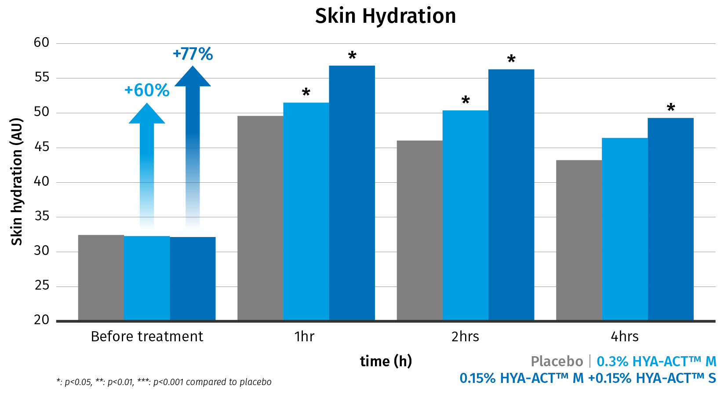
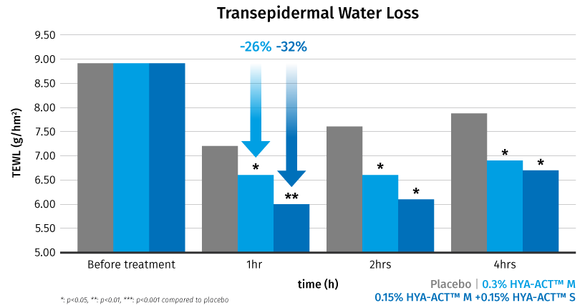
HYA-ACT™ S
Acts as a hydration booster and fortifies the skin’s natural barrier
Test protocol: 20 female volunteers; application: single application, inner forearm; test products: lotion (placebo), lotion with 0.30% HYA-ACT™ M, lotion with 0.15% HYA-ACT™ M and 0.15% HYA-ACT™ S; measurement time points 1h, 2h and 4h; skin parameters: skin hydration (corneometer) and transepidermal water loss (TEWL).
Up to 77% hydration boost by combining
HYA-ACT™ S (0.15%) to HYA-ACT™ M (0.15%).
HYA-ACT™ S (0.15%) and HYA-ACT™ M (0.15%) fortify the skin’s natural barrier, with an up to 32% reduction in TEWL.

Slide 31
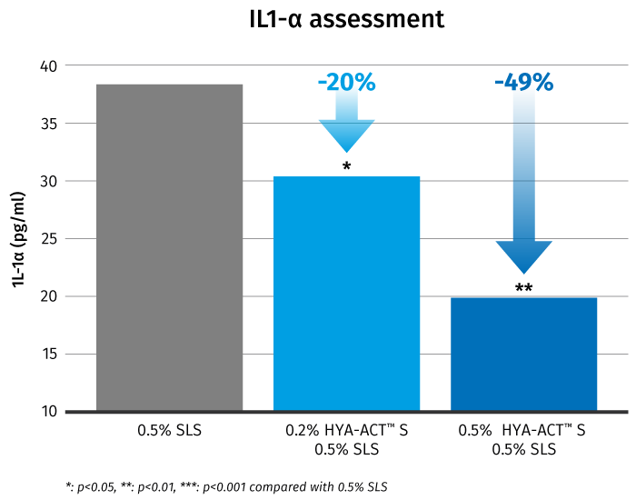
HYA-ACT™ S
Calms reddened skin in vitro
Epidermal skin models were treated topically with 0.5% Sodium Lauryl Sulfate (SLS), a mixture of 0.2% HYA-ACT™ S + 0.5% SLS and a mixture of 0.5% HYA-ACT™ S + 0.5% SLS.
The effects on the inflammatory marker IL-1a were evaluated using ELISA assay.
  HYA-ACT™ S calms reddened skin by inhibiting IL-1α* induced by Sodium Lauryl Sulfate significantly in vitro
  Up to 49% significant reduction of IL-1α
*IL-1α (Interleukin 1 alpha ) is a master regulator of inflammation and is associated with skin redness

Slide 32
HYA-ACT™ XS (Very Small Molecular Weight)
ID Card
INCI NAME:
Hydrolyzed Hyaluronic Acid
Very small molecular weight hyaluronic acid of 37 – 56 KDa, obtained by bio-fermentation.
Derived from sweet corn seeds
GMO free
100% natural origin (ISO 16128)
TECHNOLOGY:
TECHNICAL:
Form: Off-white powder to granules
pH of use: 4.0-11.0
Use level: 0.01-1%
Preservative: free
Solubility: Quickly and completely water soluble
Provides skin with a continuous burst of intense hydration and plumps out fine wrinkles*
Improved skin’s elasticity after just 15 days*
Suitable for all kinds of facial and body care leave-on and rinse-off hydration products
Recommended for anti aging serums and creams
BENEFITS:
REGISTRATION
CERTIFICATION
Raw material verified by ECOCERT GREENLIFE, conform to the COSMOS Standard
* in vivo

Slide 33

HYA-ACT™ XS
Certified as Microbiome-friendly
Tested according to MyMicrobiome Standard 18.10*
Different aspects were tested at 0.1% in vitro
Diversity
Vitality
Balance
HYA-ACT™ XS
respects the natural diversity of the skin microbiome
HYA-ACT™ XS
doesn’t interfere with the growth behaviour of the natural skin microbiome
HYA-ACT™ XS
respects the balance between skin-friendly bacteria such as Staphylococcus epidermidis and skin-harmful bacteria such as Staphylococcus aureus
* https://www.mymicrobiome.info/mymicrobiome-standard-18-10-tests-skin-microbiome-friendly.html

Slide 34
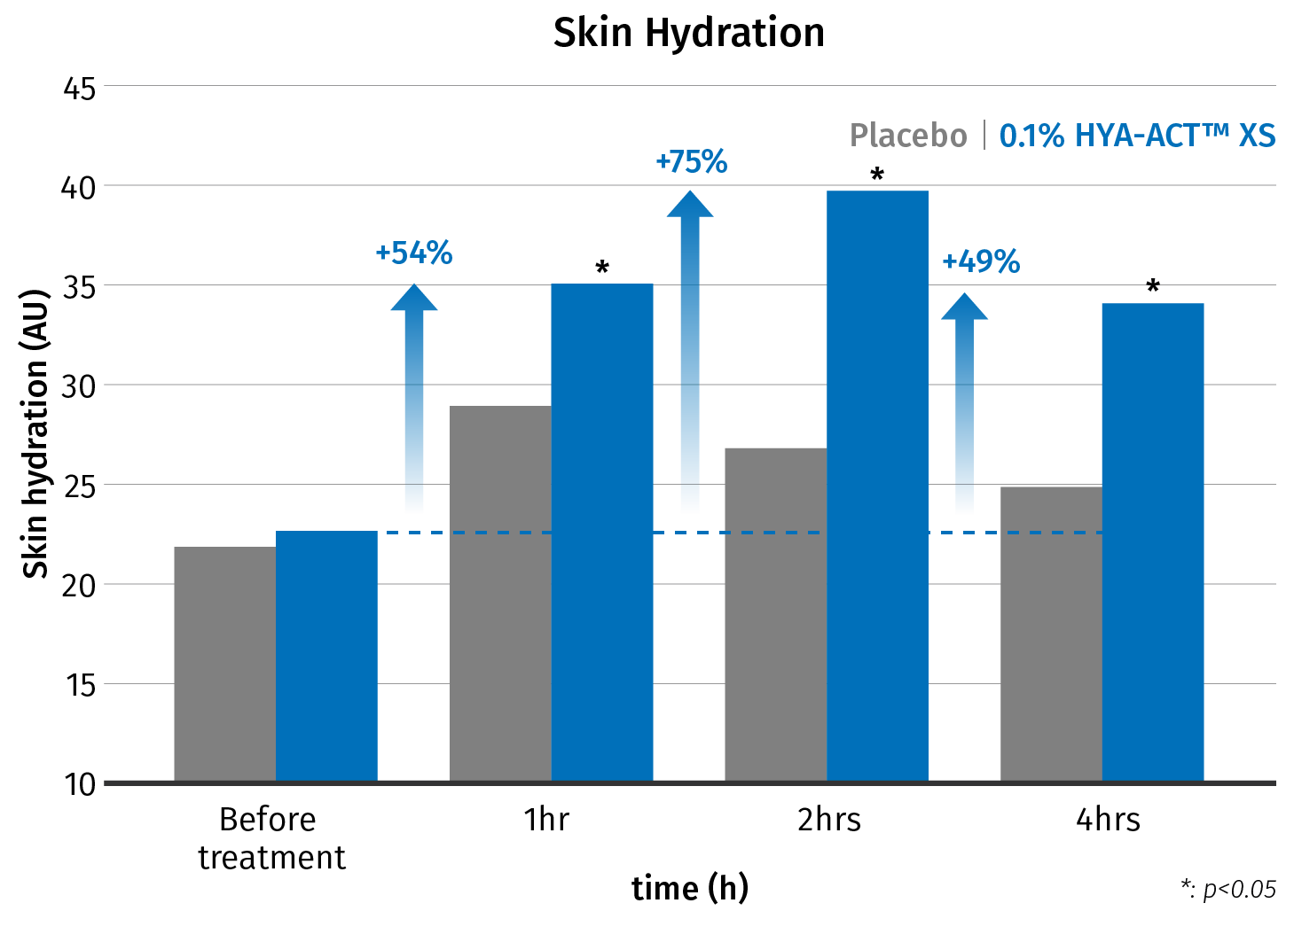
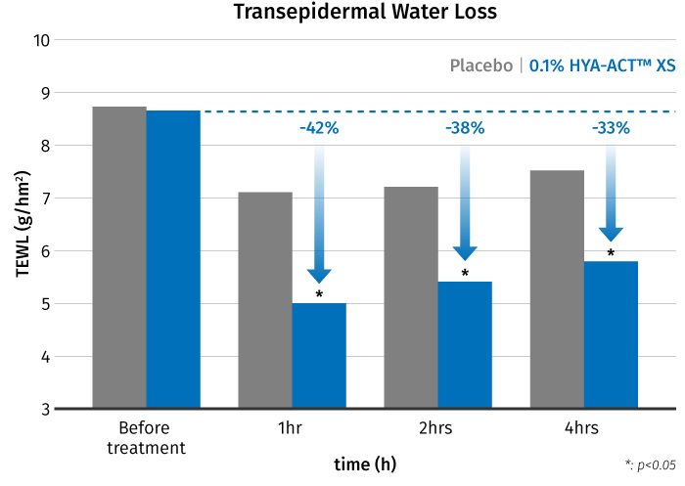
HYA-ACT™ XS
Provides intense hydration and prevents water loss
Test protocol: 20 female volunteers; application: single application, inner forearm; test products: cream (placebo), cream with 0.10% HYA-ACT™ XS; measurement time points 1h, 2h and 4h; skin parameters: skin hydration (corneometer) and transepidermal water loss (TEWL)
Provides skin with a continuous burst
of intense hydration.
Prevents water loss, with an up to 42% reduction in TEWL.

Slide 35
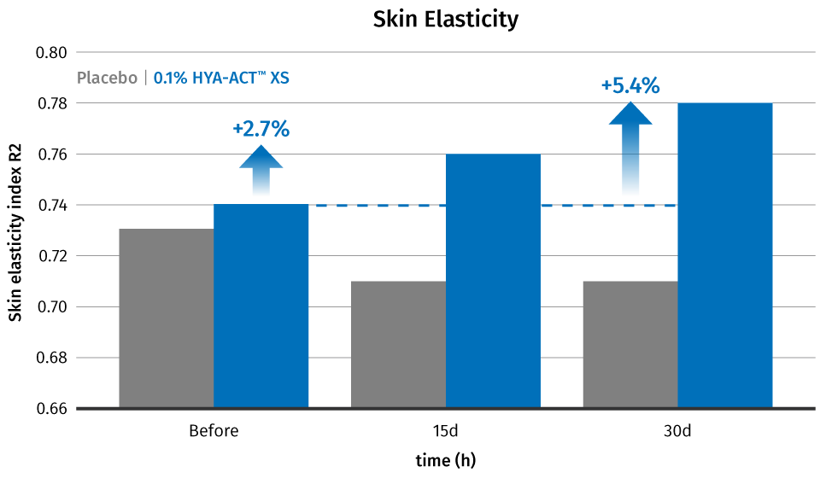
HYA-ACT™ XS
Improves skin elasticity after just 15 days
Test protocol: 30 female volunteers; application: twice daily application, face; test products: cream (placebo), cream with 0.1% HYA-ACT™ XS; measurement time points: before and after 15 and 30 days of application; analysis: cutometry (skin elasticity) (MPA 580 Courage & Kazaka)
HYA-ACT™ XS effectively improves skin elasticity after 15 and 30 days of treatment.

Slide 36
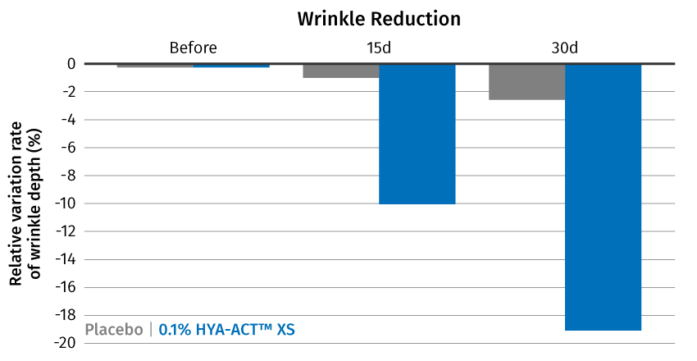
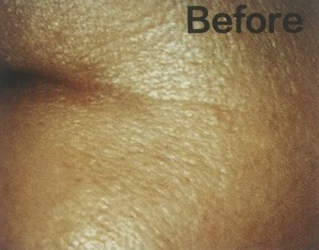
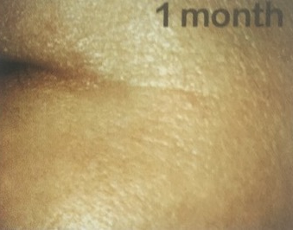
HYA-ACT™ XS
Plumps out fine wrinkles
Efficacy study of a cream containing 0.1% HYA-ACT™ XS, the left faces of 30 volunteers were applied placebo samples, and the right faces were applied HYA-ACT™ XS (0.1%) creams; the trial time was 30 days, and test products were used twice per day, test parameters: wrinkle depth measured by optical 3D skin measuring device (Primos).
Visible wrinkle-decreasing effect
before
1 month
After 30 days of application the appearance of crow’s feet wrinkles is visibly reduced.
HYA-ACT™ XS reduces the appearance of wrinkles after 15 and 30 days of treatment.

Slide 37

HYA-ACT™ IN & ON
Wrinkle Filler Serum
This lightweight serum contains a balanced mix of HYA-ACT™ M (0.5%), HYA-ACT™ S (0.5%) and
HYA-ACT™ XS (0.5%) combined with SYN®-HYCAN CB, our unique peptide that together with Vitamin B12 cryst Food Grade work to smooth wrinkles and provide more youthful-looking skin from within.
The ultimate beauty boost, HYA-ACT™ IN & ON plumps-tired skin and delivers intense hydration, a strong skin barrier, and a vibrant complexion.
HYA-ACT™ IN & ON melts into the skin on contact imparting a subtle sheen.

Slide 38

HYA-ACT™ IN & ON
Wrinkle Filler Serum
99,2% Natural Origin*
Phase | Ingredients | INCI name | %w/w
A | Water Dem. | Aqua | 89.275
 | Sodium Gluconate granular | Sodium Gluconate | 0.200
 | Dermosoft® Octiol | Caprylyl Glycol | 0.200
 | Eumulgin CO 60 | PEG-60 Hydrogenated Castor Oil | 0.300
B | Propanediol | Propanediol | 3.000
 | Cosphaderm Pentiol natural | Pentylene Glycol | 3.000
 | SYN®-HYCAN CB | Glycerin, Aqua, Magnesium Chloride, Tetradecyl Aminobutyroylvalylaminobutyric Urea Acetate | 2.500
C | HYA-ACT™ M | Sodium Hyaluronate | 0.500
 | HYA-ACT™ S | Sodium Hyaluronate | 0.500
 | HYA-ACT™ XS | Hydrolyzed Hyaluronic acid | 0.500
D | Vitamin B12 cryst food grade | Cyanocobalamin | 0.005
SK-E-101690-14
Procedure:
1. Prepare Phase A under stirring until homogeneous.
2. Prepare Phase B and add it into Phase A under stirring.
3. Add ingredients of Phase C one by one into Phase A+B under stirring until homogeneous.
4. Prepare Phase D and add it into the formulation.
5. Adjust pH to 5.5 with Phase E if necessary.
Technical Data:
pH: 5.5
Viscosity (spindle RV-3/10 rpm): 1800 mPa.s
The formulation fulfils the 3 months stability at 4°C, 40°C, 50°C, room temperature and daylight.
*Natural origin content calculated according to ISO 16128 by including formulation water
See disclaimer Guide Formulations

Slide 39
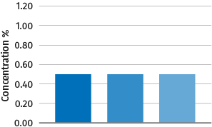
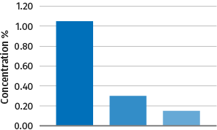
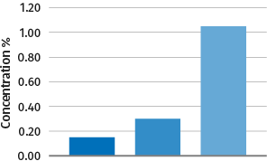
HYA-ACT™ IN & ON
Wrinkle Filler Serum
Efficacy with an ideal sensory profile
Total content of HYA-ACT™ XS, S, M is 1.5% | Watery Feel | Oily Feel | Greasy Feel | Spread-ability | Thickness | Time to Absorb | Residual Film | Glossines
  Thanks to dsm-firmenich sensory expertise, different content of HYA-ACT™ XS, S, M has different sensory properties on top of different skin benefits.
  HYA-ACT™ IN & ON the formula with a ratio 1:1:1 of HYA-ACT™ M, S, XS has a well-balanced sensory. It melts into the skin on contact imparting a subtle glossiness (SK E 101690 14).
  Higher content of HYA-ACT™ XS vs. HYA-ACT™ M leads to more fluid serum and lighter feeling (SK E 10169017).
  Higher content of HYA-ACT™ M vs. HYA-ACT™ XS leads to more textured serum and richer feeling (SK E 101690 13).
HYA-ACT™ IN & ON
SK E 101690 14
SK E 101690 17
SK E 101690 13
Benchmark for the texture: https://www.loreal-paris.co.uk/revitalift/filler-renew/hyaluronic-acid-anti-wrinkle-serum

Slide 40
Disclaimer
Copyright © dsm-firmenich Switzerland AG, 2026, 4002 Basel, Switzerland.
www.dsm-firmenich.com. All rights reserved.
dsm-firmenich has used diligent care to ensure that the information provided herein is accurate and up-to-date to the best of its knowledge. However, dsm-firmenich makes no representation or warranty, either expressly or implied, of the accuracy, reliability, completeness, or suitability thereof. The information provided herein contains scientific and product information for business-to-business use and does not constitute or provide scientific or medical advice, diagnosis or recommendation for treatment options. Country or region-specific information should be considered when labelling or advertising to final consumer. In no event shall dsm-firmenich be liable for any direct or indirect damages arising from or reliance upon, or use of, any information provided herein. The content of this document is subject to change without further notice. Please contact your local dsm-firmenich representative for the latest information. All trademarks listed in this document are either (registered) trademarks of, or trademarks licensed by, the dsm-firmenich group of companies, unless explicitly stated otherwise.
Disclaimer Formulation Guideline
The information provided herein is provided for information purposes only and has been prepared by dsm-firmenich in accordance with its own methodology.
dsm-firmenich has used diligent care to ensure that it is accurate and up-to-date, however, dsm-firmenich makes no representation or warranty, either expressly or implied, of the accuracy, reliability, or completeness thereof. In no event shall dsm-firmenich be liable for any damages arising from or reliance upon, or use of, any information provided herein. Further, dsm-firmenich shall not bear any liability for the application and/or use of any processed material containing its product(s). The formulation of the finished product is the customer’s sole responsibility. It is the customer’s responsibility to determine the suitability of dsm-firmenich’s products regarding user specific purposes, assess compatibility and stability of their finished product(s) and to ensure compliance of their finished product(s) with relevant laws and regulations. Any product, marketing or other claims made by customer are its sole responsibility. The content of this document is subject to change without further notice. Please contact your local dsm-firmenich representative for further details. © dsm-firmenich Switzerland AG, 2026.
© 2026

