Slide 1
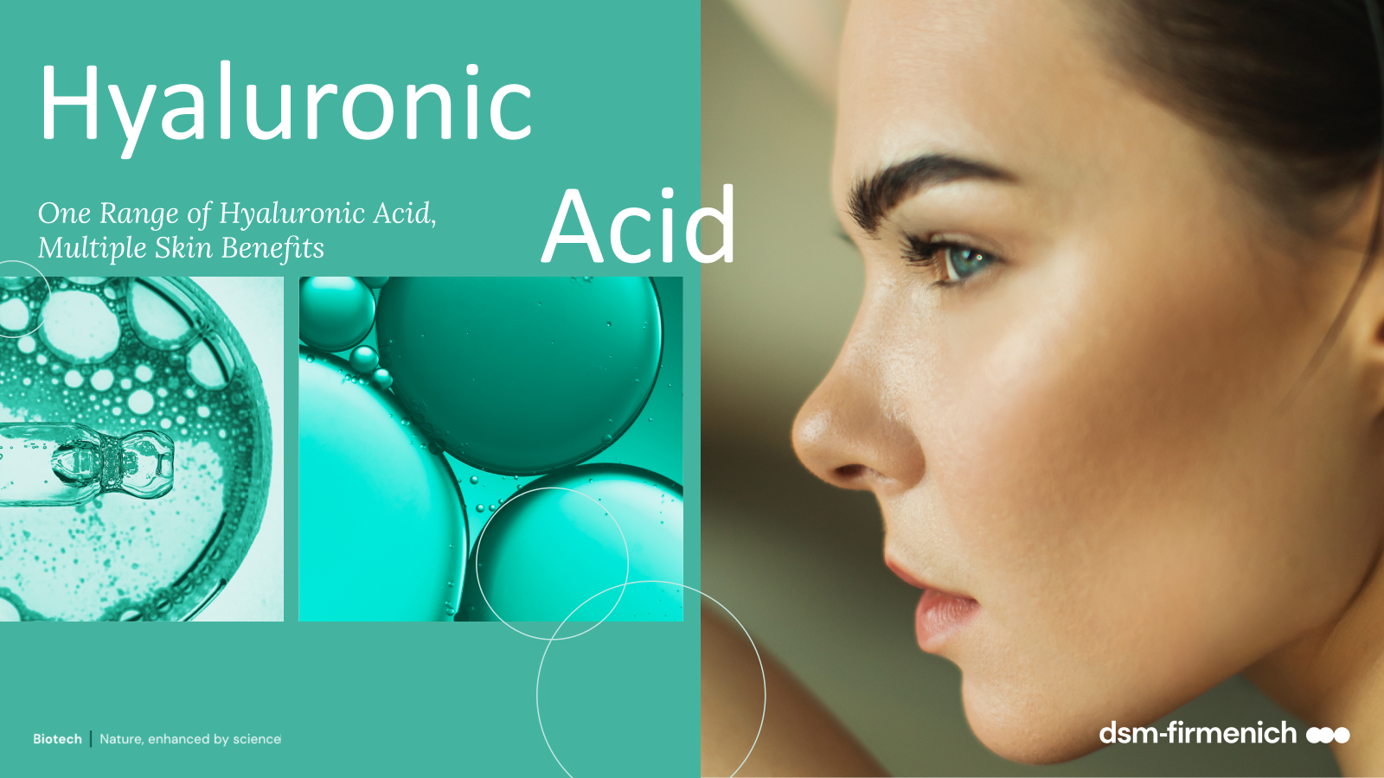
September 2026

Slide 2


Hyaluronic
Acids
One Range of Hyaluronic Acids,
Multiple Skin Benefits
HYALURONIC ACID-BT/ HYASOL PF · High Molecular Weight
HYALURONIC ACID MMW · Medium-High Molecular Weight
HYA-ACT™ M · Medium Molecular Weight
HYA-ACT™ S · Small Molecular Weight
HYA-ACT™ XS · Very Small Molecular Weight
NEW!

Slide 3
dsm-firmenich hyaluronic acid portfolio
Different sizes for different benefits
Product | Molecular Weight (MW) | INCI name | PhysicalForm | Biotech process | Sugar Origin | Benefits
HYALURONIC ACID-BT | High MW 1.45-1.77 Mda | Sodium Hyaluronate | Powder | Fermentation | Beet root | Acts as a sponge to deliver immediate hydration and forms uniform viscoelastic surface film. Outstanding tactile experience and skin revival immediately after application.
HYASOL™ PF | High MW 1.45-1.77 Mda | Sodium Hyaluronate | Liquid | Fermentation | Beet root | Ready to use 1% aqueous solution of HYALURONIC ACID BT. Same benefits as HYALURONIC ACID BT.
HYALURONIC ACID MMW | Medium-High MW 1.0–1.8 Mda | Sodium Hyaluronate | Powder | Fermentation | Corn seeds | • Reliable standard HA hydration performance. • Scalable solution for large-scale manufacturing. • Commercial 10 kg pack size.
HYA-ACT™ M | Medium MW 1.0–1.3 Mda | Sodium Hyaluronate | Powder | Fermentation | Corn seeds | Provides immediate hydration Strengthens the protective skin barrier by building a superior protecting film.
HYA-ACT™ S | Small MW 200 – 400 Kda | Sodium Hyaluronate | Powder | Fermentation | Corn seeds | Acts as a hydration booster. Lock in moisture for an even greater hydration boost and calms reddened skin.
HYA-ACT™ XS | Very small MW 37 – 56 Kda | Hydrolyzed Hyaluronic Acid | Powder | Fermentation | Corn seeds | Supplies hyaluronic acid into the skin and plumps out fine wrinkles. Improves skin elasticity.
NEW!

Slide 4
dsm-firmenich hyaluronic acid portfolio
A powerhouse of different hyaluronic acid forms that delivers various consumer benefits
NEW!
HYALURONIC ACID MMW - MW 1.0–1.8 MDa
HYA-ACT™ XS
MW 37-56 kDa
HYA-ACT™ S
MW 200-400 kDa
HYA-ACT™ M
MW 1.0–1.3 MDa
HYALURONIC ACID-BT
MW 1.45 – 1.77 MDa
MW (MDa)
Hydration from within Plumps out fine wrinkles
Hydration booster Calms reddened skin
Immediate hydration Strengthens the protective barrier
Binds tremendous amounts of moisture to skin Outstanding tactile experience
  Very Small Molecular Weight
  (MW 37-56 kDa)
  INCI: Hydrolyzed Hyaluronic Acid
  Main benefits: Supplies hyaluronic acid into the skin and plumps out fine wrinkles
  Small Molecular Weight (MW 200-400 kDa)
  INCI: Sodium Hyaluronate
  Main benefits: Locks in moisture for an even greater hydration boost and calms reddened skin.
  Medium Molecular Weight (MW 1.0-1.3 MDa)
  INCI: Sodium Hyaluronate
  Main benefits: Enhances skin hydration and strengthens the protective barrier
  High Molecular Weight (MW 1.45-1.77 MDa)
  INCI: Sodium Hyaluronate
  Main benefits: Acts as a sponge to deliver immediate hydration and forms uniform viscoelastic surface film
HYALURONIC ACID MMW - Volume and manufacturing-friendly MMW HA
  Medium-High Molecular Weight (MW 1.0-1.3 MDa)
  INCI: Sodium Hyaluronate
  Main benefits: Reliable hydration support, Scalable production, Pack size convenient for high-volume manufacturing
NEW!

Slide 5




HYALURONIC ACID-BT
ID Card
INCI NAME:
Sodium Hyaluronate
Powerful high molecular (1.45-1.77 MDa) Hyaluronic acid, manufactured by biotechnological fermentation in Europe
Derived from beet root - GMO free
Fine granuled powder for easier handling
100% natural origin (ISO 16128)
TECHNOLOGY:
TECHNICAL:
Form: White powder or granules
pH of use: 6.0-7.5
Use level: 0.01 - 1.00%
Preservative: free
Solubility: Slowly but completely water soluble
Acts as a sponge to deliver immediate hydration to the surface of skin
Forms uniform viscoelastic surface film
Binds tremendous amounts of moisture to skin
Outstanding tactile experience and skin revival immediately after application
BENEFITS:
REGISTRATION
CERTIFICATION
Raw material verified by ECOCERT GREENLIFE, conform to the COSMOS Standard
* in vitro ** in vivo

Slide 6
HYASOL PF
ID Card
INCI NAME:
Sodium Hyaluronate, Aqua, Phenoxyethanol
TECHNOLOGY:
1% aqueous solution of high molecular (1.45-1.77 MDa) HYALURONIC ACID-BT
Highly convenient and ready-to-use
99.1% natural origin (ISO 16128)
TECHNICAL:
Form: Clear to slightly opalescent, colorless, viscous solution
pH of use: 4.0-10.0
Use level: 3–5%
Preservative: Phenoxyethanol
Solubility: Water soluble
Same benefits as HYALURONIC ACID-BT
BENEFITS:
REGISTRATION
CERTIFICATION

Slide 7

HYALURONIC ACID MMW
NEW!
ID Card
INCI NAME:
Sodium Hyaluronate
Pure, biotechnologically manufactured, medium - high molecular weight hyaluronic acid of 1.0–1.8 MDa
Derived from corn seeds
GMO free
100% natural origin (ISO 16128)
TECHNOLOGY:
TECHNICAL:
Form: White, pale-yellow powder
pH of use: 4.0-11.0
Use level: 0.01-1%
Preservative: free
Solubility: Slowly but completely water soluble
Reliable standard hyaluronic acid hydration performance
Suitable for broad skin-care applications
Production-friendly solution attractive for customers looking for larger commercial pack sizes
Generates less dust, supporting easier use during production
BENEFITS:
REGISTRATION
CERTIFICATION
100
%
W
Raw material verified by ECOCERT GREENLIFE, conform to the COSMOS Standard
H
M
Y
M
A
-
L
D
U
I
R
C
O
A
C
N
I

Slide 8




HYA-ACT™ M (Medium Molecular Weight)
ID Card
INCI NAME:
Sodium Hyaluronate
Pure, biotechnologically manufactured, medium molecular weight hyaluronic acid of 1.0 – 1.3 MDa
Derived from sweet corn seeds
GMO free
100% natural origin (ISO 16128)
TECHNOLOGY:
TECHNICAL:
Form: White powder to granules
pH of use: 4.0-11.0
Use level: 0.01-1%
Preservative: free
Solubility: Slowly but completely water soluble
Provides immediate hydration : A single application enhances skin hydration up to 60% after just 1h.*
Strengthens the protective skin barrier, with an up to 26% reduction in TEWL after just 1h.*
Suitable for all kinds of facial and body care leave-on and rinse-off hydration products
BENEFITS:
REGISTRATION
CERTIFICATION
Raw material verified by ECOCERT GREENLIFE, conform to the COSMOS Standard
* in vivo

Slide 9
HYA-ACT™ S (Small Molecular Weight)
ID Card
INCI NAME:
Sodium Hyaluronate
Biotechnologically manufactured, small molecular weight hyaluronic acid of 200 – 400 KDa
Derived from sweet corn seeds
GMO free
100% natural origin (ISO 16128)
TECHNOLOGY:
TECHNICAL:
Form: White or almost white powder to granules
pH of use: 4.0-11.0
Use level: 0.01-1%
Preservative: free
Solubility: Quickly and completely water soluble
Acts as a hydration booster for thirsty skin*
Lock in moisture for an even greater hydration boost*
Calms reddened skin**
Suitable for all kinds of facial and body care leave-on and rinse-off hydration products
BENEFITS:
REGISTRATION
CERTIFICATION
Raw material verified by ECOCERT GREENLIFE, conform to the COSMOS Standard
* in vitro ** in vivo

Slide 10
HYA-ACT™ XS (Very Small Molecular Weight)
ID Card
INCI NAME:
Hydrolyzed Hyaluronic Acid
Very small molecular weight hyaluronic acid of 37 – 56 KDa, obtained by bio-fermentation.
Derived from sweet corn seeds
GMO free
100% natural origin (ISO 16128)
TECHNOLOGY:
TECHNICAL:
Form: Off-white powder to granules
pH of use: 4.0-11.0
Use level: 0.01-1%
Preservative: free
Solubility: Quickly and completely water soluble
Provides skin with a continuous burst of intense hydration and plumps out fine wrinkles*
Improved skin’s elasticity after just 15 days*
Suitable for all kinds of facial and body care leave-on and rinse-off hydration products
Recommended for anti aging serums and creams
BENEFITS:
REGISTRATION
CERTIFICATION
Raw material verified by ECOCERT GREENLIFE, conform to the COSMOS Standard
* in vivo

Slide 11
Disclaimer
Copyright © dsm-firmenich Switzerland AG, 2026, 4002 Basel, Switzerland.
www.dsm-firmenich.com. All rights reserved.
dsm-firmenich has used diligent care to ensure that the information provided herein is accurate and up-to-date to the best of its knowledge. However, dsm-firmenich makes no representation or warranty, either expressly or implied, of the accuracy, reliability, completeness, or suitability thereof. The information provided herein contains scientific and product information for business-to-business use and does not constitute or provide scientific or medical advice, diagnosis or recommendation for treatment options. Country or region-specific information should be considered when labelling or advertising to final consumer. In no event shall dsm-firmenich be liable for any direct or indirect damages arising from or reliance upon, or use of, any information provided herein. The content of this document is subject to change without further notice. Please contact your local dsm-firmenich representative for the latest information. All trademarks listed in this document are either (registered) trademarks of, or trademarks licensed by, the dsm-firmenich group of companies, unless explicitly stated otherwise.
Disclaimer Formulation Guideline
The information provided herein is provided for information purposes only and has been prepared by dsm-firmenich in accordance with its own methodology.
dsm-firmenich has used diligent care to ensure that it is accurate and up-to-date, however, dsm-firmenich makes no representation or warranty, either expressly or implied, of the accuracy, reliability, or completeness thereof. In no event shall dsm-firmenich be liable for any damages arising from or reliance upon, or use of, any information provided herein. Further, dsm-firmenich shall not bear any liability for the application and/or use of any processed material containing its product(s). The formulation of the finished product is the customer’s sole responsibility. It is the customer’s responsibility to determine the suitability of dsm-firmenich’s products regarding user specific purposes, assess compatibility and stability of their finished product(s) and to ensure compliance of their finished product(s) with relevant laws and regulations. Any product, marketing or other claims made by customer are its sole responsibility. The content of this document is subject to change without further notice. Please contact your local dsm-firmenich representative for further details. © dsm-firmenich Switzerland AG, 2026.
© 2026

