Slide 1

Life's GLA™
Omega-6 Flower Seed Oils
Master Presentation
10-2020

Slide 2
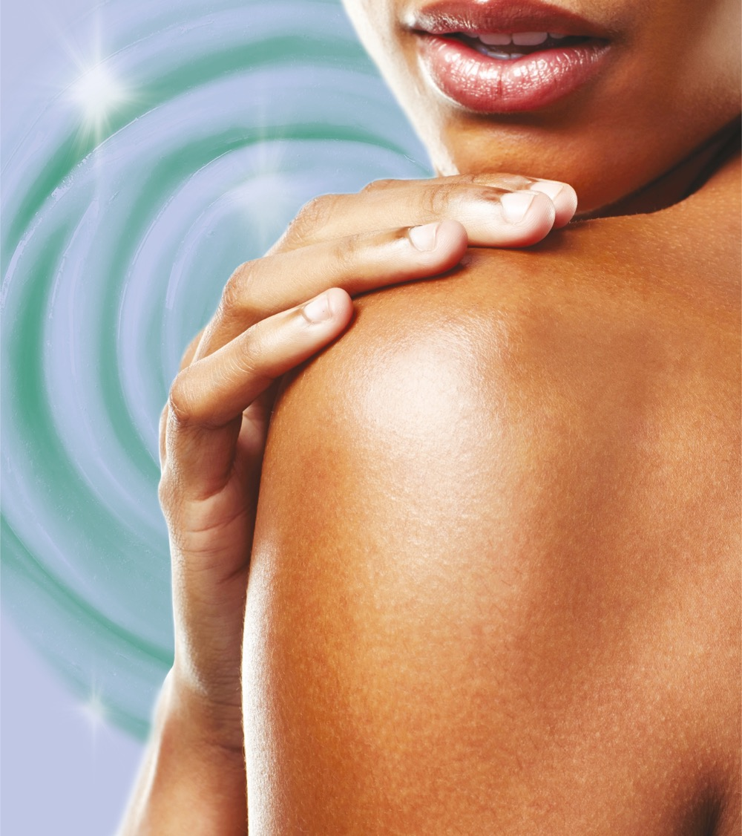
Relieves your skin from stress, allowing a healthy and natural look & feel!

Slide 3
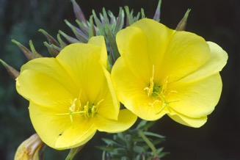

Flower Power for your skin
Our flower seed oils are naturally rich in polyunsaturated fatty acids with a high content of gamma linolenic acid (GLA).
Evening Primrose
life'sGLA™ '10' N-6 OIL(former ROPUFA®'10'n-6 oil) is prepared by extraction of oil from seeds of Oenothera plant or Evening primrose (9% GLA)
Starflower/Borage
life'sGLA™ '25' N-6 OIL (former ROPUFA®'25'n-6 oil) is prepared by extraction
of oil from seeds of the Borage plant (23% GLA).
Our improved production process results in a natural oil with a good stability, slight yellowish color, low odor, and bland taste.
Picture sources: Getty images

Slide 4

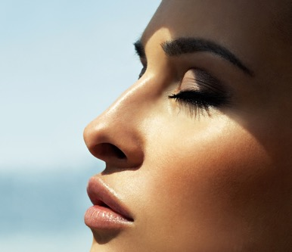

Skin under pressure
Our skin is our largest organ and our shield to the environment.
Regulation | Protection
Body temperature | UV radiation damage
Water balance | Pathogen attack
 | Mechanical, physical and chemical insults
Our way of life stresses the skin barrier each day. The protective function of the skin is constantly challenged:
  Sunbathing, cold wind
  Washing, bathing
  Chemicals in cosmetics and perfumes
  Urban pollution

Slide 5
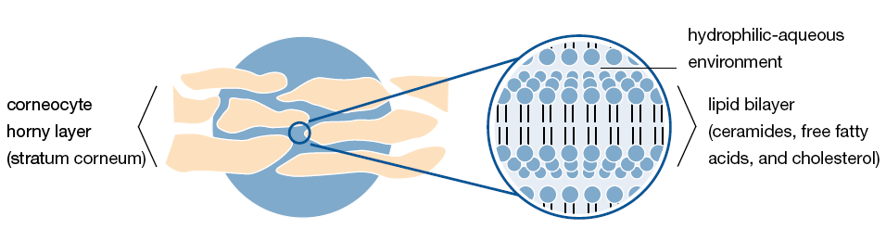
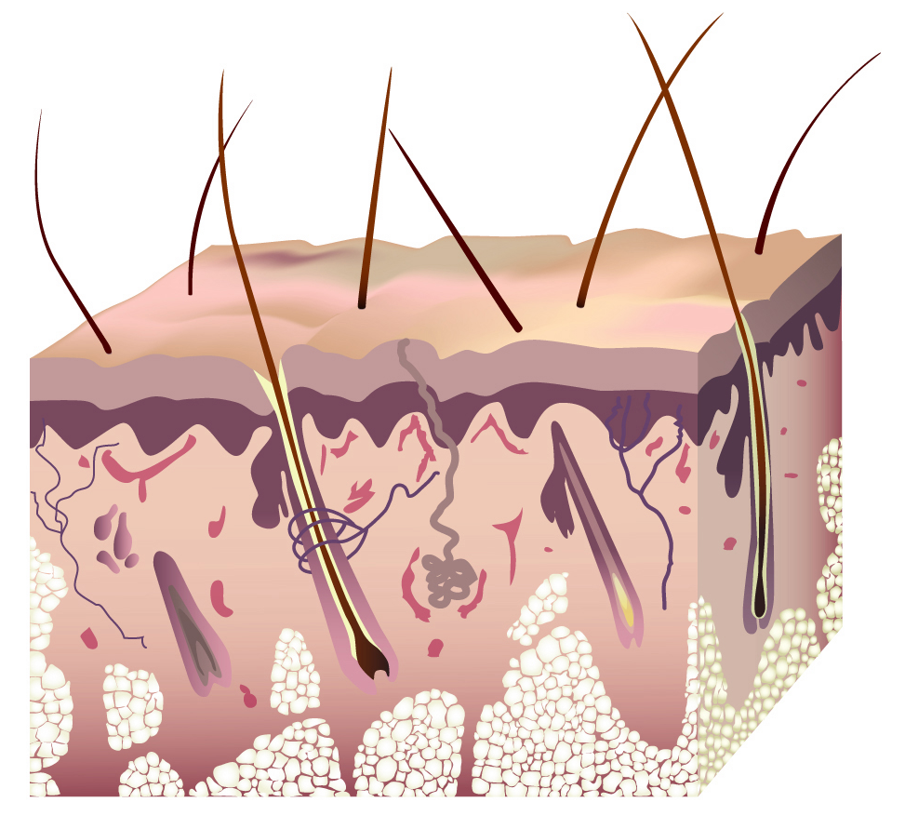
Skin Barrier Function
Hydrophilic-aqueous environment
Corneocyte
Horny layer
(stratum corneum)
Lipid bilayer
(ceramides, free fatty acids, and cholesterol)
„mortar“
ceramides (40%)
cholesterol (25%)
free fatty acids (25%)
“bricks”
Layers of horny cells (corneocytes) form a tight wall.
The essential free fatty acids, specifically gamma linolenic acid (GLA), are important for the skin barrier function.

Slide 6
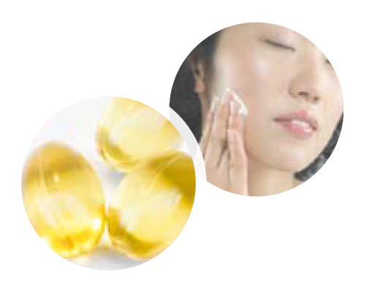
GLA Deficiency
Gamma linolenic acid (GLA) deficiency can result in
increased transepidermal water loss (TEWL)
dry, chapped, or rough skin
irritations, infections and inflammation
higher susceptibility to external stressors (allergens)
Refilling the “mortar” with lipids and GLA
is an excellent way to strengthen the protective function of the skin and to avoid skin barrier degradation.

Slide 7

GLA helps protect our skin
Overall a younger and smoother appearance of the skin can be achieved by supplying gamma linolenic acid (GLA) from flower seed oils like life'sGLA™
(See scientific references for details)
Proven Benefits | Application
Reducing TEWL | Topical, oral
Moisturizing effect | Topical, oral
Smoothness | Topical, oral
Skin firmness | Oral
Fatigue resistance | Oral
Reduced itching | Oral

Slide 8
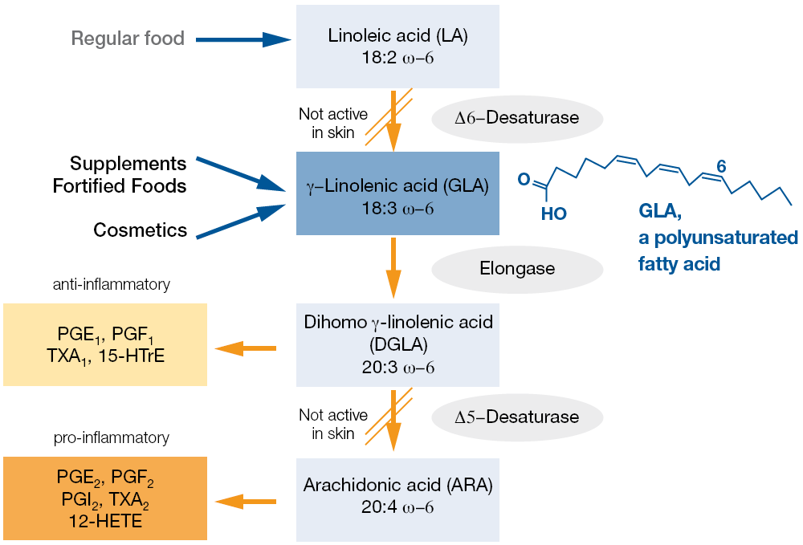
GLA – essential for healthy skin
Notes:
Gamma linolenic acid (GLA) is essential for our skin. Normally the body is able to produce GLA from
linoleic acid (LA) by enzymatic conversion. However, the required enzyme activity to convert LA to
GLA is not available in skin. Also, older people often have problems synthesizing enough GLA from
their diet.
Therefore GLA rich oils are the ideal source to supply our body and skin with this essential fatty acid.
In addition to its role in the skin barrier function of the stratum corneum, the GLA is partly converted to
dihomo gamma linolenic acid (DGLA), which is a precursor of a number of anti-inflammatory signaling
compounds, like the prostaglandin PGE1.
Supply with GLA seems to normalize the balance of pro- and anti-inflammatory eicosanoids and
mitigate the symptoms of skin infections with an inflammatory component. A number of scientific
papers have been published studying the positive effects of GLA-rich plant oils on atopic eczema and
irritated skin.4

Slide 9
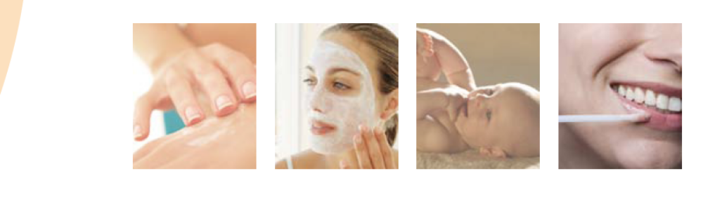
Topical
Application Concepts
Facial care and body care: dry and sensitive skin segment, 45+ age class
Baby products
Natural products
Hair care products: scalp moisturizing and dandruff or treatment products
Lip gloss, lip care, nail polish
DSM’s life'sGLA™ has been used in cosmetics products for over 20 years.
Recent scientific publications have again confirmed their benefits for a healthy skin.
Use life'sGLA™ to enrich your products with natural flower seed oils rich in gamma linolenic acid (GLA).

Slide 10
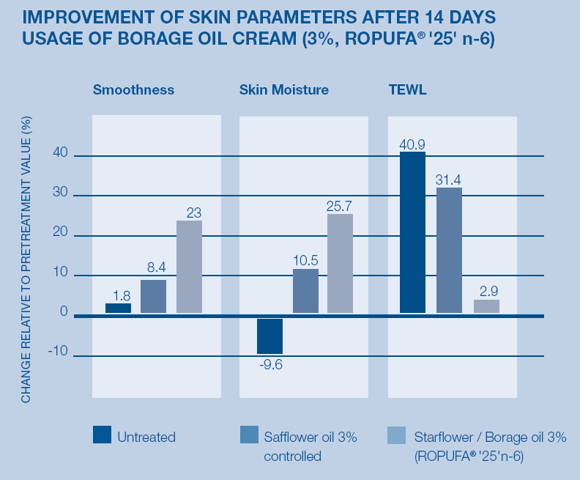
Topical
Test:
20 healthy men and women
(age 25-58)
Creams:
  3% safflower oil
  (control)
  3% starflower oil
  life'sGLA™ '25' n-6, borage)
Twice a day on their right forearm. 2 mg of cream per cm² were applied. Smoothness, skin humidity and TEWL were measured on days 0, 7 and 14.
Results:
After 14 days the skin was significantly smoother, had more moisture and less trans-epidermal water loss.
[see reference: Nissen 1995]
Notes:
20 healthy men and women between the ages of 25 and 58
were using a cream containing either 3% of a safflower oil
(control) or 3% of starflower oil (ROPUFA® ('25' n-6, borage)
twice a day on their right forearm. 2 mg of cream per cm2
were applied.
Smoothness, skin humidity and TEWL were measured on
days 0, 7 and 14. After 14 days the skin was significantly
smoother, had more moisture and less transepidermal water
loss. This effect was even more positive on irritated skin
(after pretreatment with SDS, not included here).
[Lit. 1, Nissen 1995]

Slide 11
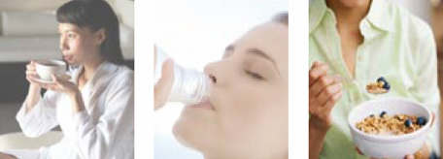
Oral- Beauty from within
Application Concepts
Beauty drinks: soft drinks, breakfast shots
Dietary supplements in segments botanical/
herbal, hydrating, and Beauty from Within
Fortified food: margarine, yogurt, snacks, milk drink, orange beverage, bread
life'sGLA™ provides the well-known skin benefits of evening primrose and borage seed oils into your supplements.
Evening primrose oil supplements have proven their efficacy for a younger appearance of the skin.

Slide 12
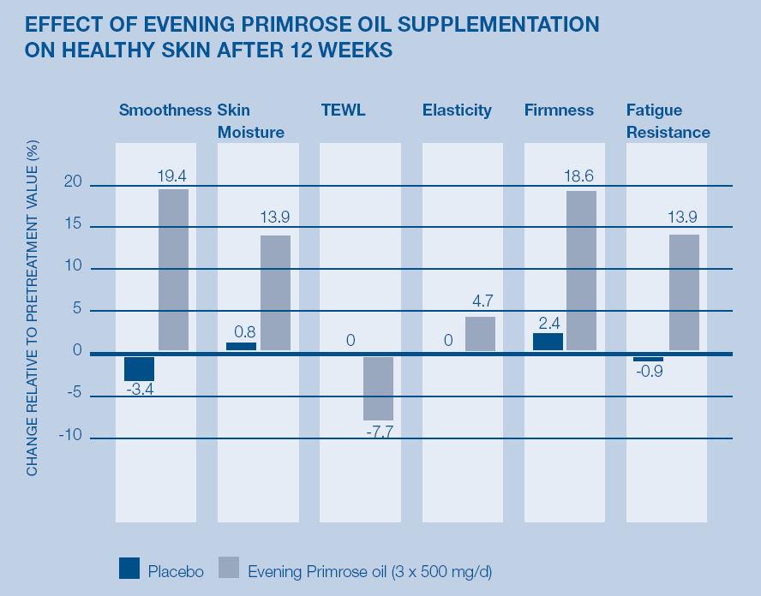
Oral- Beauty from within
Test:
A double-blind, placebo-controlled, parallel trial of 40 men and women (age 32-60)
2 gelatine capsules of 500 mg evening primrose oil three times daily
Results:
The study shows structure repairs and improvements of appearance of dry and irritated skin in three months.
Volunteers with dry skin showed improvement of skin moisture, smoothness and some age-related skin properties such as elasticity, firmness and strength after 12 weeks.
[see reference: Muggli 2005]

Slide 13
life'sGLA™ in a nutshell
• Improves skin elasticity and firmness
• Restores the skin barrier function
• Reduces skin itching
• Heals dry skin, due to a strong moisturizing effect

Slide 14
Available Products
Flower | Product | INCI Name | GLA Content | Product Code
Evening Primrose | life'sGLA™ (ROPUFA®) '10' n-6 oil | Oenothera Biennis (Evening Primrose) Oil | >9% | 0422398
Starflower/Borage | life'sGLA™ (ROPUFA® ) '25' n-6 oil | Borago Officinalis Seed Oil | >23% | 5008549

Slide 15
Backup
Formulation Guidelines
Scientific References

Slide 16
Topical: Formulation Guidelines
Store life'sGLA™ at cool temperature (<15°C).
Peroxide value of ROPUFA® should be below 5 when you produce a cosmetic product.
life'sGLA™ is sensitive to light and oxygen. Reseal container after adding nitrogen or argon to protect leftover.
When formulating always use EDTA.
Recommended use level is 0,1% – 8%.
Use in conjunction with antioxidants, most preferred are BHT, BHA, or mixed tocopherols.
Add life'sGLA™ below 40°C, e.g. together with perfume oils or the preservative system.
Remove as much oxygen as possible by boiling the water phase and producing/filling under vacuum.
Final cosmetic formulation should be in a sealed container (glass, aluminum or laminate tube/bottle).
Plastic will be penetrated by oxygen and should not be used.

Slide 17
Scientific References
1: Nissen, H.P., H. Biltz, and R. Muggli, Borage oil. Cosmetics & Toiletries, 1995. 110(10): p. 71-73, 76.
2: Muggli, R., Systemic evening primrose oil improves the biophysical skin parameters of healthy adults. International Journal of Cosmetic Science, 2005. 27(4): p. 243-249.
3: Brosche, T. and D. Platt, Effect of borage oil consumption on fatty acid metabolism, transepidermal water loss and skin parameters in elderly people. Archives of Gerontology and Geriatrics, 2000. 30(2): p. 139-150.
4: Henz, B.M., et al., Double-blind, multicentre analysis of the efficacy of borage oil in patients with atopic eczema. British Journal of Dermatology, 1999. 140(4): p. 685-688.

Slide 18
DISCLAIMER
Copyright © 2020 DSM Nutritional Products, 4002 Basel, Switzerland.
www.dsm.com/personal-care. All rights reserved.
Although DSM has used diligent care to ensure that the information provided herein is accurate and up to date, DSM makes no representation or warranty of the accuracy, reliability, or completeness of the information. This presentation only contains scientific and technical information for business to business use. Country- or region-specific information should also be considered when labeling or advertising to final consumers. This publication does not constitute or provide scientific or medical advice, diagnosis, or treatment and is distributed without warranty of any kind, either expressly or implied. In no event shall DSM be liable for any damages arising from the reader’s reliance upon, or use of, these materials. The reader shall be solely responsible for any interpretation or use of the material contained herein. The content of this document is subject to change without further notice. Please contact your local DSM representative for more details. All trademarks listed in this brochure are either registered trademarks or trademarks of DSM in The Netherlands and/or other countries unless explicitly otherwise stated.
DISCLAIMER FORMULATION GUIDELINES
This information is for illustration purposes only and based upon our current knowledge and experience at the time of printing. We do not make any representation or warranty of any kind, express or implied, including merchantability or fitness for a particular use, with respect to such information or its application. Use of this information is at your discretion and risk. Nothing herein relieves you from carrying out your own suitability determinations and tests. You are responsible for observing all laws and regulations relevant to your products, uses or processes. We do not assume any liability in connection with your product and its use. The foregoing information and suggestions are also provided without warranty of non-infringement as to the intellectual property rights of third parties, and shall not be construed as any inducement to infringe the rights of third parties.

