Slide 1
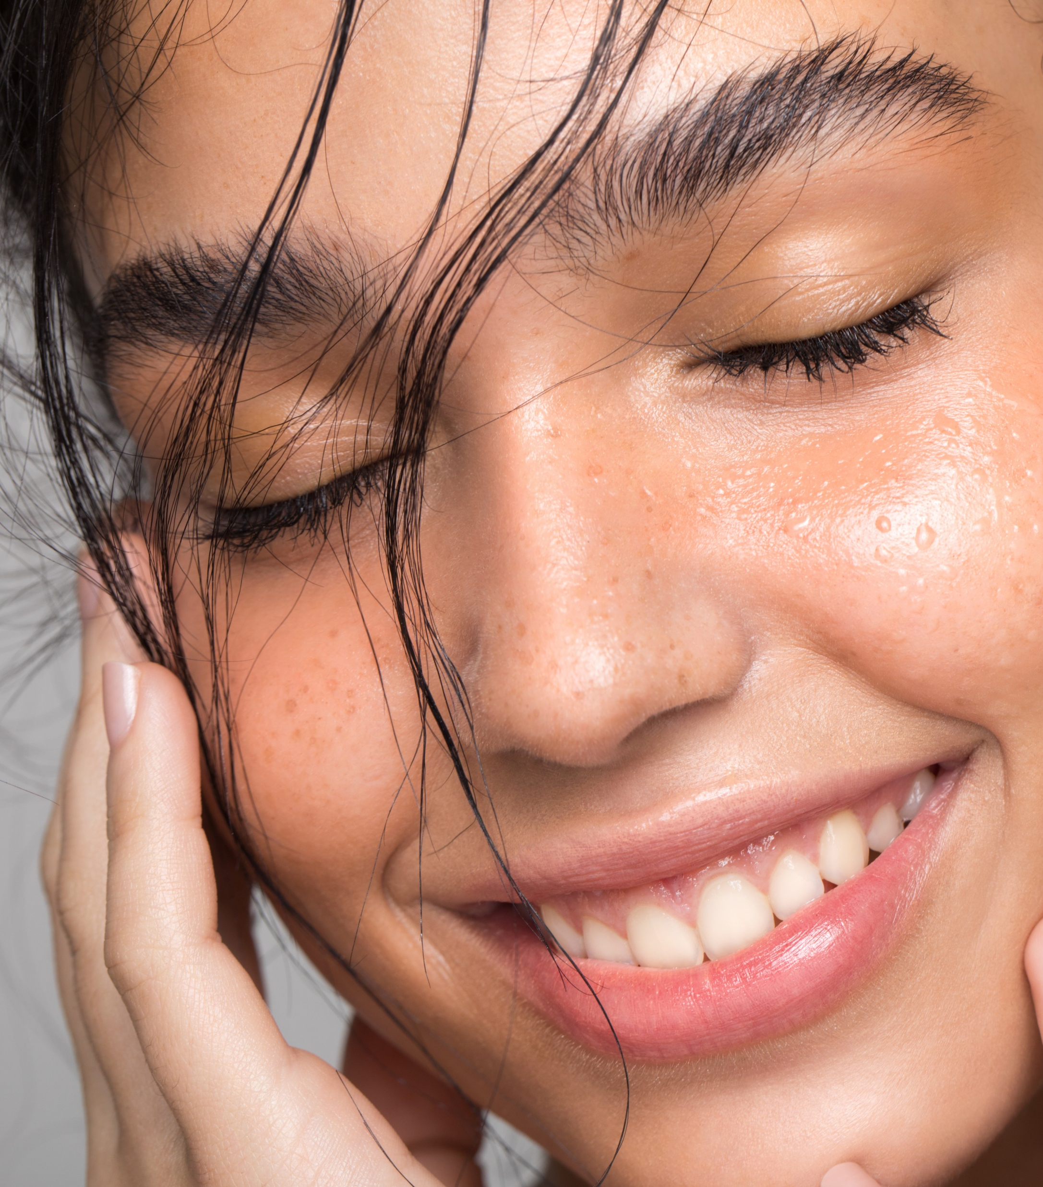
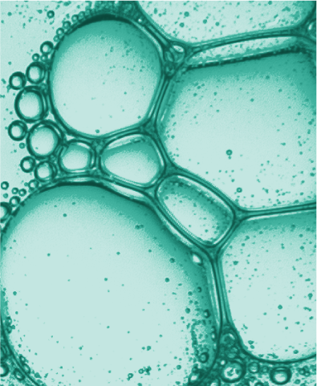
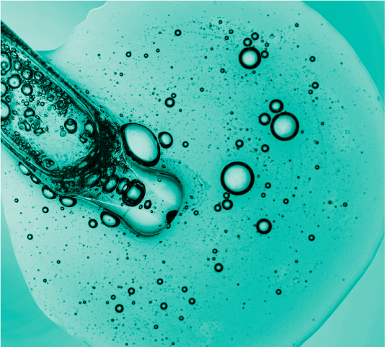

Coenzyme Q10
Has become a leading cosmetic ingredient
July 2025

Slide 2

What is Coenzyme Q10 ?
  Over the last years, Coenzyme Q10 has become a leading cosmetic ingredient particularly in anti-aging formulations.
  Coenzyme Q10 (CoQ10), also known as Q10 or ubiquinone
  Coenzyme Q10 is a naturally occurring, fat-soluble compound found in virtually all human cells, particularly in the mitochondria.
  Coenzyme Q10 levels decline with age and UV exposure
*Biofactors. 2015 Nov 12; 41(6): 383–390

Slide 3
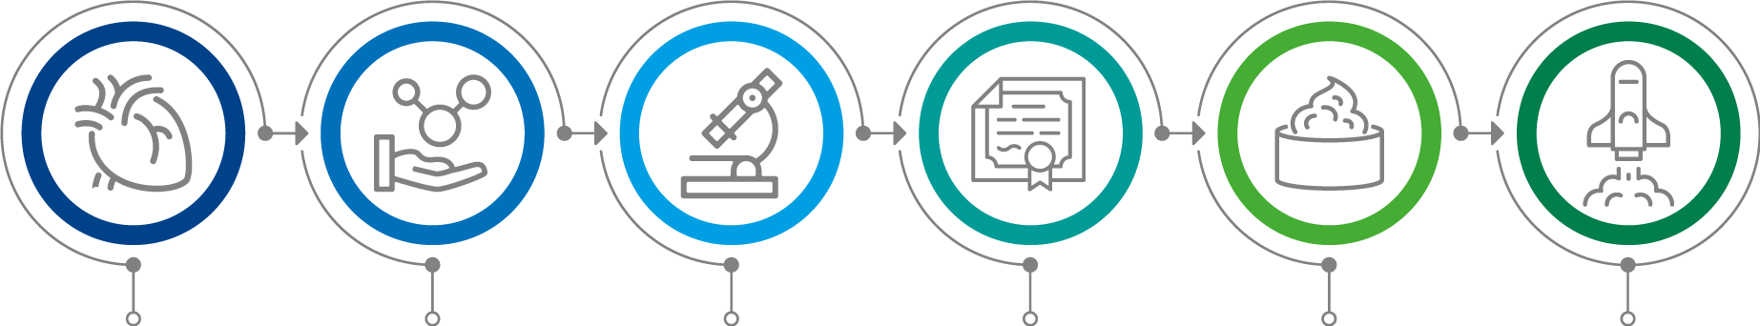

History of Coenzyme Q10
1957
Coenzyme Q10 first isolated from beef heart mitochondria by Dr Frederick Crane of Wisconsin, named ubiquinone
1958
Prof. Karl Folkers of Merck determined chemical structure
1975
Coenzyme Q10 synthesis developed by the Japanese
1978
Peter Mitchell received Nobel Prize for biological energy transfer theory, including role of Coenzyme Q10
1999
First larger promoted use in a cosmetic product: Beiersdorf
2003
Launch of LIPOGARD
2010
Launch of ALL-Q® Plus

Slide 4
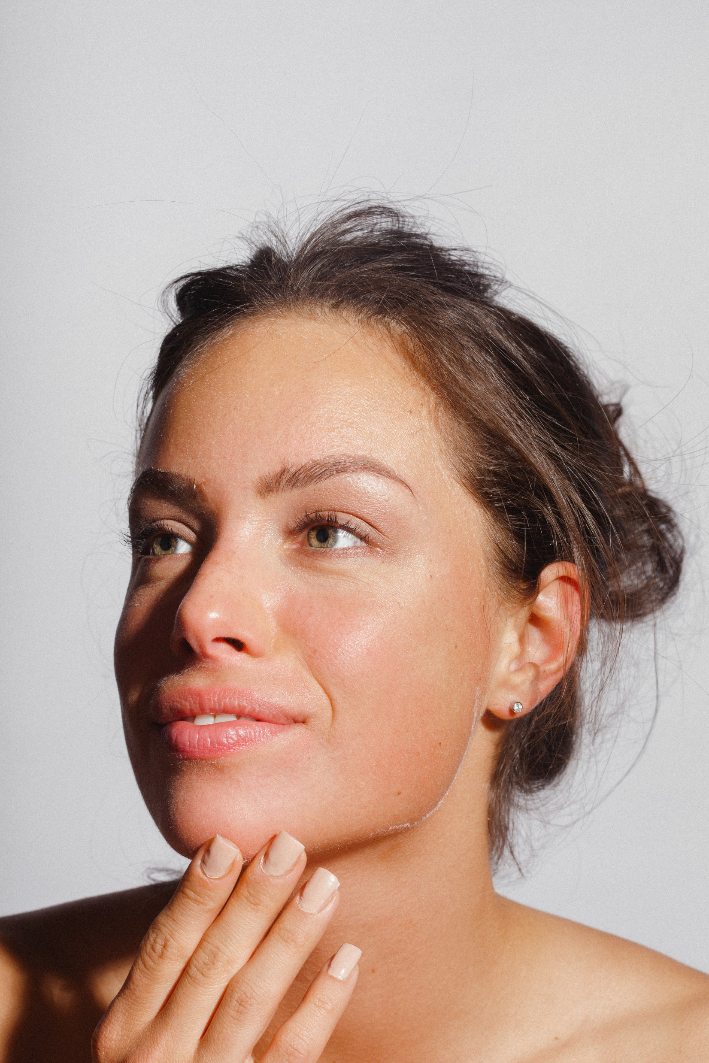
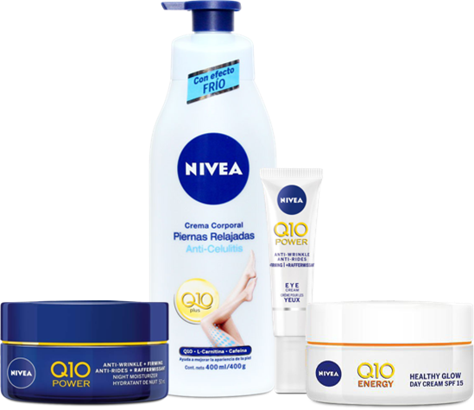
Coenzyme Q10 - the ingredient of more than 20 years of research
  Beiersdorf have invested more than 20 years of intensive research into Q10, how it works and the benefits for skin care.
  This has made it possible to create an anti-wrinkle face care range that combats the aging process naturally.*
* Source: https://www.nivea.co.uk/advice/skin/what-is-q10-233

Slide 5

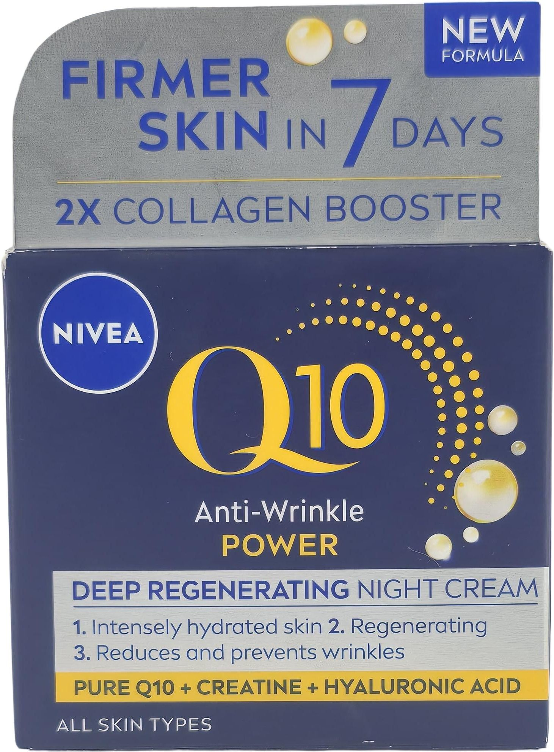
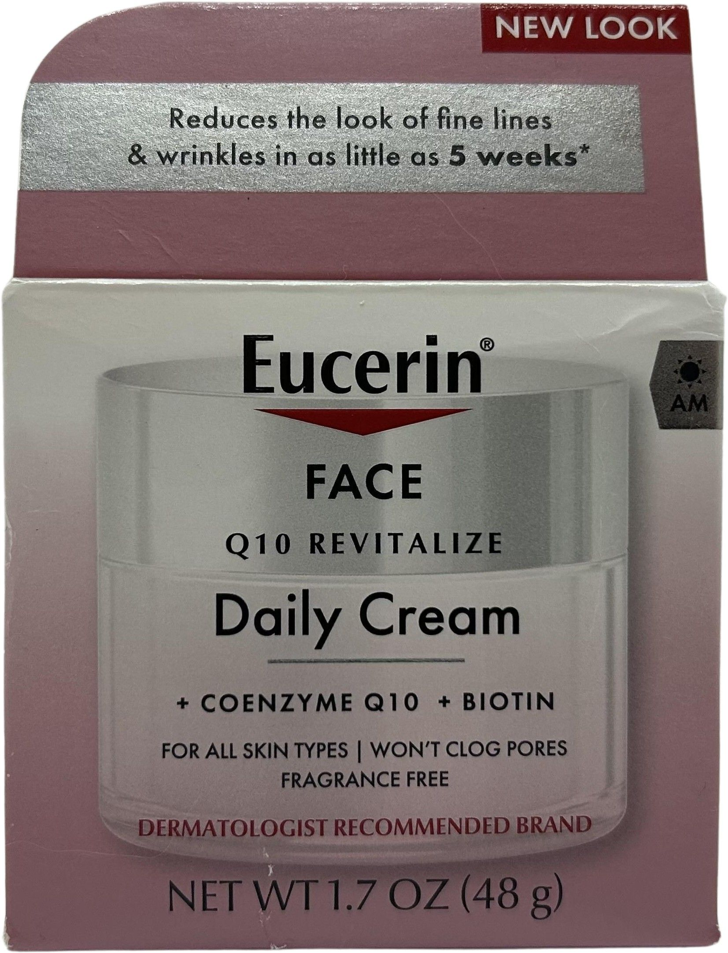
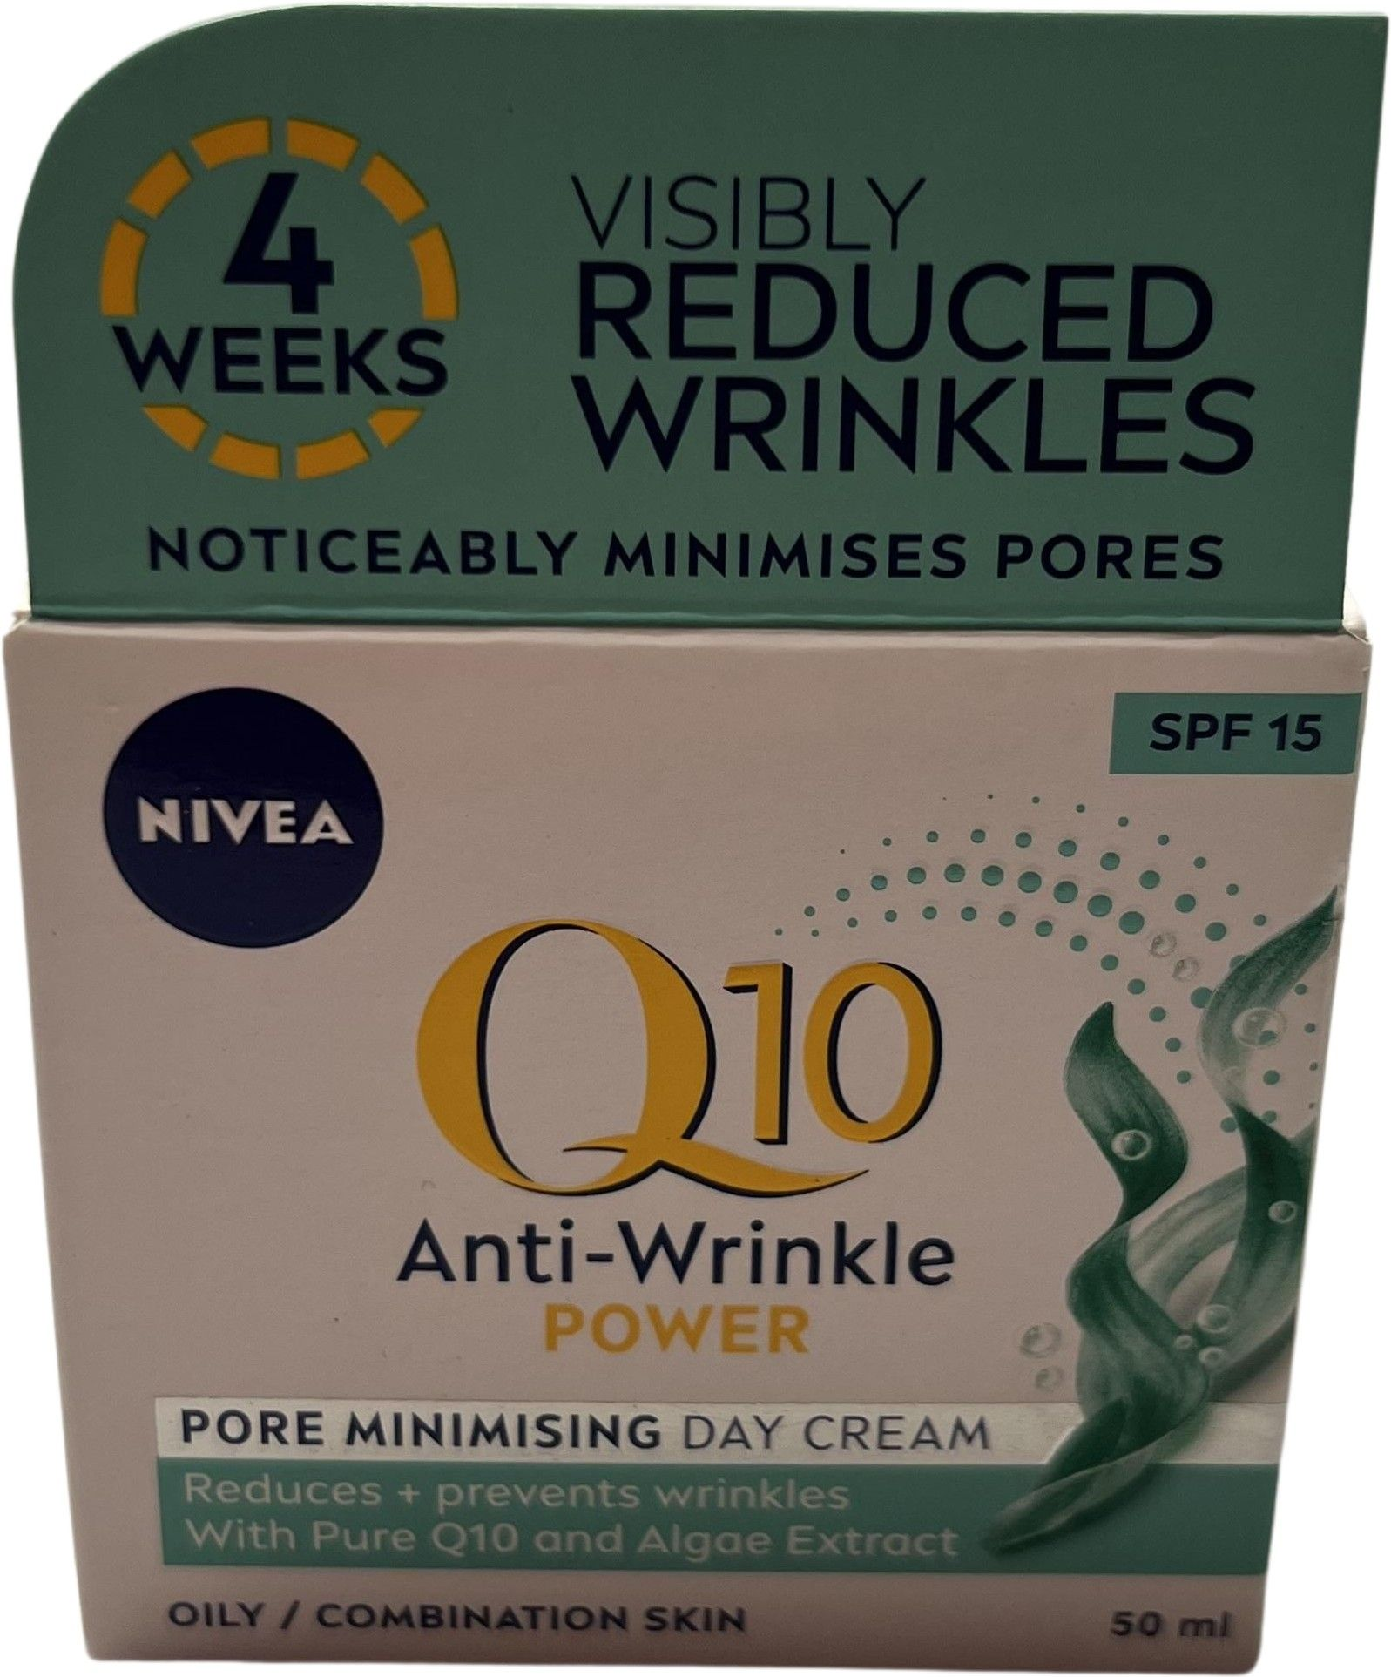
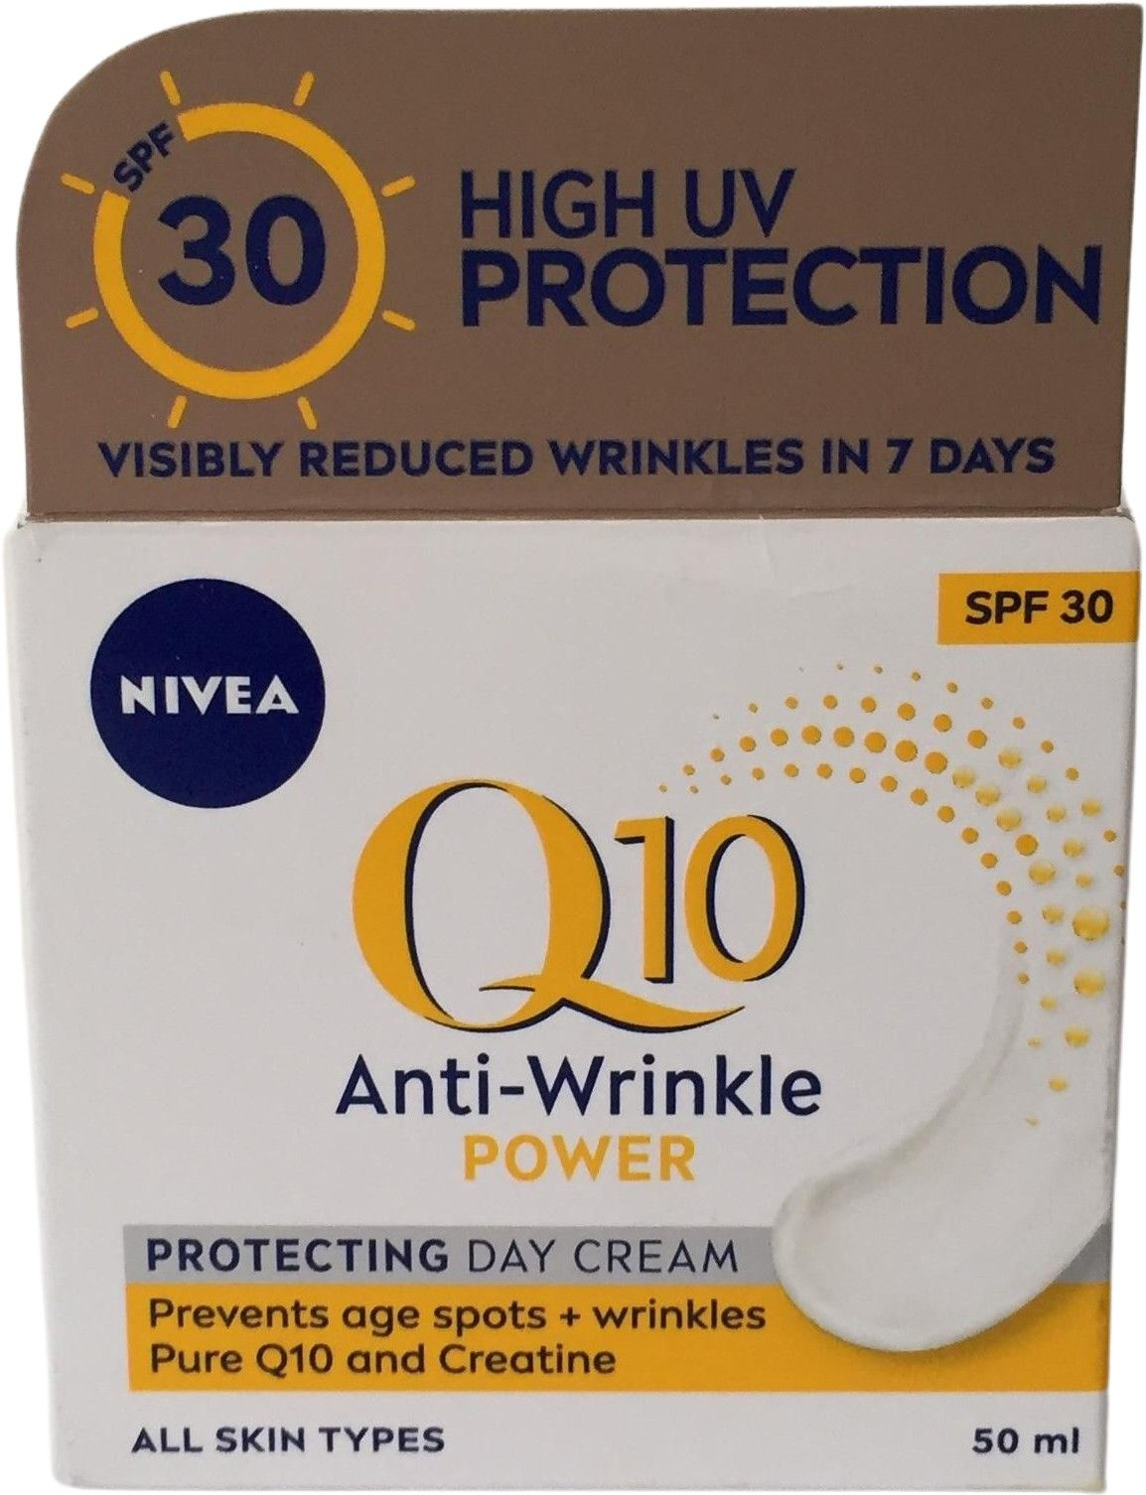
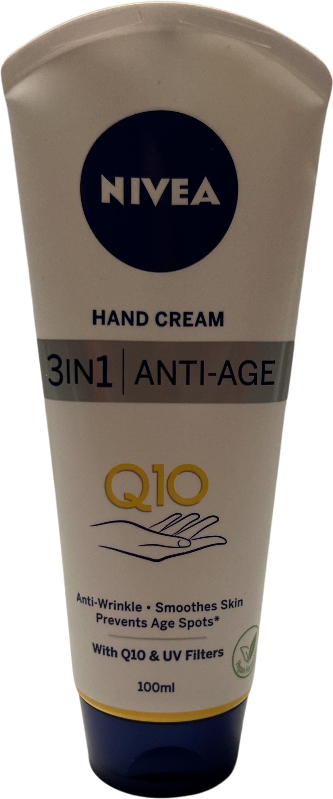
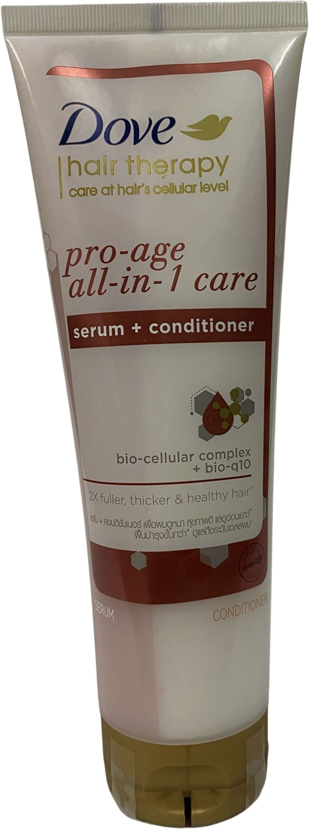
Coenzyme Q10 (Q10) - a still unbroken trend
Anti-Wrinkle Power
Revitalize
Pore Minimising
Protecting Day Cream
Anti-Age Hand Cream
Hair Therapy

Slide 6
How does Coenzyme Q10 work?
Coenzyme Q10 (Q10) works through two primary biological mechanisms that are especially relevant in skincare and cellular health:
  Energy production (ATP Synthesis)
  Coenzyme Q10 is a vital component of the mitochondrial electron transport chain. This process is essential for the production of adenosine triphosphate (ATP), the energy currency of cells. In skin cells, this energy supports:
    Cell regeneration
    Repair of damaged tissues
    Maintenance of skin elasticity and firmness
  Antioxidant defense
  Coenzyme Q10 acts as a lipid-soluble antioxidant, neutralizing reactive oxygen species (ROS) and preventing oxidative damage to:
    Lipids
    Cell membranes
    Proteins
    DNA
This is particularly important in protecting the skin from UV-induced aging, inflammation, and lipid peroxidation.

Slide 7
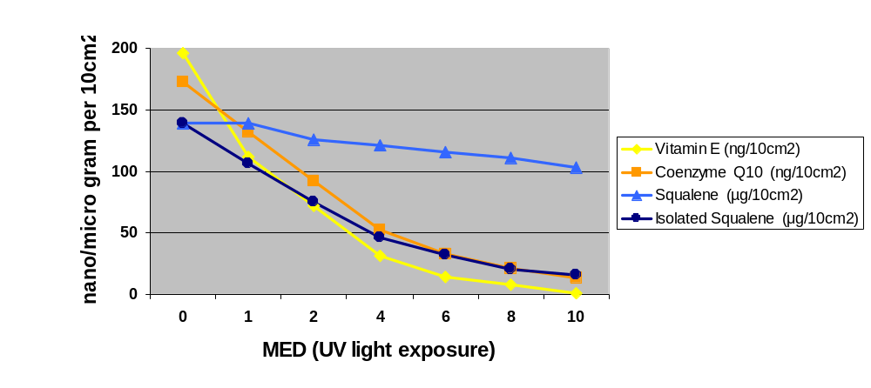
CoQ10 protects together with Vitamin E the skin surface lipids from peroxidation​
Lit: Passi et al.: Lipophilic antioxidants in human sebum and aging. Free Radical Research, 36, 471-477 (2002)
The study by Passi et al. (2002) is frequently cited in dermatological literature for its insights into how Coenzyme Q10 (CoQ10) and Vitamin E protect skin surface lipids from oxidative damage, particularly under UV exposure
Skin surface lipids (mixture of sebum and lipids originating from corneocytes) were collected from healthy volunteers. Coenzyme Q10 and Vitamin E were determined in skin surface lipids.
Irradiation of the skin surface lipids with increasing amounts of UV light led to an almost complete depletion of CoQ10 and Vitamin E, whereas squalene was only marginally decreased i.e. oxidized.
The protective effect of CoQ10 and Vitamine E on squalene becomes obvious when isolated squalene is exposed to UV-irradiation. It is almost completely peroxidized.
The decline of CoQ10 and Vitamin E under UV stress underscores the need for topical replenishment

Slide 8
CoQ10 reduces wrinkle depth
Reduction of wrinkles depth around the eyes after application of CoQ10 in 6 months
Lit: Hoppe et al 1999 BioFactors 9, 1999, 371-378
Placebo-controlled study involving two groups of 24 healthy, aged volunteers with a formulation with 0.3% CoQ10 were once daily applied. The reduction of the wrinkle depth was measured by profilometry. Silicon replicas were taken from defined skin area around the eye and the Rt-value = max wrinkle depth was measured by means of a laser.
-27%
27% reduction of wrinkle depth after application of 0.3% CoQ10 in 6 month

Slide 9






Coenzyme Q10 – The Ultimate Benefits
Coenzyme Q10 is a powerful antioxidant¹
Coenzyme Q10 works to sustain energy production to fulfil the skin’s vital functions²
Coenzyme Q10 protects the deeper layers of your skin from damage caused by UVA³
Coenzyme Q10 fights against wrinkles⁴
Coenzyme Q10 can help to prevent hyperpigmentation⁵
1 Biofactors. 2015 Nov 12; 41(6): 383–390.
2 Biochemical and Biophysical Research Communications 396 (2010) 74–79.
3 BioMed Research International Volume 2020.
4 BioFactors 32 (2008) 237–243.
5 Biochemical Pharmacology 164 (2019) 299–310.

Slide 10
LIPOGARD
Replenish your skin’s natural superpowers

Slide 11
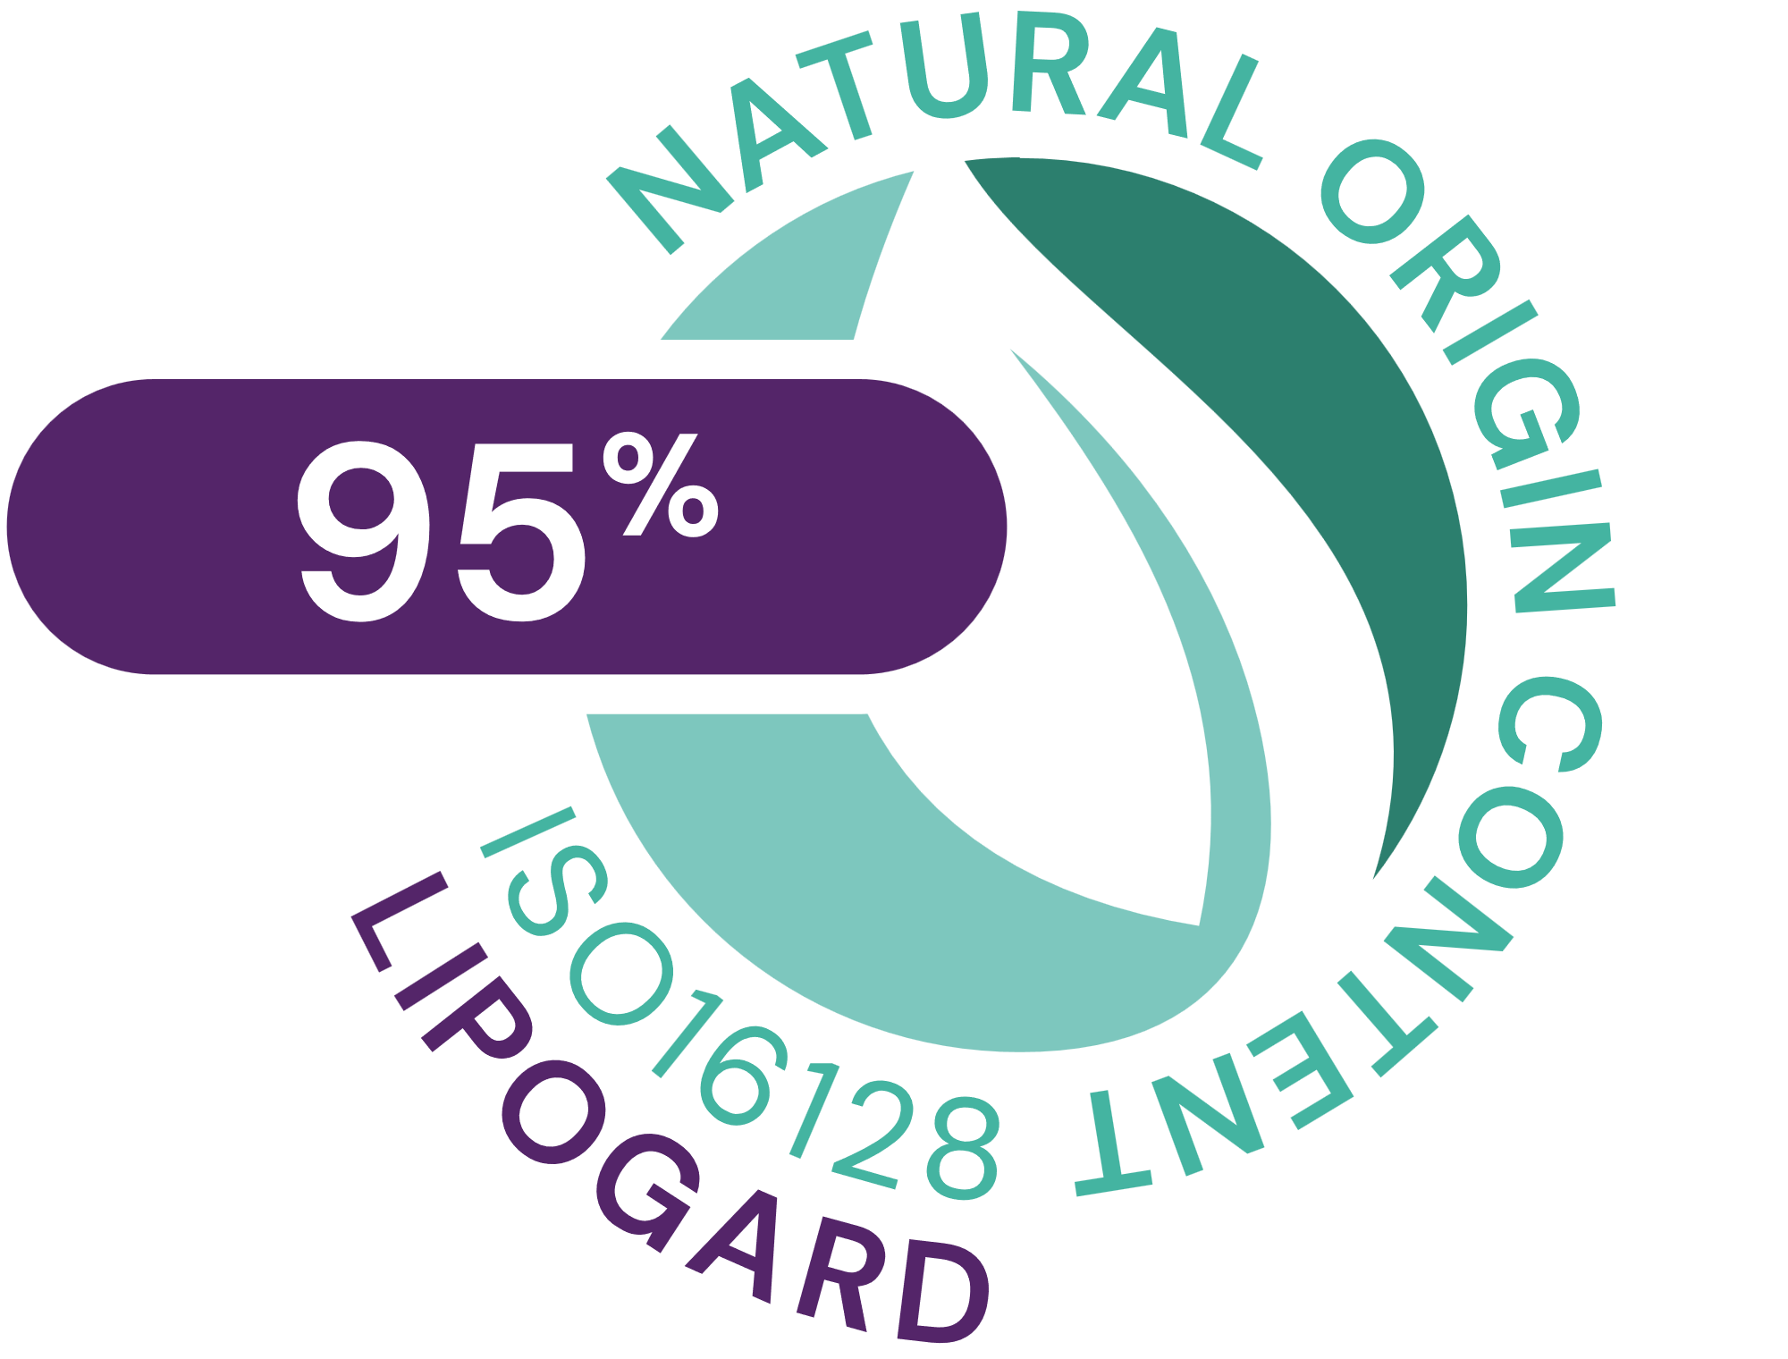




LIPOGARD
ID Card
INCI NAME:
Tocopheryl Acetate, Ubiquinone, Squalane
A perfect blend of 1% Ubiquinone, 5% Tocopheryl Acetate, 94% Squalane
Q10/Ubiquinone: manufactured by biotechnological fermentation
Tocopheryl Acetate: synthetic origin, acts as a powerful antioxidant that may be effective to protect your skin
Squalane: derived from olives, found naturally in the skin, is a natural emollient and protects the skin from moisture loss
95% natural origin (ISO 16128)
TECHNOLOGY:
TECHNICAL:
Form: Clear, orange colored, slightly viscous, oily solution
Use level: 1 - 3%
Preservative: Free
Solubility: Soluble in lipophilic components
Storage: 15-25°C
Replenishing endogenous antioxidant levels of Q10 and Vitamin E.
Inhibiting lipid peroxidation on human skin
Protecting the skin barrier from UV and pollution-induced damage.
Boosting skin cell activity and reducing casual inflammation
Reduces wrinkle depth
Gives skin the energy it needs for natural repair and regeneration
Helps to reduce sun damage
Makes the skin look and feel firmer, softer and well toned
BENEFITS:
REGISTRATION
CERTIFICATION
11

Slide 12
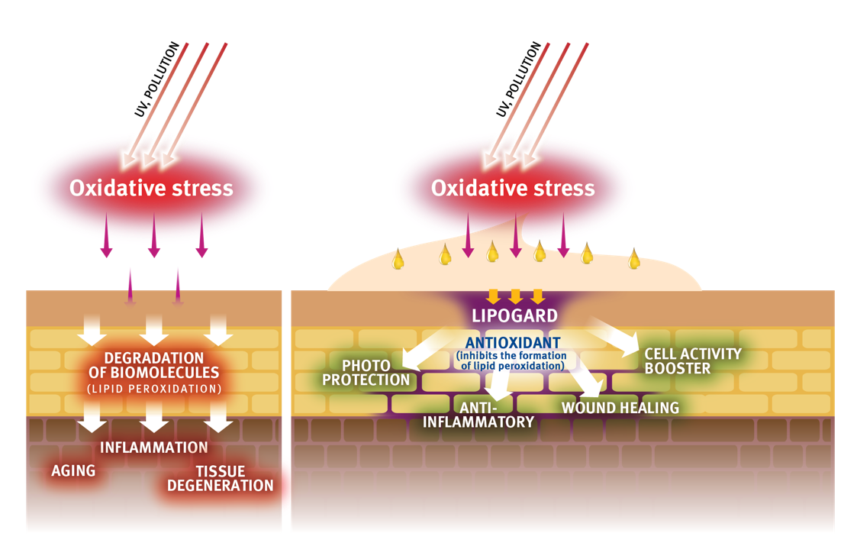
LIPOGARD
Mode of action
  Replenishing endogenous antioxidant levels of Q10 and Vitamin E.
  Inhibiting lipid peroxidation on human skin
  Protecting the skin barrier from UV and pollution-induced damage.
  Boosting skin cell activity and reducing casual inflammation

Slide 13
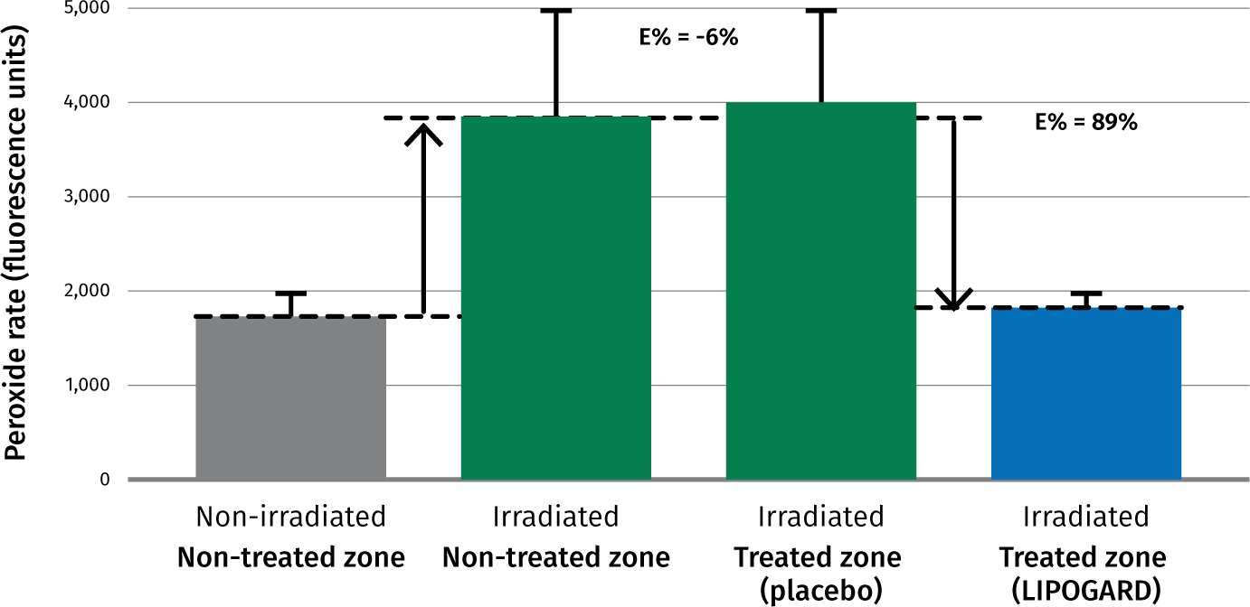
LIPOGARD
Strong inhibition of lipid peroxidation
Ex
vivo
Scavenging effect of LIPOGARD vs placebo ex vivo on human skin
Test method
Selection of subjects
6 healthy volunteers aged between 23 and 41.
Principle an devices
The efficacy of LIPOGARD (3%) has been investigated with a method, assessing the basal or UV-induced peroxidation of the stratum corneum
An UVA irradiation allows to increase the free radical rate. On cutaneous lipids free radicals generate lipoperoxides. The measuring tool was implemented with a probe which became fluorescent in presence pf peroxides. The fluorescence is detected by fluorimetry with the Fluoroskan II® (Labsystem).
LIPOGARD inhibits the formation of lipid peroxidation on human skin by up to 89%

Slide 14
ALL-Q® plus
Replenish your skin’s natural superpowers

Slide 15


ALL-Q® Plus
ID Card
INCI NAME:
Tocopheryl Acetate, Ubiquinone, C12-15 Alkyl Benzoate
Blend of 7.5% Ubiquinone, 20% Tocopheryl Acetate, 72.5% C12-15 Alkyl Benzoate
Q10/Ubiquinone: manufactured by biotechnological fermentation
Tocopheryl Acetate: synthetic origin, acts as a powerful antioxidant that may be effective to protect your skin
C12-15 Alkyl Benzoate: synthetic, cosmetic carrier oil, acts as an emollient
7.5% natural origin (ISO 16128)
TECHNOLOGY:
TECHNICAL:
Form: Reddish clear liquid
Use level: 0.5 - 4%
Preservative: Free
Solubility: Soluble in lipophilic components
Storage: 15-25°C
Replenishing endogenous antioxidant levels of Q10 and Vitamin E.
Inhibiting lipid peroxidation on human skin
Protecting the skin barrier from UV and pollution-induced damage.
Boosting skin cell activity and reducing casual inflammation
Reduces wrinkle depth
Gives skin the energy it needs for natural repair and regeneration
Helps to reduce sun damage
Makes the skin look and feel firmer, softer and well toned
BENEFITS:
REGISTRATION
CERTIFICATION
15

Slide 16
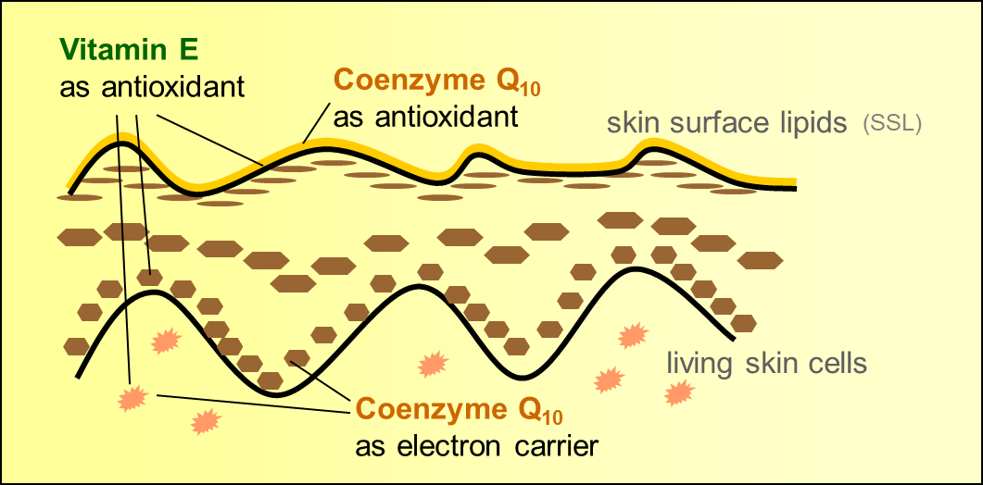
ALL-Q® plus
Mode of action
  ALL-Q® plus mirrors the natural presence of Coenzyme Q10 and Vitamin E in the skin
  ALL-Q® plus is a powerful antioxidant active ingredient to protects the skin surface lipids
  ALL-Q® plus acts as a mitochondrial electron carrier to fulfil the skin’s vital functions
ALL-Q® Plus

Slide 17
ALL-Q® Plus
Strong inhibition of lipid peroxidation
In
vivo
Scavenging effect of LIPOGARD vs placebo on human skin
Test method in vivo
20 healthy volunteers (37 – 65 years) were treated once daily for seven days with the tests products (placebo, formulation with 2% ALL-Q® Plus), which were applied on the inner forearm. The forearm was then irradiated with UVA light (10J/cm²) and the squalene peroxide formed were quantitatively determined by HPLC.
ALL-Q® plus protects the skin lipids from UV-induced peroxidation

Slide 18
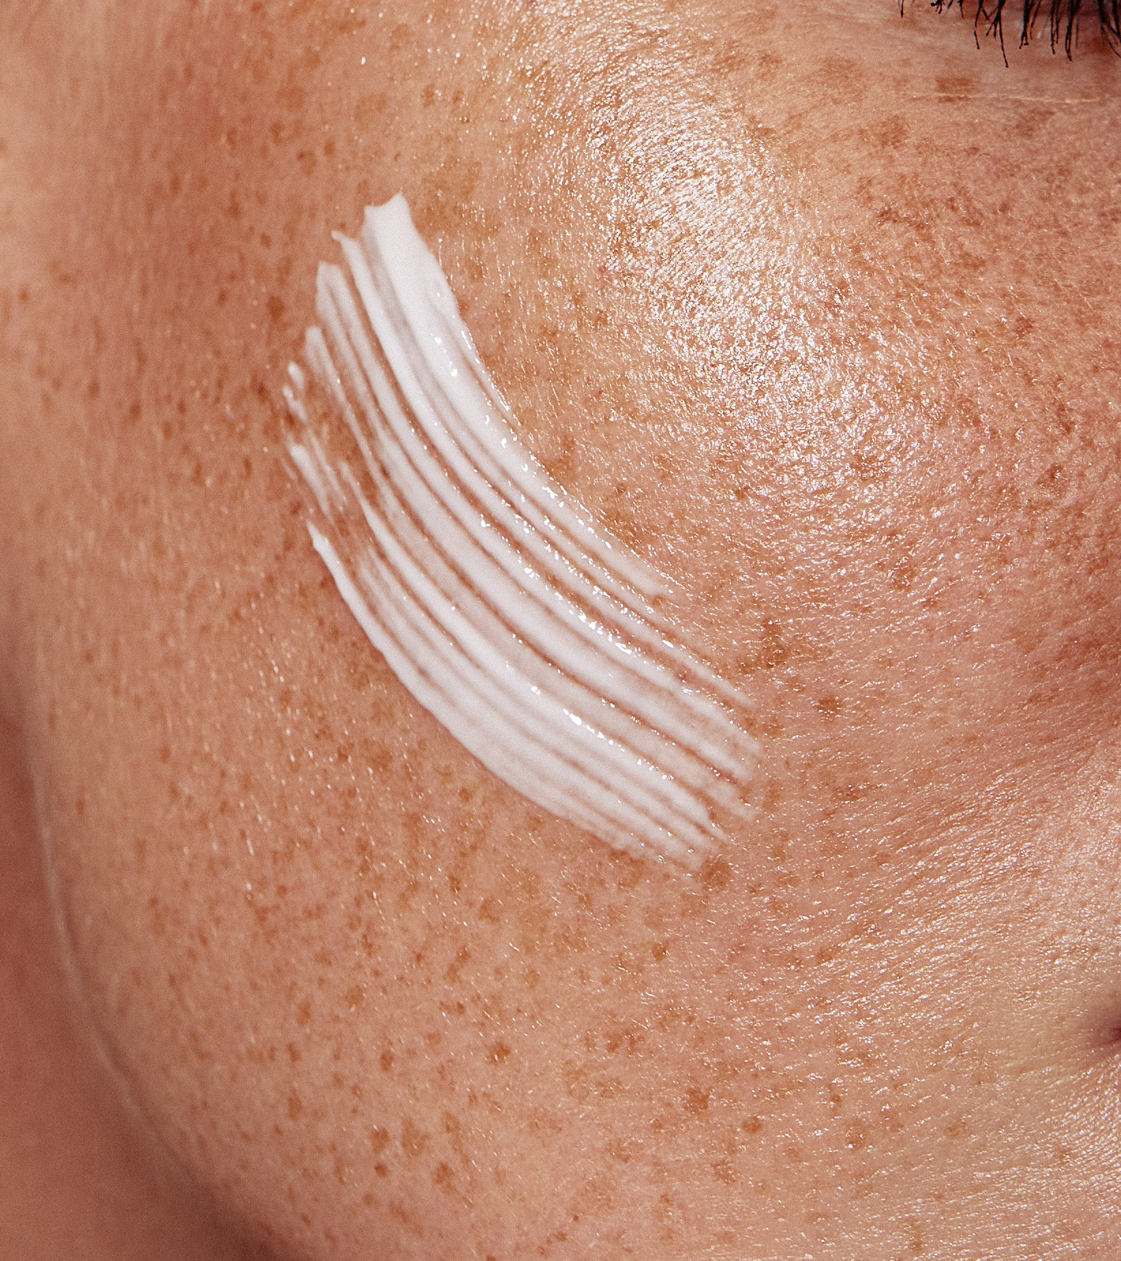
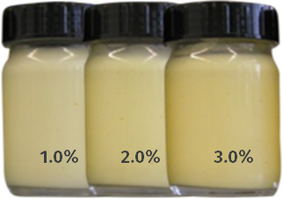
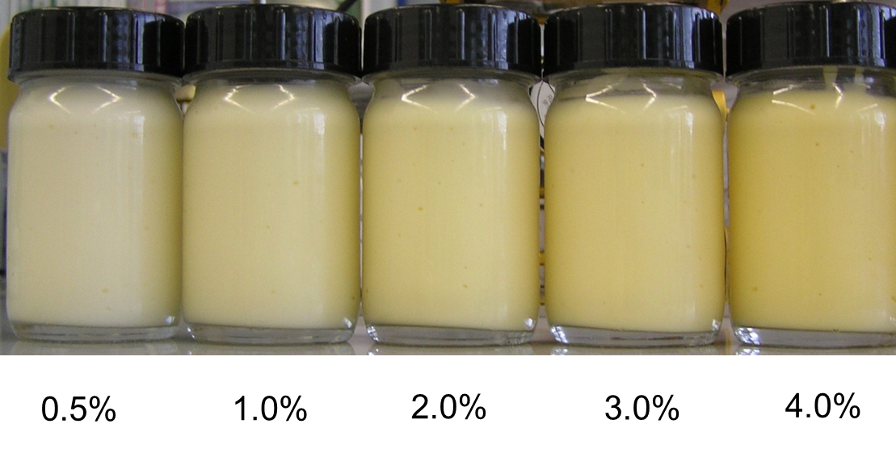
LIPOGARD/ALL-Q® Plus
The formulation
  LIPOGARD and ALL-Q® Plus are oil-miscible
  Ready-to-use liquid, orange-colored form
  Processing either hot (up to 80°C) or cold
  LIPOGARD :
    Contains 1% Ubiquinone, 5% Tocopheryl Acetate, 94% Squalane
    Recommended use level: 1-3%
    Appearance of different LIPOGARD concentrations in a cosmetic formulation:
  ALL-Q® Plus:
    7.5% Ubiquinone, 20% Tocopheryl Acetate, 72.5% C12-15 Alkyl Benzoate
    Recommended use level: 0.5 - 4%
    Appearance of different ALL-Q® Plus concentrations in a cosmetic formulation

Slide 19

LIPOGARD/ALL-Q® Plus
The benefits
  Replenishes your skin’s natural superpowers
  Maintains younger-looking skin for longer
  Gives skin the energy it needs for natural
  repair and regeneration
  Helps to reduce sun damage
  Makes the skin look and feel firmer,
  softer and well toned
  LIPOGARD/ALL-Q® Plus are the ideal active ingredients for:
  Skin protection formulations (sun care, environmental stress…)
  Regenerating products to reduce wrinkles
  Intensive treatment products: eye care
  Energizing applications (wake-up formulations)

Slide 21
Disclaimer
Copyright © DSM Nutritional Products Ltd 2025, 4002 Basel, Switzerland.
www.dsm-firmenich.com. All rights reserved.
dsm-firmenich has used diligent care to ensure that the information provided herein is accurate and up-to-date to the best of its knowledge. However, dsm-firmenich makes no representation or warranty, either expressly or implied, of the accuracy, reliability, completeness, or suitability thereof. The information provided herein contains scientific and product information for business-to-business use and does not constitute or provide scientific or medical advice, diagnosis or recommendation for treatment options. Country or region-specific information should be considered when labelling or advertising to final consumer. In no event shall dsm-firmenich be liable for any direct or indirect damages arising from or reliance upon, or use of, any information provided herein. The content of this document is subject to change without further notice. Please contact your local dsm-firmenich representative for the latest information. All trademarks listed in this document are either (registered) trademarks of, or trademarks licensed by, the dsm-firmenich group of companies, unless explicitly stated otherwise.
Disclaimer Formulation Guideline
The information provided herein is provided for information purposes only and has been prepared by dsm-firmenich in accordance with its own methodology.
dsm-firmenich has used diligent care to ensure that it is accurate and up-to-date, however, dsm-firmenich makes no representation or warranty, either expressly or implied, of the accuracy, reliability, or completeness thereof. In no event shall dsm-firmenich be liable for any damages arising from or reliance upon, or use of, any information provided herein. Further, dsm-firmenich shall not bear any liability for the application and/or use of any processed material containing its product(s). The formulation of the finished product is the customer’s sole responsibility. It is the customer’s responsibility to determine the suitability of dsm-firmenich’s products regarding user specific purposes, assess compatibility and stability of their finished product(s) and to ensure compliance of their finished product(s) with relevant laws and regulations. Any product, marketing or other claims made by customer are its sole responsibility. The content of this document is subject to change without further notice. Please contact your local dsm-firmenich representative for further details. © 2025 dsm-firmenich group.

