Slide 1




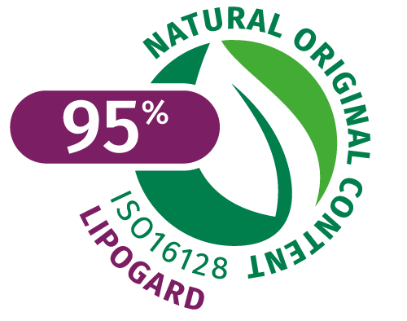

LIPOGARD
Replenish your skin’s
natural superpowers
2023-01

Slide 2

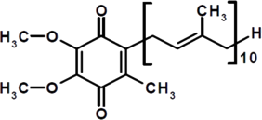
What is Coenzyme Q10?
Overview
A natural, fat-soluble
compound found in
all body cells
Known as ubiquinone (‘Ubi’, Latin for ‘everywhere’) or Coenzyme Q10 (CoQ10)
CoQ10 is part of the inner membrane of the mitochondria, the power station of the cells and is involved in the generation of energy to fulfil the skin's basic functions such as regeneration and repair.
As we age, the natural levels of CoQ10 in our skin decrease*
Over the last few years, CoQ10 has become a leading cosmetic ingredient
*Biofactors. 2015 Nov 12; 41(6): 383–390

Slide 3
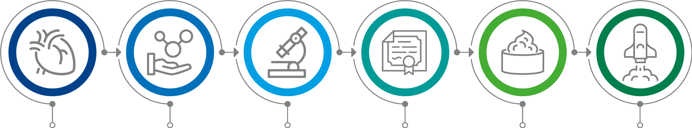

The History of CoQ10
1957
CoQ10 first isolated from beef heart mitochondria by
Dr Frederick Crane of Wisconsin
Named ubiquinone
(=ubiquitous quinone)
1958
Prof. Karl Folkers of Merck determined chemical structure
1975
CoQ10 synthesis developed by the Japanese
1978
Peter Mitchell received Nobel Prize for biological energy transfer theory, including role of CoQ10
1999
First larger promoted use in a cosmetic product: Beiersdorf
2003
Launch of LIPOGARD
3

Slide 4
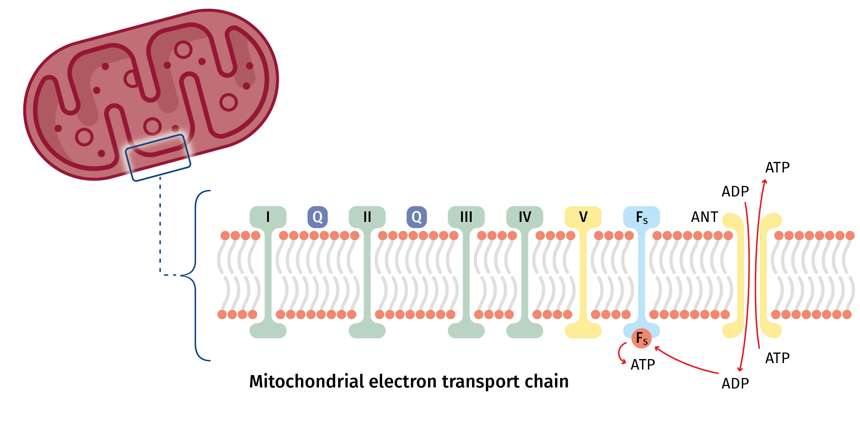
How does CoQ10 work?
CoQ10…
… is naturally produced by the body and plays key roles in cellular energy production in mitochondria.
… is part of the electron transport chain. It is located between complexes I, II and III, and functions as an electron transporter to generate cellular energy in the form of ATP, an Adenosine triphoshate.
… acts also as a potent antioxidant to clean harmful reactive oxygen radicals (ROS), which means cells can continue to do their life-sustaining work.

Slide 5
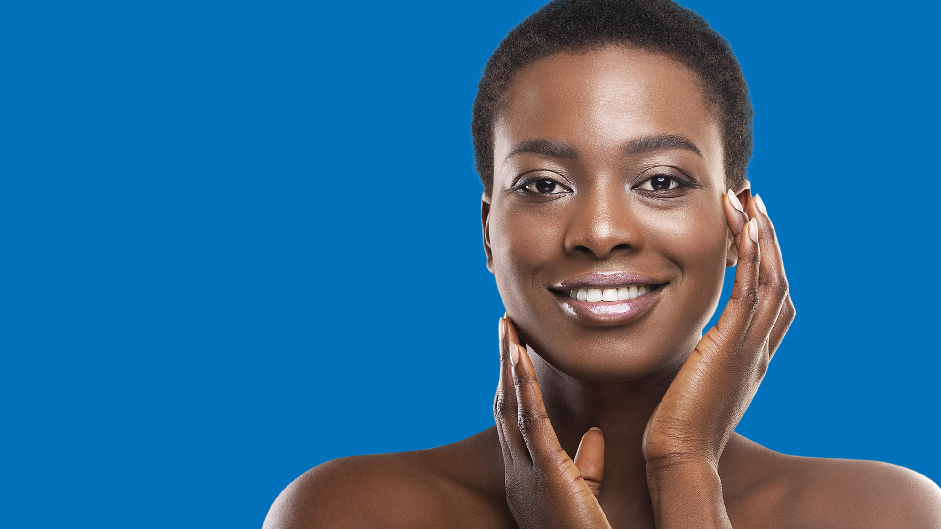





The Ultimate Benefits of CoQ10
CoQ10 is a powerful antioxidant¹
Gives skin the energy it needs to maintain a radiant complexion²
Helps to reduce sun damage³
1 Biofactors. 2015 Nov 12; 41(6): 383–390.
2 Biochemical and Biophysical Research Communications 396 (2010) 74–79.
3 BioMed Research International Volume 2020.
4 BioFactors 32 (2008) 237–243.
5 Biochemical Pharmacology 164 (2019) 299–310.
Helps to reduce the emergence of fine lines & wrinkles⁴
It can help to prevent hyperpigmentation that are caused by an excess
production of melanin⁵

Slide 6
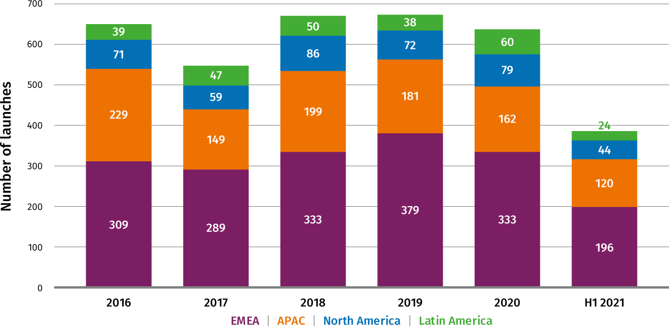
Coenzyme Q10
Product launch history
Global product launches: CoQ10
Key product claims in launches with CoQ10
Moisturizing/Hydrating
Antioxidant
Anti-Aging
Skin Tone/Illuminating
Time/Speed
Reduces Fine Lines/Wrinkles
Vitamin/Mineral Fortified
Source: from Mintel

Slide 7
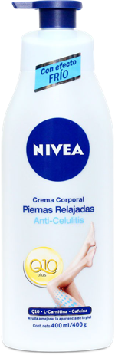


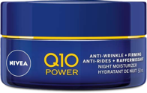
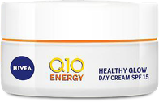
Coenzyme Q10
Extensively researched ingredient
What is CoQ10?
Coenzyme Q10 has brought exciting innovation to anti-wrinkle skin care, with intensive research carried out to determine its skin benefits.*
Q10 Power – The product of more
than 20 years of research
Beiersdorf have invested more than 20 years of intensive research into CoQ10, how it works and the benefits for skin care. This has made it possible
to create an anti-wrinkle face
care range that combats the
ageing process naturally.*
Nivea Q10 Plus
Relaxed Legs Anti-Cellulite
Body Cream
Contains an effective and 'unique' formula combining skin's own Coenzyme Q10, L-carnitine and caffeine, designed to deeply penetrate and moisturize the skin for more than 48 hours.
Nivea Q10 Power
Anti-Wrinkle + Firming Revitalizing Night Cream
Effectively fights the appearance of lines and wrinkles and leave skin feeling firmer. It contains Q10, a powerful antioxidant and natural ageing defense, combined with creatine to stimulate skin's collagen production.
Nivea Q10 Energy
Healthy Glow Day Cream SPF 15
Contains 3X anti-oxidants: 100% skin identical Q10, vitamin C, and vitamin E, claimed to support skin's own ability to improve its energy metabolism by protecting it from skin damaging free radicals, for an instantly refreshed, smooth skin feeling.
Nivea Q10 Power
Anti-Wrinkle + Firming Eye Cream
Specially designed for the delicate eye area, this eye cream is formulated with creatine and antioxidant co-enzyme Q10, claimed to visibly reduce the look of fine lines and wrinkles, leaving the skin looks firmer.
* Source: https://www.nivea.co.uk/advice/skin/what-is-q10-233

Slide 8

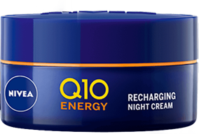

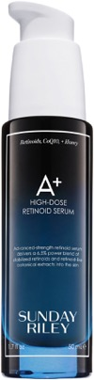
Notable Brands
Product claims highlight Q10
Nivea Q10 Energy
Anti-Wrinkle Night Cream
A night cream that targets tired looking skin and the main signs of premature skin aging, visible fine lines and the look of dullness and lifelessness. Features a unique combination of three antioxidants, including co-enzyme Q10, 100% identical to the one made by skin; vitamin C and vitamin E.
Tarte
Knockout 10% Acid Complex Serum
A five-in-one AHA serum with a 10 percent glycolic- and lactic-acid blend for more-youthful-looking skin. Infused with collagen-supporting coenzyme 10, moisturizing vegan squalane, and soothing aloe, this serum visibly re-texturizes, brightens, hydrates, and firms skin while minimizing the look of pores.
Sunday Riley
A+ High-Dose Retinoid Serum
An advanced retinoid serum powered by a blend of retinoid ester and retinol to improve the look of lines, wrinkles, and dark spots, while hydrating honey and antioxidant CoQ10 offer anti-aging support.
Source: from brand websites

Slide 9

LIPOGARD
A perfect blend of Q10, Vitamin E-acetate and Squalane
ORIGIN
Q10/Ubiquinone: extracted from yeast through a fermentation method.
Vitamin E-acetate: synthetic origin
  – Acts as a powerful antioxidant that may be effective to help nourish and protect your skin
Squalane: derived from olives
  – It is a saturated and stable hydrocarbon that is found naturally in the skin
  – It has very high emollience, is a skin hydrator and can prevent ongoing loss of hydration
COMPOSITION
INCI name: Ubiquinone, Tocopheryl Acetate, Squalane
No preservatives
RECOMMENDED DOSAGE
1-3%

Slide 10
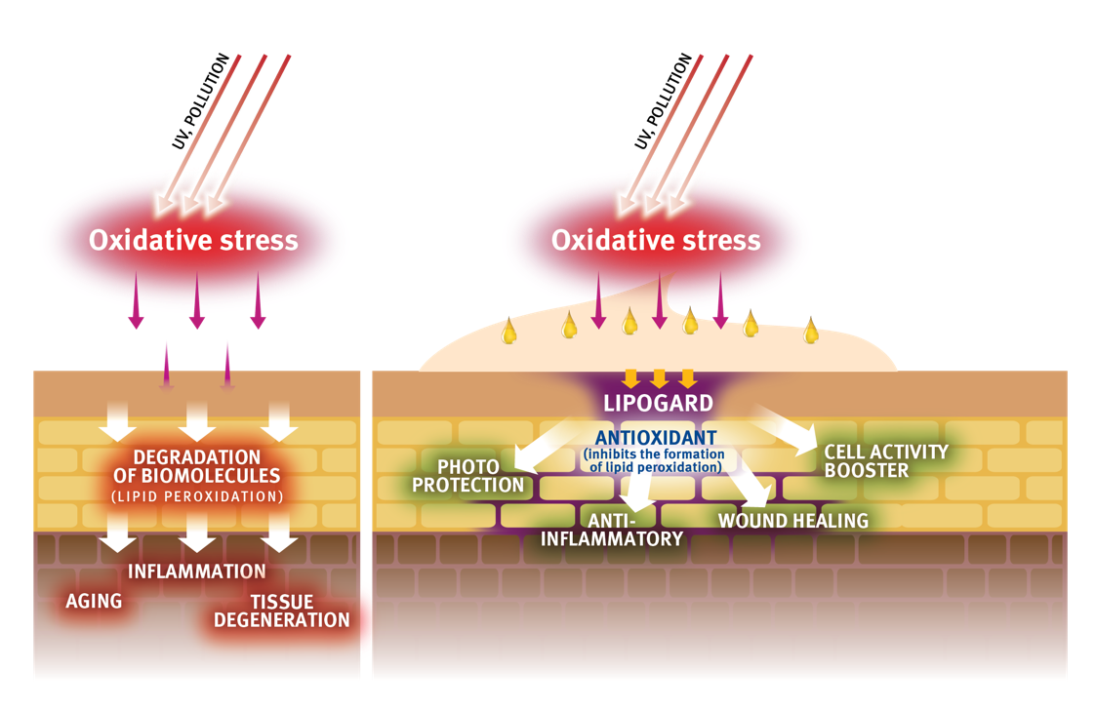
LIPOGARD
Mode of Action
Topical application of LIPOGARD helps to replenish the endogenous antioxidant level of Q10 and Vitamin E.
As an antioxidant, it inhibits the formation of skin lipid peroxidation.
Here it protects the skin barrier from damages caused by ultraviolet rays of the sun or pollution thereby increasing skin’s ability to remain in shape.
The anti-oxidant properties it posses makes it also potent in dealing with casual skin inflammations.
LIPOGARD also boosts skin cell activity thus helping get rid of toxins easily and making better use of nutrients; all these normally fade out as your skin starts aging.
Notes:
Topical application of CoQ10 and Vitamin E acetate helps to balance the endogenous antioxidant level and to protect of peroxidation. This is important mainly for young and older skin, which have are known to have a significantly decreased Vitamin E and CoQ10 content compared to people in their thirties. Lit: Passi et al.: Lipophilic antioxidants in human sebum and aging. Free Radical Research, 36, 471-477 (2002)

Slide 11
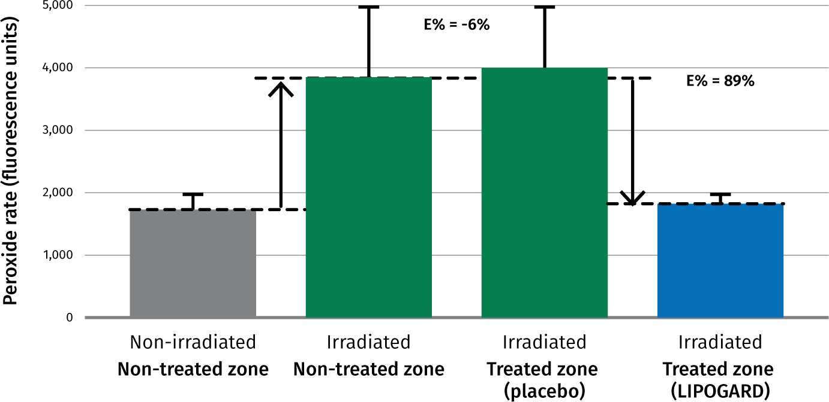
LIPOGARD
Strong inhibition of lipid peroxidation
Scavenging effect of LIPOGARD vs placebo ex vivo on human skin
LIPOGARD inhibits the formation of lipid peroxidation on human skin by up to 89%
Test method
Selection of subjects
6 healthy volunteers aged between 23 and 41.
Principle an devices
An UVA irradiation allows to increase the free radical rate. On cutaneous lipids free radicals generate lipoperoxides. The measuring tool was implemented with a probe which became fluorescent in presence pf peroxides. The fluorescence is detected by fluorimetry with the Fluoroskan II® (Labsystem).
Notes:
Aim
To quantify, ex vivo on human, the scavenging effect of the product LIPOGARD versus PLACEBO.
Selection of subjects
6 healthy volunteers aged between 23 and 41.
Principle an devices
An UVA irradiation allows to increase the free radical rate. On coetaneous lipids free radicals generate lipoperoxides. The measuring out was implemented with a probe which became fluorescent in presence of peroxides.
Experimental schedule
On the inner part of the forearm, four zones are delimited:
- on irradiated zone which will not be treated
- a non irradiated non treated zone (base rate of the subject)
- an irradiated zone which will be treated with placebo
- an irradiated zone which will be treated with the product LIPOGARD
- Just after irradiation: application of the product LIPOGARD an placebo
Conclusion
The product LIPOGARD has a scavenger activity ad decreases under these experimental conditions, the peroxide rate of stratum corneum induced by UVA-rays.
The treatment with LIPOGARD can neutralize the negative irradiation effect by decreasing the peroxide rate of the treated irradiated zone.
LIPOGARD can be considered as a good free radicals scavenging product.

Slide 12




LIPOGARD
The formulation
LIPOGARD is oil-miscible
Ready-to-use liquid, orange-colored form
Processing either hot (up to 80°C) or cold
Concentration of 1-3% for best efficacy results
Appearance of different
LIPOGARD concentrations
in a cosmetic formulation:
LIPOGARD is the ideal active ingredient for:
  Skin protection formulations (sun care, environmental stress…)
  Regenerating products such as night creams
  to reduce wrinkles
  Intensive treatment products: eye or hand care
  Energizing applications (wake-up formulations)
1.0%
2.0%
3.0%

Slide 13
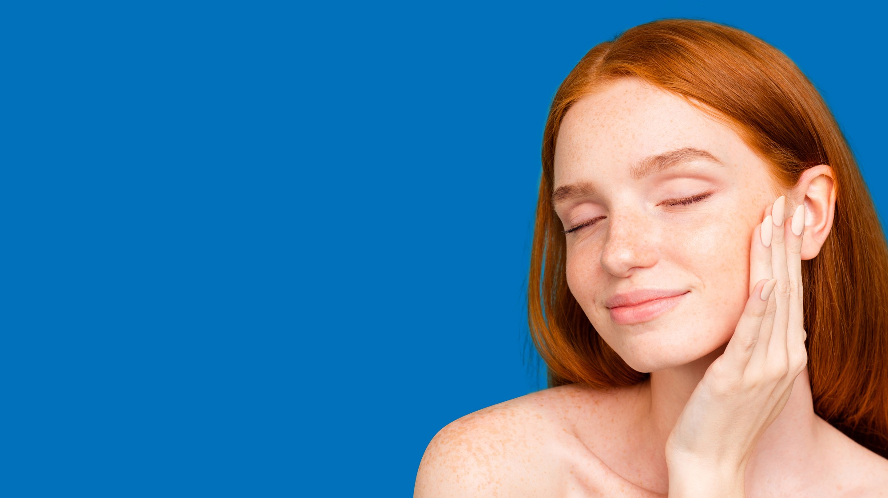





The benefits of LIPOGARD
Replenishes your skin’s natural superpowers
Maintains younger-looking skin for longer
Gives skin the energy it needs for natural
repair and regeneration
Helps to reduce sun damage
Makes the skin look and feel firmer,
softer and well toned
Notes:
it strengthens cell viability by increasing cellular ATP production and prevents collagen degradation by inhibiting MMP-1 expression.

Slide 14
Disclaimer
Copyright © 2023 DSM Nutritional Products, 4002 Basel, Switzerland.
www.dsm.com/personal-care. All rights reserved.
DSM has used diligent care to ensure that the information provided herein is accurate and up-to-date, however, DSM makes no representation or warranty, either expressly or implied, of the accuracy, reliability, or completeness thereof. The information provided herein contains scientific and product information for business to business use and does not constitute or provide scientific or medical advice, diagnosis or recommendation for treatment. Country or region-specific information should be considered when labeling or advertising to final consumer. In no event shall DSM be liable for any damages arising from or reliance upon, or use of, any information provided herein. The content of this document is subject to change without further notice. Please contact your local DSM representative for further details. All trademarks listed in this document are either (registered) trademarks of, or trademarks licensed by, the DSM group of companies in the Netherlands and/or other countries, unless explicitly stated otherwise.

