Slide 1



MELFADE® PF
The gentle way to
get radiant skin

Slide 2


MELFADE® PF
combines the benefits of natural arbutin with those of magnesium ascorbyl phosphate

Slide 3



Bearberry leaf
(Arctostaphylos uva-ursi)
The bearberry (Arctostaphylos uva-ursi)
is a small shrub with evergreen leaves
Can be found on the high mountains of Europe, America and Asia
Leaves have astringent and
anti-inflammatory properties:
Used medicinally in parts of Europe to heal wounds and reduce scarring
The mean constituent of bearberry leaves is a glucoside named arbutin, which is known as an effective inhibitor
of tyrosinase

Slide 4

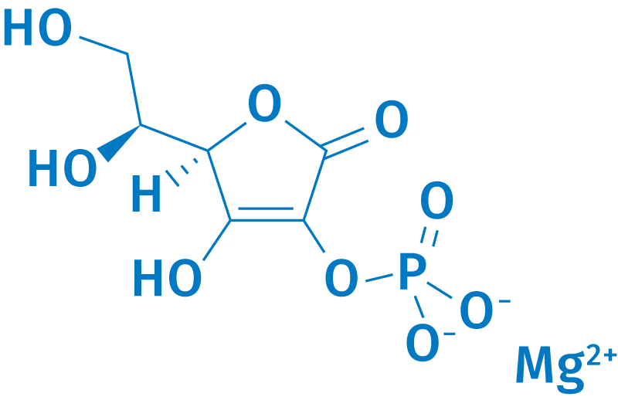

Magnesium Ascorbyl Phosphate is a multi-functioning form of vitamin C
Main functions
Tyrosinase inhibition
Reduction of active oxygen species
Enhancement of collagen synthesis

Slide 5
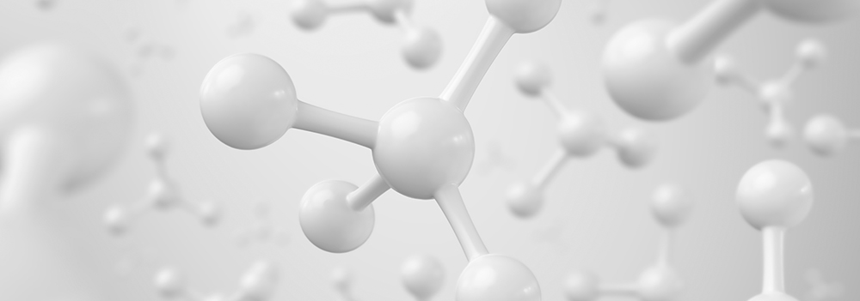
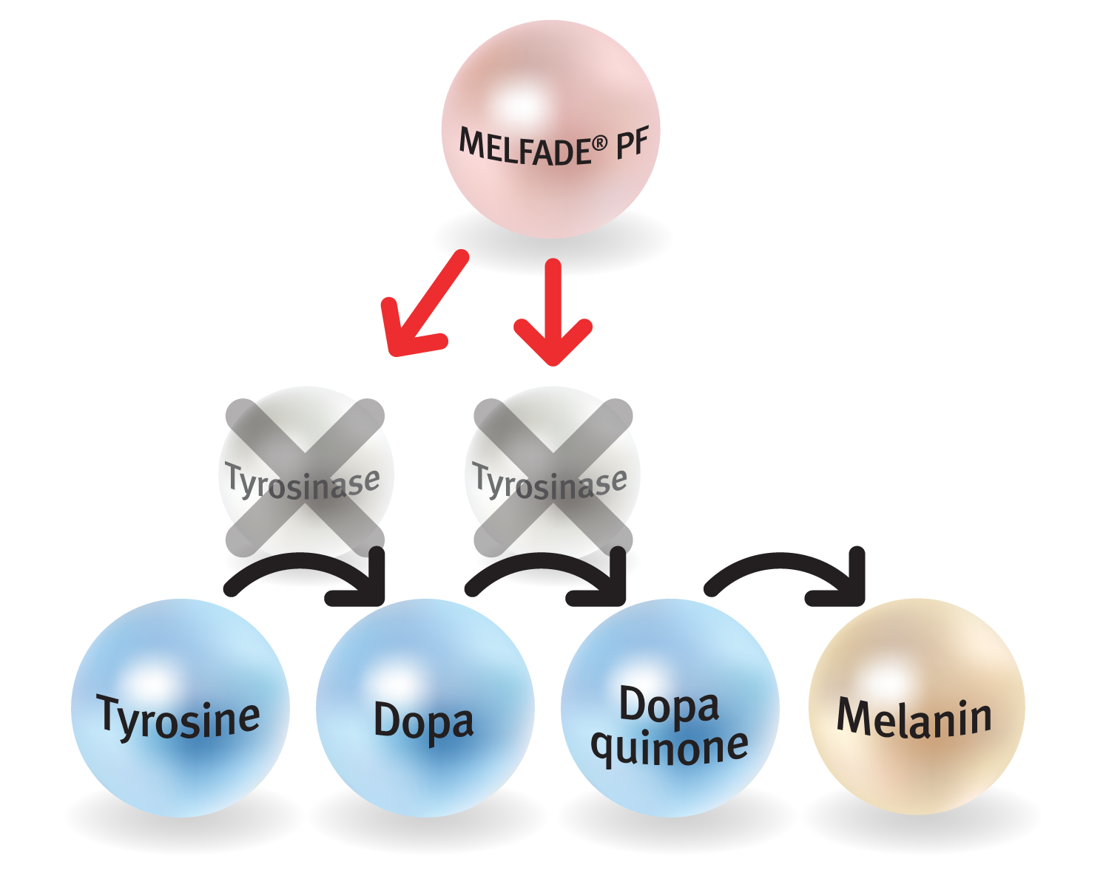
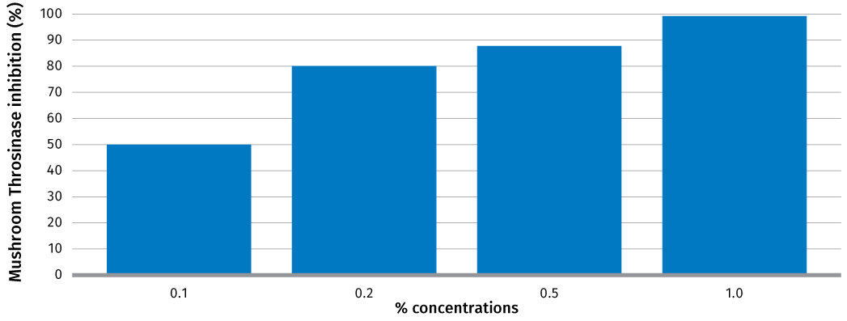
MELFADE® PF inhibits tyrosinase at very low concentrations
Method: mushroom tyrosinase inhibition assay that use spectrophotometrical determination of the dopaquinone formation with L-Dopa as substrate.
100% tyrosinase inhibition obtained with 1% MELFADE®-J.
50% tyrosinase inhibition obtained with 0.1% MELFADE®-J.

Slide 6
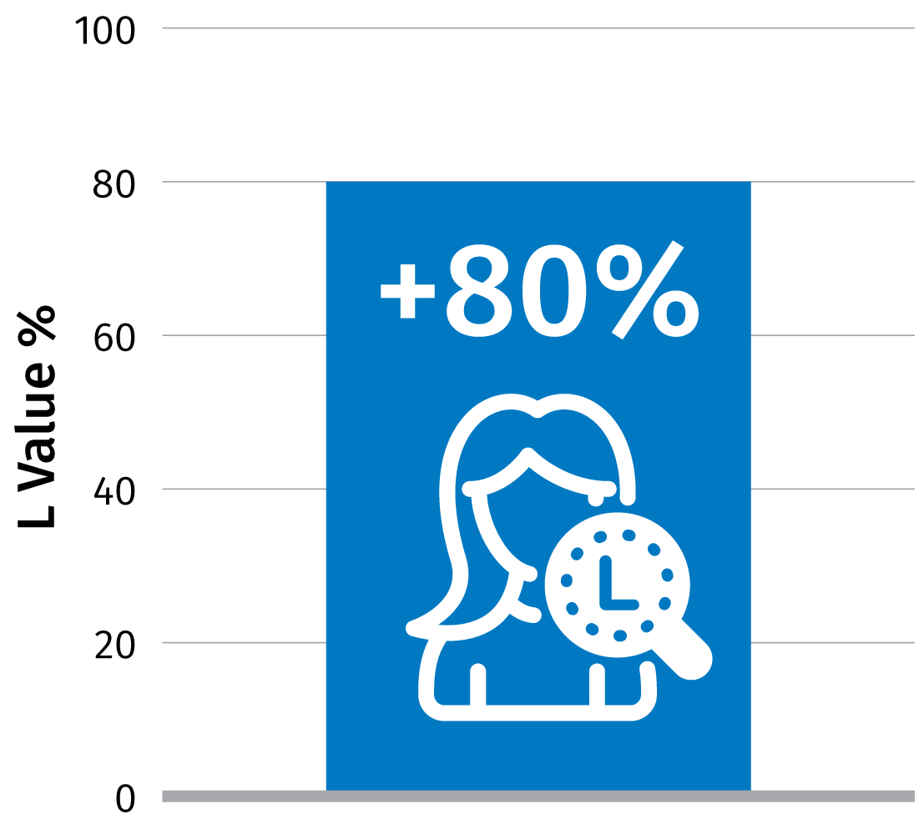



MELFADE® PF
More efficient than arbutin
MELFADE® PF or arbutin in a 5% formulation were applied to the forearms of 40 women of Chinese descent twice a day for three months.
The efficacy was evaluated by Chromameter studies.
The graph shows the efficacy of the products compared to the control zone for the “L” Lightening parameter which represents lightness after three months.
MELFADE® PF is 80% more effective than Arbutin alone.

Slide 7


MELFADE® PF
The gentle way to get radiant skin
Unique Product Features
Combines the benefits of natural arbutin with those of magnesium ascorbyl phosphate
Very effective tyrosinase inhibitor
at low concentrations
More effective than arbutin alone
Benefits
Skin complexion appears more even,
radiant and youthful

Slide 8
Disclaimer
Copyright © 2020 DSM Nutritional Products, 4002 Basel, Switzerland.
www.dsm.com/personal-care. All rights reserved.
DSM has used diligent care to ensure that the information provided herein is accurate and up-to-date, however, DSM makes no representation or warranty, either expressly or implied, of the accuracy, reliability, or completeness thereof. The information provided herein contains scientific and product information for business to business use and does not constitute or provide scientific or medical advice, diagnosis or recommendation for treatment. Country or region-specific information should be considered when labeling or advertising to final consumer. In no event shall DSM be liable for any damages arising from or reliance upon, or use of, any information provided herein. The content of this document is subject to change without further notice. Please contact your local DSM representative for further details. All trademarks listed in this document are either (registered) trademarks of, or trademarks licensed by, the DSM group of companies in the Netherlands and/or other countries, unless explicitly stated otherwise.
Disclaimer Formulation Guideline
This information is for illustration purposes only and based upon our current knowledge and experience at the time of printing. We do not make any representation or warranty of any kind, express or implied, including merchantability or fitness for a particular use, with respect to such information or its application. Use of this information is at your discretion and risk. Nothing herein relieves you from carrying out your own suitability determinations and tests. You are responsible for observing all laws and regulations relevant to your products, uses or processes. We do not assume any liability in connection with your product and its use. The foregoing information and suggestions are also provided without warranty of non-infringement as to the intellectual property rights of third parties, and shall not be construed as any inducement to infringe the rights of third parties.

