Slide 1
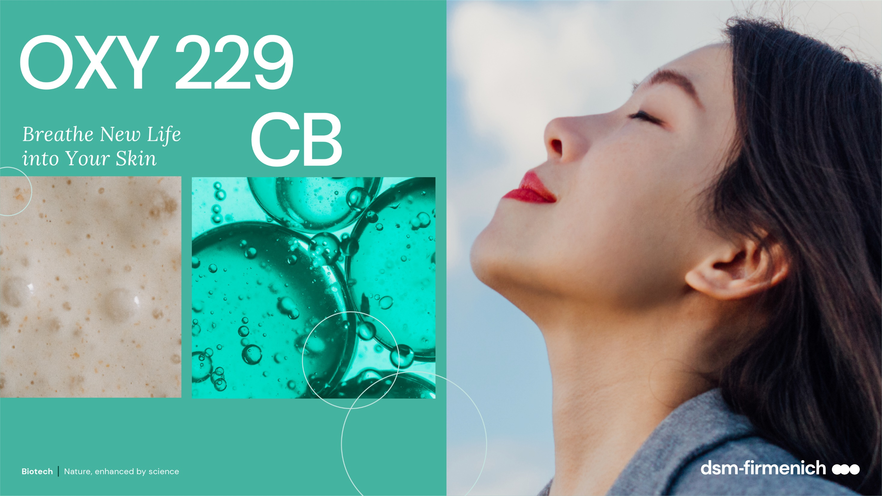
April 2025

Slide 2
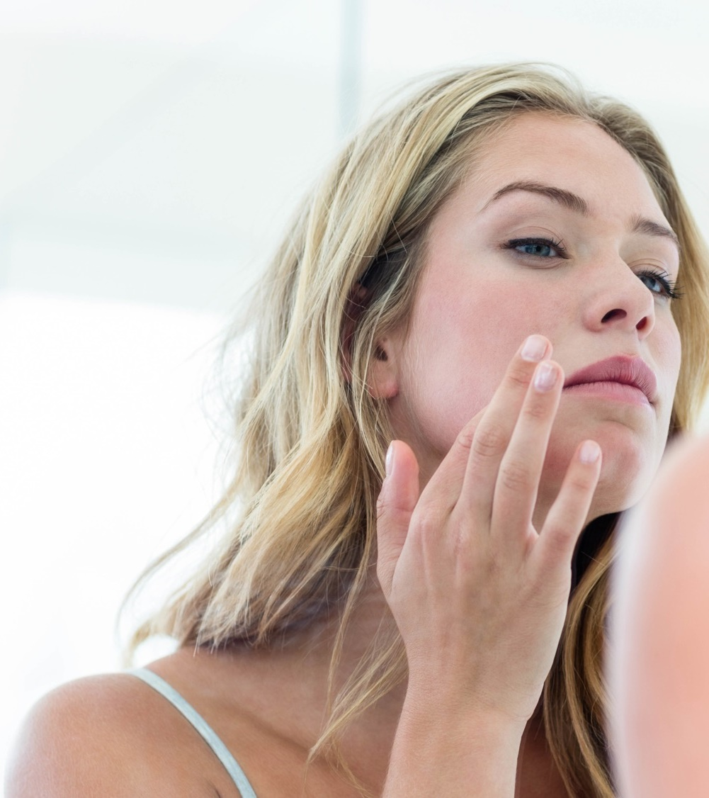
What is dull skin?
If you’ve looked in the mirror and noticed that your complexion lacks radiance or glow, that could be a sign that you are experiencing dull skin.
Dull skin may appear dry, patchy, ashy, or lackluster. Additionally, dullness is often accompanied by an uneven skin texture.
Many factors - from your skincare routine (lack of moisturizer) to your age and even your lifestyle (inadequate sleep, lack of exercise, too much screen time ..) can contribute to dull skin.

Slide 3

How can skin become dull?
Age
As we get older our skin’s natural cell turnover rate slows down, which can cause a dull-looking skin tone.
Dry skin
When skin isn’t hydrated, fine lines can be more pronounced. The skin appears rough, and skin tone can appear dull.
Environmental factors
Dry weather, harsh winds, and sun exposure can potentially cause skin-dulling skin.
Pollution affect your skin
The dirt in the air creates free radicals on the skin, damages collagen and stimulates pigment production, causing the complexion to look tired and drab.
Fatigue
It’s during sleep that our skin has an opportunity to renew and refresh itself. If you’re had a few too many sleepless nights your skin can appear less radiant.

Slide 4
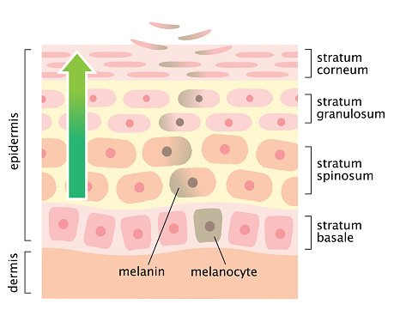
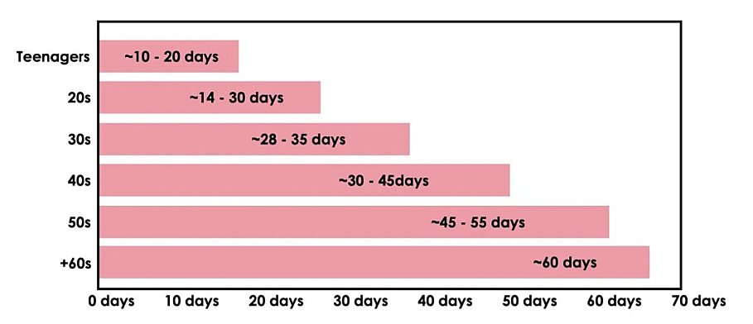
What is cellular turnover? Why is it important for dull-looking skin?
The importance
of skin cell turnover
Skin cell turnover slows down with age
Melanin pigments
are lost during skin cell turnover
Cellular turnover is the continuous process of shedding dead skin cells and subsequently replacing them with younger cells.
New skin cell are “born” in the deepest layer of the epidermis.
The cell then travels up through the epidermis until it reaches the uppermost layer (stratum corneum) of the skin.
Once the cell reaches this layer, it matures — what we consider a “dead” skin cell.
Our skin turnover every 20-60 days on average.
When we’re young, dead skin is shed quickly, and replaced with new skin cells.
As we age, cell turnover slows, leaving dead skin cells on the surface of the skin for longer.
This leads to skin looking dull, uneven, and rough.
The basal cell layer contains cells called melanocytes.
Melanocytes produce the skin coloring or pigment known as melanin
Melanin pigments are lost with the dead cells during epidermal turnover.
If the turnover rate declines, Melanin will remain apparent on the skin for longer.
4

Slide 5



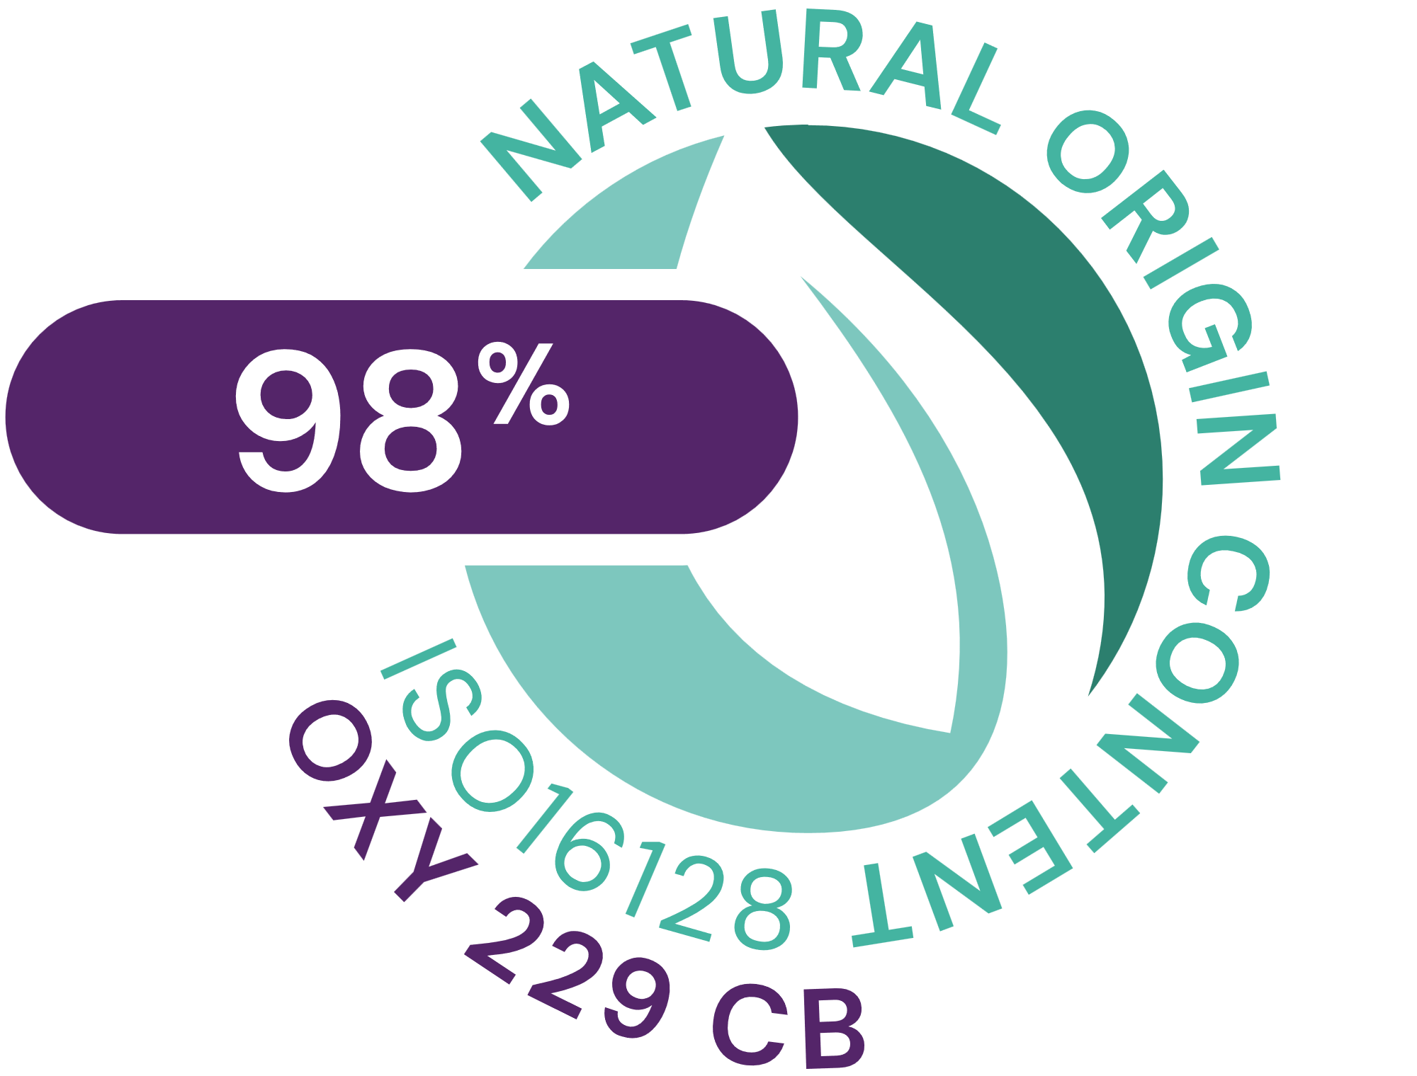

OXY 229 CB
ID Card
INCI NAME:
Aqua, Glycerin, Caprylyl Glycol, 1,2-Hexanediol, Saccharomyces Lysate, Valine, Threonine, Glutamic acid, Glycine, Disodium Succinate
TECHNOLOGY:
Contains postbiotics from a specific yeast strain obtained by fermentation and a sophisticated mixture of skin respiration facilitators
98% of natural origin (according to ISO 16128)
Solubility: water soluble
Biodegradability: readily biodegradable
TECHNICAL:
Form: liquid
Use level: 1–5%
pH of use: 3–7.5
Preservative: free
BENEFITS:
Helps to increase oxygen uptake to maintain healthy-looking skin glow*
Stimulates cell viability in the epidermis to revitalize skin*.
Up to 25% increased cell turnover to revive dull-looking skin**
Helps to modulate oily skin and rebalances bacteria potentially involved in facial redness**
Combined with NIACINAMIDE PC, OXY 229 CB ensures a lighter skin tone**
REGISTRATION
CERTIFICATION
5
*In vitro **In vivo

Slide 6
Fermented Beauty trend
Fermentation claims are popping up in beauty products everywhere
When most people hear the word "fermentation,"
they think of processed foods and beverages. But fermentation isn’t just a cooking technique, it's also instrumental to the creation of beauty products.
Fermentation is a natural process where microorganisms (like yeast or bacteria) break down an ingredient into a smaller molecular structure making it more concentrated
and more easily absorbed by the skin.
Fermented skincare refers to beauty products, which contain certain ingredients that have undergone the fermentation process.
Over the last few years, fermentation claims have been increasing very rapidly in facial care, especially in Asia Pacific and North America. The driver of this growth can be linked to the increasing consumer interest in everything perceived as natural (Mintel Jan 2025).

Slide 7
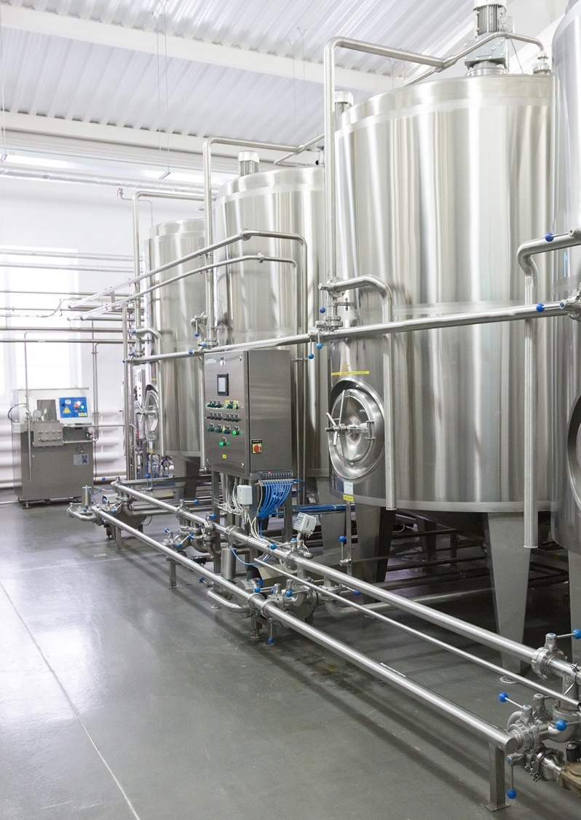
OXY 229 CB contains postbiotics from a specific yeast strain
Obtained by fermentation
The Saccharomyces lysate in OXY 229 CB is a postbiotic yeast obtained by fermentation.
It is made from the extraordinary baker’s yeast strain VdH2:
    Chosen for its ability to provide high energy, which causes bread to rise.
The VdH2 yeast cells are cultured by aerobic fermentation.
The resulting biomass undergoes a selective cell lysis.
Subcellular fractionation is achieved, and the insoluble fragments are separated.
The soluble fraction is purified and concentrated.
The result is a yeast extract that is both low in color and odor.
Its by-products, known as postbiotics, awaken the skin’s natural power.

Slide 8
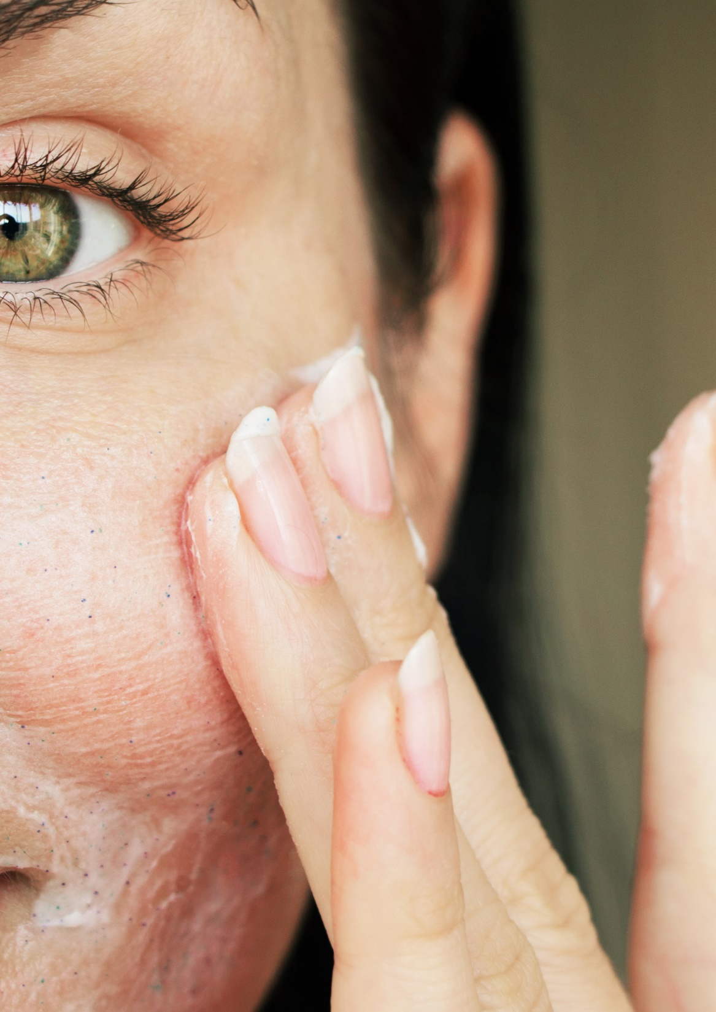
OXY 229 CB contains a sophisticated mixture of respiration facilitators
Gives skin the energy it needs
For OXY 229 CB the Saccharomyces lysate is blended with a sophisticated mixture of skin respiration facilitators such as threonine, valine, glycine, glutamic acid and disodium succinate all of which support the natural cellular revitalizing capacity to maintain a glowing complexion.
Threonine –
essential amino acid
Plays a role in the process of skin energy production in the matrix of the mitochondria (known as the “powerhouses of the cell,” mitochondria produce the energy necessary for the cell's survival and functioning)
Glycine – non-essential amino acid
Improves mitochondrial
health
Glutamic acid –
non-essential amino acid
Supports skin energy production
Valine – essential amino acid
Serves as an energy fuel
Disodium succinate
Helps skin respiration

Slide 9
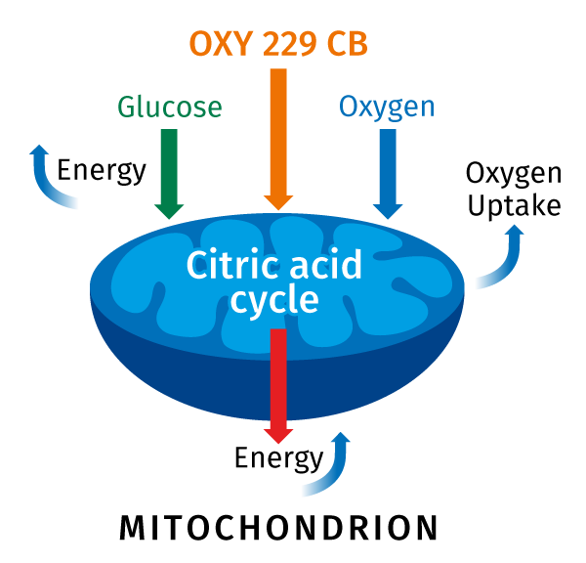
OXY 229 CB
The mode of action
A healthy glow is the essence of beauty
A healthy glow has a balanced energy metabolism that
is responsible for the ability of cells to revitalize and to manage cell turnover.
Over time essential energy processes in the skin
slow down; the skin looks tired and dull. Now the
skin needs energy.
OXY 229 CB increases cells oxygen uptake for more energy and faster turnover to maintain a healthy-looking skin glow*.
The increase is potentially due to the stimulation of the citric acid cycle that plays a starring role in the process of skin energy production¹.
* In vitro
¹R. Schütz et al. / Journal of Photochemistry & Photobiology, B: Biology 159 (2016) 142–148

Slide 10
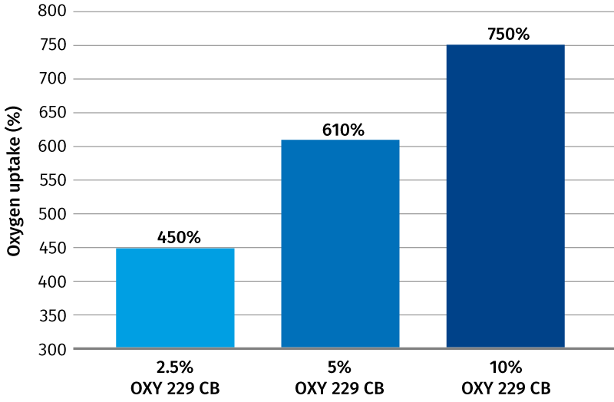
OXY 229 CB enhances oxygen uptake
dsm-firmenich in vitro study
A high uptake of oxygen in skin cells is a sign of good metabolic activity and is very important to the natural revitalizing capacity of the skin.
The activity of OXY 229 CB was evaluated using the Gilson Respirometer, which measured oxygen uptake by a known quantity of a tissue homogenate. The oxygen consumption was determined one hour after the addition of the OXY 229 CB samples compared to untreated control.
Oxygen uptake activity of OXY 229 CB
OXY 229 CB enhances cells oxygen uptake by up to 750%*
* In vitro
10

Slide 11
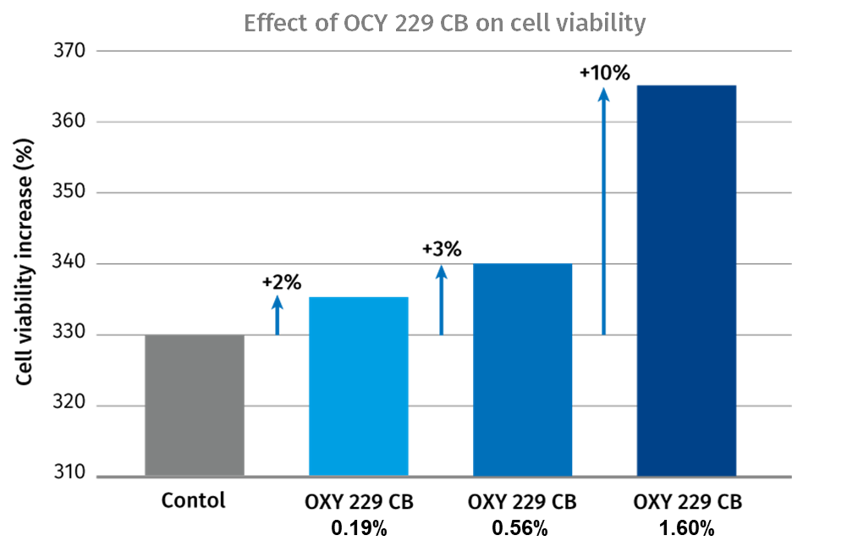
OXY 229 CB induces cell viability
dsm-firmenich in vitro study
Metabolic activity in cells must be high enough for them to carry out their normal functions and survive. The more active the cells, the healthier skin will be.
The influence of OXY 229 CB on the growth and survival of fibroblasts using the colorimetric MTT-tetrazolium
assay has been investigated.
Effect of OXY-229 CB on cell viability
Cell Viability increase (%)
OXY 229 CB induces cell viability by up to 10%*
* In vitro
11

Slide 12
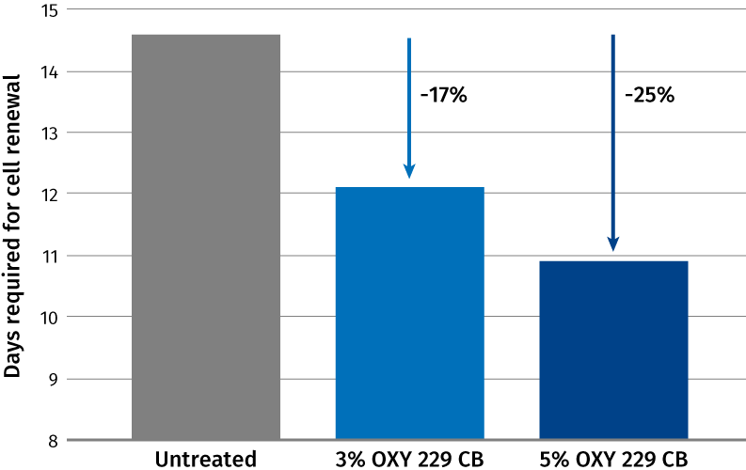
OXY 229 CB stimulates skin cell turnover
dsm-firmenich in vivo study
Standard dansyl chloride method:
After pre-treatment with dansyl chloride patches, two test products containing 3% and 5% OXY 229 CB were applied twice daily to the volar forearms of 12 volunteers aged 30–55 years.
Fluorescent intensity was monitored throughout the study using black light. Differences in removal of the dansyl chloride stain were recorded. Endpoints (days required for cell renewal) were determined and % change in cell turnover rates calculated.
Effect of OXY-229 CB on Cell Turnover Rate
Days required for cell renewal
OXY 229 CB dose-dependently stimulates skin cell turnover by up to 25%* to improve the look of tired and dull-looking skin.
* In vitro
12

Slide 13
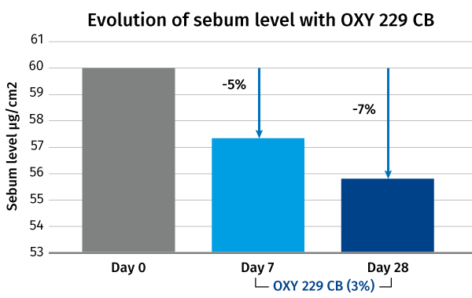
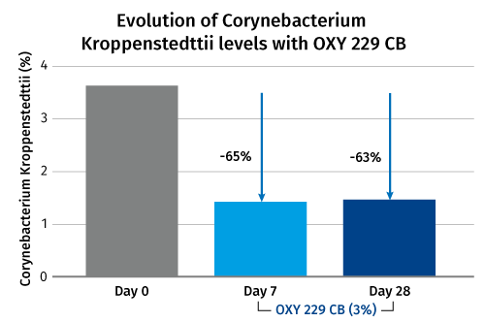
OXY 229 CB helps to modulate oily skin and rebalances bacteria potentially involved in facial redness
dsm-firmenich EPIBIOME BEAUTY™ in vivo study
OXY 229 CB (3%) in gelled water was applied twice daily onto the face of 6 Caucasian volunteers. Sebum level was measured with Sebumeter SM 815 and microbiome profiling with focus on Corynebacterium Kroppenstedtii was measured by 16S rRNA gene sequence analysis, measuring time points: day 0, 7 days, 28 days
Why Corynebacterium Kroppenstedtii¹:
It is an opportunistic bacteria, associated with skin redness, inflammatory dermatoses and rosacea. Its relative abundance increases with age.
Helps to control oily skin and rebalances bacteria potentially involved in facial redness:
Up to 7% sebum reduction
Up to 65% Corynebacterium Kroppenstedtii reduction
¹ K. Malik, The Cinco de Mayo study 2018
* In vivo
13
13
13

Slide 14
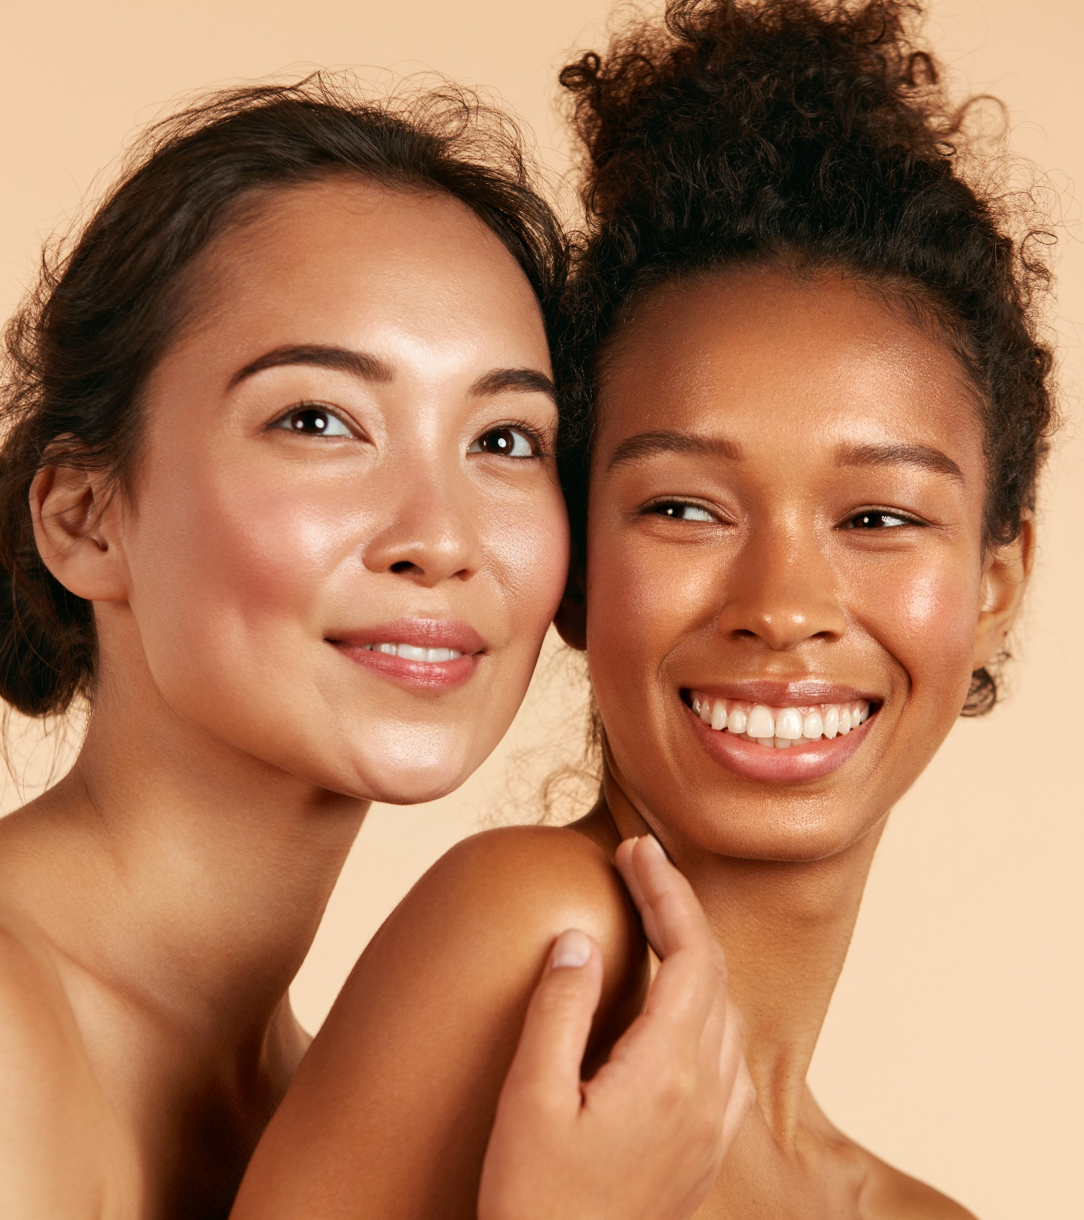
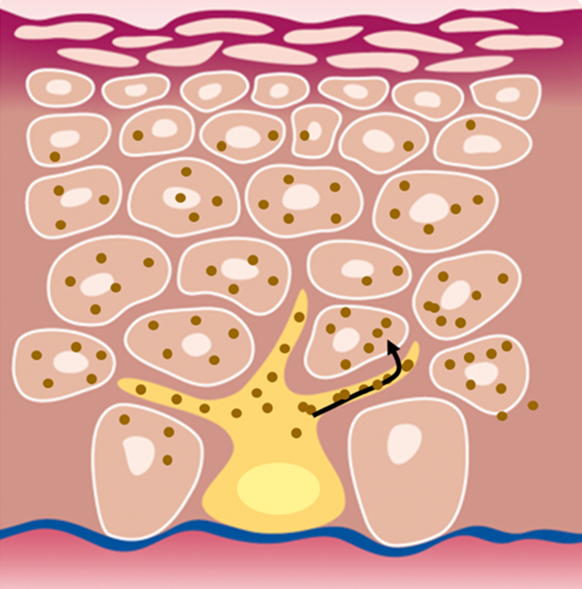
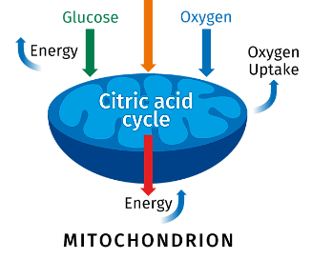
DOUBLE ACTIVE
OXY 229 CB plus NIACINAMIDE PC
2 different levels of action for a lighter skin tone
OXY 229 CB stimulates epidermal turnover and the removal of pigmented cells
NIACINAMIDE PC inhibits melanosome transfer from melanocytes to surrounding keratinocytes
OXY 229 CB
Cell turnover
NIACINAMIDE PC
X

Slide 15



DOUBLE ACTIVE
OXY 229 CB plus NIACINAMIDE PC
 | 4 Days | D0 | Week 1 | Week 2 | Week 3 | Week 3
UV stress¹ | X | - | - | - | - | -
Product application² | - | - | X | X | X | X
Skin ITA° measurement³ | - | X | X | X | X | X
Melanin index (MI) measurement⁴ | - | X | X | X | X | X
Study design according NMPA China⁵ skin whitening standard test (I)
Single-blind, comparative (benchmark), randomized clinical study performed in China
30 Chinese subjects
7 males and 23 females aged from 26 – 60 years old
Test area: thigh
Formulation with 7% Ascorbic acid
Formulation with
3% Niacinamide PC 2% OXY 229 CB
Measuring time points:
D0, Week 1, Week 2, Week 3, Week 4
¹ Each test area was irradiated with a xenon arc lamp daylight simulator (with UVA+UVB wavelengths) at 0.75 times the MED dose once a day for 4 consecutive days.
² Product application: twice a day
³ Skin ITA° (lightening) characterizes human skin color by measuring skin L*a*b* data with a skin colorimeter
⁴ Melanin index (MI) is an optical skin parameter related to the melanin content in the tissue. It can be measured by spectrophotometry (Melanin meter).
⁵ NMPA (National Medical Products Administration) China
In vivo
15

Slide 16
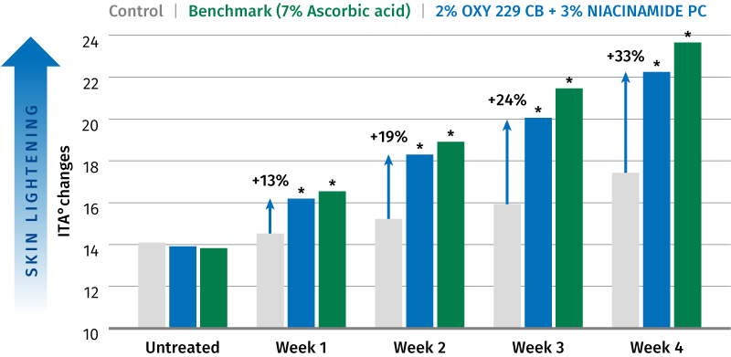
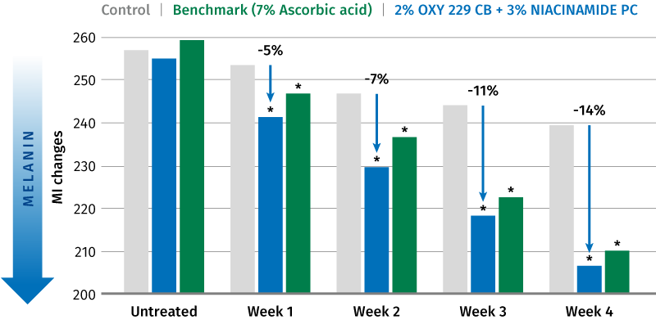
OXY 229 CB plus NIACINAMIDE PC
Evolution of ITA°changes
Significant and visible lighter skin tone
After 1 week
+13% lighter skin
-5% melanin
After 2 weeks
+19% visibly (ITA° > 3) lighter skin
-7% melanin
After 4 weeks
+33% visibly (ITA° > 3) lighter skin
-14% melanin
Similar to the benchmark 7% Ascorbic acid
* P < 0.05 compared to control Δ ITA° of >3 can be distinguished visually
Evolution of Melanin Index (MI) changes
The new power couple OXY 229 CB (2%) and NIACINAMIDE PC (3%) significantly ensures a lighter skin tone
* P < 0.05 compared to control
*Tested according National Medical Products Administration (NMPA) skin whitening standard test in China
16

Slide 17
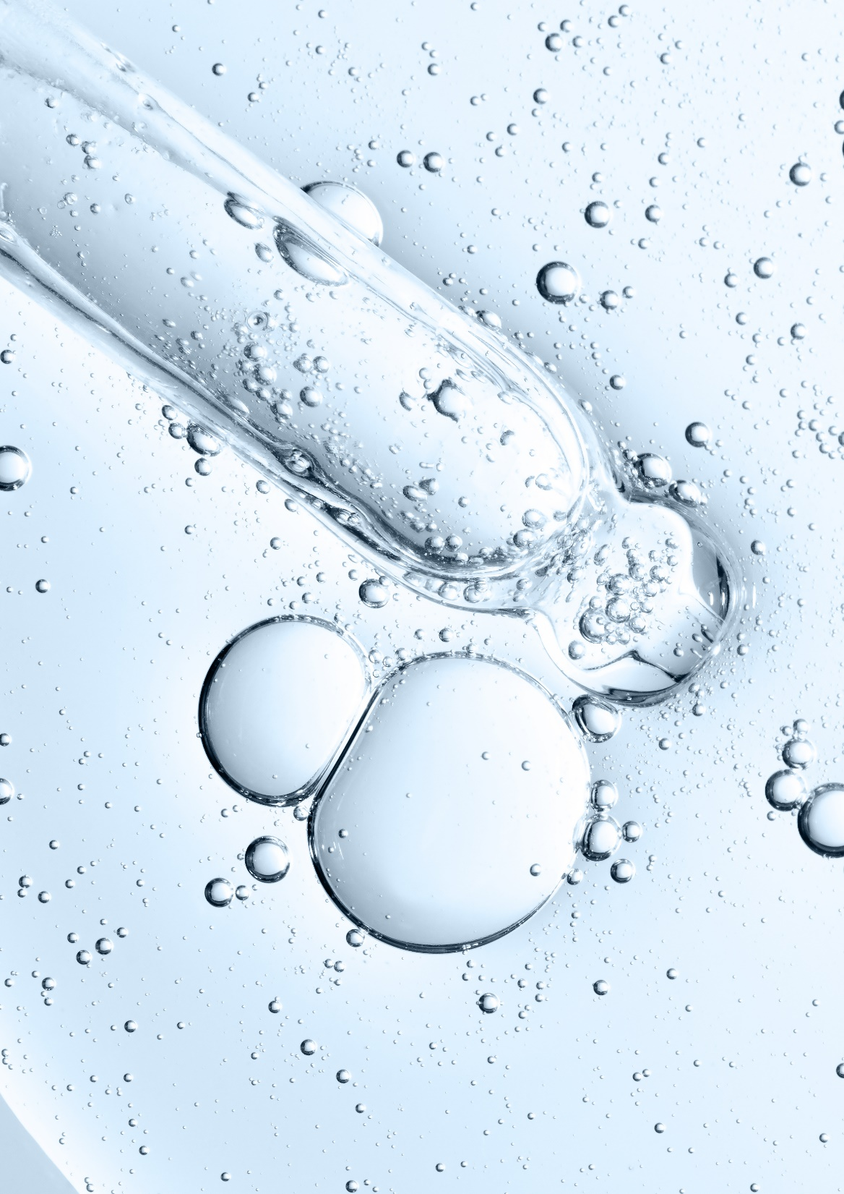






OXY 229 CB: Easy-to-use
Formulation guideline
Clear, aqueous solution, low in color and odor
Soluble in water at all ratios
Stable in a broad pH-range from 3-7.5
Can be processed either warm (<80°C) or cold and is incorporated in the aqueous phase of a cosmetic formulation
Recommended dosage: 1 to 5%
17

Slide 18
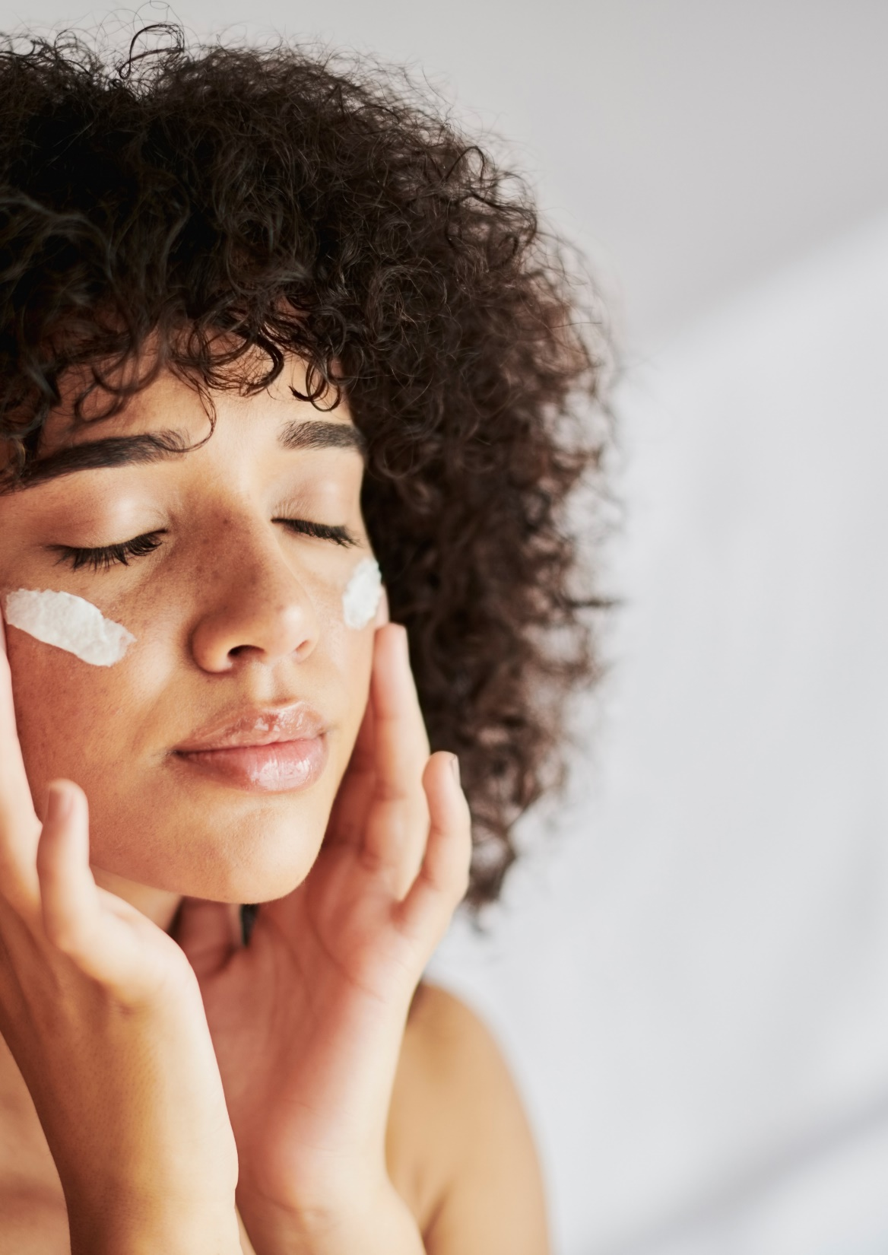
Microbiome Care Whipped Cream
With OXY 229 CB
A smooth, preservative-free whipped cream that nourishes your skin while leaving a silky, fresh after-feel.
Enriched with
OXY 229 CB It keeps your skin looking fresh and helps to control facial redness.

Slide 19
Microbiome Care Whipped Cream
98.25% Natural Origin (ISO 16128)
 | Ingredient | % w/w | Function
A | Aqua | 75,70 | Solvent
 | Caprylyl Glycol | 0,20 | Co-Preservative
B | Sodium Polyacrylate Starch | 1,00 | Rheology modifier
 | Pentylene Glycol | 3,00 | Humectant, Co-Preservative
 | Propanediol | 7,00 | Sensory, Hydration, Active carrier and Preservative booster
 | Xanthan Gum | 0,20 | Rheology modifier
C | Cetearyl Olivate, Sorbitan Olivate | 3,00 | Emulsifier
 | Caprylic/Capric Triglyceride | 4,00 | Emollient
 | Coco-Caprylate | 2,00 | Emollient
 | Stearic Acid, Palmitic Acid | 0,70 | Co-emulsifier
D | Parfum | 0,20 | Provides olfactive identity
 | OXY 229 CB (Saccharomyces Lysate, Valine, Threonine, Glutamic Acid, Glycine, Glycerin, Aqua, Disodium Succinate, 1,2-Hexanediol, Caprylyl Glycol) | 3,00 | Active
Procedure
Mix Phase A and start heating it up to 80°C.
Premix Sodium Polyacrylate Starch + Xanthan Gum into Glycols.
When Phase A reach 60°C, add this premix under stirring and keep heating up to 80°C.
Heat phase C up to 85°C, it will turn transparent.
Add it into A+B under high stirring.
Let cool down under slower stirring and add phase D below 40°C.
Do not adjust the pH.
pH: 6.62
Viscosity: 25700 mPa.S
(AR 550 plate 40 mm SST ST sheer rate 10/s 25°C)
SK-E-101657-1 See disclaimer Guide Formulations

Slide 20
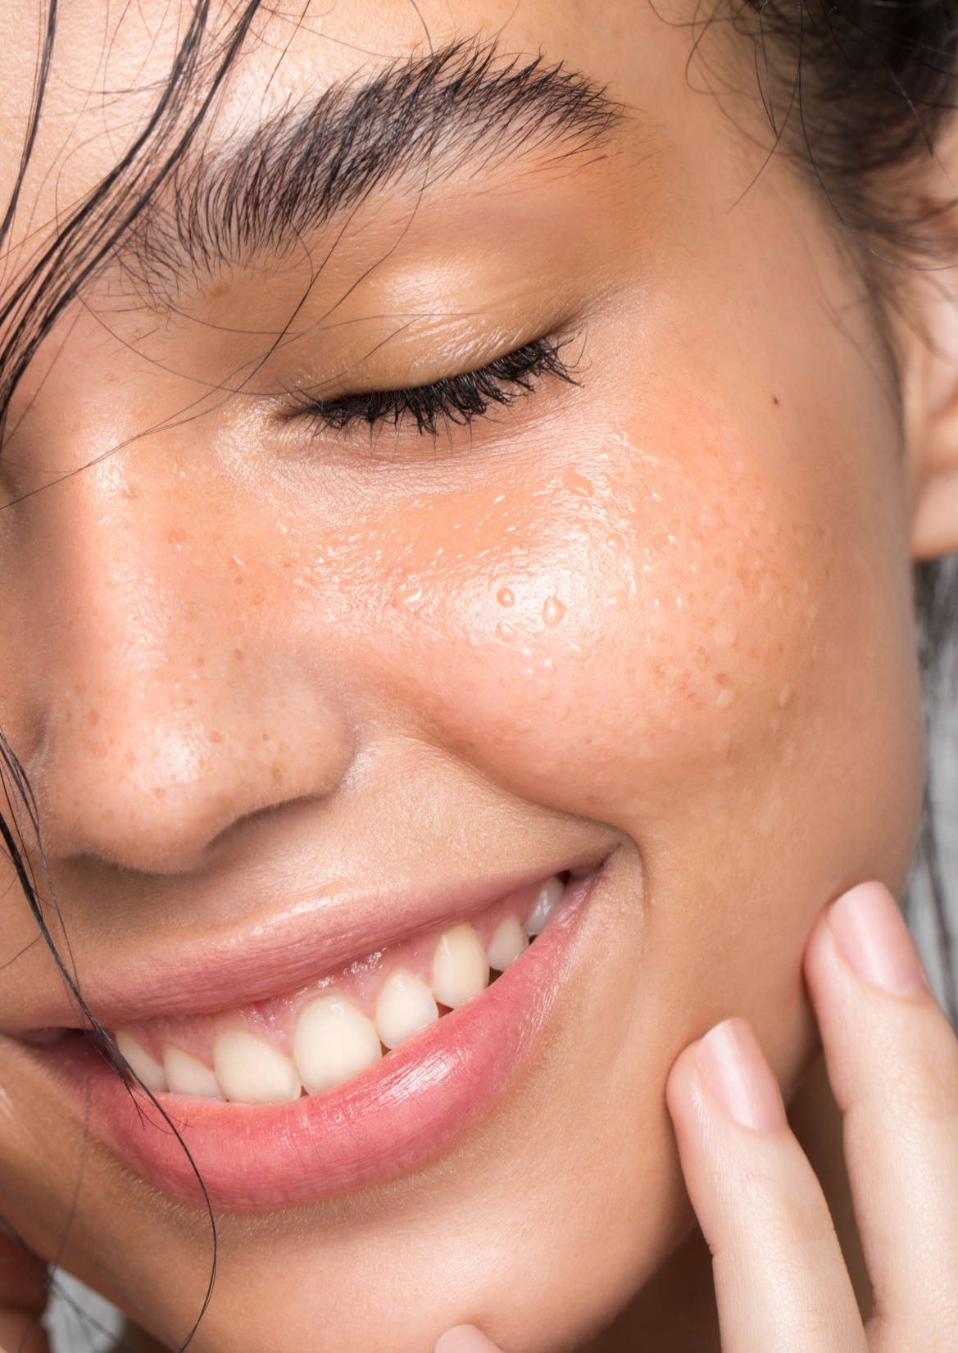
Oxygen-Glow Day Cream
With OXY 229 CB and NIACINAMIDE PC
This lightweight, quick absorbing day cream specially developed for Chinese skin effectively increases skin lightness and enhances cell activity to reveal a fresh, bouncy glow beneath.
Enriched with
OXY 229 CB It functions as an energizing oxygen booster, enhances cell viability and cell turnover to revive the look of dull skin.
NIACINAMIDE PC Famous for visibly reducing enlarged pores and improving the appearance of dull, uneven skin tone. It prevents movement of melanin rising to skin surface and formation of blemish marks.

Slide 21
Oxygen-Glow Day Cream
95.15% Natural Origin (ISO 16128)
 | Ingredient | % w/w | Function
A | Aqua | 82.62 | Solvent
 | NIACINAMIDE PC | 3,00 | Active
 | Ammonium Acryloyldimethyltaurate/VP copolymer | 0,70 | Thickening agent
 | Propanediol | 5,00 | Hydration, Sensory, Active carrier and Preservative booster
 | Disodium EDTA | 0.03 | Chelating agent
 | Sodium Metabisulfite | 0.05 | Preservative
B | Cetearyl Alcohol | 1,00 | Co-emulsifier
 | Caprylic/Capric Triglyceride | 4,00 | Emollient
 | Glyceryl Stearate, PEG-100 Stearate | 1,00 | Co-emulsifier
C | Phenoxyethanol, Ethylhexylglycerin | 0,60 | Preservative
 | OXY 229 CB (Saccharomyces Lysate, Valine, Threonine, Glutamic Acid, Glycine, Glycerin, Aqua, Disodium Succinate, 1,2-Hexanediol, Caprylyl Glycol) | 2,00 | Active
Procedure
Mix all ingredients of phase A stirring until uniform and heat up to around 85°C.
Mix all ingredients of phase B stirring until uniform and heat up to around 85°C.
Add phase B into Phase A under homogenization with the speed of 5000 RPM for 5 min.
Cool down to 45°C.
Add each ingredient of Phase C under stirring.
Adjust pH to around 5.5.
pH: 5.4
Viscosity: 24076 mPa.S
(spindle 04 / 12 rpm)
SK-E-102260-1 See disclaimer Guide Formulations

Slide 22

Midnight Secret Recovery Cream
With OXY 229 CB, STAY-C® 50, Vitamin B12 0,1% WS,
The secret formula that helps you recover from lack of sleep. A cocktail of effective ingredients helps to reduce the appearance of puffiness and smooth away visible signs of tired skin so you wake up looking rested, with a revitalized complexion and smoother skin.
Enriched with
OXY 229 CB It revitalizes the skin during the night, stimulating cell regeneration in the epidermis to reveal bright and healthy-looking skin.
STAY-C® 50 It functions as an antioxidant on and within skin, effective for brightening a dull skin tone and helps slow down wrinkles.
Vitamin B12 0.1% WS It plays an important part in speeding up cell recovery and regeneration. Skin looks more vibrant.

Slide 23
Midnight Secret Recovery Cream
89.70% Natural Origin (ISO 16128)
 | Ingredient | % w/w | Function
A | Aqua | 70.30 | Solvent
 | Glycerin | 3.00 | Humectant
 | Propanediol | 5,00 | Sensory, Hydration, Active carrier and Preservative booster
 | Xanthan Gum | 0.10 | Rheology modifier
 | PEG-240/HDI Copolymer Bis-Decyltetradeceth-20 Ether, Butylene Glycol, Aqua | 3.00 | Thickener
 | Hydrogenated Lecithin, C12-16 Alcohols, Palmitic Acid | 2.00 | Emulsifier
 | Squalane | 2.00 | Emollient
 | STAY-C® 50 (Sodium Ascorbyl Phosphate) | 3.00 | Active
 | Phenoxyethanol, Ethylhexylglycerin | 0.60 | Preservative
 | Vitamin B12 0.1% WS (Cyanocobalamin, Citric Acid, Maltodextrin, Sodium Citrate) | 0,30 | Active
B | Cetearyl Alcohol, Cetearyl Glucoside | 0.50 | Emulsifier
 | Polysorbate 20 | 0.50 | Emulsifier
C | Dimethicone | 2.00 | Emollient
 | Cyclopentasiloxane, Cyclohexasiloxane | 3,00 | Emollient
 | Cyclopentasiloxane, Cyclohexasiloxane, Dimethicone/Vinyl Dimethicone Crosspolymer | 1,00 | Rheology modifier Sensory enhancer
D | Hydroxyethyl Acrylate/Sodium Acryloyldimethyl Taurate Copolymer | 0,50 | Rheology modifier
 | PVP | 0.20 | Film forming
E | OXY 229 CB (Saccharomyces Lysate, Valine, Threonine, Glutamic Acid, Glycine, Glycerin, Aqua, Disodium Succinate, 1,2-Hexanediol, Caprylyl Glycol) | 3,00 | Active
Procedure
Mix all ingredients of Phase A under stirring and heat up to 75°C.
Mix all ingredients of Phase B under stirring and heat up to 75°C.
Add phase B into Phase A under homogenization for 5 minutes.
Mix all ingredients of Phase C, add it into Phase A+B under stirring for 2 minutes.
Add each ingredient of Phase D under stirring for 2 minutes.
Cool down under stirring to 40°C.
Add each ingredient of Phase E one by one under stirring.
Adjust pH value above 6.8.
pH: 7.10
Viscosity: 20546 mPa.S
(spindle RV04 / 12 rpm)
SK-A-101624-1 See disclaimer Guide Formulations

Slide 24
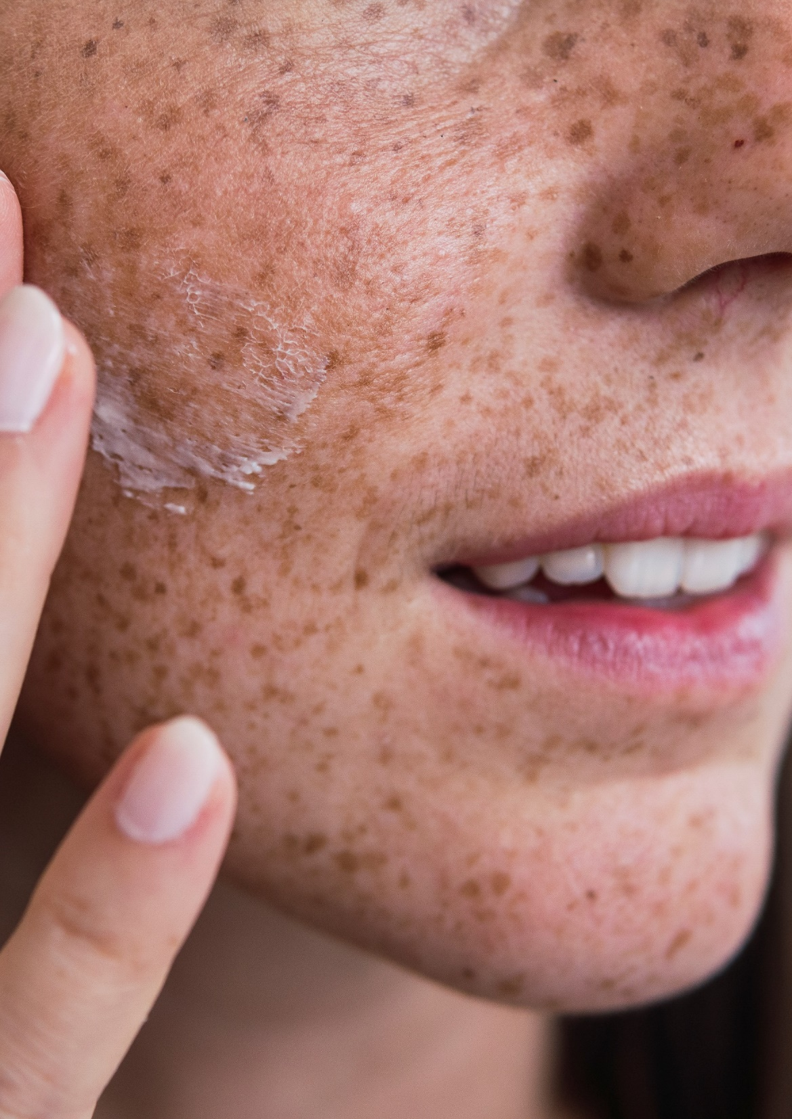
OXY 229 CB
In a nutshell
Contains postbiotics from a specific yeast strain obtained by fermentation and skin respiration facilitators to revive dull-looking skin.
Helps to increase oxygen uptake to maintain healthy-looking skin glow*.
Stimulates cell viability in the epidermis to revitalize skin*.
Up to 25% increased cell turnover to improve the look of tired, dull-looking skin**.
Helps to modulate oily skin and rebalances bacteria potentially involved in facial redness**.
Combined with NIACINAMIDE PC, OXY 229 CB ensures a visible, lighter skin tone**.
* In vitro **In vivo

