Slide 1
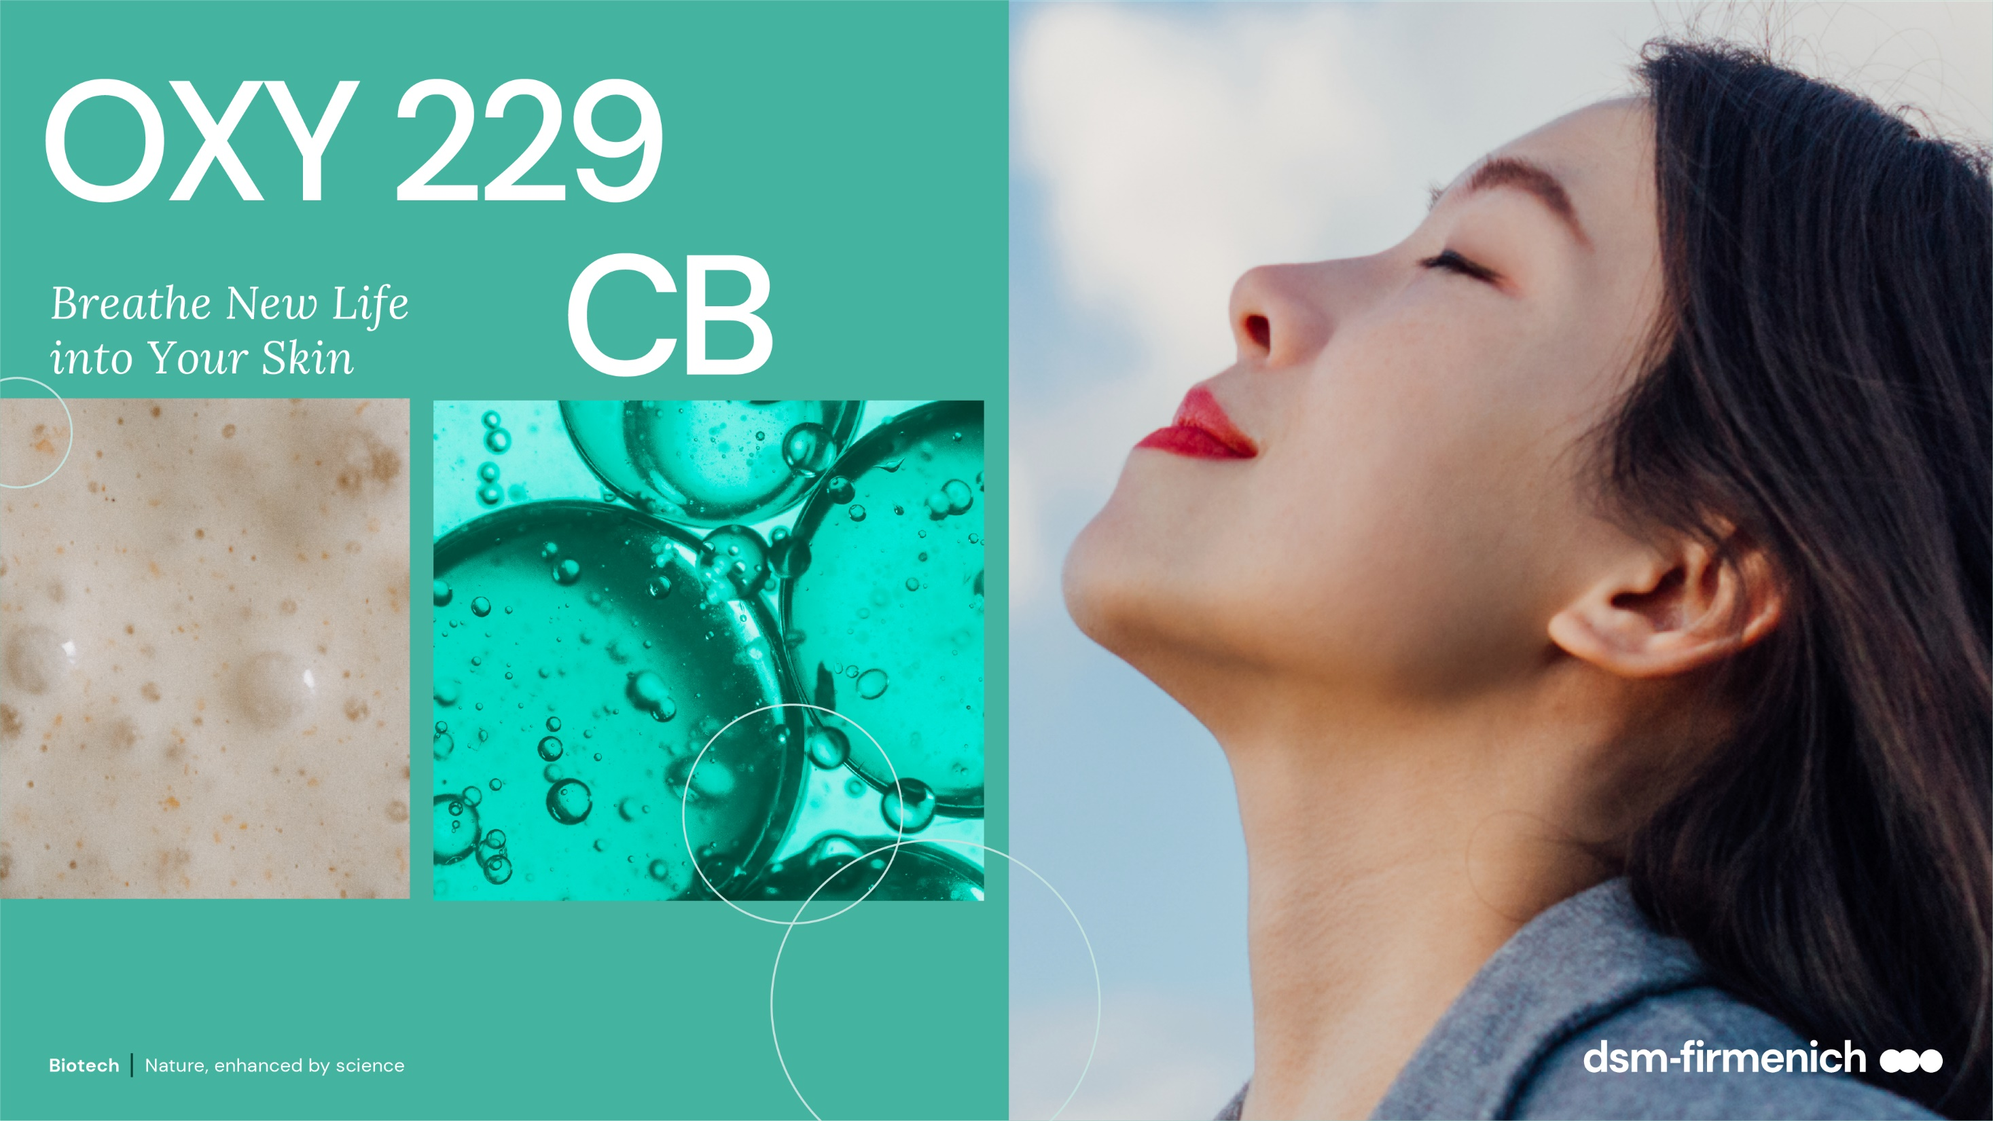
April 2025

Slide 2



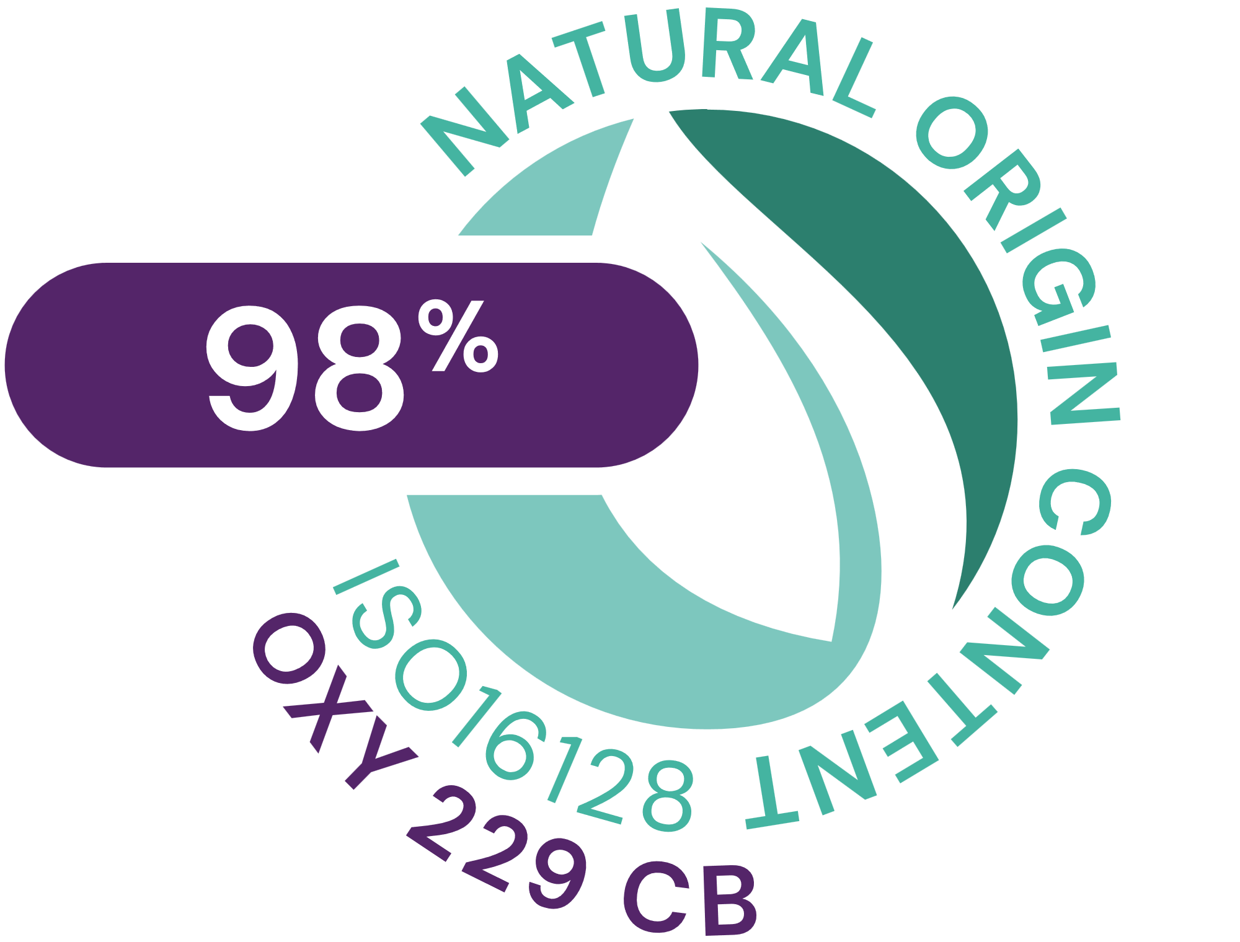

OXY 229 CB
ID Card
INCI NAME:
Aqua, Glycerin, Caprylyl Glycol, 1,2-Hexanediol, Saccharomyces Lysate, Valine, Threonine, Glutamic acid, Glycine, Disodium Succinate
TECHNOLOGY:
Contains postbiotics from a specific yeast strain obtained by fermentation and a sophisticated mixture of skin respiration facilitators
98% of natural origin (according to ISO 16128)
Solubility: water soluble
Biodegradability: readily biodegradable
TECHNICAL:
Form: liquid
Use level: 1–5%
pH of use: 3–7.5
Preservative: free
BENEFITS:
Helps to increase oxygen uptake to maintain healthy-looking skin glow*
Stimulates cell viability in the epidermis to revitalize skin*.
Up to 25% increased cell turnover to revive dull-looking skin**
Helps to modulate oily skin and rebalances bacteria potentially involved in facial redness**
Combined with NIACINAMIDE PC, OXY 229 CB ensures a lighter skin tone**
REGISTRATION
CERTIFICATION
2
*In vitro **In vivo

Slide 3
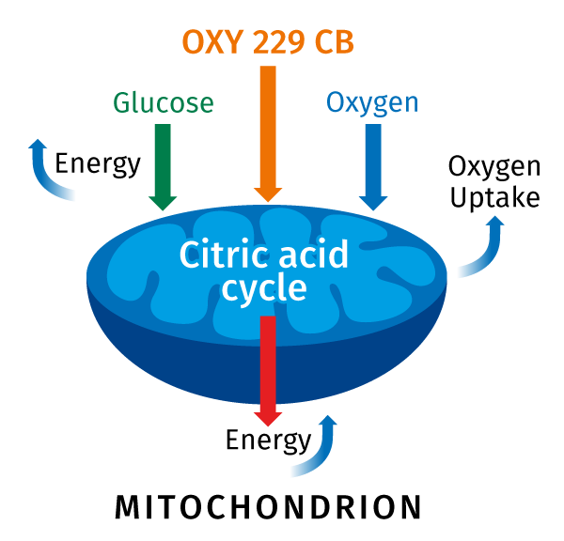
OXY 229 CB
The mode of action
A healthy glow is the essence of beauty
A healthy glow has a balanced energy metabolism that
is responsible for the ability of cells to revitalize and to manage cell turnover.
Over time essential energy processes in the skin
slow down; the skin looks tired and dull. Now the
skin needs energy.
OXY 229 CB increases cells oxygen uptake for more energy and faster turnover to maintain a healthy-looking skin glow*.
The increase is potentially due to the stimulation of the citric acid cycle that plays a starring role in the process of skin energy production¹.
* In vitro
¹R. Schütz et al. / Journal of Photochemistry & Photobiology, B: Biology 159 (2016) 142–148

Slide 4
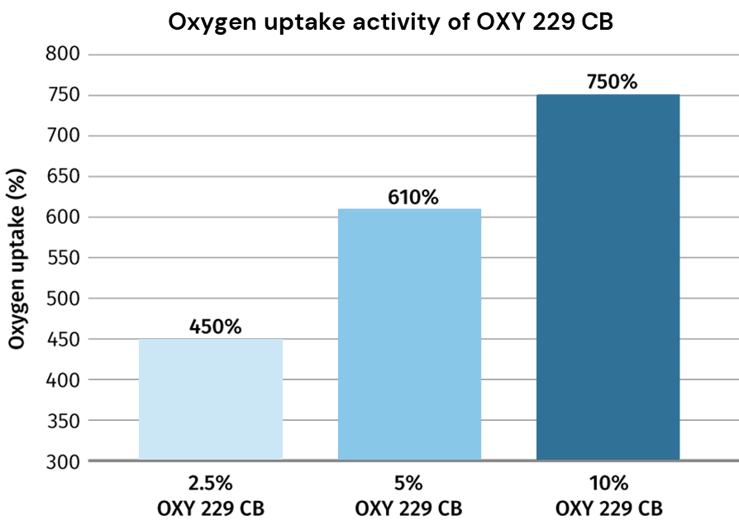
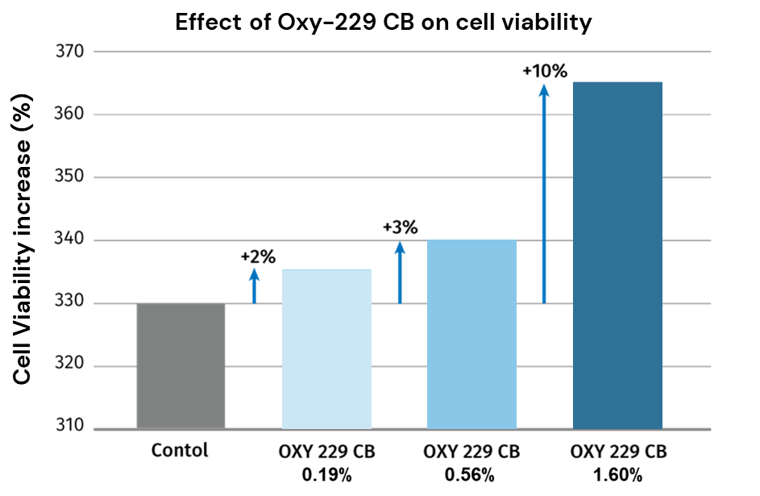
OXY 229 CB
In vitro
Oxygen uptake study
Cell viability study
OXY 229 CB enhances cells oxygen uptake by up to 750%*
OXY 229 CB induces cell viability by up to 10%*
4

Slide 5
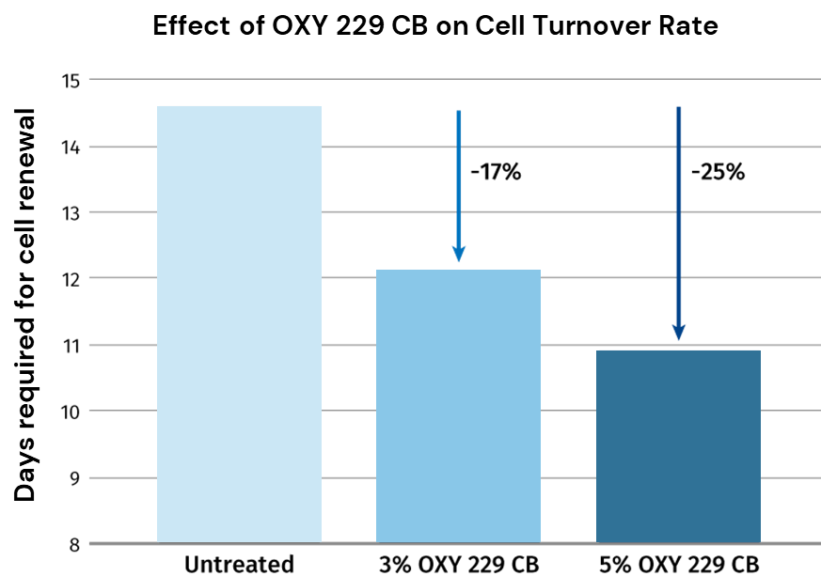
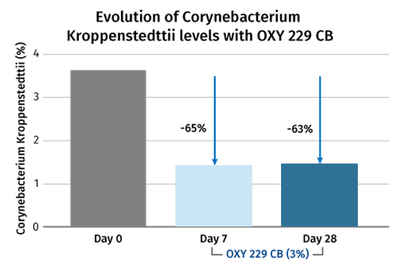
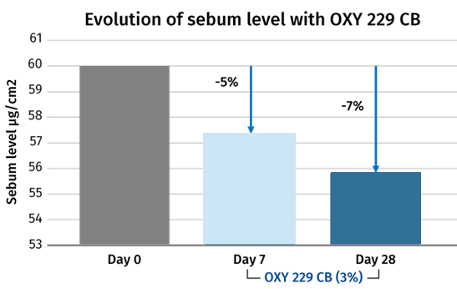
OXY 229 CB
In vivo
Epibiome beauty™ study
OXY 229 CB dose-dependently stimulates skin cell turnover by up to 25%* to improve the look of tired and dull-looking skin.
OXY 229 CB helps to control oily skin and rebalances bacteria potentially involved in facial redness:
Up to 7% sebum reduction
Up to 65% Corynebacterium Kroppenstedtii reduction
5

Slide 6
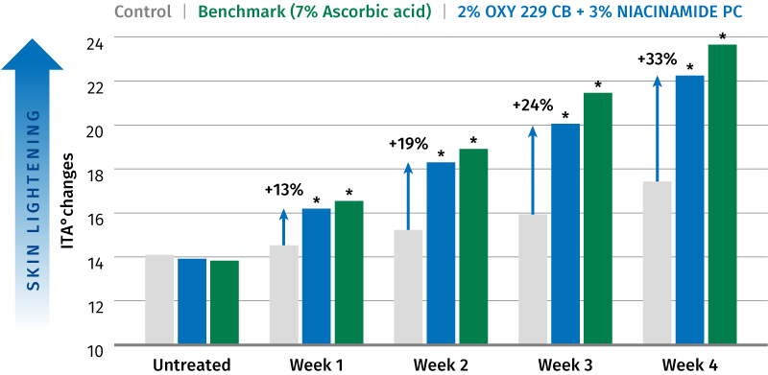
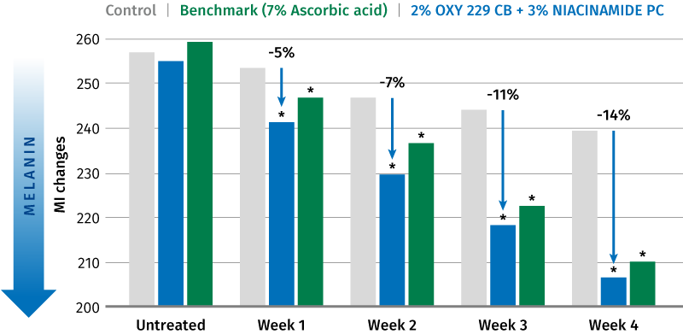
OXY 229 CB plus NIACINAMIDE PC
Evolution of ITA°changes
Significant and visible lighter skin tone
After 1 week
+13% lighter skin
-5% melanin
After 2 weeks
+19% visibly (ITA° > 3) lighter skin
-7% melanin
After 4 weeks
+33% visibly (ITA° > 3) lighter skin
-14% melanin
Similar to the benchmark 7% Ascorbic acid
* P < 0.05 compared to control Δ ITA° of >3 can be distinguished visually
Evolution of Melanin Index (MI) changes
The new power couple OXY 229 CB (2%) and NIACINAMIDE PC (3%) significantly ensures a lighter skin tone
* P < 0.05 compared to control
6

