Slide 1
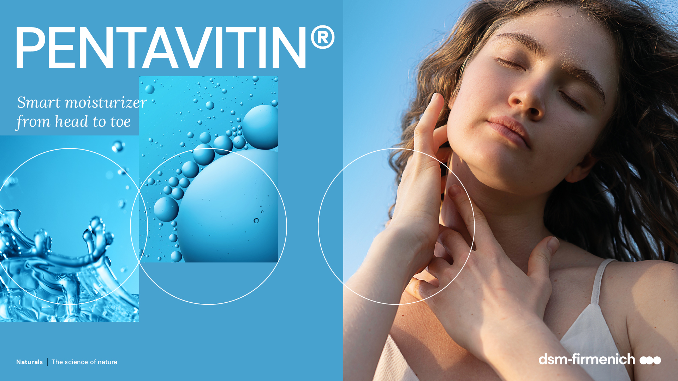
April 2026

Slide 2
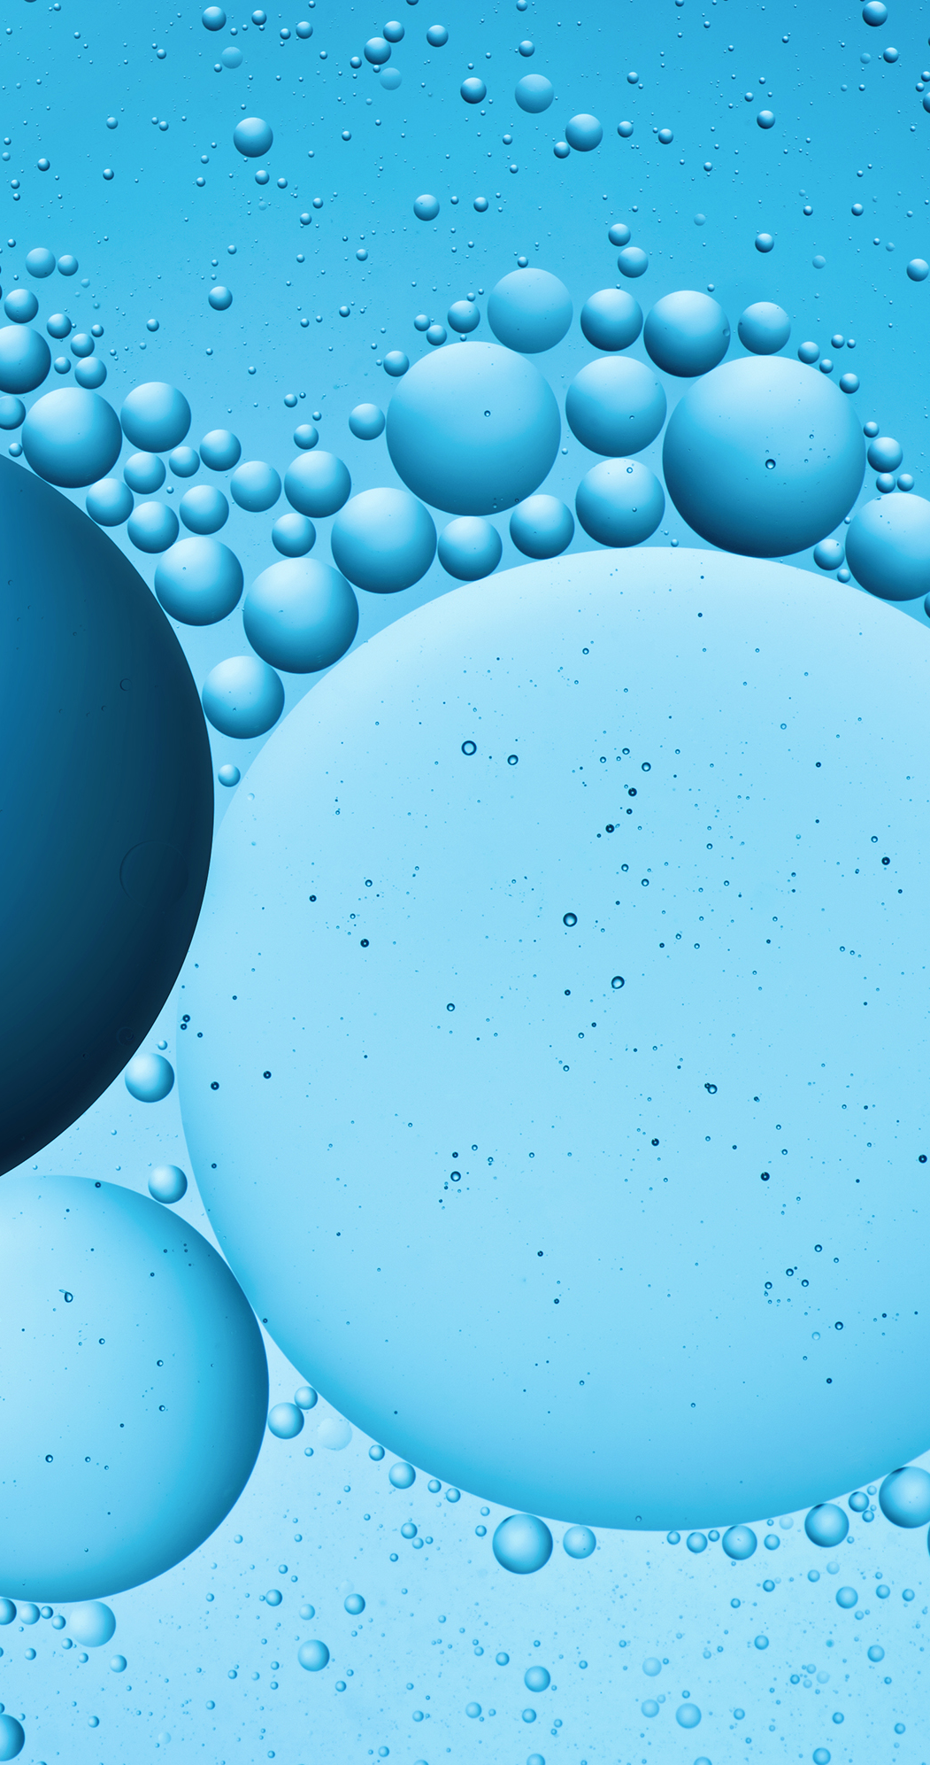

Index
01
Dry skin & hydration
02
Introducing Pentavitin
a. Product Properties
b. Mode of Action
c. Microbiome
03
Benefits cross applications
a. Facial & Body Care
b. Rinse-off
c. Scalp Care

Slide 3
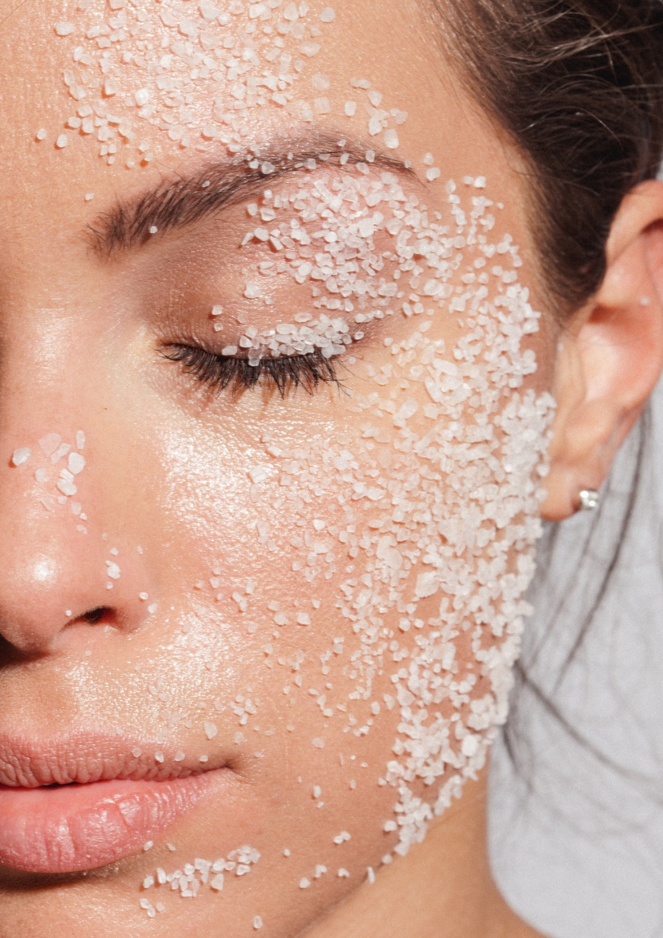
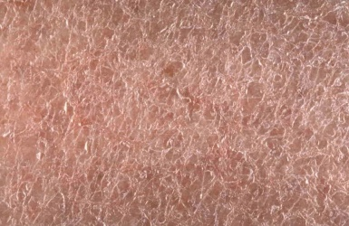
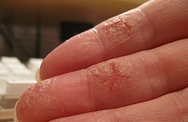
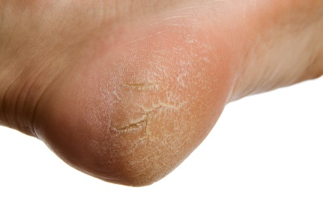
Dry skin affects millions of people!
Dry skin is skin that doesn't have enough moisture
and oil in it to keep it feeling soft.
Dry skin is nature’s way of warning you that the protective elements of your skin barrier is not working properly anymore.
Dry skin feels:
Tight
Rough
Itchy
Irritated
Dry skin looks:
Less healthy
Dull
Older
Slight to severe
flaking, scaling
or cracked
3

Slide 4
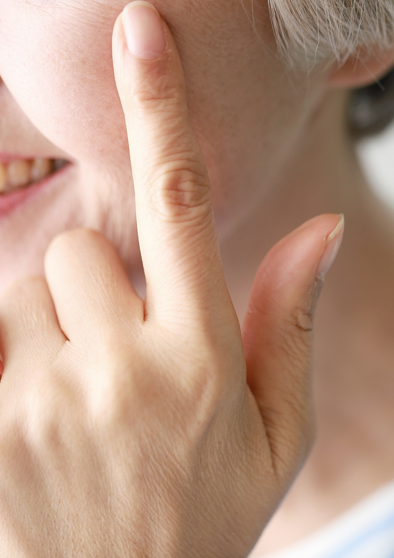
What to know about dry skin …
Some people are more at risk of dry skin*
People over 40 — as people get older, their skin makes less NMF (Natural Moisturizing Factor) and oil
People with brown, black, or fair skin
People with jobs that mean their hands are in water a lot, such as nurses and hairdressers
People who live in cold climates
People who smoke
Causes of dry skin include:
Living in cold, dry conditions
Using heat sources, such as central heating, that dry out the air
Using harsh deodorants or cleaning products
Taking long, hot showers or baths
*American Academy of Dermatology Association

Slide 5
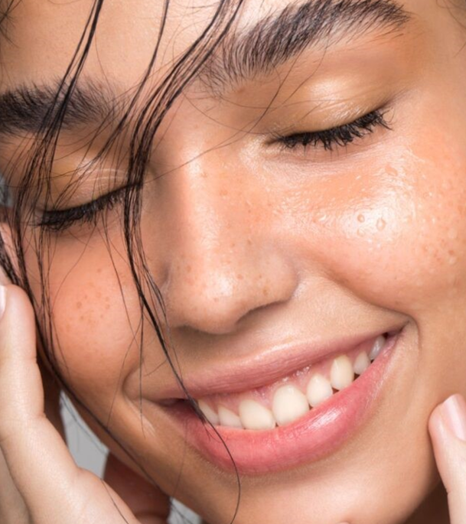




People with dry skin need …
Desired outcome
Quick & long-lasting
Key need
Trouble shooting
Get dry skin back to life
Targeted problem areas
Smile & confidence

Slide 6
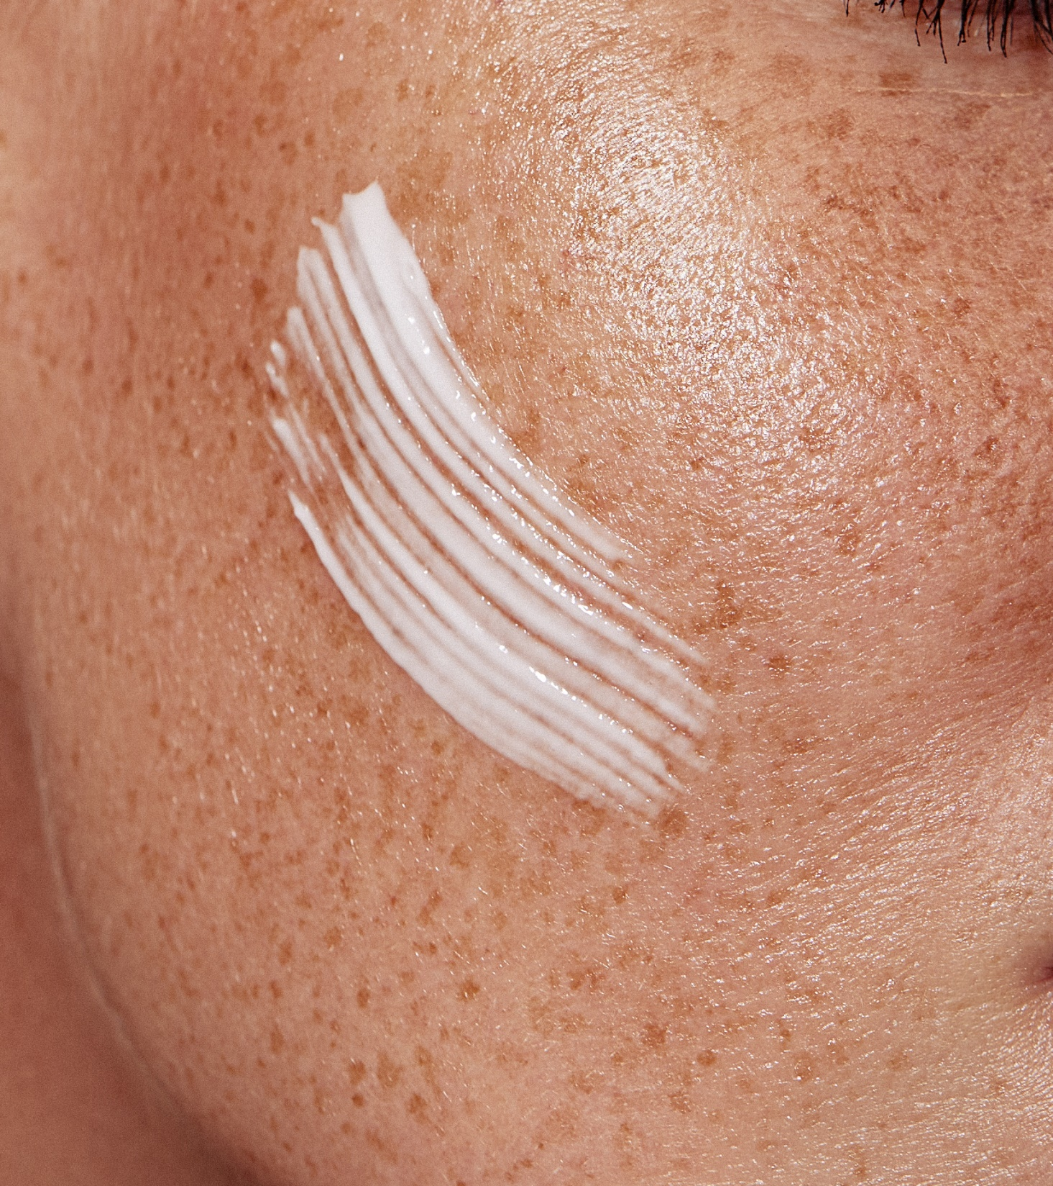
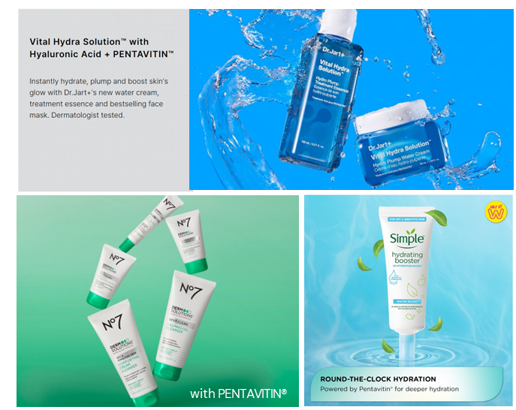
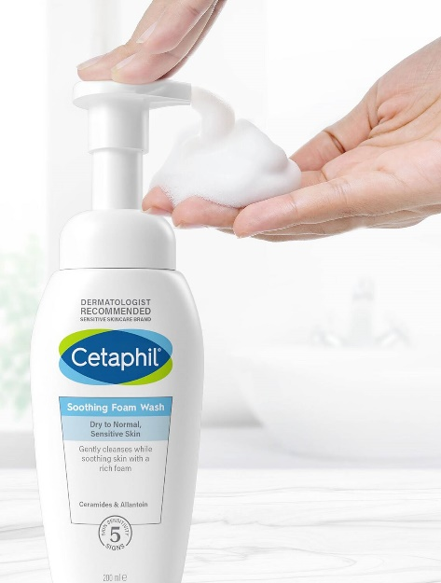
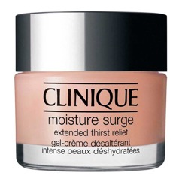
High demand for skin care products for dry skin
83%
of consumers are actively looking for skin care products that are created
for dry skin
Some examples …
6

Slide 7
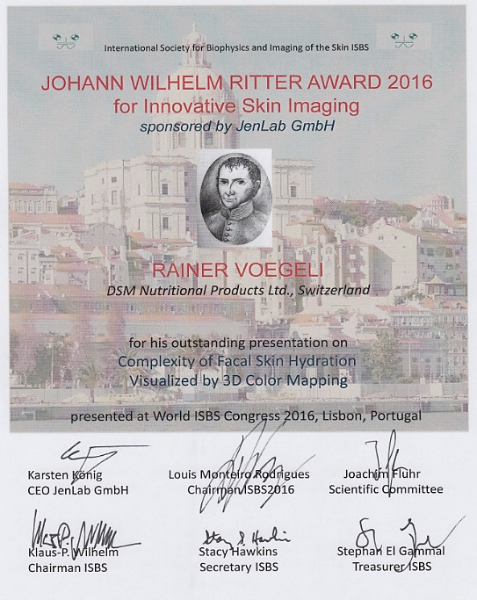
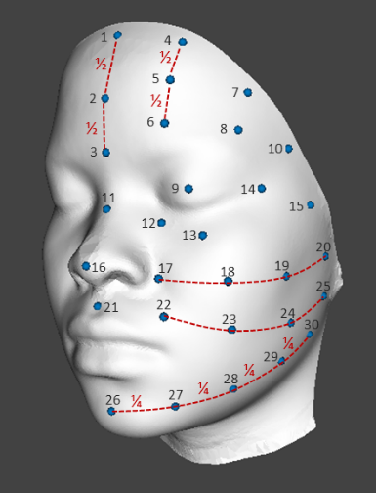
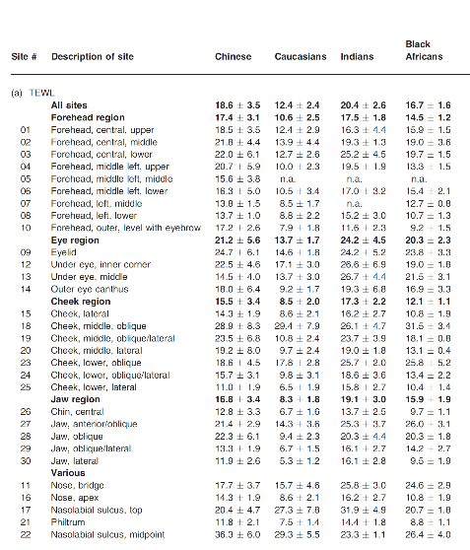
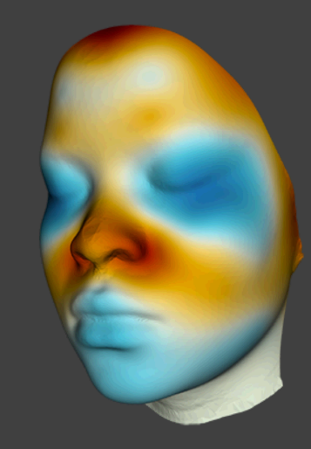

And this is… what dsm-firmenich scientists discovered
dsm-firmenich facial color hydration mapping technology
displays complex hydration data in an easy-to-understand way with a "wow" effect
30 measurings sites on the face are selected
CORNEOMETER or SCICON readings
Facial Color
Hydration Mapping
dsm-firmenich R. Voegeli et al; International Journal of Cosmetic Science, 2015, 37, 595-605
7

Slide 8
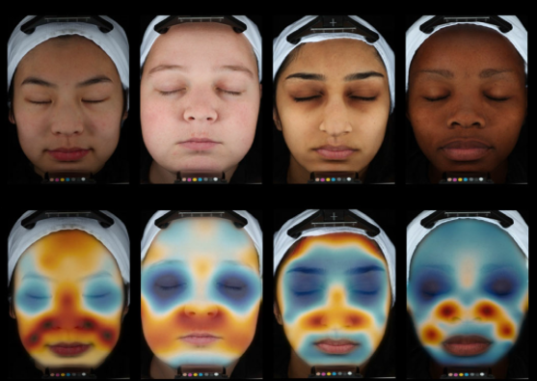
Facial Color Hydration Mapping shows the need of a moisturizer for problem areas
Skin hydration color maps of four ethnic groups
(Chinese, Caucasian, Indian, African)
living in the highly-polluted city of Pretoria**, South Africa
Facial hydration is much more complex than generally described
Remarkable differences exist within short distances and between different ethnic groups
Very dry skin around the nasolabial fold area in all four ethnic groups.
Very dry
Well hydrated
dsm-firmenich Voegeli et al. 2019 review article in IJCS; 41, 411 - 424
8

Slide 9
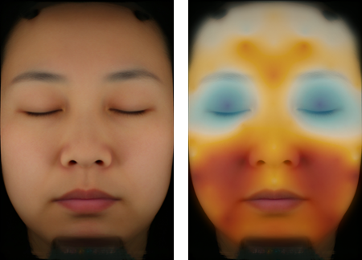
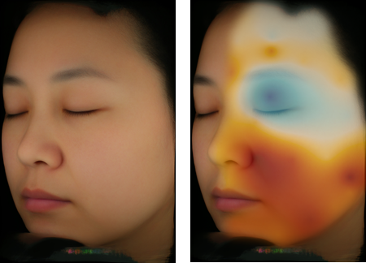
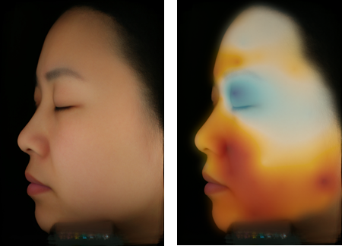
Facial Color Mapping Hydration Study
Beijing/China
Our discovery
Chinese women have excessively dry skin particularly in the lower part of the face
Very dry
Well hydrated
Very dry
Well hydrated
Very dry
Well hydrated
Naturals | The science of nature

Slide 11
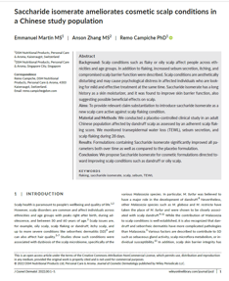
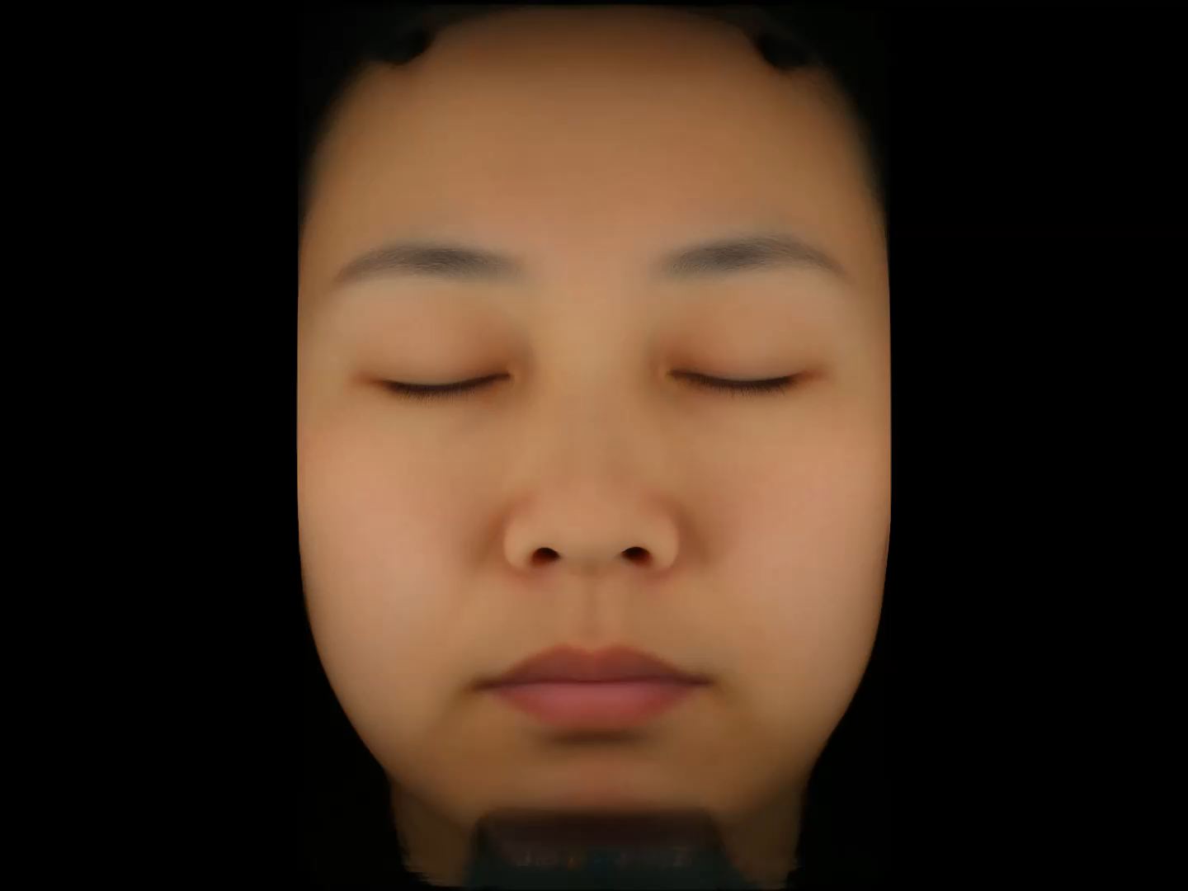
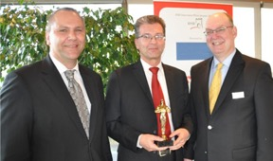
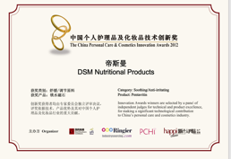
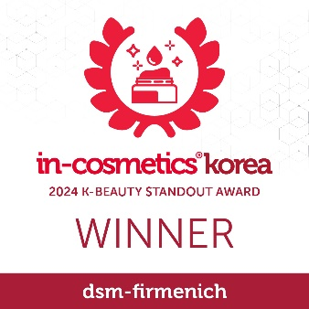
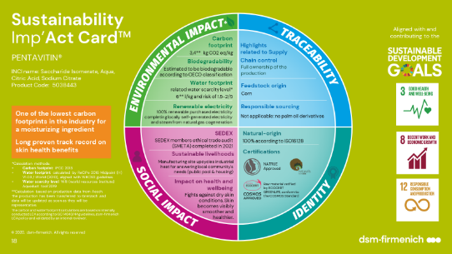

PENTAVITIN®
Since 1982 …
Sugar isomerization technology
Start to evaluate sugar isomerisation technology for the Beauty industry
Patented/Padberg et al
Influence of the bonding
of sugars to keratin on the water retention of the stratum corneum
72-hour long-lasting
deep hydration
BSB Award for the Most Innovative Raw Material in the Natural Products Category
Novel facial color mapping technology makes PENTAVITIN® benefits visible
New discoveries for body and scalp care
1970s
2012
2015
2019–2022
PENTAVITIN® Launch
Soothing & anti-irritation
China Personal Care
& Cosmetics Innovation Award
Fully sustainable
One of the lowest carbon footprints in the industry for a moisturizing ingredient
Helps to repair sun damaged skin
1982
2012
2017
2024
11

Slide 12
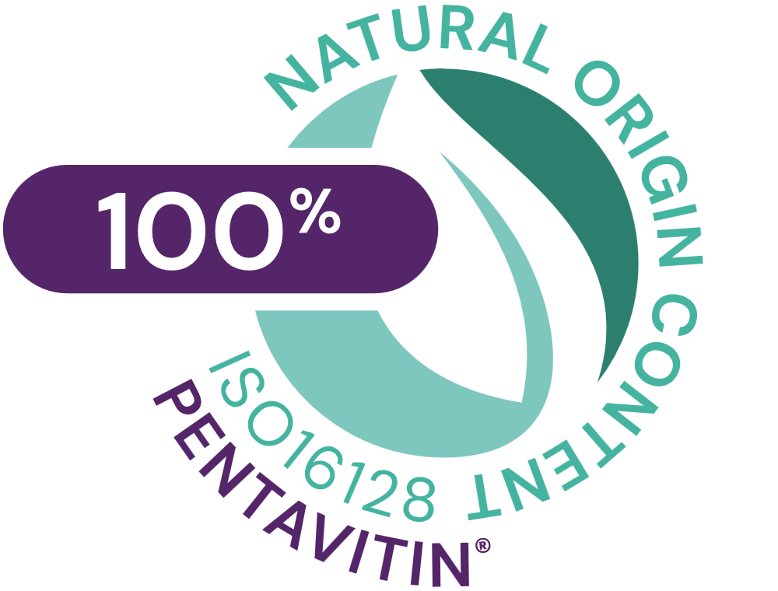
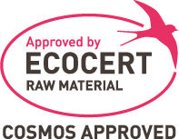






PENTAVITIN®
ID card
INCI NAME:
Saccharide Isomerate, Aqua, Citric Acid, Sodium Citrate,
TECHNOLOGY:
Skin identical sugar complex, produced sustainably using sophisticated sugar technology
100% of natural origin
Edible maize kernels derived
TECHNICAL:
Form: Liquid
pH of use: 3 - 10
Use level: 0.2 - 5%
Preservative: Free
Solubility: Soluble in water at all ratios and in alcohol
Biodegradable: Expected to be biodegradable
BENEFITS:
It binds to keratin and gives back vitality to your skin (vital keratin), meaning hydration continues long after application (moisture magnet)*
Unlike Glycerin and Hyaluronic Acid, it can’t be washed away, meaning it keeps working even if you miss a day*
Boosts your skin’s natural moisturizers for supple, dewy-fresh skin*
Hydration is instant and lasts for up to 72 hours**
This versatile active helps to soothe the skin, but also enhances its barrier and repairs sun-damaged skin*
Relieves itchy, flaky, sensitive skin, helping it to feel soft and smooth**
REGISTRATION
CERTIFICATION
Raw material verified by ECOCERT GREENLIFE, conform to the COSMOS Standard
NATRUE
Approved
* in vitro ** in vivo

Slide 13
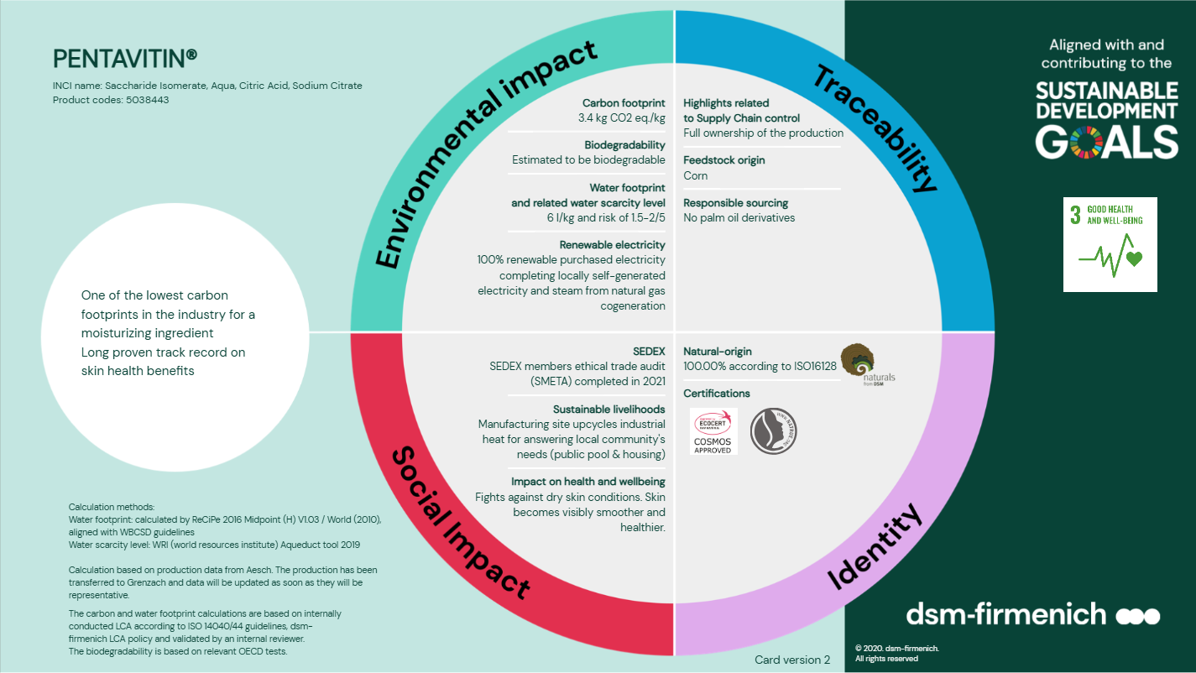

Slide 14
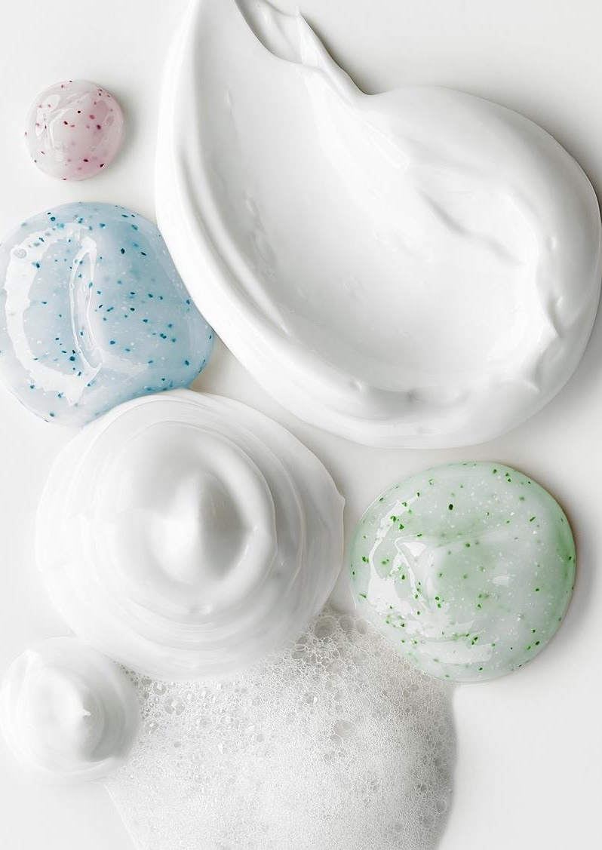





PENTAVITIN®
Easy to use
Soluble in water at all ratios
Stable in formulation containing alcohol
Can be added during the manufacturing process at any time (< 60°C) to the aqueous phase of a formulation
It is recommended to add it below 40°C to avoid unnecessary heating of the active and to use amine-free formulation
Recommended dosage 0.2 - 5%

Slide 15

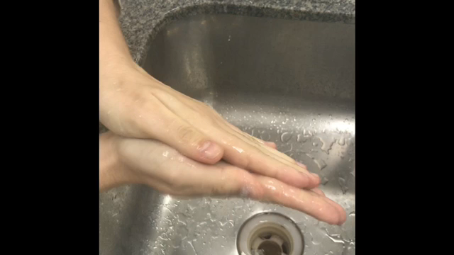
Patented for boosting foam performance
PENTAVITIN® enhances foam volume across cleansing formats
Crystal Goats Milk Soap with 0.2% PENTAVITIN® shows higher foam volume compared to the same formula without PENTAVITIN®.
Method
Foam generation and decay were measured with the SITA Foam Tester R‑2000 under fully automated, standardized conditions.
Key test parameters
  5 g/L in tap water
  Sample volume: 250 mL at 25 °C
  Stirring: 60 × 10 s at 1500 rpm
  Foam decay: 10 s intervals, max. 10 min
Results
Crystal Goats Milk Soap 0.2% PENTAVITIN®
Ingredients | % w / w
aqua, glycerin, sodium stearate, sorbitol, sodium laurate, goat milk, propylene glycol, sodium laureth sulfate, sodium chloride, sodium lauryl sulfate, titanium dioxide, stearic acid, lauric acid, pentasodium pentetate, tetrasodium etidronate | 99.8
PENTAVITIN® | 0.2%
Granted patents for improving foaming properties
China: CN115298296B (0.1–5% PENTAVITIN®)
US: US12496261B2 (0.01–10% PENTAVITIN®)
Pending patents
Europe, Korea, Japan
SK-E-101338-26
Cream Cleanser with 0.5% PENTAVITIN® demonstrates enhanced foam generation compared to the same formula without PENTAVITIN®.
Results
Cream cleanser with 0.5% PENTAVITIN®
Superior foam volume with 0.2% PENTAVITIN® in a soap bar
Ingredients | % w / w
Aqua | 23.78
Disodium EDTA | 0.05
Glycerin | 25.00
Myristic acid | 25.00
Stearic acid | 5.50
Glyceryl Stearate, PEG-100 Stearate | 3.00
PEG-150 | 5.00
Potasium Hydroxide | 5.17
Polyquaternium-7 | 2.00
Cocamidopropyl Betaine | 3.00
Olive Oil PEG-8 Esters | 2.00
PENTAVITIN | 0.50
SK-E-800010-1

Slide 16
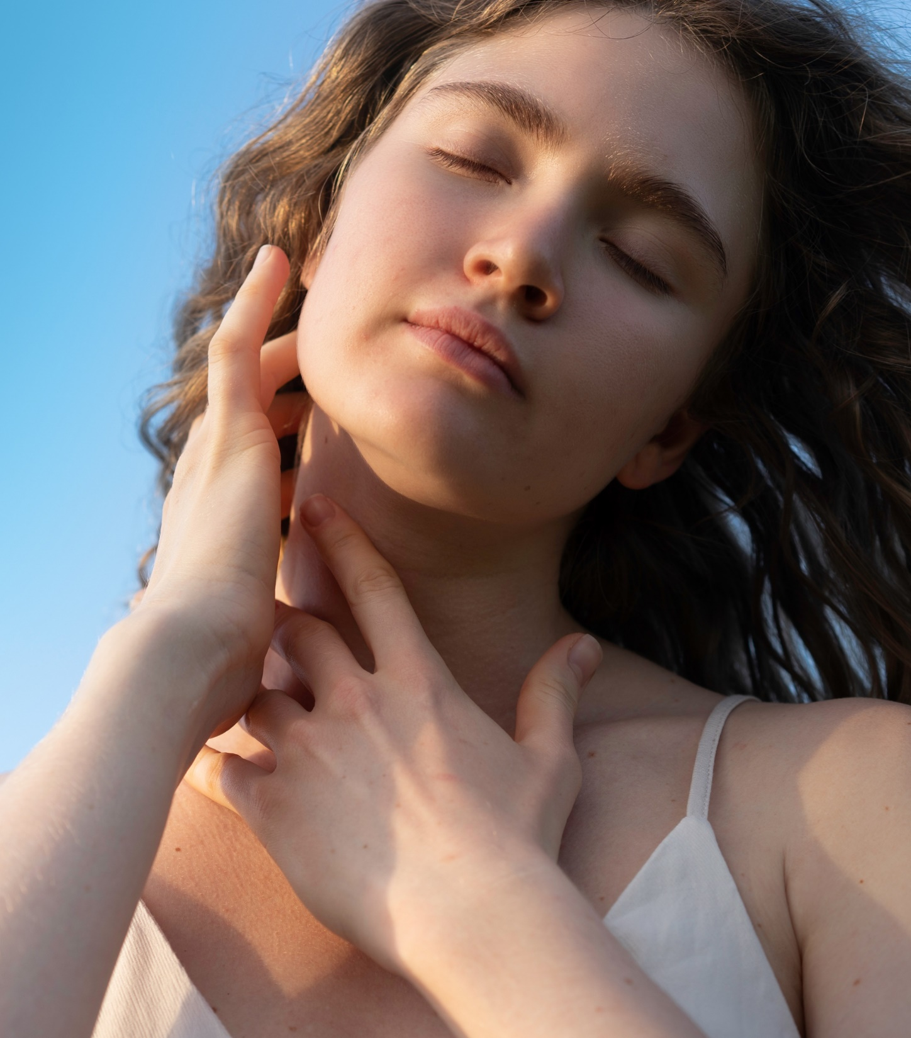
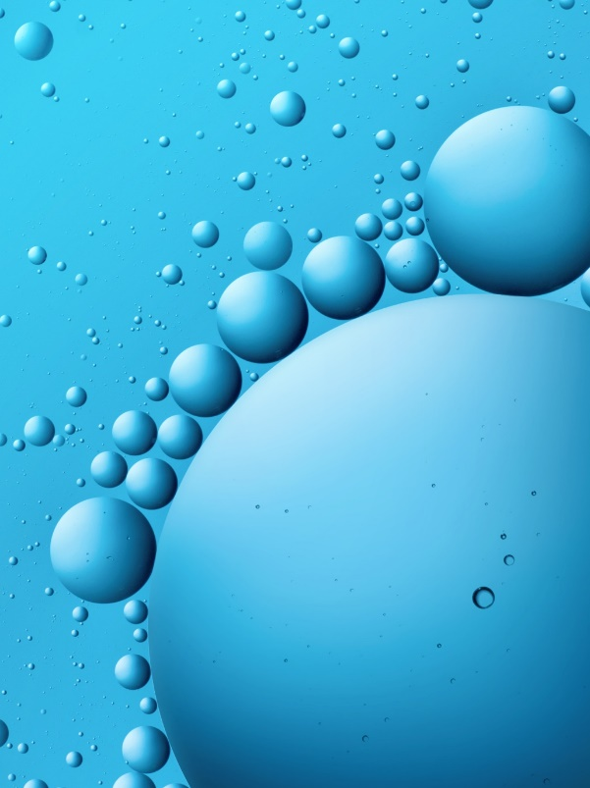
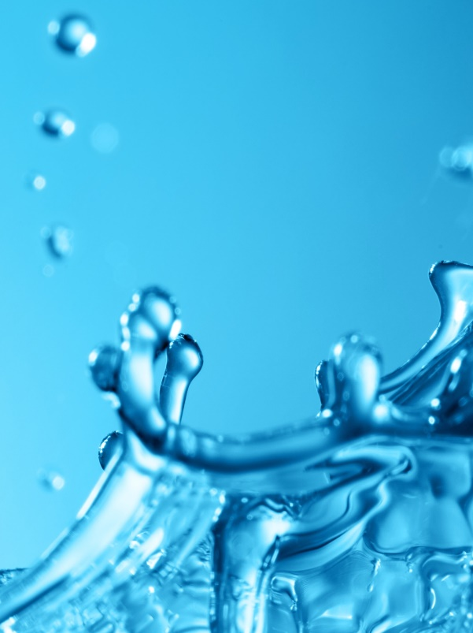

PENTAVITIN®
Mode of action

Slide 17


Binding hydration
  Binds to keratin and gives back vitality to your skin like a Moisture Magnet*
  The unique binding mechanism ensures that the active is not washed away but continues to improve skin’s natural hydration ability until removed naturally by desquamation.
*Binding of PENTAVITIN® to Keratin
G. Padberg; Journal of the Society of Cosmetic Chemists; 1972
CH₂-OH
Active sites
C = O
NH₂-R2
PENTAVITIN®
HO-C-H
Keratin
Keratin
R1
PENTAVITIN®
R2 = lysine

Slide 18
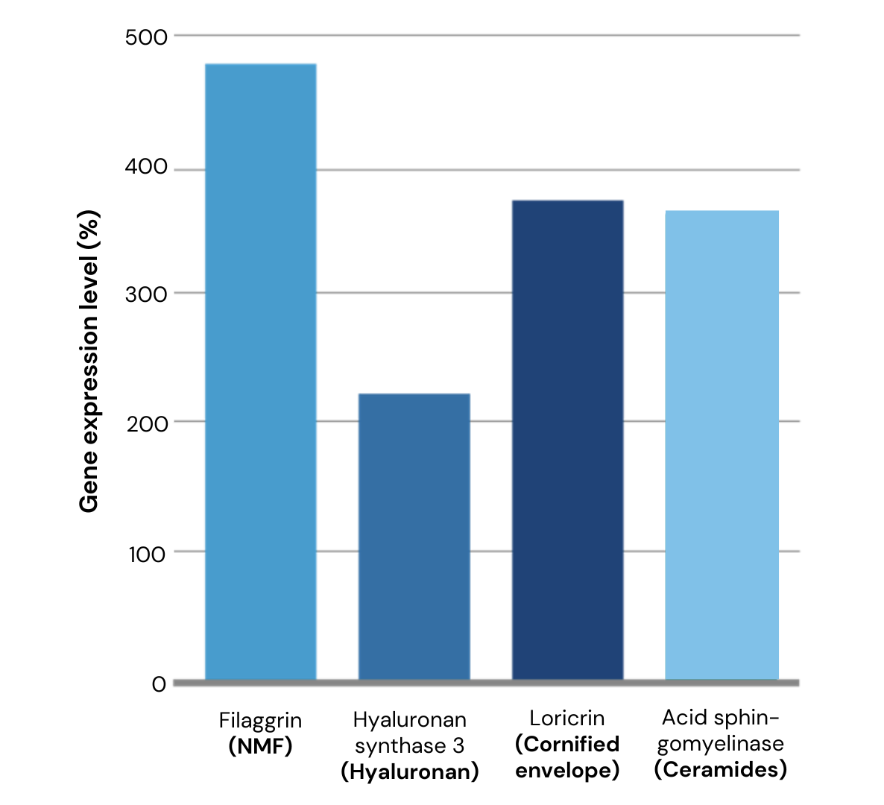
Supporting Skin Hydration and Barrier Integrity at the Gene‑Expression Level
Gene expression test
Gene expression test
Model: Normal Human Epidermal Keratinocytes (NHEK)
Method: Quantitative RT‑PCR
Treatment: PENTAVITIN® (0.3%) added directly to assay medium
Replicates: Triplicates
Outcome measured: Expression of genes involved in epidermal differentiation and skin barrier formation
-------------------
Baseline
PENTAVITIN® supports key skin‑barrier pathways at the gene expression level
In‑vitro gene expression studies show that PENTAVITIN® supports key skin‑barrier pathways:
Filaggrin: Boosts NMF formation for improved skin hydration
HAS3: Promotes epidermal hyaluronan synthesis
Loricrin: Reinforces the cornified envelope structure
SMPD1: Supports ceramide synthesis for barrier lipids

Slide 19
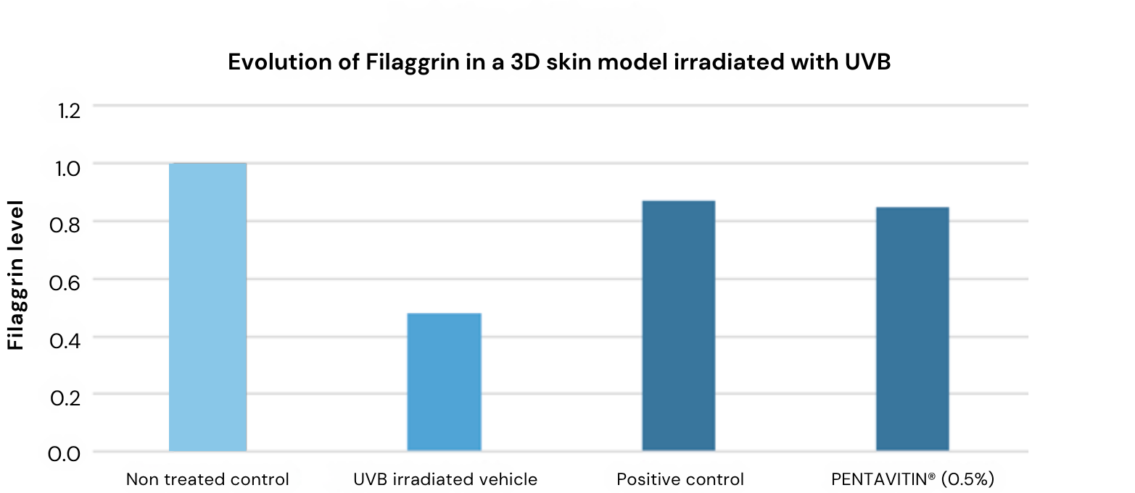
Boosts Filaggrin Expression in a 3D Epidermal Skin Model under UV Stress
Immunofluorescence (IF) pictures
The green IF is the Filaggrin protein expression site, and the stronger the IF intensity the higher the Filaggrin content
**
**
+77%
##
-------------------------------------
Non treated control
UVB irradiated vehicle
Positive control
PENTAVITIN® (0.5%)
After UVB-Induced Skin Barrier Damage the Filaggrin content
is decreased significantly
77% increase in Filaggrin indicating that PENTAVITIN® boost skin’s natural moisturizer (NMF) and helps to repair UVB-Induced Damaged Skin
Positive control: Pirinixic acid (50 µl) is often used in biochemical assays. It reduces inflammation and triggers epidermal differentiation.
Significances are expressed by UVB irradiated vehicle vs non treated control as #, P-value < 0.05 and UVB irradiated vehicle vs UVB irradiated positive control level and UVB irradiated PENTAVITIN® as ** P-value < 0.01
The results are significant and PENTAVITIN® is at the same level as the benchmark (positive control)​

Slide 20
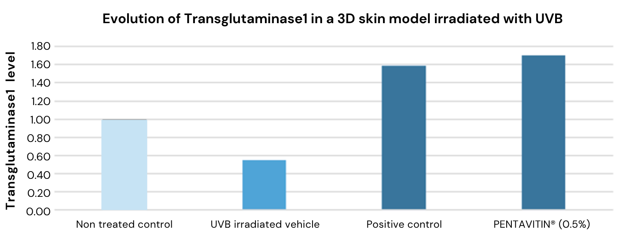
Boosts Transglutaminase Expression in a 3D Skin Model
under UV Stress
Immunofluorescence (IF) pictures
The green IF is the Transglutaminase 1 protein expression site, and the stronger the IF intensity the higher the Transglutaminase 1 content
**
**
+209%
Blank Control (without UVB)
UVB
(600mJ/cm²)
Positive control
PENTAVITIN® (0.5%)
##
-------------------------------
After UVB-Induced Skin Barrier Damage the Transglutaminase 1 content is decreased significantly
209% increase in Transglutaminase 1 indicating that PENTAVITIN® has a strong barrier strengthening effect
Positive control: Pirinixic acid (50 µl) is often used in biochemical assays. It reduces inflammation and triggers epidermal differentiation.
Significances are expressed by UVB irradiated vehicle vs non treated control as #, P-value < 0.05 and UVB irradiated vehicle vs UVB irradiated positive control level and UVB irradiated PENTAVITIN® as ** P-value < 0.01
The results are significant and PENTAVITIN® is at the same level as the benchmark (positive control)​

Slide 21
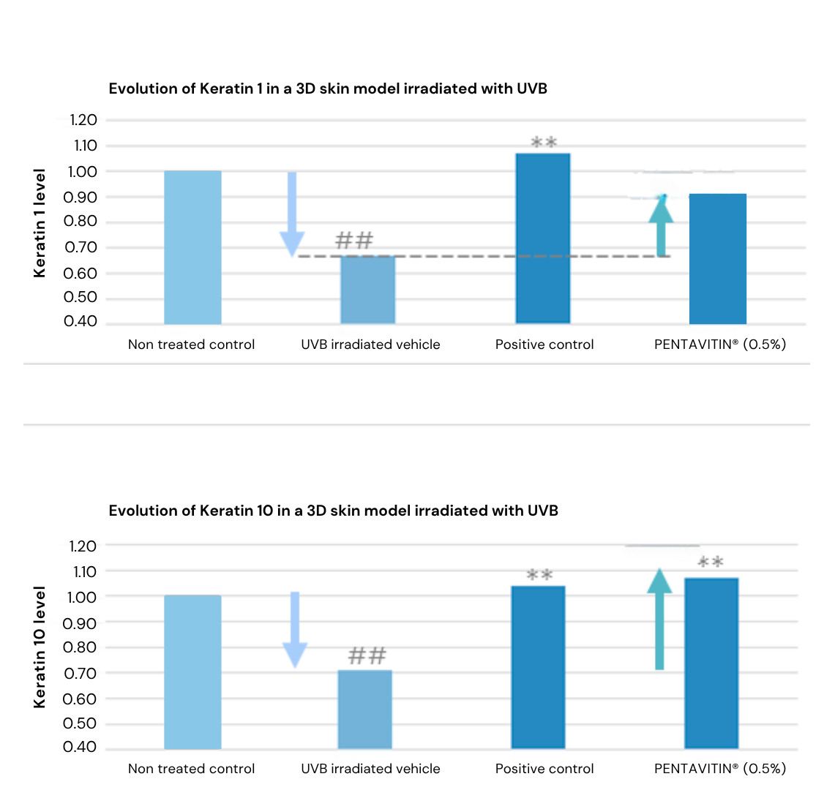
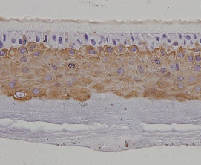
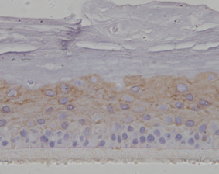
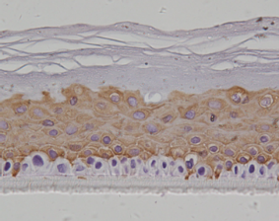
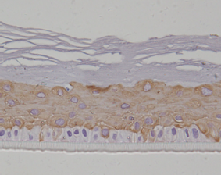
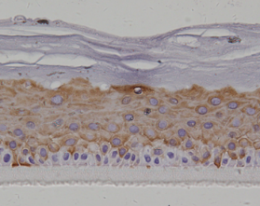
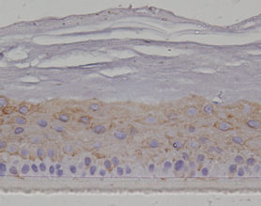
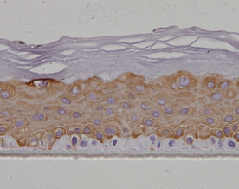
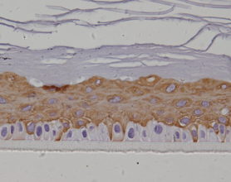
Boosts Keratin 1 and 10 Expression in a 3D Skin Model
under UV Stress
Immunohistochemistry (IHF) pictures
The brown IHC is the Keratin 1 expression site, and the stronger the IHC the higher the Keratin 1 content
+35%
**
After UVB-Induced Skin Barrier Damage the Keratin 1 and 10 content are decreased significantly.
Blank Control (without UVB)
UVB
(600mJ/cm²)
Positive control
PENTAVITIN® (0.5%)
The brown IHC is the Keratin 10 expression site, and the stronger the IHC the higher the Keratin 10 content
+50%
**
-----------------------
Blank Control (without UVB)
UVB
(600mJ/cm²)
Positive control
PENTAVITIN® (0.5%)
Positive control: Pirinixic acid (50 µl) is often used in biochemical assays. It reduces inflammation and triggers epidermal differentiation.
Significances are expressed by UVB irradiated vehicle vs non treated control as #, *P-value < 0.05 and UVB irradiated vehicle vs UVB irradiated positive control level and UVB irradiated PENTAVITIN® as ** P-value < 0.01
35% increase in Keratin 1 and 50% increase in Keratin 10 indicating that PENTAVITIN® has a strong skin barrier recovery and strengthening effect
The results are significant

Slide 22
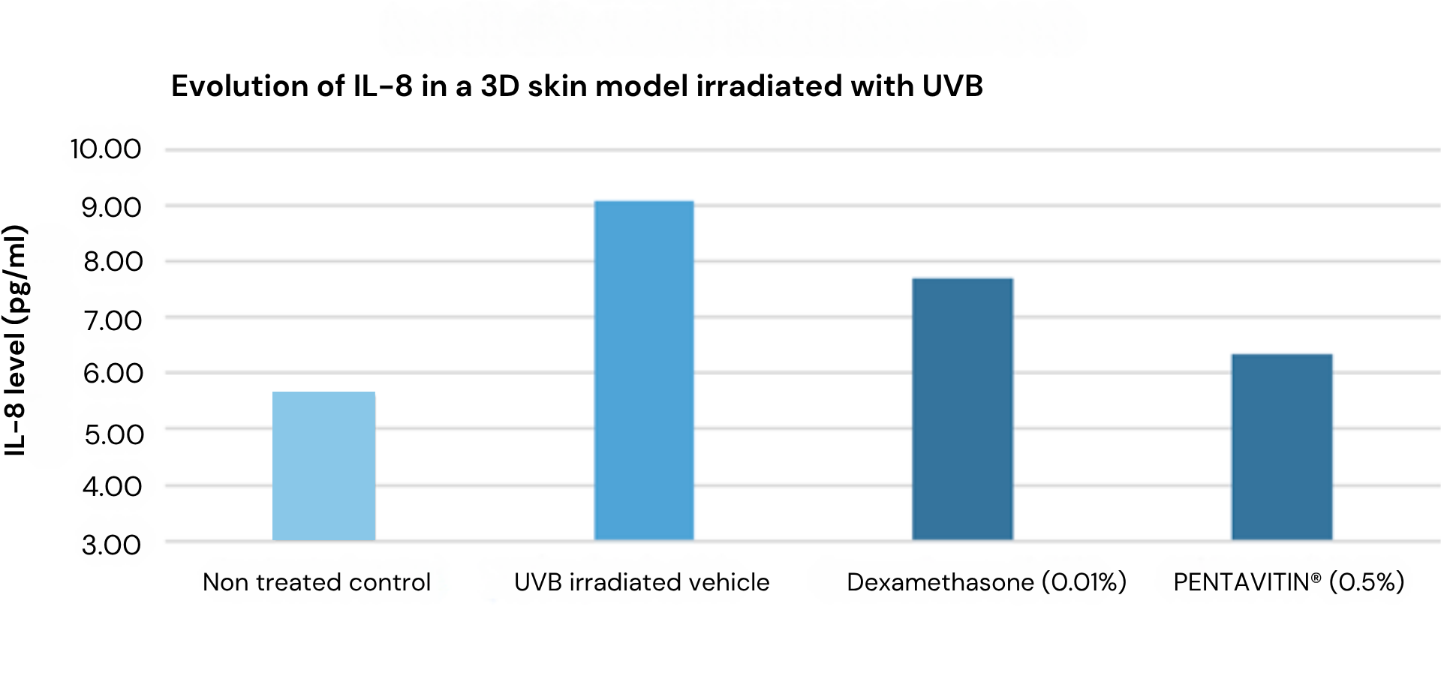
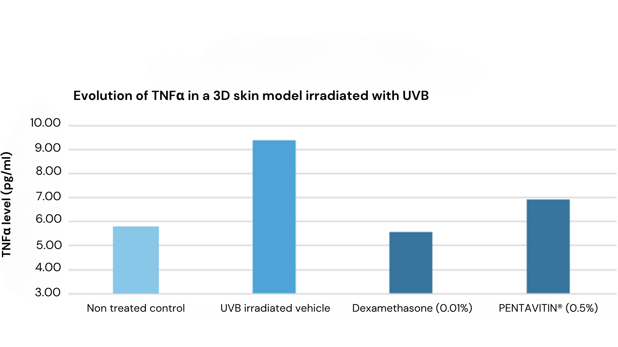
Decreases proinflammatory cytokines IL‑8 and TNFα in a 3D Skin Model under UV Stress
After UV-Induced stress IL-8 and TNFα (pro-inflammatory cytokines triggered by UVB light) levels are increased significantly.
##
-----------------------------------
*
-30%
**
-------------
30% decrease in IL-8 and 26% decrease in TNFα indicating that PENTAVITIN® helps to soothe signs of skin redness
The results are significant
-----------------------------------
##
-26%
*
-------------
**
Significances are expressed by UVB irradiated vehicle vs non treated control as #, P-value < 0.05 and UVB irra diated vehicle vs UVB irradiated positive control (Dexamethasone 0.01%) as ** P-value < 0.01 and UVB irradiated vehicle vs UVB irradiated PENTAVITIN 0.5% as * P-value < 0.05

Slide 23
PENTAVITIN®
Microbiome

Slide 24
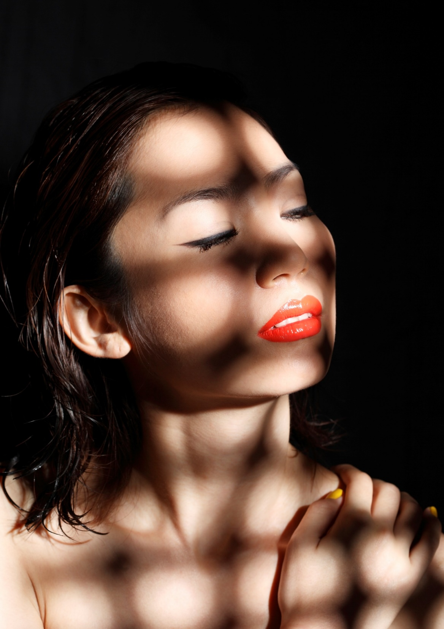




Microbiome friendly¹
Tested according to MyMicrobiome Standard 18.10*
Diversity
Vitality
Balance
PENTAVITIN® (3%)
respects the natural diversity of the skin microbiome
PENTAVITIN® (3%)
doesn’t interfere with the growth behaviour of the natural skin microbiome
PENTAVITIN® (3%)
respects the balance between skin-friendly bacteria such as Staphylococcus epidermidis and skin-harmful bacteria such as Staphylococcus aureus
Source: www.mymicrobiome.info/mymicrobiome-standard-18-10-tests-skin-microbiome-friendly.html
¹ Unilever patent WO2020052916A1 covers the topical use of saccharide isomerate as a prebiotic.
China: patent granted, Europe: EP application remains pending
24

Slide 25
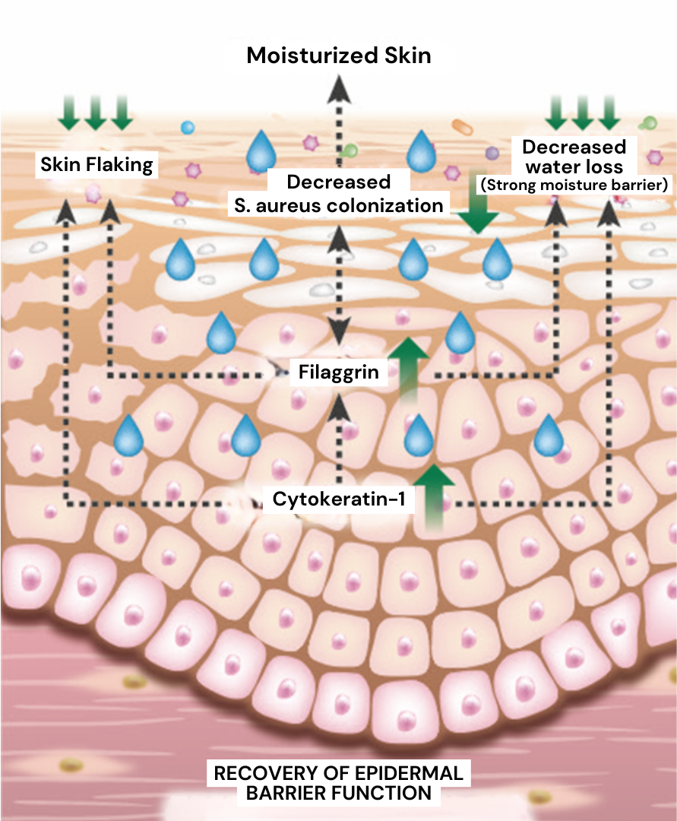



Reduces dry skin conditions in the best possible way
Tested on a St. Aureus colonized 3D skin model to mimic dry skin conditions
Evolution of Cytokeratin-1 in a microbiota colonized 3D skin model
Evolution of Filaggrin in a microbiota colonized 3D skin model
Boosts Filaggrin and Keratin 1 (Cytokeratin-1) and helps to keep Staphylococcus Aureus on a low level
Forms a strong moisture-barrier and strengthens the skin barrier
Helps to reduce dry skin conditions
BACTERIA
PENTAVITIN®
25
25

Slide 26
Hydrated skin and a rebalanced microbiome after 7 days
Tested in a leave-on peoduct
Skin hydration ↑
St. Epidermidis ↑
St. Aureus level ↓
26
26

Slide 27
Instant barrier support and a rebalanced skin microbiome
Tested in a body wash
St. Epidermidis levels ↑ St. Aureus levels ↓
The body wash formulation with 0.5% PENTAVITIN® keeps Staphylococcus Aureus on a lower level and Staphylococcus Epidermidis on a higher level compared to placebo
Reinforced skin barrier
The body wash formulation with 0.5% PENTAVITIN® significantly helps to reinforce skin’s barrier compared to placebo
*
--------------------
**
*
*P < 0.1 **p < 0.0
27
27

Slide 28
PENTAVITIN®
Facial & Body Care

Slide 29
Strengthen the skin barrier function
Tested on 12 female subjects, 40±1 y, evaluated skin area: calf; twice daily application of 1% aqueous PENTAVITIN®, measurements before and after 4w treatment phase, barrier disruption induced by 20 tape strippings; assessment of barrier repair by TEWL
±SEM
-20%
TEWL showed a 20% reduction following a 28 days application
-20%
T 0
T 4w
T 0
T 4w
Before tape stripping
After 20 tape stripping

Slide 30
Long lasting effect, after stopping the treatment
Test design
The study included 12 female subjects (40 ± 1 years) and assessed skin on the calf. Participants applied a 1% aqueous PENTAVITIN® formulation twice daily for 4 weeks. After the treatment phase, skin condition was evaluated during a regression period, with clinical assessments performed 72 h and 144 h after the last application. Skin dryness was graded using Kligman’s clinical grading scale, a well‑established and widely accepted method for evaluating visible signs of dryness.
*
*
Significant hydration improvement observed 72 hours after the last application
Hydration benefits persist for up to 144 hours (6 days) beyond the final use
* P < 0.1 ** p < 0.01 *** p < 0.001 compared to baseline

Slide 31

Accelerates skin barrier recovery
TEWL recovery study
Test design
18 subjects, age 32-46, skin type II/III,
14 days treatment of 0.2% aqueous PENTAVITIN® solution and 0.03% Bisabolol under rinse-off conditions at the forearm
Skin irritation and barrier disruption induced by tape stripping
Assessment of barrier repair by TEWL (Tewameter TM 300®)
Results
PENTAVITIN® accelerates the skin’s natural barrier repair, even under rinse‑off conditions, helping the skin recover faster from daily aggressions.
Skin barrier restored within 3 days
Superior efficacy vs. Bisabolol (0.03%)
Full repair skin defined at TEWL levels before stripping

Slide 32


PENTAVITIN®: Facial Color‑Mapping Study reveals targeted hydration where skin needs it most
Data collection: | April-May 2017
Study population: | 94 Chinese women, 35.0 ± 0.9 years old Three age and count matched groups Subjects living in Beijing for >3 years
Type of study: | Randomized, double-blind, placebo-controlled study.
Test products: | Placebo, Vehicle with 1% PENTAVITIN®, Vehicle with 3% PENTAVITIN®.
Conditioning phase: | 3 days
Application*: | Test products (0.8 – 1g) were applied twice daily (morning and evening) onto the face.
Test site: | Left side of the face, 30 predefined sites.
Test parameter: | Continuous skin hydration level is visualized with color scales based on SKICON-200 EX* readings.
Time points: | Baseline, 3 hours, 28 days

Slide 33


PENTAVITIN® (1%) demonstrates measurable, visible facial hydration
Three hours after single application of 1% PENTAVITIN® excessively dry cheek area is already significantly more hydrated.
Data analysis
Visualisation
After twice daily application for 28 days of 1% PENTAVITIN®, there is much better significant hydration to all facial areas.

Slide 34



PENTAVITIN® (3%) enhances hydration performance across the entire face
Three hours after single application of 3% PENTAVITIN® significant hydration boost of forehead, eye region and
cheek area.
Data analysis
Visualisation
After twice daily application for 28 days of 3% PENTAVITIN®, there is highly significant hydration power to all facial areas.

Slide 35



See and feel the difference: visibly smoother, more comfortable skin
Self‑assessment results
A before/after comparison on the leg showing a visible reduction of dry skin after 4 weeks with 1% PENTAVITIN®.
Consumer panel (39 – 41 years old) testing confirms the benefits of PENTAVITIN® (1%)
Before application
(on leg)
After 4 weeks application of 1% PENTAVITIN®
(on leg)
Three key self‑assessment benefits
Reduces dry skin conditions
Relieves signs of sensitivity including flaking and itching
Leaves skin soft and smooth

Slide 36
Instant hydration boost in a hand sanitizer formula
Hydration effect in a hand sanitizer formula containing PENTAVITIN® (1%) compared to placebo sanitizer
The sanitizer formulation with 1% PENTAVITIN® helps prevent the development of skin dryness and noticeably improves hydration compared to untreated skin.
+9% hydration just 1 hour after use
+14% hydration after 3 hours
Significant improvement vs. sanitizer placebo
+9%
+14%
1 hour
3 hours

Slide 37

Effective against irritation caused by Lactic acid
Lactic acid stinging test
Tested on 12 female subjects, 40-60 y, evaluated skin area: face; 5% lactic acid cream/pH: 3.0 with and without 5% PENTAVITIN®, 4 weeks twice daily application, the efficacy was evaluated by trained clinician and rated on a 5-point scale (stinging score)
Lactic acid stinging test
-22%
Effective against irritation caused by exfoliation with Lactic acid
22% reduced irritation
* W.Smith, SÖFW-Journal, 121;14/95

Slide 38

Feel good after daily showering
Tested in a body moisturizer
Feel-good with PENTAVITIN® after daily showering
+ 275% more moisture after single application
Working like a moisture-magnet, PENTAVITIN® (0.2%) in a body moisturizer boosts skin moisture compared to placebo just 8 hours after a single application (T2).
Helps to protect skin against dehydration
PENTAVITIN® (0.2%) in a body moisturizer helps to protect skin against dehydration, even after daily showering (T3 and T5).
Strong cumulative moisture recovery effect
Repeated use of PENTAVITIN® (0.2%) in a body moisturizer (T4 and T6) after daily showering guarantees a strong cumulative moisture recovery effect.
All data are normalized against control (untreated)

Slide 39
PENTAVITIN®
Rinse-off

Slide 40

All‑Day hydration, even after frequent showers
Tested in a shower gel
24-hour hydration
PENTAVITIN® (0.2%, 0.5%) boosts skin hydration for 24 hours after one use.
Dryness prevention
After one week of frequent showering, PENTAVITIN® formulas keep skin hydrated and help prevent dryness.
Significant effects
Placebo causes an immediate hydration drop that does not recover after 7 days.
PENTAVITIN® 0.5% delivers significant hydration at all time points vs. placebo.
PENTAVITIN® 0.2% shows a significant boost after 1 hour vs. placebo.

Slide 41

Helps reinforce the skin’s barrier function, even post‑shower
Tested in a shower gel
Reinforced skin barrier
Shower gels with PENTAVITIN® (0.2%, 0.5%) help reinforce the skin barrier just 1 hour after a single use—and continue to do so even after one week of frequent showering.
Significant effects
Shower gels with PENTAVITIN® (0.2%, 0.5%) show barrier‑reinforcing benefits compared with untreated skin (D0).

Slide 42

Helps skin move from dry to normal in 1 hour, even with frequent showering
Tested in a body wash
Skin moves from dry to normal
Within 1 hour of showering, body‑wash formulations with PENTAVITIN® (0.2%, 0.5%) help shift skin from dry to normal.
Maintained skin hydration over repeated use
After 7 days of daily showering, formulations with PENTAVITIN® (0.2%, 0.5%) maintain elevated skin-hydration levels
Significant hydration increase
Body‑wash formulations with PENTAVITIN® (0.2%, 0.5%) deliver a statistically significant improvement in skin hydration versus the placebo formulation.

Slide 43

24-hour moisture boost & lock
Tested in a soap bar
24-hour moisture boost
3 times more moisture after one single application of PENTAVITIN® (0.2%) in a moisturizing soap bar compared to placebo at 24 hours.
24-hour moisture lock PENTAVITIN® (0.2%) significantly helps to lock in moisture within the skin for up to
24 hours.
Hydration booster of glycerin
After one single use, PENTAVITIN® (0.2%) significantly boosts the hydration efficacy of a moisturizing soap bar containing 8% glycerin at 24 hours.
24 hours moisture lock
24 hours moisture boost
*
*

Slide 44



Instant body hydration after one single application
Reduces unwanted effects of dryness caused by bar soap
Evaluation of skin hydration properties of a bar soap product with PENTAVITIN® after a single washing procedure (rinse-off application), by means of biometric measurements (Dermalab® Hydration device, CORTEX Technology, DEN). Measurement of 24 predefined sites on the lower leg 1 hour after application. Application was done on both legs on every individual, one leg was washed with placebo soap and the other leg with PENTAVITIN® soap.
Moisture units
Visible hydration boost after 1 hour
Hydrated skin
Dry skin
After soap (placebo) application
1 hour after soap application with PENTAVITIN® (0.35%)

Slide 45
PENTAVITIN®
Scalp Care

Slide 46

Reinforced scalp barrier
24 hour after one single application
and frequent showering
Use of the shampoo placebo damages the scalp barrier after showering and it is not recovered even after 28 days.
24 hour (D1) after one single application and even after 28 days of frequent showering, shampoos with 0.2% and 0.5% PENTAVITIN® reinforce the scalp barrier.
PENTAVITIN®’s improvements over the placebo are highly statistically significant.
Shampoo Placebo
Sh. + 0.2% PENTAVITIN®
Sh. + 0.5% PENTAVITIN®
Tewameter TM nano – Dandruff site
n=30 – SEM error bars
***p < 0.001
Reduction versus placebo

Slide 47

Scalp sebum reduction
24 hour after one single application
and frequent showering
15% sebum reduction 24 hour (D1) after one single application with a shampoo containing PENTAVITIN® (0.5%)
37% sebum reduction after frequent showering with a shampoo containing PENTAVITIN® (0.5%)
PENTAVITIN®’s (0.2% and 0.5%) improvements over the placebo are highly statistically significant
Shampoo Placebo
Sh. + 0.2% PENTAVITIN®
Sh. + 0.5% PENTAVITIN®
Meibometer , MB560– Dandruff site
n=30 – SEM error bars
***p < 0.001 *p < 0.01
Reduction versus placebo

Slide 48

Reduced scalp flaking
24 hour after one single application
and frequent showering
14% reduction of scalp flaking 24 hour (D1) after one single application with shampoos containing PENTAVITIN® (0.2% and 0.5%)
Up to and 55% reduction of scalp flaking after frequent showering with shampoos containing PENTAVITIN® (0.5%)
PENTAVITIN®’s (0.2% and 0.5%) improvements over the placebo are highly statistically significant
Shampoo Placebo
Sh. + 0.2% PENTAVITIN®
Sh. + 0.5% PENTAVITIN®
Grade of ASFS dandruff - Dermatologist
n=30 – SEM error bars
***p < 0.001 *p < 0.05
Reduction versus placebo

Slide 49






Visible flaking reduction
24 hour after one single application and frequent showering
D0 - Before treatment
D1 - 24 hours, after just one use of a shampoo with PENTAVITIN® (0.2%)
D28 – 28 days, after frequent showering with
a shampoo containing PENTAVITIN® (0.2%)
D0 - Before treatment
D1 - 24 hours, after just one use of a shampoo with PENTAVITIN® (0.5%)
D28 – 28 days, after frequent showering witha shampoo containing PENTAVITIN® (0.5%)

Slide 50



Fully hydrated scalp after frequent use
Shampoo Placebo
Shampoo 0.5% PENTAVITIN®
FTIR scalp hydration color 3D mapping
Shampoo placebo / 7 days vs baseline
FTIR scalp hydration color 3D mapping
Shampoo with 0.5% PENTAVITIN® / 7 days vs baseline
Less hydrated
More hydrated
Visible hydration power after 7 days frequent use of PENTAVITIN® (0.5%) in a shampoo compared to placebo.

Slide 51

Visible sebum reduction after frequent use
Shampoo Placebo
Shampoo 0.5% PENTAVITIN®
FTIR scalp sebum color 3D mapping Shampoo placebo / 7 days vs baseline
FTIR scalp sebum color 3D mapping Shampoo placebo / 7 days vs baseline
More sebum
Less sebum
After 7-days frequent use of PENTAVITIN® (0.5%) in a shampoo, visible reduction in sebum observed on scalp.

Slide 52
Disclaimer
Copyright © dsm-firmenich Switzerland AG, 2026, 4002 Basel, Switzerland.
www.dsm-firmenich.com. All rights reserved.
dsm-firmenich has used diligent care to ensure that the information provided herein is accurate and up-to-date to the best of its knowledge. However, dsm-firmenich makes no representation or warranty, either expressly or implied, of the accuracy, reliability, completeness, or suitability thereof. The information provided herein contains scientific and product information for business-to-business use and does not constitute or provide scientific or medical advice, diagnosis or recommendation for treatment options. Country or region-specific information should be considered when labelling or advertising to final consumer. In no event shall dsm-firmenich be liable for any direct or indirect damages arising from or reliance upon, or use of, any information provided herein. The content of this document is subject to change without further notice. Please contact your local dsm-firmenich representative for the latest information. All trademarks listed in this document are either (registered) trademarks of, or trademarks licensed by, the dsm-firmenich group of companies, unless explicitly stated otherwise.
Disclaimer Formulation Guideline
The information provided herein is provided for information purposes only and has been prepared by dsm-firmenich in accordance with its own methodology.
dsm-firmenich has used diligent care to ensure that it is accurate and up-to-date, however, dsm-firmenich makes no representation or warranty, either expressly or implied, of the accuracy, reliability, or completeness thereof. In no event shall dsm-firmenich be liable for any damages arising from or reliance upon, or use of, any information provided herein. Further, dsm-firmenich shall not bear any liability for the application and/or use of any processed material containing its product(s). The formulation of the finished product is the customer’s sole responsibility. It is the customer’s responsibility to determine the suitability of dsm-firmenich’s products regarding user specific purposes, assess compatibility and stability of their finished product(s) and to ensure compliance of their finished product(s) with relevant laws and regulations. Any product, marketing or other claims made by customer are its sole responsibility. The content of this document is subject to change without further notice. Please contact your local dsm-firmenich representative for further details. © dsm-firmenich Switzerland AG, 2026.
© 2026

Slide 53
© 2026

