Slide 1
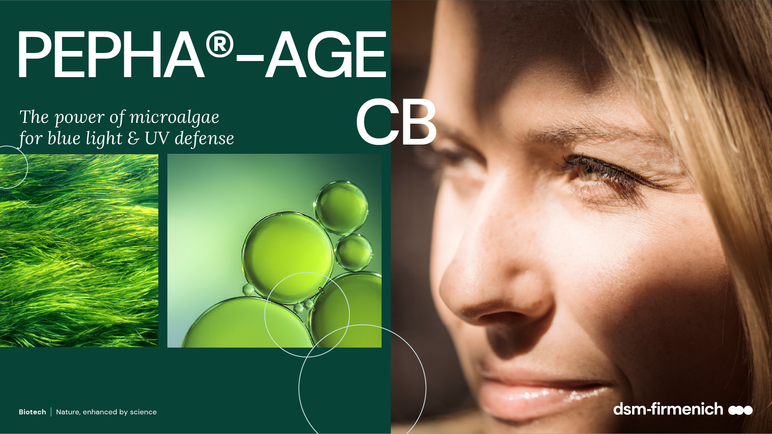
June 2025

Slide 2
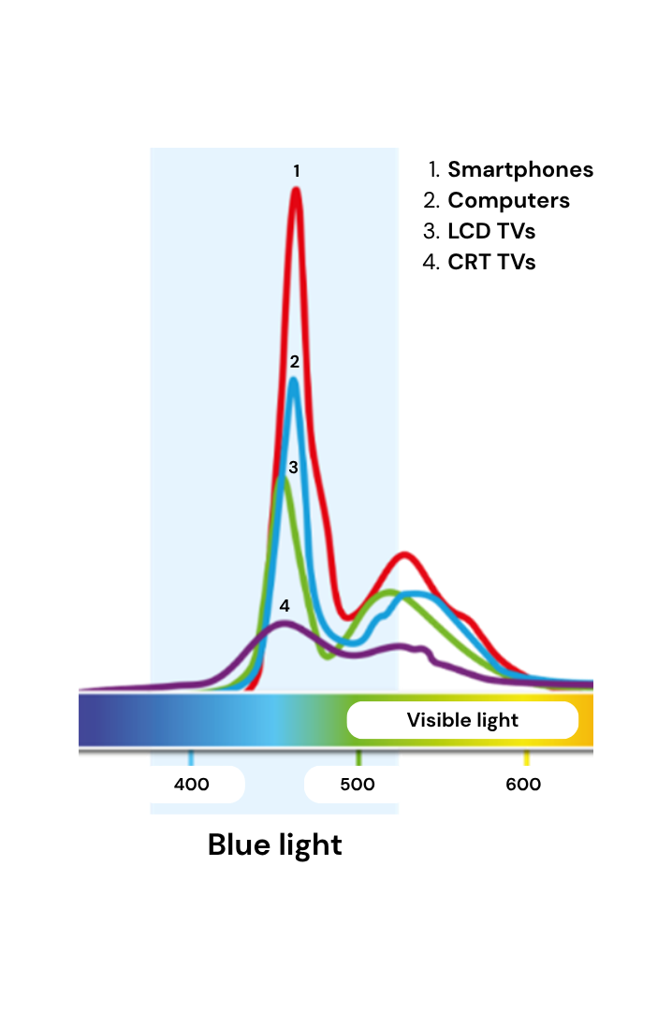
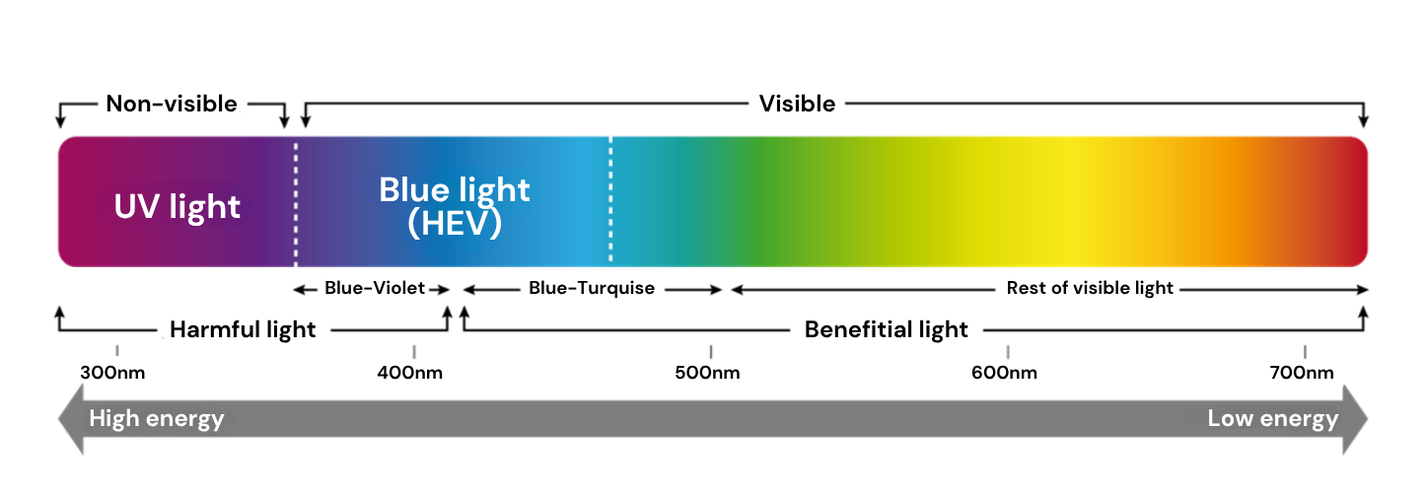




We’re exposed to different forms of blue light every day…
25-30% of solar radiation reaching the earth’s surface is blue light
Source of blue light high energy visible (HEV 400 – 500NM)
Natural light
Artificial light LED
Digital devices
25-30% blue
light emission
35% blue
light emission
35% blue
light emission
Indirect sun (Blue light 17mW/cm2) is about 100-fold more intense than electronic devices
Notes:
The natural dose of blue light you get within one hour from European midsummer sun is 60 J/cm^{2 /} 17mW/cm²x3600s=60J/cm²
60J/cm2 from a smartphone represents 416hours exposure (60J/40uW=1.5*10⁶/3600)
Be careful not to confuse radiometric (irradiance) and photometric (luminance) values
Sun radiation is composed by 5% UV, 50% visible and 45% IR
Smartphone: 40 μW/cm2 LCD monitor: about 80 μW/cm² LED: about 400 μW/cm²

Slide 3
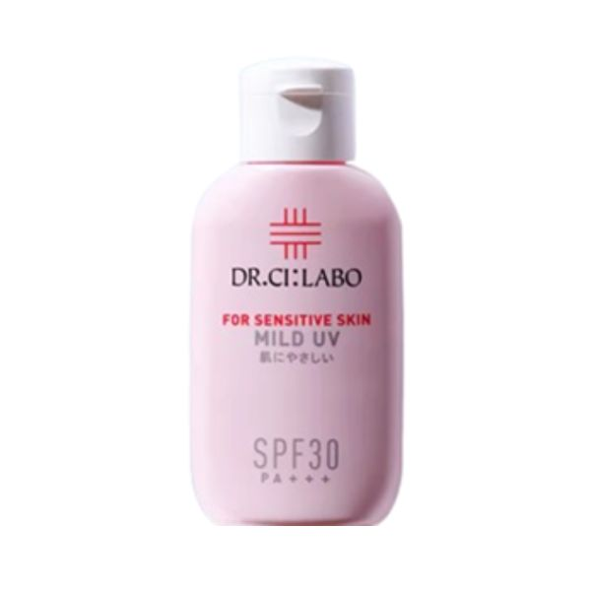
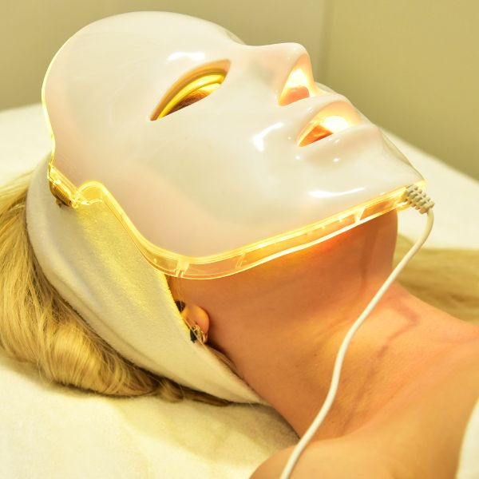
Blue light protection
A need for skin protection against environmental and digital stressors
In the US*
22%
of consumers look for blue light protection in suncare and skin protection products.
In India**
17%
of respondents expressed interest in trying skin brightening products with blue light protection
A growing consumer demand
Upgraded protection
Beauty devices
There is a growing consumer interest in products with blue light protection.
Many skincare products are now incorporating blue light protection as a key feature. These products often combine protection against blue light with other benefits such as UV protection, anti-pollution, and anti-aging.
Suncare products upgrade their protection.
For example, Dr.Ci: Labo Mild UV For Sensitive Skin SPF30 PA+++ combines 4 efficient protection features for the skin from:
Blue light emitted by screens
UVA to prevent spots, signs of aging and wrinkles
UVB to keep from getting tanned or sunburnt
Damages caused by near-infrared radiation.
Devices like LED light therapy are being used to manage skin tone and protect against blue light.
These devices are perceived as effective and safe, offering a trendy solution for skin tone concerns
* Mintel: Suncare and Skin Protection – US – 2025 - Topline Questions – Mintel 1,545 internet users aged 18+ who use sunscreen, or beauty or personal care products with SPF
** Mintel: Skintone Management – Indian Consumer – 2024 - Topline Questions - Mintel 2,569 Indian adults aged 18+ who have skin tone aspiration
3

Slide 4
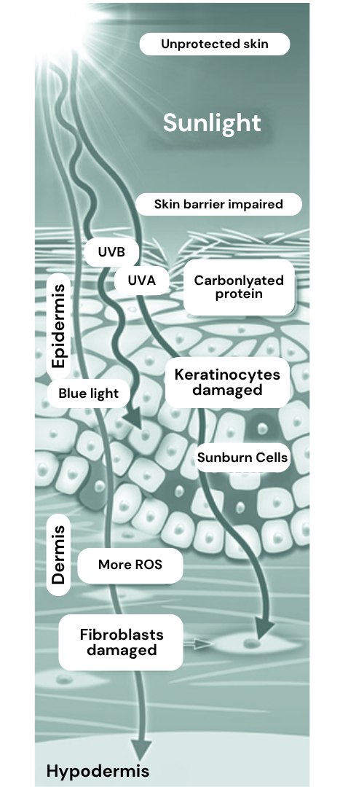
Blue light contributes to aging
Blue light penetrates deep into the skin, contributing
to short- and long-term skin aging
Skin hyper-pigmentation and dark spots
Premature aging of skin induced by oxidative stress
  increasing level of free radicals (Reactive Oxygen Species)
  generates carbonylated proteins, proteins losing their functionality (responsible for yellowish, brownish color)
Less production of collagen: the fibroblasts are damaged, losing their functionality in turn leading to accelerated aging (UVA adverse effect)
Skin barrier impaired: the keratinocytes are damaged, increasing number of sunburn cells (UVB adverse effect)
Other negative effects on human health caused by blue light:
Eye damage (retina, macular degeneration)
Exposure in late evening impact the circadian rhythm (suppress production of melatonin - prevent sleep)
Notes:
During the daytime, the light that comes into our eyes releases enzymes in the morning, bringing melatonin levels down and helping us wake up. A consistent cycle of rest and wake, regulated by melatonin, comprises our circadian rhythm
415-455nm range is the most harmful compared to range 380-400
POSITIVE EFFECT ON HUMAN HEALTH:
Regulate our sleeping patterns (to stay awake all day)
Acne care

Slide 5
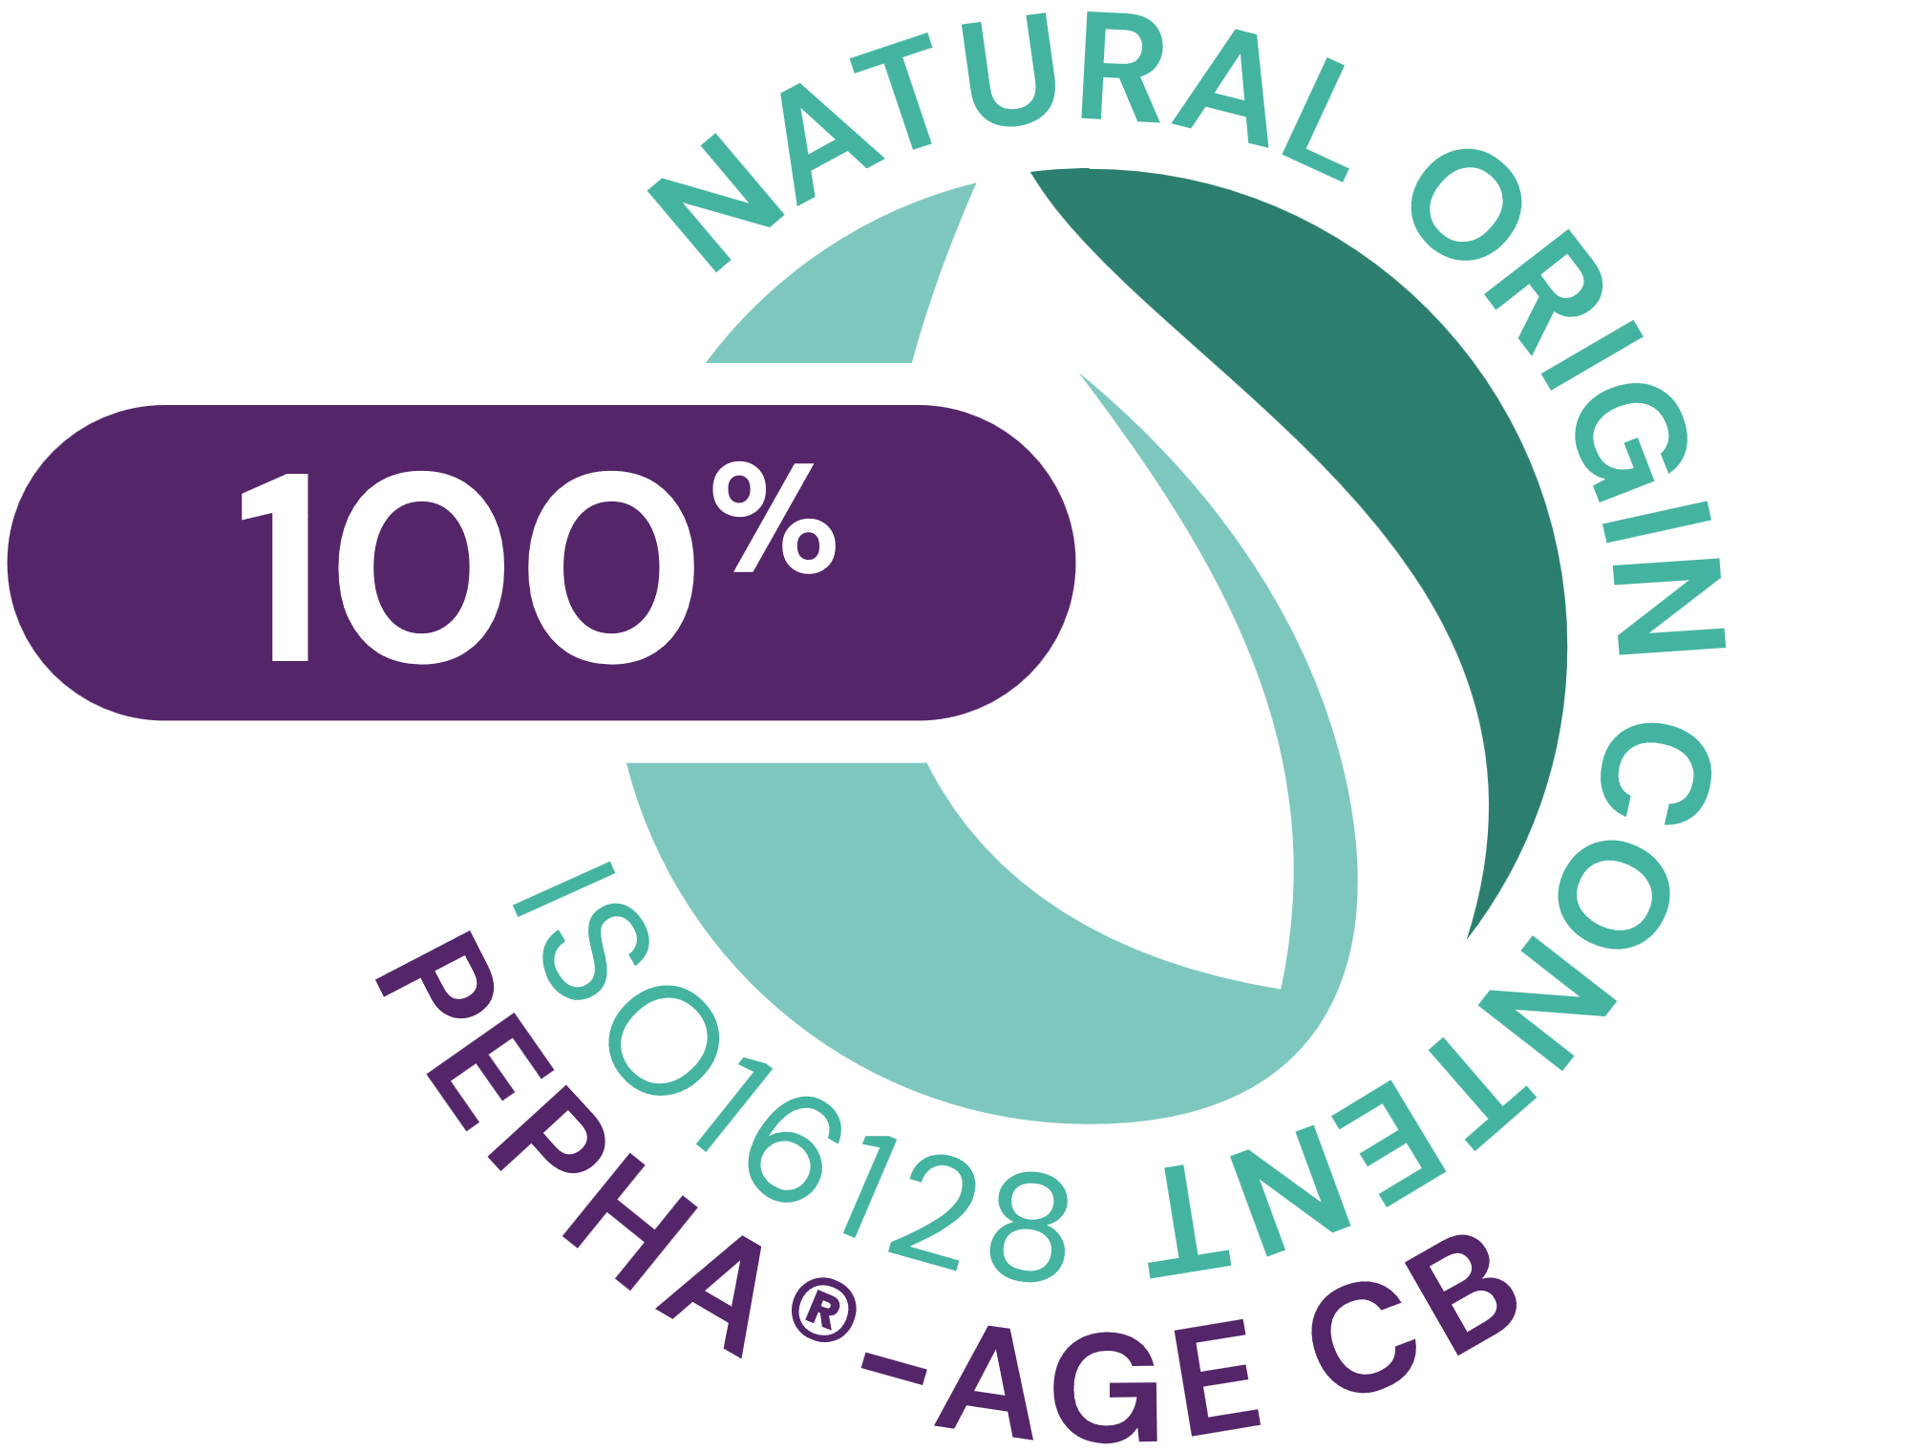




PEPHA®-AGE CB
ID Card
INCI name:
Scenedesmus Rubescens Extract, Aqua, Citric Acid, Pentylene Glycol
Sustainably farmed in photo-bioreactors, guaranteeing maximum quality (no risk of contamination, reproducibility of process, fully traceable
Derived from Scendesmus rubescens microalgae
100% naturally-derived origin (ISO 16128)
TECHNOLOGY:
Solubility: Soluble in water
Technical:
Form: Yellowish-brownish clear liquid
Use level: 1–3%
pH of use: 3.0 – 7.5
Preservative: Free
Prevents skin premature aging
Boosts skin’s own defenses against blue light*/**
Reduces blue light induced skin pigmentation (dark spots); evens skin tone***
Benefits:
Registration
certification
Raw material verified by ECOCERT GREENLIFE, conform to the COSMOS Standard
* in vitro ** ex vivo *** in vivo
Biotech | Nature, enhanced by science

Slide 6
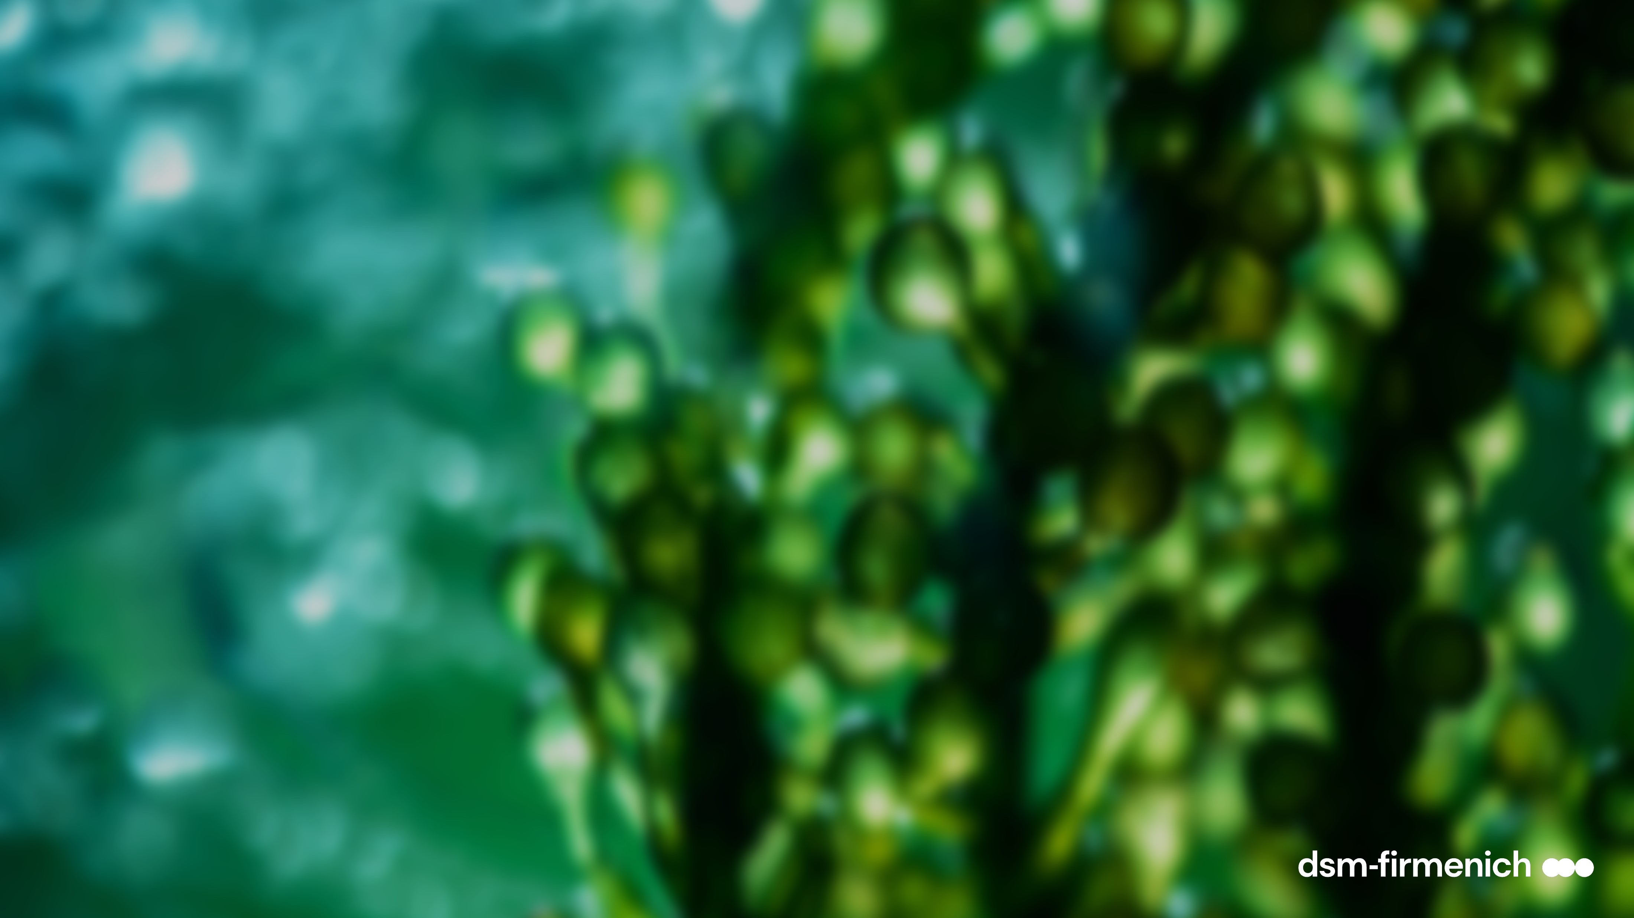
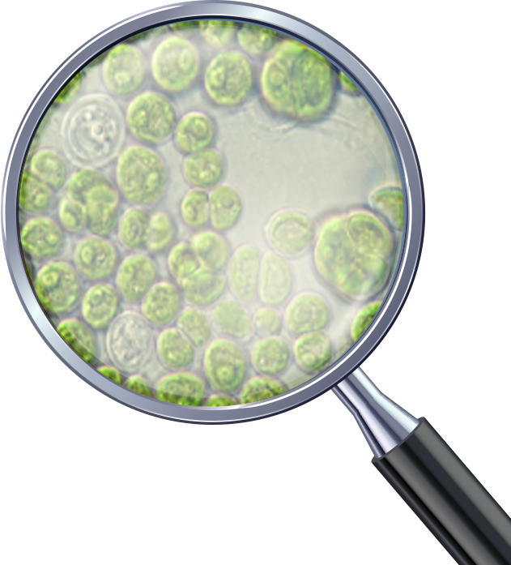
The algae
Scendesmus Rubescens
Selection of the most active micro-algae living in freshwater lakes, after a screening of several species
This unicellular organism (5 - 10 μm) has a very strong cell wall, the unique protection against harsh environment (sunlight, current, pollution), which releases an unique set of active components.
“rubescens” is coming from the latin name ruber (red) and escens (becoming). This specific species contains red dots, rich in carotenoids (compound known to absorb blue light, red lens scientifically blocks blue light)
This algae has a circadian cycle (growing with daylight and multiplying by cellular division in the dark
Biotech | Nature, enhanced by science
6
Notes:
Scenedesmus’ meaning comes from skene (tent) and demos (bind) as the algae has the tendency to be colonized (4 – 8 cells)

Slide 7
Offers a unique variety of relevant active ingredients
PEPHA®-AGE CB
Amino-acids
Several key amino acids (Proline, Glycine, Alanine, Arginine) stimulating collagen synthesis and boosting epidermal renewing (Glutamic acid).
Multifunctional Vitamin B3, plays a central role in cellular metabolism. Energy storage, for healthy skin barrier, even pigmentation, anti-oxidant for multi-functional anti-aging benefits.
Important mono and oligosaccharides relevant to stimulate cell proliferation and increase of extracellular matrix biosynthesis.
Zinc, trace element, essential cofactor for biosynthesis of bio molecules for the collagen synthesis.
Vitamins
Sugars
Minerals

Slide 8
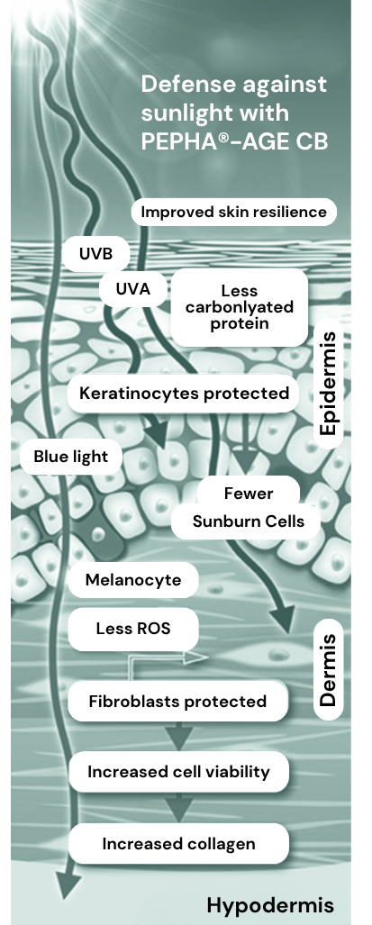
dsm-firmenich Solution: PEPHA®-AGE CB
Protects from blue light and UV skin damages
Ex vivo, PEPHA®-AGE CB: prevents skin premature aging
Protects against oxidative stress. Reduces free radicals (ROS) and carbonylated proteins levels after blue light exposure
In vitro / ex vivo PEPHA®-AGE CB: boosts the skin’s own defence
Stimulates fibroblasts viability and collagen production (collagen III) (in vitro & ex vivo)
Protects and repairs Fibroblasts viability against UVA exposure (in vitro)
Repairs the skin barrier function and protects Keratinocytes against UVB (ex vivo)
In vivo PEPHA®-AGE CB: evens skin tone
Reduces immediate blue light induced skin pigment darkening and dark spots
Reduces immediate blue light induced skin redness
Rebalances faster to skin normal pigmentation

Slide 9

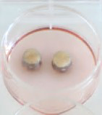
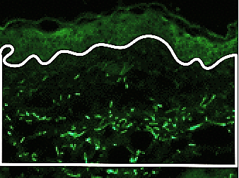
Premature skin aging
PEPHA®-AGE CB reduces blue light induced free radicals up to 35%
Significant reduction of ROS levels
(blue light 380-470 nm)
Topical treatment with products before
and after blue light irradiation 100J/cm2*
Skin biopsies in culture
Donor: 65-year-old female
***
*
After 24h analysis and quantification of fluorescent signal (green) corresponding to ROS
The ROS reduction leads to drop inflammation reactions and then to reduce skin irritation and redness
* Representing the natural dose of blue light you get within 2 hours from European midsummer sun
*** p<0.001 vs non irradiated, * p<0.05 vs irradiated blue light
Notes:
Evaluation of reactive oxygen species (ROS)
Following the paper of Marionnet et al (Plos One, 9. 2014) the detection probe DCFH-DA has been applied in the culture medium for 30 minutes before the irradiation. Dichlorofluorescein diacetate (DCFH-DA) reacts with ROS becoming fluorescent. After changing the medium, blue light irradiation (380-470nm, max at 420nm) has been applied. 24h post-irradiation, the skin samples are harvested, cryo-fixed and cut at the cryostat for subsequent image acquisition and analysis.
The analysis of fluorescence is performed within the dermis area. The analyzed area is selected from the upper part by following the perimeter of the basal lamina, to the deep dermis, by carefully avoiding the risk of including irregularities and agglomerates, such as blood vessels, sebaceous glands, hair follicles, etc.
For each skin sample two sections have been taken and fluorescent image acquired. For each image the upper dermis has been analyzed by evaluating the fluorescence through modified Image-J application (NIH, USA). The obtained value has been normalized upon the dimension of the selected area

Slide 10
Premature skin aging
PEPHA®-AGE CB reduces blue light induced carbonylated proteins up to 61%
Significant reduction of carbonylated protein levels (blue light 380-470 nm)
Skin biopsies in culture.
Topical treatment with products before and after blue light irradiation (100J/cm2).
Donor: 65-year-old female
*
*
***
Carbonylated proteins result from an irreversible oxidative damage and give a yellowish/brownish color to the skin
*** p<0.001 vs irradiated blue light; *p,0.05 vs irradiated blue light
10
Notes:
Analysis and quantification of carbonylated proteins with Western plot anti body detection (visualized by staining)
The modification of amino acids such as histidine, cysteine, and lysine in proteins to carbonyl derivatives is known as protein carbonylation. Oxidative stress triggers protein carbonylation. Carbonylated proteins are missing their functionality.
Evaluation of carbonylated proteins
Carbonylated proteins were extracted from tissues 48h post-irradiation with blue light (380-470nm, max at 420nm). After harvesting, the frozen skin samples have been weighted and minced. The skin samples for each tested condition have been pooled and processed together by homogenization in cold extraction buffer. Total cell lysates have been recovered by centrifugation.
Carbonylated proteins in skin samples have been determined by “OxyBlot Protein Oxidation Detection Kit” (Millipore, #S7150) according to the manufacturers instructions by western blot and chemiluminescence detection.
The extent of the carbonyl content obtained for each sample have been normalized on actin protein signal band.

Slide 11

Collagen stimulation
PEPHA®-AGE CB boosts cellular viability and enhances collagen by 34%
Stimulates the viability of human dermal fibroblasts
Induced total collagen synthesis in human dermal fibroblasts
Cellular viability was analyzed on primary normal human dermal fibroblasts by MTT method after 48 h treatment
Total collagen content was quantified by Sirus Red staining after 48 h treatment.
*
**
**
**
*
Mean± SD; t-test significance
* p<0.05;
** p<0.01 vs control
* p=0.07 vs control by t-test
Scenedesmus dry extract (%)
Scenedesmus dry extract (%)
PEPHA®-AGE CB, at low concentration, stimulates in vitro total collagen up to 34% to reduce visible signs of sunlight induced ageing
Notes:
Scenedesmus dry extract = 2,5% PEPHA®-AGE CB (concentration has to be multiplied by 40)

Slide 12
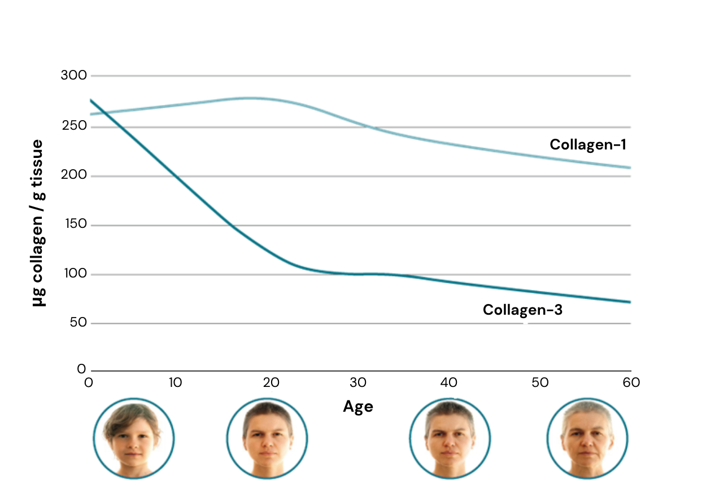
Collagen III (youth collagen) 29% production boost
PEPHA®-AGE CB
Collagen III dramatically decreases with age
Collagen III stimulation with PEPHA®-AGE CB
**
+29%
*
+21%
+10%
Scenedesmus rubescens
dry extract (%)
Comparison of daily topical treatments versus DMSO at day 6.
Mean value ± SEM;*p<0.05,
** p<0.01 vs vehicle control by t-test
Test samples and control (4 µl) were topically applied on human skin biopsies (Ø 8 mm)
for 6 days, donor: 43 years old Immunohistochemical staining of Collagen type III
PEPHA®-AGE CB significantly strengthens the dermis and reduces visible sign of sunlight induced ageing

Slide 13
PEPHA®-AGE CB protects and regenerates fibroblasts
Viability before and after UVA exposure
Cellular protection
Cellular regeneration
PEPHA®-AGE CB: Treatment 1h before UVA
PEPHA®-AGE CB: Treatment 1h after UVA
*
Scenedesmus rubescens dry extract (%)
* p<0.05 vs control by t-test
Scenedesmus rubescens dry extract (%)
Cellular viability was measured
48 h after UVA irradiation
(20 J/cm2) using human dermal fibroblasts
PEPHA®-AGE CB protects the fibroblasts (up to 50%) from UV stress and regenerates the fibroblasts functionality (up to 200 %) after UV stress.

Slide 14
Skin barrier repair
PEPHA®-AGE CB reduces the number of sunburn cells by 63% against UVB
***
Protection of keratinocytes
Sunburn cells are keratinocytes undergoing programmed cell death (apoptosis) after they have received
a UVB dose that irreversibly and severely damaged their DNA.
An increasing number is a key indicator for ongoing damage
in the epidermis.
-21%
-24%
-37%
**
Comparison of treatments versus DMSO at day 2 Mean value ± SEM;
** p<0.01 vs DMSO; *** p<0.001 vs noUV by (unpaired t-test)
Test samples and control were topically applied on human skin biopsies
24 h and 1 h prior UVB irradiation
(1 J/cm2) against standard market product SPF 50+
PEPHA®-AGE CB protects skin against sunlight induced epidermal damage
*** p<0.001 vs no UV by t-test
** p<0.01vs vehicle by t-test

Slide 15
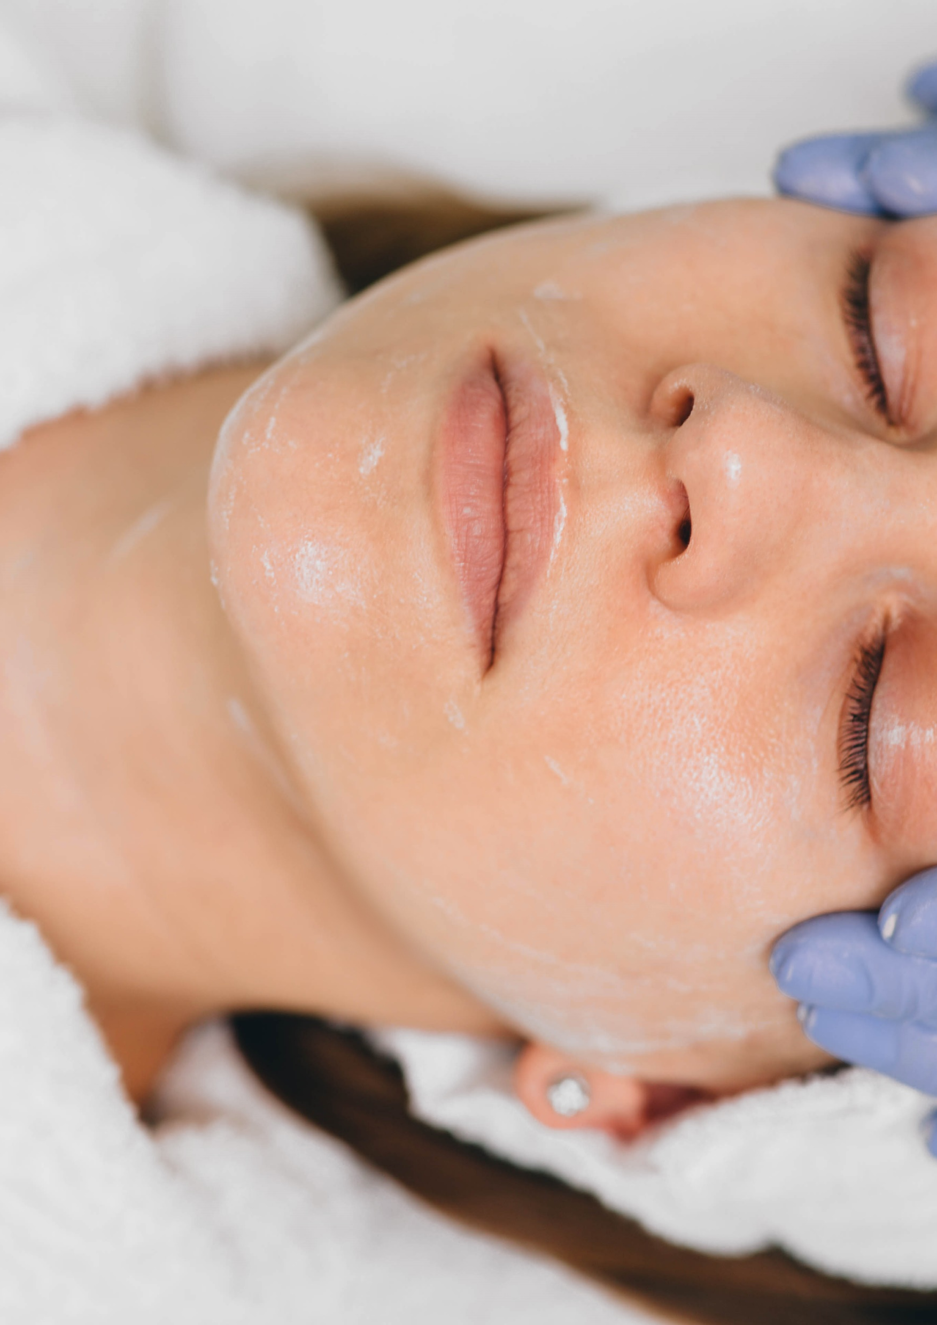

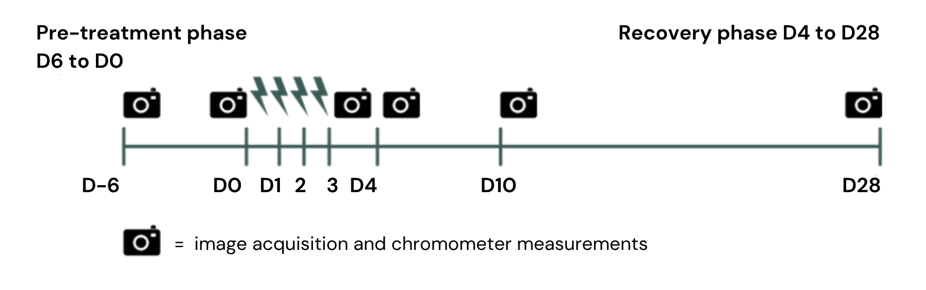
PEPHA®-AGE CB blue light
in vivo study design
33 female volunteers (mean 32 years old, Caucasian 80% and Asian skin 20%)
Randomized double blind with placebo
Cream formulations with 3% PEPHA®-AGE CB (without sun filter)
Forearm application once a day for 34 days (application started 6 days before blue light exposure to strengthen the skin)
Exposition 4 days consecutively on forearm with LED lamp at 450nm with 60J/cm2*:
Skin color measurements (chromameter) and Image analysis
* natural dose you get within one hour from European midsummer sun)
Biotech | Nature, enhanced by science
15
Notes:
Study for 28 days in Mauritius
21 - 41 years old (mean 32, mainly millennials)
Exposition on forearm (4x6cm)
450 nm (peak in blue light with LED and electronic devices)
Application of PEPHA®-AGE CB during 6 days before blue light exposure to strengthen the skin by pre-conditioning it and continuing all along the study

Slide 16
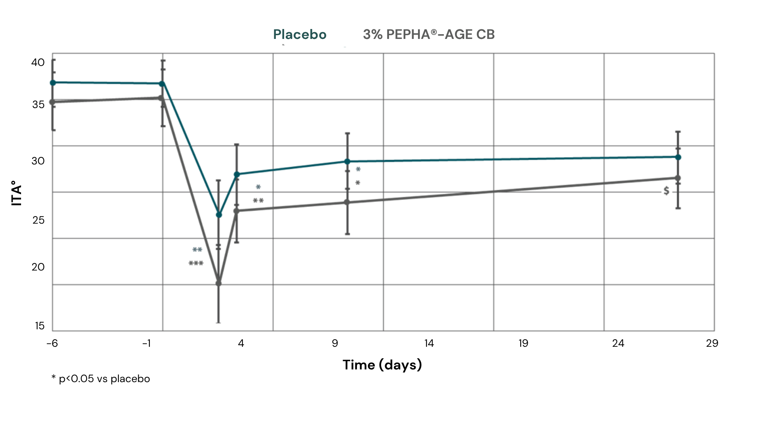
Skin darkening
PEPHA®-AGE CB reduces blue light induced immediate skin hyper-pigmentation by 30%
Colorimetry ITA° angle
PEPHA®-AGE CB proves to be highly effective against hyper-pigmentation:
Immediate reduction of skin pigment darkening (-30%)
Rebalance faster to skin normal pigmentation
Restores even skin tone
ITA° is inversely correlated with skin pigmentation: the lower the ITA value, the darker the skin
Colorimetry ITA angle, ITA° takes into account 2 parameters: luminance (L*) and yellow-blue tone (b*).
Notes:
Reminder: at D4, not anymore blue light irradiation

Slide 17
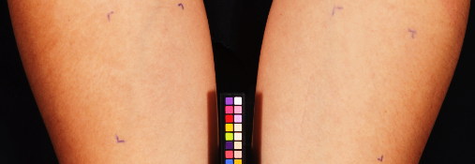
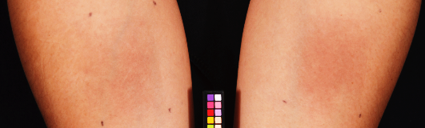
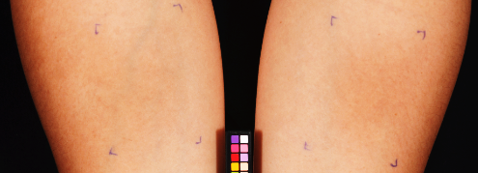
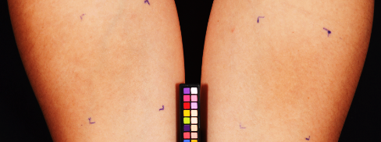
Reduces blue light induced skin pigment darkening
PEPHA®-AGE CB
RD012 right
3% PEPHA®-AGE CB
D0
RD012 left
Placebo
RD012 right
3% PEPHA®-AGE CB
D3
RD012 left
Placebo
Skin coloration: ITA°
35.4
34.4
28.6
17.3
RD012 right
3% PEPHA®-AGE CB
D4
RD012 left
Placebo
RD012 right
3% PEPHA®-AGE CB
D10
RD012 left
Placebo
31.0
24.3
32.8
27.0
Volunteer 12 – ITA° - left forearm with placebo and right with 3% PEPHA®-AGE CB

Slide 18
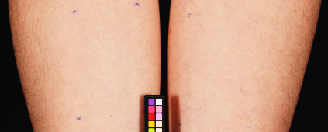
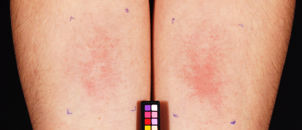
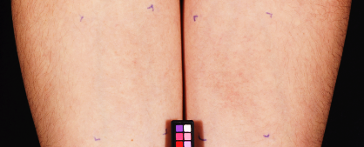
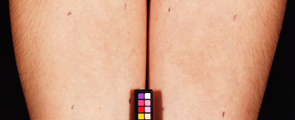
Reduces blue light induced redness
PEPHA®-AGE CB
RD013 right
3% PEPHA®-AGE CB
D0
RD013 left
Placebo
RD013 right
3% PEPHA®-AGE CB
D3
RD013 left
Placebo
Skin coloration
a* value
7.1
6.9
10.4
13.4
RD013 right
3% PEPHA®-AGE CB
D4
RD013 left
Placebo
RD013 right
3% PEPHA®-AGE CB
D10
RD013 left
Placebo
8,1
11.6
7.9
8.7
Volunteer 13 – left forearm with placebo and right with PEPHA®-AGE CB a higher a* value a higher redness

Slide 19
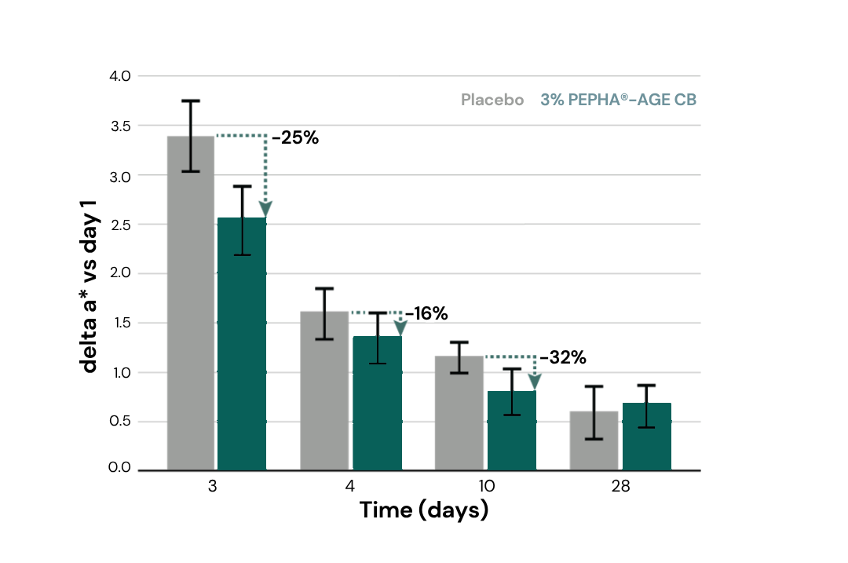
Reduces blue light induced redness
30% reduction of blue light induced skin redness with PEPHA®-AGE CB
PEPHA®-AGE CB protects the skin against immediate irritation induced by blue light.
The skin color is less red (-25% with 3% PEPHA®-AGE CB compared to placebo) just after 4 days blue light irradiation
Redness: a* value (delta to do) normalized to placebo

Slide 20
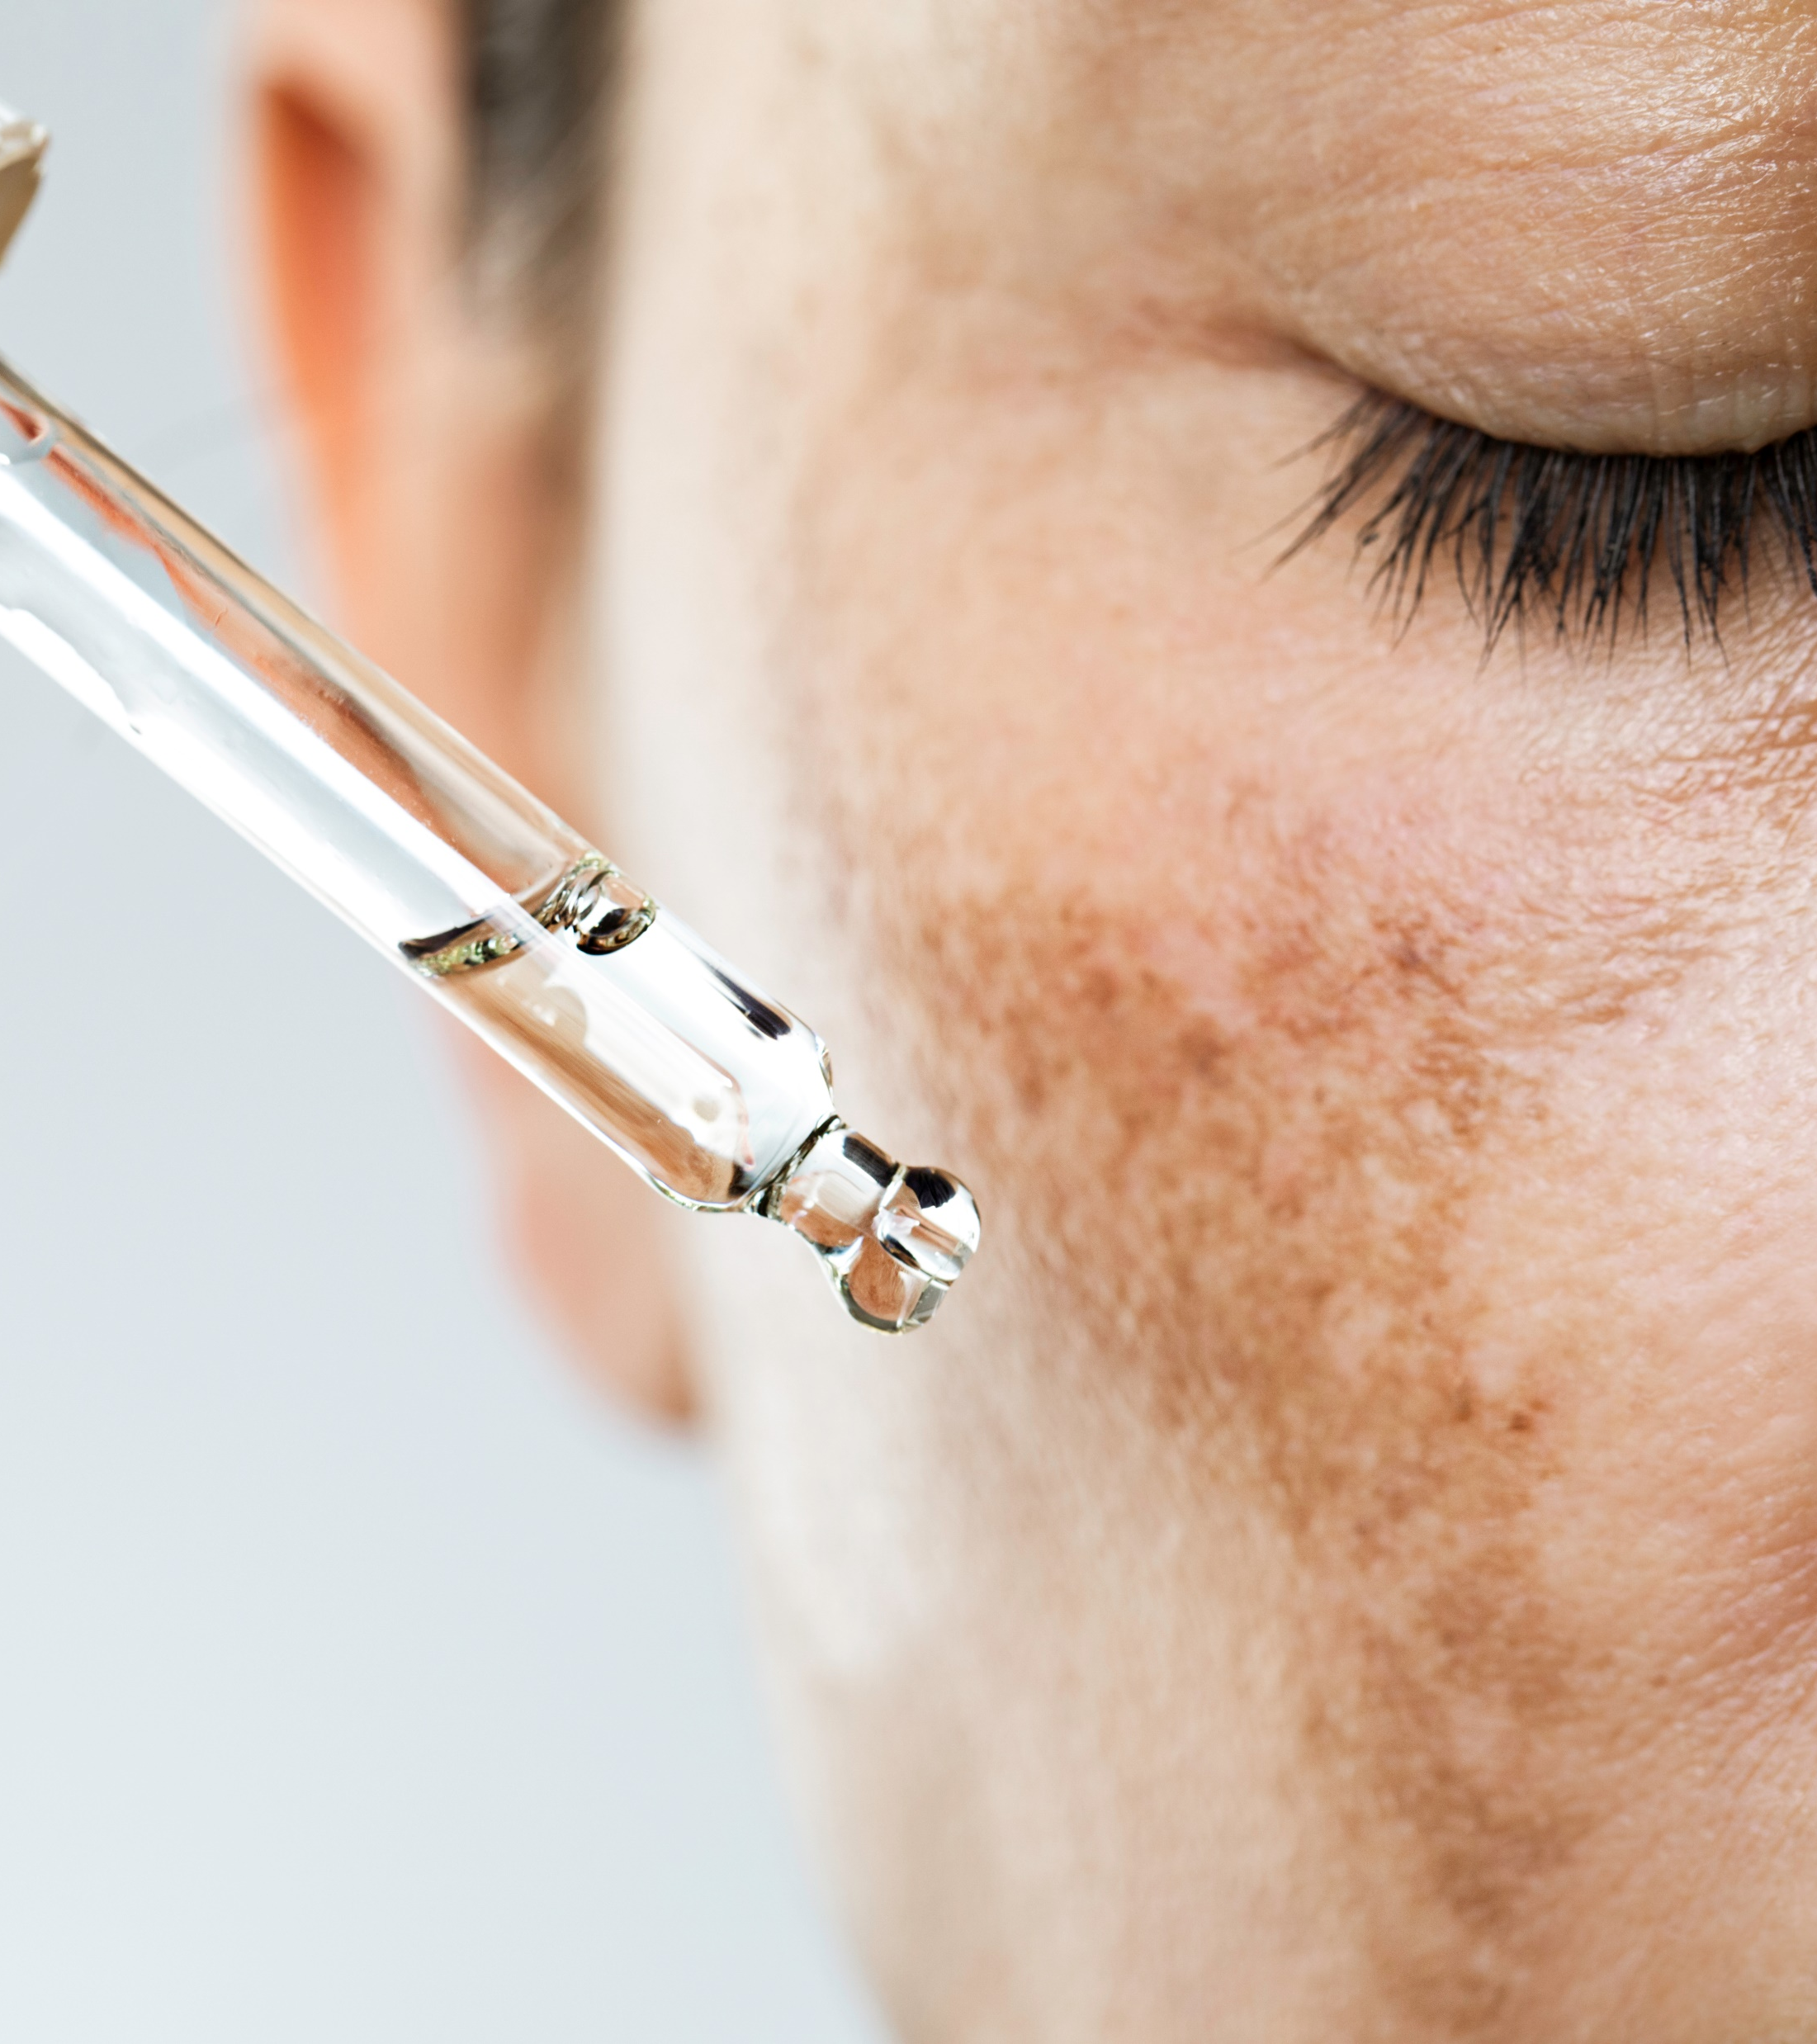
Formulation Guidelines
PEPHA®-AGE CB
INCI name (active): Scenedesmus Rubescens Extract
Clear yellow-brownish to brown liquid
Stable at pH ranges from 3.0 to 7.5
Should be processed below 40°C
Suggested concentration: 1–3 %
Cosmetic application
Day care products
Sun care and after sun formulations
Regenerative night care
Anti-aging products
Biotech | Nature, enhanced by science

Slide 21
PEPHA®-CTIVE
Supported marketing claims
Minimizes the appearance of ageing after exposure to blue light and UV
Reduces skin damage caused by natural and artificial blue light sources
Improves overall skin appearance and offers an even skin tone

Slide 22
Disclaimer
Copyright © DSM Nutritional Products Ltd 2025, 4002 Basel, Switzerland.
www.dsm-firmenich.com. All rights reserved.
dsm-firmenich has used diligent care to ensure that the information provided herein is accurate and up-to-date to the best of its knowledge. However, dsm-firmenich makes no representation or warranty, either expressly or implied, of the accuracy, reliability, completeness, or suitability thereof. The information provided herein contains scientific and product information for business-to-business use and does not constitute or provide scientific or medical advice, diagnosis or recommendation for treatment options. Country or region-specific information should be considered when labelling or advertising to final consumer. In no event shall dsm-firmenich be liable for any direct or indirect damages arising from or reliance upon, or use of, any information provided herein. The content of this document is subject to change without further notice. Please contact your local dsm-firmenich representative for the latest information. All trademarks listed in this document are either (registered) trademarks of, or trademarks licensed by, the dsm-firmenich group of companies, unless explicitly stated otherwise.
Disclaimer Formulation Guideline
The information provided herein is provided for information purposes only and has been prepared by dsm-firmenich in accordance with its own methodology.
dsm-firmenich has used diligent care to ensure that it is accurate and up-to-date, however, dsm-firmenich makes no representation or warranty, either expressly or implied, of the accuracy, reliability, or completeness thereof. In no event shall dsm-firmenich be liable for any damages arising from or reliance upon, or use of, any information provided herein. Further, dsm-firmenich shall not bear any liability for the application and/or use of any processed material containing its product(s). The formulation of the finished product is the customer’s sole responsibility. It is the customer’s responsibility to determine the suitability of dsm-firmenich’s products regarding user specific purposes, assess compatibility and stability of their finished product(s) and to ensure compliance of their finished product(s) with relevant laws and regulations. Any product, marketing or other claims made by customer are its sole responsibility. The content of this document is subject to change without further notice. Please contact your local dsm-firmenich representative for further details. © 2025 dsm-firmenich group.

Slide 24
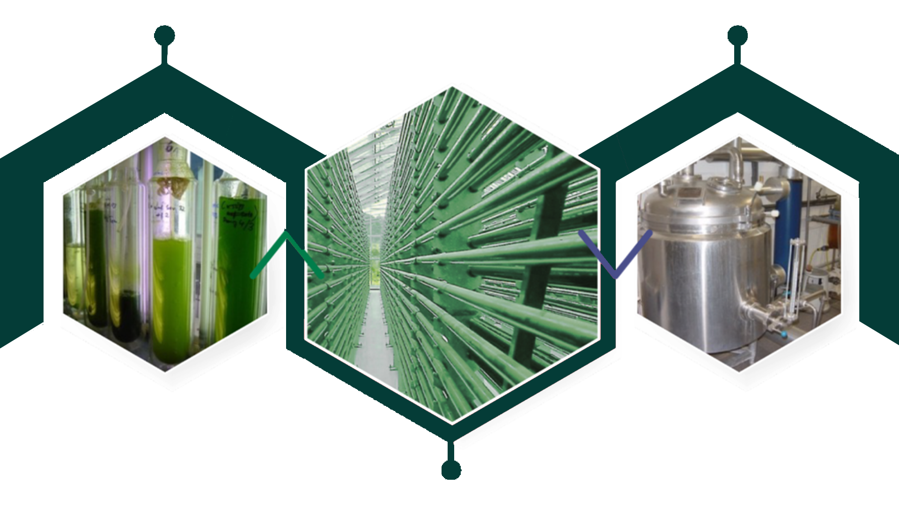
The production process
A special growth by photobioreactors, for maximum quality & sustainability
Preculture
Hot water
extraction
Maximizes the optimal
growth conditions by
providing sufficient light and minimizes the contamination risk: purity, high quality and high content of active substances are ensured
Enables standardization
Respects biodiversity
High level of renewable sources of energy
Cultivation in huge
photobioreactor

Slide 25
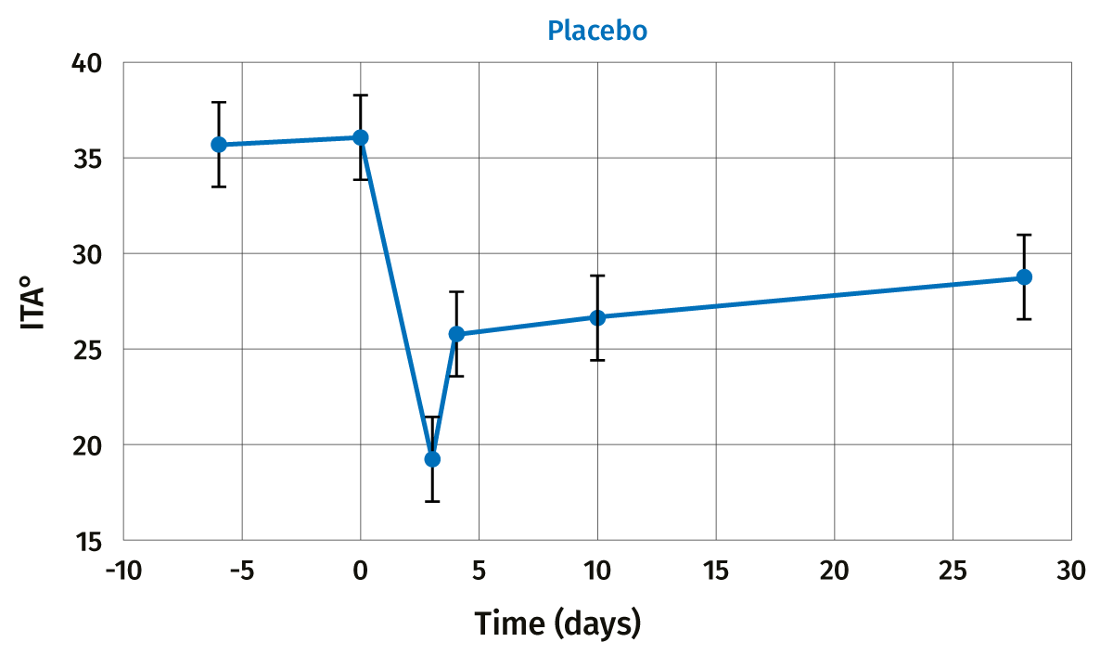
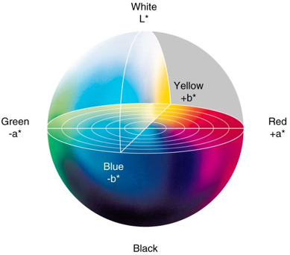
Skin Darkening
Blue light irradiation provokes immediate pigment darkening
Measurements of pigment darkening
Colorimetry ITA angle, ITA° takes into account 2 parameters of the color: the luminance (L*) and the yellow-blue tone (b*).
It is inversely correlated with skin pigmentation: the lower the ITA value, the darker the skin
Placebo
ITA°
$ p<0.1
* p<0.05
** p<0.01
*** p<0.001
all vs baseline day 0
Time (days)
Blue light irradiation for 4 days darkens immediately and significantly the skin (strong coloration -15°ITA)

Slide 26
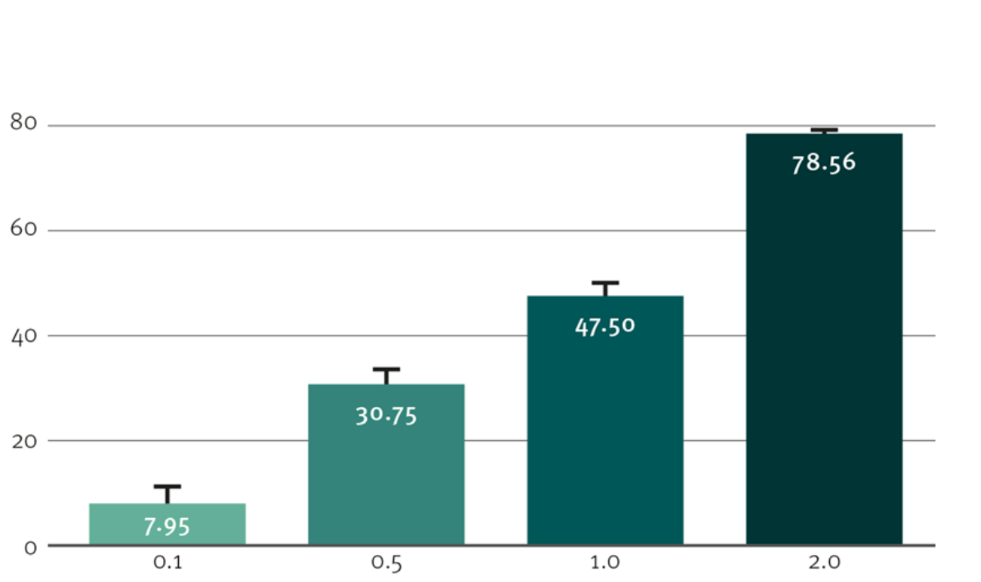
PEPHA®-AGE CB Inhibited tyrosinase activity
Activity of mushroom tyrosinase (Sigma) as a function of Scenedesmus extract concentrations determined based on the enzymatic conversion of L-DOPA to dopachrome:
PEPHA®-AGE CB helps to reduce blue light induced hyperpigmentation to achieve an even skin tone
Tyrosinase Inhibition (% vs control)
Scenedesmus rubescens dry extract (%)

Slide 27
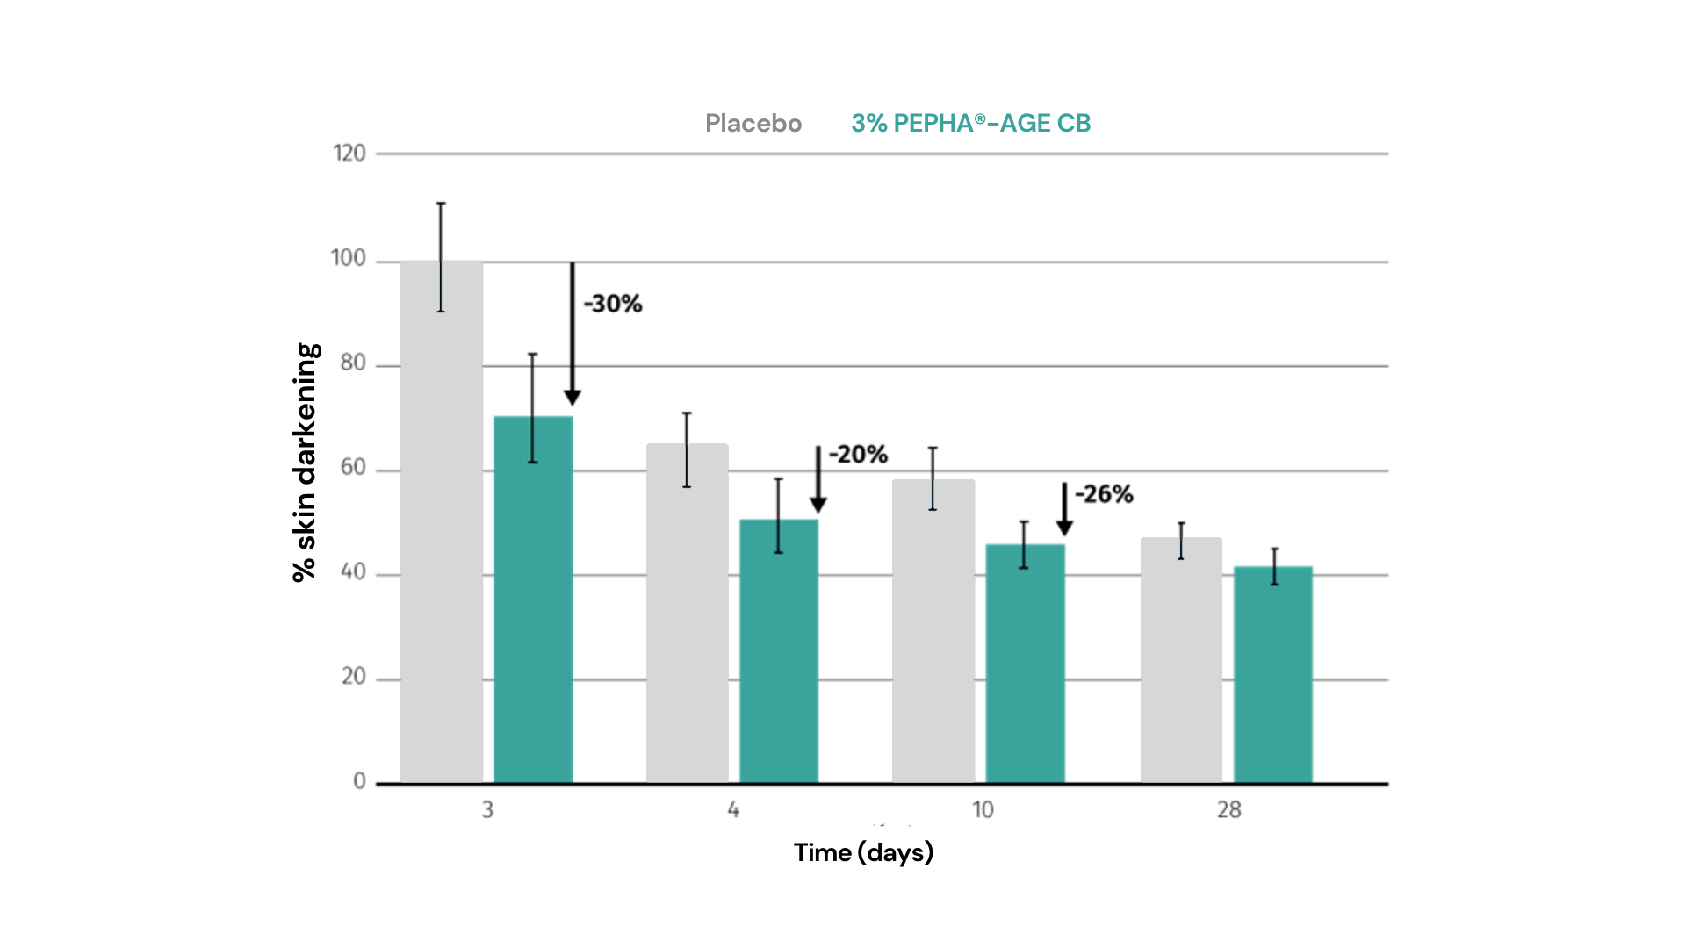
Skin Darkening
PEPHA®-AGE CB reduces blue light induced immediate skin hyper-pigmentation by 30%
PEPHA®-AGE CB protects the skin better than placebo:
Immediate reduction of skin pigment darkening (-30%)
Rebalance faster to skin normal pigmentation
Provides even skin tone
Colorimetry ITA° angle (delta to D0), normalized to 100% with placebo at D3
Reminder: at D4, not anymore blue light irradiation
* p<0.05 vs placebo

Slide 28
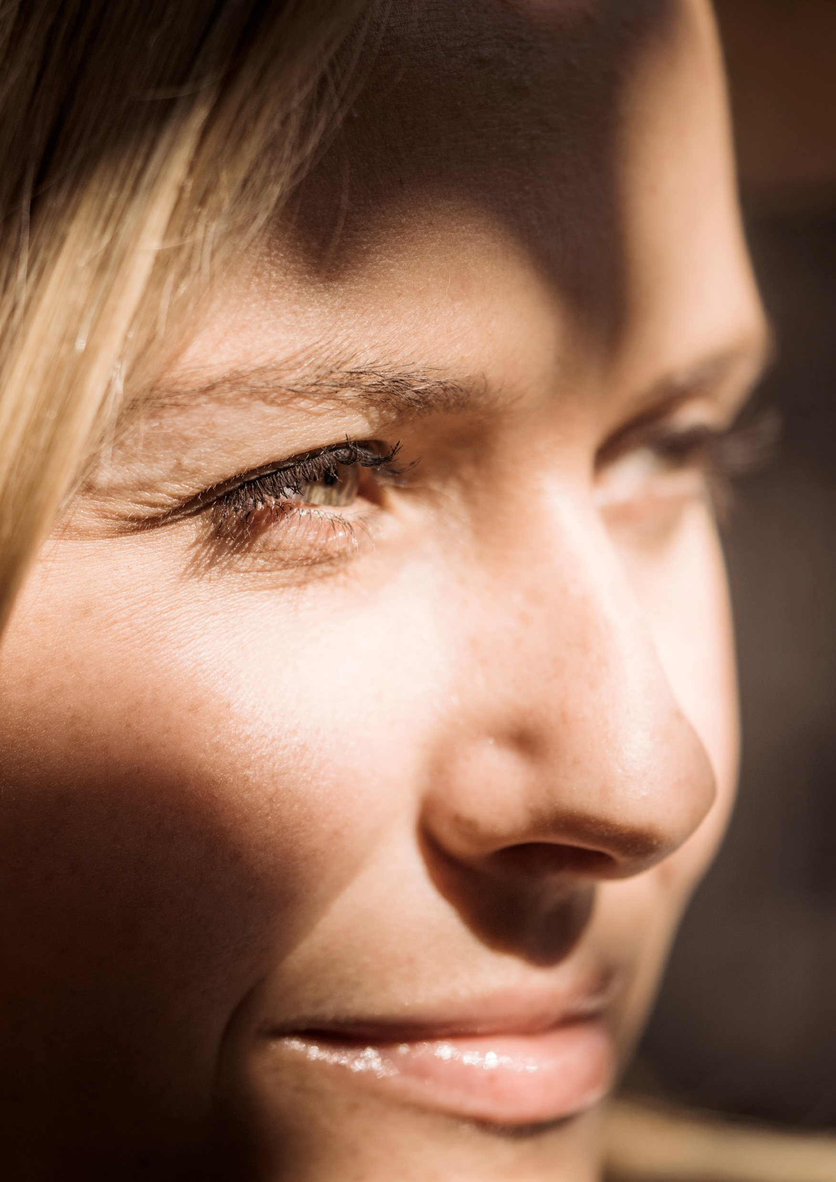
Going beyond on blue light protection
In vivo efficacy
To complement PEPHA®-AGE CB activity on blue light…
In vivo efficacy
You might consider adding these ingredients for full protection…
Sun filters
„blocking also blue light“ beyond UV protection
Key active: PARSOL® Max and PARSOL® TX
Vitamins: Anti-oxidant
Counteracts oxidative stress at skin surface
Key active: Niacinamide PC and Tocopherol
Nutraceuticals
Carotenoids, lutein and Zeaxanthin, as blue light absorbers
Key active: FloraGLO Lutein
Biotech | Nature, enhanced by science

