Slide 1

June 2025

Slide 2

Algae are becoming a major skincare ingredient…
Biotech | Nature, enhanced by science
2

Slide 3
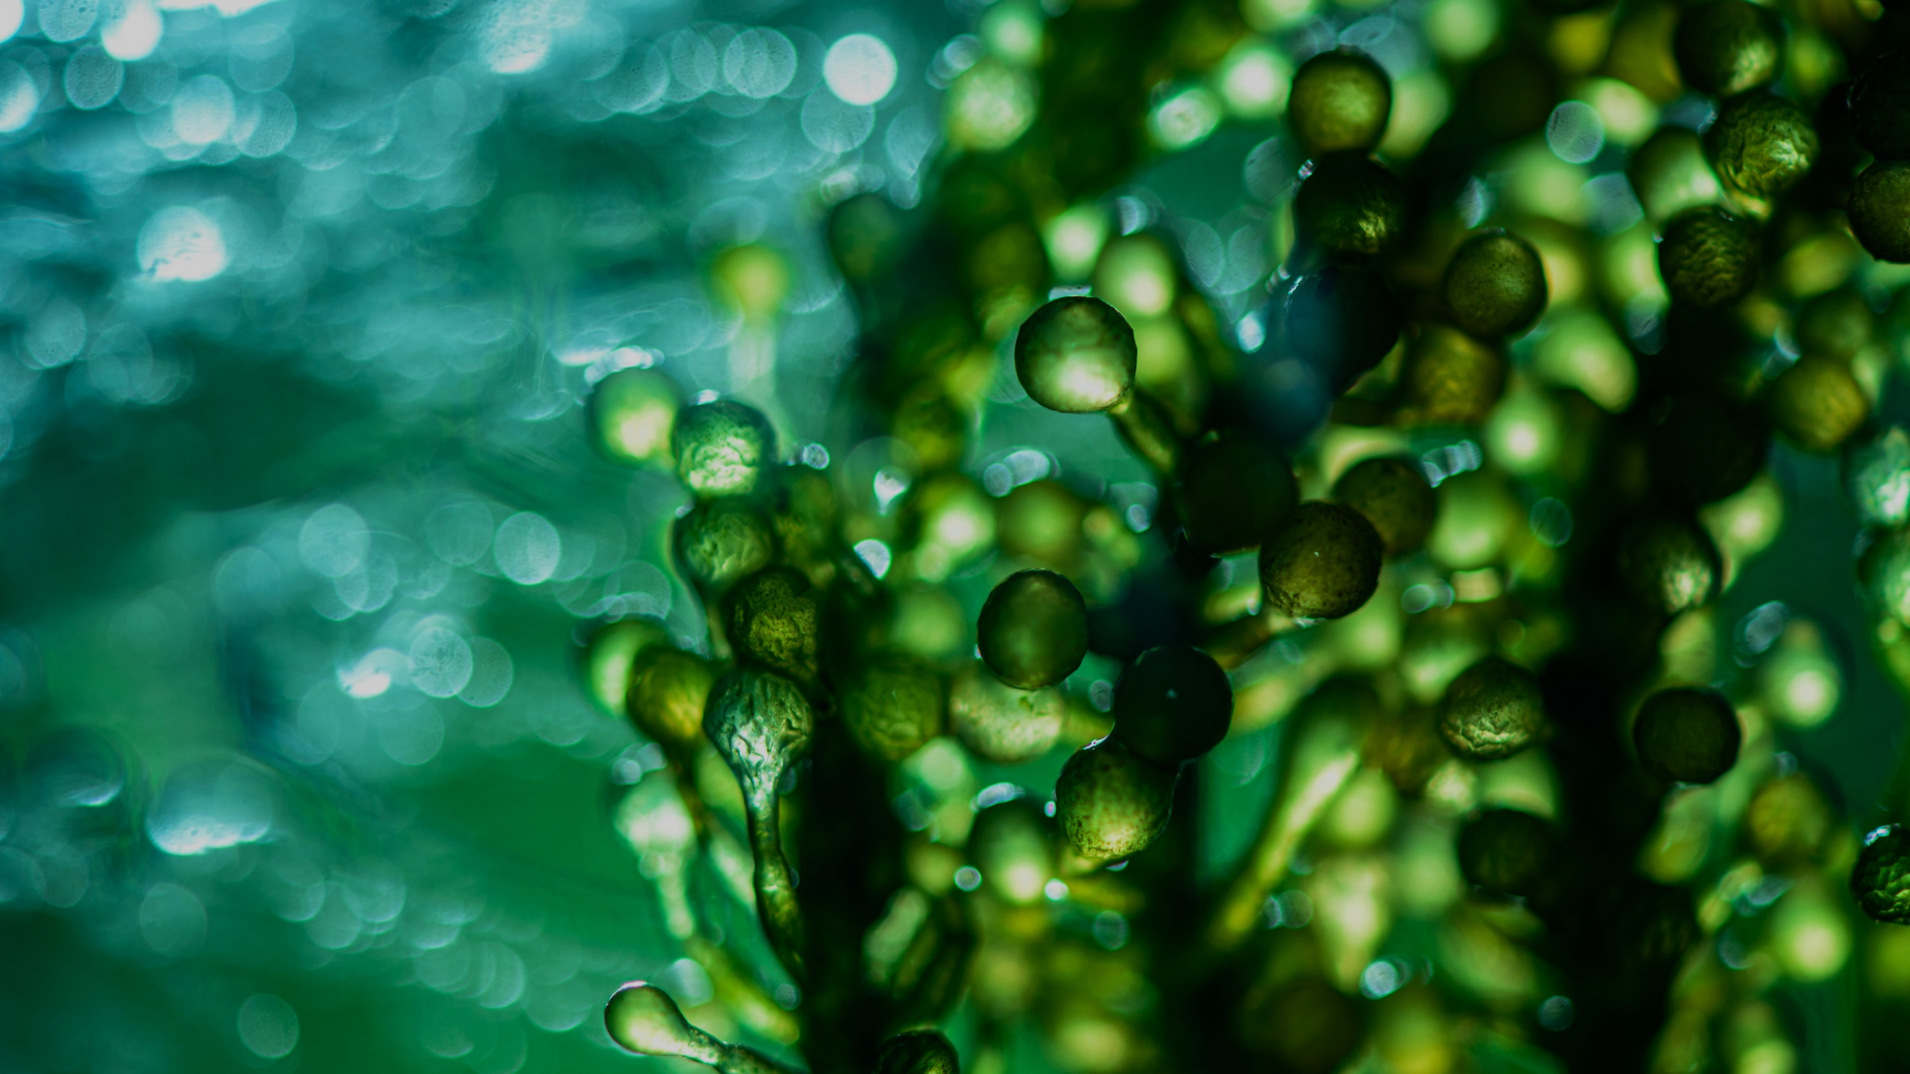

A story of natural resilience
Oldest plant surviving geological ordeals
ALGAE
Very stable, resistant and resilient organisms
For thousands years, microalgae has been able to survive under the
stress of different environments
More than 70% of the earth
is covered by water.
It provides many unique environments and
rich resources.
Rich in nutrients, like Vitamins & Minerals
Source of effective Bioactives
for pharmaceuticals, nutraceuticals and skincare
Biotech | Nature, enhanced by science
3

Slide 4

A major ally for the skin!
The skincare benefits of algae are well-known
Algae are superfood for healthy looking skin!
An abundant source of amino acids, vitamins, minerals, antioxidants and essential fatty acids.
They are known and proven to provide a wide range of highly sought-after skincare benefits, including skin firming, restoration and boosting of Collagen synthesis, skin radiance and protection from blue light which causes skin hyperpigmentation and redness.

Slide 5
Algae keeps buzzing in latest skincare innovation
A dynamic and attractive solution for brands & consumers
Uncover the potential of emerging marine beauty
Younger consumers' positive perception
Key industry players feature & claim “algae” in latest innovations
Despite ongoing consumer interest, the use of marine ingredients remains relatively small.
However, the segment has grown in key beauty markets such as France, the US and the UK in recent years, indicating promising expectations for expansion.
Marine ingredients have been gaining more attention in beauty products.
This is especially so among younger consumers, more of whom perceive these ingredients positively (30% of US consumers aged 25-34 find them effective compared to only 9% of those aged 65+.
Algae remain a popular ingredient claimed by brands across the globes from key industry players. Mainly claimed by botanical & marine brands.
Social media data indicates that global consumers primarily associate marine ingredients with keywords such as health, natural, vitamins and hydration.
Sources: Mintel GNPD (algae/kelp/seaweed; total), April 2019-March 2024
Kantar Profiles/Mintel, November 2023 / US: 1,970 internet users aged 18+ who have used BPC products in the past 12 months
Mintel GNPD Face/Neck Innovations featuring & claiming “algae” in the last 5 yrs / Infegy Atlas/Mintel, April 2021-March 2024
5

Slide 6
Ticking the box of naturality and sustainability
Consumers are seeking natural and ethical ingredients
In the US
In the UK
In Spain
of facial skincare users say it is important for their products to ﻿contain natural ingredients
of Gen Z beauty users always look for products that are environmentally friendly
of ﻿adults would be willing to buy BPC made exclusively with lab-grown ingredients if they are better for the planet
41%
58%
51%
Lab-grown is the next-natural in sustainability
Algae can be lab-grown, the key to true sustainability as we reassess our relationship with oceans and planet.
Consumers will be accepting of lab-grown alternatives, perceived as natural and sustainable.
Source: Lightspeed/Mintel
Notes:
Algae also tick the box of naturality and sustainability, which are the must-have for conscious consumers
Consumers start understanding that natural doesn’t mean necessarily sustainable and lab-grown solutions are becoming the next natural in sustainability, because they allow preserving the biodiversity of the environment

Slide 7



dsm-firmenich PEPHA® CB Range: 3 products & skin benefits
The power of algae for healthy-looking skin
PEPHA®-TIGHT CB
Skin tightening
PEPHA®-CTIVE CB
Skin energizing
PEPHA®-AGE CB
Skin protection

Slide 8
dsm-firmenich PEPHA® CB Range
PEPHA®-TIGHT CB
PEPHA®-CTIVE CB
PEPHA®-AGE CB
SKIN BENEFIT
Immediate¹ & long-lasting tightening and firming
ORIGIN
100% naturally-derived origin (ISO 16128)
Derived from Nannochloropsis oculata microalgae and high performing polysaccharide
BIOTECH
Sustainably farmed in photo-bioreactors, guaranteeing maximum quality (no risk of contamination, reproducibility of process, fully traceable)
Polysaccharides obtained from natural fermentation of tapioca starch
DEMONSTRATED EFFICACY
In vitro Stimulates fibroblasts’ proliferation and Collagen-I; Protects the skin against oxidative stress and urban dust
In vivo Short-term Flawless skin after 1 application. Long-lasting lifting result up to 12hrs, already with 2 applications. Long-term With regular usage wrinkles reduction by over -20%
RECOMMENDED DOSAGE 1–5%
INCI Nannochloropsis oculata extract, Pullulan - China listed
SKIN BENEFIT
Energizes skin for revived, glowing complexion
ORIGIN
100% naturally-derived origin (ISO 16128)
Derived from Dunaliella salina microalgae
BIOTECH
Sustainably farmed in photo-bioreactors, guaranteeing maximum quality (no risk of contamination, reproducibility of process, fully traceable). Cultivated in controlled conditions, optimally exposed to the right cellular stress: high salinity, high light intensity, nutrient deprivation, and extreme temperatures
DEMONSTRATED EFFICACY
In vitro Protects the mitochondria against oxidative stress; Increases the energy content in keratinocytes; Stimulates fibroblasts’ proliferation
In vivo Induce faster skin renewal and visibly improves skin’s luminosity
RECOMMENDED DOSAGE 1–3%
INCI Dunaliella salina Extract - China listed
SKIN BENEFIT
Protects from blue light and UV skin damages
ORIGIN
100% naturally-derived origin (ISO 16128)
Derived from Scenedesmus rubescens microalgae
BIOTECH
Sustainably farmed in photo-bioreactors, guaranteeing maximum quality (no risk of contamination, reproducibility of process, fully traceable)
DEMONSTRATED EFFICACY
In vitro & ex vivo Prevents skin premature aging; Boosts skin’s own defenses against blue light
In vivo Reduces blue light induced skin pigmentation (dark spots); evens skin tone
RECOMMENDED DOSAGE 1–3%
INCI Scenedesmus rubescens Extract
¹ Based on dsm-Firmenich clinical study where improvements in skin smoothness and texture homogeneity were detected already within 15min from 1st product application

Slide 9
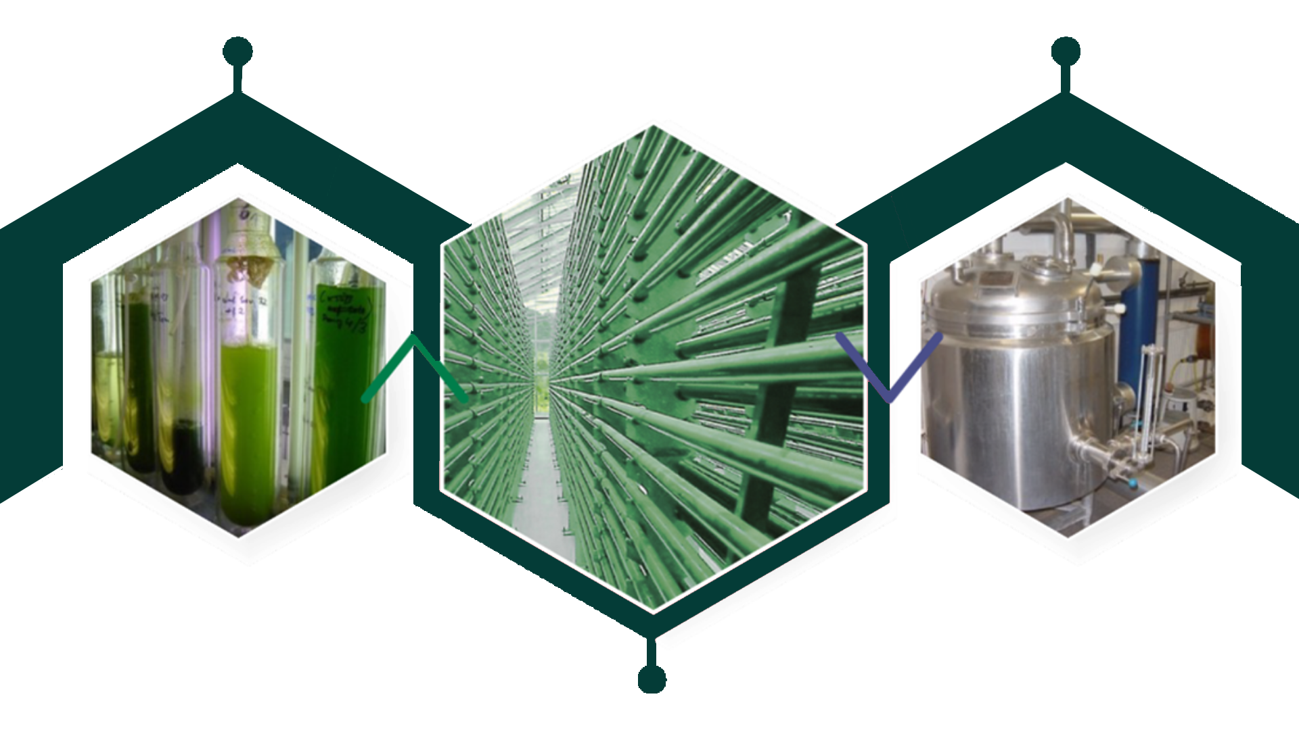
The production process
A special growth by photobioreactors, for maximum quality & sustainability
Preculture
Hot water
extraction
Maximizes the optimal
growth conditions by
providing sufficient light and minimizes the contamination risk: purity, high quality and high content of active substances are ensured
Enables standardization
Respects biodiversity
High level of renewable sources of energy
Cultivation in huge
photobioreactor

Slide 10
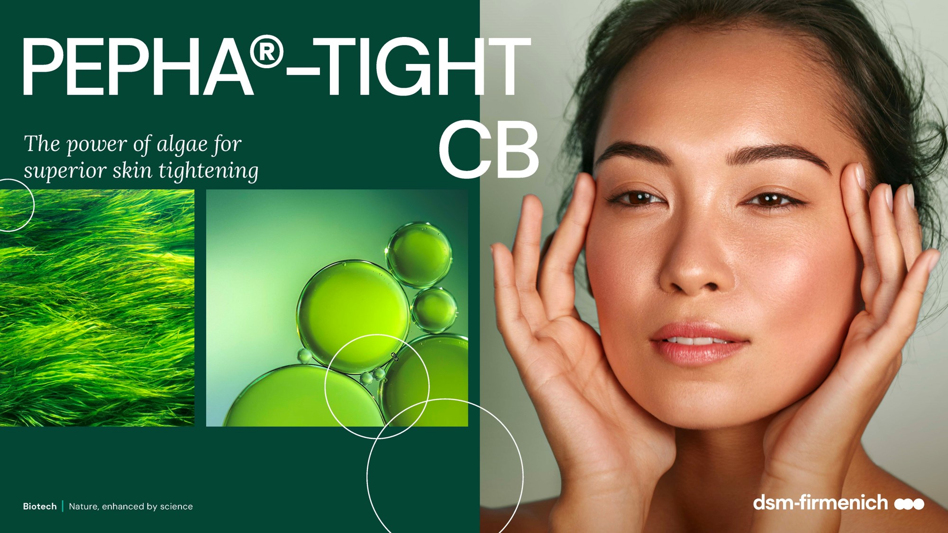

Slide 11
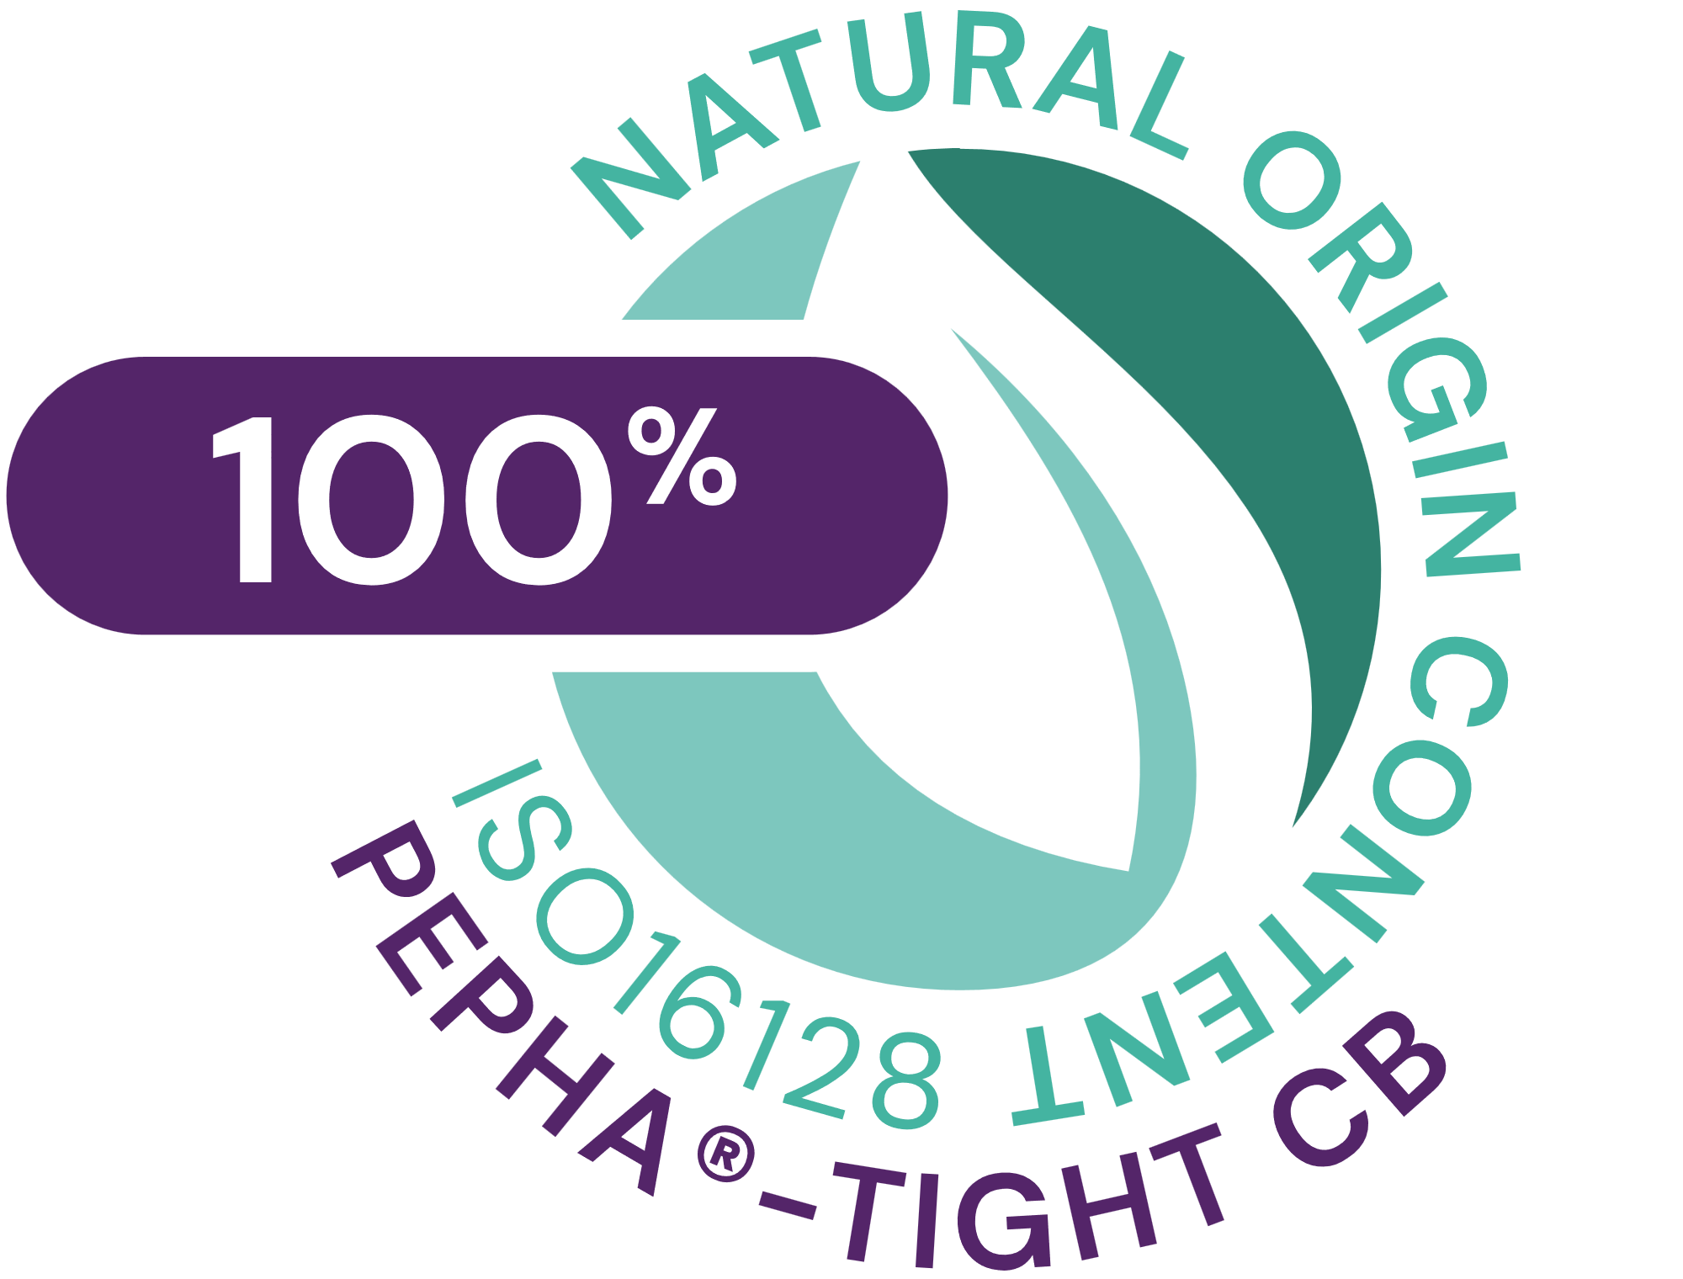




PEPHA®-TIGHT CB
ID Card
INCI NAME:
Nannochloropsis Oculata Extract, Pullulan, Pentylene Glycol, Citric Acid, Aqua
Sustainably farmed in photo-bioreactors, guaranteeing maximum quality (no risk of contamination, reproducibility of process, fully traceable)
Derived from Nannochloropsis oculata microalgae and high performing polysaccharide
Polysaccharides obtained from natural fermentation of tapioca starch
100% naturally-derived origin (ISO 16128)
TECHNOLOGY:
Solubility: Soluble in water
TECHNICAL:
Form: Transparent to turbid yellow to amber highly viscous liquid
Use level: 1–5%
pH of use: 3.5 – 7.5
Preservative: Free
Stimulates fibroblasts’ proliferation and Collagen I*
Protects the skin against oxidative stress and urban dust*
Short-term: Flawless skin after 1 application. Long-lasting lifting result up to 12hrs, already with 2 applications***.
Long-term: With regular usage wrinkles reduction by over -20%
BENEFITS:
REGISTRATION
CERTIFICATION
Raw material verified by ECOCERT GREENLIFE, conform to the COSMOS Standard
¹ Based on dsm-firmenich clinical study where improvements in skin smoothness and texture homogeneity were detected already within 15min from 1st product application
* in vitro ** ex vivo *** in vivo
Biotech | Nature, enhanced by science

Slide 12

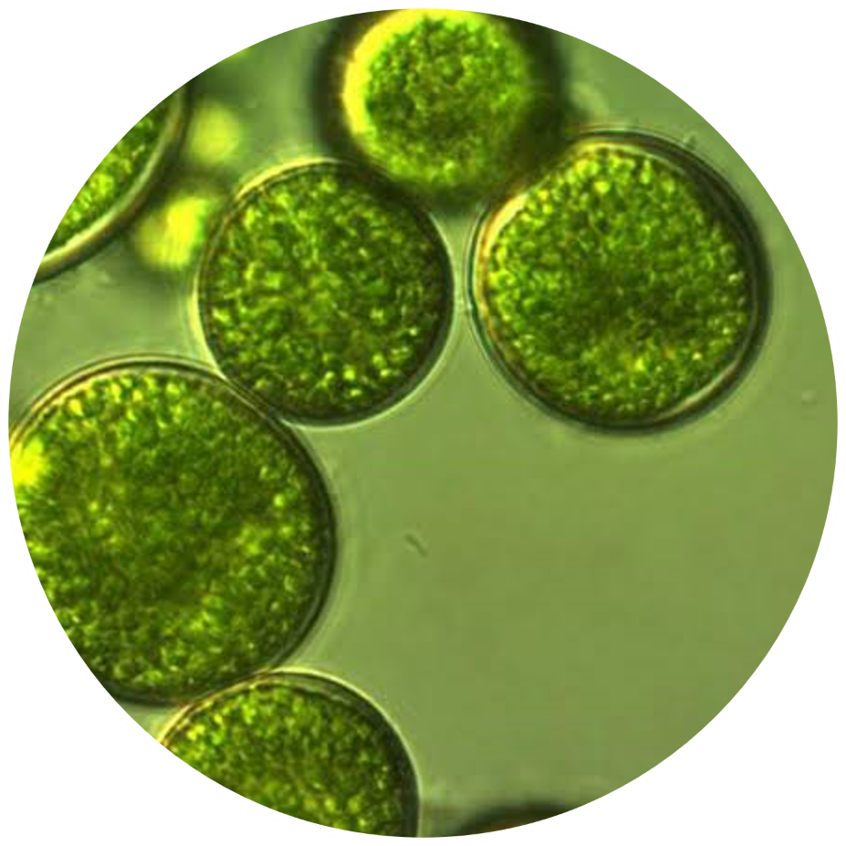
The algae
Nannochloropsis Oculata
Lives in both marine and freshwater lakes
Used for several decades to PRODUCE NUTRACEUTICALS and FEED SUPPLEMENTS
A STRONG COCCOID CELL WALL that protects its bioactives
Supplies the skin with ESSENTIAL AMINO ACIDS, PRECIOUS VITAMINS
(especially vitamins C and B12) and POWERFUL ANTIOXIDANTS
Biotech | Nature, enhanced by science
12

Slide 13
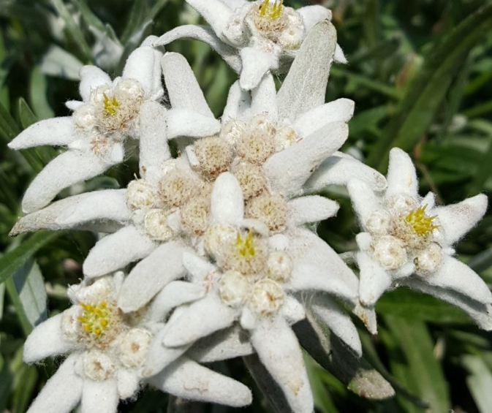
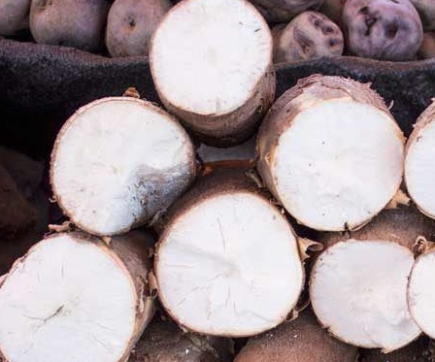
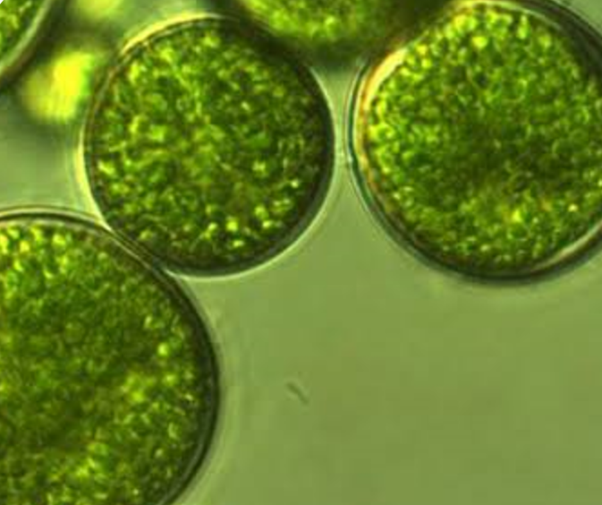
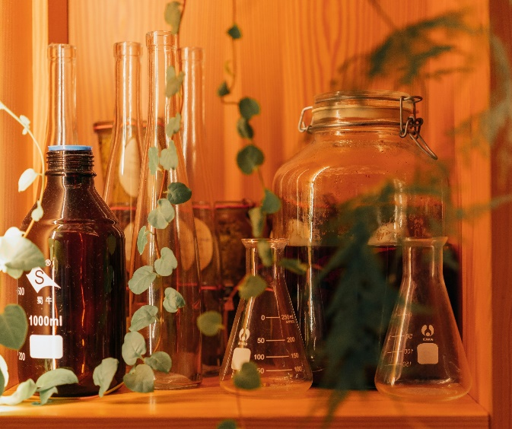


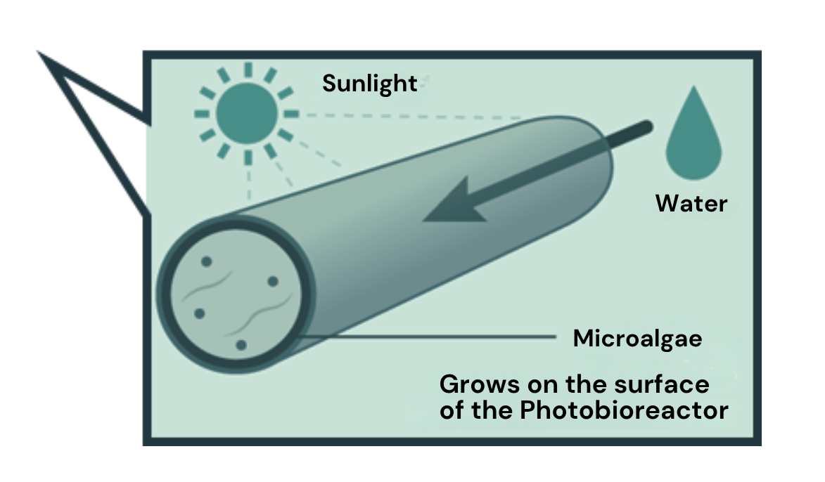
Unique combination for efficacy & sustainability
A concentrated mixture of powerful functional ingredients produced by biotechnologies, fully naturally derived & renewable
A transparent concentrated mixture with 3 powerful functional ingredients
Microalgae
Pullulan
Pentylene Glycol
Produced in photobioreactor
as a more sustainable solution compared to open ponds cultivation
Safer and better quality
More respectful of terrestrial biodiversity
Use of renewable energy
Fermentation of tapioca starch
Produced from valorised and naturally-derived material
13
Notes:
Photo de Marcos Acosta sur Unsplash
Photo de Eric Prouzet sur Unsplash
Photo de Yohan Marion sur Unsplash
The Microalgae, is produced in photobioreactors and grows in water on sunlight, carbon dioxide from the air, and some nutrients. It is natural up to the solvent used for the extraction of the algae, as only water is used.
By using biotechnology to produce the microalgae, we are making a more sustainable choice compared to open ponds culture:
A safer choice because photobioreactors are less susceptible to contamination
A lower impact on terrestrial diversity, as the construction of the open ponds is usually associated with a destruction of local fauna habitat
The energy used for the photobioreactors is mostly renewable
The Pullulan is produced by fermentation of tapioca starch (manioc), an alternative to using starch from grains.
Those are preserved in Pentylene Glycol, produced from corn cobs, therefore valorizing a residual stream after the extraction of the more valuable materials from the crop.
PEPHA®-TIGHT CB is a very powerful combination of anti-ageing effects, based on biological sources, processed with biotechnology and fitting in a net zero climate change policy. All production processes are operated under mild conditions without hazardous chemical substances and generate only small amounts of non-hazardous waste.

Slide 14
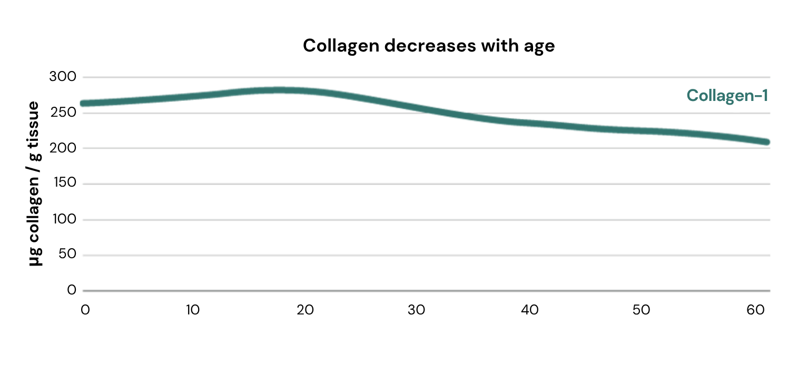
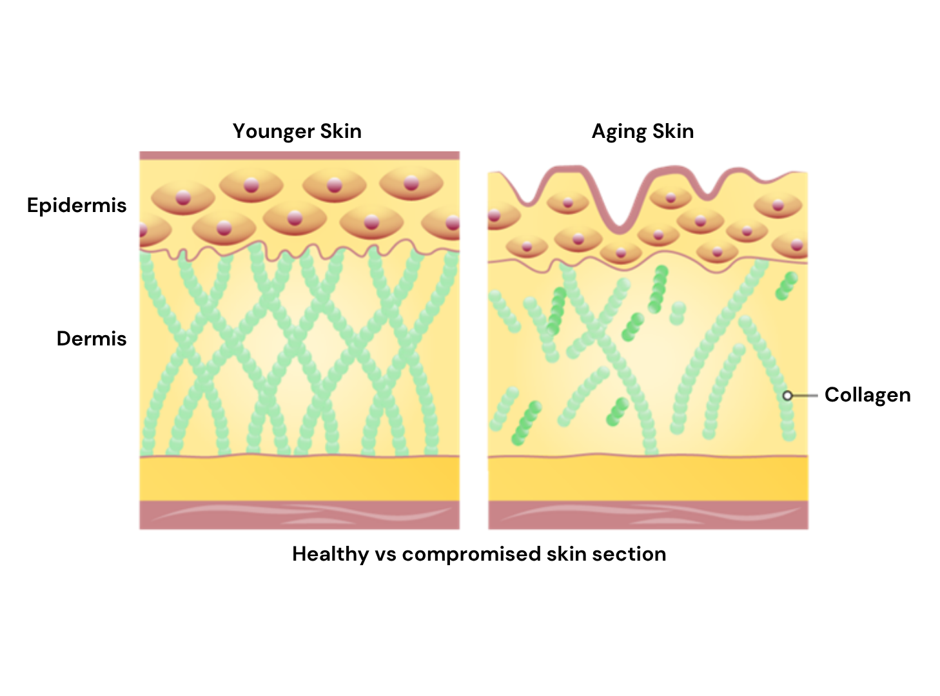

Over time skin works less efficiently
Reference: Asserin et al. (2015) J Cosmet Dermatol, 14, 291-301
Profound changes occur in the structure of the dermis and epidermis, through processes of intrinsic and extrinsic aging, leading to the appearance of wrinkles and the loss of tone
With age, the Collagen density in the Dermis decreases and its network becomes increasingly fragmented, presenting shorter and less
organized fibres.
An increase in Matrix Metalloproteinase (MMP) expression accelerates the Collagen degradation.
In parallel, the synthesis of new extracellular matrix components by dermal fibroblasts slows down, failing to adequately replace the degraded matrix.
Papakonstantinou et al. (2012) Dermato-Endocrinol 4:3, 253–258

Slide 15
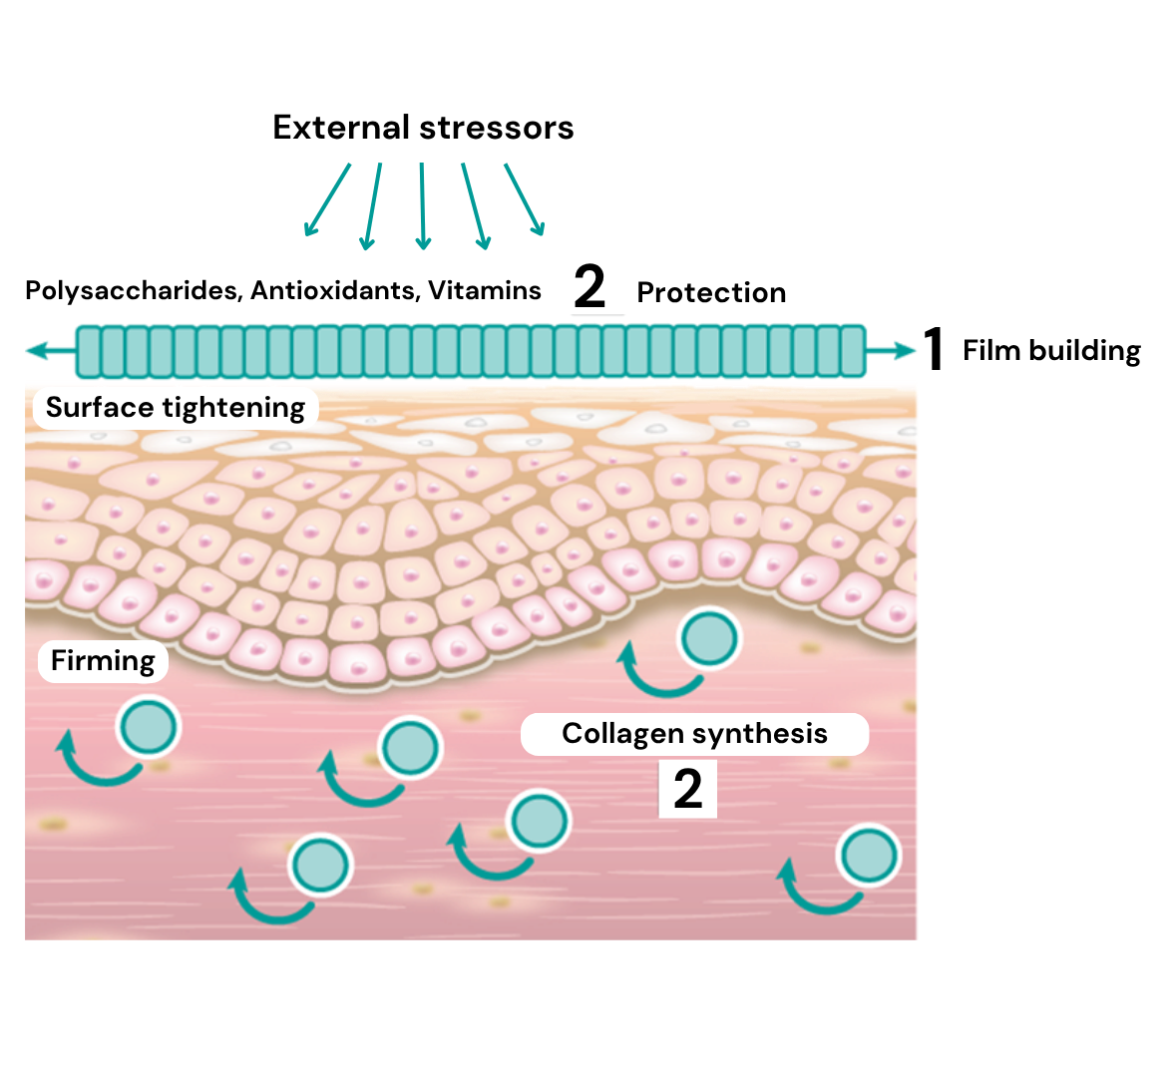
How does it work?
PEPHA®-TIGHT CB combines short- and long-term efficacy
1. Short-term, with 1 application:
PEPHA®-TIGHT CB forms a thin film on the skin, exerting an instant and long-lasting perceptible skin smoothing & lifting effect.
2. Long-term, with regular applications:
PEPHA®-TIGHT CB acts as a protective shield against oxidative stress, helps to stimulate the formation of Collagen I, an essential part of the skin’s connective tissue, helping reducing wrinkles & improving skin elasticity.

Slide 16

Highly increases fibroblasts proliferation and Collagen-I synthesis
Stimulation of fibroblasts proliferation by 350% and Collagen-I by 70%
Aged skin is characterized by a decline of cell number and proliferative cells. Therefore, less ECM is produced, leading to a lack of structural components, such as collagen fibers. The skin gets thinner, less resilient and less firm.
Results:
    Increase in cell proliferation of human
    fibroblasts, and consequently support for
    collagen production increase.
    Stimulation of Collagen-I synthesis in human fibroblasts, improving the structure of the connective tissue
**p<0.01 against 0.
***p<0.001 against 0.

Slide 17
Protects the skin against stressors
Protection against oxidative stress
Protection of cell viability against urban dust
+Urban Dust
**
**
+30%
**
Reactive Oxygen Species (ROS) are known to accelerate the aging process.
In addition, aged cells are less able to protect themselves against oxidative stress.
This leads to an accelerated collagen breakdown and cross-linking of proteins. The skin gets thinner and less resilient. In vitro protection was measured by the ROS assay:
Human fibroblasts were exposed to hydrogen peroxide (H2O2) to induce an intracellular oxidative stress. The release of ROS was quantified by fluorescence staining.
Results:
Dose dependent protection of human fibroblasts from oxidative stress, and consequently, protection of the collagen fiber network from damaging processes.
Used in the dsm-firmenich assay and research Standard Reference Material ® (SRM) 1649b “urban dust” is an authentic surrogate for urban air pollution of the National Institute of Standards and Technology (Gaithersburg, MD, USA).
Results:
With PEPHA®-TIGHT CB, cell viability improves up to +30%
vs stressed cells
Urban dust: SRM16495 extract, Mean ± SD, It=3, Student t-test, ** p 0.01 vs. urban dust stressed cells
Notes:
Used in the dsm-firmenich assay and research Standard Reference Material ® (SRM) 1649b “urban dust” is an authentic surrogate for urban air pollution of the National Institute of Standards and Technology (Gaithersburg, MD, USA). SRM1649b was prepared from atmospheric particulate material collected in the Washington, DC area.
The particles contain certified ingredients, i.e. 23 PAHs, 13 PCB (polychlorinated biphenyls), 3 heavy metals
SRM1649b was resuspended in DMSO (100 mg/ml), stirred for 1 hour. After centrifugation the supernatant was added to cell culture (0.3 mg/ml final).
For ROS assay: 24 hours incubation with compound. Then add H2O2 and do DCF assay.

Slide 18


Short-term in vivo Study
Study design, Spring 2022 (Lyon, France)
Randomized double-blind, mono-center study. Caucasian female volunteers.
Two groups:
Placebo & 3% PEPHA®-TIGHT CB
27 volunteers by group, 40-65 years (mean 55 years)
Twice daily product application
Within
Up to
15mins
12hrs
Baseline
Measurement
T 0
Morning
Product
application
1st
Measurements
T Imm
Evening
Product
application
2nd Measurements
The morning of the day after
T 1
Notes:
Baseline measurements were taken.
Further measurements were taken:
- Immediately, within min after first product application
- At day 1 or 12 hrs after second product application

Slide 19



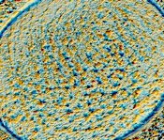
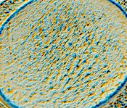
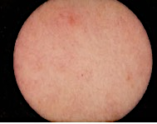
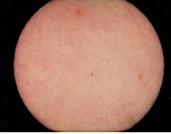
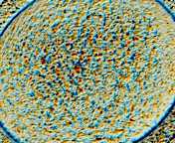
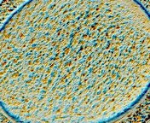
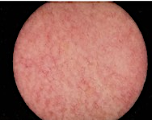
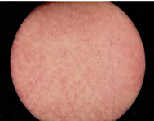
Flawless skin in minutes with PEPHA®-TIGHT CB
SkinCam measurement
Skin Smoothness Improvement below eye
Skin Texture Improvement on Neck Area
$p<0.1 vs placebo
4x better than placebo
Measurement area
(Under eye)
Measurement area
(Neck)
Placebo
3% PEPHA®-TIGHT CB
Immediately after 1 application
Immediately after 1 application
Volunteer 19
Volunteer 09
SkinCam takes an image of the skin surface and shows how the irregularities of the skin texture evolve.
After PEPHA®-TIGHT CB application, skin surface appears smoother and texture more homogeneous
Baseline
Immediately after
1 application
Baseline
Immediately after
1 application
Volunteer 36
Volunteer 58
Notes:
SkinCam takes an image of the skin surface and show how the irregularities of the skin texture evolve. After PEPHA-TIGHT CB application, skin surface appear smoother and texture more homogeneous
$ p=0.062 vs placebo

Slide 20

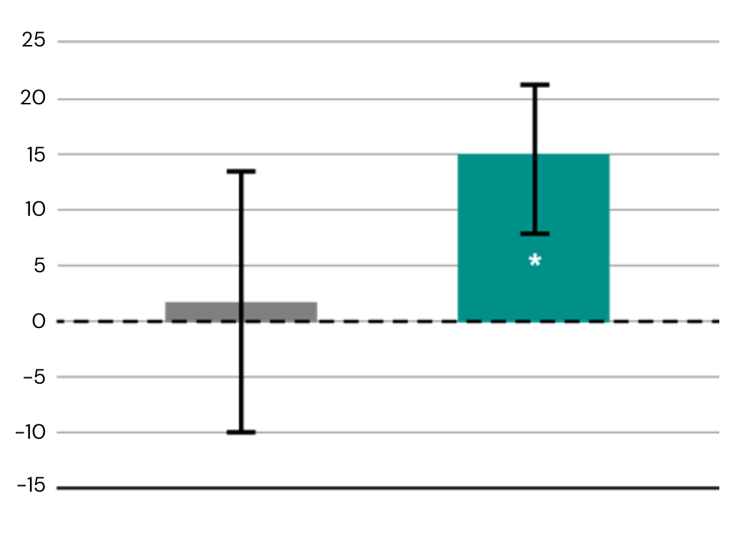
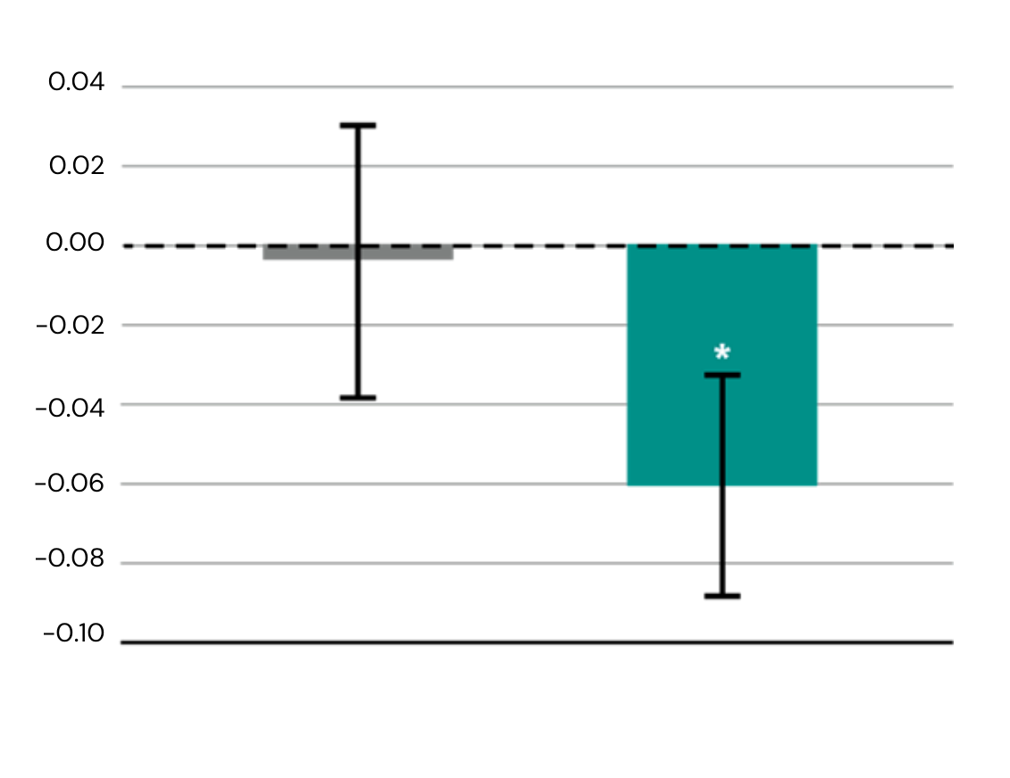
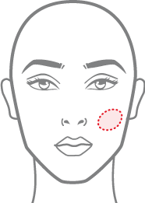

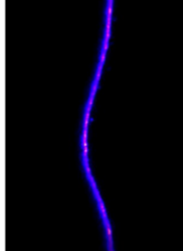
Significant long-lasting lifting effect with PEPHA®-TIGHT CB
SkinFlex measurement
PEPHA-TIGHT CB is 13X better than placebo
Increase in skin firmness
Decrease in skin sagging
Volunteer 39
*p<0.05 vs placebo
*p<0.05 vs placebo
Skin deformation upon strain
Skin firmness improvement
(%) vs baseline
Skin sagging decrease
Vs. baseline [mm]
Measurement area
Baseline T0
T1
Placebo
3% PEPHA®-TIGHT CB
Placebo
3% PEPHA®-TIGHT CB
Time T1
12 hrs after 2nd product application
Time T1
12 hrs after 2nd product application
An airstream is blown perpendicularly to the cheek: it pushes the skin inwards forming a kind of “hole” in the cheek.
The firmer & more lifted is the skin, the more it’s able to resist the airstream, as shown for Volunteer 39 in the pic
Notes:
An airstream (representing a strain) is blown perpendicularly to the cheek: it pushes the skin inwards forming a kind of “hole” in the cheek.
The firmer & more lifted is the skin, the more it’s able to resist the airstream, as shown for Volunteer 39 in the pic

Slide 21
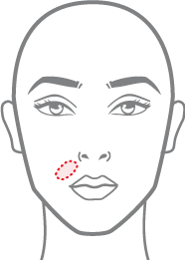



Skin gains elasticity in critical facial areas with PEPHA®-TIGHT CB
Cutometer measurement
Elasticity (nasolabial fold)
Elasticity (eyelid)
PEPHA-TIGHTCB is 6X better than placebo
The Cutometer applies
a vacuum to the skin, pulls on the skin and then lets it go. The time, velocity and return to the original position are measured, from this the elasticity is calculated. Elastic skin can bounce back to its original position fully and fast. with PEPHA®-TIGHT CB, we see an improvement of this skin behavior.
Placebo
3% PEPHA®-TIGHT CB
Placebo
3% PEPHA®-TIGHT CB
Time T1
12hrs after 2nd product application
Time T1
12hrs after 2nd product application
Elasticity (anterior jawline)
Elasticity (posterior jawlin)
Placebo
3% PEPHA®-TIGHT CB
Placebo
3% PEPHA®-TIGHT CB
Time T1
12hrs after 2nd product application
Time T1
12hrs after 2nd product application
Measurement area
Biotech | Nature, enhanced by science
Notes:
Cutometer applies a vacuum to the skin, pulls on the skin and then lets it go. The time, velocity and return to the original position are measured and from this the elasticity is calculated. Elastic skin can bounce back to its original position fully and fast. Here we see an improvement of this with the 3% PEPHA-TIGHT CB formulation.

Slide 22
Consumers perceive the improvement
Qualitative questionnaire, for immediate & long-lasting perception
% of affirmative answers to «My skin looks & feels firmer with PEPHA®-TIGHT CB»
Overall facial skin
Skin around the eyes
Neck & neckline
Time immediate
Within minutes after 1st product application
Time T1
12hrs after 2nd product application
Time immediate
Within minutes after 1st product application
Time T1
12hrs after 2nd product application
Time immediate
Within minutes after 1st product application
Time T1
12hrs after 2nd product application
Notes:
Cutometer applies a vacuum to the skin, pulls on the skin and then lets it go. The time, velocity and return to the original position are measured and from this the elasticity is calculated. Elastic skin can bounce back to its original position fully and fast. Here we see an improvement of this with the 3% PEPHA®-TIGHT CB formulation.

Slide 23
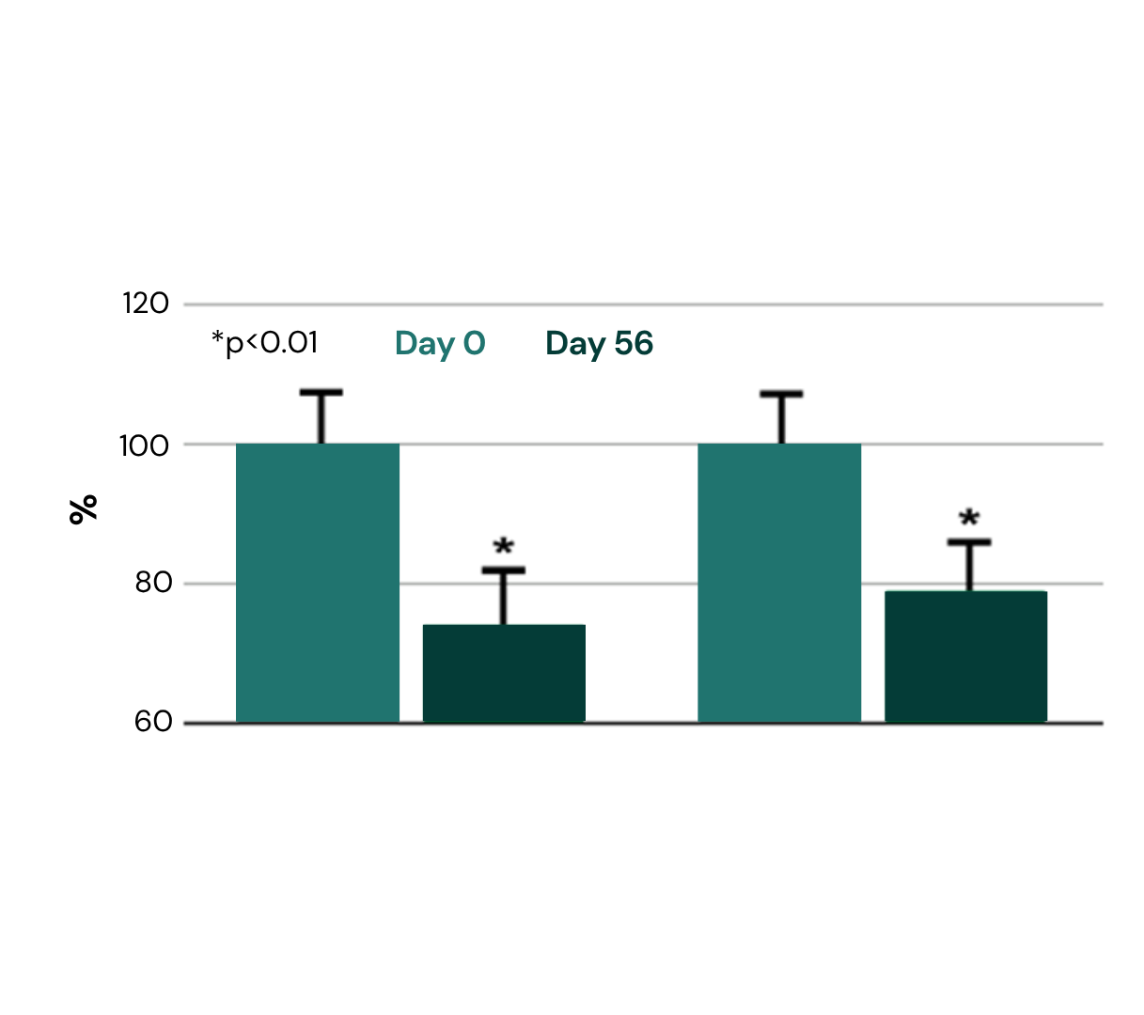
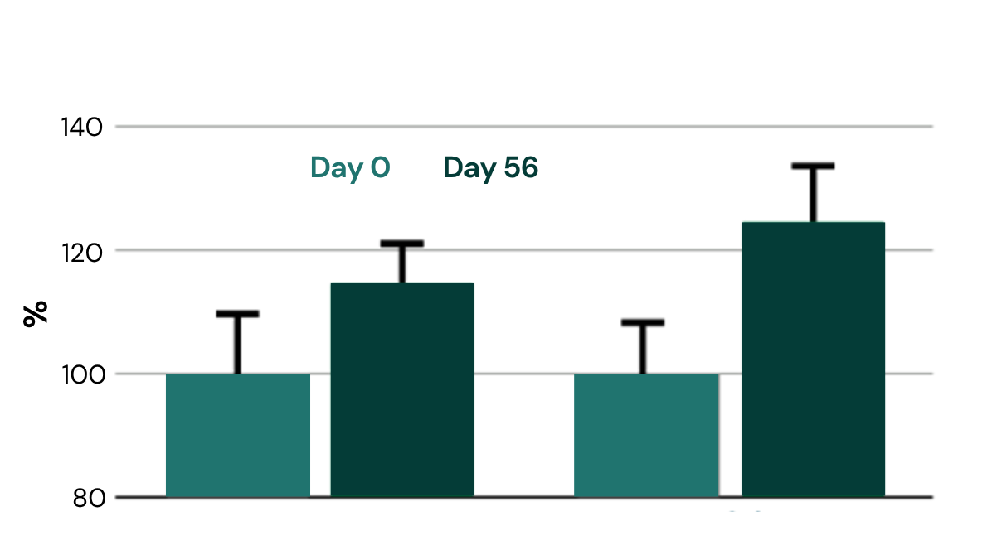
Long-term well-aging result with regular usage of PEPHA®-TIGHT CB
Profilometer and Cutometer measurement
Wrinkle reduction (profilometry):
Skin firming (cutometry):
26%
21%
15%
24%
Cream with 3% PEPHA®-TIGHT CB applied on the face twice daily over
2 months. 13 female volunteers
30-55y.o., mean 40yrs.
reduction of wrinkle surface
reduction of wrinkle length
improvement of elasticity
improvement of tonicity
Visible wrinkle reduction after 2 months
Lond-term skin firming results after 2 months!
$p<0.1 vs baseline
$p<0.1 vs baseline
Wrinkle Surface
Wrinkle Length
Elasticity
Tonicity

Slide 24
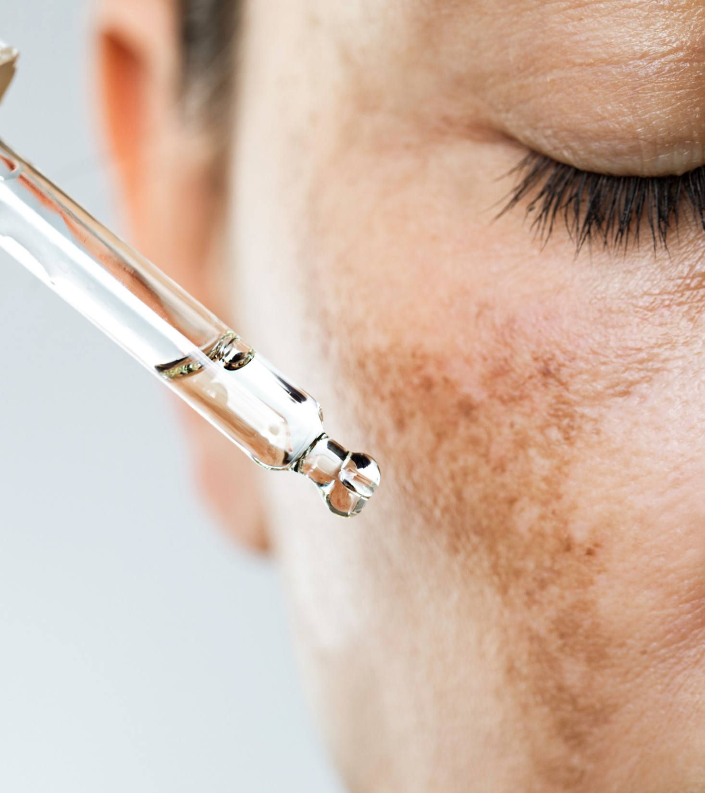
Formulation Guidelines
PEPHA®-TIGHT CB
INCI name (active):
Nannochloropsis oculata Extract, Pullulan
    Viscous, yellowish to amber solution
    Stable at pH ranges from 3.5 to 7.5
    Should be processed below 50°C
    Suggested concentration: 1–5%
Cosmetic application
    Facial skin tightening products
    Protective care for long-term firmer skin
    Firming and lifting Neck & Décolleté formulations
    Added value for anti-wrinkle products

Slide 25

PEPHA®-TIGHT CB
Supported marketing claims
Flawless skin within minutes¹
With just 1 application, skin surface appears smoother and texture more homogeneous
Long-lasting lifting effect, up to 12hrs from last application
Skin gains elasticity in critical facial areas
After multiple applications, long-term well-aging effect with wrinkles reduction by over -20%
¹ Based on dsm-firmenich clinical study where improvements in skin smoothness and texture homogeneity were detected already within 15min from 1st product application
Biotech | Nature, enhanced by science

Slide 26
PEPHA®-TIGHT CB B2C potential
This ingredient serves different market trends & products’ narratives
Fast Beauty
Looking for rapid & perceivable
skin improvements
Consumers want instant gratification and fast visible results. Consumption can also be occasion driven (e.g. a special meeting, a night out, the wedding day…and consumers want to look at their best).
We offer: PEPHA-TIGHT® provides smoother skin texture & flawless skin within minutes from 1st application. Long-lasting lifting effect, proven to last up to 12hrs
Good Beauty
Looking for transparency and
solutions that can make a positive impact
Consumers want: compromised-free solutions, good for the skin & for the planet.
We offer: PEPHA-TIGHT® combines efficacy and sustainability.
  Rapid and long-lasting visible results, already with 1 application.
  Derived from microalgae and high performing polysaccharides, produced by biotechnologies, fully naturally-derived & renewable. Vegan-friendly, COSMOS approved
Healthy Beauty
Beautiful skin starts with healthy skin
Consumers want: solutions that goes beyond the superficial, as they know that beautiful skin starts with healthy skin
We offer: PEPHA-TIGHT® microalgae, superfood for more resilient and healthy-looking skin. It delivers smoother & lifter skin already after few applications. Additionally, with a more regular consumption, it can act as a protective shield against oxidative stress and pollution, for long-term well-aging effects. This 2 in 1 proposition, might also serve the “minimal beauty” positioning

Slide 27
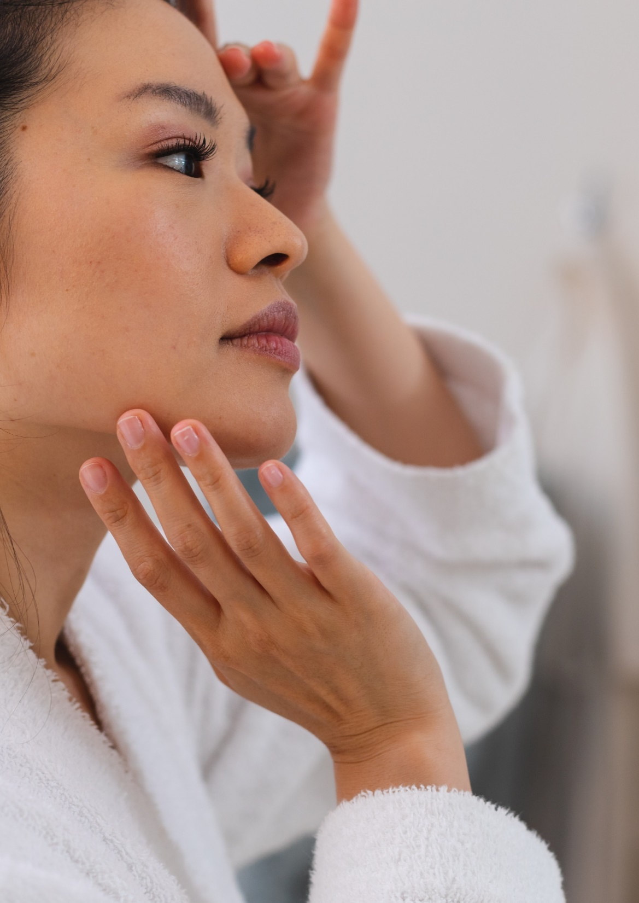
dsm-firmenich solution: PEPHA®-TIGHT CB
The fast lane to superior skin tightening
in vitro PEPHA®-TIGHT CB:
Stimulates Fibroblasts’ proliferation by +350% and Collagen-I by +70%
Protects the skin against oxidative stress and urban dust
in vivo PEPHA®-TIGHT CB:
Within minutes from 1st application:
  Visibly smoothens skin texture for an immediate¹ flawless effect
Up to 12hrs long-lasting effect:
  Skin looks and feels firmer, more lifted and more elastic already after 2 applications
Long-term result, after 2 months treatment:
  Reduces the wrinkles’ surface by -26% and length by -21%
  Improves skin elasticity by 15% and tonicity by 24%
¹ Based on dsm-firmenich clinical study where improvements in skin smoothness and texture homogeneity were detected already within 15min from 1st product application

Slide 28
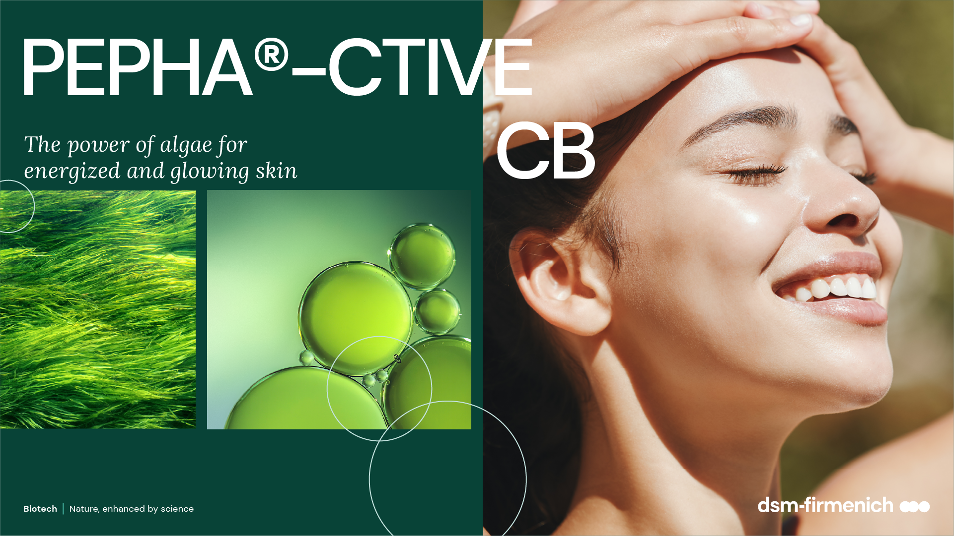

Slide 29
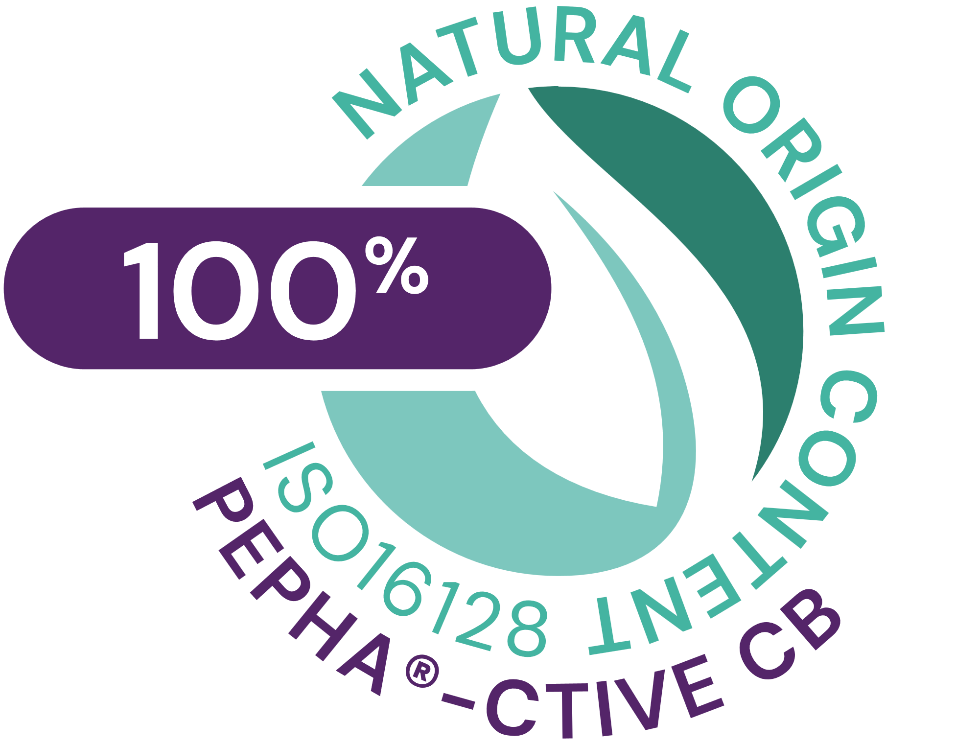


PEPHA®-CTIVE CB
ID Card
INCI name:
Dunaliella Salina Extract, Aqua, Citric Acid, Pentylene Glycol
Sustainably farmed in photo-bioreactors, guaranteeing maximum quality (no risk of contamination, reproducibility of process, fully traceable). Cultivated in controlled conditions, optimally exposed to the right cellular stress: high salinity, high light intensity, nutrient deprivation, and extreme temperatures
Derived from Dunaliella salina microalgae
100% naturally-derived origin (ISO 16128)
TECHNOLOGY:
Technical:
Form: Yellowish clear liquid
Use level: 1–3%
pH of use: 3.0 – 6.0
Preservative: Free
Solubility: Soluble in water
Induces faster skin renewal by 4 to 5 days, for a Induce faster skin renewal and visibly improves skin’s luminosity***
Benefits:
Protects the mitochondria against oxidative stress*
Increases the energy content in keratinocytes*
Stimulates fibroblasts’ proliferation*
Registration
certification
Raw material verified by ECOCERT GREENLIFE, conform to the COSMOS Standard
* in vitro ** ex vivo *** in vivo
Biotech | Nature, enhanced by science
29

Slide 30
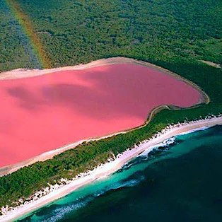

The algae
Dunaliella salina
Dunaliella salina is a very small unicellular microalga in
the green algae family
It was first discovered in 1838 by Dunal in the salters of Montpellier, on the Mediterranean coast of France.
Naturally grows in salt lakes with up to 30% salinity (9x higher than regular sea water) and constantly exposed to harsh environmental conditions (High osmotic pressure, elevated oxygen levels and high UV irradiation).
To withstand these conditions, the microalgae produces high levels of energy through photosynthesis and adapts by generating large amounts of beta-carotene, which gives it (and so the water) a pinkish color
Biotech | Nature, enhanced by science
30
Notes:
The microalgae Dunaliella salina is a very small unicellular microalgae.
It was first discovered in 1838 by Dunal in the salters of Montpellier, on the Mediterranean coast of France.
It naturally grows in salt lakes with up to 30% salinity (this is nine times higher than regular sea water). It is therefore constantly exposed to harsh environmental conditions, such as high osmotic pressures, elevated oxygen levels, and high UV irradiation.
To withstand these conditions, the microalgae produce high levels of energy through photosynthesis.
Dunaliella salina key protective compounds:
β-carotene is a type of pro-vitamin A, responsible for inhibiting the production of free radicals from ultraviolet light.
Among various carotenoid-rich microalgae, Dunaliella salina has the greatest carotene concentration making up ~10% algal dry weight.
- Glycerol is a compatible solute in which not only contributes to osmotic balance of the cell but also maintains enzyme activity.

Slide 31
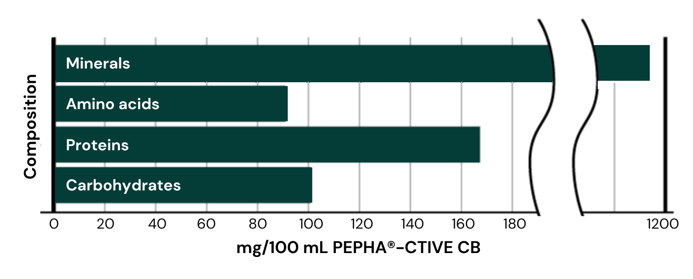
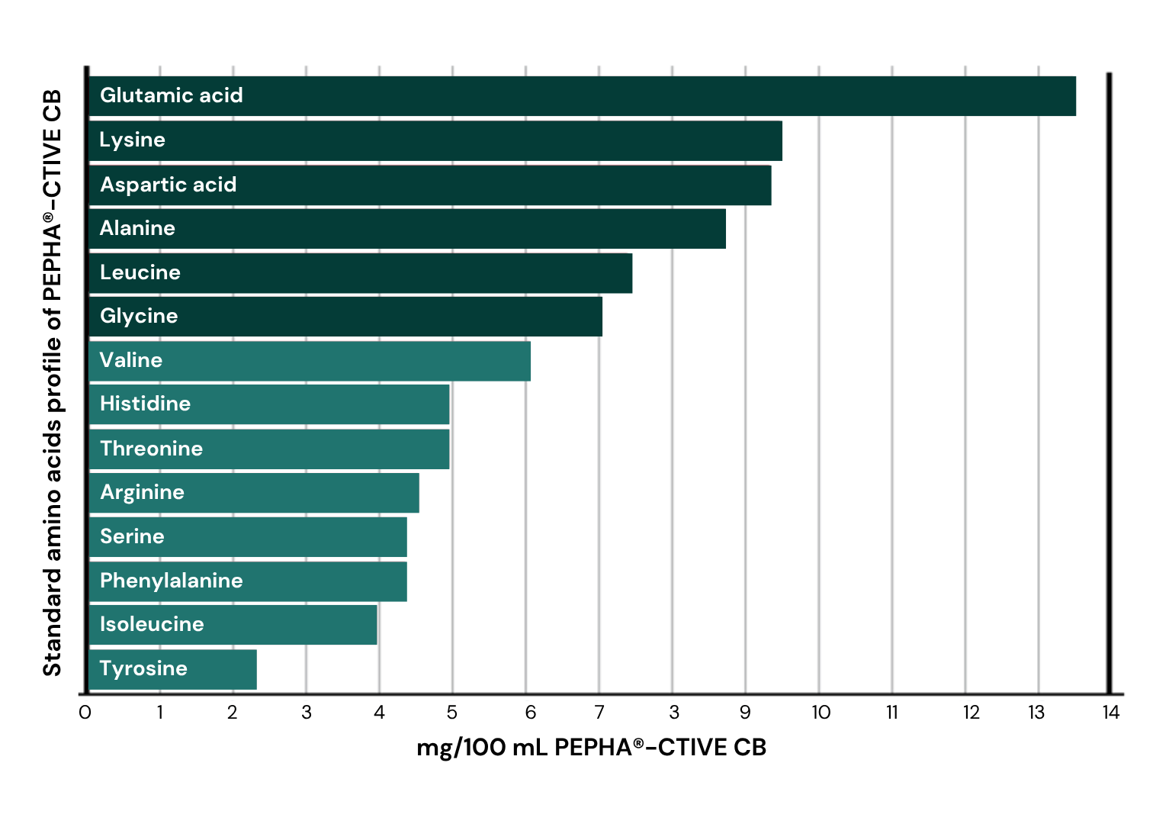
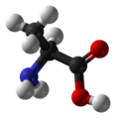
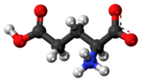
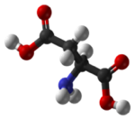
Unique Amino Acids composition
PEPHA®-CTIVE CB
Essential to cell energy production:
Alanine
Glutamic acid
Aspartic acid
Amino acids, proteins, carbohydrates, and minerals are fundamental
bio-catalysts and building blocks for the cellular metabolism, e.g. ATP synthesis
Notes:
PEPHA®-CTIVE CB is composed of a powerful and complex cocktail of active compounds.
This slide represents the main compounds. Additionally, vitamins, co-factors, enzymes are also part of the composition, but were not individually quantified.
Source: internal analysis 2006

Slide 32

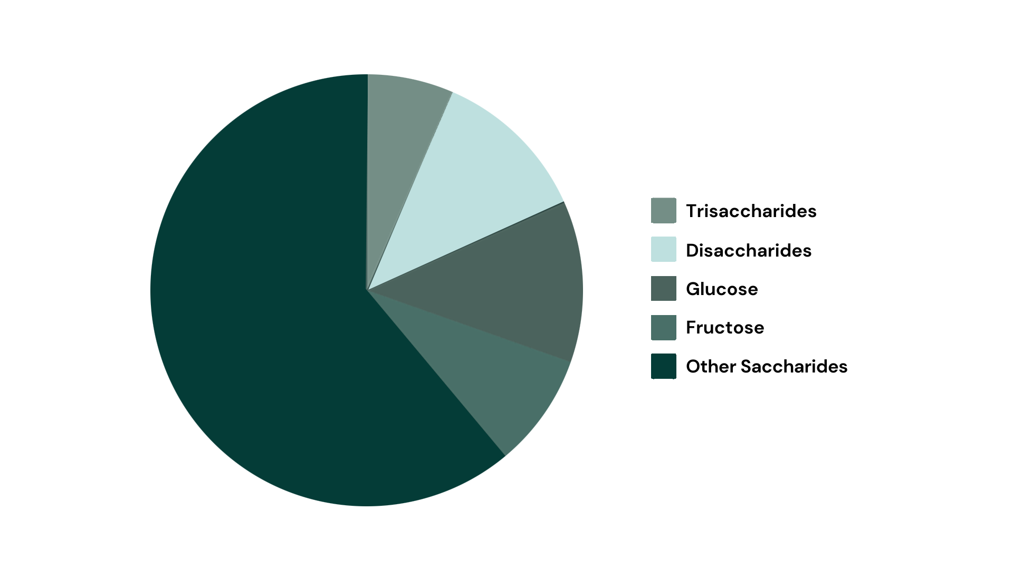
PEPHA®-CTIVE CB’s Carbohydrates
Source of cellular energy
Essential role of carbohydrates for cells metabolism, communication, and structure
Notes:
Carbohydrates play an essential role in the cellular metabolism, communication, and structure.
This key role was broadly communicated by L’Oréal with the launch of Yves Saint Laurent new product “Forever Youth Liberator”:
“Glycobiology is one of the 10 sciences that will change future medicine according to the Massachusetts Institute of Technology. Glycobiology has to do with the structure, metabolism and biological role of glycans found in living beings. Glycans are macromolecules formed by chains of complex sugar. Research has demonstrated that glycans are present in the organism at three levels: in other words on the cell’s surface inside the cell and between the cells. This particularity gives them three functions concerning the skin: metabolism of the cells, communication between the cells and the structure of the tissues which plays on the aspect of the skin.
Used in cosmetics and skincare for the first time, glycobiology has become an innovative scientific field which helps better understand and combat visible signs of ageing. Found naturally in the skin, glycans are responsible for the transmission for the youth messages of the cells. With age, the rate and quantity of glycans diminishes, hindering the skin’s regeneration process. The first signs of ageing appear: wrinkles, loss of tone, and dull complexion.”
Source: http://magazine.loreal-finance.com/en/glycobiology-used-first-time-cosmetics.htm

Slide 33
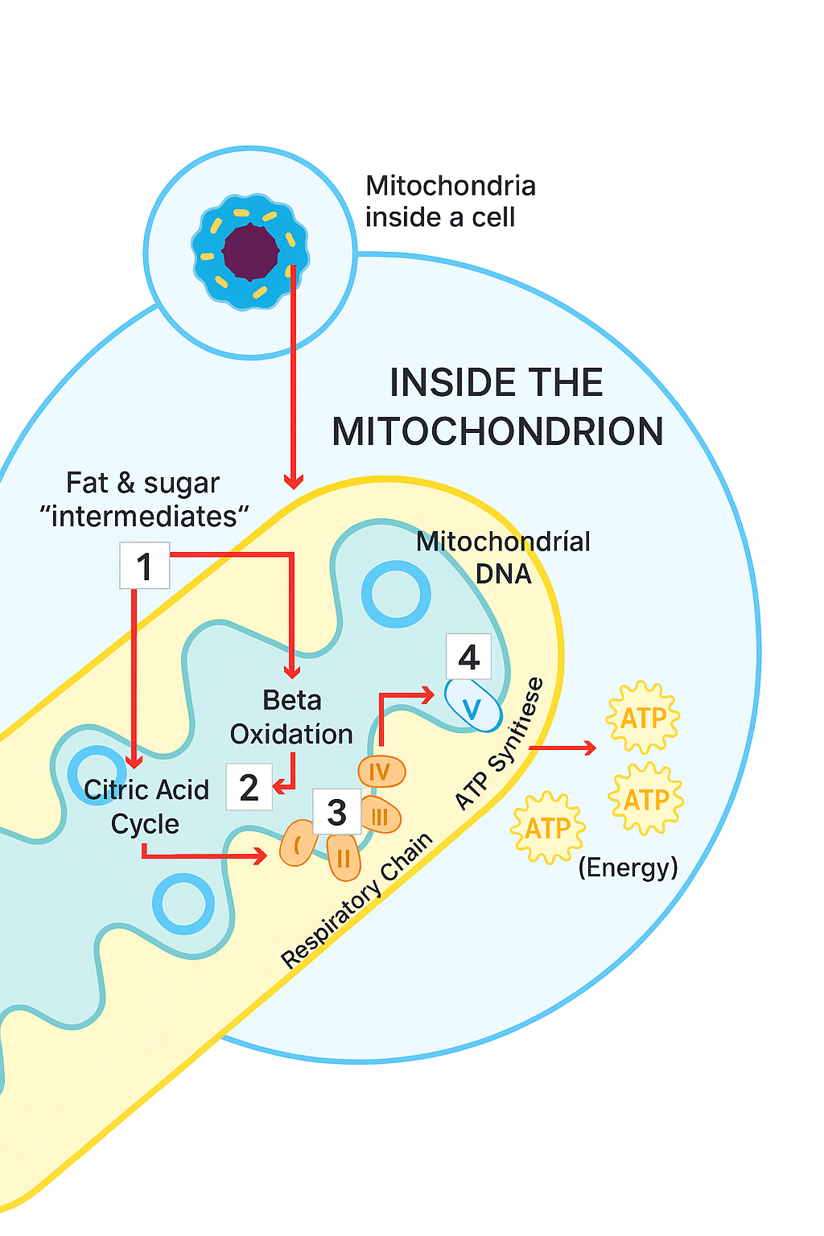
Mitochondria
The secret power within cells
Mitochondria are the power stations of skin cells, responsible to produce ATP.
ATP is necessary to maintain the functionality of cells.
Over time, the mitochondria lose their activity.
The skin cells are not sufficiently supplied with energy anymore, their functionality is reduced.
33
Notes:
Mitochondria act as the power plants of the cell. They are the sites of cellular respiration which ultimately generate fuel in the form of ATP (Adenosine Triphosphate) for the cell’s activities.
Normal ageing processes and a person's lifestyle, as well as exposure to UV radiation can cause the release of free radicals, which in turn causes the mitochondria to decrease their activity. As a consequence, cells are not supplied with enough energy to maintain cell turnover. The result is dull, tired-looking skin.

Slide 34




Feeling a power blackout?
When skin gets dull & tired
Energized & luminous skin
Cell respiration
Energy metabolism
Cell turnover
Luminous, Youthful-
looking skin
Tired & dull Skin
Cell respiration
Energy metabolism
Cell turnover
Atonic, dull and
stressed-looking skin
Notes:
Natural luminous looking skin has a balanced energy metabolism that is responsible for the ability of cells to revitalize, to proliferate, to differentiate, and to manage cell turnover. Fully energized skin is luminous and looks youthful.
Over time, essential energy processes in the skin slow down, leading to a reduced cell turnover; the skin looks tired and dull. Now the skin needs energy.

Slide 35

dsm-firmenich solution: PEPHA®-CTIVE CB
The secret of a natural glowing skin
In vitro PEPHA®-CTIVE CB:
Protects the mitochondria against oxidative stress caused by free radicals
Increases the ATP content in keratinocytes up to +140%
Increases the proliferation rate of fibroblasts up to +320%
In vivo PEPHA®-CTIVE CB:
Induces faster skin renewal by 4 to 5 days, for a fresher looking appearance
Visibly improves skin’s luminosity for more than 4 out of 5 consumers

Slide 36
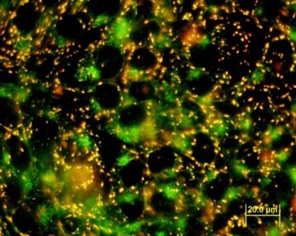
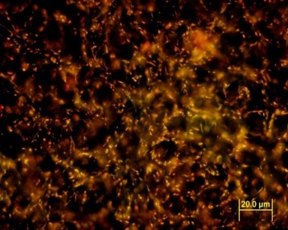
Cell’s battery protection
Protection
PEPHA®-CTIVE CB
Fluorescence microscopy
in vitro assay with human keratinocytes HaCaT
Cells treated with PEPHA®-CTIVE CB vs. untreated cells
24 hours incubation
Oxidative stress with 500 μmol H₂O₂
Mitochondria polarization indicated by fluorescence
Healthy mitochondria appear red
Control
Stressed with 500 μmol H₂O₂
 Visible green staining
1% PEPHA®-CTIVE CB
Stressed with 500 μmol H₂O₂
 No visible green staining
PEPHA®-CTIVE CB visibly protects the mitochondria against oxidative stress caused by free radicals
Notes:
Aim:
Determination of the influence of PEPHA®-CTIVE CB on the polarization of mitochondria of HaCaT keratinocytes stressed by incubation with hydrogen peroxide.
HaCaT cell is a cell type belonging to an immortal human keratinocyte line.
Polarization of mitochondria membrane was indicated with the fluorescent dye JC-1 from Molecular Probes by fluorescence microscopy and in a quantitative way with a fluorescence microplate reader.
Results:
The fluorescent dye accumulates in the mitochondria of healthy cells as red aggregates.
If the mitochondria are stressed, the mitochondrial membrane potential gets depolarized, which means that they lose their activity: the fluorescent dye can no longer accumulate in the mitochondria and remains in the cytoplasm in a monomeric form which fluoresces in green.
After incubation with PEPHA®-CTIVE CB there is no depolarization detectable, which is to be seen on the red coloration of the picture. The mitochondria treated with PEPHA®-CTIVE CB are active and have their full integrity.
It can be concluded that PEPHA®-CTIVE CB has a protection effect on the mitochondria.

Slide 37
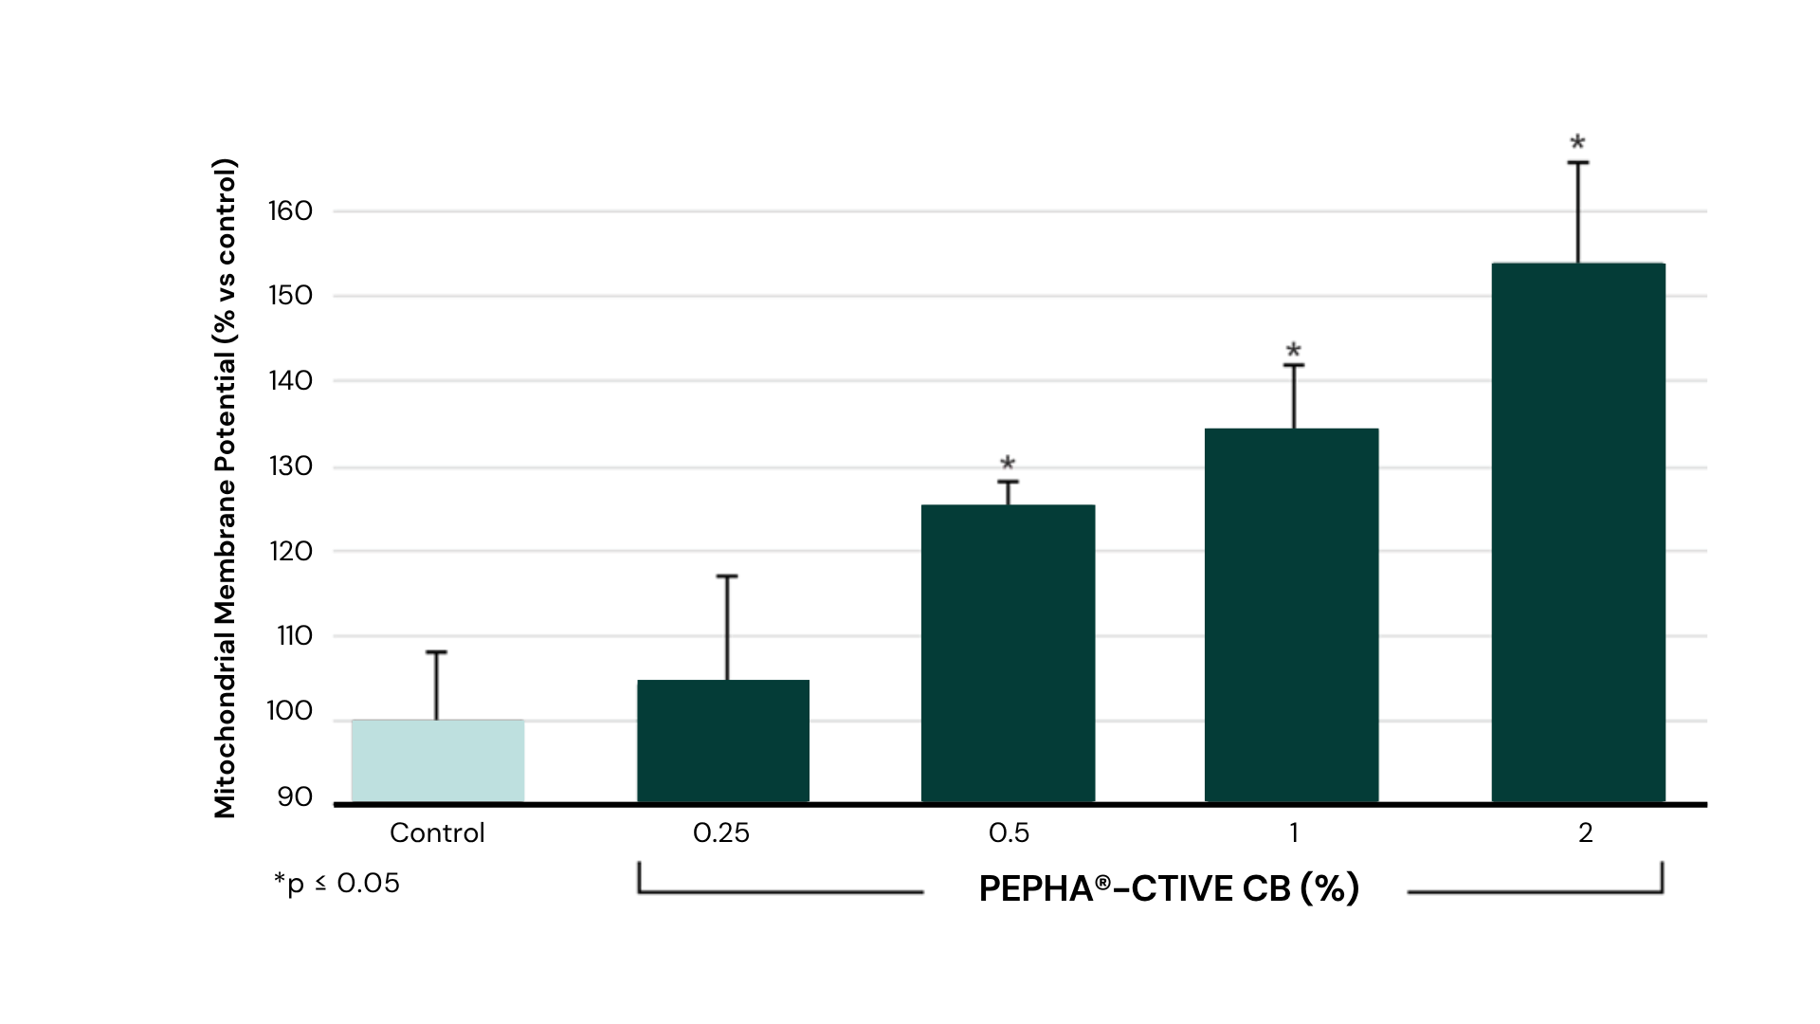
Cell’s battery protection up to 150%
Protection
PEPHA®-CTIVE CB
in vitro assay with human keratinocytes HaCaT
Cells treated with PEPHA®-CTIVE CB vs. untreated cells (control)
24 hours incubation
Oxidative stress with 2mM H2O2
Mitochondria polarization indicated by fluorescence
Quantitative assay
PEPHA®-CTIVE CB dose-dependently protects the mitochondria against
oxidative stress caused by free radicals
Notes:
Aim:
Determination of the influence of PEPHA®-CTIVE CB on the polarization of mitochondria of HaCaT keratinocytes stressed by incubation with hydrogen peroxide.
HaCaT cell is a cell type belonging to an immortal human keratinocyte line.
Polarization of mitochondria membrane was indicated with the fluorescent dye JC-1 from Molecular Probes by fluorescence microscopy and in a quantitative way with a fluorescence microplate reader.
Results:
The fluorescent dye accumulates in the mitochondria of healthy cells as red aggregates.
If the mitochondria are stressed, the mitochondrial membrane potential gets depolarized, which means that they lose their activity: the fluorescent dye can no longer accumulate in the mitochondria and remains in the cytoplasm in a monomeric form which fluoresces in green.
After incubation with PEPHA®-CTIVE CB there is no depolarization detectable, which is to be seen on the red coloration of the picture. The mitochondria treated with PEPHA®-CTIVE CB are active and have their full integrity.
It can be concluded that PEPHA®-CTIVE CB has a protection effect on the mitochondria.

Slide 38
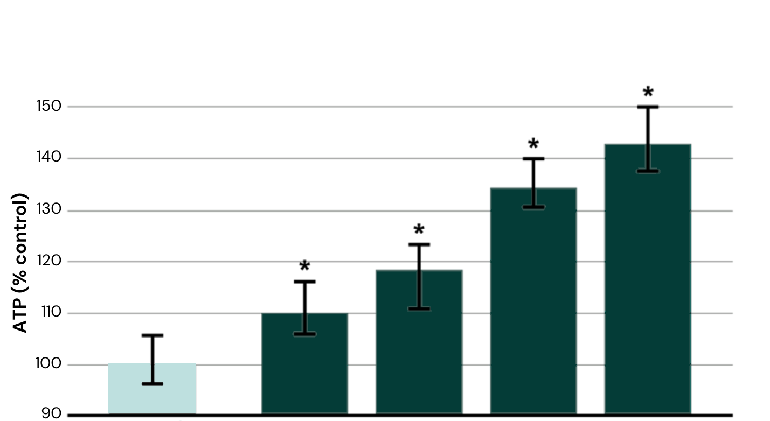

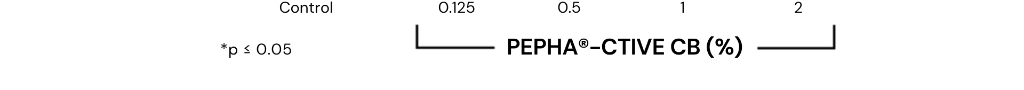
Cellular energy activation up to 140%
PEPHA®-CTIVE CB
Activation
in vitro assay with human keratinocytes HaCaT
Cells treated with PEPHA®-CTIVE CB vs. untreated cells (control)
48 hours incubation
Measurement of cellular ATP content
PEPHA®-CTIVE CB significantly und dose-dependently increases the ATP content up to 140%
Notes:
Aim of the assay:
Determination of the influence of PEPHA®-CTIVE CB on the content of ATP (Adenosine Triphosphate) of confluent cultures of the human keratinocyte cell line HaCaT.
The cells were incubated with PEPHA®-CTIVE CB for 48 hours.
Results:
PEPHA®-CTIVE CB dose-dependently increases the ATP-content of keratinocytes up to more than 140%. It can be concluded that PEPHA®-CTIVE CB has a stimulating effect on the mitochondria to produce ATP.

Slide 39
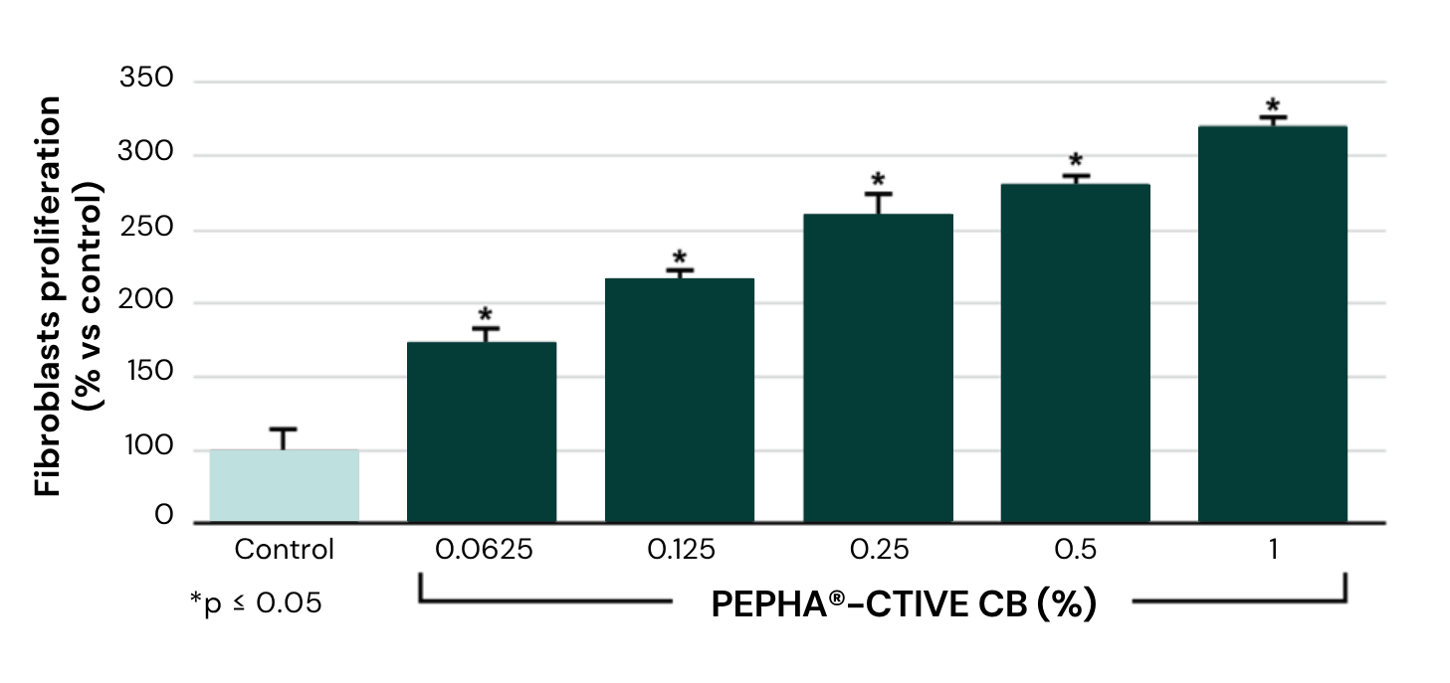
Cellular proliferation up to 320%
PEPHA®-CTIVE CB
Activation
in vitro assay with normal human fibroblasts from skin
Cells treated with PEPHA®-CTIVE CB vs. untreated cells (control)
24 hours incubation
Fibroblasts quantification by ELISA
PEPHA®-CTIVE CB significantly increases the fibroblast proliferation up to 320%
Notes:
Fibroblasts proliferation
Aim of the assay:
Determination of the influence of PEPHA®-CTIVE CB on the proliferation of normal human fibroblasts from skin.
The cells were incubated with PEPHA®-CTIVE CB for 24 hours.
Results:
PEPHA®-CTIVE CB dose-dependently increases the proliferation rate of fibroblasts up to 320%.

Slide 40
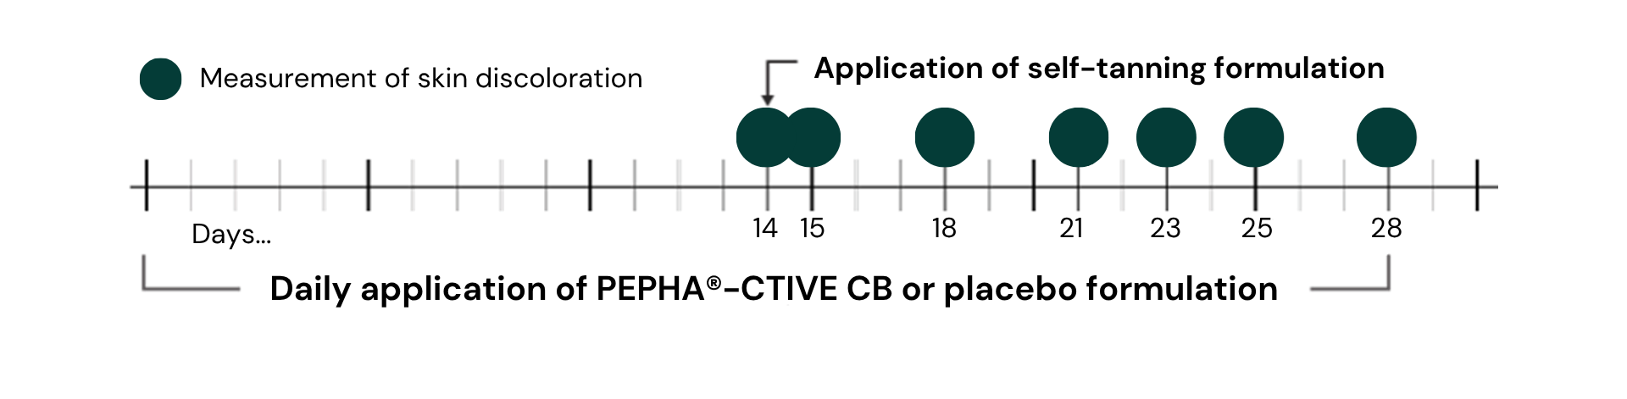
Skin renewal
Study design
20 female volunteers, 22 – 65 years old
Placebo controlled study; 3% PEPHA®-CTIVE CB in a cosmetic formulation
Application: 1. Day 0 – Day 28: across 4 weeks, randomized daily application of the PEPHA®-CTIVE CB
formulation on one forearm, and of the placebo on the second forearm;
2. Day 14: after the first 2 weeks, tanning of the skin with a unique application of a DHA
formulation (on both forearms);
3. Days 15, 18, 21, 23, 25, 28: measurement of skin discoloration, correlated to the skin renewal
Parameters: Skin coloration (Chromameter)
Notes:
Aim:
The aim of the study was to determine the influence of PEPHA®-CTIVE CB on cell turnover by evaluating the speed of epidermal renewal.
Protocole:
20 volunteers applied a cream containing 3% PEPHA®-CTIVE CB to one forearm over 4 weeks. A placebo was applied to the second forearm. After the first 2 weeks, a self-tanning formulation containing dihydroxyacetone (DHA) was applied on both forearms in order to give the skin a brown tint. The degree of fading due to desquamation was then measured for each arm to determine the comparative rate of cell turnover.

Slide 41
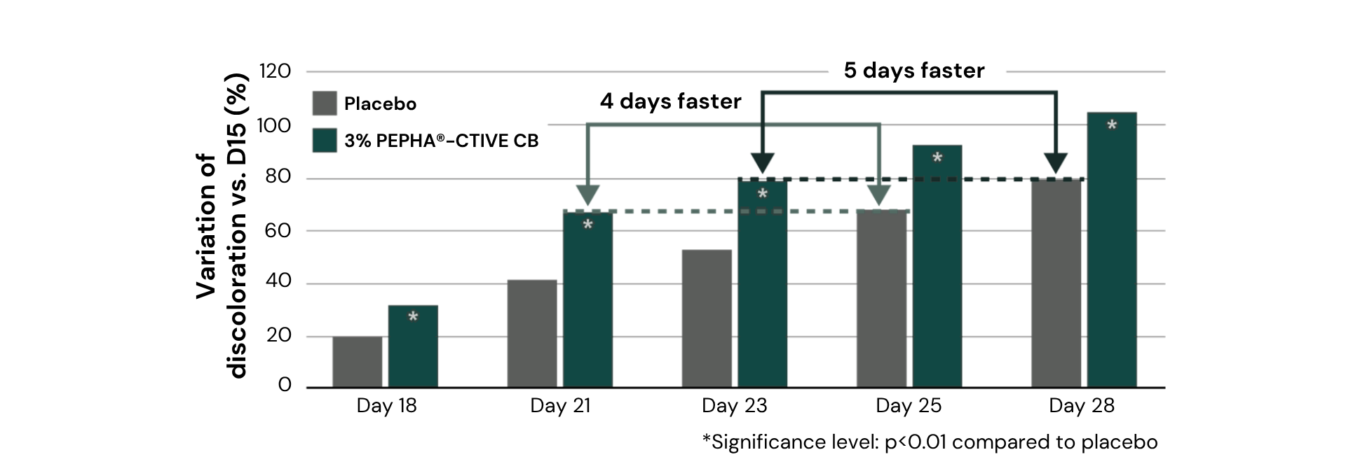
5 days faster skin renewal for luminous looking skin
PEPHA®-CTIVE CB
      PEPHA®-CTIVE CB visibly increased the skin renewal, inducing a faster skin renewal by 4 to 5 days.
      Result is a luminous looking appearance.
Notes:
Results:
On days 21 and 25, the skin treated with PEPHA®-CTIVE CB showed the same level of skin rejuvenation as the skin treated with a placebo on days 25 and 28 respectively.
PEPHA®-CTIVE CB thus significantly (p<0.01) increases cell turnover, inducing faster skin renewal by 4 to 5 days. The result is a fresher looking appearance.

Slide 42

Skin complexion
In vivo efficacy
PEPHA®-CTIVE CB
Volunteers
30 female volunteers, 35 – 60 years old
Presenting a dull skin complexion
Phototype I to III
Formulation
3% PEPHA®-CTIVE CB in a cosmetic formulation
Application
Randomized half-face application
Twice daily
28 days
Parameters
Evaluation of the CLBT-Parameters (Colour, Luminosity,
Brightness, Transparency) by trained professionals
Self-evaluation questionnaire
Biotech | Nature, enhanced by science
Notes:
The study was carried out on 30 volunteers presenting a dull skin complexion. A cream containing 3% PEPHA®-CTIVE CB was applied on half of face twice a day over 28 days.

Slide 43
Perfect luminous skin with the microalgae power
PEPHA®-CTIVE CB
Clinical study
Self-evaluation questionnaire
PEPHA®-CTIVE CB visibly improves skin’s luminosity for more than 4 out of 5 consumers.
Excellent acceptance among uses, with a significant improvement in skin complexion.
Notes:
Results:
PEPHA®-CTIVE CB received an excellent rating from the volunteers and dermatologists in all tested parameters.
This demonstrates its outstanding ability to visibly improve skin’s luminosity and the overall complexion.

Slide 44
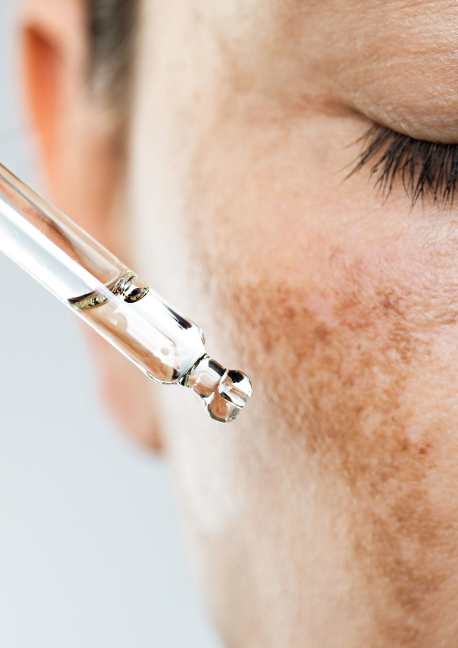
Formulation Guidelines
PEPHA®-CTIVE CB
INCI name (active): Dunaliella Salina Extract
Clear, yellowish liquid
Stable at pH ranges from 3.0 to 6.0
Should be processed below 50°C
Suggested concentration: 1–3 %
Cosmetic application
Skin energizing facial product
Glow, radiance enhancer
Protective day care for fresher and radiant looking skin
Biotech | Nature, enhanced by science

Slide 45
PEPHA®-CTIVE
Supported marketing claims
Clinically proven to improve skin glow on 9 users out of 10
It accelerates skin cell turnover for fresher looking skin… faster!
80% of users showed a visible improvement in skin brightness in Clinical Study
Excellent acceptance among users, with a significant perceived improvement in skin complexion

Slide 46
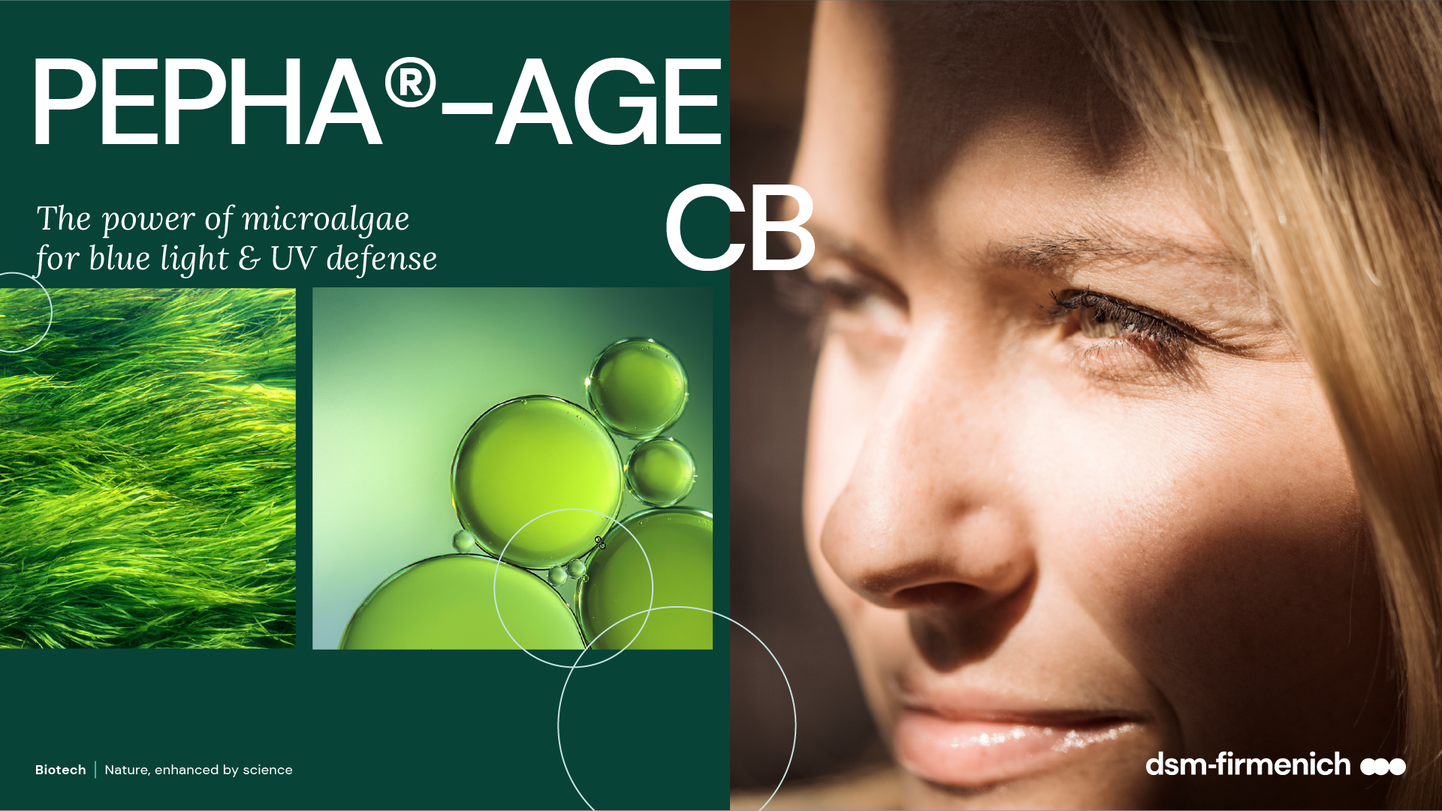

Slide 47





We’re exposed to different forms of blue light every day…
25-30% of solar radiation reaching the earth’s surface is blue light
Source of blue light high energy visible (HEV 400 – 500NM)
Natural light
Artificial light LED
Digital devices
25-30% blue
light emission
35% blue
light emission
35% blue
light emission
Indirect sun (Blue light 17mW/cm2) is about 100-fold more intense than electronic devices
Notes:
The natural dose of blue light you get within one hour from European midsummer sun is 60 J/cm^{2 /} 17mW/cm²x3600s=60J/cm²
60J/cm2 from a smartphone represents 416hours exposure (60J/40uW=1.5*10⁶/3600)
Be careful not to confuse radiometric (irradiance) and photometric (luminance) values
Sun radiation is composed by 5% UV, 50% visible and 45% IR
Smartphone: 40 μW/cm2 LCD monitor: about 80 μW/cm² LED: about 400 μW/cm²

Slide 48

Blue light contributes to aging
Blue light penetrates deep into the skin, contributing
to short- and long-term skin aging
Skin hyper-pigmentation and dark spots
Premature aging of skin induced by oxidative stress
  increasing level of free radicals (Reactive Oxygen Species)
  generates carbonylated proteins, proteins losing their functionality (responsible for yellowish, brownish color)
Less production of collagen: the fibroblasts are damaged, losing their functionality in turn leading to accelerated aging (UVA adverse effect)
Skin barrier impaired: the keratinocytes are damaged, increasing number of sunburn cells (UVB adverse effect)
Other negative effects on human health caused by blue light:
Eye damage (retina, macular degeneration)
Exposure in late evening impact the circadian rhythm (suppress production of melatonin - prevent sleep)
Notes:
During the daytime, the light that comes into our eyes releases enzymes in the morning, bringing melatonin levels down and helping us wake up. A consistent cycle of rest and wake, regulated by melatonin, comprises our circadian rhythm
415-455nm range is the most harmful compared to range 380-400
POSITIVE EFFECT ON HUMAN HEALTH:
Regulate our sleeping patterns (to stay awake all day)
Acne care

Slide 49



PEPHA®-AGE CB
ID Card
INCI name:
Scenedesmus Rubescens Extract, Aqua, Citric Acid, Pentylene Glycol
Sustainably farmed in photo-bioreactors, guaranteeing maximum quality (no risk of contamination, reproducibility of process, fully traceable
Derived from Scendesmus rubescens microalgae
100% naturally-derived origin (ISO 16128)
TECHNOLOGY:
Technical:
Form: Yellowish-brownish clear liquid
Use level: 1–3%
pH of use: 3.0 – 7.5
Preservative: Free
Solubility: Soluble in water
Prevents skin premature aging
Boosts skin’s own defenses against blue light*/**
Reduces blue light induced skin pigmentation (dark spots); evens skin tone***
Benefits:
Registration
certification
Raw material verified by ECOCERT GREENLIFE, conform to the COSMOS Standard
* in vitro ** ex vivo *** in vivo
Biotech | Nature, enhanced by science

Slide 50


The algae
Scendesmus Rubescens
Selection of the most active micro-algae living in freshwater lakes, after a screening of several species
This unicellular organism (5 - 10 μm) has a very strong cell wall, the unique protection against harsh environment (sunlight, current, pollution), which releases an unique set of active components.
“rubescens” is coming from the latin name ruber (red) and escens (becoming). This specific species contains red dots, rich in carotenoids (compound known to absorb blue light, red lens scientifically blocks blue light)
This algae has a circadian cycle (growing with daylight and multiplying by cellular division in the dark
Biotech | Nature, enhanced by science
50
Notes:
Scenedesmus’ meaning comes from skene (tent) and demos (bind) as the algae has the tendency to be colonized (4 – 8 cells)

Slide 51
Offers a unique variety of relevant active ingredients
PEPHA®-AGE CB
Amino-acids
Several key amino acids (Proline, Glycine, Alanine, Arginine) stimulating collagen synthesis and boosting epidermal renewing (Glutamic acid).
Multifunctional Vitamin B3, plays a central role in cellular metabolism. Energy storage, for healthy skin barrier, even pigmentation, anti-oxidant for multi-functional anti-aging benefits.
Important mono and oligosaccharides relevant to stimulate cell proliferation and increase of extracellular matrix biosynthesis.
Zinc, trace element, essential cofactor for biosynthesis of bio molecules for the collagen synthesis.
Vitamins
Sugars
Minerals

Slide 52

dsm-firmenich Solution: PEPHA®-AGE CB
Protects from blue light and UV skin damages
Ex vivo, PEPHA®-AGE CB: prevents skin premature aging
Protects against oxidative stress. Reduces free radicals (ROS) and carbonylated proteins levels after blue light exposure
In vitro / ex vivo PEPHA®-AGE CB: boosts the skin’s own defence
Stimulates fibroblasts viability and collagen production (collagen III) (in vitro & ex vivo)
Protects and repairs Fibroblasts viability against UVA exposure (in vitro)
Repairs the skin barrier function and protects Keratinocytes against UVB (ex vivo)
In vivo PEPHA®-AGE CB: evens skin tone
Reduces immediate blue light induced skin pigment darkening and dark spots
Reduces immediate blue light induced skin redness
Rebalances faster to skin normal pigmentation

Slide 53



Premature skin aging
PEPHA®-AGE CB reduces blue light induced free radicals up to 35%
Significant reduction of ROS levels
(blue light 380-470 nm)
Topical treatment with products before
and after blue light irradiation 100J/cm2*
Skin biopsies in culture
Donor: 65-year-old female
***
*
After 24h analysis and quantification of fluorescent signal (green) corresponding to ROS
The ROS reduction leads to drop inflammation reactions and then to reduce skin irritation and redness
* Representing the natural dose of blue light you get within 2 hours from European midsummer sun
*** p<0.001 vs non irradiated, * p<0.05 vs irradiated blue light
Notes:
Evaluation of reactive oxygen species (ROS)
Following the paper of Marionnet et al (Plos One, 9. 2014) the detection probe DCFH-DA has been applied in the culture medium for 30 minutes before the irradiation. Dichlorofluorescein diacetate (DCFH-DA) reacts with ROS becoming fluorescent. After changing the medium, blue light irradiation (380-470nm, max at 420nm) has been applied. 24h post-irradiation, the skin samples are harvested, cryo-fixed and cut at the cryostat for subsequent image acquisition and analysis.
The analysis of fluorescence is performed within the dermis area. The analyzed area is selected from the upper part by following the perimeter of the basal lamina, to the deep dermis, by carefully avoiding the risk of including irregularities and agglomerates, such as blood vessels, sebaceous glands, hair follicles, etc.
For each skin sample two sections have been taken and fluorescent image acquired. For each image the upper dermis has been analyzed by evaluating the fluorescence through modified Image-J application (NIH, USA). The obtained value has been normalized upon the dimension of the selected area

Slide 54
Premature skin aging
PEPHA®-AGE CB reduces blue light induced carbonylated proteins up to 61%
Significant reduction of carbonylated protein levels (blue light 380-470 nm)
Skin biopsies in culture.
Topical treatment with products before and after blue light irradiation (100J/cm2).
Donor: 65-year-old female
*
*
***
Carbonylated proteins result from an irreversible oxidative damage and give a yellowish/brownish color to the skin
*** p<0.001 vs irradiated blue light; *p,0.05 vs irradiated blue light
54
Notes:
Analysis and quantification of carbonylated proteins with Western plot anti body detection (visualized by staining)
The modification of amino acids such as histidine, cysteine, and lysine in proteins to carbonyl derivatives is known as protein carbonylation. Oxidative stress triggers protein carbonylation. Carbonylated proteins are missing their functionality.
Evaluation of carbonylated proteins
Carbonylated proteins were extracted from tissues 48h post-irradiation with blue light (380-470nm, max at 420nm). After harvesting, the frozen skin samples have been weighted and minced. The skin samples for each tested condition have been pooled and processed together by homogenization in cold extraction buffer. Total cell lysates have been recovered by centrifugation.
Carbonylated proteins in skin samples have been determined by “OxyBlot Protein Oxidation Detection Kit” (Millipore, #S7150) according to the manufacturers instructions by western blot and chemiluminescence detection.
The extent of the carbonyl content obtained for each sample have been normalized on actin protein signal band.

Slide 55
Collagen stimulation
PEPHA®-AGE CB boosts cellular viability and enhances collagen by 34%
Stimulates the viability of human dermal fibroblasts
Induced total collagen synthesis in human dermal fibroblasts
Cellular viability was analyzed on primary normal human dermal fibroblasts by MTT method after 48 h treatment
Total collagen content was quantified by Sirus Red staining after 48 h treatment.
*
**
**
**
*
Mean± SD; t-test significance
* p<0.05;
** p<0.01 vs control
* p=0.07 vs control by t-test
Scenedesmus dry extract (%)
Scenedesmus dry extract (%)
PEPHA®-AGE CB, at low concentration, stimulates in vitro total collagen up to 34% to reduce visible signs of sunlight induced ageing
Notes:
Scenedesmus dry extract = 2,5% PEPHA®-AGE CB (concentration has to be multiplied by 40)

Slide 56

Collagen III (youth collagen) 29% production boost
PEPHA®-AGE CB
Collagen III dramatically decreases with age
Collagen III stimulation with PEPHA®-AGE CB
**
+29%
*
+21%
+10%
Scenedesmus rubescens
dry extract (%)
Comparison of daily topical treatments versus DMSO at day 6.
Mean value ± SEM;*p<0.05,
** p<0.01 vs vehicle control by t-test
Test samples and control (4 µl) were topically applied on human skin biopsies (Ø 8 mm)
for 6 days, donor: 43 years old Immunohistochemical staining of Collagen type III
PEPHA®-AGE CB significantly strengthens the dermis and reduces visible sign of sunlight induced ageing

Slide 57
PEPHA®-AGE CB protects and regenerates fibroblasts
Viability before and after UVA exposure
Cellular protection
Cellular regeneration
PEPHA®-AGE CB: Treatment 1h before UVA
PEPHA®-AGE CB: Treatment 1h after UVA
*
Scenedesmus rubescens dry extract (%)
* p<0.05 vs control by t-test
Scenedesmus rubescens dry extract (%)
Cellular viability was measured
48 h after UVA irradiation
(20 J/cm2) using human dermal fibroblasts
PEPHA®-AGE CB protects the fibroblasts (up to 50%) from UV stress and regenerates the fibroblasts functionality (up to 200 %) after UV stress.

Slide 58
Skin barrier repair
PEPHA®-AGE CB reduces the number of sunburn cells by 63% against UVB
***
Protection of keratinocytes
Sunburn cells are keratinocytes undergoing programmed cell death (apoptosis) after they have received
a UVB dose that irreversibly and severely damaged their DNA.
An increasing number is a key indicator for ongoing damage
in the epidermis.
-21%
-24%
-37%
**
Comparison of treatments versus DMSO at day 2 Mean value ± SEM;
** p<0.01 vs DMSO; *** p<0.001 vs noUV by (unpaired t-test)
Test samples and control were topically applied on human skin biopsies
24 h and 1 h prior UVB irradiation
(1 J/cm2) against standard market product SPF 50+
PEPHA®-AGE CB protects skin against sunlight induced epidermal damage
*** p<0.001 vs no UV by t-test
** p<0.01vs vehicle by t-test

Slide 59


PEPHA®-AGE CB blue light
in vivo study design
33 female volunteers (mean 32 years old, Caucasian 80% and Asian skin 20%)
Randomized double blind with placebo
Cream formulations with 3% PEPHA®-AGE CB (without sun filter)
Forearm application once a day for 34 days (application started 6 days before blue light exposure to strengthen the skin)
Exposition 4 days consecutively on forearm with LED lamp at 450nm with 60J/cm2*:
Skin color measurements (chromameter) and Image analysis
* natural dose you get within one hour from European midsummer sun)
Biotech | Nature, enhanced by science
59
Notes:
Study for 28 days in Mauritius
21 - 41 years old (mean 32, mainly millennials)
Exposition on forearm (4x6cm)
450 nm (peak in blue light with LED and electronic devices)
Application of PEPHA®-AGE CB during 6 days before blue light exposure to strengthen the skin by pre-conditioning it and continuing all along the study

Slide 60

Skin darkening
PEPHA®-AGE CB reduces blue light induced immediate skin hyper-pigmentation by 30%
Colorimetry ITA° angle
PEPHA®-AGE CB proves to be highly effective against hyper-pigmentation:
Immediate reduction of skin pigment darkening (-30%)
Rebalance faster to skin normal pigmentation
Restores even skin tone
ITA° is inversely correlated with skin pigmentation: the lower the ITA value, the darker the skin
Colorimetry ITA angle, ITA° takes into account 2 parameters: luminance (L*) and yellow-blue tone (b*).
Notes:
Reminder: at D4, not anymore blue light irradiation

Slide 61




Reduces blue light induced skin pigment darkening
PEPHA®-AGE CB
RD012 right
3% PEPHA®-AGE CB
D0
RD012 left
Placebo
RD012 right
3% PEPHA®-AGE CB
D3
RD012 left
Placebo
Skin coloration: ITA°
35.4
34.4
28.6
17.3
RD012 right
3% PEPHA®-AGE CB
D4
RD012 left
Placebo
RD012 right
3% PEPHA®-AGE CB
D10
RD012 left
Placebo
31.0
24.3
32.8
27.0
Volunteer 12 – ITA° - left forearm with placebo and right with 3% PEPHA®-AGE CB

Slide 62




Reduces blue light induced redness
PEPHA®-AGE CB
RD013 right
3% PEPHA®-AGE CB
D0
RD013 left
Placebo
RD013 right
3% PEPHA®-AGE CB
D3
RD013 left
Placebo
Skin coloration
a* value
7.1
6.9
10.4
13.4
RD013 right
3% PEPHA®-AGE CB
D4
RD013 left
Placebo
RD013 right
3% PEPHA®-AGE CB
D10
RD013 left
Placebo
8,1
11.6
7.9
8.7
Volunteer 13 – left forearm with placebo and right with PEPHA®-AGE CB a higher a* value a higher redness

Slide 63

Reduces blue light induced redness
30% reduction of blue light induced skin redness with PEPHA®-AGE CB
PEPHA®-AGE CB protects the skin against immediate irritation induced by blue light.
The skin color is less red (-25% with 3% PEPHA®-AGE CB compared to placebo) just after 4 days blue light irradiation
Redness: a* value (delta to do) normalized to placebo

Slide 64

Formulation Guidelines
PEPHA®-AGE CB
INCI name (active): Scenedesmus Rubescens Extract
Clear yellow-brownish to brown liquid
Stable at pH ranges from 3.0 to 7.5
Should be processed below 40°C
Suggested concentration: 1–3 %
Cosmetic application
Day care products
Sun care and after sun formulations
Regenerative night care
Anti-aging products
Biotech | Nature, enhanced by science

Slide 65
PEPHA®-CTIVE
Supported marketing claims
Minimizes the appearance of ageing after exposure to blue light and UV
Reduces skin damage caused by natural and artificial blue light sources
Improves overall skin appearance and offers an even skin tone

Slide 66

The power of algae with PEPHA® MICROALGAE ingredients
Biotech | Nature, enhanced by science
66

Slide 67


Discover the hidden secret of nature
for a healthy-looking skin!
Powered by blue biotechnology ingredients, the deep beauty skincare range nourishes skin, protects against external aggressors and helps minimize the appearance of fine lines and wrinkles with an immediate and long-lasting lifting effect. For skin that looks firmer, more vibrant healthier.
Is this not the ultimate deep beauty?!
For internal use only. Illustrated products are for experimental use and are not for sale. dsm-firmenich is not responsible for final products claims
Biotech | Nature, enhanced by science

Slide 68

        For internal use only. Illustrated products are for experimental use and are not for sale. dsm-firmenich is not responsible for final products claims

Slide 69


With PEPHA®-AGE CB, PARSOL® UV-filters,
DL-alpha-Tocopheryl Acetate, VALVANCE® Touch 210, HYA-ACT™ M
This luxurious soft texture is designed to boost skin’s own defenses against photo-ageing for a radiant looking complexion. Packed with high-performing UV-filters and Blue Biotechnology, it protects against external aggressors (including UV & blue light) and promotes skin natural repair processes.
For skin that feels stronger and healthier looking.
80.17% natural origin content according to ISO 16128.
SK-E-102111-4
        For internal use only. Illustrated products are for experimental use and are not for sale. dsm-firmenich is not responsible for final products claims

Slide 70



Radiant day shield SPF 30
 | Ingredients | INCI Name | % w/w
A | Cetiol® B | DIBUTYL ADIPATE | 7,00
 | PARSOL® EHS | ETHYLHEXYL SALICYLATE | 3,00
 | PARSOL® EHT | ETHYLHEXYL TRIAZONE | 2,00
 | PARSOL® Shield | BIS-ETHYLHEXYLOXYPHENOL METHOXYPHENYL TRIAZINE | 1,50
 | PARSOL® 1789 | BUTYL METHOXYDIBENZOYLMETHANE | 1,00
 | Dermosoft® GMCY MB | GLYCERYL CAPRYLATE | 0,50
 | TEGIN® M Pellets MB | GLYCERYL STEARATE | 0,40
 | TEGO CARE PBS 6 MB | POLYGLYCERYL-6 STEARATE, POLYGLYCERYL-6 BEHENATE | 3,20
 | DL-alpha-Tocopheryl Acetate | TOCOPHERYL ACETATE | 0,50
 | Lanette® O | CETEARYL ALCOHOL | 1,00
 | Lexfilm Sun Natural MB | CAPRYLOYL GLYCERIN/SEBACIC ACID COPOLYMER | 1,50
 | VALVANCE® Touch 210 | SILICA | 2,00
 | DUB DIS | DIISOPROPYL SEBACATE | 4,00
B | PARSOL® HS | PHENYLBENZIMIDAZOLE SULFONIC ACID | 2,00
 | HYA-ACT™ M | SODIUM HYALURONATE | 0,10
 | Sodium Hydroxide Pellets Emprove | SODIUM HYDROXIDE | 0,30
 | Dermofeel® PA-3 | SODIUM PHYTATE, AQUA, ALCOHOL | 0,10
 | Water Dem | AQUA | 60,27
 | PARSOL® Max | METHYLENE BIS-BENZOTRIAZOLYL TETRAMETHYLBUTYLPHENOL, AQUA, DECYL GLUCOSIDE, PROPYLENE GLYCOL, XANTHAN GUM | 4,00
 | Dermosoft® Octiol | CAPRYLYL GLYCOL | 0,20
C | Propanediol | PROPANEDIOL | 2,00
 | Verdessence Xanthan | XANTHAN GUM | 0,30
D | PEPHA®-AGE CB | SCENEDESMUS RUBESCENS EXTRACT, AQUA, PENTYLENE GLYCOL, CITRIC ACID | 3,00
E | Sodium Hydroxide 10% Solution | AQUA, SODIUM HYDROXIDE | 0,13
Procedure
Mix ingredients of Phase A and warm up to 75°C, until a clear solution is obtained.
Mix Phase B while heating up to 75°C.
Premix Phase C and add it to Phase B.
Add Phase A to Phase B+C and homogenize 5 minutes.
Cool down to room temperature under gentle stirring.
Add Phase D at 30°C and keep stirring.
Adjust the pH to 7.0-7.5 with Phase E.
Technical Data
pH: 7.28
Viscosity (spindle RV 03/ 10 rpm): 4540 mPa.s
The formulation fulfils the 3 months stability
at 4°C, 40°C, 50°C, Room Temperature and Daylight
SK-E-102111-4
This information is for illustration purposes only and based upon our current knowledge and experience at the time of printing. We do not make any representation or warranty of any kind, express or implied, including merchantability or fitness for a particular use, with respect to such information or its application. Use of this information is at your discretion and risk. Nothing herein relieves you from carrying out your own suitability determinations and tests. You are responsible for observing all laws and regulations relevant to your products, uses or processes. We do not assume any liability in connection with your product and its use. The foregoing information and suggestions are also provided without warranty of non-infringement as to the intellectual property rights of third parties and shall not be construed as any inducement to infringe the rights of third parties.
With an Eco Class A rating, this formulation minimizes the impact on the environment.
SPF and Eco Class calculated by the dsm-firmenich Sunscreen Optimizer™ 2.0

Slide 71



With PEPHA®-TIGHT CB, PEPHA®-CTIVE CB, ARGAN OIL, Mixed Tocopherols 95, SYN®-COLL CB and D-Panthenol 75 L
Your skin ally for an on-the-go extra boost of nourishment! Packed with Marine Biotech Complex, rich in amino acids, vitamins, minerals, antioxidants and essential fatty acids for immediate and long-lasting healthy-looking skin. This lightweight milky texture is designed for dual application:
roll it over targeted zones for precision tightening
spray it in a fine facial mist for instant hydration that smoothens and re-energizes your skin
99.39% natural origin content according to ISO 16128
SK-E-102022-36
        For internal use only. Illustrated products are for experimental use and are not for sale. dsm-firmenich is not responsible for final products claims

Slide 72


2in1 milky lotion on-the-go
 | Ingredients | INCI Name | % w/w
A | Water Dem | AQUA | 88,23
 | Cosphaderm® Pentiol natural | PENTYLENE GLYCOL | 3,00
 | Dermosoft® Octiol | CAPRYLYL GLYCOL | 0,20
 | Sucrathix VX | MICROCRYSTALLINE CELLULOSE, CELLULOSE GUM, XANTHAN GUM | 1,00
 | SOLAGUM™ AX | ACACIA SENEGAL GUM, XANTHAN GUM | 0,20
 | SUCRABLEND SP V2 | SUCROSE STEARATE, SUCROSE PALMITATE | 1,00
B | Myritol® 331 | COCOGLYCERIDES | 2,75
 | Kokosoel raffiniert Ph. Eur. | COCOS NUCIFERA OIL | 1,00
 | ARGAN OIL | ARGANIA SPINOSA KERNEL OIL | 1,00
 | Lanette® O | CETEARYL ALCOHOL | 0,25
 | Mixed Tocopherols 95 | TOCOPHEROL | 0,10
C | PEPHA®-TIGHT CB | NANNOCHLOROPSIS OCULATA EXTRACT, PULLULAN, AQUA, PENTYLENE GLYCOL, CITRIC ACID | 0,35
 | SYN®-COLL CB | PALMITOYL TRIPEPTIDE-5, GLYCERIN, AQUA | 0,46
 | PEPHA®-CTIVE CB | DUNALIELLA SALINA EXTRACT, AQUA, PENTYLENE GLYCOL, CITRIC ACID | 0,30
 | D-Panthenol 75 L | PANTHENOL, AQUA | 0,10
D | Citric Acid 10% Solution | CITRIC ACID, AQUA | 0,06
Procedure
Mix Phase A and heat up to 75-80°C.
Mix Phase B and heat up to 75-80°C.
Add Phase B to Phase A.
Homogenize 1 min with Ultra-Turrax.
Let cool down under stirring.
Add Phase C at room temperature.
Adjust pH to 5.5 with Phase D.
Homogenize again 1 min with Ultra-
Turrax.
Technical Data
pH: 5.43
Viscosity (spindle RV 03/ 10 rpm): 1080 mPa.s
The formulation fulfils the 3 months stability
at 4°C, 40°C, 50°C, Room Temperature and Daylight
SK-E-102022-36
This information is for illustration purposes only and based upon our current knowledge and experience at the time of printing. We do not make any representation or warranty of any kind, express or implied, including merchantability or fitness for a particular use, with respect to such information or its application. Use of this information is at your discretion and risk. Nothing herein relieves you from carrying out your own suitability determinations and tests. You are responsible for observing all laws and regulations relevant to your products, uses or processes. We do not assume any liability in connection with your product and its use. The foregoing information and suggestions are also provided without warranty of non-infringement as to the intellectual property rights of third parties and shall not be construed as any inducement to infringe the rights of third parties.

Slide 73


With PEPHA®-CTIVE CB, PEPHA®-TIGHT CB
A concentrated shot of the most powerful marine ingredients for strong anti-aging benefits. Skin looks firmer and plumper, evener and re-energized.
100% natural origin content according to ISO 16128
SK-E-102087-5
        For internal use only. Illustrated products are for experimental use and are not for sale. dsm-firmenich is not responsible for final products claims

Slide 74

Revitalizing serum
 | Ingredients | INCI Name | % w/w
A | Water Dem | AQUA | 54,50
 | PEPHA®-CTIVE CB | DUNALIELLA SALINA EXTRACT, AQUA, PENTYLENE GLYCOL, CITRIC ACID | 3,00
 | PEPHA®-TIGHT CB | NANNOCHLOROPSIS OCULATA EXTRACT, PULLULAN, AQUA, PENTYLENE GLYCOL, CITRIC ACID | 3,00
B | Propanediol | PROPANEDIOL | 39,50
Procedure
Prepare the Phase A.
Prepare Phase B and add it to Phase A.
Technical Data
pH: 5.4
Viscosity: Liquid
The formulation fulfils the 3 months stability
at 4°C, 40°C, 50°C, Room Temperature and Daylight
SK-E-102087-5
This information is for illustration purposes only and based upon our current knowledge and experience at the time of printing. We do not make any representation or warranty of any kind, express or implied, including merchantability or fitness for a particular use, with respect to such information or its application. Use of this information is at your discretion and risk. Nothing herein relieves you from carrying out your own suitability determinations and tests. You are responsible for observing all laws and regulations relevant to your products, uses or processes. We do not assume any liability in connection with your product and its use. The foregoing information and suggestions are also provided without warranty of non-infringement as to the intellectual property rights of third parties and shall not be construed as any inducement to infringe the rights of third parties.

Slide 75


With PEPHA®-TIGHT CB, ALPAFLOR® EDELWEISS CB
A concentrated solid serum stick for targeted application. Enriched with powerful Active Algae, it helps minimize the appearance of fine lines and wrinkles with an immediate tightening effect and, when applied regularly, it acts as a protective shield against oxidative stress for healthier and firmer looking skin.
100% natural origin content according to ISO 16128
SK-E-101904-15
        For internal use only. Illustrated products are for experimental use and are not for sale. dsm-firmenich is not responsible for final products claims

Slide 76

Instant tightening ultra-precision stick
 | Ingredients | INCI Name | % w/w
A | Water Dem | AQUA | 48.70
 | Glycerine CremerGLYC 86.5% | GLYCERIN | 15,00
B | Propanediol | PROPANEDIOL | 15,00
 | Kelcogel® CG-LA | GELLAN GUM | 0,50
C | RonaCare® Sodium Chloride | SODIUM CHLORIDE | 0,50
 | Water Dem | AQUA | 9,00
D | Sodium Stearate OP-200 V | SODIUM STEARATE | 6,30
E | Silica, Titanium Dioxide | SILICA, TITANIUM DIOXIDE | 1,00
F | ALPAFLOR® EDELWEISS CB | LEONTOPODIUM ALPINUM FLOWER/LEAF EXTRACT, GLYCERIN, AQUA, CITRIC ACID | 3,00
 | PEPHA®-TIGHT CB | NANNOCHLOROPSIS OCULATA EXTRACT, PULLULAN, AQUA, PENTYLENE GLYCOL, CITRIC ACID | 1,00
Procedure
Mix Phase B and add to Phase A.
Heat up to 90°C.
Stir until homogeneous.
Add Phase C and stir until homogeneous.
Add Phase D and stir until dissolved (light turbid).
Add Phase E and cool down to 80°C.
Add Phase F and stir until homogeneous.
Then fill into packaging at 75°C.
The formulation fulfils the 3 months stability
at 4°C, 40°C, 50°C, Room Temperature and Daylight
SK-E-101904-15
This information is for illustration purposes only and based upon our current knowledge and experience at the time of printing. We do not make any representation or warranty of any kind, express or implied, including merchantability or fitness for a particular use, with respect to such information or its application. Use of this information is at your discretion and risk. Nothing herein relieves you from carrying out your own suitability determinations and tests. You are responsible for observing all laws and regulations relevant to your products, uses or processes. We do not assume any liability in connection with your product and its use. The foregoing information and suggestions are also provided without warranty of non-infringement as to the intellectual property rights of third parties and shall not be construed as any inducement to infringe the rights of third parties.

Slide 77
Disclaimer
Copyright © DSM Nutritional Products Ltd 2025, 4002 Basel, Switzerland.
www.dsm-firmenich.com. All rights reserved.
dsm-firmenich has used diligent care to ensure that the information provided herein is accurate and up-to-date to the best of its knowledge. However, dsm-firmenich makes no representation or warranty, either expressly or implied, of the accuracy, reliability, completeness, or suitability thereof. The information provided herein contains scientific and product information for business-to-business use and does not constitute or provide scientific or medical advice, diagnosis or recommendation for treatment options. Country or region-specific information should be considered when labelling or advertising to final consumer. In no event shall dsm-firmenich be liable for any direct or indirect damages arising from or reliance upon, or use of, any information provided herein. The content of this document is subject to change without further notice. Please contact your local dsm-firmenich representative for the latest information. All trademarks listed in this document are either (registered) trademarks of, or trademarks licensed by, the dsm-firmenich group of companies, unless explicitly stated otherwise.
Disclaimer Formulation Guideline
The information provided herein is provided for information purposes only and has been prepared by dsm-firmenich in accordance with its own methodology.
dsm-firmenich has used diligent care to ensure that it is accurate and up-to-date, however, dsm-firmenich makes no representation or warranty, either expressly or implied, of the accuracy, reliability, or completeness thereof. In no event shall dsm-firmenich be liable for any damages arising from or reliance upon, or use of, any information provided herein. Further, dsm-firmenich shall not bear any liability for the application and/or use of any processed material containing its product(s). The formulation of the finished product is the customer’s sole responsibility. It is the customer’s responsibility to determine the suitability of dsm-firmenich’s products regarding user specific purposes, assess compatibility and stability of their finished product(s) and to ensure compliance of their finished product(s) with relevant laws and regulations. Any product, marketing or other claims made by customer are its sole responsibility. The content of this document is subject to change without further notice. Please contact your local dsm-firmenich representative for further details. © 2025 dsm-firmenich group.

