Slide 1
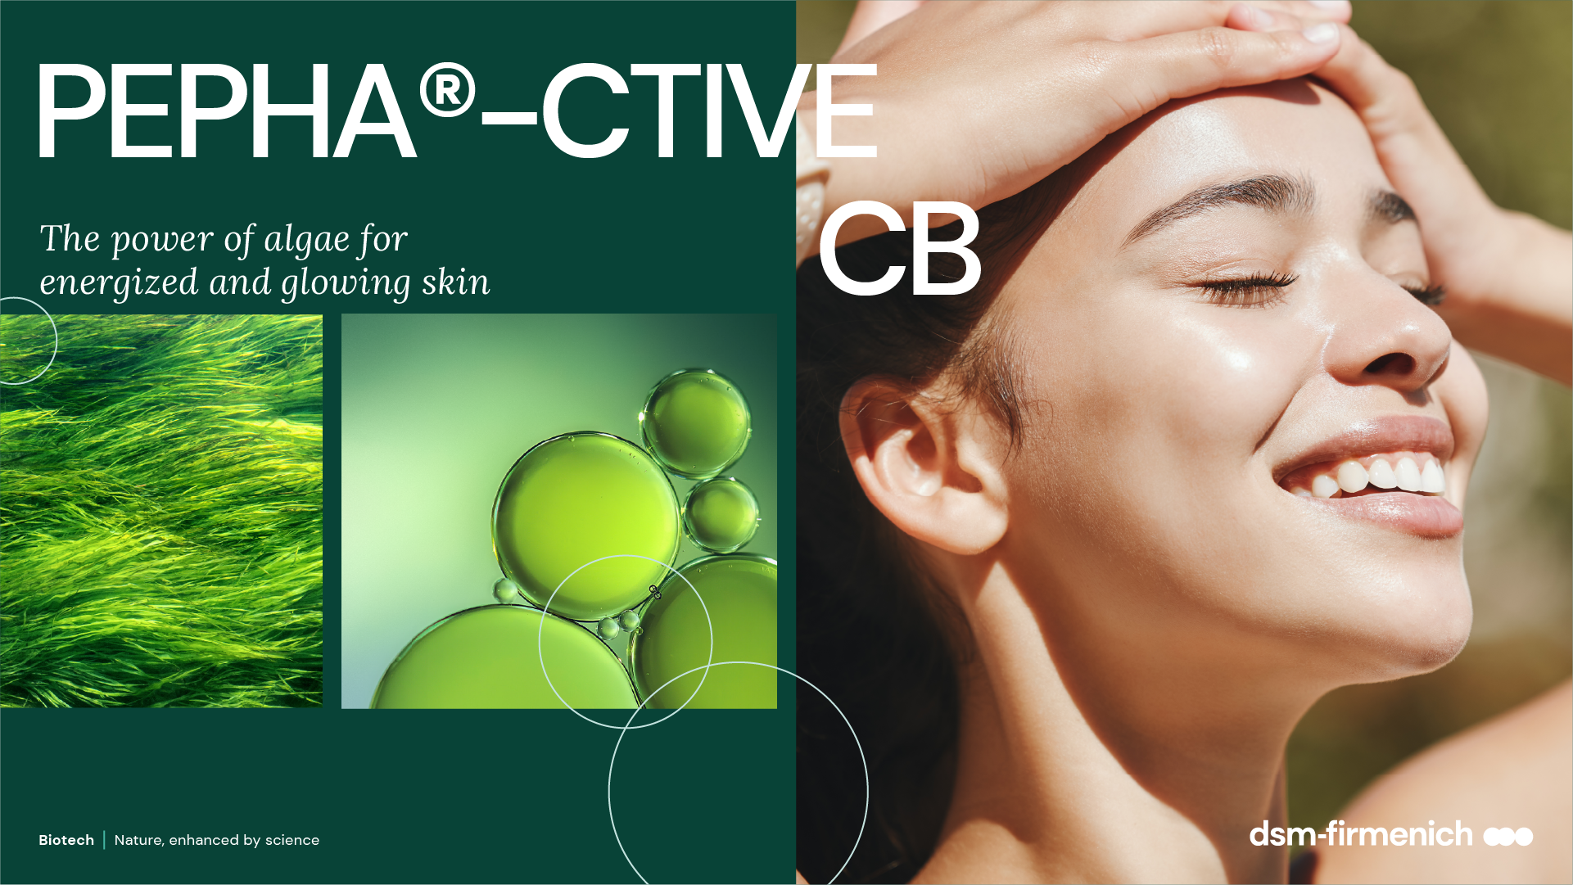
June 2025

Slide 2
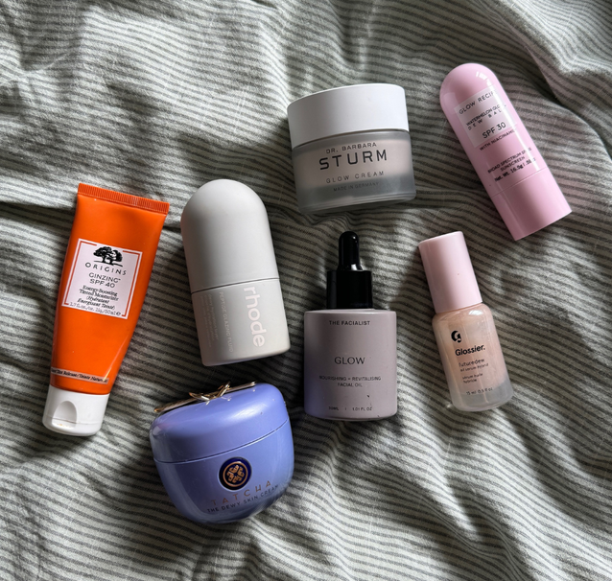
Healthy skin: A new skincare dialogue
Amplifying the desire for Glowing, Energized, and Rejuvenated skin benefits
Skincare and make-up blurring the lines*
Glowing & Luminous skin
Energized and Radiant skin
In 2022, skincare products have surpassed makeup products in conversations about skin finishes. Skin finishes refer to the final appearance and texture of the skin after applying makeup or skincare.
In July 2024, 43% of users discussing skin finishes mentioned terms like "glowing," "radiant," or "luminous."
The demand for a "healthy" look is rising across regions. In 2022, social media mentions of "glowy," "radiant," and "luminous" dominated skin finish aesthetics.*
Achieving a glowing skin requires a streamlined skincare routine with effective ingredients.**
Energized skin is emerging as a new standard for healthy skin, combining glow, brightness, and rejuvenation. ***
Brands are capitalizing on this trend by introducing products that promise to invigorate and refresh the skin, often using innovative ingredients like ATP for energy boosting. ***
*WGSN TrendCurve: Evolving Skin Finishes
** Glowing Skin Routine: Tips & Product Recommendations | Marie Claire UK
***Mintel: Infegy Atlas/Mintel, November 2023- October 2024; Ipsos Observer/Mintel, September 2024

Slide 3

Algae are becoming a major skincare ingredient…
Biotech | Nature, enhanced by science
3

Slide 4


A story of natural resilience
Oldest plant surviving geological ordeals
ALGAE
Very stable, resistant and resilient organisms
For thousands years, microalgae has been able to survive under the
stress of different environments
More than 70% of the earth
is covered by water.
It provides many unique environments and
rich resources.
Rich in nutrients, like Vitamins & Minerals
Source of effective Bioactives
for pharmaceuticals, nutraceuticals and skincare
Biotech | Nature, enhanced by science
4

Slide 5
Ticking the box of naturality and sustainability
Consumers are seeking natural and ethical ingredients
In the US
In the UK
In Spain
of facial skincare users say it is important for their products to ﻿contain natural ingredients
of Gen Z beauty users always look for products that are environmentally friendly
of ﻿adults would be willing to buy BPC made exclusively with lab-grown ingredients if they are better for the planet
41%
58%
51%
Lab-grown is the next-natural in sustainability
Algae can be lab-grown, the key to true sustainability as we reassess our relationship with oceans and planet.
Consumers will be accepting of lab-grown alternatives, perceived as natural and sustainable.
Source: Lightspeed/Mintel
Notes:
Algae also tick the box of naturality and sustainability, which are the must-have for conscious consumers
Consumers start understanding that natural doesn’t mean necessarily sustainable and lab-grown solutions are becoming the next natural in sustainability, because they allow preserving the biodiversity of the environment

Slide 6
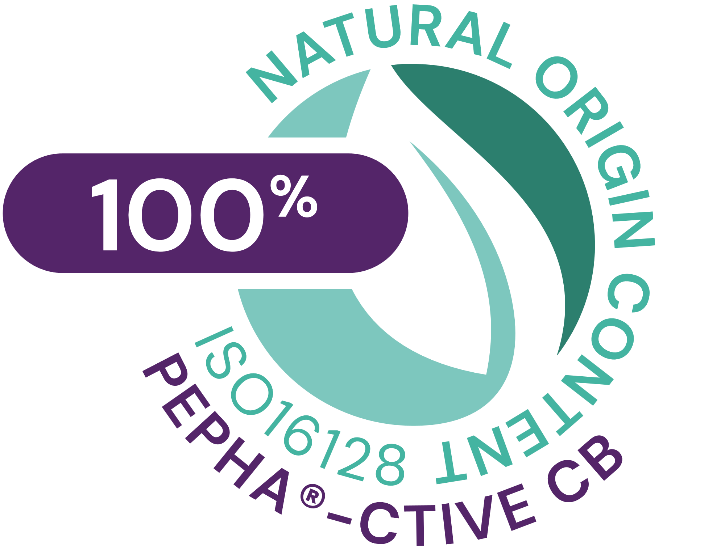





PEPHA®-CTIVE CB
ID Card
INCI name:
Dunaliella Salina Extract, Aqua, Citric Acid, Pentylene Glycol
Sustainably farmed in photo-bioreactors, guaranteeing maximum quality (no risk of contamination, reproducibility of process, fully traceable). Cultivated in controlled conditions, optimally exposed to the right cellular stress: high salinity, high light intensity, nutrient deprivation, and extreme temperatures
Derived from Dunaliella salina microalgae
100% naturally-derived origin (ISO 16128)
TECHNOLOGY:
Technical:
Form: Yellowish clear liquid
Use level: 1–3%
pH of use: 3.0 – 6.0
Preservative: Free
Solubility: Soluble in water
Induces faster skin renewal by 4 to 5 days, for a Induce faster skin renewal and visibly improves skin’s luminosity***
Benefits:
Protects the mitochondria against oxidative stress*
Increases the energy content in keratinocytes*
Stimulates fibroblasts’ proliferation*
Registration
certification
Raw material verified by ECOCERT GREENLIFE, conform to the COSMOS Standard
* in vitro ** ex vivo *** in vivo
Biotech | Nature, enhanced by science
6

Slide 7

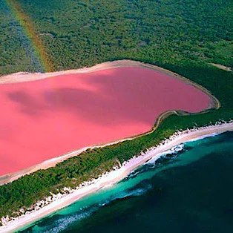

The algae
Dunaliella salina
Dunaliella salina is a very small unicellular microalga in
the green algae family
It was first discovered in 1838 by Dunal in the salters of Montpellier, on the Mediterranean coast of France.
Naturally grows in salt lakes with up to 30% salinity (9x higher than regular sea water) and constantly exposed to harsh environmental conditions (High osmotic pressure, elevated oxygen levels and high UV irradiation).
To withstand these conditions, the microalgae produces high levels of energy through photosynthesis and adapts by generating large amounts of beta-carotene, which gives it (and so the water) a pinkish color
Biotech | Nature, enhanced by science
7
Notes:
The microalgae Dunaliella salina is a very small unicellular microalgae.
It was first discovered in 1838 by Dunal in the salters of Montpellier, on the Mediterranean coast of France.
It naturally grows in salt lakes with up to 30% salinity (this is nine times higher than regular sea water). It is therefore constantly exposed to harsh environmental conditions, such as high osmotic pressures, elevated oxygen levels, and high UV irradiation.
To withstand these conditions, the microalgae produce high levels of energy through photosynthesis.
Dunaliella salina key protective compounds:
β-carotene is a type of pro-vitamin A, responsible for inhibiting the production of free radicals from ultraviolet light.
Among various carotenoid-rich microalgae, Dunaliella salina has the greatest carotene concentration making up ~10% algal dry weight.
- Glycerol is a compatible solute in which not only contributes to osmotic balance of the cell but also maintains enzyme activity.

Slide 8
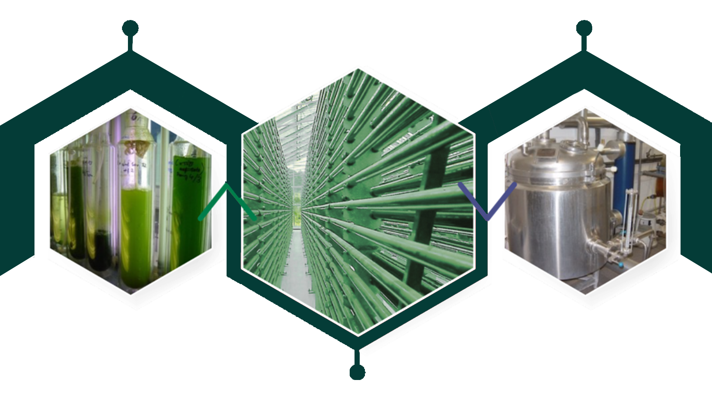
The production process
A special growth by photobioreactors, for maximum quality & sustainability
Preculture
Hot water
extraction
Maximizes the optimal
growth conditions by
providing sufficient light and minimizes the contamination risk: purity, high quality and high content of active substances are ensured
Enables standardization
Respects biodiversity
High level of renewable sources of energy
Cultivation in huge
photobioreactor

Slide 9
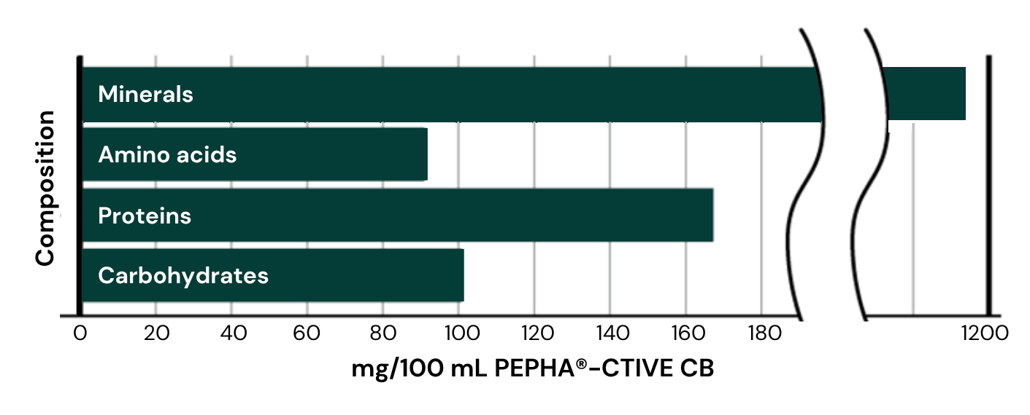
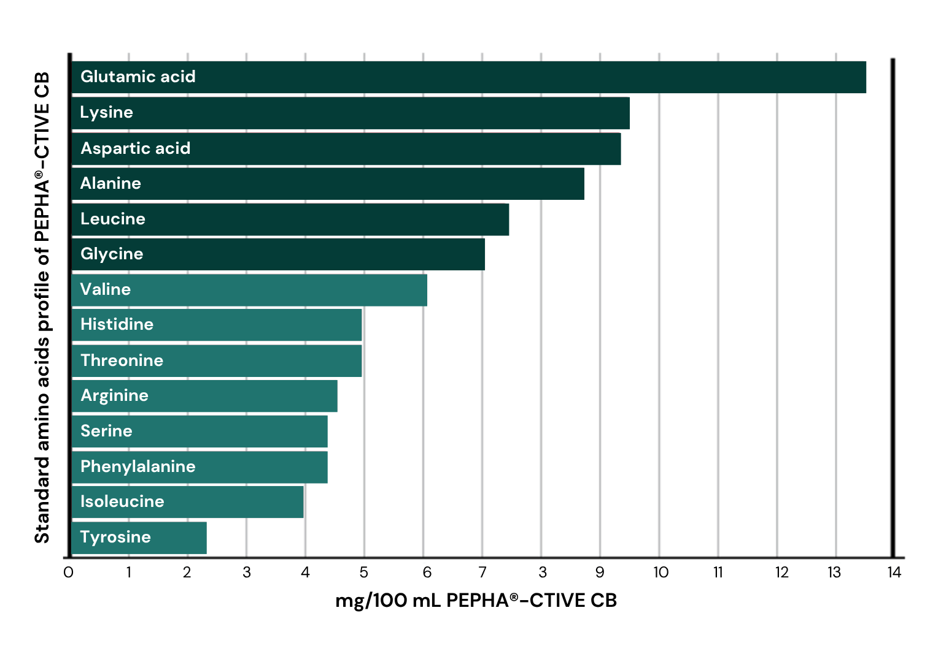
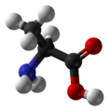
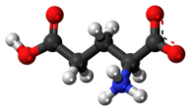
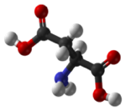
Unique Amino Acids composition
PEPHA®-CTIVE CB
Essential to cell energy production:
Alanine
Glutamic acid
Aspartic acid
Amino acids, proteins, carbohydrates, and minerals are fundamental
bio-catalysts and building blocks for the cellular metabolism, e.g. ATP synthesis
Notes:
PEPHA®-CTIVE CB is composed of a powerful and complex cocktail of active compounds.
This slide represents the main compounds. Additionally, vitamins, co-factors, enzymes are also part of the composition, but were not individually quantified.
Source: internal analysis 2006

Slide 10

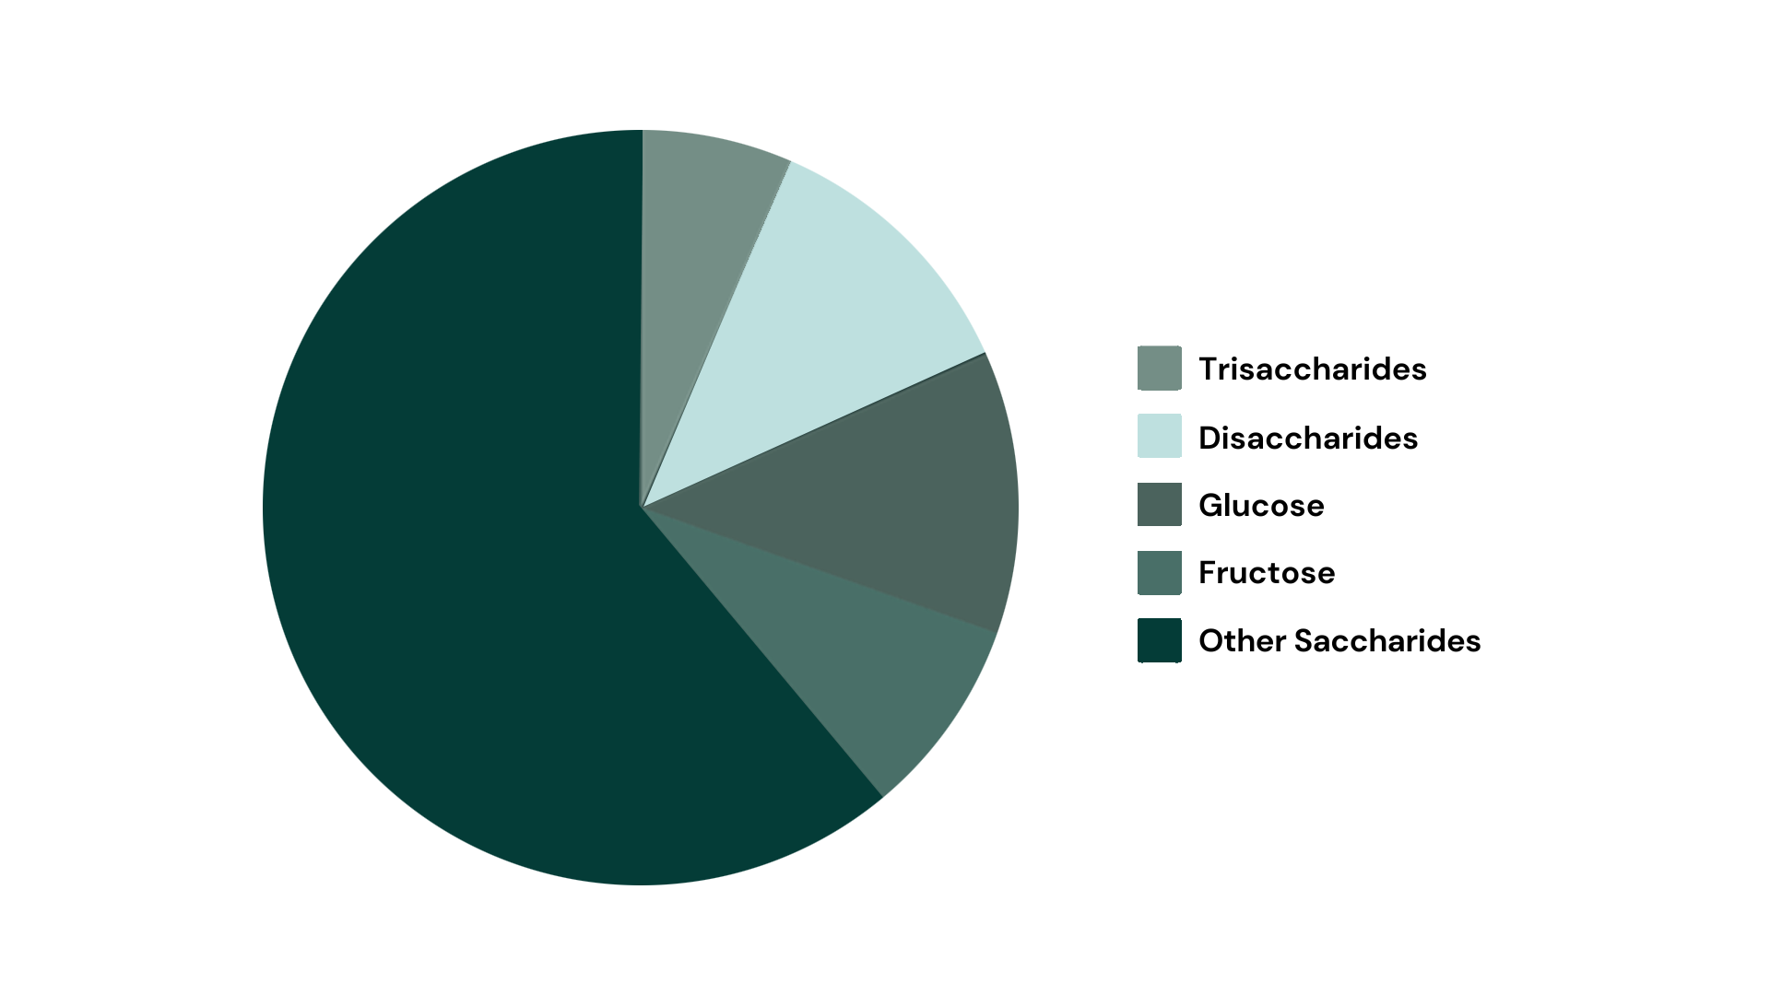
PEPHA®-CTIVE CB’s Carbohydrates
Source of cellular energy
Essential role of carbohydrates for cells metabolism, communication, and structure
Notes:
Carbohydrates play an essential role in the cellular metabolism, communication, and structure.
This key role was broadly communicated by L’Oréal with the launch of Yves Saint Laurent new product “Forever Youth Liberator”:
“Glycobiology is one of the 10 sciences that will change future medicine according to the Massachusetts Institute of Technology. Glycobiology has to do with the structure, metabolism and biological role of glycans found in living beings. Glycans are macromolecules formed by chains of complex sugar. Research has demonstrated that glycans are present in the organism at three levels: in other words on the cell’s surface inside the cell and between the cells. This particularity gives them three functions concerning the skin: metabolism of the cells, communication between the cells and the structure of the tissues which plays on the aspect of the skin.
Used in cosmetics and skincare for the first time, glycobiology has become an innovative scientific field which helps better understand and combat visible signs of ageing. Found naturally in the skin, glycans are responsible for the transmission for the youth messages of the cells. With age, the rate and quantity of glycans diminishes, hindering the skin’s regeneration process. The first signs of ageing appear: wrinkles, loss of tone, and dull complexion.”
Source: http://magazine.loreal-finance.com/en/glycobiology-used-first-time-cosmetics.htm

Slide 11
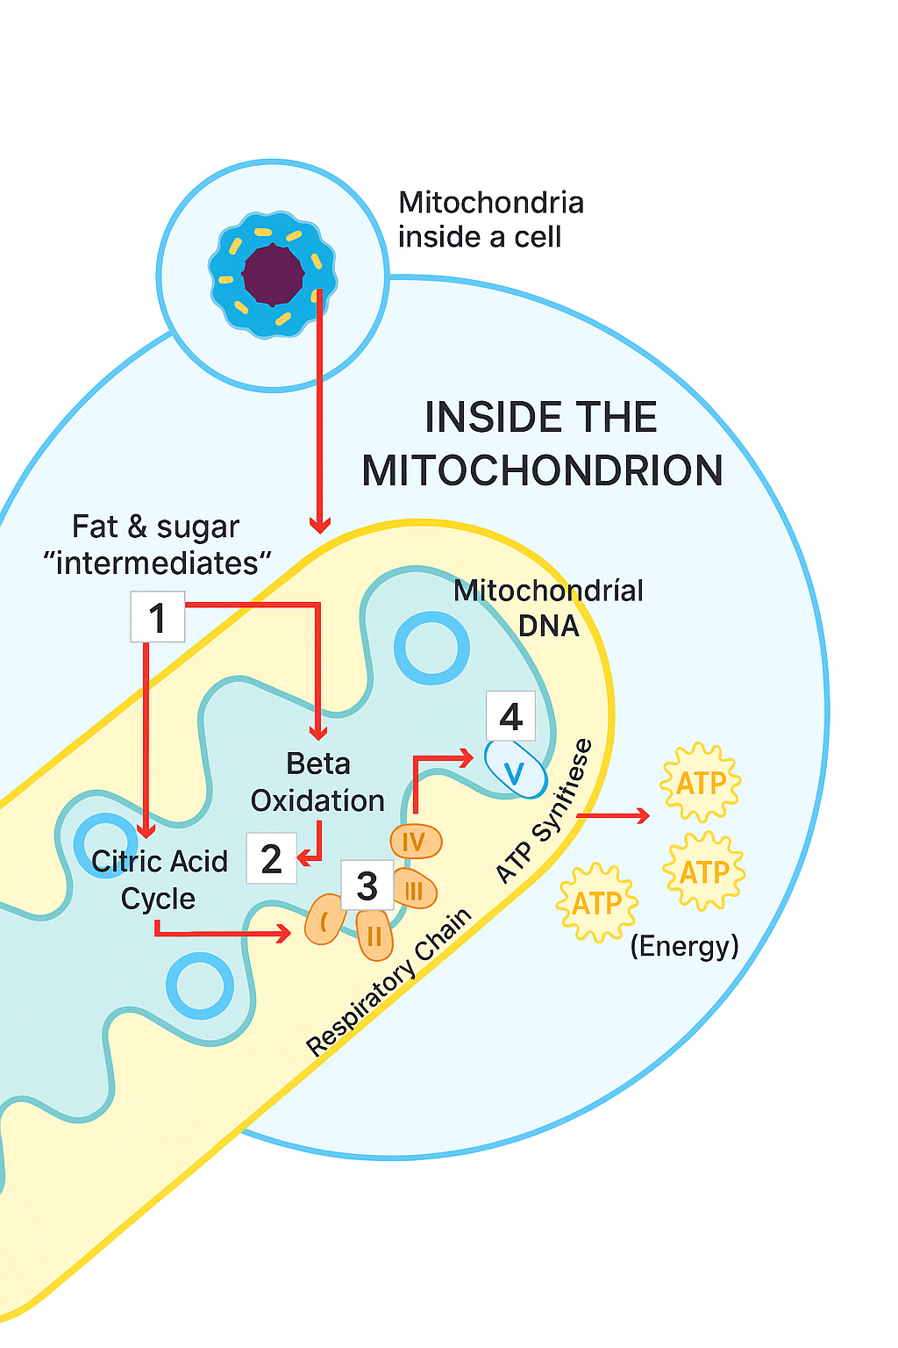
Mitochondria
The secret power within cells
Mitochondria are the power stations of skin cells, responsible to produce ATP.
ATP is necessary to maintain the functionality of cells.
Over time, the mitochondria lose their activity.
The skin cells are not sufficiently supplied with energy anymore, their functionality is reduced.
11
Notes:
Mitochondria act as the power plants of the cell. They are the sites of cellular respiration which ultimately generate fuel in the form of ATP (Adenosine Triphosphate) for the cell’s activities.
Normal ageing processes and a person's lifestyle, as well as exposure to UV radiation can cause the release of free radicals, which in turn causes the mitochondria to decrease their activity. As a consequence, cells are not supplied with enough energy to maintain cell turnover. The result is dull, tired-looking skin.

Slide 12




Feeling a power blackout?
When skin gets dull & tired
Energized & luminous skin
Cell respiration
Energy metabolism
Cell turnover
Luminous, Youthful-
looking skin
Tired & dull Skin
Cell respiration
Energy metabolism
Cell turnover
Atonic, dull and
stressed-looking skin
Notes:
Natural luminous looking skin has a balanced energy metabolism that is responsible for the ability of cells to revitalize, to proliferate, to differentiate, and to manage cell turnover. Fully energized skin is luminous and looks youthful.
Over time, essential energy processes in the skin slow down, leading to a reduced cell turnover; the skin looks tired and dull. Now the skin needs energy.

Slide 13

dsm-firmenich solution: PEPHA®-CTIVE CB
The secret of a natural glowing skin
In vitro PEPHA®-CTIVE CB:
Protects the mitochondria against oxidative stress caused by free radicals
Increases the ATP content in keratinocytes up to +140%
Increases the proliferation rate of fibroblasts up to +320%
In vivo PEPHA®-CTIVE CB:
Induces faster skin renewal by 4 to 5 days, for a fresher looking appearance
Visibly improves skin’s luminosity for more than 4 out of 5 consumers

Slide 14

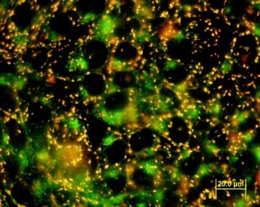
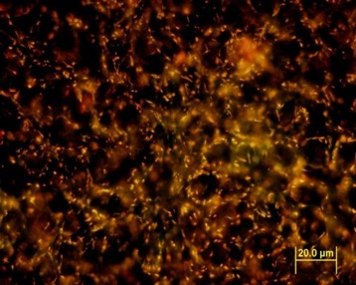
Cell’s battery protection
Protection
PEPHA®-CTIVE CB
Fluorescence microscopy
in vitro assay with human keratinocytes HaCaT
Cells treated with PEPHA®-CTIVE CB vs. untreated cells
24 hours incubation
Oxidative stress with 500 μmol H₂O₂
Mitochondria polarization indicated by fluorescence
Healthy mitochondria appear red
Control
Stressed with 500 μmol H₂O₂
 Visible green staining
1% PEPHA®-CTIVE CB
Stressed with 500 μmol H₂O₂
 No visible green staining
PEPHA®-CTIVE CB visibly protects the mitochondria against oxidative stress caused by free radicals
Notes:
Aim:
Determination of the influence of PEPHA®-CTIVE CB on the polarization of mitochondria of HaCaT keratinocytes stressed by incubation with hydrogen peroxide.
HaCaT cell is a cell type belonging to an immortal human keratinocyte line.
Polarization of mitochondria membrane was indicated with the fluorescent dye JC-1 from Molecular Probes by fluorescence microscopy and in a quantitative way with a fluorescence microplate reader.
Results:
The fluorescent dye accumulates in the mitochondria of healthy cells as red aggregates.
If the mitochondria are stressed, the mitochondrial membrane potential gets depolarized, which means that they lose their activity: the fluorescent dye can no longer accumulate in the mitochondria and remains in the cytoplasm in a monomeric form which fluoresces in green.
After incubation with PEPHA®-CTIVE CB there is no depolarization detectable, which is to be seen on the red coloration of the picture. The mitochondria treated with PEPHA®-CTIVE CB are active and have their full integrity.
It can be concluded that PEPHA®-CTIVE CB has a protection effect on the mitochondria.

Slide 15
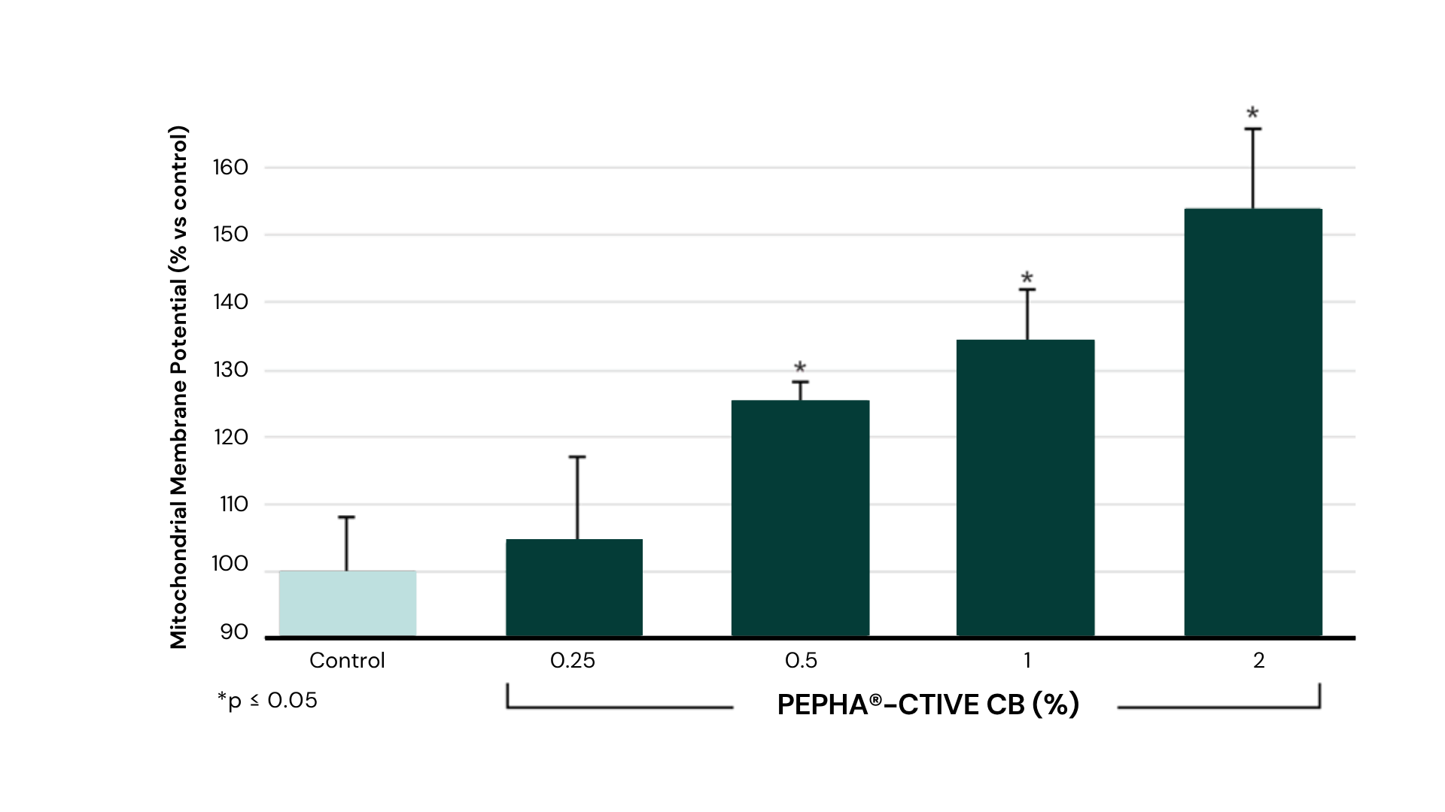
Cell’s battery protection up to 150%
Protection
PEPHA®-CTIVE CB
in vitro assay with human keratinocytes HaCaT
Cells treated with PEPHA®-CTIVE CB vs. untreated cells (control)
24 hours incubation
Oxidative stress with 2mM H2O2
Mitochondria polarization indicated by fluorescence
Quantitative assay
PEPHA®-CTIVE CB dose-dependently protects the mitochondria against
oxidative stress caused by free radicals
Notes:
Aim:
Determination of the influence of PEPHA®-CTIVE CB on the polarization of mitochondria of HaCaT keratinocytes stressed by incubation with hydrogen peroxide.
HaCaT cell is a cell type belonging to an immortal human keratinocyte line.
Polarization of mitochondria membrane was indicated with the fluorescent dye JC-1 from Molecular Probes by fluorescence microscopy and in a quantitative way with a fluorescence microplate reader.
Results:
The fluorescent dye accumulates in the mitochondria of healthy cells as red aggregates.
If the mitochondria are stressed, the mitochondrial membrane potential gets depolarized, which means that they lose their activity: the fluorescent dye can no longer accumulate in the mitochondria and remains in the cytoplasm in a monomeric form which fluoresces in green.
After incubation with PEPHA®-CTIVE CB there is no depolarization detectable, which is to be seen on the red coloration of the picture. The mitochondria treated with PEPHA®-CTIVE CB are active and have their full integrity.
It can be concluded that PEPHA®-CTIVE CB has a protection effect on the mitochondria.

Slide 16
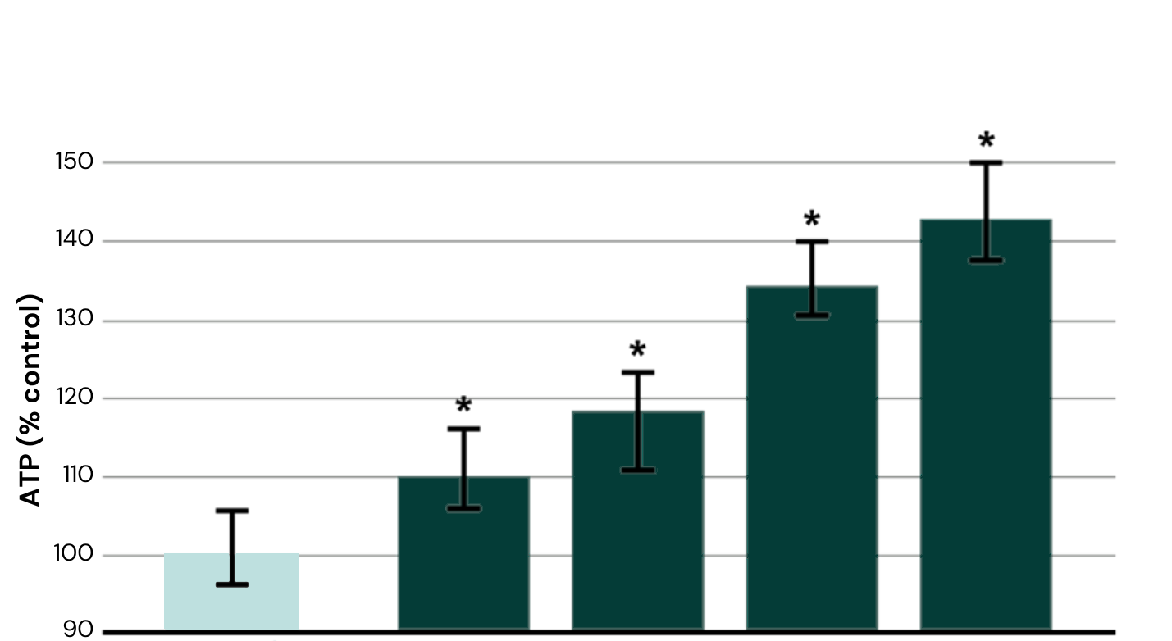

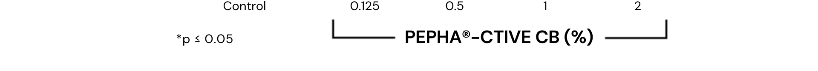
Cellular energy activation up to 140%
PEPHA®-CTIVE CB
Activation
in vitro assay with human keratinocytes HaCaT
Cells treated with PEPHA®-CTIVE CB vs. untreated cells (control)
48 hours incubation
Measurement of cellular ATP content
PEPHA®-CTIVE CB significantly und dose-dependently increases the ATP content up to 140%
Notes:
Aim of the assay:
Determination of the influence of PEPHA®-CTIVE CB on the content of ATP (Adenosine Triphosphate) of confluent cultures of the human keratinocyte cell line HaCaT.
The cells were incubated with PEPHA®-CTIVE CB for 48 hours.
Results:
PEPHA®-CTIVE CB dose-dependently increases the ATP-content of keratinocytes up to more than 140%. It can be concluded that PEPHA®-CTIVE CB has a stimulating effect on the mitochondria to produce ATP.

Slide 17
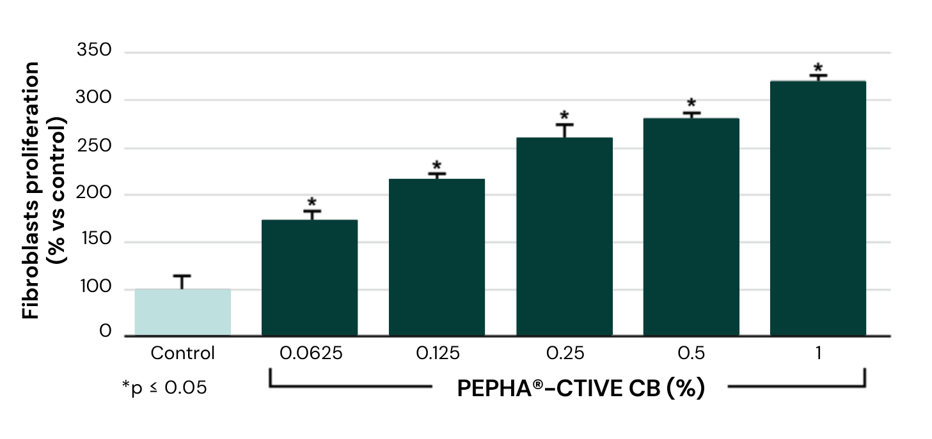
Cellular proliferation up to 320%
PEPHA®-CTIVE CB
Activation
in vitro assay with normal human fibroblasts from skin
Cells treated with PEPHA®-CTIVE CB vs. untreated cells (control)
24 hours incubation
Fibroblasts quantification by ELISA
PEPHA®-CTIVE CB significantly increases the fibroblast proliferation up to 320%
Notes:
Fibroblasts proliferation
Aim of the assay:
Determination of the influence of PEPHA®-CTIVE CB on the proliferation of normal human fibroblasts from skin.
The cells were incubated with PEPHA®-CTIVE CB for 24 hours.
Results:
PEPHA®-CTIVE CB dose-dependently increases the proliferation rate of fibroblasts up to 320%.

Slide 18
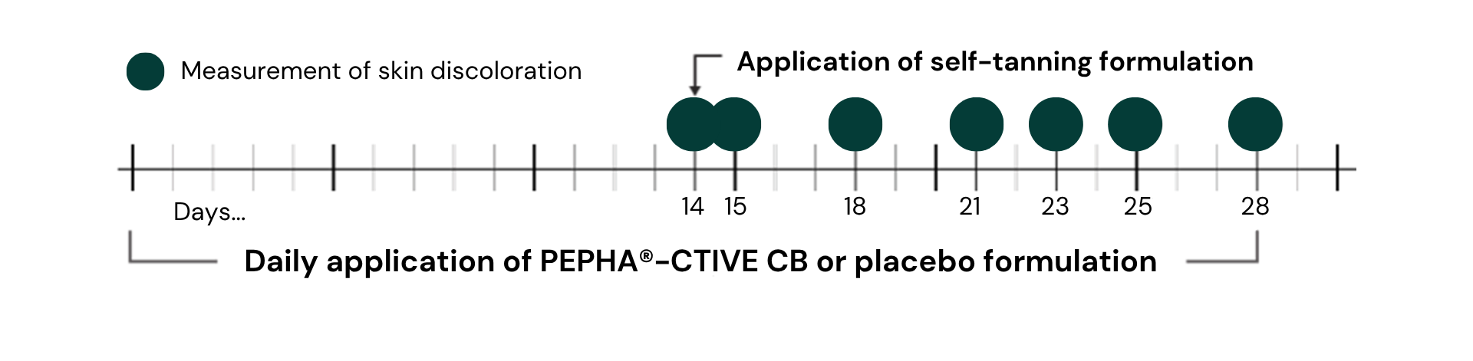
Skin renewal
Study design
20 female volunteers, 22 – 65 years old
Placebo controlled study; 3% PEPHA®-CTIVE CB in a cosmetic formulation
Application: 1. Day 0 – Day 28: across 4 weeks, randomized daily application of the PEPHA®-CTIVE CB
formulation on one forearm, and of the placebo on the second forearm;
2. Day 14: after the first 2 weeks, tanning of the skin with a unique application of a DHA
formulation (on both forearms);
3. Days 15, 18, 21, 23, 25, 28: measurement of skin discoloration, correlated to the skin renewal
Parameters: Skin coloration (Chromameter)
Notes:
Aim:
The aim of the study was to determine the influence of PEPHA®-CTIVE CB on cell turnover by evaluating the speed of epidermal renewal.
Protocole:
20 volunteers applied a cream containing 3% PEPHA®-CTIVE CB to one forearm over 4 weeks. A placebo was applied to the second forearm. After the first 2 weeks, a self-tanning formulation containing dihydroxyacetone (DHA) was applied on both forearms in order to give the skin a brown tint. The degree of fading due to desquamation was then measured for each arm to determine the comparative rate of cell turnover.

Slide 19
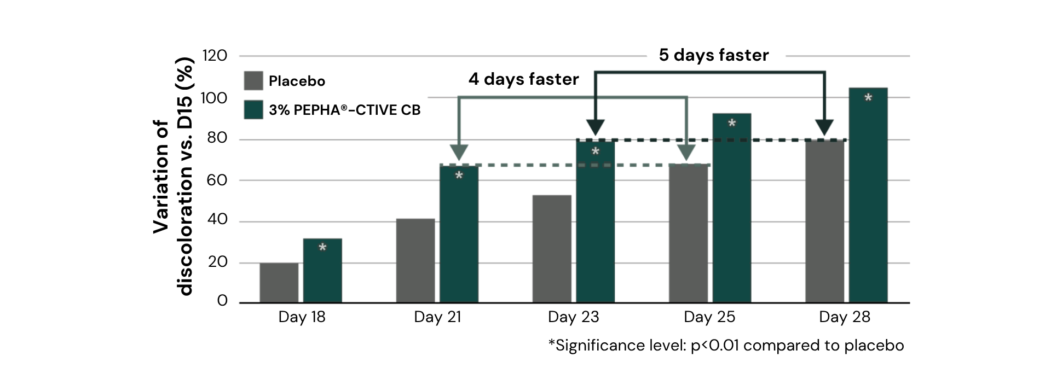
5 days faster skin renewal for luminous looking skin
PEPHA®-CTIVE CB
      PEPHA®-CTIVE CB visibly increased the skin renewal, inducing a faster skin renewal by 4 to 5 days.
      Result is a luminous looking appearance.
Notes:
Results:
On days 21 and 25, the skin treated with PEPHA®-CTIVE CB showed the same level of skin rejuvenation as the skin treated with a placebo on days 25 and 28 respectively.
PEPHA®-CTIVE CB thus significantly (p<0.01) increases cell turnover, inducing faster skin renewal by 4 to 5 days. The result is a fresher looking appearance.

Slide 20

Skin complexion
In vivo efficacy
PEPHA®-CTIVE CB
Volunteers
30 female volunteers, 35 – 60 years old
Presenting a dull skin complexion
Phototype I to III
Formulation
3% PEPHA®-CTIVE CB in a cosmetic formulation
Application
Randomized half-face application
Twice daily
28 days
Parameters
Evaluation of the CLBT-Parameters (Colour, Luminosity,
Brightness, Transparency) by trained professionals
Self-evaluation questionnaire
Notes:
The study was carried out on 30 volunteers presenting a dull skin complexion. A cream containing 3% PEPHA®-CTIVE CB was applied on half of face twice a day over 28 days.

Slide 21
Perfect luminous skin with the microalgae power
PEPHA®-CTIVE CB
Clinical study
Self-evaluation questionnaire
PEPHA®-CTIVE CB visibly improves skin’s luminosity for more than 4 out of 5 consumers.
Excellent acceptance among uses, with a significant improvement in skin complexion.
Notes:
Results:
PEPHA®-CTIVE CB received an excellent rating from the volunteers and dermatologists in all tested parameters.
This demonstrates its outstanding ability to visibly improve skin’s luminosity and the overall complexion.

Slide 22
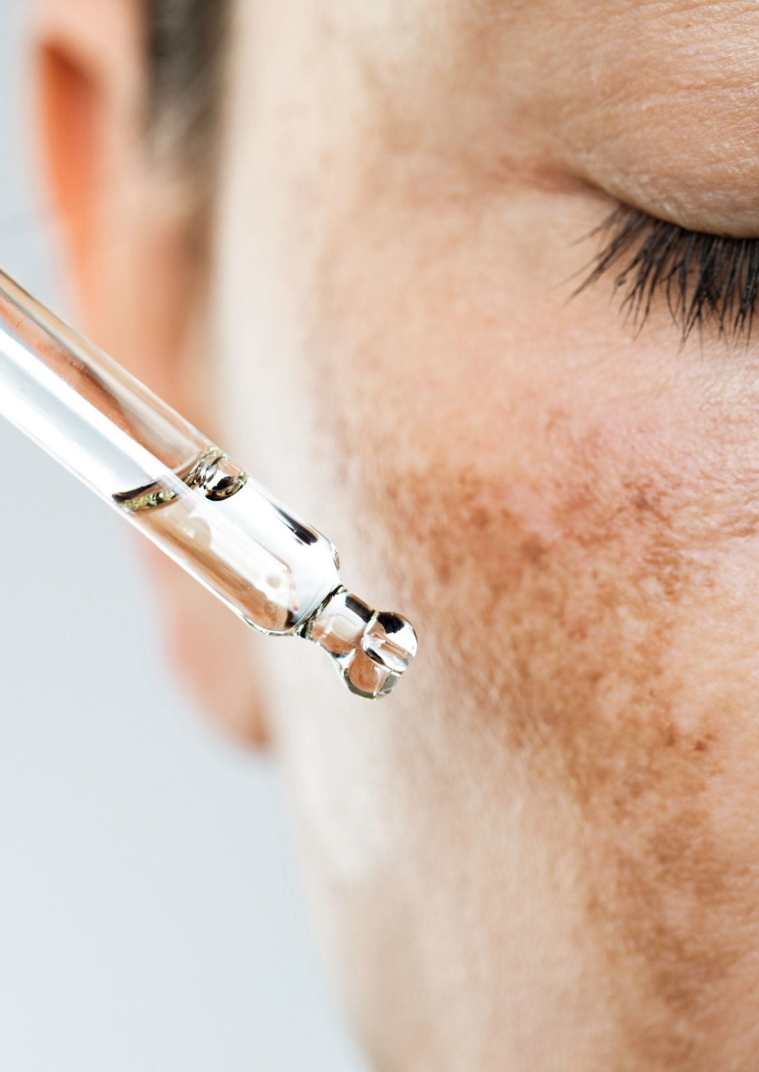
Formulation Guidelines
PEPHA®-CTIVE CB
INCI name (active): Dunaliella Salina Extract
Clear, yellowish liquid
Stable at pH ranges from 3.0 to 6.0
Should be processed below 50°C
Suggested concentration: 1–3 %
Cosmetic application
Skin energizing facial product
Glow, radiance enhancer
Protective day care for fresher and radiant looking skin

Slide 23
PEPHA®-CTIVE
Supported marketing claims
Clinically proven to improve skin glow on 9 users out of 10
It accelerates skin cell turnover for fresher looking skin… faster!
80% of users showed a visible improvement in skin brightness in Clinical Study
Excellent acceptance among users, with a significant perceived improvement in skin complexion

Slide 24

Energy & Luminosity
Key market claims
Claims examples*
  Helps renew skin’s youthful radiance
  Truly vital skin radiates with energy and light
  Helps restore skin’s natural radiance and vital appearance
  Skin’s inner light energy
  Promotes skin’s natural cellular energy for truly luminous, radiant beauty
  Energy recharge
  Energie de vie
Main ingredients*
  Antioxidants from plants
  Vitamins
  Sugars
  Amino acids
  Algae extracts
  ATP or adenosine
*Source: GNPD

Slide 25
Disclaimer
Copyright © DSM Nutritional Products Ltd 2025, 4002 Basel, Switzerland.
www.dsm-firmenich.com. All rights reserved.
dsm-firmenich has used diligent care to ensure that the information provided herein is accurate and up-to-date to the best of its knowledge. However, dsm-firmenich makes no representation or warranty, either expressly or implied, of the accuracy, reliability, completeness, or suitability thereof. The information provided herein contains scientific and product information for business-to-business use and does not constitute or provide scientific or medical advice, diagnosis or recommendation for treatment options. Country or region-specific information should be considered when labelling or advertising to final consumer. In no event shall dsm-firmenich be liable for any direct or indirect damages arising from or reliance upon, or use of, any information provided herein. The content of this document is subject to change without further notice. Please contact your local dsm-firmenich representative for the latest information. All trademarks listed in this document are either (registered) trademarks of, or trademarks licensed by, the dsm-firmenich group of companies, unless explicitly stated otherwise.
Disclaimer Formulation Guideline
The information provided herein is provided for information purposes only and has been prepared by dsm-firmenich in accordance with its own methodology.
dsm-firmenich has used diligent care to ensure that it is accurate and up-to-date, however, dsm-firmenich makes no representation or warranty, either expressly or implied, of the accuracy, reliability, or completeness thereof. In no event shall dsm-firmenich be liable for any damages arising from or reliance upon, or use of, any information provided herein. Further, dsm-firmenich shall not bear any liability for the application and/or use of any processed material containing its product(s). The formulation of the finished product is the customer’s sole responsibility. It is the customer’s responsibility to determine the suitability of dsm-firmenich’s products regarding user specific purposes, assess compatibility and stability of their finished product(s) and to ensure compliance of their finished product(s) with relevant laws and regulations. Any product, marketing or other claims made by customer are its sole responsibility. The content of this document is subject to change without further notice. Please contact your local dsm-firmenich representative for further details. © 2025 dsm-firmenich group.

