Slide 1


PEPHA®-PROTECT
Powerful bodyguard for naturally protected skin
October 2020

Slide 2
Agenda
1
DNA Protection – A Growing Trend
2
Sun & Skin – Not Always the Best Combination
3
PEPHA®-PROTECT – A Bodyguard from the Desert
4
PEPHA®-PROTECT – Outstanding Capabilities
5
PEPHA®-PROTECT in a Nutshell

Slide 3
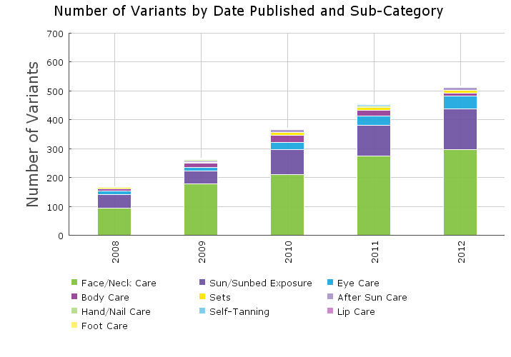
+205% Skin Care Launches with Focus “DNA Protection” (2008-2012)
Source: GNPD, 2008-2012
Notes:
DNA protection is a continuous key trend since 5-6 years.
Leading brands communicate on this trend, see examples of market products on next slide.

Slide 4
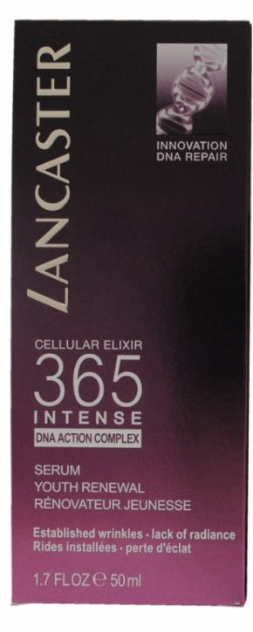
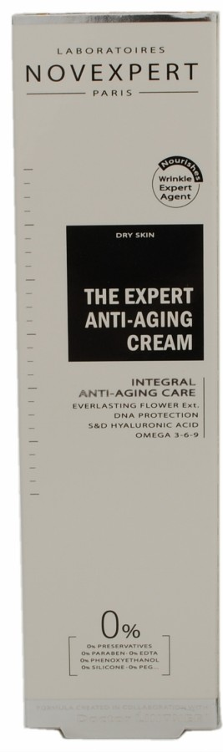
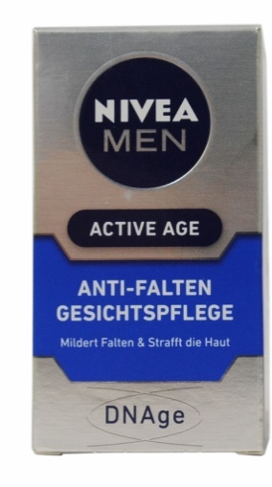
New Skin Care Launches with Focus on DNA
“DNA ACTION COMPLEX”
“DNA PROTECTION”
“DNAge”
Source: GNPD, 2012-2013
Notes:
Leading brands communicate on the DNA trend, see here examples of market products:
LANCASTER/ 365 Cellular Elixir Intense:
The Lancaster 365 Cellular Elixir range is described as the first step of a daily beauty ritual. The range is said to address skin ageing at its root by helping repair visible signs of past damage and preventing future signs of skin ageing, 365 days a year. As part of the range, Serum Rénovateur Jeunesse (Intense Youth Renewal Serum) is a breakthrough product said to help repair three main types of DNA damage: UV rays, pollution and stress, leaving the skin texture visibly regenerated, firmer and plumped.
BEIERSDORF/ Nivea Men DNAge:
Nivea Men Active Age Anti-Falten Gesichtspflege (Anti-Wrinkle Face Care) features a formula with creatine, cell active folic acid and UVA/UVB filters with SPF 8 that is claimed to reduce wrinkles, improve firmness and elasticity, provide lasting hydration, and protect the DNA against environmental aggressions.
LABORATOIRES NOVEXPERT / Anti-Aging cream:
The Expert Anti-Aging Cream is described as a nourishing wrinkle expert agent cream formulated in collaboration with Dr. Lintner. The 100% natural formula features: omegas 3, 6 and 9, shea butter and macadamia nut oil, to offer a nourishing action; and light-reflecting and antioxidant ingredients that target DNA and collagen for in-depth skin regeneration and radiance.

Slide 5
Agenda
1
DNA Protection – A Growing Trend
2
Sun & Skin – Not Always the Best Combination
3
PEPHA®-PROTECT – A Bodyguard from the Desert
4
PEPHA®-PROTECT – Outstanding Capabilities
5
PEPHA®-PROTECT in a Nutshell

Slide 6
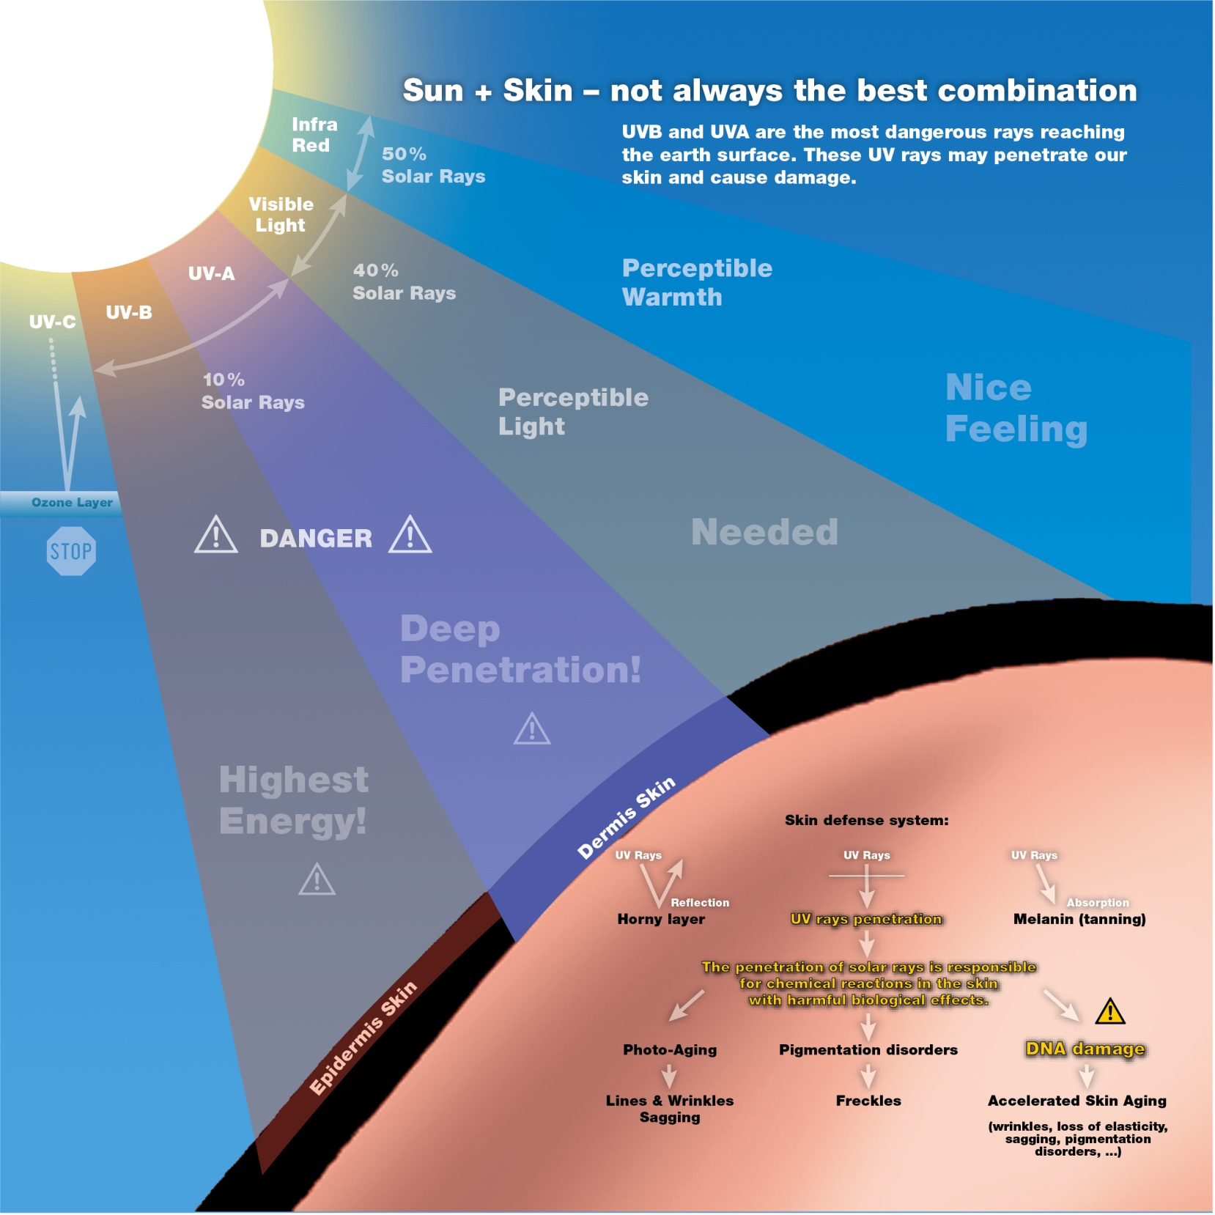
Notes:
UV radiation has severe consequences: the penetration of solar rays is responsible for chemical reactions in the skin with harmful biological effects:
PHOTO-AGING:
Decreased barrier function due to lipid peroxidation
Collagen destruction due to increased MMP level
Destruction of enzymes like catalase
PIGMENTATION DISORDERS
DNA DAMAGE

Slide 7
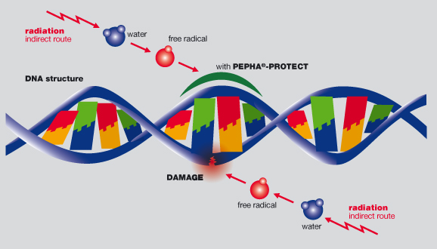
Harmful Consequences of DNA Damages
Accelerated skin aging
Apoptosis of skin cells
    Mutations in skin cell DNA
      Precancerous lesions in skin
        Induction of skin lesions
Notes:
The DNA (DeoxyriboNucleic Acid) molecule encodes the genetic instructions needed for life to develop and function properly. It forms a double-stranded helix structure, with each strand consisting of two long polymers made from repeating units called nucleotides (guanine, adenine, thymine, and cytosine).
Although normally very stable, in skin the DNA can be damaged by UVA (ultra violet A) radiation from the sun. This damage results either directly from the energy of the radiation, or indirectly from the release of free radicals, which can cleave DNA strands in the skin.
Damaged DNA leads to erroneous genetic function with following consequences:
Accelerated skin aging, characterized by wrinkles, loss of elasticity and sagging, or pigmentation disorders;
It can lead to apoptosis of the cells;
If cells with damaged DNA survive, this leads to genetically mutations. That means this cell contain changed, false information;
Such mutations lead to precancerous lesions and finally result in developing of skin cancer.
Even if our skin has its own defense strategies against such stress, the skin‘s defense system needs some support.

Slide 8
Agenda
1
DNA Protection – A Growing Trend
2
Sun & Skin – Not Always the Best Combination
3
PEPHA®-PROTECT – A Bodyguard from the Desert
4
PEPHA®-PROTECT – Outstanding Capabilities
5
PEPHA®-PROTECT in a Nutshell

Slide 9
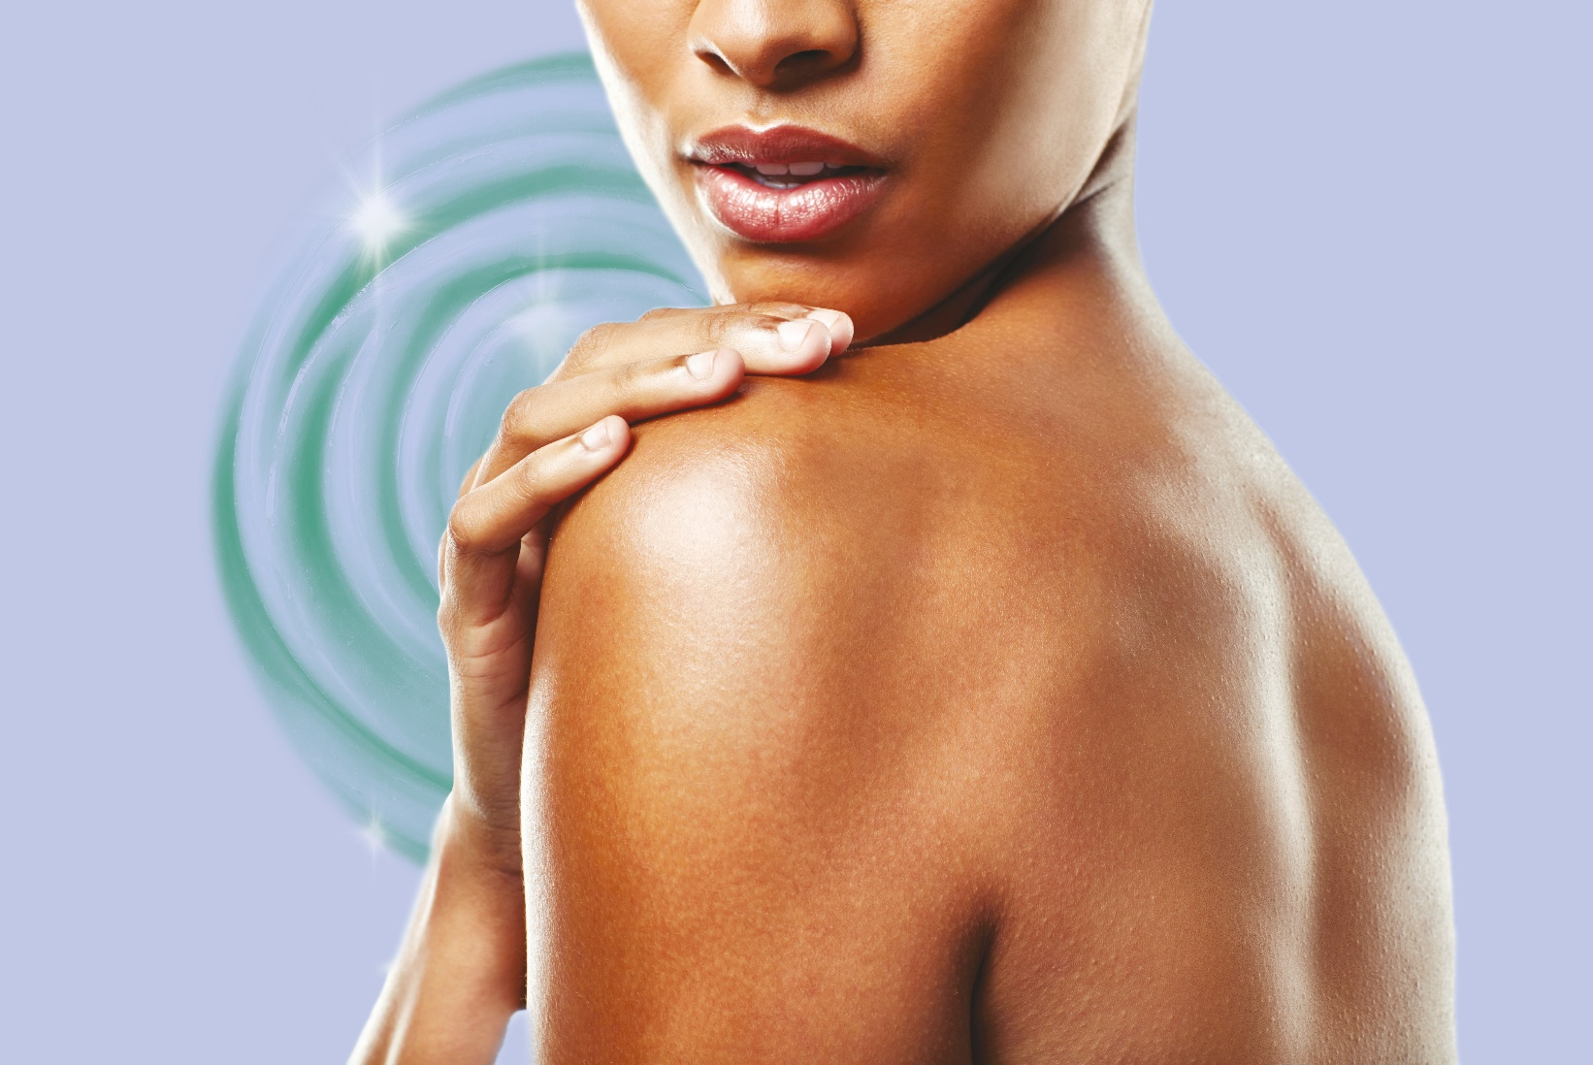

Slide 10

A Bodyguard from the Desert
Plants growing under extreme conditions require exceptional survival strategies;
In the Kalahari desert grows a special kind of watermelon (Citrullus lanatus); in order to survive, it synthesizes tough defensive compounds, so-called compatible solutes - to protect important cellular structures such as DNA;
PEPHA®-PROTECT is a highly purified Citrullus lanatus extract from a species that originates from Kalahari desert.
Kalahari desert
Notes:
The two largest deserts in Africa are the Sahara in the North and the Kalahari in the South.
Deserts are very dry places. Plants growing under such extreme conditions develop their own defense strategy against heat, drought and high UV exposition.
PEPHA®-PROTECT is a highly purified watermelon (Citrullus lanatus) extract containing high quantities of precious compatible solutes - naturally occurring vitamins, carbohydrates, and specific amino acids, such as Trehalose, Glycine, Betaine, and Citrulline. Compatible solutes protect important cell structures - such as DNA - from damage.
PEPHA®-PROTECT is an extract from a species that originates from Kalahari desert. The fruit effectively used for the production of PEPHA®-PROTECT is cultivated under conditions which are similar to the natural ones in the Kalahari desert.

Slide 11
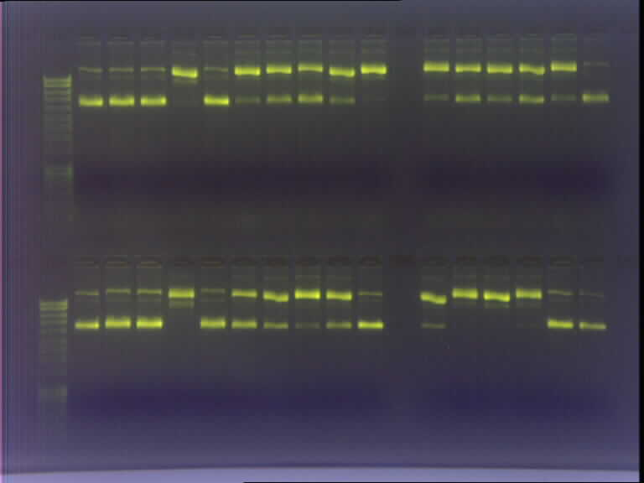
PEPHA®-PROTECT – a Unique Highly Purified Watermelon Extract
Plasmid assay
+E
+S
+E
+S
+E
+S
+ E
+E
+S
+E
+S
+E
+S
+ E
+E
+S
+E
+S
+E
+S
+ E
+S
+S
+S
DNA
Damaged DNA
Undamaged DNA
(supercoiled)
highly pure
Watermelon extract
Watermelon extract after first purification step
Watermelon extract before purification
+E = plus Melon Extract
+S = plus H₂O₂ Stress
Notes:
The active compounds of the melon’s defense system, the compatible solutes, are water soluble molecules. A standard hydrophilic watermelon extract as well as extracts purified by several purification steps were therefore produced. A plasmid assay combined with electrophoresis was applied to confirm the activity of these extracts.
The assay was performed on isolated plasmid DNA, which was stressed by peroxide to induce DNA damage. Damaged DNA changed its conformation and could be distinguished from undamaged DNA (supercoiled DNA) by electrophoresis: the undamaged and supercoiled DNA is more compact and migrates faster from the top downwards compared to damaged DNA. Supercoiled (undamaged) DNA and damaged DNA become therefore visible as separate bands in the gel.
+ E: plus melon extract. + S: plus H2O2 stress
Results clearly showed that only the highly purified watermelon extract, used to formulate PEPHA®-PROTECT, can provide almost complete DNA protection in vitro.

Slide 12
Agenda
1
DNA Protection – A Growing Trend
2
Sun & Skin – Not Always the Best Combination
3
PEPHA®-PROTECT – A Bodyguard from the Desert
4
PEPHA®-PROTECT – Outstanding Capabilities
5
PEPHA®-PROTECT in a Nutshell

Slide 13
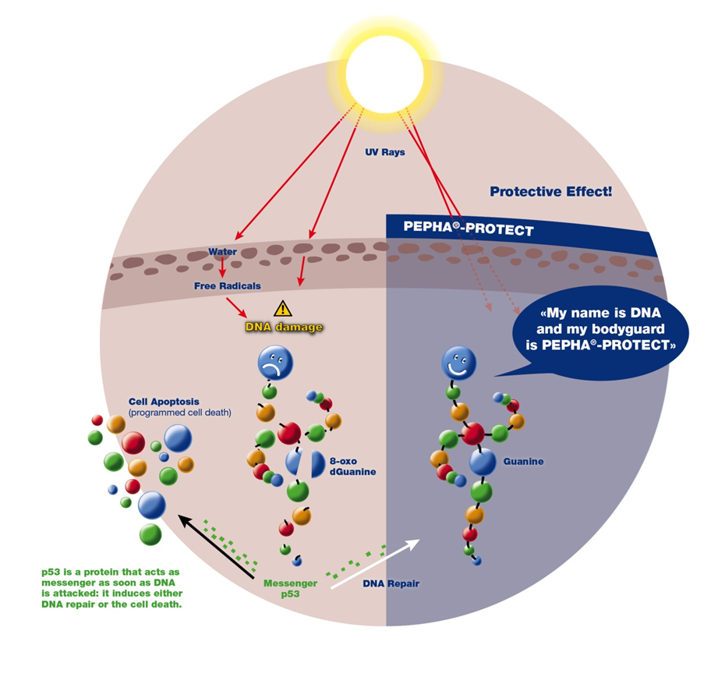
State-of-the-art in vitro Assays that Highlight PEPHA®-PROTECT’ Strong Capacity to Protect from DNA Damages
with 0.2% PEPHA®-PROTECT
COMET assay shows 69% decrease of DNA fragmentation
P53 assay shows 75% decrease of phospho-p53 production
8-oxo-guanine assay shows 92% decrease of 8-oxo-dG production
Notes:
UVA modification of DNA in skin cells triggers different responses which include activation of a dedicated protein, p53, by a process known as phosphorylation. This initiates either DNA repair or apoptosis (programmed
cell death).
Another effect of UV irradiation is oxidation of the guanine nucleotide to form 8-oxo guanine, which can lead to the breakdown of DNA strands.
Several advanced in vitro assays based on the quantification of both 8-oxo guanine and phospho-p53 protein demonstrate the tremendous capacity of PEPHA®-PROTECT to protect skin DNA from irreversible damage,
keeping cells in good shape and thereby sustaining skin’s natural beauty.

Slide 14
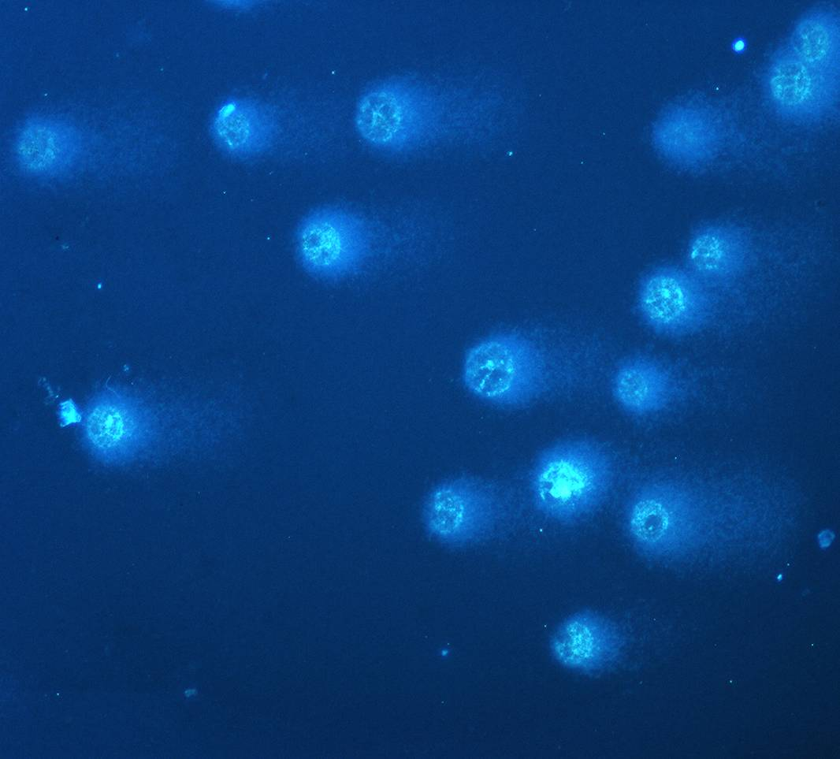
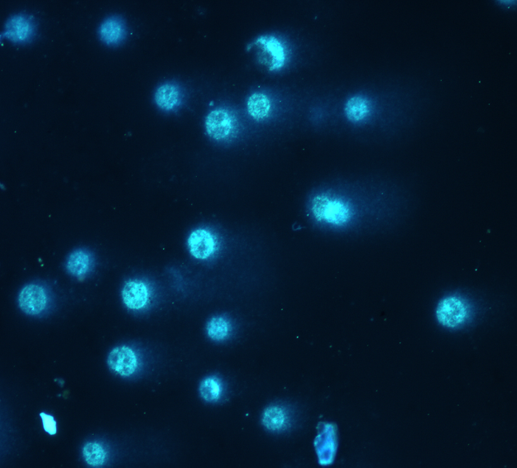
in vitro COMET Assay Shows 69% DNA Protection with 0.2% PEPHA®-PROTECT
H₂ O₂ 100μM
The keratinocytes of a human skin model are stressed by UV or radicals, which causes DNA fragmentation;
During electrophoresis small sections of damaged DNA may migrate out of the nucleus into the cytoplasm and thereby lead to the so called comet effect;
The expansion of the COMET is expressed as tail moment
The comets are significantly smaller by using PEPHA®-PROTECT
H₂ O₂ 100μM
+0,2% PEPHA®-PROTECT
Notes:
Carried out on fibroblasts and on a human skin model consisting of keratinocytes, in order to show DNA protecting capacity of PEPHA®-PROTECT.
The keratinocytes have been stressed by hydroperoxide, which leads to DNA breakdowns.
During electrophoresis, small sections of damaged DNA may migrate out of the nucleus into the cytoplasm and thereby cause the so-called comet effect.
A longer tail indicates more DNA damage.

Slide 15
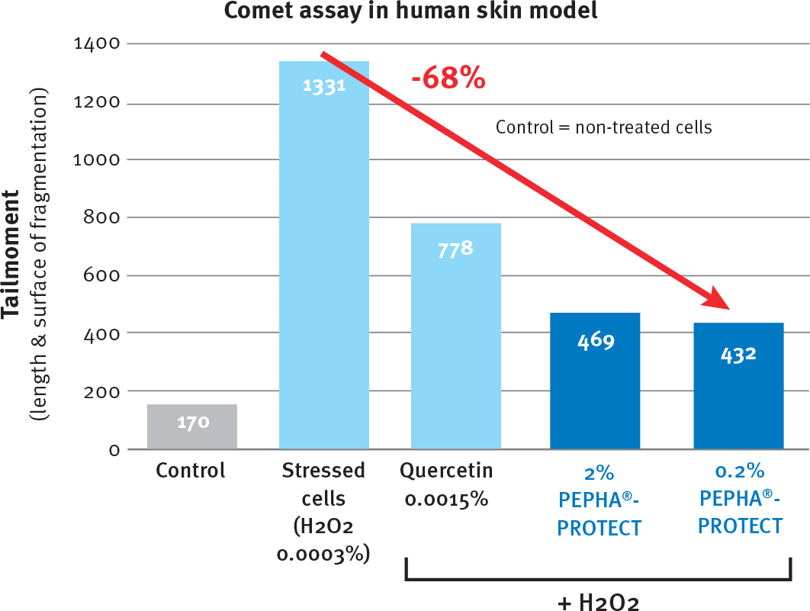
Significant Prevention of DNA Fragmentation
Notes:
Even at low concentration PEPHA®-PROTECT shows a high protection of the stressed DNA.

Slide 16

P53 – a Key Cellular Marker for DNA Damage
Stress
P
Apoptosis
p53
P
DNA damage
Cell cycle arrest
P
P
DNA repair
Notes:
In a further in vitro assay on keratinocytes we used the protein p53 as a marker for DNA damage.
What is p53?
Healthy cells contain naturally little amounts of the protein p53. As soon as DNA damage in a cell is detected, this p53 is activated by phosphorylation.
This phospho-p53 is a key compound in preventing uncontrolled cell growth. P53 is a tumor suppressor protein and therefore it regulates the cell cycle.
Depending on the severity of the DNA damage, p53 initiate DNA repair or apoptosis. In case of DNA damage the cell cycle is stopped.
Apoptosis is the so called programmed cell death. Therefore it is very important to prevent uncontrolled cell growth.
In summary we can say that the amount of phosphorylated p53 in a cell is a marker for the amount of damaged DNA.
That means high amount of phospho p53 correlates with the extent DNA damage.
That’s the basis of this in vitro assay.
Keratinocytes were cultured under appropriate condition and then stressed with BaP (Benzoapyren).
The phosph-p53 were detected with their appropriate antibodies which are marked.

Slide 17
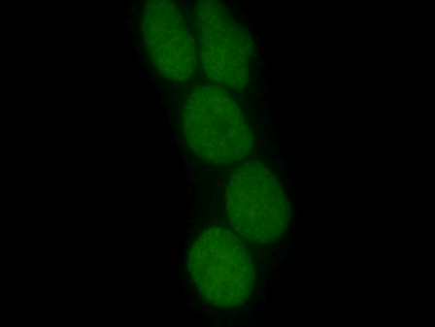
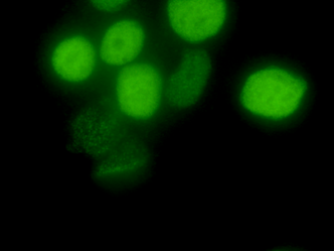
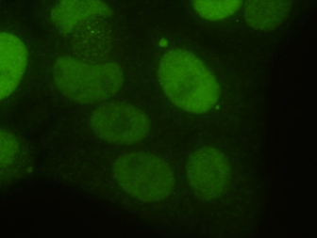
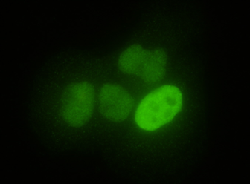
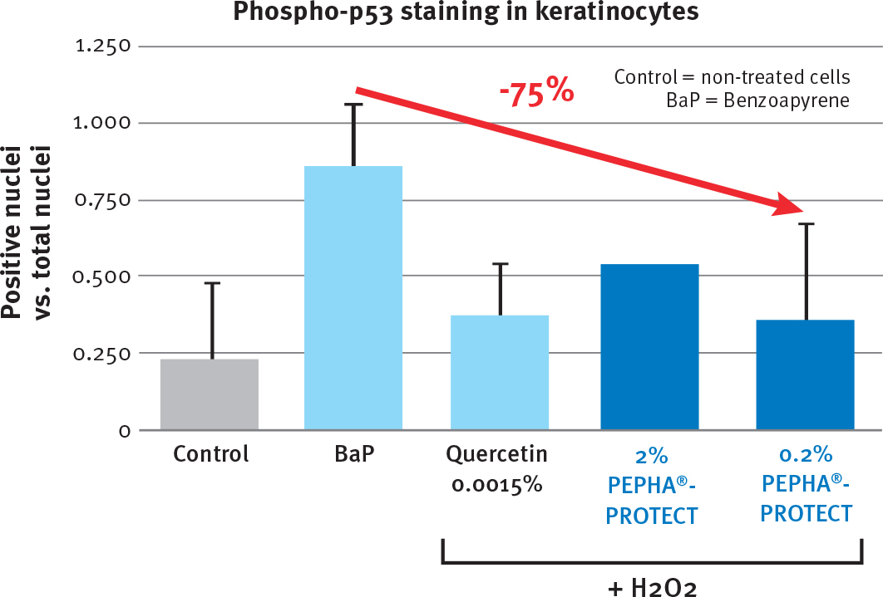
Significant Phospho-p53 Reduction Proving Strong DNA Protection
CONTROL
BaP
0.2% PEPHA®-PROTECT + BaP
2% PEPHA®-PROTECT + BaP
Notes:
Results of the Phospho-p53 assay:
Control: keratinocytes without treatment.
BaP: stressed cells. These bright green stained bowls here show the phospho-p53 in the cell nucleus.
A strong decrease of phospho-p53 is observed after treatment with different concentration of PEPHA®-PROTECT.
PEPHA®-PROTECT showed a very good DNA protection in this assay.

Slide 18
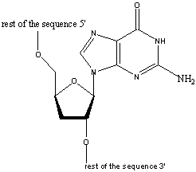
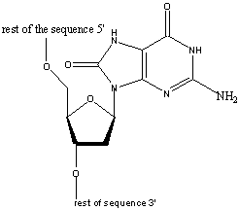
8-oxo-dG is a Molecular in vitro Marker for DNA Damage - Mechanism
UV, Radicals
Guanine nucleoside
8-oxo-Guanine nucleoside
After UV irradiation of the cells, the guanine base is oxidized at the C8 position and thus transformed into 8-oxo-Guanine
Notes:
For a further in vitro assay we used another marker for damaged DNA.
As we have seen in a previous picture, DNA consists of a double helix.
Each of these DNA strand consists of nucleotides and here you can see an intact guanine nucleotide.
A nucleotide consists of a base, a sugar and phosphate.
After UV irradiation the guanine base is oxidized at the position C8 here and is transformed to 8-oxo guanine.
And such oxidation leads to DNA strand breaks.
This 8-oxo-guanine bases can be detected with appropriate antibodies which are treated with a marker.

Slide 19
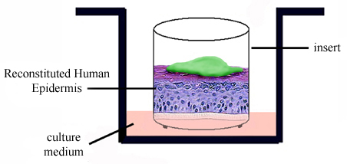
8-oxo-dG is an in vitro Marker for DNA Damage - Assay
PEPHA®- PROTECT
BaP
(Benzoapyren)
Detection of
8-oxo-dG by
using antibodies
APPLICATION
DNA STRESS
DETECTION
This 8-oxo-Guanine base can be detected with appropriate antibodies which are treated with a marker
Notes:
This assay cannot be performed in vivo. Therefore we used a 3D skin model.
This skin model is located in an insert and the insert is in a cell culture medium.
PEPHA®-PROTECT was applied on the surface of the skin model and then the system was stressed with BaP (Benzoapyren).
After addition of the 8-oxo-dG antibodies the amount of destroyed DNA are detected.

Slide 20
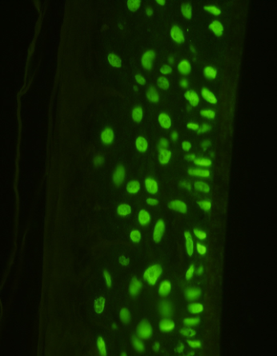
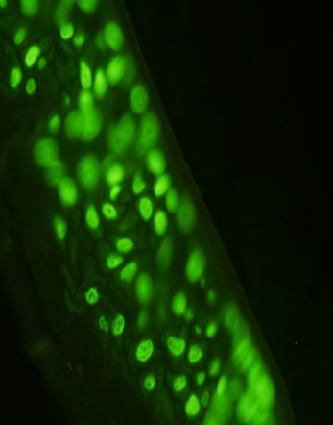
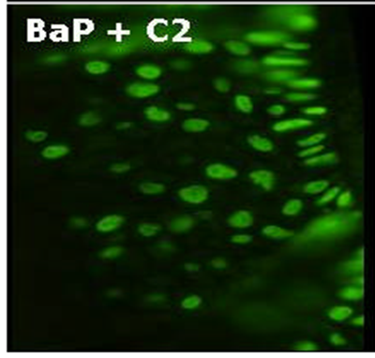
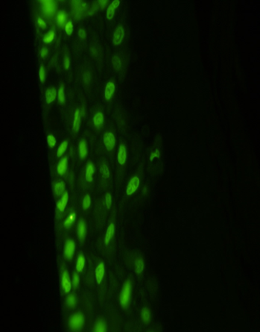
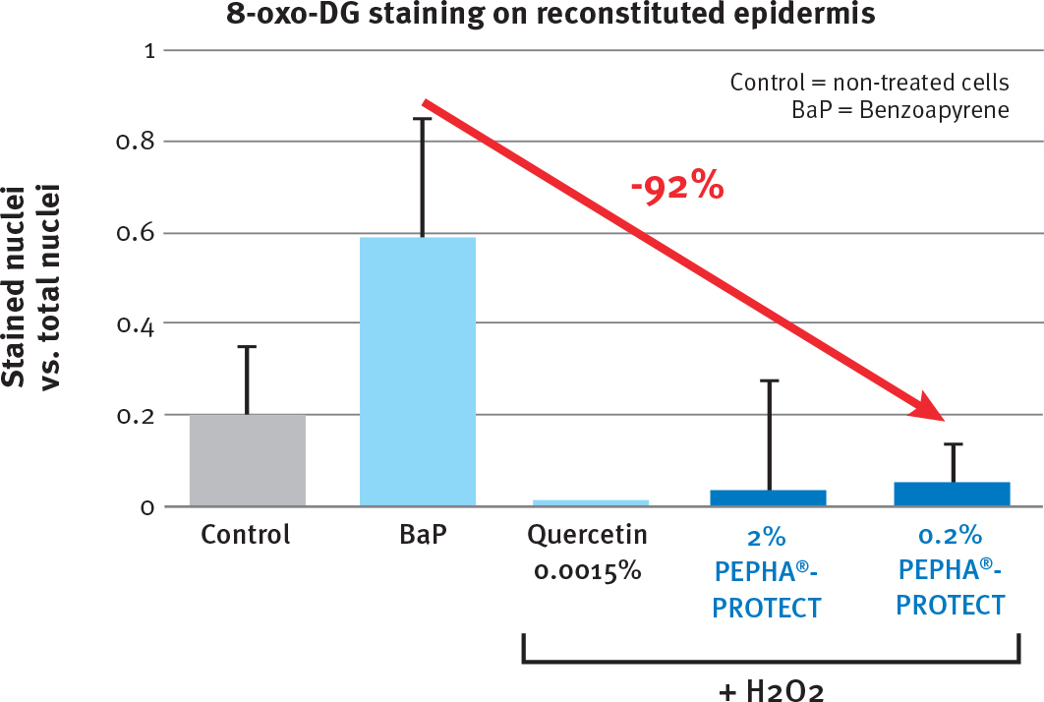
Significant 8-oxo-dG Reduction Proving Strong DNA Protection
CONTROL
BaP
0.2% PEPHA®-PROTECT + BaP
2% PEPHA®-PROTECT + BaP
Notes:
Results of the 8-oxo-dG assay:
The green stained bowls show the 8-oxo-dG positive DNA.
Control: skin without treatment.
BaP: stressed skin.
A strong decrease of 8-oxo-dG is observed after treatment with different concentrations of PEPHA®-PROTECT.
PEPHA®-PROTECT showed a very good DNA protection in this assay.

Slide 21
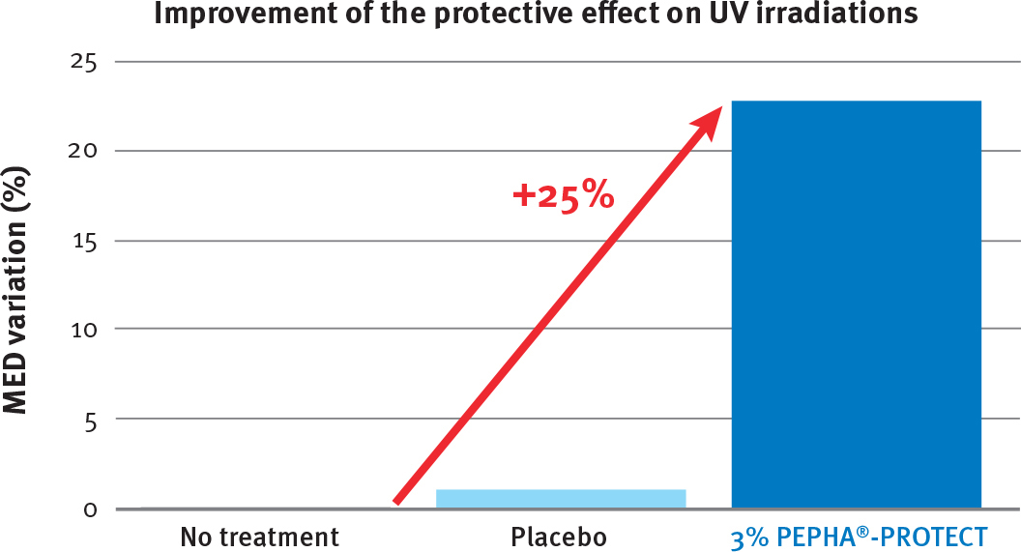
Strong Reinforcement of the Skin Defense System – in vivo
MED measurement at T0 and T28 days
Cream containing 3% PEPHA®-PROTECT
15 volunteers with skin type II / III
25% increase in skin protection
60% of volunteers perceived a protective effect
Notes:
In a 28-day study with PEPHA®-PROTECT, Minimal Erythema Dose (MED) was measured. This is the UV radiation level needed to cause skin reddening.
The higher the MED for a substance, the greater its protective effect.
In this study a cream containing 3% PEPHA®-PROTECT was applied twice daily. Measured parameter: minimum dosage of UV light needed to turn the skin red at a read-out point 24 h later.
Results:
Nearly no protection could be obtained with the placebo formulation.
• 25% increase in skin protection
• 60% of volunteers perceived a protective effect
PEPHA®-PROTECT delays perceptible skin reddening and irritation while at the same time delivering protection to the deeper layers of the skin.

Slide 22
Agenda
1
DNA Protection – A Growing Trend
2
Sun & Skin – Not Always the Best Combination
3
PEPHA®-PROTECT – A Bodyguard from the Desert
4
PEPHA®-PROTECT – Outstanding Capabilities
5
PEPHA®-PROTECT in a Nutshell

Slide 23
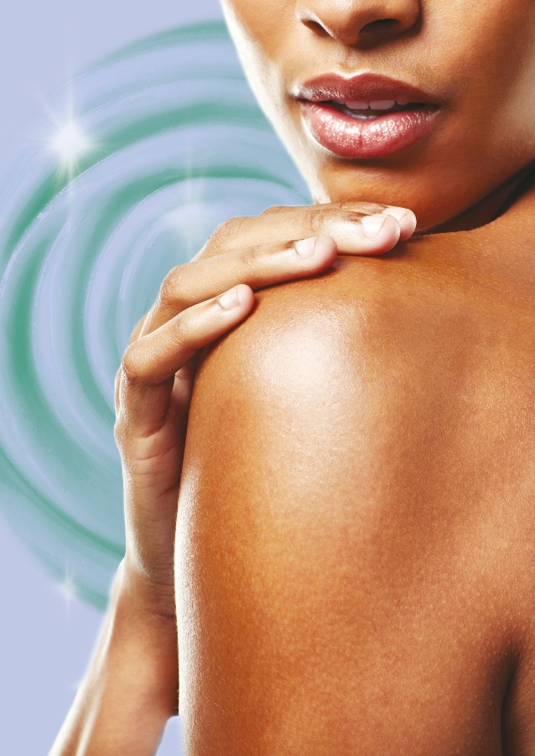
PEPHA®-PROTECT
Powerful bodyguard for naturally protected skin
Unique Product Features
Unique highly purified Citrullus lanatus extract with high concentration of compatible solutes
Significant DNA protection in vitro against UV damage and damage induced by free radicals
Significant protection of DNA nucleotides in vitro from oxidation processes
In vivo proven 25% increase in skin protection

Slide 24
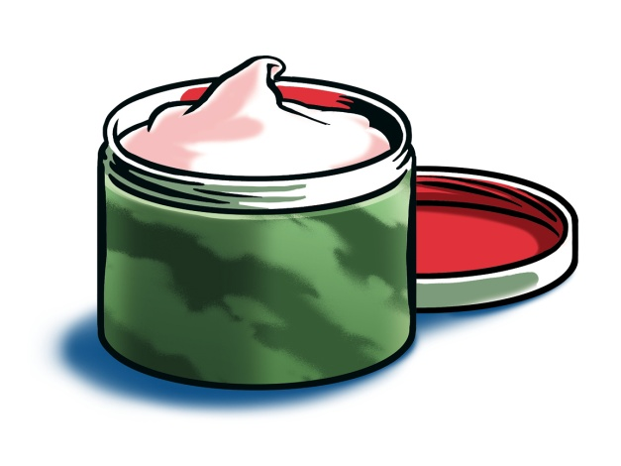
PEPHA®-PROTECT
A broad range of application
Benefits
Strengthens skin’s own cell regeneration ability and helps to protect from DNA damage
Protects the skin from UV induced inflammation and irritation, providing a more even skin texture
Helps prevent premature skin aging, the skin’s appearance remains younger
Cosmetic application
Anti-aging day care claiming DNA protection
Facial care with regenerating and repairing properties
Skin protection products in combination with UVA/UVB filters

Slide 25



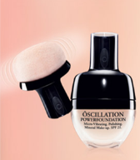
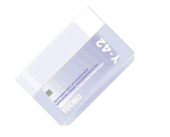
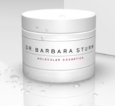
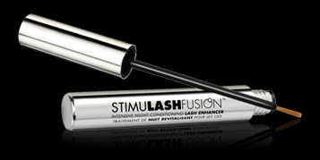
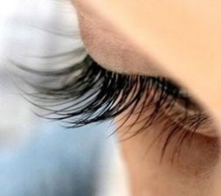
PEPHA®-PROTECT - Perfectly fits with global trend Pure & Elegant Performance
Overall:
  High interest in beauty innovations
  Beauty on all levels: Body, mind, and soul
Benefits: perceivable effects
for timeless beauty
Ingredients and RTBs:
  With an exclusive and scientific appeal
  Nature 2.0: Uncommon natural ingredients upgraded via technology
Manifestations:
  „HighTech“ Beauty tools
  Very exclusive ingredients, e.g. discovered on Mars, made from own blood
  Care products for special body parts, e.g. overnight lash treatment that stimulates lash growth (StimuLashFusion)
24
Notes:
This target group is very interested in „technological“ beauty innovations. In the quest for beauty, they want to improve on all levels: body, mind and soul.
They look for perceivable effects and aim for timeless beauty with character, not some young „babyface“.
Ingredients that appeal to them should be with an exclusive and scientific appeal. They like the idea of „Nature 2.0“: uncommon natural ingredients that are upgraded via technology.
In this view, the scientific backgrounds of the natural REGU-SCENCE and its proven efficacy to protect cells DNA perfectly fit to this trend.

Slide 26
PEPHA®-PROTECT
Formulation guidelines
Formulation
Yellowish liquid
Can be easily be processed warm (<60°C) or during cooling phase
Recommended concentration: 1 to 3%
Preservation: Sodium benzoate, Potassium sorbate, Phenoxyethanol
INCI name (active)
Citrullus lanatus (Watermelon) Fruit Extract, Citrulline

Slide 27
Disclaimer
Copyright © 2021 DSM Nutritional Products, 4002 Basel, Switzerland.
www.dsm.com/personal-care. All rights reserved.
Although DSM has used diligent care to ensure that the information provided herein is accurate and up to date, DSM makes no representation or warranty of the accuracy, reliability, or completeness of the information. This presentation only contains scientific and technical information for business to business use. Country or region-specific information should also be considered when labeling or advertising to final consumers. This publication does not constitute or provide scientific or medical advice, diagnosis, or treatment and is distributed without warranty of any kind, either expressly or implied. In no event shall DSM be liable for any damages arising from the reader’s reliance upon, or use of, these materials. The reader shall be solely responsible for any interpretation or use of the material contained herein. The content of this document is subject to change without further notice. Please contact your local DSM representative for more details. All trademarks listed in this brochure are either registered trademarks or trademarks of DSM in The Netherlands and/or other countries unless explicitly otherwise stated.

Slide 28
Back up PEPHA®-PROTECT

Slide 29
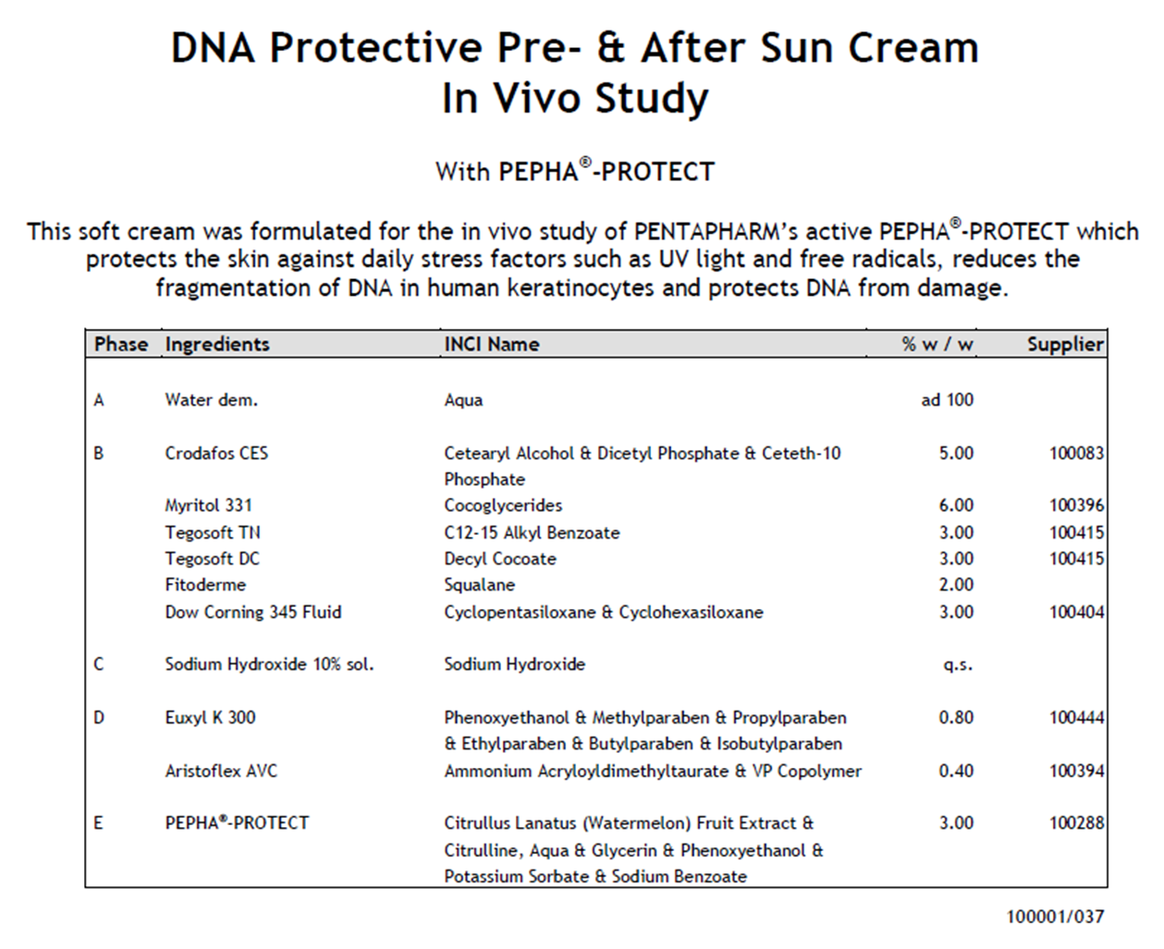
PEPHA®-PROTECT in vivo Study – Guide Formulation

Slide 30
DNA Protection
Continuously Growing Trend in Beauty Care
 | 2008 | 2012 | 2008-2012 growth
Skin care launches with “DNA protection” claims | 169 | 516 | +205%
 | 2002 | 2012 | 2008-2012 growth
Skin care launches with “DNA protection” claims | 14 | 516 | +3585%
Source: GNPD, 2002-2012

Slide 31
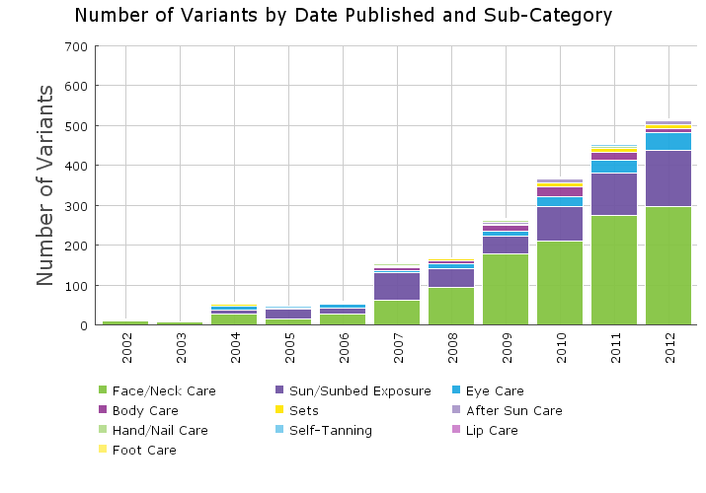
Exponential Increase of Skin Care Launches with Focus “DNA Protection”
Source: GNPD, 2002-2012

Slide 32

Compatible Solutes
The Survival Secret
What are they?
Small, water soluble molecules such as Trehalose, Glycine, Betaine and Citrulline
How are they produced?
By organisms under extreme conditions - heat, cold, drought, high salt concentration
What do they do?
Protect important cell structures – such as DNA - from damage

Slide 33
Market products focusing on DNA claims
Some additional examples…
Source: GNPD 2011-2013

Slide 34
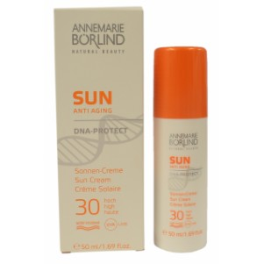

Annemarie Börlind Natural Beauty Sun Anti Aging DNA-Pro…
Company:
Börlind
Country:
Germany
Date Published:
Aug 2012
Sub-Category:
Sun - Sun/Sunbed Exposure
Price (local):
€29.90
Price (major currencies):
$38.17
The Annemarie Börlind Natural Beauty Sun range is claimed to provide UVA/UVB protection with skin-friendly UV filters, and contains kombu algae extract to help prevent sunburn, and a sea buckthorn complex and vitamin E to promote healthy cell activity and prevent premature ageing. Additionally, panthenol provides deep hydration. The paraben-free range includ…
1831891
Ingredients:
Aqua, Dicaprylyl Carbonate, Diethylamino Hydroxybenzoyl Hexyl Benzoate, Alcohols, Ethylhexyl Triazone, Caprylic/Capric Triglyceride, Bis-ethylhexyloxyphenol Methoxyphenyl Triazine, Glycerin, Ethy…
Claims:
GMO-Free, No Additives/Preservatives, Vitamin/Mineral Fortified, For Sensitive Skin, Water Resistant*, Brightening / Illuminating*, Botanical/Herbal, Hypoallergenic, Ethical - Environmentally Friendly Package, UV Protection, Ethical - Animal, Ethical - Environmentally Friendly Product, Ethical - Charity, Organic, No Animal Ingredients, Antioxidant, Dermatologically Tested, Anti-Ageing, Protects Against Elements*, Moisturising / Hydrating, Paraben Free
33
Notes:
Product Description: The Annemarie Börlind Natural Beauty Sun range is claimed to provide UVA/UVB protection with skin-friendly UV filters, and contains kombu algae extract to help prevent sunburn, and a sea buckthorn complex and vitamin E to promote healthy cell activity and prevent premature ageing. Additionally, panthenol provides deep hydration. The paraben-free range includes Anti Aging DNA-Protect Sonnen-Creme 30 (DNA-Protect Sun Cream SPF 30), which features a water-resistant formula that is designed to offer high sun protection and active cell and DNA protection. It is formulated with a natural DNA-Protect complex, developed to treat skin stressed by UV exposure, to fight free radicals and effectively counteract the formation of UV damage; and an anti-ageing complex to protect against UV-induced premature skin ageing, helping to maintain skin's youthful radiance. According to the manufacturer, the sun cream protects DNA better in situations of increased exposure to UV rays, while assisting DNA repair in the cells. This product retails in an FSC-certified pack. All Annemarie Börlind products are manufactured and processed in an environmentally-friendly way, dermatologically-tested, not tested on animals, hypoallergenic, suitable for sensitive skin, offer protection from damaging environmental influences, are based on sustainably sourced botanical ingredients, preferably from organic agriculture, readily biodegradable, free from animal ingredients, synthetic preservatives, artificial additives, petrochemicals, GMOs, PEG, paraffin, silicone oil, polycylic musk compounds, toxins, pesticides and other pollutants, and come in environmentally-friendly packaging. They are certified by Neuform and Eco Control. The company has supported socio-ecological projects for years.
Ingredients: Aqua, Dicaprylyl Carbonate, Diethylamino Hydroxybenzoyl Hexyl Benzoate, Alcohols, Ethylhexyl Triazone, Caprylic/Capric Triglyceride, Bis-ethylhexyloxyphenol Methoxyphenyl Triazine, Glycerin, Ethylhexyl Salicylate, Sucrose Palmitate, Distarch Phosphate, Helianthus Annuus Seed Oil (Seed), Sorbitol, Panthenol, Titanium Dioxide, Glyceryl Stearate, Candelilla/jojoba/rice Bran Polyglyceryl-3 Esters (Bran), Benzyl Alcohol, Xanthan Gum, Microcrystalline Cellulose, Algin, Cetearyl Alcohol, Sodium Stearoyl Lactylate, Tocopheryl Acetate, aroma (fragrance), Allantoin, Laminaria Ochroleuca Extract (Extract), Polyhydroxystearic Acid, Ethyl Ferulate, Alumina, Polyglyceryl-5 Trioleate, Stearic Acid, Linalool, Rosmarinus Officinalis Leaf Extract (Extract), Achillea Millefolium Extract (Extract), Viola Tricolor Extract (Extract), L-limonene, Tocopherol, Ascorbyl Palmitate, Hydrogenated Palm Glycerides Citrate (Hydrogenated), Benzyl Salicylate, Lecithin, Disodium Uridine Phosphate, Citronellol, Citral, Citric Acid
Claims: GMO-Free, No Additives/Preservatives, Vitamin/Mineral Fortified, For Sensitive Skin, Water Resistant*, Brightening / Illuminating*, Botanical/Herbal, Hypoallergenic, Ethical - Environmentally Friendly Package, UV Protection, Ethical - Animal, Ethical - Environmentally Friendly Product, Ethical - Charity, Organic, No Animal Ingredients, Antioxidant, Dermatologically Tested, Anti-Ageing, Protects Against Elements*, Moisturising / Hydrating, Paraben Free

Slide 35
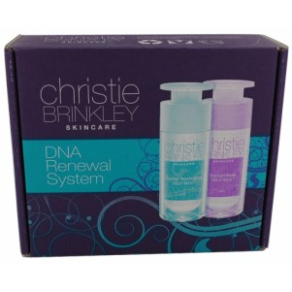

Christie Brinkley Skincare DNA Renewal System
Company:
Christie Brinkley Beauty
Country:
USA
Date Published:
Jan 2012
Sub-Category:
Sets
Price (local):
$99.95
Price (major currencies):
€74.32
Christie Brinkley Skincare DNA Renewal System is a set containing: Daytime Rejuvenating Treatment, designed to improve the health of skin cells, increase collagen and elastin production and protect skin cells from the damaging effects of the environment; and Overnight Repair Treatment, designed to penetrate the skin to receive maximum ingredient absorption p…
1702033
Ingredients:
day time rejuvenating treatment: Aqua, Isododecane, Cyclopentasiloxane, Cetyl Alcohol, Butyrospermum Parkii Butter, Cetearyl Methicone, Glycerin, Maris Aqua, Glyceryl Stearate, PEG-100 Stearate, …
Claims:
All Natural Product, Vitamin/Mineral Fortified, Refill, Botanical/Herbal, UV Protection, Antioxidant, Anti-Ageing, Ethical - Environmentally Friendly Package, Ethical - Animal, Brightening / Illuminating*, Collagen Increasing*, Firming*, Long-Lasting*, Mattifying*, Moisturising / Hydrating, Plumping*, Protects Against Elements*, Reduces Fine Lines / Wrinkles*, Reduces Redness*, Reduces the Appearance of Pores*, For Sensitive Skin, Paraben Free, Toning*, Vegan, Time/Speed, No Animal Ingredients
34
Notes:
Product Description: Christie Brinkley Skincare DNA Renewal System is a set containing: Daytime Rejuvenating Treatment, designed to improve the health of skin cells, increase collagen and elastin production and protect skin cells from the damaging effects of the environment; and Overnight Repair Treatment, designed to penetrate the skin to receive maximum ingredient absorption promoting greater blood flow, detoxification and cellular repair from skin damage that may have occurred during the day. The products are based on revolutionary Active Epigenetic Technology to bring unparalleled anti-aging restoration and protection, to repair and reverse the signs of aging 24 hours a day, minimize fine lines, scars and wrinkles, reduce redness, and control oil production. Both treatments are said to have a rich and creamy texture and penetrate the skin easily, leaving a non-greasy feel for a significantly smoother moisturized skin with improved tone, firmness and texture with reduced pores. They are formulated with natural and vegan ingredients derived from exotic botanicals and plant stem cells to promote and restore positive Epigenetic gene interaction to deliver younger, healthier and more radiant looking skin in just 14 days. The Epigenetics technology is claimed to apply a natural active blend containing laminaria digitata extract, rich in proteins, vitamins, minerals and lipids; ergothioneine, a powerful antioxidant; plankton extract, a plant based marine extract; and vitamin E that protects against UV exposure, during the day; arabidopsis thaliana extract, a repair enzyme; limonium narbonese extract, a perennial seaside plant; micrococcus lysate, a natural DNA repair enzyme; a plant complex consisting of aminoguanidine and decarboxy carnosine HCI; and citrullus vulgaris fruit extract, a natural fruit extract, which provides instant skin plumping, at night. The paraben- and cruelty-free system is all natural, suitable for all skin types including dry and sensitive, is certified vegan, free from animal products, and is retailed in packaging that is FSC-certified, eco-friendly and refillable.
Ingredients: day time rejuvenating treatment:
Aqua, Isododecane, Cyclopentasiloxane, Cetyl Alcohol, Butyrospermum Parkii Butter, Cetearyl Methicone, Glycerin, Maris Aqua, Glyceryl Stearate, PEG-100 Stearate, Dimethicone/Vinyl Dimethicone Crosspolymer, Theobroma Cacao Seed Butter (Seed), Ascorbic Acid, Butylene Glycol, Caprylyl Glycol, Carbomer, Cholecalciferol, Citrus Tangerina Extract (Extract), Citrus Aurantium Dulcis Fruit Extract (Extract), Disodium EDTA, Ergothioneine, Ethylhexylglycerin, Hydrogenated Vegetable Oil (Hydrogenated, Vegetable Based), Laminaria Digitata Extract (Extract), Lavandula Angustifolia Flower/leaf/stem Extract (Extract), Mangifera Indica Seed Butter (Seed), Persea Gratissima Oil, Phormidium Persicinum Extract (Extract), Plankton Extract (Extract), Polysorbate 60, Retinyl Palmitate, Rosmarinus Officinalis Leaf Extract (Extract), Tocopheryl Acetate, Tridecyl Salicylate, Xanthan Gum, Zea Mays Oil, Phenoxyethanol, fragrance (parfum), Hexyl Cinnamal, Benzyl Salicylate, Linalool, L-limonene, Hydroxycitronellal, Butylphenyl Methylpropionalovernight repair treatment:
Aqua, Cocos Nucifera Oil (Coconut Oil Derived), Caprylic/capric/myristic/stearic Triglyceride, Ethylhexyl Palmitate, Cetearyl Alcohol, Polysorbate 60, Aminomethyl Propanol, Aminoguanidine, Arabidopsis Thaliana Extract (Extract), Ascorbic Acid, Butylene Glycol, Caprylyl Glycol, Carbomer, Cholecalciferol, Citrullus Vulgaris Fruit Extract (Extract), Citrus Tangerina Extract (Extract), Decarboxy Carnosine HCl, Disodium EDTA, Ethylhexylglycerin, Glycerin, Helianthus Annuus Seed Oil (Seed), Hydroxyethylcellulose, Isopentyldiol, Jasminum Officinale Extract (Extract), Laminaria Digitata Extract (Extract), Lavandula Angustifolia Flower/leaf/stem Extract (Extract), Lecithin, Lens Esculenta Fruit Extract (Extract), Limonium Narbonense Flower/Leaf/Stem Extract (Extract), Micrococcus Lysate, Peumus Boldus Leaf Extract (Extract), Plankton Extract (Extract), Polygonum Cuspidatum Root Extract (Extract, Root), Pyrus Malus Fruit Extract (Extract), Retinyl Palmitate, Rosmarinus Officinalis Leaf Extract (Extract), Sodium Lactate, Sodium Lactate, Sodium PCA, Steareth-2, Tocopherol, Zea Mays Oil, Phenoxyethanol, fragrance (parfum), Hexyl Cinnamal, Butylphenyl Methylpropional, Benzyl Salicylate, Linalool, Alpha-isomethyl Ionone, L-limonene, Coumarin
Claims: All Natural Product, Vitamin/Mineral Fortified, Refill, Botanical/Herbal, UV Protection, Antioxidant, Anti-Ageing, Ethical - Environmentally Friendly Package, Ethical - Animal, Brightening / Illuminating*, Collagen Increasing*, Firming*, Long-Lasting*, Mattifying*, Moisturising / Hydrating, Plumping*, Protects Against Elements*, Reduces Fine Lines / Wrinkles*, Reduces Redness*, Reduces the Appearance of Pores*, For Sensitive Skin, Paraben Free, Toning*, Vegan, Time/Speed, No Animal Ingredients

Slide 36
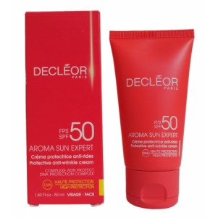
Decléor Aroma Sun Expert Protective Anti-Wrinkle Face C…
Company:
Decléor
Country:
Germany
Date Published:
May 2012
Sub-Category:
Sun - Sun/Sunbed Exposure
Price (local):
€30.00
Price (major currencies):
$38.76
The Decléor Aroma Sun Expert range is designed to provide a true energy cocktail to protect the skin more effectively, allowing the user to tan safely. Each product features 'new-generation' formulas that are said to be non-greasy, non-sticky and rapidly absorbed ensuring no white finish is left on the skin. Available as part of the range is Anti-Aging Sonne…
1809586
Ingredients:
Aqua, Octocrylene, C12-15 Alkyl Benzoate, Methylene Bis-benzotriazolyl Tetramethylbutylphenol, Butylene Glycol, Cyclopentasiloxane, Pentylene Glycol, Ethylhexyl Salicylate, Glycerin, Bis-ethylhex…
Claims:
No Additives/Preservatives, For Sensitive Skin, Botanical/Herbal, Ethical - Environmentally Friendly Package, UV Protection, Time/Speed, Ease of Use, Antioxidant, Moisturising / Hydrating, Anti-Ageing, Reduces Fine Lines / Wrinkles*
35
Notes:
Product Description: The Decléor Aroma Sun Expert range is designed to provide a true energy cocktail to protect the skin more effectively, allowing the user to tan safely. Each product features 'new-generation' formulas that are said to be non-greasy, non-sticky and rapidly absorbed ensuring no white finish is left on the skin. Available as part of the range is Anti-Aging Sonnenschutzcreme LSF 50 (Protective Anti-Wrinkle Face Cream SPF 50), which is specifically designed for sensitive, fragile and mature skin in need of extra protection. It features UVA/UVB filters and a DNA Protection Complex, blending extracts of jasmine and antioxidant vanilla to boost the skin's defence system and protect the DNA; essential oil of damask rose to protect from the harmful effects of the sun and premature skin ageing; rea extract from Tahiti to help reduce skin irritations triggered by the sun; and Sol-Collagenine, an anti-ageing complex to reduce fine lines and wrinkles. Skin is said to be better protected and moisturised for prolonged youthfulness, whilst safely developing a natural and long lasting tan. According to the manufacturer, the easy to apply light formula will not leave any white marks, and is sensually scented with a delight summer fragrance. This product is free from colourant and mineral oils, and comes in an FSC-certified pack.
Ingredients: Aqua, Octocrylene, C12-15 Alkyl Benzoate, Methylene Bis-benzotriazolyl Tetramethylbutylphenol, Butylene Glycol, Cyclopentasiloxane, Pentylene Glycol, Ethylhexyl Salicylate, Glycerin, Bis-ethylhexyloxyphenol Methoxyphenyl Triazine, Butyl Methoxydibenzoylmethane, Cyclohexasiloxane, Glyceryl Stearate, PEG-100 Stearate, Argania Spinosa Kernel Oil, Potassium Cetyl Phosphate, Tricontanyl PVP, Helianthus Annuus Seed Oil (Seed), Decyl Glucoside, Dimethicone, Helianthus Annuus Seed Oil Unsaponifiables (Seed), parfum (fragrance), Tocopheryl Acetate, Triethanolamine, Palmitic Acid, Carbomer, Cetyl Alcohol, Chlorphenesin, Stearic Acid, 1,2-hexanediol, Benzyl Salicylate, Caprylyl Glycol, Jasminum Officinale Flower Extract (Extract), Disodium EDTA, Hydroxyethylcellulose, Lupinus Albus Seed Extract (Extract, Seed), Hexyl Cinnamal, Hydroxycitronellal, Xanthan Gum, L-limonene, Rosa Damascena Flower Oil, Geraniol, Vanilla Tahitensis Fruit Extract (Extract), Curcuma Longa Root Extract (Extract, Root), Citronellol, Coumarin, Benzyl Alcohol, IL170511
Claims: No Additives/Preservatives, For Sensitive Skin, Botanical/Herbal, Ethical - Environmentally Friendly Package, UV Protection, Time/Speed, Ease of Use, Antioxidant, Moisturising / Hydrating, Anti-Ageing, Reduces Fine Lines / Wrinkles*

Slide 37
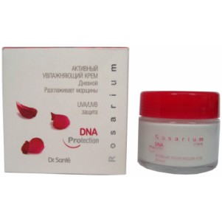

Dr. Santé Rosarium DNA Protection Active Moisturising D…
Company:
NPO El'fa
Country:
Russia
Date Published:
Feb 2011
Sub-Category:
Face/Neck Care
Price (local):
RUR120.00
Price (major currencies):
$3.99 / €3.03
The Dr. Santé Rosarium DNA Protection range is designed to protect skin from age-related changes with its GP4G technology. According to the manufacturer, all the products in the range contain: shore, shea, and olive oil; moisturising properties of hyaluronic acid, avocado oil, seaweed and Nalidon; regenerative properties of ceramides and camellia oil; Avocad…
1480465
Ingredients:
Aqua, Ethylhexyl Cocoate, Ethylhexyl Stearate, Glyceryl Stearate, Ceteareth-20, Ceteareth-12, Cetearyl Alcohol, Cetyl Palmitate, Propylheptyl Caprylate, Glycerin, Mannan, Cetearyl Olivate, Sorbit…
Claims:
Botanical/Herbal, Anti-Ageing, UV Protection, Moisturising / Hydrating
36
Notes:
Product Description: The Dr. Santé Rosarium DNA Protection range is designed to protect skin from age-related changes with its GP4G technology. According to the manufacturer, all the products in the range contain: shore, shea, and olive oil; moisturising properties of hyaluronic acid, avocado oil, seaweed and Nalidon; regenerative properties of ceramides and camellia oil; Avocadol, konjak mannane, violet and rosemary extract, which allow the cells to breathe; and UVA/UVB protection and Vital ET essential oil of rose, to provide protection against photo-ageing. Available as part of the range is Aktivnyy Uvlazhnayuschiy Dnevnoy Krem (Active Moisturising Day Care), which is retailed in a 50ml pack.
Ingredients: Aqua, Ethylhexyl Cocoate, Ethylhexyl Stearate, Glyceryl Stearate, Ceteareth-20, Ceteareth-12, Cetearyl Alcohol, Cetyl Palmitate, Propylheptyl Caprylate, Glycerin, Mannan, Cetearyl Olivate, Sorbitan Olivate, Triceteareth-4 Phosphate, Isodecyl Neopentanoate, Diisopropyl Sebacate, Lauryl Lactate, Phenoxyethanol, Ethylhexyl Methoxycinnamate, Cyclopentasiloxane, C30-45 Alkyl Cetearyl Dimethicone Crosspolymer, Methylparaben, Ethylparaben, Propylparaben, Butylparaben, Acrylates/C10-30 Alkyl Acrylate Crosspolymer, Triethanolamine, Ethylhexyl Triazone, Retinyl Palmitate, Linoleic Acid, Linolenic Acid, Rosa Canina Flower (Extract), parfum, artemia salina
Claims: Botanical/Herbal, Anti-Ageing, UV Protection, Moisturising / Hydrating

Slide 38
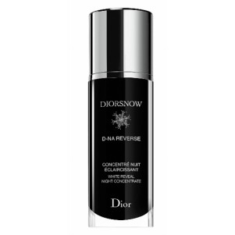
Dior DiorSnow White Reveal D-NA Reverse Night Concentra…
Company:
Parfums Christian Dior
Country:
USA
Date Published:
Apr 2012
Sub-Category:
Face/Neck Care
Price (local):
$145.00
Price (major currencies):
€115.99
Dior DiorSnow White Reveal D-NA Reverse Intense Night Concentrate has been relaunched as Night Concentrate, now featuring a new pack design and a new formula with Icelandic Glacial Water and Dior's exclusive Transparency Enhancing Complex (T.E.C.), which acts on the five key features of transparent skin: evenness; luminosity; moisture; texture; and plumpness…
1842417
Ingredients:
No information available
Claims:
Ethnic, Dermatologically Tested, Time/Speed, Whitening, Moisturising / Hydrating, Plumping*
37
Notes:
Product Description: Dior DiorSnow White Reveal D-NA Reverse Intense Night Concentrate has been relaunched as Night Concentrate, now featuring a new pack design and a new formula with Icelandic Glacial Water and Dior's exclusive Transparency Enhancing Complex (T.E.C.), which acts on the five key features of transparent skin: evenness; luminosity; moisture; texture; and plumpness. According to the manufacturer, the concentrated formula stimulates the DNA to repair the skin's enzymes and helps reverse the chain reaction at the source of melanin production to instantly brighten skin, and correct and prevent the appearance of dark spots. The entire Dior DiorSnow range has been dermatologically-tested on Asian skin.
Ingredients: Not Available
Claims: Ethnic, Dermatologically Tested, Time/Speed, Whitening, Moisturising / Hydrating, Plumping*

Slide 39
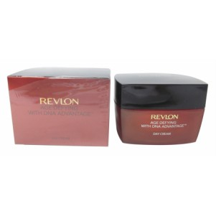

Revlon Age Defying with DNA Advantage Day Cream
Company:
Revlon
Country:
China
Date Published:
Oct 2012
Sub-Category:
Face/Neck Care
Price (local):
CNY240.00
Price (major currencies):
$37.85 / €30.53
Revlon Age Defying with DNA Advantage is a range of anti-ageing products designed and tested for Asian skin. It is formulated with the brand's proprietary Renewist Complex, a combination of copper (copper gluconate), alfalfa, cottonseed botanical extracts and vitamins, which is claimed to enhance the skin's natural repair systems to renew the appearance of s…
1916863
Ingredients:
Aqua, Ethylhexyl Methoxycinnamate, C12-15 Alkyl Benzoate, Titanium Dioxide, CI 77947, Steareth-21, Glycerin, Neopentyl Glycol Diheptanoate, Magnesium Aluminum Silicate, Methyl Trimethicone, Penty…
Claims:
Vitamin/Mineral Fortified, Ethnic, Botanical/Herbal, Brightening / Illuminating*, Firming*, Moisturising / Hydrating, Anti-Ageing, Reduces Fine Lines / Wrinkles*
38
Notes:
Product Description: Revlon Age Defying with DNA Advantage is a range of anti-ageing products designed and tested for Asian skin. It is formulated with the brand's proprietary Renewist Complex, a combination of copper (copper gluconate), alfalfa, cottonseed botanical extracts and vitamins, which is claimed to enhance the skin's natural repair systems to renew the appearance of skin, help reduce the visible effects of environmental skin damage, reduce the appearance of wrinkles, fine lines and uneven skin tone, promote hydration to smooth skin texture and reduce dryness, and restore firmness for a renewed, flawless and younger looking skin. Available as part of the range is Day Cream, which is said to repair, moisturise and nourish the skin in the day whilst improving the appearance of fine lines for a firm, elastic and radiant appearance.
Ingredients: Aqua, Ethylhexyl Methoxycinnamate, C12-15 Alkyl Benzoate, Titanium Dioxide, CI 77947, Steareth-21, Glycerin, Neopentyl Glycol Diheptanoate, Magnesium Aluminum Silicate, Methyl Trimethicone, Pentylene Glycol, Steareth-2, Dextrin, Trisiloxane, Dimethicone, Aluminum Starch Octenylsuccinate, Artemia Extract (Extract), Stearyl Alcohol, Sorbitol, Cetearyl Glucoside, Morus Bombycis Extract (Extract), Scutellaria Baicalensis Root Extract (Extract), Medicago Sativa Extract (Extract), Vitis Vinifera Fruit Extract (Extract), Saxifraga Sarmentosa Extract (Extract), Thermus Thermophillus Ferment, Gossypium Hirsutum Extract (Extract), Sodium Hyaluronate, Bisabolol, Tocopheryl Acetate, Ascorbyl Glucoside, Glyceryl Linolenate, Cetearyl Alcohol, Zinc Gluconate, Copper Gluconate, Aluminum Hydroxide, PPG-12/SMDI Copolymer, Caprylyl Methicone, Potassium Cetyl Phosphate, Glyceryl Linolenate, Polysorbate 20, Butylene Glycol, Triethoxycaprylylsilane, Cellulose Gum, PEG-9 Polydimethylsiloxyethyl Dimethicone, Sorbitan Stearate, Glyceryl Acrylate/acrylic Acid Copolymer, Triethoxysilylethyl Polydimethylsiloxyethyl Hexyl Dimethicone, Polyhydroxystearic Acid, fragrance, Alpha-isomethyl Ionone, Hydroxyisohexyl 3-cyclohexene Carboxaldehyde, Benzyl Salicylate, Hydroxycitronellal, Sodium Citrate, Citric Acid, Disodium EDTA, Phenoxyethanol, Caprylyl Glycol, 1,2-hexanediol
Claims: Vitamin/Mineral Fortified, Ethnic, Botanical/Herbal, Brightening / Illuminating*, Firming*, Moisturising / Hydrating, Anti-Ageing, Reduces Fine Lines / Wrinkles*

Slide 40


