Slide 1
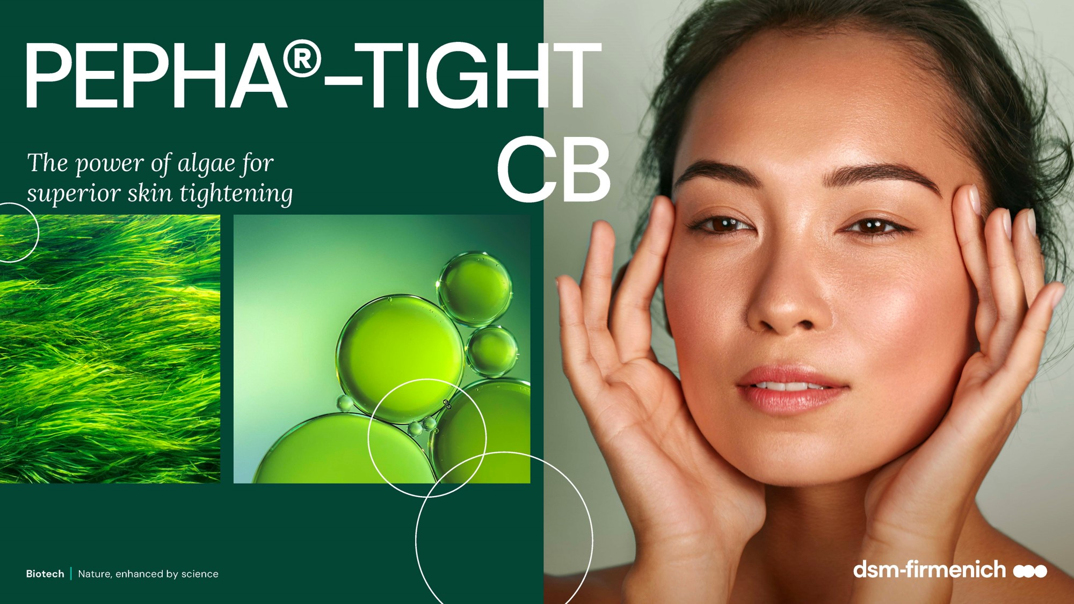
April 2025

Slide 2
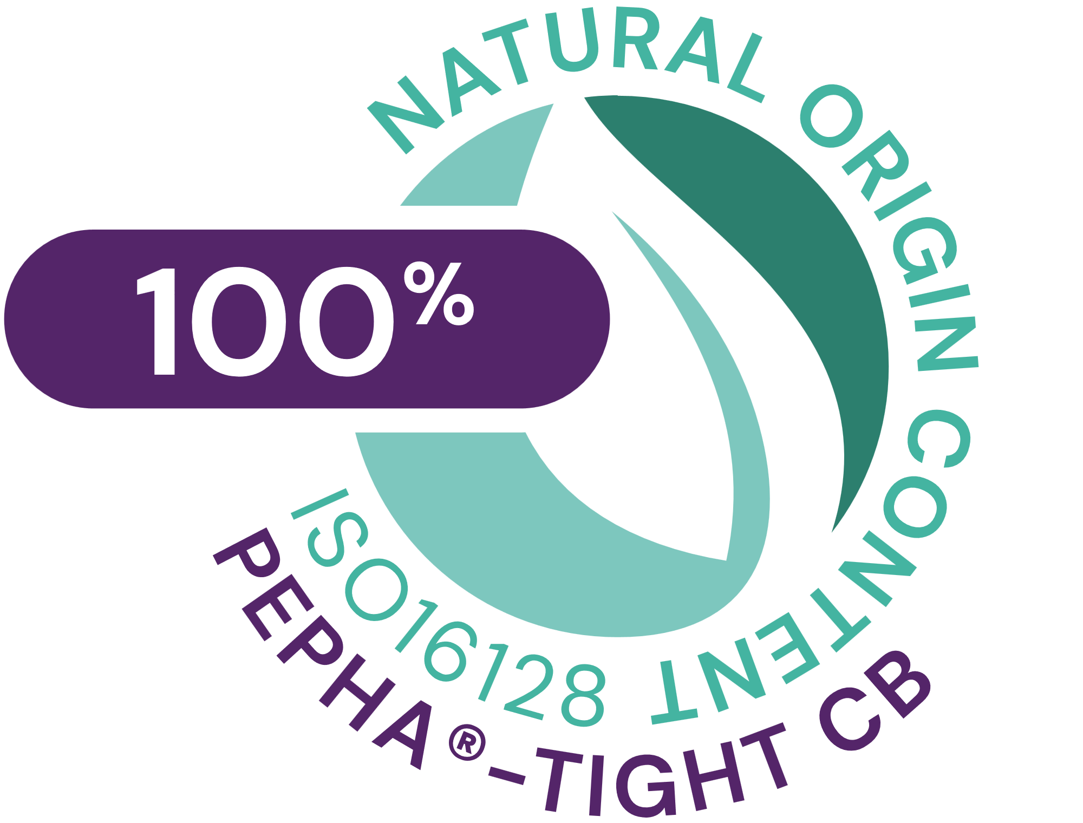



PEPHA®-TIGHT CB
ID Card
INCI NAME:
Nannochloropsis Oculata Extract, Pullulan, Pentylene Glycol, Citric Acid, Aqua
Sustainably farmed in photo-bioreactors, guaranteeing maximum quality (no risk of contamination, reproducibility of process, fully traceable)
Derived from Nannochloropsis oculata microalgae and high performing polysaccharide
Polysaccharides obtained from natural fermentation of tapioca starch
100% naturally-derived origin (ISO 16128)
TECHNOLOGY:
Solubility: Soluble in water
TECHNICAL:
Form: Transparent to turbid yellow to amber highly viscous liquid
Use level: 1–5%
pH of use: 3.5 – 7.5
Preservative: Free
Stimulates fibroblasts’ proliferation and Collagen I*
Protects the skin against oxidative stress and urban dust*
Short-term: Flawless skin after 1 application. Long-lasting lifting result up to 12hrs, already with 2 applications***.
Long-term: With regular usage wrinkles reduction by over -20%
BENEFITS:
REGISTRATION
CERTIFICATION
Raw material verified by ECOCERT GREENLIFE, conform to the COSMOS Standard
¹ Based on dsm-firmenich clinical study where improvements in skin smoothness and texture homogeneity were detected already within 15min from 1st product application
* in vitro ** ex vivo *** in vivo

Slide 3

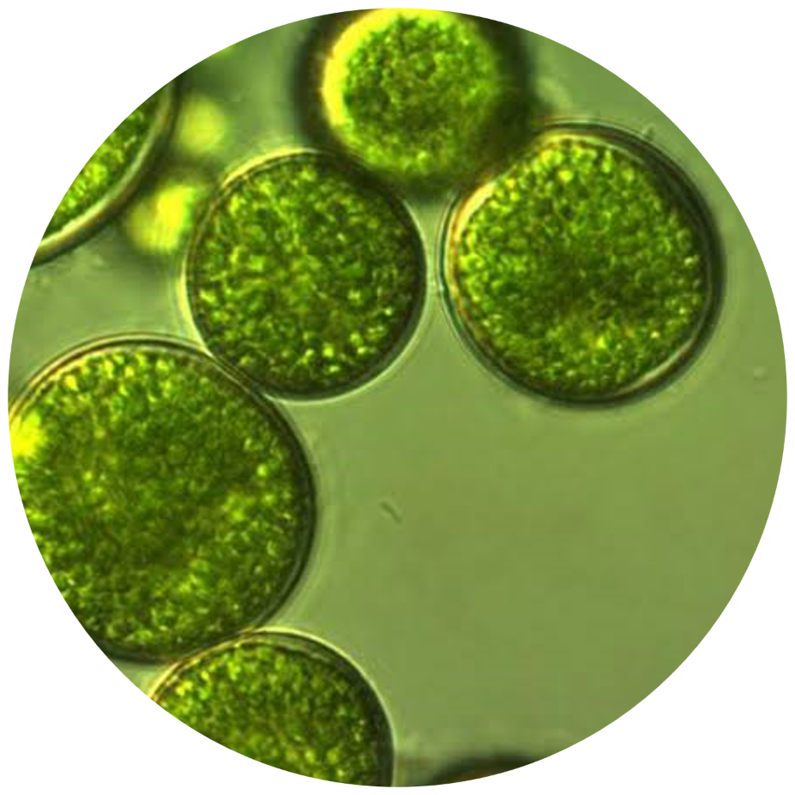
The algae
Nannochloropsis Oculata
Lives in both marine and freshwater lakes
Used for several decades to PRODUCE NUTRACEUTICALS and FEED SUPPLEMENTS
A STRONG COCCOID CELL WALL that protects its bioactives
Supplies the skin with ESSENTIAL AMINO ACIDS, PRECIOUS VITAMINS
(especially vitamins C and B12) and POWERFUL ANTIOXIDANTS

Slide 4
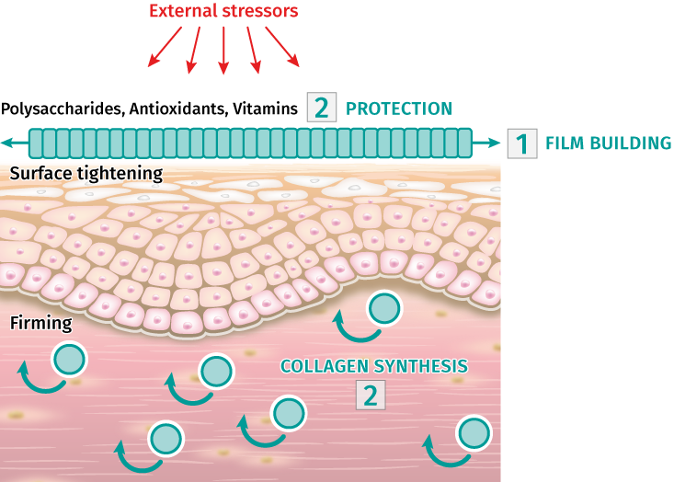
How does it work?
PEPHA®-TIGHT CB combines short- and long-term efficacy
1. Short-term, with 1 application:
PEPHA®-TIGHT CB forms a thin film on the skin, exerting an instant and long-lasting perceptible skin smoothing & lifting effect.
2. Long-term, with regular applications:
PEPHA®-TIGHT CB acts as a protective shield against oxidative stress, helps to stimulate the formation of Collagen I, an essential part of the skin’s connective tissue, helping reducing wrinkles & improving skin elasticity.

Slide 5
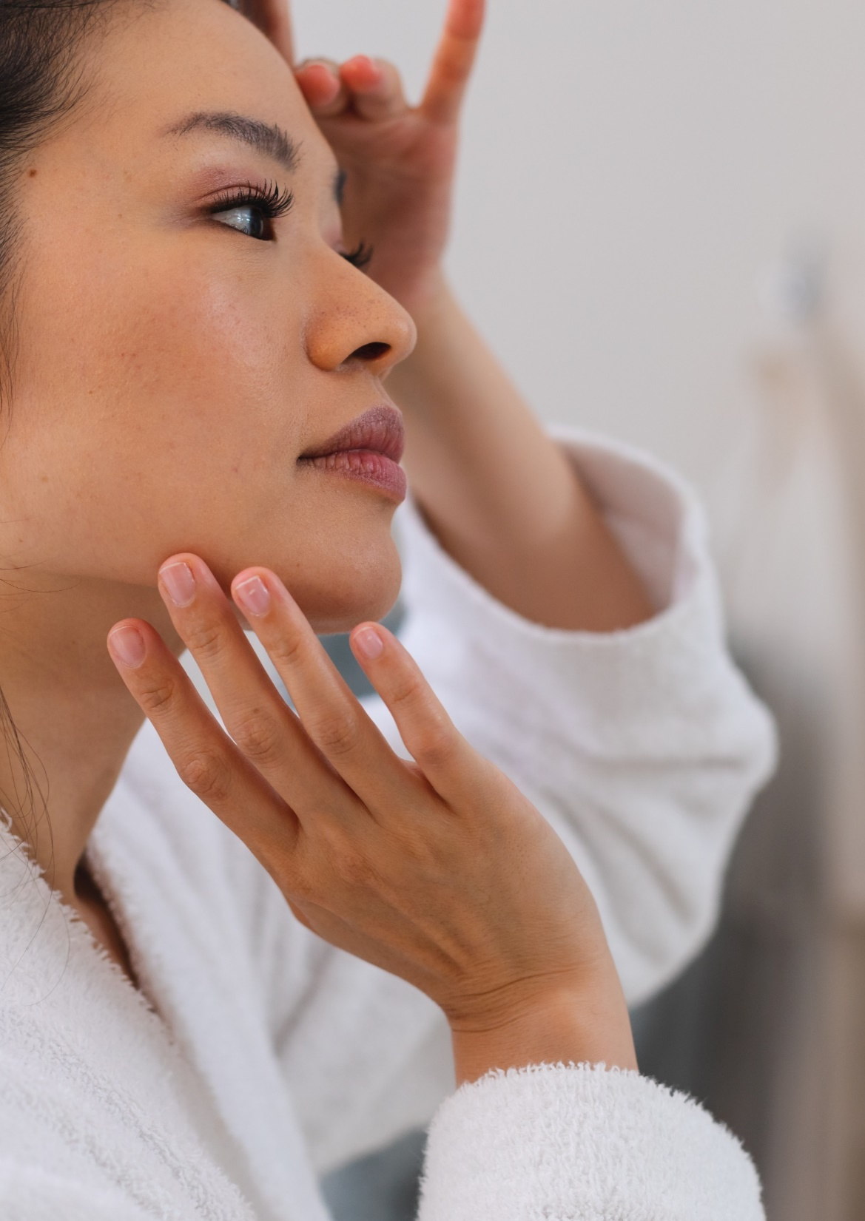
dsm-firmenich solution: PEPHA®-TIGHT CB
The fast lane to superior skin tightening
In vitro PEPHA®-TIGHT CB:
Stimulates Fibroblasts’ proliferation by +350% and Collagen-I by +70%
Protects the skin against oxidative stress and urban dust
In vivo PEPHA®-TIGHT CB:
Within minutes from 1st application:
  Visibly smoothens skin texture for an immediate¹ flawless effect
Up to 12hrs long-lasting effect:
  Skin looks and feels firmer, more lifted and more elastic already after 2 applications
Long-term result, after 2 months treatment:
  Reduces the wrinkles’ surface by -26% and length by -21%
  Improves skin elasticity by 15% and tonicity by 24%
¹ Based on DSM clinical study where improvements in skin smoothness and texture homogeneity were detected already within 15min from 1st product application
Notes:
For China “quick or fast”, better than immediate. may be regarded as exaggerate wording

Slide 6
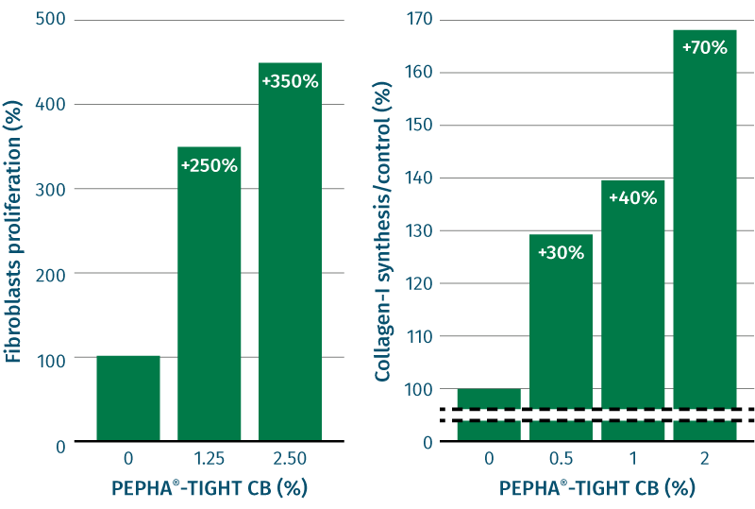
Highly increases fibroblasts proliferation and Collagen-I synthesis
In vitro efficacy
Stimulation of fibroblasts proliferation by 350% and Collagen-I by 70%
Aged skin is characterized by a decline of cell number and proliferative cells. Therefore, less ECM is produced, leading to a lack of structural components, such as collagen fibers. The skin gets thinner, less resilient and less firm.
Results:
    Increase in cell proliferation of human
    fibroblasts, and consequently support for
    collagen production increase.
    Stimulation of Collagen-I synthesis in human fibroblasts, improving the structure of the connective tissue
**p<0.01 against 0.
***p<0.001 against 0.

Slide 7
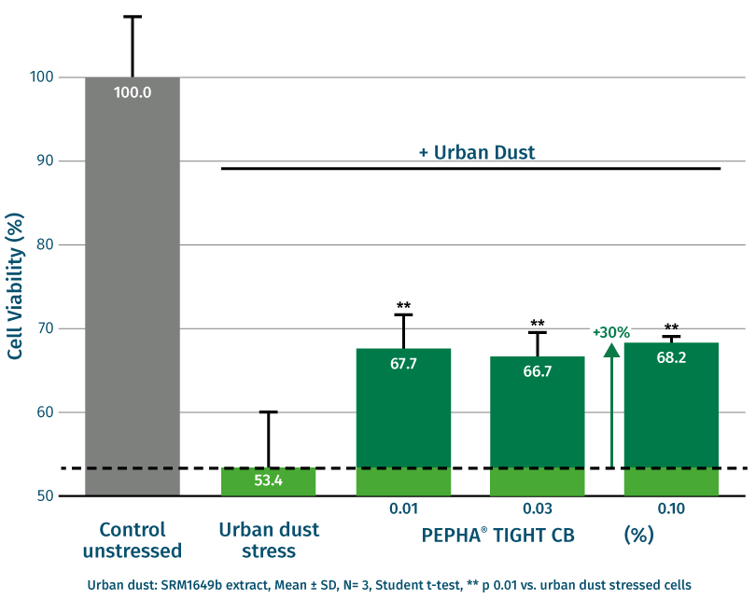
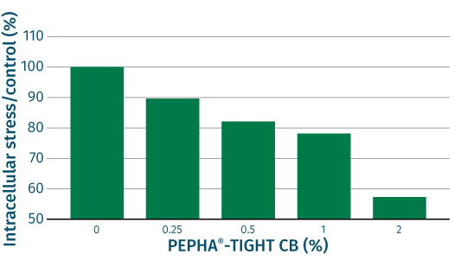
Protects the skin against stressors
In vitro efficacy
Protection against oxidative stress
Protection of cell viability against urban dust
Reactive Oxygen Species (ROS) are known to accelerate the aging process. In addition, aged cells are less able to protect themselves against oxidative stress. This leads to an accelerated collagen breakdown and cross-linking of proteins. The skin gets thinner and less resilient. In vitro protection was measured by the ROS assay: Human fibroblasts were exposed to hydrogen peroxide (H2O2) to induce an intracellular oxidative stress. The release of ROS was quantified by fluorescence staining.
Results:
Dose dependent protection of human fibroblasts from oxidative stress,
and consequently, protection of the collagen fiber network from
damaging processes.
Used in the dsm-firmenich assay and research Standard Reference Material ® (SRM) 1649b “urban dust” is an authentic surrogate for urban air pollution of the National Institute of Standards and Technology (Gaithersburg, MD, USA).
Results:
With PEPHA®-TIGHT CB, cell viability improves up to +30%
vs stressed cells
Notes:
Used in the dsm-firmenich assay and research Standard Reference Material ® (SRM) 1649b “urban dust” is an authentic surrogate for urban air pollution of the National Institute of Standards and Technology (Gaithersburg, MD, USA). SRM1649b was prepared from atmospheric particulate material collected in the Washington, DC area.
The particles contain certified ingredients, i.e. 23 PAHs, 13 PCB (polychlorinated biphenyls), 3 heavy metals
SRM1649b was resuspended in DMSO (100 mg/ml), stirred for 1 hour. After centrifugation the supernatant was added to cell culture (0.3 mg/ml final).
For ROS assay: 24 hours incubation with compound. Then add H2O2 and do DCF assay.

Slide 8

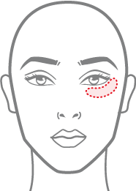

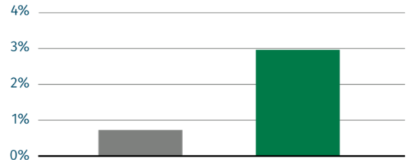
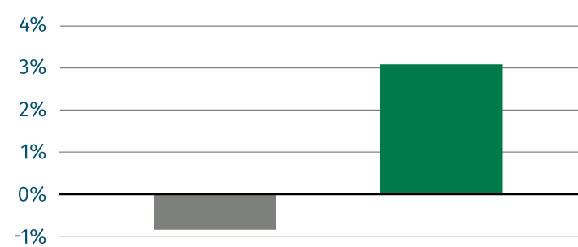
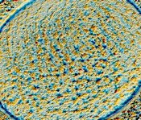
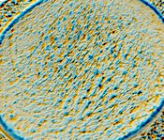
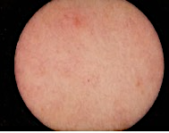
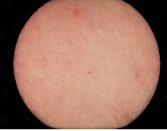
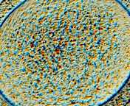
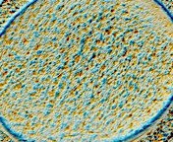
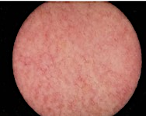
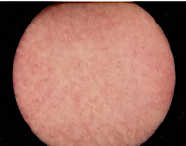
Flawless skin in minutes with PEPHA®-TIGHT CB
In vivo efficacy
SkinCam measurement
Skin Smoothness Improvement below eye
Skin Texture Improvement on Neck Area
$p<0.1 vs placebo
4x better than placebo
Skin smoothness
evolution [dSpa]
Average Texture homogeneity
Measurement area
(Under eye)
Measurement area
(Neck)
Placebo
3% PEPHA®-TIGHT CB
Placebo
3% PEPHA®-TIGHT CB
Immediately after 1 application
Immediately after 1 application
Volunteer 19
Volunteer 09
SkinCam takes an image of the skin surface and shows how the irregularities of the skin texture evolve.
After PEPHA®-TIGHT CB application, skin surface appears smoother and texture more homogeneous
Baseline
Immediately after
1 application
Baseline
Immediately after
1 application
Volunteer 36
Volunteer 58
Notes:
SkinCam takes an image of the skin surface and show how the irregularities of the skin texture evolve. After PEPHA-TIGHT application, skin surface appear smoother and texture more homogeneous
$ p=0.062 vs placebo

Slide 9

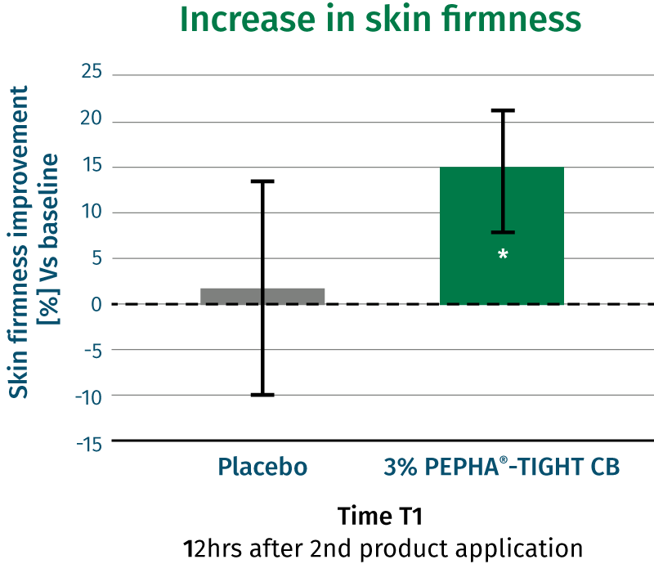
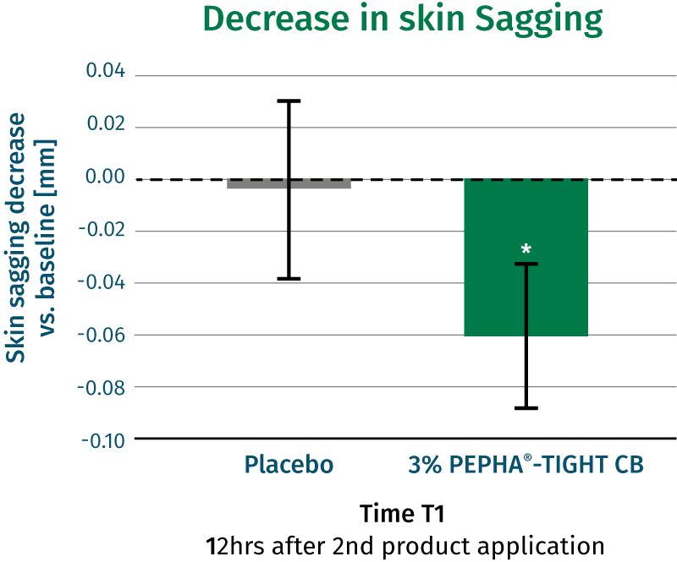
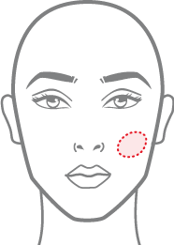
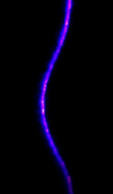
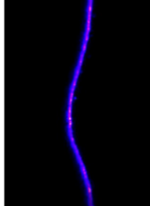
Significant long-lasting lifting effect with PEPHA®-TIGHT CB
In vivo efficacy
SkinFlex measurement
PEPHA-TIGHT CB is 13X better than placebo
Increase in skin firmness
Decrease in skin sagging
Volunteer 39
*p<0.05 vs placebo
*p<0.05 vs placebo
Skin deformation upon strain
Skin firmness improvement
(%) vs baseline
Skin sagging decrease
Vs. baseline [mm]
Measurement area
Baseline T0
T1
Placebo
3% PEPHA®-TIGHT CB
Placebo
3% PEPHA®-TIGHT CB
Time T1
12 hrs after 2nd product application
Time T1
12 hrs after 2nd product application
An airstream is blown perpendicularly to the cheek: it pushes the skin inwards forming a kind of “hole” in the cheek.
The firmer & more lifted is the skin, the more it’s able to resist the airstream, as shown for Volunteer 39 in the pic
Notes:
An airstream (representing a strain) is blown perpendicularly to the cheek: it pushes the skin inwards forming a kind of “hole” in the cheek.
The firmer & more lifted is the skin, the more it’s able to resist the airstream, as shown for Volunteer 39 in the pic

Slide 10
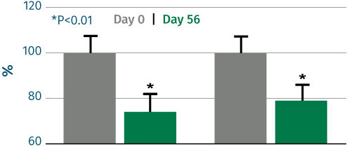
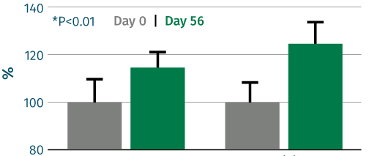
Long-term well-aging result with regular usage of PEPHA®-TIGHT CB
In vivo efficacy
Profilometer and Cutometer measurement
Wrinkle reduction (profilometry):
Skin firming (cutometry):
26%
21%
15%
24%
reduction of wrinkle surface
reduction of wrinkle length
improvement of elasticity
improvement of tonicity
Visible wrinkle reduction after 2 months
Lond-term skin firming results after 2 months!
$p<0.1 vs baseline
$
Cream with 3% PEPHA®-TIGHT CB applied on the face twice daily over 2 months. 13 female volunteers 30-55y.o., mean 40yrs.
Wrinkle Surface
Wrinkle Length
Elasticity
Tonicity
$p<0.1 vs baseline

Slide 11

PEPHA®-TIGHT CB
Supported marketing claims
Flawless skin within minutes¹
With just 1 application, skin surface appears smoother and texture more homogeneous
Long-lasting lifting effect, up to 12hrs from last application
Skin gains elasticity in critical facial areas
After multiple applications, long-term well-aging effect with wrinkles reduction by over -20%
¹ Based on dsm-firmenich clinical study where improvements in skin smoothness and texture homogeneity were detected already within 15min from 1st product application

