Slide 1
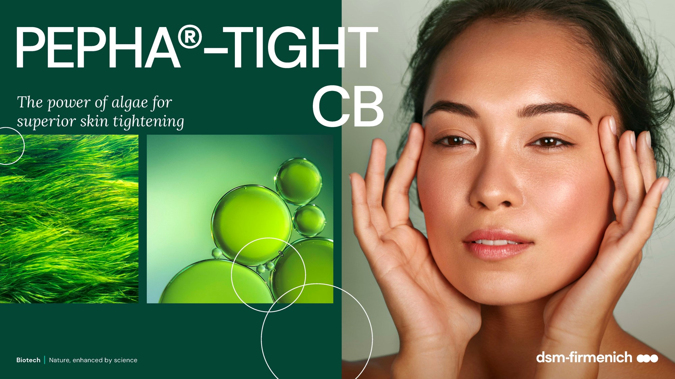
June 2025

Slide 2

Algae are becoming a major skincare ingredient…
Biotech | Nature, enhanced by science
2

Slide 3


A story of natural resilience
Oldest plant surviving geological ordeals
ALGAE
Very stable, resistant and resilient organisms
For thousands years, microalgae has been able to survive under the
stress of different environments
More than 70% of the earth
is covered by water.
It provides many unique environments and
rich resources.
Rich in nutrients, like Vitamins & Minerals
Source of effective Bioactives
for pharmaceuticals, nutraceuticals and skincare
Biotech | Nature, enhanced by science
3

Slide 4

A major ally for the skin!
The skincare benefits of algae are well-known
Algae are superfood for healthy looking skin!
An abundant source of amino acids, vitamins, minerals, antioxidants and essential fatty acids.
They are known and proven to provide a wide range of highly sought-after skincare benefits, including skin firming, restoration and boosting of Collagen synthesis, skin radiance and protection from blue light which causes skin hyperpigmentation and redness.

Slide 5
Algae keeps buzzing in latest skincare innovation
A dynamic and attractive solution for brands & consumers
Uncover the potential of emerging marine beauty
Younger consumers' positive perception
Key industry players feature & claim “algae” in latest innovations
Despite ongoing consumer interest, the use of marine ingredients remains relatively small.
However, the segment has grown in key beauty markets such as France, the US and the UK in recent years, indicating promising expectations for expansion.
Marine ingredients have been gaining more attention in beauty products.
This is especially so among younger consumers, more of whom perceive these ingredients positively (30% of US consumers aged 25-34 find them effective compared to only 9% of those aged 65+.
Algae remain a popular ingredient claimed by brands across the globes from key industry players. Mainly claimed by botanical & marine brands.
Social media data indicates that global consumers primarily associate marine ingredients with keywords such as health, natural, vitamins and hydration.
Sources: Mintel GNPD (algae/kelp/seaweed; total), April 2019-March 2024
Kantar Profiles/Mintel, November 2023 / US: 1,970 internet users aged 18+ who have used BPC products in the past 12 months
Mintel GNPD Face/Neck Innovations featuring & claiming “algae” in the last 5 yrs / Infegy Atlas/Mintel, April 2021-March 2024
5

Slide 6
Ticking the box of naturality and sustainability
Consumers are seeking natural and ethical ingredients
In the US
In the UK
In Spain
of facial skincare users say it is important for their products to ﻿contain natural ingredients
of Gen Z beauty users always look for products that are environmentally friendly
of ﻿adults would be willing to buy BPC made exclusively with lab-grown ingredients if they are better for the planet
41%
58%
51%
Lab-grown is the next-natural in sustainability
Algae can be lab-grown, the key to true sustainability as we reassess our relationship with oceans and planet.
Consumers will be accepting of lab-grown alternatives, perceived as natural and sustainable.
Source: Lightspeed/Mintel
Notes:
Algae also tick the box of naturality and sustainability, which are the must-have for conscious consumers
Consumers start understanding that natural doesn’t mean necessarily sustainable and lab-grown solutions are becoming the next natural in sustainability, because they allow preserving the biodiversity of the environment

Slide 7
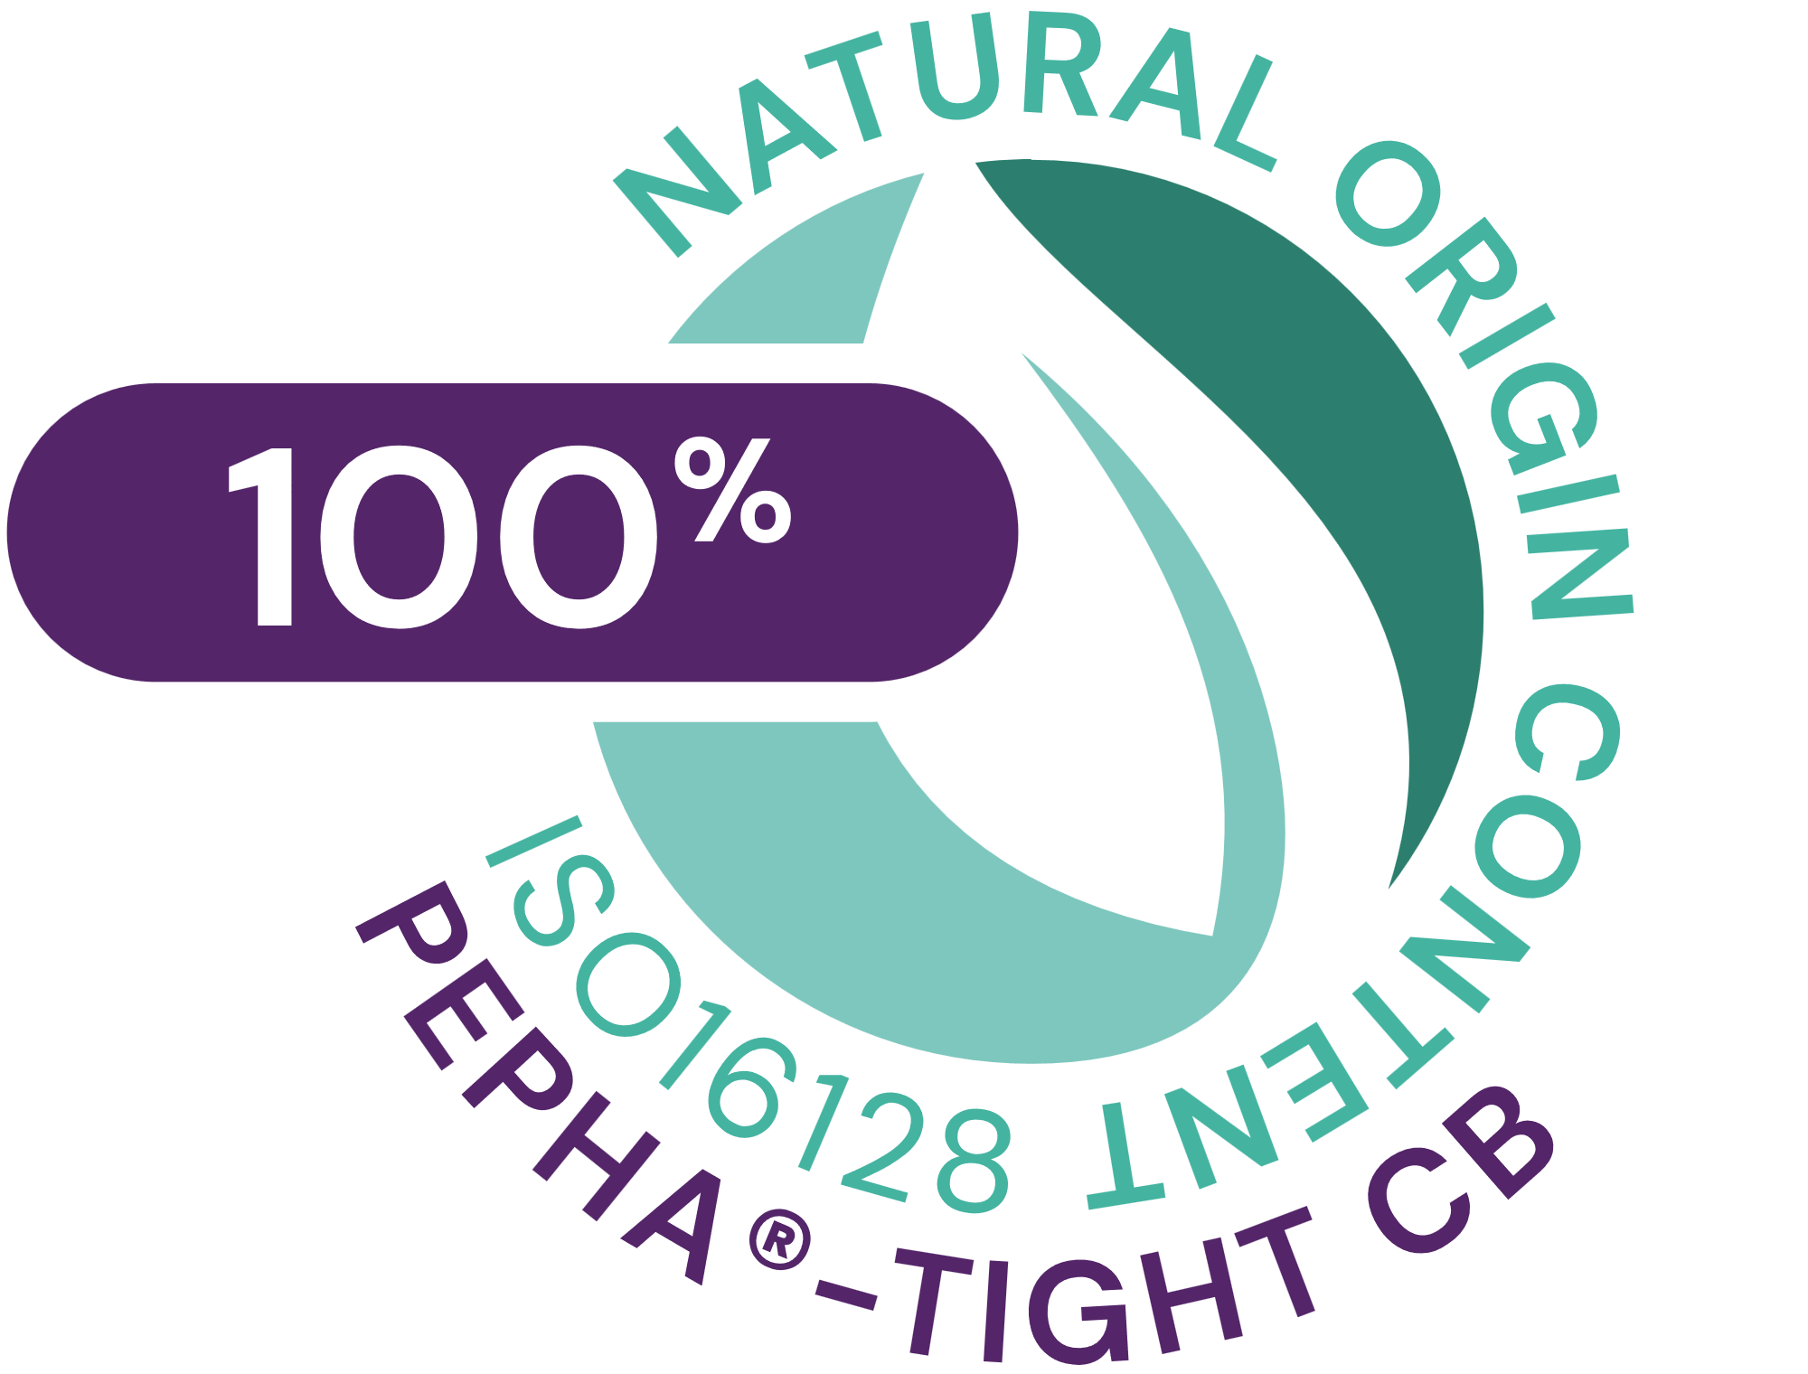




PEPHA®-TIGHT CB
ID Card
INCI NAME:
Nannochloropsis Oculata Extract, Pullulan, Pentylene Glycol, Citric Acid, Aqua
Sustainably farmed in photo-bioreactors, guaranteeing maximum quality (no risk of contamination, reproducibility of process, fully traceable)
Derived from Nannochloropsis oculata microalgae and high performing polysaccharide
Polysaccharides obtained from natural fermentation of tapioca starch
100% naturally-derived origin (ISO 16128)
TECHNOLOGY:
Solubility: Soluble in water
TECHNICAL:
Form: Transparent to turbid yellow to amber highly viscous liquid
Use level: 1–5%
pH of use: 3.5 – 7.5
Preservative: Free
Stimulates fibroblasts’ proliferation and Collagen I*
Protects the skin against oxidative stress and urban dust*
Short-term: Flawless skin after 1 application. Long-lasting lifting result up to 12hrs, already with 2 applications***.
Long-term: With regular usage wrinkles reduction by over -20%
BENEFITS:
REGISTRATION
CERTIFICATION
Raw material verified by ECOCERT GREENLIFE, conform to the COSMOS Standard
¹ Based on dsm-firmenich clinical study where improvements in skin smoothness and texture homogeneity were detected already within 15min from 1st product application
* in vitro ** ex vivo *** in vivo
Biotech | Nature, enhanced by science

Slide 8

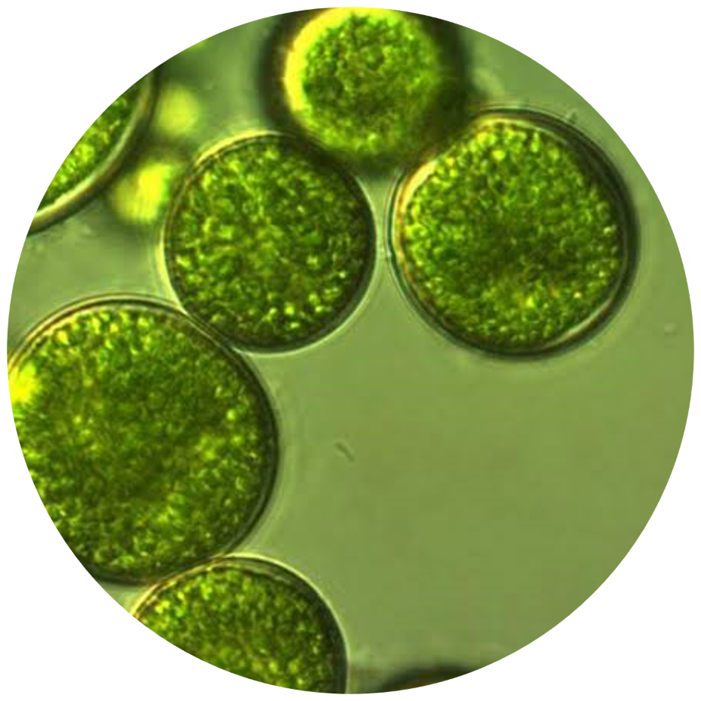
The algae
Nannochloropsis Oculata
Lives in both marine and freshwater lakes
Used for several decades to PRODUCE NUTRACEUTICALS and FEED SUPPLEMENTS
A STRONG COCCOID CELL WALL that protects its bioactives
Supplies the skin with ESSENTIAL AMINO ACIDS, PRECIOUS VITAMINS
(especially vitamins C and B12) and POWERFUL ANTIOXIDANTS
Biotech | Nature, enhanced by science
8

Slide 9
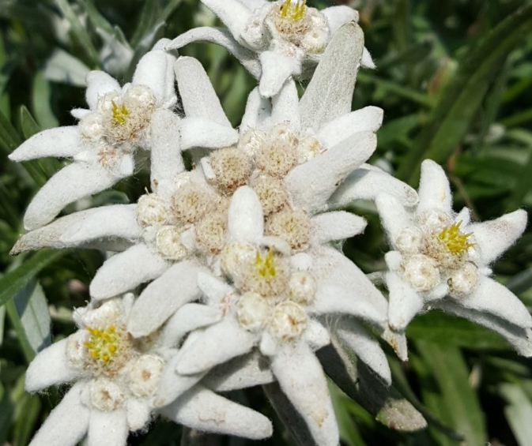
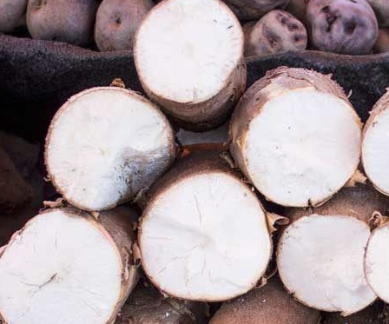
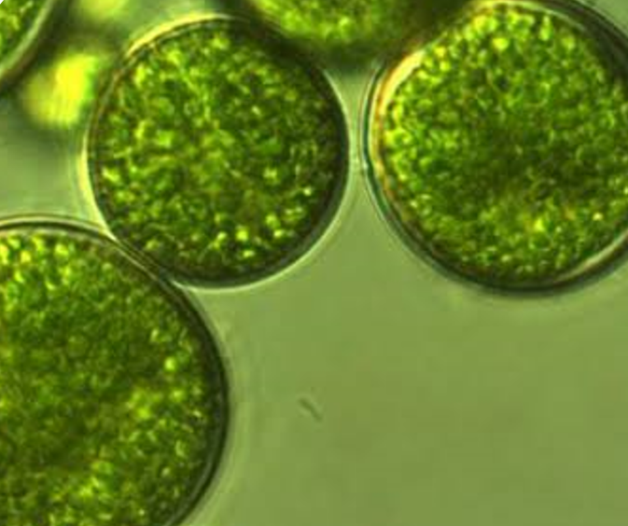



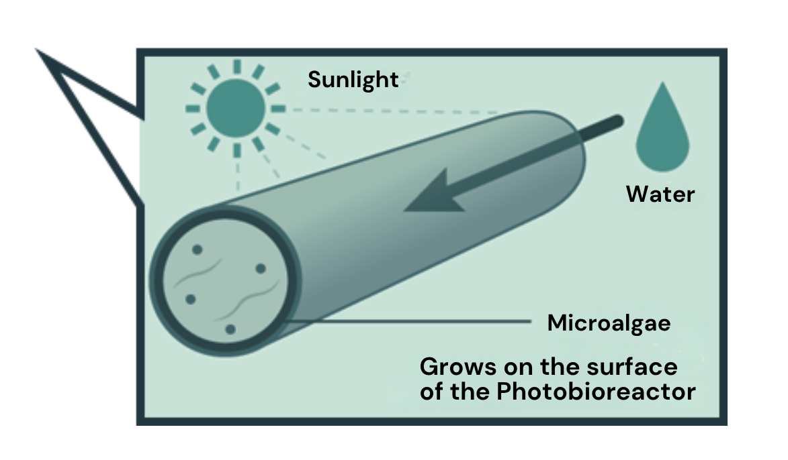
Unique combination for efficacy & sustainability
A concentrated mixture of powerful functional ingredients produced by biotechnologies, fully naturally derived & renewable
A transparent concentrated mixture with 3 powerful functional ingredients
Microalgae
Pullulan
Pentylene Glycol
Produced in photobioreactor
as a more sustainable solution compared to open ponds cultivation
Safer and better quality
More respectful of terrestrial biodiversity
Use of renewable energy
Fermentation of tapioca starch
Produced from valorised and naturally-derived material
9
Notes:
Photo de Marcos Acosta sur Unsplash
Photo de Eric Prouzet sur Unsplash
Photo de Yohan Marion sur Unsplash
The Microalgae, is produced in photobioreactors and grows in water on sunlight, carbon dioxide from the air, and some nutrients. It is natural up to the solvent used for the extraction of the algae, as only water is used.
By using biotechnology to produce the microalgae, we are making a more sustainable choice compared to open ponds culture:
A safer choice because photobioreactors are less susceptible to contamination
A lower impact on terrestrial diversity, as the construction of the open ponds is usually associated with a destruction of local fauna habitat
The energy used for the photobioreactors is mostly renewable
The Pullulan is produced by fermentation of tapioca starch (manioc), an alternative to using starch from grains.
Those are preserved in Pentylene Glycol, produced from corn cobs, therefore valorizing a residual stream after the extraction of the more valuable materials from the crop.
PEPHA®-TIGHT CB is a very powerful combination of anti-ageing effects, based on biological sources, processed with biotechnology and fitting in a net zero climate change policy. All production processes are operated under mild conditions without hazardous chemical substances and generate only small amounts of non-hazardous waste.

Slide 10
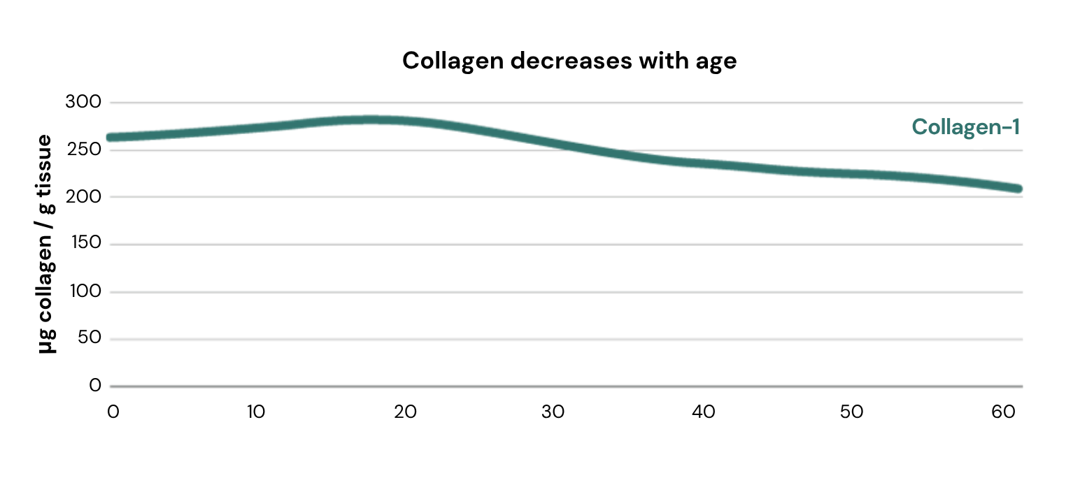
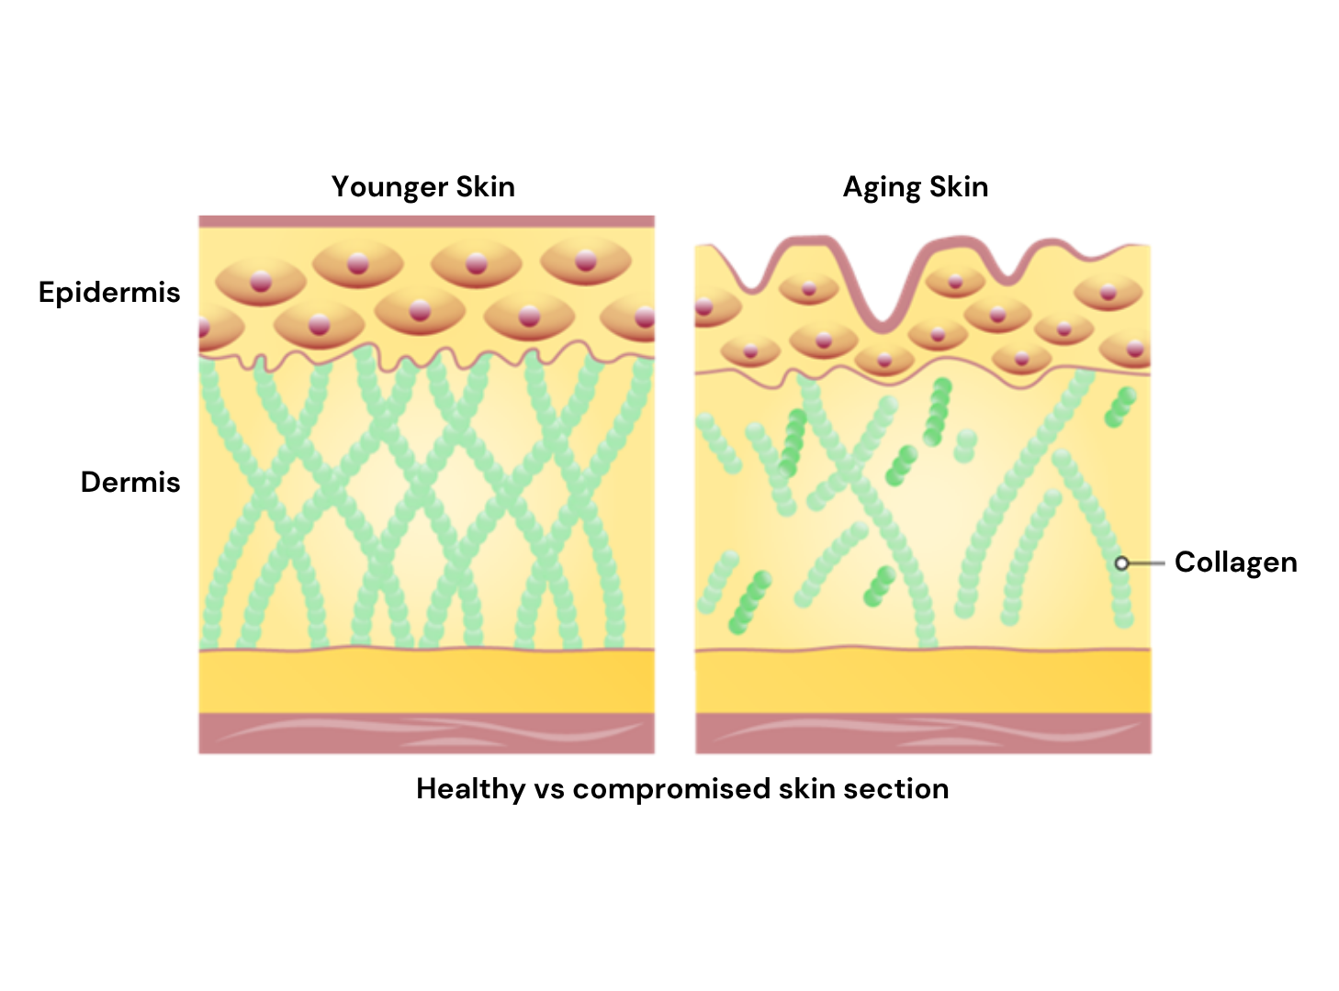

Over time skin works less efficiently
Reference: Asserin et al. (2015) J Cosmet Dermatol, 14, 291-301
Profound changes occur in the structure of the dermis and epidermis, through processes of intrinsic and extrinsic aging, leading to the appearance of wrinkles and the loss of tone
With age, the Collagen density in the Dermis decreases and its network becomes increasingly fragmented, presenting shorter and less
organized fibres.
An increase in Matrix Metalloproteinase (MMP) expression accelerates the Collagen degradation.
In parallel, the synthesis of new extracellular matrix components by dermal fibroblasts slows down, failing to adequately replace the degraded matrix.
Papakonstantinou et al. (2012) Dermato-Endocrinol 4:3, 253–258

Slide 11
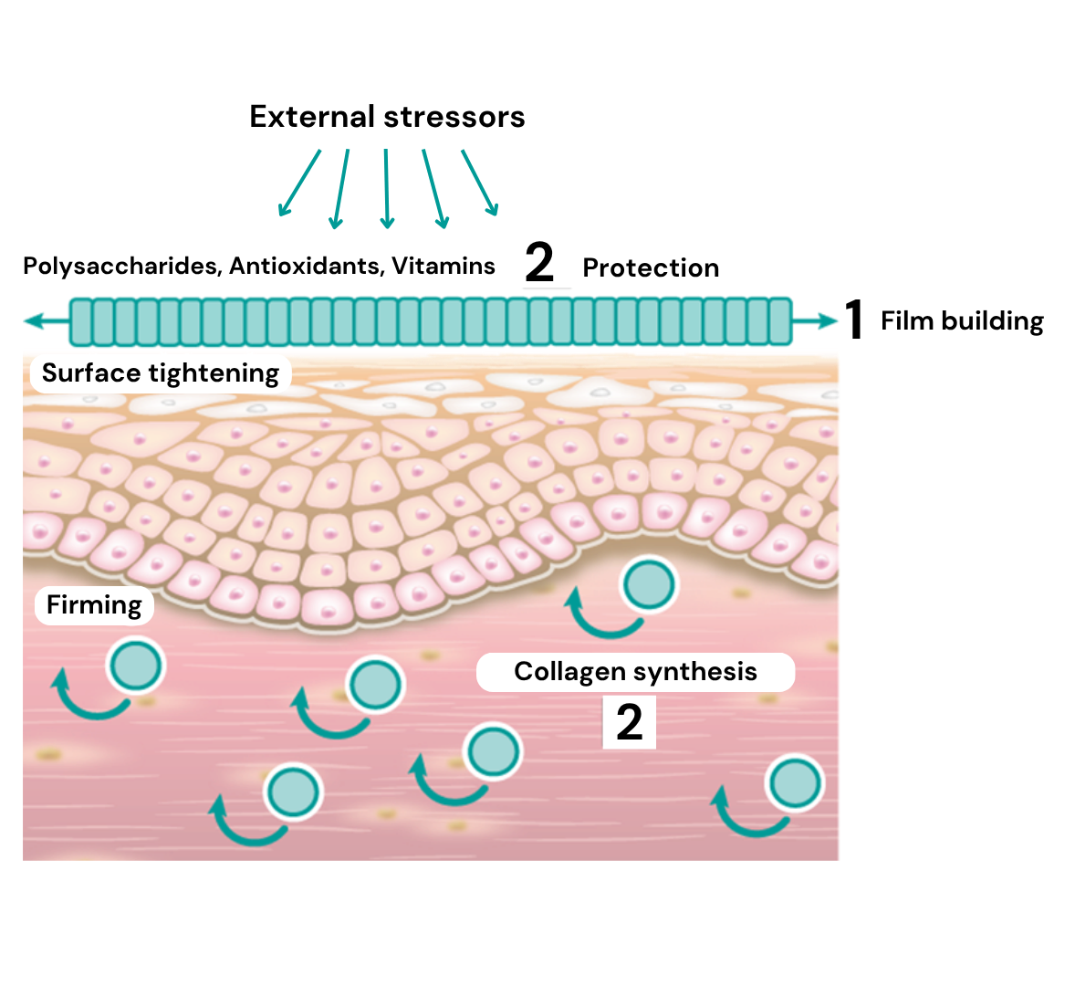
How does it work?
PEPHA®-TIGHT CB combines short- and long-term efficacy
1. Short-term, with 1 application:
PEPHA®-TIGHT CB forms a thin film on the skin, exerting an instant and long-lasting perceptible skin smoothing & lifting effect.
2. Long-term, with regular applications:
PEPHA®-TIGHT CB acts as a protective shield against oxidative stress, helps to stimulate the formation of Collagen I, an essential part of the skin’s connective tissue, helping reducing wrinkles & improving skin elasticity.

Slide 12

Highly increases fibroblasts proliferation and Collagen-I synthesis
Stimulation of fibroblasts proliferation by 350% and Collagen-I by 70%
Aged skin is characterized by a decline of cell number and proliferative cells. Therefore, less ECM is produced, leading to a lack of structural components, such as collagen fibers. The skin gets thinner, less resilient and less firm.
Results:
    Increase in cell proliferation of human
    fibroblasts, and consequently support for
    collagen production increase.
    Stimulation of Collagen-I synthesis in human fibroblasts, improving the structure of the connective tissue
**p<0.01 against 0.
***p<0.001 against 0.

Slide 13
Protects the skin against stressors
Protection against oxidative stress
Protection of cell viability against urban dust
+Urban Dust
**
**
+30%
**
Reactive Oxygen Species (ROS) are known to accelerate the aging process.
In addition, aged cells are less able to protect themselves against oxidative stress.
This leads to an accelerated collagen breakdown and cross-linking of proteins. The skin gets thinner and less resilient. In vitro protection was measured by the ROS assay:
Human fibroblasts were exposed to hydrogen peroxide (H2O2) to induce an intracellular oxidative stress. The release of ROS was quantified by fluorescence staining.
Results:
Dose dependent protection of human fibroblasts from oxidative stress, and consequently, protection of the collagen fiber network from damaging processes.
Used in the dsm-firmenich assay and research Standard Reference Material ® (SRM) 1649b “urban dust” is an authentic surrogate for urban air pollution of the National Institute of Standards and Technology (Gaithersburg, MD, USA).
Results:
With PEPHA®-TIGHT CB, cell viability improves up to +30%
vs stressed cells
Urban dust: SRM16495 extract, Mean ± SD, It=3, Student t-test, ** p 0.01 vs. urban dust stressed cells
Notes:
Used in the dsm-firmenich assay and research Standard Reference Material ® (SRM) 1649b “urban dust” is an authentic surrogate for urban air pollution of the National Institute of Standards and Technology (Gaithersburg, MD, USA). SRM1649b was prepared from atmospheric particulate material collected in the Washington, DC area.
The particles contain certified ingredients, i.e. 23 PAHs, 13 PCB (polychlorinated biphenyls), 3 heavy metals
SRM1649b was resuspended in DMSO (100 mg/ml), stirred for 1 hour. After centrifugation the supernatant was added to cell culture (0.3 mg/ml final).
For ROS assay: 24 hours incubation with compound. Then add H2O2 and do DCF assay.

Slide 14


Short-term in vivo Study
Study design, Spring 2022 (Lyon, France)
Randomized double-blind, mono-center study. Caucasian female volunteers.
Two groups:
Placebo & 3% PEPHA®-TIGHT CB
27 volunteers by group, 40-65 years (mean 55 years)
Twice daily product application
Within
Up to
15mins
12hrs
Baseline
Measurement
T 0
Morning
Product
application
1st
Measurements
T Imm
Evening
Product
application
2nd Measurements
The morning of the day after
T 1
Notes:
Baseline measurements were taken.
Further measurements were taken:
- Immediately, within min after first product application
- At day 1 or 12 hrs after second product application

Slide 15



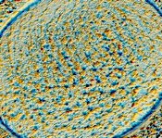
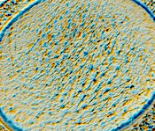
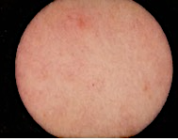
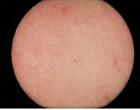

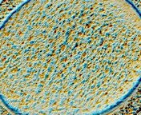
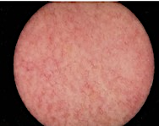
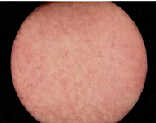
Flawless skin in minutes with PEPHA®-TIGHT CB
SkinCam measurement
Skin Smoothness Improvement below eye
Skin Texture Improvement on Neck Area
$p<0.1 vs placebo
4x better than placebo
Measurement area
(Under eye)
Measurement area
(Neck)
Placebo
3% PEPHA®-TIGHT CB
Immediately after 1 application
Immediately after 1 application
Volunteer 19
Volunteer 09
SkinCam takes an image of the skin surface and shows how the irregularities of the skin texture evolve.
After PEPHA®-TIGHT CB application, skin surface appears smoother and texture more homogeneous
Baseline
Immediately after
1 application
Baseline
Immediately after
1 application
Volunteer 36
Volunteer 58
Notes:
SkinCam takes an image of the skin surface and show how the irregularities of the skin texture evolve. After PEPHA-TIGHT CB application, skin surface appear smoother and texture more homogeneous
$ p=0.062 vs placebo

Slide 16

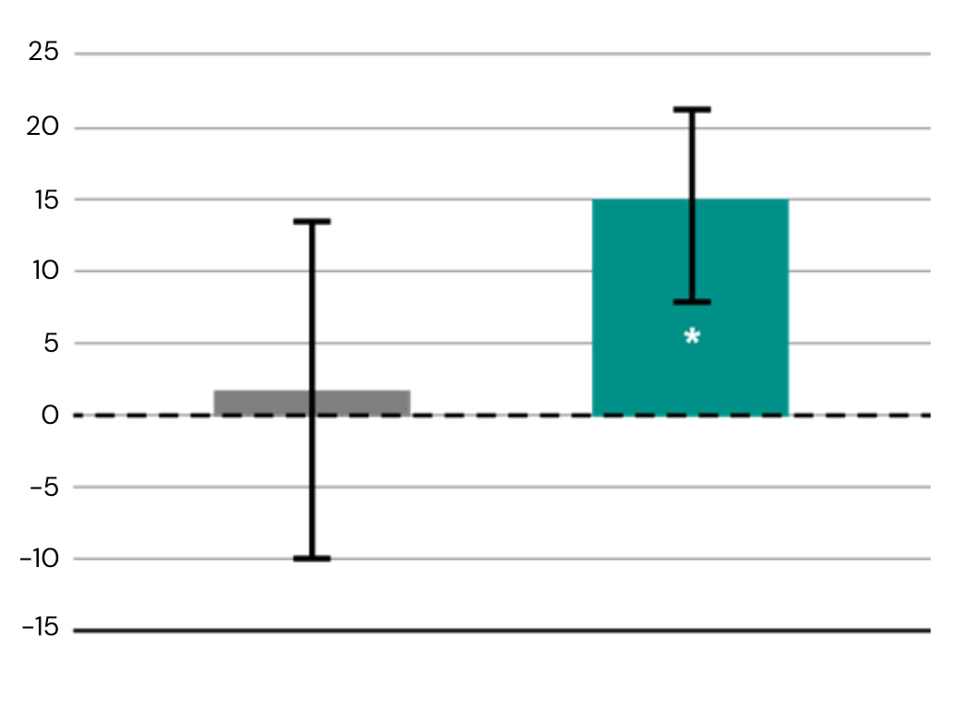
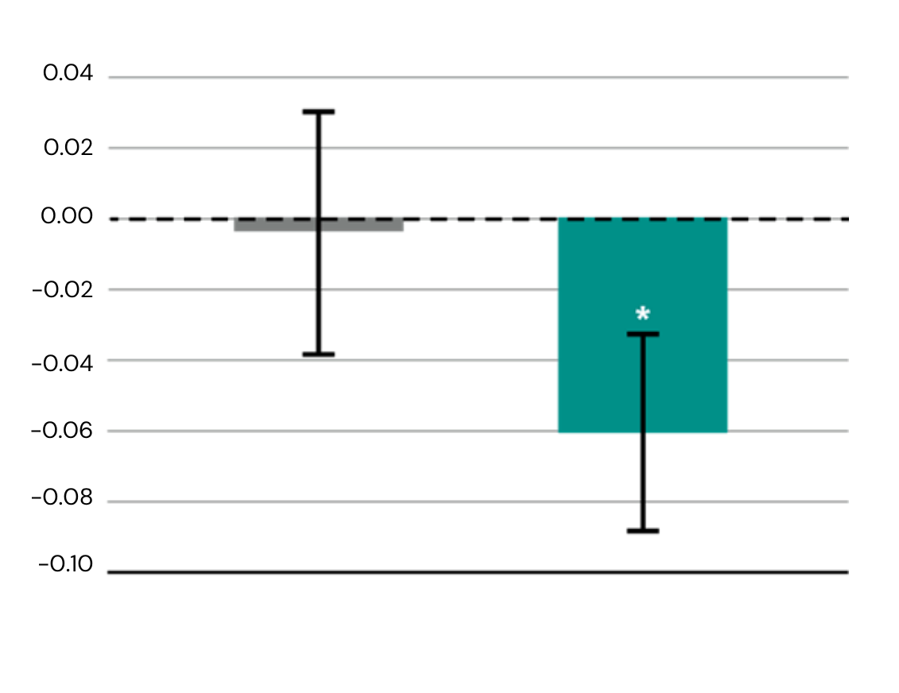



Significant long-lasting lifting effect with PEPHA®-TIGHT CB
SkinFlex measurement
PEPHA-TIGHT CB is 13X better than placebo
Increase in skin firmness
Decrease in skin sagging
Volunteer 39
*p<0.05 vs placebo
*p<0.05 vs placebo
Skin deformation upon strain
Skin firmness improvement
(%) vs baseline
Skin sagging decrease
Vs. baseline [mm]
Measurement area
Baseline T0
T1
Placebo
3% PEPHA®-TIGHT CB
Placebo
3% PEPHA®-TIGHT CB
Time T1
12 hrs after 2nd product application
Time T1
12 hrs after 2nd product application
An airstream is blown perpendicularly to the cheek: it pushes the skin inwards forming a kind of “hole” in the cheek.
The firmer & more lifted is the skin, the more it’s able to resist the airstream, as shown for Volunteer 39 in the pic
Notes:
An airstream (representing a strain) is blown perpendicularly to the cheek: it pushes the skin inwards forming a kind of “hole” in the cheek.
The firmer & more lifted is the skin, the more it’s able to resist the airstream, as shown for Volunteer 39 in the pic

Slide 17




Skin gains elasticity in critical facial areas with PEPHA®-TIGHT CB
Cutometer measurement
Elasticity (nasolabial fold)
Elasticity (eyelid)
PEPHA-TIGHTCB is 6X better than placebo
The Cutometer applies
a vacuum to the skin, pulls on the skin and then lets it go. The time, velocity and return to the original position are measured, from this the elasticity is calculated. Elastic skin can bounce back to its original position fully and fast. with PEPHA®-TIGHT CB, we see an improvement of this skin behavior.
Placebo
3% PEPHA®-TIGHT CB
Placebo
3% PEPHA®-TIGHT CB
Time T1
12hrs after 2nd product application
Time T1
12hrs after 2nd product application
Elasticity (anterior jawline)
Elasticity (posterior jawlin)
Placebo
3% PEPHA®-TIGHT CB
Placebo
3% PEPHA®-TIGHT CB
Time T1
12hrs after 2nd product application
Time T1
12hrs after 2nd product application
Measurement area
Biotech | Nature, enhanced by science
Notes:
Cutometer applies a vacuum to the skin, pulls on the skin and then lets it go. The time, velocity and return to the original position are measured and from this the elasticity is calculated. Elastic skin can bounce back to its original position fully and fast. Here we see an improvement of this with the 3% PEPHA-TIGHT CB formulation.

Slide 18
Consumers perceive the improvement
Qualitative questionnaire, for immediate & long-lasting perception
% of affirmative answers to «My skin looks & feels firmer with PEPHA®-TIGHT CB»
Overall facial skin
Skin around the eyes
Neck & neckline
Time immediate
Within minutes after 1st product application
Time T1
12hrs after 2nd product application
Time immediate
Within minutes after 1st product application
Time T1
12hrs after 2nd product application
Time immediate
Within minutes after 1st product application
Time T1
12hrs after 2nd product application
Notes:
Cutometer applies a vacum to the skin, pulls on the skin and then lets it go. The time, velocity and return to the original position are measured and from this the elasticity is calculated. Elastic skin can bounce back to its original position fully and fast. Here we see an improvement of this with the 3% PEPHA-TIGHT CB formulation.

Slide 19
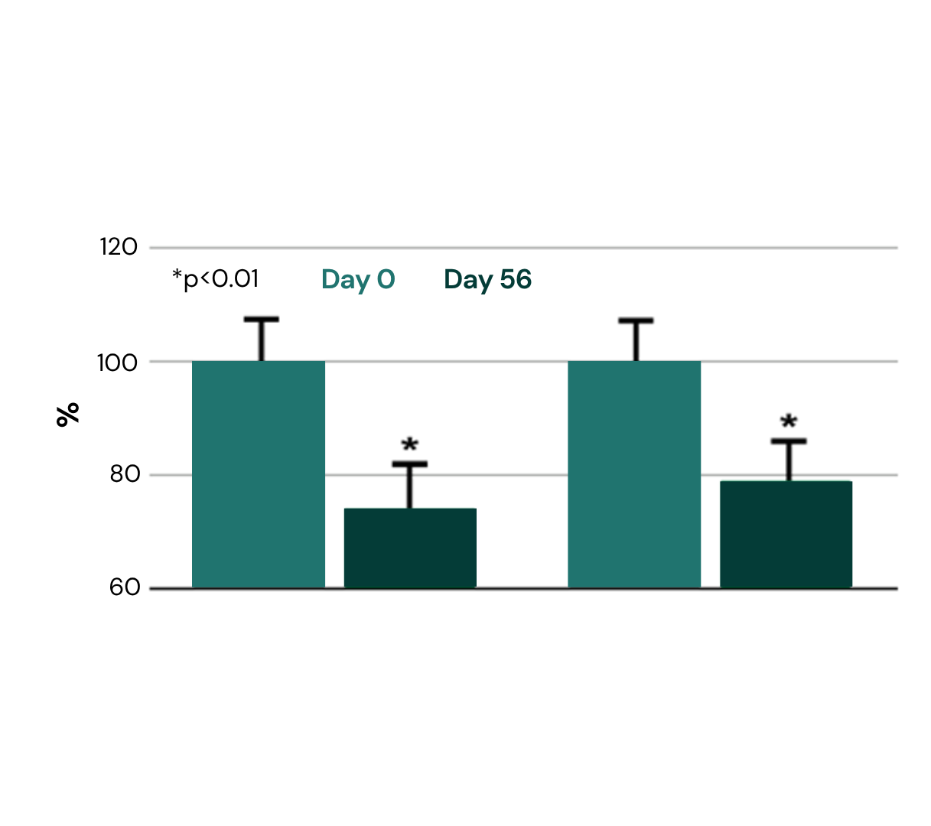
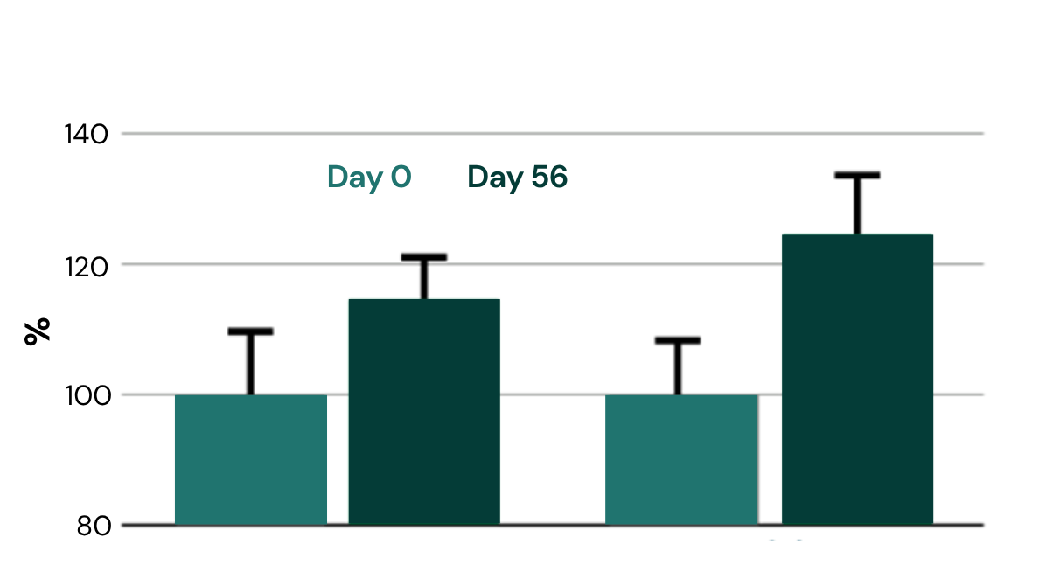
Long-term well-aging result with regular usage of PEPHA®-TIGHT CB
Profilometer and Cutometer measurement
Wrinkle reduction (profilometry):
Skin firming (cutometry):
26%
21%
15%
24%
Cream with 3% PEPHA®-TIGHT CB applied on the face twice daily over
2 months. 13 female volunteers
30-55y.o., mean 40yrs.
reduction of wrinkle surface
reduction of wrinkle length
improvement of elasticity
improvement of tonicity
Visible wrinkle reduction after 2 months
Lond-term skin firming results after 2 months!
$p<0.1 vs baseline
$p<0.1 vs baseline
Wrinkle Surface
Wrinkle Length
Elasticity
Tonicity

Slide 20
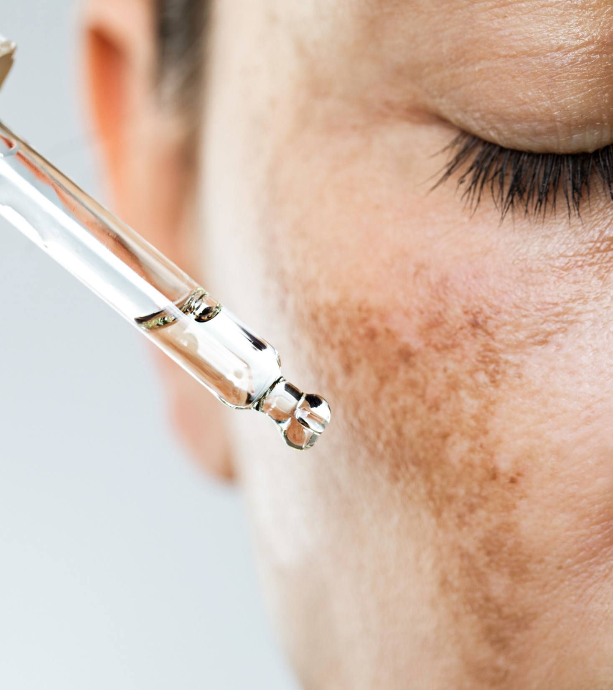
Formulation Guidelines
PEPHA®-TIGHT CB
INCI name (active):
Nannochloropsis oculata Extract, Pullulan
    Viscous, yellowish to amber solution
    Stable at pH ranges from 3.5 to 7.5
    Should be processed below 50°C
    Suggested concentration: 1–5%
Cosmetic application
    Facial skin tightening products
    Protective care for long-term firmer skin
    Firming and lifting Neck & Décolleté formulations
    Added value for anti-wrinkle products

Slide 21

PEPHA®-TIGHT CB
Supported marketing claims
Flawless skin within minutes¹
With just 1 application, skin surface appears smoother and texture more homogeneous
Long-lasting lifting effect, up to 12hrs from last application
Skin gains elasticity in critical facial areas
After multiple applications, long-term well-aging effect with wrinkles reduction by over -20%
¹ Based on dsm-firmenich clinical study where improvements in skin smoothness and texture homogeneity were detected already within 15min from 1st product application

Slide 22
PEPHA®-TIGHT CB B2C potential
This ingredient serves different market trends & products’ narratives
Fast Beauty
Looking for rapid & perceivable
skin improvements
Consumers want instant gratification and fast visible results. Consumption can also be occasion driven (e.g. a special meeting, a night out, the wedding day…and consumers want to look at their best).
We offer: PEPHA-TIGHT® provides smoother skin texture & flawless skin within minutes from 1st application. Long-lasting lifting effect, proven to last up to 12hrs
Good Beauty
Looking for transparency and
solutions that can make a positive impact
Consumers want: compromised-free solutions, good for the skin & for the planet.
We offer: PEPHA-TIGHT® combines efficacy and sustainability.
  Rapid and long-lasting visible results, already with 1 application.
  Derived from microalgae and high performing polysaccharides, produced by biotechnologies, fully naturally-derived & renewable. Vegan-friendly, COSMOS approved
Healthy Beauty
Beautiful skin starts with healthy skin
Consumers want: solutions that goes beyond the superficial, as they know that beautiful skin starts with healthy skin
We offer: PEPHA-TIGHT® microalgae, superfood for more resilient and healthy-looking skin. It delivers smoother & lifter skin already after few applications. Additionally, with a more regular consumption, it can act as a protective shield against oxidative stress and pollution, for long-term well-aging effects. This 2 in 1 proposition, might also serve the “minimal beauty” positioning

Slide 23

dsm-firmenich solution: PEPHA®-TIGHT CB
The fast lane to superior skin tightening
in vitro PEPHA®-TIGHT CB:
Stimulates Fibroblasts’ proliferation by +350% and Collagen-I by +70%
Protects the skin against oxidative stress and urban dust
in vivo PEPHA®-TIGHT CB:
Within minutes from 1st application:
  Visibly smoothens skin texture for an immediate¹ flawless effect
Up to 12hrs long-lasting effect:
  Skin looks and feels firmer, more lifted and more elastic already after 2 applications
Long-term result, after 2 months treatment:
  Reduces the wrinkles’ surface by -26% and length by -21%
  Improves skin elasticity by 15% and tonicity by 24%
¹ Based on dsm-firmenich clinical study where improvements in skin smoothness and texture homogeneity were detected already within 15min from 1st product application

Slide 24


Discover the hidden secret of nature for
a healthy-looking skin!
Powered by blue biotechnology ingredients, the deep beauty skincare range nourishes skin, protects against external aggressors and helps minimize the appearance of fine lines and wrinkles with an immediate and long-lasting lifting effect. For skin that looks firmer, more vibrant healthier.
Is this not the ultimate deep beauty?!
For internal use only. Illustrated products are for experimental use and are not for sale. dsm-firmenich is not responsible for final products claims
Biotech | Nature, enhanced by science

Slide 25
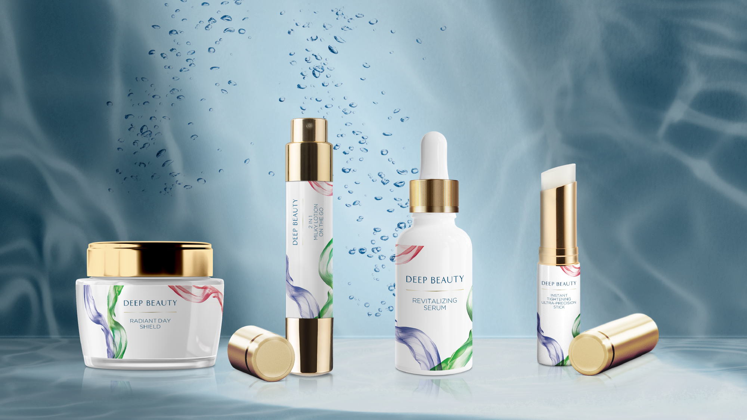

        For internal use only. Illustrated products are for experimental use and are not for sale. dsm-firmenich is not responsible for final products claims

Slide 26
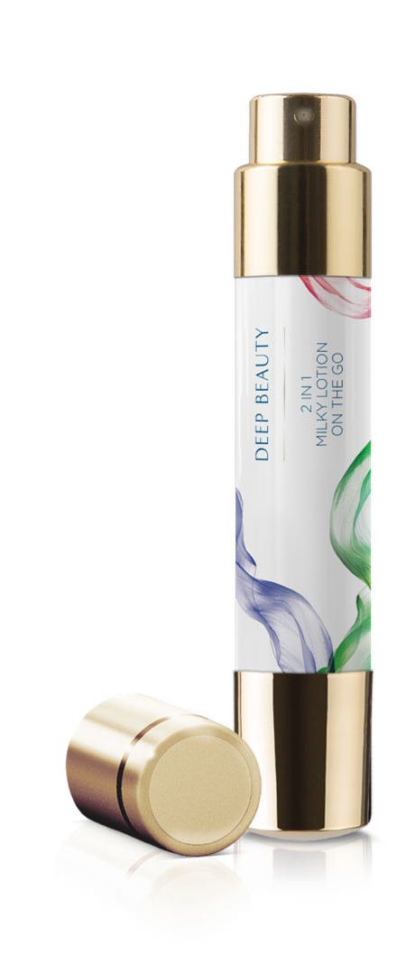

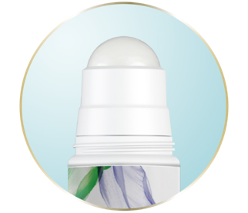
With PEPHA®-TIGHT CB, PEPHA®-CTIVE CB, ARGAN OIL, Mixed Tocopherols 95, SYN®-COLL CB and D-Panthenol 75 L
Your skin ally for an on-the-go extra boost of nourishment! Packed with Marine Biotech Complex, rich in amino acids, vitamins, minerals, antioxidants and essential fatty acids for immediate and long-lasting healthy-looking skin. This lightweight milky texture is designed for dual application:
roll it over targeted zones for precision tightening
spray it in a fine facial mist for instant hydration that smoothens and re-energizes your skin
99.39% natural origin content according to ISO 16128
SK-E-102022-36
        For internal use only. Illustrated products are for experimental use and are not for sale. dsm-firmenich is not responsible for final products claims

Slide 27
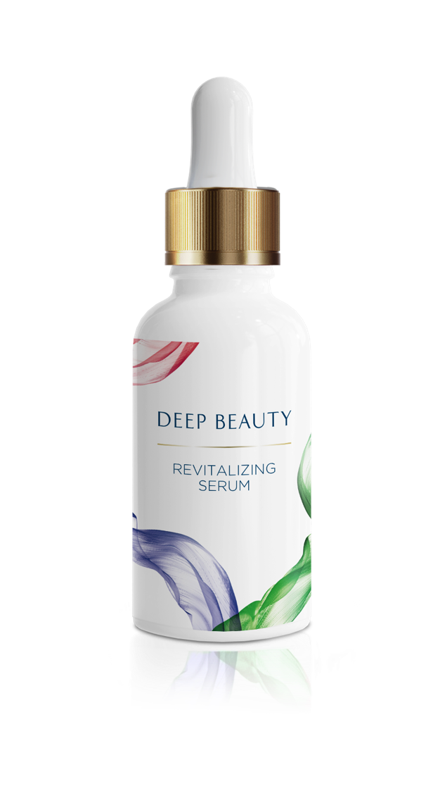

With PEPHA®-CTIVE CB, PEPHA®-TIGHT CB
A concentrated shot of the most powerful marine ingredients for strong anti-aging benefits. Skin looks firmer and plumper, evener and re-energized.
100% natural origin content according to ISO 16128
SK-E-102087-5
        For internal use only. Illustrated products are for experimental use and are not for sale. dsm-firmenich is not responsible for final products claims

Slide 28
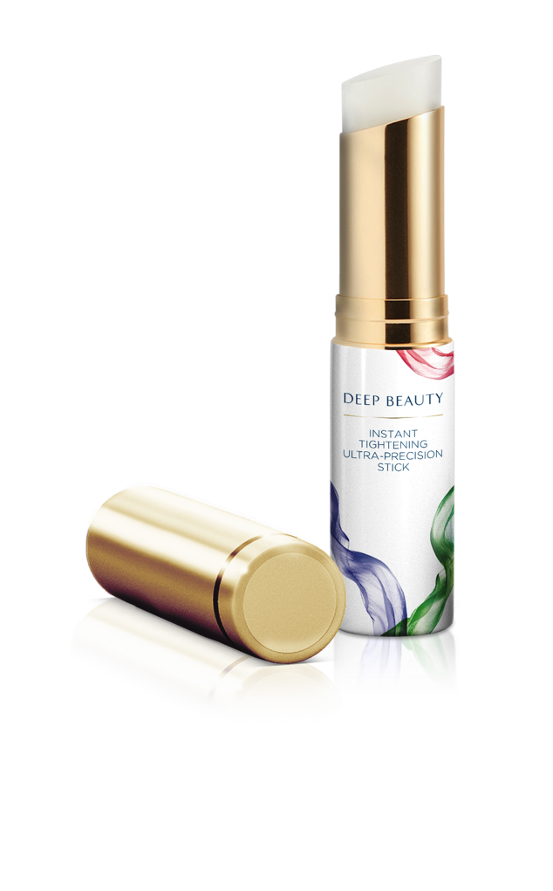

With PEPHA®-TIGHT CB, ALPAFLOR® EDELWEISS CB
A concentrated solid serum stick for targeted application. Enriched with powerful Active Algae, it helps minimize the appearance of fine lines and wrinkles with an immediate tightening effect and, when applied regularly, it acts as a protective shield against oxidative stress for healthier and firmer looking skin.
100% natural origin content according to ISO 16128
SK-E-101904-15
        For internal use only. Illustrated products are for experimental use and are not for sale. dsm-firmenich is not responsible for final products claims

Slide 29
Disclaimer
Copyright © DSM Nutritional Products Ltd 2025, 4002 Basel, Switzerland.
www.dsm-firmenich.com. All rights reserved.
dsm-firmenich has used diligent care to ensure that the information provided herein is accurate and up-to-date to the best of its knowledge. However, dsm-firmenich makes no representation or warranty, either expressly or implied, of the accuracy, reliability, completeness, or suitability thereof. The information provided herein contains scientific and product information for business-to-business use and does not constitute or provide scientific or medical advice, diagnosis or recommendation for treatment options. Country or region-specific information should be considered when labelling or advertising to final consumer. In no event shall dsm-firmenich be liable for any direct or indirect damages arising from or reliance upon, or use of, any information provided herein. The content of this document is subject to change without further notice. Please contact your local dsm-firmenich representative for the latest information. All trademarks listed in this document are either (registered) trademarks of, or trademarks licensed by, the dsm-firmenich group of companies, unless explicitly stated otherwise.
Disclaimer Formulation Guideline
The information provided herein is provided for information purposes only and has been prepared by dsm-firmenich in accordance with its own methodology.
dsm-firmenich has used diligent care to ensure that it is accurate and up-to-date, however, dsm-firmenich makes no representation or warranty, either expressly or implied, of the accuracy, reliability, or completeness thereof. In no event shall dsm-firmenich be liable for any damages arising from or reliance upon, or use of, any information provided herein. Further, dsm-firmenich shall not bear any liability for the application and/or use of any processed material containing its product(s). The formulation of the finished product is the customer’s sole responsibility. It is the customer’s responsibility to determine the suitability of dsm-firmenich’s products regarding user specific purposes, assess compatibility and stability of their finished product(s) and to ensure compliance of their finished product(s) with relevant laws and regulations. Any product, marketing or other claims made by customer are its sole responsibility. The content of this document is subject to change without further notice. Please contact your local dsm-firmenich representative for further details. © 2025 dsm-firmenich group.

Slide 31
Unique combination for efficacy & sustainability
A concentrated mixture of powerful functional ingredients produced by biotechnologies, fully naturally derived & renewable
The Microalgae, is produced in photobioreactors and grows in water on sunlight, carbon dioxide from the air, and some nutrients. It is natural up to the solvent used for the extraction of the algae, as only water is used.
By using biotechnology to produce the microalgae, we are making a more sustainable choice compared to open ponds culture:
A safer choice because photobioreactors are less susceptible to contamination
A lower impact on terrestrial diversity, as the construction of the open ponds is usually associated with a destruction of local fauna habitat
The energy used for the photobioreactors is mostly renewable
The Pullulan is produced by fermentation of tapioca starch.
Those are preserved in Pentylene Glycol, produced from corn cobs, therefore valorizing a residual stream after the extraction of the more valuable materials from the crop.
PEPHA®-TIGHT CB is a very powerful combination of anti-ageing effects, based on biological sources, processed with biotechnology and fitting in a net zero climate change policy. All production processes are operated under mild conditions without hazardous chemical substances and generate only small amounts of non-hazardous waste.

