Slide 1


Phytantriol
The time-tested hair secret to repair, enhance and protect, from root to tip
November 2020
http://www.youtube.com/
watch?v=hHRa54b9rr8

Slide 2

The product
The market
Claim substantiation
Formulation concepts
Build on latest trends

Slide 3

DSM PHYTANTRIOL
OH
OH
O
H
INCI Phytantriol
CAS 74563-64-7
EINECS 277-932-2
Empirical Formula C₂₀H₄₂O₃
Colorless to light yellow, viscous liquid
Excellent formulation compatibility and stability
Recommended use levels between 0.1-1%
China approved
EXCLUSIVE
Key benefits on hair
Moisturization - Strengthening – Heat/Spliss/Color Protection
Notes:
Phytantriol – a long-branched triol
Can be used for shampoo, conditioner, treatments, styling aids
soluble in ethanol, mineral oils, corn oil, propylene glycol, alkanolamides, etc…, and insoluble in water; dispersible in dimethicone, cyclomethicone and glycerol.
Stable up to 80°C and at a broad pH range (3-9)

Slide 4
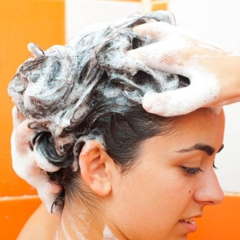

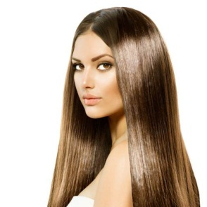
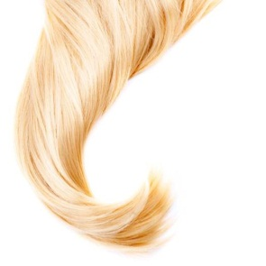

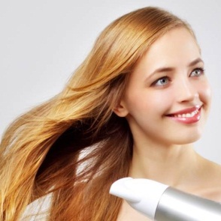
Phytantriol Claim Summary
Deposition
Boosts effects of Panthenol, Ethyl-Panthenol and keratin amino acids
Color Protection
Visible prevention of wash-out from various color shades
Moisturization
Excellent water retention by Phytantriol alone and in synergy with Panthenol
Split-end Protection
Excellent prevention of split ends after just one application
Strengthening
Greatly strengthens damaged hair when delivered in shampoos and conditioners
Heat Protection
Good protection against heat damage (shampoos and conditioners)
Notes:
Regarding our data on claim substantiation please note the following:
Data on depositioning, moisturization, color protection and spliss protection are still solid and reliable
Data on strengthening and heat protection (going back on the slope analysis) are not state of the art anymore and according to our inhouse R&D experts not reliable. In the consequence R&D is not supporting these data and would like to have them seen as marketing promotion only!

Slide 5


