Slide 1


PREREGEN® PF
Unique active complex to protect skin from external pollution
October 2020

Slide 2
Environmental Exposure Accelerates Skin Ageing
Everyday, slight, invisible irritation reactions occur on our skin due to growing environmental stress.
This leads to a continuous damage and without preventive measure to accelerated skin ageing.
Main causes
atmospheric pollution (ozone, smog, NOx, smoke,...
heat and cold
UV radiation
household chemicals (cleaning products, detergents,...)
dry air (overheated rooms, airstreams, etc.)

Slide 3

Harmful Influence of Ozone on the Skin
O₃
Lipid Peroxidation (cell membrane)
Destruction of the skin barrier
Triggering off inflammatory reaction
Notes:
Ozone (O3) is a known air pollutant. It is the major component of photochemical smog. It is a toxic highly reactive oxidant pollutant.
Skin is the organ most directly exposed to ozone, which causes injury by its oxidant capacity:
Oxidation and degradation of skin lipids which could affect the barrier function
Inflammatory response due to the increase of peroxidation product

Slide 4

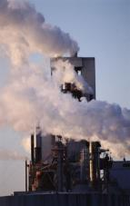

Skin Answer to a Daily Aggression
Increased vascular
permeability
Leukocyte
activation
Vasodilation
Formation of
free radicals
Release of
proteinases
O₃
Damage to the
skin structure
Skin irritation

Slide 5

PREREGEN® PF
Unique active complex to protect skin from external pollution

Slide 6
PREREGEN® PF
An Outstanding Protecting Shield
Formation of
free radicals
Release of
Proteinases (Elastase)
PREREGEN® PF
Protection of
skin structure
PREREGEN® PF exceptional composition:
Biotechnologically produced Oxido reductases as radical neutralizer combined to
Specially purified Soya polypeptides as proteinase inhibitor
Notes:
The various already mentioned environmental stressors (pollution, UV etc.) lead to skin irritation and/or damage of the skin structure, such as damaged barrier function.
This is linked to inflammatory reactions which in the dermis trigger the release of an enzyme called ELASTASE. This enzyme is mainly responsible for the degradation of Elastin, a dermal protein forming the elastic fiber network. The elastic fiber network makes up for the skin’s elasticity, and its damage leads to skin sagging.
PREREGEN®PF now efficiently blocks the activity of Elastase and hence protects Elastin from degradation, preserving the skin’s elasticity.

Slide 7
How Does PREREGEN® PF Work as Elastase Inhibitor?
+
Elastase
Elastin
products
+
Elastase
PREREGEN® PF
Notes:
How does PREREGEN® PF inhibit the enzyme Elastase to protect the skin’s elasticity?
PREREGEN® PF acts as a competitive substrate for the enzyme Elastase. Elastase cannot bind to its normal substrate Elastin because its binding site is already occupied by PREREGEN PF.

Slide 8
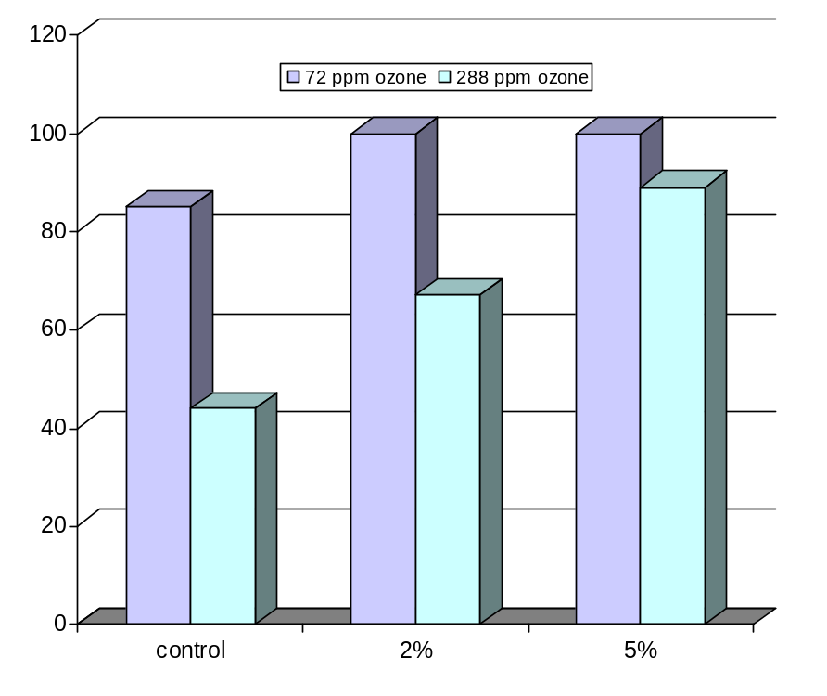
PREREGEN® PF Protects Keratinocytes from Ozone Harmful Influence (in vitro)
Cell viability (%)
PREREGEN® PF
Notes:
Assay method:
Human keratinocytes
2 different concentrations of ozone were applied for 24 hours
Measurement of cell viability
Result:
This graph shows a higher cell viability of the cells treated with PREREGEN® PF in comparison to the control.
Therefore, the keratinocytes treated with PREREGEN® PF are very well protected.

Slide 9
PREREGEN® PF Strongly Reduces Skin Irritation (in vivo)
240
placebo
10 subjects
Application of 2% SLS under semi-occlusion for 24 hours
Followed by application of 5% PREREGEN® PF
Skin irritation analysis with Laser Doppler
Skin irritation (%)
180
120
60
5% PREREGEN® PF
0
0
1
2
3
4
time (h)
Notes:
On ten subjects, several 2 cm x 3 cm forearm test sites were patched with 2% SLS (Sodium Lauryl Sulfate) under semi-occlusion for 24 hours.
The patches were removed and 5% PREREGEN® PF was applied.
Skin irritation was assessed visually and with Laser Doppler over the next 8 hours or until all irritation had disappeared.
Result:
PREREGEN® PF rapidly decreases skin irritation.

Slide 10
PREREGEN® PF in vivo
Study Design
Volunteers: 30 female volunteers, 30+ years old
Formulation: Placebo controlled study
5% PREREGEN® PF in a gel
Application: Hemi-face twice per day after facial cleansing
8 weeks
Parameters: Skin firmness (Ballistometer)
Skin moisturization (Impedance measurement)
Lines & wrinkles (SFL Scoring and Image Analysis)

Slide 11
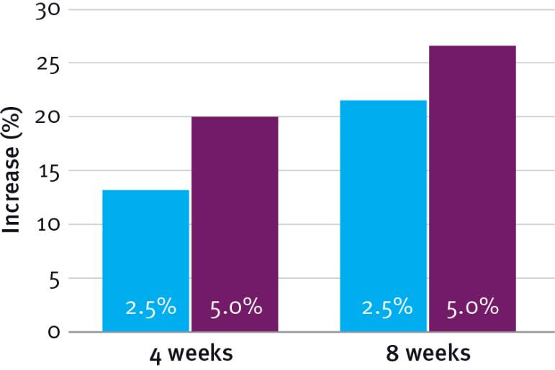
PREREGEN® PF Significantly Increases Skin Firmness
Significant skin firmness increase after 8 weeks of treatment:
21.9% with 2.5% PREREGEN® PF
27.1% with 5% PREREGEN® PF
Notes:
The Ballistometer measures skin firmness by dropping a pendulum to the surface of under-eye area and the resultant bouncing pattern of the pendulum will be analysed via computer to determine skin firmness.

Slide 12
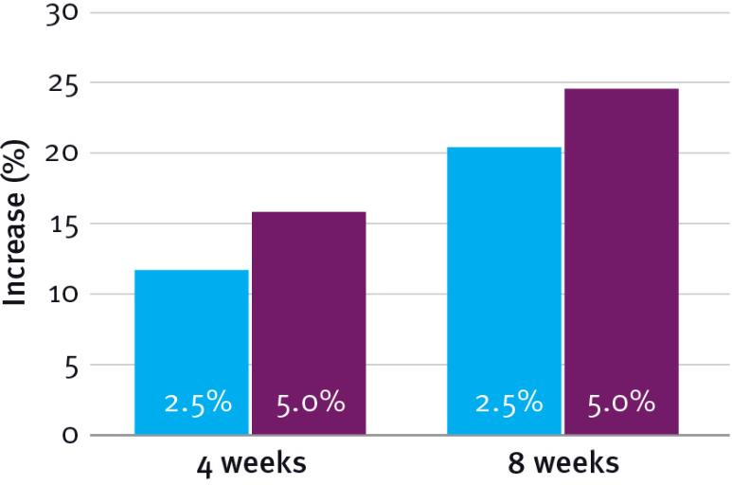
PREREGEN® PF Significantly Increases Skin Moisturization
Significant skin moisturization increase after 8 weeks of treatment:
20.2% with 2.5 % PREREGEN® PF
24.2% with 5% PREREGEN® PF
Notes:
The impedance meter is a well documented and widely used device to measure changes in skin moisture content.

Slide 13
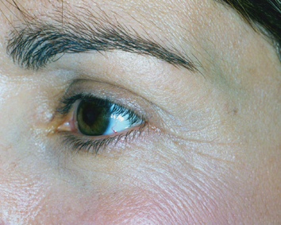
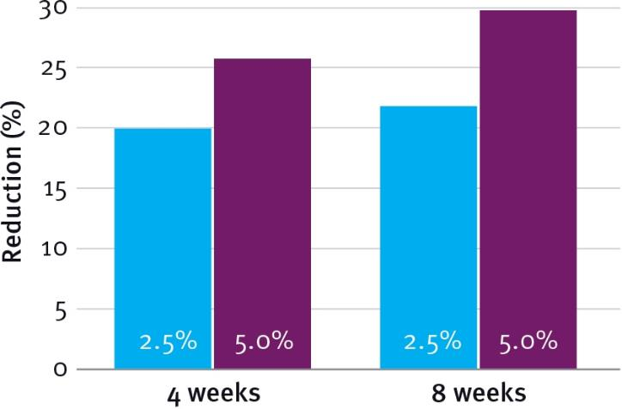
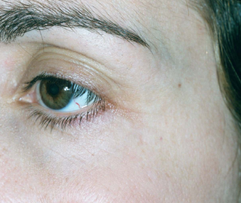
PREREGEN® PF Visibly Reduces Superficial Facial Lines (SFL) and Wrinkles
Day 0
Visible SFL reduction after 8 weeks of treatment:
22.5% with 2.5% PREREGEN® PF
29.4% with 5% PREREGEN® PF
After 8 weeks
Notes:
Wrinkle reduction was assessed visually by the investigator according to the method of Packman et al. (Packman EW, J. Soc. Chem. 29, 70-90, 1978).
As per this method, at each visit, the depth, shallowness and the total number of superficial facial lines (SFLs) of each subject has been carefully scored and recorded.

Slide 14

Cosmetic Application
Anti-ageing products
Sensitive skin care products
After sun products
Regenerative products

Slide 15
PREREGEN® PF
Unique Active Complex to Protect Skin from External Pollution
unique anti-ageing
and anti-irritant
properties
ingredient of choice
to combat against
accelerated
skin ageing
increases skin
moisturization
free radicals &
protease
inhibiting properties
prevents the ageing
of the skin’s
supporting tissue
increases skin
firmness
reduces superficial
facial lines and
wrinkles
protects the skin
from ozone
harmful
influences

Slide 16
Disclaimer
Copyright © 2021 DSM Nutritional Products, 4002 Basel, Switzerland.
www.dsm.com/personal-care. All rights reserved.
Although DSM has used diligent care to ensure that the information provided herein is accurate and up to date, DSM makes no representation or warranty of the accuracy, reliability, or completeness of the information. This presentation only contains scientific and technical information for business to business use. Country or region-specific information should also be considered when labeling or advertising to final consumers. This publication does not constitute or provide scientific or medical advice, diagnosis, or treatment and is distributed without warranty of any kind, either expressly or implied. In no event shall DSM be liable for any damages arising from the reader’s reliance upon, or use of, these materials. The reader shall be solely responsible for any interpretation or use of the material contained herein. The content of this document is subject to change without further notice. Please contact your local DSM representative for more details. All trademarks listed in this brochure are either registered trademarks or trademarks of DSM in The Netherlands and/or other countries unless explicitly otherwise stated.

Slide 17


