Slide 1
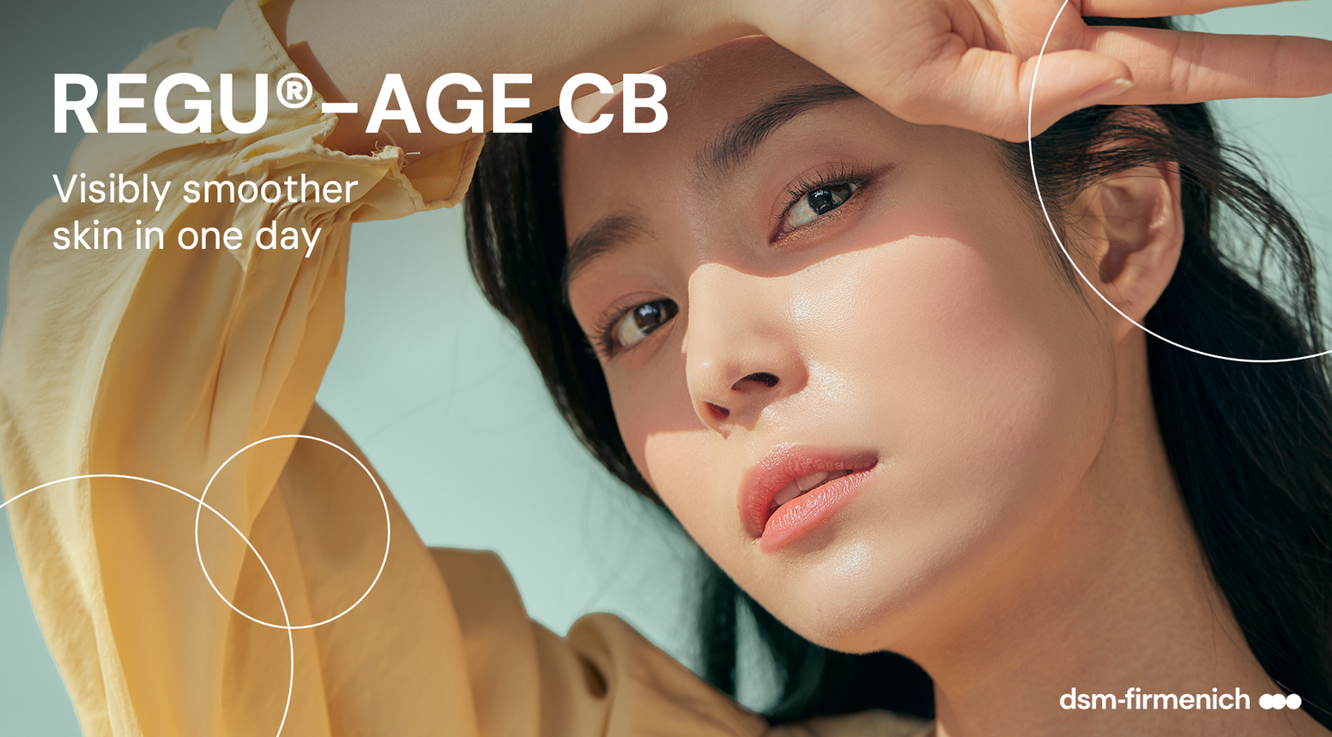
April 2025

Slide 2
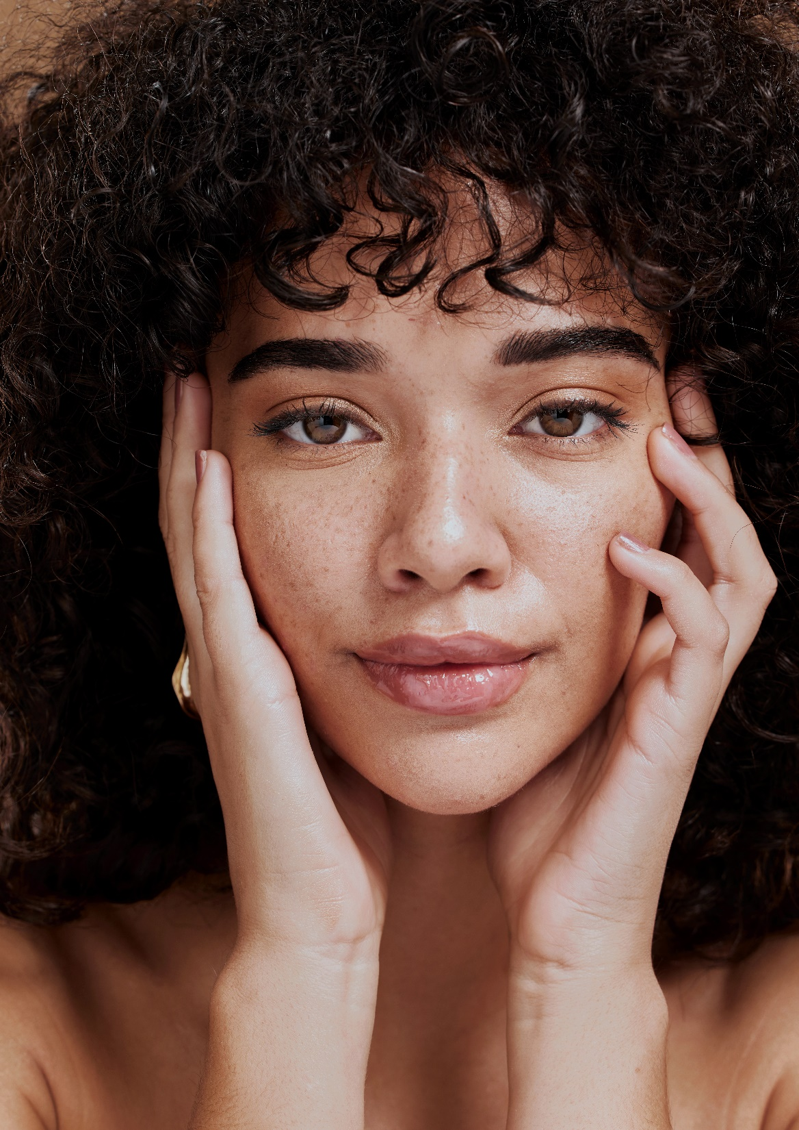
Holistic Beauty: The New Normal
Superfood – Natural Peptides
Consumers are no longer solely concerned with surface level aesthetics but are actively seeking products that contribute to holistic well-being (Kline 2024).
Holistic beauty refers to looking at beauty as a "whole picture" situation, where beauty comes from health, and health comes from within.
Holistic beauty products focus on using natural and sustainable ingredients.
The concept of incorporating “Superfood ingredients” into holistic beauty products has gained popularity over the years.
Superfood like soybean and rice are good for the inside and can also be good for the skin because they are rich in various nutrients.
Soybean and rice proteins are a superior source of natural peptides that offer numerous skin benefits.
To maximize healthy-looking skin benefits dsm-firmenich produces a potent multi-peptide solution from soybean and rice proteins and a powerful biotechnologically produced Superoxide Dismutase for holistic beauty solutions.

Slide 3
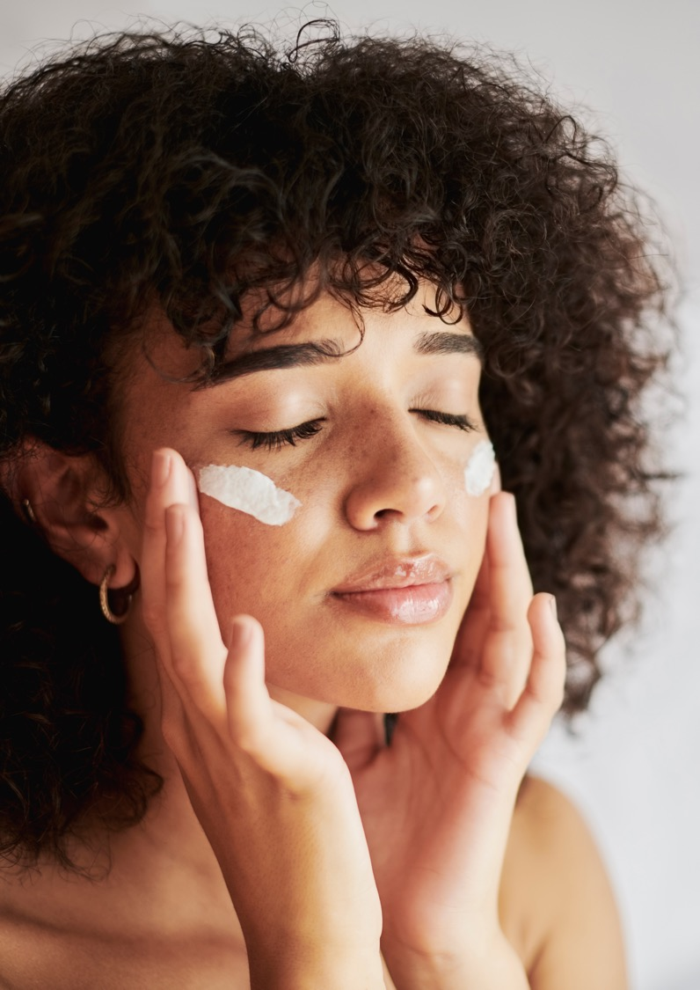
REGU®-AGE CB
Natural peptides plus skin-identical SOD
“222” Rice and Soybean Peptides
Thanks to a very targeted hydrolysis process of rice and soybean proteins, dsm-firmenich produces a unique rice and soybean peptides complex.
Scientist of dsm-firmenich identified with advanced analysis* peptides with low molecular weight:
222 peptides in total
134 peptides are identified as tetra-, penta-, hexa- and heptapeptides
88 peptides are identified as di- and tripeptides
“1” Skin-identical Superoxide Dismutase (SOD)
To address all the needs of the skin the soybean and rice peptides go hand in hand with a powerful biotechnologically produced skin-identical Superoxide Dismutase (SOD), known for its strong antioxidant properties.
dsm-firmenich produces a highly purified skin-identical Superoxide Dismutase, obtained by aerobic fermentation isolated from a natural yeast strain of Saccharomyces cerevisiae.
* LC-HR-MS (liquid chromatography-high-resolution mass spectrometry + in silico tool analysis)

Slide 4
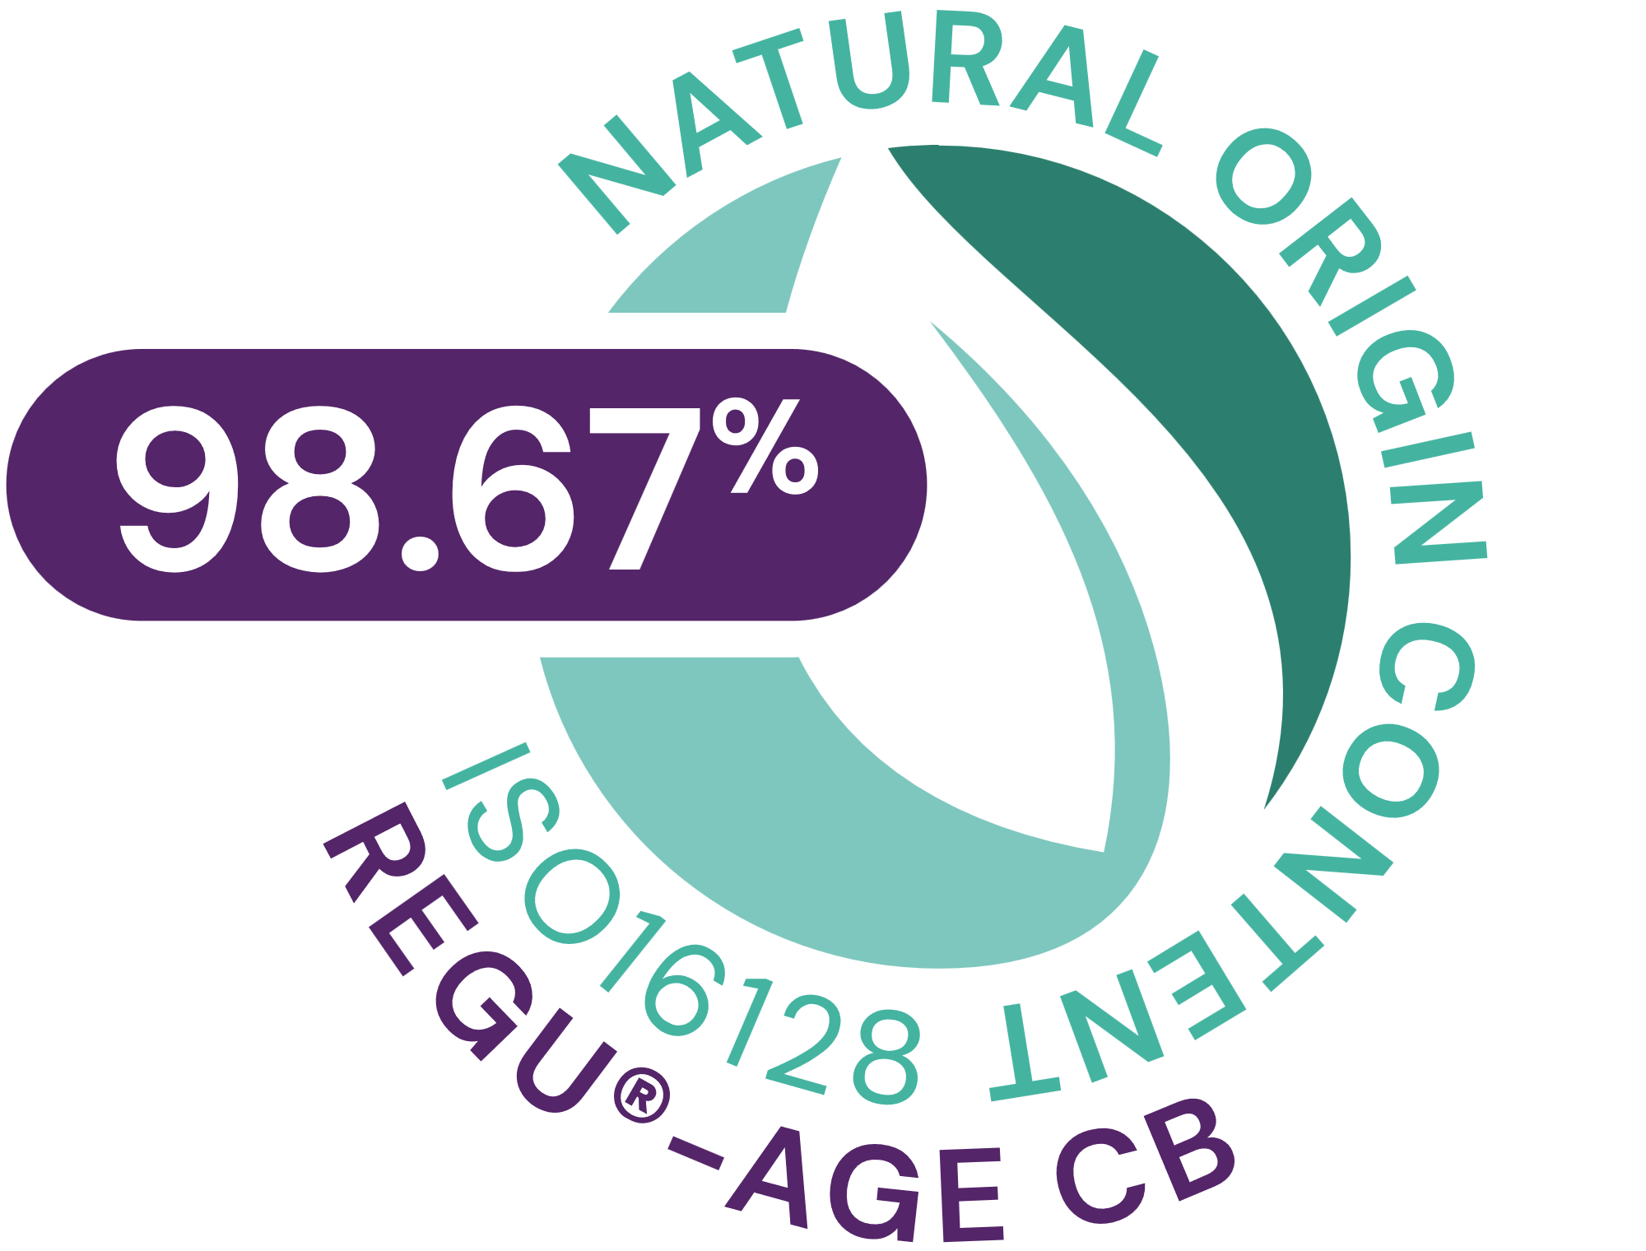


REGU®-AGE CB
ID Card
INCI NAME:
Glycine Soja (Soybean) Protein, Hydrolyzed Rice Protein, Superoxide Dismutase, Glycerin, Aqua, Pentylene Glycol, 1,2-Hexanediol, Caprylyl Glycol, Sodium Benzoate, Sodium Dextran Sulfate
TECHNOLOGY:
At the core of this unique active complex is a mixture of 222 powerful rice and soybean peptides and 1 biotechnologically produced skin-identical superoxide dismutase
98.67% of natural origin (according to ISO 16128)
TECHNICAL:
Form: Liquid
pH of use: 3.5-8.0
Use level: 2–5%
Preservative: Yes, but no Phenoxyethanol
Solubility: Water soluble
Visibly smoother skin in 1 day**
Significant and visible reduction of forehead wrinkles, crow’s feet, underneath eye wrinkles and neck lines in 2 weeks**
Eye lid is more lifted and less saggy skin in 2 weeks**
Significant reduced under-eye dark circles and puffiness in 4 weeks**
BENEFITS:
Clean holistic beauty complex
Strongly improves microcirculation*
Inhibits reactive oxygen radicals, inflammatory elastases and collagenases*
Healthier-looking skin in 2 weeks **
REGISTRATION
CERTIFICATION
* in vitro ** in vivo

Slide 5
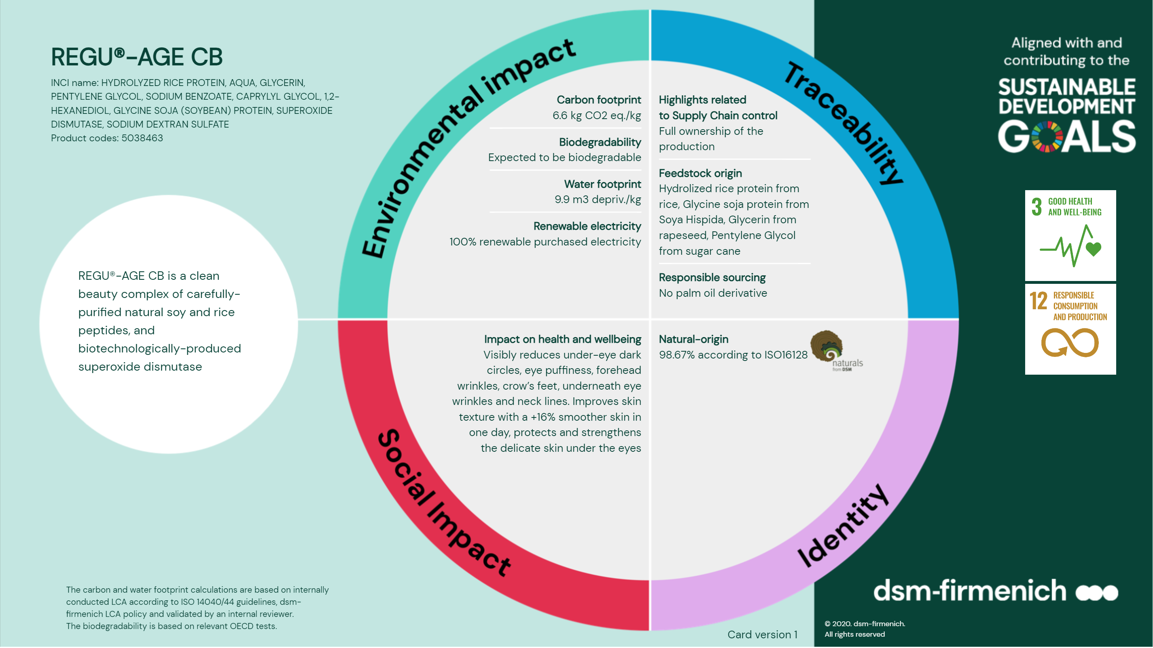

Slide 6

REGU®-AGE CB
Multi-Talent
❶
Inhibits reactive oxygen radicals
to protect skin against oxidative stress
SOD activity: > 1000 ORU /ml*
ORU = Oxido Reductase Unit
❷
Inhibits inflammatory (leucocyte) elastases
to retain skin elasticity and moisturization
Elastase inhibitor activity: > 5 EIU /ml*
EIU = Elastase Inhibitor Unit
❸
Inhibits collagenases
for firmer and more elastic skin
Collagenase inhibitory activity: > 10 ColU /ml *
ColU = Collagenase Inhibitor Unit
❹
Stimulates fibroblast proliferation
to minimize fines lines and wrinkles
Increased fibroblast proliferation: up to 200%**
❺
Strongly improves microcirculation to reduce the appearance of dark circles
Enhanced microcirculation, extending Thrombin Time (TT)**
*specified
**in vitro

Slide 7
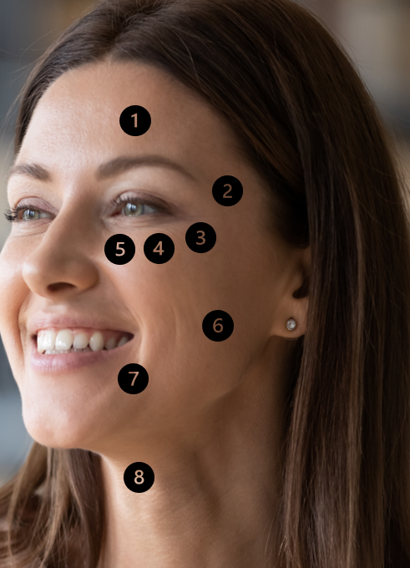
In vivo efficacy
Significant facts & benefits
Benefits | Day 1 | Week 2 | Week 4 | Week 8
Forehead wrinkles volume reduction² Forehead wrinkles number reduction² | n/a n/a | -7%* -25%* | -12%* -28%* | n/a n/a
Crow’s feet wrinkles volume reduction² Crow’s feet wrinkles number reduction² | n/a n/a | -6%* -29%* | -9%* -31%* | n/a n/a
Canthus skin texture improvement¹ | n/a | n/a | +32%* | +42%*
Under-eye wrinkles volume reduction² Under-eye wrinkles number reduction² | n/a n/a | -7%* -30%* | -10%* -32%* | n/a n/a
Under-eye puffiness improvement¹ | n/a | n/a | +32%* | +35%*
Under-eye dark circle improvement¹ | n/a | n/a | +25%* | +31%*
Cheek skin moisturization increase¹ | n/a | n/a | +19%* | +28%*
Cheek skin elasticity improvement² | n/a | +5%* | +11%* | n/a
Cheek skin firmness improvement² | n/a | +7%* | +10%* | n/a
Cheek skin smoothness improvement² | +16%* | +16%* | +23%* | n/a
Cheek skin roughness reduction² | -5% | -8%* | -9%* | n/a
Nasolabial folds volume reduction² Nasolabial folds number reduction² | n/a n/a | -6%* -20%* | -7%* -23%* | n/a n/a
Neck skin elasticity improvement² | n/a | +2%* | +5%* | n/a
Neck skin firmness improvement² | n/a | +8%* | +12%* | n/a
Neck lines volume reduction² Neck lines number reduction² | n/a n/a | -22%* -15%* | -42%* -34%* | n/a n/a
❶
❷
❷
❸
❹
❺
❻
❻
❻
❻
❻
❼
❽
❽
❽
** In vivo proven *significant vs placebo
¹ tested on Caucasian skin ² tested on Chinese skin

Slide 8
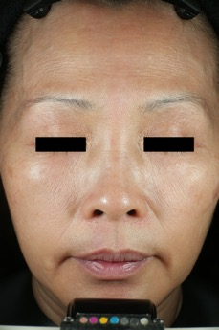
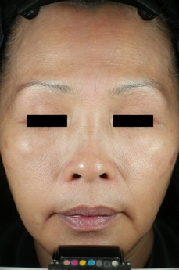
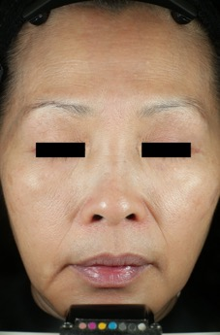
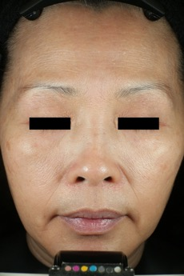

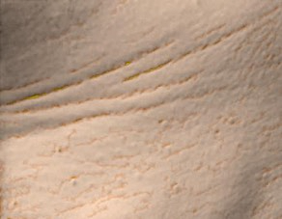
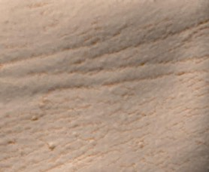


Significant and visible results on cheek and neck area
Visualization of skin smoothness changes
Visibly smoother skin in 1 day, even more pronounced in 2 and 4 weeks
+16% smoother skin in 1 day, up to +23% in 4 weeks
Significant results vs. placebo
Untreated
Day 0
3% REGU®-AGE CB
Day 1
3% REGU®-AGE CB
Week 2
3% REGU®-AGE CB
Week 4
The images taken by Visia-CR camera show the changes of skin smoothness of a selected subject
Visualization of neck lines changes
Visible reduction of neck lines in 2 weeks, even more pronounced in 4 weeks
-22% length of neck lines in 2 weeks, up to -42% in 4 weeks
-15% number of neck lines in 2 weeks, up to -34% in 4 weeks
Significant results vs. placebo
Untreated
Day 0
3% REGU®-AGE CB
Week 2
3% REGU®-AGE CB
Week 4
The images taken by Antera 3D show the changes of neck lines of a selected subject.
tested on Chinese skin

Slide 9
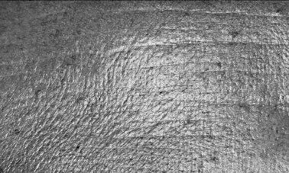

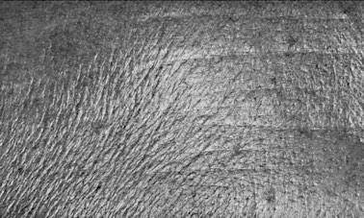
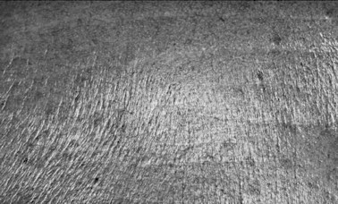
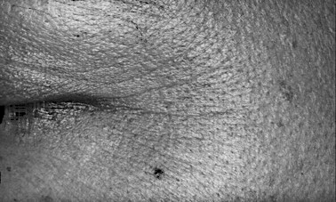
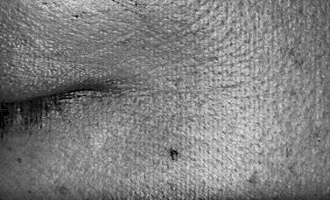
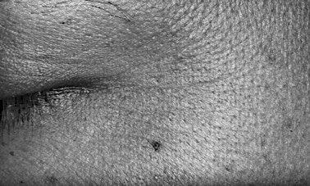


Significant and visible wrinkle reduction in 2 weeks
Visualization of forehead wrinkle changes
Visible reduction of forehead wrinkles in 2 weeks, even more pronounced in 4 weeks
-7% volume of forehead wrinkles in 2 weeks, up to -12% in 4 weeks
-25% number of forehead wrinkles in 2 weeks, up to -28% in 4 weeks
Significant results vs. placebo
Untreated
D0
3% REGU®-AGE CB
Week 2
3% REGU®-AGE CB
Week 4
The images taken by Primos CR show the changes of forehead wrinkle volume and number of a selected subject.
Visualization of crow’s feet changes
Visible reduction of crow’s feet in 2 weeks, even more pronounced in 4 weeks
-6% volume of crow’s feet in 2 weeks, up to -9% in 4 weeks
-29% number of crow’s feet
in 2 weeks, up to -31% in 4 weeks
Significant results vs. placebo
Untreated
D0
3% REGU®-AGE CB
Week 2
3% REGU®-AGE CB
Week 4
The images taken by Primos CR show the changes of crow’s feet volume and number of a selected subject.
tested on Chinese skin

Slide 10
Disclaimer
Copyright © DSM Nutritional Products Ltd 2025, 4002 Basel, Switzerland.
www.dsm-firmenich.com. All rights reserved.
dsm-firmenich has used diligent care to ensure that the information provided herein is accurate and up-to-date to the best of its knowledge. However, dsm-firmenich makes no representation or warranty, either expressly or implied, of the accuracy, reliability, completeness, or suitability thereof. The information provided herein contains scientific and product information for business-to-business use and does not constitute or provide scientific or medical advice, diagnosis or recommendation for treatment options. Country or region-specific information should be considered when labelling or advertising to final consumer. In no event shall dsm-firmenich be liable for any direct or indirect damages arising from or reliance upon, or use of, any information provided herein. The content of this document is subject to change without further notice. Please contact your local dsm-firmenich representative for the latest information. All trademarks listed in this document are either (registered) trademarks of, or trademarks licensed by, the dsm-firmenich group of companies, unless explicitly stated otherwise.
Disclaimer Formulation Guideline
The information provided herein is provided for information purposes only and has been prepared by dsm-firmenich in accordance with its own methodology.
dsm-firmenich has used diligent care to ensure that it is accurate and up-to-date, however, dsm-firmenich makes no representation or warranty, either expressly or implied, of the accuracy, reliability, or completeness thereof. In no event shall dsm-firmenich be liable for any damages arising from or reliance upon, or use of, any information provided herein. Further, dsm-firmenich shall not bear any liability for the application and/or use of any processed material containing its product(s). The formulation of the finished product is the customer’s sole responsibility. It is the customer’s responsibility to determine the suitability of dsm-firmenich’s products regarding user specific purposes, assess compatibility and stability of their finished product(s) and to ensure compliance of their finished product(s) with relevant laws and regulations. Any product, marketing or other claims made by customer are its sole responsibility. The content of this document is subject to change without further notice. Please contact your local dsm-firmenich representative for further details. © DSM Nutritional Products AG, 2025.

