Slide 1

June 2025

Slide 2

Holistic Beauty: The New Normal
Superfood – Natural Peptides
Consumers are no longer solely concerned with surface level aesthetics but are actively seeking products that contribute to holistic well-being (Kline 2024).
Holistic beauty refers to looking at beauty as a "whole picture" situation, where beauty comes from health, and health comes from within.
Holistic beauty products focus on using natural and sustainable ingredients.
The concept of incorporating “Superfood ingredients” into holistic beauty products has gained popularity over the years.
Superfood like soybean and rice are good for the inside and can also be good for the skin because they are rich in various nutrients.
Soybean and rice proteins are a superior source of natural peptides that offer numerous skin benefits.
To maximize healthy-looking skin benefits dsm-firmenich produces a potent multi-peptide solution from soybean and rice proteins and a powerful biotechnologically produced Superoxide Dismutase for holistic beauty solutions.

Slide 3
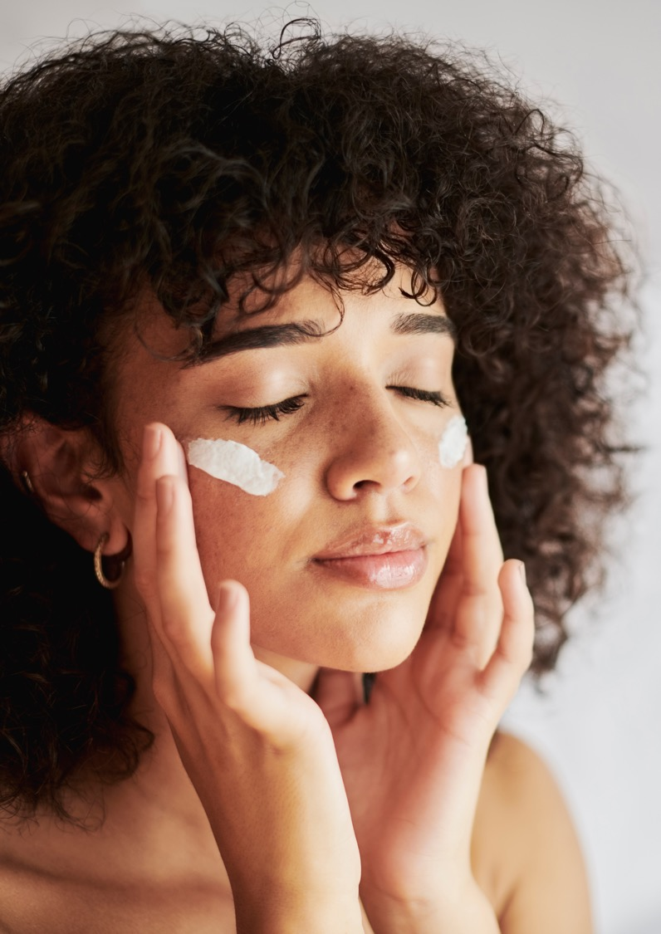
REGU®-AGE CB
Natural peptides plus skin-identical SOD
“222” Rice and Soybean Peptides
Thanks to a very targeted hydrolysis process of rice and soybean proteins, dsm-firmenich produces a unique rice and soybean peptides complex.
Scientist of dsm-firmenich identified with advanced analysis* peptides with low molecular weight:
222 peptides in total
134 peptides are identified as tetra-, penta-, hexa- and heptapeptides
88 peptides are identified as di- and tripeptides
“1” Skin-identical Superoxide Dismutase (SOD)
To address all the needs of the skin the soybean and rice peptides go hand in hand with a powerful biotechnologically produced skin-identical Superoxide Dismutase (SOD), known for its strong antioxidant properties.
dsm-firmenich produces a highly purified skin-identical Superoxide Dismutase, obtained by aerobic fermentation isolated from a natural yeast strain of Saccharomyces cerevisiae.
* LC-HR-MS (liquid chromatography-high-resolution mass spectrometry + in silico tool analysis)

Slide 4
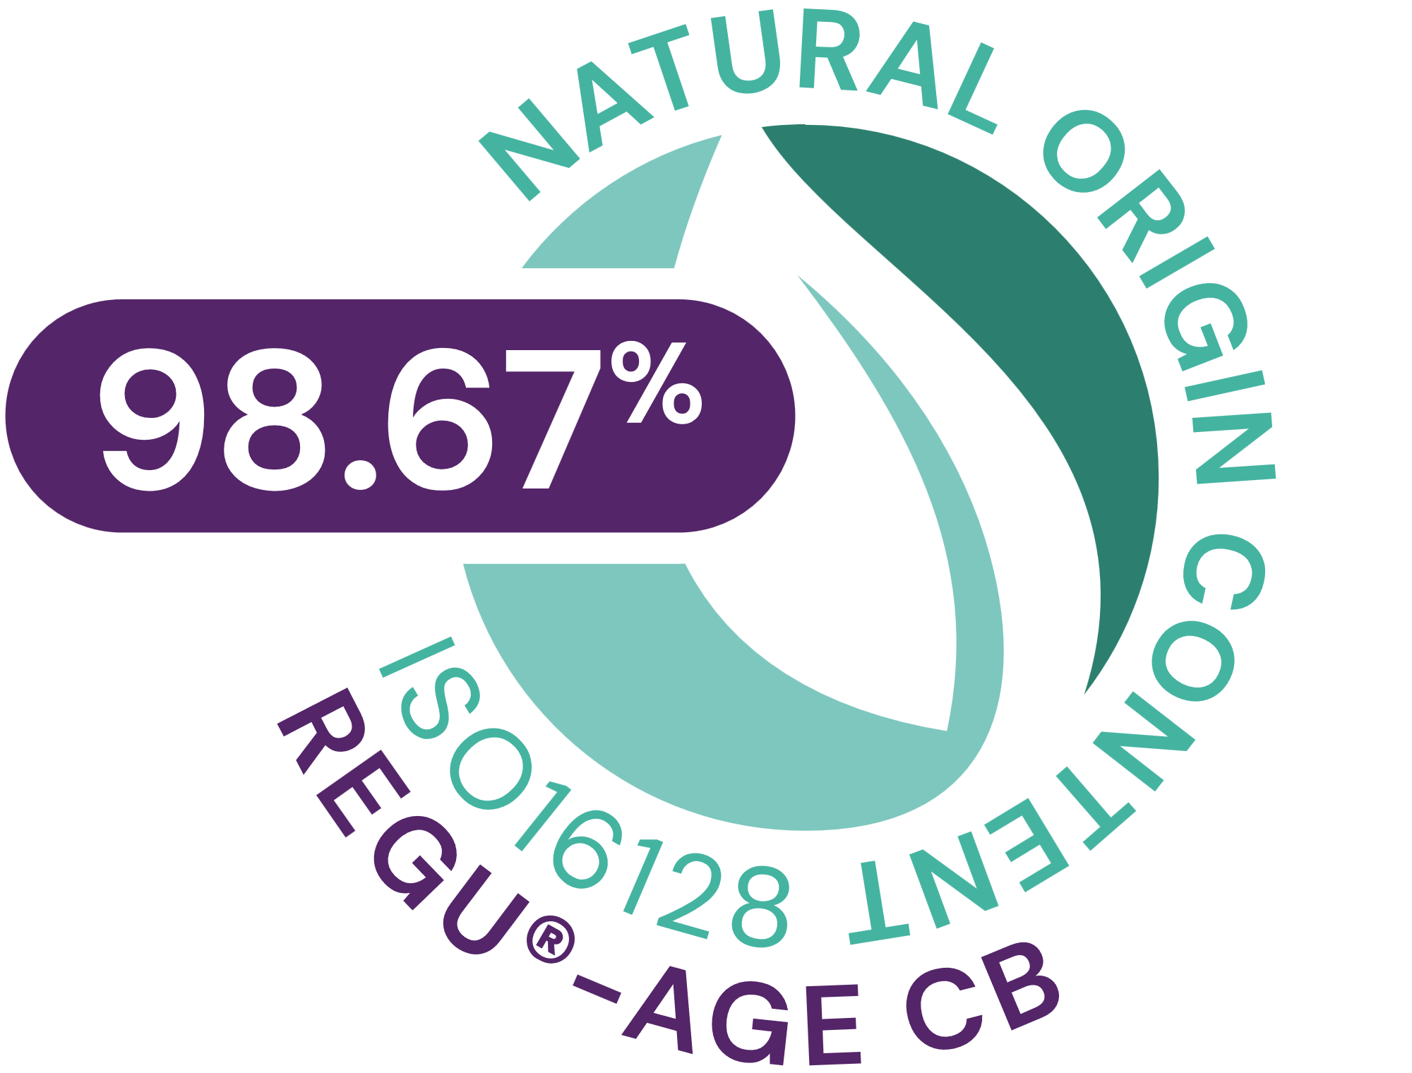


REGU®-AGE CB
ID Card
INCI NAME:
Glycine Soja (Soybean) Protein, Hydrolyzed Rice Protein, Superoxide Dismutase, Glycerin, Aqua, Pentylene Glycol, 1,2-Hexanediol, Caprylyl Glycol, Sodium Benzoate, Sodium Dextran Sulfate
TECHNOLOGY:
At the core of this unique active complex is a mixture of 222 powerful rice and soybean peptides and 1 biotechnologically produced skin-identical superoxide dismutase
98.67% of natural origin (according to ISO 16128)
TECHNICAL:
Form: Liquid
pH of use: 3.5-8.0
Use level: 2–5%
Preservative: Yes, but no Phenoxyethanol
Solubility: Water soluble
Visibly smoother skin in 1 day**
Significant and visible reduction of forehead wrinkles, crow’s feet, underneath eye wrinkles and neck lines in 2 weeks**
Eye lid is more lifted and less saggy skin in 2 weeks**
Significant reduced under-eye dark circles and puffiness in 4 weeks**
BENEFITS:
Clean holistic beauty complex
Strongly improves microcirculation*
Inhibits reactive oxygen radicals, inflammatory elastases and collagenases*
Healthier-looking skin in 2 weeks **
REGISTRATION
CERTIFICATION
* in vitro ** in vivo

Slide 5
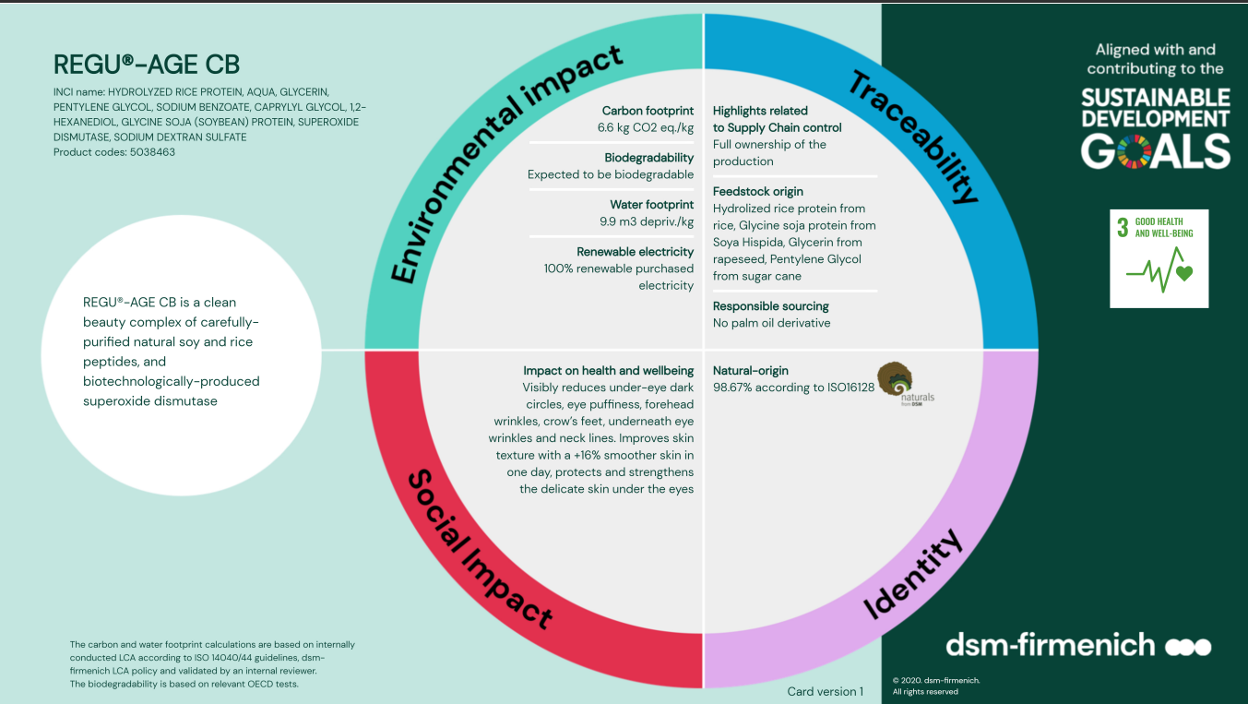
5
Notes:
Glycine Soja (Soybean) Protein :
Plant: Soybeans, cultivated variety Glycine Hispida Phaseolus max
Cultivation of non-GMO soy beans
Country of Origin: Production in Netherlands with Soybeans from USA
ProTerra certified
Hydrolyzed Rice Protein:
Plant: Rice Grain, Botanical name Oryza
Cultivation of non-genetically modified plant
Country of Origin: Global procurement possible, exception North America, Central / South Africa
Superoxide Dismutase
Starting material: yeast (Saccharaomycs cerevisiae)
Non GMO

Slide 6

Science and Consumer Benefits

Slide 7
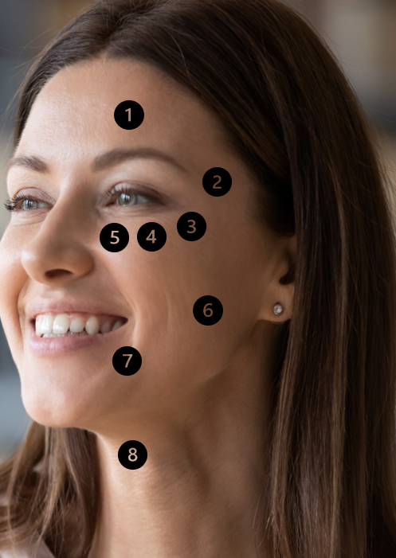
What happens when you age?
Forehead wrinkles: Caused by the breakdown of collagen and elastin due to aging and external aggressors.
Fine lines & crow’s feet: With age, increased release of collagenases & inflammatory elastases and high levels of reactive oxygen species contribute to the degradation of the collagen and elastin matrix.
Underneath eye wrinkles: Under the eyes, the skin is very thin, which is why the first wrinkles often become visible in this area. With age, loss of volume in the cheeks contribute to sagging of the area which coupled with less elastic skin.
Under-eye puffiness: Puffy eyes are caused by an accumulation of fluid in the skin tissue around the eye area. As the skin in this area is thin and delicate, this fluid can cause irritation, making the eye area swell and become discolored.
Under-eye dark circles: Dark circles are mainly seen as a problem of insufficient micro-circulation in the eye area. This leads to the damage of the connecting tissue and beginning signs of inflammation processes.
Cheek roughness: Rough skin patches are often the result of dryness. It is uncomfortable and can make a person look older.
Nasolabial fold: Wrinkles around the mouth can add years to your appearance. Collagen and elastin are two essential proteins, as you get older, production naturally declines.
Neck lines: Neck skin is thin. Loss of subcutaneous fat and excessive skin laxity due to loss of collagen and elastin are common conditions.
Skin needs: Anti-oxidant, Collagen booster, Collagenase & Elastase regulation, Microcirculation stimulation, Hydration booster

Slide 8

REGU®-AGE CB
Multi-Talent
❶
Inhibits reactive oxygen radicals
to protect skin against oxidative stress
SOD activity: > 1000 ORU /ml*
ORU = Oxido Reductase Unit
❷
Inhibits inflammatory (leucocyte) elastases
to retain skin elasticity and moisturization
Elastase inhibitor activity: > 5 EIU /ml*
EIU = Elastase Inhibitor Unit
❸
Inhibits collagenases
for firmer and more elastic skin
Collagenase inhibitory activity: > 10 ColU /ml *
ColU = Collagenase Inhibitor Unit
❹
Stimulates fibroblast proliferation
to minimize fines lines and wrinkles
Increased fibroblast proliferation: up to 200%**
❺
Strongly improves microcirculation to reduce the appearance of dark circles
Enhanced microcirculation, extending Thrombin Time (TT)**
*specified
**in vitro

Slide 9

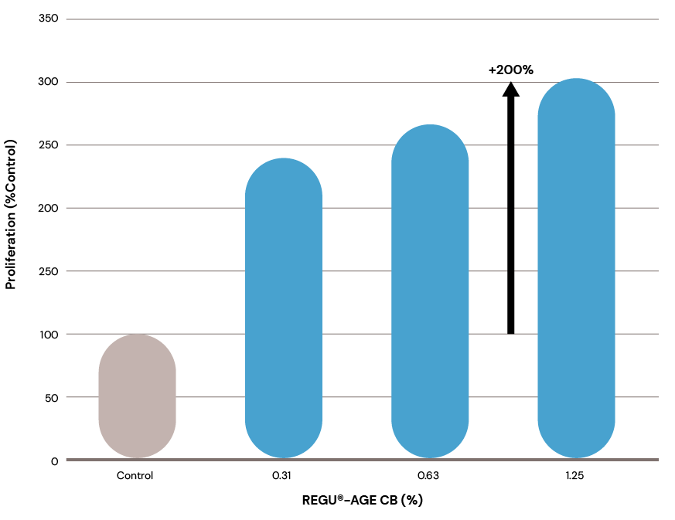

REGU®-AGE CB
Strengthens the dermis by stimulating fibroblast proliferation
REGU®-AGE CB has a dose-dependent stimulation capacity on fibroblast proliferation.
Already at the low concentration of 0.31% the benefit on the fibroblast proliferation could be shown - greater than the control.

Slide 10
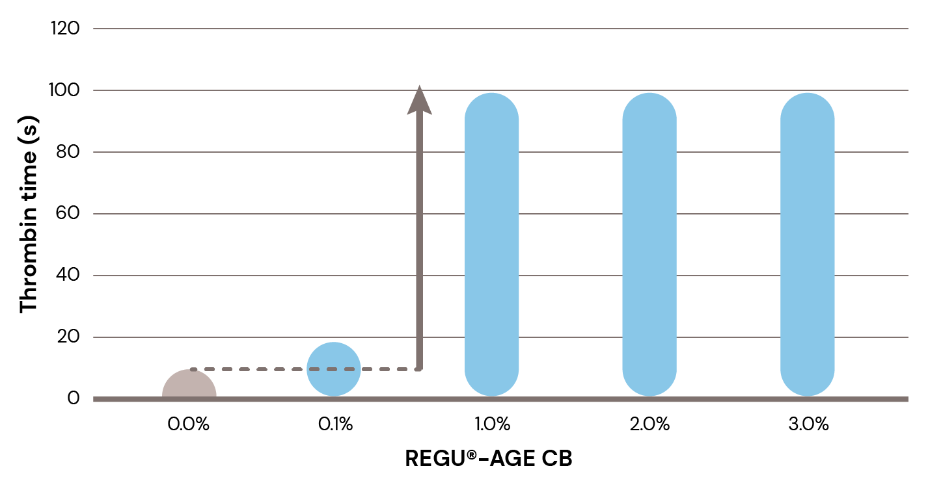
REGU®-AGE CB
Improves microcirculation to limit the appearance of under-eye dark circles
Thrombin Time (TT) in vitro test
Thrombin Time (TT) changes
Activator: Thrombin
(enzyme)
Fibrinogen
(soluble blood component)
X
Fibrin
Polymerization
(insoluble)
Clots
-----------
Thrombin Time (TT)
REGU®-AGE CB
Thrombin Time (TT) is a standard screening test designed to measure the time until blood is coagulated. It is an indicator for microcirculation.
Thrombin is an enzyme in the liquid part of human blood (plasma). It catalyzes the conversion of soluble fibrinogen (a blood component) into insoluble fibrin.
A fibrinogen solution was pre-incubated with REGU®-AGE CB during 1 min and afterwards a thrombin solution was added to trigger coagulation. The clotting time was measured using a coagulometer. Typical reference time is 10-15s.
REGU®-AGE CB enhances the Thrombin Time (TT) and hence improves microcirculation.
Already at the low concentration of 1% REGU®-AGE CB the benefit on the microcirculation could be shown.
Therefore REGU®-AGE CB is recommended to limit the appearance of dark circles.*
Notes:
Dark circles and bags under the eyes are caused by complex interactions. The skin around the eyes, which is already very thin, becomes even thinner as we age. Fatigue, sun damage and aging weaken the collagen and elastin matrix and cause the skin to lose its elasticity. If blood circulation is sluggish in skin capillaries and they become clogged, the pressure build-up has a damaging effect on the already weakened connective tissue. Insufficient supply of oxygen and ongoing inflammation processes by high levels of reactive oxygen species and increased activity of proteolytic enzymes such as collagenase and elastase contribute to the degradation of the collagen and elastin matrix. The result is visible dark circles and eye puffiness.
REGU®-AGE CB improves capillary circulation
Hemostasis is the arrest of bleeding. It is the combined activity of a large number of individual processes. A number of in vitro tests are available to diagnose and monitor the functionality of hemostasis. Thrombin Time (TT) is a standard screening assay that measure the time until blood is coagulated in vitro. It is a performance indicator for the efficacy of the hemostasis process. Both in vitro tests have demonstrated that REGU®-AGE CB has a beneficial effect on capillary circulation, preventing and minimizing under-eye dark circles

Slide 11


in vivo study
Caucasian skin
Type of study | Double-blind, randomized, placebo-controlled study
Study panel | 20 Caucasian females, age: 30+
Formulation | Placebo formulation Active formulation with 5% REGU®-AGE CB
Application | Application twice daily in the morning and in the evening, whole face
Time points | Day 0 (D0, the day before applying the test product) Week 4 (the 28th day after applying the test product) Week 8 (the 56th day after applying the test product)
Test area Test items Methods | Cheek - skin moisturization – Nova Impedance Meter Canthus area - skin texture – replicas analyzed with computer image analysis system Under-eye puffiness and dark circle - assessed by trained technicians using a scoring scale of 0 to 3 – photos using a digital camera

Slide 12
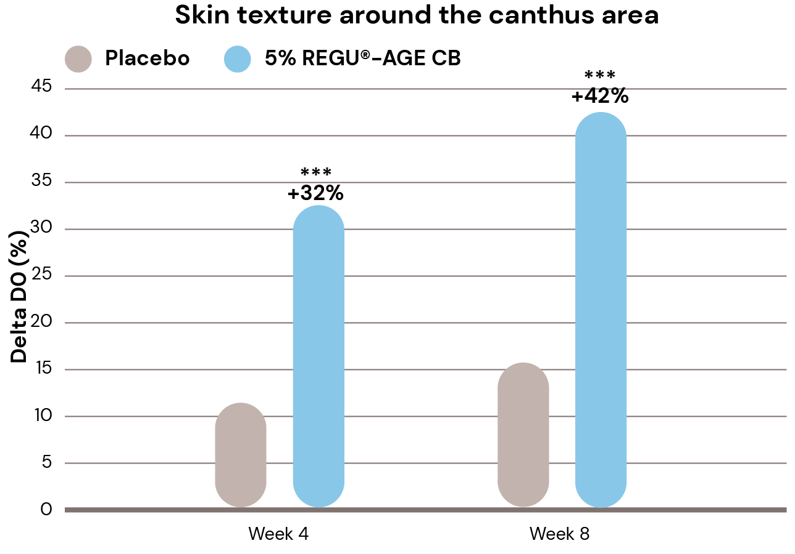
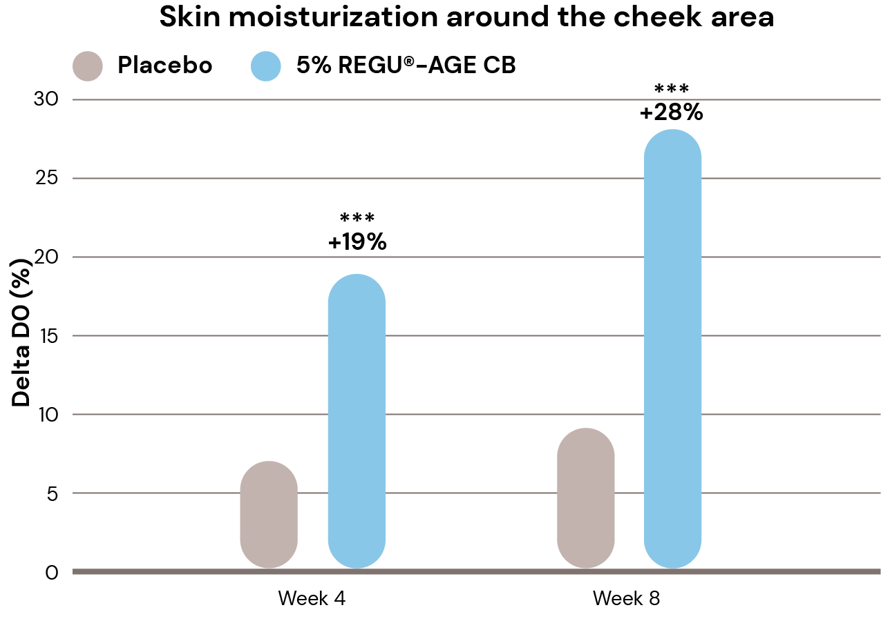
Significant increase of skin texture and moisturization
Skin texture improvement around the canthus area
Skin moisturization improvement
Changes in skin texture vs. Day 0 (D0) are quantified by taking replicas around the canthus area and analyzed with a computer image analysis system.
Changes in skin moisture vs. Day 0 (D0) are assessed with the Nova Impedance Meter on defined sites around the cheek area of subjects.
+32% skin texture improvement in 4 weeks, up to +42% in 8 weeks
Significant results vs. placebo
+19% skin moisturization in 4 weeks, up to +28% in 8 weeks
Significant results vs. placebo
*P < 0.1, ** p < 0.01, ***p < 0.001 compared to placebo
tested on Caucasian skin

Slide 13
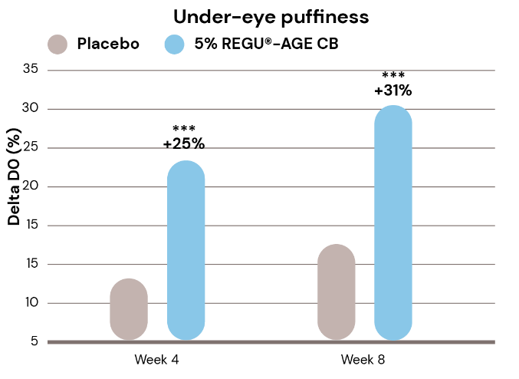
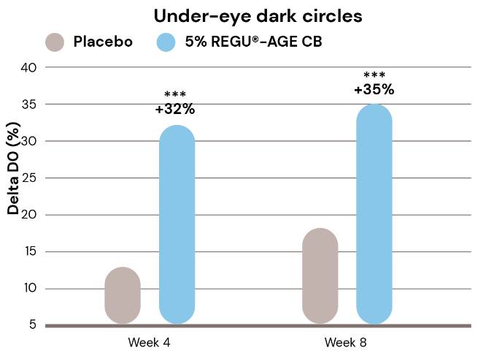
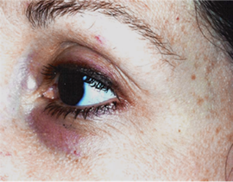
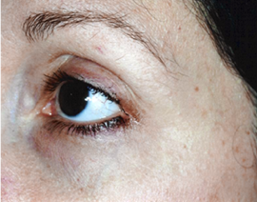
Visible and significant improvement of under-eye puffiness and dark circles
Under-eye puffiness improvement
Under-eye puffiness and dark circle changes
Under-eye dark circles improvement
Untreated
Day 0
5% REGU®-AGE CB
Week 8
Changes in under-eye puffiness vs Day 0 (D0)
are assessed by trained technicians
using a scoring scale of 0 to 3.
Changes in under-eye dark circles vs Day 0 (D0) are assessed by trained technicians using
a scoring scale of 0 to 3.
The photos using a digital camera show the changes of under-eye dark circle and puffiness of a selected subject.
+25% under-eye puffiness improvement in 4 weeks, up to +31% in 8 weeks
Significant results vs. placebo
+32% under-eye dark circles improvement in 4 weeks,
up to +35% in 8 weeks
Significant results vs. placebo
Visible reduction of under-eye dark circle and puffiness in 8 weeks
*P < 0.1, ** p < 0.01, ***p < 0.001 compared to placebo
tested on Caucasian skin

Slide 14


in vivo study
Chinese skin
Type of study | Single-blind, randomized, placebo-controlled study
Study panel | 66 Chinese females, age: 35 – 60, 2 groups,
Formulation | Placebo formulation Active formulation with 3% REGU®-AGE CB
Application | Application twice daily in the morning and in the evening, whole face and neck area
Time points | Day 0 (D0, the day before applying the test product) Day 1 (the 1st day after applying the test product) Week 2 (the 14th day after applying the test product) Week 4 (the 28th day after applying the test product)
Test area Test items Methods | Cheek and neck - skin elasticity (R2) - Cutometer, MPA580 Cheek and neck - skin firmness (F4) - Cutometer, MPA580 Cheek - skin roughness (Ra) - Antera 3D image capture and analysis Cheek - skin smoothness/texture - Visia-CR + IPP software analysis Forehead wrinkles, crow’s feet, underneath eye wrinkles, nasolabial folds - Primos CR image capture and analysis Neck lines - Antera 3D image capture and analysis Self-questionnaire by subjects

Slide 15
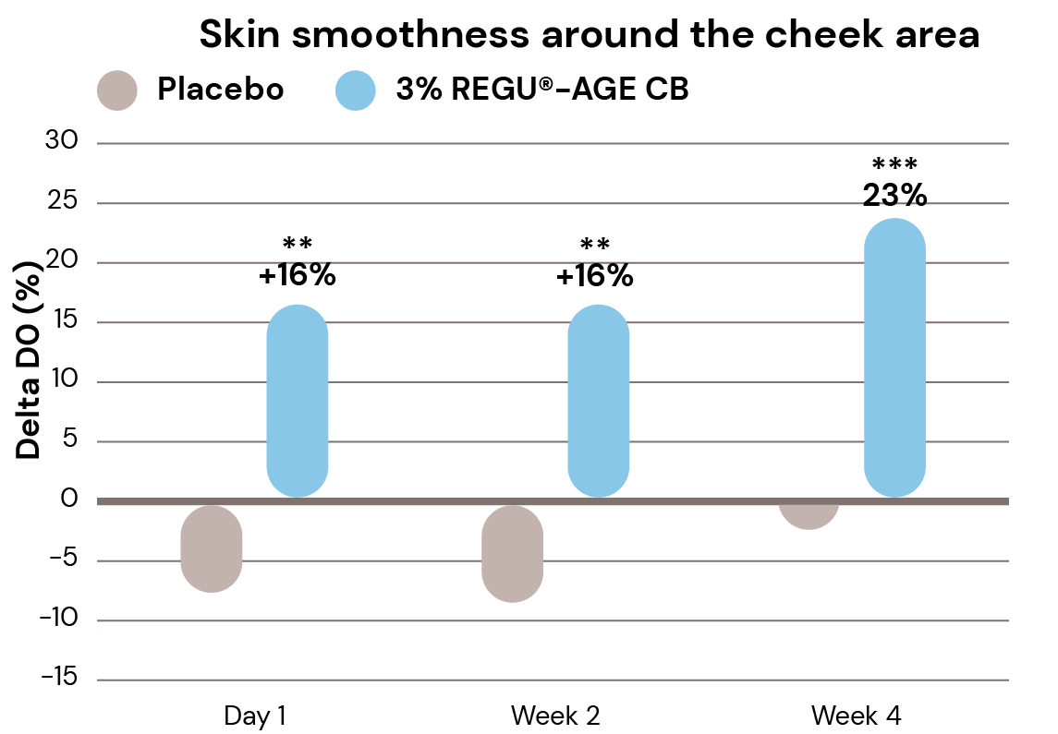
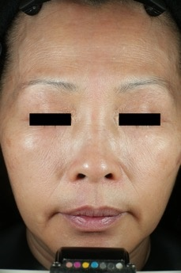
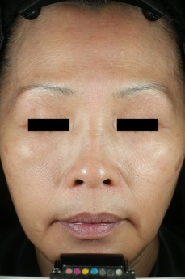
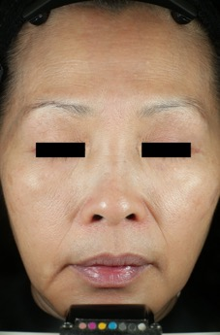
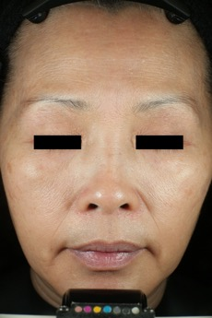
Visible and significant improvement of skin smoothness in 1 day
Visualization of skin smoothness changes
Skin smoothness improvement
Untreated
Day 0
3% REGU®-AGE CB
Day 1
3% REGU®-AGE CB
Week 2
3% REGU®-AGE CB
Week 4
The images taken by Visia-CR camera show the changes of skin smoothness of a selected subject.
Changes of skin smoothness (texture) vs. Day 0 (D0) are assessed by Visia-CR +
IPP software on defined sites around the cheek area of subjects.
Visibly smoother skin in 1 day, even more pronounced in 2 and 4 weeks
+16% smoother skin in 1 day, up to +23% in 4 weeks
Significant results vs. placebo
*P < 0.1, ** p < 0.01, ***p < 0.001 compared to placebo
tested on Chinese skin

Slide 16
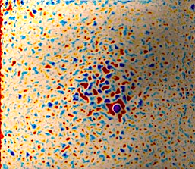
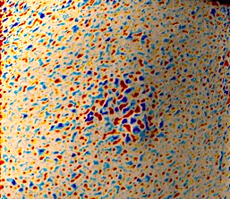
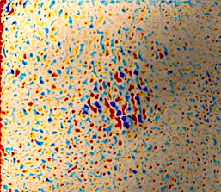
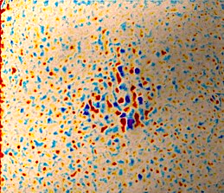
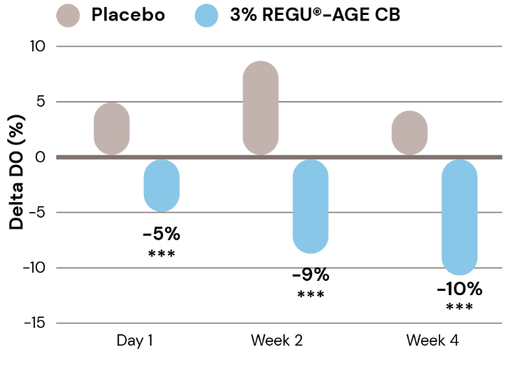
Visible and significant reduction of skin roughness in 1 day
Visualization of skin roughness changes
Skin roughness reduction
Untreated
Day 0
3% REGU®-AGE CB
Day 1
3% REGU®-AGE CB
Week 2
3% REGU®-AGE CB
Week 4
Visuals from a subjects’ cheek area using the Antera 3D texture mode. A false-color map is used to identify the areas with textural roughness (Ra), where red and yellow colors represent depressed areas, and blue and purple colors represent elevated areas.
Changes of skin roughness (Ra) vs Day 0 (D0) are assessed by Antera 3D on defined sites of the cheek area of subjects.
Visible reduction of skin roughness in 1 day, even more pronounced in 4 weeks
-5% skin roughness in 1 day, up to -10% in 4 weeks
Significant results vs. placebo
*P < 0.1, ** p < 0.01, ***p < 0.001 compared to placebo
tested on Chinese skin

Slide 17
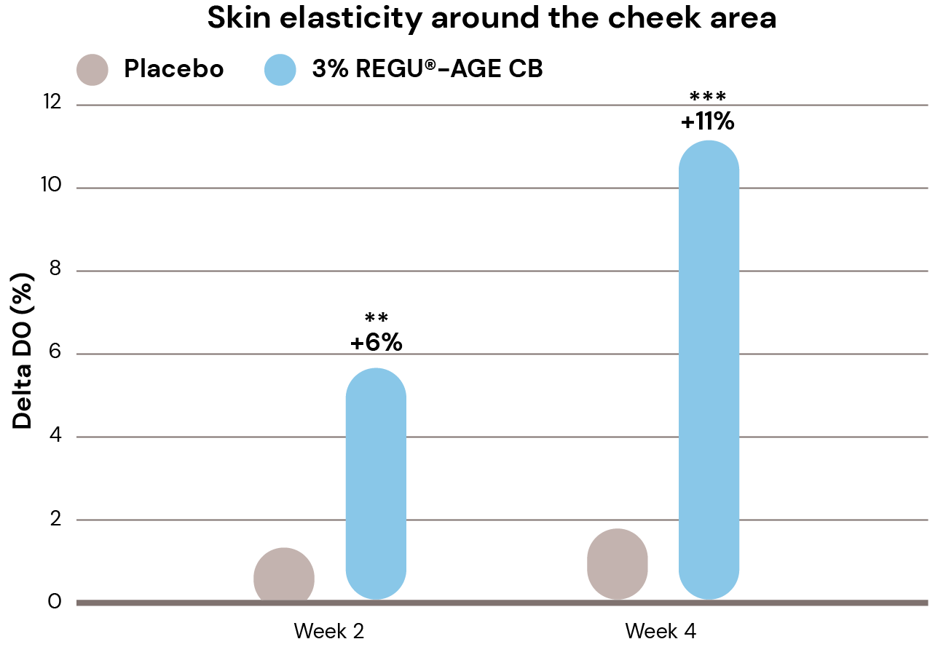
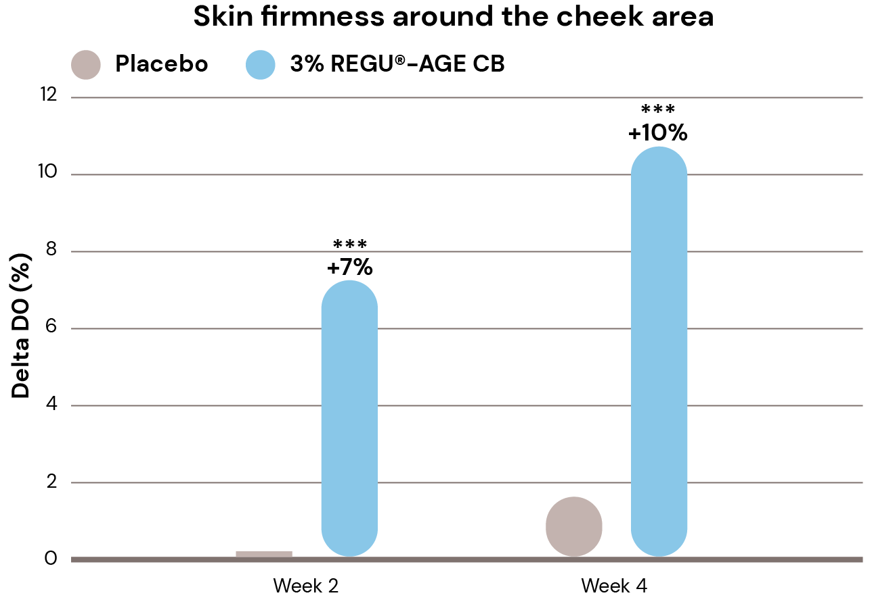
Significant improved skin elasticity and firmness in 2 weeks
Skin elasticity improvement
Skin firmness improvement
Changes of skin elasticity (R2) vs. Day 0 (D0) are assessed with Cutometer,
MPA580 on defined sites around the cheek area of subjects.
Changes of skin firmness (F4) vs. Day 0 (D0) are assessed with the Cutometer, MPA580 on defined sites around the cheek area of subjects.
+6% improved skin elasticity in 2 weeks, up to +11% in 4 weeks
Significant results vs. placebo
+7% firmer skin in 2 weeks, up to 10% in 4 weeks
Significant results vs. placebo
*P < 0.05 ** p < 0.01, ***p < 0.001 compared to placebo
tested on Chinese skin

Slide 18
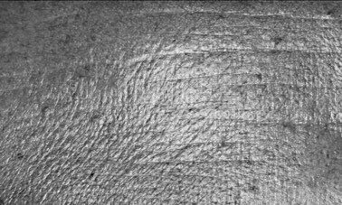


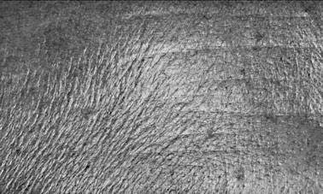
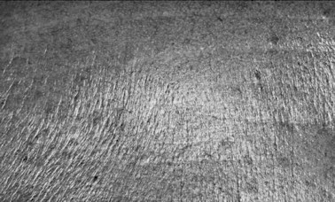
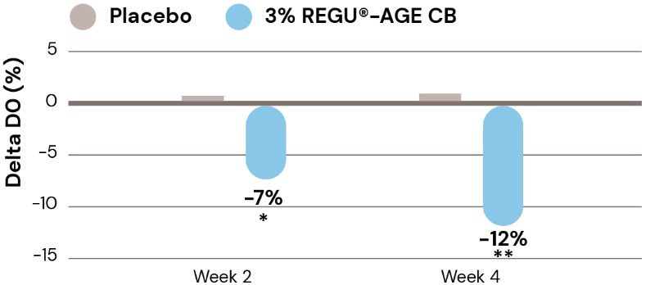
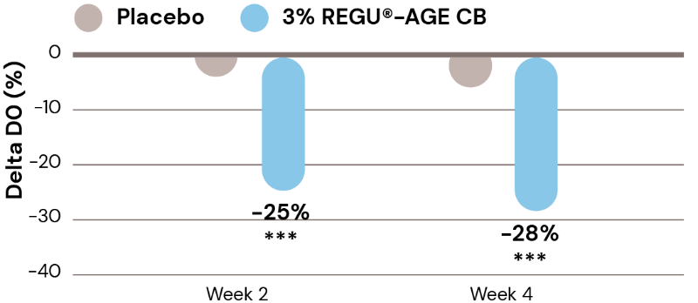
Visible and significant reduction of forehead wrinkles in 2 weeks
Visualization of forehead wrinkle changes
Visible reduction of forehead wrinkles in 2 weeks, even more pronounced in 4 weeks
Untreated
Day 0
3% REGU®-AGE CB
Week 2
3% REGU®-AGE CB
Week 4
The images taken by Primos CR show the changes of forehead wrinkle volume and number of a selected subject.
-7% volume of forehead wrinkles in 2 weeks, up to -12% in 4 weeks
Volume of forehead wrinkles
Number of forehead wrinkles
-25% number of forehead wrinkles in 2 weeks, up to -28% in 4 weeks
Significant results vs. placebo
Changes of forehead wrinkles volume vs. Day 0 (D0) are assessed by Primos CR on a defined site of subjects.
Changes of forehead wrinkles number vs. Day 0 (D0) are assessed by Primos CR on a defined site of subjects.
*P < 0.1, ** p < 0.01, ***p < 0.001 compared to placebo
tested on Chinese skin

Slide 19
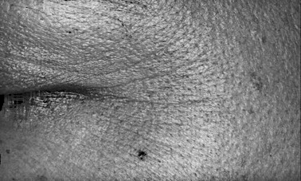
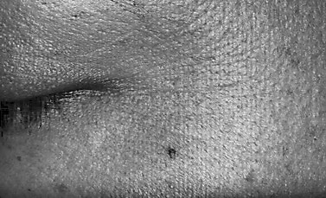
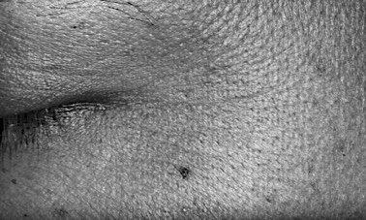


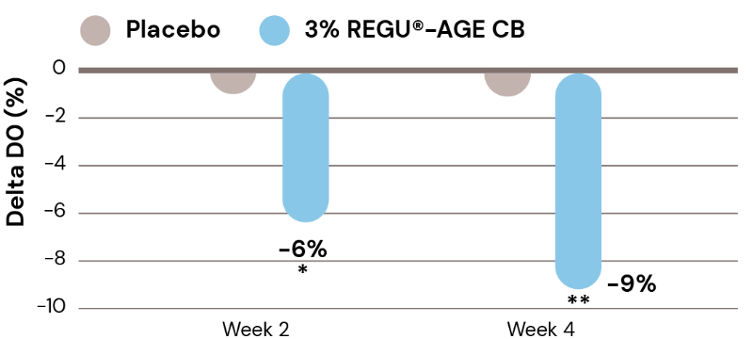
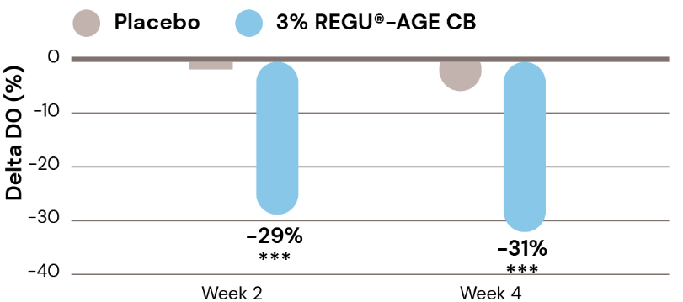
Visible and significant reduction of crow’s feet in 2 weeks
Visualization of crow’s feet changes
Visible reduction of crow’s feet in 2 weeks, even more pronounced in 4 weeks
Untreated
Day 0
3% REGU®-AGE CB
Week 2
3% REGU®-AGE CB
Week 4
-6% volume of crow’s feet in 2 weeks, up to -9% in 4 weeks
The images taken by Primos CR show the changes of crow’s feet volume and number of a selected subject.
Volume of crow’s feet
Number of crow’s feet
-29% number of crow’s feet
in 2 weeks, up to -31% in 4 weeks
Significant results vs placebo
Changes on volume of crow’s feet vs. Day 0 (D0) are assessed by Primos CR on a defined site of subjects.
Changes on number of crow’s feet vs. Day 0 (D0) are assessed by Primos CR on a defined site of subjects.
*P < 0.1, ** p < 0.01, ***p < 0.001 compared to placebo
tested on Chinese skin

Slide 20
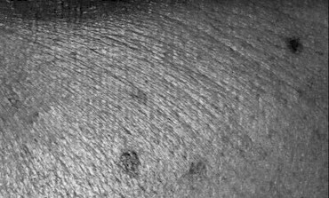
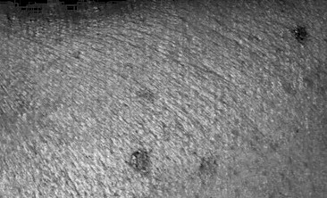
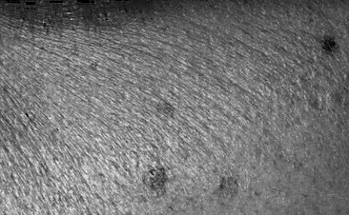


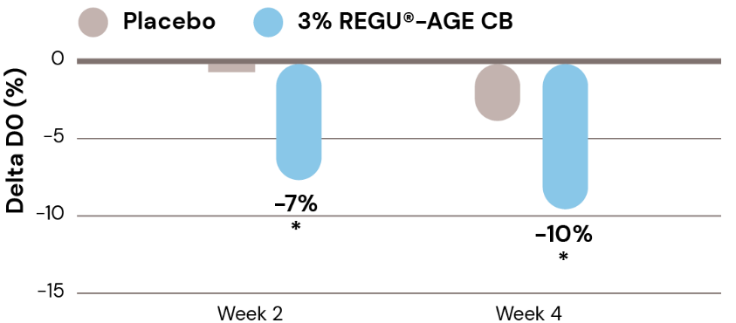
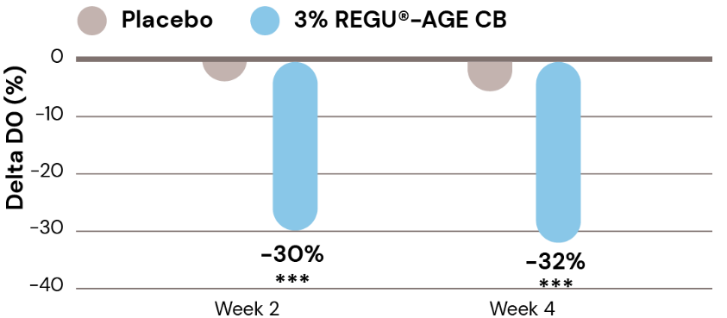
Visible and significant reduction of underneath eye wrinkles in 2 weeks
Visualization of underneath eye wrinkles changes
Visible reduction of underneath eye wrinkles in 2 weeks, even more pronounced in 4 weeks
Untreated
Day 0
3% REGU®-AGE CB
Week 2
3% REGU®-AGE CB
Week 4
The images taken by Primos CR show the changes of fine lines underneath the eye of a selected subject.
-7% volume of underneath eye wrinkles in 2 weeks, up to -10% in 4 weeks
Volume of underneath eye wrinkles
Number of underneath eye wrinkles
-30% number of underneath eye wrinkles in 2 weeks, up to -32% in 4 weeks
Significant results vs. placebo
Changes on volume of underneath eye wrinkles vs. Day 0 (D0) are assessed by Primos CR on a defined site of subjects.
Changes on number of underneath eye wrinkles vs. Day 0 (D0) are assessed by Primos CR on a defined site of subjects.
*P < 0.1, ** p < 0.01, ***p < 0.001 compared to placebo
tested on Chinese skin

Slide 21
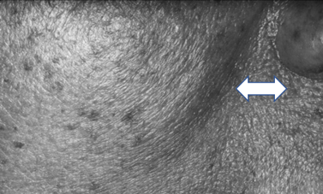
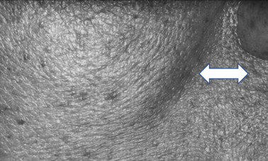
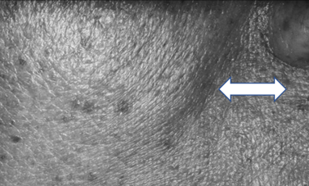
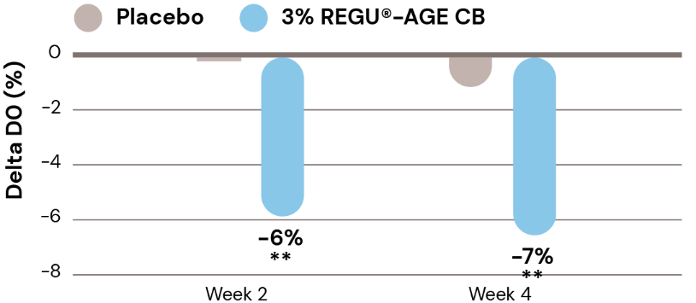
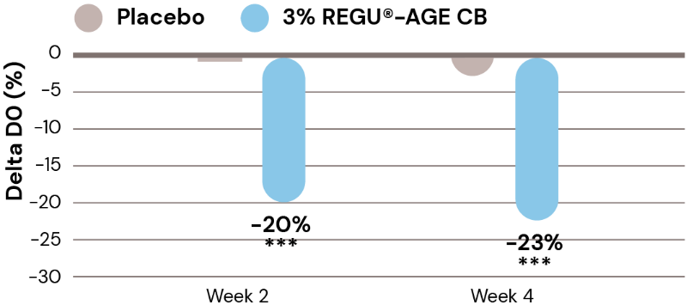
Visible and significant reduction of nasolabial folds in 2 weeks
Visualization of nasolabial folds changes
Fold gets wider and flattens in 2 weeks, even more pronounced in 4 weeks
Untreated
Day 0
3% REGU®-AGE CB
Week 2
3% REGU®-AGE CB
Week 4
The images taken by Primos-CR camera show the changes of nasolabial folds of a selected subject.
-6% volume of nasolabial folds in 2 weeks
Volume of nasolabial folds
Number of nasolabial folds
-20% number of nasolabial folds in 2 weeks, up to -23% in
4 weeks
Significant results vs. placebo
Changes on volume of nasolabial folds vs. Day 0 (D0) are assessed by Primos CR on a defined site of subjects.
Changes on number of nasolabial folds vs. Day 0 (D0) are assessed by Primos CR on a defined site of subjects.
*P < 0.1, ** p < 0.01, ***p < 0.001 compared to placebo
tested on Chinese skin

Slide 22
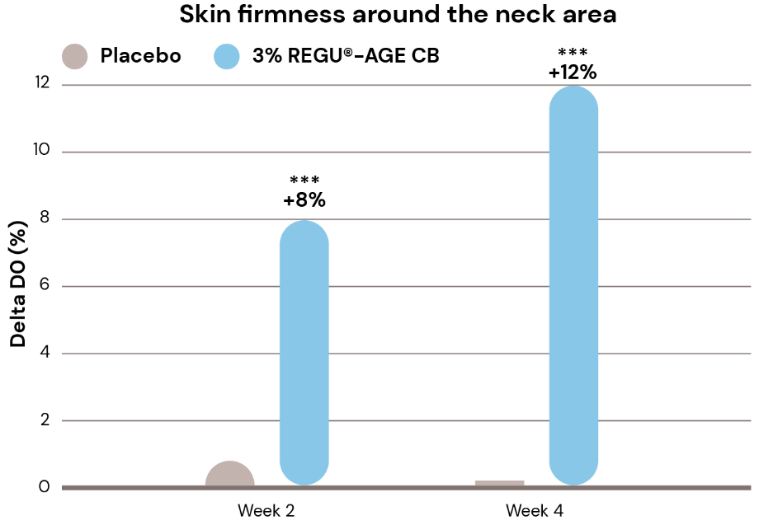
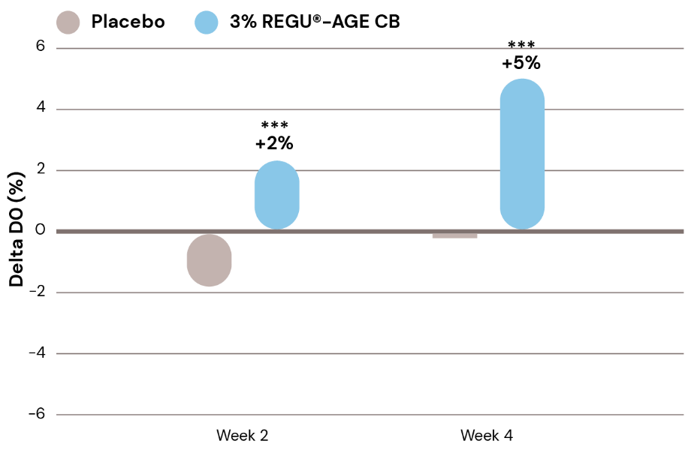
Increased neck skin elasticity and firmness in 2 weeks
Neck skin elasticity improvement
Neck skin firmness improvement
Skin elasticity around the neck area
Changes of skin elasticity (R2) vs. Day 0 (D0) are assessed by Cutometer,
MPA580 at defined sites of the neck area of subjects.
Changes of skin firmness (F4) vs. Day 0 (D0) are assessed with the Cutometer, MPA580 on defined sites of the neck area of subjects.
Increased neck skin elasticity in 2 weeks, up to +5% in 4 weeks
Significant results vs. placebo
+8% firmer neck skin in 2 weeks, up to +12% in 4 weeks
Significant results vs. placebo
*P < 0.1, ** p < 0.01, ***p < 0.001 compared to placebo
tested on Chinese skin

Slide 23
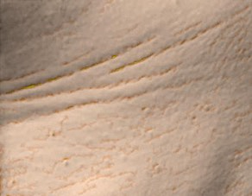
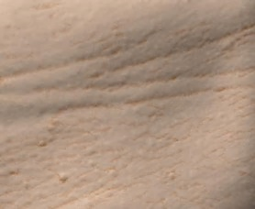

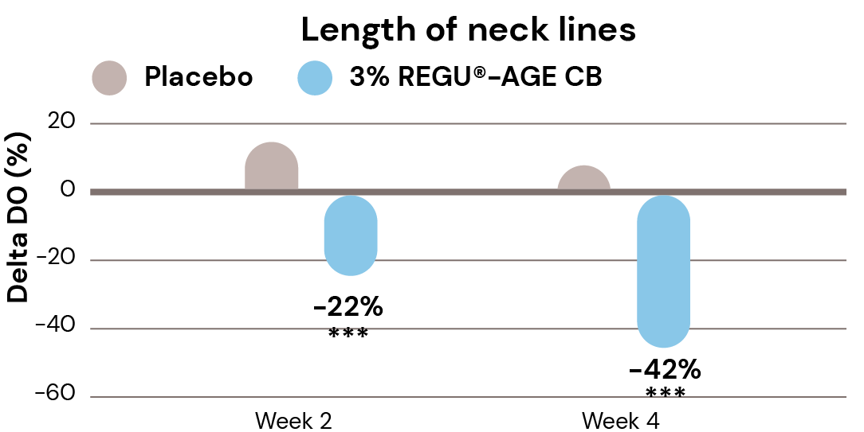
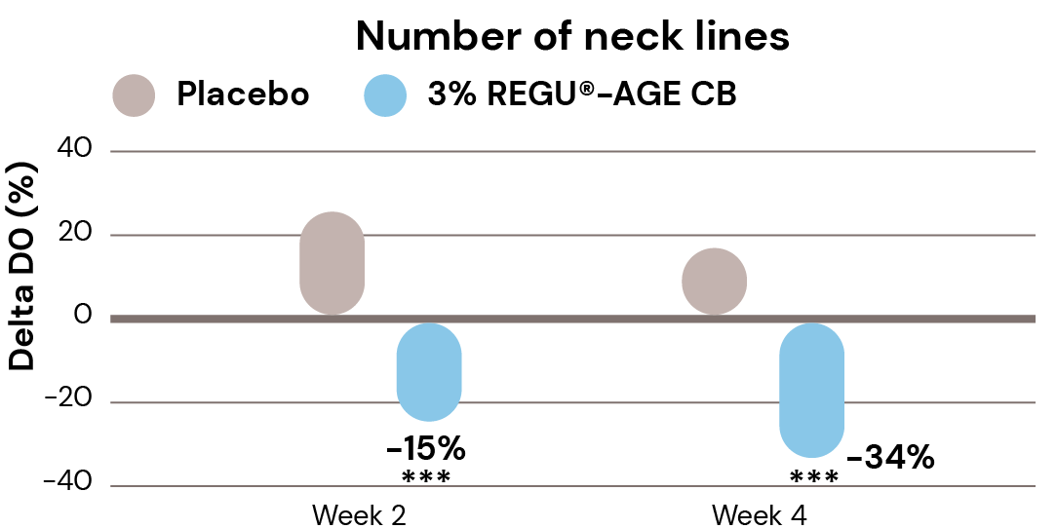
Visible and significant reduction of neck lines in 2 weeks
Visualization of neck lines changes
Visible reduction of neck lines in 2 weeks, even more pronounced in 4 weeks
Untreated
Day 0
3% REGU®-AGE CB
Week 2
3% REGU®-AGE CB
Week 4
The images taken by Antera 3D show the changes of neck lines of a selected subject.
-22% length of neck lines in 2 weeks, up to -42% in 4 weeks
-15% number of neck lines in 2 weeks, up to -34% in 4 weeks
Significant results vs. placebo
Changes on length of neck lines vs. Day 0 (D0) are assessed by Primos CR on a defined site of subjects.
Changes on number of neck lines vs. Day 0 (D0) are assessed by Primos CR on a defined site of subjects.
*P < 0.1, ** p < 0.01, ***p < 0.001 compared to placebo
tested on Chinese skin

Slide 24

Healthier-looking skin in 2 weeks
Self-questionnaire
In 2 weeks subjects observed:
Healthier-looking skin
Dark circles are reduced
Fine lines & wrinkles look
smoother in the eye area
Eye lid is more lifted
Skin looks less saggy
Facial contour looks more defined
The subjects clearly preferred the formula containing REGU®-AGE CB compared to placebo
tested on Chinese skin

Slide 25

in vivo efficacy
Significant facts & benefits
Benefits | Day 1 | Week 2 | Week 4 | Week 8
Forehead wrinkles volume reduction² Forehead wrinkles number reduction² | n/a n/a | -7%* -25%* | -12%* -28%* | n/a n/a
Crow’s feet wrinkles volume reduction² Crow’s feet wrinkles number reduction² | n/a n/a | -6%* -29%* | -9%* -31%* | n/a n/a
Canthus skin texture improvement¹ | n/a | n/a | +32%* | +42%*
Under-eye wrinkles volume reduction² Under-eye wrinkles number reduction² | n/a n/a | -7%* -30%* | -10%* -32%* | n/a n/a
Under-eye puffiness improvement¹ | n/a | n/a | +32%* | +35%*
Under-eye dark circle improvement¹ | n/a | n/a | +25%* | +31%*
Cheek skin moisturization increase¹ | n/a | n/a | +19%* | +28%*
Cheek skin elasticity improvement² | n/a | +5%* | +11%* | n/a
Cheek skin firmness improvement² | n/a | +7%* | +10%* | n/a
Cheek skin smoothness improvement² | +16%* | +16%* | +23%* | n/a
Cheek skin roughness reduction² | -5% | -8%* | -9%* | n/a
Nasolabial folds volume reduction² Nasolabial folds number reduction² | n/a n/a | -6%* -20%* | -7%* -23%* | n/a n/a
Neck skin elasticity improvement² | n/a | +2%* | +5%* | n/a
Neck skin firmness improvement² | n/a | +8%* | +12%* | n/a
Neck lines volume reduction² Neck lines number reduction² | n/a n/a | -22%* -15%* | -42%* -34%* | n/a n/a
❶
❷
❷
❸
❹
❺
❻
❻
❻
❻
❻
❼
❽
❽
❽
** in vivo proven *significant vs placebo
¹ tested on Caucasian skin ² tested on Chinese skin

Slide 26

Formulation Guidelines
INCI name: Glycine Soja (Soybean) Protein, Hydrolyzed Rice Protein, Superoxide Dismutase, Glycerin, Aqua, Pentylene Glycol, 1,2-Hexanediol, Caprylyl Glycol, Sodium Benzoate, Sodium Dextran Sulfate
Clear to turbid yellowish to amber solution
Soluble in water at all ratios
Stable at pH ranges from 3.5 to 8.0
Should be processed below 40°C or cold and is incorporated in the aqueous phase of a cosmetic formulation
Suggested concentration: 2–5%

Slide 27


Slide 28

Rejuvenation Serum
REGU®-AGE CB, ETERWELL™ YOUTH and
SPARK THE SENSES P00Z613
This Rejuvenation Serum has a minimalistic formula containing ETERWELL™ YOUTH in combination with REGU®-AGE CB for a smoother, rejuvenated and healthier-looking complexion. Its lightweight texture is effortless absorbed into the skin, heightening the strength of its barrier without weighting it down.
REGU®-AGE CB minimizes the look of wrinkles around the eyes, nose and neck, and fights appearance of under-eye dark circles and puffiness.
ETERWELL™ YOUTH clears senescent cells and promote cellular beauty, reduces the appearance of fine lines and wrinkles and provides a rejuvenated skin appearance with vibrant healthy looking-skin.
SPARK THE SENSES P00Z613 fragrance is inspired by the sparkling freshness of the Sicilian citrus groves evokes the purity of youth. An elegant floral bouquet blends with creamy musks and sandalwood wrapping the fragrance in a gentle bliss.
Products are for experimental use only and are not for sale. dsm-firmenich is not responsible for final products claims.

Slide 29
Rejuvenation Serum
99,88% Natural Origin*
 | Ingredients | % w / w | Function
A | AQUA | 74,90 | Solvent
 | ETERWELL™ YOUTH (EPILOBIUM FLEISCHERI LEAF / STEM EXTRACT, GLYCERIN, AQUA, CITRIC ACID) | 3,00 | Active
 | REGU®-AGE CB (GLYCINE SOJA (SOYBEAN) PROTEIN, HYDROLYZED RICE PROTEIN, SUPEROXIDE DISMUTASE, GLYCERIN, AQUA, PENTYLENE GLYCOL, 1,2-HEXANEDIOL, CAPRYLYL GLYCOL, SODIUM BENZOATE, SODIUM DEXTRAN SULFATE) | 2,00 | Active
B | PROPANEDIOL | 20,00 | Sensory, Hydration, Active carrier and Preservative booster
C | SPARK THE SENSES P00Z613 (PARFUM, LINALOOL, LIMONENE, CITRUS LIMON PEEL OIL, CITRUS AURANTIUM BERGAMIA PEEL OIL, HYDROXYCITRONELLAL, LINALYL ACETATE, CITRONELLOL, CITRUS AURANTIUM PEEL OIL) | 0,10 | Provides olfactive identity
Procedure
Prepare Phase A
Prepare Phase B
Add Phase B into Phase A under stirring.
Add Phase C into Phase A+B little by little under stirring
Technical Data
pH: 4.5
Viscosity: Liquid
SK-E-102409-26
The formulation fulfils the 6 weeks stability at 50°C and the 3 months stability at 4°C, 40°C, room temperature and daylight.
*Natural origin content calculated according to ISO 16128 by including formulation water
See disclaimer Guide Formulations
Products are for experimental use only and are not for sale. dsm-firmenich is not responsible for final products claims.

Slide 30

Post-Workout Body Gel
REGU®-AGE CB, ALPAFLOR® SAMBUCUS AO, ALPAFLOR® SCUTELLARIA CB, VALVANCE® Touch 210 and AROMACTIVE HARMONY P01A744
A cooling body cream-gel designed to relieve stressed skin after a workout. It acts as a decongestant, provides relief for heavy legs, aids in post-workout recovery, and offers an instant cooling effect.
REGU®-AGE CB minimizes the look of wrinkles around the eyes, nose and neck, and fights appearance of under-eye dark circles and puffiness.
ALPAFLOR® SAMBUCUS AO shows astringent properties and protects against the appearance of puffiness and heavy legs.
ALPAFLOR® SCUTELLARIA CB mitigates the weakening of the skin barrier, preserves skin hydration and relieves unpleasant sensation.
VALVANCE® Touch 210 is a sensory modifier, delivering optimal oil absorption without compromising comfort.
AROMACTIVE HARMONY P01A744 fragrance is inspired by a spa moment after a workout session. Crushed mint and juicy citrus notes are the perfect combination to feel relaxed. Associated to touch of menthol for an instant cooling sensation.
Products are for experimental use only and are not for sale. dsm-firmenich is not responsible for final products claims.

Slide 31
Post-Workout Body Gel
99,67% Natural Origin*
 | Ingredients | % w / w | Function
A | AQUA | 80,61 | Solvent
 | LYSOLECITHIN, SCLEROTIUM GUM, PULLULAN, XANTHAN GUM | 2,50 | Gelling-emulsifying agent
 | PROPANEDIOL | 3,00 | Sensory, Hydration, Active carrier and Preservative booster
 | CAPRYLYL GLYCOL, GLYCERYL CAPRYLATE/CAPRATE, GLYCERIN | 0.20 | Preservative
 | PENTYLENE GLYCOL | 3,00 | Humectant, Co- Preservative
B | CAPRYLIC/CAPRIC TRIGLYCERIDE | 5,00 | Co-Emulsifier
C | VALVANCE® Touch 210 (SILICA) | 1,00 | Sensory modifier
D | REGU®-AGE CB (GLYCINE SOJA (SOYBEAN) PROTEIN, HYDROLYZED RICE PROTEIN, SUPEROXIDE DISMUTASE, GLYCERIN, AQUA, PENTYLENE GLYCOL, 1,2-HEXANEDIOL, CAPRYLYL GLYCOL, DEXTRAN SULFATE) | 2,00 | Active
 | ALPAFLOR® SAMBUCUS AO (SAMBUCUS NIGRA FLOWER EXTRACT, GLYCERIN, AQUA, CITRIC ACID, SODIUM BENZOATE, POTASSIUM SORBATE) | 1,00 | Active
 | ALPAFLOR® SCUTELLARIA CB (GLYCERIN, AQUA, CITRIC ACID, SCUTELLARIA ALPINA FLOWER/LEAF/STEM EXTRACT) | 1,00 | Active
 | AROMACTIVE HARMONY P01A744 (PARFUM, LIMONENE, CITRUS AURANTIUM PEEL OIL, LINALOOL, CITRUS LIMON PEEL OIL, PINENE, MENTHOL, MENTHA PIPERITA OIL, CITRAL, POGOSTEMON CABLIN OIL, MENTHA VIRIDIS LEAF OIL, CARVONE,) | 0,50 | Provides olfactive identity
 | MENTHOL | 0,10 | Cooling agent
E | SODIUM HYDROXIDE, AQUA | 0,09 | pH adjuster
Procedure
Prepare Phase A and heat-up to 75°C-80°C under stirring for 30 min.
Prepare Phase B under stirring.
Add Phase B into Phase A under stirring.
Add Phase C into Phase A+B and homogenize at 18000 rpm for 2 min.
Cool down to 35°C under stirring.
Add ingredients of Phase D one by one into the emulsion under stirring.
Adjust pH to 7 with Phase E.
Technical Data
pH: 6.9
Viscosity: (spindle RV-3 / 10 rpm): 8420 mPa.s
SK-E-102552-2
The formulation fulfils the 3 months stability at 4°C, 40°C, 50°C, room temperature and daylight.
*Natural origin content calculated according to ISO 16128 by including formulation water
See disclaimer Guide Formulations
Products are for experimental use only and are not for sale. dsm-firmenich is not responsible for final products claims.

Slide 32

Anti-Wrinkle Eye Contour Cream
REGU®-AGE CB, SYN®-COLL CB, AMPHISOL® K
This concentrated cream replenishes and conditions the delicate skin around the eye area to help reduce wrinkles and fine lines whilst diminishing the appearance of dark circles and puffiness.
REGU®-AGE CB minimizes the look of wrinkles around the eyes, nose and neck, and fights appearance of under-eye dark circles and puffiness.
SYN®-COLL CB simultaneously boosts collagen production and protects against collagen degradation, combating lines and wrinkles. It helps create a more lifted, sculpted look, and refined pore appearance.
AMPHISOL® K is used as a co-emulsifier to beautify the formulation. It improves moisturization and brings a remarkable sensory signature.
Products are for experimental use only and are not for sale. dsm-firmenich is not responsible for final products claims.

Slide 33
Anti-Wrinkle Eye Contour Cream
REGU®-AGE CB, SYN®-COLL CB and AMPHISOL® K
 | Ingredients | % w / w | Function
A | AMPHISOL® K (POTASSIUM CETYL PHOSPHATE) | 1,00 | Emulsifier
 | CETYL ALCOHOL | 3,00 | Thickening agent
 | CETYL PALMITATE | 1,50 | Thickening agent
 | OCTYLDODECANOL | 3,00 | Emollient
 | C12-15 ALKYL BENZOATE | 2,50 | Emollient
B | ACRYLATES/C10-30 ALKYL ACRYLATE CROSSPOLYMER | 0,10 | Emulsifier, Thickening agent
C | GLYCERIN | 3,00 | Humectant
 | AQUA | 81,10 | Solvent
D | REGU®-AGE CB (GLYCINE SOJA (SOYBEAN) PROTEIN, HYDROLYZED RICE PROTEIN, SUPEROXIDE DISMUTASE, GLYCERIN, AQUA, PENTYLENE GLYCOL, 1,2-HEXANEDIOL, CAPRYLYL GLYCOL, SODIUM BENZOATE, SODIUM DEXTRAN SULFATE) | 3,00 | Active
 | SYN®-COLL CB (PALMITOYL TRIPEPTIDE-5, GLYCERIN, AQUA) | 1,00 | Active
 | PHENOXYETHANOL, ETHYLHEXYLGLYCERIN | 0,80 | Preservative
Procedure
Prepare Phase A and heat up to 75°C under stirring.
At 75°C, add Phase B into Phase A under stirring.
Prepare Phase C and heat up to 75°C.
Add Phase C into Phase A+B under stirring, then homogenize.
Cool down to 40°C.
Prepare Phase D and add it into the emulsion.
Cool down to room temperature under gentle stirring.
Technical Data
pH: 5,5
Viscosity: (spindle RV-4 / 10 rpm): 17140 mPa.s
SK-E-100358-18
The formulation fulfils the 3 months stability at 4°C, 40°C, room temperature.
See disclaimer Guide Formulations
Products are for experimental use only and are not for sale. dsm-firmenich is not responsible for final products claims.

Slide 34

Sublime Glow Daily Essence
REGU®-AGE CB, REVITALIN® CB,
Niacinamide PC, AMPHISOL® K
This essence provides the skin with a daily dose of energy boost through multi-targeted mechanism.
REGU®-AGE CB minimizes the look of wrinkles around the eyes, nose and neck, and fights appearance of under-eye dark circles and puffiness.
REVITALIN® CB boosts skin's energy and outsmarts skin's internal clock for a youthful glowing complexion.
Niacinamide PC is a building block ingredient for skin care and provides an even skin texture and skin glow.
AMPHISOL® K is used as a co-emulsifier to beautify the formulation.
It improves moisturization and brings a remarkable sensory signature.
Products are for experimental use only and are not for sale. dsm-firmenich is not responsible for final products claims.

Slide 35
Sublime Glow Daily Essence
REGU®-AGE CB, REVITALIN® CB, Niacinamide PC and AMPHISOL® K
 | Ingredients | % w / w | Function
A | AQUA | 87,30 | Solvent
 | Niacinamide PC (NIACINAMIDE) | 2,00 | Active
 | POLYACRYLATE CROSSPOLYMER-11 | 1,50 | Thickening Agent
 | PHENOXYETHANOL, ETHYLHEXYLGLYCERIN | 0,80 | Preservative
 | CI 16035 | 0,00025 | Colorant
B | AMPHISOL® K (POTASSIUM CETYL PHOSPHATE) | 0,30 | Co-Emulsifier
 | ISONONYL ISONONANOATE | 3,00 | Emollient
 | NEOPENTYL GLYCOL DIHEPTANOATE | 2,50 | Emollient
 | CYCLOPENTASILOXANE | 0,50 | Emollient
C | REVITALIN® CB (GLYCOPROTEINS, GLUTAMIC ACID, VALINE, THREONINE, AQUA, 1,2-HEXANEDIOL, CAPRYLYL GLYCOL) | 1,00 | Active
 | REGU®-AGE CB (GLYCINE SOJA (SOYBEAN) PROTEIN, HYDROLYZED RICE PROTEIN, SUPEROXIDE DISMUTASE, GLYCERIN, AQUA, PENTYLENE GLYCOL, 1,2-HEXANEDIOL, CAPRYLYL GLYCOL, DEXTRAN SULFATE) | 1,00 | Active
 | PARFUM | 0,10 | Provides olfactive identity
Procedure
Prepare Phase A and heat up to 70°C under stirring.
Prepare Phase B and heat up to 70°C.
Add Phase B into Phase A under stirring.
Cool down to 35°C.
Add ingredients of Phase C one by one into Phase A+B.
Cool down to room temperature under stirring.
Adjust pH to 5.5 - 6.0 if necessary.
Technical Data
pH: 5,7
Viscosity: (spindle RV-3 / 10 rpm): 11320 mPa.s
SK-E-101094-17
The formulation fulfils the 3 months stability at 4°C, 40°C, room temperature.
See disclaimer Guide Formulations
Products are for experimental use only and are not for sale. dsm-firmenich is not responsible for final products claims.

Slide 36





Market products with Glycine Soja (Soybean) Protein, Hydrolyzed Rice Protein and Superoxide Dismutase …
Wrinkle Resist
Eye Cream
USA
“8-Peptide Blend”
Eye Cream
USA
Fractionated
Eye Contour Concentrate
Canada
Lifting Peptide
Eye Cream
South Korea
Energizing
Face and Eye Gel
Germany
Mintel 2023

Slide 38
Disclaimer
Copyright © DSM Nutritional Products Ltd 2025, 4002 Basel, Switzerland.
www.dsm-firmenich.com. All rights reserved.
dsm-firmenich has used diligent care to ensure that the information provided herein is accurate and up-to-date to the best of its knowledge. However, dsm-firmenich makes no representation or warranty, either expressly or implied, of the accuracy, reliability, completeness, or suitability thereof. The information provided herein contains scientific and product information for business-to-business use and does not constitute or provide scientific or medical advice, diagnosis or recommendation for treatment options. Country or region-specific information should be considered when labelling or advertising to final consumer. In no event shall dsm-firmenich be liable for any direct or indirect damages arising from or reliance upon, or use of, any information provided herein. The content of this document is subject to change without further notice. Please contact your local dsm-firmenich representative for the latest information. All trademarks listed in this document are either (registered) trademarks of, or trademarks licensed by, the dsm-firmenich group of companies, unless explicitly stated otherwise.
Disclaimer Formulation Guideline
The information provided herein is provided for information purposes only and has been prepared by dsm-firmenich in accordance with its own methodology.
dsm-firmenich has used diligent care to ensure that it is accurate and up-to-date, however, dsm-firmenich makes no representation or warranty, either expressly or implied, of the accuracy, reliability, or completeness thereof. In no event shall dsm-firmenich be liable for any damages arising from or reliance upon, or use of, any information provided herein. Further, dsm-firmenich shall not bear any liability for the application and/or use of any processed material containing its product(s). The formulation of the finished product is the customer’s sole responsibility. It is the customer’s responsibility to determine the suitability of dsm-firmenich’s products regarding user specific purposes, assess compatibility and stability of their finished product(s) and to ensure compliance of their finished product(s) with relevant laws and regulations. Any product, marketing or other claims made by customer are its sole responsibility. The content of this document is subject to change without further notice. Please contact your local dsm-firmenich representative for further details. © 2025 dsm-firmenich group.

