Slide 1



REGU®-FADE
The most effective solution for noticeable brighter skin

Slide 2
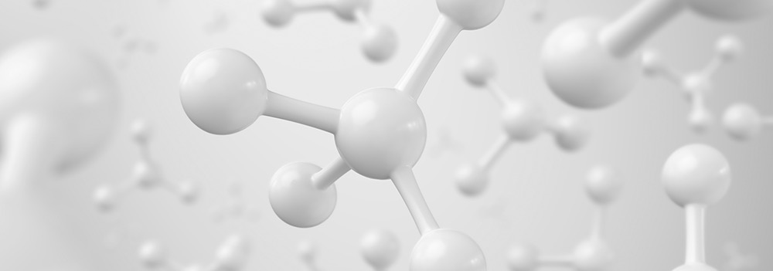
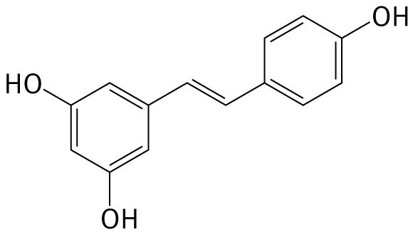
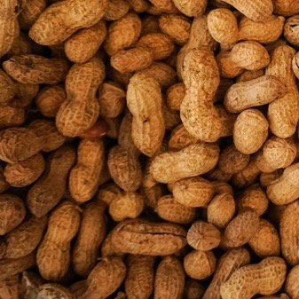
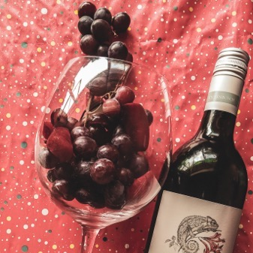
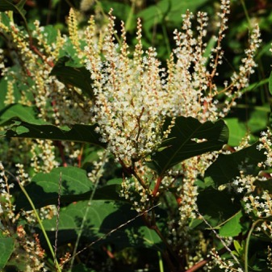
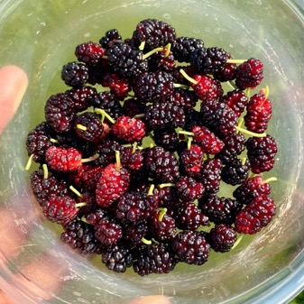
What is Resveratrol and where is it found?
Resveratrol is a powerful antioxidant, a polyphenol found in nature in small amounts, most notably in red wine
Peanuts
(<<0.1%)
Grapes & Wine
(<0.02%)
Polygonum cuspidatum “Knotweed“ (<0.3%)
Mulberries

Slide 3
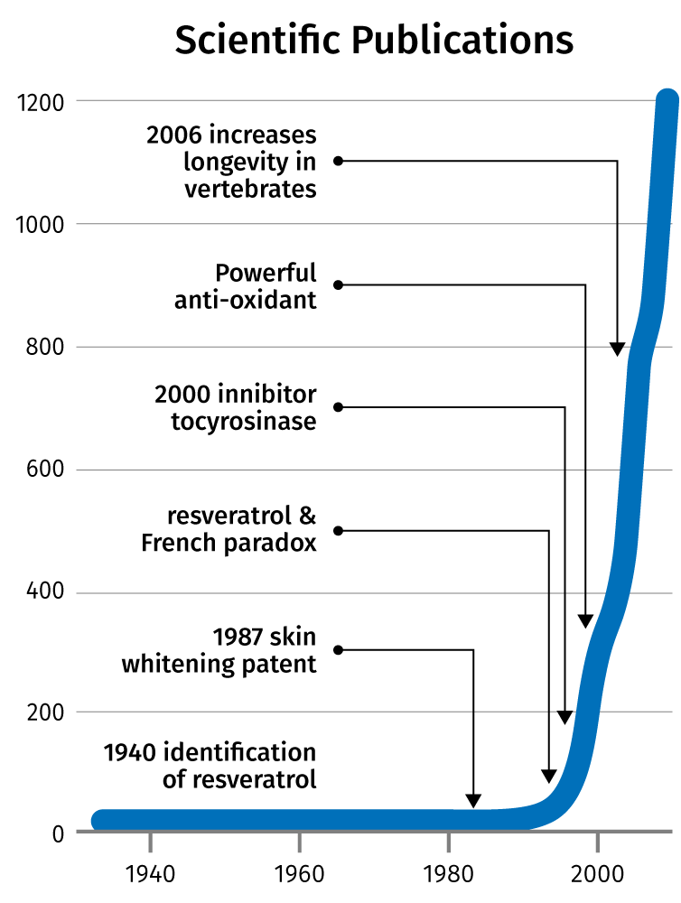
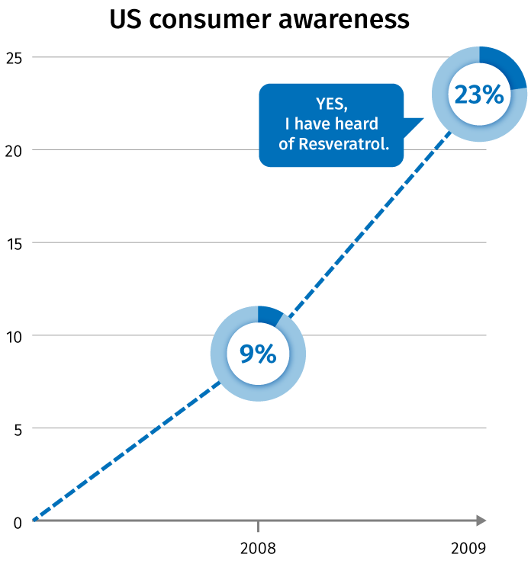
Resveratrol: Science and consumer awareness are building up rapidly
Source: Multi-Sponsor Surveys 2009

Slide 4

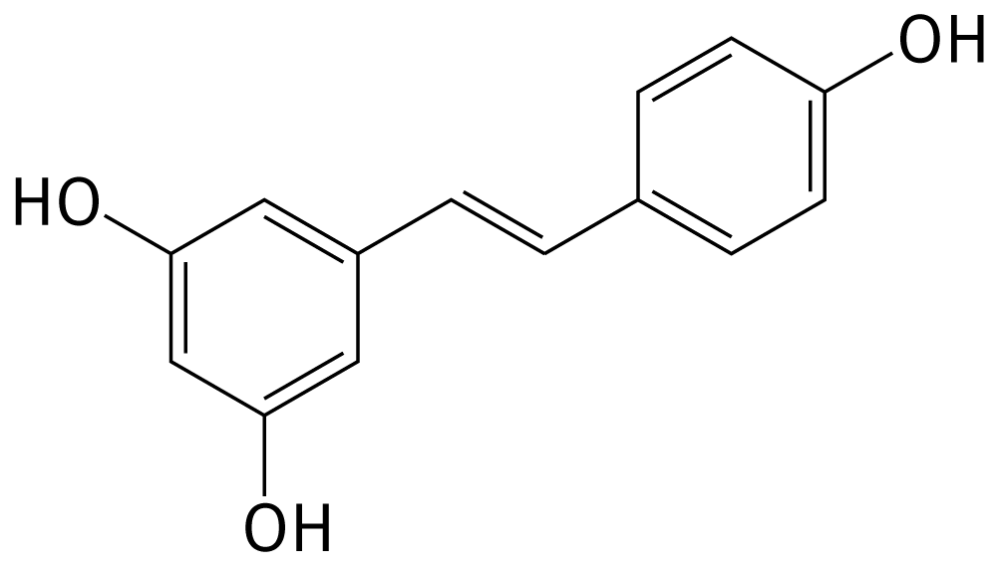
Resveratrol: Radical scavenging and anti oxidative properties
Resveratrol exhibited stronger anti radical activity than kaempferol and is more efficient than α-tocopherol
Resveratrol was found to be stronger anti oxidant than catechin and kaempherol
K L Khandujja et al: Stable free radical scavenging and anti oxidative properties of resveratrol - Indian Journal of Biochemistry & Biophysics Vol. 40, December 2003, pp. 416-422

Slide 5

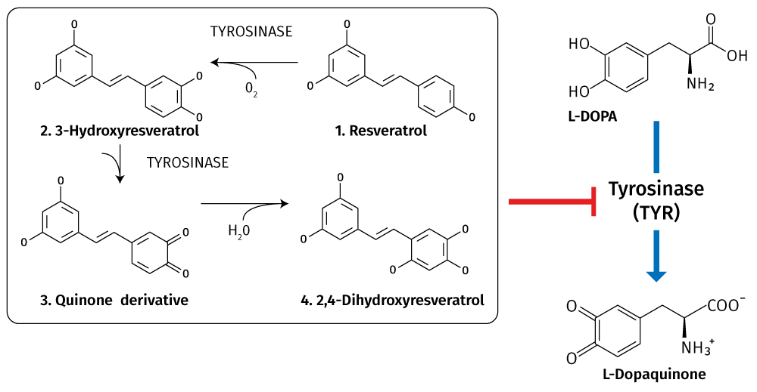

Resveratrol: Inhibitor to Tyrosinase
Bernard P. and Berton J.-Y., IJoCS, 22, 219-226 (2000)

Slide 6
What is REGU®-FADE?
Nature-identical, pure, substantiated
Why REGU®-FADE?
Fast, visible results (14 days)
Multi target mechanism
Strong scientific substantiation
Two Clinical studies with significant results
Complete safety dossier
High consumer awareness for resveratrol
Registered in China
Appealing stories: red wine,
life-extending, french paradox
Why a nature-identical form?
Free from pesticides
Free from emodin
Does not contain cis-form
Organic synthesis vs. solvent extraction from low yield plants
Consistent supply
> 99% trans-Resveratrol

Slide 7
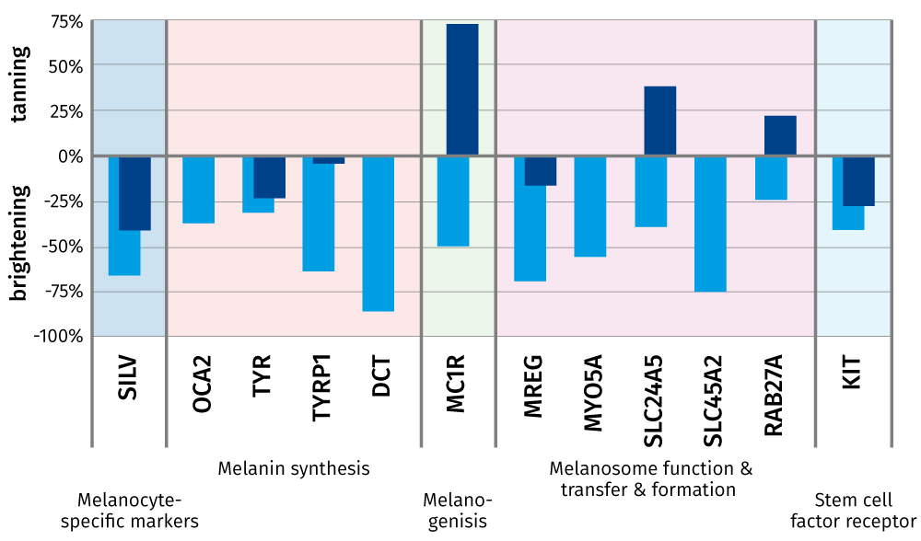
REGU®-FADE: Multi target mechanism
Efficacy: in vitro - Gene expression (PCR array)
REGU®-FADE vs Ascorbyl Glucoside
Tissue
Human Melanocytes
Treatment
88µM REGU®-FADE
1180µM Ascorbyl Glucoside
Timepoint
72h
0.002% REGU®-FADE downregulates the expression of key genes involved in the pigmentation process

Slide 8
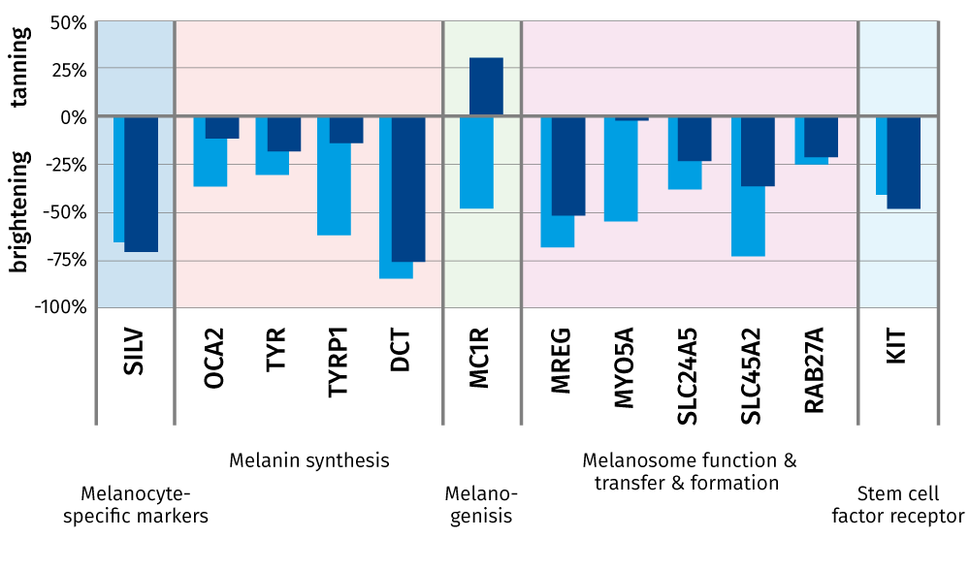
REGU®-FADE: Multi target mechanism
Efficacy: in vitro - Gene expression (PCR array)
REGU®-FADE vs cis-Resveratrol
Tissue
Human Melanocytes
Treatment
88µM REGU®-FADE
88µM cis-Resveratrol
Timepoint
72h
REGU®-FADE is more effective than cis-Resveratrol

Slide 9
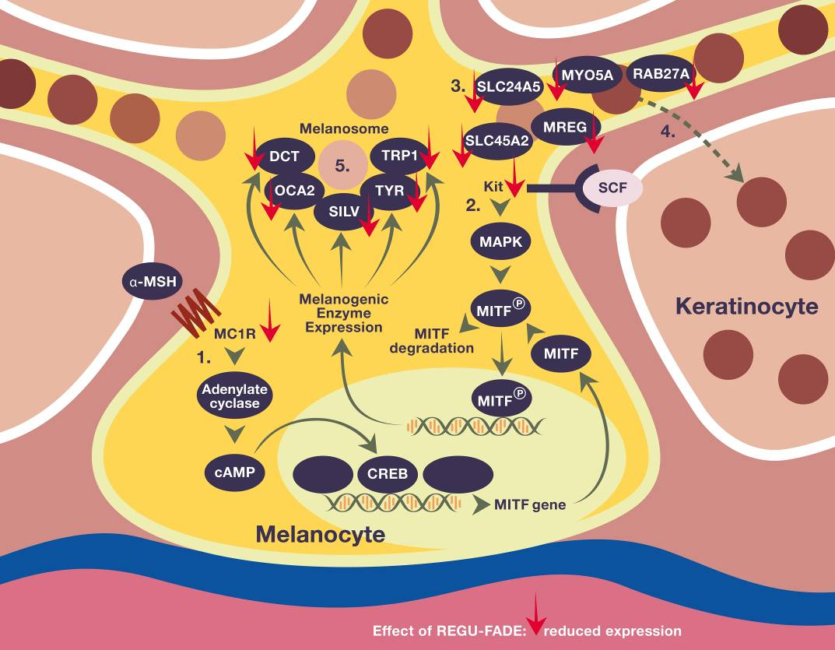
REGU®-FADE: Multi target mechanism
α - MSH signaling
REGU®-FADE downregulates the MCR1 (α - MSH receptor) expression level, leading to decreased expression of MITF-regulated genes such as SILV, TYR (tyrosinae), TRP1, DCT, OCA2 which reduces melanin synthesis.
KIT signaling
REGU®-FADE decreases KIT (=stem cell factor receptor) gene expression which additionally reduces melanin synthesis.
Melanosome function & maturation
REGU®-FADE also affects the function and maturation of melanosomes by reduction of SLC24A5 and SLC45A2 gene expression levels.
Melanosome transport
REGU®-FADE attenuates melanosome transport within melanocytes, shown by the reduction of the MYO5A and MREG gene expression levels as well as the melanosome transport to keratinocytes, shown by the reduction of RAB 27A gene expression levels.
Melanin synthesis

Slide 10
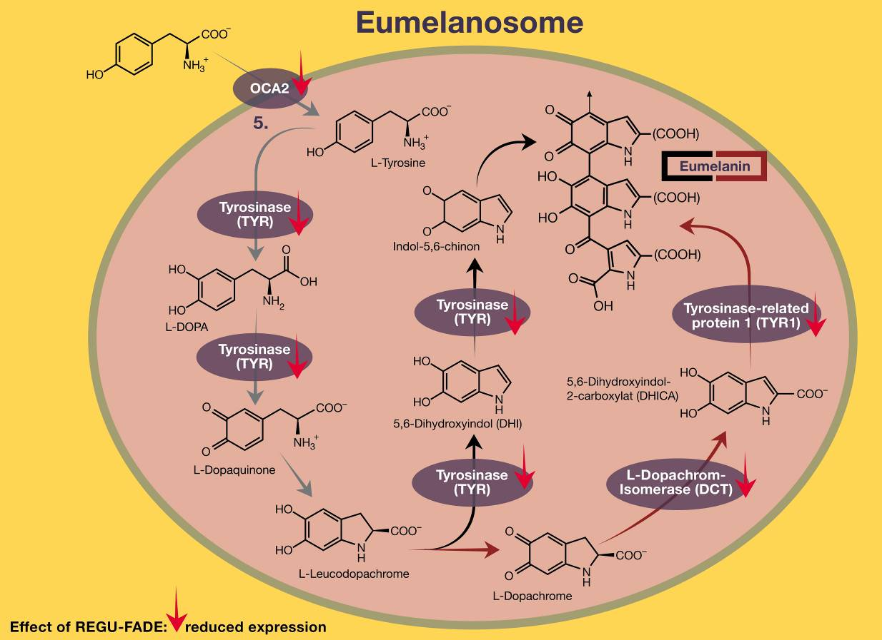
REGU®-FADE: Multi target mechanism
Eumelanin synthesis
REGU®-FADE reduces the conversion of tyrosine into eumelanin at various points, shown by the downregulation of OCA2, TYR (tyrosinase), DCT and TYR1 gene expression levels

Slide 11
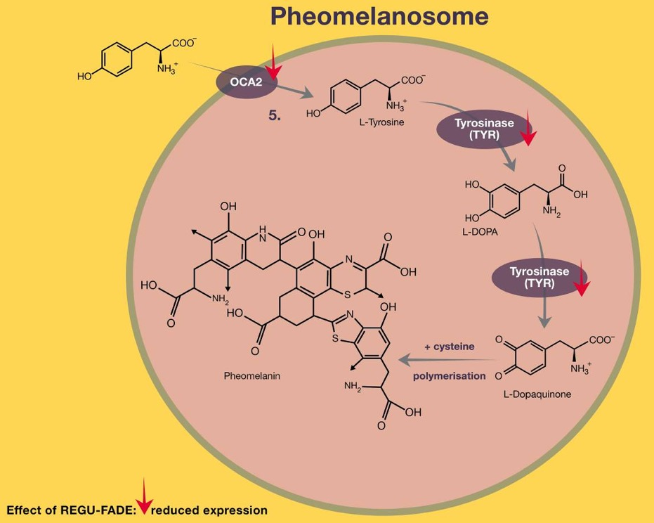
REGU®-FADE: Multi target mechanism
Pheomelanin synthesis
REGU®-FADE reduces the conversion of tyrosine into pheomelanin at various points, shown by the downregulation of OCA2 and TYR (tyrosinase) gene expression levels.

Slide 12
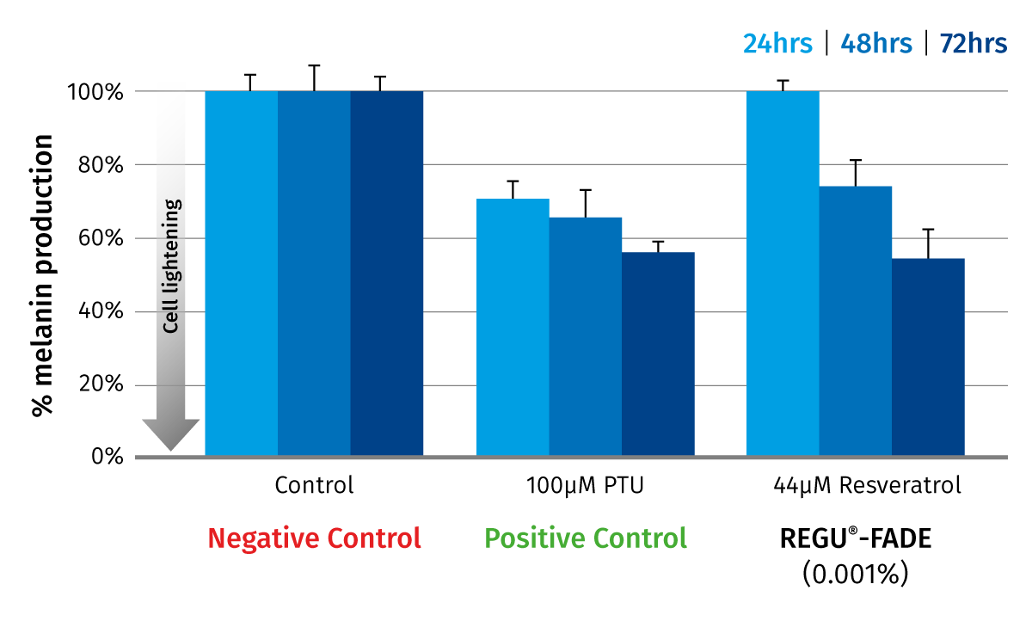
Efficacy: in vitro –
Melanin Assay in B16F10 Cells
0.001% REGU®-FADE reduces melanin production by 50% in B16F10 Melanin Assay

Slide 13
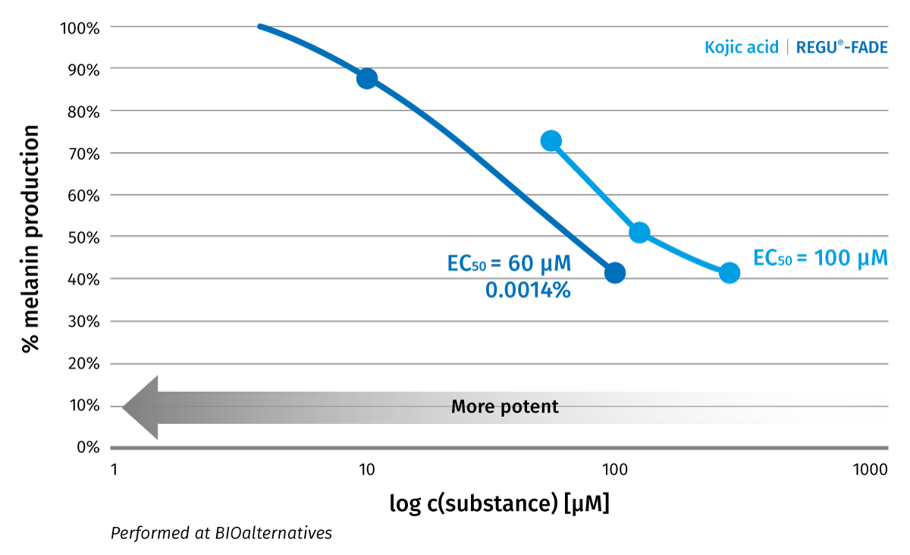
Efficacy: in vitro on
Normal Human Melanocytes
REGU®-FADE performes better than Kojic acid
Tissue
Normal Human Melanocytes
Treatment
REGU®-FADE
Kojic acid

Slide 14
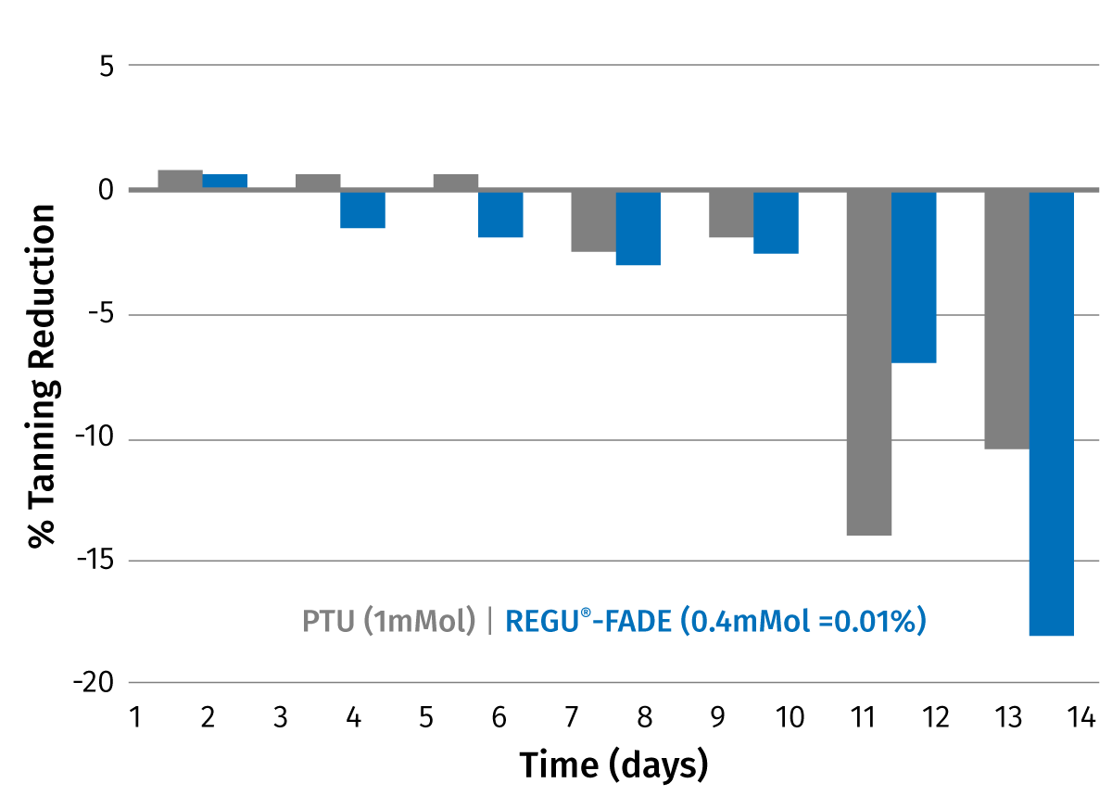


Efficacy: in vitro – Skin brightening in 3D-human reconstituted epidermis
REGU®-FADE performs excellent after 14 days in 3D - human reconstituted epidermis
before
after 14 days

Slide 15







Efficacy: in vivo – long term study
Double-blind placebo controlled study with 53 Indian volunteers performed by CLAIMS (India)
Study duration: 90 days
Per test area a cream (SPF ~10) + test substance (0.2% REGU®-FADE, 1% REGU®-FADE, 2% Ascorbylglucoside, Placebo) was applied twice daily on the volar forearms.
Colorimetric measurements were performed after 2 and 4 weeks, 2 and 3 months (ITA° value’s define the degree of skin pigmentation)

Slide 16
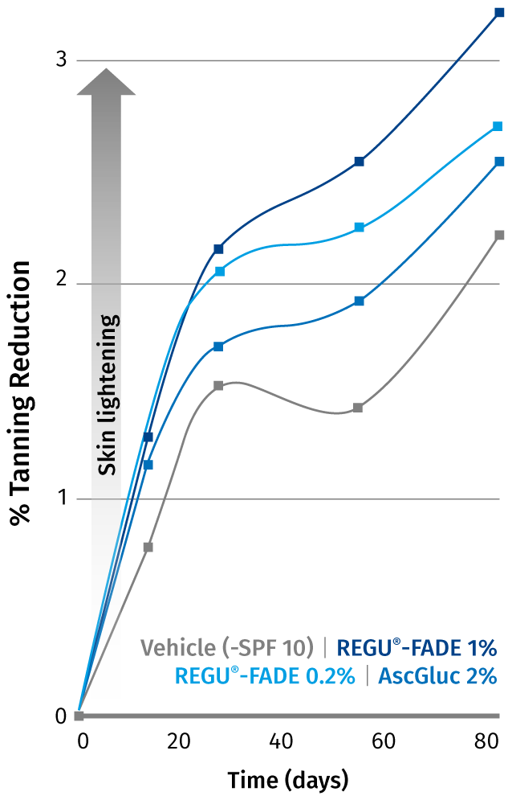
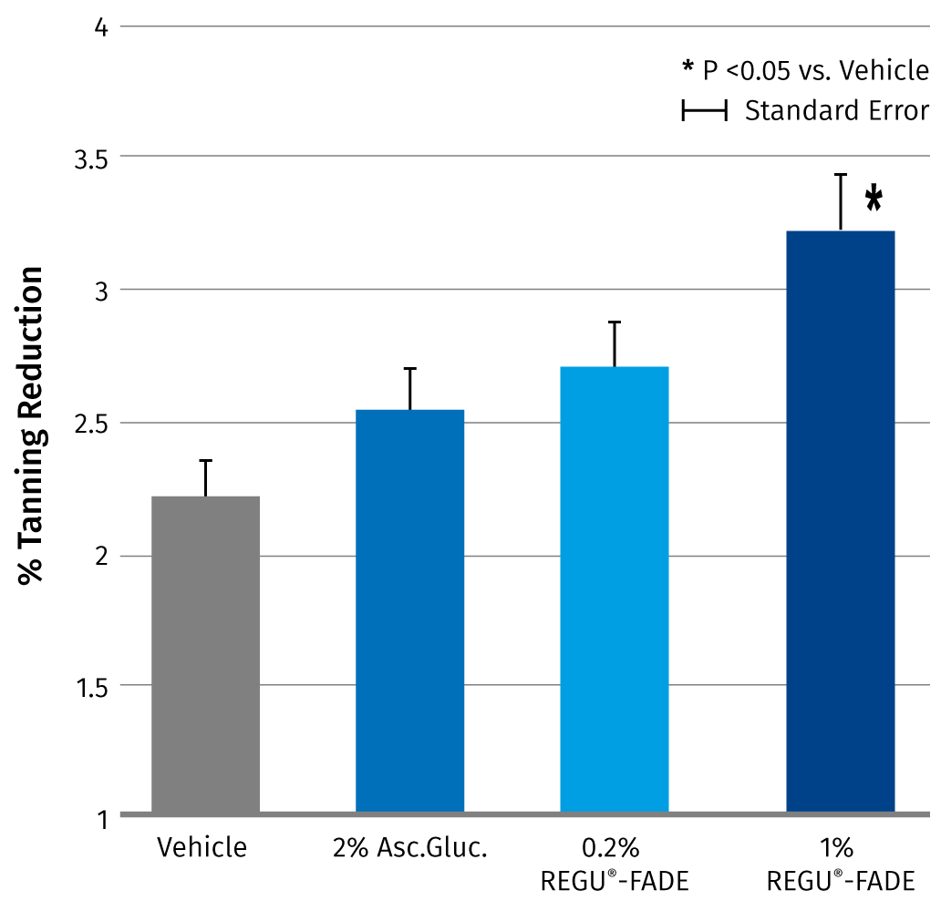
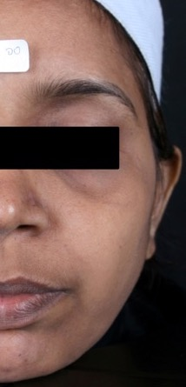
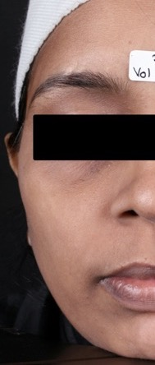
Efficacy: in vivo – long term study
D0
D90
Visible and significant skin brightening with
1% REGU®-FADE

Slide 17




REGU®-FADE: in vivo short term study
A double-blind placebo controlled study performed by proDERM (Germany) was performed with 12 Caucasian volunteers.
Per test area creams (1% REGU®-FADE, 2% Ascorbyl Glucoside, Placebo) were applied 3 times per day on their volar forearms
Study duration: 14 days
Colorimetric measurements were performed after 14 days

Slide 18
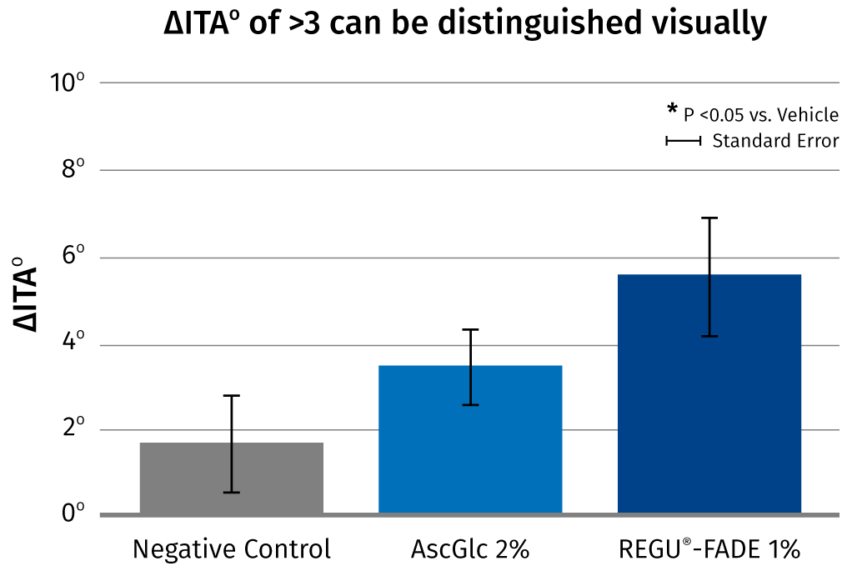
REGU®-FADE: in vivo short term study
Fast-acting:
Visible and significant results in only 2 weeks!

Slide 19
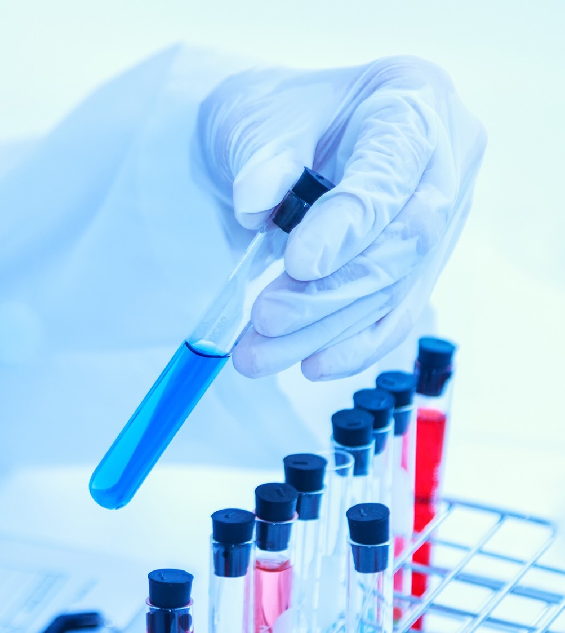
REGU®-FADE - Properties
General properties:
Off-white to light brown
Practically odorless
Preservative-free
Thermostable
Sensitive to light
Almost insoluble in water (23 mg/l)
and in lipophilic components
A broad range of suitable solubilizers for
REGU®-FADE was identified to produce stable formulations.*

Slide 20
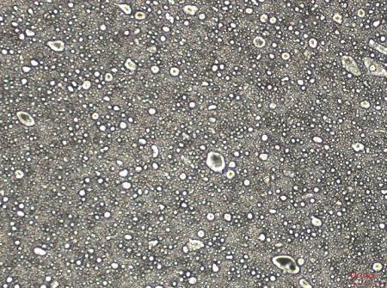
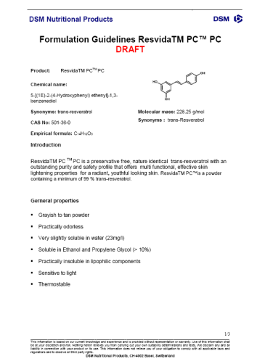
REGU®-FADE – Formulation Guidelines
Recommended solubilizers INCI
PEG/PPG-18/18 Dimethicone
Coceth-7 & PPG-1-PEG-9 Lauryl Glycol Ether & PEG-40 Hydrogenated Castor Oil (Eumulgin HPS)
PEG-40 Hydrogenated Castor Oil
PEG-120 Methyl Glucose Dioleate
PEG-20 Methyl Glucose Sesquistearate
Ceteareth-12
PEG-20 Stearate
PEG-30 Glyceryl Stearate
PEG-7 Glyceryl Cocoate
PPG-1-PEG-9 Lauryl Glycol Ether
No crystals were found
after three months storage at 5°C, RT, 43 °C with 1% REGU®-FADE.
Formulation Guidelines available

Slide 21

REGU®-FADE –
Formulation Guidelines
Cosmetic application
REGU®-FADE can be used for different kinds of products like O/W, W/O or Si/W formulations, toners, as well as in gel formulations
Skin brightening facial and body
care products
Anti-age spot creams and serums
Anti-aging skin care products for more even skin tone
Suggested concentration
Up to 1 % REGU®-FADE in cosmetic formulations
INCI name
Resveratrol

Slide 22
REGU®-FADE –
Formulation Guidelines
Additional information
Optimal pH range from 3 to 6.5 in formulations
Exposure of the final formulations to direct sun light should be avoided (use opaque packaging)
The addition of UV filters is recommended for day care products

Slide 23
REGU®-FADE
Intensive Skin Tone Corrector
Phase | Ingredients | INCI Name | % w/w
A | Imwitor 372 P Schuppen | Glyceryl Stearate Citrate | 2.00
 | Lanette 16 | Cetyl Alcohol | 1.00
 | Lipocire Na 10 Pastilles | Hydrogenated Coco Glycerides | 1.00
 | Finsolv TN | C12-15 Alkyl Benzoate | 4.00
 | Dow Corning 200 Fluid 100 cs | Dimethicone | 2.00
 | Tegosoft M | Isopropyl Myristate | 6.00
 | da-Tocopheryl Acetate | Tocopheryl Acetate | 0.20
B | Keltrol CG-T | Xanthan Gum | 0.15
 | Pemulen TR-1 | Acrylates/C10-30 Alkyl Acrylate Crosspolymer | 0.30
 | Water dem. | Aqua | 72.33
C | REGU®-FADE | Resveratrol | 1.00
 | Dow Corning 190 Surf. | PEG/PPG-18/18 Dimethicone | 4.00
 | 1,2-Propanediol | Propylene Glycol | 5.00
D | Preservative | q.s.
 | Triethanolamine (T.E.A.) | Triethanolamine | 0.22
Сontains
1% REGU®-FADE
Solubilizer:
4% PEG/PPG – 18/18 Dimethicone
Solvent:
5% Propylene Glycol
Example formulation with high content of REGU®-FADE without any cristal formation or discoloration after 3 months storage at RT, 4°C, and 43°C.
100250-301

Slide 24
REGU®-FADE
Multi-active Brightening Cream
Phase | Ingredients | INCI Name | % w/w
A | Isopropyl Myristate | Isopropyl Myristate | 2.00
 | Myritol 318 | Caprylic/Capric Triglyceride | 5.00
 | Fitoderm | Squalane | 1.50
 | Preservative | q.s.
 | Novemer EC-1 | Acrylates/Acrylamide Copolymer Mineral Oil & Polysorbate-85 | 1.00
B | D-PANTHENOL 75L | Panthenol | 2.00
 | Carbopol Ultrez 21 | Acrylates/C10-30 Alkyl Acrylate Crosspolymer | 0.20
 | Water dem. | Aqua | 86.40
C | Cremophor RH 40 | PEG-40 Hydrogenated Castor Oil | 1.00
 | REGU®-FADE | Resveratrol | 0.10
D | Triethanolamine (T.E.A) | Triethanolamine | 0.20
Сontains
0.1 % REGU®-FADE
+ 2.0 % Panthenol
Solubilizer:
1% PEG-40 Hydrogenated Castor Oil
Example formulation with high water content without any cristall formation or discoloration after 3 months storage at RT, 4°C, and 43°C.
100250-269

Slide 25
REGU®-FADE – Summary
The most effective solution for noticeably brighter skin
Visibly brighter skin in 2 weeks
Nature-identical pure trans-resveratrol
for more effectiveness and even skin brightening
Multi-target mechanism
Clinically proven in 2 studies
Broad range of supporting preclinical studies
Nature-identical pure resveratrol
With full safety documentation
Extensive formulation guidelines
Registered in China

Slide 26
Disclaimer
Copyright © 2020 DSM Nutritional Products, 4002 Basel, Switzerland.
www.dsm.com/personal-care. All rights reserved.
DSM has used diligent care to ensure that the information provided herein is accurate and up-to-date, however, DSM makes no representation or warranty, either expressly or implied, of the accuracy, reliability, or completeness thereof. The information provided herein contains scientific and product information for business to business use and does not constitute or provide scientific or medical advice, diagnosis or recommendation for treatment. Country or region-specific information should be considered when labeling or advertising to final consumer. In no event shall DSM be liable for any damages arising from or reliance upon, or use of, any information provided herein. The content of this document is subject to change without further notice. Please contact your local DSM representative for further details. All trademarks listed in this document are either (registered) trademarks of, or trademarks licensed by, the DSM group of companies in the Netherlands and/or other countries, unless explicitly stated otherwise.
Disclaimer Formulation Guideline
This information is for illustration purposes only and based upon our current knowledge and experience at the time of printing. We do not make any representation or warranty of any kind, express or implied, including merchantability or fitness for a particular use, with respect to such information or its application. Use of this information is at your discretion and risk. Nothing herein relieves you from carrying out your own suitability determinations and tests. You are responsible for observing all laws and regulations relevant to your products, uses or processes. We do not assume any liability in connection with your product and its use. The foregoing information and suggestions are also provided without warranty of non-infringement as to the intellectual property rights of third parties, and shall not be construed as any inducement to infringe the rights of third parties.

Slide 27

Back-up
REGU®-FADE

Slide 28
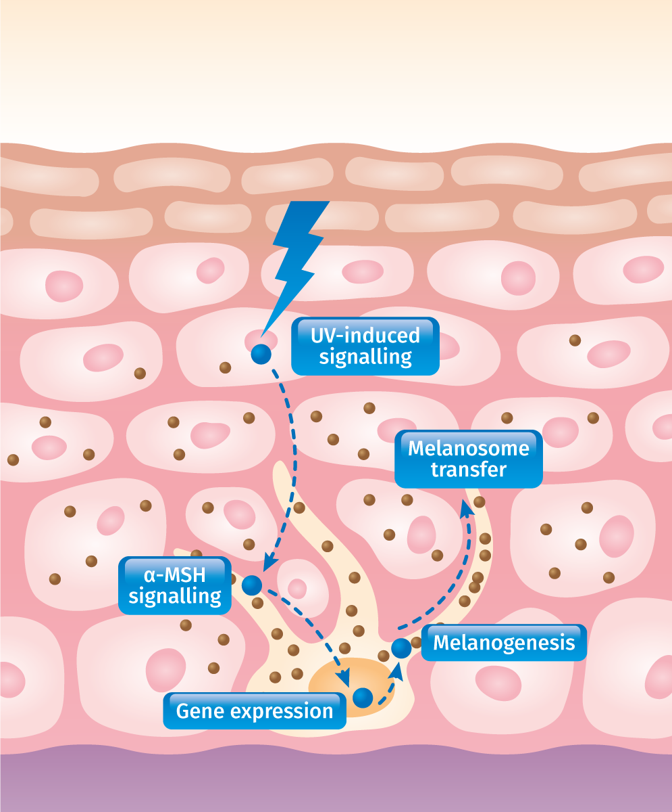
Safe Skin Brightening is Inhibition of Tanning
Melanocytes
part of the basal cell layer of the epidermis
form long, finger-like dendrites which reach to neighboring keratinocytes
create enzymes (e.g. tyrosinase) and the
amino acid tyrosine
Melanosome
is an organelle (specialized subunit within a cell) containing melanin
converts tyrosine into Eumelanin (brown – black) and Pheomelanin (yellow – red)
migrates upward into the dendrites and are taken up by keratinocytes
Effective skin brightening requires to attenuate the melanin production cascade at multiple points.

Slide 29

Resveratrol content in wines
Variety | mg/L
Pinot noir | 3.1
Cabernet sauvignon | 1.8
Cabernet franc | 2.0
White wines | 1.0
Creasy et al., 1998

Slide 30

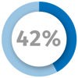


Resveratrol The French Paradox
French Paradox and Resveratrol associated since the late 90s.
The French exhibit an astonishing low incidence of heart disease (42% lower than Americans) while consuming one of the highest fat diets in the world.
They are also famous for their soft spot for good red wine in modest but regular quantities.
The regular consumption of red wine has been found to correlate with a reduced risk of coronary heart disease.

Slide 31

Melanogenesis associated genes
GENES | FUNCTIONS
SILV | melanosome marker on transcript and protein level
OCA2 | transmembrane transport
TYR | provides instructions for making tyrosinase
TYRP1 | stabilizes tyrosinase protein and modulates its catalytic activity
DCT | regulates eumelanin
MC1R | activated by α-msh controls the melanogenesis
MYO5A | melanosome transport
MREG | melanosome formation and transport
SLC24A5 | melanosome function and maturation
SLC45A2 | melanosome function
RAB27A | transfer of melanin to keratinocytes
KIT | stem cell factor receptor involves in the process of proliferation diferrentiation and activity of melanocytes triggers mitf mediated gene expression

Slide 32
Melanogenesis associated genes in hyperpigmentated skin
Melanogenesis associated genes: e.g. TYRP1 (tyrosinase-related protein 1), DCT (dopachrome tautomerase), Pmel-17 (SILV protein), MITF (microphthalmia-associated transcription factor) are all increased in actinic lentigos.
There is also a role for stem cell factor (SCF) in hyperpigmentation (solar lentigos in particular)
Latest Insights into Skin Hyperpigmentation - review
Jean-Paul Ortonne1 and Donald L. Bissett;
Journal of Investigative Dermatology Symposium Proceedings (2008) 13, 10–14; doi:10.1038/jidsymp.2008.7

Slide 33
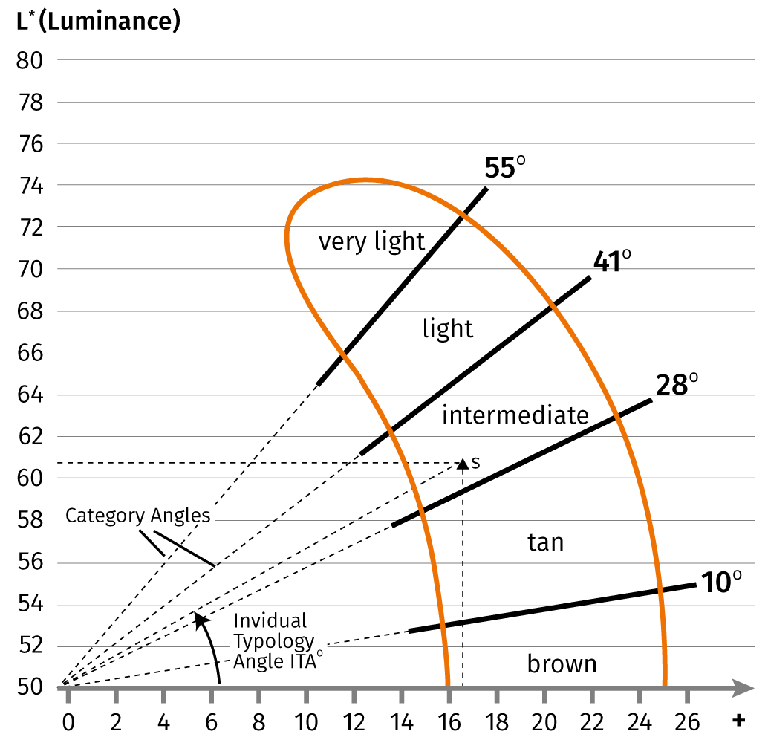
ITA°: Individual Typology Angle
(defines the degree of skin pigmentation)
SKIN COLOUR TYPING
CIE-L*a*b (1976) COLOUR SPACE
Plane L*⋀*b
(Chardon 1990)
Individual Typology Angle:
ITA°= (ArcTan((L*-50)/b*))x180/3.1415
(when ArcTan calculated in radians)
L: 55 a: 9.3 b: 28 | L: 55 a: 9.3 b: 10
ITA°= 12° 26°
L: Luminance (dark – light)
a: green to red spectrum
b: blue to yellow spectrum
The higher L parameter and the ITA are, the lighter the skin

Slide 34
Efficacy: performed by CLAIMS
(India) study formulation
PHASE | Ingredients | INCI Name | % w/w | Supplier
A | PARSOL® 1789 | Butyl Methoxydibenzoylmethane (Avobenzone; USAN) | 2.00 | 100288
 | PARSOL® 340 | Octocrylene (Octocrilene; USAN) | 6.00 | 100288
 | Imwitor 372 P Schuppen | Glyceryl Stearate Citrate | 2.00 | 100398
 | Lanette O | Cetearyl Alcohol | 1.50 | 100396
 | Lipocire Na 10 Pastilles | Hydrogenated Coco-Glycerides | 1.00 | 100413
 | REGU®-FADE | Resveratrol | 0.20 | 100288
 | Finsolv TN | C12-15 Alkyl Bezoate | 7.00 | 100472
 | Myritol PC | Propylene Glycol Dicaprylate/Dicaprate | 5.00 | 100396
 | d-alpha Tocopheryl Acetate | Tocopheryl Acetate | 0.20 | 100288
B | Keltrol CG-T | Xanthan Gum | 0.15 | 100400
 | Pemulen TR-1 | Acrylates/C10-30 Alkyl Acrylate Crosspolymer | 0.30 | 100435
 | Dow Corning 190 Surfactant | PEG/PPG-18/18 Dimethicone | 4.00 | 100404
 | 1,2-Propanediol | Propylene Glycol | 5.00 | 100134
 | Water dem. | Aqua | 62.63 | 0
D | Phenonip | Phenoxyethanol & Methylparaben & Ethylparaben & Butylparaben & Propylparaben & Isobutylparaben | 0.80 | 100394
 | Triethanolamine (T.E.A.) | Triethanolamine | 0.22 | 100134
 | Ethanol | Alcohol | 2.00 | 100230
100250-100/001

Slide 35
REGU®-FADE: performed by PRODERM
(GERMANY) study formulation
PHASE | Ingredients | INCI Name | % w/w | Supplier
A | Imwitor 372 P Schuppen | Glyceryl Stearate Citrate | 2.00 | 100398
 | Lanette O | Cetearyl Alcohol | 1.50 | 100396
 | Lipocire Na 10 Pastilles | Hydrogenated Coco-Glycerides | 1.00 | 100413
 | Finsolv TN | C12-15 Alkyl Benzoate | 7.00 | 100472
 | Myritol PC | Propylene Glycol Disaprylate/Dicaprate | 5.00 | 100396
 | d-alpha Tocopheryl Acetate | Tocopheryl Acetate | 0.20 | 100288
 | Tegosoft M | Isopropyl Myristate | 8.00 | 100415
B | Keltrol CG-T | Xanthan Gum | 0.15 | 100400
 | Pemulen TR-1 | Acrylates/C10-30 Alkyl Acrylate Crosspolymer | 0.30 | 100435
 | Water dem. | Aqua | 63.83 | 0
C | Dow Corning 190 Surfactant | PEG/PPG-18/18 Dimethicone | 4.00 | 100404
 | 1,2-Propanediol | Propylene Glycol | 5.00 | 100134
 | REGU®-FADE | Resveratrol | 1.00 | 100288
D | Phenonip | Phenoxyethanol & Methylparaben & Ethylparaben & Butylparaben & Propylparaben & Isobutylparaben | 0.80 | 100394
 | Triethanolamine (T.E.A.) | Triethanolamine | 0.22 | 100134
100250-187/001

