Slide 1


REGU® -SEB
Balances and mattifies oily skin to unveil a natural look
October 2020

Slide 2
Agenda
1
Consumer insights & market data
2
Oily skin - backstage
3
Oily skin – how to serve unmet consumer needs
4
REGU®-SEB – from oily to mattified skin
5
REGU®-SEB in a nutshell

Slide 3
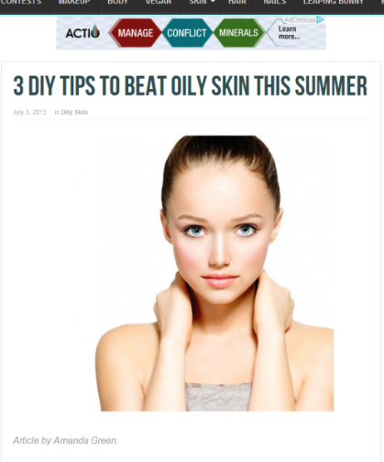
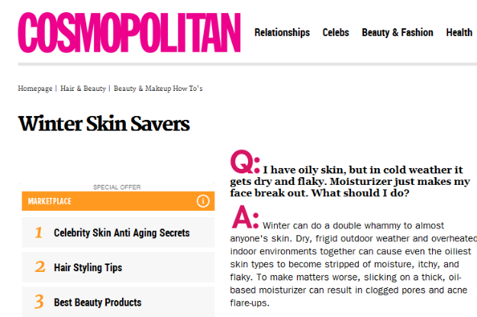
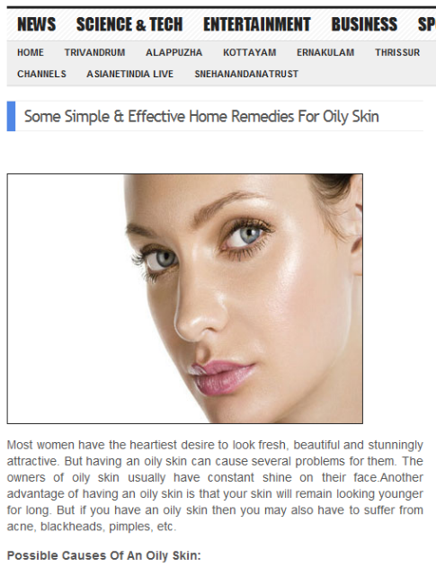
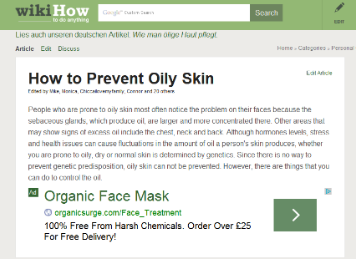
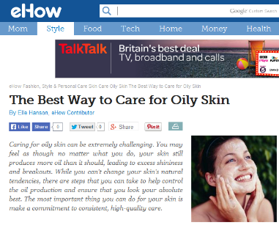
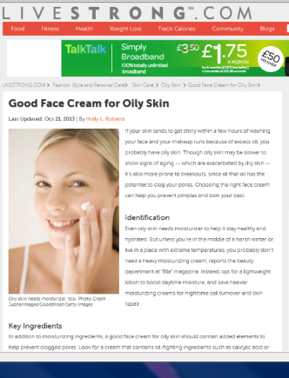
Oily skin – a bunch of questions, advises, and helplessness

Slide 4
Oily skin – not the easiest skin type
The characteristics
Endogeneous factors
Gene and hormone related
Exogeneous factors
Humidity, sun & hot weather
Lifestyle factors
Smog and stress
Insufficient skin care
Diet
Open and larger pores, particularly down the T-Zone
Shiny looking skin
Greasy experience
Tendency of irritated skin, acne, blemishes, and blackheads
Mattifiying ingredients and formulations with pore-refining properties to control the oiliness in skin
Gentle exfoliating ingredients to remove dead cells which may clog pores and cause blackheads
Care for impure skin
The causes
The proposed treatments
Notes:
Publications on the relation between oily skin and diet, stress, or climate:
Sakuma T.; Oily skin: an overview; Skin Pharmacol Physiol (2012);25:227–235.
Bowe W.; Diet and acne; J. Am. Acad. Dermatol. (2009); vol 63, number 1.
Burris J.; Acne: The Role of Medical Nutrition Therapy; J Acad Nutr Diet. (2013);113:416-430.
Zahra S.; Prevalence, Severity, and Severity Risk Factors of Acne in High School Pupils; Journal of Investigative Dermatology (2009) 129, 2136–2141.

Slide 5
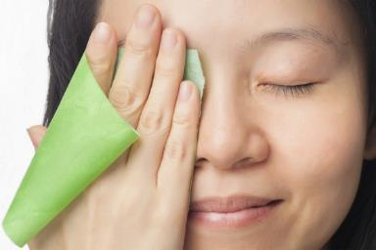
Oily skin – but not only a burden
It is said, that people with oily skin appear to age slower than
those with dry skin.
But this doesn’t provide any consolation for what people feel when they have oily skin.
Outbreaks can happen at any time and anywhere, and normally on the go, resulting in ‘midday makeup meltdown’. This leaves women feeling dirty, ugly and more importantly worried that people will think them to be messy, unkempt and unprofessional.
The most important task for them is to keep the shine under control and regaining some sense of normality!

Slide 6

“I don't have any option than to deal
with my oily skin, because I worry what people will think of me, but many of the treatments I use have irritating and drying out properties. My concern is that I more damage my skin than nourishing it
in a gentle and safe way.”
“I have learnt lots of ways of dealing with oily skin, because I’ve been living with it for years. But I’m always worried that I’ll be caught off guard with nothing I can do.”
Susan, 32 years old, living in Berlin
Characteristic of her skin:
Very oily, acne prone, greasy appearance
Her skin routine:
Washes her face several times per day to get rid of the oily appearance. She uses a combination of wash lotion, toner and day cream with less moisturizing properties and ingredients that prevent her from getting spot and blackheads.
Joy, 28 years old, living in Bangkok
Characteristic of her skin:
Sensitive, oily skin, porous surface
Her skin routine:
Uses in the morning and in the evening wash lotions and during the day cosmetic tissues against oily skin. Applies a serum and a mattifying powder to control the oiliness of her skin.
Page
5

Slide 7

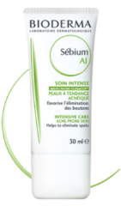
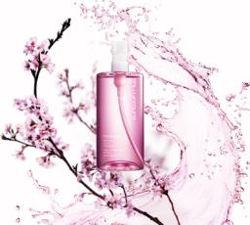
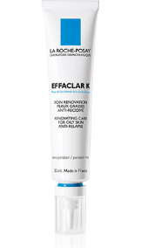
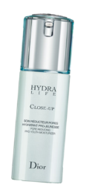
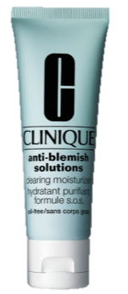
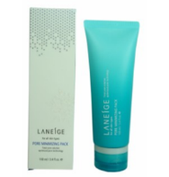




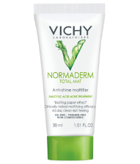
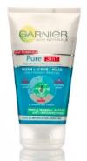
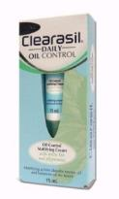
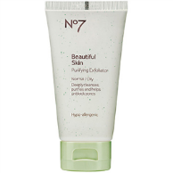
Current oily skin strategies
Anti-imperfection
Pore refining
REGU®-SEB gently unveils a natural mattifying look
Purifying / Cleansing
Mattifying

Slide 8
Agenda
1
Consumer insights & market data
2
Oily skin backstage
3
Oily skin – how to serve unmet consumer needs
4
REGU®-SEB – from oily to glow skin
5
REGU®-SEB in a nutshell

Slide 9

Oily skin -
What happens behind the stage?
Page

Slide 10
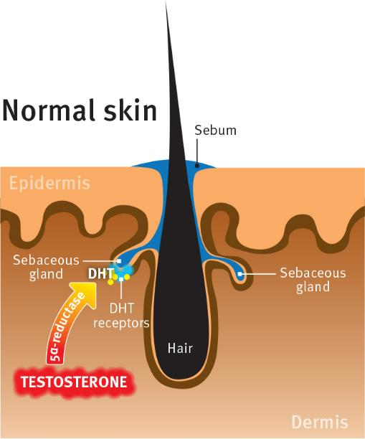
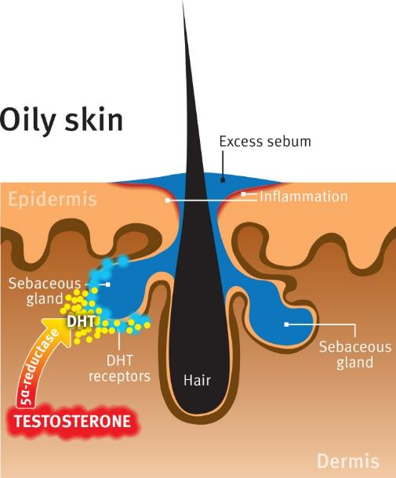
Oily skin
Increased 5α-reductase leads to excess sebum
Notes:
“Normal skin” illustration on the left:
The sebum is an oily mixture of triglycerides, wax esters, squalene, and free fatty acids, which provide lubrication for the skin, and thus prevents it from drying out and protects it from friction.
The sebum production is regulated in the sebaceous glands by androgens hormones such as testosterone and dihydrotestosterone (DHT): Testosterone is converted by the enzyme 5α-reductase into DHT, which binds on the DHT receptors, located at the surface of the sebaceous glands.
“Oily skin” illustration on the right:
Seborrhoea (excessive sebum production) results from an increased action of the androgens hormones on the skin.
Increased DHT levels lead to enhanced sebum synthesis and subsequently to oily skin. The sebaceous glands are enlarging. Oily skin is subject to inflammation.

Slide 11
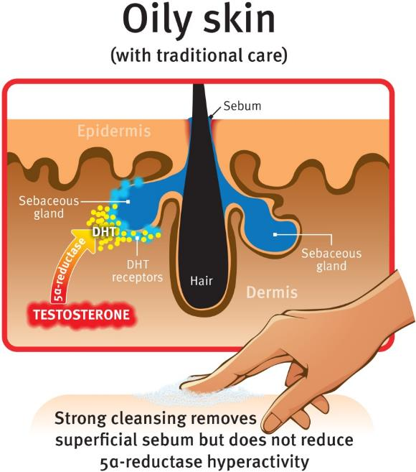
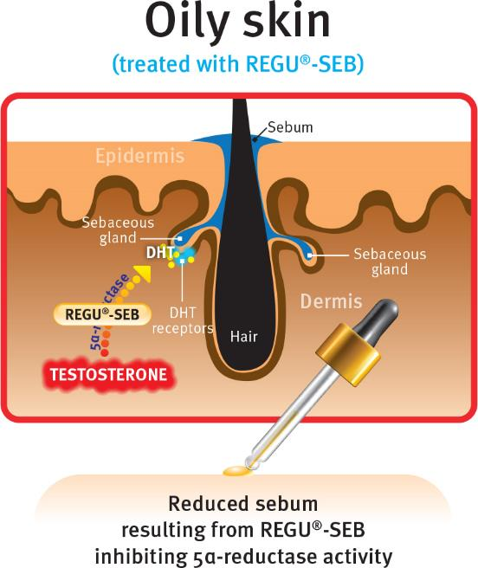
Inhibition of 5α-reductase
As a key step to rebalance skin oiliness
Notes:
A quite common behavior to care oily skin is: CLEAN – CLEAN – CLEAN!
No matter if oily skin gets cleaned with soaps or alcoholic tonics, a feeling of clean skin is immediate, however:
Oily skin has a tendency to be irritated, and using soaps or alcoholic tonics will further harm the skin barrier balance, thus enhancing local inflammation / irritation;
The biological origin of the excessive sebum production is not treated: this brings the skin to produce even more sebum.
Thanks to its lipophilicity, REGU®-SEB acts exactly where needed at the surface of the sebaceous glands by reducing the activity of the 5α-reductase Type 1 and of the DHT receptors.
This leads to a long-lasting, natural, mattifying effect.

Slide 12
Agenda
1
Consumer insights & market data
2
Oily skin backstage
3
Oily skin – how to serve unmet consumer needs
4
REGU®-SEB – from oily to mattified skin
5
REGU®-SEB in a nutshell

Slide 13
Oily skin –
But what about combat oily skin with oil?
Page
12

Slide 14


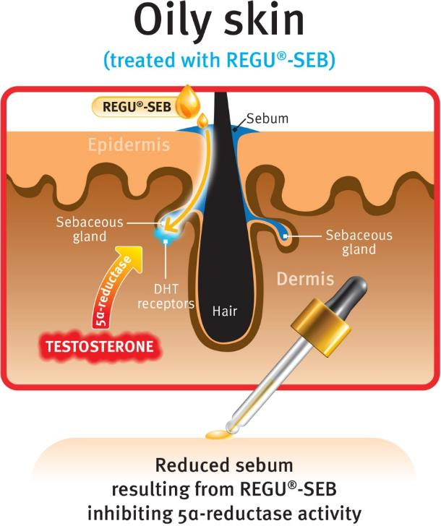
Inspired by TCM* philosophy
Like the TCM*
exhorting the fighting of
poison with poison, the “good” oils of REGU®-SEB are the best way for removing excess of sebum
Better affinity, increased availability
Natural efficacy
Rebalanced skin mantle
Gentle & safe treatment
Long-lasting effect
*TCM= Traditional Chinese Medecine

Slide 15
Agenda
1
Consumer insights & market data
2
Oily skin backstage
3
Oily skin – how to serve unmet consumer needs
4
REGU®-SEB – from oily to mattified skin
5
REGU®-SEB in a nutshell

Slide 16
REGU®-SEB
Balances and mattifies oily skin
to unveil a natural look
The magic oil-based elixir
Saw Palmetto Extract
Sesame Seed Oil
Argan Oil
From oily to
mattified skin
Page
15

Slide 17
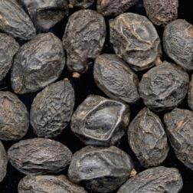


Saw Palmetto Extract
Extract from the fruit of Serenoa repens, originally growing in the Southern United States, where it is one of the most common palm.
Used in traditional Native Americans medicine and was one of the most important food for people in the early centuries (specially the Indians).
Believed for topical use in formulations for greasy skin with acneic aspects due to its unique phytosterol (Δ5 sterols) and fatty acids profile.^{1,2}
¹ Raynaud JP, Cousse H, Martin PM. 2002 Inhibition of type 1 and type 2 5alpha-reductase activity by free fatt acids, active ingredients of Permixon. J Steroid Biochem Mol Biol. Oct;82(2-3):233-9.
² Saw Palmetto: The US Pharmacopeial Convention
Notes:
Saw Palmetto (ENG)
Sägeplame (D)
Palmier nain (FR)
Palma enana americana (SP)
Palma nana (or palmetto) (IT)
According to the USDA (natural resources conservation service), saw palmetto refers to Serenoa repens which has different synonyms : Serenoa serrulata, Brahea serrulata, Corypha repens, Sabal serrulata, Chamaerops serrulata…

Slide 18
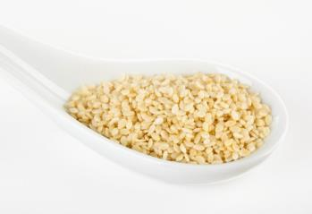

II. Sesame Seed Oil
Sesame oil is acquired from the Sesamum indicum plant and is known as one of the eldest oil based plant.
Enjoys a well reputation in China, Japan, and Arabian countries on food basis.
One traditional element in the Ayurveda treatment.
Rich in Lignans, which have an impact on DHT flow.¹
Contains Phytosterol (Δ-7 stigmasterol & Δ-5 sterols) which rejuvenates skin barrier and can help to keep the skin hydrated.²
High Vitamin E content with antioxidant properties.
Anti-inflammatory properties.
¹Schöttner M, Spiteller G, Gansser D. 1998 Lignans interfering with 5 alpha-dihydrotestosterone binding to human sex hormone-binding globulin. J Nat Prod. 61(1):119-21
² Puglia C, Bonina F, in vivo spectrophotometric evaluation of skin barrier recovery after topical application of soybean phytosterols. J. Cosmet. Sci., 59, 217-224 (May/June 2008)

Slide 19
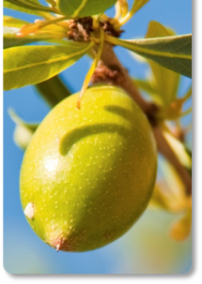
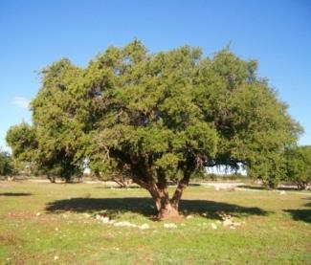
III. Argan Oil
Endemic tree from south-west Morocco.
Traditional Moroccan beauty elixir.
Topical applications for skin, hair, and nail care.
Dietary use today and in traditional medicine for its health properties.
Outstanding composition of Unsaturated fatty acids, Squalene, Phenolic acid, and Tocopherols. ¹
Contains rare phytosterols -Δ7 sterols- used as a remedy for acne vulgaris in Moroccan folk medicine.
¹ Hanae El Monfalouti, Therapeutic potential of argan oil, Journal of Pharmacy and Pharmacology, 2010, 62:1669-1675

Slide 20

5 ingredients specifically taking up the challenge to gently & visibly treat oily skin
Phytosterols
Helps to recover skin barrier!
Squalene
Provides a non oily pleasant
skin feeling to soften and
protect the skin!
Lignans
Impact on DHT flow!
Unsaturated fatty acids
Helps to prevent and reduce
skin inflammation!
Phytosterols
Inhibit the activity of the testosterone converting enzyme 5α-reductase!
Tocopherols
Provide strong anti-oxidant properties!

Slide 21
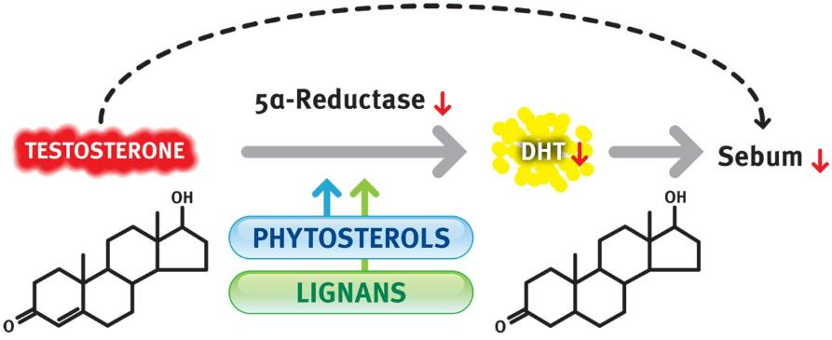
The spot light centers on
Phytosterols & Lignans
Sebum production is regulated through the activity of the enzyme 5α-reductase which converts testosterone into the biologically active form dihydrotestosterone (DHT).
Phytosterols and Lignans of Saw Palmetto and Sesame have been shown to inhibit the activity of the testosterone converting enzyme 5α-reductase
¹Voegeli R. et al. 2007, 5alpha-reductase and its inhibitors, in Acne and its Therapies page 167 by Webster, G. F. and A. V. Rawlings (Editors): Informa Healthcare
²Hirata N, Tokunaga M, Naruto S, Iinuma M, Matsuda H. 2007, Testosterone 5alpha-reductase inhibitory active constituents of Piper nigrum leaf. Biol Pharm Bull. 30(12):2402-5
Notes:
5α-Reductase Typ 1

Slide 22
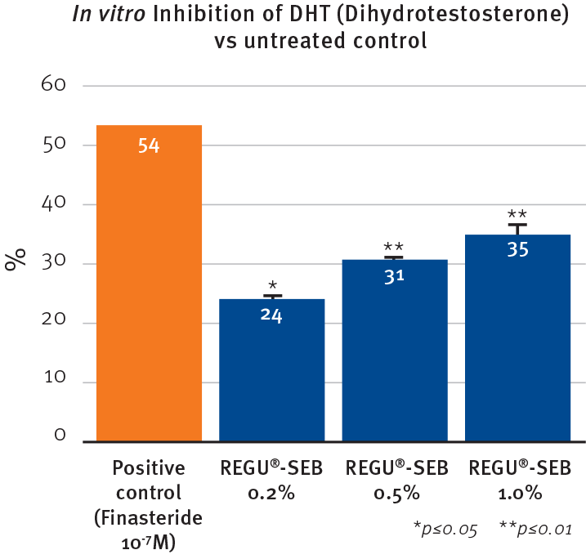
REGU®-SEB in vitro
Up to 35% DHT synthesis reduction
Study Design
Reconstructed human epidermis SkinEthic®
REGU®-SEB vs. finasteride (positive control)
Measurement of DHT level in the skin
Values calculated against untreated control
Notes:
The aim of this study was to assess the effect of REGU®-SEB on the metabolism of testosterone in reconstructed human epidermis (SkinEthic®).
It is known that the 5α-reductase enzyme transforms the testosterone into DHT (5-dihydrotestosterone).
Assay:
The epidermal tissues were cultivated for 24h
Adding of REGU®-SEB or finasteride (positive control, well known for the treatment of baldness)
Adding of labelled testosterone solution on the stratum corneum of each epidermis
After 24h, collection of the medium underneath the tissues for analysis (Analysis: How much of the testosterone, that passed through the epidermis was converted to DHT)
Results:
After 24h of culture, the degree of testosterone metabolism was important for the untreated controls (baseline, maximum conversion of T into DHT).
Finasteride at 10⁻⁷M induced a clear inhibition of the transformation of testosterone into DHT.
REGU®-SEB at 0.2%, 0.5%, and 1% significantly reduced the production of DHT from testosterone by respectively 24%, 31%, and 35%.
Remark: the in vitro test provided the quantity of DHT that was converted from Testosterone in the skin. For the graph we first calculated the difference between the DHT amount measured with the active and with the control. Then we transformed this difference of DHT amount into a DHT inhibition value (100-DHT quantity). That’s why the untreated control is not shown on the graph. The positive control shows that the test runs correctly.

Slide 23
REGU®-SEB in vivo
Visible efficacy after 4 weeks
Study Design
20 male & female volunteers, 17-50 years old, with oily or combined skin
Application twice daily during 4 weeks
2% REGU®-SEB in a cream-gel
Parameters: Instrumental skin bioengineering
Clinical assessment
Self-evaluation questionnaire
Source:
H. Dobrev, MD, PhD; Medical University Hospital
Department of Dermatology and Venereology
Skin Bioengineering Laboratory

Slide 24
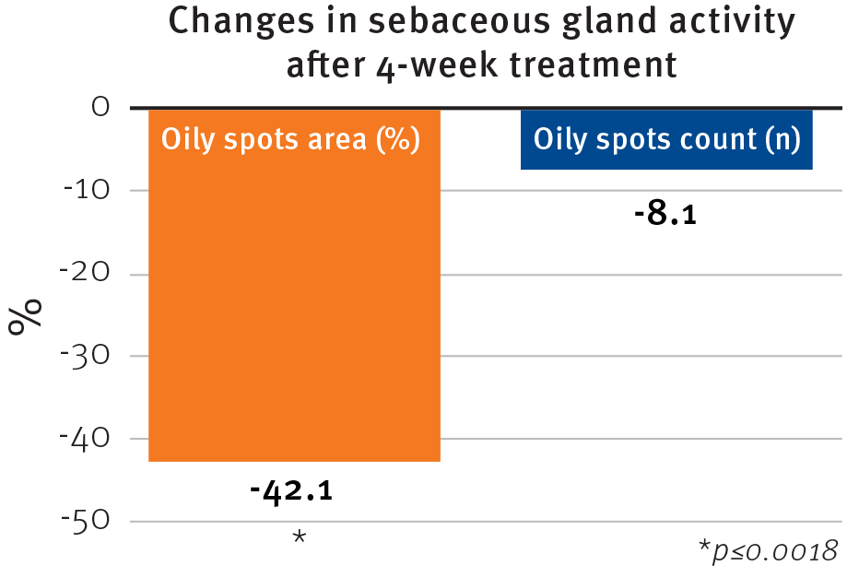
REGU®-SEB in vivo
Decreases the oily spots surface by 42%
Instrumental skin bioengineering
Devices
Sebufix® F16 foils and Visioscope® (Courage & Khazaka)
Method
Application of the foils during 30s on the skin
Evaluation of the foils by Visioscope®

Slide 25
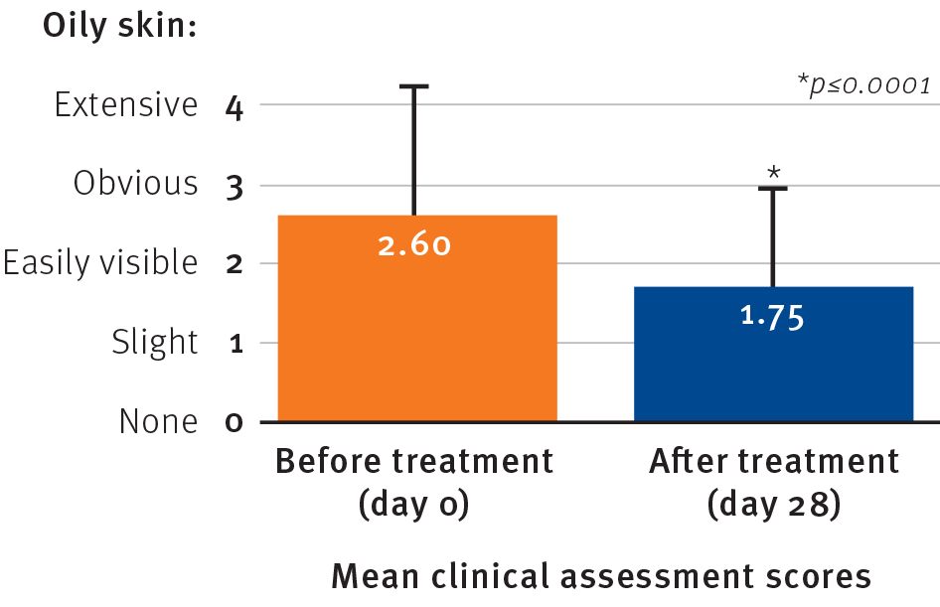
REGU®-SEB in vivo
Decreases the severity of oily skin condition by 33%
Clinical assessment

Slide 26
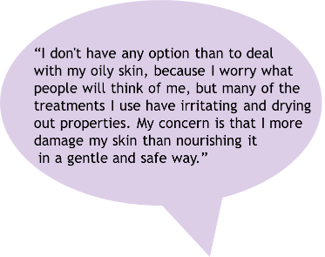
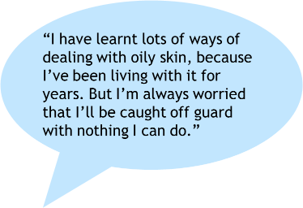
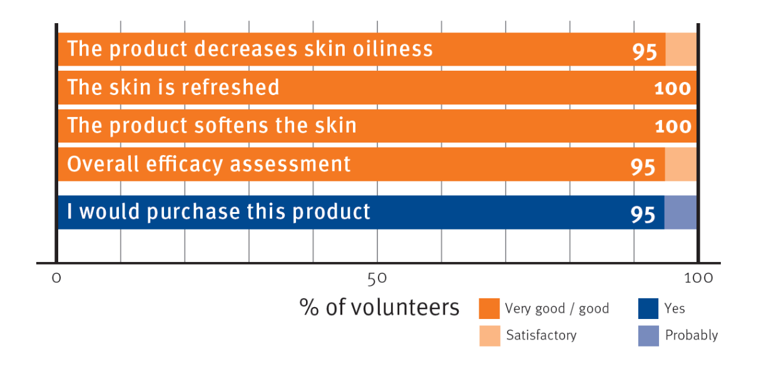

REGU®-SEB in vivo
Excellent consumer acceptance and visible efficacy
Self-evaluation questionnaire
Visible release for consumers afflicted by oily skin

Slide 27
Agenda
1
Consumer insights & market data
2
Oily skin backstage
3
Oily skin – how to serve unmet consumer needs
4
REGU®-SEB – from oily to mattified skin
5
REGU®-SEB in a nutshell

Slide 28

REGU®-SEB
Regulatory Status
China Status:
IECSC listed (Chemical notification) ✓
IECIC listing (Cosmetic ingredient registration) ✓
Chinese name ✓
INCI Name (active): Argania spinosa Kernel Oil, Sesamum indicum (Sesame) Seed Oil, Serenoa serrulata Fruit Extract
Suggested concentration: 1-5% REGU®-SEB

Slide 29


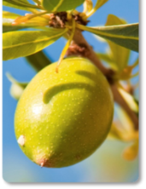
REGU®-SEB
in a nutshell
Visibly rebalances skin oiliness within 4 weeks
Unique multi-targeted activity
Visible efficacy reported by 95% of the volunteers
Best-in-class oil elixir to gently combat excess oil production
Leads to a smooth, mattifying, and natural look
Notes:
Unique multi-targeted activity:
Inhibition of 5α-reductase (by lignans; see publication: Hirata N_Testosterone 5alpha-reductase inhibitory active constituents of Piper nigrum leaf_2007)
Inhibition of DHT receptors (by phytosterols; see publication:
Inhibition of sebaceous gland growth (by lignans; see publication: Azrad M_Flaxseed-derived enterolactone is inversely associated with tumor cell proliferation in men with localized prostate cancer_2013)

Slide 30





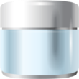
Application concepts featuring REGU®-SEB
Mattifying & moisturizing cream
(with PENTAVITIN®)
Intense Care for impure skin
(with NIACINAMIDE PC)
Even smooth skin cream
(with SYN®-COLL)
Luminous skin lotion
(with PEPHA®-CTIVE)
Mattifying & lift up serum
(with PEPHA®-TIGHT & VALVANCE™ Touch150)
Long-lasting make up
(with VALVANCE™ Touch 150 & Look 100)
3 minutes “on-the-go” mask for oily skin
(with STIMU®-TEX AS)
Notes:
Long-lasting make up: 1.5% Touch 150 for mattifying effect and 1.5% Look 100 for visible skin refinement.

Slide 31
Disclaimer
Copyright © 2021 DSM Nutritional Products, 4002 Basel, Switzerland.
www.dsm.com/personal-care. All rights reserved.
Although DSM has used diligent care to ensure that the information provided herein is accurate and up to date, DSM makes no representation or warranty of the accuracy, reliability, or completeness of the information. This presentation only contains scientific and technical information for business to business use. Country or region-specific information should also be considered when labeling or advertising to final consumers. This publication does not constitute or provide scientific or medical advice, diagnosis, or treatment and is distributed without warranty of any kind, either expressly or implied. In no event shall DSM be liable for any damages arising from the reader’s reliance upon, or use of, these materials. The reader shall be solely responsible for any interpretation or use of the material contained herein. The content of this document is subject to change without further notice. Please contact your local DSM representative for more details. All trademarks listed in this brochure are either registered trademarks or trademarks of DSM in The Netherlands and/or other countries unless explicitly otherwise stated.

Slide 32

Back up

Slide 33
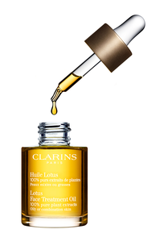
Listen to some voices out of the market
“I have oily, acne-prone skin and was completely skeptical about putting oil on it, in common with many reviewers below. (..)
I have noticed an improvement in the quality of my skin
(not in terms of red marks) when it comes to smaller pores and a face that stays matte for longer in the daytime. (..)
Don't be put off by the fact it's an oil and you have oily
skin – this is lovely stuff.”
Naturally astringent for Oily or Combination Skin. 100% pure plant extracts. Clarins’ exclusive blend of Rosemary, Geranium and Lotus extracts purifies, tightens pores and refines the skin texture. Hazelnut Oil softens, soothes and seals in moisture to prevent fine lines.
“Adore this oil. I have combo dehydrated skin with a history of horrendous hormonal acne. (..)Beautiful and heavenly- two drops applied after serum and before moisturizer and my skin is balanced, pores reduced and for the first time in my life I glow rather than shine.”(..)
“
“I am so in love with this oil! I never thought my combination-oily skin can tolerate treatment oils so very well. Works wonders for my acne.. I have 2 big acne on my forehead previously and after 2 days mixing this oil with my toner, my acne becomes less reddish and smaller in size..no kiddin.”(..)
(..) “From my experience, ANY oil makes oily skin less oily, even your kitchen olive oil is better than drying AHA/BHA treatments (those made my skin so dry and flaky on the outside, which caused oil glands to produce huge amounts of oil that clogs the pores - perfect environment for zits).”(…)

Slide 34
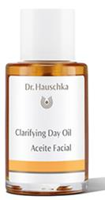
Listen to some voices out of the market
Clarifying Day Oil is a fast-absorbing daily moisturizer that balances excessive oiliness, refines the appearance of pores and reduces the appearance of blemishes for a calm, beautiful complexion.
“The ONLY product I've tried that actually regulates my oiliness. I find it a bit pricey, but am willing to pay for something that gets results.”(..)
“I really like this oil. It works as it says and is really effective for balancing oil on combo or oily skin. It's surprising, because most oils make my face greasy.” (..)
(..)”An esthetician recommended this and at first I thought 'the last thing I want on my face is more oil but it did work! Just 2 drops in the morning did the trick. It really controlled the excess oil and moisturized the dry areas.(…)”

Slide 35
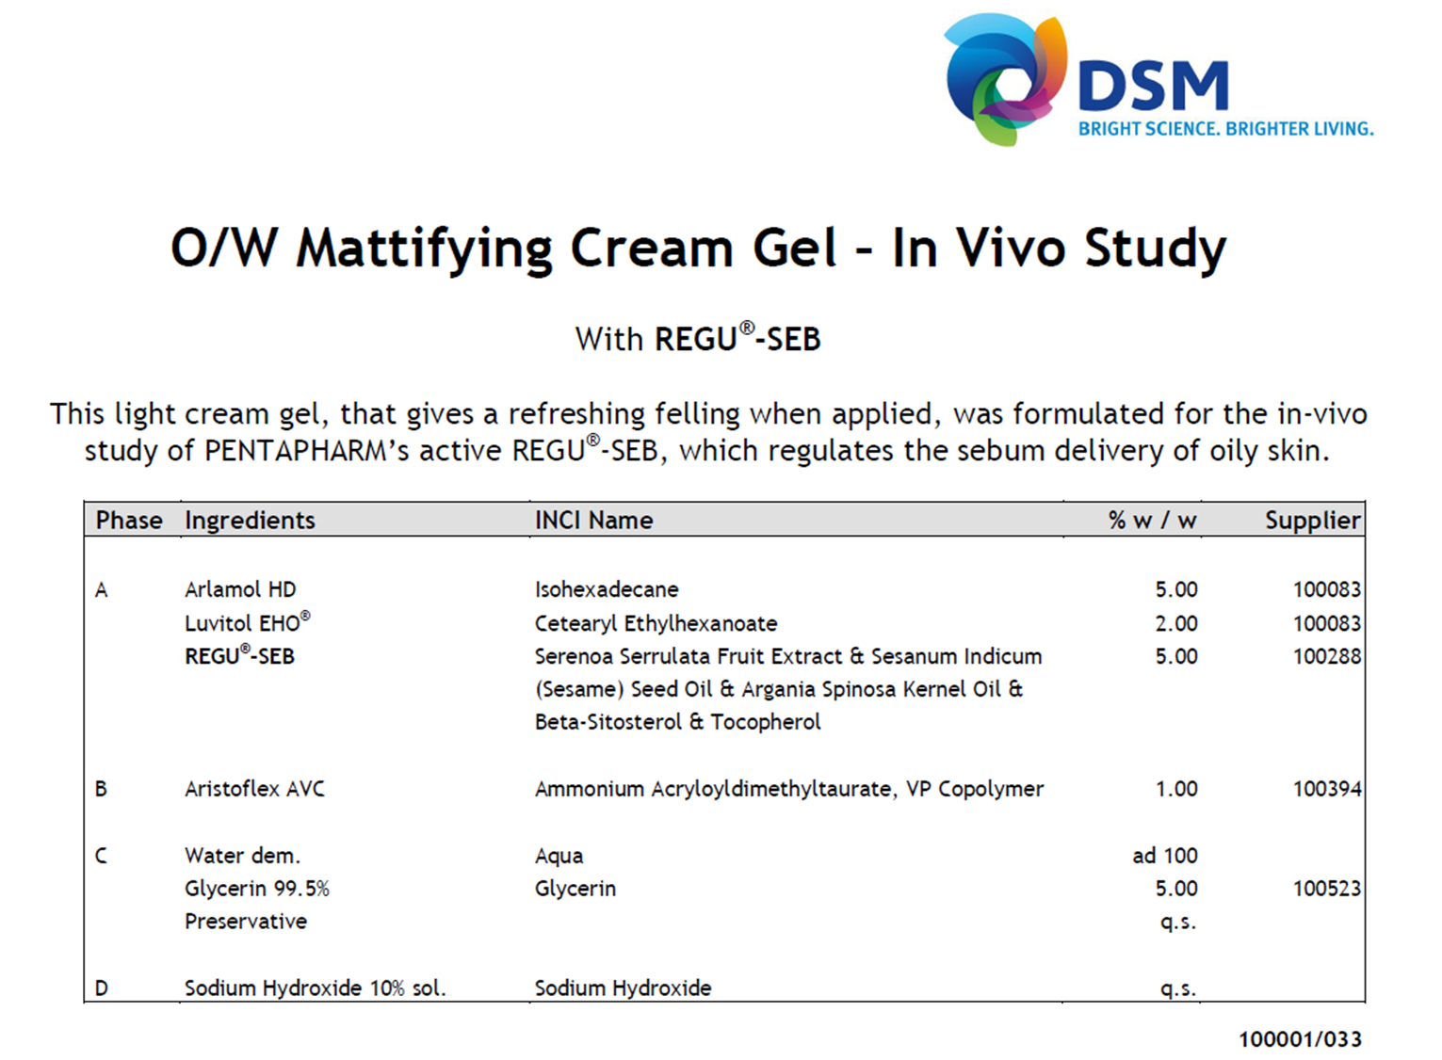

Slide 36
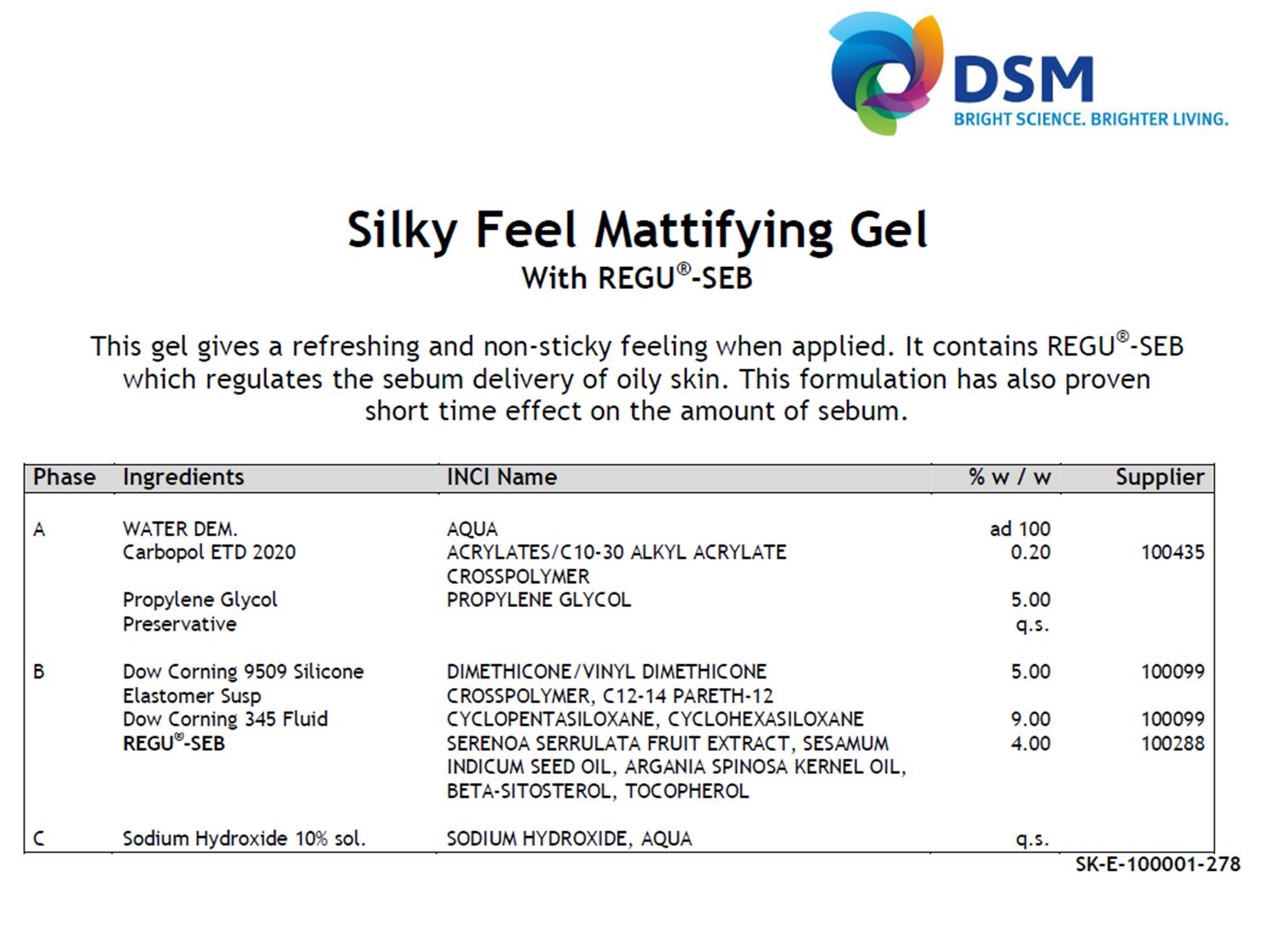

Slide 37
Disclaimer for guide formulations
“This information is for illustration purposes only and based upon our current knowledge and experience at the time of printing. We do not make any representation or warranty of any kind, express or implied, including merchantability or fitness for a particular use, with respect to such information or its application. Use of this information is at your discretion and risk. Nothing herein relieves you from carrying out your own suitability determinations and tests. You are responsible for observing all laws and regulations relevant to your products, uses or processes. We do not assume any liability in connection with your product and its use. The foregoing information and suggestions are also provided without warranty of non-infringement as to the intellectual property rights of third parties, and shall not be construed as any inducement to infringe the rights of third parties.”

Slide 38
REGU®-SEB in vivo
Visible efficacy after 3 months
Study Design
10 male volunteers, 19-40 years old, with seborrhoic skin condition
Application twice daily during 90 days
5% REGU®-SEB in a cream-gel
Parameters: Dermatologists assessments
Self-evaluation questionnaire

Slide 39
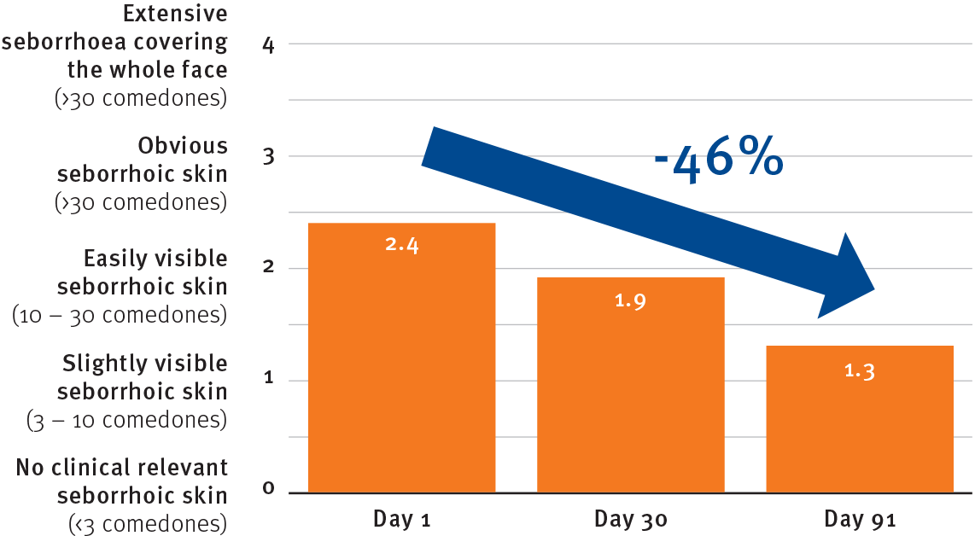
REGU®-SEB in vivo
Decreases the severity of seborrhoic skin by 46%
Dermatologists assessments

Slide 40
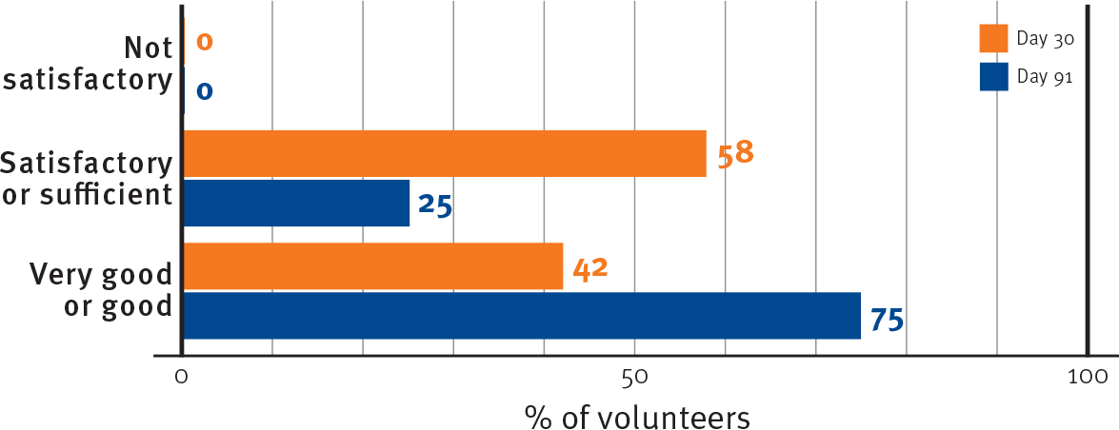
REGU®-SEB in vivo
Visible efficacy reported by 75% of the volunteers
Self-evaluation questionnaire

Slide 41


