Slide 1


REGU® -SLIM
The ideal method to re-shape and smooth your body
October 2020

Slide 2

Agenda
The market
The product
Claim substantiation
Cosmetic use
Page
1

Slide 3


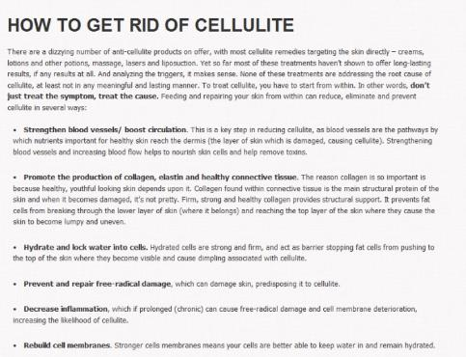


Advice and talks around the best effective way to shape the body
Notes:
Vogue, Issue April, 2012
Vogue, issue July, 2010
http://www.vogue.co.uk/blogs/david-gandy/2010/07/21/the-perfect-body
http://from-fat-to-fit-me.tumblr.com/post/81371910317
http://www.superskinnyme.com/how-to-get-rid-of-cellulite-slim-legs.html

Slide 4
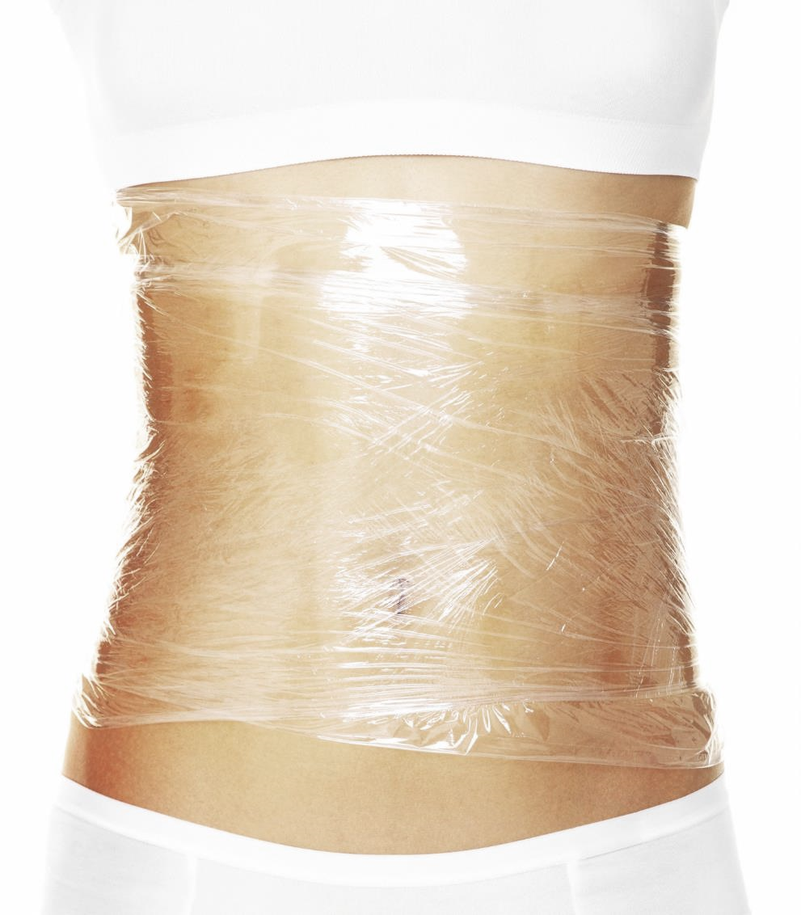
Many women are critical with their body appearance
“Among women over 18 looking at themselves in the mirror, research indicates that at least 80% are unhappy with what they see.”
“Research confirms what most of us already know: the main focus of dissatisfaction for most women looking in the mirror is the size and shape of their bodies, particularly their hips, waists, and thighs.”
Page
Source SIRC, Katie Fox, 1997: Mirror, mirror
A summary of research findings on body image
Figures highlighted in red from DSM
Notes:
http://www.sirc.org/publik/mirror.html
Kate Fox, 1997

Slide 5
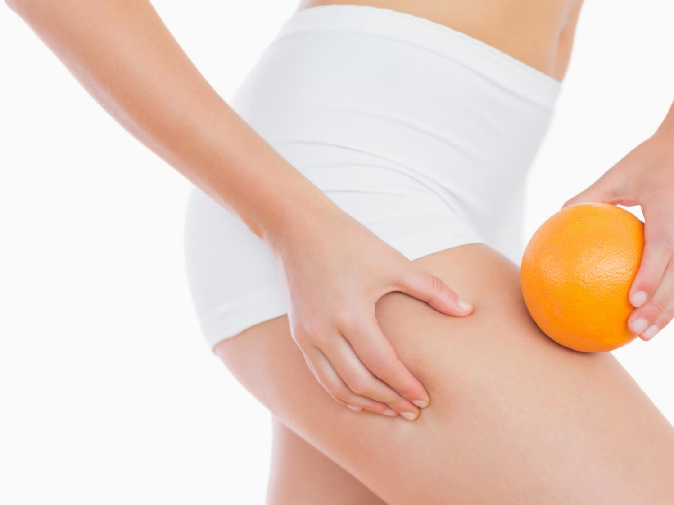

They are sensitive to their bodies specially when they observe visibly symptoms such as cellulite, also known as orange peel skin
“I would love to have a product that gives me confidence in my fight against orange peel skin.
My dream would be a product, that provides my body with an even and smooth surface to relieve myself from the pressure of being perfect.”
Page
Notes:
“You can not imagine, how frustrated and disappointed I am!
I do sports on a regular basis, I try to avoid food that does not support a great and healthy appearance of my skin.
I tried every new product that has been launched in the last three years: But still, by looking into the mirror, I see NO, NO single improvement at all. I would love to have a product that supports me and gives me confidence in my fight against orange peel skin. A product, that provides my body with an even and smooth surface to relieve myself from the pressure of being perfect.”

Slide 6
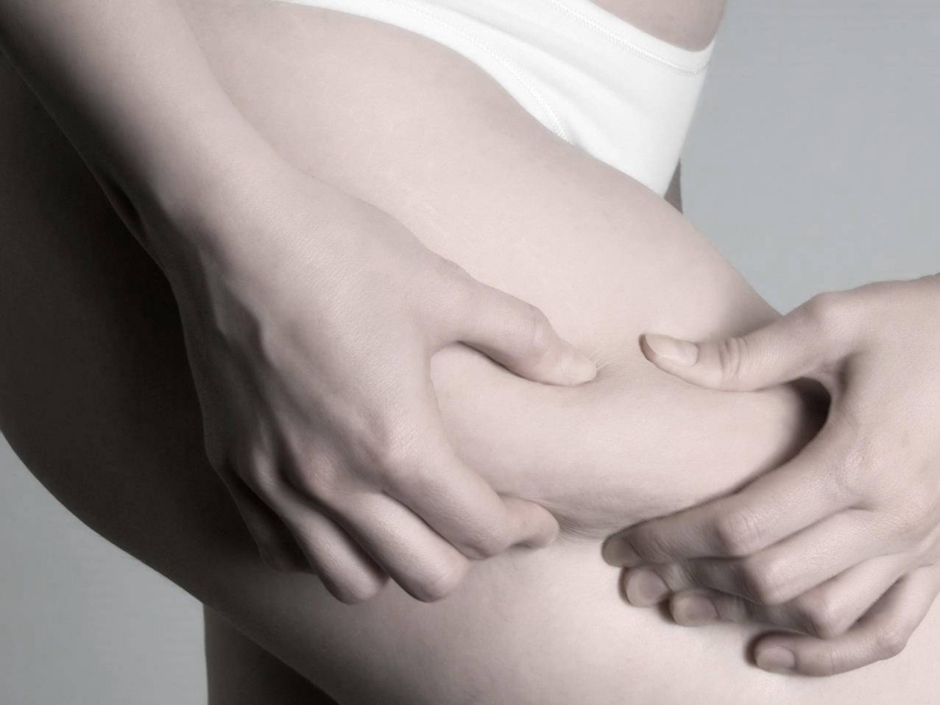
Zooming into the skin
Where does cellulite have its origin?

Slide 7
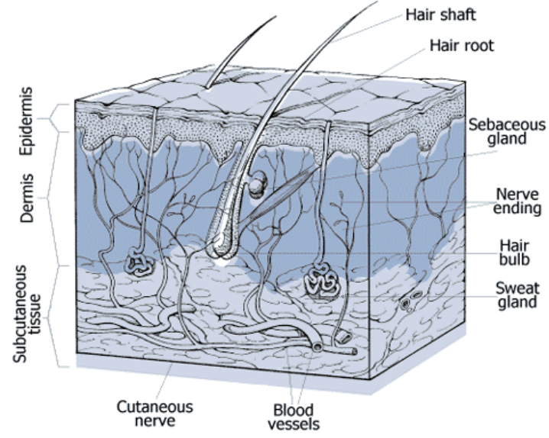
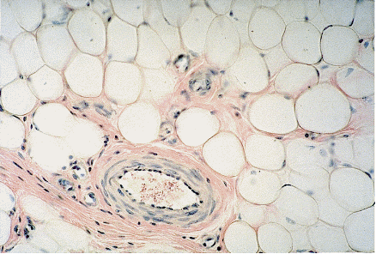
Adipocyte infiltration stands at the beginning of a negative cycle
Characteristic:
Deposits of subcutaneous fat
within the connective tissue that provides an appearance of nodules turning into a bumpy surface
Orange peel skin is not mandatory related to overweight. Alternative reasons: hormonal aspects, diet, genetic factors, certain lifestyle…
85% of women over the age of 20 have a degree of cellulite
Enlargement of adipocytes
Poor
microcirculation
Reduced firmness of connective tissue
Leads to an uneven skin surface
Notes:
Fat infiltration is more than just a cosmetic problem.
Let‘s have a look at this picture in order to understand the development for example orange peel skin: Epidermis, Dermis and Subcutis.
Blood and lymphatic vessels are located in the Subcutis and Dermis.
Adipocytes (fat cells) are located in the subcutaneous layer. Adipocytes store more and more fat and increase in size.
These fat cells press on blood vessels and the lymphatic system towards to the Epidermis.
As a consequence the enlarged adipocytes cause poor micro circulation and leads to a accumulation of liquids due to the reduced lymphatic drainage. This leads in connection with slack connective tissue to dimples on the skin surface.
Poor microcirculation can lead to edema and pain in the affected area.

Slide 8
Agenda
The market
The product
Claim substantiation
Cosmetic use
Page
7

Slide 9

REGU®-SLIM a unique blend to re-shape and smooth your body
L-Carnitin
Caffeine
Cysteic acid
Pantetheine-S-
Sulfonate
Page
8

Slide 10
4 in 1 complex for outmost activity
L-Carnitin transports long-chain fatty acids across the inner mitochondrial membrane to the mitochondrial matrix, where b-oxidation of fatty acids takes place.
L-Carnitin
Caffeine exerts lipolytic effects through the inhibition of phosphodiesterase (PDE) and induction of cyclic adenosine monophosphate (cAMP) in adipocytes.
Caffeine
  Cysteic acid is a cAMP inducers. cAMP is an activator of protein kinase A which activates again hormone sensitive lipase (HSL). HSL decompose triglycerides into free fatty acid (FFA) and glycerol.
Cysteic acid
Pantetheine-S-
Sulfonate
Pantetheine-S-sulfonate is a precursor of Coenzym A (CoA). In cytoplasma FFA are activated by binding to CoA. Just in this activated condition FFA can be formed to acyl-carnitine and transported across the mitochondrial membrane.

Slide 11
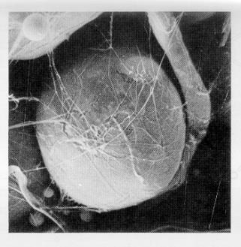
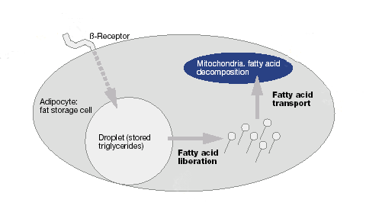
REGU®-SLIM- unique mechanism build on 3 main activities
cAMP stimulator and phosphodiesterase inhibitor
=> Caffeine, Cysteic acid
2. Fatty acid liberation and
transport promoter
=> Carnitin, Cysteic acid,
Pantetheine-S- Sulfonate
3. beta-oxidation stimulator
=> Carnitin, Pantetheine-S-
Sulfonate
Stimulation
Notes:
REGU®-SLIM accelerates lipolysis in adipocytes. Its ingredients are effective as cAMP stimulator, phosphodiesterase inhibitor, fatty acid liberation, transport promoter and β-oxidation stimulator.
Cysteic acid, caffeine and guarana are cAMP inducers. cAMP is an activator of protein kinase A which activates again hormone sensitive lipase (HSL). HSL decomposes triglycerides into free fatty acid (FFA) and glycerol.
Because of its strong effect as phosphodiesterase inhibitors caffeine and guarana stabilize cAMP. By blocking phosphodiesterase activity caffeine and guarana promote lipolysis in the same way as cysteic acid.
Pantetheine-S-sulfonate and L-carnitine are β-oxidation stimulators. Pantetheine-S-sulfonate is a precursor of Coenzym A (CoA). In cytoplasma FFA are activated by binding to CoA. Just in this activated condition FFA can be formed to acyl-carnitine, as acyl-carnitine FFA can be transported across the mitochondrial membrane into mitochondrial matrix. In the mitochondrial matrix acyl-carnitine is formed again into acyl-CoA. Acyl-CoA is decomposed into acetyl-CoA which is converted into CO₂ by citric acid cycle.

Slide 12
Agenda
The market
The product
Claim substantiation
Cosmetic use
Page
11

Slide 13
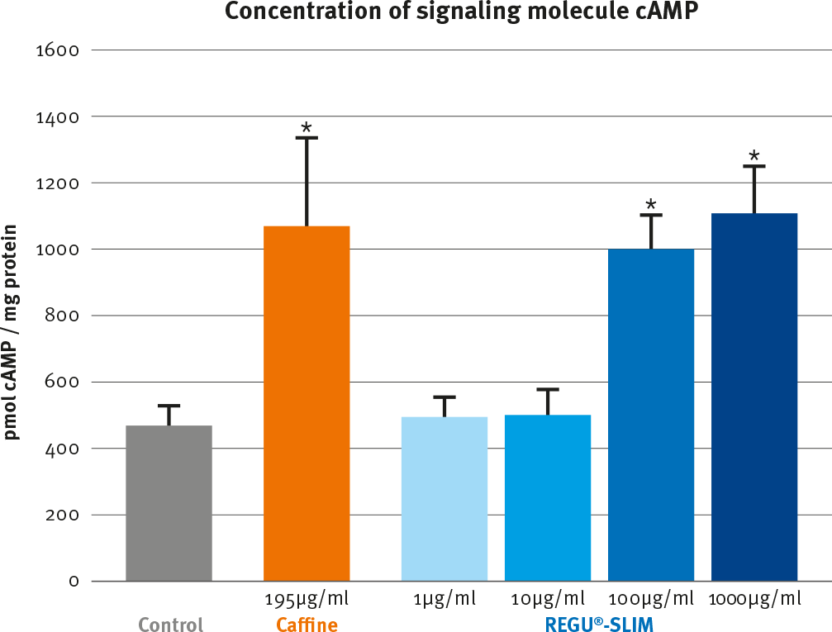
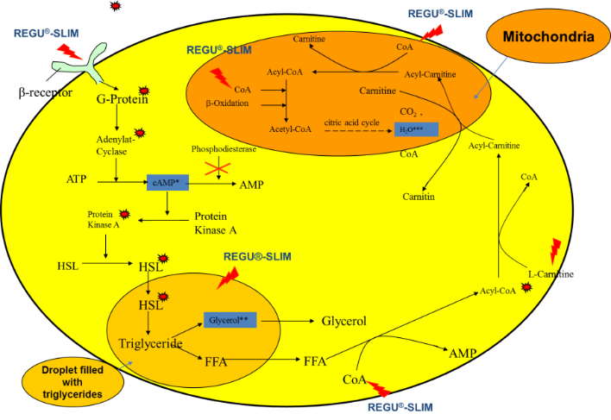
1) REGU®-SLIM cAMP stimulator and phosphodiesterase inhibitor
Triggers off the lipolysis process in human adipocytes in-vitro

Slide 14
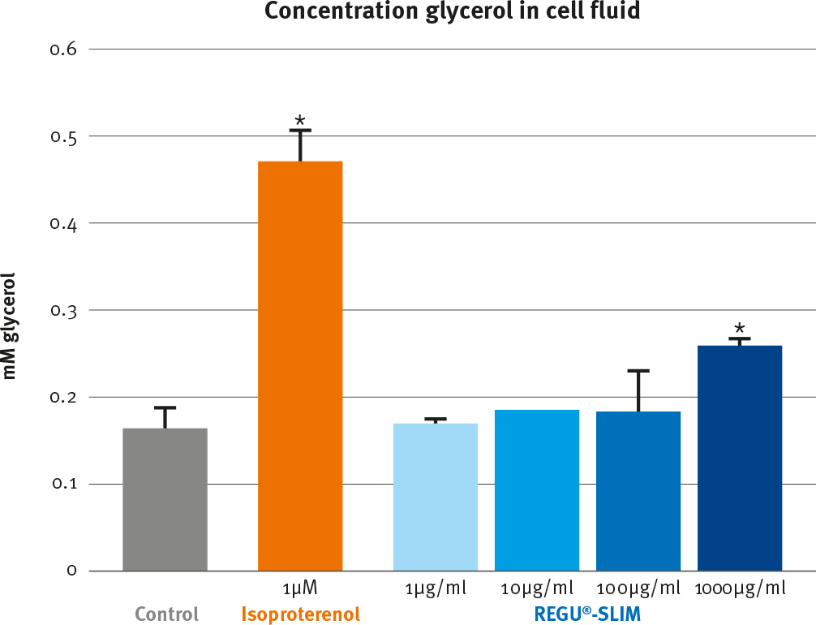
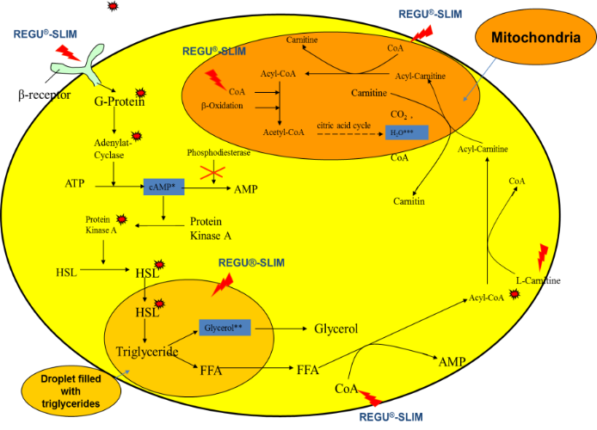
2) REGU®-SLIM fatty acid liberation and transport promoter
Significantly enhances the hydrolysis of triglycerides in human adipocytes in vitro

Slide 15
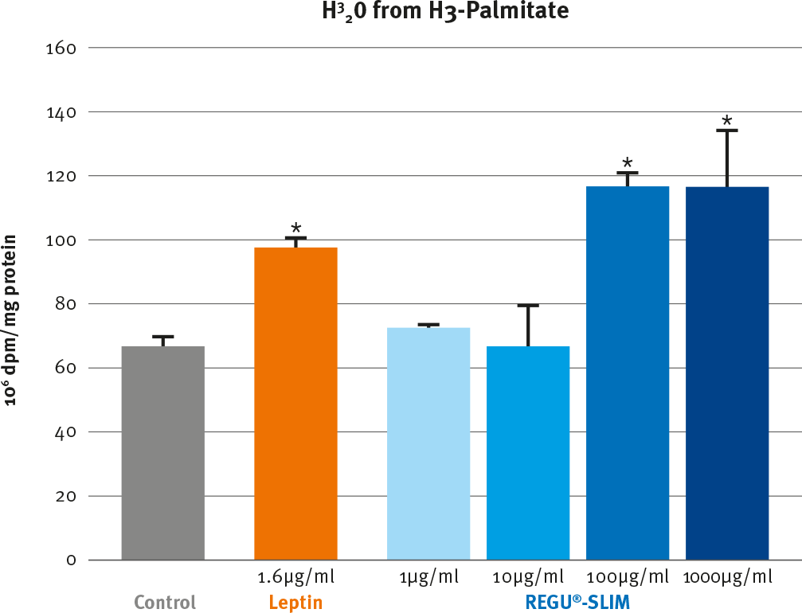

3) REGU®-SLIM β-oxidation stimulator
Accelerates the oxidation of free fatty acids in mitochondria in-vitro

Slide 16

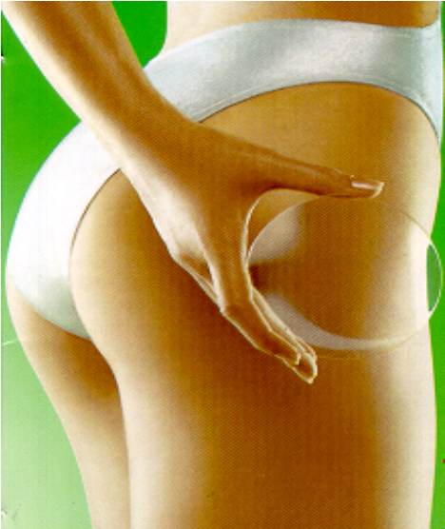
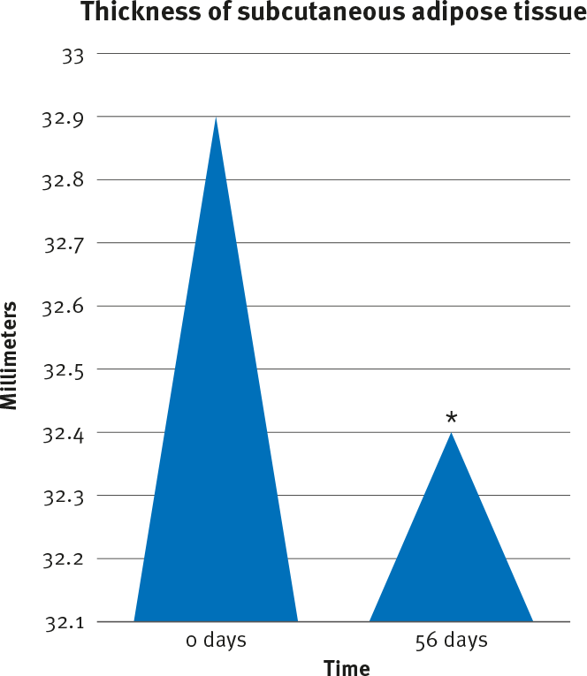
REGU®-SLIM dramatically reduces the thickness of adipose tissue
20 subjects with moderate cellulite were treated with a formulation containing 2% REGU^{®-}SLIM twice a day for 56 days.
REGU®-SLIM drastically reduces the thickness of adipose tissue (ultra-sound imaging).

Slide 17
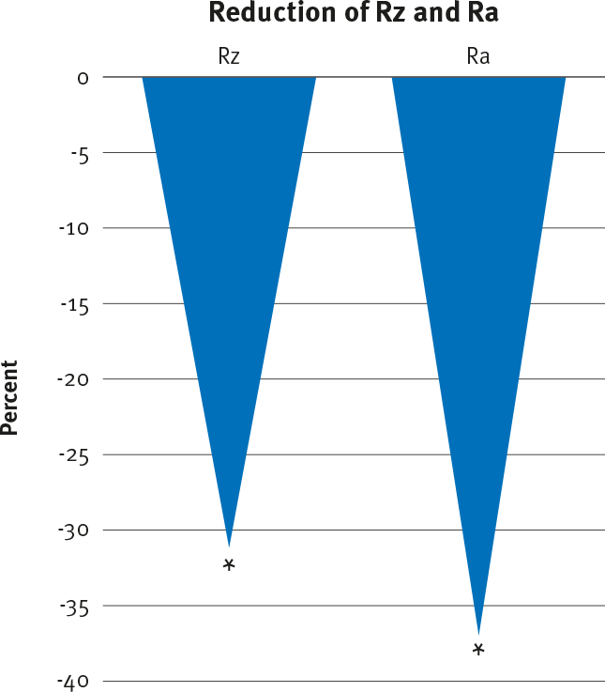
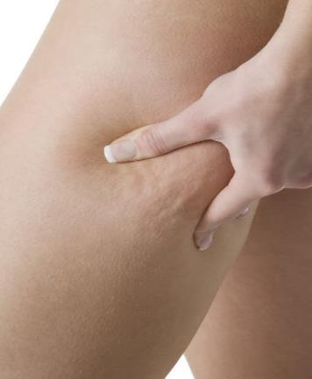
REGU®-SLIM significantly reduces the orange peel aspect of tight skin in vivo
20 subjects with moderate cellulite were treated with a formulation containing 2% REGU^{®-}SLIM twice a day for 56 days. The roughness parameters Ra and Rz were determined on pinched thighs by profilometry.
Significant decrease of Ra and Rz could be observed for the thighs treated with
REGU®-SLIM after 56 days of application.
Notes:
In vivo, REGU®-SLIM showed significant improvement of the orange peel appearance. That for, 20 subjects with moderate cellulite were treated with a formulation containing 2% REGU®-SLIM. REGU®-SLIM was applied twice a day for 56 days. The roughness parameters Ra and Rz were determined on pinched thighs by profilometry. Significant decrease of Ra and Rz could be observed for the thighs treated with REGU®-SLIM after 56 days of application. The variation means that REGU®-SLIM was able to reduce the relief of the thighs.

Slide 18
Agenda
The market
The product
Claim substantiation
Cosmetic use
Page
17

Slide 19
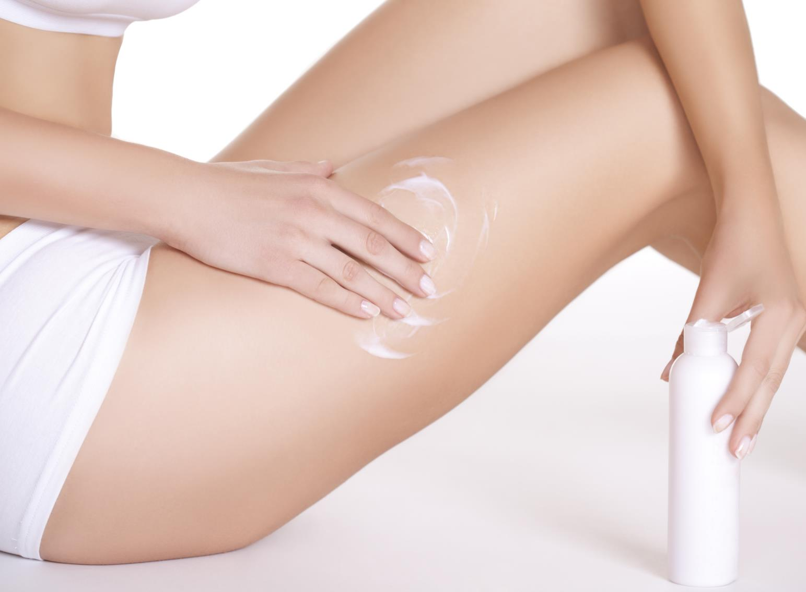
REGU®-SLIM
What is in for the consumer?
Decreases the appearance of orange peel skin
supports subcutaneous fat diminishment
Visible improvement of the aspect and state of the skin
The ideal method to re-shape and smooth your body
Page

Slide 20
REGU®-SLIM
Regulatory Status
Global Status | REGU®-SLIM may be globally commercialized. See specific statement for more details | ✓
China Status | Chemical notification (IECSC) Chinese INCI name 2004 CTFA inventory SFDA list (IECIC) | ✓ ✓ ✓ ✓
INCI name (active) | Caffeine, Paullinia Cupana Seed Extract, Carnitine, Cysteic Acid, Calcium Pantetheine Sulfonate | ✓
Suggested use level | 0.5 -3 % REGU®-SLIM | ✓

Slide 21
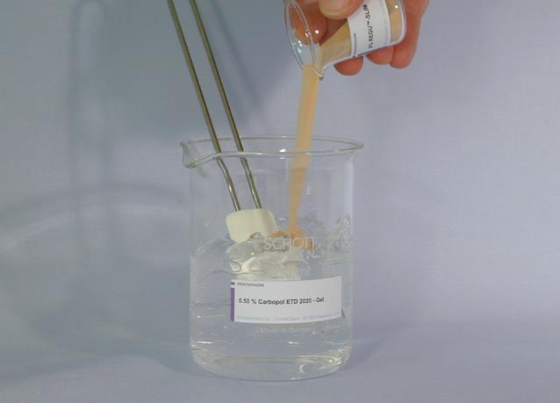
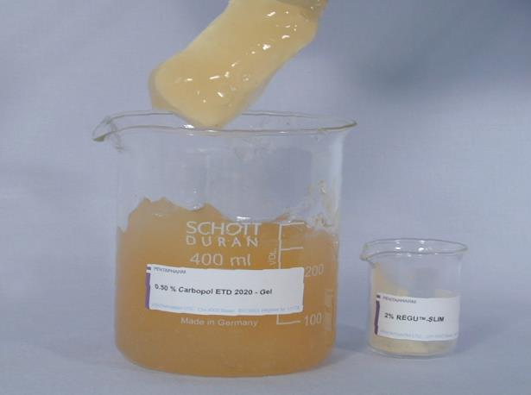
REGU®-SLIM
Application and handling
REGU®-SLIM – a granulated powder
Dispersible granulate is very easy to formulate
Can be incorporated in any type of formulation
Highly concentrated active ingredient

Slide 22
Formulation Guidelines
  Dosage: For skin care / body shaping preparations a concentration of 0.5-3 % REGU®-SLIM is recommended.
Processing: REGU®-SLIM can be processed either warm (80°C) or cold and is preferably incorporated as a powder at the of the formulation process.
pH: The optimal pH-range of a formulation with REGU®-SLIM is between 3 and 7.
Ethanol: REGU®-SLIM is compatible with up to 30 % ETHANOL.
Storage: Between 15 and 25°C in the original sealed container, protected from light in a clean place. REGU®-SLIM is hygroscopic, and in order to avoid a high humidity absorption following opening, containers should be handled with special care and hermetically closed after use. Once opened, use contents quickly.

Slide 23
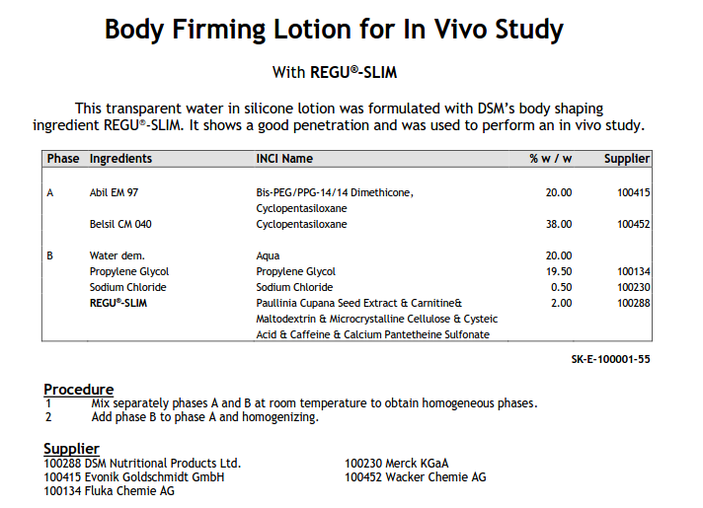
Application Concept with REGU®-SLIM
Page
23

Slide 24
Disclaimer
Copyright © 2021 DSM Nutritional Products, 4002 Basel, Switzerland.
www.dsm.com/personal-care. All rights reserved.
Although DSM has used diligent care to ensure that the information provided herein is accurate and up to date, DSM makes no representation or warranty of the accuracy, reliability, or completeness of the information. This presentation only contains scientific and technical information for business to business use. Country- or region-specific information should also be considered when labeling or advertising to final consumers. This publication does not constitute or provide scientific or medical advice, diagnosis, or treatment and is distributed without warranty of any kind, either expressly or implied. In no event shall DSM be liable for any damages arising from the reader’s reliance upon, or use of, these materials. The reader shall be solely responsible for any interpretation or use of the material contained herein. The content of this document is subject to change without further notice. Please contact your local DSM representative for more details. All trademarks listed in this brochure are either registered trademarks or trademarks of DSM in The Netherlands and/or other countries unless explicitly otherwise stated.
Disclaimer formulation guideline
“This information is for illustration purposes only and based upon our current knowledge and experience at the time of printing. We do not make any representation or warranty of any kind, express or implied, including merchantability or fitness for a particular use, with respect to such information or its application. Use of this information is at your discretion and risk. Nothing herein relieves you from carrying out your own suitability determinations and tests. You are responsible for observing all laws and regulations relevant to your products, uses or processes. We do not assume any liability in connection with your product and its use. The foregoing information and suggestions are also provided without warranty of non-infringement as to the intellectual property rights of third parties, and shall not be construed as any inducement to infringe the rights of third parties.”)

Slide 25


