Slide 1


REGU® -STRETCH
Just relax and forget
about stretch marks
October 2020

Slide 2

Stretch Marks…
Zebra-like White Skin Patches
Stretch Marks or striae are a form of white scarring on the skin.
They occur in areas with high skin stretch.
They first appear as reddish or purple lines, but tend to gradually fade to a lighter color.
The affected areas appear empty
and soft to the touch.

Slide 3
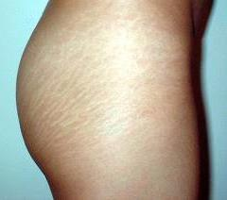
Stretch Marks Affects Millions of People
Main causes
Quick weight gain
Rapid growth during puberty
Pregnancy
Body building
Stretch marks affect both men and women with about
90% of women who are or have been pregnant
70% of adolescent females and 40% of adolescent males
having stretch marks somewhere on their bodies

Slide 4
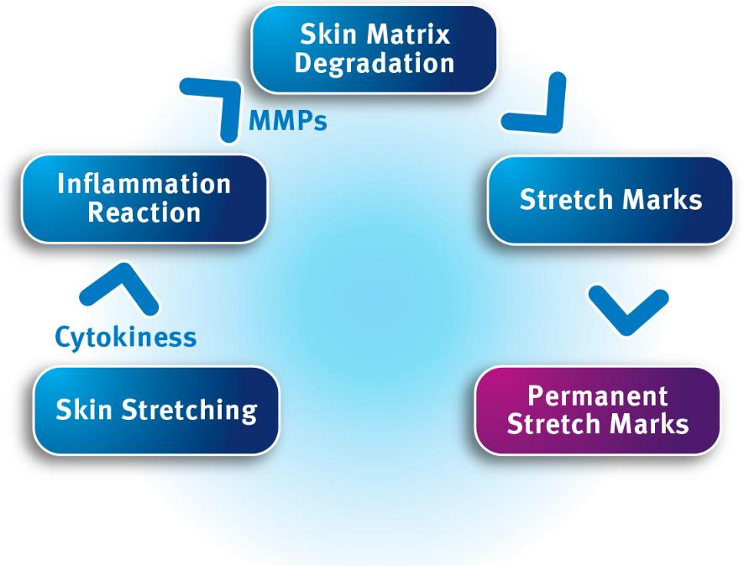
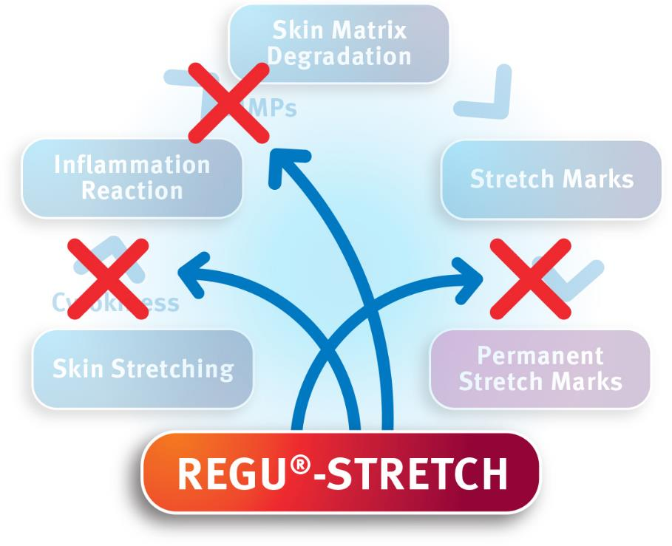
REGU®-STRETCH - Multi-targeted Mechanism for Optimum Effects
Notes:
Stretching the skin induces a complex cascade of inflammation and skin matrix degradation reactions well before stretch marks become visible.
To prevent the appearance of stretch marks, interventions are required at multiple levels of the cascade.
REGU®-STRETCH downregulates the expression of pro-inflammatory cytokines and collagen-degrading enzymes (Matrix MetalloProteinases, MMPs).
Application of REGU®-STRETCH helps protect the skin against the consequences of stretching and supports the healing process, leaving skin looking healthier and smoother.

Slide 5

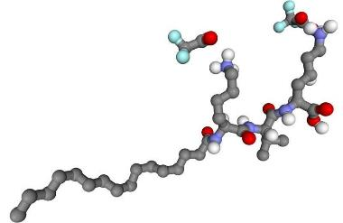
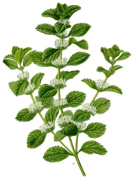
REGU®-STRETCH
A Carefully Selected Blend
Panthenol
helps to keep the skin moist and supple
stimulates cell growth and tissue repair
inhibits inflammation and reddening
Palmitoyl tripeptide-5
stimulates the production of collagen
repairs extracellular matrix damages
firms the skin
Marrubium vulgare
protects the skin from degradation
reduces inflammation
well known for its anti-inflammatory and healing properties

Slide 6
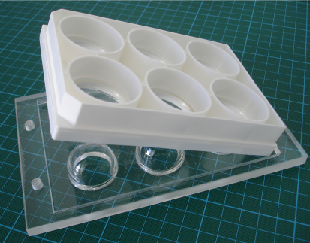
DSM Developed Unique Technology to Simulate Stretch Marks in vitro
PROTECTION AGAINST STRETCH MARKS
A innovative screening model has been developed by DSM to test the protective effects of various compounds.
Method characteristics
Simulation of stretched skin in monolayer fibroblasts cultures
Flexible silicone bottom to be stretched
over glass hemispheres
Equibiaxal stretching possible up to + 40%
Parameters analysis
Measurement of cell number and morphology
Quantification of interleukins and MMP
Notes:
An innovative model was developed to simulate stretch marks in vitro.
This consists of an acrylic base with glass spheres. Cells are grown on a cell culture plate with a flexible silicone bottom.
The set-up satisfied the following criteria: equibiaxial stretching to 40% surface increase, active substances can be added at any time-point during culture, continuous microscopic monitoring is possible and cell culture supernatant can be harvested for further analysis of cytokines and MMPs (protein quantity, not activity).

Slide 7
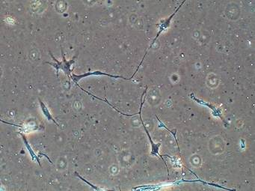
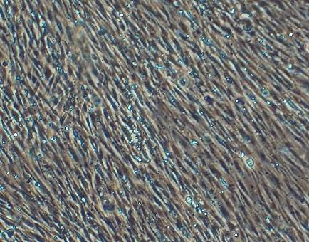
REGU®-STRETCH Visibly Protects Skin in vitro Against Mechanical Stress
Stretched and destroyed fibroblasts
- not protected
Stretched and intact fibroblasts’ structure
- protected by REGU®-STRETCH (0.05%)
REGU®-STRETCH protects the skin cells from degradation during intensive and quick stretching
Notes:
Not only signalling- and enzyme-mediated degrading forces were definitely influenced by REGU®-STRETCH, but also the cell morphology.
An uninhibited healthy growth pattern of the tissue could be substantiated by microscopic pictures as proof of beneficial effect on the cells

Slide 8
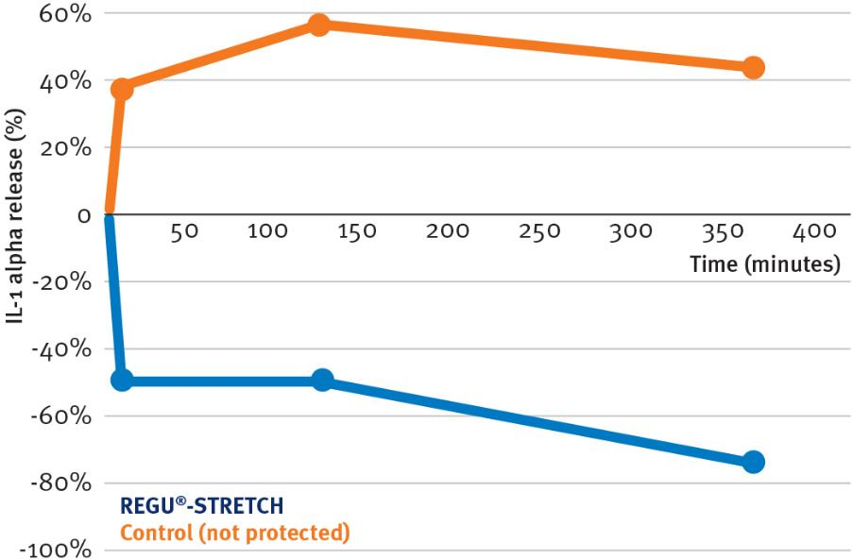
REGU®-STRETCH Significantly Reduces Inflammation Stress Marker IL-1α (in vitro)
REGU®-STRETCH inhibits the inflammatory process
Notes:
Pro-inflammatory cytokines and MMP enzymes are instrumental in the damage inflicted on skin cells by mechanical stress.
We were able to monitor the performance of REGU®-STRETCH by simultaneously quantifying cytokines and MMPs at different time-points.
Interleukin 1 alpha is the first induced pro-inflammatory cytokine produced by the cells after stretching. After its production the inflammation cascade starts.

Slide 9
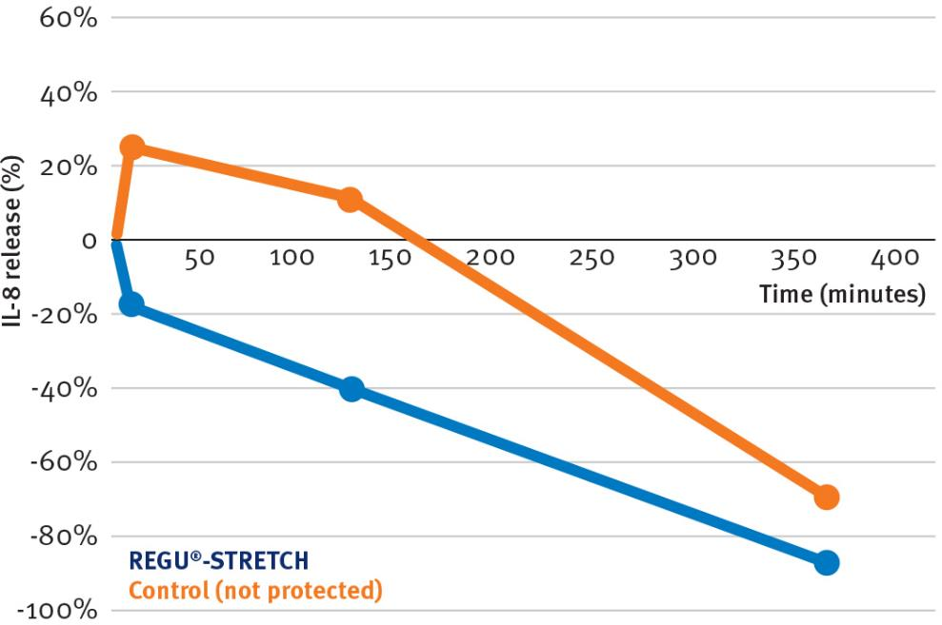
REGU®-STRETCH Significantly Reduces Inflammation Stress Marker IL-8 (in vitro)
REGU®-STRETCH inhibits the inflammatory process
Notes:
Interleukin 8 is one of the most important pro-inflammatory cytokines.
It is found in the cells themselves, after being released it must be synthesized again; therefore we see this decrease after 6 hours.

Slide 10
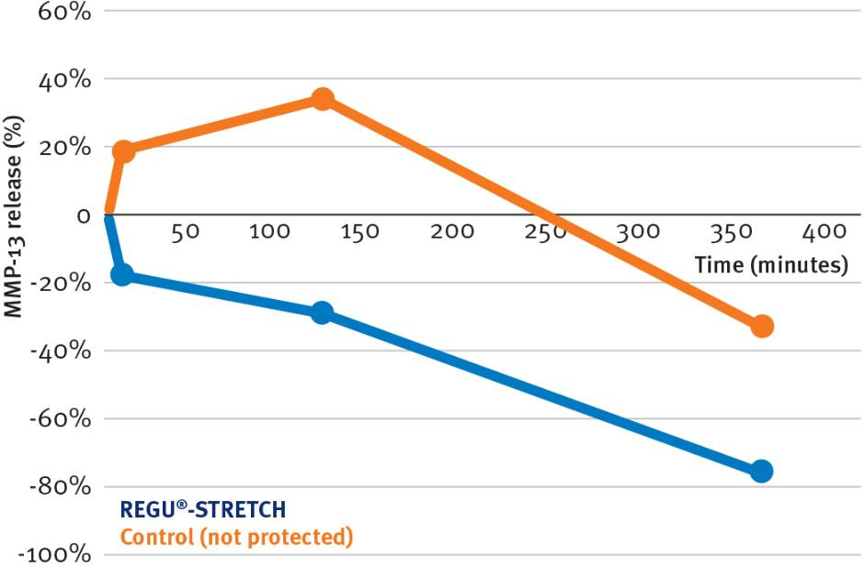
REGU®-STRETCH Significantly Inhibits
MMP-13 release (in vitro)
REGU®-STRETCH inhibits skin matrix degradation
Notes:
MMP-13 is a collagenase which is responsible for the degradation of the collagen/ elastin matrix.
(MMP: Matrix MetalloProteinase)

Slide 11
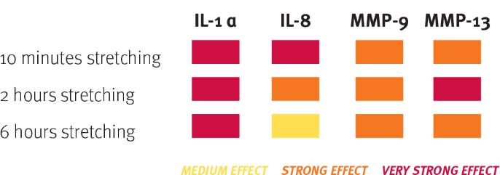
REGU®-STRETCH
in vitro efficacy in a nutshell
REGU®-STRETCH showed outstanding capacity to protect the structure of skin cells from degradation by reducing inflammation during quick, intensive stretching
IL-1 alpha Inhibition - the first induced pro-inflammatory cytokine produced by cells after stretching
IL-8 Inhibition - one of the most important pro-inflammatory cytokines
MMP-13 Inhibition – collagenase responsible for the degradation of the skin matrix

Slide 12
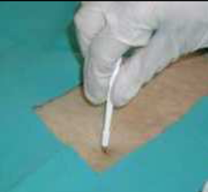
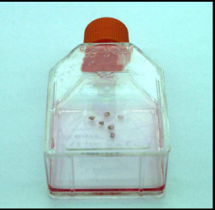
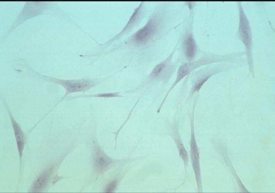
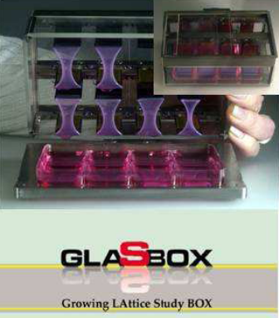
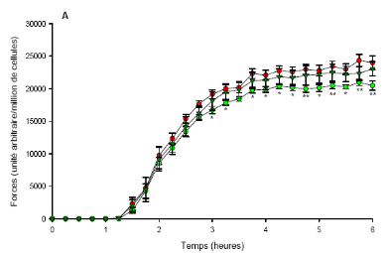
REGU®-STRETCH Efficacy in vitro
Repair of Young Stretch Marks
Method characteristics
GLASBOX® (Growing LAttice Study BOX): measurement of isometric forces of fibroblasts
The fibroblast force of red (young) stretch marks is higher than for healthy cells
A reduction of the force developed by the fibroblasts represents a lasting relaxing effect; the young stretch marks disappear
Fibroblasts from abdomen biopsy (15 year old woman)

Slide 13
REGU®-STRETCH Efficacy in vitro
Repair of Young Stretch Marks
Forces developed by the fibroblasts under stretching in the GLASBOX System
SYN®-COLL and Panthenol reduce contractile forces fibroblasts that were directly derived from young stretch marks.
Marrubium vulgare is essential to the repair effect due to its well-known healing and
anti-inflammatory properties.
Contractile forces [Δ % of control]
Relaxing effect compared to control after 24hrs
REGU®-STRETCH components decrease fibroblast tension and support the repair and scarless healing process.
Notes:
Standard Deviations:
2% for SYN-COLL
2.7% for Panthenol

Slide 14
REGU®-STRETCH
Efficacy in vivo
Study design
18 female volunteers (Caucasian, >18 years)
Recent / red stretch marks (less than 6 months old)
Emulsion containing 3% REGU®-STRETCH
Duration: 3 months, measurements at days 0 and 84
Parameters
Length and width of stretch marks
Dermis density (Dermascan®)
Illustrative photographs
Questionnaire evaluating the product efficacy

Slide 15
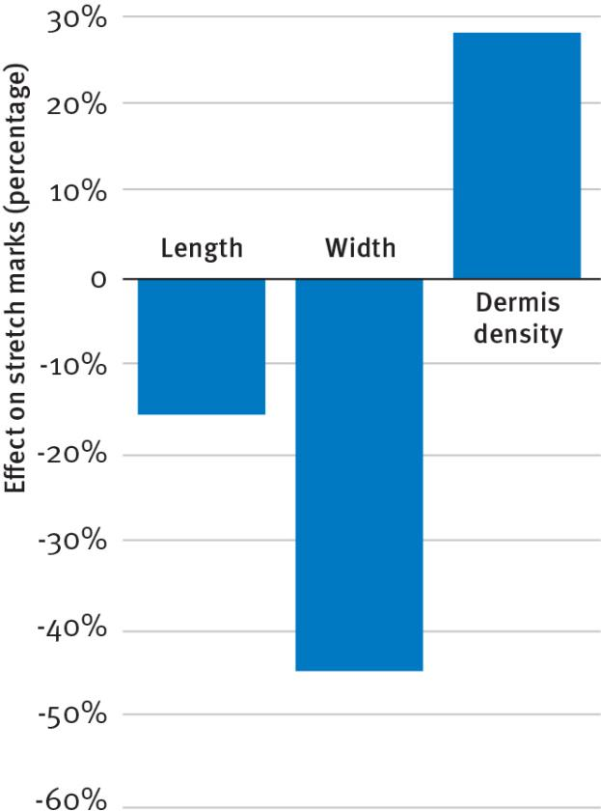
REGU®-STRETCH Visible Effects in vivo
REGU®-STRETCH visibly reduced stretch marks and improved general skin tissue properties
Maximal results after 84 days compared to day 0.
Notes:
Dermis density increase = improvement of the stretch marks as well as of the skin tissue properties

Slide 16
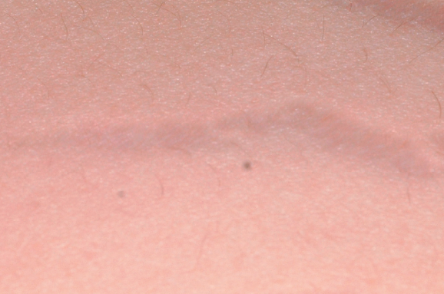
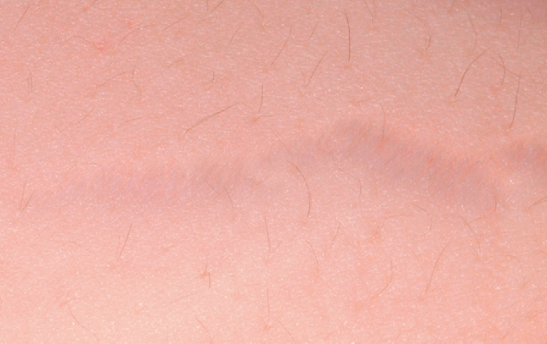
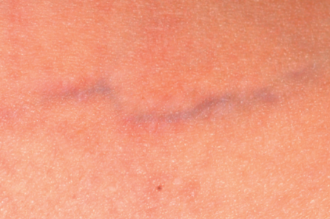
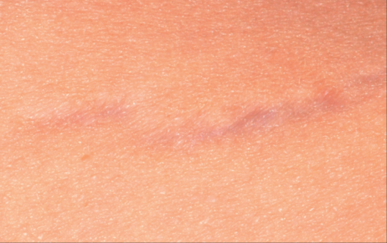
REGU®-STRETCH Visible Effects in vivo
Macro photographs
Day 0
Day 84
Volunteer #1, Age 28
Day 0
Day 84
Volunteer #13, Age 28
Appearance is clearly improved and the stretch mark is visibly reduced

Slide 17
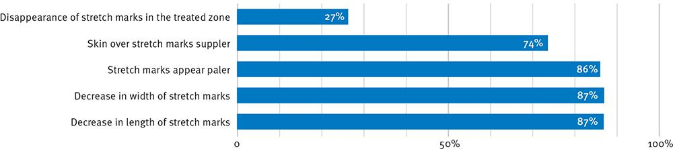
REGU®-STRETCH Efficacy in vivo
Volunteer Evaluation after 84 days
Notes:
This test aimed at asking the volunteers for their subjective evaluation of the tested formulation.
Most volunteers observed a reduction of stretch marks appearance (color, width, and length). In addition the skin on stretch marks got suppler during the treatment, which is a sign of repair of the extracellular matrix.
Most remarkably, some treated stretch marks totally disappeared for 27% of the volunteers.

Slide 18

REGU®-STRETCH
Making Stretch Marks a Thing of the Past
Unique Product Features
Complex designed to help prevent or repair all types of stretch marks during and after mechanical stretching
Unique combination that protects skin from tissue degradation and reduces inflammation
Positive effect on collagen levels
Supports re-epithelialization
Benefits
Helps prevent stretch marks occurring
Helps restore the appearance of stretch marks
Visible results in as little as two months
Improves skin firmness, smoothness, and elasticity

Slide 19
REGU®-STRETCH
Product Profile
Cosmetic application
Anti-stretch marks and anti-striae treatments
Body contour remodeling products for adolescent skin
Firming, moisturizing, and anti-cellulite products
Treatment for fine lines and wrinkles
Formulation
Glycerine-based aqueous solution
Suggested concentration: 1-3%
Optimal pH range: 3 to 6
Stable at elevated temperature (70°C) for up to 2 hours
Paraben-free. Preserved with Sodium benzoate and Potassium sorbate

Slide 20
REGU®-STRETCH
Product and Marketing Concepts
Stretch marks care: body lotions, gels and concentrates
Creams or pens to treat local scars
Expert treatments: 1. Body massage 2. Apply corrective treatment
Ultimate hydration and protection against stretch marks | with PENTAVITIN®
Body care lotions for dry skin | with STIMU-TEX® AS
Post partum body activator | with PEPHA®-CTIVE
Body building ultimate care | with PEPHA®-CTIVE
Firming & slimming products | with PEPHA®-TIGHT and REGU®-SHAPE
Corrective body treatments for young people | with PENTAVITIN® and REGU®-SHAPE

Slide 21
Disclaimer
Copyright © 2021 DSM Nutritional Products, 4002 Basel, Switzerland.
www.dsm.com/personal-care. All rights reserved.
Although DSM has used diligent care to ensure that the information provided herein is accurate and up to date, DSM makes no representation or warranty of the accuracy, reliability, or completeness of the information. This presentation only contains scientific and technical information for business to business use. Country or region-specific information should also be considered when labeling or advertising to final consumers. This publication does not constitute or provide scientific or medical advice, diagnosis, or treatment and is distributed without warranty of any kind, either expressly or implied. In no event shall DSM be liable for any damages arising from the reader’s reliance upon, or use of, these materials. The reader shall be solely responsible for any interpretation or use of the material contained herein. The content of this document is subject to change without further notice. Please contact your local DSM representative for more details. All trademarks listed in this brochure are either registered trademarks or trademarks of DSM in The Netherlands and/or other countries unless explicitly otherwise stated.

Slide 22


