Slide 1

April 2025

Slide 2

Trend
‘Skin Energy & Clean Beauty’
‘Skin Energy’ is a Big Skin Care Trend.¹
Consumers show an increasing interest in naturally functional beauty products to
help them feel energized and healthy.
Clean Beauty
Consumers tend to avoid controversial ingredients and showing more interest in 'cleaner’, energy-boosting products to adopt healthier and 'cleaner' lifestyles.
¹ https://www.elle.com/beauty/makeup-skin-care/a41446994/skin-energy-skin-care-trend/

Slide 3

‘Skin Energy’ is crucial for healthy-looking skin
The term ‘skin energy’ refers to the cellular life force that circulates through the skin.
Skin charged with energy is radiant and healthy looking.
Most of a cell’s energy is produced by small components inside our cells called mitochondria (known as the “powerhouses of the cell”).
The source is adenosine triphosphate (ATP) and its presence is an indicator of energy production.
ATP fuels all kind of cellular activities.
But over time, the function of mitochondria slows down depending on a variety of factors such as aging and lifestyle meaning they produce ATP less efficiently.
Skin’s energy levels follow a 24-hour rhythm known as the internal clock or circadian rhythm.
During daytime hours and particularly with UV stress, levels of ATP in the cells drop.
During nighttime hours levels of ATP in the cells need to recharge

Slide 4
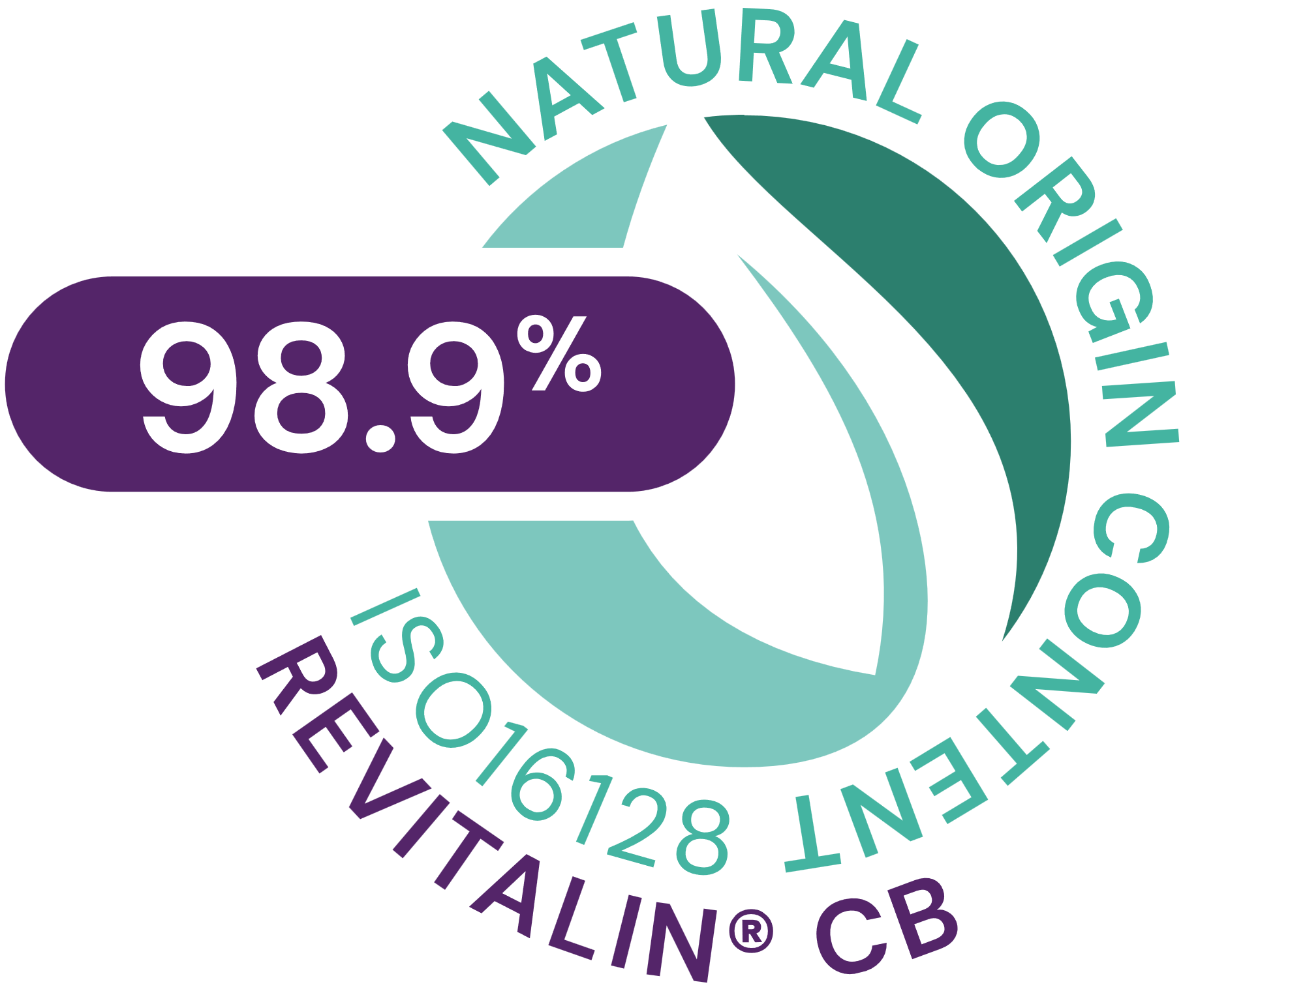




REVITALIN® CB
ID Card
INCI NAME:
Glycoproteins, Glutamic acid, Valine, Threonine, Aqua, 1,2-Hexanediol, Caprylyl Glycol
TECHNOLOGY:
Postbiotic mixture of glycoproteins obtained by fermentation of baker’s yeast
Blended with a sophisticated mixture of 3 skin respiration facilitators
98.9% of natural origin (ISO 16128)
TECHNICAL:
Form: Clear yellowish solution
Use level: 1–5%
pH of use: 3.0 – 7.5
Preservative: Free
Solubility: Water soluble
Helps to accelerate skin renewal by up to 4 days**
Maintains sufficient availability of ATP all day long*
Vitality boost for less energetic (tired) skin cells*
Energy kick for stressed skin cells*
Restores mitochondrial vitality after UV stress*
BENEFITS:
‘Clean Vitality Booster’ to sustain a healthy-looking skin
Contains a combination of postbiotic glycoproteins and three amino acids
Unlocks the Power of Vital Mitochondria
For controlling circadian rhythm
REGISTRATION
CERTIFICATION
* in vitro ** in vivo

Slide 5
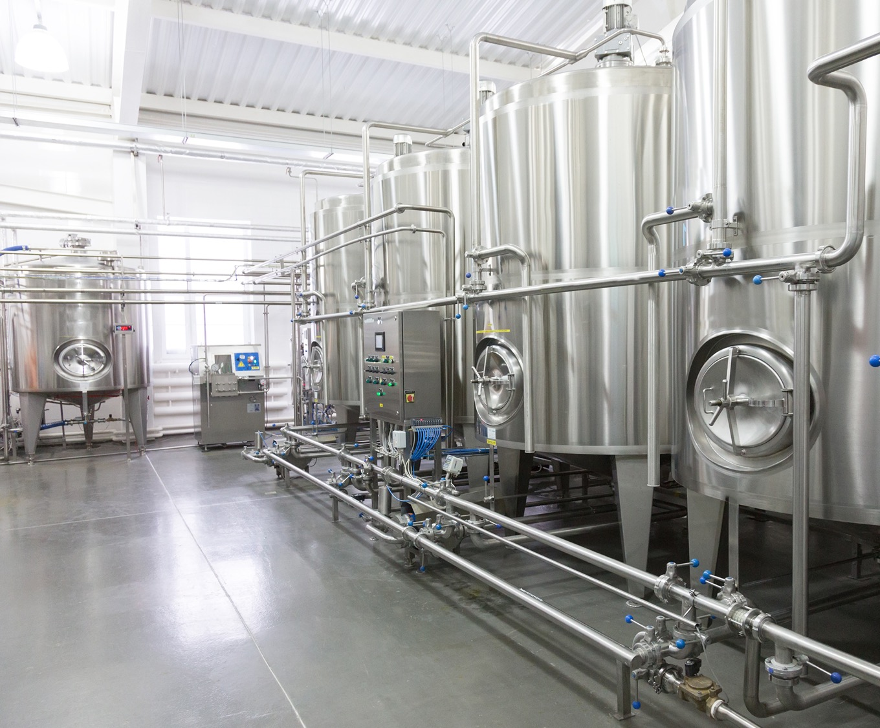

With postbiotic,
energy-providing glycoproteins
The postbiotic glycoproteins in REVITALIN® CB are obtained by aerobic fermentation of baker’s yeast
It is made by the extraordinary baker’s yeast strain VdH2, known to cause bread to rise and chosen for its ability to provide high cellular energy.
The resulting biomass undergoes a selective cell autolysis process (breaking down of the membrane of the yeast cells).
The insoluble fragments are separated and the soluble fraction is purified and concentrated.
The result is a mixture of postbiotic, energy-providing glycoproteins.
5

Slide 6
Enriched with revitalizing amino acids
REVITALIN® CB is enriched with a sophisticated mixture of 3 amino acids – threonine, valine and glutamic acid – together they support the natural cellular revitalizing capacity.
Threonine
Boosts skin energy factory by enhancing metabolic flux in the mitochondrial matrix
Valine
Serves as an energy fuel to produce more ATP in mitochondria
Glutamic acid
Also supports skin energy production synergistically with Valine and Threonine

Slide 7
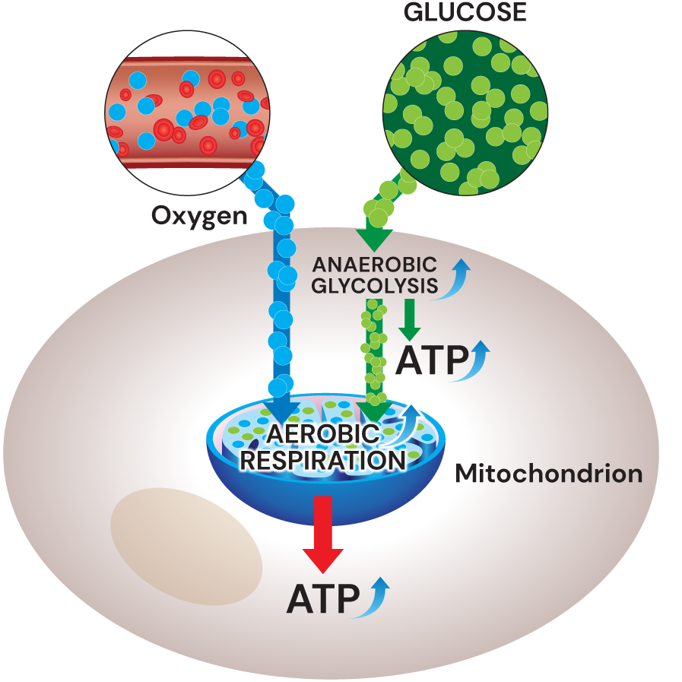

Mitochondria: More than just production sites for ATP
Cell’s energy is carried out by the mitochondria and relies on the presence of oxygen and glucose:
With oxygen, mitochondria uses aerobic respiration (breaking down glucose in presence of oxygen) which produce large amounts of ATP.
Without oxygen, mitochondria uses anaerobic glycolysis (metabolic degradation of glucose) to produce ATP in a fast way.
Lack of sufficient oxygen (hypoxia) has negative effects on mitochondria respiration processes and generates ROS stress
Hypoxia researchers won 2019 Nobel Prize in Medicine
ROS can damage all molecules in a cell and have long been thought to cause aging.
Aged/damaged mitochondria produces few energy but a lot of reactive oxygen species (ROS)
ROS
The aim is to maintain mitochondria vitality but few ROS to keep skin healthiness and glow

Slide 8
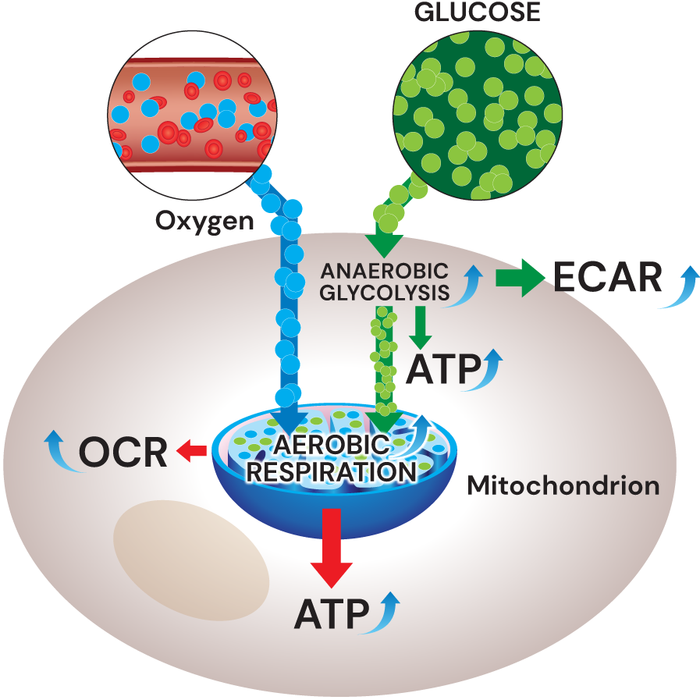
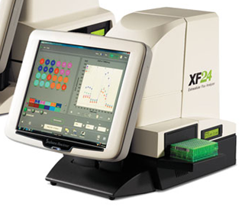
Extracellular Flux Analysis Technology
Extracellular Flux Analyzer, produced by Seahorse Bioscience USA, is the gold standard for measuring cellular bioenergetics in the pharmaceutical and diagnostic industry
Extracellular flux analysis measures
simultaneously the two major energy
producing pathways of the cell - mitochondrial
respiration and glycolysis.
This is done by measuring the rates of oxygen consumption rate (OCR) and extracellular
acidification rate (ECAR) in the media
surrounding the cells (extracellular flux).
OCR is predominately the result of mitochondrial respiration - breaking down glucose in presence of oxygen to form ATP
ECAR is an indicator of glycolysis - metabolic degradation of glucose to yield ATP and acid
The ECAR/OCR ratio determines the level of energy.
* In vitro ** in vivo

Slide 9
Unlocks the power of ‘vital mitochondria
REVITALIN® CB delivers a lot of ATP by boosting the two fundamental mitochondrial pathways*
1
Anaerobic glycolysis, measured by ECAR (Extracellular Acidification Rate) ³
Aerobic respiration, measured by OCR (Oxygen Consumption Rate) ³
ATP (Adenosine triphosphate), measured by Mitochondrial Toxglo™ kit⁴
2
1
3
3
REVITALIN® CB restores mitochondrial vitality after UV stress*
2
4
4
Stimulates mitochondria-related genes linked to cell energy, regeneration and detoxification*
5
REVITALIN® CB sustains a healthy- looking skin**
3
5
Helps to accelerate cell renewal activity by up to 4 days**.
* In vitro ** In vivo
1 R. Schütz et al. / Journal of Photochemistry & Photobiology, B: Biology 159 (2016) 142–148
2 R. Schütz et al. /Monitoring the energy status of primary human keratinocytes and the effect of REVITALIN® CB on cellular homeostasis, IFSCC 2014
3 Extracellular Flux Analyzer, produced by Seahorse Bioscience USA
4 Mitochondrial Toxglo™ kit, produced by Promega USA

Slide 10
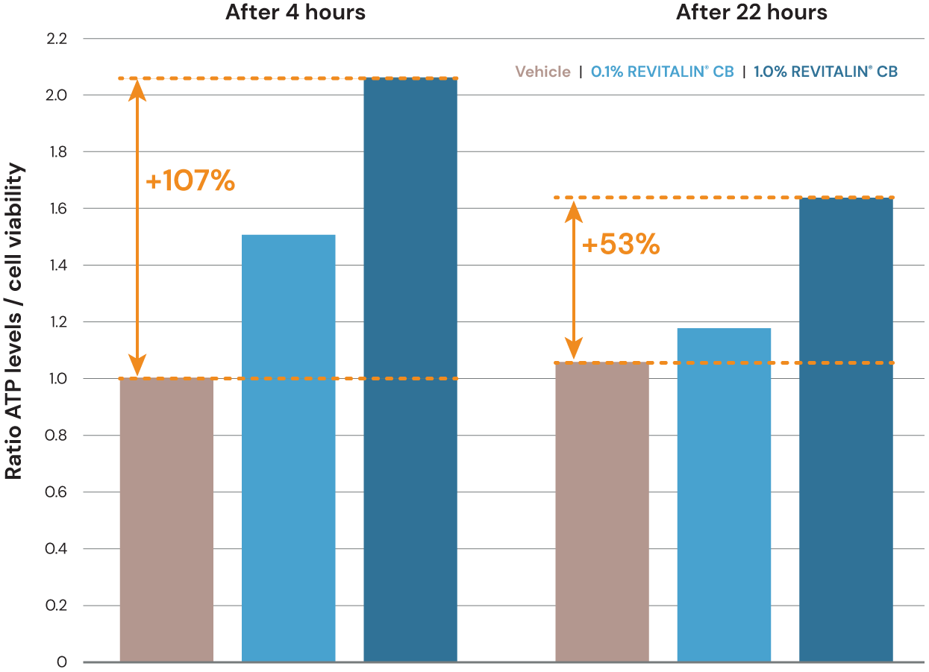
Maintains sufficient availability of ATP supply all day long
Effect of REVITALIN® CB on cellular viability and ATP in human primary keratinocytes
Cellular viability and Cellular ATP levels were measured by Mitochondrial ToxGlo™ Assay.
REVITALIN® CB (0.1% and 1.0%) shows pronounced, dose-dependent, significant effect on ATP levels in human primary keratinocytes (HPEK).
*
*
Enhanced ATP levels by up to 110% after 4 hours and by up to 53% after 22 hours*
ATP levels vs cell viability in keratinocytes after 4 and 22 hours of REVITALIN® CB treatment, respectively. The data are expressed as ratio of ATP production versus cell membrane integrity by caspase activity. *p < 0.01 (n = 3).
* In vitro

Slide 11
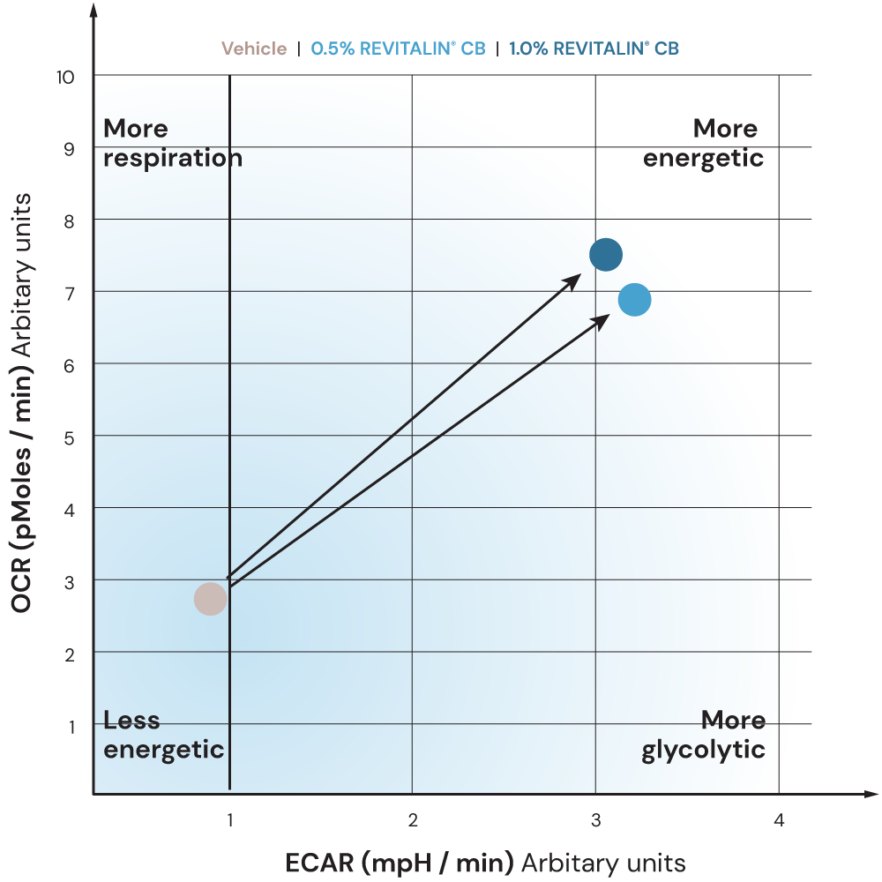
Vitality boost for less energetic (tired) skin cells
Effect of REVITALIN® CB on respiration and glycolysis in less energetic human primary keratinocytes
Real-time measurements of the OCR and ECAR were performed with Seahorse Bioscience XFe96 Extracellular Flux Analyzer. Less energetic human primary keratinocytes were pre-treated for 4 hours with REVITALIN® CB (0.5%; 1%).
Vitality boost for less energetic (tired) skin cells, as reflected in the ECAR/OCR matrix*
Effect of REVITALIN® CB (0.5% and 1.0%) on respiration and glycolysis referring to less energetic keratinocytes compared to vehicle-treated cells after 4 hours treatment
* In vitro

Slide 12
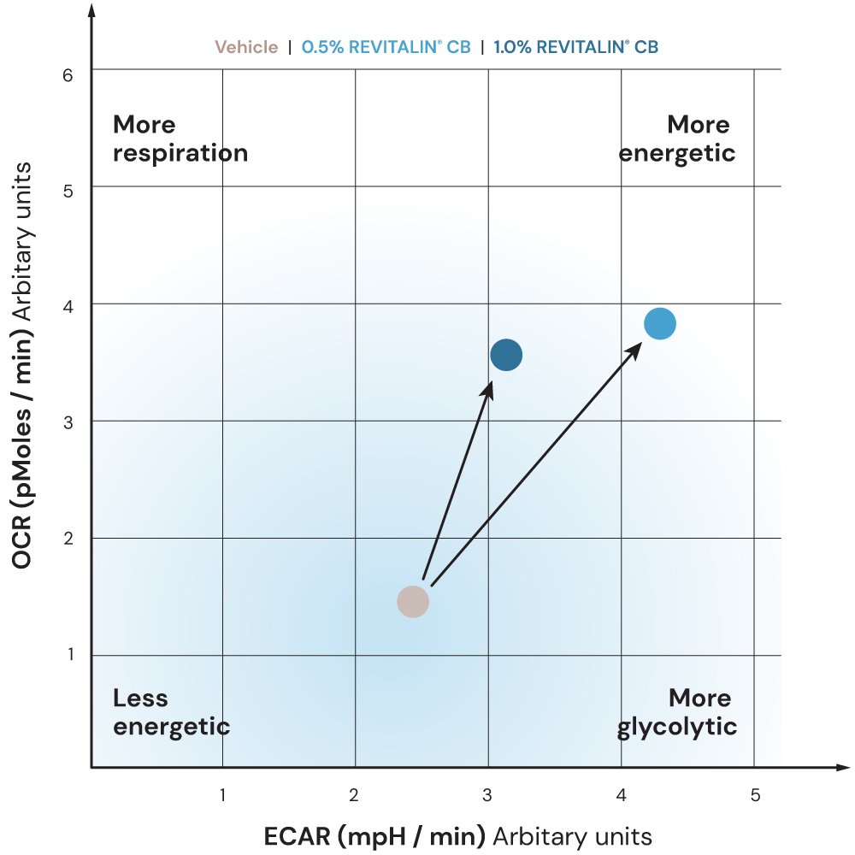
Energy kick for stressed skin cells
Effect of REVITALIN® CB on respiration and glycolysis in stressed human primary keratinocytes
Real-time measurements of the OCR and ECAR were performed with Seahorse Bioscience XFe96 Extracellular Flux Analyzer. Chemically stressed human primary keratinocytes, which simulated mitochondrial dysfunction were pre-treated for 4 hours with REVITALIN® CB (0.5% and 1.0%).
Energy kick for stressed skin cells, as reflected in the ECAR/OCR matrix*
Effect of REVITALIN® CB (0.5 and 1.0%) on respiration and glycolysis referring to chemically induced, stressed keratinocytes compared to vehicle-treated cells after 4 hours treatment.
*In vitro

Slide 13
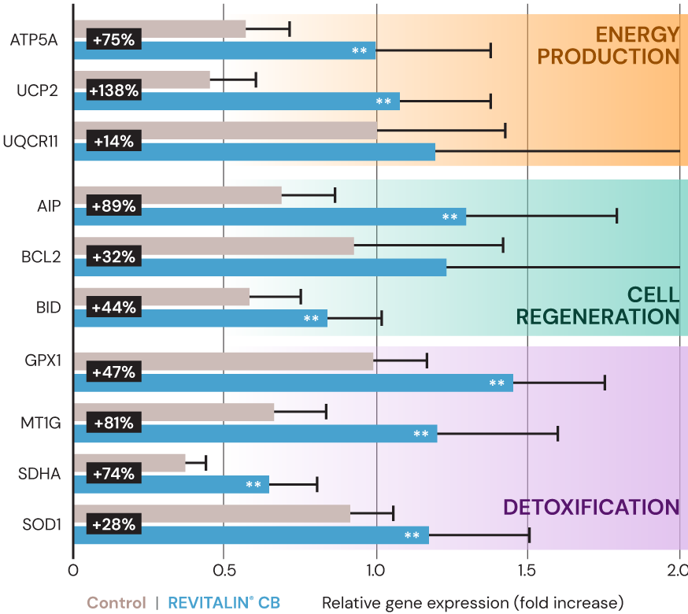
Restores mitochondrial vitality after UV stress*
Effect of 0.5% REVITALIN® CB on expression of mitochondria-related genes in human keratinocytes 4 hours after UVB-irradiation (60 mJ/cm²)*
Energy production
+75% ATP5A1 (ATP synthesis)
+138% UCP2 (Mitochondrial proton flux)
**
**
Significant effects are observed on key genes linked to:
**
Cell regeneration
+89% AIP
+44% BID
**
**
Activation of Detoxification helps to reduce hypoxic conditions
+47% GPX1 (Detoxification of hydrogen peroxide)
+81% MT1G (Detoxification of heavy metals)
+28% SOD1 (Detoxification of superoxide radicals)
**
**
**
Effect of 0.5% REVITALIN® CB (blue bars) on expression of mitochondria-related genes in human keratinocytes 4 h after UVB-irradiation (60 mJ/cm²) relative to the vehicle treated, UV-irradiated control (gray bars). Data are represented as fold change ± SEM from three observations (**significance level p < 0.01 vs. UV-irradiated vehicle control).
* In vitro

Slide 14
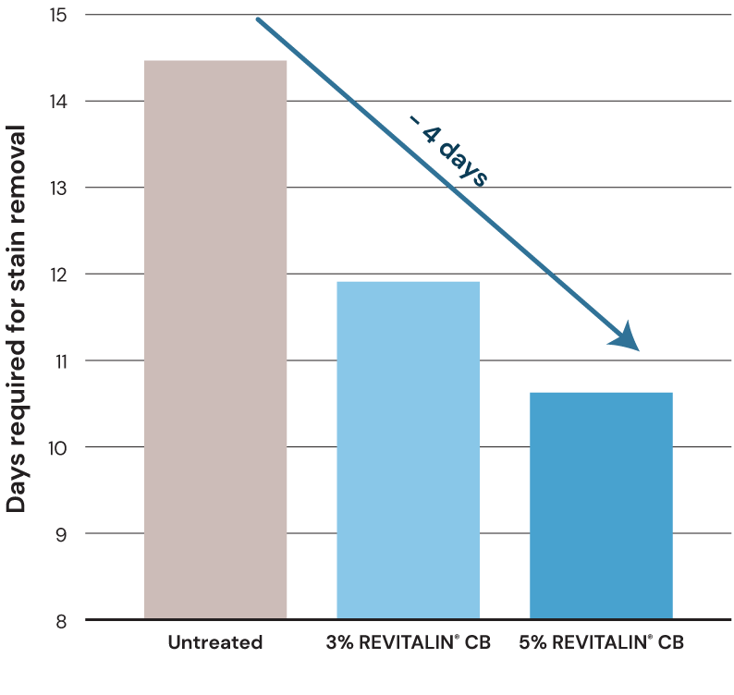
Helps to accelerate in vivo skin renewal by up to 4 days
Standard dansyl-chloride method:
A glowing complexion and fresh-looking skin is assessed by measuring skin renewal using the dansyl-chloride staining method.
The ability of REVITALIN® CB to stimulate skin cell turnover was tested when twelve volunteers (aged 30–55 years) applied 3% and 5% REVITALIN® CB on their forearms twice a day for a period of 20 days. The time for removal of all dansyl chloride staining was determined.
REVITALIN® CB helps to accelerate skin renewal by up to 4 days to sustain a healthy-looking skin**
** In vivo

Slide 15
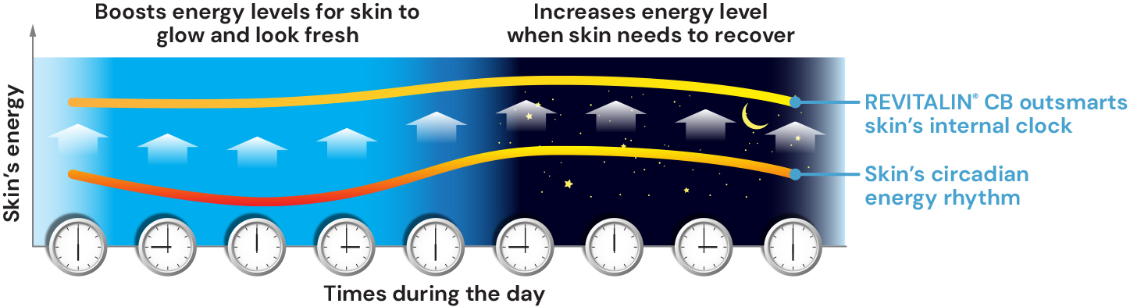
Outsmarts skin’s internal clock
For controlling circadian rhythms
Skin that is optimally energized throughout the cell’s circadian rhythm has a consistent glow and generally fresh complexion.
REVITALIN® CB recharges skin cells with energy during the skin's nighttime and boosts daily energy levels when skin needs it most.

Slide 16
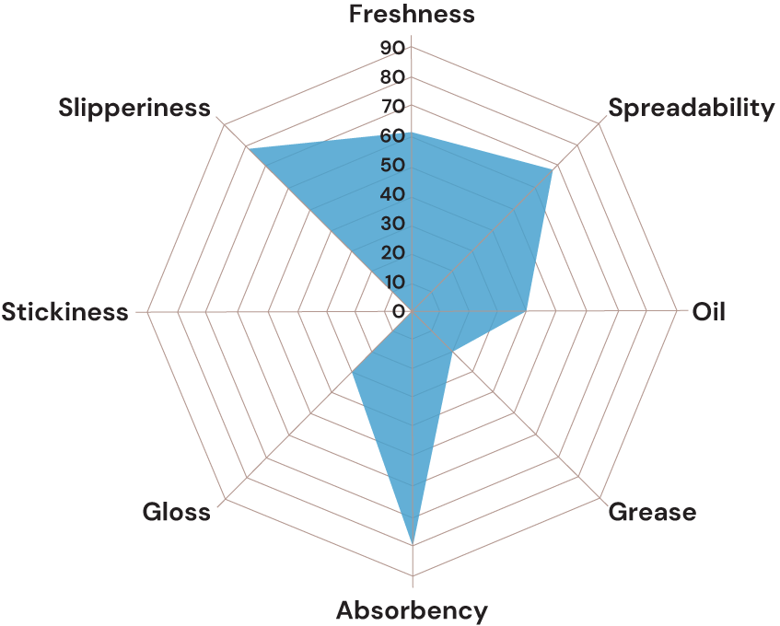
REVITALIN® CB
Energy-boosting Cream-gel
The Energy-boosting cream Gel is designed to intensely and durably refresh the whole face. It’s perfect to use every morning and leaves tired and dull skin looking fresh, glowing and naturally beautiful all day long.
Tested by our
sensory panel:
light (low grease,
low oil), fresh, easy
to spread, reasonable
playtime and
unchanged slip
of the skin.

Slide 17
Energy-boosting Cream Gel
92.85% natural origin content*
 | Ingredients | % w/w | Function
A | C12-15 ALKYL BENZOATE | 4,50 | Emollient
 | OCTYLDODECANOL | 4,00 | Emollient
 | CETEARYL ALCOHOL | 2,00 | Thickening agent, Emulsion stabilizer
 | ACRYLATES/C10-30 ALKYL ACRYLATE CROSSPOLYMER | 0,20 | Emulsifier, Thickening agent
 | NEOPENTYL GLYCOL DIHEPTANOATE | 3,00 | Emollient
 | CAPRYLIC/CAPRIC TRIGLYCERIDE | 6,00 | Emollient
 | HYDROGENATED COCO-GLYCERIDES | 1,00 | Emollient
B | PHENOXYETHANOL, ETHYLHEXYLGLYCERIN | 0,90 | Preservative
 | GLYCERIN | 2,00 | Humectant
 | XANTHAN GUM | 0,20 | Rheology modifier
 | AQUA | 73,45 | Solvent
C | AQUA, SODIUM HYDROXIDE | 0,70 | pH adjuster
D | REVITALIN® CB ( GLYCOPROTEINS, GLUTAMIC ACID, VALINE, THREONINE, AQUA, 1,2-HEXANEDIOL, CAPRYLYL GLYCOL) | 2,00 | Active
E | PARFUM | 0,05 | Provides olfactive identity
Procedure
Prepare Phase A and heat up to 75°C under stirring.
Prepare Phase B and heat up to 75°C.
Add Phase B into Phase A under stirring and homogenize.
Add Phase C under stirring.
Cool down to 35°C under stirring.
Prepare Phase D and add it into the emulsion under stirring, then homogenize for 1 min.
Adjust pH to 5.0 – 6.0 if necessary.
Technical data
pH: 5,4
Viscosity: 11140 mPa.s
(spindle 5 / 10 rpm)
SU-E-101043-24
*Calculated according to ISO 16128 by including formulation water
For experimental use only. Not for sale. dsm-firmenich is not responsible for final products claims. See disclaimer Guide Formulations

Slide 18
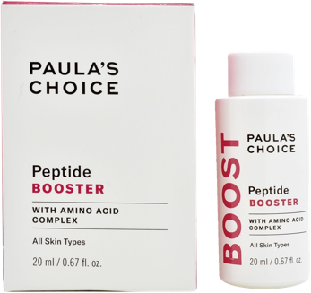
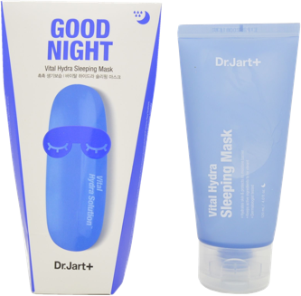
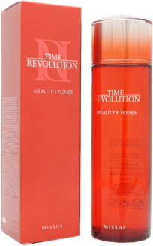
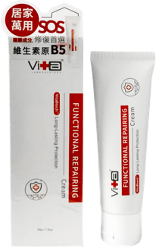
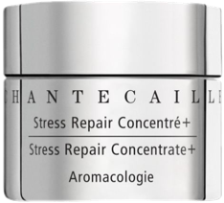
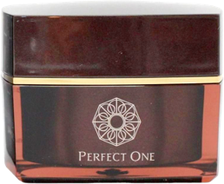
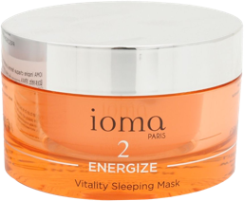
Market products with Glycoproteins, Valine, Threonine, Glutamic acid…
Peptide Booster
With Amino Acid Complex
USA
Vital Hydra
Sleeping Mask
South Korea
Time
Revolution Vitality
South Korea
Functional
Repairing Cream
Switzerland
Stress Repair
Concentrate+
USA
Perfect One
Night Cream
Japan
Vitality
Sleeping Mask
France

