Slide 1

April 2025

Slide 2

Trend
‘Skin Energy & Clean Beauty’
‘Skin Energy’ is a Big Skin Care Trend.¹
Consumers show an increasing interest in naturally functional beauty products to
help them feel energized and healthy.
Clean Beauty
Consumers tend to avoid controversial ingredients and showing more interest in 'cleaner’, energy-boosting products to adopt healthier and 'cleaner' lifestyles.
¹ https://www.elle.com/beauty/makeup-skin-care/a41446994/skin-energy-skin-care-trend/

Slide 3
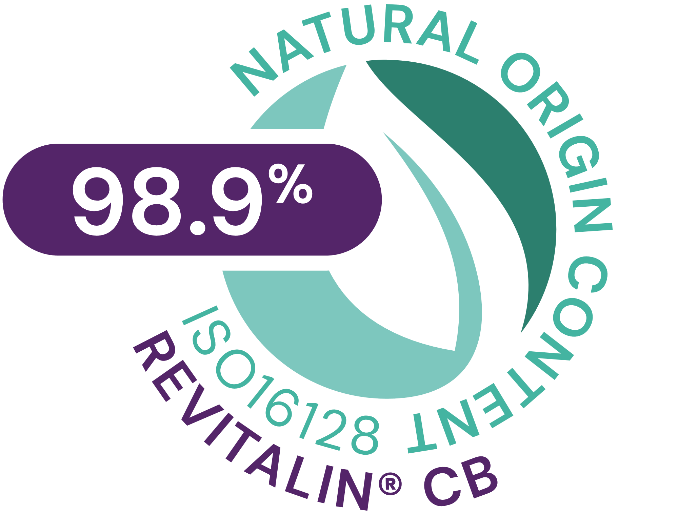




REVITALIN® CB
ID Card
INCI NAME:
Glycoproteins, Glutamic acid, Valine, Threonine, Aqua, 1,2-Hexanediol, Caprylyl Glycol
TECHNOLOGY:
Postbiotic mixture of glycoproteins obtained by fermentation of baker’s yeast
Blended with a sophisticated mixture of 3 skin respiration facilitators
98.9% of natural origin (ISO 16128)
TECHNICAL:
Form: Clear yellowish solution
Use level: 1–5%
pH of use: 3.0 – 7.5
Preservative: Free
Solubility: Water soluble
Helps to accelerate skin renewal by up to 4 days**
Maintains sufficient availability of ATP all day long*
Vitality boost for less energetic (tired) skin cells*
Energy kick for stressed skin cells*
Restores mitochondrial vitality after UV stress*
BENEFITS:
‘Clean Vitality Booster’ to sustain a healthy-looking skin
Contains a combination of postbiotic glycoproteins and three amino acids
Unlocks the Power of Vital Mitochondria
For controlling circadian rhythm
REGISTRATION
CERTIFICATION
* in vitro ** in vivo

Slide 4
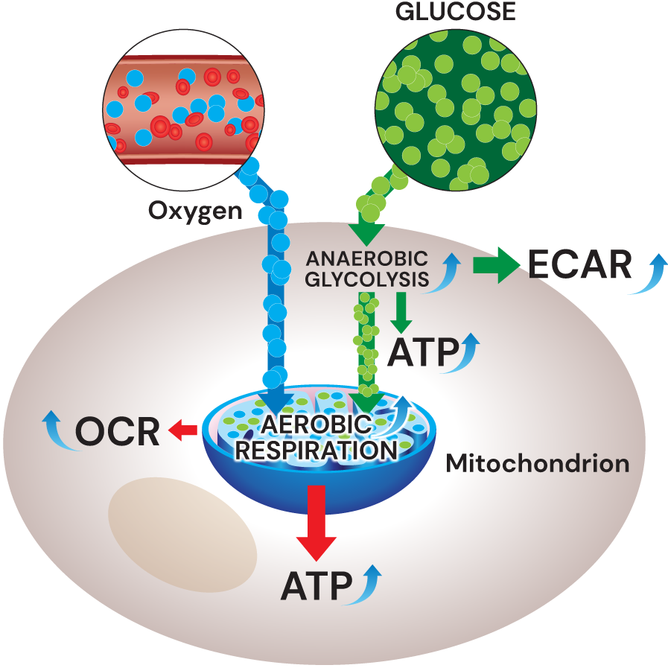
Unlocks the power of ‘vital mitochondria
REVITALIN® CB delivers a lot of ATP by boosting the two fundamental mitochondrial pathways*
1
Anaerobic glycolysis, measured by ECAR (Extracellular Acidification Rate) ³
Aerobic respiration, measured by OCR (Oxygen Consumption Rate) ³
ATP (Adenosine triphosphate), measured by Mitochondrial Toxglo™ kit⁴
2
1
3
3
REVITALIN® CB restores mitochondrial vitality after UV stress*
2
4
4
Stimulates mitochondria-related genes linked to cell energy, regeneration and detoxification*
5
REVITALIN® CB sustains a healthy- looking skin**
3
5
Helps to accelerate cell renewal activity by up to 4 days**.
* In vitro ** In vivo
1 R. Schütz et al. / Journal of Photochemistry & Photobiology, B: Biology 159 (2016) 142–148
2 R. Schütz et al. /Monitoring the energy status of primary human keratinocytes and the effect of REVITALIN® CB on cellular homeostasis, IFSCC 2014
3 Extracellular Flux Analyzer, produced by Seahorse Bioscience USA
4 Mitochondrial Toxglo™ kit, produced by Promega USA

Slide 5
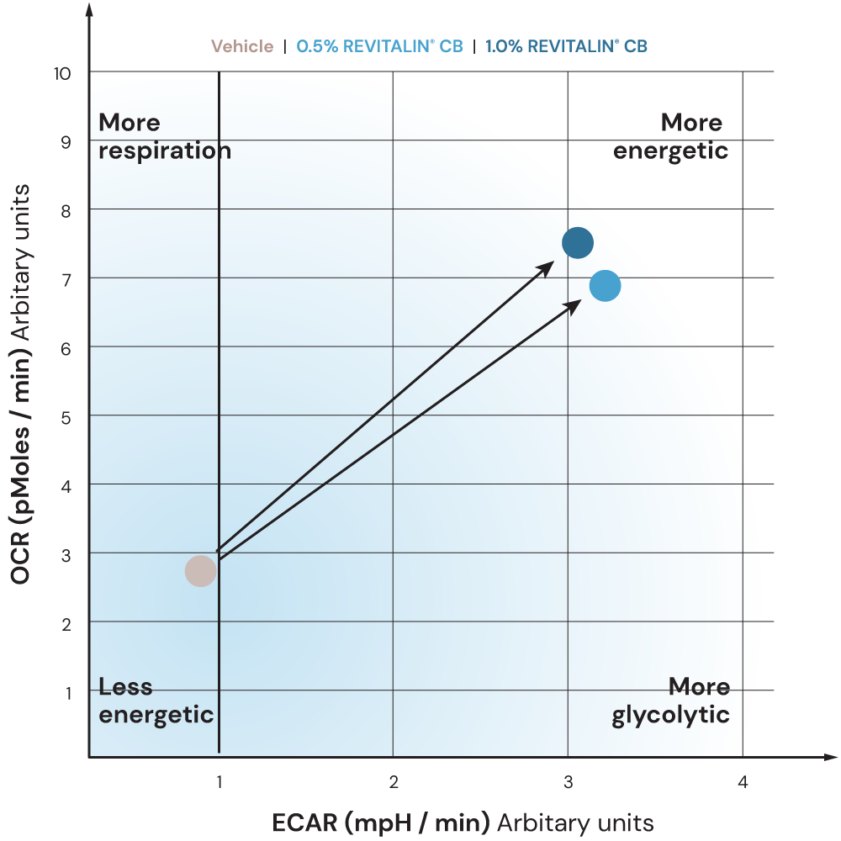
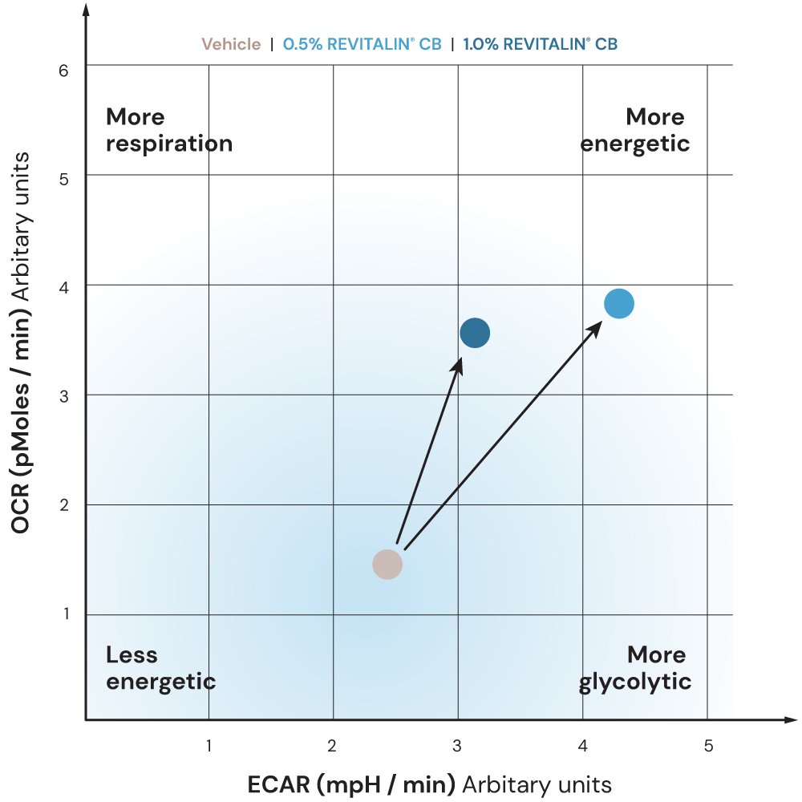
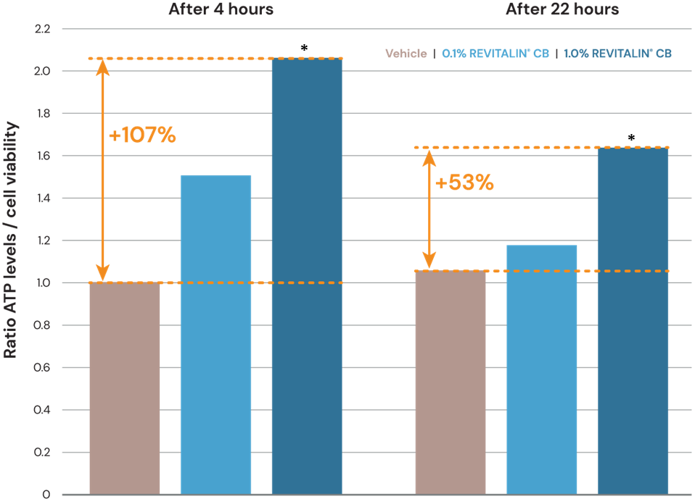
REVITALIN® CB
In vitro proof
Maintains sufficient availability of ATP all day long*
Vitality boost for less energetic (tired) skin cells*
Energy kick for stressed skin cells*
ATP levels vs cell viability in keratinocytes after 4 and 22 hours of REVITALIN® CB treatment, respectively. The data are expressed as ratio of ATP production versus cell viability measured by caspase activity. *p < 0.01 (n = 3).
Effect of REVITALIN® CB (0.5% and 1.0%) on respiration and glycolysis referring to less energetic keratinocytes compared to vehicle-treated cells after 4 hours treatment
Effect of REVITALIN® CB (0.5 and 1.0%) on respiration and glycolysis referring to chemically induced, stressed keratinocytes compared to vehicle-treated cells after 4 hours treatment

Slide 6
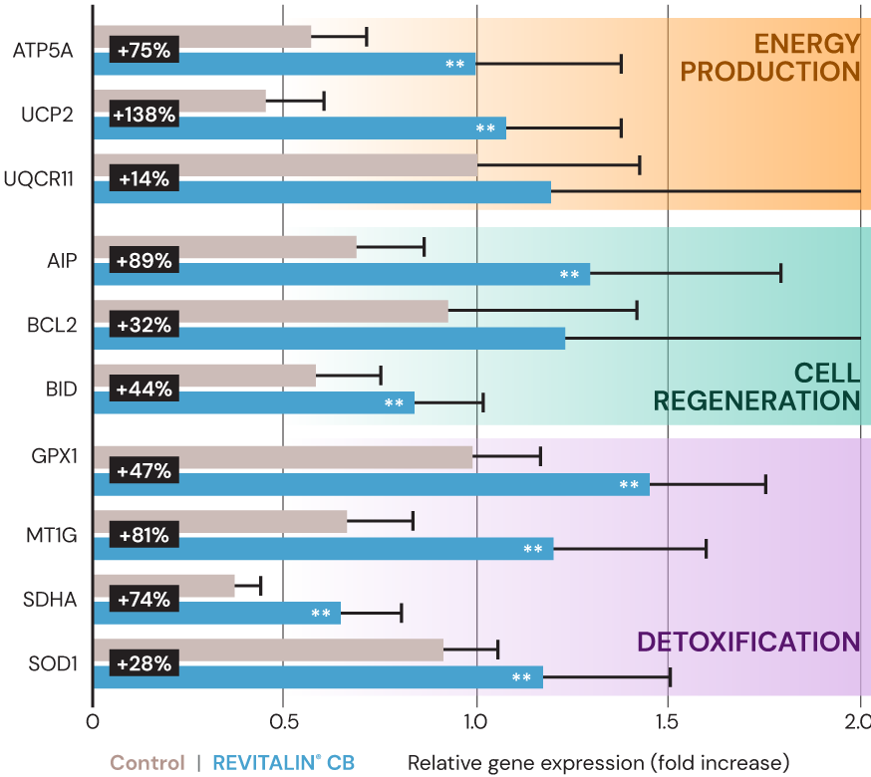
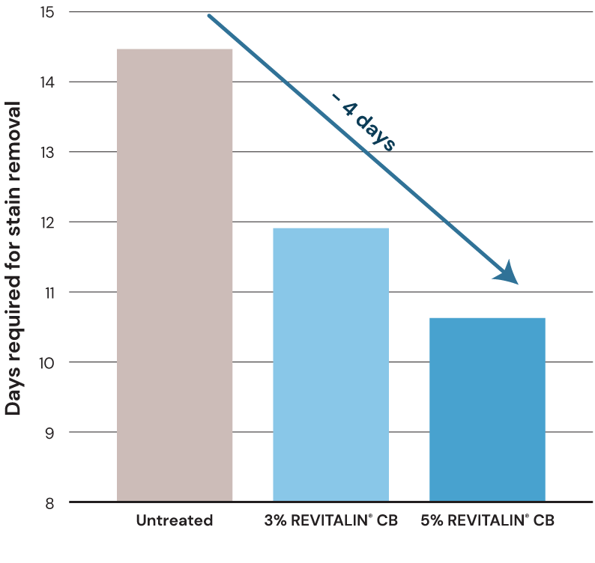
REVITALIN® CB
In vitro and in vivo proofs
Restores mitochondrial vitality after UV stress*
Significant effects on mitochondria-related genes linked to cell energy, cell regeneration and detoxification*
Helps to accelerate skin renewal by up to 4 days to sustain a healthy-looking skin**
Effect of 0.5% REVITALIN® CB (blue bars) on expression of mitochondria-related genes in human keratinocytes 4 h after UVB-irradiation (60 mJ/cm2) relative to the vehicle treated, UV-irradiated control (gray bars). Data are represented as fold change ± SEM from three observations (**significance level p < 0.01 vs. UV-irradiated vehicle control).
The ability of REVITALIN® CB to stimulate skin cell turnover was tested when twelve volunteers (aged 30–55 years) applied 3% and 5% REVITALIN® CB on their forearms twice a day for a period of 20 days. The time for removal of all dansyl chloride staining was determined.
* In vitro **In vivo

Slide 7
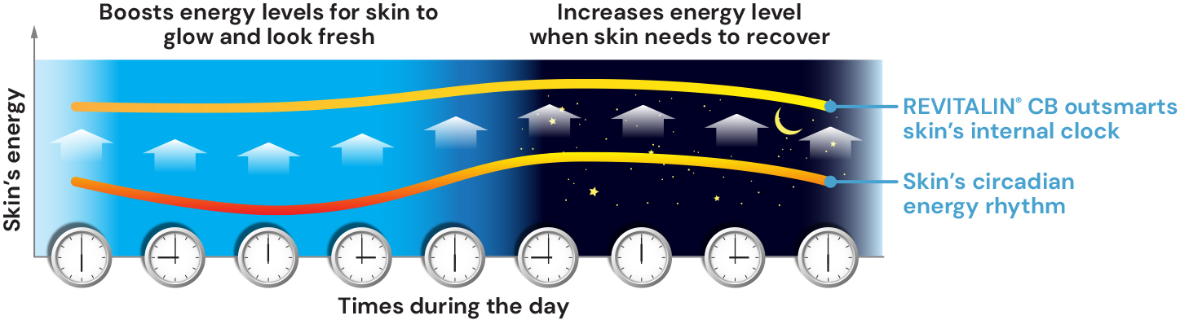
Outsmarts skin’s internal clock
For controlling circadian rhythms
Skin that is optimally energized throughout the cell’s circadian rhythm has a consistent glow and generally fresh complexion.
REVITALIN® CB recharges skin cells with energy during the skin's nighttime and boosts daily energy levels when skin needs it most.

