Slide 1

SERICIN
Creating a silky skin cocoon
Master Presentation
11-2020

Slide 2
Agenda
Consumer demand & market trends
The product
Claim substantiation
Cosmetic use

Slide 3

“I believe in products which protect and prevent my skin from dehydration.
The pleasurable feeling of smooth and luminous skin endorses myself in treating my skin the right way!”

Slide 4

Famous fashion designer
Oscar de la Renta:
"Silk does for the body what diamonds do for the hand.”
Image source: https://www.luxuo.com/culture/celebrities/oscar-de-la-renta-has-died.html

Slide 5

The rise of silk cocoon in skin care
Silk cocoon-based skin care formulations are starting to take off in Asia as consumers seek an alternative way to treat the ageing process!
Source: http://www.cosmeticsdesign-asia.com/Market-Trends/The-rise-of-the-silkworm-cocoon-in-skin-care

Slide 6
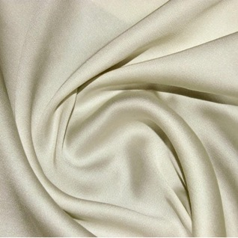
SILK
Some facts
Silk has been synonymous with luxury and beauty
Silk culture has been successfully practiced for
at least 5000 years in China
The history
The fabric is renowned for its sensual feel
Silk fibers are very fine, about 10 nanometers (1/2500th of an inch) in diameter.
The shimmering appearance for which silk is prized comes from the fiber’s triangular prism-like structure which allows silk cloth to refract incoming light at different angles.
The characteristic
Source: https://texeresilk.com/article/silk_facts_tutorial
Notes:
https://texeresilk.com/article/silk_facts_tutorial

Slide 7
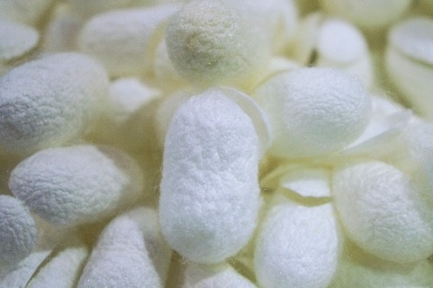
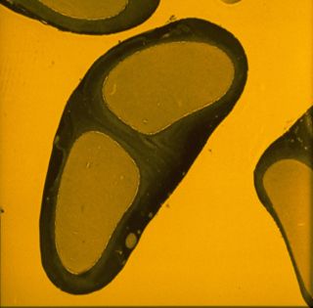
The potential of silk cocoon
Silkworms spin a protective cocoon from a single length of fine, strong, lustrous silk thread up to 1 km in length, which is the source of commercial silk
Sericin
A silk cocoon consists of two classes of cocoon proteins: Fibroin & Sericin.
Sericin is the protein wrapping fibroin
Sericin contributes about 20-30% of total cocoon weight
Fibroin

Slide 8

Natural Sericin is like a “second skin”.

Slide 9
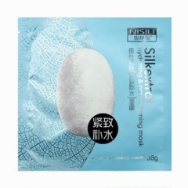
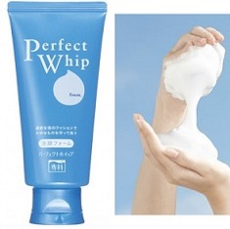
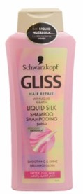
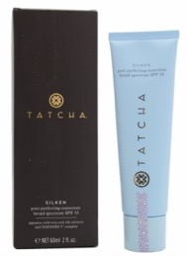
SERICIN
Recent market trends
Silk Mask - China
Silk Foam - Japan
With DSM Sericin derived from delicate white silk cocoon
prevents the loss of skin moisture leaving the skin feeling soft and hydrated
Replenish skin with moisture and nutrients, prevent dryness, and smooth out wrinkles, for a smooth and tender finish
Liquid Silk Shampoo - Germany
Silken Pore Perfecting - USA
Contains silk sericin extracts to reduce the appearance of pores, leaving skin glowing while providing elegant and effective broad spectrum protection against harmful UVA and UVB
Formulated with liquid nutri-silk
Smooth the hair surface, offering suppleness and gloss shine, leaving hair like silk.

Slide 10
Agenda
Consumer demand & market trends
The product
Claim substantiation
Cosmetic use

Slide 11
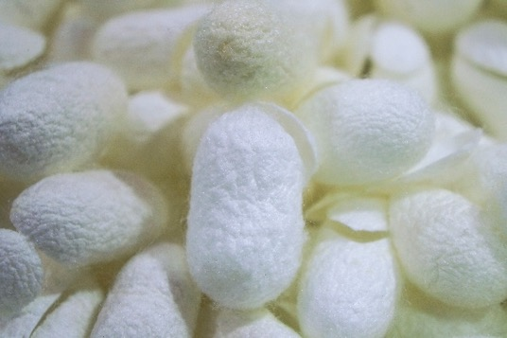
SERICIN
Creating a silky skin cocoon
Sericin is isolated from the delicate white silk cocoon made by the sole domesticated silkworm species, Bombyx mori
The silk glands of Bombyx mori are highly specialized for the synthesis of the cocoon protein Sericin

Slide 12
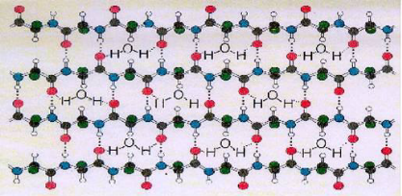
SERICIN
Characteristics & Functions
Composition (INCI): Aqua, Sericin, Potassium Sorbate, Citric Acid
Characteristics | Functions
High proportion of high molecular weight (15000 – 25000 Dalton) oligopeptides | Forms a multifunctional protective film on the skin and hair surface, imparting an immediate, long lasting, smooth, silky feeling
High content of the hydroxy amino acids Serine, Threonine | High affinity to hydrophobic proteins such as keratin and high water binding capacity which regulates skin moisturization
Voegeli R et al; Sericin Silk Protein : Unique Structure and Properties Cosmetics & Toiletries 108(12) 101-108 (1993)

Slide 13
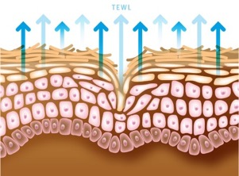
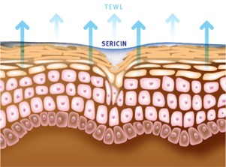
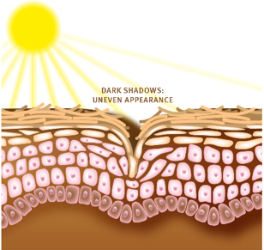
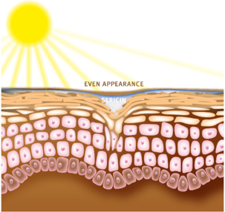
SERICIN
Benefits
Creates a silky skin hydration cocoon by reducing TEWL
Smoothes and protects skin like silk
SERICIN
SERICIN

Slide 14
Agenda
Consumer demand & market trends
The product
Claim substantiation
Cosmetic use

Slide 15
SERICIN EFFICACY – in vivo
Lock in moisture
Study Design
6 female volunteers,
40-48 years
Single application on inner forearm with 224 µl of SERICIN
TEWL measurement with Evaporimeter

Slide 16
SERICIN EFFICACY – in vivo
Lock in moisture
Reduction of Transepidermal Water Loss (TEWL) after single application
After single application, SERICIN strengthens the epidermal barrier by decreasing TEWL .

Slide 17
SERICIN EFFICACY – in vivo
Upregulates skin’s moisture content
Study Design
6 female volunteers,
40-48 years
Single application on inner forearm with 224µl of SERICIN
Determination of moisture in
the skin by Transient Thermal Transfer measurement

Slide 18
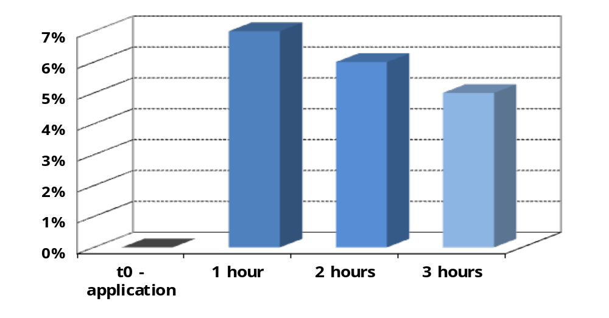
SERICIN EFFICACY – in vivo
Upregulates skin’s moisture content
Moisture content increase in epidermis after single application
Strong moisturizing effect after single application.

Slide 19
SERICIN EFFICACY – in vivo
Wipe away wrinkles
Study Design
10 female volunteers,
35-50 years
Twice daily application on the crow’s feet with 7% SERICIN in a o/w cream against placebo
Three dimensional analysis of the image by WRINKLE®, measured before and after a treatment of 21 days

Slide 20
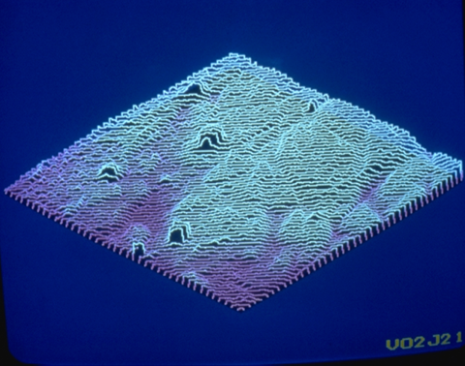
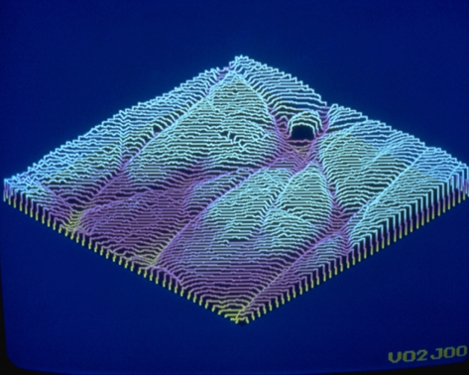
SERICIN Efficacy – in vivo
Wipe away wrinkles
Image of the cutaneous relief of one volunteer before and after
the treatment
SERICIN induces an improvement of the cutaneous relief and a decrease in deep wrinkles
Before application
After application

Slide 21
SERICIN EFFICACY – in vivo
Anti-irritant properties
Study Design
10 subjects
SERICIN was dissolved at 5%
into a gel on the day of the test and patched on the forearm (vs. placebo)
Skin irritation was assessed with laser Doppler over the next four hours

Slide 22
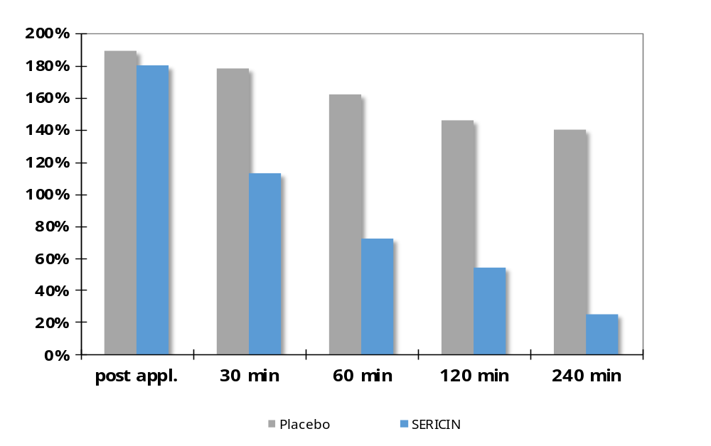
SERICIN Efficacy – in vivo
Anti-irritant properties
Reduction of irritation after SLS application
Laser Doppler: blood flow
SERICIN reduces irritation caused by SLS

Slide 23
Agenda
Consumer demand & market trends
The product
Claim substantiation
Cosmetic use

Slide 24



SERICIN
Formulation guidance
  Dosage: For skin and hair care preparations a use level of 1- 7 % SERICIN is recommended.
Processing: SERICIN is very easy to handle, it can be processed either warm (80°C) or cold.
pH: The optimal pH-range of a formulation with SERICIN is between 5 and 9.
Ethanol: SERICIN is not compatible with ethanol.
Storage: Between 15 and 25°C in the original sealed container, protected from light in a clean place.

Slide 25
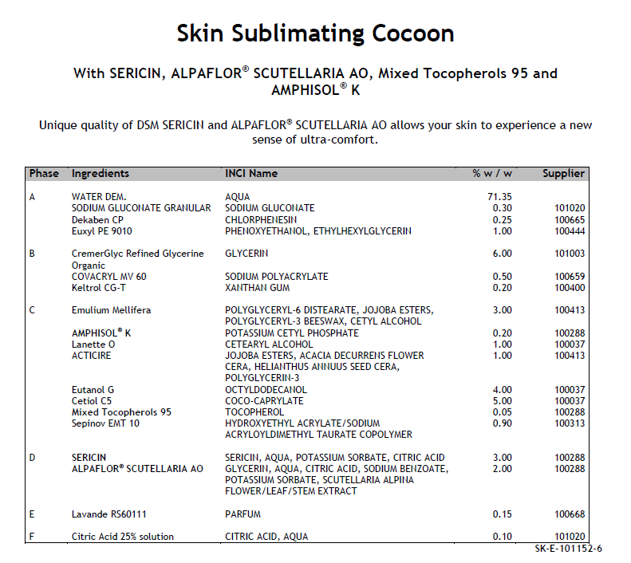
SERICIN
Guide formulation

Slide 26
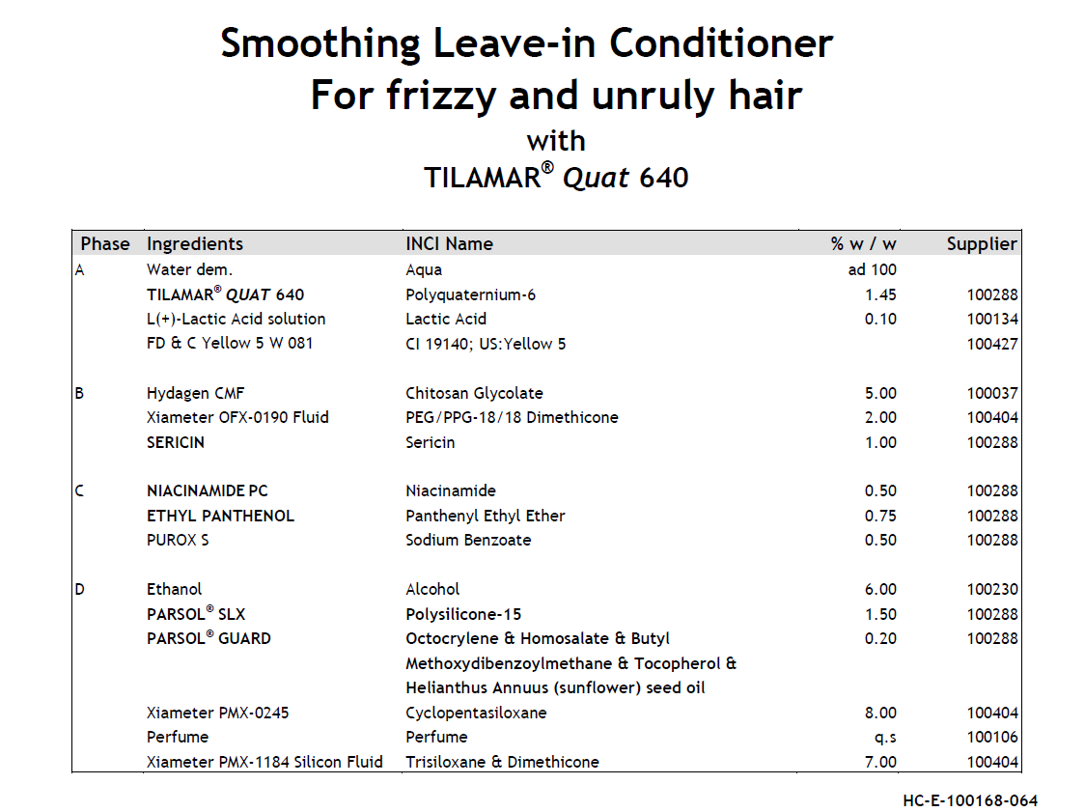
SERICIN
Guide formulation

Slide 27
SERICIN
Application concepts
Skin sublimating cocoon:
SERICIN and ALPAFLOR® SCUTELLARIA AO
Anti-Wrinkle Night Cream W/O SERICIN
Smoothing Leave-in Conditioner for frizzy and unruly hair:
SERICIN and TILAMAR® Quat 640
Smoothness boost: Mix it with the Mix and Match shampoo with SERICIN

Slide 28

SERICIN
What is in it for the consumer?
Long lasting silky film on skin & hair
Unique multi-functionality:
  Silky Feel and Touch
  Moisturization
  Protection
  Smoothing
  Anti-wrinkle effect
  Anti-irritation effect
Pampering and Well-Being

Slide 29
DISCLAIMER
Copyright © 2020 DSM Nutritional Products, 4002 Basel, Switzerland.
www.dsm.com/personal-care. All rights reserved.
Although DSM has used diligent care to ensure that the information provided herein is accurate and up to date, DSM makes no representation or warranty of the accuracy, reliability, or completeness of the information. This presentation only contains scientific and technical information for business to business use. Country- or region-specific information should also be considered when labeling or advertising to final consumers. This publication does not constitute or provide scientific or medical advice, diagnosis, or treatment and is distributed without warranty of any kind, either expressly or implied. In no event shall DSM be liable for any damages arising from the reader’s reliance upon, or use of, these materials. The reader shall be solely responsible for any interpretation or use of the material contained herein. The content of this document is subject to change without further notice. Please contact your local DSM representative for more details. All trademarks listed in this brochure are either registered trademarks or trademarks of DSM in The Netherlands and/or other countries unless explicitly otherwise stated.
DISCLAIMER FORMULATION GUIDELINES
This information is for illustration purposes only and based upon our current knowledge and experience at the time of printing. We do not make any representation or warranty of any kind, express or implied, including merchantability or fitness for a particular use, with respect to such information or its application. Use of this information is at your discretion and risk. Nothing herein relieves you from carrying out your own suitability determinations and tests. You are responsible for observing all laws and regulations relevant to your products, uses or processes. We do not assume any liability in connection with your product and its use. The foregoing information and suggestions are also provided without warranty of non-infringement as to the intellectual property rights of third parties, and shall not be construed as any inducement to infringe the rights of third parties.

