Slide 1
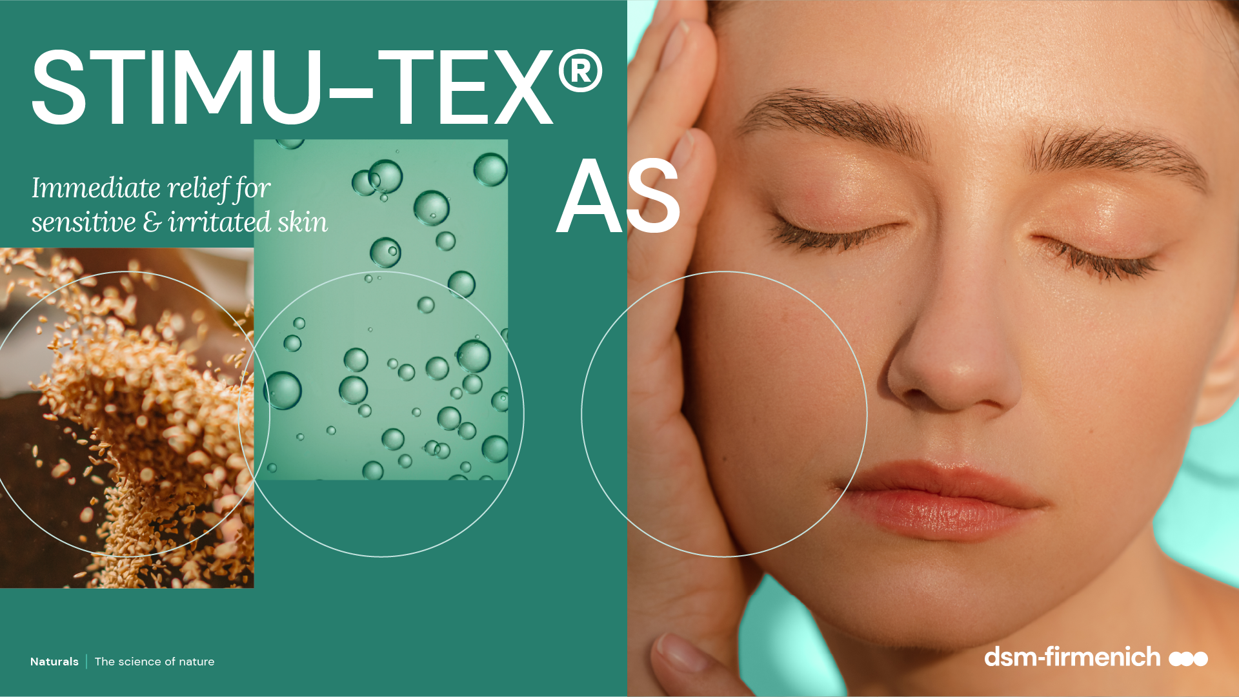
April 2026

Slide 2

Sensitive skin is a universal phenomenon
>70%
>70% of global consumers say they have experienced signs of sensitivity, like redness, dryness, or stinging / burning / itching on their facial skin
Sensitive skin is equally common across all ethnicities.
Women are more likely to report sensitive skin than men.
Post-menopausal women claiming sensitive skin, over
70% perceived their skin sensitivity increased after menopause.
Younger age groups report higher rates of sensitive skin.
https://www.personalcareinsights.com/news/aveeno-reveals-increasing-skin-sensitivity-and-related-emotional-disorders-in-consumers.html

Slide 3

What is sensitive skin?
Sensitive skin is characterized by an extreme reaction to everyday factors like dust, pollution, chemicals, heat, cold or UV.
As skin becomes sensitized, it becomes vulnerable to outside attacks, and responds with redness, stinging or itchy feelings, and even burning sensations.
People with sensitive skin report impairment of health-related quality of life.
https://www.personalcareinsights.com/news/aveeno-reveals-increasing-skin-sensitivity-and-related-emotional-disorders-in-consumers.html

Slide 4

High demand for products for sensitive skin
Consumer demand for sensitive skincare products is at an all-time high because
of environmental aggressors.
83%
of consumers are actively looking for skin care products that are created for sensitive skin
https://www.personalcareinsights.com/news/aveeno-reveals-increasing-skin-sensitivity-and-related-emotional-disorders-in-consumers.html

Slide 5





STIMU-TEX® AS
ID Card
INCI NAME:
Spent Grain Wax, Argania Spinosa (Argan) Kernel Oil, Butyrospremum Parkii (Shea Butter) Extract, Tocopherol
TECHNOLOGY:
A unique mixture of premium, upcycled spent grain wax a by-product of the beer production, cold-processed argan oil, and shea butter.
100% of natural origin
TECHNICAL:
Form: Off-white to yellowish lipidic mass
Use level: 1–5%
Preservative: Free
Solubility: Oil soluble
BENEFITS:
Significantly decreases the expression of IL-1α, a marker for inflammatory reactions**
Helps to reduce itch mediators such as histamine*
Effectively reduces histamine-related symptoms like itching and redness, while significantly enhancing skin comfort within 5 minutes***
REGISTRATION
CERTIFICATION
* in vitro ** ex vivo *** in vivo
Naturals | The science of nature

Slide 6

The rise of upcycled beauty
Consumers around the world are increasingly looking for authentic products with scientifically proven efficacy.
Upcycled ingredients for use in our modern world is proving popular among those who want to nourish their skin for a naturally flawless look.
What is upcycling?
It transforms by-products and waste materials into something new and exciting - something that consumers want to use and find great joy from.
STIMU-TEX® AS is enriched with upcycled spent grain wax

Slide 7

Brewers have always had smooth, soft hands
For generations, beer brewers have recognized the soothing properties of spent grain, traditionally associated with calming skin and relieving itching.
But what exactly is brewer’s spent grain?
Brewer’s spent grain is the most abundant by‑product of the beer‑brewing process, accounting for around 85% of all brewing by‑products.
It is the natural residue left after pure barley (Hordeum vulgare) is transformed into malt through successive physical and fermentative processing steps.

Slide 8

Pure Spent Grain Wax — From Brewery By-Product to High Value Skin Soother
Rooted in the German brewing tradition, Pure Spent Grain Wax is upcycled from brewer’s spent grain left after beer production.
Using gentle supercritical CO₂ extraction, it is transformed into a pure, golden wax that:
  Avoids harsh solvents
  Preserves skin‑soothing lipids
  Delivers a soft, skin‑loving texture
Unique upcycled origin
Role in STIMU-TEX® AS
Provides skin‑soothing lipids that enhance comfort
Supports relief from itching and irritation
Contributes to the soft, caring sensory profile of the blend
A fusion of heritage and green innovation, turning an overlooked by‑product into a comforting, sustainable skin ingredient.

Slide 9

Spent grain wax delivers strong relief on skin with atopic conditions
Dermatological study performed on skin with atopic conditions*
100 volunteers, 1% and 5% spent grain wax used in a w/o emulsion; placebo, half-face blind application of verum & placebo; twice daily, 1-4 weeks
84%
Preferred formula
80%
Result: strong and perceivable itching alleviation
Better anti-itching effect
Spent grain wax | Placebo
** Source: Entwicklung und Prüfung eines neuen dermatologisch-kosmetischen Wirkstoffes aus Gerstentreber (development and testing of a new dermatological-cosmetic active ingredient from barley grains), H. Tronnier, P. Haas and L. Motitschke, Ärztliche Kosmetologie 17, 342-352 (1987)
Notes:
The properties of Spent Grain – the key ingredient of STIMU-TEX AS – were investigated in extensive studies on skin with atopic conditions.
Volunteers - with a.o. severe skin dermatitis, psoriasis, or pruritus - tested the effect of Spent Grain on their skin by use of as bath additive or as O/W emulsion.

Slide 10

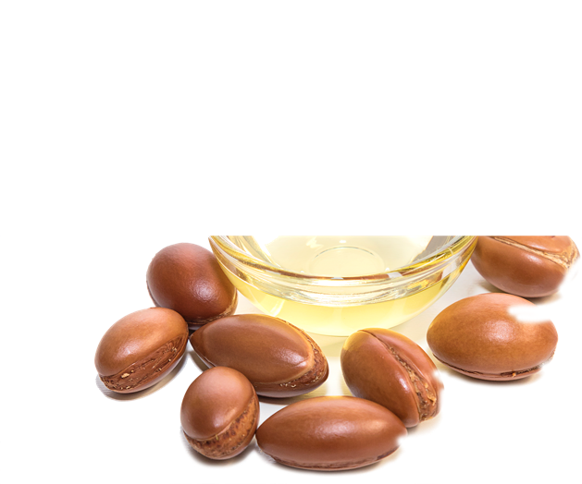
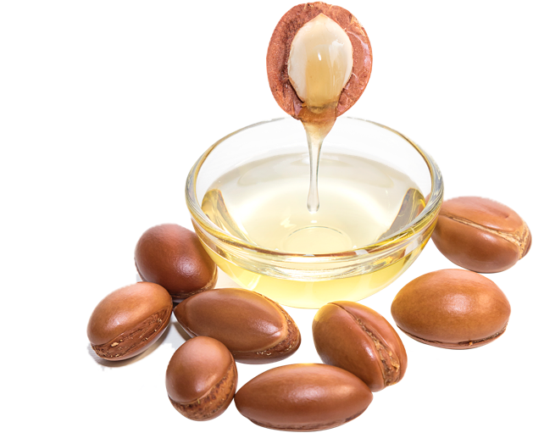
Argan Oil — Purity, Heritage & High Concentration of Actives
Exceptional quality & processing
Cold pressed from Argania spinosa kernels to maintain a high concentration of soothing compounds
Minimal processing preserves purity and maximizes skin calming efficacy
Specifically deodorized resulting in a clear and nearly colorless product
Authentic multicultural sourcing
It is known to the Berbers living there as the “Tree of Life”.
Responsibly sourced from Morocco, rooted in centuries old beauty traditions
Role in STIMU-TEX® AS
Reinforces the blend’s instant soothing action
Helps restore comfort for sensitive and irritated skin

Slide 11

Shea Butter — Time Honored Comfort with Deep Soothing Power
Rich cultural heritage
Known as the “African wonder”, cherished for more than 2,000 years
A symbol of natural nourishment and protection from ancient Egypt to today
The extraction of the fruit’s kernels provides the butter, which consists mostly of fatty acids – linoleic acid in particular.
Dermatological comfort
Naturally soothing, nourishing, and skin softening
Role in STIMU-TEX® AS
Complements the full blend to deliver long lasting comfort

Slide 12
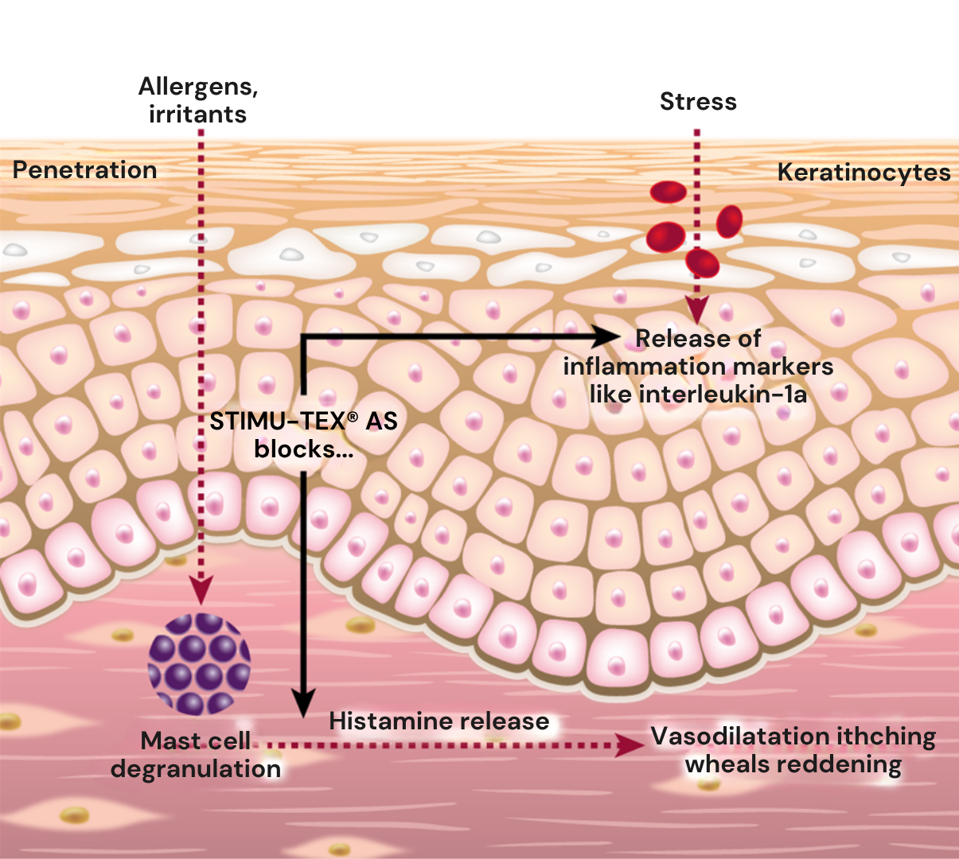

STIMU-TEX® AS
Mode of action
Dry and sensitive skin is characterized by a weak barrier function and a low threshold for allergic reactions, which can be triggered by different stimuli present in our environment. In response,
dsm-firmenich has developed STIMU-TEX® AS, which effectively eases sensitive skin complaints thanks to the complementary skin-care properties of its three compounds.
STIMU-TEX® AS liberates feeling of skin comfort
It effectively helps to inhibit epidermal reddening processes.*
It helps to reduce the effects of histamine release like redness and itching**.
*in vitro
**in vivo
Notes:
Dry and sensitive skin is characterized by a weak barrier function and a low threshold for allergic reactions, which can be triggered by different stimuli present in our environment.
Penetration of allergens or irritants through the skin leads to mast cell (also known as mastocyte) degranulation, which in turn releases histamine. Histamine release provokes local inflammatory reaction with the known topical symptoms (itching, reddening, oedema).
STIMU-TEX® AS effectively eases sensitive skin complaints thanks to the complementary skin-care properties of its three compounds:
It effectively helps to inhibit epidermal inflammation processes.
It helps to strongly reduce the effects of histamine release.
It visibly regenerates irritated skin.
Stressed skin’s red appearance and itchy sensation are substantially alleviated, leaving the skin looking healthy and feeling soothed.
This slide explained that STIMU-TEX® AS eases histamine-induced skin complaints.
Histamine is a marker for allergic reactions. Histamine-blocking products inhibit symptoms of allergy such as itching, swelling, and red skin.
E-selectin expression was found to be a convenient way to study the histamine-neutralizing capacity of STIMU-TEX® AS (see more detailed information on E-selectin below).
Assay background:
Histamine increases the permeability of blood vessels which leads to oedema and inflammation.
One of the key molecules in this regard is the molecule E-selectin.
However Histamine can not activate the expression of the intercellular E-selectin directly; it needs the presence of TNF (Tumor Necrosis Factor).
That’s why this dedicated in vitro model was developed, in order to allow the contact between histamine and E-selectin.
Results:
Medium + STIMU-TEX® AS (negative control): no activation of E-selectin expression (column 1).
Adding TNF induced a cellular inflammatory response, seen as strong expression of the E-selectin (column 2).
This effect was significantly enhanced in the presence of histamine (column 3).
STIMU-TEX® AS did not interfere with TNF, however it almost completely blocked the enhancing effect of histamine (added at 1 microMol).
STIMU-TEX® AS nearly completely blocks E-selectin expression, a downstream target of histamine.
As E-selectin is involved in the inflammatory process, its reduced expression is seen as a positive anti-inflammatory effect.
What is E-selectin?
E-selectin plays a key role in the progress of an inflammatory reaction: as shown on previous slide, mast cell (also known as mastocyte) degranulation releases histamin, provoking local inflammatory reaction. This induces a signal for E-selectin up-regulation at the inner surface of the blood vessel wall. E-selectin is a protein that acts as a “cell adhesion molecule”. Circulating leucocytes in the blood have an affinity for E-selectin (which is located at the inner surface of the blood vessel) and bind to it. Leucocytes then stick to the blood vessel wall via E-selectin at the site of beginning inflammation. Leucocytes that are halted by E-selectin may then migrate out of the blood vessel into the tissue and boost there the inflammatory process. This whole damaging process can be blocked if E-selectin is inhibited (as seen on this in vitro assay).
(Reminder: a mast cell (or mastocyte) is a resident cell of several types of tissues and contains many granules rich in histamine and heparin. Although best known for their role in allergy and anaphylaxis, mast cells play an important protective role as well, being intimately involved in wound healing and defense against pathogens).
This ex vivo assay complements the results of the in vitro test, showing the significant properties of STIMU-TEX® AS to reduce the expression of inflammation markers.
Anti-inflammatory assay
Determination of the inflammation marker interleukin-1α, released in the supernatants of stripped human skin disks.
A human skin fragment was taken after abdominal plastic surgery and stripped 10 times. STIMU-TEXR AS was tested on the skin surface at a concentration of 1 mg/cm2.
Dexamethasone is a glucocorticoid, used as positive control.
Result:
STIMU-TEX® AS significantly decreases the expression of IL-1α by 58%, a marker for inflammatory reactions.

Slide 13

STIMU-TEX® AS
Strong histamine rebalancing capacity in vitro
Histamine effect blocking assay
Histamine is a marker for allergic reactions. Histamine blocking products inhibit the symptoms of allergy such as itching, swelling, and red skin.
An in vitro assay with human endothelial cells was developed to quantify histamine effects: Histamine combined with TNF (Tissue Necrosis Factor) enhances the induction of E-selectin on endothelial cells. E-selectin induction is the starting point of an inflammatory reaction.
STIMU-TEX® AS nearly completely rebalances
E-selectin expression on endothelial cells,
a downstream target of histamine*.
*in vitro
Notes:
This slide explained that STIMU-TEX® AS eases histamine-induced skin complaints.
Histamine is a marker for allergic reactions. Histamine-blocking products inhibit symptoms of allergy such as itching, swelling, and red skin.
E-selectin expression was found to be a convenient way to study the histamine-neutralizing capacity of STIMU-TEX® AS (see more detailed information on E-selectin below).
Assay background:
Histamine increases the permeability of blood vessels which leads to oedema and inflammation.
One of the key molecules in this regard is the molecule E-selectin.
However Histamine can not activate the expression of the intercellular E-selectin directly; it needs the presence of TNF (Tumor Necrosis Factor).
That’s why this dedicated in vitro model was developed, in order to allow the contact between histamine and E-selectin.
Results:
Medium + STIMU-TEX® AS (negative control): no activation of E-selectin expression (column 1).
Adding TNF induced a cellular inflammatory response, seen as strong expression of the E-selectin (column 2).
This effect was significantly enhanced in the presence of histamine (column 3).
STIMU-TEX® AS did not interfere with TNF, however it almost completely blocked the enhancing effect of histamine (added at 1 microMol).
STIMU-TEX® AS nearly completely blocks E-selectin expression, a downstream target of histamine.
As E-selectin is involved in the inflammatory process, its reduced expression is seen as a positive anti-inflammatory effect.
What is E-selectin?
E-selectin plays a key role in the progress of an inflammatory reaction: as shown on previous slide, mast cell (also known as mastocyte) degranulation releases histamin, provoking local inflammatory reaction. This induces a signal for E-selectin up-regulation at the inner surface of the blood vessel wall. E-selectin is a protein that acts as a “cell adhesion molecule”. Circulating leucocytes in the blood have an affinity for E-selectin (which is located at the inner surface of the blood vessel) and bind to it. Leucocytes then stick to the blood vessel wall via E-selectin at the site of beginning inflammation. Leucocytes that are halted by E-selectin may then migrate out of the blood vessel into the tissue and boost there the inflammatory process. This whole damaging process can be blocked if E-selectin is inhibited (as seen on this in vitro assay).
(Reminder: a mast cell (or mastocyte) is a resident cell of several types of tissues and contains many granules rich in histamine and heparin. Although best known for their role in allergy and anaphylaxis, mast cells play an important protective role as well, being intimately involved in wound healing and defense against pathogens).
This ex vivo assay complements the results of the in vitro test, showing the significant properties of STIMU-TEX® AS to reduce the expression of inflammation markers.
Anti-inflammatory assay
Determination of the inflammation marker interleukin-1α, released in the supernatants of stripped human skin disks.
A human skin fragment was taken after abdominal plastic surgery and stripped 10 times. STIMU-TEXR AS was tested on the skin surface at a concentration of 1 mg/cm2.
Dexamethasone is a glucocorticoid, used as positive control.
Result:
STIMU-TEX® AS significantly decreases the expression of IL-1α by 58%, a marker for inflammatory reactions.

Slide 14

STIMU-TEX® AS
Strong reducing of skin reddening ex vivo
Anti-inflammatory assay ex vivo
Determination of the inflammation marker interleukin-1α, released in the supernatants of stripped human skin disks.
A human skin fragment was taken after abdominal plastic surgery and stripped 10 times. STIMU-TEX® AS was tested on the skin surface at a concentration of 1 mg/cm2. Dexamethasone is a glucocorticoid, used as positive control.
-58%
STIMU-TEX® AS significantly decreases the expression of IL-1α by 58%, a marker for inflammatory reactions*.
*ex vitro
Notes:
This slide explained that STIMU-TEX® AS eases histamine-induced skin complaints.
Histamine is a marker for allergic reactions. Histamine-blocking products inhibit symptoms of allergy such as itching, swelling, and red skin.
E-selectin expression was found to be a convenient way to study the histamine-neutralizing capacity of STIMU-TEX® AS (see more detailed information on E-selectin below).
Assay background:
Histamine increases the permeability of blood vessels which leads to oedema and inflammation.
One of the key molecules in this regard is the molecule E-selectin.
However Histamine can not activate the expression of the intercellular E-selectin directly; it needs the presence of TNF (Tumor Necrosis Factor).
That’s why this dedicated in vitro model was developed, in order to allow the contact between histamine and E-selectin.
Results:
Medium + STIMU-TEX® AS (negative control): no activation of E-selectin expression (column 1).
Adding TNF induced a cellular inflammatory response, seen as strong expression of the E-selectin (column 2).
This effect was significantly enhanced in the presence of histamine (column 3).
STIMU-TEX® AS did not interfere with TNF, however it almost completely blocked the enhancing effect of histamine (added at 1 microMol).
STIMU-TEX® AS nearly completely blocks E-selectin expression, a downstream target of histamine.
As E-selectin is involved in the inflammatory process, its reduced expression is seen as a positive anti-inflammatory effect.
What is E-selectin?
E-selectin plays a key role in the progress of an inflammatory reaction: as shown on previous slide, mast cell (also known as mastocyte) degranulation releases histamin, provoking local inflammatory reaction. This induces a signal for E-selectin up-regulation at the inner surface of the blood vessel wall. E-selectin is a protein that acts as a “cell adhesion molecule”. Circulating leucocytes in the blood have an affinity for E-selectin (which is located at the inner surface of the blood vessel) and bind to it. Leucocytes then stick to the blood vessel wall via E-selectin at the site of beginning inflammation. Leucocytes that are halted by E-selectin may then migrate out of the blood vessel into the tissue and boost there the inflammatory process. This whole damaging process can be blocked if E-selectin is inhibited (as seen on this in vitro assay).
(Reminder: a mast cell (or mastocyte) is a resident cell of several types of tissues and contains many granules rich in histamine and heparin. Although best known for their role in allergy and anaphylaxis, mast cells play an important protective role as well, being intimately involved in wound healing and defense against pathogens).
This ex vivo assay complements the results of the in vitro test, showing the significant properties of STIMU-TEX® AS to reduce the expression of inflammation markers.
Anti-inflammatory assay
Determination of the inflammation marker interleukin-1α, released in the supernatants of stripped human skin disks.
A human skin fragment was taken after abdominal plastic surgery and stripped 10 times. STIMU-TEXR AS was tested on the skin surface at a concentration of 1 mg/cm2.
Dexamethasone is a glucocorticoid, used as positive control.
Result:
STIMU-TEX® AS significantly decreases the expression of IL-1α by 58%, a marker for inflammatory reactions.

Slide 15

STIMU-TEX® AS
Immediate relief within 5 minutes in vivo
The release of histamine induces a vasodilatation, an increase of vascular permeability, inflammation, and skin redness. Laser Doppler flow measurements enable this increased blood flow to be quantified.
Histamine was applied on the inner forearm of 10 healthy female volunteers between the ages of 18 and 39.
Penetration of histamine into the skin was stimulated non-invasively by iontophoresis in order to produce a mild reaction.
Results for distilled water (negative control), histamine alone (positive control), and 5% STIMU-TEX® AS with histamine were compared.
The reactions were determined non-invasively as perfusion modification by means of a laser Doppler imager and as wheal formation by computerized surface measurement.
-30%
*
**
STIMU-TEX® AS formulation significantly reduces histamine-related symptoms by 30% after as little as 5 minutes**
**in vivo

Slide 16
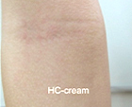
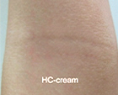
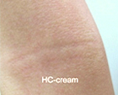
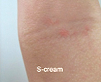
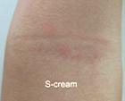
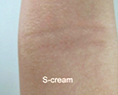
STIMU-TEX® AS
Dermatological study on Asian skin with atopic conditions¹
29 Asian (Thai) patients (18 male and
11 female), aged between 2–15 years
3% STIMU-TEX® AS (S cream) vs
1% Hydrocortisone (HS cream)
The body was randomly divided to left and right side. One side was applied with S cream and the other side was applied with HC cream twice daily for four weeks.
Baseline
Week 2
Week 4
Hydrocortisone Cream
Hydrocortisone Cream
Hydrocortisone Cream
STIMU-TEX® AS Cream
STIMU-TEX® AS Cream
STIMU-TEX® AS Cream
Visible reduction of Childhood Atopic Dermatitis by a STIMU-TEX® AS (3%) cream after already 2 weeks
¹: Panaya Jirabundansuk MD*, Suwirakorn Ophaswongse MD*, Montree Udompataikul MD* Skin Center, Faculty of Medicine, Srinakharinwirot University, Bangkok, Thailand; J Med Assoc Thai Vol. 97 No. 8 2014

Slide 17


STIMU-TEX® AS
Easy to use
Off-white to yellowish, lipidic mass with a pleasant smell.
Soluble/miscible in lipophilic products.
Can be incorporated into the oily phase of a cosmetic formulation either hot (up to 80°C) or after the emulsion step around 40°C.
Stress relief cosmetic lines for sensitive and irritated skin.
Recommended dosage: 1 to 5%.
Naturals | The science of nature

Slide 18

Advanced Skin Relief Cream
Liberates feeling of skin comfort
This gentle cream helps skin feel relieved from irritation and discomfort. It transforms dry and sensitive skin into a smoother, healthier appearance.
STIMU-TEX® AS helps to calm irritated and itchy skin.
ALPAFLOR® EDELWEISS CB reinforces the skin barrier, helps reduce skin redness, helps the skin preserve its natural balance, and reduces skin sensitivity.
VALVANCE® Touch 210 provides sensory enhancement
Products are for experimental use only and are not for sale. dsm-firmenich is not responsible for final products claims
Naturals | The science of nature

Slide 19
Advanced Skin Relief Cream
99.7% natural origin content*
 | Ingredients | % w/w | Function
A | Cetearyl Olivate, Sorbitan Olivate | 2,50 | Emulsifier
 | Cetyl Alcohol | 1,00 | Co-Emulsifier
 | Caprylic/Capric Triglyceride | 3,00 | Emollient
 | Squalane | 5,00 | Emollient
 | Capryloyl Glycerin/Sebacic Acid Copolymer, Diheptyl Succinate | 2,00 | Emulsifier
 | Macadamia Integrifolia Seed Oil | 1,00 | Emollient
B | Propanediol | 2,00 | Sensory, Hydration, Active carrier and Preservative booster
 | Gluconolactone, Sodium Benzoate | 0,80 | Preservative
 | Glycerin | 3,00 | Humectant
 | Xanthan Gum | 0,30 | Rheology modifier
 | Aqua | 70,83 | Solvent
C | ALPAFLOR® EDELWEISS CB (Leontopodium Alpinum Flower/Leaf Extract, Glycerin, Aqua, Citric Acid) | 3,00 | Active
 | STIMU-TEX® AS (Argania Spinosa Kernel Oil, Tocopherol, Butyrospermum Parkii Butter Extract, Spent Grain Wax) | 2,50 | Active
 | VALVANCE® Touch 210 (Silica) | 2,00 | Sensory modifier
D | Aqua, Sodium Hydroxide | 1,07 | pH adjuster
Procedure
Mix Phase A and heat up under stirring to 80°C.
Add the Macadamia Seed Oil at the end of the heating phase.
Phase B and heat up under stirring to 75°C.
Add Phase A to Phase B under stirring and homogenize 1.5 min at 18'000 rpm.
Let cool down and add Phase C under stirring at about 30°C.
Let cool down to room temperature and adjust the pH with Phase D to ± 5.0.
Technical data
pH: 5.02
Viscosity (spindle RV-3/10 rpm): 7180 mPaS
SK-E-102382-1
See disclaimer Guide Formulations
*Calculated according to ISO 16128 by including formulation water
Products are for experimental use only and are not for sale. dsm-firmenich is not responsible for final products claims

Slide 20
Soothing Fluid
Helps to calm irritated skin
This fluid delivers a creamy and smooth texture, providing lasting care for your skin. It delivers maximum hydration and helps to calm irritated skin.
PENTAVITIN® excellent moisture-retaining capacities by binding to skin, brings dry skin back to life, restores & calms stressed skin, strengthens skin barrier function for a more resilient skin
STIMU-TEX® AS helps to calm irritated and itchy skin.
ARGAN OIL has been used for its soothing properties
HYA-ACT™ M provides immediate hydration and strengthens the protective skin barrier by building a superior protecting film
Vitamin B12 cryst Food Grade helps relieve sensitive and stressed skin, skin looks more vibrant
dl-alpha-Tocopheryl Acetate helps the skin defend itself against external aggressions (UVs, pollutants) and to make use of its antioxidant and anti-pollution properties
Mixed Tocopherols 95 is mostly used to stabilize oxygen-sensitive ingredients in the formulation
Products are for experimental use only and are not for sale. dsm-firmenich is not responsible for final products claims
Naturals | The science of nature

Slide 21
Soothing Fluid
97.5% natural origin content*
 | Ingredients | % w/w | Function
A | Aqua | 75,25 | Solvent
 | Caprylyl Glycol | 0,20 | Preservative
B | Propanediol | 2,00 | Sensory, Hydration, Active carrier and Preservative booster
 | Pentylene Glycol | 4,00 | Humectant, Co-Preservative
 | Xanthan Gum | 0,20 | Rheology modifier
 | HYA-ACT™ M (Sodium Hyaluronate) | 0,70 | Active
C | Cetearyl Alcohol, Glyceryl Stearate, Jojoba Esters, Helianthus Annuus Seed Cera, Sodium Stearoyl Glutamate, Aqua, Polyglycerin-3 | 4,00 | Emollient
 | Glyceryl Behenate | 1,50 | Thickening agent
 | AMPHISOL® K (Potassium Cetyl Phosphate) | 0,50 | Co-Emulsifier
 | STIMU-TEX® AS (Argania Spinosa Kernel Oil, Tocopherol, Butyrospermum Parkii Buttere Xtract, Spent Grain Wax) | 2,00 | Active
 | ARGAN OIL (Argania Spinosa Kernel Oil) | 1,00 | Active
 | Caprylic/Capric Triglyceride | 3,00 | Emollient
 | Isononyl Isononanoate | 4,00 | Emollient
D | dl-alpha-Tocopheryl Acetate (Tocopheryl Acetate) | 0,50 | Active
 | dl-alpha-Tocopherol (Tocopherol) | 0,10 | Active
 | PENTAVITIN® (Saccharide Isomerate, Aqua, Citric Acid, Sodium Citrate) | 0,20 | Active
 | Vitamin B12 cryst Food Grade (Cyanocobalamin) | 0,01 | Active
 | PARFUM | 0,10 | Provides olfactive identity
E | CITRIC ACID, AQUA | 0,74 | pH adjuster
Procedure
Prepare Phase A.
Pre-disperse HYA-ACT™ M and Xanthan Gum in glycols under stirring (Phase B).
Add Phase B into Phase A and heat up to 85°C.
Prepare Phase C and heat up to 85˚C.
Add Phase C into Phase A+B and homogenize at 13500 rpm for 2 min.
Cool down to 40°C under stirring.
Add ingredients of Phase D one by one into the emulsion.
Adjust the pH (5.5) with Phase E if necessary.
Technical data
pH: 5.5
Viscosity: 5 287 mPaS
(AR 550 plate 40 mm SST, ST sheer rate 10/s 25°C)
SK-E-102146-1
See disclaimer Guide Formulations
*Calculated according to ISO 16128 by including formulation water
Products are for experimental use only and are not for sale. dsm-firmenich is not responsible for final products claims

Slide 22
Disclaimer
Copyright © dsm-firmenich Switzerland AG, 2026, 4002 Basel, Switzerland.
www.dsm-firmenich.com. All rights reserved.
dsm-firmenich has used diligent care to ensure that the information provided herein is accurate and up-to-date to the best of its knowledge. However, dsm-firmenich makes no representation or warranty, either expressly or implied, of the accuracy, reliability, completeness, or suitability thereof. The information provided herein contains scientific and product information for business-to-business use and does not constitute or provide scientific or medical advice, diagnosis or recommendation for treatment options. Country or region-specific information should be considered when labelling or advertising to final consumer. In no event shall dsm-firmenich be liable for any direct or indirect damages arising from or reliance upon, or use of, any information provided herein. The content of this document is subject to change without further notice. Please contact your local dsm-firmenich representative for the latest information. All trademarks listed in this document are either (registered) trademarks of, or trademarks licensed by, the dsm-firmenich group of companies, unless explicitly stated otherwise.
Disclaimer Formulation Guideline
The information provided herein is provided for information purposes only and has been prepared by dsm-firmenich in accordance with its own methodology.
dsm-firmenich has used diligent care to ensure that it is accurate and up-to-date, however, dsm-firmenich makes no representation or warranty, either expressly or implied, of the accuracy, reliability, or completeness thereof. In no event shall dsm-firmenich be liable for any damages arising from or reliance upon, or use of, any information provided herein. Further, dsm-firmenich shall not bear any liability for the application and/or use of any processed material containing its product(s). The formulation of the finished product is the customer’s sole responsibility. It is the customer’s responsibility to determine the suitability of dsm-firmenich’s products regarding user specific purposes, assess compatibility and stability of their finished product(s) and to ensure compliance of their finished product(s) with relevant laws and regulations. Any product, marketing or other claims made by customer are its sole responsibility. The content of this document is subject to change without further notice. Please contact your local dsm-firmenich representative for further details. © dsm-firmenich Switzerland AG, 2026.
© 2026

Slide 23
© 2026

