Slide 1
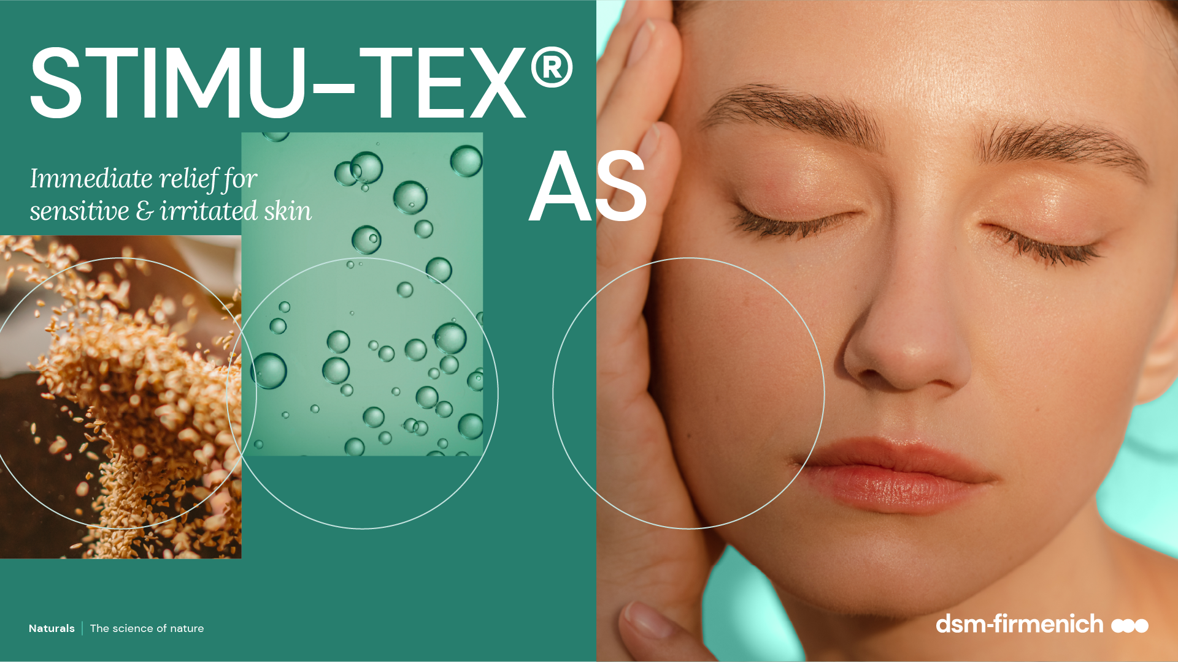
April 2026

Slide 2

A high percentage of consumers have self-declared sensitive skin
>70%
>70% of global consumers say they have experienced signs of sensitivity, like redness, dryness, or stinging / burning / itching on their facial skin
83%
of consumers are actively looking for skin care products that are created for sensitive skin
I Chen W, Dai R, Li L. The prevalence of self-declared sensitive skin: J Eur Acad Dermatol Venereol. 2020, 34 (8)
II https://www.glossy.co/beauty/why-every-brand-is-launching-sensitive-skin-products/

Slide 3





STIMU-TEX® AS
ID Card
INCI NAME:
Spent Grain Wax, Argania Spinosa (Argan) Kernel Oil, Butyrospremum Parkii (Shea Butter) Extract, Tocopherol
TECHNOLOGY:
A unique mixture of premium, upcycled spent grain wax a by-product of the beer production, cold-processed argan oil, and shea butter.
100% of natural origin
TECHNICAL:
Form: Off-white to yellowish lipidic mass
Use level: 1–5%
Preservative: Free
Solubility: Oil soluble
BENEFITS:
Significantly decreases the expression of IL-1α, a marker for inflammatory reactions**
Helps to reduce itch mediators such as histamine*
Effectively reduces histamine-related symptoms like itching and redness, while significantly enhancing skin comfort within 5 minutes***
REGISTRATION
CERTIFICATION
* in vitro ** ex vivo *** in vivo
Naturals | The science of nature

Slide 4

The rise of upcycled beauty
Consumers around the world are increasingly looking for authentic products with scientifically proven efficacy.
Upcycled ingredients for use in our modern world is proving popular among those who want to nourish their skin for a naturally flawless look.
What is upcycling?
It transforms by-products and waste materials into something new and exciting - something that consumers want to use and find great joy from.
STIMU-TEX® AS is enriched with upcycled spent grain wax

Slide 5
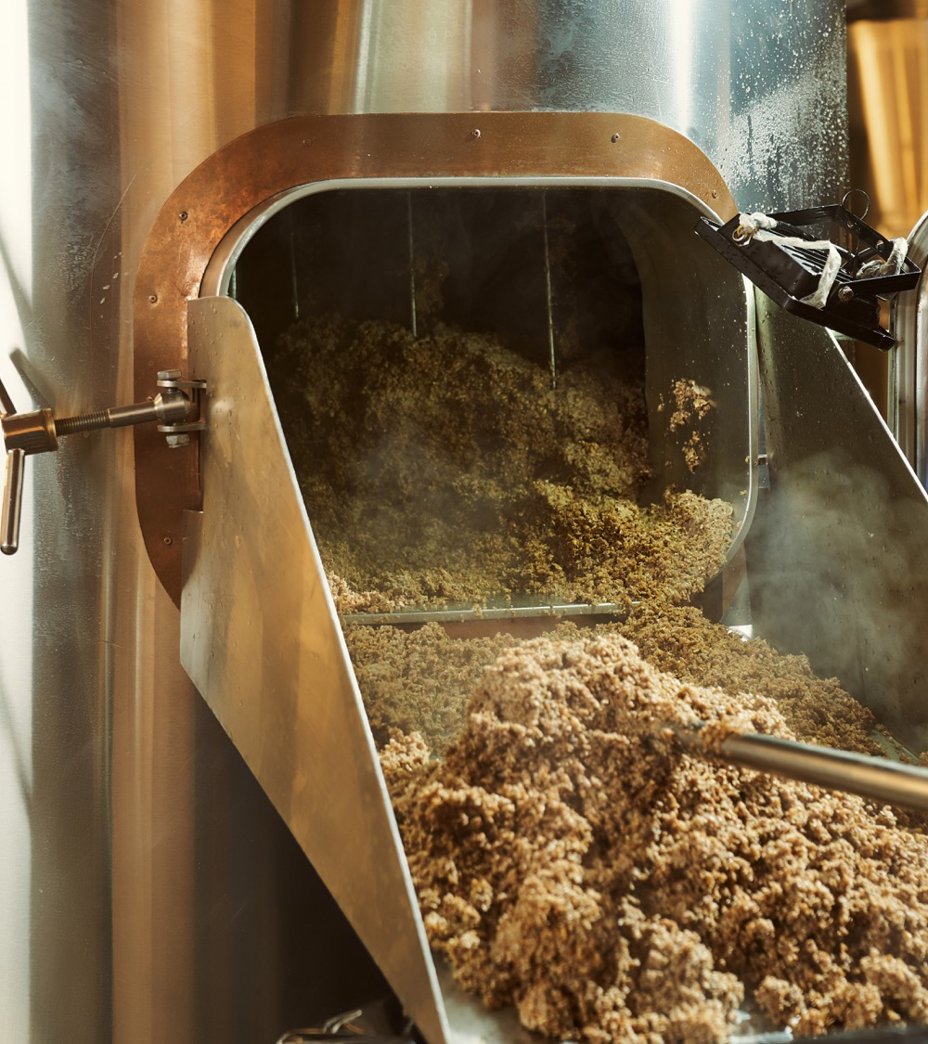
Brewers have always had smooth, soft hands
For generations, beer brewers have recognized the soothing properties of spent grain, traditionally associated with calming skin and relieving itching.
But what exactly is brewer’s spent grain?
Brewer’s spent grain is the most abundant by‑product of the beer‑brewing process, accounting for around 85% of all brewing by‑products.
It is the natural residue left after pure barley (Hordeum vulgare) is transformed into malt through successive physical and fermentative processing steps.

Slide 6
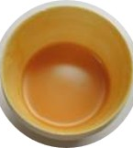
Pure Spent Grain Wax — From Brewery By-Product to High Value Skin Soother
Rooted in the German brewing tradition, Pure Spent Grain Wax is upcycled from brewer’s spent grain left after beer production.
Using gentle supercritical CO₂ extraction, it is transformed into a pure, golden wax that:
  Avoids harsh solvents
  Preserves skin‑soothing lipids
  Delivers a soft, skin‑loving texture
Unique upcycled origin
Role in STIMU-TEX® AS
Provides skin‑soothing lipids that enhance comfort
Supports relief from itching and irritation
Contributes to the soft, caring sensory profile of the blend
A fusion of heritage and green innovation, turning an overlooked by‑product into a comforting, sustainable skin ingredient.

Slide 7
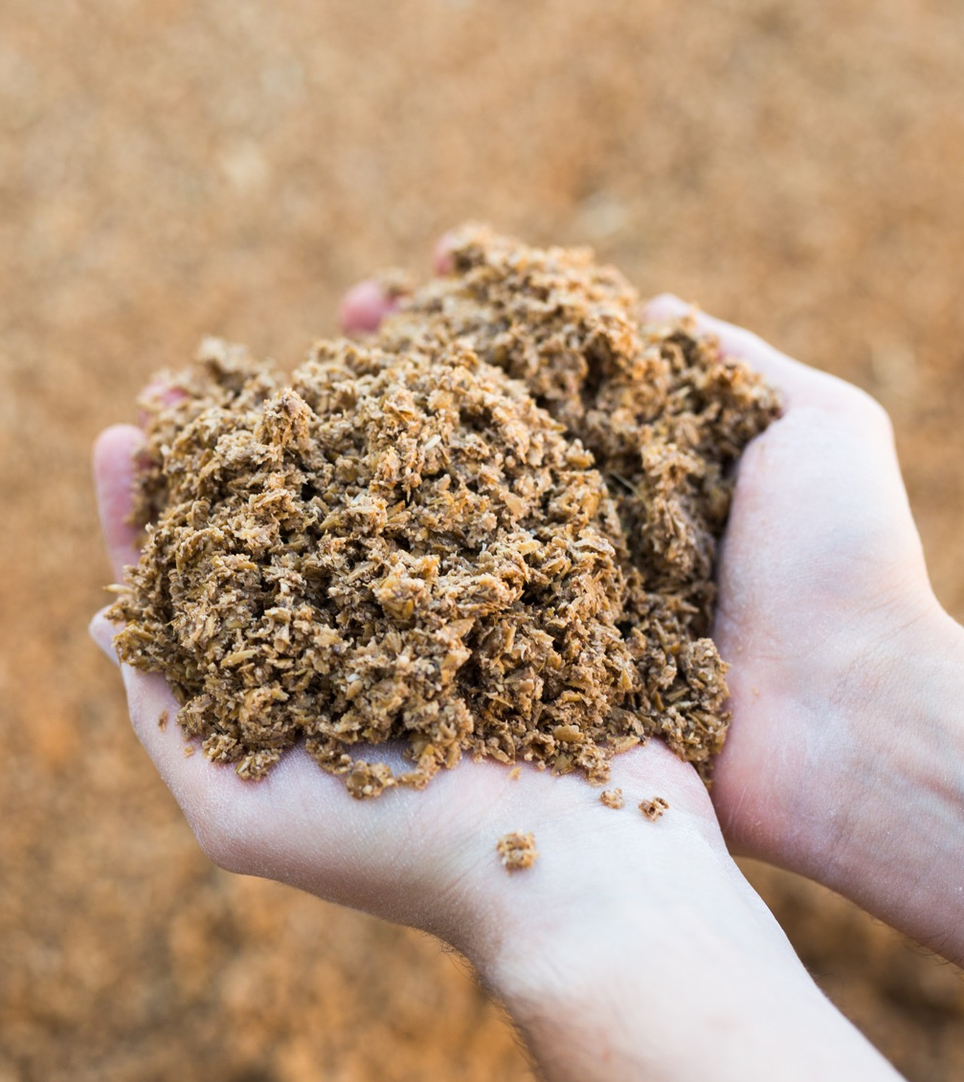
Spent grain wax delivers strong relief on skin with atopic conditions
Dermatological study performed on skin with atopic conditions*
100 volunteers, 1% and 5% spent grain wax used in a w/o emulsion; placebo, half-face blind application of verum & placebo; twice daily, 1-4 weeks
84%
Preferred formula
80%
Result: strong and perceivable itching alleviation
Better anti-itching effect
Spent grain wax | Placebo
** Source: Entwicklung und Prüfung eines neuen dermatologisch-kosmetischen Wirkstoffes aus Gerstentreber (development and testing of a new dermatological-cosmetic active ingredient from barley grains), H. Tronnier, P. Haas and L. Motitschke, Ärztliche Kosmetologie 17, 342-352 (1987)
Notes:
The properties of Spent Grain – the key ingredient of STIMU-TEX AS – were investigated in extensive studies on skin with atopic conditions.
Volunteers - with a.o. severe skin dermatitis, psoriasis, or pruritus - tested the effect of Spent Grain on their skin by use of as bath additive or as O/W emulsion.

Slide 8
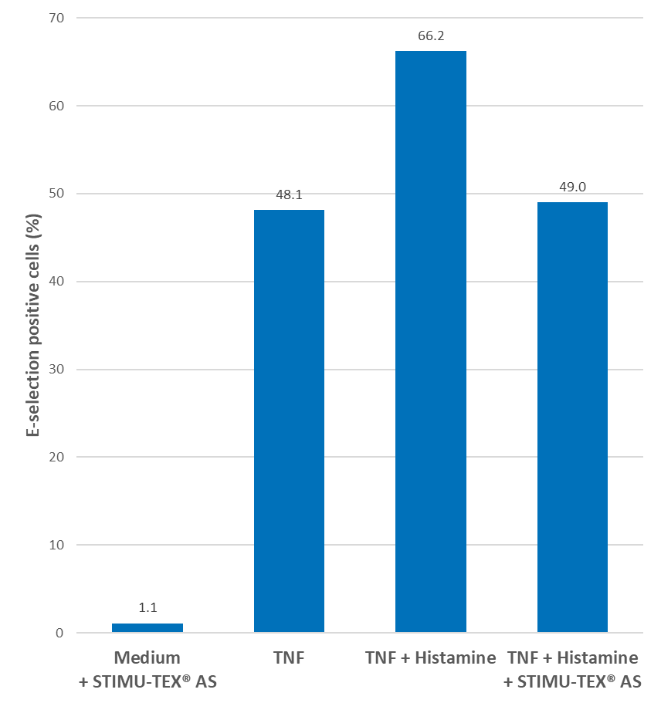
STIMU-TEX® AS
Strong histamine rebalancing capacity in vitro
Histamine effect blocking assay
Histamine is a marker for allergic reactions. Histamine blocking products inhibit the symptoms of allergy such as itching, swelling, and red skin.
An in vitro assay with human endothelial cells was developed to quantify histamine effects: Histamine combined with TNF (Tissue Necrosis Factor) enhances the induction of E-selectin on endothelial cells. E-selectin induction is the starting point of an inflammatory reaction.
STIMU-TEX® AS nearly completely rebalances E-selectin expression on endothelial cells, a downstream target of histamine*.
*in vitro

Slide 9
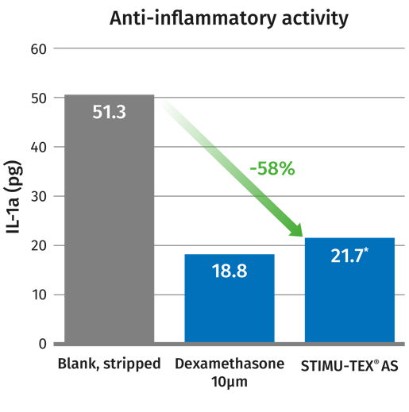
STIMU-TEX® AS
Strong reducing of skin reddening ex vivo
Anti-inflammatory assay ex vivo
Determination of the inflammation marker interleukin-1α, released in the supernatants of stripped human skin disks.
A human skin fragment was taken after abdominal plastic surgery and stripped 10 times. STIMU-TEX® AS was tested on the skin surface at a concentration of 1 mg/cm2. Dexamethasone is a glucocorticoid, used as positive control.
STIMU-TEX® AS significantly decreases the expression of IL-1α by 58%, a marker for inflammatory reactions*.
*ex vitro

Slide 10
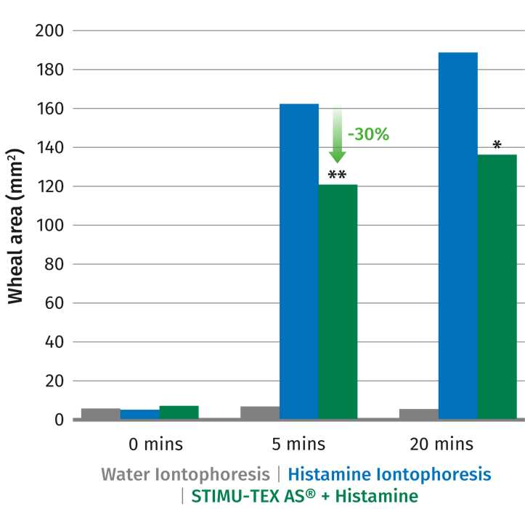
STIMU-TEX® AS
Immediate relief within 5 minutes in vivo
The release of histamine induces a vasodilatation, an increase of vascular permeability, inflammation, and skin redness. Laser Doppler flow measurements enable this increased blood flow to be quantified.
Histamine was applied on the inner forearm of 10 healthy female volunteers between the ages of 18 and 39.
Penetration of histamine into the skin was stimulated non-invasively by iontophoresis in order to produce a mild reaction.
Results for distilled water (negative control), histamine alone (positive control), and 5% STIMU-TEX® AS with histamine were compared.
The reactions were determined non-invasively as perfusion modification by means of a laser Doppler imager and as wheal formation by computerized surface measurement.
STIMU-TEX® AS formulation significantly reduces histamine-related symptoms by 30% after as little as 5 minutes**
**in vivo

Slide 11
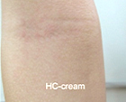
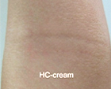
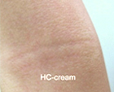
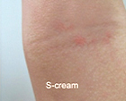
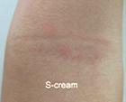
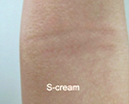
STIMU-TEX® AS
Dermatological study on Asian skin with atopic conditions¹
29 Asian (Thai) patients (18 male and
11 female), aged between 2–15 years
3% STIMU-TEX® AS (S cream) vs
1% Hydrocortisone (HS cream)
The body was randomly divided to left and right side. One side was applied with S cream and the other side was applied with HC cream twice daily for four weeks.
Baseline
Week 2
Week 4
Hydrocortisone Cream
Hydrocortisone Cream
Hydrocortisone Cream
Visible reduction of Childhood Atopic Dermatitis by a STIMU-TEX® AS (3%) cream after already 2 weeks
STIMU-TEX® AS Cream
STIMU-TEX® AS Cream
STIMU-TEX® AS Cream
*ex vitro

Slide 12
Disclaimer
Copyright © dsm-firmenich Switzerland AG, 2026, 4002 Basel, Switzerland.
www.dsm-firmenich.com. All rights reserved.
dsm-firmenich has used diligent care to ensure that the information provided herein is accurate and up-to-date to the best of its knowledge. However, dsm-firmenich makes no representation or warranty, either expressly or implied, of the accuracy, reliability, completeness, or suitability thereof. The information provided herein contains scientific and product information for business-to-business use and does not constitute or provide scientific or medical advice, diagnosis or recommendation for treatment options. Country or region-specific information should be considered when labelling or advertising to final consumer. In no event shall dsm-firmenich be liable for any direct or indirect damages arising from or reliance upon, or use of, any information provided herein. The content of this document is subject to change without further notice. Please contact your local dsm-firmenich representative for the latest information. All trademarks listed in this document are either (registered) trademarks of, or trademarks licensed by, the dsm-firmenich group of companies, unless explicitly stated otherwise.
Disclaimer Formulation Guideline
The information provided herein is provided for information purposes only and has been prepared by dsm-firmenich in accordance with its own methodology.
dsm-firmenich has used diligent care to ensure that it is accurate and up-to-date, however, dsm-firmenich makes no representation or warranty, either expressly or implied, of the accuracy, reliability, or completeness thereof. In no event shall dsm-firmenich be liable for any damages arising from or reliance upon, or use of, any information provided herein. Further, dsm-firmenich shall not bear any liability for the application and/or use of any processed material containing its product(s). The formulation of the finished product is the customer’s sole responsibility. It is the customer’s responsibility to determine the suitability of dsm-firmenich’s products regarding user specific purposes, assess compatibility and stability of their finished product(s) and to ensure compliance of their finished product(s) with relevant laws and regulations. Any product, marketing or other claims made by customer are its sole responsibility. The content of this document is subject to change without further notice. Please contact your local dsm-firmenich representative for further details. © dsm-firmenich Switzerland AG, 2026.
© 2026

Slide 13
© 2026

