Slide 1


STAY-C® 50
The all-round naturally derived beauty solution for skin perfection
November 2022

Slide 2



Agenda
Revealing the power of vitamins for beauty care
Click on the number to get redirected to the chapter
1
DSM in the sustainable
vitamin c journey
4
Scientific evidence
2
Consumers &
customers insights
5
Comparison among different forms of vitamin C
3
stay-c® 50 in formulation

Slide 3

DSM in the Sustainable Vitamin C Journey
Our promise

Slide 4


DSM in the sustainable Vitamin C journey
The vitamin pioneer & leader
DSM – A leader in the vitamins journey
As the longest-standing producer
of vitamins in the world
First to explore the beauty of potential of vitamins
1936 - It was at today’s DSM’s site in Grenzach, Germany, that vitamin C has been first industrially produced
Vitamin C industrial production, Grenzach, 1936
Today, DSM remains fully committed to explore the beauty potential of our vitamins further.
Comprehensive portfolio: Full range of 13 vitamins, including the most demanded forms for cosmetics
Leading production capabilities: DSM high commitment to keep technology leadership at best value for money
.
1936
1983
2018
Today
Notes:
DSM has been pioneering the industrial production of vitamins ever since their discovery a century ago and can now proudly claim the top spot as the world’s leading supplier of these vital nutrients.

Slide 5















Card™
Sustainability
Aligned with and contributing to the
Carbon
emissions
Supply
Chain control
STAY-C® 50
119 kg CO2 equivalent per kg
Exclusive production
Biodegradability
Well inherently biodegradable according to OECD Test 302B
Water footprint
STAY-C® 50
The stabilized form of vitamin C, anti-oxidant gold standard
Vitamin of natural origin
1700 l/kg, water risk level
3 out of 5
RSPO certificate
Not applicable: no palm oil derivatives
Working conditions and community development
Naturality with ISO 16128
    Natural-origin score: 100%
    (renewable carbon measured by third party 14C analysis)
Ethical trade social audit SMETA from Sedex completed in 2021
Health and Well-being
Eco certifications
The anti-oxidant gold standard, protects against oxidative stress, improves
skin condition and skin tone
NATRUE approved (100% derived natural)
INCI name: Sodium Ascorbyl phosphate
Product Code: 5016285
card version1
NATRUE Approved
© 2021. DSM. All rights reserved
Notes:
Sale CFP & WFP are considered for different grades of the same product in the same plant
Added in 2022

Slide 6
Consumer & customer insights

Slide 7






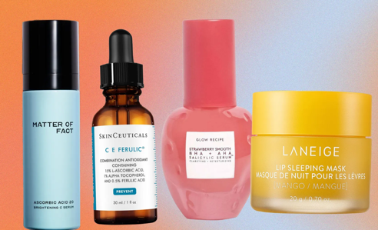

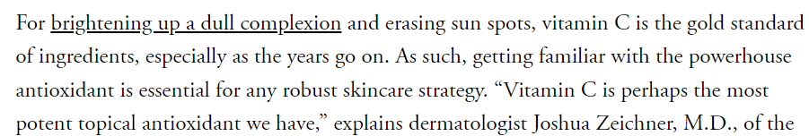
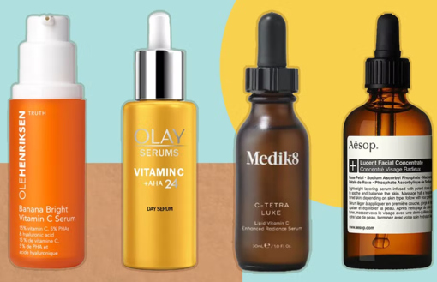
Vitamin C: the eternal hero ingredient in beauty
Magazines and blogs are giving full visibility to Vitamin C still in 2022
Vitamin C serums are one of the most talked-about beauty buys at the moment.
Vit C: the most googled skin care ingredient of all time
Notes:
Sources:
-https://www.allure.com/gallery/get-brighter-skin-vitamin-c
-https://www.independent.co.uk/extras/indybest/fashion-beauty/skincare/best-vitamin-c-skincare-products-a8235486.html
-https://www.vogue.co.uk/article/skincare-summer-advice

Slide 8




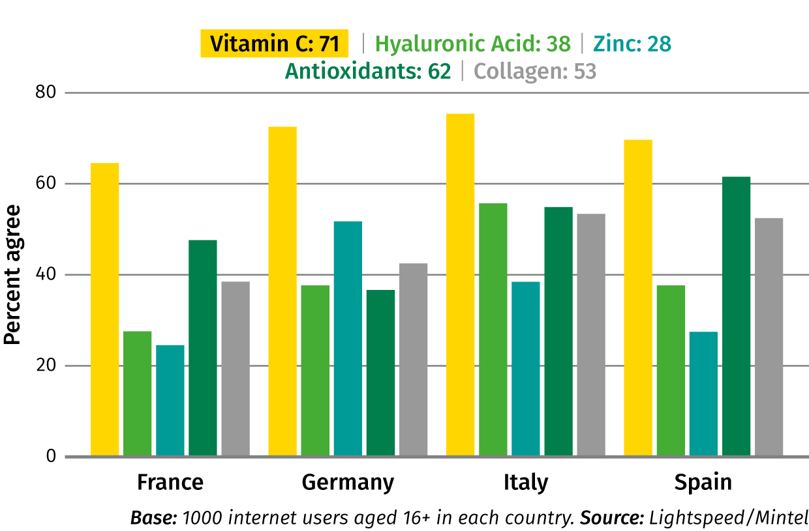


Vitamins are associated with good health and trusted by consumers*
put % of awareness in
3 out of every 5
..and awareness of vitamin C is much higher than other beauty-boosting actives (European consumers)!
women know that vitamins are in cosmetic products*
In the past years, there was an increase of 32% (to 52%) of women being aware of Vitamin C being used in cosmetic products*
* DSM PCA Vits study, Jan 2016. Global – N=1600, USA – N=400, France – N=400, China – N=400, Japan – N=400 – All females, National representation of age
Notes:
Sources of information displayed on the slide
Interpretation of the graph:
Vitamin C:71 : on an average through the 4 countries, 71% of the interviewed persons said to be aware that Vitamin C promotes the appearance of skin, hair, and nails.

Slide 9



Consumers perception of Vitamin C benefits on the skin
5 key areas
Skin
booster
Rediscovery of vitamin C in high concentration
and
pure form!
Healthy
beauty
The all-in remedy
against oxidative
Stress
The
anti-aging superstar!
Versatile
…a brilliant multitasker!
Notes:
Photo by Anthony Tran on Unsplash

Slide 10

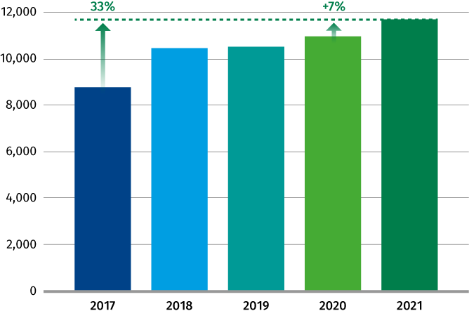

Launches with Vitamin C derivatives for Beauty and
Personal care increased by 33% in 2021 compared to 2017
Total launches over the past 5 years (2017-201)
Worldwide, 1 product over 15 contains Vitamin C
Notes:
Mintel analysis:
where Super-Category matches Beauty & Personal Care
and Date Published is within the last five complete years
and Ingredient Search matches Vitamin C Derivatives and all child ingredients as the Ingredients

Slide 11
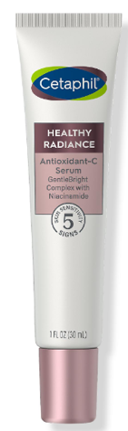
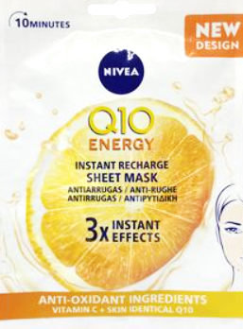
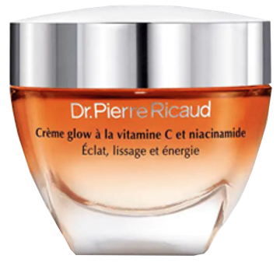
Latest launches:
high concentration of Vitamin C in serum is still very trendy!
Cetaphil: healthy radiance antioxidant-c serum
Nivea: Instant recharge sheet mask
Dr Pierre Ricaud: Glow cream with Vitamin C
and Niacinamide
10% Sodium Ascorbyl Phosphate
Sodium Ascorbyl Phosphate
Sodium Ascorbyl Phosphate

Slide 12
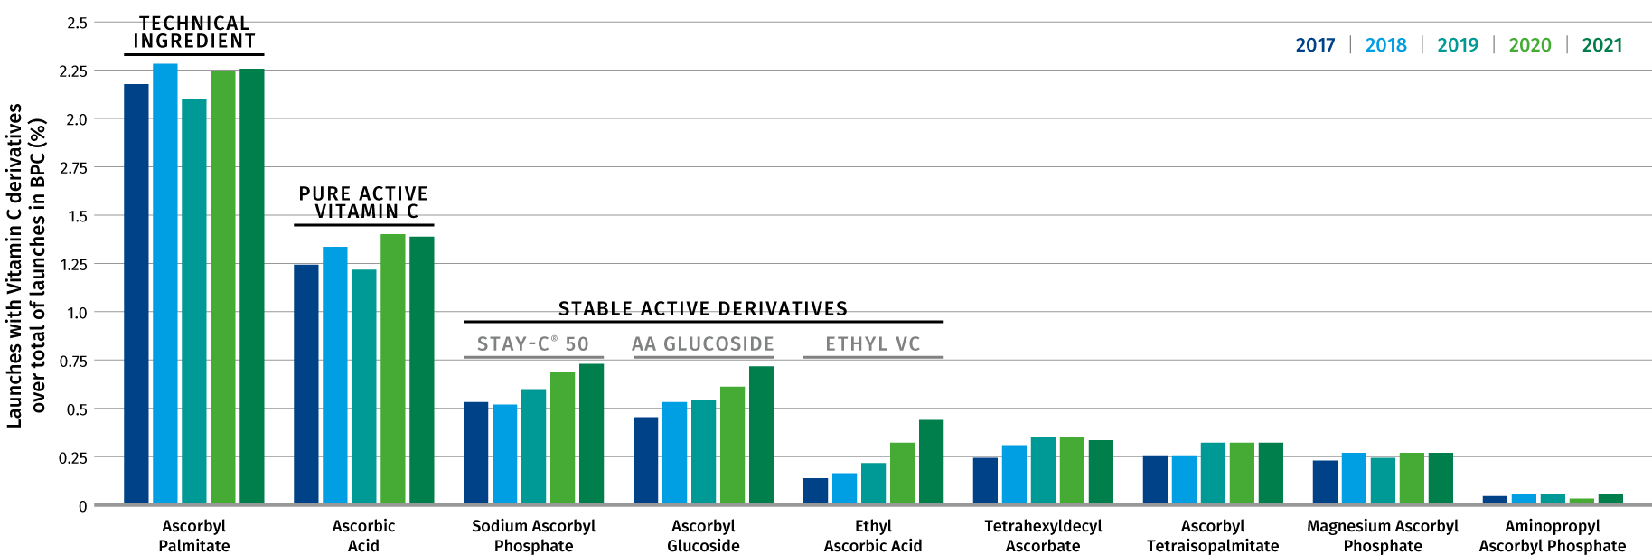

The number of launches with Vitamin C is growing
Continuous growth between 2017–2021, with a total penetration rate of 6.2%!
Strong growth for stable forms such as Sodium Ascorbyl Phosphate, Ascorbyl Glucoside and Ethyl Ascorbic Acid
Notes:
where Super-Category matches Beauty & Personal Care
and Date Published is within the last five complete years
and Ingredient Search matches Vitamin C Derivatives and all child ingredients as the Ingredients
Launches With STAY C 50 did not grow in the last year. This means there is room to improve with good substantiation. see at slide 82-83 how STAY-C® 50 overperforms AA2G!
Attention: in this graph the % of launches is shown as compared to the total launches in beauty and personal care. If we look at the absolute number of launches per se, they are continuously growing each year as shown in slide n 16 for both Ascorbic acid and STAY-C50.

Slide 13
STAY-C® 50
DSM naturally derived active ingredient to deliver vitamin C efficiently into the skin
Formulation tips

Slide 14

Vitamin C at a glance
Our body needs Vitamin C from external source
Vitamin C is Ascorbic Acid in different forms
Vital functions for life
Humans are unable to synthesize Vitamin C and therefore rely entirely on external supplementation such as topical application
Vitamin C is the most abundant anti-oxidant in the skin
Exposure to oxidative stress via pollutants or UV irradiation provokes Vitamin C depletion in the epidermis
Even high dose oral supplementation does not provide the sufficient amount of Vitamin C into the skin
        ➔ We need topical application with Vitamin C to afford skin benefits!
Juliet M. Pullar. Nutrients 2017, 9(8), 866

Slide 15

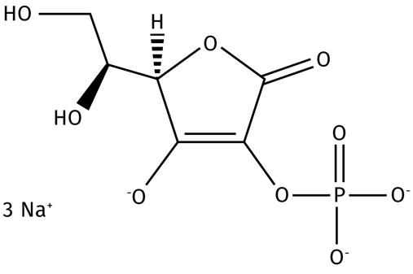
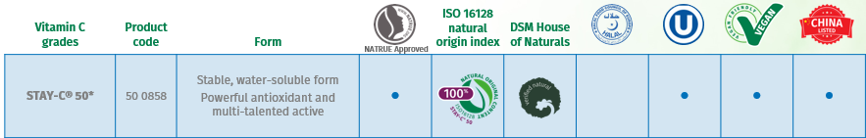
To ensure better stability of Vitamin C, DSM developed STAY-C® 50
SODIUM ASCORBYL 2-PHOSPHATE:
STAY-C® 50
Stable, water soluble cosmetic Vitamin C specialty
100% naturally derived (based on renewable carbon)
Fully bio-converted into ascorbic acid in the skin
Powerful antioxidant and multi-talented active
*: a special Halal certified grade is available upon request

Slide 16
STAY-C® 50 – Benefits vs other derivatives
Our stable cosmetic Vitamin C specialty
Good skin penetration
Proven conversion into the active form ascorbic acid
A multi-talent beauty remedy addressing almost every skin concern from acne to UV damage…and its activity is proven!
Overperformance in melanin synthesis inhibition and antioxidant properties vs other derivatives
Stable in aqueous environment
Easy to formulate
Only derivative with use level up to 15%
Approved quasi-drug active ingredient for whitening products in Japan

Slide 17

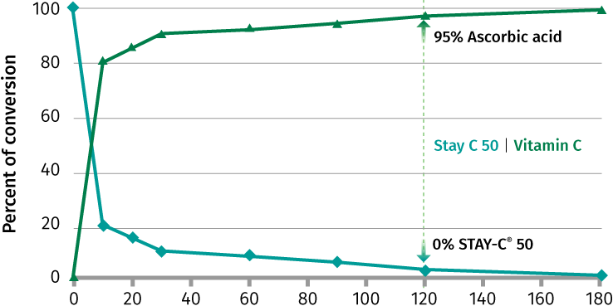
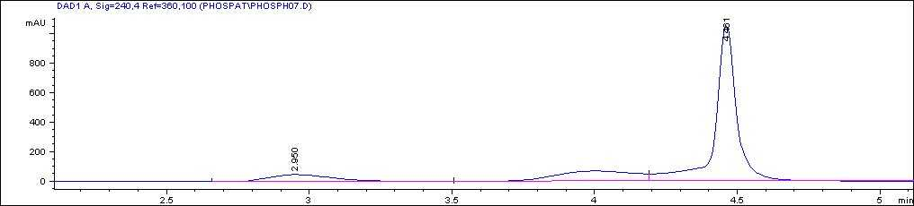
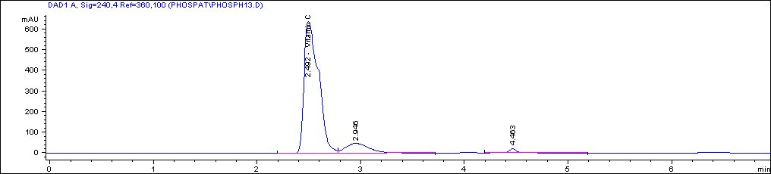
STAY-C® 50 – Two steps to be active
1) bio-activation
Acid phosphatases are able to bioactivate about 95% of STAY-C® 50 into ascorbic acid within 2 minutes
Time-dependent conversion of STAY-C® 50
by acid phosphatases
HPLC chromatogram
time point: 0 min
STAY-C 50®
time point: 2 min
Vitamin C
2 min
DSM Internal study
Notes:
Time-dependent conversion of STAY C-50® by acid phosphatases
assay procedure:
citrate buffer pH6.5 at 37°C
8 µM (2.9 µg) STAY C-50® per analysis
0.008 U (4 µg/ml) acid phosphatase per analysis
varying incubation time

Slide 18
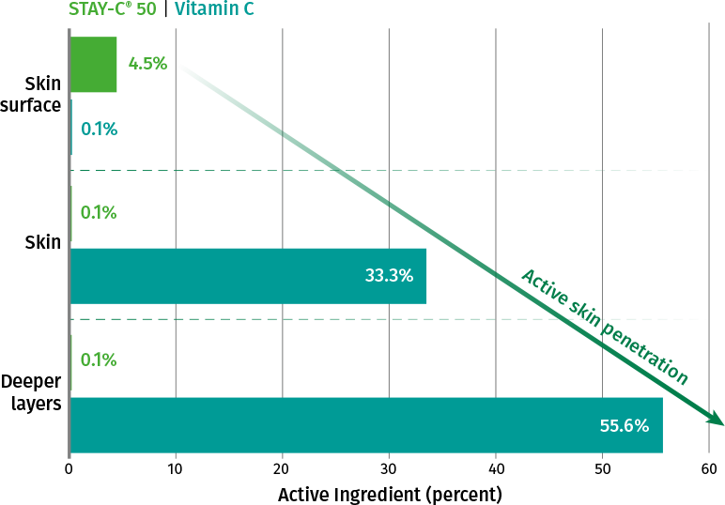
STAY-C® 50 – Two steps to be active
2) Skin Penetration
STAY-C® 50 is bio-converted in the upper skin layer into the active ascorbic acid, which easily penetrates into deeper skin layers
STAY-C® 50 and ascorbic acid concentration
on each skin layers by HPLC
Any STAY-C® 50 which crosses the stratum corneum is metabolized to ascorbic acid, which further penetrates into deeper skin layers within 2h
STAY-C® 50 is detectable only on skin surface
Ascorbic acid content is high in the deeper skin layers
0.5% STAY-C® 50 in w/o lotion
2h on ex vivo skin (Franz-type diffusion cell testing)
DSM Internal study
Notes:
A W/O-lotion containing 0.5 % STAY-C® 50 was applied (2 mg/c²) to the skin surface and allowed to penetrate for 2 hours
The stratum corneum of rat skin was removed by tape stripping. The skin was placed on a Franz-type diffusion cell
The skin was then removed from the cell and all residual material from its surface was wiped off with cotton. The cotton was extracted with MeOH/water and analyzed for STAY-C® 50 and ascorbic acid. The skin was homogenized and the homogenate filtered and analyzed by HPLC. The receptor fluid from the diffusion cell was directly analyzed by HPLC.
STAY-C® 50 could only be detected in significant amounts on the skin surface. All material penetrated was metabolized to ascorbic acid.
The penetration in the skin is very rapidly. Therefore, any STAY-C® 50 which has crossed the skin barrier (stratum corneum) is metabolized immediately to the bioavailable ascorbic acid (Vitamin C) and does further penetrated rapidly into deeper skin layers.

Slide 19


Guide formulation
STAY-C® 50
Stability
For a better performance
pH ≥ 6
Add 0.05-0.1% Sodium Metabisulfite to improve color stability
Add chelating agents (EDTA, phytic acid, etc..) to prevent degradation by heavy metal ions
Check stability with acrylic acid thickeners and some ionic emulsifiers
Note: STAY-C® 50 is able to improve the stability of Retinol in formulation at room temperature (but also at 40°C after 6 weeks where the recovery rate of retinol is above 70% with 0.5% STAY-C® 50 in formulation)

Slide 20
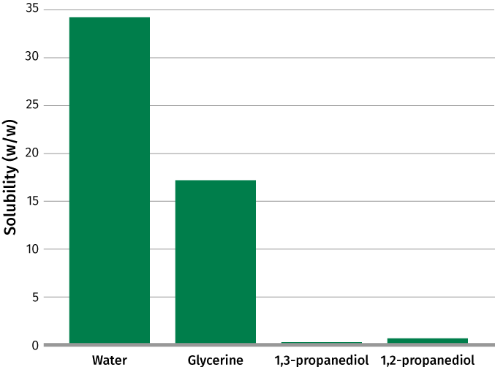
Guide formulation
STAY-C® 50
Solubility
Readily soluble in water (nearly 35%) and in glycerin (up to 18%)
Insoluble in lipophilic components or alcohols
Dissolve STAY-C® 50 in water and add it to an emulsion as an aqueous solution below 35-40°C

Slide 21
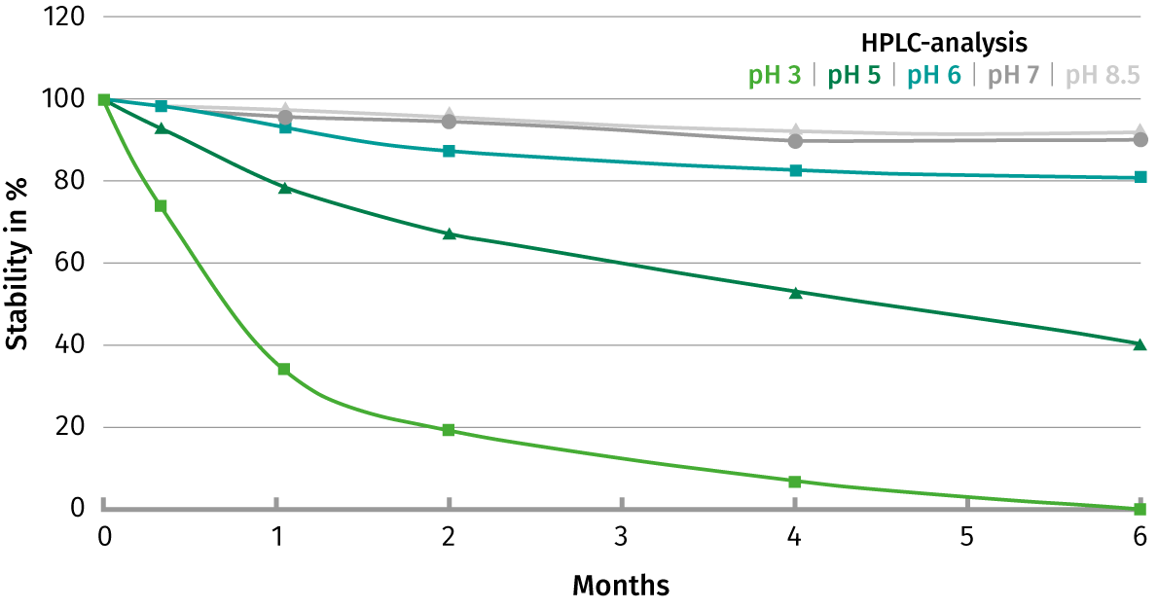
STAY-C® 50 – Stability in formulation
STAY-C® 50 is 80 to 100% stable after 6 months in solution at pH ≥ 6
Stability of 3% STAY-C® 50 in water 43°C without light
STAY-C® 50 is highly stable at
a pH of 6 and higher
Even at 43°C 90% of the STAY-C® 50 initial concentration has been detected after 6 months
DSM Internal study
Notes:
The concentration of STAY-C® 50 was measured by HPLC.
Based on these results a pH below 6 should be avoided for long term stability to prevent degradation of STAY-C® 50.
A very good stability can be achieved by adjusting the pH at pH 6 or even higher.
Formulations displayed in the study: Rapport final STAY-C 50 (REPORT No. 1004857)

Slide 22

DSM innovation with high content of Vitamin C
Water C Whitening Ampoule
SK-A-101389-1
Vitamin C (STAY-C® 50) 12%
 | Ingredients | Function | % w/w
A | Aqua | Solvent | 68.63
 | Disodium EDTA, Aqua | Chelating agent | 0.05
 | Betaine | Humectant | 2.00
 | TILAMAR® PDO with NØØVISTA™ (Propanediol) | Hydration, Sensory, Active carrier and Preservative booster | 6.00
 | Glycerin | Humectant | 2.00
 | Biosaccharide Gum-1 | Sensory enhancer | 3.00
 | PEG/PPG/Polybutylene Glycol-8/5/3 Glycerin | Humectant | 1.00
 | Phenoxyethanol, Ethylhexylglycerin | Preservative | 0.50
 | HYALURONIC ACID-BT (Sodium Hyaluronate) | Active | 0.02
 | STAY-C® 50 (Sodium Ascorbyl Phosphate) | Active | 12.00
 | Sodium Metabisulfite | Antioxidant | 0.05
 | BIS-PEG-18 Methyl Ether Dimethyl Silane | Emollient | 1.00
 | Diethoxyethyl Succinate | Emollient | 2.00
 | Ingredients | Function | % w/w
B | Cellulose Gum | Thickener | 0.10
 | Xanthan Gum | Thickener | 0.40
C | Peg-60 Hydrogenated Castor Oil | Solubilizer | 0.30
 | Cyclopentasiloxane, Cyclohexasiloxane | Emollient | 0.50
 | Parfum | Parfum | 0.05
 | Polysorbate 20 | Solubilizer | 0.40
Technical data:
pH: 7.32
Viscosity (Brookfield RV3/12rpm): 1 760 mPa.s
Formulation 94.2% of natural origin according to ISO 16128 by including formulation water

Slide 23

DSM innovation with high content of Vitamin C
Fresh Energizing Mist C
SK-E-101300-17
Vitamin C (STAY-C® 50) 10%
 | Ingredients | Function | % w/w
A | Aqua | Water | 60.52​
 | Disodium EDTA, Aqua | Chelating agent | 0.20
 | Pentylene Glycol | Multifunctional | 3.00​
 | TILAMAR® PDO with NØØVISTA™ (Propanediol) | Hydration, Sensory, Active carrier and Preservative booster | 2.00
 | Chlorphenesin | Preservative | 0.20​
 | Bis-PEG 18 Methyl Ether Dimethyl Silane | Humectant | 1.00
B | Parfum | Parfum | 0.20​
 | PEG-40 Hydrogenated Castor OIl | Solubilizer | 1.00
C | STAY-C® 50 (Sodium Ascorbyl Phosphate)​ | Active | 0.50​
 | Aqua | Water | 20.00
D | Citric acid, Aqua | Buffer | 1.88
Technical data:
pH: 7.75
Viscosity: Liquid
Formulation 94.4% of natural origin according to ISO 16128 by including formulation water

Slide 24
Formulation with Retinol and STAY-C® 50 as stabilizer Cocooning Vitamins Mask Soap
SK-E-102144-10
STAY-C® 50 0.5% - Retinol CB 50 0.2%
 | Ingredients | Function | % w/w
A | Prunus Amygdalus Dulcis Oil | Emollient | 14.60​
 | Passiflora Incarnata Seed Oil​ | Emollient | 14.60​
 | Persea Gratissima Oil​ | Emollient | 6.10​
 | ARGAN OIL (Argania Spinosa Kernel Oil)​ | Emollient | 3.00​
 | Theobroma cacao Seed Butter | Emollient | 3.70​
 | Macadamia Integrifolia Seed Oil​ | Emollient | 14.60​
 | Life’s GLATM ‘10’ n-6 Oil (Oenothera Biennis Oil, Ascorbyl Palmitate, Tocopherol) | Emollient, Active | 2.00​
 | Ricinus Communis Seed Oil​ | Emollient | 2.00​
B | Kaolin | Absorbing agent | 10.00
 | VALVANCE® Look 100 (Silica, Titanium Dioxide) ​ | Sensory Modifier, Whitener | 3.00​
 | CI 77891, Polyglyceryl-2 Tetraisostearate | Pigment | 2.00​
Technical data:
pH: 10.79
Viscosity: Solid
 | Ingredients | Function | % w/w
C | Sodium Hydroxide​ | Buffer | 7.60​
 | Aqua​ | Solvent | 14.20​
D | RETINOL CB 50 (Retinol, Undecane, Tridecane, Tocopherol)​ | Active | 0.20​
 | STAY-C® 50 (Sodium Ascorbyl Phosphate)​ | Active | 0.50​
 | Tocopherol, Helianthus Annuus Seed Oil​ | Active | 0.20​
 | PENTAVITIN® (Saccharide Isomerate, Aqua, Citric acid, Sodium Citrate​) | Active | 1.00​
 | Parfum​ | Parfum | 0.70​
Formulation 99.89% of natural origin according to ISO 16128 by including formulation water

Slide 25
Scientific Evidence –STAY-C® 50
Mode of action & efficacy

Slide 26






STAY-C® 50 – The all-round beauty solution for skin perfection
Anti-oxidant and photoprotective
Neutralizes the oxidative stress acting as radical scavenger
Protects against UV- and ozone- induced oxidative damage
Anti-ageing activities
Stimulates collagen synthesis
Improves skin firmness
Skin lightening activity
Decreases melanin synthesis
Hair care activity
Promotes hair growth
Support of healthy teeth and gum
Inactivates harmful oral bacteria
Deodorant activity
Reduces malodor
Cosmetic improvement of
acne-prone skin
Reduces the appearance of acne
Scientific evidence that explains why
STAY-C® 50 is so popular

Slide 27

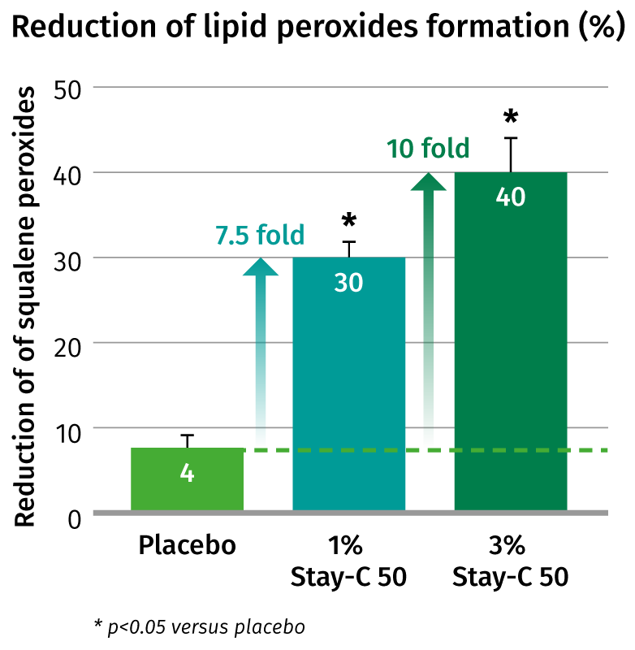

STAY-C® 50 – in photoprotection
In vivo
STAY-C® 50 reduces the UV-induced lipid peroxides up to 40%
STAY-C® 50 significantly protects against the UV-induced formation of oxidized molecules in human skin in a dose-dependent way
20 volunteers
7 days prior UV-irradiation, twice daily
1% STAY-C® 50 or 3% STAY-C® 50 vs placebo
Klock J et al. International Journal of Cosmetic Science, 2005, 27,171–176
Notes:
Oxidative stress was induced by UV-A dose = 10 J/cm2
The lipids present at the test area were harvested via solvent extraction method and finally analyzed for squalene and squalene hydroperoxide by HPLC
After 7 days of application (twice a day) the skin was
irradiated with 10J/cm2 UV-A light. Squalene and squalene
peroxide were quantified by HPLC and referred to untreated
skin after UV-irradiation.
STAY-C ® 50 shows a significant reduction in lipid formation of 30% with a 1% STAY-C ® 50 formulation and 40% reduction with 3% STAY-C ® 50
This study was executed by Derma Consult, an outside institute in Germany.
The aim of this study was to evaluate the efficacy of the anti-free radical/ anti-oxidant active ingredient STAY-C® 50 following the exposure to low sub erythematous doses of UVA in the region close to MED.
The study has been targeted to the external layers of the stratum corneum, the body’s principal barrier to the environment.
Peroxidation of sebum squalene by UVA stress is used as parameter.
After a 7 days pre-treatment period the subjects’s back (age 18-39, 12 female, 8 male) was irradiated with UVA, two hours after the last daily application. The lipids present on the test areas were harvested via a solvent extraction. Squalene and squalene hydroperoxide were then analysed HPLC.

Slide 28

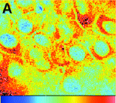
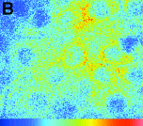
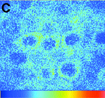
STAY-C® 50 – in photoprotection
In vivo
STAY-C® 50 doubles the UVA/UVB protection of sun filters and Vitamin E
Image of live human skin showing the effect of three products on reduction of ROS after UV irradiation (1600J/m2)
SPF 8 +
2.5% Vitamin E Ac +
2.5% STAY-C® 50
Ex vivo human skin (breast and facial), 2 individuals
Formulations applied for 3h
SPF 8 +
2.5% Vitamin E Ac
Two-photon fluorescence
microscopy
SPF 8
Image before UV-irradiation
Blue = no ROS
control
23% reduction
47% reduction
Min
Max
Fluorescense Intensity Scale Bar
2 fold increase protection!
Hanson et al. J Cosmet Sci. 2003 Nov-Dec;54(6):589-98.
Notes:
Ex vivo human skin (breast and facial), 2 individuals
Formulations applied for 3h
ROS induced by UV-irradiation
UV filters + active ingredients composition displayed in the publication
Photo-damage occurs due to reactions involving reactive oxygen species (ROS) in the skin. Many visible signs of aging are attributed to ROS-induced photo-damage that accumulates over the lifetime.
Quenching ROS induction. Images based on two-photon fluorescence microscopy. Different O/W formulation (as depicted) were applied on human ex vivo skin for 3h. A following incubation step with Dihydrorhodamin is the basis to monitor ROS by fluorescence signals. ROS are induced by UV-irradiation with 1600J/m2. A: ROS formation after SPF 8 control formulation was applied; B: ROS formation after application of control formulation containing 2.5% vitamin E acetate; C: ROS formulation after application of control formulation containing 2.5% vitamin E acetate and additionally 2.5% STAY-C ® 50 ; D: Control image before UV irradiation.
The data are from the lower spinous layer.

Slide 29

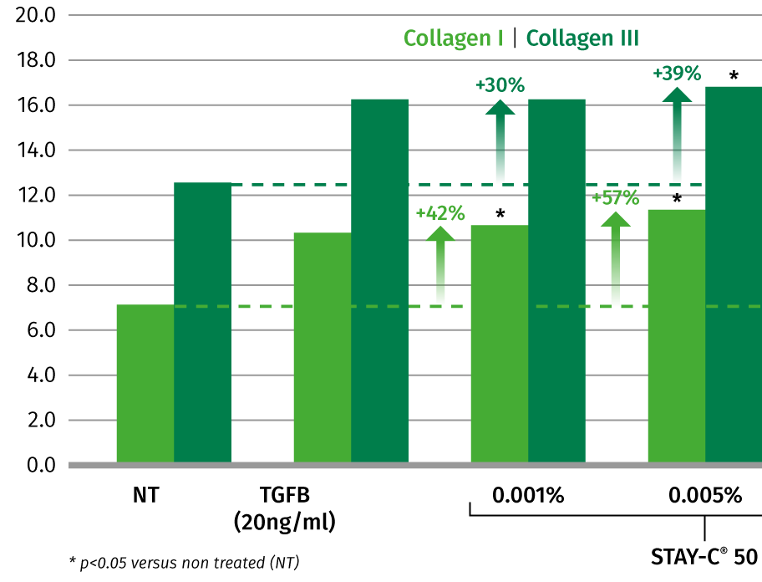

STAY-C® 50 – in anti-ageing – dermis
In vitro
STAY-C® 50 promotes collagen I (+57%) and collagen III (+39%) synthesis in human fibroblasts
Collagen production (ratio collagen / total protein)
STAY-C® 50 significantly stimulates both Collagen I and Collagen III production
Human dermal fibroblasts
STAY-C® 50 at different concentrations
72h
R Jermann & AA Gripp. Cosmetics and Toiletries Manufacture Worldwide 153-157 (2004)
Notes:
measurement of Collagen: ELISA
collagen protein content determined by ELISA
measurement of total protein: CVDE (crystal violet dye elution)
3 intra- assay replica, 72h treatment with 4 different concentrations of STAY-C® 50
TGFb served as a positive control, NT= non treated.

Slide 30
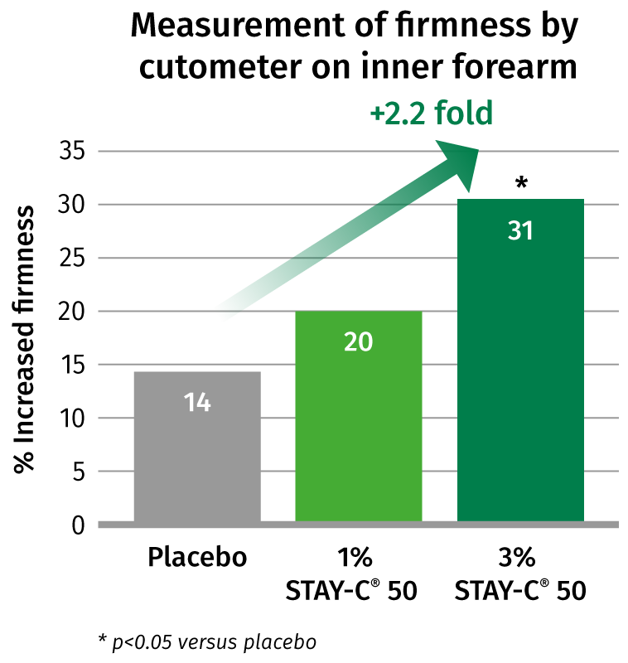
STAY-C® 50 – in anti-ageing
In vivo
Skin firmness increase doubles with 3% STAY-C® 50
vs placebo
Regular application of STAY-C® 50 containing cream leads to a significantly firmer skin
2X
20 volunteers
Products twice daily applied over 42 days
1% STAY-C® 50
3% STAY-C® 50
DSM Internal study
Notes:
Cutometer measurement on inner forearm to determine skin firmness
Even after this relative short treatment period, the formulations containing 3% STAY-C ® 50 increased firmness already significantly as compared to untreated skin sites and the placebo control.
The study results also indicate that a certain concentration and/or a certain treatment time is necessary to measure significant different values.
It seems that a certain depot of ascorbic acid (released from STAY-C 50) has to be built up before significant improvements would be measured.
This study gives indirect evidence that STAY-C ® 50 acts on the level of collagen and therefore leads to mesurable improvement of the skin.

Slide 31
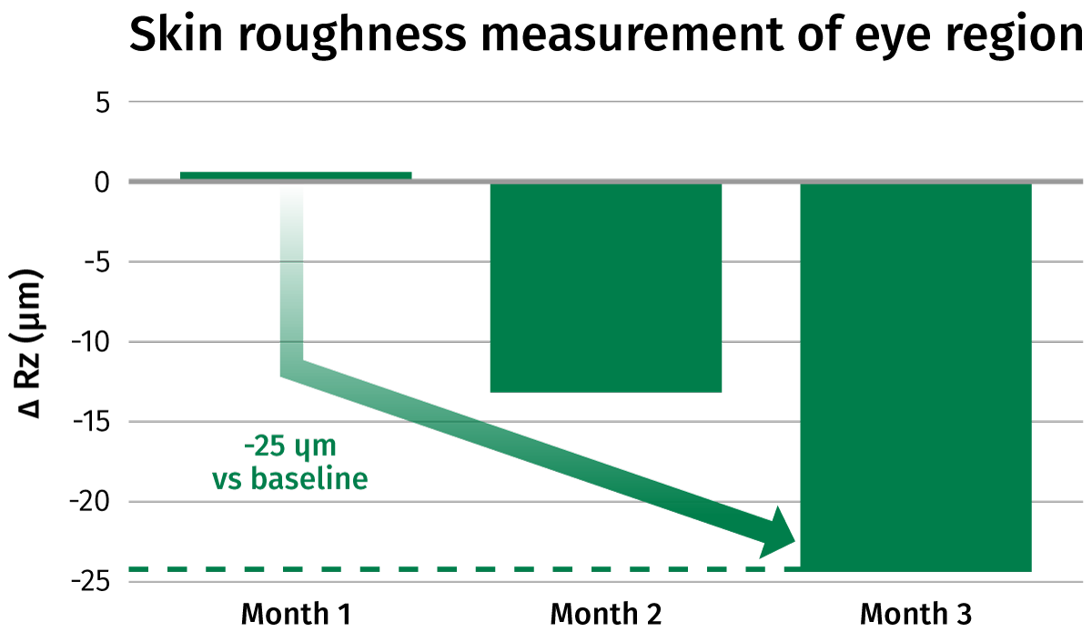
STAY-C® 50 + Biotin – combination in anti-ageing
In vivo
A topical mixture containing STAY-C® 50 and Biotin reduces wrinkles by 25 μm in 12 weeks
Significantly smoothens fine wrinkles around the eye in 3 months
Double blind study
39 Volunteers
2 applications daily, 12 weeks around the eye
3% STAY-C® 50 + 0.1% Biotin formulation vs placebo
DSM Internal study
Notes:
o/w emulsion as placebo
Rz (μm): Height between mean peak and mean valley of the wrinkle
Skin roughness was measured with Phase shift Rapid In vivo Measurement Of Skin (=PRIMOS)* on day 1, 29, 57, 85. Result shown as difference to placebo and before treatment
Formulation on the study report 50 04500
radiance is made of min 50% SAP + 1-4% d-biotin with a carrier of mannitol
This test was realized at the German test institute proDERM in Hamburg.
Important:
No changes of skin hydration was observed. That shows that the anti-wrinkle and skin roughness effect is not due to enhanced skin moisture content
* PRIMOS is an optical 3D skin measurement device. It is a digital stripe projection technique. A digital light projector emits a light in phase shifts, covering the surface area of the skin that we are trying to analyze or measure. The computer analysis involves several steps which basically divide the circular area of skin into 12 equal sectors, generating fine surface profile lines or traces for each sector. A total of sixty profile lines are obtained. A measurement called Rz value, which is calculated as the mean peak to valley height from the profile lines, provides a measurement of wrinkle severity. "As we follow a profile line, the greatest differences in height between surface peaks and valleys correspond to the more severe or course wrinkles

Slide 32

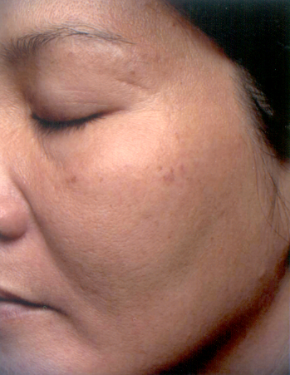
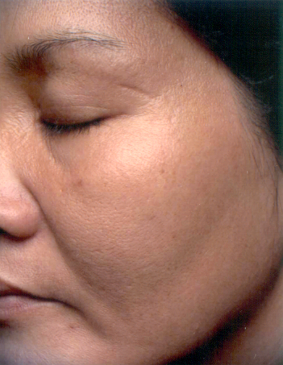
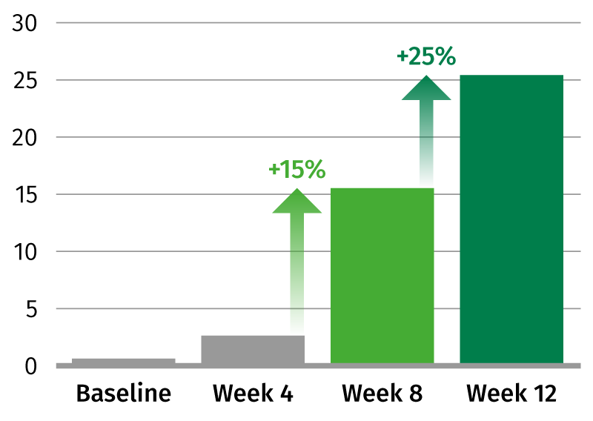
STAY-C® 50 – skin lightening activities
In vivo
STAY-C® 50 visibly evens the skin tone and reduces the color intensity of age spots by 25% in 3 month
Photographic evidence of spot reduction
Quantification of improvement by visual assessment (dermatological evaluation)
Before
After 12 weeks
STAY-C® 50
Double blind study with half face treatment
39 female volunteers
Test cream with 3% STAY-C® 50 and 1% Vitamin E acetate
12 weeks, twice daily application
J. Klock. SÖFW-Journal | 130 | 9-2004 (no data report available)
Notes:
30 to 45 years old
Clinical evaluation and grading by dermatologists
a 3-month in vivo study on Asian skin has shown that regular use of a cream with STAY-C® 50 resulted in a reduced color intensity of facial age spots. The overall skin lightening effect of STAY-C® 50 was assessed as 25% by dermatological reading
Formulation SK-E-100097-123
Report S123_006

Slide 33
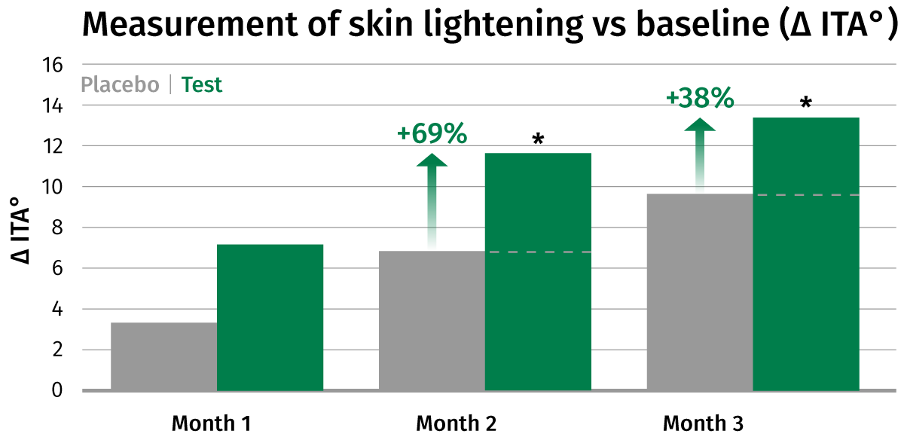
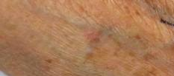
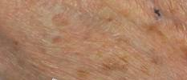

STAY-C® 50 + Biotin – combination in skin lightening
In vivo
A topical mixture containing STAY-C® 50 and biotin lightens the skin up to 69% in 2 months
Before
After 3 months
Double blind study
39 volunteers
2 applications daily, 12 weeks on
back of hands
3% STAY-C® 50 + 0.1% Biotin formulation vs placebo
Strong lightening effect with increase of 13 ITA° after 3 months!
Images taken with digital camera Canon EOS D30
Notes:
o/w emulsion as placebo
The ITA* value gives a measure of the skin color (brown pigmentation)
Formulation on the study report 50 04500
This test was realized at the German test institute proDERM in Hamburg.
*Skin pigmentation expressed as ITA°=[arctan((L*-50)/b*)]x180/π with L* and b* being chromametric values
Changes with placebo are due to natural lightening of skin (study carried out during winter months)

Slide 34

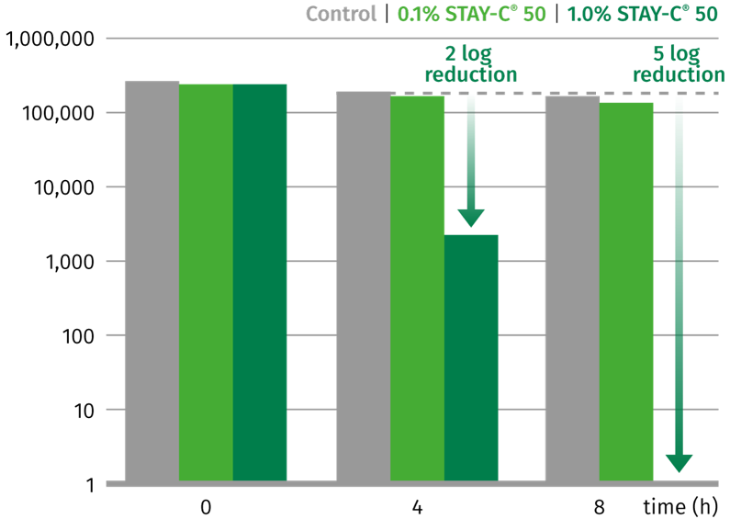
STAY-C® 50 – reduces the appearance of acne
In vitro
STAY-C® 50 inactivates Cutibacterium acnes by 5 log after 8 hours of incubation
Bacterial Count
1% STAY-C® 50 is effective against Cutibacterium acnes already after 4h
After 8h the log reduction of bacterial count is 5, which means that most bacteria are killed
Cultivation of bacterium Cutibacterium acnes
Addition of different concentrations of STAY-C® 50 to the media
Klock J et al. Int J Cosmet Sci 2005;27:171-176
Notes:
Cultivation of bacterium P. acnes under anaerobic conditions
Addition of different concentrations of STAY-C® 50 to the media
Bacterial counts performed after 0, 4 and 8 hours

Slide 35
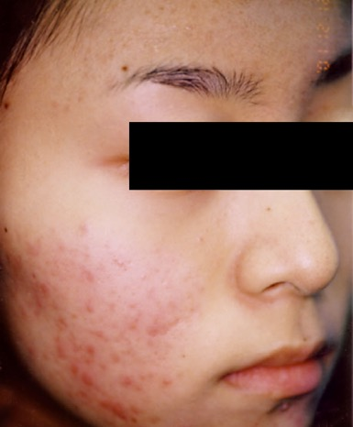
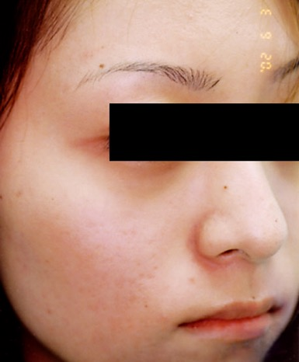
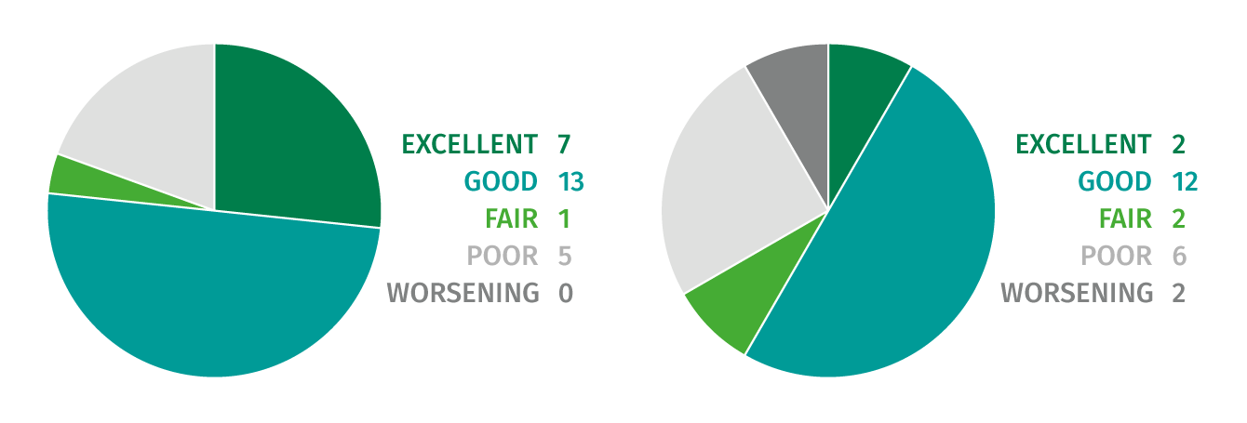
STAY-C® 50 – reduces the appearance of acne
In vivo
STAY-C® 50 visibly improves skin condition of acne vulgaris by 77 % in 12 weeks
Improvement of skin conditions after treatment
5% STAY-C® 50
5% Benzoyl Peroxide
77% excellent/good
61% excellent/good
Before
After 12 weeks STAY-C® 50
STAY-C® 50 visibly reduces the appearance of acne lesions in 12 weeks and outperforms Benzoyl Peroxide#
2x30 patients with acne vulgaris
5% STAY-C® 50 or 5% Benzoyl Peroxide
12 week treatment, twice daily application
Klock J et al. Int J Cosmet Sci 2005;27:171-176
# Benzoyl peroxide is a bactericidal powerful ingredient against acne
Notes:
Measurement by CCD microscopic device
Assessment by grading into 5 groups: excellent, good, fair, poor, worsening performed by the investigator based on CCD microscopic device which captures clinical digital photographs and microscopic images
Number of subjects who completed the study 26 for stay c and 23 for BP
The formulation is displayed in the publication

Slide 36
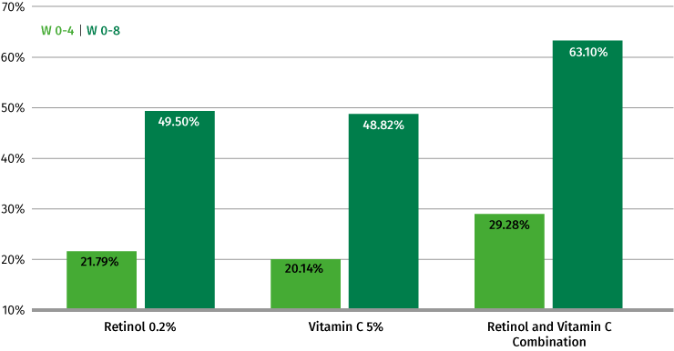
STAY-C® 50 + Retinol – synergy in anti-acne
In vivo
Combination of STAY-C® 50 and Retinol reduced the inflammatory lesions up to 63% in 8 weeks
Reduction of inflammatory lesions (%) after 4 and 8 weeks of topical application vs baseline
STAY-C® 50 reduces the inflammatory lesions by 20.14% and 48.82% (4 and 8 weeks). Addition of retinol improved the treatment efficacy by 30%.
45 volunteers
4- and 8-weeks study
5% STAY-C® 50 (twice daily) and 0.2% Retinol (once daily), separately or in combination vs baseline
C. Ruamrak, N. Lourith, S. Natakankitkul. Comparison of clinical efficacies of SAP, retinol and their combination in acne treatment. Int J Cosmet Sci, 2009, 31: 41-46
Notes:
45 subjects between 18 and 40 years old having facial acne of grade II-III with 10-50 inflammatory lesions (papules, pustules, and nodules). All subjects had neither used any acne topical treatment nor retinoids for 4 and 6 weeks, respectively, prior to the enrollment to the study. Was a cross double-blind study, examination and counting of inflammatory lesions was performed by a physician and all subjects were photographed under the same condition. Aa subjects were patch tested for 48 hours prior to starting the experiment. The subjects were randomly assigned to use 5% SAP lotion with control base cream (n=15), 0.2% retinol creamwith control base lotion (n=15) and 5% SAP lotion along with 0.2% retinol cream (n=15), separately. Subjects assigned to 5% SAP applied it twice daily, those used retinol, applied it once during night time, and those who did the combination treatment applied 5% lotion twice daily and retinol cream once during the night. Efficacy was assessed by lesion counting grading system. Statistical analysis was performed using one-way ANOVA test at 0.05 significant value.
The resulting data showed that SAP reduced the inflammatory lesion by 20.14% and 48.82% within 4 and 8 weeks respectively. Application of the formulation containing retinol slightly improved the treatment efficacy as the lesion reduced by 21.79% and 49.50% after 4 and 8 weeks respectively. The combination treatment significantly reduced the inflammatory lesion by 29.28% after 4 weeks and 63.10% after 8 weeks of application. The most effective treatment was by using the combination of 5% SAP and 0.2% retinol, which incorporated the synergistic effects on lipid peroxidation and sebaceous gland function in addition to the enhancement of SAP permeability by the desquamation of stratum corneum influenced by retinol, keratin plug removal and anti-inflammatory effect of retinol. This study promises for the development of cosmetic products to overcome aesthetic and psychological problems caused by acne vulgari

Slide 37

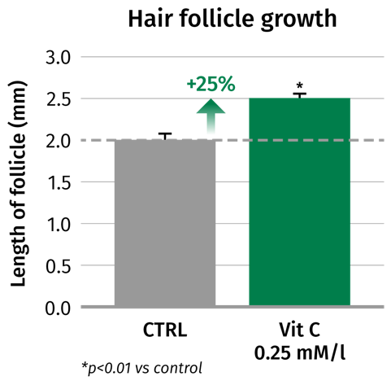
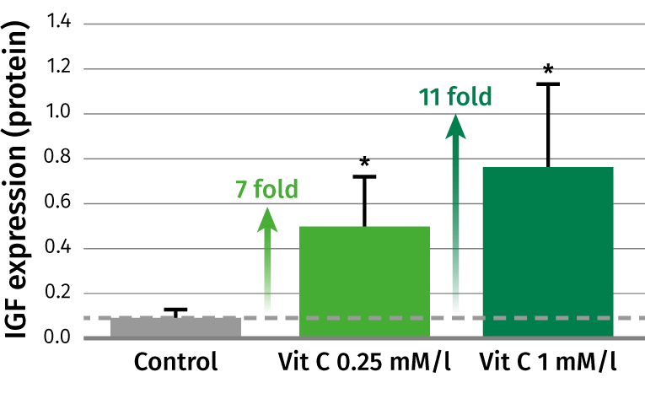
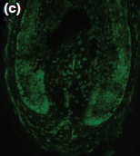
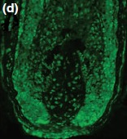
STAY-C® 50 – in hair care
Ex vivo
STAY-C® 50 induces hair follicle growth up to 25%
Insulin-line growth factor-1 (IGF1)
expression in hair follicle
STAY-C® 50 stimulated the growth of cultured human hair follicle by upregulating IGF-1 up to 11 fold
Human hair follicles obtained from scalp biopsies
Vitamin C #,0.25 and 1 mM/l, 9 days
CTRL
Vit C
IGF expression
IGF expression
Kwack MH et al. Br J Dermatol. 2009 Jun;160(6):1157-62.
# L-Ascorbic acid 2-phosphate
Notes:
The concentrations of IGF-1 in conditioned media were measured by ELISA. Gene expression was analysed by RT PCR
Isolated human hair follicles incubated in the absence (c) or presence(d) of 0.25 and 1 mM/L of Vitamin C for 12 h and immuno-stained with polyclonal antibodies against IGF1
The stimulation of IGF1 is important to counteract the thinning of hair and a slow hair growth as reported recently (Trueb. Skin Appendage Disord. 2018 Apr;4(2):90-95)"

Slide 38

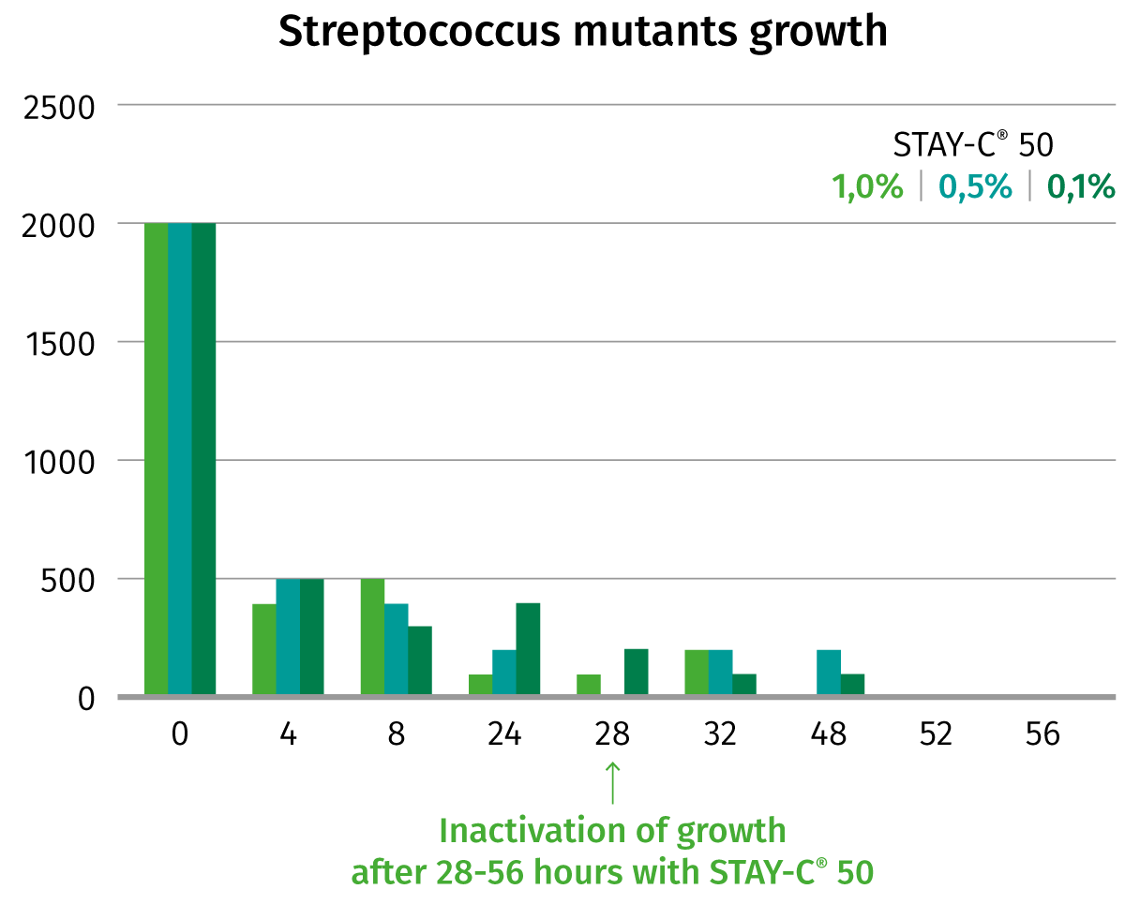
STAY-C® 50 – in oral care
In vitro
STAY-C® 50 inhibits growth of oral bacteria Streptococcus mutants, key bacteria for caries
STAY-C® 50 effectively inactivates in vitro Streptococcus mutants, the main bacteria responsible for caries
Similar efficiency against key bacteria for gingivitis, Actinobacillus actinomycetemcomitans and periodontis, Porphyromonas gingivalis (back up slides)
STAY-C® 50 incubated with the bacteria up to 56 hours
STAY-C® 50 1%
STAY-C® 50 0.5%
STAY-C® 50 0.1%
R Jermann & AA Gripp. Cosmetics and Toiletries Manufacture Worldwide 153-157 (2004)
Notes:
STAY-C ® 50 was incubated with the bacteria in the vessel for up to 56 hours.
Aliquots to be plated on culture dishes were taken at the times indicated.
Contact time 0 means that the aliquot were taken immediately after dosing of STAY-C ® 50 to the bacteria culture.
In the formation of cavities (caries), several bacteria are involved whereas one of the most predominant found in the saliva is Streptococcus mutans.
Streptococcus mutans principal causative plaque bacterium for caries in humans
STAY-C ® 50 at 0.1% and 0.5% effectively inactivates Streptococcus mutans in vitro and, therefore, helps to prevent caries when added to oral care products

Slide 39
Comparison among Different Forms of Vitamin C

Slide 40
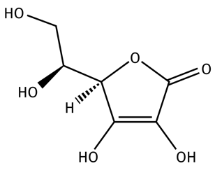
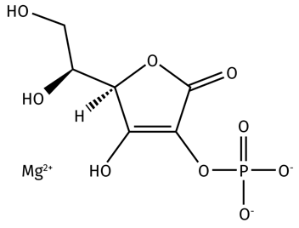
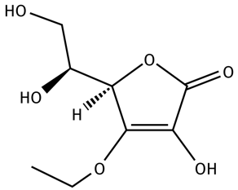

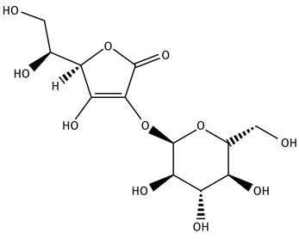
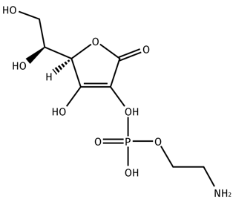
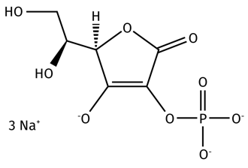
A closer look at the main water-soluble derivatives of Vitamin C used in cosmetics
Vitamin C,
L-Ascorbic Acid
Magnesium Ascorbyl
Phosphate, MAP
3-O-Ethyl Ascorbic
Acid, Ethyl-VC
Sodium Ascorbyl
2-Phosphate
STAY-C® 50
L-Ascorbic Acid
2-Glucoside,
AA glucoside
Aminopropyl
Ascorbyl Phosphate
Stamford et al. Journal of Cosmetic Dermatology, 11, 310—317 (2012)
Juliet M. Pullar. Nutrients 2017, 9(8), 866

Slide 41

Use properties
Comparison
Parameter | L-Ascorbic Acid 2-Glucoside (AA Glucoside) | 3-O-Ethyl Ascorbic Acid (Ethyl-VC) | Aminopropyl Ascorbyl Phosphate | Magnesium Ascorbyl Phosphate (MAP)# | Sodium Ascorbyl 2-Phosphate (STAY-C®50) | L-Ascorbic Acid
Optimum pH range | pH 5.5-7 | pH 4-5.5 | pH 1–10 | pH 6–7.5 | pH 6–8.5 | pH 3-4
Solubility | Water soluble (up to 71.4g/100mL) | Water soluble | Water soluble (up to 20.0g/100mL) | Slightly water soluble (up to 8.0g/100mL) | Water soluble (up to 78.9g/mL) | Water soluble (up to 30.0g/100ml)
Ascorbic acid equivalents (MW) | 52.0% | 86.3% | 56.2% | 46.4% | 50.0% | 100.0%
Resistance to discoloration | RT + HT(40-45°C) + | RT + HT(40-45°C) + | Claimed, not shown | RT + HT(40-45°C) - | RT + HT(40-45°C) - | RT - HT(40-45°C) --
Stability in solution (% of active) | Yes (≥90%, 3 months) | Yes (≥90%, 3 months) | Yes, shown for 4h | Yes (≥90%, 3 months) | Yes (≥90%, 3 months) | Slightly (60%, 3 months)
Conversion to AA | Claimed | NA | Claimed | Claimed | Yes | NA
Recommended use level | ≤2.0% | 0.1-3.0% | 0.1–2.0% | 0.1-3.0% | 0.1-15% | 0.1-15%
Parameters as reported on the available documentation (RT= room temperature: HT= 40-45°C)
Parameter was tested internally
Notes:
Solubility in Water :
STAY-C 50= 789g/L at 20°C so 78.9 g/mL
3-O-Ethyl Ascorbic acid:
AA2G: 71.4g/100mL
MAP: 8g/100mL
Aminopropyl Ascrobyl Phosphate: up to 20g/100mL
Glycerine solubility:
STAY-C 50: 13.2g/100mL
3-O-Ethyl Ascorbic acid: 45g/100mL
AA2G: ?
MAP: ?
Aminopropyl Ascrobyl Phosphate:?

Slide 42
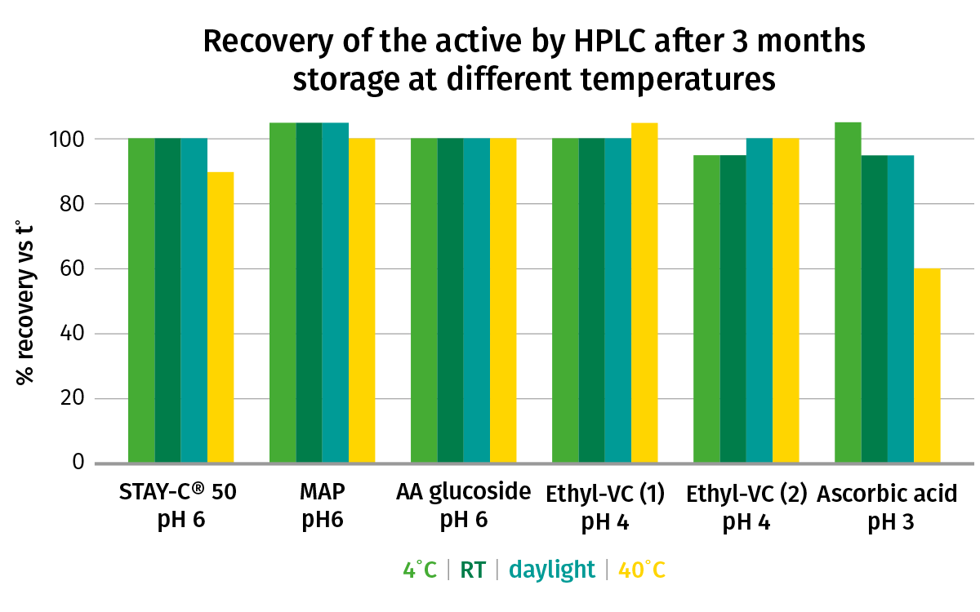
Comparison – stability in formulation
STAY-C® 50 is ≥90% stable at all temperature conditions after 3 months, comparable to other stable derivatives #
The recovery rate of pure Ascorbic acid is ≥ 80% when stored at 4°C, RT and daylight. At 40°C the recovery is 50-60%
DSM Internal study
Tests were performed at 2 different recommended pH for each grade, results at the lowest tested pH for each grade are shown in emulsion-based formula
# From left to right: Sodium Ascorbyl 2-Phosphate (STAY-C® 50), Magnesium ascorbyl phosphate (MAP), ascorbyl 2-glucoside (AA glucoside), 3-O-ethyl ascorbic acid (Ethyl-VC 1 and 2), Ascorbic Acid Ultra Fine Powder (Ascorbic Acid). All grades were tested at 2%
Notes:
Study report 2018-014 formulations number SK-E-101308-1 to 24
Except for the pure Ascorbic acid, all Vit C derivatives showed a very good stability in formulation at all storage conditions.
HPLC analysis performed on all samples confirmed again that all these Vitamin C derivates are more stable that pure ascorbic acid in common cosmetic formulations.

Slide 43
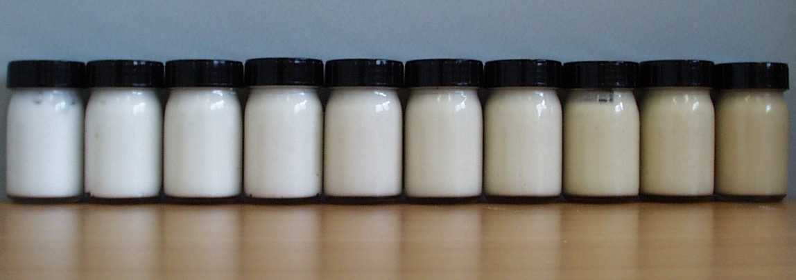
STAY-C® 50 – Color stability in formulation
STAY-C® 50 is color-stable when stored at RT for 18 months.
Accelerated stability test at 40°C does not reflect the long-term color-stability
Long-term color-stability of 3% STAY-C® 50 or MAP
in Brij-emulsion formulation (b* value)
The visual aspect of a STAY-C® 50 emulsion after 1.5 years at room temperature (RT) is comparable MAP emulsion
STAY-C® 50 is color-stable when stored at RT for 18 months.
STAY-C® 50
MAP
MAP
STAY-C® 50
MAP
STAY-C® 50
Even though some slight discoloration occurs at 40°C, it does not impact the long-term color stability.
-0.5
2.5
3.50
4.31
7.8
9.1
9.8
14.33
15.30
17.5
initial
initial
1.5 y RT
1.5 y RT
3 Mt, 43°C
3 Mt, 43°C
DSM Internal study
Notes:
Report S085, formulations 8-12

Slide 44
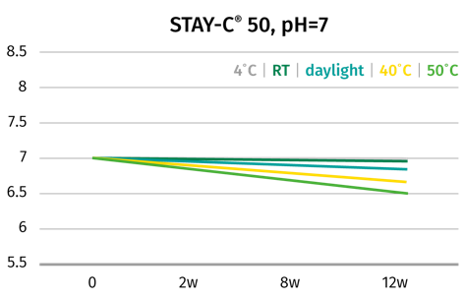
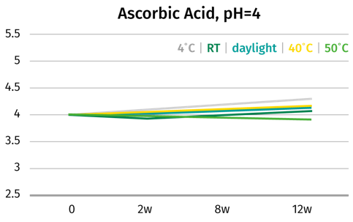




Comparison – pH stability in formulation
pH is more stable with STAY-C® 50 and Ascorbic Acid than with AA glucoside and Ethyl-VC#
DSM Internal study
Tests were performed at 2 different recommended pH for each grade, results at the highest tested pH for each grade are shown in emulsion-based formula
# From left to right: Sodium Ascorbyl 2-Phosphate (STAY-C® 50), Ascorbic Acid Ultra Fine Powder (Ascorbic acid), Magnesium ascorbyl
phosphate (MAP), ascorbyl 2-glucoside (AA glucoside), 3-O-ethyl ascorbic acid (Ethyl-VC 1 and 2), All grades were tested at 2%
Notes:
pH stability is the opposite of the color stability, so pH is respectively more stable with pure ascorbic acid, than Stay-C® 50 and MAP, than AA2G and both 3-O ethyl ascorbic acid.
In general, pH shifts toward more acidic pH
Study report 2018-014 formulations number SK-E-101308-1 to 24

Slide 45
Activity claims based on published documentation
Comparison
Parameter | L-Ascorbic Acid 2-glucoside (AA glucoside)# | 3-O-ethyl ascorbic acid (Ethyl-VC)# | Aminopropyl Ascorbyl Phosphate | Magnesium Ascorbyl Phosphate (MAP)# | Sodium Ascorbyl 2-Phosphate (STAY-C® 50)#
Antioxidant | In vitro | In vitro | • | In vitro | In vivo
Protection from UV-induced damage | In vitro ! | In vitro / Ex vivo | - | In vitro | Ex vivo
Collagen stimulation | In vitro | In vitro | In vitro | In vitro | In vitro
Skin lightening/Age spots fading | In vitro / In vivo ! | In vitro / In vivo ! | In vivo | In vitro ! | In vitro / In vivo
Anti-ageing | In vitro / In vivo | • | In vivo | • | In vivo
Reduces the appearance of acne | • | – | – | In vivo | In vitro / In vivo
Promotes hair growth | – |  | – | • | In vitro
Deodorant activity | – | – | – | – | In vivo
Support of healthy gum and teeth | – | – | – | – | In vitro
SUBSTANTIATED CLAIM: a direct experimental evidence is showed to the brochure/documentation to support the claim
CLAIM NOT SUBSTANTIATED: there is no direct evidence to support the claim on the brochure/documentation, the claim comes from an indirect interpretation
!: Controversial results comparing competitor documentation and internal know-how/scientific published results
# used as whitening active ingredient for Quasi Drugs in Japan
Notes:
Substantiated claims: info provided based on the product brochures.

Slide 46

Comparison – skin lightening activities
STAY-C® 50 and ascorbic acid show superior skin lightening activity as compared to MAP, AA Glucoside and Ethyl-VC#
Inhibition of melanin synthesis
STAY-C® 50 dose-dependently decreases melanin content up to -22%
Ascorbic acid dose-dependently decreases melanin content up to –40%
DSM Internal study
NHEM-LP Melanocytes
Different Vitamin C forms, 10 days
*p < 0.05 **p < 0.01 vs control
DSM Internal study
# From left to right: STAY-C® 50, Magnesium Ascorbyl Phosphate (MAP), ascorbyl 2-glucoside (AA glucoside), 3-O-ethyl ascorbic acid (Ethyl-VC), Ascorbic Acid Ultra Fine Powder
Notes:
Melanin was extracted using 0.5 NaOH solution. OD was measured at 405 nm and melanin quantity was determined against a melanin standard curve
We know that Et-VC is not toxic and could potentially be tested on the cells also at higher concentrations. However this could also be an indication and argument to say that Et-VC is not converted efficiently to ascorbic acid since ascorbic acid start to be toxic at concentration higher than 0.037% while Et-VC does not even show toxicity at 1%!
T-test * p < 0.05 **p < 0.01 vs control

Slide 47

Comparison – antioxidant activity
In vivo
Vitamin C reduces protein oxidation by 91%, while AA Glucoside# does not show any activity
Reduction of protein oxidation (carbonylation)
Vitamin C shows excellent antioxidant capability in the stratum corneum, similar to Vitamin E
Single-blind test
8 volunteers, forehead
0.5% Vitamin C or Vitamin E or AA Glucoside# emulsion vs placebo
4 weeks, twice daily
F.J.Tsai et al. J Photochem Photobiol B. 2012 Jul 2;112:7-15
# AA Glucoside is ascorbyl 2-glucoside
Notes:
Determination of protein carbonylation by tape stripping followed by anti-dinitrophenyl (DNP) antibody immunoblotting
Skin photoaging is related with oxidative stress which often causes lipid peroxidation, glycation as well as protein oxidation and therefore the above chemical reactions can be used as biomarkers for oxidative stress.
It has been reported that the protein carbonylation could be used as a biomarker for oxidative stress. The current study detects the change of the level of exposed protein carbonyl group in the most outer layer of human SC. The concentration of the antioxidant in each subject emulsion formulation was 0.5% (w/w). The data indicated that alpha-tocopherol (a-Vit E) and ascorbic acid (Vit C) have excellent antioxidative capability. Ascorbic acid 2-glucoside represented an insignificant antioxidative capability.

Slide 48

Comparison – antioxidant properties ex vivo
Ex vivo
Skin Antioxidative Power (SAP): STAY-C® 50 shows superior anti-oxidant activities than Tocopherol and Ascorbyl glucoside (up to 46%) after 5 hours
Skin Antioxidative Power performed using Electron Spin Resonance spectroscopy on skin explant labelled with semi-stable free radical that is reduced by the antioxidant system inside the epidermis and dermis
Actives applied on the epidermal side, 5h experiment allowing the skin penetration, done in triplicate
Ascorbic acid has a much higher SAP after 10 min (SAP at 10.9, +46% vs placebo) because Ascorbic acid is quickly absorbed by the skin
STAY-C® 50 is the sole ingredient showing a significant increase of SAP compared to placebo after 5 hours
DSM Internal study
* Statistically significant at p<0.05 (ANOVA)

Slide 49






The all-round beauty solution for skin perfection
STAY-C® 50
Biological Concepts
Consumer Benefits
Counteracts skin oxidation:
Neutralization of UV-induced ROS
Reduction of peroxides formation
Photoprotection from UVA & UVB
Reduction of photodamage
Promotes collagen production (dermis)
Strengthens skin’s barrier (epidermis)
Anti-ageing
Improvement of skin firmness and texture
Decreases melanin synthesis and reduces age spot
Improves the appearance of acne inflammatory lesions
Evens the
skin tone and skin lightening
Cosmetic treatment of acne-prone skin
Limits the growth of oral bacteria
Promotes elongation
of hair follicle
Support of healthy
teeth and gum
Stimulation of hair growth

Slide 50
STAY-C® 50 – benefits vs other derivatives
Our stable cosmetic Vitamin C specialty
Good skin penetration
Proven conversion into the active form ascorbic acid
A multi-talent beauty remedy addressing almost every skin concern from acne to UV damage…and its activity is proven!
Overperformance in melanin synthesis inhibition and antioxidant properties vs other derivatives
Stable in aqueous environment
Easy to formulate
Only derivative with use level up to 15%
Approved quasi-drug active ingredient for whitening products in Japan
Use in Daycare, Suncare, anti-aging product, anti-acne and Oral and body care

Slide 51

STAY-C® 50 – Regulatory Status
Allows development of global products
US status: Full cosmetic registration
    *Cosmetic Ingredient Review: safe as used
EU status: Full chemical and cosmetic registration
    Chemical REACH registration 
    Cosmetic registration 
China status: Full chemical and cosmetic registration
Chemical REACH registration 
Chinese INCI name 
Cosmetic registration 
Japan Status: Full cosmetic registration
*Used as whitening active ingredient for Quasi Drugs in Japan
Product free for sales as cosmetic ingredient for the application and use level recommended by DSM!
Notes:
IECSC = Inventory of Existing Chemical Substances in China
IECIC = Inventory of Existing Cosmetic Ingredients in China, June 30, 2014, also called CFDA inventory of cosmetic ingredients which have been used in China.
ENCS = Japanese Existing and New Chemical Substances Inventory(ENCS)
TSCA = Toxic Substances Control Act (TSCA)
CIR-cosmetic ingredient review: considering the available toxicological data, it can be concluded that no undue risk is expected from exposure to the product at the intended use levels.
Int J Toxicol. 2005;24 Suppl 2:51-111.Final report of the safety assessment of L-Ascorbic Acid, Calcium Ascorbate, Magnesium Ascorbate, Magnesium Ascorbyl Phosphate, Sodium Ascorbate, and Sodium Ascorbyl Phosphate as used in cosmetics.

Slide 52


DISCLAIMER
Copyright © 2022 DSM Nutritional Products, 4002 Basel, Switzerland.
www.dsm.com/personal-care. All rights reserved.
Although DSM has used diligent care to ensure that the information provided herein is accurate and up to date, DSM makes no representation or warranty of the accuracy, reliability, or completeness of the information. This presentation only contains scientific and technical information for business-to-business use. Country- or region-specific information should also be considered when labeling or advertising to final consumers. This publication does not constitute or provide scientific or medical advice, diagnosis, or treatment and is distributed without warranty of any kind, either expressly or implied. In no event shall DSM be liable for any damages arising from the reader’s reliance upon, or use of, these materials. The reader shall be solely responsible for any interpretation or use of the material contained herein. The content of this document is subject to change without further notice. Please contact your local DSM representative for more details. All trademarks listed in this brochure are either registered trademarks or trademarks of DSM in The Netherlands and/or other countries unless explicitly otherwise stated.
DISCLAIMER GUIDE FORMULATION
“This information is for illustration purposes only and based upon our current knowledge and experience at the time of printing. We do not make any representation or warranty of any kind, express or implied, including merchantability or fitness for a particular use, with respect to such information or its application. Use of this information is at your discretion and risk. Nothing herein relieves you from carrying out your own suitability determinations and tests. You are responsible for observing all laws and regulations relevant to your products, uses or processes. We do not assume any liability in connection with your product and its use. The foregoing information and suggestions are also provided without warranty of non-infringement as to the intellectual property rights of third parties, and shall not be construed as any inducement to infringe the rights of third parties.”)
This document only contains scientific and technical information for business-to-business use. Country or region-specific regulatory requirements should be considered when developing claims for labeling or advertising to final consumers.

Slide 54
Back-up
Additional slides, with partly more comprehensive data than in main presentation

Slide 55
STAY-C® 50: the all-round naturally derived beauty solution for skin perfection
Biological Concepts
Consumer Benefits
Counteracts skin oxidation:
Neutralization of UV-induced ROS
Reduction of peroxides formation
Photoprotection from UVA & UVB
Reduction of photodamage
Promotes collagen production (dermis)
Strengthens skin’s barrier (epidermis)
Anti-ageing
Improvement of skin firmness and texture
Decreases melanin synthesis and reduces age spot
Improves the appearance of acne inflammatory lesions
Evens the
skin tone and skin lightening
Cosmetic treatment of acne-prone skin
Limits the growth of oral bacteria
Promotes elongation
of hair follicle
Support of healthy
teeth and gum
Stimulation of hair growth

Slide 56

STAY-C® 50 – skin lightening activities
In vitro
STAY-C® 50 dose-dependently inhibits melanin synthesis by 20% in
L-tyrosine stimulated human melanocytes
STAY-C® 50 reduces the melanin content in human melanocytes in a dose-dependent way
NHEM-LP Melanocytes
10 days incubation with different concentration of STAY-C® 50
DSM Internal study
Notes:
Melanin was extracted using 0.5 NaOH solution. OD was measured at 405 nm and melanin quantity was determined against a melanin standard curve

Slide 57


STAY-C® 50 – reduces the appearance of acne
In vivo
STAY-C® 50 improves the appearance of inflammatory and
non-inflammatory lesions by 64% to 70% vs placebo in 12 weeks
Improvement in acne lesions (%)
89 volunteers
Lotion with 5% STAY-C® 50 or
1% Clindamycin vs placebo
12 weeks, twice daily
Measuring acne index and
comparison to day=0
STAY-C® 50 outperforms clindamycin# in cosmetic treatment of acne prone skin
Hiroshi Ikeno et al, 2003, IID, Poster #0324
# topical clindamycin is an antibiotic commonly used to treat inflammatory acne
Notes:
Clindamycin is a topical antibiotic and a 1% Clindamycin lotion is typically prescribed by dermatologists for acne treatment .
The performance of 1% Clindamycin lotion for inflammatory lesions was only 60% and for non-inflammatory lesions only 50%.

Slide 58

STAY-C® 50 – in oral care
In vitro
1 % STAY-C® 50 inhibits growth of oral bacteria Actinobacillusa actinomycetemcomitans, key bacteria for gingivitis
STAY-C® 50 at 1% and 0.5% strongly decreases the bacterial count of Actinobacillus actinomycetemcomitans, the main bacteria responsible for gingivitis
STAY-C® 50 incubated with the bacteria up to 56 hours
STAY-C® 50 1%
STAY-C® 50 0.5%
DSM Internal study
Notes:
This graph shows that STAY-C ® 50 inhibits the growth of Actinobacillus actinomycetemcomitans in a concentration dependent manner.
0.5% reduces the number of colonies already quite significantly, but with 1% STAY-C ® 50 there is a very strong effect.
Actinobacillus Actinomycetemcomitans is mainly involved in the induction and progress of periodontitis. (Listgarten 2001, Müller et al. 1991, Schilke et al 1995)

Slide 59

STAY-C® 50 – in oral care
In vitro
STAY-C® 50 strongly inactivates growth of oral bacteria Porphyromonas gingivalis, key bacteria for periodontitis
STAY-C® 50 rapidly decreases the growth of Porphyromonas gingivalis at all tested concentrations
STAY-C® 50 incubated with the bacteria up to 56 hours
STAY-C® 50 1%
STAY-C® 50 0.5%
STAY-C® 50 0.1%
DSM Internal study
Notes:
Porphyromonas gingivalis is a bacterium which divides very fast in the culture medium. The exponential growth did still go further on when STAY-C ® 50 was added (contact time 0).
Aliquots taken and cultivated later showed that STAY-C ® 50 in the growth of Porphyromonas gingivalis at all tested concentrations.
Porphyromonas Gingivalis induces many signaling pathways, which finally lead to the destruction of the connective tissue and the periodontal bone. (Schilke et al 1995)

Slide 60

STAY-C® 50 – in deodorants
In vivo
STAY-C® 50 reduces malodor by more than 40% 8 hours post-application and performs 10% better than placebo
Underarm sniff – difference to baseline
24 hours after the application, the STAY-C® 50 formulation performed an additional 10% better than the placebo
10 female volunteers, underarm
2 weeks washout period prior test start
0.2% STAY-C® 50 in a water base containing 12% EtOH
Single application
* p<0.05 versus initial conditions
R Jermann & AA Gripp. Cosmetics and Toiletries Manufacture Worldwide 153-157 (2004)
Notes:
Bacteria cause malodor, especially in the axillary area as they digest certain components from sweat gland secretions. The following underarm sniff test was conducted to assess whether STAY-C® 50 has deodorant activity.
Test performed at Derma Consult Institute, Dermatika
Scoring by 3 trained assessors
Formulation 9% Glycerin
12% Alcohol
84.80% Water
0.20% STAY-C 50.
1. S141_15OPE/16.12.02
2. S141_151 PE/16.12.02

Slide 61




STAY-C® 50 + Biotin – combination in skin lightening
Specific claims and combinations with additional ingredients
STAY-C® 50 + Biotin + Niacinamide

Slide 62



STAY-C® 50 – stability in formulation
STAY-C® 50 is 100% stable at room temperature and 90% at 43°C after 6 months
C
DSM Internal study
Notes:
Stability checked by HPLC-analysis
This graph illustrates that STAY-C® 50 is very stable compared to ascorbic acid.
HPLC-analysis of the two substances in water demonstrates the outstanding stability of STAY-C® 50 while the ascorbic acid concentration continuously decreased over time.

Slide 63







STAY-C® 50 – stability in formulation
STAY-C® 50 is highly stable over 3 months. Even the slight discoloration at 40°C does not impact the content of the active
Recovery of active in 2% STAY-C® 50
or Ascorbic Acid formulation
With STAY-C® 50, the recovery of active is ≥90%
at all conditions
With Ascorbic acid the recovery is ≥ 80% when stored at 4°C, RT and daylight. At 40°C the recovery is 50-60%
At 4°C
At room temperature (daylight)
At 40°C
STAY-C® 50
Ascorbic acid
STAY-C® 50
Ascorbic acid
STAY-C® 50
Ascorbic acid
pH=6
pH=3
pH=6
pH=3
pH=6
pH=3
DSM Internal study
Tests were performed at 2 different recommended pH for each grade. All grades were tested at 2%
Notes:
Study report 2018-014 formulations number SK-E-101308-1 to 24

Slide 64

Comparison – stability in formulation
STAY-C® 50 is 100% stable at room temperature even after 6 months, comparable to other stable Vitamin C derivatives
Ascorbyl Glucoside
DSM Internal study
Notes:
Study report No. 1004857 21-Mai-2001, N. Girard

Slide 65



Comparison – color stability in emulsion formulation
STAY-C® 50 and MAP show coloration at elevated temperature, while AA glucoside and Ethyl-VC# have good color stability after 3 months
At 4°C
At room temperature (daylight)
AA glucoside
Ethyl-VC
(1)
Ethyl-VC
(2)
Ascorbic
acid
AA glucoside
Ethyl-VC
(1)
Ethyl-VC
(2)
Ascorbic
acid
At 40°C, AA glucoside and Ethyl-VC have a lower impact on the color stability of finished formulas
STAY-C® 50
MAP
STAY-C® 50
MAP
pH=6
pH=6
pH=6
pH=4
pH=4
pH=3
pH=6
pH=6
pH=6
pH=4
pH=4
pH=3
At 40°C
DSM Internal study
Tests were performed at 2 different recommended pH for each grade, results at the lowest tested pH for each grade are shown in emulsion-based formula
STAY-C® 50
MAP
AA glucoside
Ethyl-VC
(1)
Ethyl-VC
(2)
Ascorbic
acid
pH=6
pH=6
pH=6
pH=4
pH=4
pH=3
# From left to right: Sodium Ascorbyl 2-Phosphate (STAY-C® 50), Magnesium ascorbyl phoshate (MAP), ascorbyl 2-glucoside (AA glucoside), 3-O-ethyl ascorbic acid (Ethyl-VC 1 and 2), Ascorbic Acid Ultra Fine Powder (Ascorbic Acid). All grades were tested at 2%
Notes:
Study report 2018-014 formulations number SK-E-101308-1 to 24
Ascorbyl Glucoside (AA2G) and mainly both qualities of the 3-O-Ethyl Ascorbic Acid (SpecWhite VCE & Et-VC) showed a good color stability after 3 months storage at the chosen pH in the emulsion base (shown here) as well as in aqueous solution (not shown here). There is almost no to only light coloration at elevated temperatures.
STAY-C® 50 (Sodium Ascorbyl Phosphate) & Magnesium Ascorbyl Phosphate (SpecWhite MAP) showed a light (daylight) to strong coloration (elevated temperatures).
The coloration with Ascorbic Acid Ultra Fine Powder is the most intense.
Coloration in aqueous solution(not shown here) is always more intense than in emulsion base.
In general, the lowest tested pH for each grade showed the highest coloration. This confirms the pH recommendation mentioned for each grade.

Slide 66
STAY-C® 50 – color stability in formulation
STAY-C® 50 is color-stable when stored at RT for 18 months.
Accelerated stability test at 40°C does not reflect the long-term color-stability
Long-term color-stability of 3% STAY-C® 50 or MAP
in Brij-emulsion formulation (b* value)
The visual aspect of a STAY-C® 50 emulsion after 1.5 years at room temperature (RT) is comparable MAP emulsion
STAY-C® 50 is color-stable when stored at RT for 18 months.
STAY-C® 50
MAP
MAP
STAY-C® 50
MAP
STAY-C® 50
Even though some slight discoloration occurs at 40°C, it does not impact the long-term color stability.
-0.5
2.5
3.50
4.31
7.8
9.1
9.8
14.33
15.30
17.5
initial
initial
1.5 y RT
1.5 y RT
3 Mt, 43°C
3 Mt, 43°C
DSM Internal study
Notes:
Report S085, formulations 8-12

