Slide 1

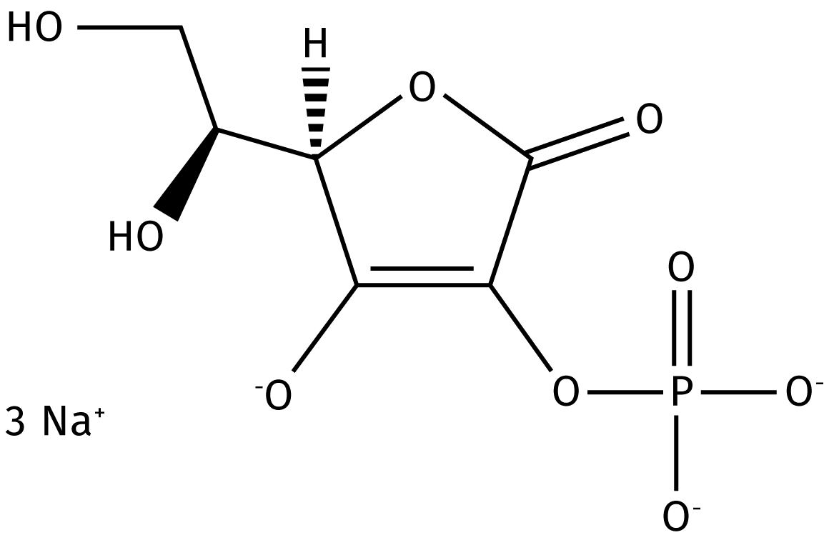

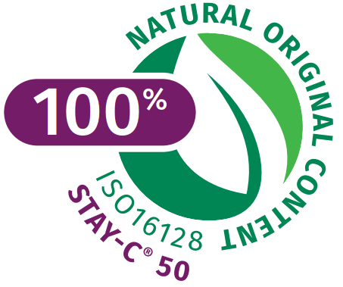





STAY-C® 50 – the all-round naturally derived beauty solution for skin perfection
INCI: SODIUM ASCORBYL 2-PHOSPHATE
Water soluble cosmetic Vitamin C specialty
100% naturally derived (renewable carbon)
A powerful in-vivo anti-oxidant and free radical scavenger but our studies have proven that its efficacy profile is by far broader!
Quickly and fully bio-converted into ascorbic acid in the skin
Recommended dosage: 0.1-15%
1
NATRUE Approved

Slide 2


STAY-C® 50 – the all-round naturally derived beauty solution for skin perfection
To ensure better stability of Vitamin C, DSM developed STAY-C®50
A multi-talented active addressing almost every skin concern: UV damage, skin ageing, dull complexion, age spot, acne and hair loss with proven activity!
Overperformance in melanin synthesis inhibition and antioxidant properties vs other derivatives
Quickly and fully bio-converted into ascorbic acid in the upper skin layers.
Easy to formulate, very stable at pH≥6
Use level up to 15%
Many cosmetic applications
Day care products
Sun care products
Clarifying perfection products (anti-acne)
Anti-ageing products
Skin tone application
Oral and body care

Slide 3
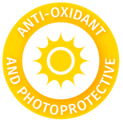


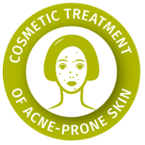


STAY-C® 50: the all-round naturally derived beauty solution for skin perfection
Biological Concepts
Consumer Benefits
Counteracts skin oxidation:
Neutralization of UV-induced ROS
Reduction of peroxides formation
Photoprotection from UVA & UVB
Reduction of photodamage
Promotes collagen production (dermis)
Strengthens skin’s barrier (epidermis)
Anti-ageing
Improvement of skin firmness and texture
Decreases melanin synthesis and reduces age spot
Improves the appearance of acne inflammatory lesions
Evens the
skin tone and skin lightening
Cosmetic treatment of acne-prone skin
Limits the growth of oral bacteria
Promotes elongation
of hair follicle
Support of healthy
teeth and gum
Stimulation of hair growth

Slide 4
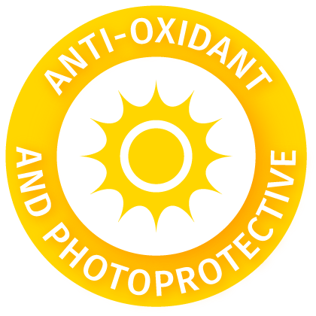

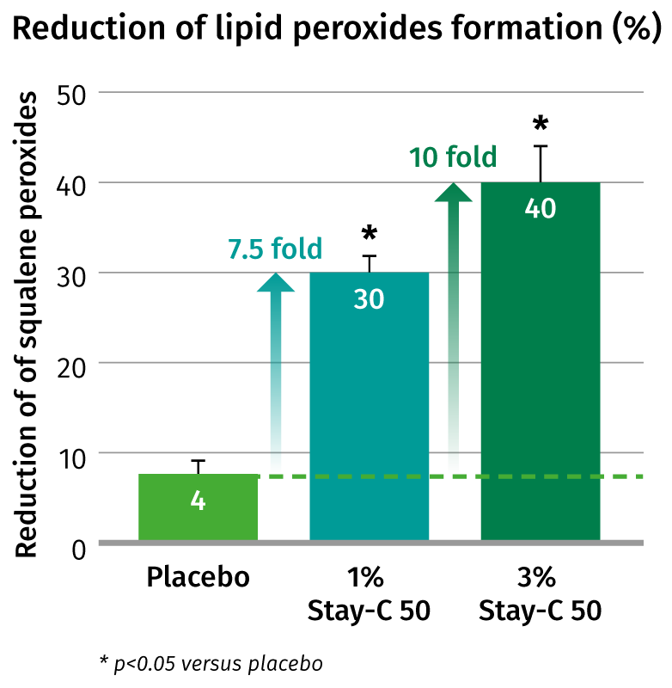
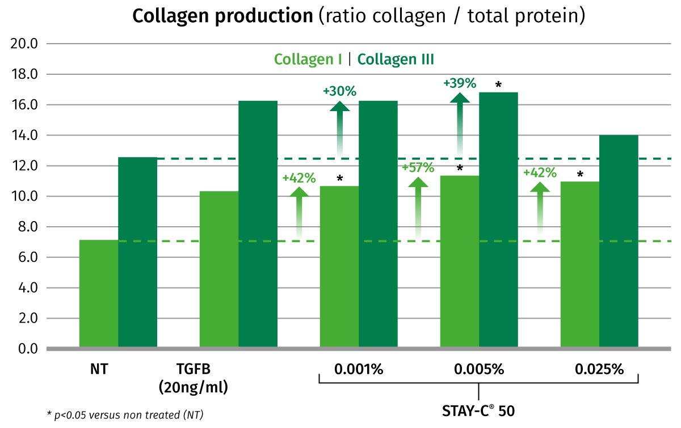


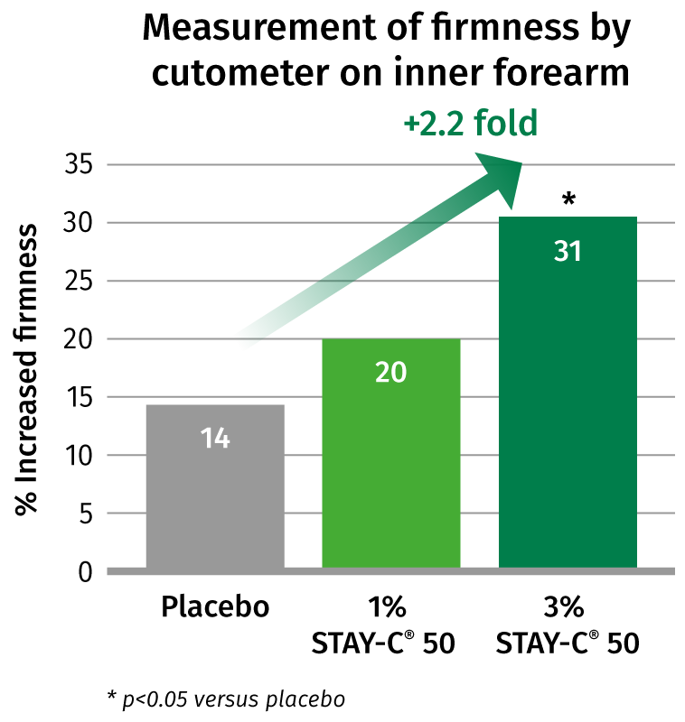
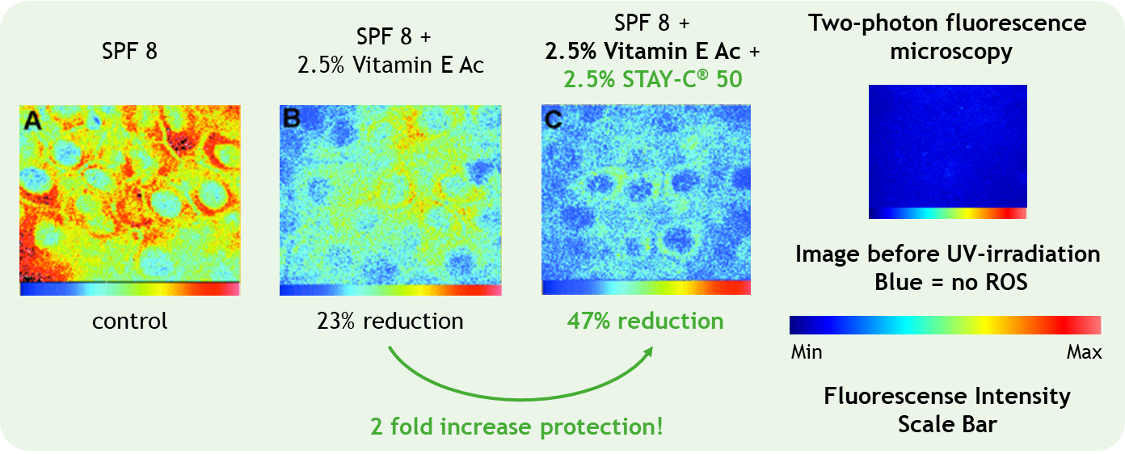
Overview of STAY-C® 50 efficacy
Anti-oxidant & photoprotective
Anti-ageing
Collagen production (ratio collagen/total protein)
3% STAY-C® 50 significantly reduces the UV-induced lipid peroxides up to 40% (in vivo)
STAY-C® 50 significantly promotes collagen I (+57%) and collagen III (+39%) synthesis in human fibroblasts (in vitro)
20 volunteers
7 days prior UVA-irradiation twice daily
2.5% STAY-C® 50 doubles the UVA/UVB protection of sun filters and Vitamin E (ex vivo)
Image of live human skin showing the effect of three products on reduction of ROS after UV irradiation (1600J/m2)
3% STAY-C® 50 significantly doubles the skin firmness increase (in vivo)
Ex vivo human skin (breast and facial), 2 individuals
Formulations applied for 3h
20 volunteers
Product twice daily over 42 days

Slide 5
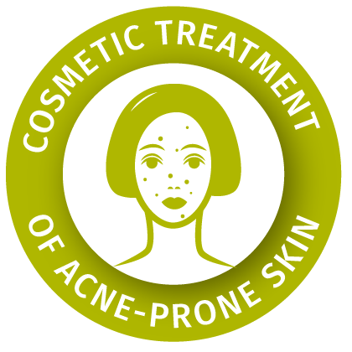

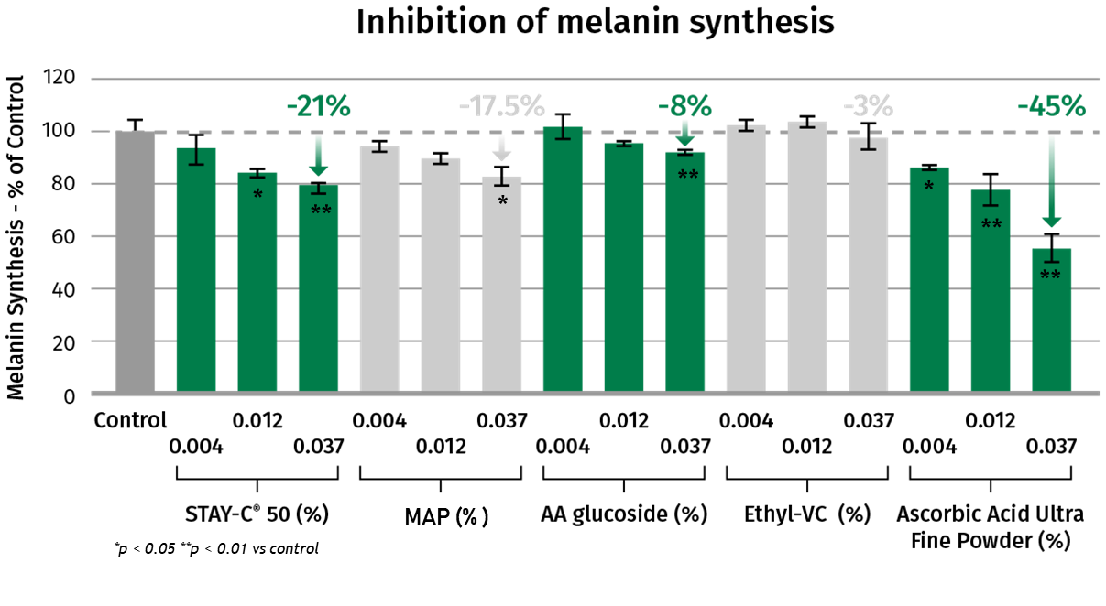
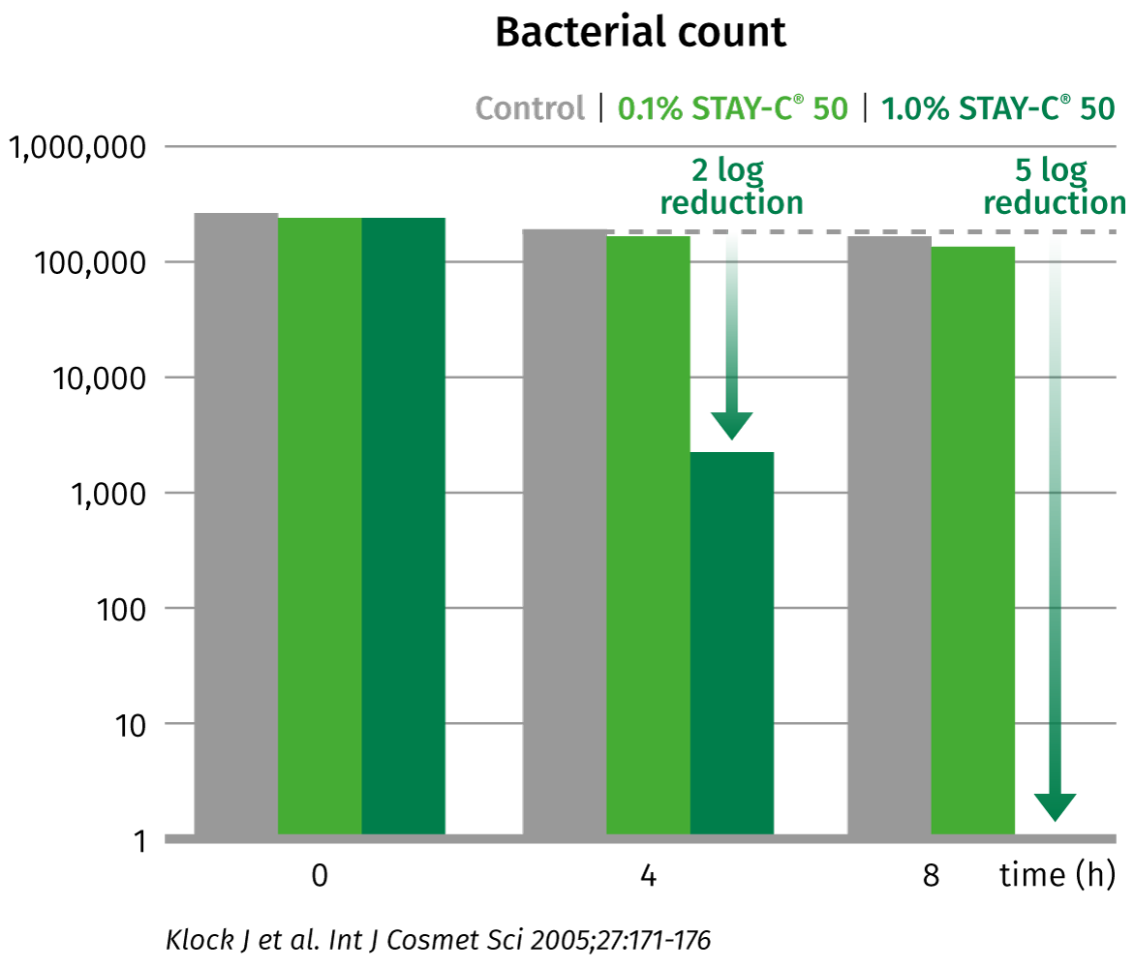
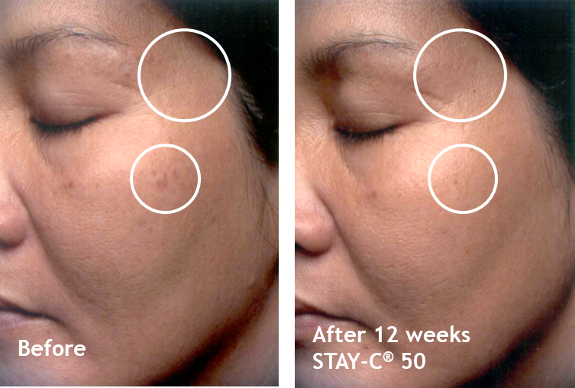
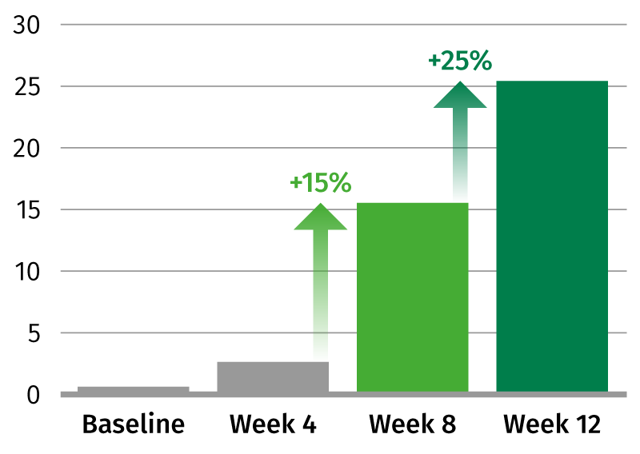
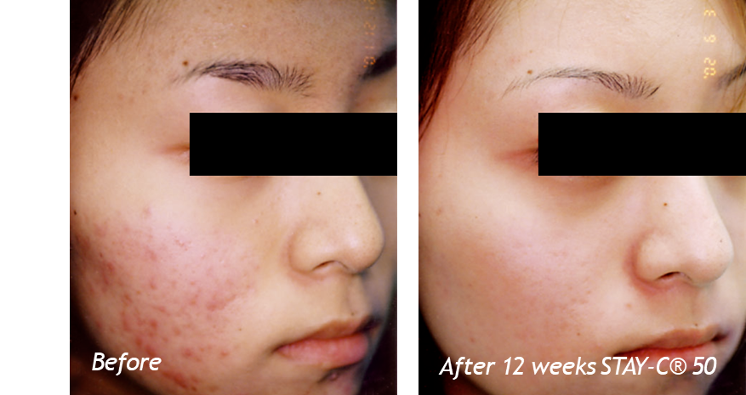
Overview of STAY-C® 50 efficacy
Skin lightening
Reduces the appearance of acne prone skin
STAY-C® 50 reduces melanin synthesis by 21% (in vitro) and is superior to other stable vitamin C derivatives
3% STAY-C® 50 reduces the color intensity of age spots by 25% in 3 months (in vivo)
1% STAY-C® 50 inactivates Cutibacterium acnes by 5 log in 8 hours (in vitro)
NHEM-LP Melanocytes
Different Vitamin C forms, 10 days
Cultivation of Cutibacterium acnes
0.1 and 1% STAY-C® 50
Efficacy assessment of STAY-C® 50: skin improvement (dermatological evaluation)
Quantification of improvement by visual assessment (dermatological evaluation)
5% STAY-C® 50 improves skin condition of acne vulgaris by 77% in 12 weeks (in vivo)
2x30 patients with acne
5% STAY-C® 50
12 weeks treatment
Photographic evidence of spot reduction
39 female volunteers
Test cream with 3% STAY-C® 50 and 1% Vitamin E acetate
12 weeks, twice daily application
Evidence of skin appearance improvement

