Slide 1

May 2025

Slide 2
Agenda
01
Embracing menopause:
The next chapter in women`s life
04
Combination of Niacinamide PC
and key bioactives for
hyperpigmentation control
02
Niacinamide PC: multi-purpose
vitamin for menopausal skin changes
05
Niacinamide PC in haircare
03
New science behind Niacinamide PC
for post-menopausal skin
06
Line-up

Slide 3

01
Embracing menopause:
The next chapter in women`s life

Slide 4
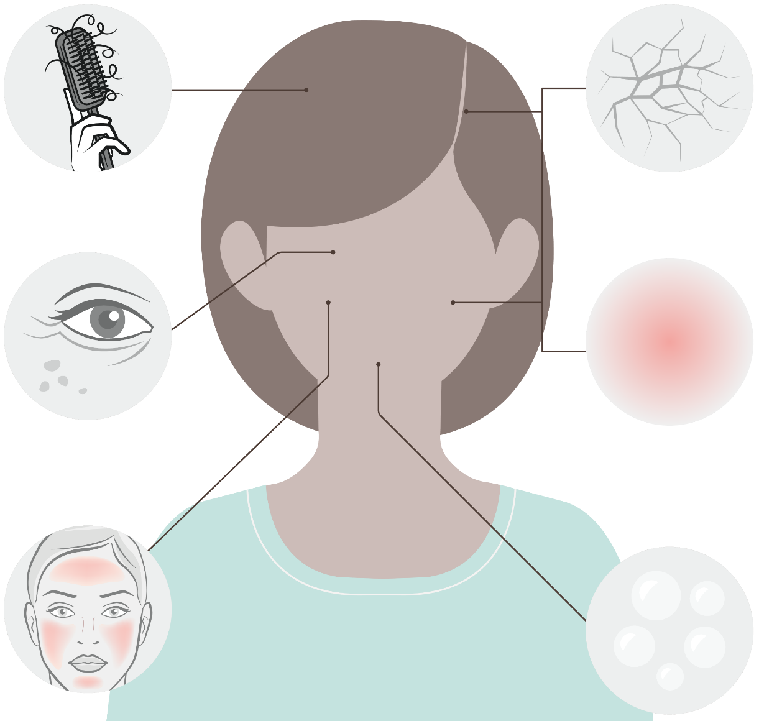







Menopause: Symptoms and effects on skin and hair
Hormonal changes during menopause affect skin and hair cell function leading to visible signs of aging
Thinning scalp hair
Hair grows slower and becomes thinner due to increased hair fall. Hair becomes to look drier, too. On the opposite, there may be an increase in facial hair due to menopause.
Dry skin and scalp
Thinning of the skin and impaired barrier. Hyaluronic acid levels also decrease.
Skin becomes visibly drier. The main symptom of menopause skin. Consumers can also experience dry scalp.*
Wrinkles and age spots
Due to age & lower estrogen levels:
Collagen synthesis is reduced. Collagen and elastin levels decrease about 30% in the first five years of menopause. Skin also loses elasticity.
Overall melanin synthesis is reduced making its transfer to skin cells less efficient ultimately leading to uneven complexion and age spots.
Itchy or red skin and scalp
Due to hormonal changes and becoming drier, skin gets itchy and slightly inflamed leading to skin redness. Consumers can
also experience itchy scalp.*
Hot flushes
Can go along with heavy sweating. They can lead to sleepless nights. Lack of sleep hampers the skin's ability to repair itself.
Oily skin
Some women experience oily skin and acne breakouts. This is due to decreased estrogen levels unmasking testosterone.
Reference: Zouboulis et al. (2022) Skin, hair and beyond: the impact of menopause. Climacteric 25(5):424-442 *dsm-firmenich Consumer Insights Hub
Notes:
Age spots:
Due to age & lower estrogen levels:
Vitamin D synthesis, skin natural photoprotection is reduced.
Overall melanin synthesis decreases, transfer to skin cells becomes less efficient.
Both leading to uneven complexion and localized hyperpigmentation.
Hot flushes :
It is linked to the change in hormonal status, specifically the decline in estrogens and progesterone.
Most research suggests that hot flashes occur when decreased estrogen levels cause body's thermostat (hypothalamus) to become more sensitive to slight changes in body temperature.
When the hypothalamus thinks the body is too warm, it starts a chain of events — a hot flash — to cool down.
See for example Freedman 2014: Menopausal hot flashes: Mechanisms, endocrinology, treatment - ScienceDirect

Slide 5
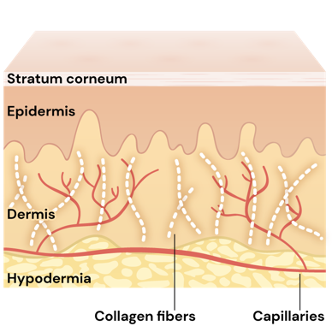
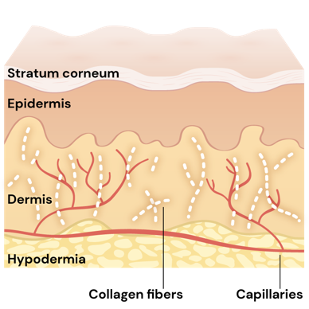
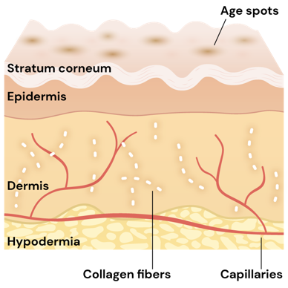
Menopause: focus on skin changes
20 year old skin
40 year old skin (pre-menopause)
50+ year old skin (post-menopause)
Up to our 40s, signs of collagen and elastin degradation become visible. Environmental stressors take their toll, we see the first appearance of fine lines and skin starts showing an uneven tone*.
In our 50s and beyond, skin becomes even thinner. Hormonal decline such as in menopause takes its toll drastically on the skin. Collagen is now significantly degraded; deep wrinkles and age spots form and skin loses water and becomes dry. Skin microbial composition does change, too. **
*Brincat et al. (1987) Decline in skin collagen content and metacarpal index after the menopause and its prevention with sex hormone replacement. Br J Obst Gyn94:126-129
**Brincat et al. (1983) Sex hormones and skin collagen content in postmenopausal women. Br Med J 287:1337-1338
Image source: Affinito et al. (1999) Effects of postmenopausal hypoestrogenism on skin collagen. Maturitas 33:239-247

Slide 6

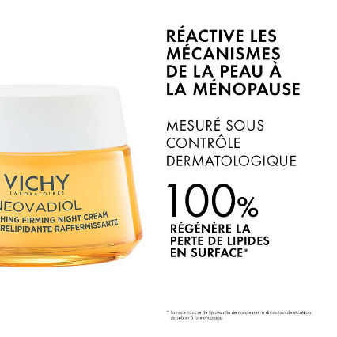
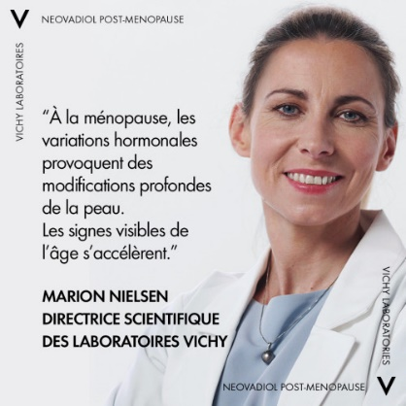
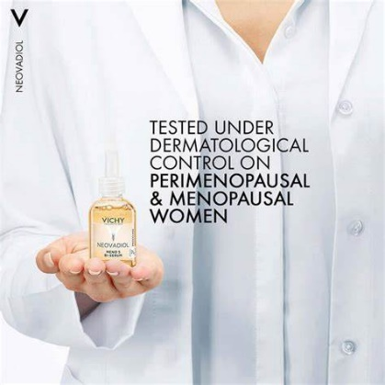
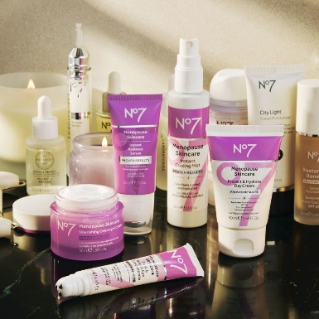
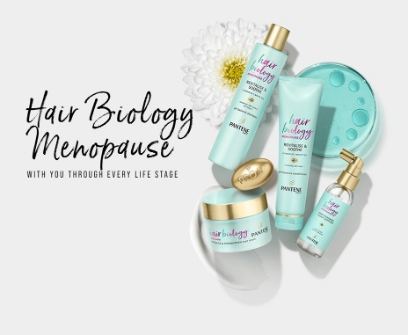
From taboo to trending topic:
Personal care innovations to be more inclusive on menopause
According to 2021 data from Grandview Research, the global menopause cosmetics market size will reach $22.7 billion by 2028.
Neovadiol by Vichy is a line of cosmetics designed to reduce visible signs of post-menopausal skin aging. Backed by dermatological tests and endorsed by experts in the field, Neovadiol offers targeted solutions for menopausal skin care.
No. 7 Menopause Skincare line specially developed to target fine lines and wrinkles. Dermatologically tested and approved by dermatologists with expertise in menopausal skincare.
Pantene Pro V Hair Biology Menopause: a range to help manage the changes brought about by age and hormone imbalance.
Product launches incl. menopause claim increase from 2018 to 2023 by 35 folds, and +24% from 2022 to 2023.
Source: Mintel, gnpd.
Notes:
Source: trendwatching.com
A menopause-focused health company announced in February 2022 that it has extended its partnership with the UK’s NHS to help expand its digital clinic for women’s health. Bia Care was the first of its kind to partner with the NHS in 2021; additional funding will allow the company to expand the availability of its digitally-enabled women’s health clinic. Bia Care connects women to menopause specialist doctors using group consultations, which improves the doctor to patient ratio and means up to six times more patients are treated. Results from the NHS pilot trial showed that the service model delivered clinically effective services at a fraction of the cost of a traditional menopause clinic. https://linktr.ee/biacare
In August 2021, France-based L’Oréal partnered with period-tracking app Clue to research how the skin is affected by the menstrual cycle. With over 12 million users in 190 countries, Clue will deploy voluntary surveys to be studied by L’Oréal’s research and development teams and Active Cosmetic Division. L’Oréal will share its findings in Clue’s reproductive health encyclopedia, found on Clue’s website, and hopes to develop science-backed personalized skincare routines that take into account menstrual cycles from puberty to menopause. Clue is based in Germany.
France-based skincare brand Vichy is aiming to alleviate the stigma surrounding working women’s menopause. In partnership with Allbright, a club created by women, for women, Vichy hosted Let’s not Pause for two days in May 2021. The virtual summit discussed the impact of menopause on working women’s lives, ways to address under-reporting of the topic, and how businesses can be demystified to its influence. Four women hosted the panel, sharing details of their experiences.
In Arabic, menopause literally translates as “the age of despair”. Upon discovering that 81% of Saudi Arabian women believe the phrase needed changing, the incontinence brand Tena launched a video campaign with the hashtag #DespairNoMore. The video depicts women sharing their positive experiences of menopause in a bid to destigmatize it and, ultimately, eradicate the Arabic translation for good. Consumers are invited to share their suggestions for a replacement phrase via Tena’s website.
Womaness is a consumer products brand created to serve the needs of women at all stages of the menopause. In Q1 2021 it launched its first range of products at US supermarket giant, Target. The products include a dietary supplement, a sexual wellness kit, and cosmetics designed to target menopause-induced skincare issues, with prices starting at USD 8.99 for a packet of sanitary towels. The brand’s overarching aim is to promote ‘menopositivity’ and to address the needs of a largely underserved demographic.
August 2020 saw UK-headquartered beauty brand Avon announce the launch of adapt Sync: a skincare collection for women experiencing menopause and perimenopause. The range was created in response to Avon’s Too Little Information report, which revealed approximately 44% of women globally were unaware of perimenopause and the effects on the body. Offering holistic solutions for menopausal skin issues, the collection is formulated with soothing botanical adaptogens, such as turmeric, with anti-inflammatory and antioxidant properties, and Avon’s patented tiliacora, helping to cool the skin and increase hydration and firmness. Included in the range, which are an Icy Cooling Elixir Facial Mist, Dream Cream Night Cream and Hydra Rescue On The Go Serum.

Slide 7

02
Niacinamide PC:
multi-purpose
vitamin for
menopausal
skin changes

Slide 8
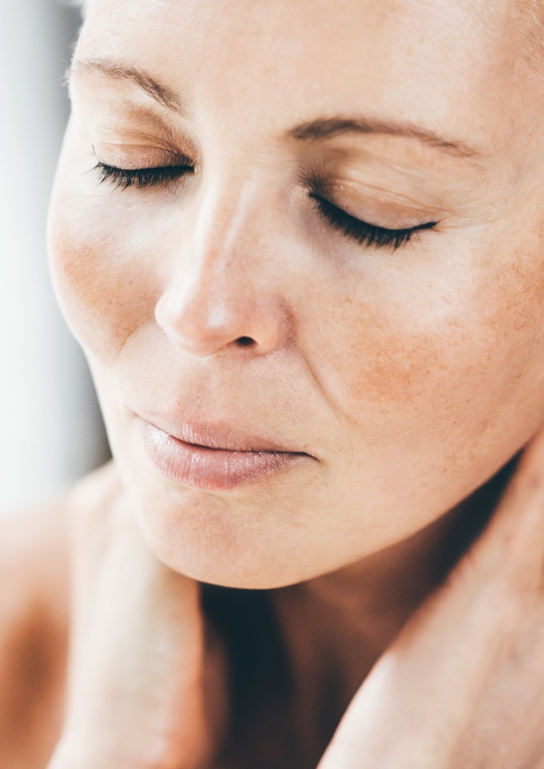





Niacinamide PC: proven benefits
Resilient, flawless skin and radiant complexion
CORNEOCARE® - Skin Resilience
Strengthens the skin barrier and stimulates and rebalances ceramides and lipids in stratum corneum¹
Increases key skin barrier proteins: involucrin, filaggrin, keratin²
Environmental stress protection
Boost cell energy production and repair (UV induced DNA damage)^{2,3}
Protection against urban pollutants, UV and blue light related premature aging damage^{1,2,3}
Even skin tone
Inhibition of melanosome transfer²
Rebalances uneven skin tone^{1,3}
Blemish Care
Reduces the appearance of acne¹
Helps to reduce sebum level¹
Anti-aging activities
Stimulates and protects collagen ^{1,2}
Improves the appearance of lines, wrinkles and skin elasticity¹
1. In vivo. 2. In vitro. 3. Ex vivo
Notes:
Niacinamide: multi-purpose solution. Now also for Menopausal skin.

Slide 9

The multi-functional vitamin for menopausal skin changes
Niacinamide PC
The multi-change stage of menopausal skin aligns well with the multi-benefit properties of Niacinamide, making it an excellent ingredient for counteracting the skin effects of menopausal hormonal changes.
The new in vivo study from dsm-firmenich shows that Niacinamide PC is an effective solution for menopausal skin concerns. It addresses issues such as dryness, sensitivity, fine lines, wrinkles by strengthening the skin barrier and protecting against collagen degradation. Its DNA repair properties and ability to fade hyperpigmentation make Niacinamide PC ideal for menopausal women skincare routines, enhancing overall skin health and resilience during this multi-change period.
Niacinamide PC strengthen the scalp barrier while keeping it hydrated, providing comprehensive care for scalp and healthy hair.

Slide 10
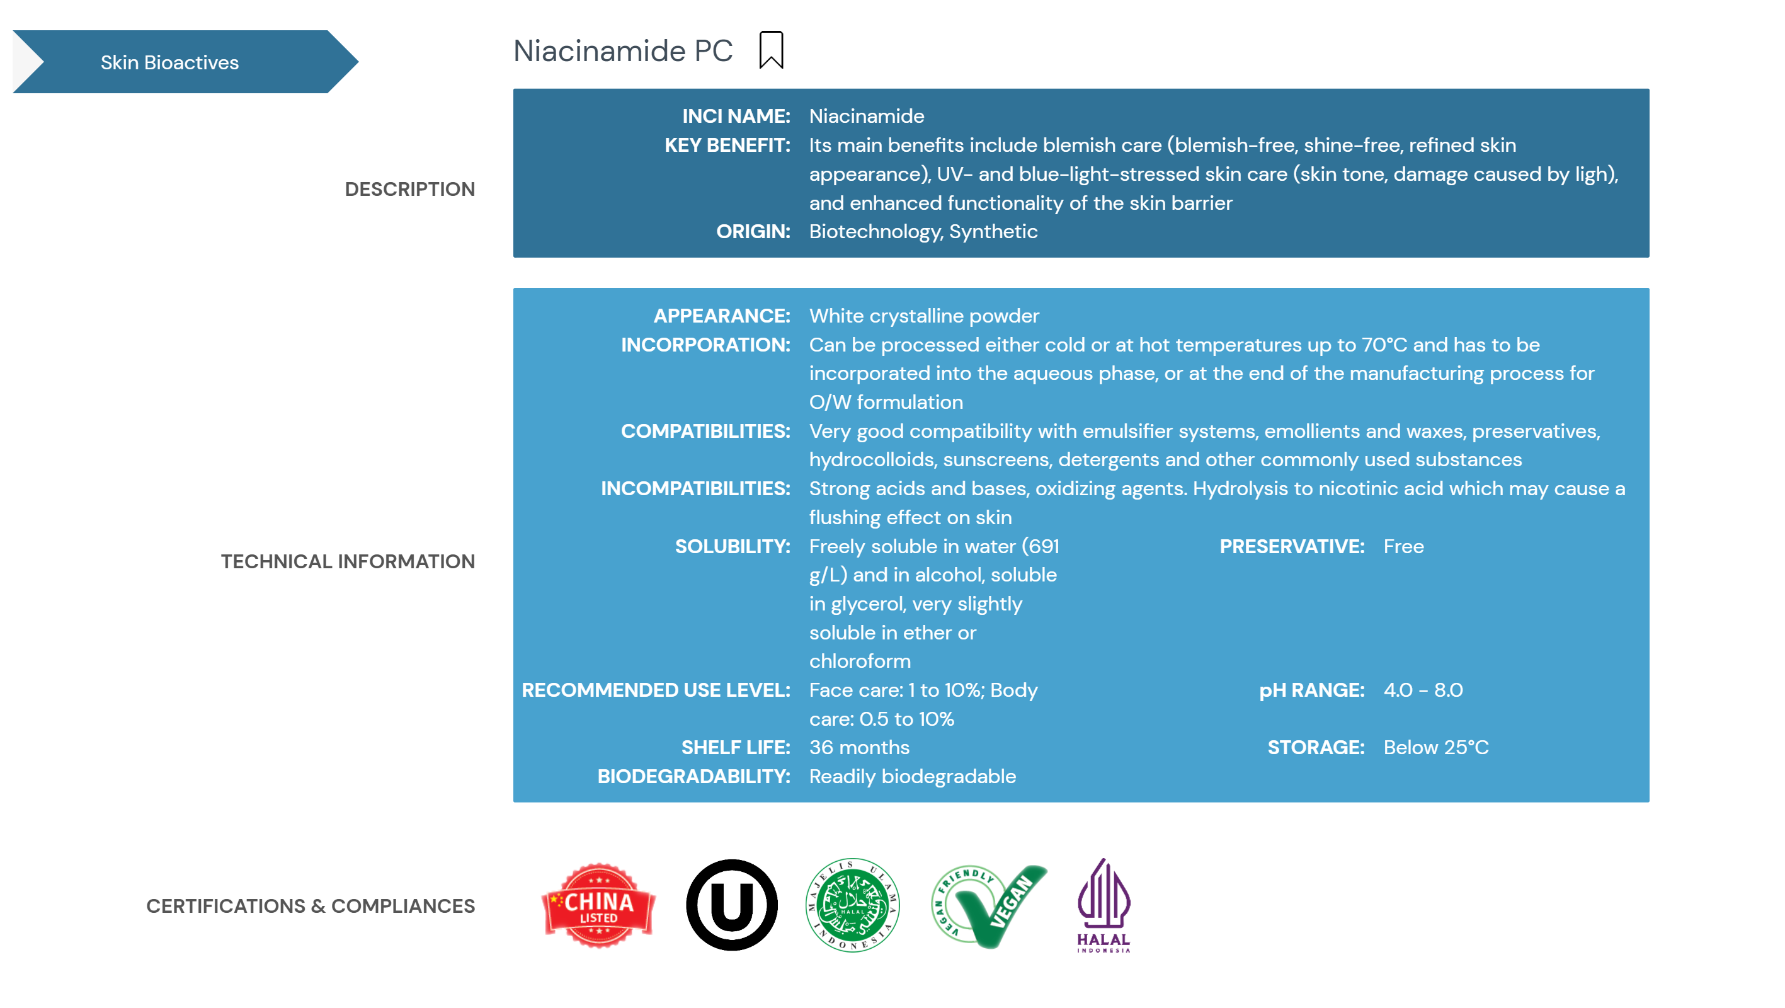

Slide 11
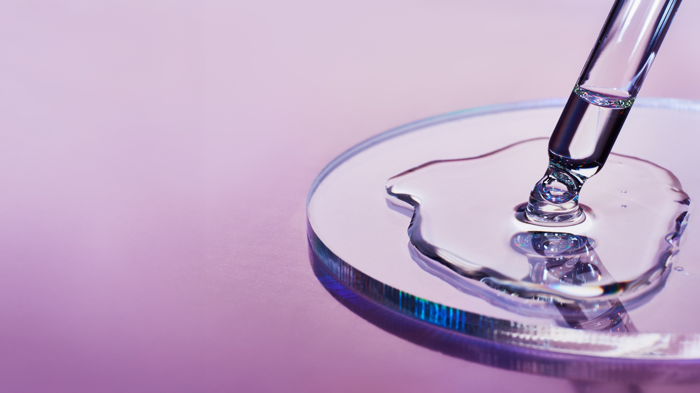
03
New science behind Niacinamide PC for post-menopausal skin

Slide 12


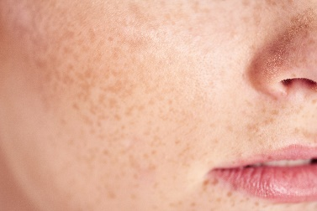


Niacinamide PC – new clinical data
New in vivo study
Study Design
Participants: healthy, Caucasian female volunteers*
Age: 48–65
Length of the study: 1 month
Application: Twice a day
Tested Skin Parameters:
TWEL (tewameter)/hydration (corneometer)
Omics Technologies (on D-Squame tape strips):
Metabolomics
Lipidomics (Ceramides)
Research listed at Top 10 finalists for
the Basic Research Award at IFSCC
Conference.
PreM Placebo
Age 48,9
N.:30
PoM Placebo
Age 59,6
N.:32
PoM Treated
Age 58,1
N.:32
Pre-menopausal control group = “young group phenotype”
Post-menopausal placebo group = “aged group”
Post-menopausal Vit B3 group = “treated group with 5% Niacinamide”
Metabolism of young
Metabolism of aged
Metabolism back to young
Tape strips 1 to 6 taken from cheek
6
5
4
3
2
1
Strip 6 for lipidomics
Strip 3 and 4
for general metabolomics
Strip 1 for the microbiome
*Pre-menopausal was deﬁned by whether menstrual cycles were regular and Post-menopausal by the last menstrual period that occurred at least 12 months ago. Perimenopausal individuals were excluded from this study.
Figure 1. Six D-Squame tape strips were taken from the same spot on the cheek.
N.1 used for microbe analysis (no clear conclusion due to variability of the group), n.3 and n.4 for metabolomics and n,6 for lipidomics.
Notes:
Microbiome: scientific tests were performed, but no clear conclusion can be generated due to variability of the group.

Slide 13
Multipurpose vitamin for multiple skin changes during menopause
Niacinamide: the versatile vitamin
Menopause skin changes
What happens in the skin
Niacinamide Treatment
Epidermal barrier dysfunction
Loss of hydration
Different distribution of Ceramides
Hydration
TEWL
Re-balance ceramides composition to pre-menopausal level
Restores hydration
Reinforces Epidermal barrier
Skin homeostasis and NMF disruption: release of imidazole compounds
Sensitive skin
Helps to relieve sensitive skin
Reduced energy availability
NAD+¹
Supports cellular energy metabolism
Slower skin repair ability
DNA protection and repair
Cytosine level (marker of DNA protection)
Enhances skin repair
Reduced skin elasticity,
promotes wrinkles
Collagen protection
Free proline (marker of collagen degradation)
Collagen production
Boosts skin elasticity,
reduced wrinkles
Upregulating histidine degradation (marker of skin homeostasis disruption): release of markers of UV skin damage
Increased UV induced skin damage and photoaging effects
Protects against UV-induced skin damage and photoaging
1: NAD+ oxidized form of Nicotinamide Adenine Dinucleotide

Slide 14
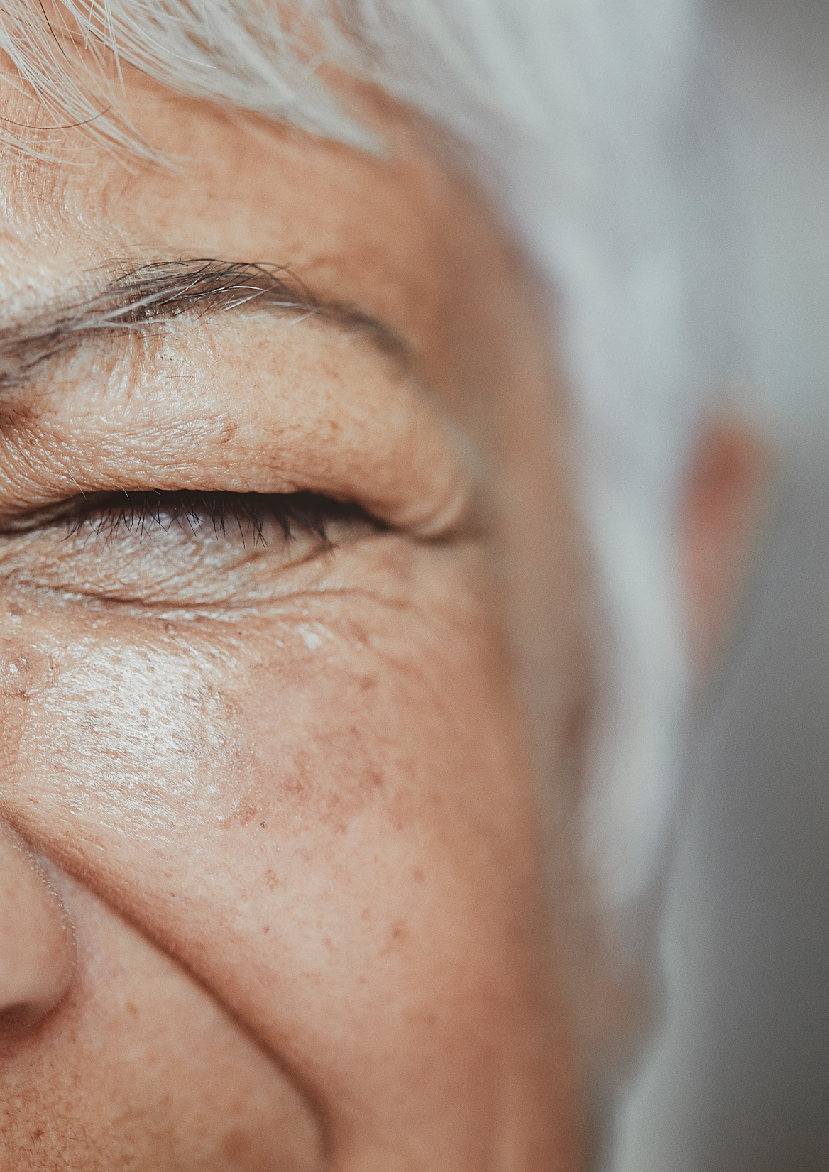
Niacinamide PC re-balances ceramides composition
Corneocare and Skin Resilience
Skin Resilience
New
NEW: in vivo study
Menopause leads to changes in ceramide composition:
The stratum corneum has a high diversity of ceramides, with over 12 main classes and various subspecies of different chain lengths.
Post-menopause skin shows a depletion of ceramides, especially NS, AS, EOS, EOH, and EO leading to:
Compromised skin barrier function
Increased dryness and sensitivity
Reduced elasticity
Susceptibility to environmental damage
Niacinamide PC boosts Ceramides from within:
Treatment with Niacinamide PC boosts the endogenous ceramides production by 30%, restoring the native distribution of ceramide composition to pre-menopausal levels.
Unlike topical application of ceramides, which may not replicate the complex ceramide profile of the skin, Niacinamide supports a balanced and diverse ceramide composition profile for an healthy skin.
in vivo study

Slide 15
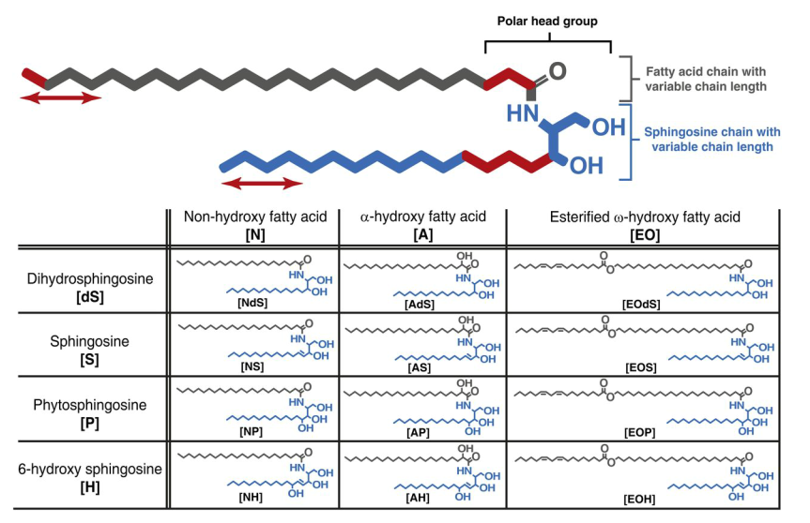
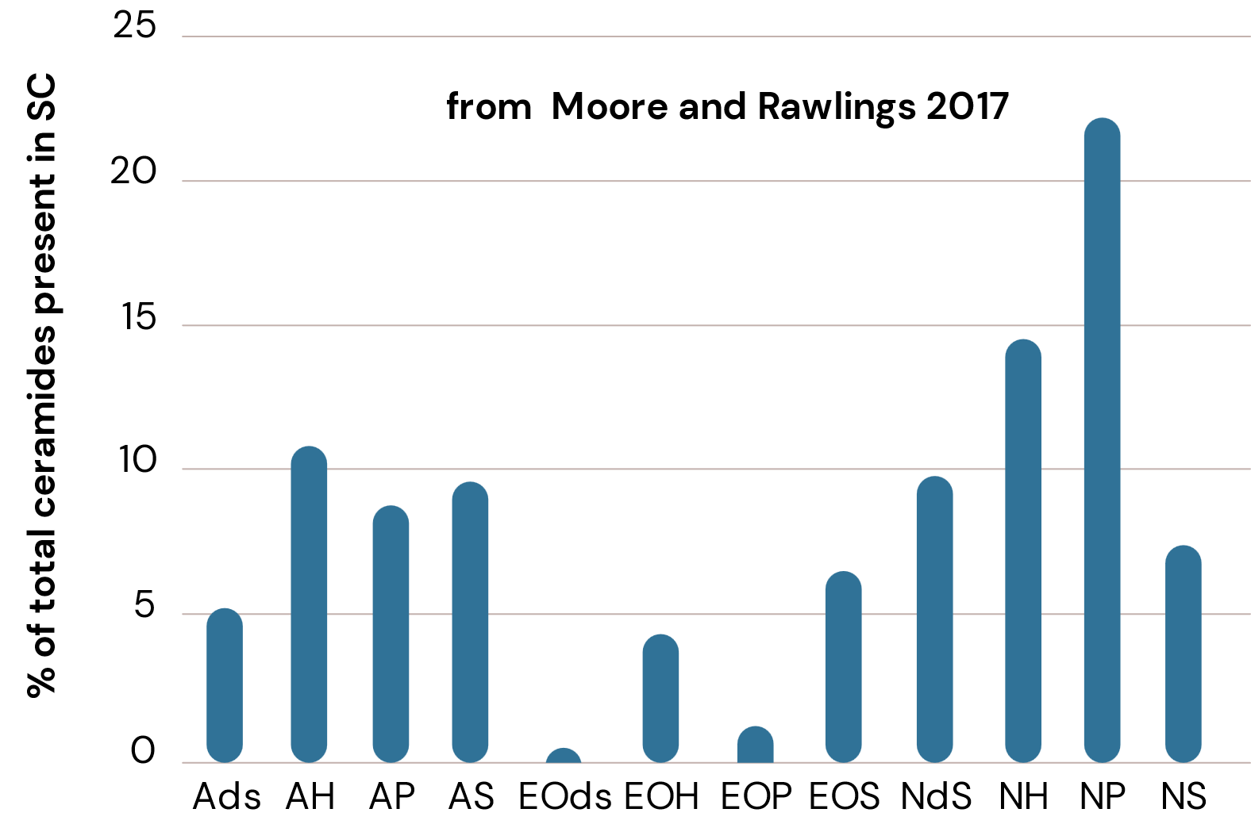
Ceramides in the skin (backup slides)
Diversity of ceramides
The stratum corneum has 12 main ceramide classes, but also many subspecies with different chain lengths, making its ceramide diversity very high.
This is a typical ceramide profile of the relative abundance in the stratum corneum of human skin (Moore and Rawlings, 2017).
Generally, ceramides NS, AH, and NH are the most abundant, while EOP and EOdS were much less present (based on our in vivo study).

Slide 16
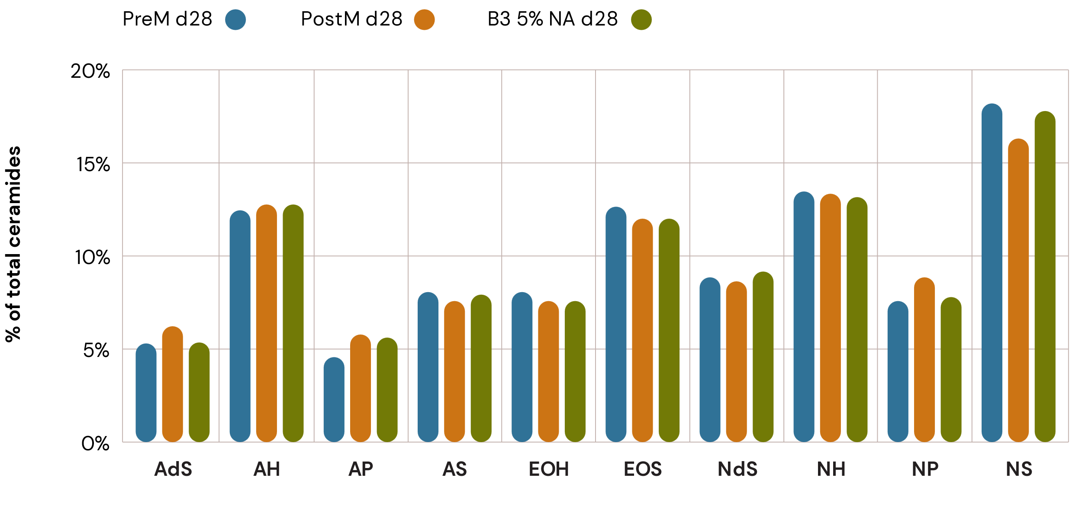
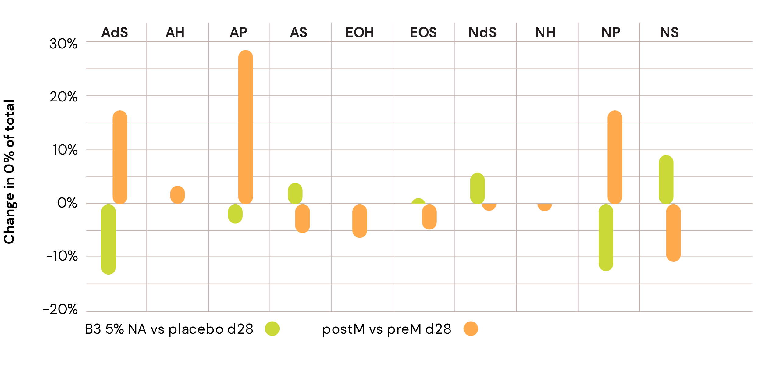
Niacinamide PC: re-balancing ceramides composition
NEW: in vivo study
Change in percentage share of total ceramides
Relative content of ceramides on total ceramides content
Ceramide Composition Changes:
Postmenopausal skin shows a tendency in reduction in ceramides NS (-10%), AS (-5%), EOS (-5%), and EOH (-6%).
There is a significant (p<0,05) increase in ceramides AP (+25%), NP (+17%), and AdS (+17%).
Niacinamide Treatment Effects:
Niacinamide upregulates ceramides vs placebo with highest increases around 30% significant for NS, NdS, and AS.
It also decreases NP, AdS, and AP levels, helping to rebalance ceramide distribution.
Treatment with Niacinamide PC restores a ceramide composition similar to premenopausal skin.
Advantages of Niacinamide:
Niacinamide PC treatment restores the natural and highly diverse ceramide composition in the skin barrier.
This approach appears to be more advantageous compared to using limited commercially available ceramides (mostly NP, AP, EOP, NS, and AS), which may increase the ceramide imbalance in post-menopausal skin.
Relative distribution of ceramide on the total of ceramides
* : p value <0.05
*
*
*
NS; AP, NP : ceramide commercially available
Notes:
Niacinamide increases ceramides level.
1` graphs: absolute ceramide levels.
2` graphs: percentage on all ceramides.
Commercially available ceramides are often already upregulated during menopause, so additional ceramides application doesn`t help.
Niacinamide, re-balance to pre-menopausal level.

Slide 17
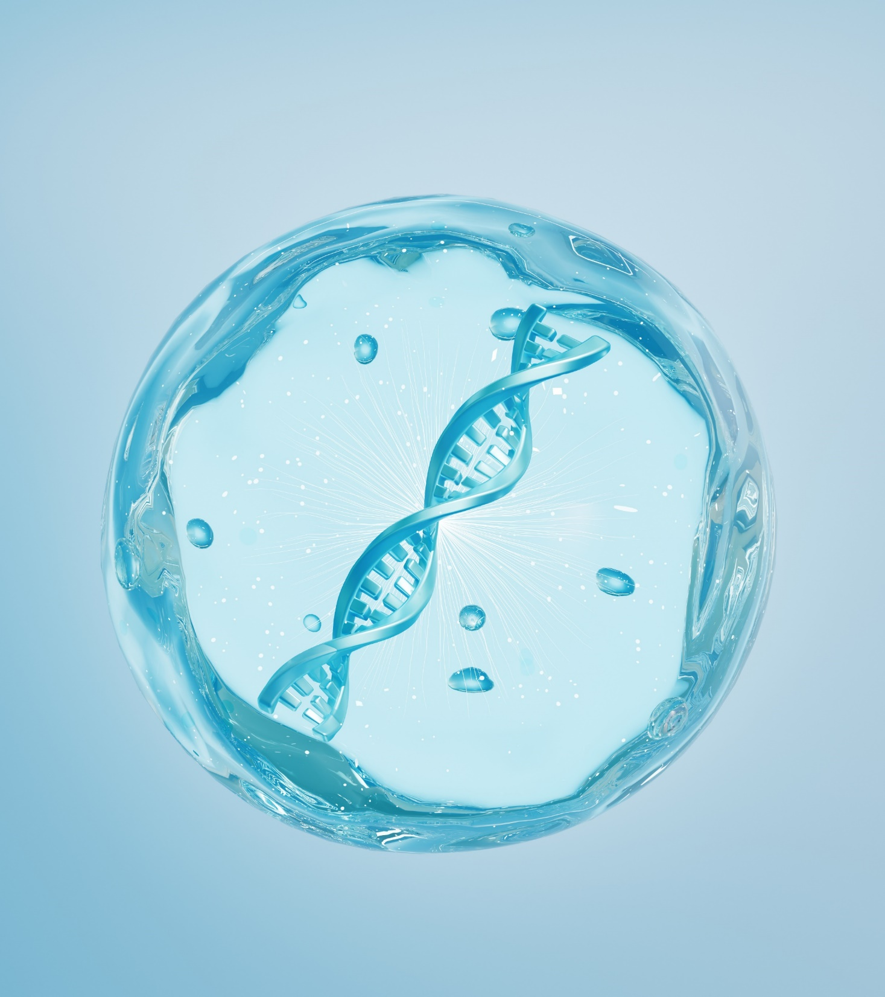
Niacinamide PC promotes skin regeneration at cellular level
Environmental stress protection
NEW: in vivo study
Postmenopausal skin is more prone
to UV-induced DNA damage:
Aged skin has lower NAD+ levels and reduced cytosine
and methyl-cytosine, indicating increased DNA damages.
Niacinamide increases NAD+ levels, boosting cell energy and enabling DNA repair (skin enzymes that repair DNA require high NAD+ levels):
DNA repair: +244% cytosine level vs placebo (in vivo).
Energy boosting: Niacinamide protects cells from ATP depletion after UV stress.

Slide 18
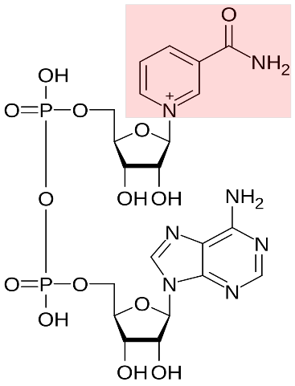
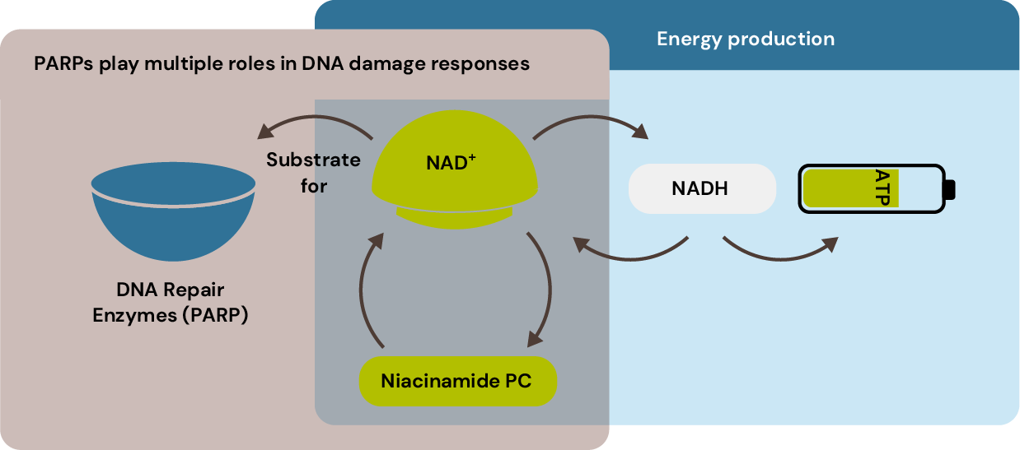
NAD+ precursor in two key pathways: energy production and DNA repair
Cellular NAD+ pools are known to be lower in aged skin and treatment with nicotinamide helps restore these levels.
Simplified pathway of cellular energy production (ATP production) with niacinamide and NAD+
Niacinamide is part of NAD+
NAD+: oxidized form of Nicotinamide Adenine Dinucleotide
PARP: Poly (ADP-ribose) polymerase:
NAD+ is a substrate for poly
(ADP-ribose) polymerases (PARP).
Enzyme PARP plays multiple roles in DNA damage responses including DNA repair and maintenance of genomic stability.
Source: Oblong J.E et al.., Metabolic dysfunction in human skin: Restoration of mitochondrial integrity and metabolic output by nicotinamide (niacinamide) in primary dermal fibroblasts from older aged donors, Âging Cell, 2020, 19 (10) , 59-63
Notes:
Study based on literature.

Slide 19
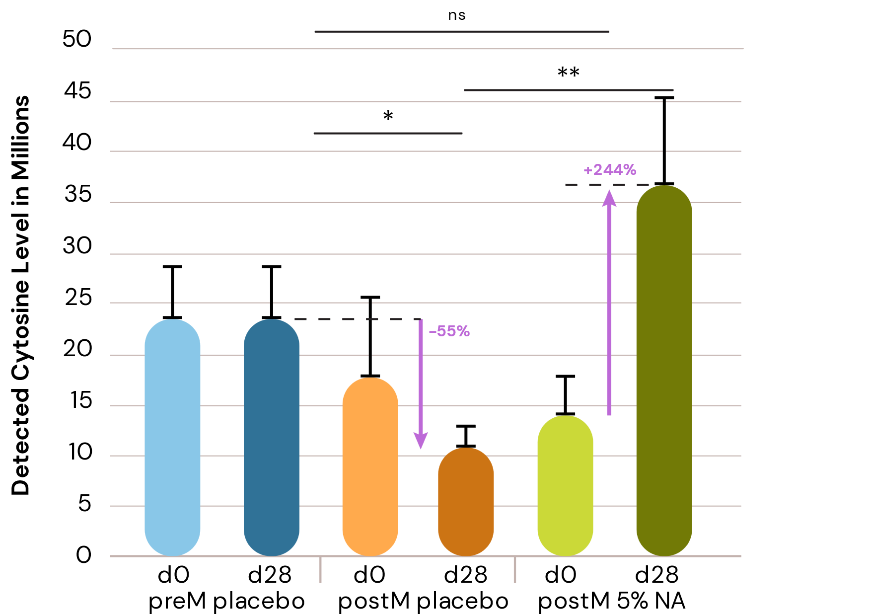
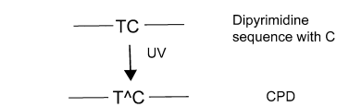
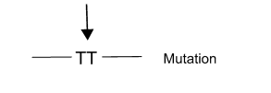
Significant recovery of cytosine levels after treatment with 5% Niacinamide PC
NEW: in vivo study
UV from sunlight can induce DNA damage in skin leading to a change in DNA sequence. This molecular lesion results in a depletion of Cytosine, a building base of DNA and RNA.
C-T mutations are highly prevalent in sequenced skin melanoma genomes¹.
Significant reduction of cytosine (-55%) was observed in post-menopausal skin
vs pre-menopausal skin as indirect indicator of increased DNA mutations.
Impressive significant recovery of cytosine levels (+244% vs placebo after
28 days, even above basal level) after treatment with 5% Niacinamide PC. Confirming in vivo the high efficacy of Niacinamide to enhance DNA repair².
Cytosine level before and after treatment
DNA mutation induced by UV, resulting to a depletion of Cytosine, converted to Thymine^{1.}
* : p value <0.05
** : p value <0.01
1: Pfeifer G.P., Mechanisms of induced mutations and skin cancer, Genome Instab Dis. ,2020, 183), 99-113
2: Surjana et al, Nicotinamide enhances repair of ultraviolet radiation-induced DNA damage in human keratinocytes and ex vivo skin, Carcinogenesis 2013, 234 (5), 1144-1149

Slide 20

Niacinamide PC reduces skin sensitivity and counteracts the effects of photo-aging in post-menopausal skin
Photo-aging
NEW: in vivo study
Post-menopausal skin is more fragile and prone to UV-induced damage:
Histidine is up-regulated with age and during menopause, which unbalances skin homeostasis and Natural Moisturizing Factor (NMF);
High levels of imidazole acetaldehyde (catabolic intermediate of histidine) lead to skin sensitivity, itchiness and redness.
High level of cis-urocanic acid (catabolic intermediate of histidine) in post-menopausal skin suggest less UV protection
Niacinamide PC helps reducing the symptoms of sensitive skin (redness and itching) and counteracts photo-aging in post-menopausal skin:
-36% significant reduction of Imidazole acetaldehyde
-28% decrease of cis-urocanic acid form, maintaining the levels of trans form (a photo-protection marker).

Slide 21
Histidine pathway
NEW: in vivo study
Stressed skin and its metabolites
Histidine catabolic pathway in post-menopausal skin at D28, with and without niacinamide treatment
Filaggrin
cis Urocanic acid
Histidine is a key amino acid, a building block of Filaggrin, a skin protein which is crucial for the Natural Moisture Factor (NMF).
The degradation of histidine leads to catabolic compounds, such as cis-urocanic acid, histamine, which are damaging the skin health:
Trans-urocanic acid, a natural sunscreen, accumulates in the epidermis and converts to cis-urocanic acid under UV exposure.
Histidine catabolism produces histamine and its metabolites (imidazole acetaldehyde and imidazole lactic acid), leading to skin sensitivity, itchiness, and redness.
UV
Imidazole pyruvic acid
Transaminase
Histidase
Trans-Urocanic acid
Histidine
Alanine
Pyruvate
Histidine decarboxylase
β-alanine
Imidazole propionic acid
Imidazole lactic acid
Histamine
carnosine
Diamine oxidase
TH-folate
Imidazole acetaldehyde
L-Glutamate
Niacinamide
Formimino-tetrahydro-folate
Histamine Dinucleotide
Metabolite has been detected at lower/higher levels in post-menopausal panel compared to the pre-menopausal
Metabolite has been detected at lower/higher levels after four weeks of B3 treatment compared to placebo post menopausal
Notes:
Histidine pathway can be related to dryness, redness and itchy skin.
It is a pathway for skin response to UV stress (urocanic acid) and allergies reaction (histamine).
Menopause imbalances the histidine pathway. More details in back-up slides.

Slide 22
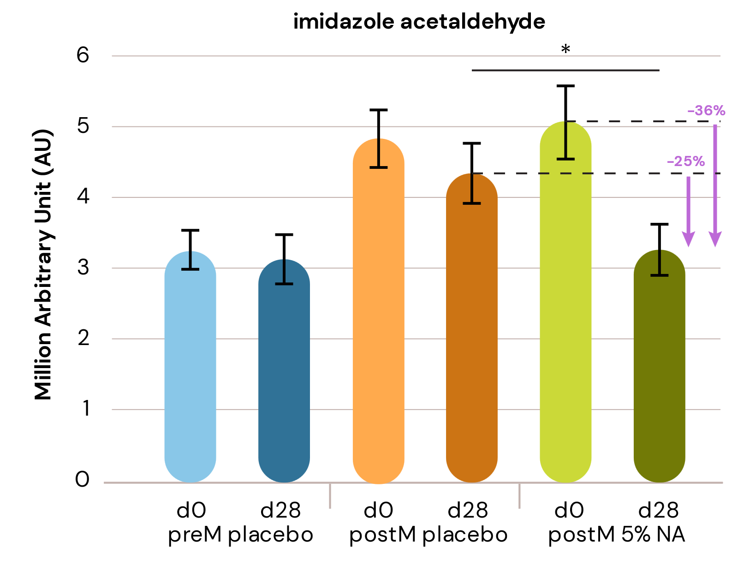
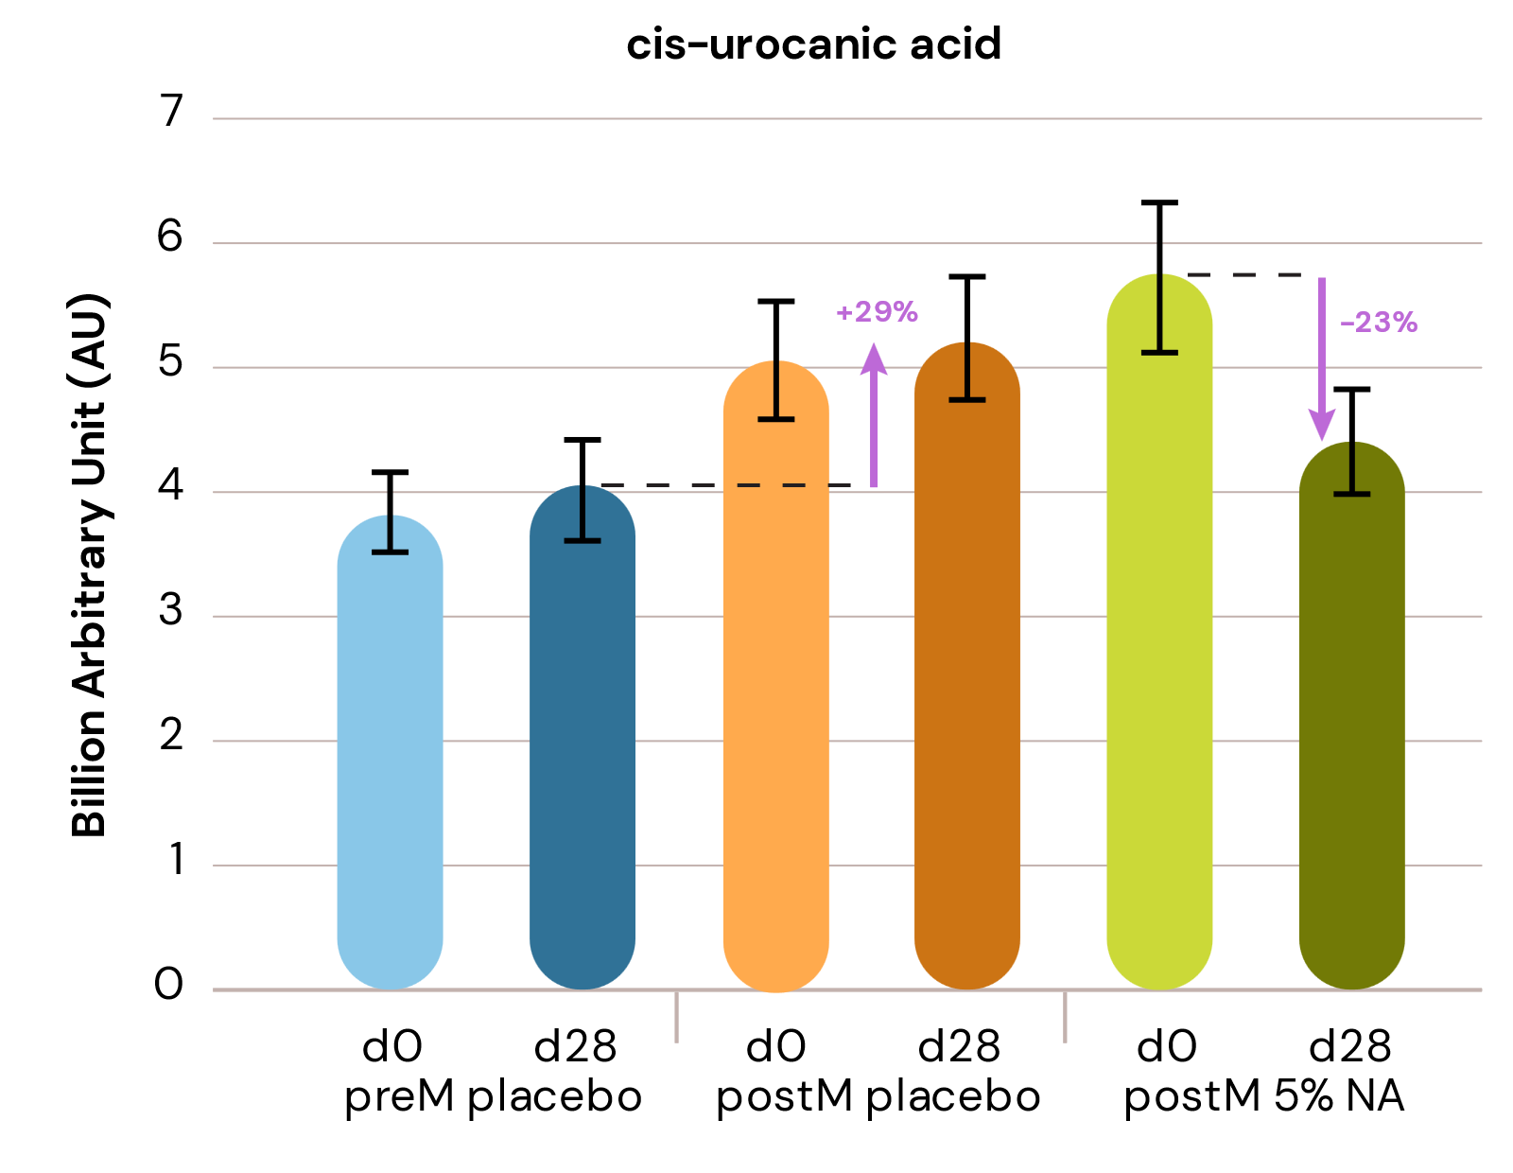
Niacinamide PC rebalances histidine pathway counteracting the effect of UV stress and menopause
NEW: in vivo study
Menopause disrupts skin homeostasis and NMF,
upregulating histidine and its catabolic intermediates.
Elevated imidazole acetaldehyde levels explain increased skin sensitivity, itching, redness, and discomfort in postmenopausal skin.
Niacinamide PC significantly downregulates imidazole-acetaldehyde by 36% vs baseline, and 25% vs placebo, indicating reduced histamine activity suggesting improvement on sensitive skin symptoms.
High cis-urocanic acid levels in postmenopausal skin suggest reduced UV protection.
Treatment with Niacinamide PC show a decrease of 23% in cis-urocanic acid content vs T0.
Niacinamide PC rebalances UV-stress markers such as cis-urocanic acid counteracting photo-aging.
* : p value <0.05
Results show clear tendency (ns).

Slide 23

Niacinamide protects and stimulates collagen production
Anti-aging Activities
Anti-aging Activities
NEW: in vivo study
NEW: in vivo study
Menopause causes loss in collagen levels in the skin:
Menopause causes a significant decline in estrogen, which reduced collagen production and a rapid drop of collagen levels in the skin:
~30% decrease in the first 5 years after menopause.
Ongoing depletion of ~2% per year for the next 15 years.
Additionally, menopausal skin shows elevated levels of free amino acids like proline and its derivatives, which are collagen degradation markers, highlighting age-related processes.
Niacinamide counteracts collagen degradation:
Niacinamide treatment effectively addresses collagen degradation.
In vivo: Reduces free proline and acetyl-proline levels.
In vitro: Stimulates collagen production.
Niacinamide improves skin health during menopause by counteracting collagen degradation and stimulating its production.

Slide 24
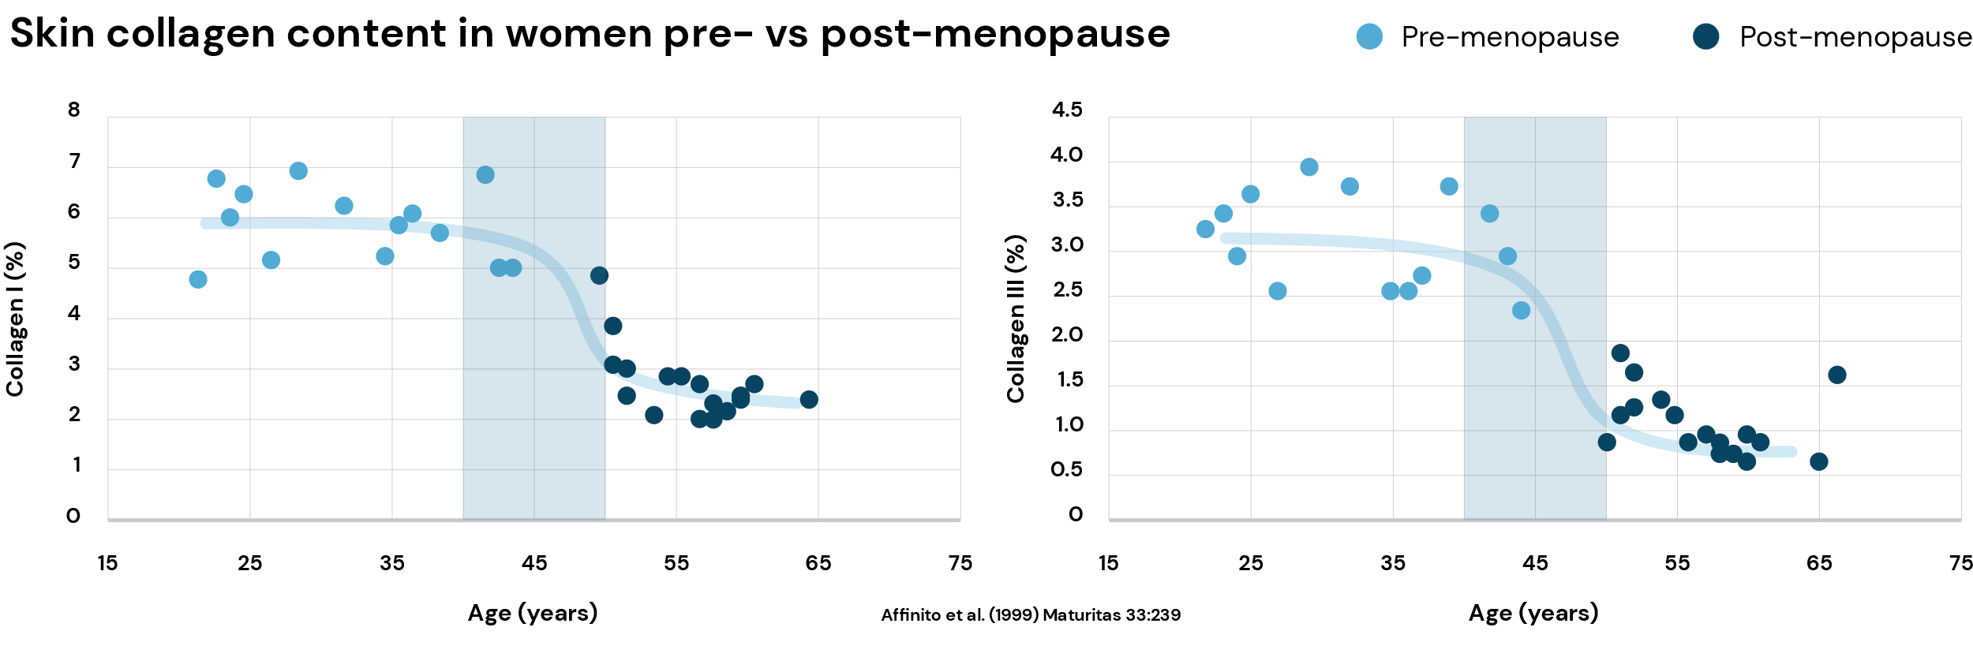
Menopause
Focus on skin changes
20s
40s (pre-menopause)
50s+ (post-menopause)
Major drop in collagen I and III levels during menopause

Slide 25
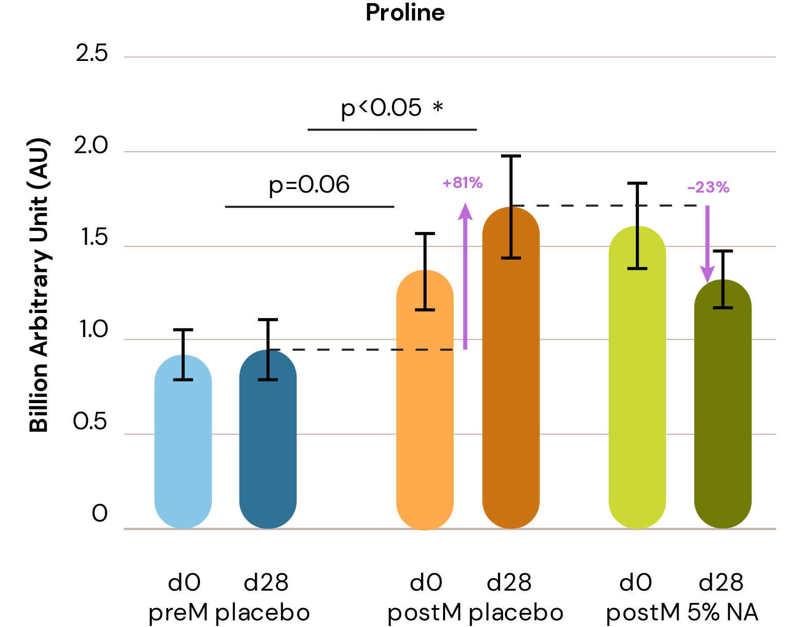
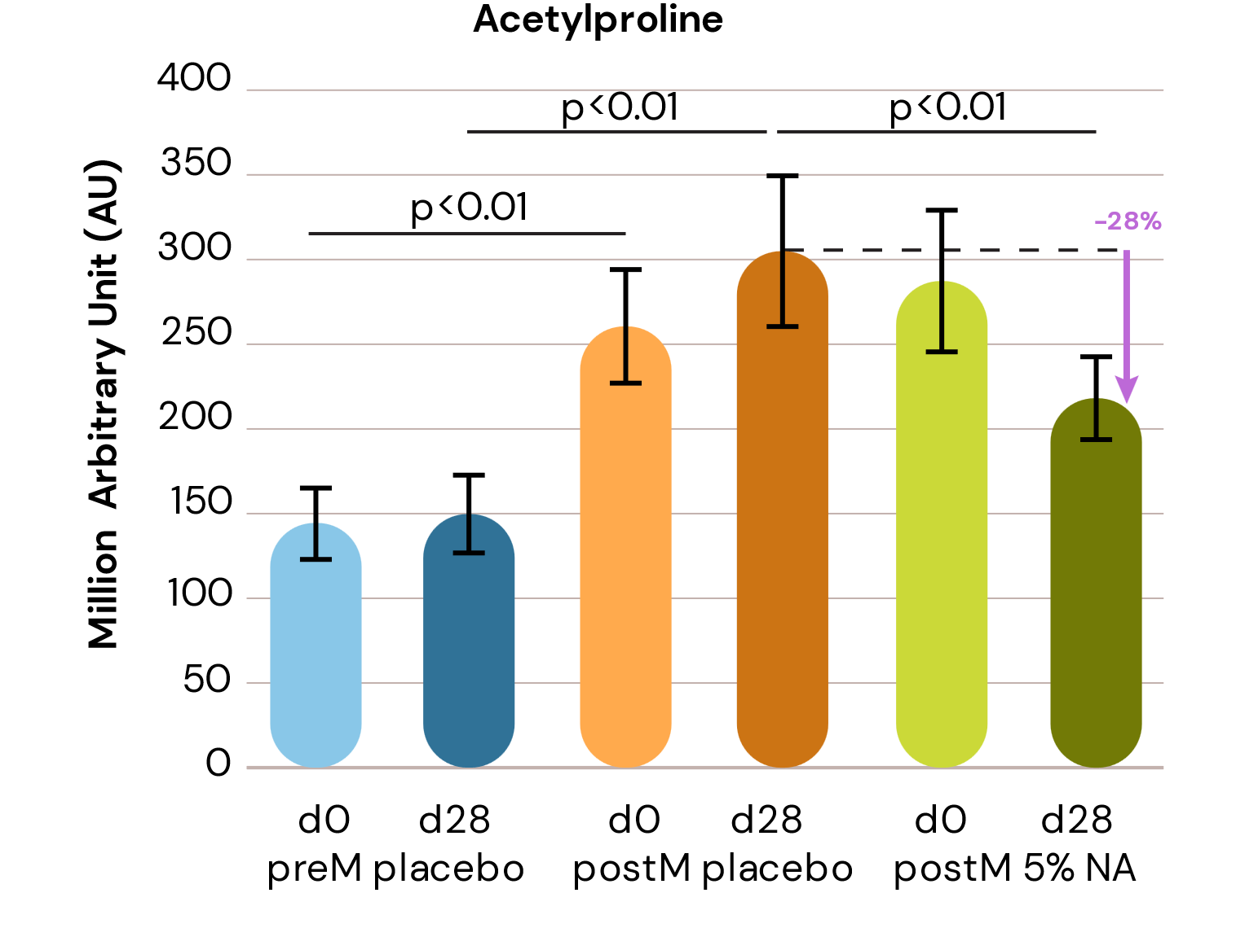
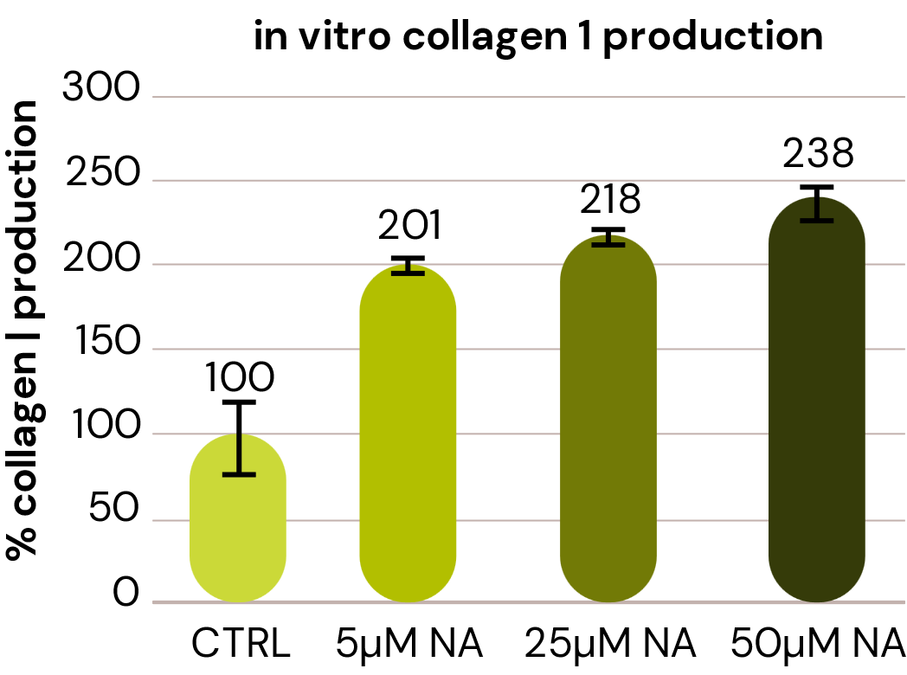
Niacinamide PC protects and stimulates collagen production
NEW: in vivo study
In vivo study:
Significant increase in post-menopausal vs pre-menopausal skin of free proline (+80%) and acetyl-proline (+100%), indicators of collagen degradation.
Significant reduction with Niacinamide PC after 28 days vs placebo
of acetyl-proline (-28%) and proline (-23%)
In vitro study:
Niacinamide PC positive effect on stimulation of collagen I synthesis (+138%) in human dermal fibroblasts.
***
***
***
***
*** p < 0.001
Note: as this is based on a dermal effect it might need more time than 4 weeks to become significant
Notes:
Both are dsm-firmenich studies.

Slide 26

Niacinamide PC improves skin hydration
Healthy skin barrier
NEW: in vivo study
Menopause can lead to reduced skin hydration:
Menopause can increase trans-epidermal water loss (TEWL)
and consequently, reduce skin hydration, contributing
to dryness and compromised skin health.
Niacinamide PC increases skin hydration:
In vivo study confirms that Niacinamide easily penetrates the skin barrier. After topical application, its derived metabolites can be observed in the skin, such as methyl nicotinamide and amino nicotinic acid derivatives, contributing to increase skin health.
High level of Niacinamide is correlated with reduced water
loss (TEWL) and consequent increase of skin hydration.
Clinical results show that, compared to T0, treatment
with 5% Niacinamide PC for 28 days led to:
+23% increase in skin hydration
- 19% reduction in TEWL
Niacinamide PC effectively improves skin hydration
and skin barrier function.

Slide 27
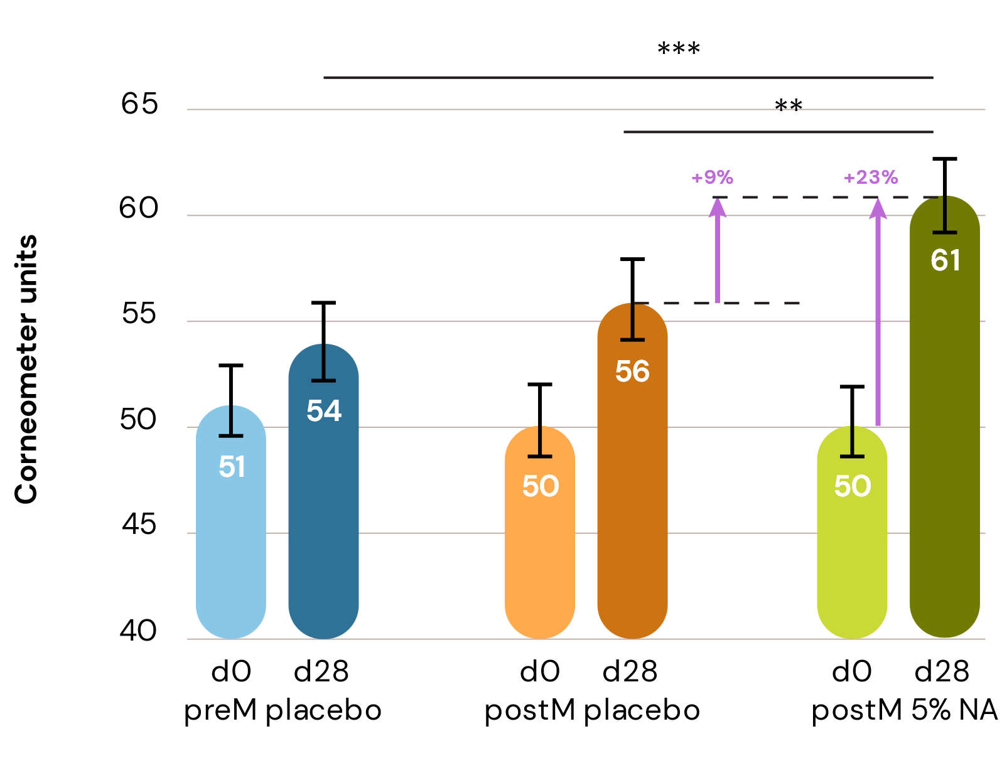
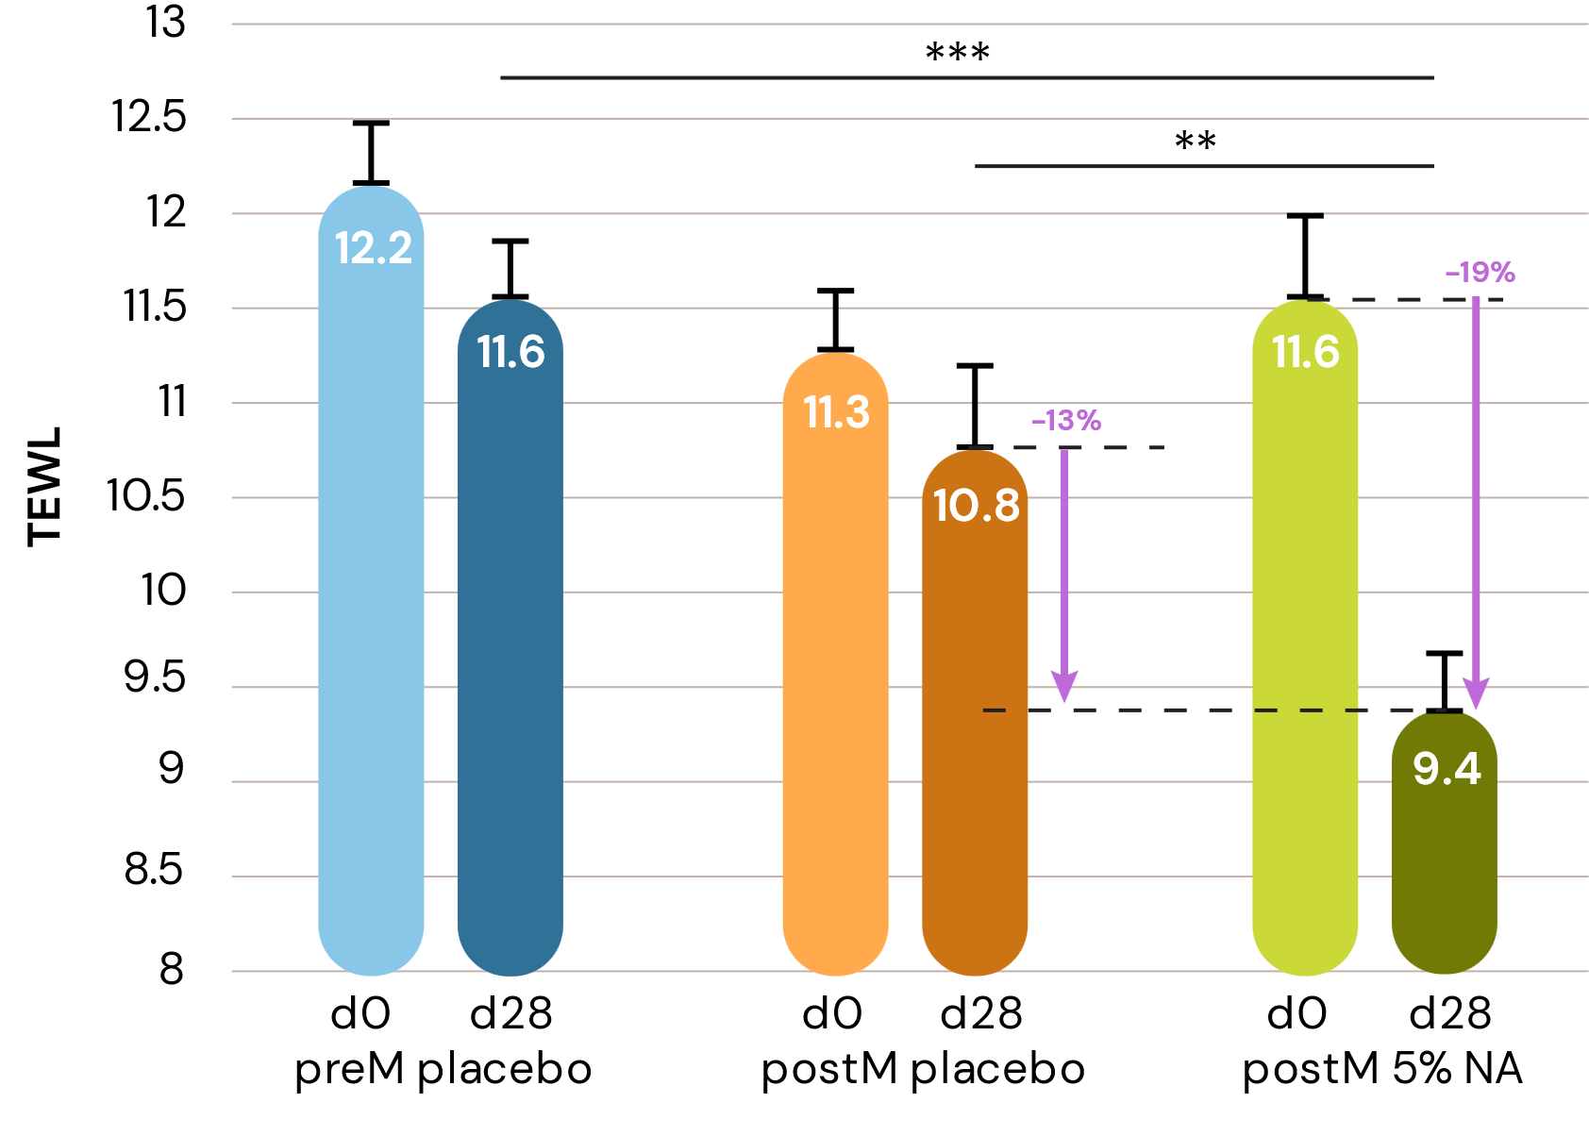
Niacinamide PC reinforces skin barrier
NEW: in vivo study
TEWL and Hydration graphs:
Pre vs post menopause
Pre vs pre/post menopause after treatment with Niacinamide
Skin Hydration
TEWL
Hydration:
At T0 no difference between pre- and post-menopausal group
+23% significant increase with 5% Niacinamide after 4 weeks on post-menopausal group vs T0 and vs placebo
TEWL:
At T0 slight difference between pre- and post-menopausal group (+5%)
-19% significant drop with 5% Niacinamide after 4 weeks on post-menopausal group vs T0 and vs placebo
** p < 0.001
** p < 0.001
*** p < 0.0001
*** p < 0.0001
Skin measurements of the premenopausal group (preM) and postmenopausal groups (poM) before day0 (left column) and after treatment day28 (right column). NA =5% niacinamide formulation. Absolute measured values are shown for Corneometer and TEWL.

Slide 28
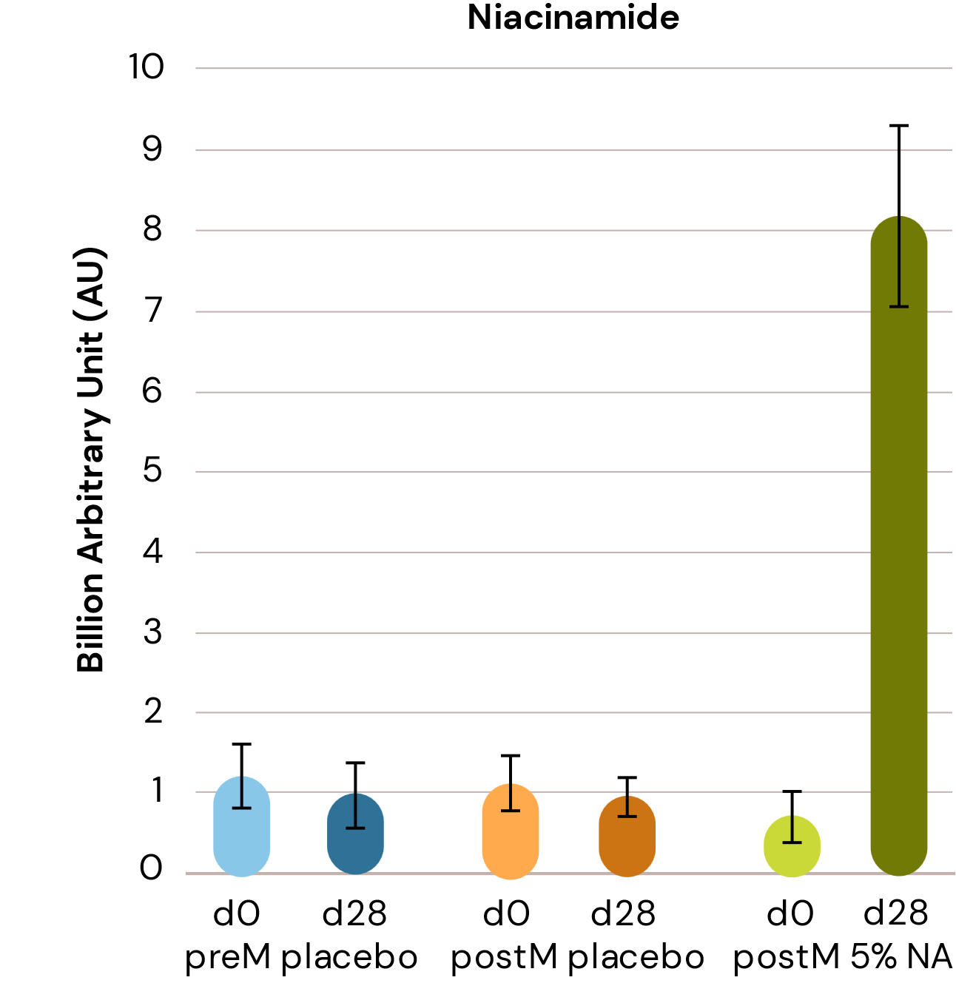
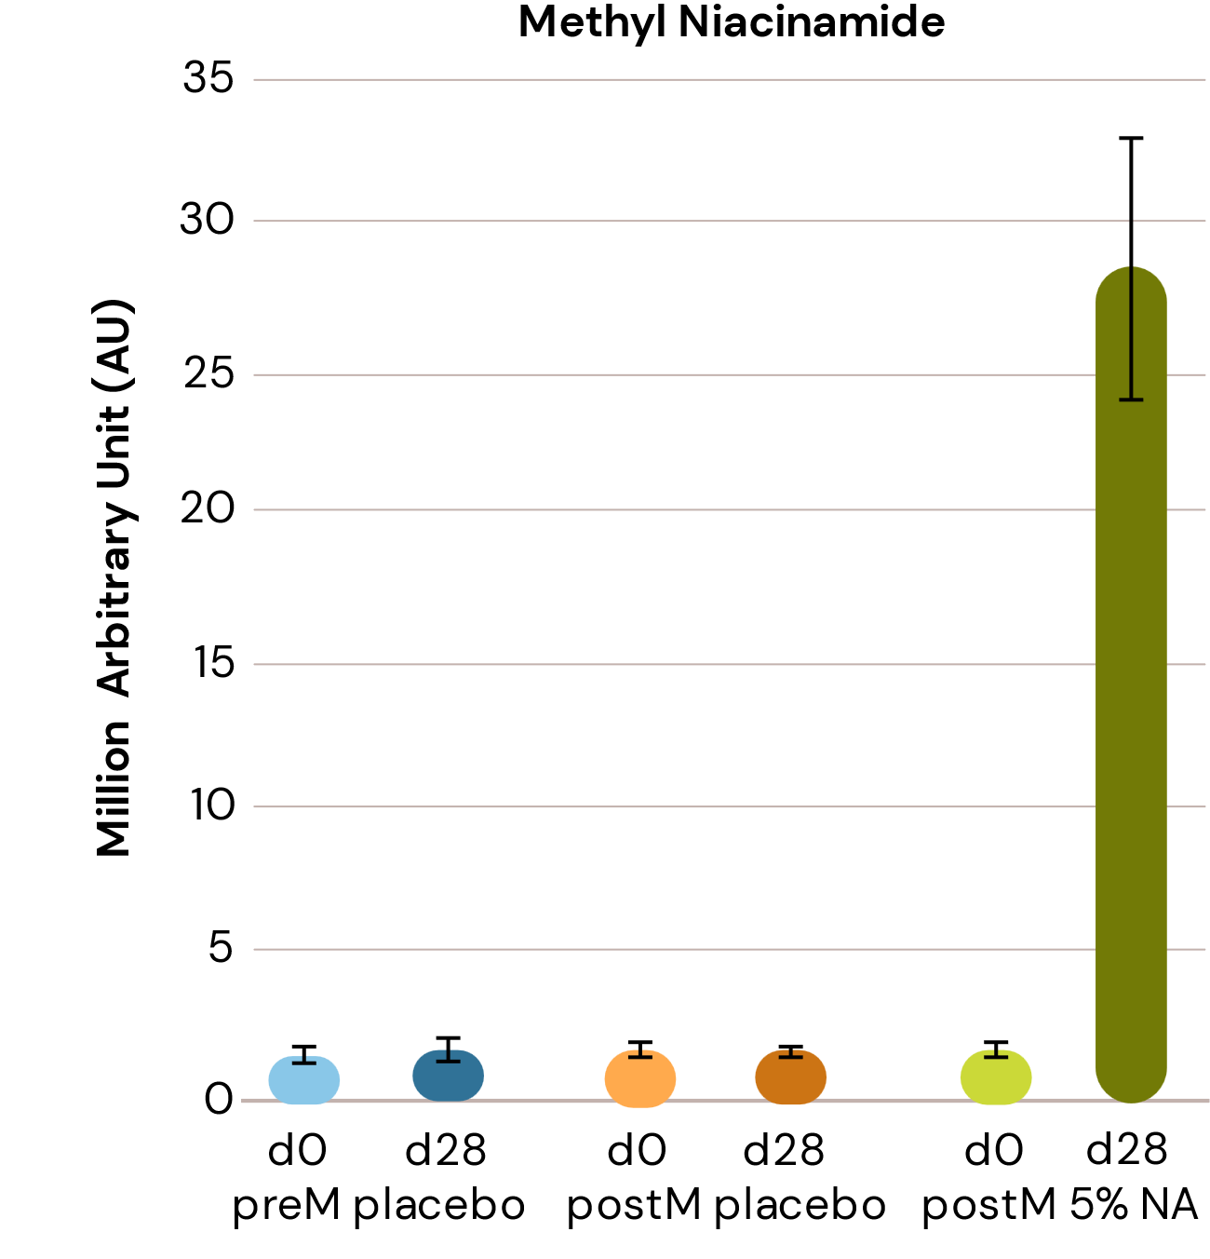
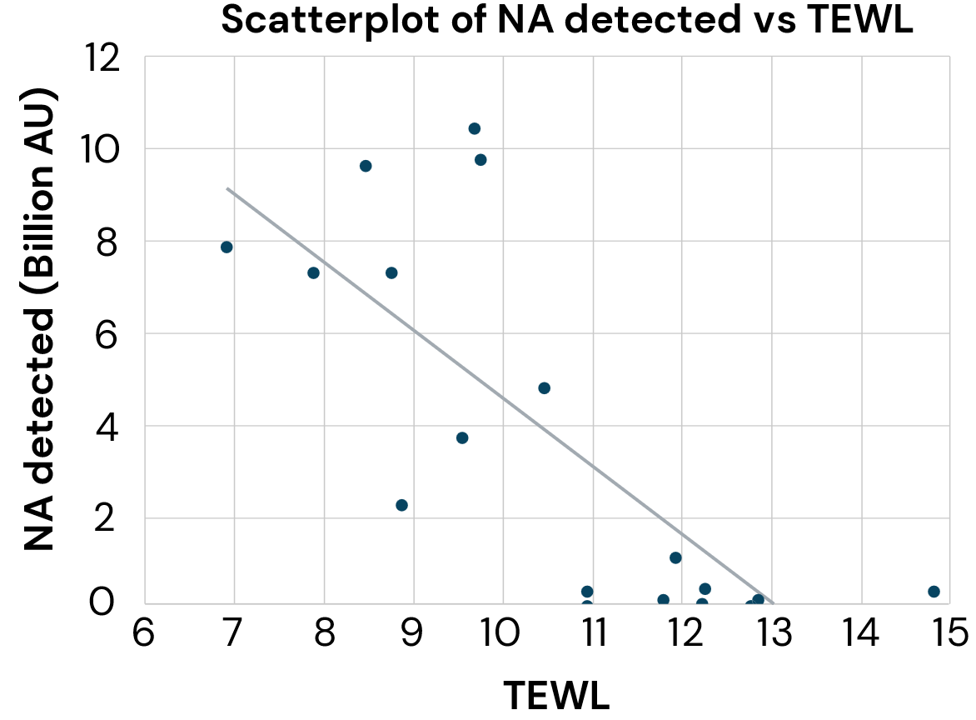
Topical application of Niacinamide PC drastically boosts Niacinamide and its metabolites in the skin
NEW: in vivo study
Niacinamide (X8) and Methyl niacinamide (x12) show significant increase after 4 weeks treatment with 5% niacinamide vs placebo.
High level of Niacinamide in skin
is clearly correlated to lower TEWL.
The Pearson correlation coefficient is –0.76 and the p value 0.0002​
Notes:
- Graph a and b are the same except the scale on y axis changed. In graph b an outlier is out of the scale and not shown.
- For a group of high performers with TEWL reductions more than 2.5 units from day 0 to day 28, a strong negative Pearson correlation of greater than 0.7 was noted between TEWL and niacinamide (and its derivative) levels detected.

Slide 29
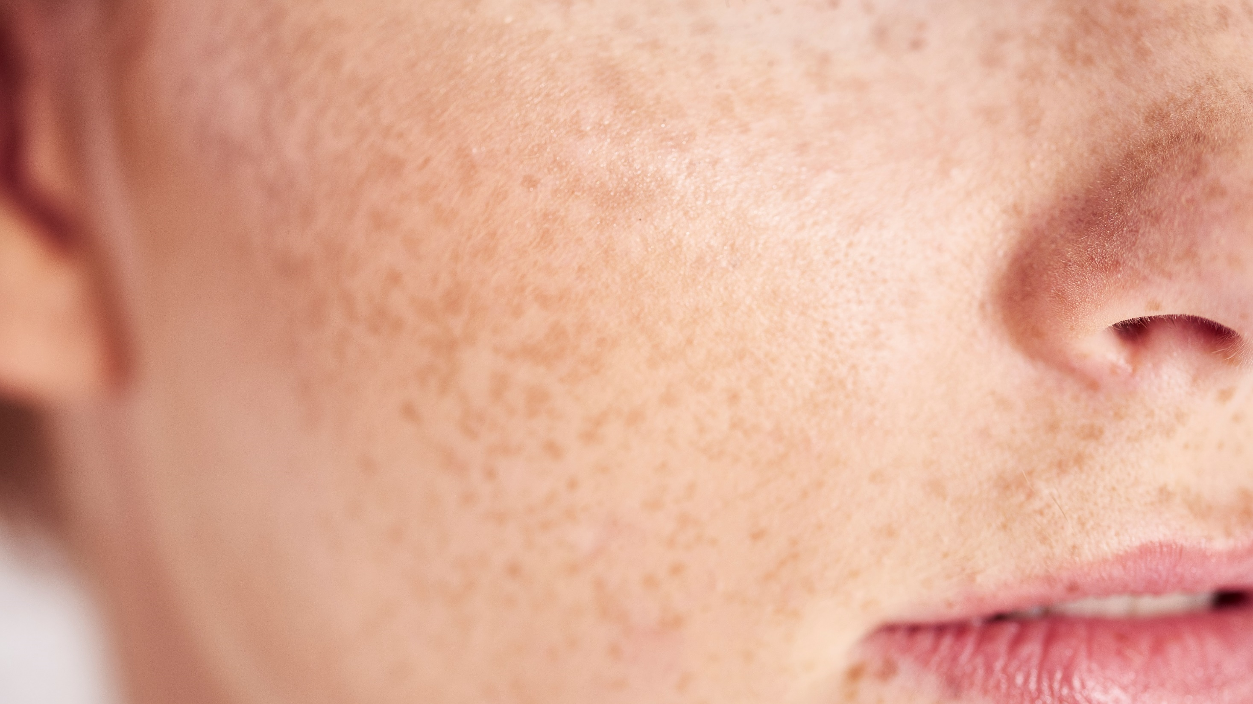
04
Combination of Niacinamide PC
and key bioactives for hyperpigmentation
control

Slide 30
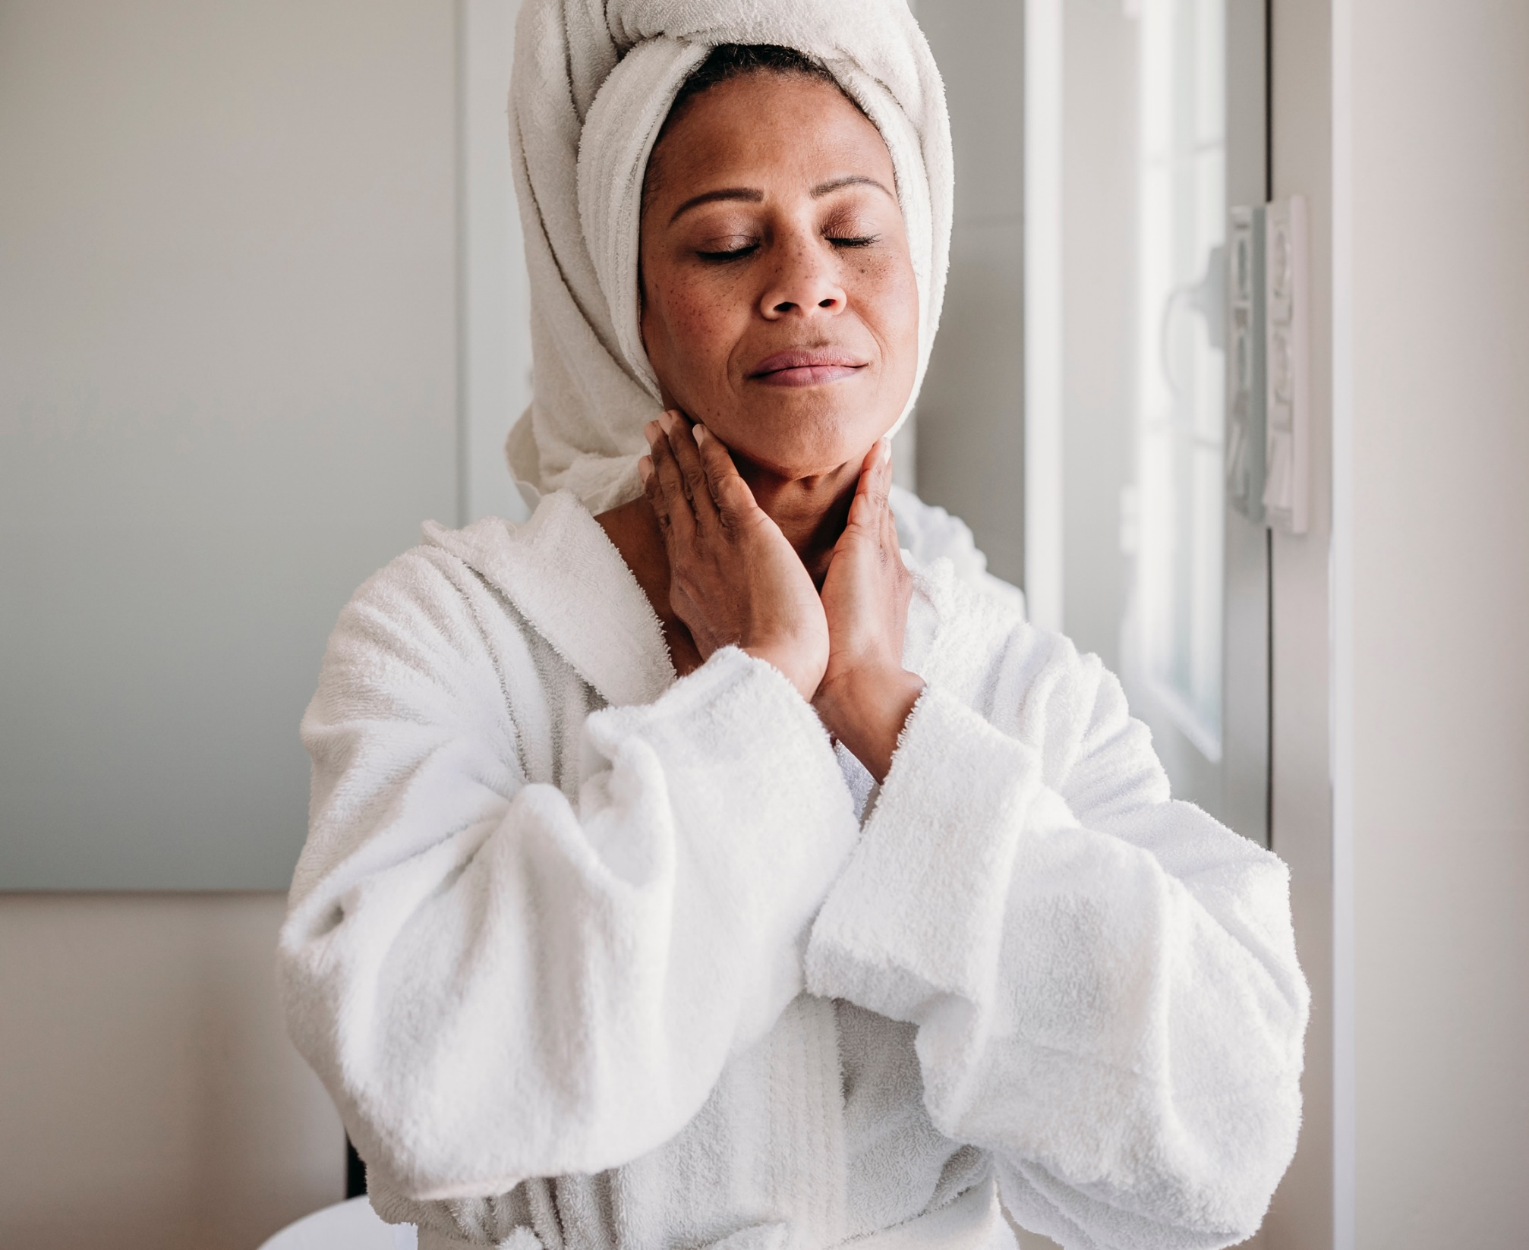

Hyperpigmentation Solutions
The approach
Carefully selecting the
best combination of active ingredients to design the
best solution to target the pigmentation problematic
It combines tried and true science-backed ingredients and heritage ingredients
Targeting different key mode of actions contributing to increased efficacy

Slide 31
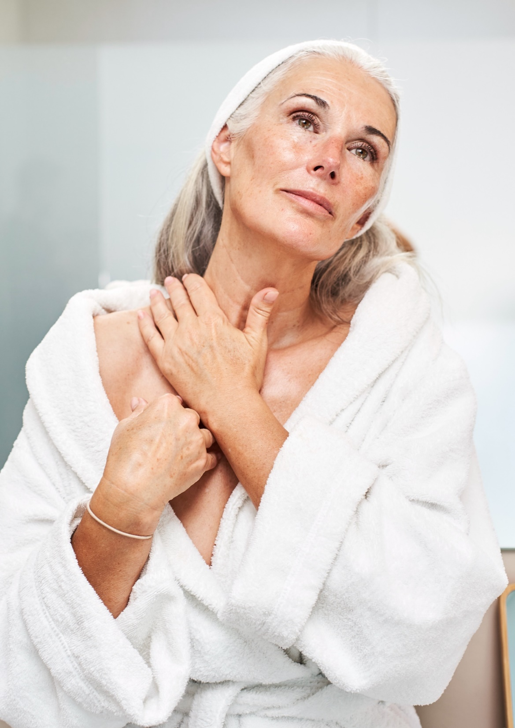
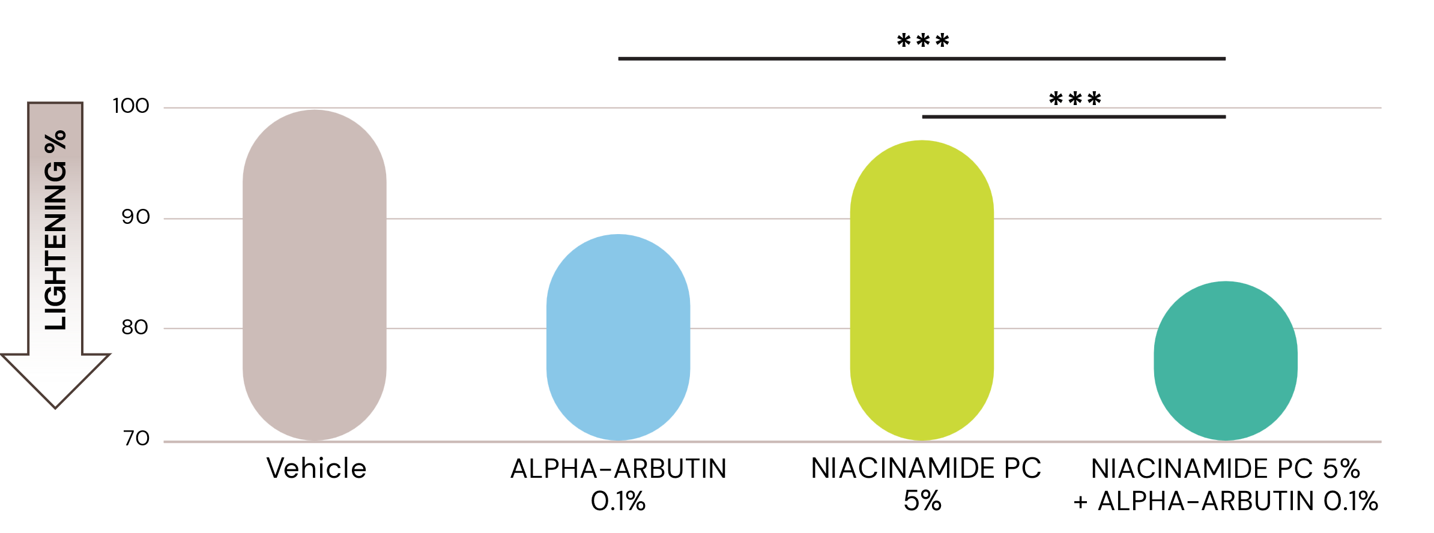
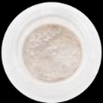
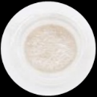
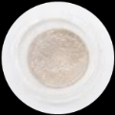
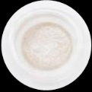
DOUBLE ACTIVE (1)
Niacinamide PC plus ALPHA-ARBUTIN
Mode of actions:
Inhibits melanosome transfer from
melanocytes to surrounding keratinocytes¹
Directly inhibiting the tyrosinase enzyme²
Tested on reconstituted tanned human skin (Fitzpatrick skin type V)
Skin lightening was measured with Chromameter
98%
89%
84%
Visible results
Significant skin lightening improvement
by ALPHA-ARBUTIN (0.1%) and NIACINAMIDE PC (5%)
¹ NIACINAMIDE PC, ² ALPHA-ARBUTIN

Slide 32
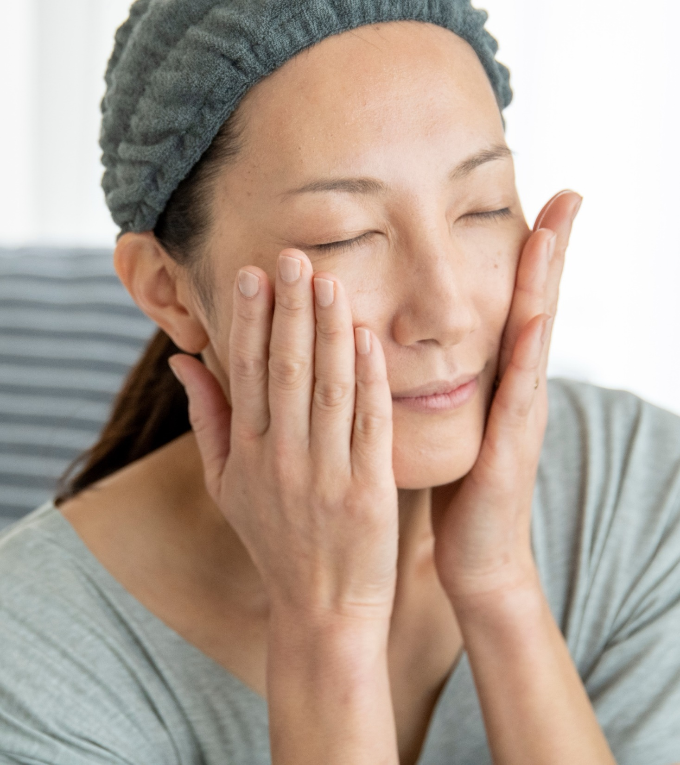
DOUBLE ACTIVE (2)
Niacinamide PC plus OXY 229 CB
Mode of action:
Helps to minimize redness^{1,2}
Inhibits melanosome transfer from melanocytes to surrounding keratinocytes¹
Favoring epidermal turnover and the removal of pigmented cells²
Dermatologically tested in China
According NMPA (National Medical Products Administration) skin whitening standard test (I) in China
1 NIACINAMIDE PC, 2 OXY 229 CB

Slide 33



DOUBLE ACTIVE
NIACINAMIDE PC plus OXY 229 CB
 | 4 Days | D0 | Week 1 | Week 2 | Week 3 | Week 3
UV stress¹ | X | - | - | - | - | -
Product application² | - | - | X | X | X | X
Skin ITA° measurement³ | - | X | X | X | X | X
Melanin index (MI) measurement⁴ | - | X | X | X | X | X
Study design according NMPA China skin whitening standard test (I)
Comparative (benchmark), randomized clinical study performed in China
30 Chinese subjects
7 males and 23 females aged from 26 – 60 years old
Test area: thigh
Formulation with 7% Ascorbic acid
Formulation with
3% NIACINAMIDE PC 2% OXY 229 CB
Measuring time points:
D0, Week 1, Week 2, Week 3, Week 4
¹ Each test area was irradiated with a xenon arc lamp daylight simulator (with UVA+UVB wavelengths) at 0.75 times the MED dose once a day for 4 consecutive days.
² Product application: twice a day
³ Skin ITA° (lightening) characterizes human skin color by measuring skin L*a*b* data with a skin colorimeter
⁴ Melanin index (MI) is an optical skin parameter related to the melanin content in the tissue. It can be measured by spectrophotometry (Melanin meter).
33

Slide 34
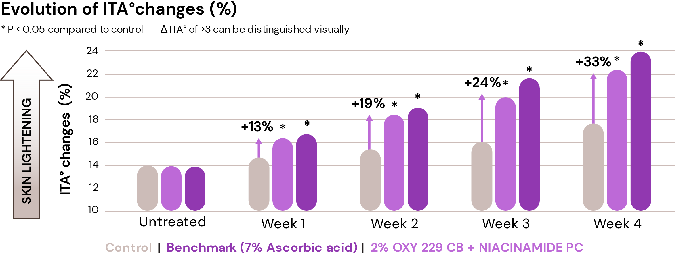
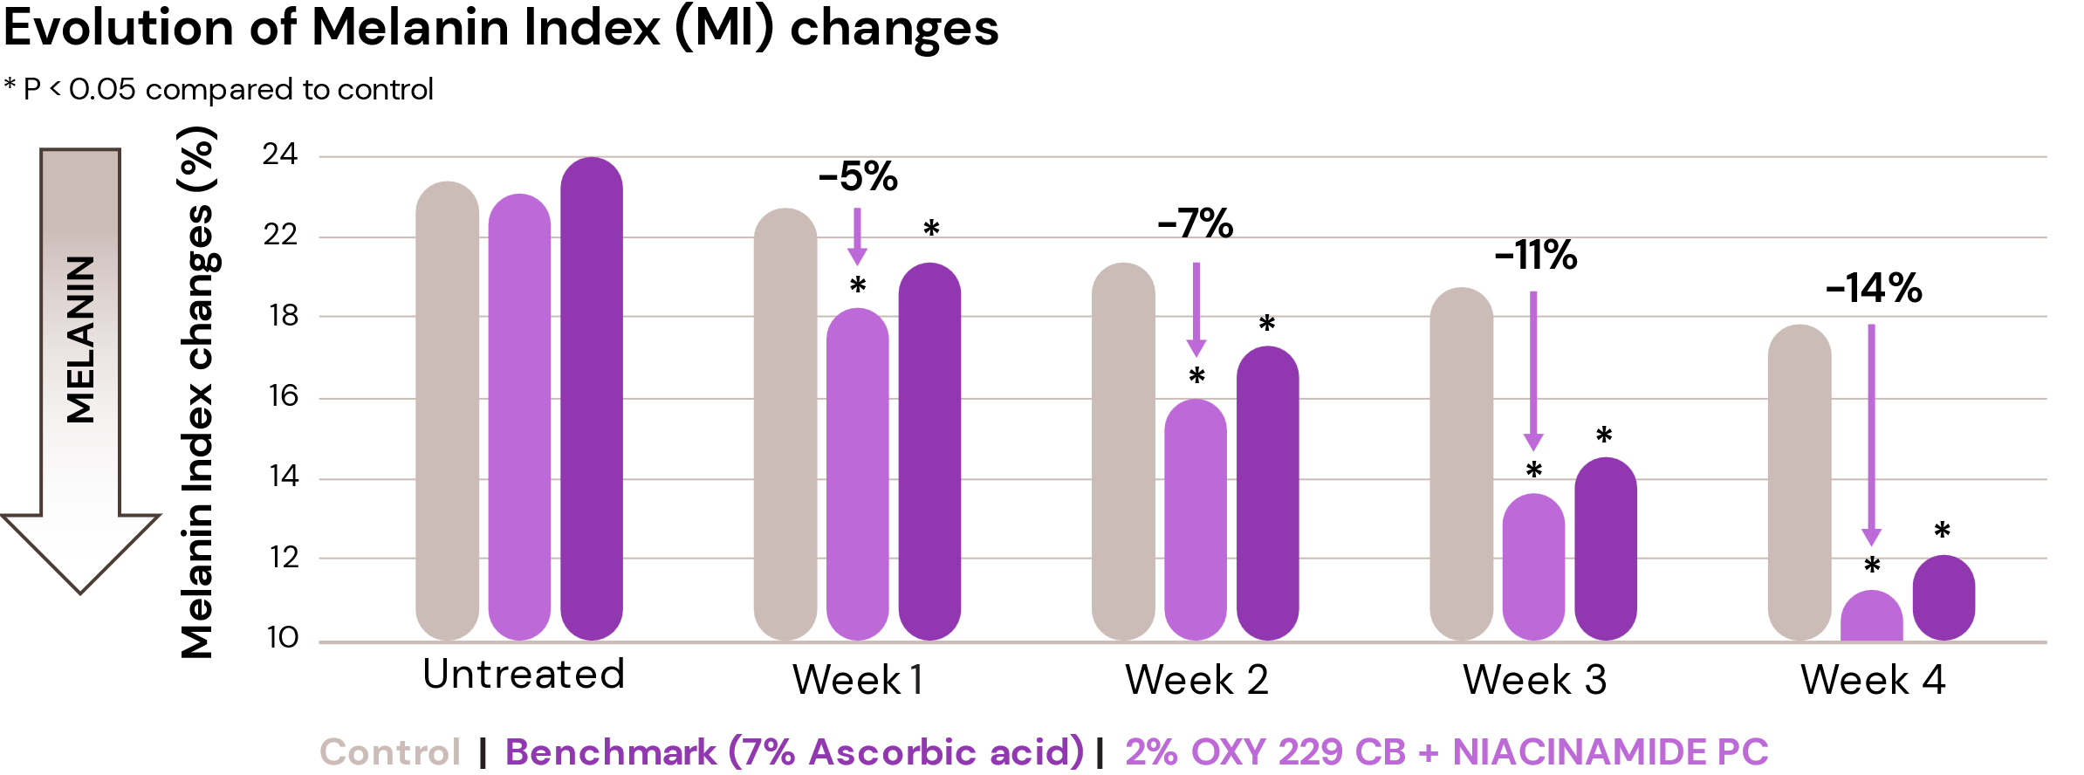
DOUBLE ACTIVE: Niacinamide PC plus OXY 229 CB
Significant and visible lighter skin tone
After 1 week
+13% lighter skin
-5% melanin
After 2 weeks
+19% visibly (ITA° > 3) lighter skin
-7% melanin
After 4 weeks
+33% visibly (ITA° > 3) lighter skin
-14% melanin
Significant results
Similar to the benchmark 7% Ascorbic acid
3%
3%
34

Slide 35
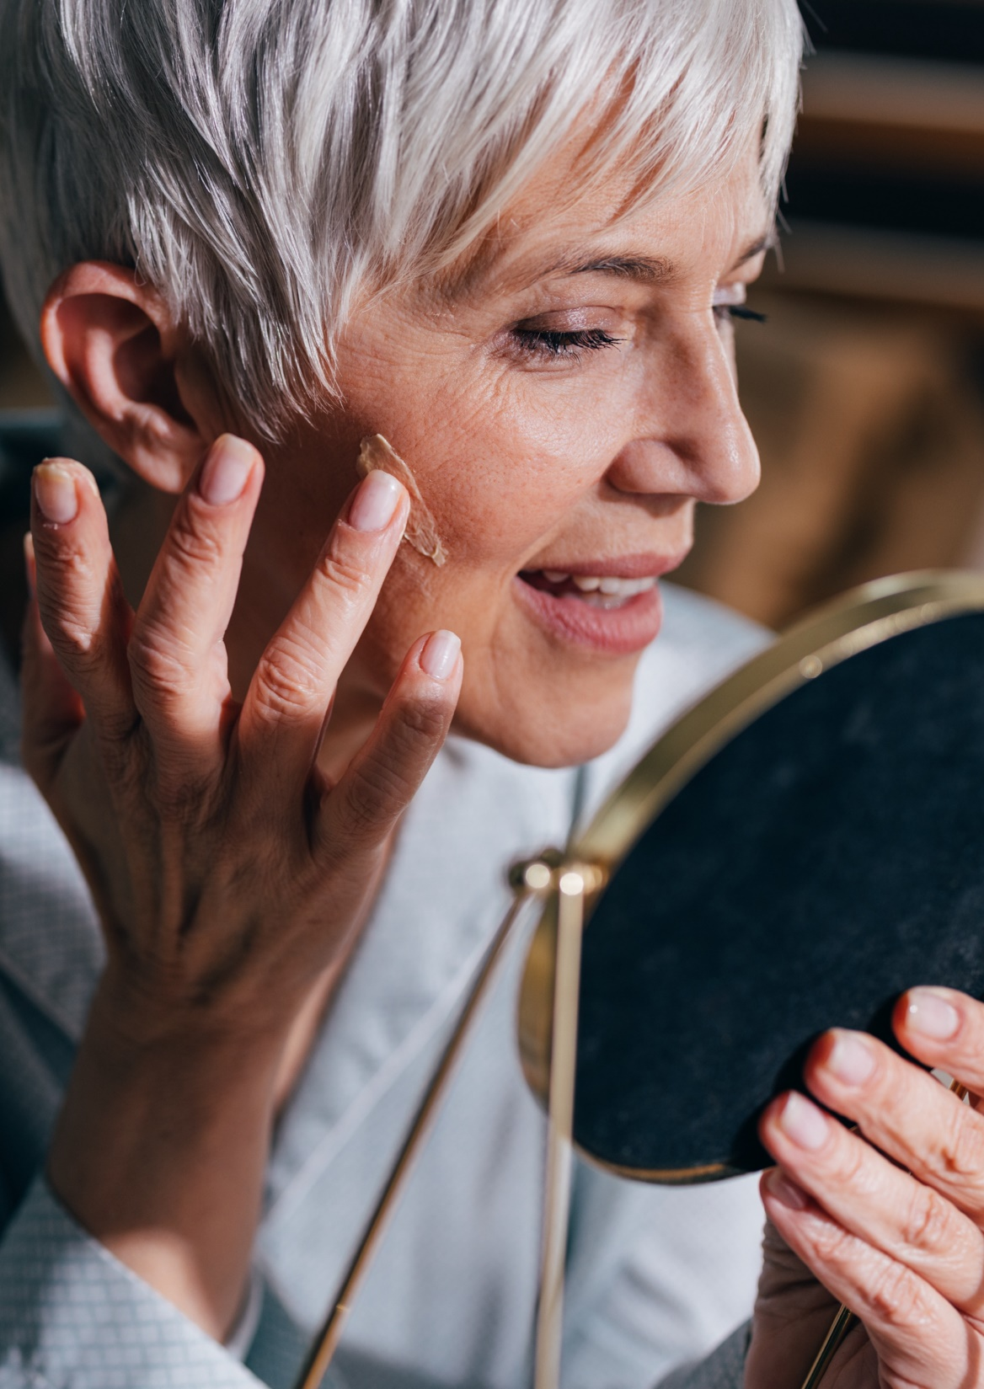
TRIPLE ACTIVE
Niacinamide PC plus ALPHA-ARBUTIN plus REGU®-FADE
Mode of action:
Help to minimize redness^{1,3}
Act as a strong antioxidant ³
Intervening in the pre-melanin synthesis processes³
Directly inhibiting the tyrosinase enzyme^{2,3}
Inhibits melanosome transfer from melanocytes
to surrounding keratinocytes^{1,3}
Dermatologically tested in China According NMPA (National Medical Products Administration) skin whitening standard test (II) in China
¹ NIACINAMIDE PC, ² ALPHA-ARBUTIN, ³ REGU®-FADE
Notes:
5 mode of actions

Slide 36
TRIPLE ACTIVE
NIACINAMIDE PC plus ALPHA-ARBUTIN plus REGU®-FADE
 | D0 | Week 2 | Week 4 | Week 8
Product application¹ | - | X | X | X
Skin ITA° measurement² | X | X | X | X
Melanin index (MI) measurement³ | X | X | X | X
Study design
according NMPA China skin whitening standard test (II)
Placebo controlled, randomized clinical study performed in China
30 Chinese subjects
(test product group)
30 Chinese subjects
(placebo group) aged from 23 – 58 years old
Test area: facial age spot areas
Formulation placebo
Formulation with 3% NIACINAMIDE PC 0.3% ALPHA-ARBUTIN 0.05% REGU®-FADE
Measuring time points:
D0, Week 2, Week 4, Week 8
¹ Product application: twice a day
² Skin ITA° (lightening) characterizes human skin color by measuring skin L*a*b* data with a skin colorimeter
³ Melanin index (MI) is an optical skin parameter related to the melanin content in the tissue. It can be measured by spectrophotometry (Melanin meter)
36

Slide 37
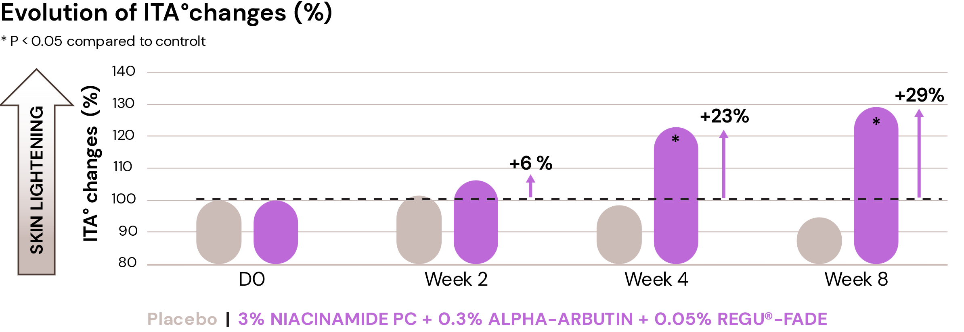
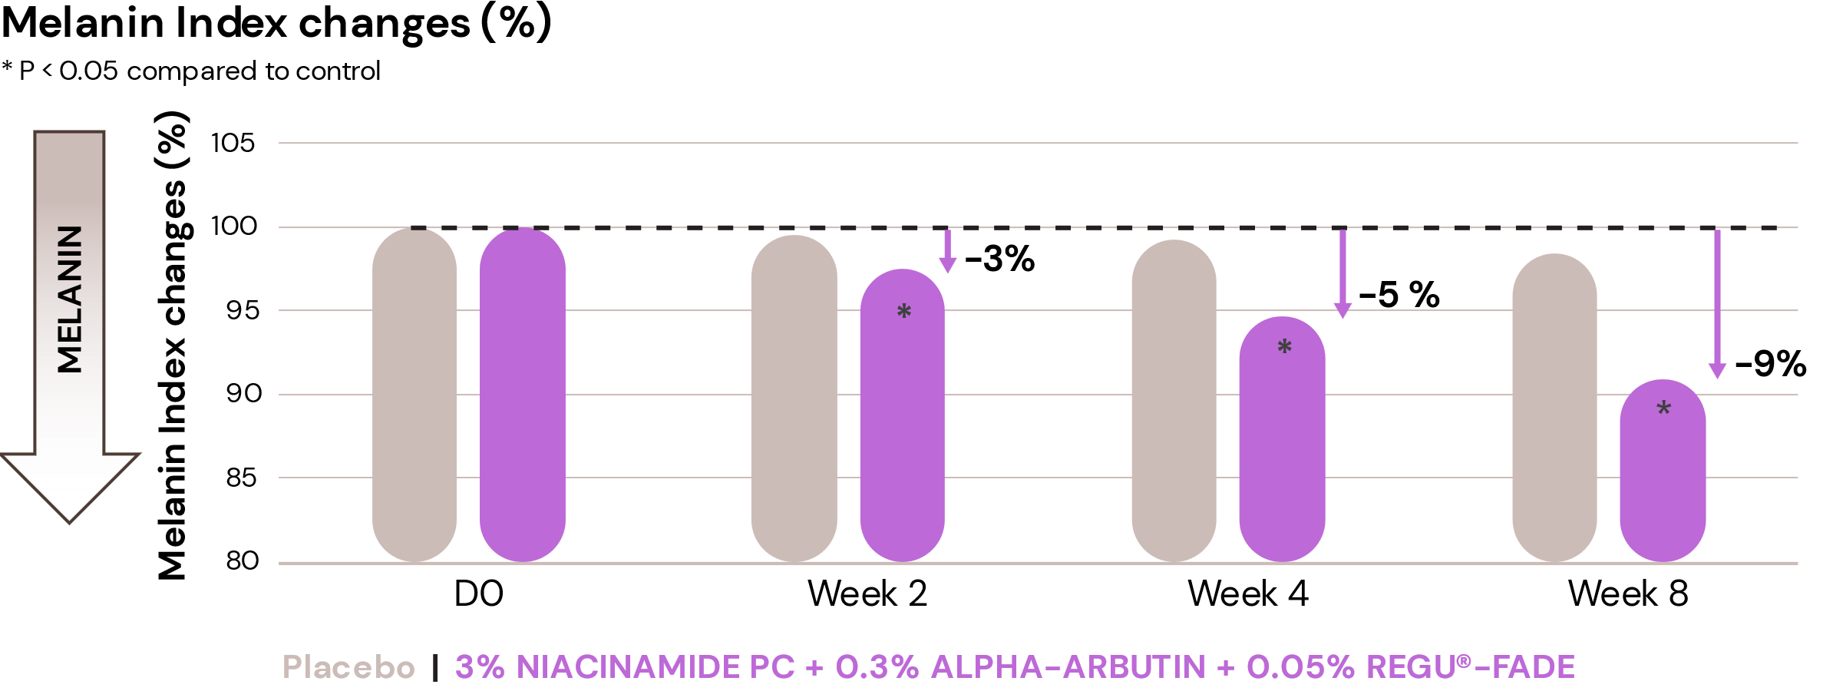
TRIPLE ACTIVE: NIACINAMIDE PC + ALPHA-ARBUTIN + REGU®-FADE
Significant lighter age spots
Significant results
After 2 week
+6% lighter age spots
-3% melanin
After 4 weeks
+23% lighter age spots
-5% melanin
After 8 weeks
+29% lighter age spots
-9% melanin

Slide 38

05
Niacinamide PC
in haircare

Slide 39
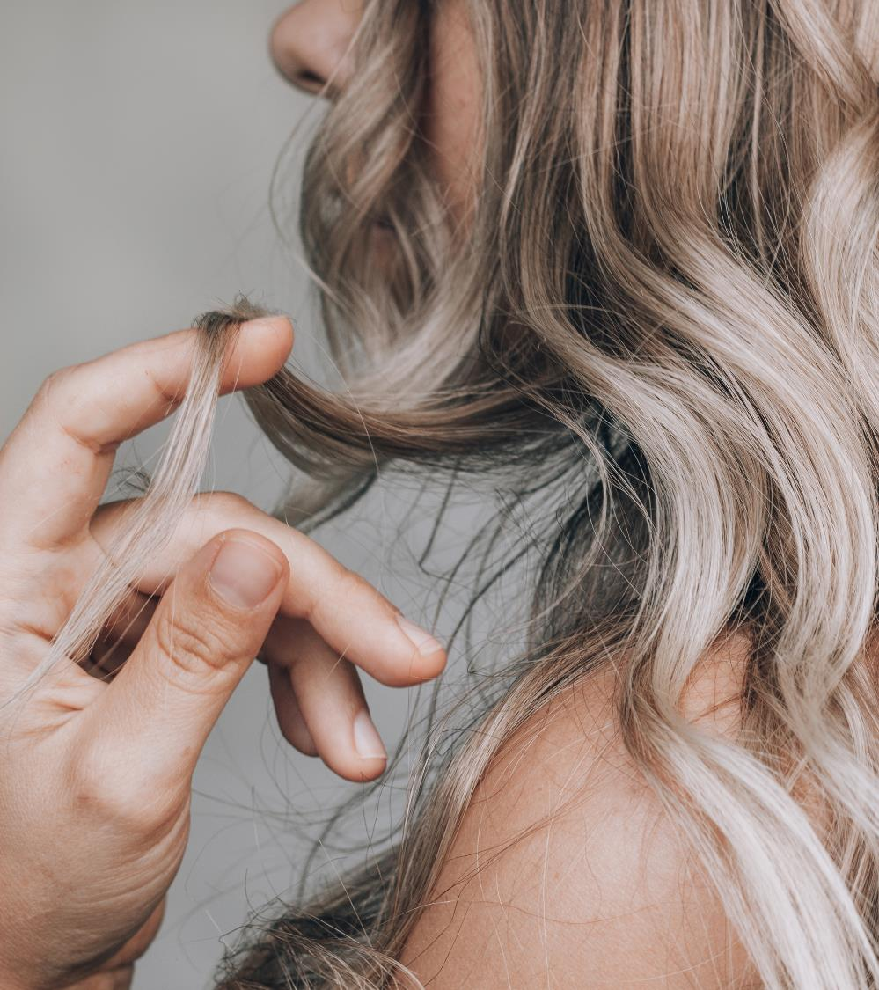
Hair changes in menopause
Healthy skin barrier
New
in vivo study
During menopause, hair grows slower, and follicles continue to shrink leaving hair thinner and thinner. Women can experience as well dry and itchy scalp.
The hair concerns related to menopause are very emotional and can lead to a loss of self-confidence and to sadness.
The main hair symptoms related to menopause are hair loss for 29% of the consumers and hair thinning (25% of the consumers) followed by scalp and hair dryness sensation.
When consumers experience hair concerns related to menopause, they start to look for dedicated solutions to their own symptoms.
Shampoo is the main preferred product for 58% of the consumers followed by conditioner and leave-on for the scalp.
Menopause is a very personal experience and each women experiments and deserves her own hair care solution.
Source: dsm-firmenich Consumer Insights Hub survey Q4 2022.
113-115 consumers; Countries: Australia, USA, and UK​
Age: 45 to 60 years old​

Slide 40





Vitamin B3 (Niacinamide PC)
ID Card
Key benefit:
Scalp Care (strengthens scalp barrier / moisturization)
Hair Thickening (helps increase hair diameter)
INCI name:
Niacinamide
Description:
Niacinamide PC has a low guaranteed level of residual nicotinic acid to address any concerns about unpleasant scalp sensations
Technical:
Form: Powder
Use level: Up to 7%
pH of use: 4 to 8
Preservative: Free
Solubility: Water soluble
Target: Scalp and hair fiber
Biodegradability: Readily biodegradable
Registration
certification
Quality for Life™ seal that guarantees the highest standards for Quality, Reliability, Traceability, and Sustainability.

Slide 41



Vitamin B3 (Niacinamide PC)
Penetrates the hair and contributes to thicken & strength the fiber
Significantly increases fiber diameter*
Improves fiber resistance to breakage by ~4%*
4%
Virgin & Fine
textured hair
6%
Bleached Hair
& Coarse hair
56%
White represents Niacinamide penetrated
and deposited on the surface of the hair fiber
Blank
Niacinamide
Autoradiographic image with Caucasian, bleached hair.
Fiber break stress for CNPDA Treated hair fibers at 60% relative humidity.
Data reported as mean + SEM.
*Results based in the combination of Caffeine, Niacinamide, Panthenol, Dimethicone and Acrylate polymer (CNPDA)
J.H. Thomas et al., A novel cosmetic approach to treat thinning hair, British Association of Dermatologists, 2011 165 (Suppl. 3), pp24–30

Slide 42


Vitamin B3 (Niacinamide PC)
Improves resilience for a healthier scalp
in vivo studies
Strengthens Scalp Barrier:
-27% water loss reduction improving scalp hydration
56%
TEWL was reduced by 27%
when skin was treated twice
daily with Niacinamide for 4 weeks
27%
2% Niacinamide PC helps to keep the scalp hydrated
S. Inoue, Nicotinamide increases biosynthesis of ceramides as well as other stratum corneum lipids to improve the epidermal permeability barrier, British Journal of Dermatology, 2000; 143: 524-531
** p < 0.01

Slide 43



Niacinamide PC for a new wave of beauty

Slide 44


Niacinamide PC for
a new wave of beauty
Aging brings its own set of challenges, but it also has the power to unlock new opportunities for a more fulfilling life. Embrace the beauty of maturity with NIAWAVE.
NIAWAVE is a skincare line crafted to cater your skin's evolving needs and to honour your powerful beauty.
Recent scientific studies on pre and post-menopausal skin highlight the pivotal role of Niacinamide PC in addressing menopausal skin changes. This potent ingredient helps prevent photoaging, boosts collagen production, reduces inflammation, and minimizes sensitivity to daily stressors, promoting healthy aging.
For skin that is stronger, more resilient,
and radiant, just like you.

Slide 45

Niacinamide PC for
a new wave of beauty
Products are for illustration only, not for sale.
dsm-firmenich is not responsible for final product claims.

Slide 46

Niacinamide PC for
a new wave of beauty
BRIGHT ENERGY SERUM
With a powerful combination of Niacinamide PC and vitamins B5, C, and E, our facial serum is perfect for maintaining radiant, even-toned skin at every stage of life. It helps control hyperpigmentation, energizes the skin, and restores its glow and vitality during the challenges of menopause. Plus, it reduces signs of aging, helping you look youthful and face hormonal changes with greater confidence.
Products are for illustration only, not for sale.
dsm-firmenich is not responsible for final product claims.

Slide 47





BRIGHT ENERGY SERUM
93,41% Natural Origin content according to ISO 16128
PHASE | INGREDIENTS | INCI NAME | % W / W
A | Water Dem | AQUA | 59,00
 | STAY-C® 50 | SODIUM ASCORBYL PHOSPHATE | 3,00
 | Niacinamide PC | NIACINAMIDE | 3,00
 | SODIUM METABISULFITE | SODIUM METABISULFITE | 0,10
 | D-PANTHENOL | PANTHENOL | 1,00
 | Edeta® BD | DISODIUM EDTA | 0,10
B | Glycerin 99.5% | GLYCERIN | 5,00
 | Propanediol | PROPANEDIOL | 25,00
 | HYA-ACT™ M | SODIUM HYALURONATE | 0,20
C | DL-alpha-Tocopheryl Acetate | TOCOPHERYL ACETATE | 0,10
 | Focusguard PE 9010 | PHENOXYETHANOL, ETHYLHEXYLGLYCERIN | 0,60
 | PEG-40 HYDROGENATED CASTOR OIL | PEG-40 HYDROGENATED CASTOR OIL | 1,20
 | RB-211127 Facial 2 | PARFUM | 0,50
D | Citric Acid 25% solution | AQUA, CITRIC ACID | 1,20
^{SK-E-103204-1}
^{PROCEDURE:}
1 | Prepare Phase A and stir until it's homogenous.
2 | Add Phase B under stirring, until it's homogenous.
3 | Add Phase C as a premix and homogenize under stirring.
4 | Adjust pH with Phase C
^{TECHNICAL DATA:}
pH: | 7,3 | Viscosity: | < 100 mPa.s
Technical Specificity: Opalescent
The information provided herein is provided for information purposes only and has been prepared by dsm-firmenich in accordance with its own methodology. dsm-firmenich has used diligent care to ensure that it is accurate and up to date, however, dsm-firmenich makes no representation or warranty, either expressly or implied, of the accuracy, reliability, or completeness thereof. In no event shall dsm-firmenich be liable for any damages arising from or reliance upon, or use of, any information provided herein. Further, dsm-firmenich shall not bear any liability for the application and/or use of any processed material containing its product(s). The formulation of the finished product is the customer’s sole responsibility. It is the customer’s responsibility to determine the suitability of dsm-firmenich’s products regarding user specific purposes, assess compatibility and stability of their finished product(s) and to ensure compliance of their finished product(s) with relevant laws and regulations. Any product, marketing or other claims made by customer are its sole responsibility. The content of this document is subject to change without further notice. Please contact your local dsm-firmenich representative for further details. © DSM Nutritional Products AG, 2024
The formulation fulfils the 3 months stability at 4°C, room temperature, 40°C

Slide 48

Niacinamide PC for
a new wave of beauty
BALANCING FACIAL CREAM
Our facial cream is your perfect partner for your skincare routine during menopause! With Niacinamide PC and vitamins B5, B6, and B12, it restores ceramide balance, strengthens the skin’s barrier, and delivers deep hydration. It also stimulates collagen production, while smoothing out fine lines and wrinkles, combating dryness and sensitivity that often accompany this life stage. Best of all, it protects against environmental stress and hormonal changes, leaving you looking radiant and full of vitality.
Products are for illustration only, not for sale.
dsm-firmenich is not responsible for final product claims.

Slide 49

BALANCING FACIAL CREAM
PHASE | INGREDIENTS | INCI NAME | % W / W
A | Water Dem | AQUA | 78,49
 | Ecogel™ | LYSOLECITHIN, SCLEROTIUM GUM, PULLULAN, XANTHAN GUM | 2,50
 | Propanediol | PROPANEDIOL | 3,00
 | Dermosoft® Octiol | CAPRYLYL GLYCOL | 0,20
 | Cosphaderm® Pentiol natural | PENTYLENE GLYCOL | 3,00
B | Myritol® 318 | CAPRYLIC/CAPRIC TRIGLYCERIDE | 5,00
 | Perfume Fleur de peau RS90514 | PARFUM | 0,15
C | VALVANCE® Touch 210 | SILICA | 1,00
D | Niacinamide PC | NIACINAMIDE | 4,00
 | D-Panthenol 75 L | PANTHENOL, AQUA | 2,00
 | PYRIDOXINE HYDROCHLORIDE (VITAMIN B6) | PYRIDOXINE HCL | 0,20
 | Vitamin B12 Cryst Food Grade | CYANOCOBALAMIN | 0,01
E | Sodium Hydroxide 10% Solution | AQUA, SODIUM HYDROXIDE | 0,45
^{SK-E-103205-1}
^{PROCEDURE:}
1 | Prepare Phase A and heat up to 75°C-80°C under stirring for 30 min.
2 | Prepare Phase B under stirring.
3 | Add Phase B into Phase A under stirring.
4 | Add Phase C into Phase A+B and homogenize at 18000 rpm for 2 min.
5 | Cool down to 35°C under stirring.
6 | Add ingredients of Phase D one by one into the emulsion under stirring.
7 | Adjust pH to 7 with Phase E.
The information provided herein is provided for information purposes only and has been prepared by dsm-firmenich in accordance with its own methodology. dsm-firmenich has used diligent care to ensure that it is accurate and up to date, however, dsm-firmenich makes no representation or warranty, either expressly or implied, of the accuracy, reliability, or completeness thereof. In no event shall dsm-firmenich be liable for any damages arising from or reliance upon, or use of, any information provided herein. Further, dsm-firmenich shall not bear any liability for the application and/or use of any processed material containing its product(s). The formulation of the finished product is the customer’s sole responsibility. It is the customer’s responsibility to determine the suitability of dsm-firmenich’s products regarding user specific purposes, assess compatibility and stability of their finished product(s) and to ensure compliance of their finished product(s) with relevant laws and regulations. Any product, marketing or other claims made by customer are its sole responsibility. The content of this document is subject to change without further notice. Please contact your local dsm-firmenich representative for further details. © DSM Nutritional Products AG, 2024
^{TECHNICAL DATA:}
pH: | 7,2 | Viscosity (spindle RV-4 / 10 rpm): | 8640 mPa.s
Technical Specificity: Opaque
The formulation fulfils the 3 months stability at 4°C, room temperature, 40°C, 50°C and daylight

Slide 50

Niacinamide PC for
a new wave of beauty
PROTECT & REPAIR STICK RADIANT SHIELD
Looking for an easier way to protect your skin from daily sun damage? Check out our powerful stick! Enriched with Niacinamide PC (2.5%),
it offers superior UV protection with the super trio of PARSOL® UV filters while boosting your skin’s natural repair against sun damage. It prevents photoaging and leaves your skin healthy and glowing like the sun itself!
Products are for illustration only, not for sale.
dsm-firmenich is not responsible for final product claims.

Slide 51

PROTECT & REPAIR STICK RADIANT SHIELD
PHASE | INGREDIENTS | INCI NAME | % W / W
A | UVAsorb HEB | DIETHYLHEXYL BUTAMIDO TRIAZONE | 3,00
 | Cetiol® B | DIBUTYL ADIPATE | 10,00
B | PARSOL® DHHB | DIETHYLAMINO HYDROXYBENZOYL HEXYL BENZOATE | 9,50
 | PARSOL® EHT | ETHYLHEXYL TRIAZONE | 2,50
 | PARSOL® Shield | BIS-ETHYLHEXYLOXYPHENOL METHOXYPHENYL TRIAZINE | 5,00
 | Finsolv® TN | C12-15 ALKYL BENZOATE | 15,00
 | Cetiol® CC | DICAPRYLYL CARBONATE, TOCOPHEROL | 10,00
 | Eutanol® G 16 | HEXYLDECANOL | 9,70
 | KahlWax 2811 Rice | ORYZA SATIVA BRAN CERA | 9,50
 | KahlWax 2225 Phyto | HELIANTHUS ANNUUS SEED CERA, OLEA EUROPAEA OIL UNSAPONIFIABLES, RHUS VERNICIFLUA PEEL CERA, SHOREA ROBUSTA RESIN | 5,00
 | KahlWax 6642 Organic Carnauba | COPERNICIA CERIFERA CERA | 3,50
 | antaron™ soja glyceride | MALEATED SOYBEAN OIL GLYCERYL/OCTYLDODECANOL ESTERS | 2,00
 | Mixed Tocopherols 95 | TOCOPHEROL | 0,20
 | DL-alpha-Tocopheryl Acetate | TOCOPHERYL ACETATE | 0,50
 | Eldew SL-205 | ISOPROPYL LAUROYL SARCOSINATE | 2,40
C | Niacinamide PC | NIACINAMIDE | 2,50
 | Water Dem | AQUA | 4,99
 | Vitamin B12 cryst Food Grade | CYANOCOBALAMIN | 0,01
 | SODIUM GLUCONATE GRANULAR | SODIUM GLUCONATE | 0,40
D | ACTICIRE MB | JOJOBA ESTERS, ACACIA DECURRENS FLOWER CERA, HELIANTHUS ANNUUS SEED CERA, POLYGLYCERIN-3 | 4,00
 | GLACIAL CASCADE CHBG-2587/15 | PARFUM, CITRONELLOL, HEXYL CINNAMAL | 0,30
^{SU-E-103209-1}
^{PROCEDURE:}
^{TECHNICAL DATA:}
1 |  | Prepare Phase A and heat up to 90°C under stirring until homogeneous.
2 |  | Prepare Phase B and add it to Phase A.
3 |  | Heat Phase A+B to 90°C under stirring until homogeneous.
4 |  | Prepare Phase C and heat up to 60°C under stirring until homogeneous.
5 |  | Prepare Phase D and add it into Phase C under stirring until homogeneous.
6 |  | Cool down Phase A+B to 80°C.
7 |  | Add Phase C+D into Phase A+B under stirring.
8 |  | Cool down to 75°C.
9 |  | Pour into the mold.
pH: | 7,2
Viscosity : | Solid
Technical Specificities: | Stick, Opaque
SPF: | 64,8 | In vitro UVA-PF: | 21,4
In vivo according to ISO 24444 |  | According to ISO 24443
UVA-PF/SPF: (60 labelled; >= 0.33) | 0,35 | Critical Wavelength: (Measurement done with Labsphere equipment) | 373 nm
The information provided herein is provided for information purposes only and has been prepared by dsm-firmenich in accordance with its own methodology. dsm-firmenich has used diligent care to ensure that it is accurate and up to date, however, dsm-firmenich makes no representation or warranty, either expressly or implied, of the accuracy, reliability, or completeness thereof. In no event shall dsm-firmenich be liable for any damages arising from or reliance upon, or use of, any information provided herein. Further, dsm-firmenich shall not bear any liability for the application and/or use of any processed material containing its product(s). The formulation of the finished product is the customer’s sole responsibility. It is the customer’s responsibility to determine the suitability of dsm-firmenich’s products regarding user specific purposes, assess compatibility and stability of their finished product(s) and to ensure compliance of their finished product(s) with relevant laws and regulations. Any product, marketing or other claims made by customer are its sole responsibility. The content of this document is subject to change without further notice. Please contact your local dsm-firmenich representative for further details. © DSM Nutritional Products AG, 2024
The formulation fulfils the 2 weeks stability at 50°C and the 3 months stability at 4°C, room
temperature, 40°C. Regulatory compliance in EU, MERCOSUR, ASEAN, CN, KR, AUS for UV filters in formulation.

Slide 52

Niacinamide PC for
a new wave of beauty
HYDRASTRENGTH HAIR DROPS
A few drops, many benefits! This advanced formula hair serum combines the power of Niacinamide PC (0.5%) with other ingredients to provide complete and sophisticated care for menopausal women’s hair and scalp. It boosts thickness, volume, and strength while keeping the scalp hydrated, leaving your hair healthier, stronger, and full of vitality.
Products are for illustration only, not for sale.
dsm-firmenich is not responsible for final product claims.

Slide 53

HYDRASTRENGTH HAIR DROPS
98.80% Natural Origin content according to ISO 16128
PHASE | INGREDIENTS | INCI NAME | % W / W
A | Water Dem | AQUA | 77,16
 | Natrosol 250 HR PC | HYDROXYETHYLCELLULOSE | 1,00
B | D-Biotin | BIOTIN | 0,02
 | PENTAVITIN® | SACCHARIDE ISOMERATE, AQUA, CITRIC ACID, SODIUM CITRATE | 0,80
 | Niacinamide PC | NIACINAMIDE | 0,50
 | SODIUM GLUCONATE GRANULAR | SODIUM GLUCONATE | 0,20
 | ALPAFLOR® EDELWEISS CB | LEONTOPODIUM ALPINUM FLOWER/LEAF EXTRACT, GLYCERIN, AQUA, CITRIC ACID | 1,00
 | Vitamin B12 cryst Food Grade | CYANOCOBALAMIN | 0,02
 | ALPAFLOR® ALP-SEBUM CB | EPILOBIUM FLEISCHERI FLOWER / LEAF / STEM EXTRACT, GLYCERIN, AQUA, CITRIC ACID | 1,50
 | Propanediol | PROPANEDIOL | 5,00
C | ALCOHOL DENAT. | ALCOHOL DENAT. | 12,00
 | U Locks P01B839 | PARFUM, COUMARIN, HEXYL CINNAMAL, BENZYL SALICYLATE, D-LIMONENE, ALPHA-ISOMETHYL IONONE, HYDROXYCITRONELLAL | 0,40
 | ARGAN OIL | ARGANIA SPINOSA KERNEL OIL | 0,10
 | Dermosoft Hexiol | 1,2-HEXANEDIOL | 0,30
^{HC-E-102436-15}
^{PROCEDURE:}
1 | Prepare Phase A by adding ingredients in water and stir until a homogeneous solution is obtained.
2 | Prepare ingredients of Phase B and slowly pour into Phase A under stirring.
3 | Prepare ingredients of Phase C one by one and add into Phase A+B under stirring.
The information provided herein is provided for information purposes only and has been prepared by dsm-firmenich in accordance with its own methodology. dsm-firmenich has used diligent care to ensure that it is accurate and up to date, however, dsm-firmenich makes no representation or warranty, either expressly or implied, of the accuracy, reliability, or completeness thereof. In no event shall dsm-firmenich be liable for any damages arising from or reliance upon, or use of, any information provided herein. Further, dsm-firmenich shall not bear any liability for the application and/or use of any processed material containing its product(s). The formulation of the finished product is the customer’s sole responsibility. It is the customer’s responsibility to determine the suitability of dsm-firmenich’s products regarding user specific purposes, assess compatibility and stability of their finished product(s) and to ensure compliance of their finished product(s) with relevant laws and regulations. Any product, marketing or other claims made by customer are its sole responsibility. The content of this document is subject to change without further notice. Please contact your local dsm-firmenich representative for further details. © DSM Nutritional Products AG, 2024
^{TECHNICAL DATA:}
pH: | 4.9 | Viscosity (HR-10/ plate 40mm/ shear rate 1/s): | 1200 mPa.s
Technical Specificity: Opalescent
The formulation fulfils the 3 months stability at 4°C, room temperature, 40°C

Slide 54

Niacinamide PC for a new wave of beauty

Slide 55

Niacinamide PC
The innovations by dsm-firmenich have resulted in the following patent series on combinations with additional ingredients:
Some dsm-firmenich patent publications
WO 2018/177969 A1 Method of protecting human skin against damage upon exposure with blue light, comprising a cosmetic composition containing an effective amount of Vitamin B3 and an effective amount of Vitamin B6 to the skin
WO 2017/102589 A1 A topical composition, characterized in that the amount of alpha-arbutin is selected in the range of 0.1 to 0.3 wt.-% and the weight ratio of niacinamide to alpha-arbutin is selected in the range of 15 to 6. Use of niacinamide for enhancing the skin lightening activity of alpha-arbutin.
WO 2008/110268 A1 Use of ascorbyl phosphate and niacinamide for suppressing the crystallization of biotin in cosmetic or dermatological compositions
WO 2018/114742 A1 Use of an ascorbyl phosphate and niacinamide to solubilize allantoin in water. Use of an ascorbyl phosphate and niacinamide for suppressing the crystallization of allantoin in cosmetic compositions.

Slide 58



ALPHA-ARBUTIN
ID Card
INCI NAME:
Alpha-Arbutin
The pioneer & leader of ALPHA-ARBUTIN
High performing enzyme related biotechnology guarantees high purity, addressing consumer awareness about safety and efficacy
66% of natural origin (according to ISO 16128)
TECHNOLOGY:
TECHNICAL:
Form: powder
pH of use: 3.5-6.5
Use level: face care: up to 2%; body care: up to 0.5%
Preservative: free
Solubility: water soluble
Biodegradability: readily biodegradable
Ensures a lighter skin tone after only one month**
Helps to minimize the appearance of dark spots**
Outperforms Hydroquinone and Beta-Arbutin after only one month**
Combination with NIACINAMIDE PC for even stronger efficacy, patented*
BENEFITS:
More than 20 times stronger inhibition of tyrosinase than with Beta Arbutin*
More efficient than Ascorbylglucoside*
Has anti-oxidant properties ¹
REGISTRATION
CERTIFICATION
* in vitro ** in vivo, ¹ Frontiers in Physiology, November 2020 | Volume 11 | Article 586843

Slide 59




OXY 229 CB
ID Card
INCI NAME:
Aqua, Glycerin, Caprylyl Glycol, 1,2-Hexanediol, Saccharomyces Lysate, Valine, Threonine, Glutamic acid, Glycine, Disodium Succinate
TECHNOLOGY:
Contains postbiotics from a specific yeast strain obtained by fermentation and a sophisticated mixture of skin respiration facilitators
98% of natural origin (according to ISO 16128)
Solubility: water soluble
Biodegradability: readily biodegradable
TECHNICAL:
Form: liquid
Use level: 1–5%
pH of use: 3.0–7.5
Preservative: free
BENEFITS:
Helps to increase oxygen uptake to maintain healthy-looking skin glow*
Stimulates cell viability in the epidermis to revitalize skin*.
Up to 25% increased cell turnover to revive dull-looking skin**
Helps to modulate oily skin and rebalances bacteria potentially involved in facial redness**
Ensures a lighter skin tone, combined with NIACINAMIDE PC**
REGISTRATION
CERTIFICATION
59
*In vitro **In vivo

Slide 60

REGU®-FADE
ID Card
INCI NAME:
Resveratrol
TECHNOLOGY:
Nature-identical, pure trans-resveratrol known as the 'longevity molecule’
Organic synthesis guarantees high purity of trans-resveratrol, free from pesticides and cis form
TECHNICAL:
Form: powder
pH of use: 3.0-6.5
Use level: up to 1%
Preservative: free
Solubility: ethanol, propylene glycol, butylene glycol soluble
BENEFITS:
Attracted attention in recent years as an ingredient that visibly reduces skin pigmentation via a multiple target mechanism*
Fights against oxidation*
Reduces irritation after urban dust stress*
Reduces redness and unpleasant skin sensations**
Visibly smoother and firmer skin**
Lighter age spots in just 2 weeks **
REGISTRATION
CERTIFICATION
* in vitro ** in vivo ¹Int Wound J. 2022;19:9–28.

Slide 61
Histidine catabolic pathway changes during menopause
Histidine and NMF:
Histidine is a key amino acid, a building block of skin protein filaggrin which is crucial for the Natural Moisture Factor (NMF).
The degradation of histidine leads to catabolic compounds, such as cis-urocanic acid, histamine, which are damaging the skin health
Trans-urocanic acid, a natural sunscreen, accumulates in the epidermis and converts to cis-urocanic acid under UV exposure.
Histidine catabolism produces histamine and its metabolites (imidazole acetaldehyde and imidazole lactic acid), leading to skin sensitivity, itchiness, and redness.
Menopausal Imbalances:
Menopause disrupts skin homeostasis and NMF, upregulating histidine and its catabolic intermediates as a compensatory mechanism.
High cis-urocanic acid levels in postmenopausal skin suggest reduced UV protection.
Elevated imidazole acetaldehyde levels explain increased skin sensitivity, itching, redness, and discomfort in postmenopausal skin.
Histidine catabolic pathway comparing niacinamide treatment at Day 28 in post-menopausal skin
Filaggrin
cis Urocanic acid
UV
Imidazole pyruvic acid
Transaminase
Histidine
Histidase
Trans-Urocanic acid
Alanine
Pyruvate
Histidine decarboxylase
β-alanine
Imidazole propionic acid
Imidazole lactic acid
Histamine
carnosine
Diamine oxidase
TH-folate
Imidazole acetaldehyde
Niacinamide
L-Glutamate
Histamine Dinucleotide
Formimino-tetrahydro-folate
Metabolite has been detected at lower/higher levels in post-menopausal panel compared to the pre-menopausal

Slide 62
Niacinamide PC:
NEW: in vivo study
Rebalances the histidine catabolic pathway for better skin health
Niacinamide PC helps reducing sensitive skin (redness and itching):
Significantly downregulates imidazole-acetaldehyde by 36% vs baseline, and 25% vs placebo indicating reduced histamine activity.
Niacinamide PC provides protection from UV damage in postmenopausal skin:
Niacinamide PC rebalances key metabolites: UV-stress markers such as cis-urocanic acid can be found at increased level in post-menopausal skin. Treatment with Niacinamide PC show a decrease of 23% in cis-urocanic acid content vs T0.
Histidine catabolic pathway comparing niacinamide treatment at Day 28 in post-menopausal skin
Filaggrin
cis Urocanic acid
UV
Imidazole pyruvic acid
Transaminase
Histidine
Histidase
Trans-Urocanic acid
Alanine
Pyruvate
Histidine decarboxylase
β-alanine
Imidazole propionic acid
Imidazole lactic acid
Histamine
carnosine
Diamine oxidase
TH-folate
Imidazole acetaldehyde
Niacinamide
L-Glutamate
Histamine Dinucleotide
Formimino-tetrahydro-folate
Metabolite has been detected at lower/higher levels in post-menopausal panel compared to the pre-menopausal
Metabolite has been detected at lower/higher levels after four weeks of B3 treatment compared to placebo post menopausal
* : p value <0.05

