Slide 1
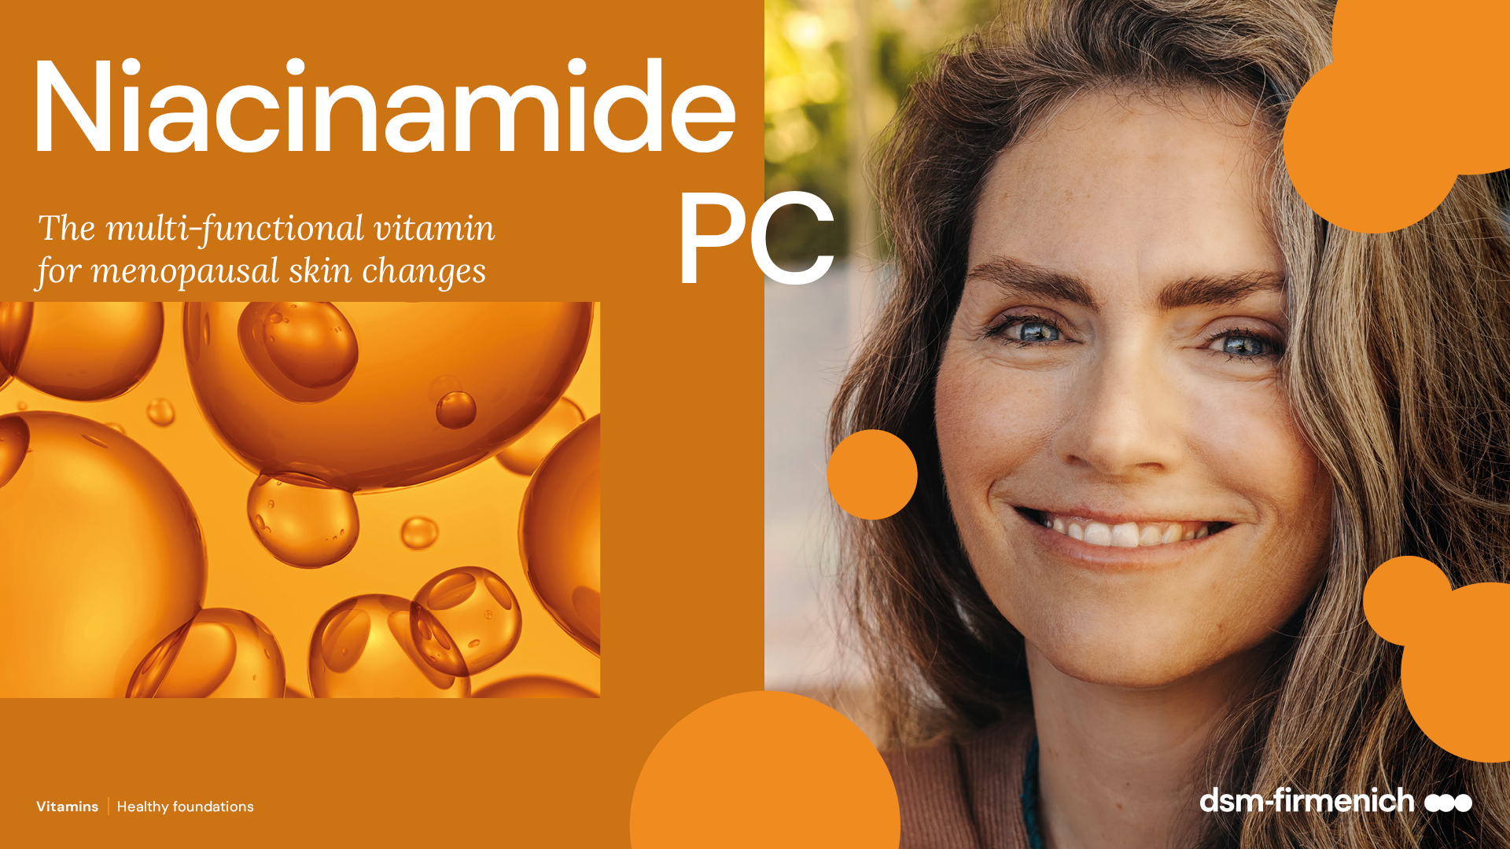
May 2025

Slide 2

Multipurpose vitamin for multiple skin changes during menopause
Niacinamide_ the versatile vitamin
The multi-change stage of menopausal skin aligns well with the multi-benefit properties of Niacinamide, making it an excellent ingredient for addressing various skin concerns during this transitional period.
During menopause, the hormonal decline takes its toll drastically on the skin. Skin becomes thinner, collagen is significantly degraded; deep wrinkles and age spots form and skin loses water and becomes dry. All these changes often lead to a sense of discomfort and diminished self-confidence as women contend with the visible alterations in their skin's texture and appearance.
Niacinamide offers significant benefits in counteracting the skin effects of menopausal hormonal changes.
The new in vivo study from dsm-firmenich shows that Niacinamide PC is an effective solution for menopausal skin concerns. It addresses issues such as dryness, sensitivity, fine lines, wrinkles by strengthening the skin barrier and protecting against collagen degradation. Its DNA repair properties and ability to fade hyperpigmentation make Niacinamide PC ideal for menopausal women skincare routines, enhancing overall skin health and resilience during this multi-change period.

Slide 3

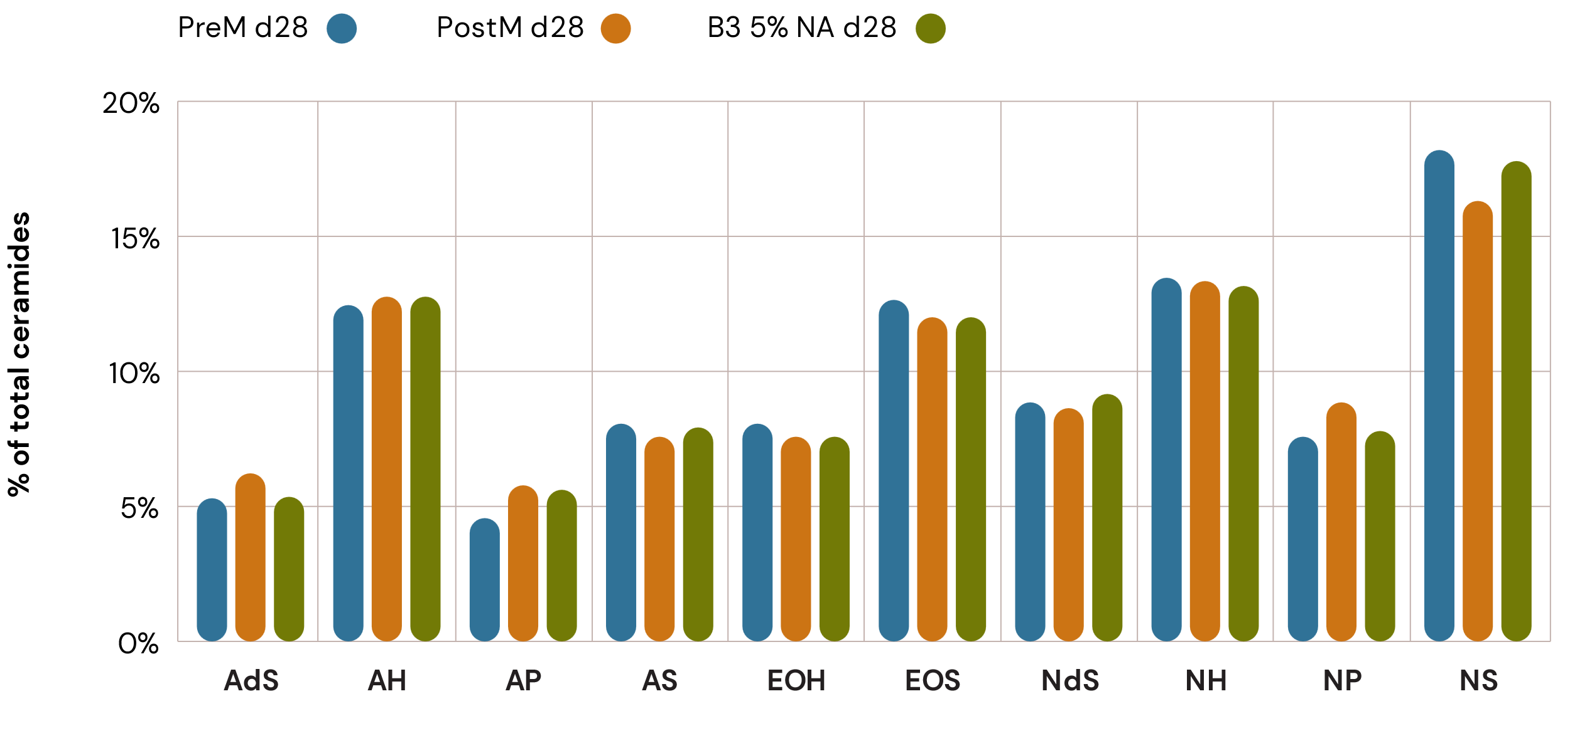
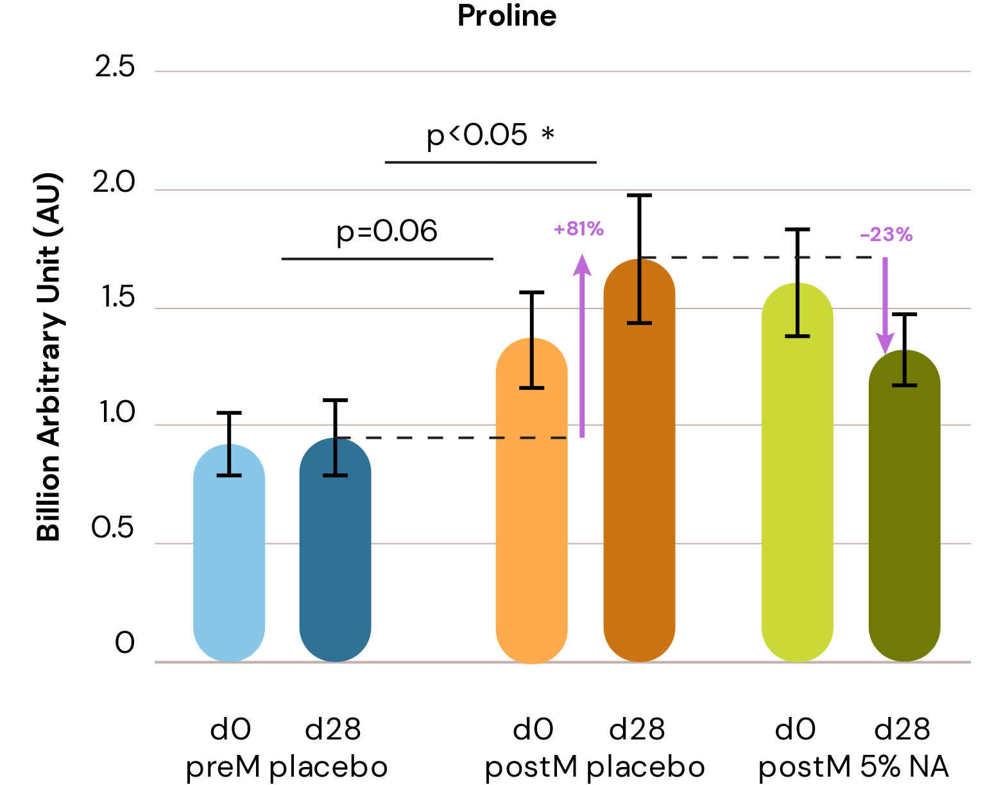
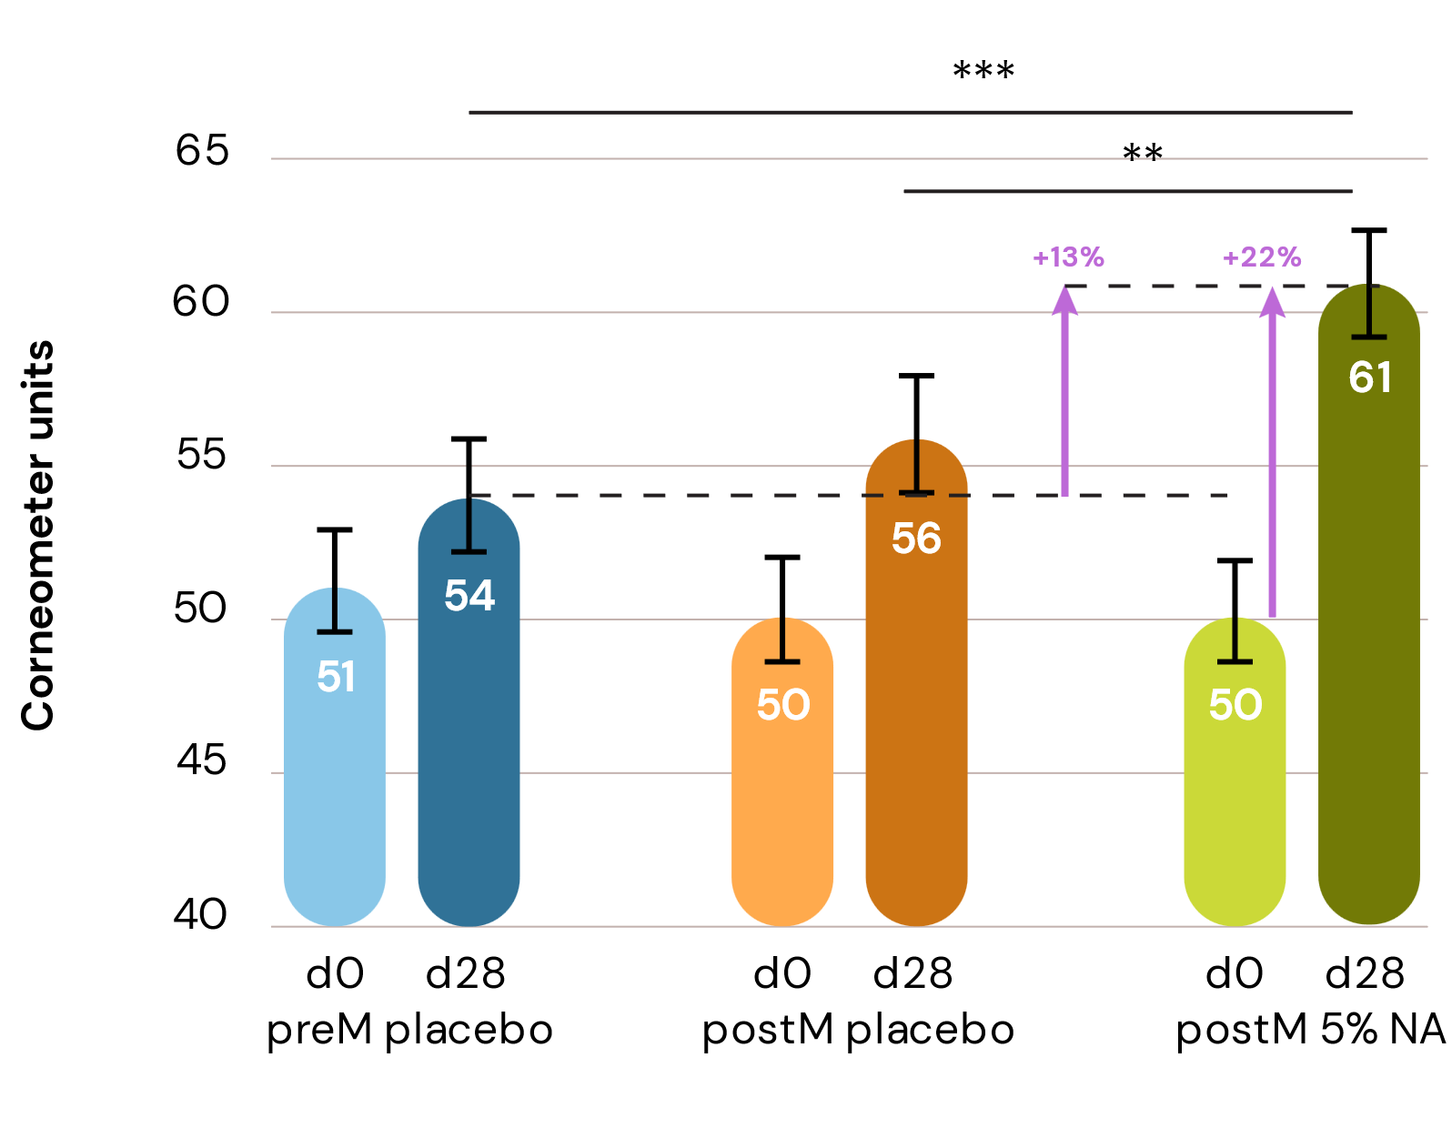
New Science on Niacinamide in post-menopausal skin
New
in vivo study
Re-balancing of Ceramides​
Protection against Collagen degradation
Skin Hydration
Menopausal skin is subject to different ceramides' composition compared to pre-menopausal skin.​ Niacinamide PC treatment boost all endogenous ceramides (with highest increase around 30%, restoring the native distribution of pre-menopausal levels of different ceramide types in the skin, much better than with topical application
Collagen synthesis is generally reduced during menopause. Treatment with Niacinamide PC resulted in lower levels of free proline and acetyl-proline, confirming its effectiveness in preserving collagen integrity and maintaining skin elasticity.
Due to hormonal changes menopausal skin tends to become drier, giving the skin an itchy feeling. High level of Niacinamide is correlated with reduced trans epidermal water loss (TEWL) and consequent increase of skin hydration.
Change in percentage share of total ceramides
Relative content of ceramides on total ceramides content
Free proline content
Skin hydration by cutometer
Niacinamide PC rebalances the ceramide distribution
Significant increase of free proline by 80% and significant reduction of free proline by 24% after treatment by 5% Niacinamide PC vs placebo
Significant increase of skin hydration by 22% vs T0 and by 13% vs Post Menopause group

Slide 4
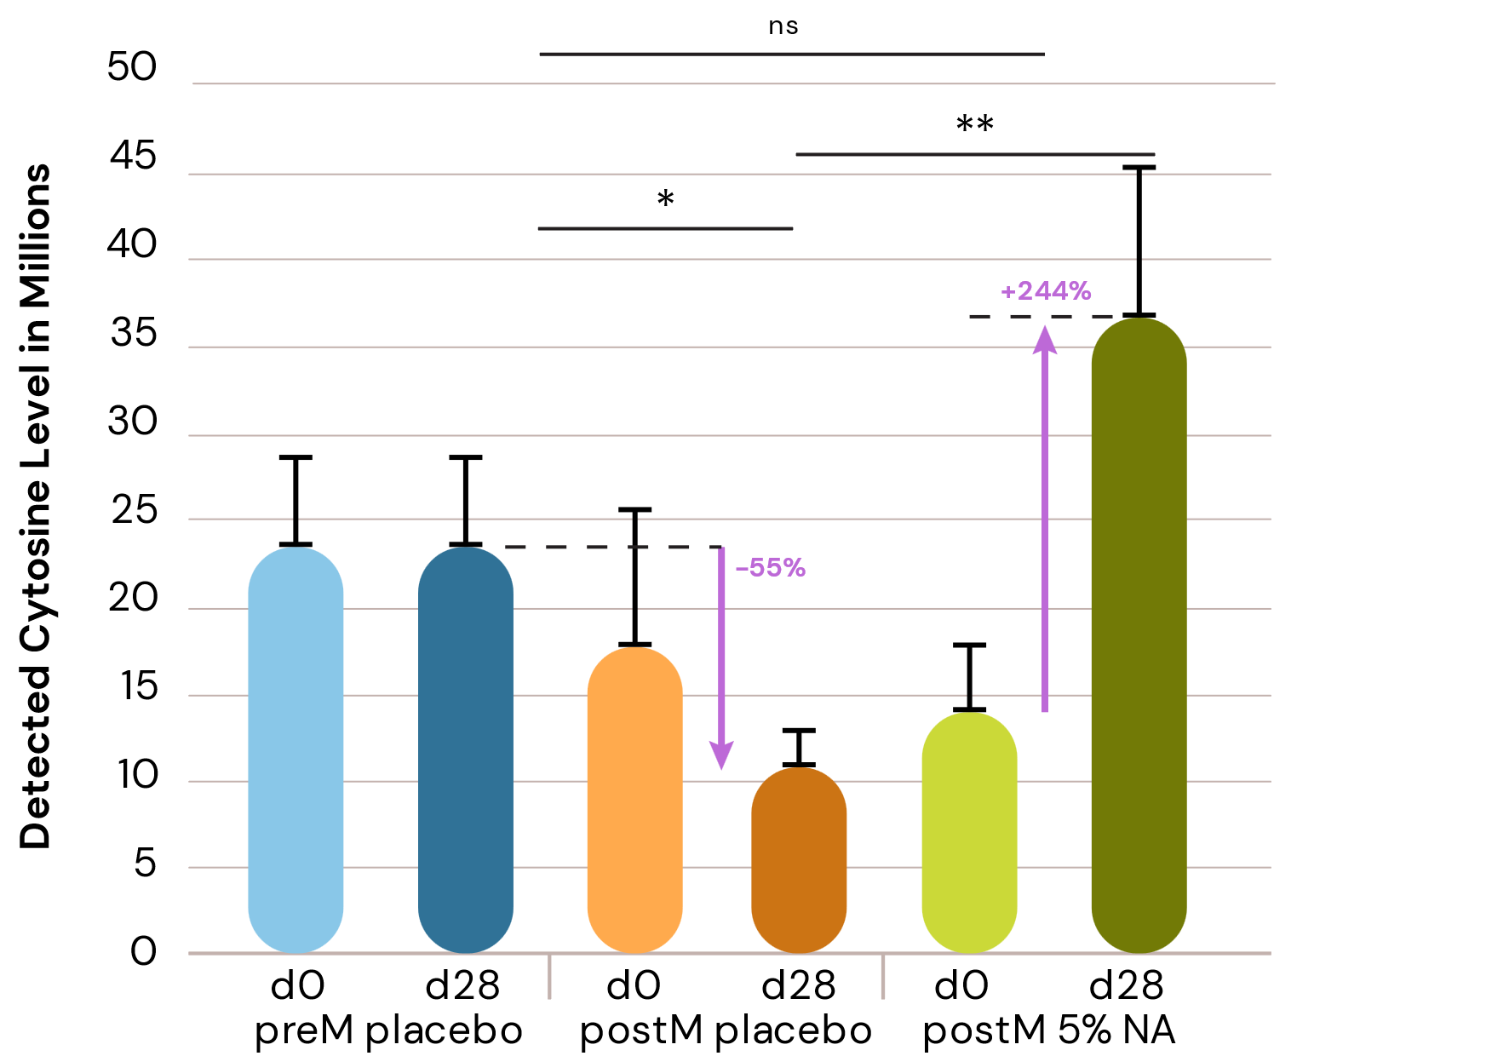
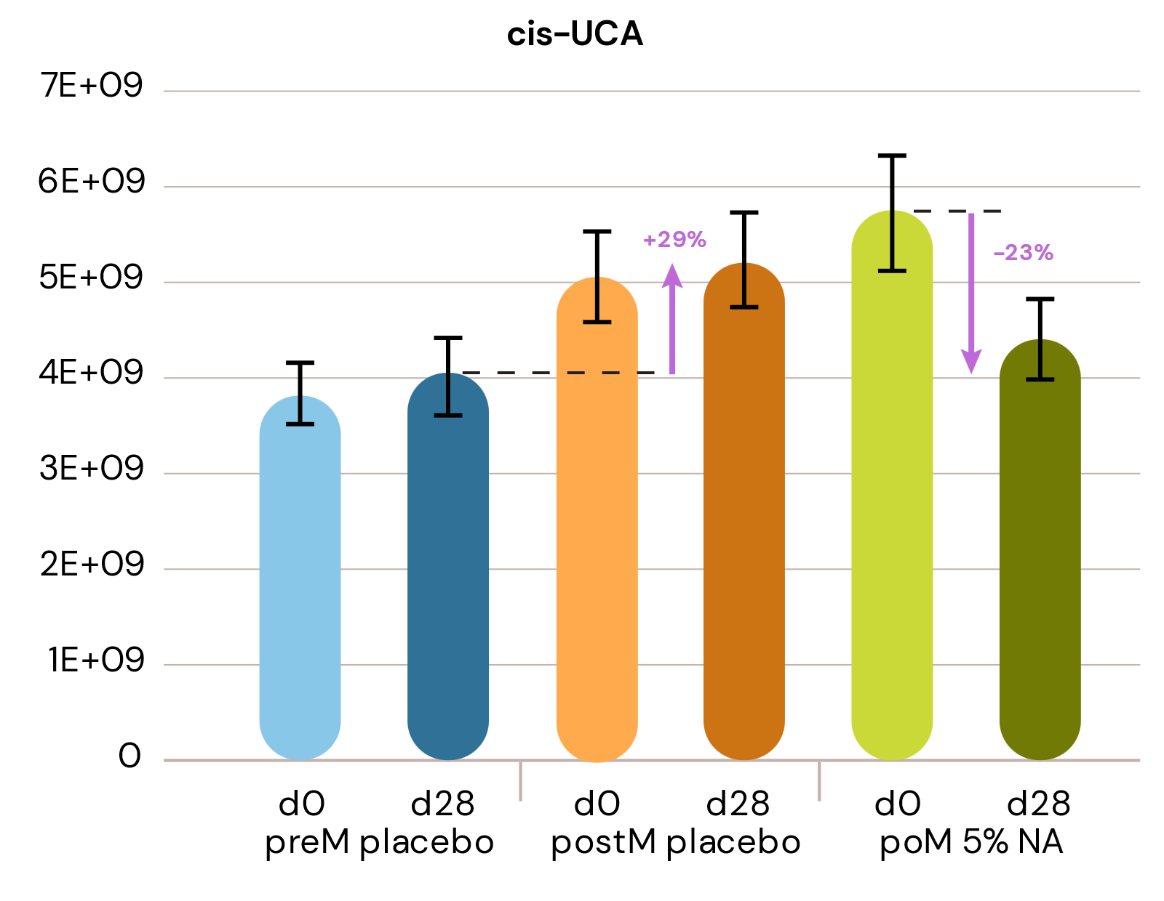
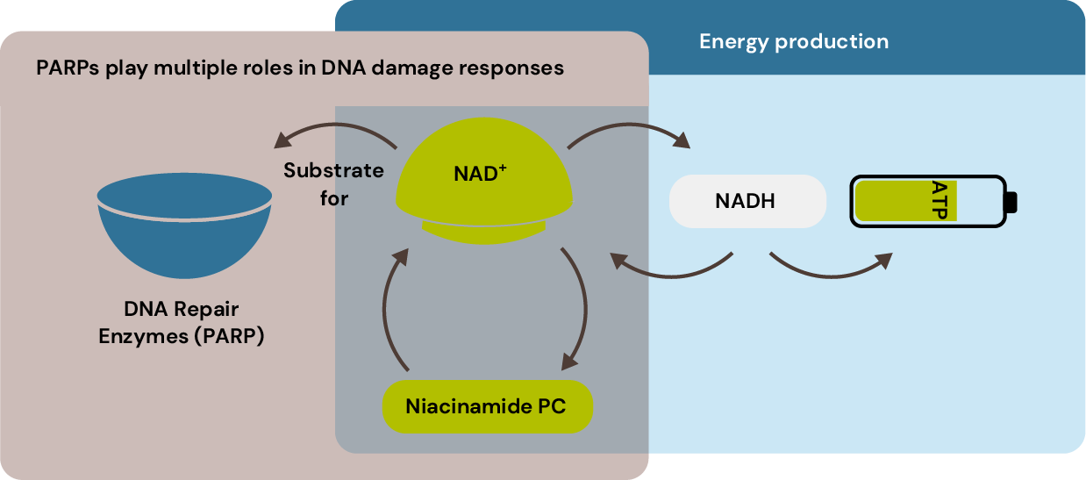
New Science on Niacinamide in post-menopausal skin
New
in vivo study
DNA Repair
Photoprotection
Energy Boosting
Post-menopausal skin is prone to DNA damage and more subject to UV-induced DNA damage compared to pre-menopausal skin. Treatment with Niacinamide PC shows significant increase of cytosine level (+244%), confirming the ability of Vitamin B3 to enhance DNA repair.
UV-stress markers such as cis-urocanic acid can be found at increased level in post-menopausal skin. Treatment with Niacinamide PC show a decrease of 28% in cis-urocanic acid content vs placebo. By promoting different catabolic pathways, Niacinamide PC provides biological protection from UV damage in postmenopausal skin.
NAD+ is a key molecule of cellular energy metabolism, and it appears to be in lower level in aged skin. As precursor of NAD+, Niacinamide is a building block to boost energy production at cellular level.
Cytosine level before and after treatment
Cis-urocanic acid
Simplified pathway of cellular energy production
(ATP production) with niacinamide and NAD+
Results show clear tendency (ns).

Slide 5
Multipurpose vitamin for multiple skin changes during menopause
Niacinamide: the versatile vitamin
Menopause skin changes
What happens in the skin
Niacinamide Treatment
Epidermal barrier dysfunction
Loss of hydration
Different distribution of Ceramides
Hydration
TEWL
Re-balance ceramides composition to pre-menopausal level
Restores hydration
Reinforces Epidermal barrier
Skin homeostasis and NMF disruption: release of imidazole compounds
Sensitive skin
Helps to relieve sensitive skin
Reduced energy availability
NAD+¹
Supports cellular energy metabolism
Slower skin repair ability
DNA protection and repair
Cytosine level (marker of DNA protection)
Enhances skin repair
Reduced skin elasticity,
promotes wrinkles
Collagen protection
Free proline (marker of collagen degradation)
Collagen production
Boosts skin elasticity,
reduced wrinkles
Upregulating histidine degradation (marker of skin homeostasis disruption): release of markers of UV skin damage
Increased UV induced skin damage and photoaging effects
Protects against UV-induced skin damage and photoaging
1: NAD+ oxidized form of Nicotinamide Adenine Dinucleotide

Slide 8

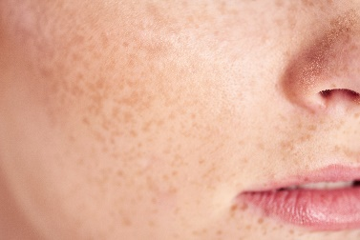


Niacinamide PC – new clinical data
New in vivo study
Study Design
Participants: healthy, Caucasian female volunteers*
Age: 48–65
Length of the study: 1 month
Application: Twice a day
Tested Skin Parameters:
TWEL (tewameter)/hydration (corneometer)
Omics Technologies (on D-Squame tape strips):
Metabolomics
Lipidomics (Ceramides)
Research listed at Top 10 finalists for
the Basic Research Award at IFSCC
Conference.
PreM Placebo
Age 48,9
N.:30
PoM Placebo
Age 59,6
N.:32
PoM Treated
Age 58,1
N.:32
Pre-menopausal control group = “young group phenotype”
Post-menopausal placebo group = “aged group”
Post-menopausal Vit B3 group = “treated group with 5% Niacinamide”
Metabolism of young
Metabolism of aged
Metabolism back to young
Tape strips 1 to 6 taken from cheek
6
5
4
3
2
1
Strip 6 for lipidomics
Strip 3 and 4
for general metabolomics
Strip 1 for the microbiome
*Pre-menopausal was deﬁned by whether menstrual cycles were regular and Post-menopausal by the last menstrual period that occurred at least 12 months ago. Perimenopausal individuals were excluded from this study.
Figure 1. Six D-Squame tape strips were taken from the same spot on the cheek.
N.1 used for microbe analysis (no clear conclusion due to variability of the group), n.3 and n.4 for metabolomics and n,6 for lipidomics.

Slide 9
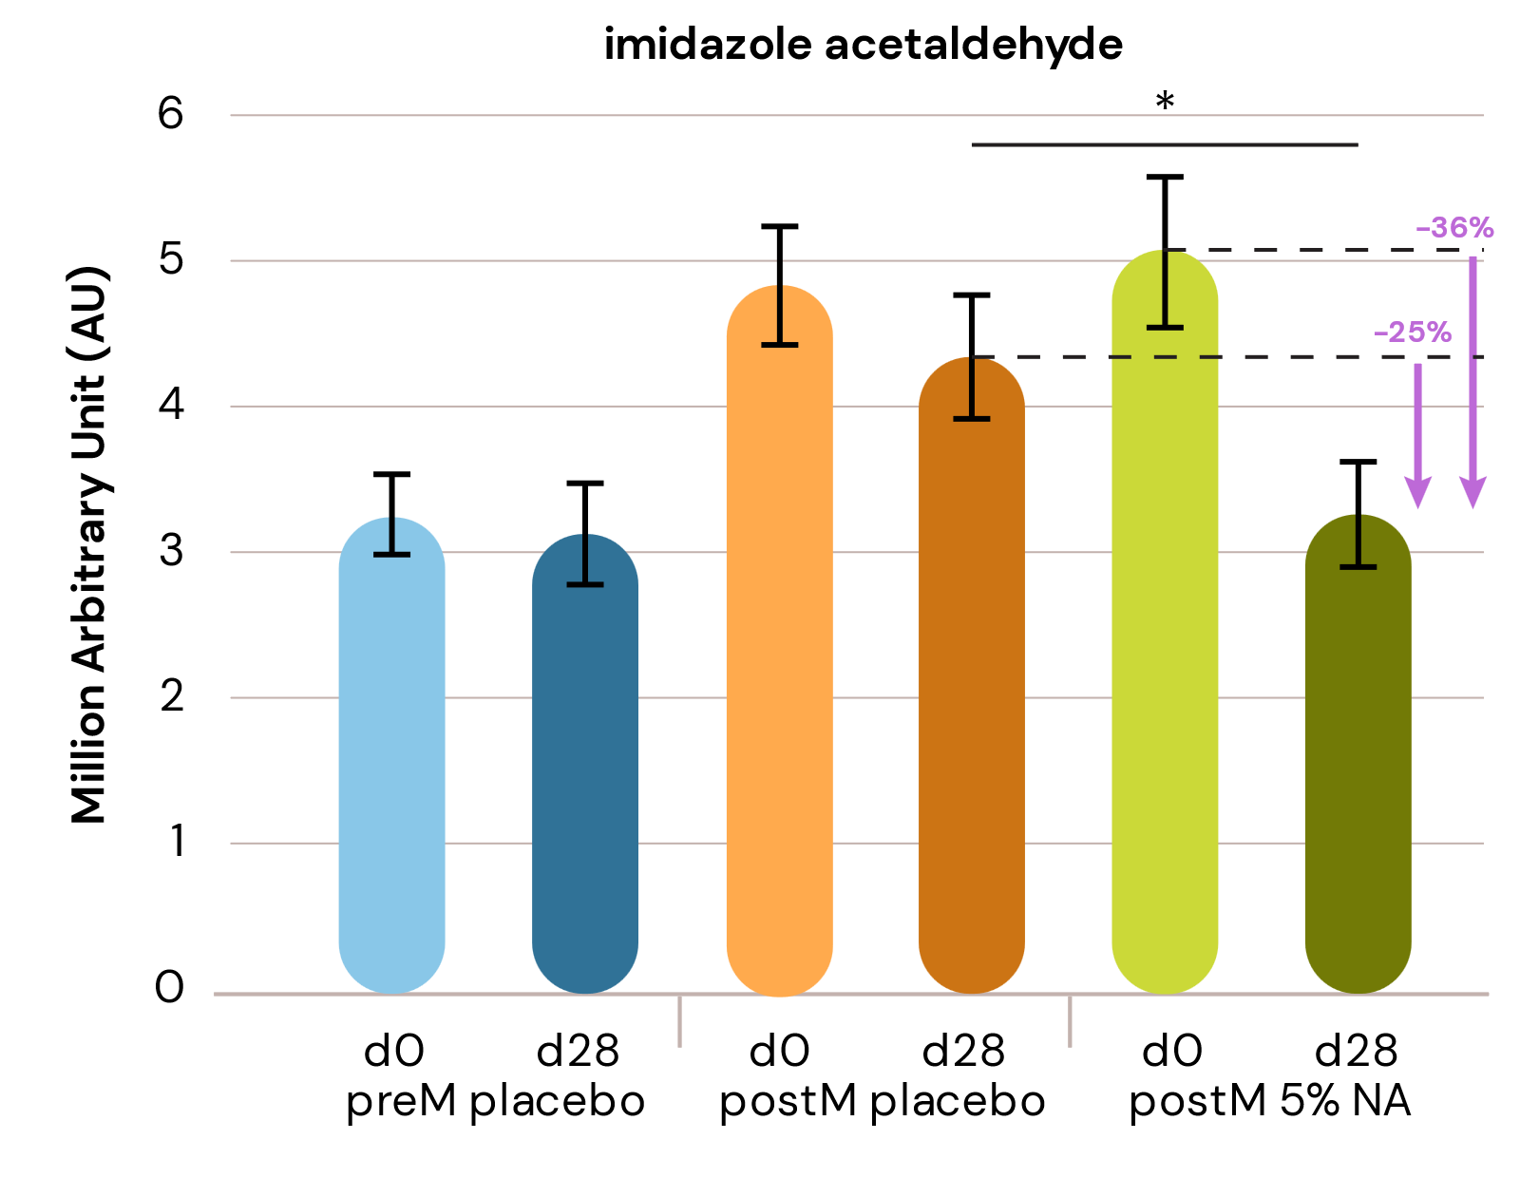
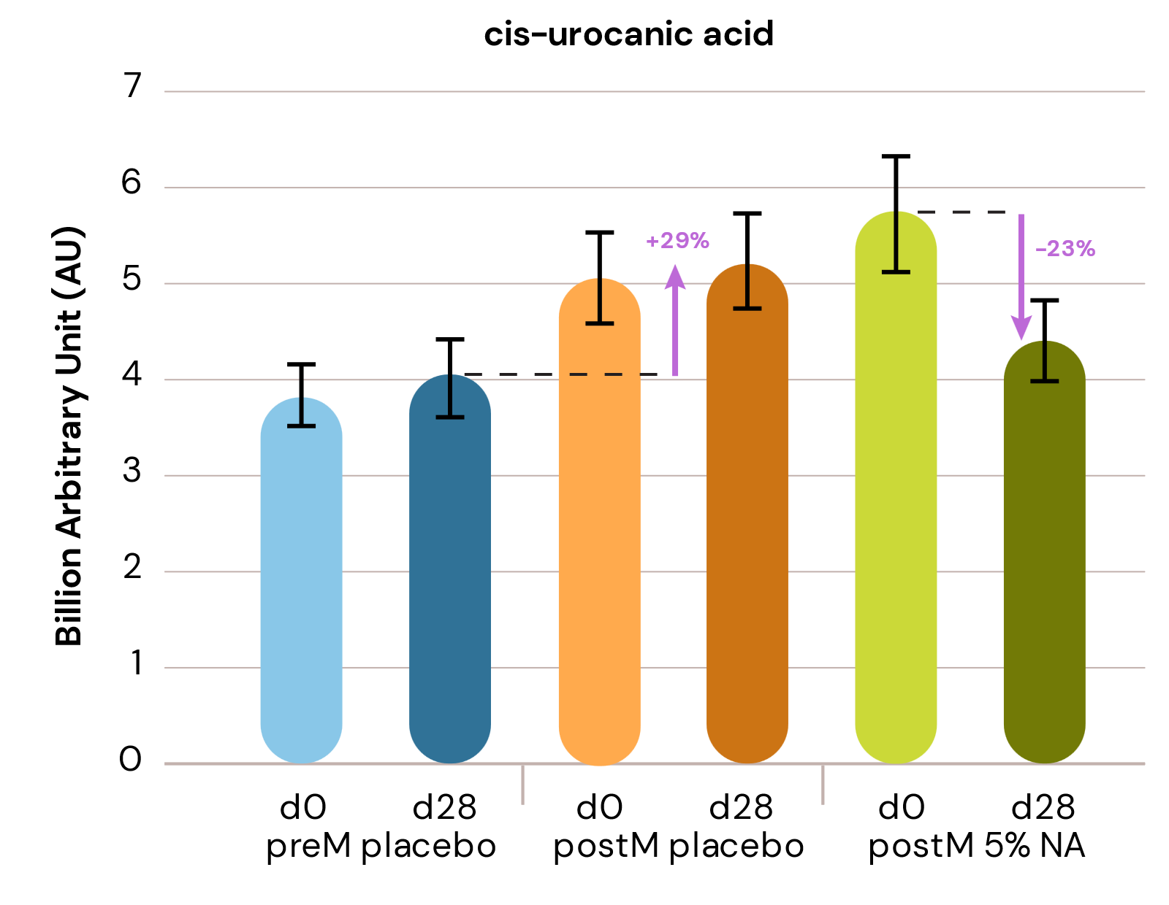
Niacinamide PC:
NEW: in vivo study
Rebalances the histidine catabolic pathway for better skin health
Niacinamide PC helps reducing sensitive skin (redness and itching):
Significantly downregulates imidazole-acetaldehyde by 36% vs baseline, and 25% vs placebo indicating reduced histamine activity.
Niacinamide PC provides protection from UV damage in postmenopausal skin:
Niacinamide PC rebalances key metabolites: UV-stress markers such as cis-urocanic acid can be found at increased level in post-menopausal skin. Treatment with Niacinamide PC show a decrease of 23% in cis-urocanic acid content vs T0.
Histidine catabolic pathway comparing niacinamide treatment at Day 28 in post-menopausal skin
Filaggrin
cis Urocanic acid
UV
Imidazole pyruvic acid
Transaminase
Histidine
Histidase
Trans-Urocanic acid
Alanine
Pyruvate
Histidine decarboxylase
β-alanine
Imidazole propionic acid
Imidazole lactic acid
Histamine
carnosine
Diamine oxidase
TH-folate
Imidazole acetaldehyde
Niacinamide
L-Glutamate
Histamine Dinucleotide
Formimino-tetrahydro-folate
Metabolite has been detected at lower/higher levels in post-menopausal panel compared to the pre-menopausal
Metabolite has been detected at lower/higher levels after four weeks of B3 treatment compared to placebo post menopausal
* : p value <0.05

Slide 10
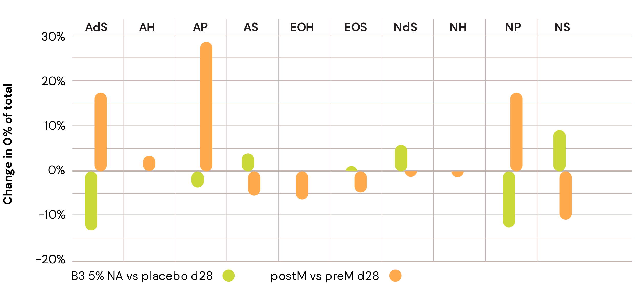
New Science on Niacinamide in post-menopausal skin
New
in vivo study
Re-balancing of Ceramides​
Protection against Collagen degradation
Skin Hydration
Menopausal skin is subject to different ceramides' composition compared to pre-menopausal skin.​ Niacinamide PC treatment boost all endogenous ceramides (with highest increase around 30%, restoring the native distribution of pre-menopausal levels of different ceramide types in the skin, much better than with topical application
Collagen synthesis is generally reduced during menopause. Treatment with Niacinamide PC resulted in lower levels of free proline and acetyl-proline, confirming its effectiveness in preserving collagen integrity and maintaining skin elasticity.
Due to hormonal changes menopausal skin tends to become drier, giving the skin an itchy feeling. High level of Niacinamide is correlated with reduced trans epidermal water loss (TEWL) and consequent increase of skin hydration.
Change in percentage share of total ceramides
Relative content of ceramides on total ceramides content
Free proline content
Skin hydration by cutometer
Niacinamide PC rebalances the ceramide distribution
Significant increase of free proline by 80% and significant reduction of free proline by 24% after treatment by 5% Niacinamide PC vs placebo
Significant increase of skin hydration by 22% vs T0 and by 13% vs Post Menopause group

