Slide 1
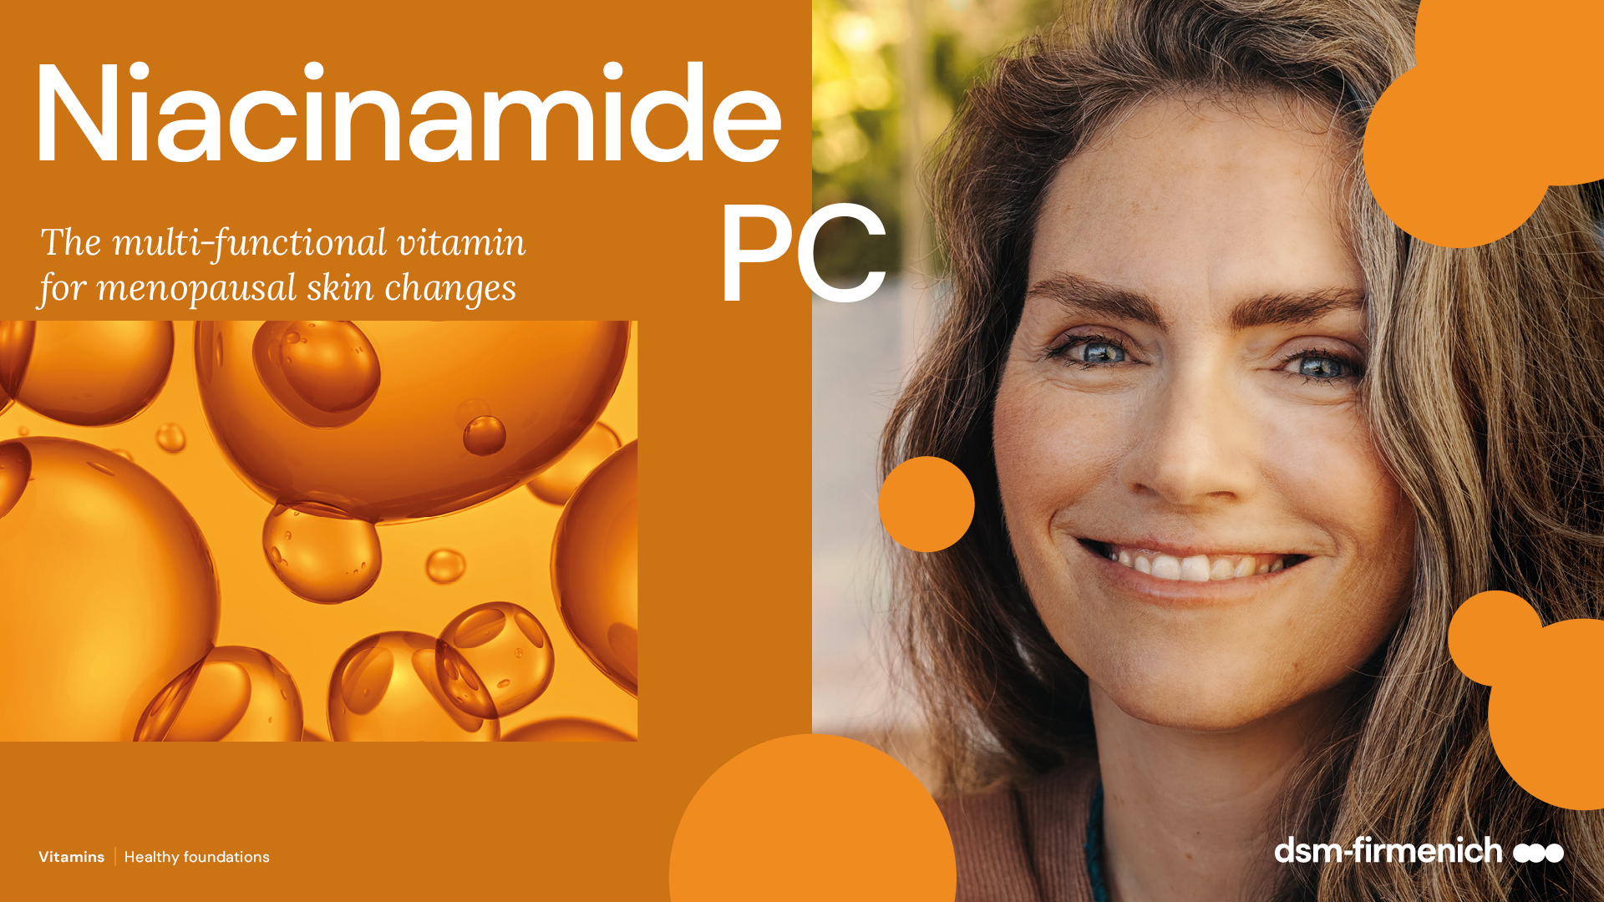
April 2025

Slide 2





Niacinamide PC
Art. 5016013
What is it?
Niacinamide (Vitamin B3) is a very stable vitamin which offers
a wide range of well-documented topical benefits.
Niacinamide is a component of NAD and NADP, essential coenzymes in ATP production, also having a central role in DNA repair and skin homeostasis.
What is special about niacinamide PC?
Niacinamide PC is a special cosmetic proprietary grade of dsm-firmenich, which has a low guaranteed level of residual nicotinic acid to address any concerns about unpleasant skin sensations.
Fully raw material backward integrated (picoline – intermediates of niacinamide- from natural origin, ex tapioca)
An all-round product for my skin?
is the ideal candidate for day care and sun care products.
Ideal for all skin types, well tolerated.
Notes:
This slide summarizes in essence Niacinamide PC. What it does, how it is different, etc…
Can be used as a teaser.

Slide 3
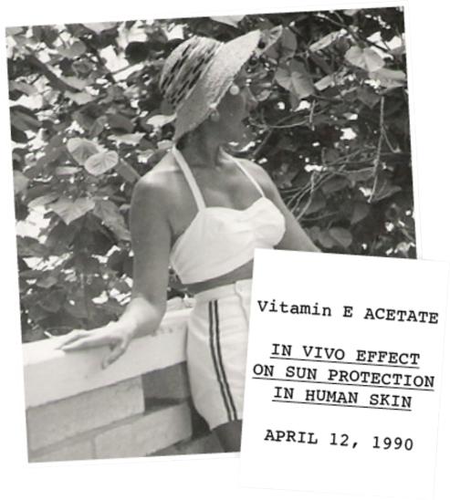



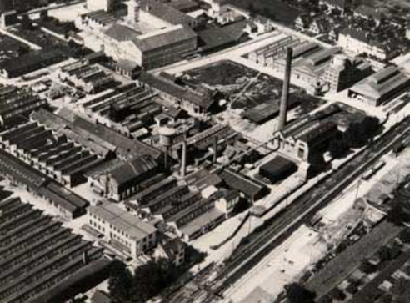
dsm-firmenich: The vitamin pioneer & leader
dsm-firmenich, a pioneer in the vitamin journey
  As the longest-standing producer of vitamins in the world
dsm-firmenich, a leader in vitamins for personal care
  The 1st to explore the beauty potential of vitamins
  The 1st to bring vitamins production
  on the industrial level
It’s with no surprise that dsm-firmenich brings
with Niacinamide PC…
The best science: We claim efficacy – we prove/document it!
The best product form: a low guaranteed level of residual nicotinic acid to address any concerns about unpleasant skin sensations.
Niacinamide PC
Vitamin C industrial production, Grenzach, 1936

Slide 4




Niacinamide PC
Card version 1
Aligned with and contributing to the
INCI name: Niacinamide PC
Product Codes: 5016013
Highlights
related to
Supply Chain
control
Partner is a dsm-firmenich qualified supplier.
Exclusive production
RSPO Certificate
Not applicable: no palm oil derivatives
Carbon
emissions
10.8 kg CO2 equivalent per kg
Biodegradability
Readily biodegradable according to OECD Test 301E
Water footprint
32 l/kg, water risk level 2.5 out of 5
Vitamin B3
Cosmetic grade
Guaranteed to contain max 100 ppm residual nicotinic acid, making it exceptionally well tolerated.
Working conditions and community development
ISO certified site for quality, environment and food safety management
Health and Well-being
Resilience to external damage (UV/Blue light/ Pollution)
Evens skin tone
Naturality with ISO 16128
Natural-origin score: 0%
The carbon and water footprint calculations are based on internally conducted LCA according to ISO 14040/44 guidelines, DSM LCA policy and validated by an internal reviewer.
© 2024. dsm-firmenich. All rights reserved

Slide 5
















Niacinamide PC– resilient, flawless skin and a radiant complexion
CORNEOCARE® - Skin Resilience
Strengthens skin barrier, stimulates ceramides and lipids in stratum corneum (in vivo at 2 and 3%)
Increasing key proteins involved in skin barrier: involucrin, filaggrin, keratin (in vitro)
Anti-aging activities
Stimulates collagen synthesis (in vitro)
Improves the appearance of lines, wrinkles and skin elasticity (in vivo at 4 and 5%)
CORNEOCARE®
SKIN RESILIENCE
ANTI-AGING
ACTIVITIES
Even skin tone
Inhibition of melanosome transfer (in vitro)
Rebalances uneven skin tone (ex-vivo, in vivo at 4 and 5%)
Blemish Care
Reduces the appearance of acne (in vivo at 4%)
Helps to reduce sebum level (in vivo at 2%)
EVEN
SKIN TONE
BLEMISH
CARE
Environmental stress protection
Boost cell energy production and repair (UV induced DNA damage in vitro, ex vivo)
Protection from urban pollutants damage (in vitro, ex vivo)
UV and Blue light protection
Helps to relieve premature aging from UV and Blue light: reduces skin discoloration from blue light (in vitro, in vivo at 3%)
ENVIRONMENTAL
STRESS PROTECTION
UV AND
BLUE LIGHT PROTECTION

Slide 6
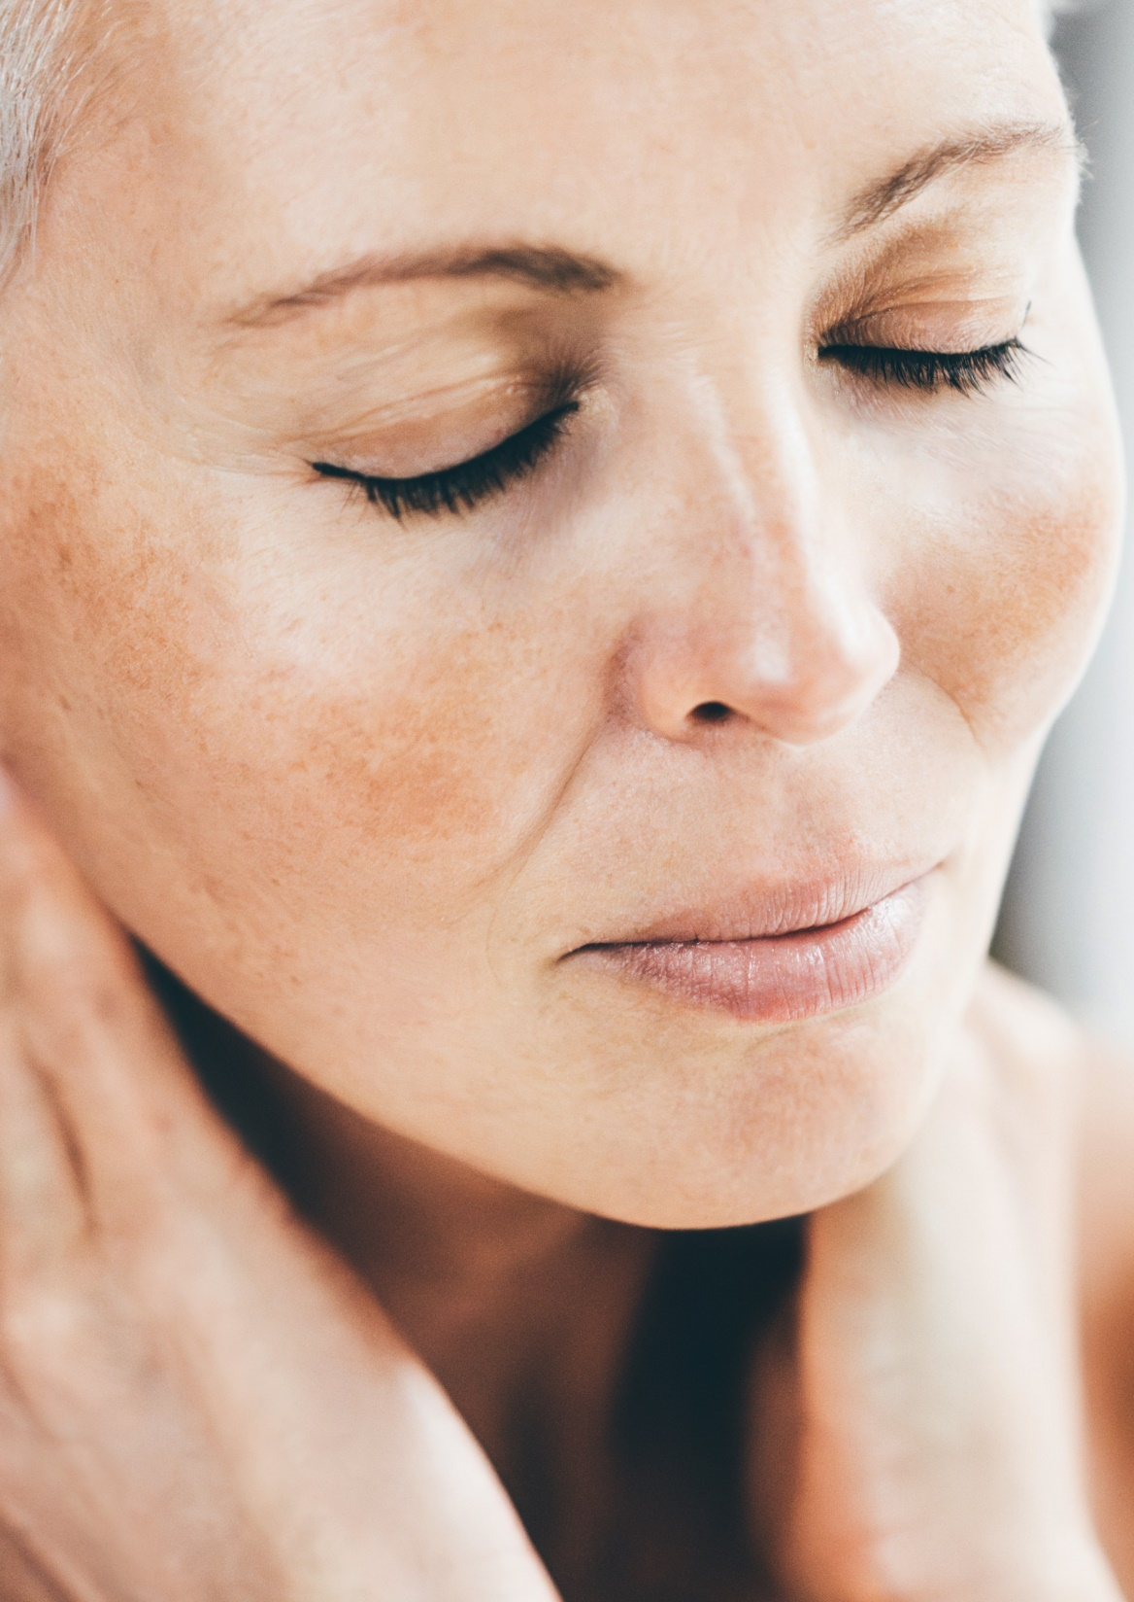



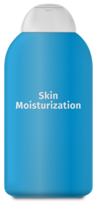
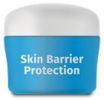
CORNEOCARE®
CORNEOCARE™
Consumer level
Funcitonal level
Skin well protected against oxidative stress (exposome)
Repair
Stimulates lipids and ceramides production
Keeps moisturized skin
Increases key proteins involved in skin barrier: involucrin, filaggrin and keratin
Decreases water loss (TEWL)

Slide 7

CORNEOCARE™ holistic approach with Niacinamide PC
CORNEOCARE™
A healthy perfect skin barrier, a key benefit of CORNEOCARE™
NIACINAMIDE PC & CORNEOCARE™
Reduction of:
-27%
Water loss
Increase of:
+67%
+34%
+44%
+100%
Fatty acids
Ceramides
Involucrin
Filaggrin

Slide 8
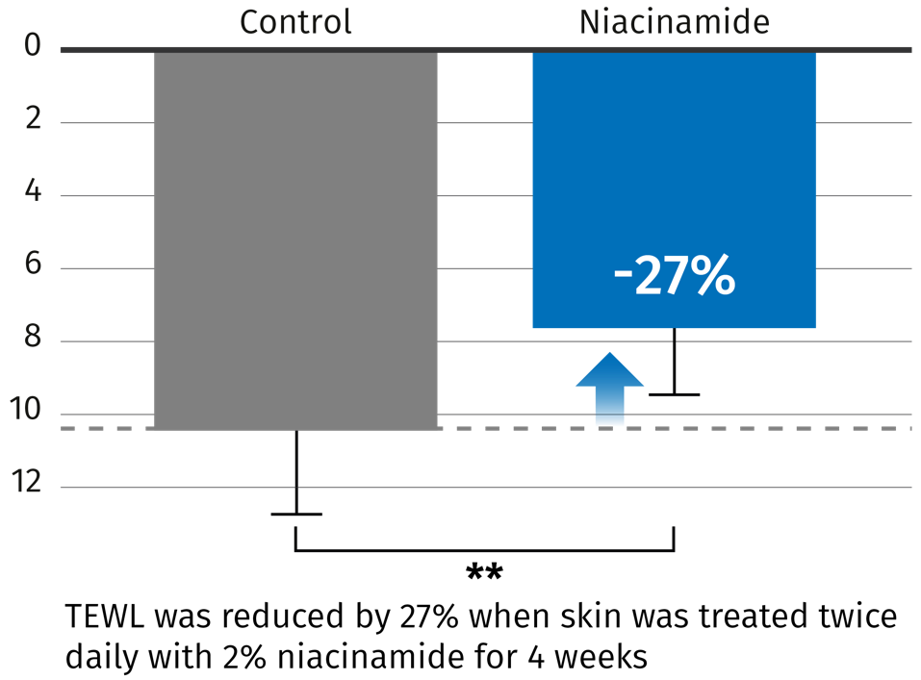
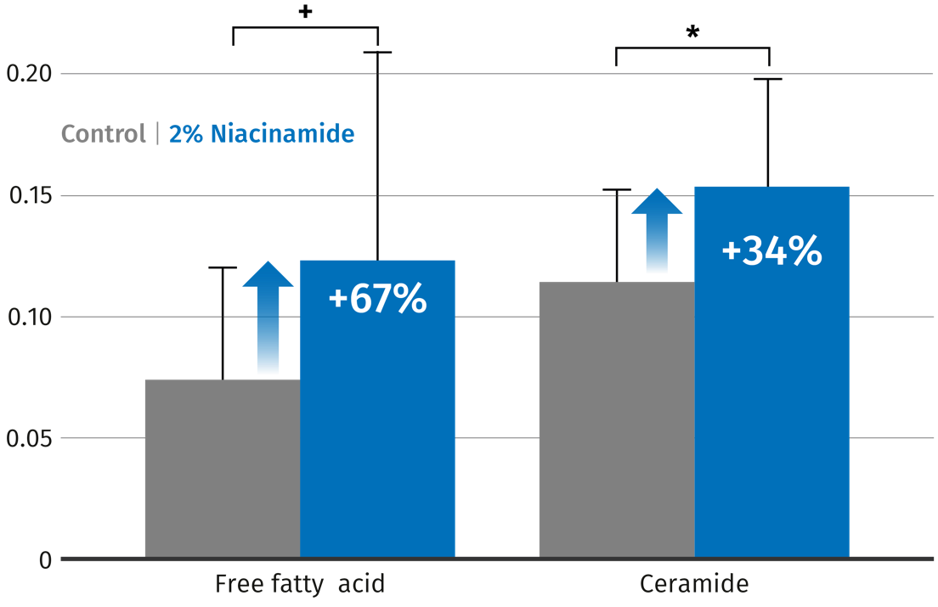
Niacinamide strengthens the skin barrier
In vivo study
Twelve healthy men volunteers with dry skin applied Niacinamide (2%) for 4 weeks.
Lipids were extracted and quantified from stripping of stratum corneum
CORNEOCARE™
Transepidermal water loss (mg/cm².h)
Increased ceramide and free fatty acids level (μg/mg protein) in stratum corneum after Niacinamide treatment
+ p < 0.01; *p < 0.05; **p < 0.01
Niacinamide PC helps to keep hydrated and normalize
the skin by balancing ceramide and fatty acids in Stratum Corneum
Tanno et al, British Journal of Derrmatology 2000, 143:524-531
Notes:
Tanno O, 2000: Nicotinamide increases biosynthesis and ceramides as well as …,
Nicotinamide (2%) was topically applied twice daily to one shin of volunteers and vehicule (0.1% polyoxyethylenesorbitan monolaurate) alone for 4 weeks. N=12, PTEWL<0.01, Student‘s test (TEWL).
TEWL is reduced by 27% (27% less of water quantity evaporated trough the skin) when the skin is treated with 2% niacinamide for 4 weeks.
This shows that the skin is healthy and does not easily let the water go through when niacinamide is topically applied
N=12 persons, Pfatty acids<0.1, Pceramide<0.05, Student‘s test.
The test was conducted with volunteers with dry skin (12 men aged 26-51 years)
At the end, lipids were extracted, ceramides, cholesterol and free fatty acids were quantified. The level of lipids was expressed in µg/mg of protein
Stratum Corneum lipids and particularly ceramides play a central role in the integrity of the epidermal barrier. For structural and functional integrity
Level of ceramides in aged skin and dry skin is decreased. Applied topically niacinamide can then help imbalance this age-related decrease.

Slide 9

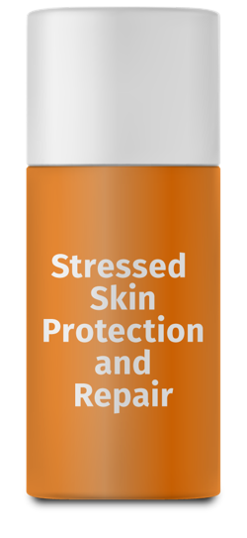

Protection and Repair
Environmental Stressed Skin Care
Consumer level
Funcitonal level
Well-protected from environmental damage for beautiful and healthy skin
Repair
Niacinamide increases physiological DNA repair by 35% ex vivo
Protection
Niacinamide prevents UV-induced ATP decline
cell energy crisis prevention
Energy refuelling allows significantly increased DNA repair

Slide 10
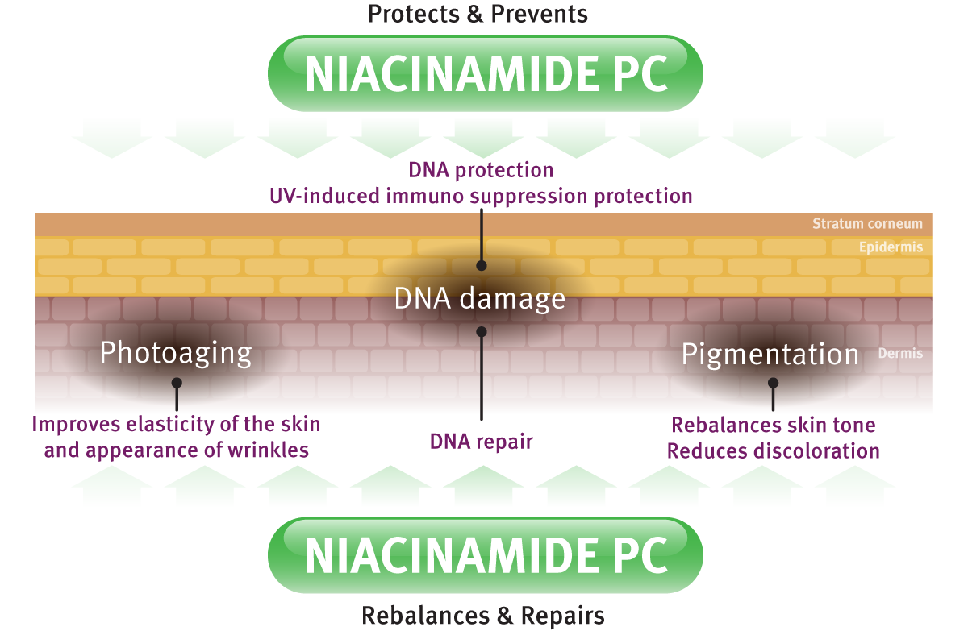

Environmental stressed Skin Care with Niacinamide PC: Protection & Repair
UV
Blue-light
Pollution
Oxidative stress
Notes:
Exposure to sun light act together with the normal aging process to prematurely age our skin. UV radiations are also triggering excessive or uneven skin pigmentation as well as skin cancer development. The mechanisms by which UV leads to cancer are complex including direct damage to DNA and effects on the immune system. Niacinamide showed to be effective in tackling UV damage: from protecting and repairing UV stressed skin to maintain its beautiful glow and elasticity

Slide 11
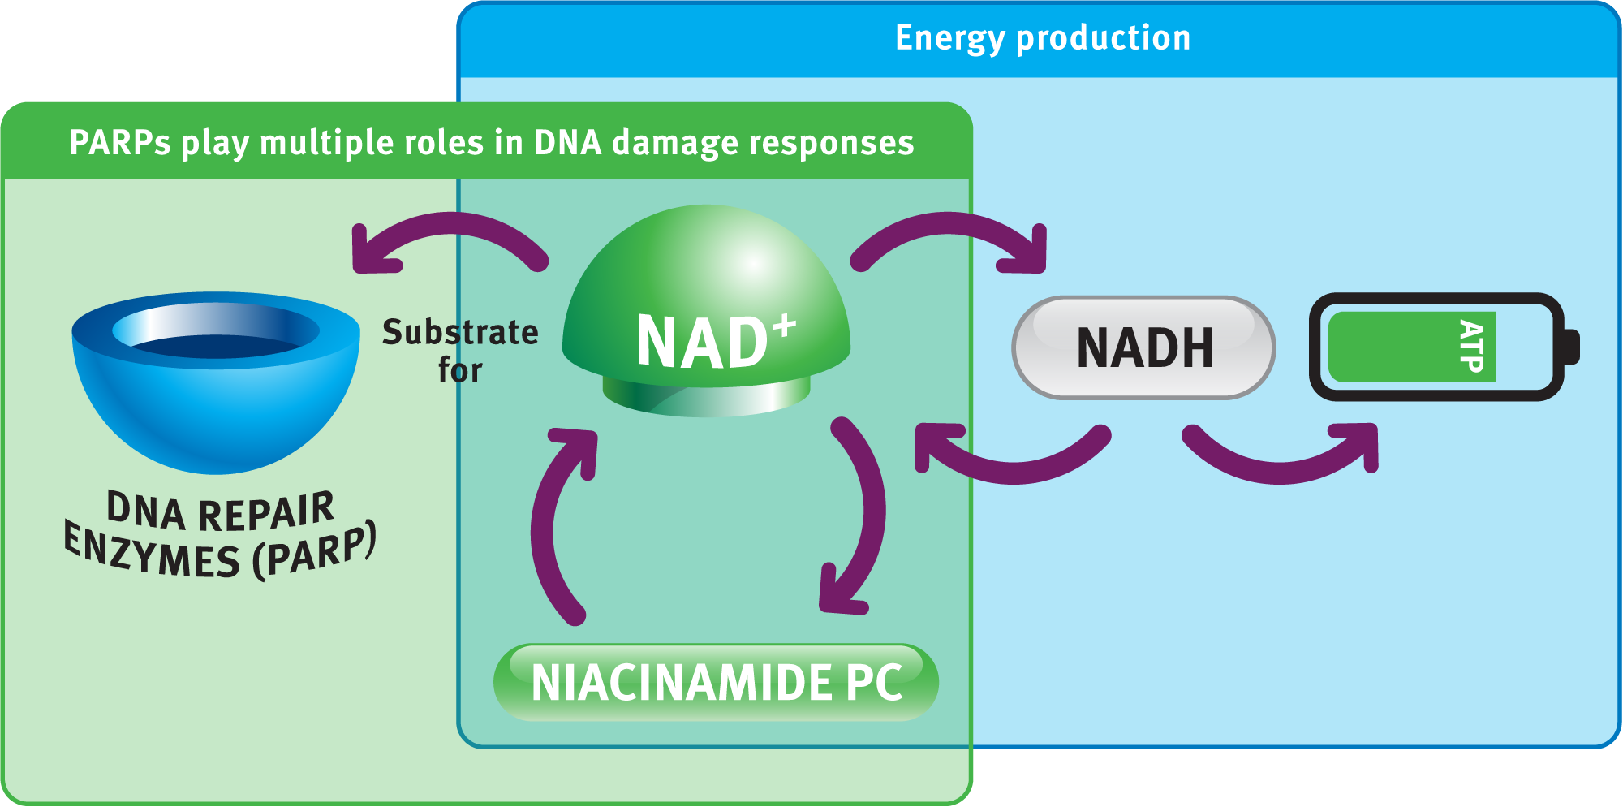
Niacinamide PC is the essential NAD+ precursor in two key pathways: energy production and DNA repair
Environmental Stressed Skin Care
NAD+ is a substrate for poly (ADP-ribose) polymerases (PARP).
PARP play multiple role in DNA damage responses including DNA repair and maintenance of genomic stability
Simplified pathway of cellular energy production (ATP production) with niacinamide
and NAD+
Notes:
Niacinamide is metabolized in nicotinamide adenine nucleotide (NAD+), the essential coenzyme in ATP production.

Slide 12
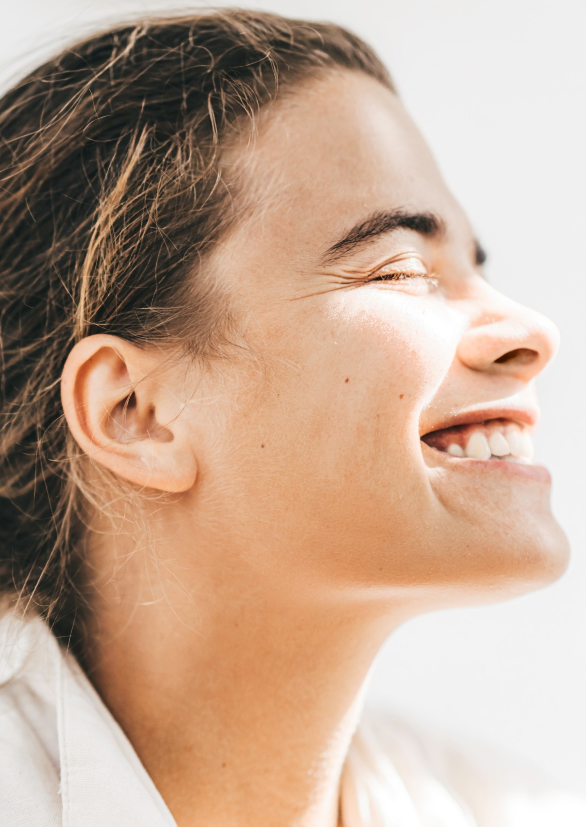
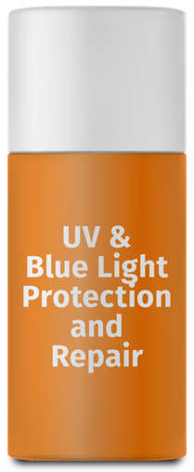
Blue Light effects
UV and Blue Light
Stressed Skin Care
Consumer level
Functional level
Helps to relieve premature aging
Niacinamide protects the skin from oxidative stress (free radicals -48%) in vitro and ex vivo
Reduces skin discoloration
Niacinamide protects the protein damage (-48%) from blue light ex vivo
In clinical trials: Niacinamide reduced the hyperpigmentation (-23%) and the redness (-25%) generated by blue light exposure

Slide 13
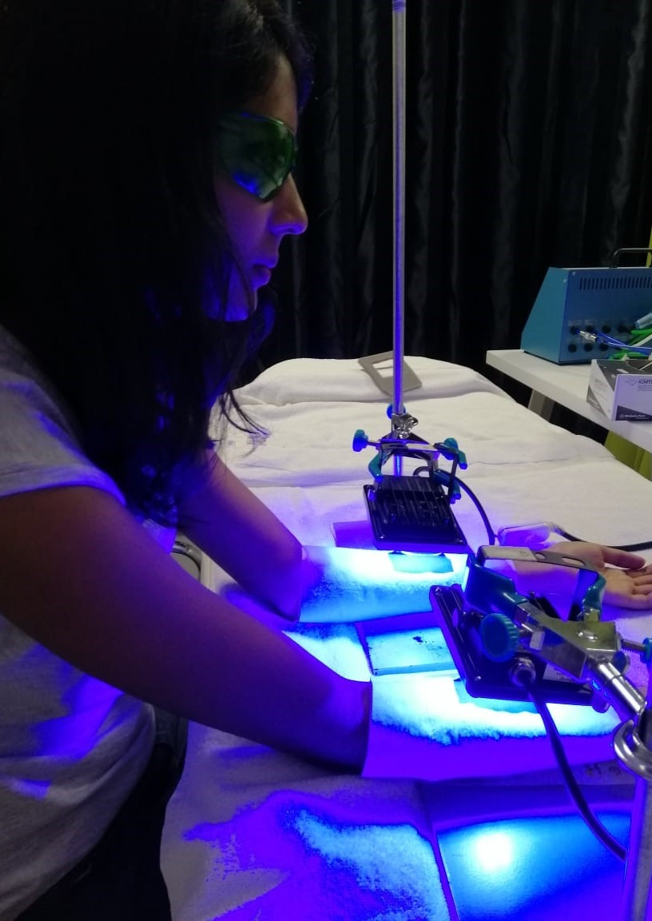
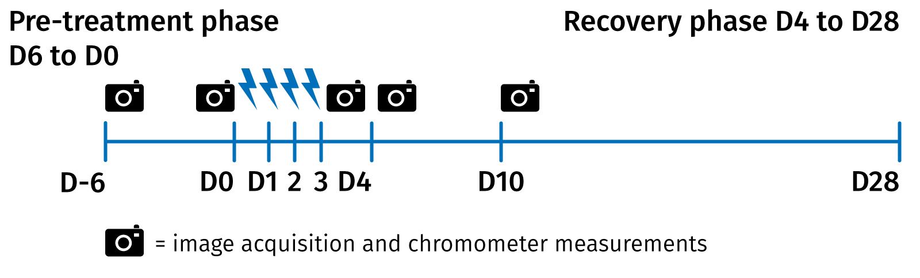



Niacinamide PC blue light in-vivo study design
UV and Blue Light
Stressed Skin Care
33 female volunteers (mean 32 years old, Caucasian 55%, Asian skin 18% and 27% mixed-ethnicity with phototype III and IV)
Randomized double blind with placebo
Cream formulations with 3% Niacinamide PC (without sun filter)
Forearm application once a day for 34 days (application started 6 days before blue light exposure to strengthen the skin)
Exposition 4 days consecutively on forearm with LED lamp at 450nm with 60J/cm2: natural dose you get within one hour from European midsummer sun
Skin color measurements (chromameter) and Image analysis
Notes:
Study for 28 days in Mauritius
21 - 41 years old (mean 32, mainly millennials)
Exposition on forearm (4x6cm)
450 nm (peak in blue light with LED and electronic devices)
Application of Niacinamide PC during 6 days before blue light exposure to strenghten the skin by pre-conditioning it and continuing all along the study

Slide 14
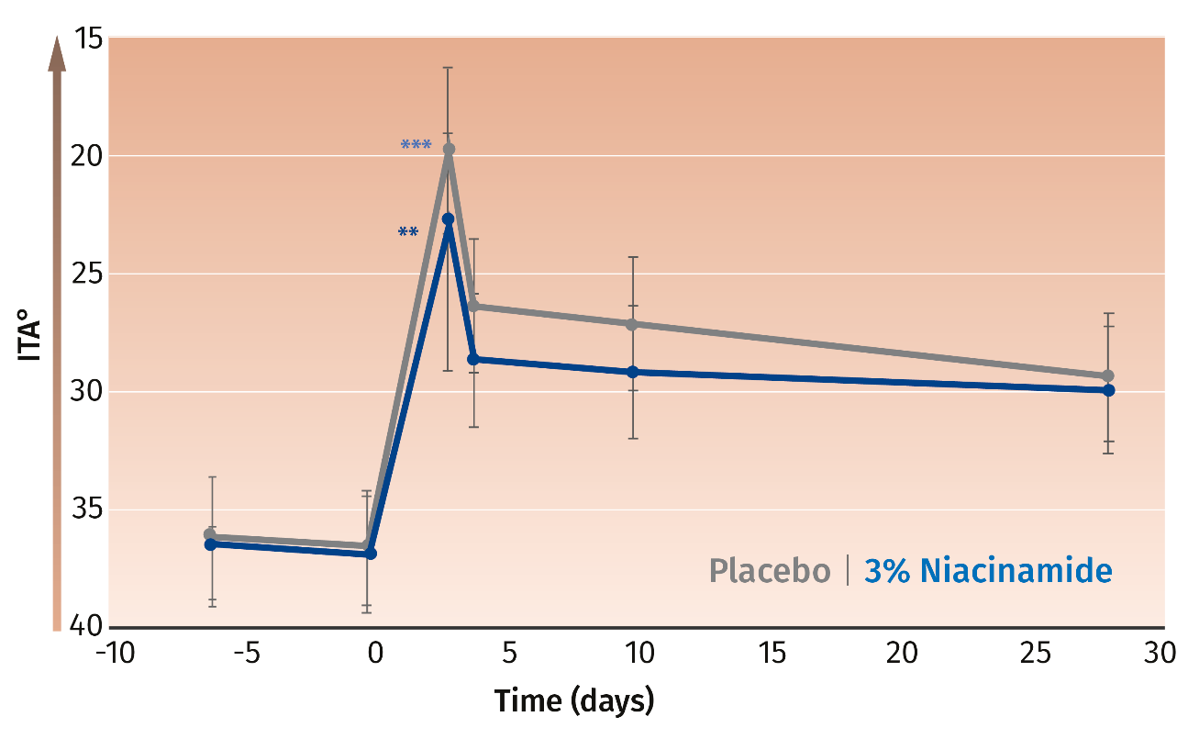

Skin darkening: Niacinamide PC protects from blue light induced immediate skin hyper-pigmentation
UV and Blue Light
Stressed Skin Care
Impact of niacinamide on protecting cellular bioenergetics under hydrogen peroxide induced oxidative stress conditions
Colorimetry ITA° angle
Niacinamide PC proves to be effective against hyper-pigmentation:
Highly significant skin darkening after 4 days blue light irradiation
Immediate reduction of skin pigment darkening with Niacinamide PC
Skin darkening
** p<0.001 vs D0
ITA° is inversely correlated with skin pigmentation: the lower the ITA value, the darker the skin Colorimetry ITA angle, ITA° takes into account 2 parameters: luminance (L*) and yellow-blue tone (b*).
Notes:
Reminder: at D4, not anymore blue light irradiation

Slide 15
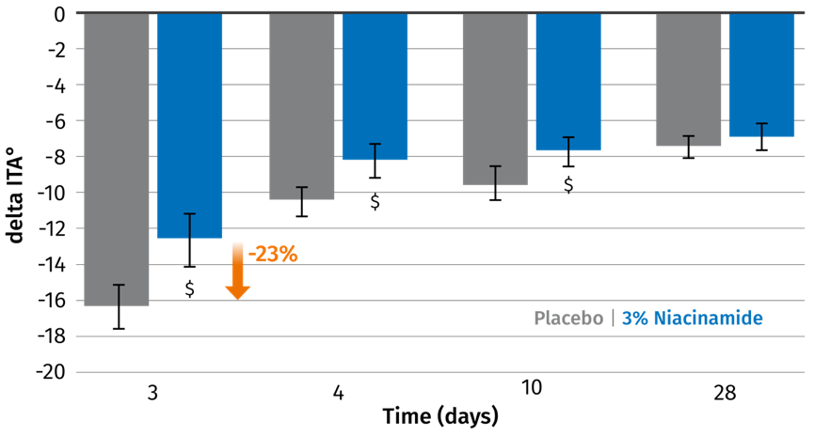
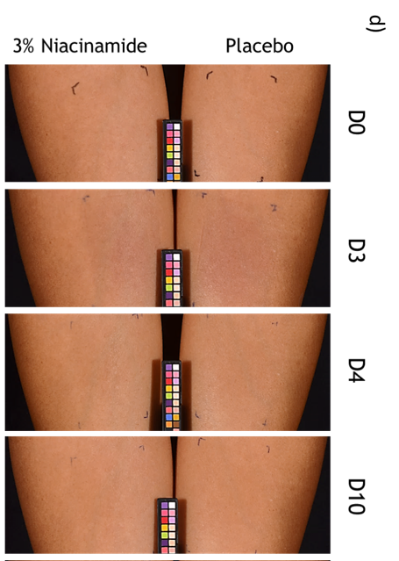
Niacinamide PC protects against blue light induced skin pigment darkening by 23%
In vivo study
UV and Blue Light
Stressed Skin Care
Niacinamide PC protects immediately by 23% the skin hyper-pigmentation induced by 4 days blue light irradiation
$: p<0.1
Volunteer 20 – ITA° - left forearm with placebo and right with 3% Niacinamide

Slide 16


Pollution protection
Pollution Protection Care
Consumer level
Funcitonal level
Well-protected from urban pollutants damage for beautiful and healthy skin
Niacinamide is the ideal candidate for urban pollution care as it:
Strengthens the skin barrier
Rebalances uneven skin tone and reduces discoloration
Air Pollution
Increases cell viability exposed to particulate matter (up to 81%) in vitro
Water Pollution
Enhances repair of arsenic (water contamination) + UV induced DNA damage

Slide 17
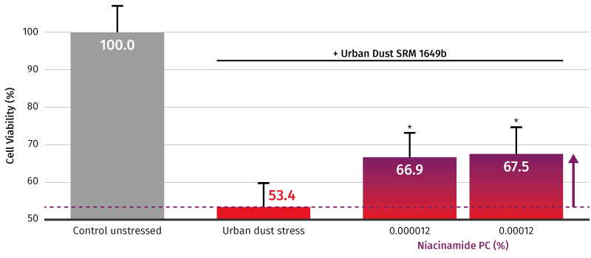
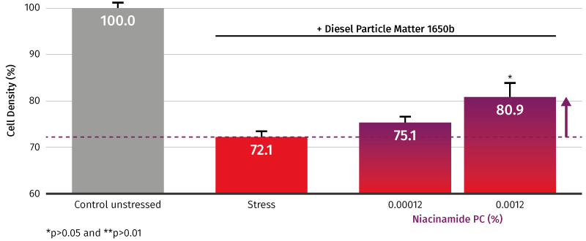
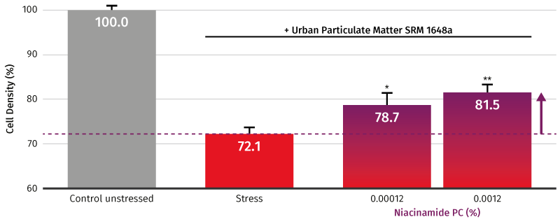

Niacinamide protective effect in presence of urban particulate matter
Pollution Protection Care
Niacinamide PC partially corrects cell viability even at very low concentrations
Notes:
To simulate urban particulate matter air pollutants we used the Standard Reference Material SRM1649b provided by the National Institute of Standards & Technology.
Preparation of PM Suspension
The particles were added into Dimethylsulfoxid (DMSO). Afterwards the suspension was vortexed rigorously and placed on a shaker for one hour. Finally the insoluble particulate material was sedimented by centrifugation. For the cell culture experiments we used the in DMSO soluble fraction.
Cell Culture
We used primary human epidermal keratinocytes obtained from CellNTec advanced Cell Systems. They were cultured in serum-free keratinocyte growth medium CnT-PR at 37°C in a humidified 5% CO2-air atmosphere. Cells were subcultured before reaching confluence.
Cell Viability Assay
For the evaluation of viable cells in culture we used the PrestoBlue Cell Viability Reagent from Thermo Fisher Scientific. PrestoBlue is a resazurin-based solution that turns red and highly fluorescent by the reducing power of living cells.
Briefly, cells were seeded into 96 well plates, pre-cultured for 24hrs and then pre-incubated with compounds for 24hrs before being exposed to pollution stress for 48hrs. Finally cell viability was assed using PrestoBlue cell viability reagent according to the manufacturer’s instruction.
Alternatively, the quantification was done with CyQuant which measures the amount of DNA present in the cell lysates. When cells duplicate, the amount of DNA is also duplicated.
Recommended use level based on extrapolation from the in vitro data: 0.1 to 1% Niacinamide PC

Slide 18
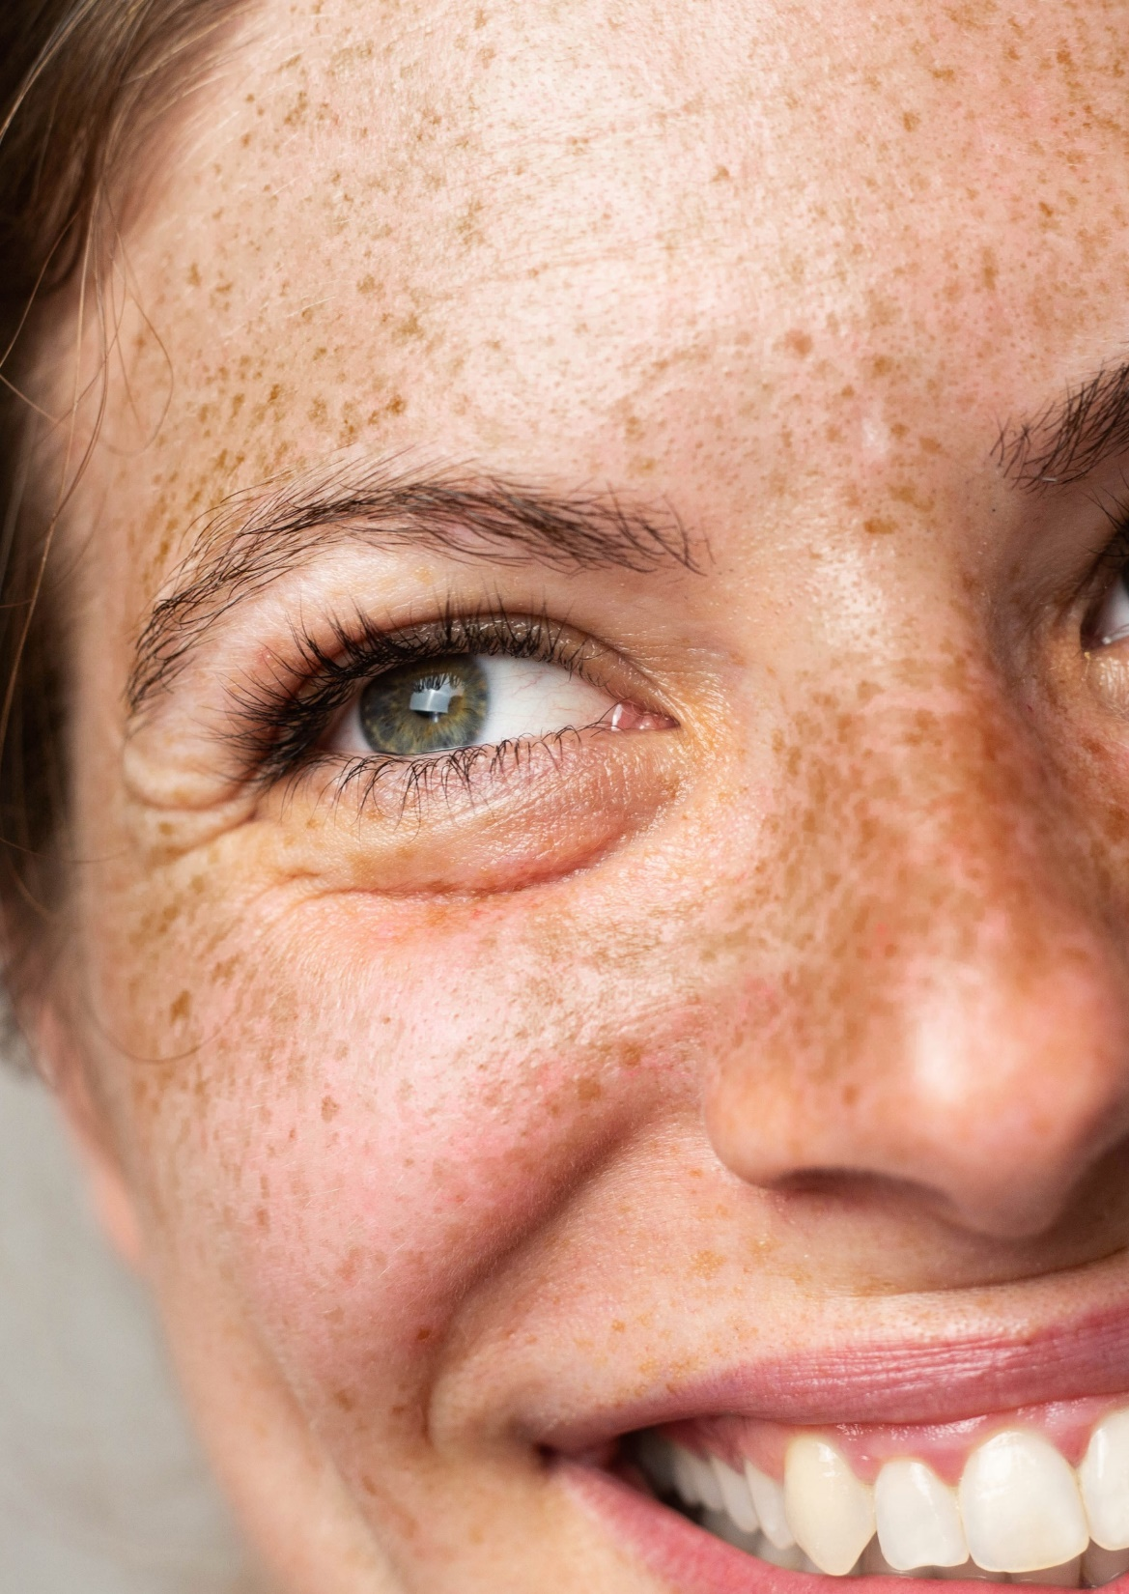
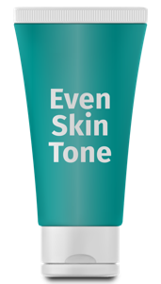
Skin Tone effects
Even skin tone care
Consumer level
Funcitonal level
Rebalances uneven
skin tone
Niacinamide prevents the pigments from surfacing on
the skin in vitro
Inhibition of melanosome transfer (up to 68%)
Reduces discoloration
Niacinamide reduces cutaneous pigmentation in 3D skin model
In clinical trials: Niacinamide shows significant skin lightening effects, as effective as hydroquinone with a safe mode of action
Niacinamide is safe and effective in helping even out skin tone

Slide 19
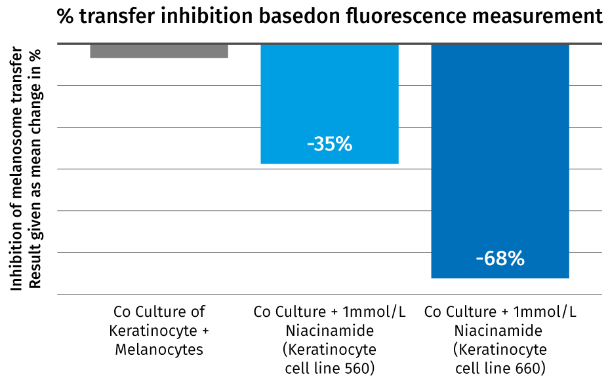

Niacinamide prevents pigments from surfacing on the skin
Even skin tone care
Even skin tone care
Co-cultures of fluorescence-labelled melanocytes/ melanosomes and keratinocytes were supplemented with niacinamide (1mmol/l).
After seven days fluorescence measurement of keratinocytes carrying.
melanosome specific label
+ keratinocyte specific label
Niacinamide inhibits the melanosomes transfer by up to 68% ⁽¹⁾
⁽¹⁾ Hakozaki et al, Br. J. Dermatol 2002;147, 20-31
Notes:
Hakokaki et al., “the effect of niacinamide on reducing cutaneous pigmentation and suppression of melanosome transfer” Br. J. Dermatol 2002;147, 20-31

Slide 20
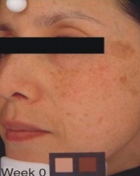
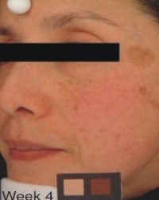
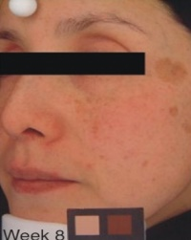
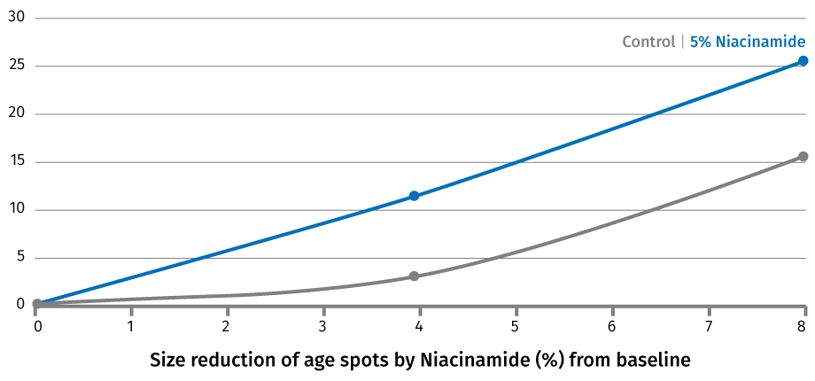
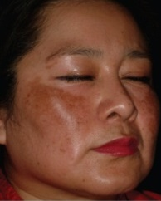
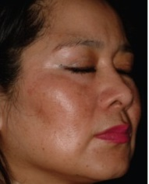
Niacinamide is safe and effective in helping even out skin tone
In vivo study
Even skin tone care
Niacinamide is an effective skin lightening compound showing in several high-quality clinical trials
effects at 2 and 5%, significant at 5%^{(1,2)}
4% niacinamide being as effective as 4% hydroquinone⁽³⁾
Niacinamide shows no side effect
5% Niacinamide at T0, 4 and 8 weeks
(2) Greatens et al. Experimental Dermatology 2005:14: 498-508
twice daily half face application for 8 weeks, 39 Japanese female, 28-54 years old
(1) Hakozaki et al Br. J. Dermatol 2002;147, 20-31
18 Japanese female – 25-60 years old with hyperpigmentation
*
*
* ^{p<0.05}
weeks
4% Niacinamide, melasma patients at week 0 (left) and week 8 (right)
(3) Navarrete-Solis J. et al, Dermatology Research and Practice, 2011
27 melasma patients with phototype IV-V – 25-53 years old, hemiface application – for 8 weeks
Notes:
Hazoki et al, the effect of niacinamide on reducing cutaneous pigmentation and suppression of melanosome transfer, figure 4
Image analysis results for the percentage change from baseline in total area of hyperpigmemtation for 5% niacinamide and vehicule control treatment.
In this study facial hyperpigmentation (total area) on each side of the face were objectively measured using image analysis technique. Images of the right and left sides of each subject’s face were captured at baseline, during the 8 weeks by a high resolution analogue camera equipped with a polarizing lens.
On a calibrated video monitor, paired pre-treatment and post-treatment images are viewed side by side. Seven judges view pairs of images for each subject. The judges are blind to which image is pre or post-treatment and to the type of treatment.
Study involving a total of 138 Japanese women in a split face trial.
Navarrete-Solis et al, randomized, double blind, split face, 27 volunteers (25-53 years), 8 weeks

Slide 21
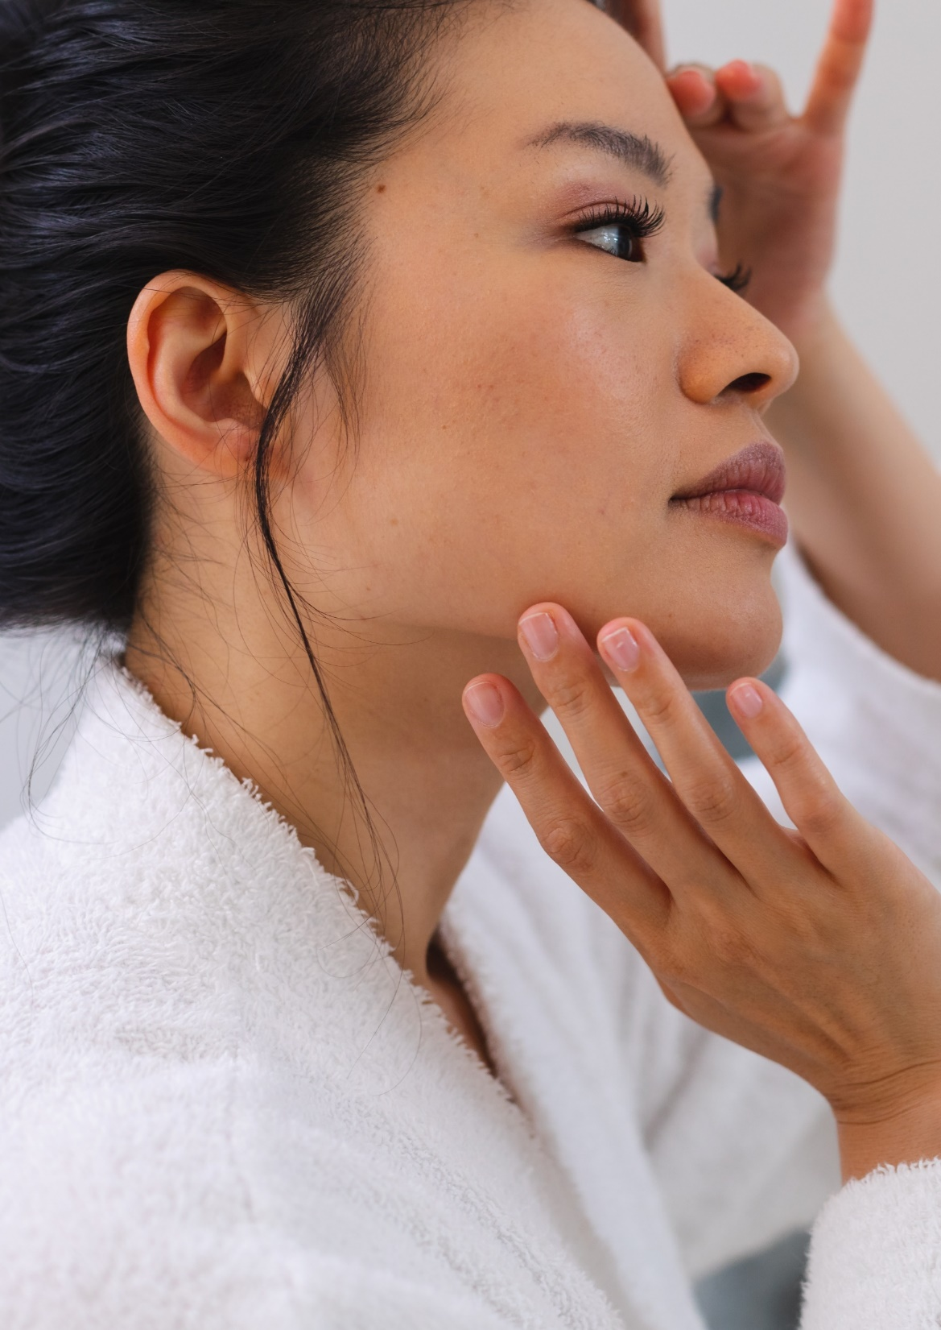

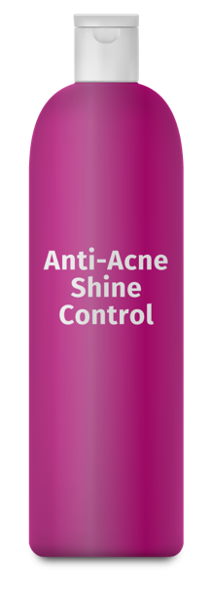
Blemish Care
Blemish Care
Consumer level
Funcitonal level
Blemish-free, shine-free refined skin appearance
Niacinamide reduces acne condition, including reduced severity (grade, -52% in vivo) and reduced lesions (number of papules, pustules: up to -73% in vivo)
Niacinamide shows trend of reduced sebum formation and excretion (-23% in vivo)

Slide 22
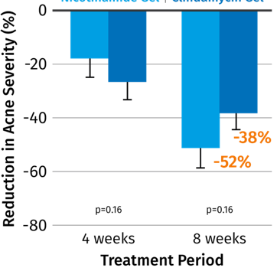
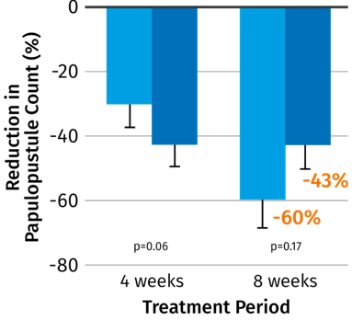
Results of several clinical trials with 4% niacinamide vs 1% clindamycin
In vivo study
Blemish Care
Acne severity grading
Number of Pustules/papules
Acne grading | 4% Niacinamide |  | 1% Clindamycin
T0 | 5.93 |  | 5.7
T4 weeks | 4.03** | -32% | 3.85** | -32%
T8 weeks | 2.08** | -65% | 2.03** | -64%
Number of papules/pustules
T0 | 88.0 |  | 88.2
T4 weeks | 49.6** | -44% | 48.6** | -45%
T8 weeks | 24.4*** | -73% | 22.5*** | -74%
4%
80 volunteers with moderate inflammatory acne vulgaris for 8 weeks. Cook’s acne grading from 0 to 8²
76 men and women (aged 13-35) with moderate inflammatory acne vulgaris for 8 weeks. Measurement by dermatologist (acne severity according to modified Cook grading by Allen and Smith)¹
Niacinamide just as effective as clindamycin, but without side effect
¹Shalita et al, International Journal of Dermatology, 1995, 34 (6):434-437
² Khodaeianii et al, International Journal of Dermatology 2013, 52:999-1004;
Notes:
Shalita et al
Test conducted with 76 men and women (age 13 to 35 years old) with moderate inflammatory acne vulgaris for 8 weeks twice daily (n=38 1% clindamycin, n=38 4% niacinamide. Moderate inflammatory acne is defined by the presence of at least 15 papules/pustules on the face.
Both treatments produced statistically similar reductions in acne lesions (papules/pustules -60% for niacinamide versus -43% for clindamycin) and acne severity (-52% for niacinamide group versus -38% for clindamycin)
Fouladi et al
Randomized, double blind, full face, twice daily, 80 volunteers (40X niacinamide, 40X clindamycin) subjects with moderate inflammatory acne vulgaris –AV-, grade III), 8 weeks
Cook’s acne grading: 0 (3 small comedones/papules) to 8: highly inflammatory acne covering most of the afce
The efﬁcacies of 4% nicotinamide and 1% clindamycin gels are comparable in treating moderate inﬂammatory facial acne vulgaris. However, nicotinamide is preferred in oily and clindamycin in non-oily skin because of better function and outcome.
Kaymak et al
38 volunteers, 18-25 years with mild to moderate Acne vulgaris, 8 weeks, 4% niacinamide
Decrease in the number of pustules, comedones and papules was statistically significant at the end of the treatment compared to onset of treatment (p<0.05)

Slide 23
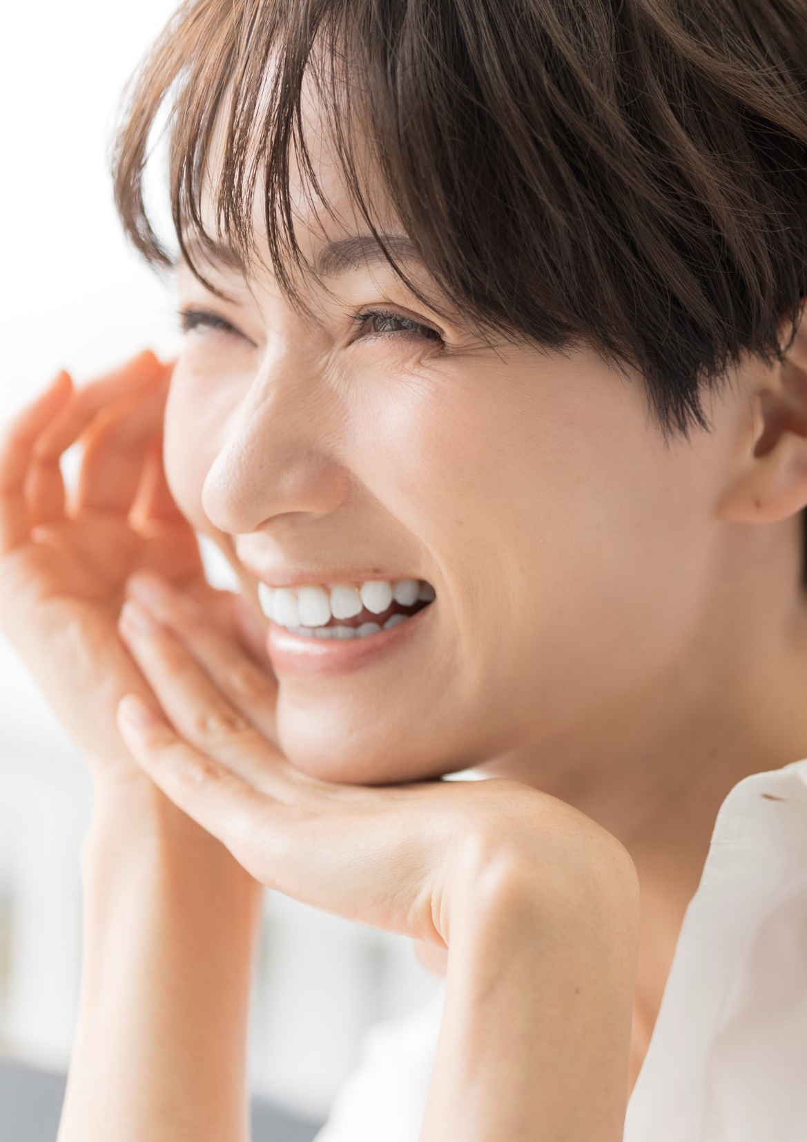
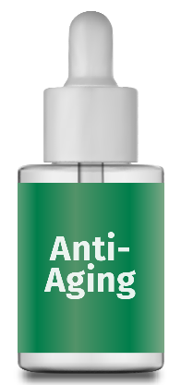
Anti-aging effects
Anti-aging care
Consumer level
Funcitonal level
Reduces the appearance of lines and wrinkles
Exposure to sun light prematurely ages our skin. Niacinamide is the ideal candidate for day care and sun care products as it:
Stimulates
collagen synthesis (+54% in vitro)
Improves the appearance
of lines and wrinkles
Improves the elasticity
of the skin

Slide 24
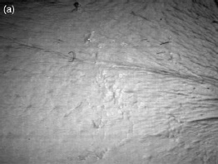
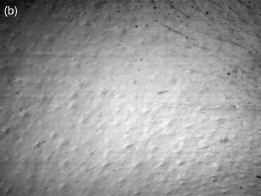
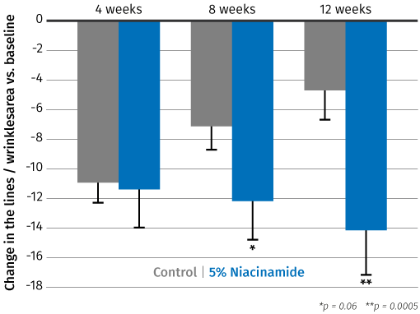
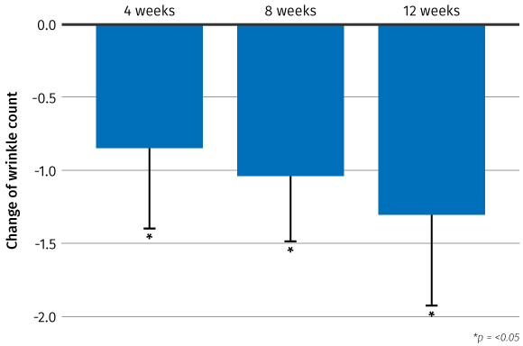
Niacinamide improves the appearance of lines and wrinkles in any skin ethnicity
In vivo study
Anti-aging care
Significant wrinkles decrease
in eye area
Significant reduction of
fine lines
Significant wrinkle
reducing effects
Japanese female volunteer
Caucasian female volunteer
Taiwanese female volunteer
Skin replica in a 44-year-old woman (a) before and (b) 8 Weeks after application of 4% Niacinamide preparation.
Significant reduction of wrinkle grades (p<0.001) after 4 and 8 weeks
Treatment with 5% Niacinamide shows significant improvement in fine lines and wrinkles following both 8 and 12 weeks of treatment.
Significant decrease (-51.6%) of wrinkle count with 4% Niacinamide after 12 weeks vs baseline.
29 Japanese female volunteer, ages 31-49, split face application,
Kawada et al., journal of Dermatology, 2008, 35:637-642
49 Caucasian female volunteer, ages 40-60, split face, for 3 months
Bissett et al., International Journal Cosmetic Science, 2004, 26:231-238
25 Taiwanese female volunteer, ages 43.4±8.3, splitface application, Visia complexion analysis system
Chiu et al., journal of cosmetic dermatology, 2007, 6:243-249

Slide 25

Niacinamide PC– For resilient, flawless skin and a radiant complexion
CORNEOCARE® - Skin Resilience
Strengthens skin barrier, stimulates ceramides and lipids in stratum corneum
Reduction of water loss
Increasing key proteins involved in skin barrier: involucrin, filaggrin, keratin
Anti-aging activities
Stimulates collagen synthesis
Improves the appearance of lines and wrinkles
Improves the elasticity of skin
CORNEOCARE®
SKIN RESILIENCE
ANTI-AGING
ACTIVITIES
Even skin tone
Inhibition of melanosome transfer
Reduces cutaneous pigmentation
Rebalances uneven skin tone
Blemish Care
Reduces the appearance of acne
Reduces skin lesions: number of papules and pustules
Helps to reduce sebum level
EVEN
SKIN TONE
BLEMISH
CARE
Environmental stress protection
Protects and repairs from environmental damage for beautiful and healthy skin
Boost cell energy production and repair (UV induced DNA damage)
Protection from urban pollutants damage
UV and Blue light protection
Helps to relieve premature aging from UV and Blue light
Reduces oxidative stress and skin discoloration from blue light exposure
ENVIRONMENTAL
STRESS PROTECTION
UV AND
BLUE LIGHT PROTECTION

Slide 26

Formulating with Niacinamide PC
Niacinamide PC is very stable (air, heat, light)
and easy to formulate with.
Highly soluble in water and alcohol and soluble
in glycerol.
Niacinamide PC shows a very good compatibility
with all groups of cosmetic ingredients
Recommended pH of the final formulation:
4.0 – 8.0
Niacinamide PC can be processed either cold or hot at temperatures up to 70°C . Generally added in the aqueous phase of a cosmetic formulation
Recommended use level: max 10%
Caution:
    Niacinamide PC is incompatible with strong acids and bases and oxidizing agents which may cause hydrolysis to nicotinic acid.
    It is important to not use ingredients containing enzymes such as amidases to avoid biological hydrolysis of niacinamide to nicotinic acid
Notes:
But due to its excellent solubility in water it can even be added to the final O/W formulation. With W/O formulations the incorporation of Niacinamide PC into the water phase is highly recommended.

Slide 27




Niacinamide PC
Regulatory status
Global status: Niacinamide PC can be used in all countries for any kind of cosmetic products
China status: Full chemical and cosmetic registration
Chemical notification
Chinese INCI name
IECIC listed
Allows development of global products

Slide 30

Hero Vitamins to nourish skin beauty
& keep skin defenses robust!
Energize
Fight stress
Please note
When translating the literature or scientific support into marketing claims, there are regulatory limitations in claiming “immunity”.
It’s recommended using consumer-friendly expressions,
as for example
“strengthening skin defenses”
Vitamin C
Energizes tired skin, leaving it fresher and revived
Protects against UV/ozone- induced oxidative damage
Fights photoaging
Collagen booster
Ensures resilient immune function
Vitamin B3
Protects from external stressors (UV, blue light & pollution)
Rebalances even skin tone
Moisturizes and improves skin elasticity
Boosts skin immunity
Antioxidant & protect
Moisture & restore
Vitamin E
The preventer, protects the skin against oxidative stress, for comfortable, beautiful and healthy-looking skin
Ideal partner for vitamin C
Panthenol
(Pro Vitamin B5)
Strong skin moisturizer
Soothes irritated skin
Helps protect and regenerate compromised skin
Rejuvenates the skin
Tightens the skin barrier against external insults
A. Carr and S. Maggini Vitamin C and Immune Function, 2017 (for vitC)
Oblong J. 2014 DNA Repair 23, 59-63 (for B3)
Yuen and Halliday Photochemistry and Photobiology, 1997, 65(3) p587-592 (for vitE)
Stettler et al. 2016 J. of Dermatol. Treatment (for Panthenol)
Notes:
Based on what we discussed so far, we decided to focus on 4 hero vitamins (Vit C, B3, E, B5): the recipe to nourish skin and keep its defences robust.
They are recognize to support skin immune function and ultimately to improve skin appearance.
Important to highlight that when we translate the literature into mktg claim, we have regulatory limitations in claiming “immunity”, but we can translate the concept into “strengthen skin defences” which at the end is also a very consumer friendly language

