Slide 1



Niacinamide PC for a new wave of beauty
April 2025

Slide 2


Niacinamide PC for
a new wave of beauty
Aging brings its own set of challenges, but it also has the power to unlock new opportunities for a more fulfilling life. Embrace the beauty of maturity with NIAWAVE.
NIAWAVE is a skincare line crafted to cater your skin's evolving needs and to honour your powerful beauty.
Recent scientific studies on pre and post-menopausal skin highlight the pivotal role of Niacinamide PC in addressing menopausal skin changes. This potent ingredient helps prevent photoaging, boosts collagen production, reduces inflammation, and minimizes sensitivity to daily stressors, promoting healthy aging.
For skin that is stronger, more resilient,
and radiant, just like you.

Slide 3
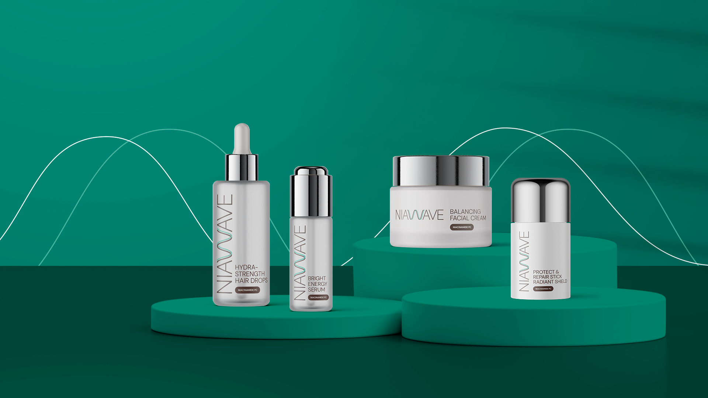
Niacinamide PC for
a new wave of beauty
Products are for illustration only, not for sale.
dsm-firmenich is not responsible for final product claims.

Slide 4

Niacinamide PC for
a new wave of beauty
BRIGHT ENERGY SERUM
With a powerful combination of Niacinamide PC and vitamins B5, C, and E, our facial serum is perfect for maintaining radiant, even-toned skin at every stage of life. It helps control hyperpigmentation, energizes the skin, and restores its glow and vitality during the challenges of menopause. Plus, it reduces signs of aging, helping you look youthful and face hormonal changes with greater confidence.
Products are for illustration only, not for sale.
dsm-firmenich is not responsible for final product claims.

Slide 5



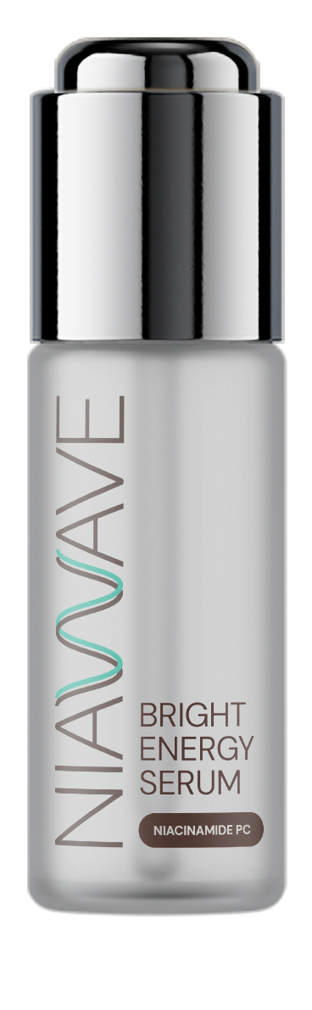

BRIGHT ENERGY SERUM
93,41% Natural Origin content according to ISO 16128
PHASE | INGREDIENTS | INCI NAME | % W / W
A | Water Dem | AQUA | 59,00
 | STAY-C® 50 | SODIUM ASCORBYL PHOSPHATE | 3,00
 | Niacinamide PC | NIACINAMIDE | 3,00
 | SODIUM METABISULFITE | SODIUM METABISULFITE | 0,10
 | D-PANTHENOL | PANTHENOL | 1,00
 | Edeta® BD | DISODIUM EDTA | 0,10
B | Glycerin 99.5% | GLYCERIN | 5,00
 | Propanediol | PROPANEDIOL | 25,00
 | HYA-ACT™ M | SODIUM HYALURONATE | 0,20
C | DL-alpha-Tocopheryl Acetate | TOCOPHERYL ACETATE | 0,10
 | Focusguard PE 9010 | PHENOXYETHANOL, ETHYLHEXYLGLYCERIN | 0,60
 | PEG-40 HYDROGENATED CASTOR OIL | PEG-40 HYDROGENATED CASTOR OIL | 1,20
 | RB-211127 Facial 2 | PARFUM | 0,50
D | Citric Acid 25% solution | AQUA, CITRIC ACID | 1,20
^{SK-E-103204-1}
^{PROCEDURE:}
1 | Prepare Phase A and stir until it's homogenous.
2 | Add Phase B under stirring, until it's homogenous.
3 | Add Phase C as a premix and homogenize under stirring.
4 | Adjust pH with Phase C
^{TECHNICAL DATA:}
pH: | 7,3 | Viscosity: | < 100 mPa.s
Technical Specificity: Opalescent
The information provided herein is provided for information purposes only and has been prepared by dsm-firmenich in accordance with its own methodology. dsm-firmenich has used diligent care to ensure that it is accurate and up to date, however, dsm-firmenich makes no representation or warranty, either expressly or implied, of the accuracy, reliability, or completeness thereof. In no event shall dsm-firmenich be liable for any damages arising from or reliance upon, or use of, any information provided herein. Further, dsm-firmenich shall not bear any liability for the application and/or use of any processed material containing its product(s). The formulation of the finished product is the customer’s sole responsibility. It is the customer’s responsibility to determine the suitability of dsm-firmenich’s products regarding user specific purposes, assess compatibility and stability of their finished product(s) and to ensure compliance of their finished product(s) with relevant laws and regulations. Any product, marketing or other claims made by customer are its sole responsibility. The content of this document is subject to change without further notice. Please contact your local dsm-firmenich representative for further details. © DSM Nutritional Products AG, 2024
The formulation fulfils the 3 months stability at 4°C, room temperature, 40°C

Slide 6

Niacinamide PC for
a new wave of beauty
BALANCING FACIAL CREAM
Our facial cream is your perfect partner for your skincare routine during menopause! With Niacinamide PC and vitamins B5, B6, and B12, it restores ceramide balance, strengthens the skin’s barrier, and delivers deep hydration. It also stimulates collagen production, while smoothing out fine lines and wrinkles, combating dryness and sensitivity that often accompany this life stage. Best of all, it protects against environmental stress and hormonal changes, leaving you looking radiant and full of vitality.
Products are for illustration only, not for sale.
dsm-firmenich is not responsible for final product claims.

Slide 7
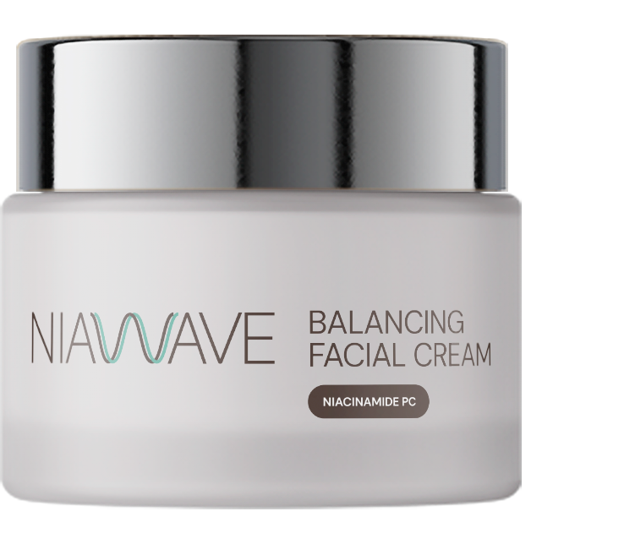
BALANCING FACIAL CREAM
PHASE | INGREDIENTS | INCI NAME | % W / W
A | Water Dem | AQUA | 78,49
 | Ecogel™ | LYSOLECITHIN, SCLEROTIUM GUM, PULLULAN, XANTHAN GUM | 2,50
 | Propanediol | PROPANEDIOL | 3,00
 | Dermosoft® Octiol | CAPRYLYL GLYCOL | 0,20
 | Cosphaderm® Pentiol natural | PENTYLENE GLYCOL | 3,00
B | Myritol® 318 | CAPRYLIC/CAPRIC TRIGLYCERIDE | 5,00
 | Perfume Fleur de peau RS90514 | PARFUM | 0,15
C | VALVANCE® Touch 210 | SILICA | 1,00
D | Niacinamide PC | NIACINAMIDE | 4,00
 | D-Panthenol 75 L | PANTHENOL, AQUA | 2,00
 | PYRIDOXINE HYDROCHLORIDE (VITAMIN B6) | PYRIDOXINE HCL | 0,20
 | Vitamin B12 Cryst Food Grade | CYANOCOBALAMIN | 0,01
E | Sodium Hydroxide 10% Solution | AQUA, SODIUM HYDROXIDE | 0,45
^{SK-E-103205-1}
^{PROCEDURE:}
1 | Prepare Phase A and heat up to 75°C-80°C under stirring for 30 min.
2 | Prepare Phase B under stirring.
3 | Add Phase B into Phase A under stirring.
4 | Add Phase C into Phase A+B and homogenize at 18000 rpm for 2 min.
5 | Cool down to 35°C under stirring.
6 | Add ingredients of Phase D one by one into the emulsion under stirring.
7 | Adjust pH to 7 with Phase E.
The information provided herein is provided for information purposes only and has been prepared by dsm-firmenich in accordance with its own methodology. dsm-firmenich has used diligent care to ensure that it is accurate and up to date, however, dsm-firmenich makes no representation or warranty, either expressly or implied, of the accuracy, reliability, or completeness thereof. In no event shall dsm-firmenich be liable for any damages arising from or reliance upon, or use of, any information provided herein. Further, dsm-firmenich shall not bear any liability for the application and/or use of any processed material containing its product(s). The formulation of the finished product is the customer’s sole responsibility. It is the customer’s responsibility to determine the suitability of dsm-firmenich’s products regarding user specific purposes, assess compatibility and stability of their finished product(s) and to ensure compliance of their finished product(s) with relevant laws and regulations. Any product, marketing or other claims made by customer are its sole responsibility. The content of this document is subject to change without further notice. Please contact your local dsm-firmenich representative for further details. © DSM Nutritional Products AG, 2024
^{TECHNICAL DATA:}
pH: | 7,2 | Viscosity (spindle RV-4 / 10 rpm): | 8640 mPa.s
Technical Specificity: Opaque
The formulation fulfils the 3 months stability at 4°C, room temperature, 40°C, 50°C and daylight

Slide 8

Niacinamide PC for
a new wave of beauty
PROTECT & REPAIR STICK RADIANT SHIELD
Looking for an easier way to protect your skin from daily sun damage? Check out our powerful stick! Enriched with Niacinamide PC (2.5%),
it offers superior UV protection with the super trio of PARSOL® UV filters while boosting your skin’s natural repair against sun damage. It prevents photoaging and leaves your skin healthy and glowing like the sun itself!
Products are for illustration only, not for sale.
dsm-firmenich is not responsible for final product claims.

Slide 9
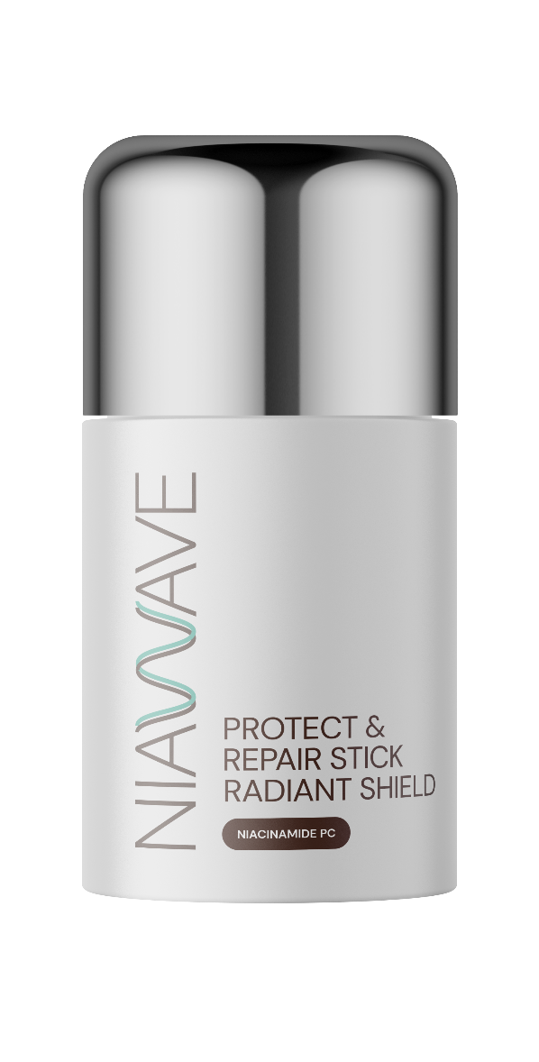
PROTECT & REPAIR STICK RADIANT SHIELD
PHASE | INGREDIENTS | INCI NAME | % W / W
A | UVAsorb HEB | DIETHYLHEXYL BUTAMIDO TRIAZONE | 3,00
 | Cetiol® B | DIBUTYL ADIPATE | 10,00
B | PARSOL® DHHB | DIETHYLAMINO HYDROXYBENZOYL HEXYL BENZOATE | 9,50
 | PARSOL® EHT | ETHYLHEXYL TRIAZONE | 2,50
 | PARSOL® Shield | BIS-ETHYLHEXYLOXYPHENOL METHOXYPHENYL TRIAZINE | 5,00
 | Finsolv® TN | C12-15 ALKYL BENZOATE | 15,00
 | Cetiol® CC | DICAPRYLYL CARBONATE, TOCOPHEROL | 10,00
 | Eutanol® G 16 | HEXYLDECANOL | 9,70
 | KahlWax 2811 Rice | ORYZA SATIVA BRAN CERA | 9,50
 | KahlWax 2225 Phyto | HELIANTHUS ANNUUS SEED CERA, OLEA EUROPAEA OIL UNSAPONIFIABLES, RHUS VERNICIFLUA PEEL CERA, SHOREA ROBUSTA RESIN | 5,00
 | KahlWax 6642 Organic Carnauba | COPERNICIA CERIFERA CERA | 3,50
 | antaron™ soja glyceride | MALEATED SOYBEAN OIL GLYCERYL/OCTYLDODECANOL ESTERS | 2,00
 | Mixed Tocopherols 95 | TOCOPHEROL | 0,20
 | DL-alpha-Tocopheryl Acetate | TOCOPHERYL ACETATE | 0,50
 | Eldew SL-205 | ISOPROPYL LAUROYL SARCOSINATE | 2,40
C | Niacinamide PC | NIACINAMIDE | 2,50
 | Water Dem | AQUA | 4,99
 | Vitamin B12 cryst Food Grade | CYANOCOBALAMIN | 0,01
 | SODIUM GLUCONATE GRANULAR | SODIUM GLUCONATE | 0,40
D | ACTICIRE MB | JOJOBA ESTERS, ACACIA DECURRENS FLOWER CERA, HELIANTHUS ANNUUS SEED CERA, POLYGLYCERIN-3 | 4,00
 | GLACIAL CASCADE CHBG-2587/15 | PARFUM, CITRONELLOL, HEXYL CINNAMAL | 0,30
^{SU-E-103209-1}
^{PROCEDURE:}
^{TECHNICAL DATA:}
1 |  | Prepare Phase A and heat up to 90°C under stirring until homogeneous.
2 |  | Prepare Phase B and add it to Phase A.
3 |  | Heat Phase A+B to 90°C under stirring until homogeneous.
4 |  | Prepare Phase C and heat up to 60°C under stirring until homogeneous.
5 |  | Prepare Phase D and add it into Phase C under stirring until homogeneous.
6 |  | Cool down Phase A+B to 80°C.
7 |  | Add Phase C+D into Phase A+B under stirring.
8 |  | Cool down to 75°C.
9 |  | Pour into the mold.
pH: | 7,2
Viscosity : | Solid
Technical Specificities: | Stick, Opaque
SPF: | 64,8 | In vitro UVA-PF: | 21,4
In vivo according to ISO 24444 |  | According to ISO 24443
UVA-PF/SPF: (60 labelled; >= 0.33) | 0,35 | Critical Wavelength: (Measurement done with Labsphere equipment) | 373 nm
The information provided herein is provided for information purposes only and has been prepared by dsm-firmenich in accordance with its own methodology. dsm-firmenich has used diligent care to ensure that it is accurate and up to date, however, dsm-firmenich makes no representation or warranty, either expressly or implied, of the accuracy, reliability, or completeness thereof. In no event shall dsm-firmenich be liable for any damages arising from or reliance upon, or use of, any information provided herein. Further, dsm-firmenich shall not bear any liability for the application and/or use of any processed material containing its product(s). The formulation of the finished product is the customer’s sole responsibility. It is the customer’s responsibility to determine the suitability of dsm-firmenich’s products regarding user specific purposes, assess compatibility and stability of their finished product(s) and to ensure compliance of their finished product(s) with relevant laws and regulations. Any product, marketing or other claims made by customer are its sole responsibility. The content of this document is subject to change without further notice. Please contact your local dsm-firmenich representative for further details. © DSM Nutritional Products AG, 2024
The formulation fulfils the 2 weeks stability at 50°C and the 3 months stability at 4°C, room
temperature, 40°C. Regulatory compliance in EU, MERCOSUR, ASEAN, CN, KR, AUS for UV filters in formulation.

Slide 10

Niacinamide PC for
a new wave of beauty
HYDRASTRENGTH HAIR DROPS
A few drops, many benefits! This advanced formula hair serum combines the power of Niacinamide PC (0.5%) with other ingredients to provide complete and sophisticated care for menopausal women’s hair and scalp. It boosts thickness, volume, and strength while keeping the scalp hydrated, leaving your hair healthier, stronger, and full of vitality.
Products are for illustration only, not for sale.
dsm-firmenich is not responsible for final product claims.

Slide 11
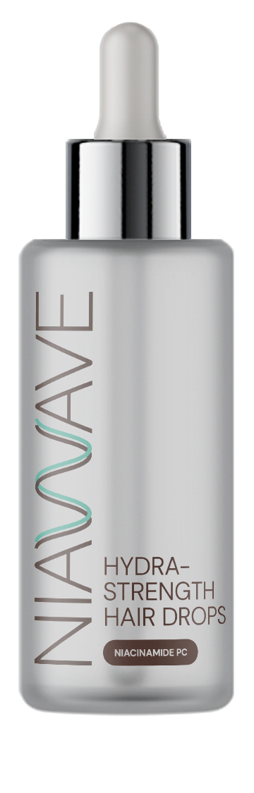
HYDRASTRENGTH HAIR DROPS
98.80% Natural Origin content according to ISO 16128
PHASE | INGREDIENTS | INCI NAME | % W / W
A | Water Dem | AQUA | 77,16
 | Natrosol 250 HR PC | HYDROXYETHYLCELLULOSE | 1,00
B | D-Biotin | BIOTIN | 0,02
 | PENTAVITIN® | SACCHARIDE ISOMERATE, AQUA, CITRIC ACID, SODIUM CITRATE | 0,80
 | Niacinamide PC | NIACINAMIDE | 0,50
 | SODIUM GLUCONATE GRANULAR | SODIUM GLUCONATE | 0,20
 | ALPAFLOR® EDELWEISS CB | LEONTOPODIUM ALPINUM FLOWER/LEAF EXTRACT, GLYCERIN, AQUA, CITRIC ACID | 1,00
 | Vitamin B12 cryst Food Grade | CYANOCOBALAMIN | 0,02
 | ALPAFLOR® ALP-SEBUM CB | EPILOBIUM FLEISCHERI FLOWER / LEAF / STEM EXTRACT, GLYCERIN, AQUA, CITRIC ACID | 1,50
 | Propanediol | PROPANEDIOL | 5,00
C | ALCOHOL DENAT. | ALCOHOL DENAT. | 12,00
 | U Locks P01B839 | PARFUM, COUMARIN, HEXYL CINNAMAL, BENZYL SALICYLATE, D-LIMONENE, ALPHA-ISOMETHYL IONONE, HYDROXYCITRONELLAL | 0,40
 | ARGAN OIL | ARGANIA SPINOSA KERNEL OIL | 0,10
 | Dermosoft Hexiol | 1,2-HEXANEDIOL | 0,30
^{HC-E-102436-15}
^{PROCEDURE:}
1 | Prepare Phase A by adding ingredients in water and stir until a homogeneous solution is obtained.
2 | Prepare ingredients of Phase B and slowly pour into Phase A under stirring.
3 | Prepare ingredients of Phase C one by one and add into Phase A+B under stirring.
The information provided herein is provided for information purposes only and has been prepared by dsm-firmenich in accordance with its own methodology. dsm-firmenich has used diligent care to ensure that it is accurate and up to date, however, dsm-firmenich makes no representation or warranty, either expressly or implied, of the accuracy, reliability, or completeness thereof. In no event shall dsm-firmenich be liable for any damages arising from or reliance upon, or use of, any information provided herein. Further, dsm-firmenich shall not bear any liability for the application and/or use of any processed material containing its product(s). The formulation of the finished product is the customer’s sole responsibility. It is the customer’s responsibility to determine the suitability of dsm-firmenich’s products regarding user specific purposes, assess compatibility and stability of their finished product(s) and to ensure compliance of their finished product(s) with relevant laws and regulations. Any product, marketing or other claims made by customer are its sole responsibility. The content of this document is subject to change without further notice. Please contact your local dsm-firmenich representative for further details. © DSM Nutritional Products AG, 2024
^{TECHNICAL DATA:}
pH: | 4.9 | Viscosity (HR-10/ plate 40mm/ shear rate 1/s): | 1200 mPa.s
Technical Specificity: Opalescent
The formulation fulfils the 3 months stability at 4°C, room temperature, 40°C

Slide 12

Niacinamide PC for a new wave of beauty

