Slide 1


RETINOL CB 50
New grade of Retinol formulated with natural origin compounds
August, 2023

Slide 2











RETINOL CB 50: the all-time Hero in Anti-Ageing!
ID Card: 5017297
INCI NAME
(active)
Retinol
Technology
RETINOL CB 50 is made from retinyl acetate by hydrolysis, followed by a dissolution into a mixture of undecane and tridecane from natural origin
Reduces skin photodamage
Improves the appearance of fine lines & wrinkles
Improves skin firmness, smoothness & elasticity
Rebalances uneven skin tone
KEY
BENEFITS
TECHNICAL
Form: Liquid
Use level: 0.1–0.6%
Solubility: oil and fat soluble
Naturality: 53.9% natural origin according to ISO 16128
pH of use: 4.5 - 8
REGISTRATION
CERTIFICATION
Patent
2

Slide 3


RETINOL CB 50 vs
RETINOL GS 50 - Comparison

Slide 4

From RETINOL GS 50 to RETINOL CB 50
RETINOL GS 50 | RETINOL CB 50
Retinol | Retinol
Polysorbate 20 | Undecane and Tridecane, 100% from natural origin (from coconut oil or RSPO Palm kernel oil)
BHA | Tocopherols (100% from natural origin, extraction and distillation of soybean oil)
BHT | n/a
RETINOL CB 50 has exactly the same retinol content and quality as RETINOL GS 50. Only the formulation differs with the replacement of polysorbate 20 by alkanes of natural origin and the replacement of BHA and BHT by natural mixed tocopherols.

Slide 5
Specifications
 |  | RETINOL GS 50 (5015117) | RETINOL CB 50 (5017297)
Appearance | Colour | yellow liquid | yellow to slight orange liquid
Assay | All trans Retinol % (m/m) | 42.75 – 49.50 | 42.75 – 49.50
 | Tocopherol % (m/m) | n/a | 0.4 – 1.0
 | BHA % (m/m) | 0.90 – 1.10 | n/a
 | BHT % (m/m) | 3.15 – 3.50 | n/a
Purity | Trans-Retinol in total Retinol % (a/a) | min. 95 | min. 95
 | Cis-Retinol in total Retinol % (a/a) | max. 5 | max. 5

Slide 6
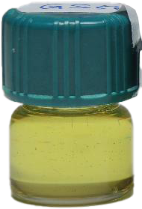
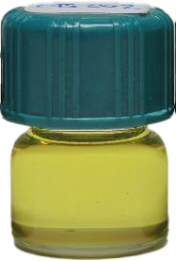
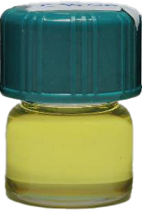
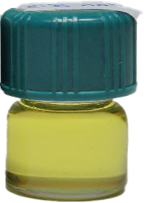
Appearance
 | RETINOL GS 50 | RETINOL CB 50 | RETINOL CB 50 | RETINOL CB 50
Lot number | SI2201K015 | UT22060002 | UT22060003 | UT22060004
Retinol content | 46.71% (w/w) | 48.76% (w/w) | 46.45% (w/w) | 47.75% (w/w)
Visual apect
RETINOL CB 50 has a comparable aspect as RETINOL GS 50.

Slide 7
Stability
Retention of Retinol Initial value (%), stored in aluminum
bottle sealed under Argon after 3 months*
 | Lots | 15°C | 25°C
RETINOL CB 50 | UT22060002 | 98.3 | 93.3
 | UT22060003 | 97.6 | 93.0
 | UT22060004 | 97.2 | 93.1
RETINOL GS 50 | SI13040003 | 94.9 | 99.5
 | SI13040004 | 100.7 | 96.9
 | SI13040005 | 97.3 | 96.3
RETINOL CB 50 shows comparable stability at 15°C and 25°C
after 3 months vs RETINOL GS 50
* Stability study still on going

Slide 8
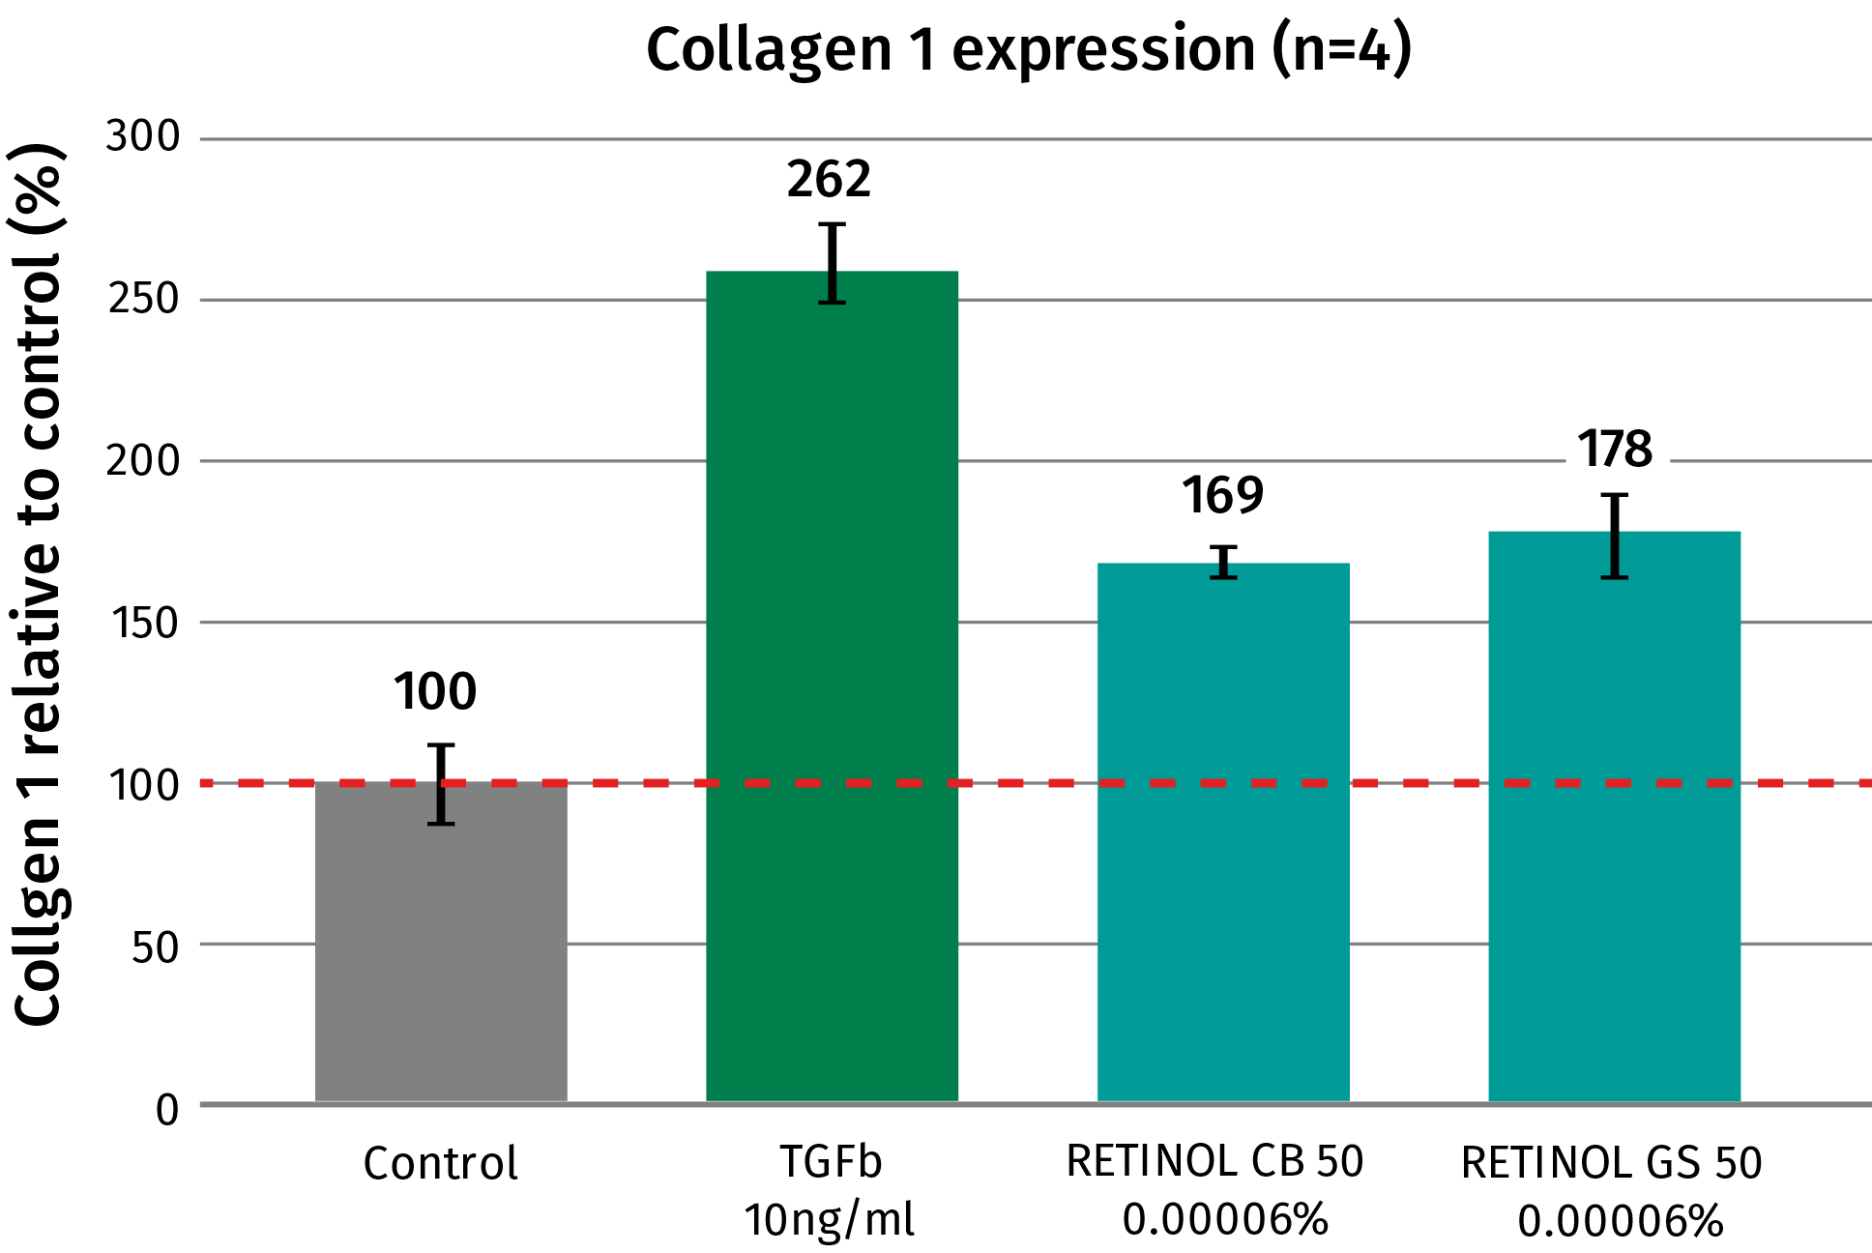
Collagen expression in vitro
Same performance with RETINOL CB 50 and RETINOL GS 50 as expected
Retinol co-culture assay with HPEK and HDF
The cells are treated with starvation media and the actives are added for 72 hours.
TGF ß is used as a positive control.
The cells are stained and measured via
flow cytometry.
RETINOL CB 50 shows comparable collagen I expression as RETINOL GS 50 in vitro, around +70% vs Control at 0.00006%
8

Slide 9

Formulation

Slide 10
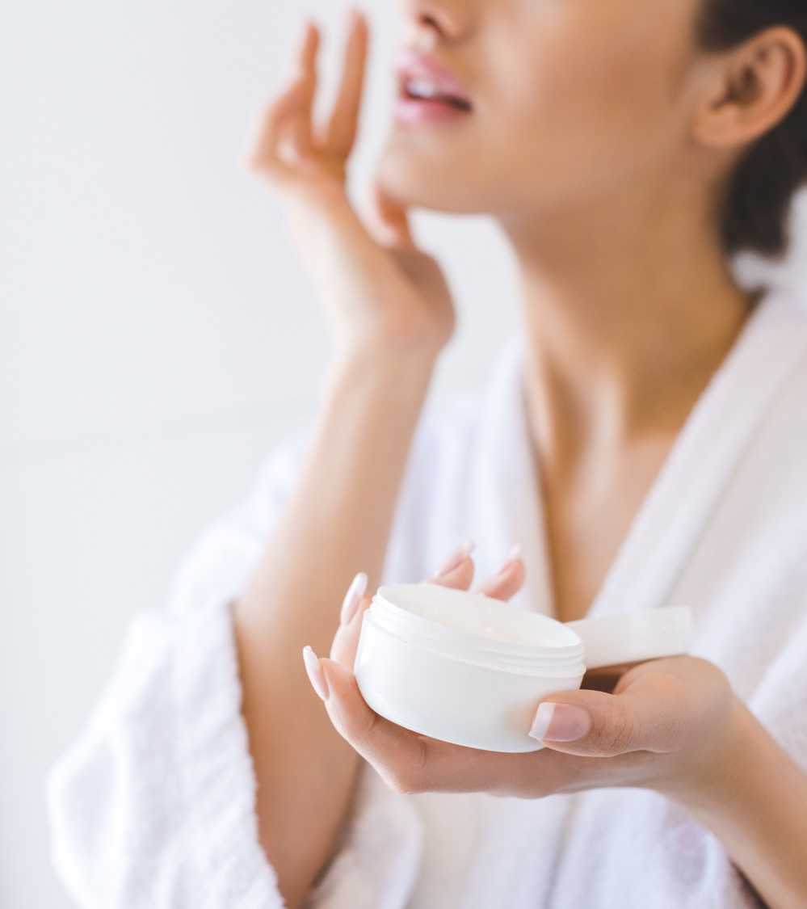
Formulation Tips
RETINOL CB 50
RETINOL CB 50 is soluble in fats and oils
Sensitive to Oxygen. It is therefore recommended to manufacture retinol formulations under an inert atmosphere or to reduce the presence of Oxygen during handling and production to the possible minimum.
Sensitive to higher temperatures (> 40°C) and daylight.
To improve the stability of RETINOL CB 50 in the formulation it is recommended to add chelating agents like EDTA, UV absorbers like PARSOL® Guard* and antioxidants like Mixed Tocopherols or STAY-C® 50.
STAY-C® 50 has recently shown high performance to recover retinol content at room temperature and 40 °C. Be aware, that it is a salt and may impact the stability of electrolytes sensitive systems.
Recommended pH of the final formulation: 4.5 – 8.0
*INCI Name: Octocrylene (and) Homosalate (and) Butyl Methoxydibenzoylmethane (and) Tocopherol (and) Helianthus Annuus (Sunflower) Seed Oil
10

Slide 11
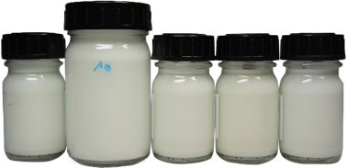
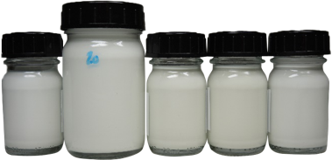
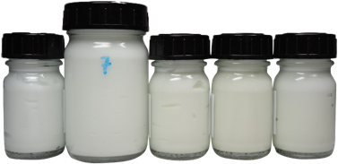
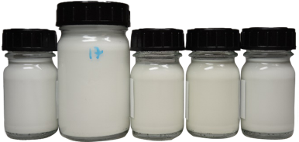
Stability in formulation
RETINOL CB 50 vs RETINOL GS 50 in 2 different formulations
 | Cream Gel 4°C – RT – 40°C -50°C - DL |  |  | W/O Emulsion 4°C – RT – 40°C -50°C - DL
RETINOL CB 50 Lot UT22060004
RETINOL GS 50 Lot SI2201K015
Retinol recovery % | Cream gel |  |  | Emulsion W/O
6 weeks | 4°C | RT | 40°C | 4°C | RT | 40°C
RETINOL CB 50 | 76 | 78 | 65 | 97 | 90 | 75
RETINOL GS 50 | 93 | 67 | 72 | 93 | 89 | 77
RETINOL CB 50/GS 50 at 0.2% in a cream gel and and w/o emulsion.
Stability* at 4°C, RT, 40°C, 50°C and under daylight after 6 weeks
RETINOL CB 50 shows comparable stability at all conditions after 6 weeks vs RETINOL GS 50
* Stability study still on going

Slide 12





Retinol: take your Cocooning time
New formulations for Millennials non-gendered
Retinol reduces the appearance of lines and wrinkles
while improving firmness and elasticity of the skin.
3 new formulations:
  Radiant Youth Face & Body Scrub
  Cocooning
  Vitamins Mask Soap
  Skin Smoothing Massage Oil

Slide 13

Radiant Youth Face & Body Scrub
Formulation: 99.75% natural origin*
A face, lips and body scrub with Retinol at low concentration for a plumping and smoothing effect to fight the first signs of aging with a radiant younger looking skin. Gentle exfoliation scrub with naturally derived undissolved Ascorbic Acid for a revitalized and purified skin
 | Ingredients | Function | % w/w
A | Caprylic/Capric Triglyceride | Emollient | 24.00
 | Octyldodecanol | Emollient | 24.00
 | Copernicia Cerifera Cera | Thickener | 15.00
 | Candelilla Cera | Thickener | 5.00
 | Polyglyceryl-4 Oleate | Solubilizer | 10.00
 | C15-C19 Alkane, Dextrin Palmitate | Thickener | 10.00
 | ARGAN OIL (Argania Spinosa Kernel Oil) | Emollient | 1.00
 | Tocopherol, Helianthus Annuus Seed Oil | Antioxidant | 0.20
B | RETINOL CB 50 (Retinol, Undecane, Tridecane, Tocopherol) | Active | 0.10
 | Ascorbic Acid | Active - Exfoliant | 10.00
 | Parfum | Parfum | 0.70
Technical data
pH: N.A.
Viscosity: Solid
SK-E-102011-37
* Natural origin content calculated according to ISO 16128 by including formulation water
13

Slide 14
Cocooning Vitamins Mask Soap
Formulation: 99.89% natural origin*
A cocooning face mask soap with Retinol, the golden standard of pro-ageing reducing the appearance of lines, improving firmness of the skin, and stabilized vitamin C for a glowing and purified skin.
 | Ingredients | Function | % w/w
A | Prunus Amygdalus Dulcis Oil | Emollient | 14.60​
 | Passiflora Incarnata Seed Oil​ | Emollient | 14.60​
 | Persea Gratissima Oil​ | Emollient | 6.10​
 | ARGAN OIL (Argania Spinosa Kernel Oil)​ | Emollient | 3.00​
 | Theobroma cacao Seed Butter | Emollient | 3.70​
 | Macadamia Integrifolia Seed Oil​ | Emollient | 14.60​
 | Life’s GLATM ‘10’ n-6 Oil (Oenothera Biennis Oil, Ascorbyl Palmitate, Tocopherol) | Emollient, Active | 2.00​
 | Ricinus Communis Seed Oil​ | Emollient | 2.00​
B | Kaolin​ | Absorbing agent | 10.00
 | VALVANCE® Look 100 (Silica, Titanium Dioxide) ​ | Sensory Modifier, Whitener | 3.00​
 | CI 77891, Polyglyceryl-2 Tetraisostearate | Pigment | 2.00​
 | Ingredients | Function | % w/w
C | Sodium Hydroxide​ | Buffer | 7.60​
 | Aqua​ | Solvent | 14.20​
D | RETINOL CB 50 (Retinol, Undecane, Tridecane, Tocopherol)​ | Active | 0.20​
 | STAY-C® 50 (Sodium Ascorbyl Phosphate)​ | Active | 0.50​
 | Tocopherol, Helianthus Annuus Seed Oil​ | Active | 0.20​
 | PENTAVITIN® (Saccharide Isomerate, Aqua, Citric acid, Sodium Citrate​) | Active | 1.00​
 | Parfum​ | Parfum | 0.70​
Technical data
pH: 10.79
Viscosity: Solid
SK-E-102144-10
* Natural origin content calculated according to ISO 16128 by including formulation water
14

Slide 15
Skin Smoothing Massage Oil
Formulation: 99.91% natural origin*
A face & body massage oil with Retinol for a smoothing effect with a radiant younger looking skin. This oil, easily absorbed by the skin, nourishes while leaving a satin finish.
 | Ingredients | Function | % w/w
A | Simmondsia Chinenses seed Oil | Emollient | 32.79
 | Prunus Amygdalus Dulcis OIl | Emollient | 15.00​
 | Sesamus Indicum Seed Oil | Emollient | 10.00​
 | Passiflora Incarnata Seed Oil | Emollient | 20.00
 | Caprylic/Capric Triglyceride | Emollient | 20.00
B | ARGAN OIL (Argania Spinosa Kernel Oil) | Emollient | 1.00
 | RETINOL CB (Retinol, Undecane, Tridecane, Tocopherol) | Active | 0.20​
 | Mixed Tocopherols 95 (Tocopherol) | Antioxidant | 0.50​
 | Beta-carotene | Colorant | 0.01
 | Parfum | Parfum | 0.50
Technical data
pH: N.A.
Viscosity: Liquid
SK-E-102196-18
* Natural origin content calculated according to ISO 16128 by including formulation water
15

Slide 16



Retinol
Scientific evidence
Learn more...
Request a sample

Slide 17


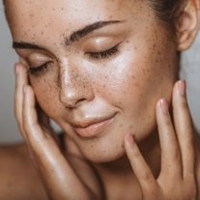
Retinol Efficacy
WRINKLES REDUCTION
EPIDERMAL
THICKENING
EVEN SKIN
TONE
Consumer Benefits
Reduces appearance of fine lines
& wrinkles
Improves skin firmness & elasticity
Molecular & Gene Level
Increases synthesis of Collagen & Elastin
Inhibits MMPs, reducing Collagen & Elastin degradation
Structural & Functional Level
Improves organization of Collagen and Elastin fibres in papillary dermis
Improves structure of Dermal-Epidermal Junction (DEJ)
Consumer Benefits
Improves skin smoothness
Decreases skin roughness
Molecular & Gene Level
Stimulates Ki-67 expression
Increases deposition of Glycosaminoglycan in the epidermis
Structural & Functional Level
Increases epidermal proliferation
Thickens the epidermis
Compacts the stratum corneum
Consumer Benefits
Reduces discoloration, mottled pigmentation
Rebalances uneven tone
Molecular & Gene Level
Downregulates Tyrosinase activity
Decreases Melanin content
Structural & Functional Level
Inhibits Melanosome transfer

Slide 18

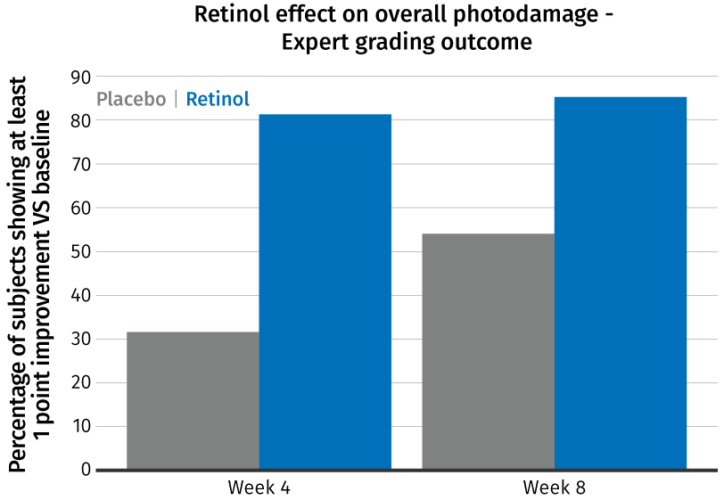

RETINOL visibly improves skin photo-damages in just 1 month
WRINKLES REDUCTION
Photo-damage is the main reason (90% of the cases) of extrinsic skin ageing. Retinol is one of the few available skin care actives effectively fighting against it.
+60%
+150%
*
8-weeks, double-blind,
split-face, vehicle-controlled, randomized in vivo study* Conducted during winter-time among 64 female volunteers aged 40–65.
0.1% Retinol containing moisturizer was applied daily. Clinical evaluations were performed by Dermatologists at baseline and at weeks 4 and 8 on each side of the face, based on the 0–9 expert grading scale.
*
*p<0.05, relative to baseline)
The aim of the study performed by S. Tucker-Samaras, T.Zedayko, C.Cole et al, 2009 was to determine the effect of Retinol on photo-ageing. It showed significant improvement on overall photodamage in just one month.
Notes:
S. Tucker-Samaras et al, A stabilized 0.1% retinol facial moisturizer improves the appearance of photodamaged skin in an eight-week, double-blind, vehicle-controlled study. Journal of drugs in dermatology, 2009, 8 (10): 932-936

Slide 19
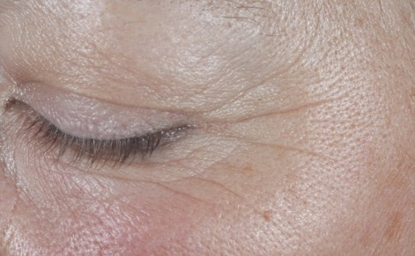
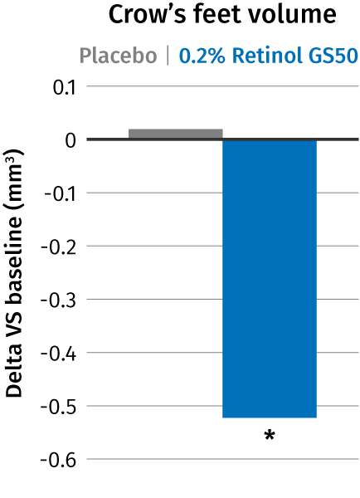
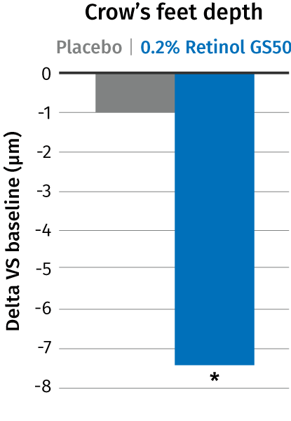
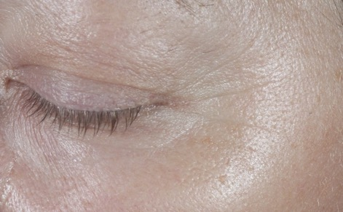

Retinol* proven to reduce crow’s feet wrinkles in just 4 weeks
WRINKLES REDUCTION
Visible effect and quantification by Primos^{lite} measurement
Significant (p<0.05) improvement on crow’s feet parameters (less volume and depth)
In the same time placebo effect was negligible
With prolonged retinol application a continuous improvement over time is expected
Baseline subject 127
In 4 weeks only
* RETINOL GS 50, same efficacy with RETINOL CB 50
4 weeks
4 weeks subject 127
Double blind in vivo study
25 volunteers per group, 50 – 65 y.o.
Application 2x per day, full face, for 4 weeks
Notes:
Only for 4 weeks.
Retinol longer you treat better the results. Continuous improvement over time
placebo has opposite effect than Retinol.
Placebo was virtually ineffective, change around zero but the retinol formulation achieved a statistically significant improvement after just 4 weeks

Slide 20

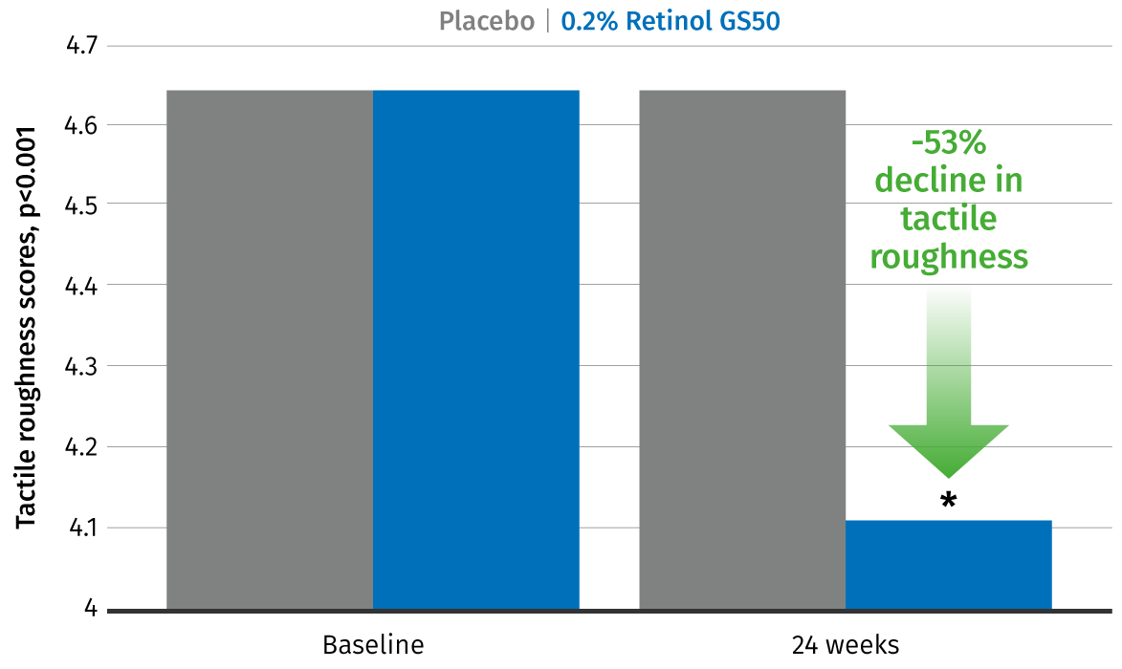
Retinol smoothens skin
EPIDERMAL THICKENING
Retinol perceptibly improves tactile skin roughness
Retinol effect on tactile roughness
In vivo study performed by R. Kafi et al, 2007
The improvement in tactile roughness in chronologically aged skin is shown with Retinol treatment.
After 24 weeks, significant differences between retinol-treated and vehicle-treated skin for changes in tactile roughness scores (−0.53 [95% CI, −0.73 to −0.33] vs 0.00 [95% CI, 0.00 to 0.00]; P.001 [N=36]).
* RETINOL GS 50, same efficacy with RETINOL CB 50
Notes:
* Reza Kafi et al, Improvement of naturally aged skin with vitamin A (Retinol), American medical association, 2007, 143: 606-612
In a study performed by R. Kafi et al, 2007 the improvement in tactile roughness in chronologically aged skin is shown with retinol treatment. After 24 weeks, intent-to-treat analyses demonstrated significant differences between retinol-treated and vehicle-treated skin for changes in tactile roughness scores (−0.53 [95% CI, −0.73 to −0.33] vs 0.00 [95% CI, 0.00 to 0.00]; P.001 [N=36]).

Slide 21

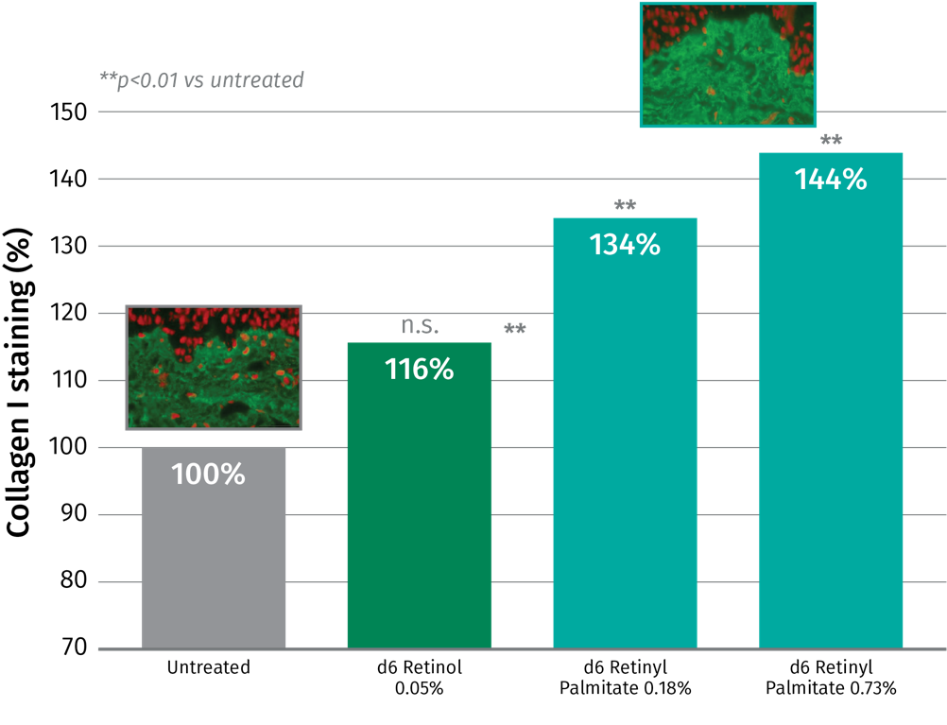

Retinol and derivative- Collagen I
6 days of ex vivo skin treatment
d6= 6 days
Retinol 0.05% boosts collagen I by 16%
Retinyl Palmitate, significantly boosts collagen I, but at higher concentration than Retinol – and dose dependently
34% collagen I boost at 0.18%
44% collagen I boost at 0.73%
 | Retinol equivalent
0.05% Retinol= 0.1% Retinol GS50 | 1x
0.18% Retinyl Palmitate | 2x
0.73% Retinyl Palmitate | 8x
Collagen I is the most abundant collagen in the dermis but more difficult to boost
Collagen I staining was quantified in the papillary dermis using cellSens software
Notes:
Pure retinol
Skin from 1 female donor 45years old, skin phototype II
in vivo use level could be 2 to 3 times higher than ex vivo. However, the regulation limits the use of retinol to 0.3% and for retinyl palmitate to 0.6% (based on retinol equivalents)

Slide 22


RETINOL (Vitamin A)
The all-time anti-aging hero
PROVEN BENEFITS
Reduces skin photo-damage effects
Improves the appearance of fine lines & wrinkles
Improves skin firmness & elasticity
Improves skin smoothness
Decreases skin roughness
Reduces skin discoloration &
mottled pigmentation
Rebalances uneven skin tone

Slide 23


DISCLAIMER
Copyright © 2023 DSM Nutritional Products, 4002 Basel, Switzerland.
www.dsm.com/personal-care. All rights reserved.
Although DSM has used diligent care to ensure that the information provided herein is accurate and up to date, DSM makes no representation or warranty of the accuracy, reliability, or completeness of the information. This presentation only contains scientific and technical information for business-to-business use. Country- or region-specific information should also be considered when labeling or advertising to final consumers. This publication does not constitute or provide scientific or medical advice, diagnosis, or treatment and is distributed without warranty of any kind, either expressly or implied. In no event shall DSM be liable for any damages arising from the reader’s reliance upon, or use of, these materials. The reader shall be solely responsible for any interpretation or use of the material contained herein. The content of this document is subject to change without further notice. Please contact your local DSM representative for more details. All trademarks listed in this brochure are either registered trademarks or trademarks of DSM in The Netherlands and/or other countries unless explicitly otherwise stated.
DISCLAIMER GUIDE FORMULATION
“This information is for illustration purposes only and based upon our current knowledge and experience at the time of printing. We do not make any representation or warranty of any kind, express or implied, including merchantability or fitness for a particular use, with respect to such information or its application. Use of this information is at your discretion and risk. Nothing herein relieves you from carrying out your own suitability determinations and tests. You are responsible for observing all laws and regulations relevant to your products, uses or processes. We do not assume any liability in connection with your product and its use. The foregoing information and suggestions are also provided without warranty of non-infringement as to the intellectual property rights of third parties, and shall not be construed as any inducement to infringe the rights of third parties.”)
This document only contains scientific and technical information for business-to-business use. Country or
region-specific regulatory requirements should be considered when developing claims for
labeling or advertising to final consumers.

Slide 24
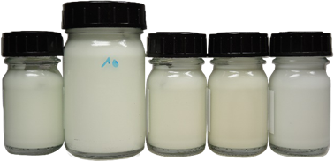
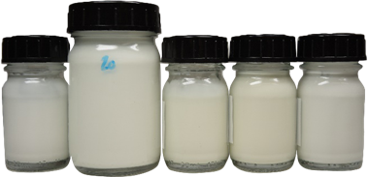
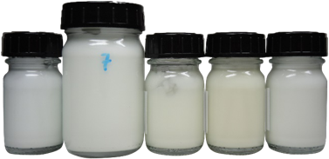
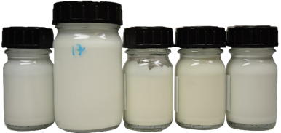
Stability in formulation
RETINOL CB 50 vs RETINOL GS 50 in 2 different formulations
 | Cream Gel 4°C – RT – 40°C -50°C - DL |  |  | W/O Emulsion 4°C – RT – 40°C -50°C - DL
RETINOL CB 50 Lot UT22060004
RETINOL GS 50 Lot SI2201K015
Retinol recovery % | Cream gel |  |  | Emulsion W/O
3 months | 4°C | RT | 40°C | 4°C | RT | 40°C
RETINOL CB 50 | 50 | 56 | 33 | 91 | 81 | 55
RETINOL GS 50 | 87 | 75 | 45 | 94 | 86 | 57
RETINOL CB 50/GS 50 at 0.2% in a cream gel and and w/o emulsion.
Stability* at 4°C, RT, 40°C, 50°C and under daylight after 3 months
RETINOL CB 50 shows comparable stability at all conditions after 3 months vs RETINOL GS 50 especially for in a w/o emulsion

