Slide 1

Vitamin A
Revealing the Power
of Vitamins for Beauty Care
August 2023

Slide 2








Agenda
Vitamin A in Skincare
DSM in the Vitamin A Journey
Consumers & Customers Insights
Scientific Evidence on Retinol
Comparison Among Different Forms of Vitamin A
Formulation Tips
Click on the number to get redirected to the chapter

Slide 3
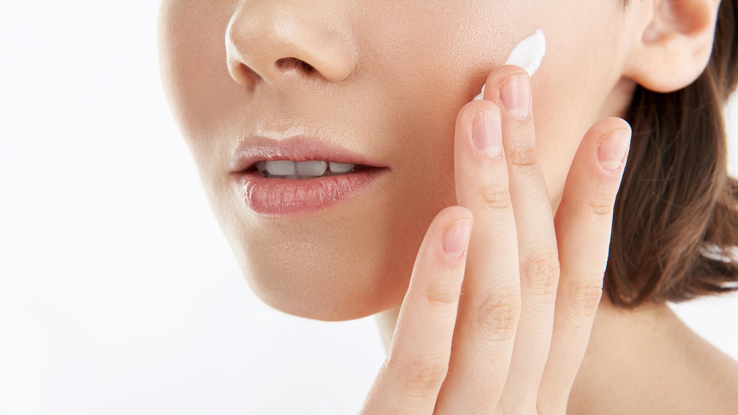


Vitamin A in skincare

Slide 4


Retinol (Vitamin A)
The all-time anti-aging hero
PROVEN BENEFITS
Reduces skin photo-damage effects
Improves the appearance of fine lines & wrinkles
Improves skin firmness & elasticity
Improves skin smoothness
Decreases skin roughness
Reduces skin discoloration &
mottled pigmentation
Rebalances uneven skin tone

Slide 5

DSM in the Vitamin A journey

Slide 6




Proud to be part of the remarkable journey of Retinol in cosmetics
1930
1947
1980s
1990s
TODAY
DISCOVERY
The discovery of Retinol
PRODUCTION
DSM pioneered the large scale industrial synthesis and production of vitamins
COSMETIC RESEARCH
DSM opened the door for vitamins in cosmetics with the first efficacy studies
MARKET RECOGNITION
Retinol’s position as the gold standard in
anti-ageing is firmly established

Slide 7





Cosmetic grades of
Product | Technical details | Size | Product Code
Retinol CB 50 | Stabilized with natural Tocopherols Based on naturally derived alkanes 428–495 mg Retinol equivalents/g | 1 kg 5 kg | 5017297.264 5017297.294 | Vitamin A alcohol – In its purest form 50% blend of retinol and alkanes
Retinol GS 50 | Stabilized with BHT and BHA Based on Polysorbate 20 428–495 mg Retinol Equivalents/g | 1kg 5 kg | 50 15117.264 50 15117.294 | Vitamin A alcohol – In its purest form 50% blend of retinol and polysorbate 20
Vitamin A Acetate 1.5 MIU/g | Stabilized with tocopherol Based on peanut oil 450 mg Retinol Equivalents/g | 5 kg | 04 18846.294 | Vitamin A acetate, adjusted to 1.5 MIU/g by adding peanut oil. Contains dl-α-tocopherol as an antioxidant

Slide 8
Cosmetic grades of
Product | Technical details | Size | Product Code
Vitamin A Palmitate 1.7 MIU/g | Stabilized with tocopherol 510 mg Retinol Equivalents/g | 5 kg 20 kg 190 kg | 04 18579.294 04 18579.336 04 18579.422 | Pure vitamin A palmitate Contains dl-α-tocopherol as an antioxidant
Vitamin A Palmitate 1.7 MIU/g | Without stabilizers 510 mg Retinol Equivalents/g | 5 kg 20 kg 190 kg | 04 24005.294 04 24005.336 04 24005.420 | Pure vitamin A palmitate, no formulation aid
Vitamin A Palmitate 1.7 MIU/g | Stabilized with BHA/BHT 510 mg Retinol Equivalents/g | 5 kg 20 kg | 04 24013.294 04 24013.336 | Pure vitamin A palmitate
Vitamin A Palmitate 1.0 MIU/g | Stabilized with tocopherol Based on peanut oil 300 mg Retinol Equivalents/g | 5 kg | 04 31400.294 | Vitamin A palmitate, adjusted to 1.0 MIU/g by adding peanut oil Contains dl-α-tocopherol as an antioxidant
Vitamin A Palmitate/M 1.0 MIU/g | Stabilized with tocopherol Based on medium chain triglycerides 300 mg Retinol Equivalents/g | 5 kg | 50 08530.294 | Vitamin A palmitate, adjusted to 1.0 MIU/g by medium chain triglycerides (INCI: caprylic/Capric Triglyceride) Contains dl-α-tocopherol as an antioxidant
Vitamin A Palmitate 1.0 MIU/g | Stabilized with BHA/BHT Based on peanut oil 300 mg Retinol Equivalents/g | 5 kg | 04 20603.294 | Vitamin A palmitate, adjusted to 1.0 MIU/g by adding peanut oil

Slide 9

Consumers’ insights

Slide 10


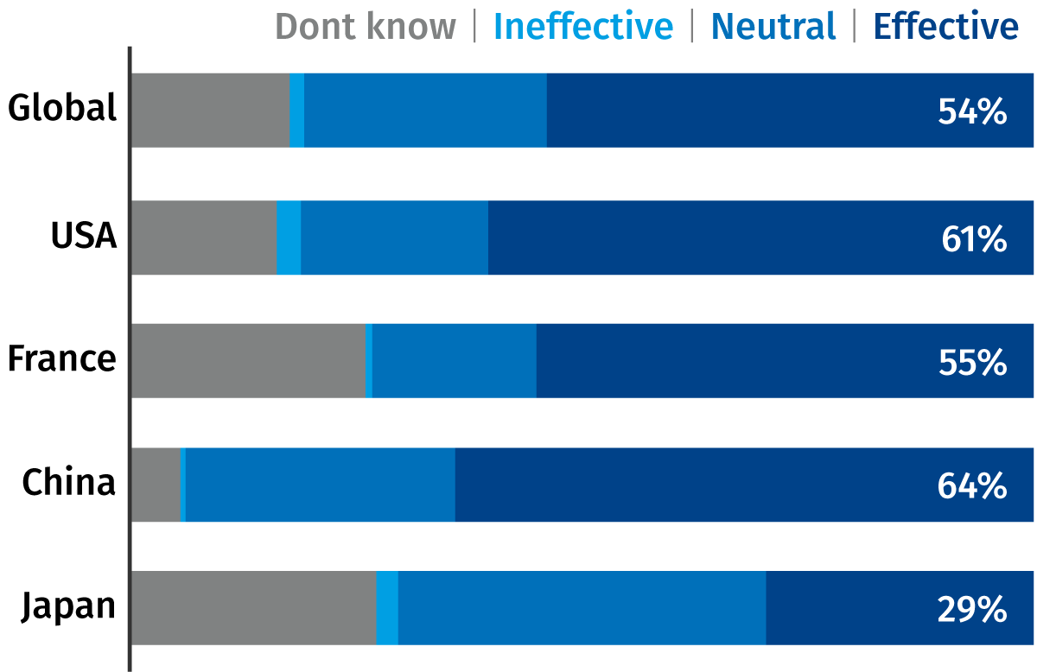



A good case of ingredient recognition
High awareness & credibility
In the US and France, 67% of women are aware of Vitamin A/ Retinol being used in cosmetics
Of US women link it to anti-aging/ removal of wrinkles
Q. How effective do you think Retinol is in cosmetic products?
73%
Of women aware of it as an ingredient sees it to be effective in cosmetics
DSM PCA Vits study, Jan 2016. Global- N=1171, USA- N=323, France- N=260, China- N=342, Japan- N=246- All females

Slide 11
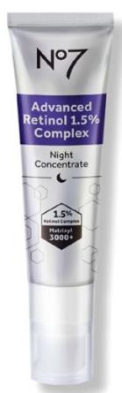
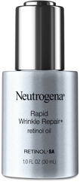

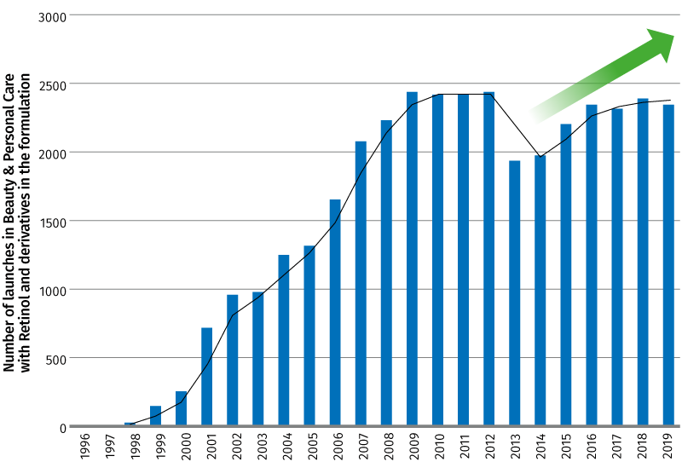
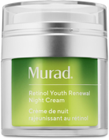
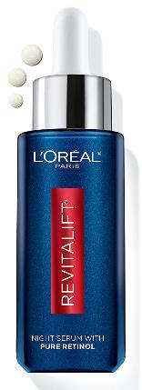

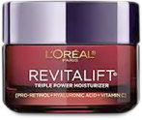

B2C companies leverage Retinol to drive innovation & sales
≈40k Beauty & personal Care products feat. Retinol (and/or derivatives) have been launched in in last 20yrs (mostly facial)
Retinol back on trend in last 5Yrs: +20% avg NPIs/year vs 2013
2019 WINNER
RECORD ON-LINE
2020 PRE-SALE
100k consumers
on waiting list at launch
Source: Mintel GNPD
BEST SELLER
AUTUMN 2020 INNOVATION
BEST SELLER

Slide 12


Retinol
Scientific evidence
Learn more...
Request a sample

Slide 13



Retinol Efficacy
WRINKLES REDUCTION
EPIDERMAL
THICKENING
EVEN SKIN
TONE
Consumer Benefits
Reduces appearance of fine lines
& wrinkles
Improves skin firmness & elasticity
Molecular & Gene Level
Increases synthesis of Collagen & Elastin
Inhibits MMPs, reducing Collagen & Elastin degradation
Structural & Functional Level
Improves organization of Collagen and Elastin fibres in papillary dermis
Improves structure of Dermal-Epidermal Junction (DEJ)
Consumer Benefits
Improves skin smoothness
Decreases skin roughness
Molecular & Gene Level
Stimulates Ki-67 expression
Increases deposition of Glycosaminoglycan in the epidermis
Structural & Functional Level
Increases epidermal proliferation
Thickens the epidermis
Compacts the stratum corneum
Consumer Benefits
Reduces discoloration, mottled pigmentation
Rebalances uneven tone
Molecular & Gene Level
Downregulates Tyrosinase activity
Decreases Melanin content
Structural & Functional Level
Inhibits Melanosome transfer

Slide 14






New DSM In vivo Study
New Clinical
Study
STUDY SET-UP
One target group
50-65 y.o.
25 Volunteers per formulation
Placebo
Retinol GS50 0.2%
Application: 4 weeks,
2x per day, full face
Randomized single centre Study
Double blind

Slide 15

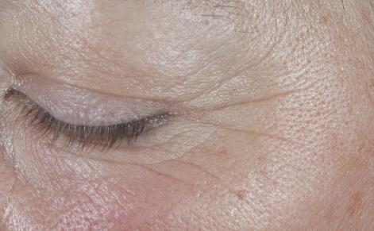
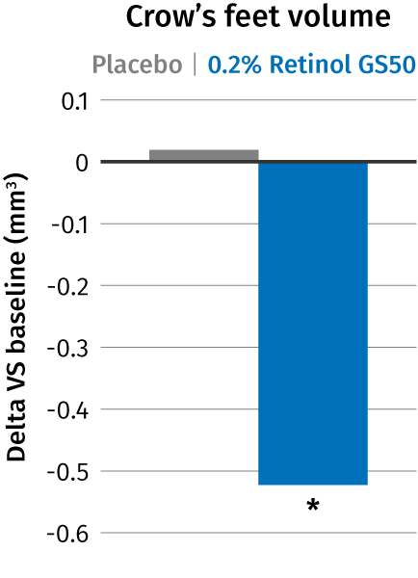
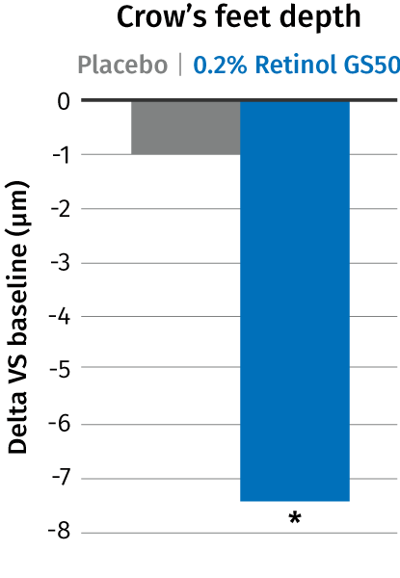
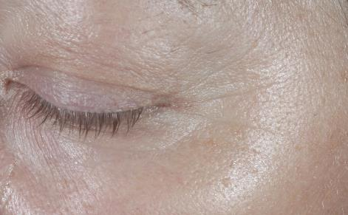

Retinol* proven to reduce crow’s feet wrinkles in just 4 weeks
WRINKLES REDUCTION
Visible effect and quantification by Primos^{lite} measurement
Significant (p<0.05) improvement on crow’s feet parameters (less volume and depth)
In the same time placebo effect was negligible
With prolonged retinol application a continuous improvement over time is expected
Baseline subject 127
In 4 weeks only
* RETINOL GS 50, same efficacy with RETINOL CB 50
4 weeks
4 weeks subject 127
Notes:
Short term effects after only for 4 weeks.
Retinol the longer you treat better the results. Continuous improvement over time
Placebo was virtually ineffective, change around zero but the retinol formulation achieved a statistically significant improvement after just 4 weeks (statistics show significance compared to baseline)

Slide 16
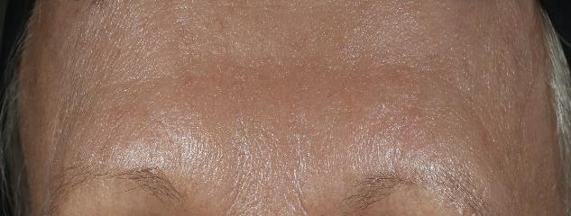
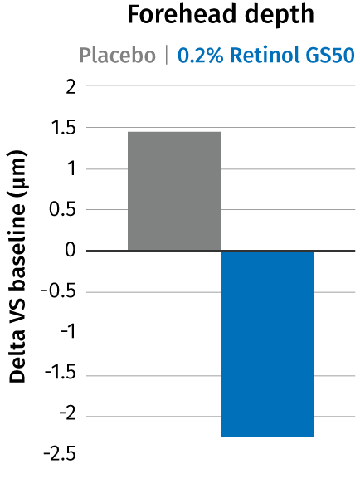
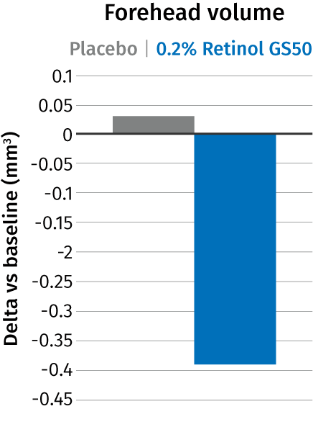
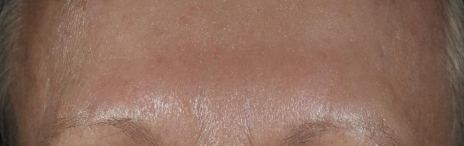
Retinol* proven to reduce forehead wrinkles in just 4 weeks
WRINKLES REDUCTION
Primos^{lite} measurement
Strong trend for improvement on forehead wrinkles (less volume and depth)
In the same time placebo was ineffective with slight aggravation
With prolonged retinol application a continuous improvement over time is expected
In 4 weeks only
4 weeks
* RETINOL GS 50, same efficacy with RETINOL CB 50
Notes:
placebo has opposite effect than Retinol.
Lack of significance confirmed, significance very likely to be expected with prolonged treatment or/and with bigger group of volunteers

Slide 17
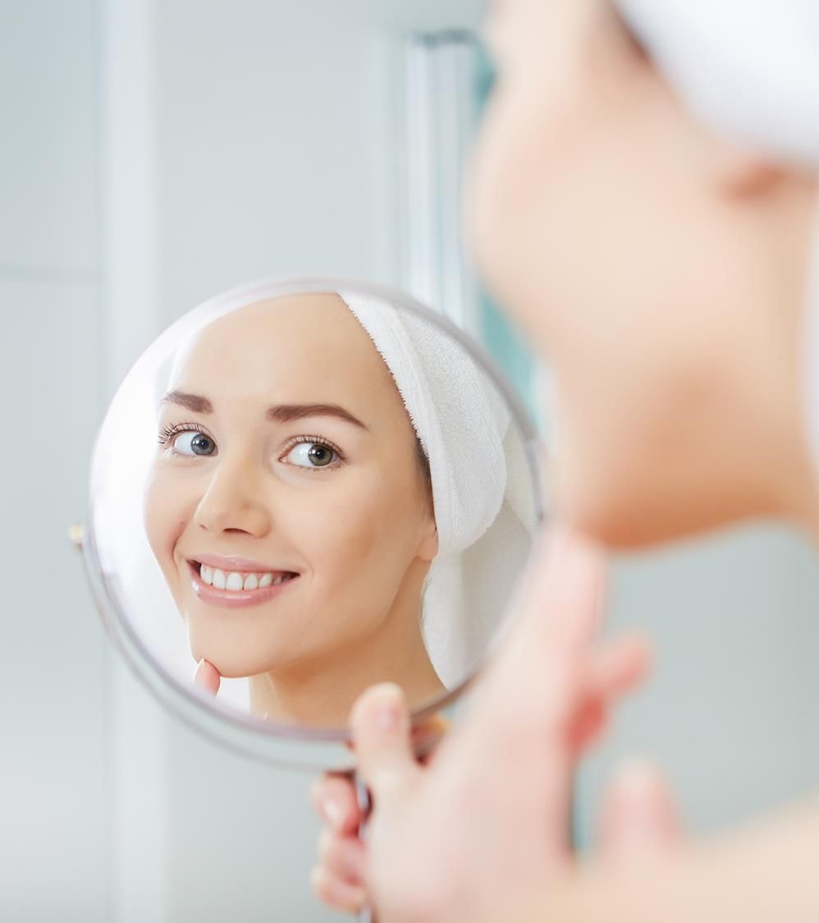
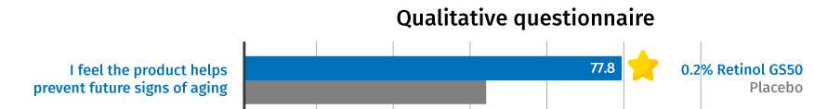
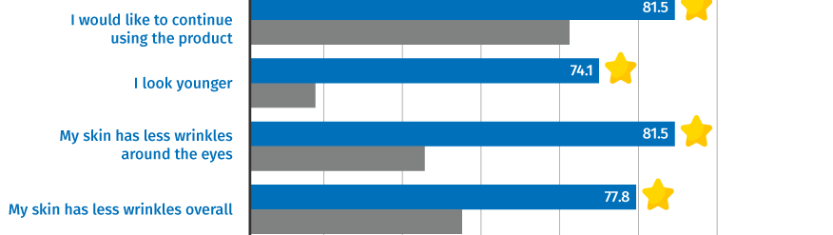
Volunteers’ self-assessment
WRINKLES REDUCTION
Amazing feedback for Retinol*!
* RETINOL GS 50, same efficacy with RETINOL CB 50

Slide 18
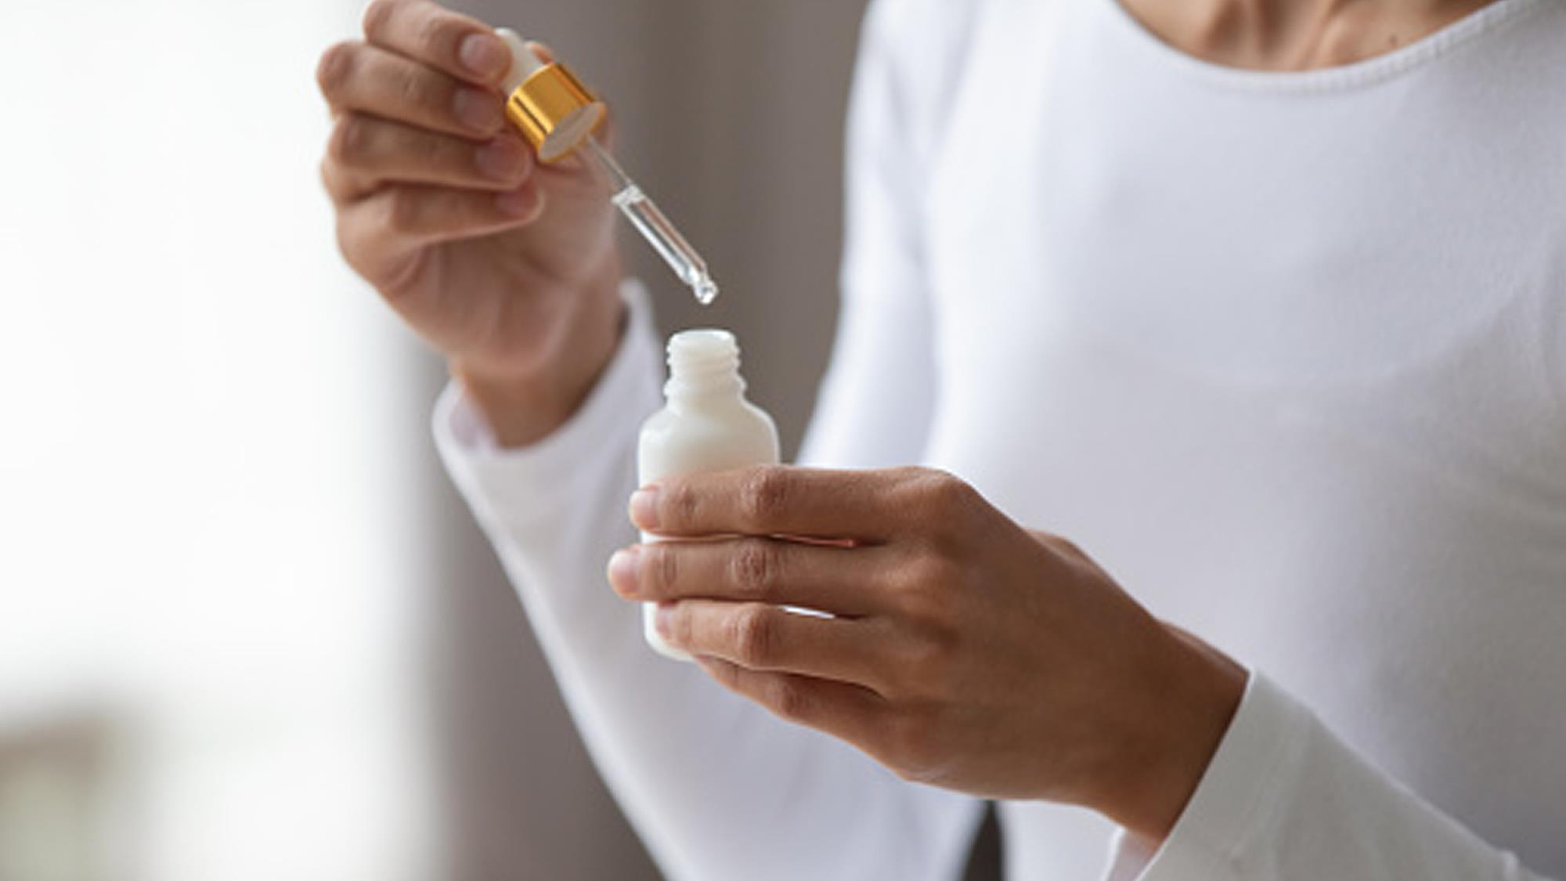
Comparison among Different Forms of Vitamin A

Slide 19
Vitamin A launches around the globe
DSM offers the 3 key forms
Source: Mintel

Slide 20
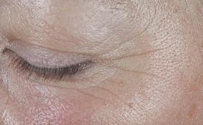
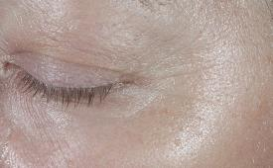
Retinyl Palmitate
Just one step away from retinol
Retinyl ester hydrolase
Retinol dehydrogenase
Retinal dehydrogenase
Retinyl palmitate
Retinol
Retinal
Trans retinoic acid
Lecitin retinol acyltransferase
Retinal reductase
Retinyl palmitate (RP) is more stable than retinol, but needs to be used in higher concentration
RP is converted to retinol and subsequently to the active form in skin
Increased use level of RP compensates for the extra conversion step compared to retinol
RP is naturally present in skin as storage form of retinol
anti aging effects
20

Slide 21
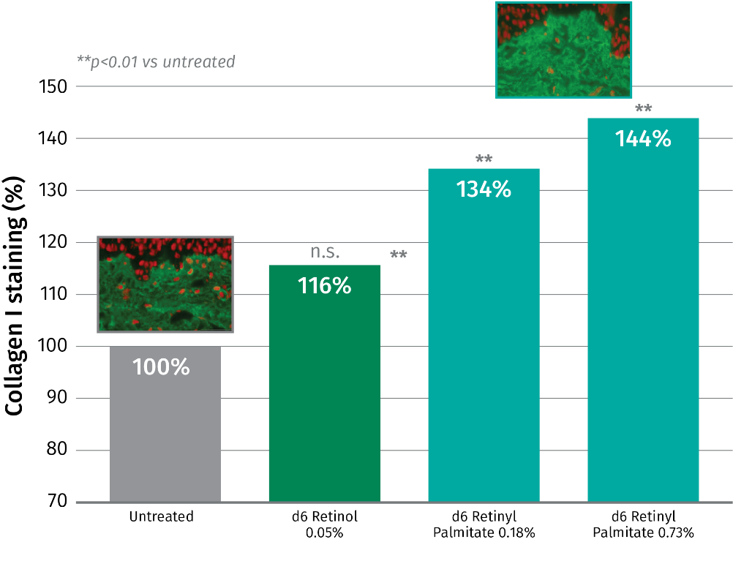

Retinol and derivative- Collagen I
6 days of ex vivo skin treatment
d6= 6 days
Retinol 0.05% boosts collagen I by 16%
Retinyl Palmitate, significantly boosts collagen I, but at higher concentration than Retinol – and dose dependently
34% collagen I boost at 0.18%
44% collagen I boost at 0.73%
 | Retinol equivalent
0.05% Retinol= 0.1% Retinol CB50 | 1x
0.18% Retinyl Palmitate | 2x
0.73% Retinyl Palmitate | 8x
Collagen I is the most abundant collagen in the dermis but more difficult to boost
Collagen I staining was quantified in the papillary dermis using cellSens software
Notes:
Increase of collagen1 staining by treatment. Method: precise quantitative assessment of collagen 1 staining by digital image analysis of collagen1 immuno-stained tissue sections
Pure retinol
Skin from 1 female donor 45years old, skin phototype II
in vivo use level could be 2 to 3 times higher than ex vivo. However, the regulation limits the use of retinol to 0.3% and for retinyl palmitate to 0.6% (based on retinol equivalents)

Slide 22
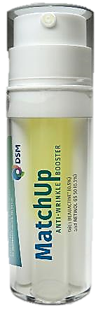
Retinol Booster
Line-up- The perfect Match
Retinol reduces the appearance of lines and wrinkles while improving firmness and elasticity of the skin.
BEAUACTIVE® high purity and sustainable patent ingredient that activates the master cell regulators, boosting collagen production.
MatchUp
Advanced dual technology that combines a magnificent
oil gel with Retinol and a smooth cream with BEAUACTIVE®
to synergistically boost collagen and deliver an effective
and visible anti- wrinkle results.

Slide 23

Formulation tips

Slide 24
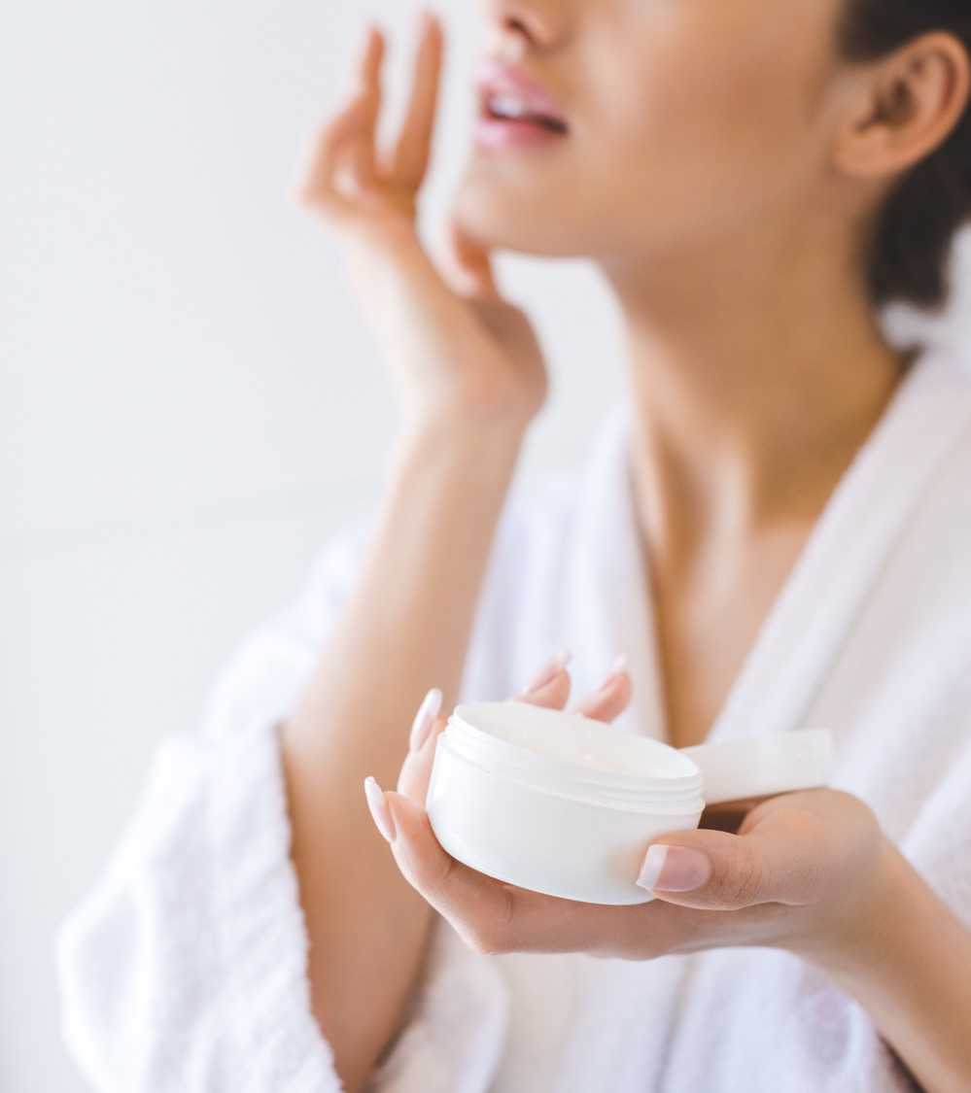
Formulation Tips
RETINOL CB 50*
RETINOL CB 50 is soluble in fats and oils
Sensitive to Oxygen. It is therefore recommended to manufacture retinol formulations under an inert atmosphere or to reduce the presence of Oxygen during handling and production to the possible minimum.
Sensitive to higher temperatures (> 40°C) and daylight.
To improve the stability of RETINOL CB 50 in the formulation it is recommended to add chelating agents like EDTA, UV absorbers like PARSOL® Guard* and antioxidants like Mixed Tocopherols or STAY-C® 50.
STAY-C® 50 has recently shown high performance to recover retinol content at room temperature and 40 °C. Be aware, that it is a salt and may impact the stability of electrolytes sensitive systems.
Recommended pH of the final formulation: 4.5 – 8.0
*: valid also for Retinol GS 50
*INCI Name: Octocrylene (and) Homosalate (and) Butyl Methoxydibenzoylmethane (and) Tocopherol (and) Helianthus Annuus (Sunflower) Seed Oil
24

Slide 25


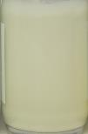
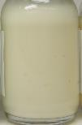
Retinol and Stabilizers
Stability after 6 weeks at 40°C versus formula with Retinol* only
Mixed Tocopherol 95 is a natural replacement to BHT with equivalent performance to recover Retinol content.
No sample stored at 40°C had a recovery content higher than 25% of initial value, except STAY-C® 50 with 70% recovery.
There is not a visual discoloration impact in the sample with STAY-C® 50 comparing to Retinol GS 50 only at RT and a slight discoloration at 40°C.
6 weeks
RT
40°C
Retinol GS 50
Without stabilizer
Retinol GS 50
Stay-C® 50 at 0.5%
Retinol GS 50
Without stabilizer
Retinol GS 50
Stay-C® 50 at 0.5%
Retinol GS 50 tested at 0.2%
*: Retinol GS 50 or Retinol CB 50
Notes:
Retinol GS 50 without stabilizer had a recovery content of only 9%.

Slide 26
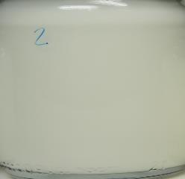
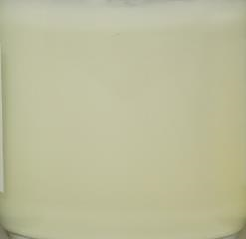
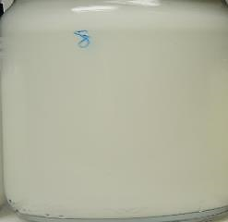
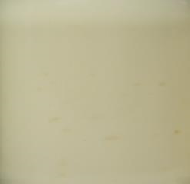
Vitamin C - The Retinol Protector
Retinol recovery content with STAY-C® 50 -3 month
RT
40°C
Retinol is highly sensitive to temperature, after 6 weeks at 40°C STAY-C® 50 was the best stabilizer tested with 70% retinol content
STAY-C® 50 recovers retinol content by 78% at RT and by 52% at 40°C after 3 month stability.
None of the other 12 stabilizer tested stored at 40°C had significant recovery content after 3-month stability.
There is not a visual discoloration impact in the sample with STAY-C® 50 comparing to Retinol GS 50* only at RT and a slight discoloration at 40°C.
Retinol GS 50
Without stabilizer
Retinol GS 50
Without stabilizer
Retinol GS 50
STAY-C® 50 at 0.5%
Retinol GS 50
STAY-C® 50 at 0.5%
*: Retinol GS 50 or Retinol CB 50
Retinol GS 50 tested at 0.2%
Notes:
Stabilizers : BHT, PARSOL® GUARD, Mixed Tocopherols 95, Tinogard TT, Covastyle MBS, STAY-C® 50, RonaCare AP, dl-alpha-Tocopherol, Sytenol A, PARSOL® SLX and dl-alpha-Tocopheryl Acetate

Slide 27
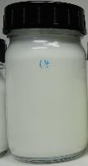
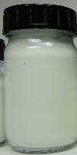
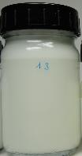
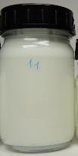
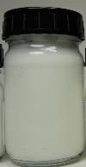
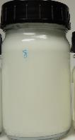
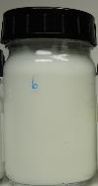

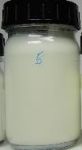
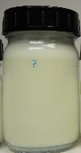
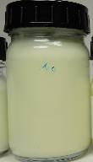
Retinol* and Stabilizers
Stability after 3 month at RT versus formula with Retinol only
3 month at RT
Retinol GS 50
Vit. E Act 0.2%
Retinol GS 50
Parsol® Guard at 0.2%
Retinol GS 50
P.SLX 0.5%
Retinol GS 50
Bakuchiol 0.4%
Retinol GS 50
BHT 0.05%
Retinol GS 50
STAY-C® 50 0.5%
Retinol GS 50
TT 0.5%
Retinol GS 50
HDBM 0.2%
Retinol GS 50
M. Tocopherol at 0.1%
Retinol GS 50
S. Metabisulfite 0.05%
Retinol GS 50
Tocopherol 0.2%
*: Retinol GS 50 or Retinol CB 50

Slide 28

Magnificent Oil Gel
Formulation
The Oil Gel contains a dual form of VITAMIN A to visibly reduce the appearance of lines and wrinkles while improving firmness and elasticity of the skin.
INGREDIENTS | INCI NAME | %W/W
Eutanol® G | OCTYLDODECANOL | 47,85
Myritol® 318 | CAPRYLIC/CAPRIC TRIGLYCERIDE | 47,85
Mixed Tocopherols 95 | TOCOPHEROL | 0,20
DL-alpha-Tocopheryl Acetate | TOCOPHERYL ACETATE | 0,50
Oilkemia™ 5S Polymer | CAPRYLIC/CAPRIC GLYCERIDES, POLYURETHANE-79 | 3,00
RETINOL GS 50* | RETINOL, POLYSORBATE 20, BHT, BHA | 0,30
Vitamin A Palmitate 1.7 MIU/g tocopherol | RETINYL PALMITATE, TOCOPHEROL | 0,30
SK-E-101695-11
The Mixed Tocopherols 95, a natural form of vitamin E, acts as an anti-oxidant prolonging Retinol performance.
*: Retinol GS 50 or Retinol CB 50

Slide 29
Cocooning Vitamins Mask Soap
Formulation: 99.89% natural origin*
A cocooning face mask soap with Retinol, the golden standard of pro-ageing reducing the appearance of lines, improving firmness of the skin, and stabilized vitamin C for a glowing and purified skin.
 | Ingredients | Function | % w/w
A | Prunus Amygdalus Dulcis Oil | Emollient | 14.60​
 | Passiflora Incarnata Seed Oil​ | Emollient | 14.60​
 | Persea Gratissima Oil​ | Emollient | 6.10​
 | ARGAN OIL (Argania Spinosa Kernel Oil)​ | Emollient | 3.00​
 | Theobroma cacao Seed Butter | Emollient | 3.70​
 | Macadamia Integrifolia Seed Oil​ | Emollient | 14.60​
 | Life’s GLATM ‘10’ n-6 Oil (Oenothera Biennis Oil, Ascorbyl Palmitate, Tocopherol) | Emollient, Active | 2.00​
 | Ricinus Communis Seed Oil​ | Emollient | 2.00​
B | Kaolin​ | Absorbing agent | 10.00
 | VALVANCE® Look 100 (Silica, Titanium Dioxide) ​ | Sensory Modifier, Whitener | 3.00​
 | CI 77891, Polyglyceryl-2 Tetraisostearate | Pigment | 2.00​
 | Ingredients | Function | % w/w
C | Sodium Hydroxide​ | Buffer | 7.60​
 | Aqua​ | Solvent | 14.20​
D | RETINOL CB 50 (Retinol, Undecane, Tridecane, Tocopherol)​ | Active | 0.20​
 | STAY-C® 50 (Sodium Ascorbyl Phosphate)​ | Active | 0.50​
 | Tocopherol, Helianthus Annuus Seed Oil​ | Active | 0.20​
 | PENTAVITIN® (Saccharide Isomerate, Aqua, Citric acid, Sodium Citrate​) | Active | 1.00​
 | Parfum​ | Parfum | 0.70​
Technical data
pH: 10.79
Viscosity: Solid
SK-E-102144-10
* Natural origin content calculated according to ISO 16128 by including formulation water
29

Slide 30

Access to learn more about DSM Quali® Vitamin A and to request a sample

Slide 32
Disclaimer
Copyright © 2023 DSM Nutritional Products, 4002 Basel, Switzerland.
www.dsm.com/personal-care. All rights reserved.
DSM has used diligent care to ensure that the information provided herein is accurate and up-to-date, however, DSM makes no representation or warranty, either expressly or implied, of the accuracy, reliability, or completeness thereof. The information provided herein contains scientific and product information for business to business use and does not constitute or provide scientific or medical advice, diagnosis or recommendation for treatment. Country or region-specific information should be considered when labeling or advertising to final consumer. In no event shall DSM be liable for any damages arising from or reliance upon, or use of, any information provided herein. The content of this document is subject to change without further notice. Please contact your local DSM representative for further details. All trademarks listed in this document are either (registered) trademarks of, or trademarks licensed by, the DSM group of companies in the Netherlands and/or other countries, unless explicitly stated otherwise.

Slide 33
Disclaimer Formulation Guideline
This information is for illustration purposes only and based upon our current knowledge and experience at the time of printing. We do not make any representation or warranty of any kind, express or implied, including merchantability or fitness for a particular use, with respect to such information or its application. Use of this information is at your discretion and risk. Nothing herein relieves you from carrying out your own suitability determinations and tests. You are responsible for observing all laws and regulations relevant to your products, uses or processes. We do not assume any liability in connection with your product and its use. The foregoing information and suggestions are also provided without warranty of non-infringement as to the intellectual property rights of third parties, and shall not be construed as any inducement to infringe the rights of third parties.

