Slide 1

Vitamin B12
The Biotech pink vitamin for sensitive and stressed skin
June 2025

Slide 2

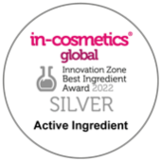


Vitamin B12
Product features
Soothes and regenerates sensitive skin, making it look more vibrant
Cobalamin: one of the most complex vitamin, with Cobalt structure
Cyanocobalamin is converted into adenosyl-cobalamin
and methylcobalamin, which are the forms that have
physiological activity
Red-pink color
Water soluble B vitamin
Not synthetized by the human body
Natural source: liver, egg, dairy products,
fish, meat, algae (nori),…

Slide 3
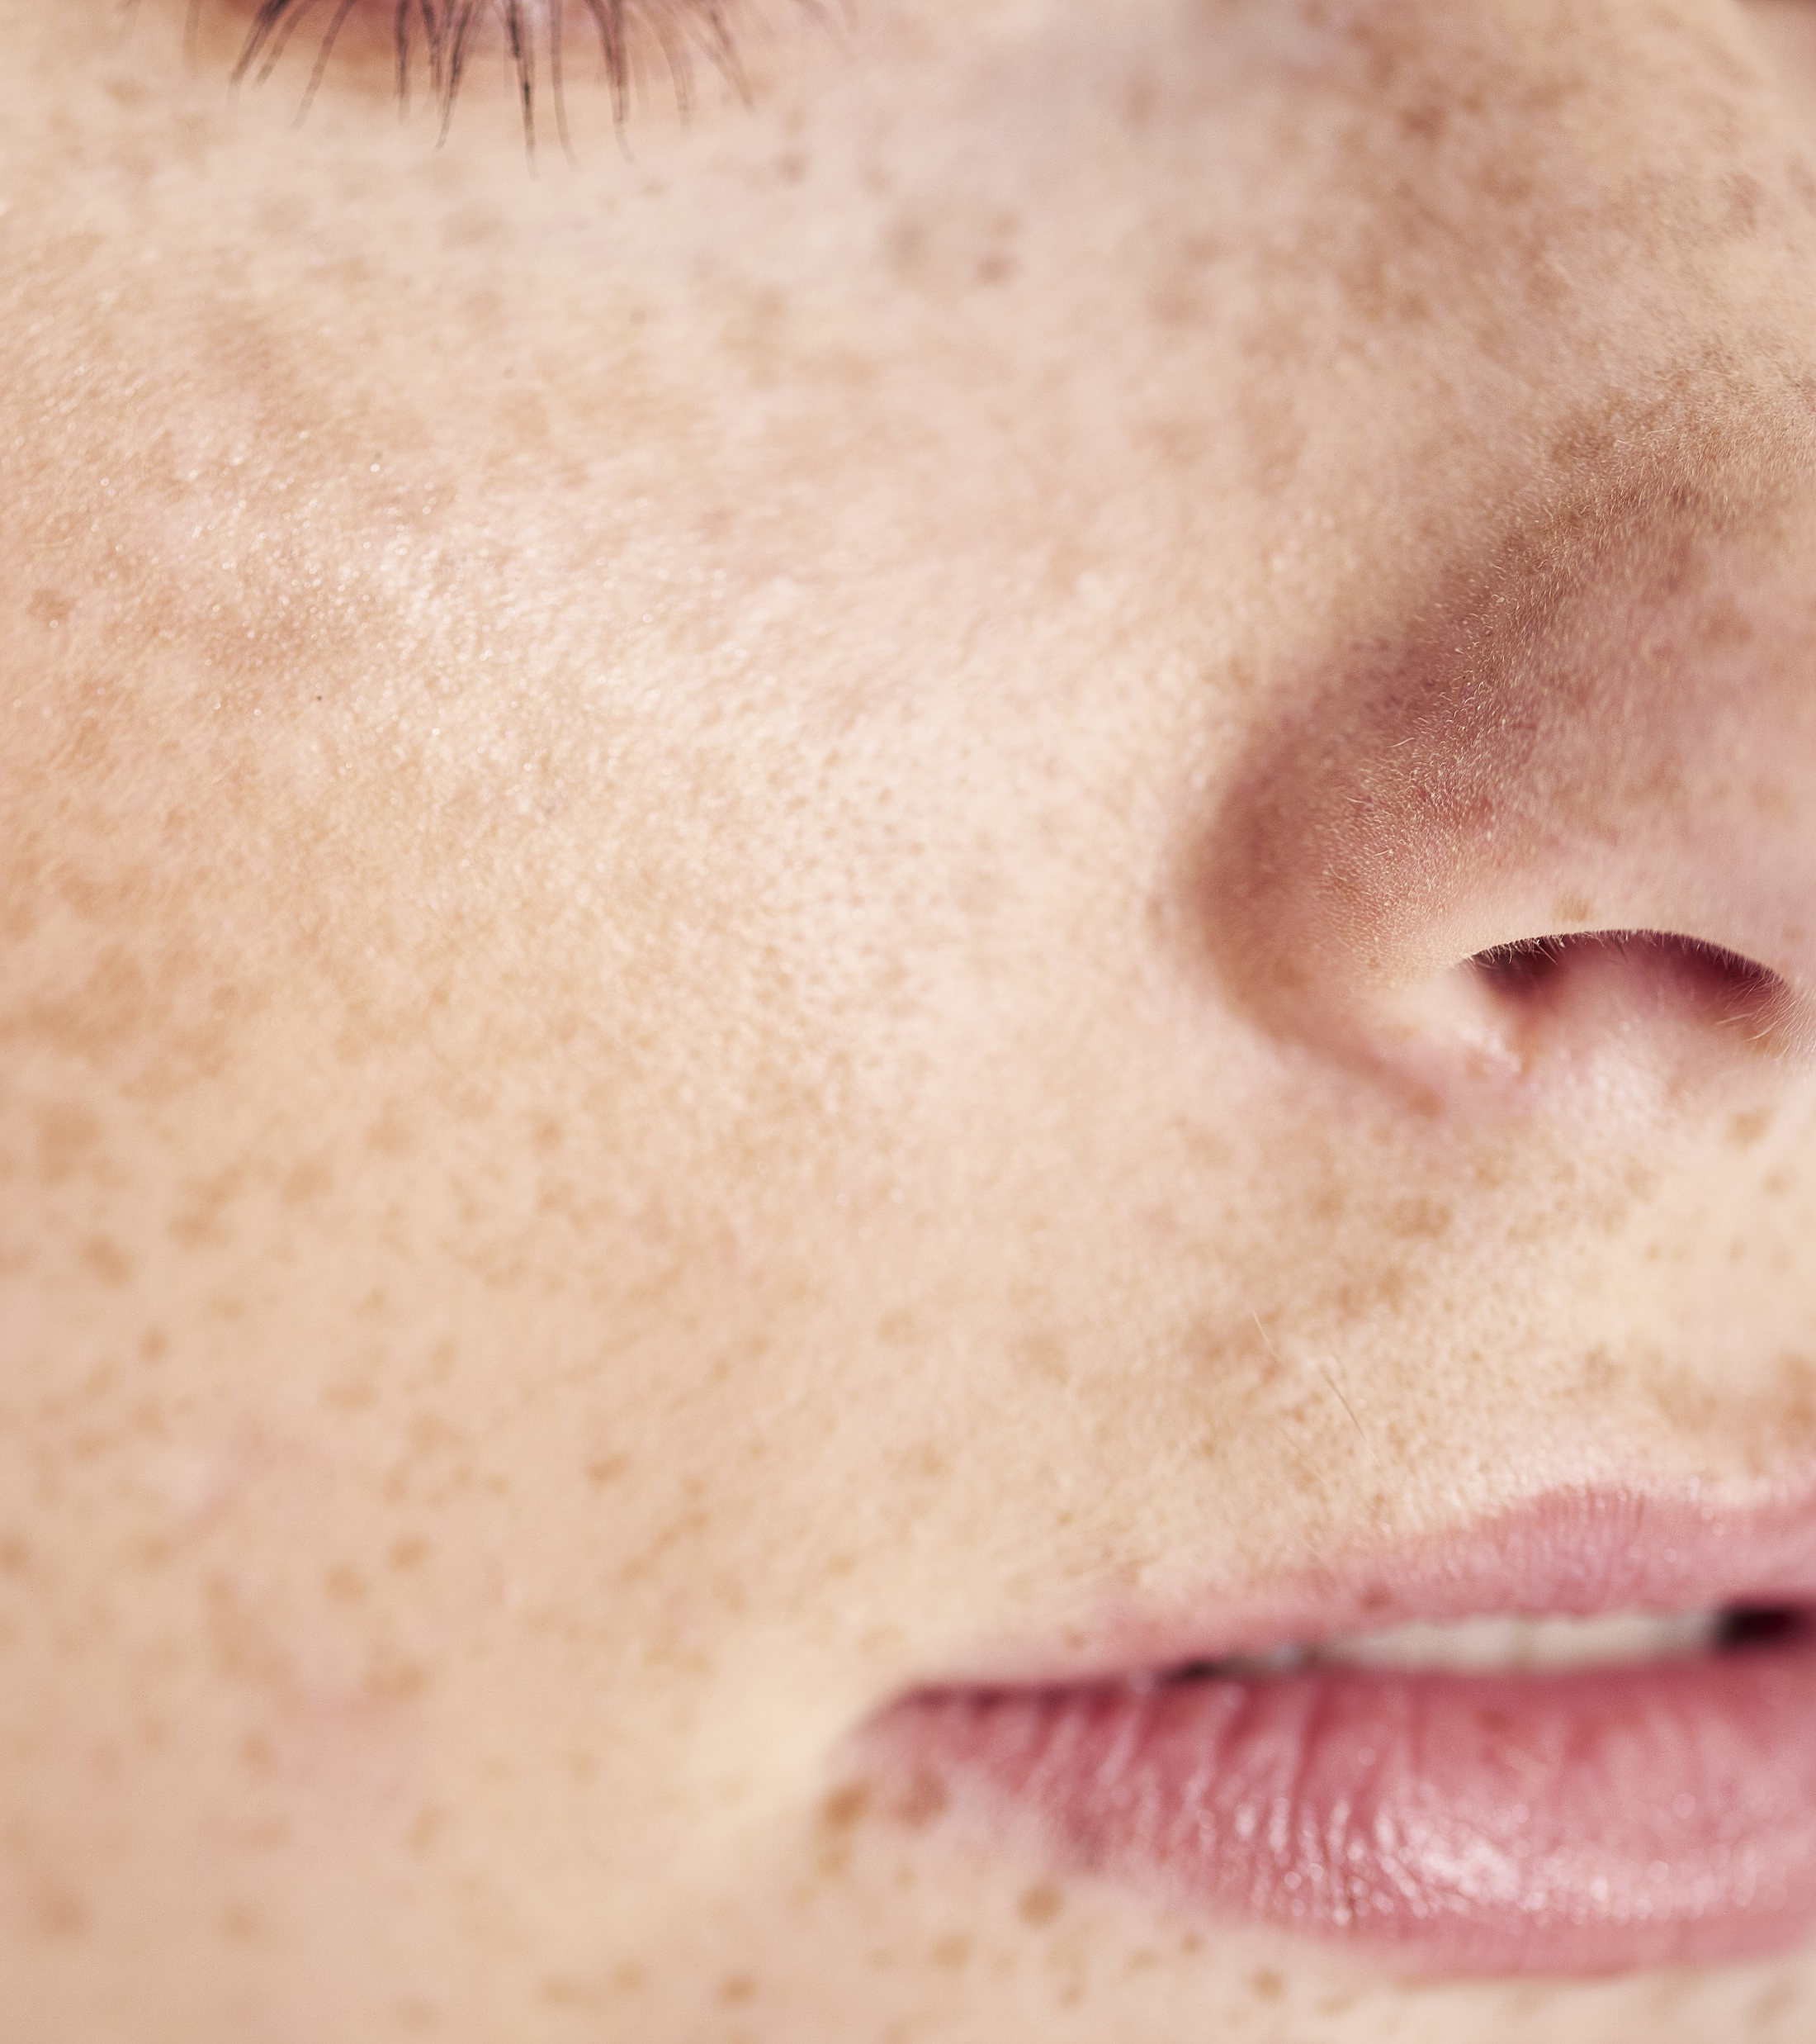
Vitamin B12
Consumer benefits
Soothes and regenerates sensitive skin, making it look more vibrant
Vitamin B12 relieves sensitive and stressed skin
Dermatological treatments for skin conditions like itchy,
dry, inflamed, red and cracked skin
Helps prevent photo-damaged skin
Protects the skin barrier damage induced by
inflammation
Plays an important part in speeding up cell recovery
and regeneration
Skin looks more vibrant
Nice pink color of the formulations

Slide 4




Vitamin B12 cryst & Vitamin B12 0.1% WS
ID Card
Vitamin B12: the biotech pink vitamin for sensitive and stressed skin
Key benefit:
Relieves sensitive and stressed skin
Helps prevent photo-damaged skin
Skin looks more vibrant
Maintains healthy skin microbiome
Protects the skin barrier damage induced
by inflammation
INCI name:
50-16420 Cyanocobalamin
50-16402 Cyanocobalamin, Maltodextrin, Sodium citrate, Citric Acid
50-16420 Vitamin B12 is made by non-GMO bacterial fermentation
50-16402 Vitamin B12 is made by non-GMO bacterial fermentation, followed by dispersion in maltodextrin and drying
Technology:
Technical:
Form: Powder
Use level: 0.001–0.1%
(50-1642-0)
1-10% (50-1640-2)
pH of use: 3.5–7.5
Solubility: in water
Naturality:
67.8% natural origin* (50-1642-0)
100% natural origin** (50-1640-2)
Registration
certification
50-1642-0
50-1640-2
*Renewable carbon according to ISO 16128
** According to ISO 16128

Slide 5
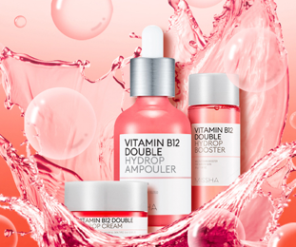
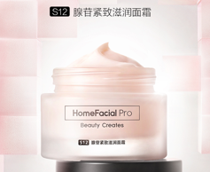
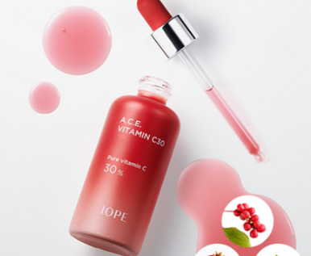
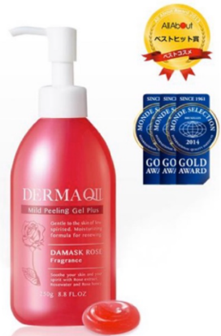
Vitamin B12: the new trendy ingredient
Particularly in Asia
Korea
China
Korea
Japan
Missha Vitamin B12 double hydrop set: skin hydration. Vitamin B12 for replenishing moisture and energy for the skin, with multi-vitamins cocktail B3, B5, A, C and E
HomeFacialPro Adenosine serum& cream. Vitamin B12 accelerates renewal and revitalizing, relieves skin fatigue, dull, dry and other problems
Amore Pacific IOPE brand.
Anti-aging red ampoule with Vitamin C 30%, Vitamin B12 and Vitamin B3
Derma QII Mild Peeling Gel.
An exfoliation gel that gently removes built-up dead skin cells, leaving your skin soft
and smooth

Slide 6
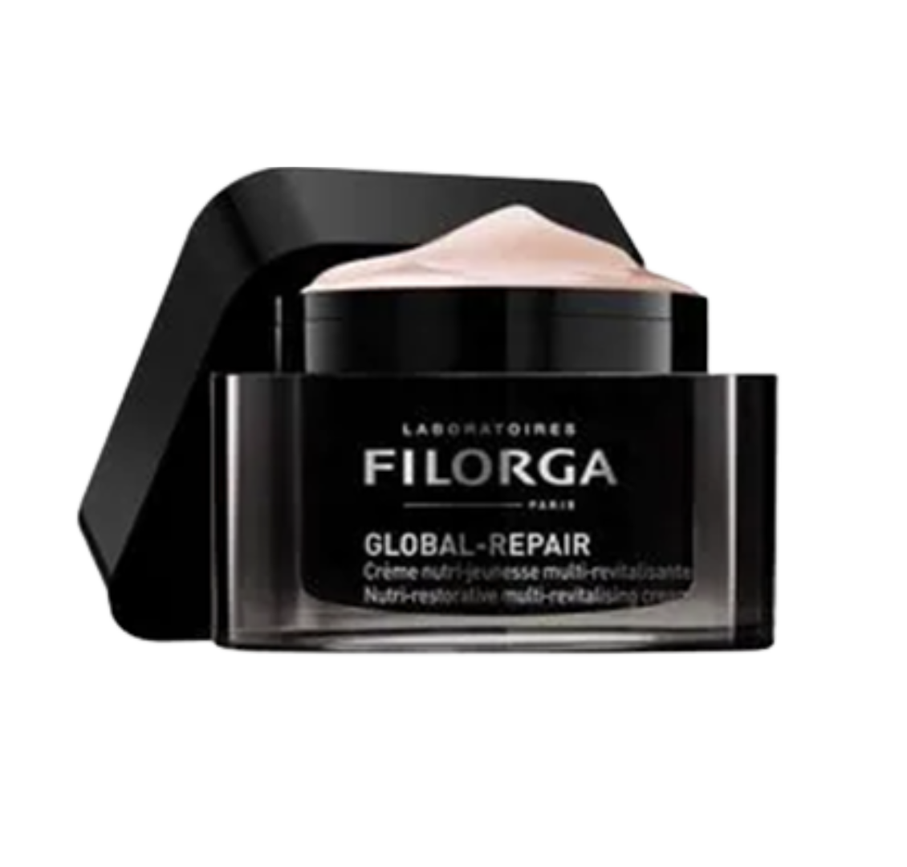
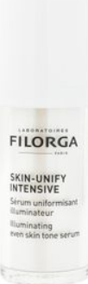
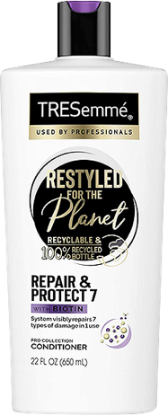
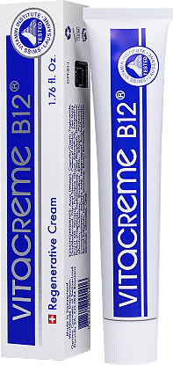
Vitamin B12: the new trendy ingredient
As well as in Western countries
France
France
UK
Switzerland
Filorga Global repair.
Nutri-restorative multi revitalizing cream
Filorga skin unify intensive.
To provide unifying, illuminating, anti-dark spot effects
Unilever Tre Semmé brand hair conditioner. Repairs seven types of damage in 1 use: blow-drying, straightening, coloring, curling, bleaching, brushing and braiding
Darvidis Vitacreme B12 regenerative cream. Prevents and fights effectively against signs of aging

Slide 7
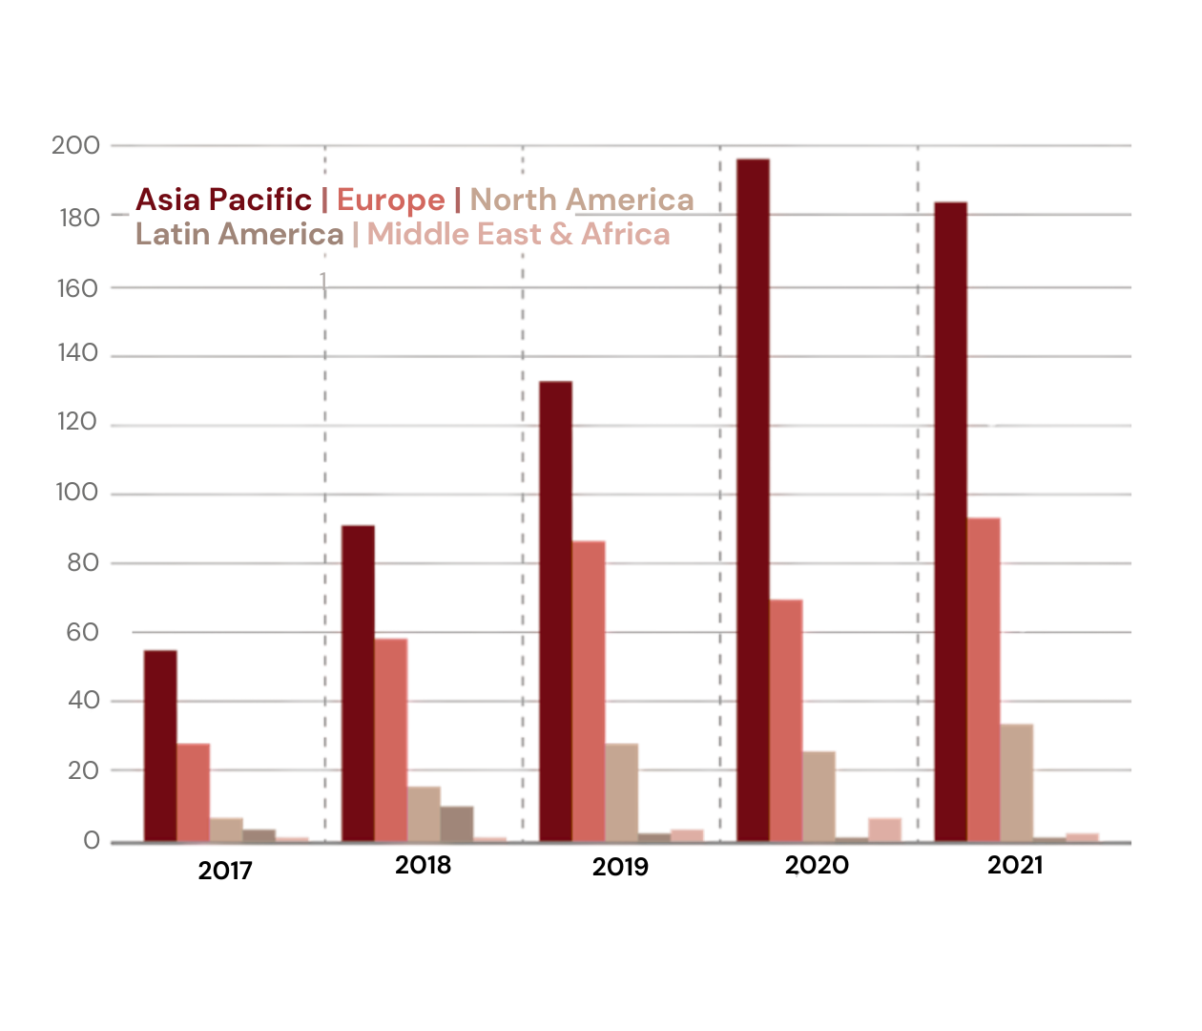
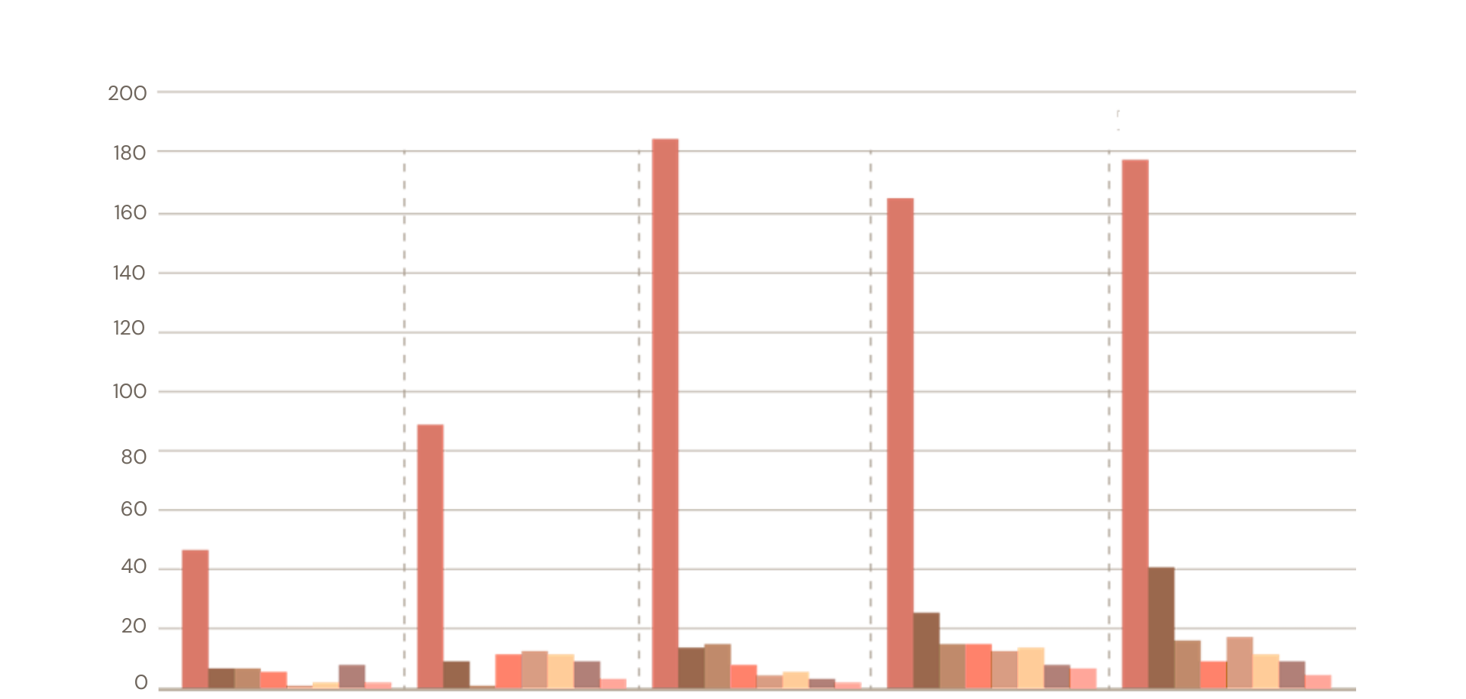
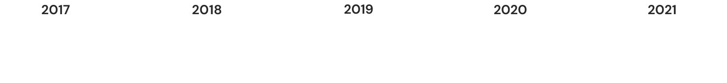
Vitamin B12: the new trendy ingredient
Still a fairly low number of launches with Vitamin B12, but it gains traction
Total BPC launches with Cyanocobalamin as ingredient:
Per region
Per category
Face/neck care | Face Cleansers | Eye Care | Shampoo | Sets | Body Care | Hair Treatments | Conditioner
Continuous growth of total of launches within BPC where Asia is the leading region followed by Europe. The application most used is face care, far ahead of hair and body care

Slide 8
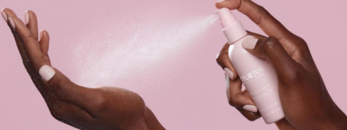



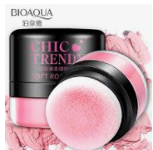
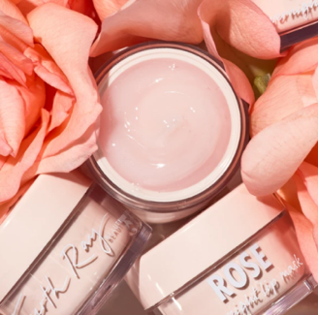
Vitamin B12 is used as naturally derived colorant
Pink is a trendy color in cosmetics/skin care
23 ideas how to use a pink color in your life:
from image …
14 dreamy pink makeup looks
for every skin tone
Pink is a universally flattering color — it works to bring out the natural flush in your cheeks and warms up the face
Source: www.pinterest.com, www.goodhousekeeping.com

Slide 9


Pink/purple
The third preferred color
The Top 5 Most Loved Colors:
Purple came 3rd with 19% of preferences – just behind green (34%) and blue (35%)¹
Influence of pink color on emotions:
Pink is a color with many positive virtues: a nurturing pink hue can both soothe & calm the mind & body
Pink naturally cleanses the body’s blood and cleanses the mind of impure thoughts
Edwin Babbitt, pioneer of the modern chromotherapy, identified violet as soothing
to all systems and as having
anti-inflammatory properties³
Violet / purple relates to the crown chakra which is at the top of the head and considered the seventh primary chakra in some yoga traditions.
Pantone released
its color trend
report for spring
/ summer 2022:
Bubble gum
It sends a message of
playfulness and positivity²
Perfect match between the influence of pink color on the body and the scientific evidences of Vitamin B12 as skin soothing
https://medium.com/illumination/the-top-5-most-loved-colors
https://www.pantone.com/articles/fashion-color-trend-report/london-fashion-week-spring-summer-2022
Principles of Light and Color. MT, USA: Kessinger Publishing; 1942. Evid Based Complement Alternat Med > v.2(4); 2005 Dec

Slide 10

Vitamin B12
Already efficient known biological activities
Involved in cell metabolism, cofactor in DNA synthesis
Coenzyme for isomerase, methyltransferase and dehalogenase involved in protein and lipids synthesis
Vitamin B12 deficiency causes: skin hyperpigmentation; atopic dermatitis; Erythema nodosum; vitiligo, glossitis;
hair and nail changes
Hyperpigmentation: first sign of vitamin B12 deficiency, shows increased melanin in the basal layer of the epidermis (in melanocytes and surrounding keratinocytes)
Atopic dermatitis: in vitro, vitamin B12 is able to suppress the cytokine production of T lymphocytes, which may initiate the inflammatory events of atopic dermatitis.
Vitamin B12 is effective as nitric oxide scavenger, and NO in excessive amount is known to cause itching and redness in eczema

Slide 11

Vitamin
B12
New dsm-firmenich scientific discoveries
on anti-inflammatory properties and healthy Microbiome

Slide 12

Vitamin B12 cryst: epigenetic screening
Epigenetic regulators (miRNA) modulated by Vitamin B12 on primary human keratinocytes: especially on anti-inflammatory activity
miRNAs modulated by Vitamin B12
With a screening on qPCR-based gene expression panel of 105 miRNAs, we have identified 22 miRNAs significantly modulated by 0.004% Vitamin B12, in particular miR-22-3p
miR-22-3p plays a role in:
Inhibiting messenger RNA and protein expression of NLRP3 and thus reduce inflammasome activity
Inhibiting the NRLP-mediated activation of Caspase 1 (enzyme that cleaves pro-IL-1β and pro-IL-18 into active forms, initiating
an inflammatory cascade)
Vitamin B12 produced
a statistically significant increase in expression in microRNAs
microRNA | Fold-change value
miR-22-3p | 2.02-fold increase
NLRP3: Nucleotide-binding domain, Leucine-rich Repeat family Pyrin domain containing 3, IL1-ß: Interleukin 1ß, IL18: Interleukin 18
Source: Hu Z. et al., Protective effects of microRNA-22-3-p against retinal pigment epithelial inflammatory damage by targeting NLRP3 inflammasome, J. Cell Physiol. 2019, 234:18849-18857

Slide 13
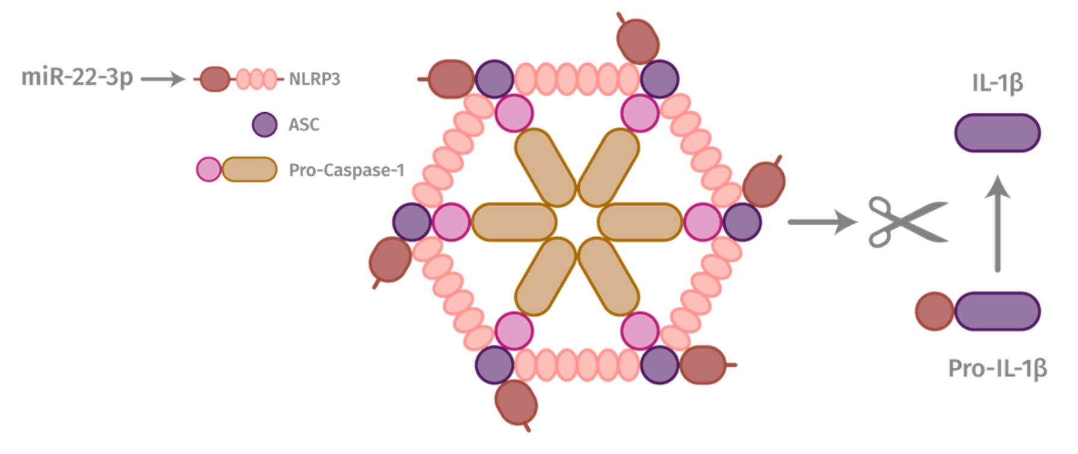
Mechanism of skin inflammatory reactions
Inflammasome in keratinocytes is a key element
NLRP3-Inflammasome activation
miR-22-3p, as gene blocker, is the regulator of the inflammasome
ASC recruits Caspase-1 to the complex forming the inflammasome
Inflammasome is intracellular multiprotein (NRPL3, ASC and Pro-Caspase-1) complex
Inflammation
Redness Irritation Itching Sensitive skin
UV
Pollution
Oxidative stress
Action of Vitamin B12
UV, pollution or any oxidative stress induce the formation of the NLRP3-inflammasome, especially in keratinocytes. This inflammasome is responsible for regulating the immunological response, triggers the inflammatory response by cytokines production such as IL-1b and IL-18.
If it gets chronically activated, it causes skin irritation and premature aging.
Vitamin B12 upregulates miR-22-3-p which is the inhibitor of the NLRP3-inflammasome, reduces the ASC complex activation and finally slows down
the cleavage of pro-IL1ß into active form
ASC: Apoptosis-associated Speck-like protein containing a Caspase recruitment domain, NLRP3: Nucleotide-binding domain, Leucine-rich Repeat family Pyrin domain containing 3
Source: Bauernfeind F. et al., NLRP3 inflammasome activity is negatively controlled by miR-223, The Journal of Immunology, 2012, 189: 4175:4181

Slide 14


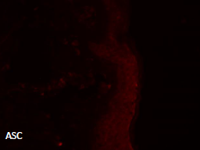
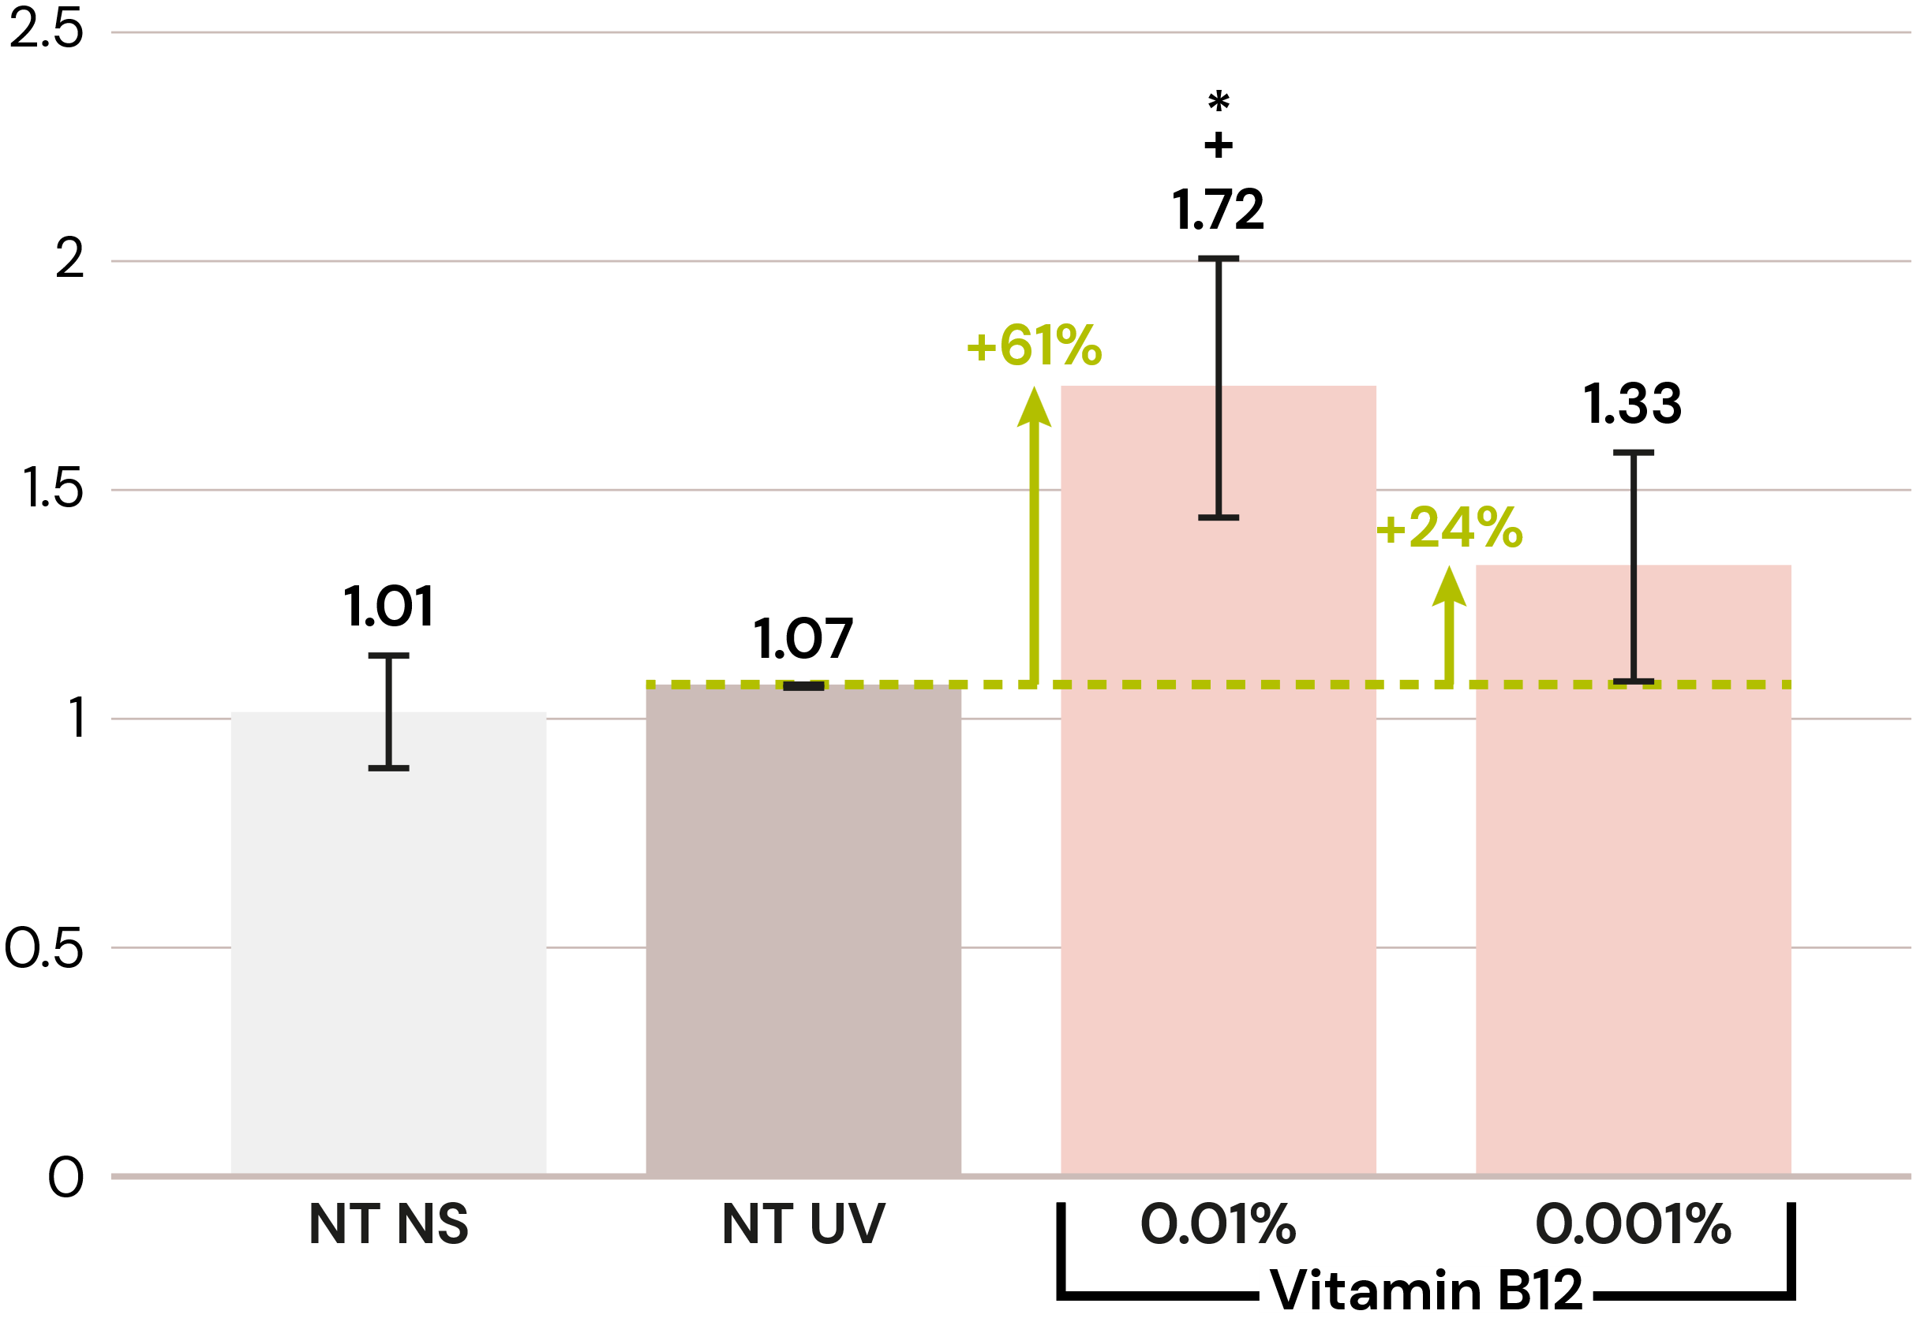
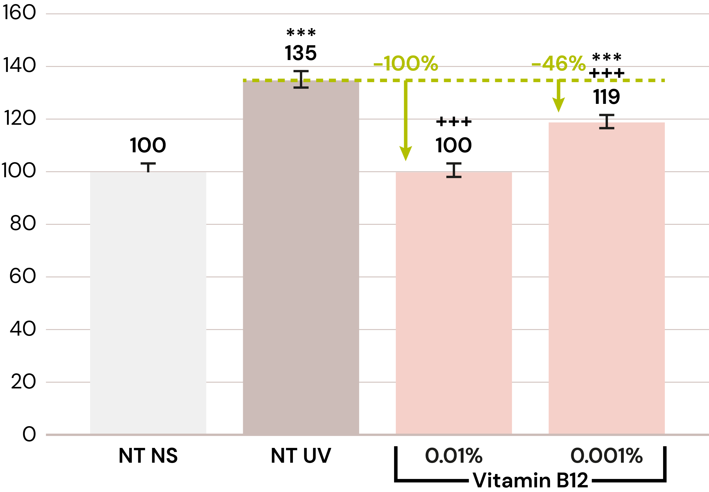
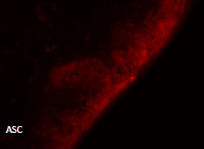
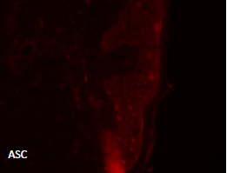
dsm-firmenich scientists discovered the action of Vitamin B12 on the inflammasome
New
Vitamin B12 reduces UV-B induced inflammasome reaction ex vivo
miR-22-3p expression after UV stress
Mean ASC intensity
Vitamin B12 significantly up regulates by 61%
miR-22-3p at 0.01%
Vitamin B12 significantly down regulates ASC complex activation by 100%, to the level of non-treated, at 0.01% after UV-B stress
ASC: Apoptosis-associated Speck-like protein containing a Caspase recruitment domain
*** vs NT NS p<0.001
+++ vs NT UV p<0.001
Female donor 52 yo Caucasian. Vitamin B12 before and after UV-B irradiation. Day 1: skin explant culture – Day 2: UV stress – Day 3: biomarker testing

Slide 15

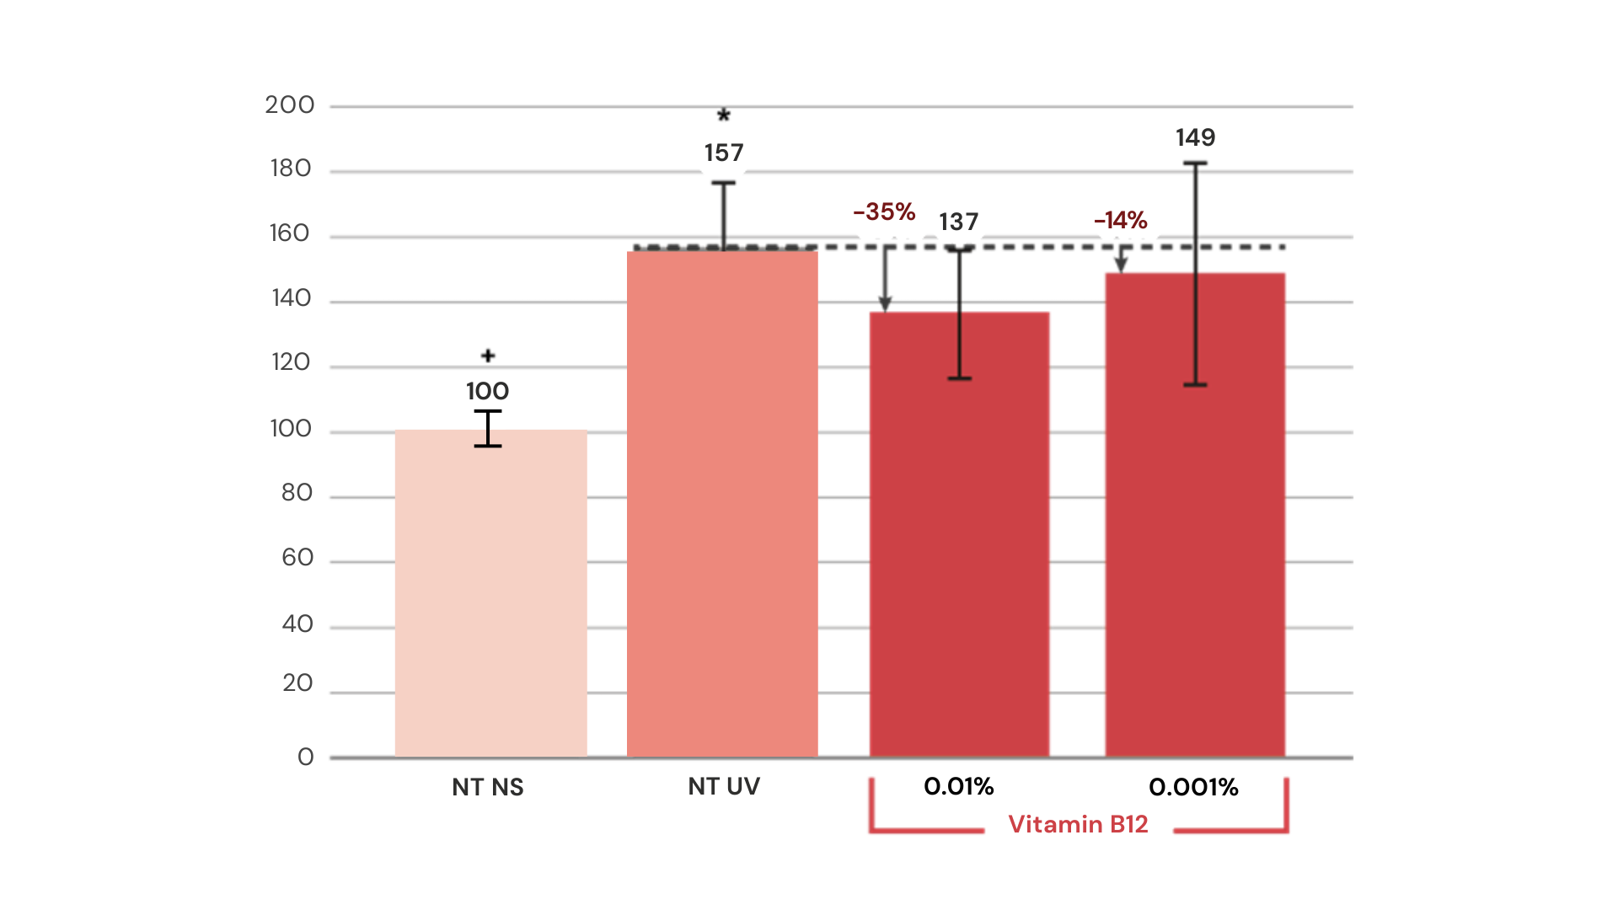
Vitamin B12
Reduces the pro-inflammatory cytokine
IL-1 beta after UV-B stress ex-vivo
Vitamin B12 reduces the increase of IL1-beta production after UV-B stress by 35% at 0.01%
* Stat vs NT NS p<0.05
+ Stat vs NT UV p>0.05
* Stat vs NT NS p<0.05
+ Stat vs NT UV p>0.05

Slide 16
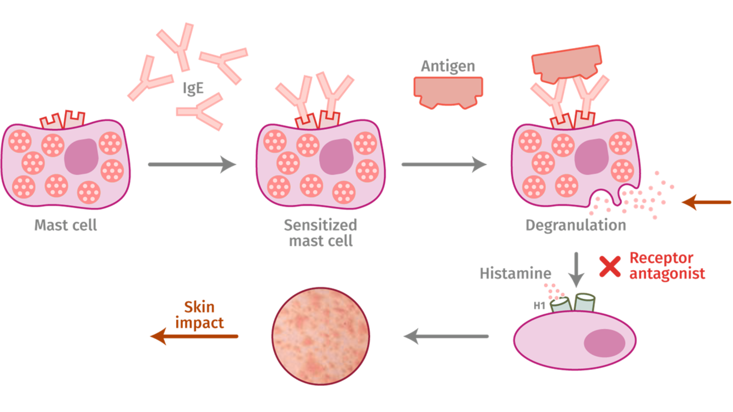
Inflammation: Mast Cell degranulation
Leads to itching, irritated, red and sensitive skin
Mechanism of action of mast cell degranulation and inhibition of histamine release
Mast cells can be activated by environmental stress factors like allergens, UV light, pollution and free radicals
Antigen
IgE
Degranulation is the release of mediators such as histamine, cytokines, proteases,…
Vitamin B12 to block mast cell degranulation
Mast cell
Sensitized
mast cell
Degranulation
Proinflammatory mediators
Histamine
Itching, stinging, burning, redness, dry & sensitive, atopic dermatitis
Skin impact
ASC: Apoptosis-associated Speck-like protein containing a Caspase recruitment domain, NLRP3: Nucleotide-binding domain, Leucine-rich Repeat family Pyrin domain containing 3
Source: Bauernfeind F. et al., NLRP3 inflammasome activity is negatively controlled by miR-223, The Journal of Immunology, 2012, 189: 4175:4181

Slide 17

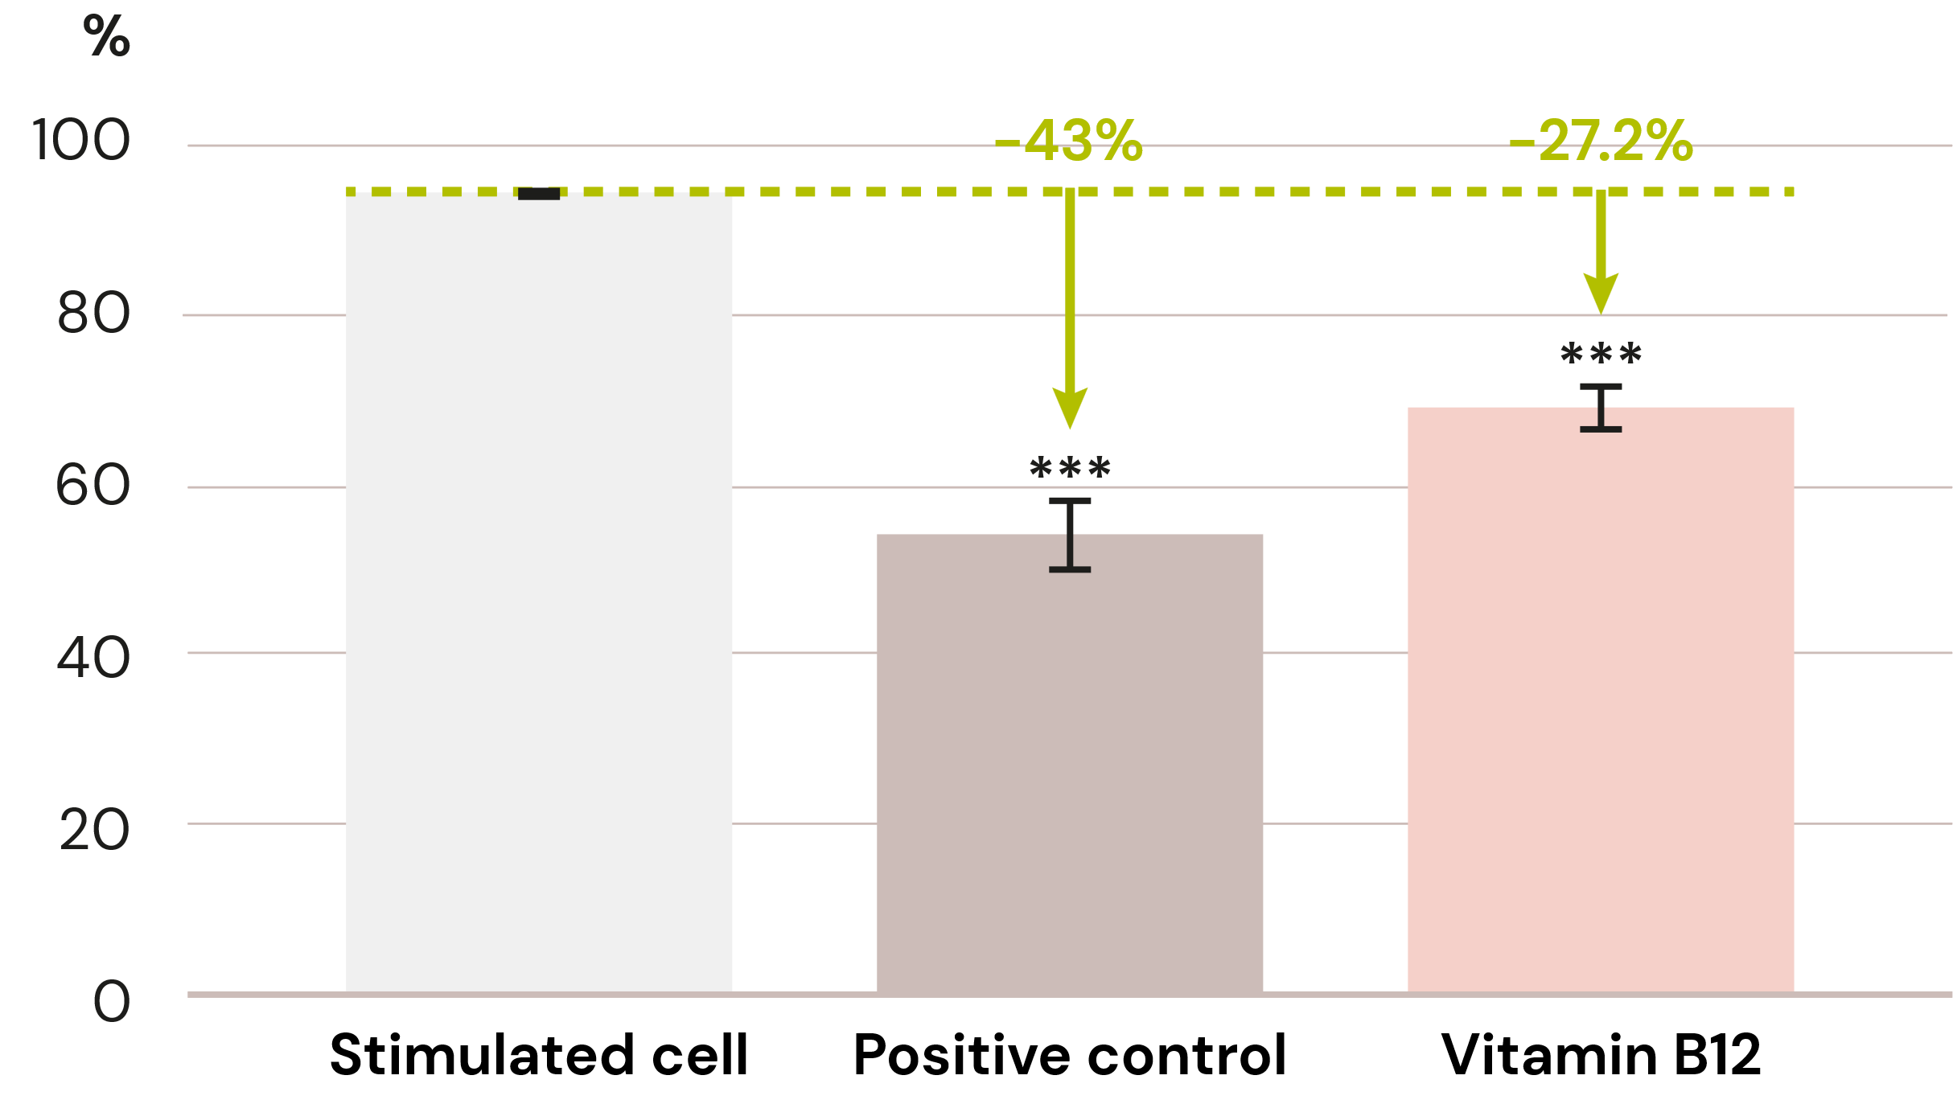
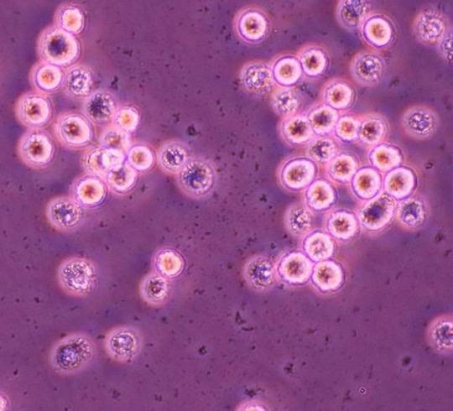
First discovery:
First discovery: Vitamin B12 reduces histamin
by inhibiting mast cell degranulation in vitro
Degranulation rate
  Vitamin B12 significantly inhibits mast cell degranulation by 31% at 0.00015%.
  It helps to protect inflammation induced skin barrier damage and relieves sensitive and irritated skin.
No degranulation occurred
Degranulation
Mast cells can be activated by environmental stress factors
like allergens, UV light, pollution and free radicals.
Degranulation is the release of pro-inflammatory mediators such as histamine, cytokines, proteases,…leading to itching, stinging, burning, redness, dry and sensitive skin

Slide 18

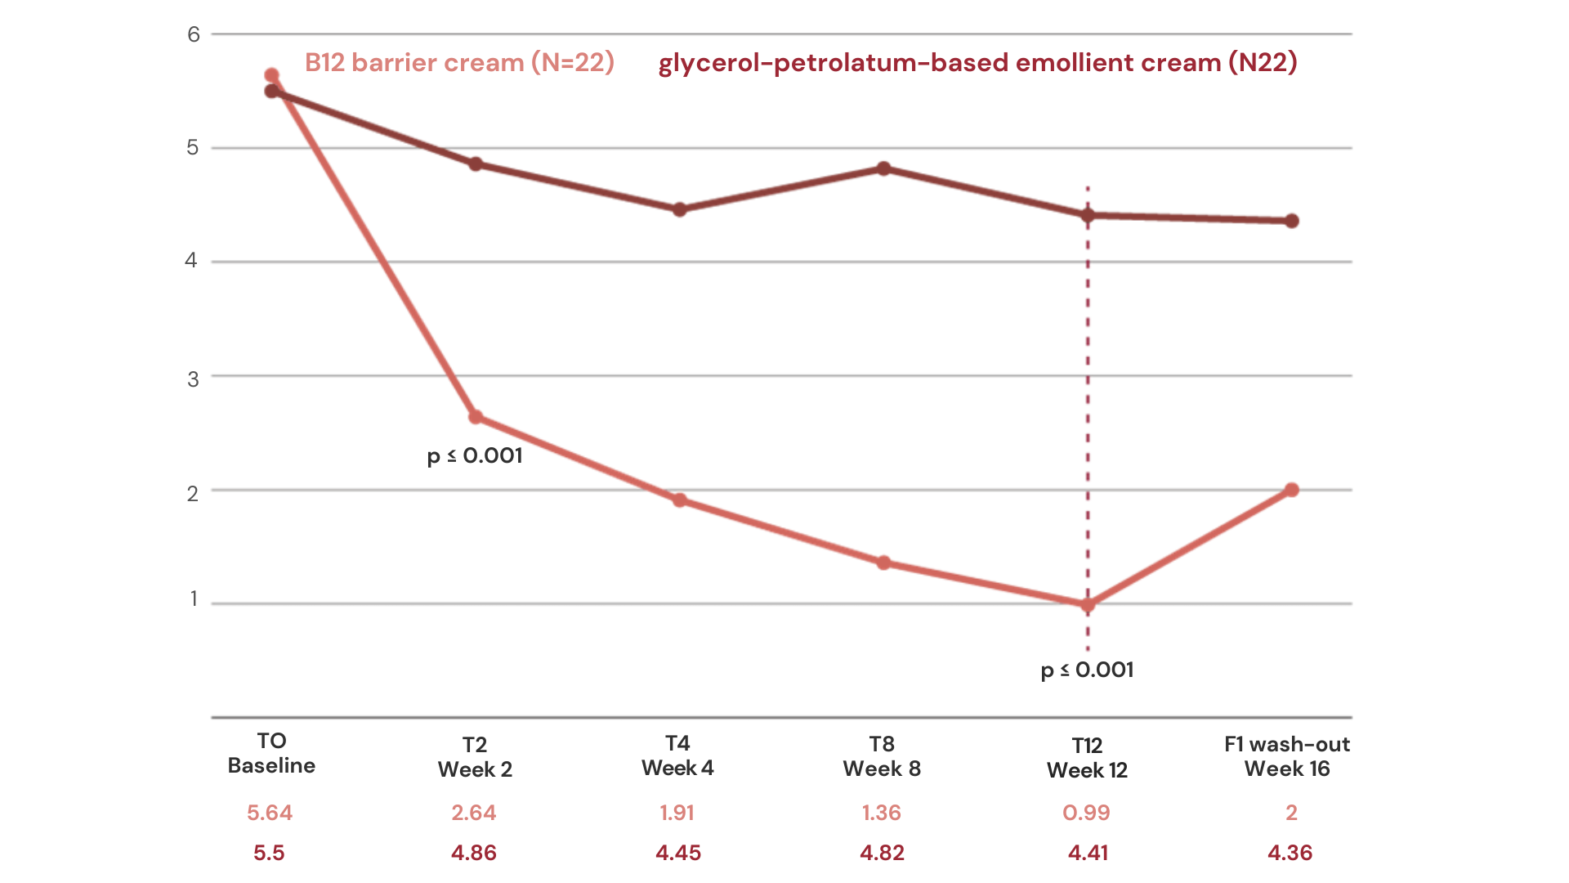
Vitamin B12: Atopic dermatitis
Vitamin B12 significantly reduces all symptoms related to atopic
dermatitis such as pruritus in vivo
Absolute SCORAD
Vitamin B12 showed in 100% of cases significant lower values of SCORAD index after 12 weeks
Significant reduction on erythema with high level of tolerability in all patients
Topical application is the most appropriate way of administration to reach peripheral target
2x 22 subjects, male and female, with mild AD
0.07% vitamin B12, hemi-body application,
2-3 times a day vs placebo
12 weeks treatment + 4 weeks
SCORAD (SCOring Atopic Dermatitis): clinical tool to assess the severity of atopic dermatitis on 3 dimensions: area, intensity (redness, swelling, scratch marks, dryness,…, subjective symptoms (itch, Sleeplessness)
Nistico S.P. et al, Dermatologic Therapy, 2017;30:e12523

Slide 19

Vitamin B12: Atopic dermatitis
Vitamin B12 significantly reduces all symptoms related to atopic
dermatitis such as pruritus in vivo
S. aureus has been drastically reduced with Vitamin B12 by 1 log at 0.001% and by 2 logs at 0.01% and completely inhibited at 0,1%, while S. epidermidis remains at the same level at and S. hominis is slightly modulated by 1 log both all Vitamin B12 concentration
Vit B12 fosters the share
of beneficial bacteria
over non-beneficial skin bacteria
S. hominis :
Harmless commensal bacteria on human skin., having potent activity against pathogenic bacteria
S. epidermidis :
Commensal bacteria, typically part of healthy human skin microbiome, acts as sentinel of skin microbiota, helps limit inflammation
Vitamin added into the medium culture, then inoculated by 10⁹ microorganisms. After 48h of incubation at 37°C, microbes have been counted
Nistico S.P. et al, Dermatologic Therapy, 2017;30:e12523

Slide 20



Formulating Vitamin B12 cryst
Easy-to-use
Sparingly soluble in water, slightly soluble in ethanol, insoluble in lipophilic components
Can be used for different kinds of leave-on and rinse-off products like O/W, W/O or W/Si formulations, cream gel, clear gel, shower gel, shampoo, body wash
To be incorporated into the aqueous phase at any time (<80°C)
Is sensitive to high temperature storage and day light. It is recommended to add a chelating agent (such as sodium phytate, Etidronic Acid, Disodium EDTA). For better stability at 50°C sodium gluconate or glycine could be added
Recommended pH of the final formulation: 3.5–7.5
Perfectly fitting to any natural formulations
Use level: 0.001–0.1%
Vitamin B12 cryst In O/W emulsion
0%
0.001%
0.005%
0.01%
0.02%
0.03%
0.04%
0.05%
Vitamin B12 cryst in water solution

Slide 21
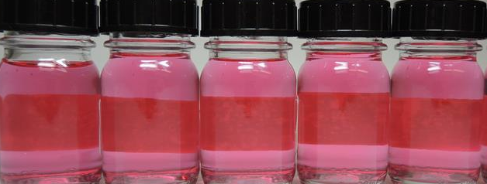

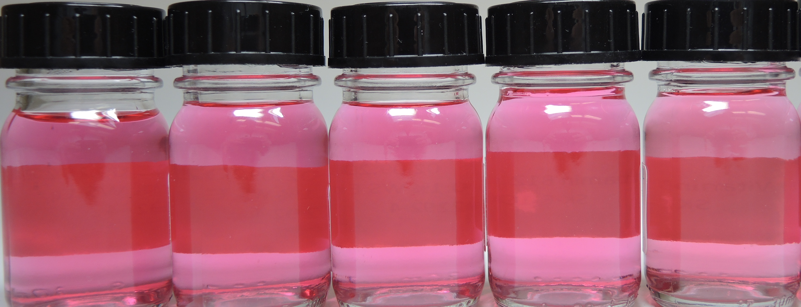
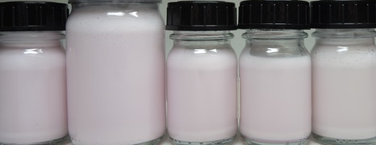


Vitamin B12 0.1% WS 5016402
Formulation guidelines
Easy-to-use
soluble in water, insoluble in lipophilic components
Can be used for different kinds of leave-on and rinse-off products like O/W, W/O or W/Si formulations, cream gel, clear gel, shower gel, shampoo, body wash
To be incorporated into the aqueous phase at any time (<80°C)
Is sensitive to day light
Perfectly fitting to any natural formulations
Recommended pH of the final formulation: 3.5–7.5
Use level: 1%–10%
Stability after 3 months
5% in aqueous solution, clear pink, very stable after 3 months
5% in emulsion, pink cream, very slight discoloration at day light after 3 months
T0
T0
T 3months
T 3months
Left to right
4°C • RT • 40°C • 50°C • Daylight
Left to right:
4°C • RT • 40°C • 50°C • Daylight
Vitamin B12 0.1% WS
In O/W emulsion
Vitamin B12 0,1% WS
in water solution

Slide 22

Vitamin B12
The biotech pink vitamin for sensitive
and stressed skin
Unique Product Features
Consumer benefits
Biotech naturally derived pink vitamin
Active on atopic dermatitis, reducing erythema and pruritus in vivo
Prevents inflammation ex vivo: significant and strong reduction of inflammasome and inflammatory cytokines such IL1-ß.
Epigenetic regulation of inflammasome: over-expression by 61% of miR-22-3p with vitamin B12 leads to a reduction of inflammasome ex vivo
Significantly reduction of Mast cell degranulation by 27%, drops the histamine release in vitro
Maintains healthy skin microbiome,
by reducing pathogenic S. aureus
vs beneficial bacteria in vitro
Vitamin B12 relieves sensitive and stressed skin
Helps relieve skin conditions like itchy, irritated, inflamed, red and cracked skin
Helps prevent photo-damaged skin
Protects the skin barrier damage induced by inflammation
Plays an important part in speeding up cell recovery and regeneration
Maintain a healthy-looking skin for
a more vibrant appearance
Provides a nice and pleasant pink color of the cosmetic products

Slide 23





dsm-firmenich vitamins promise
Today we are adding value to our
trusted heritage in Vitamins
Our Vitamins that are not only of the highest quality, totally reliable and fully traceable, but have minimum impact on the planet.
  Quality
Quality is the cornerstone of our delivering. You can trust DSM to bring you products that are consistent in quality and high in purity.
  Reliability
Our vitamins are reliable, meaning they will consistently deliver on their intended use — whether it is your skin cream, the milk you pack in your child’s lunch or the daily supplement you take to help ensure optimal nutrition.
  Traceability
Our ability to track and verify the quality of our products throughout their life cycle is what makes traceability essential to answer the clean beauty.
  Sustainability
Quality extends beyond products and services and includes our commitment to the environment, which we show by reducing the environmental impact of our activities while simultaneously optimizing land and resource use.

Slide 24
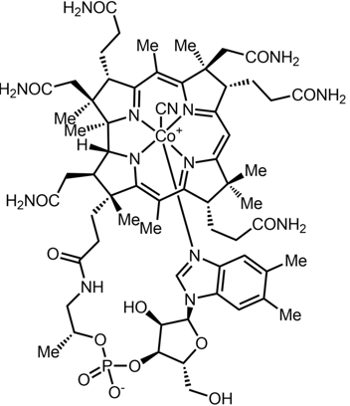
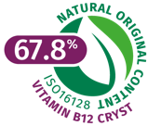
Vitamin B12: one of the most complex structure
Cyanocobalamin biosynthesis 5016420
Fermentation
(non-GMO bacteria)
Corn syrup
From non-GMO corn
Ex China
Purification
Crude
Cyanocobalamin
Vitamin B12
cryst
NaCN
Chromatography
Crystallization
Betain
5,6 DiMethylBenzimidazole
Cobalt (mineral)
C₆₃H₈₈CoN₁₄O₁₄P

