Slide 1

Vitamin B12
The Biotech pink vitamin for sensitive and stressed skin
June 2025

Slide 2



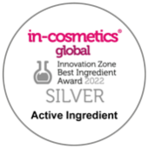



Vitamin B12
The biotech pink vitamin for sensitive
and stressed skin
Unique Product Features:
Biotech naturally derived pink vitamin
Active on atopic dermatitis, reducing erythema and pruritus in vivo
Prevents inflammation ex vivo: significant and strong reduction of inflammasome and inflammatory cytokines such IL1-ß.
Epigenetic regulation of inflammasome: over-expression by 61% of miR-22-3p with vitamin B12 leads to a reduction of inflammasome ex vivo
Significantly reduction of Mast cell degranulation by 27%, drops the histamine release in vitro
Maintains healthy skin microbiome, by reducing pathogenic S. aureus
vs beneficial bacteria in vitro

Slide 3

Vitamin B12
The biotech pink vitamin for sensitive
and stressed skin
Consumer benefits:
Vitamin B12 relieves sensitive and stressed skin
Helps relieve skin conditions like itchy, irritated, inflamed, red and cracked skin
Helps prevent photo-damaged skin
Protects the skin barrier damage induced by inflammation
Plays an important part in speeding up cell recovery and regeneration
Maintain a healthy-looking skin for a more vibrant appearance
Provides a nice and pleasant pink color of the cosmetic products

Slide 4


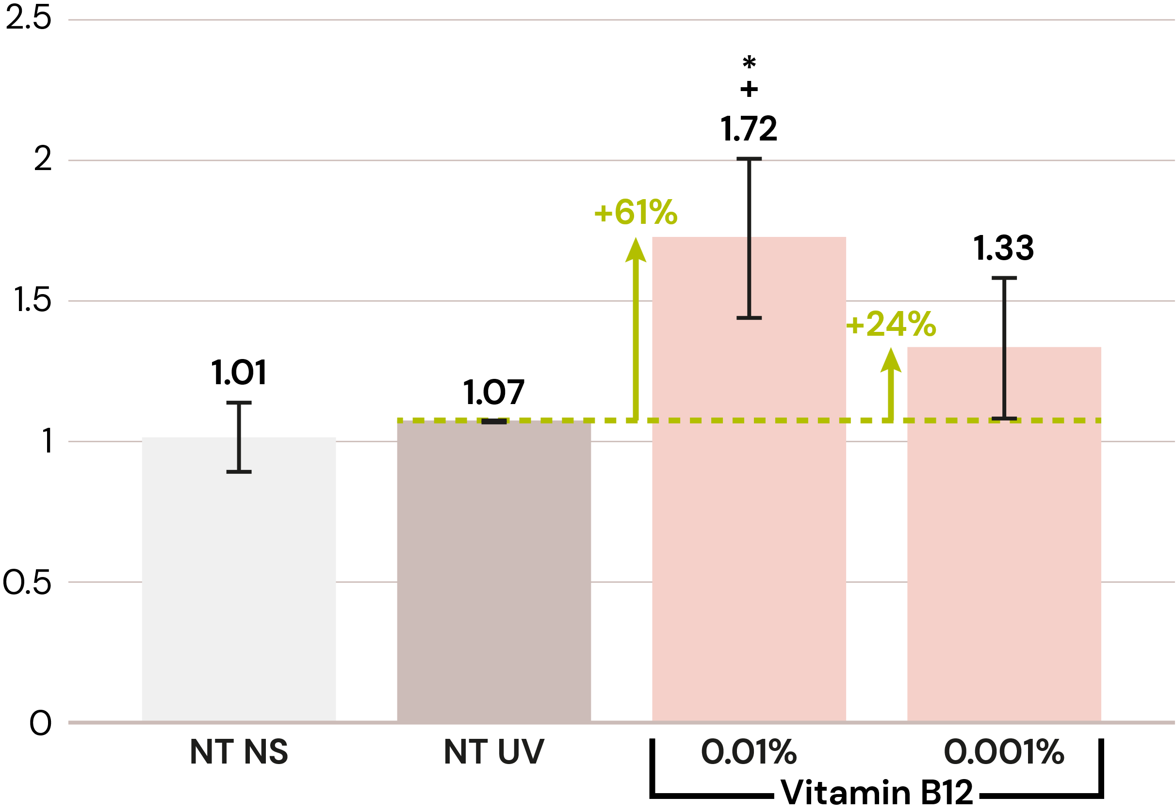
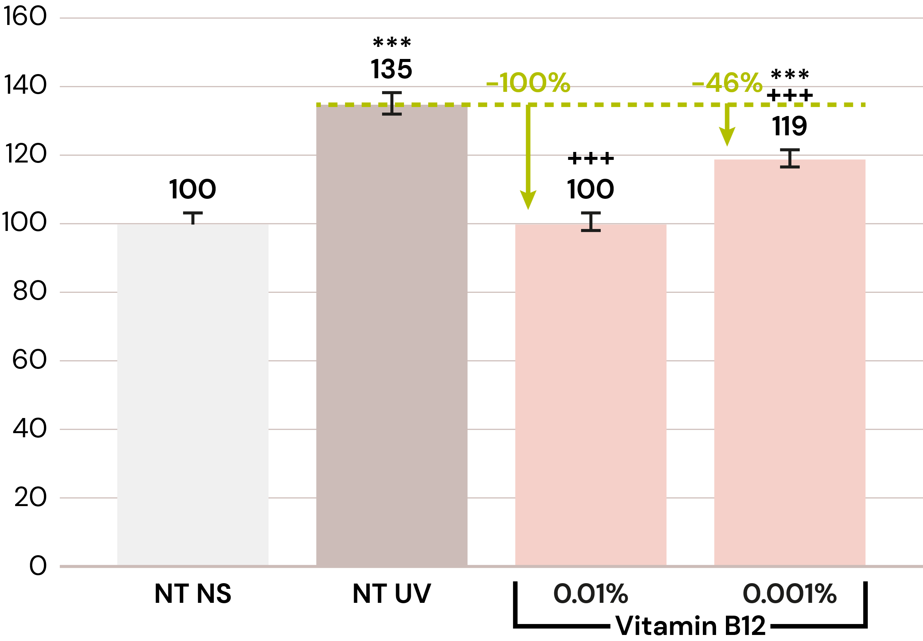
dsm-firmenich scientists discovered the action of Vitamin B12 on the inflammasome
New
Vitamin B12 reduces UV-B induced inflammasome reaction ex vivo
miR-22-3p expression after UV stress
Mean ASC intensity
  UV, pollution, bacterial invasion or any oxidative stress induce the formation of the inflammasome, especially in keratinocyte.
  Its components are pro-Caspase-1, ASC and NLRP3 which is regulated by the epigenetic factor miRNA 22-3p.
  If it gets chronically activated, it causes skin irritation, skin tissue damage and premature aging.
Vitamin B12 significantly up regulates by 61%
miR-22-3p at 0.01%
Vitamin B12 significantly down regulates ASC complex activation by 100%, to the level of non-treated, at 0.01% after UV-B stress

Slide 5

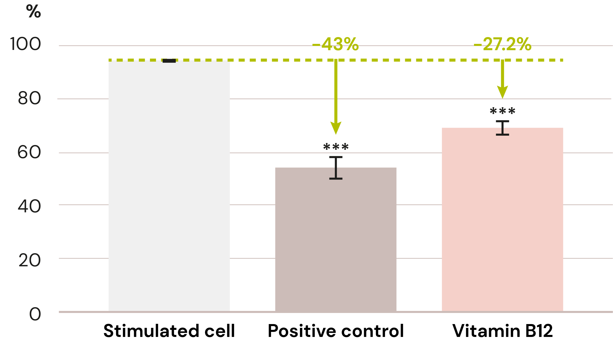
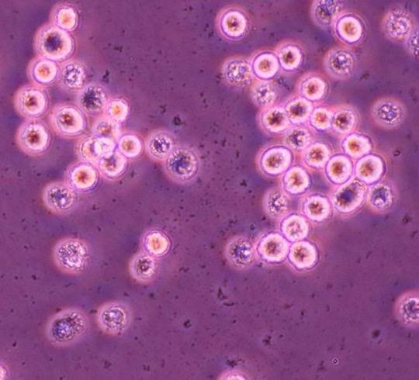
First discovery:
First discovery: Vitamin B12 reduces histamin
by inhibiting mast cell degranulation in vitro
Degranulation rate
  Vitamin B12 significantly inhibits mast cell degranulation by 31% at 0.00015%.
  It helps to protect inflammation induced skin barrier damage and relieves sensitive and irritated skin.
No degranulation occurred
Degranulation
Mast cells can be activated by environmental stress factors
like allergens, UV light, pollution and free radicals.
Degranulation is the release of pro-inflammatory mediators such as histamine, cytokines, proteases,…leading to itching, stinging, burning, redness, dry and sensitive skin

Slide 6



Vitamin B12 cryst 5016420
Formulation guidelines
Vitamin B12 cryst In O/W emulsion
0%
0.001%
0.005%
0.01%
0.02%
0.03%
0.04%
0.05%
Vitamin B12 cryst in water solution
Easy-to-use
Sparingly soluble in water, slightly soluble in ethanol, insoluble in lipophilic components
Can be used for different kinds of leave-on
and rinse-off products like O/W, W/O or W/Si formulations, cream gel, clear gel, shower gel, shampoo, body wash
Use level: 0.001–0.1%

